Slide 1



NASA’s Digital Transformation & Digital Engineering
Terry R. Hill
NASA’s Digital Engineering
Program Manager
Jan. 08-12, 2024
2024 AIAA SciTech Conference, Orlando, FL
NASA DIGITAL
TRANSFORMATION
“It is not necessary to change. Survival is not mandatory.”
(W. Edwards - Deming Institute, 2019)

Slide 2



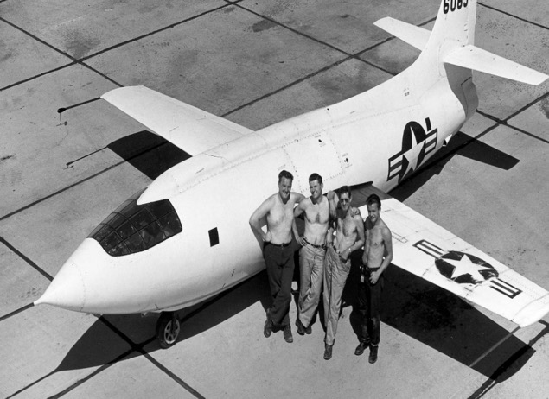
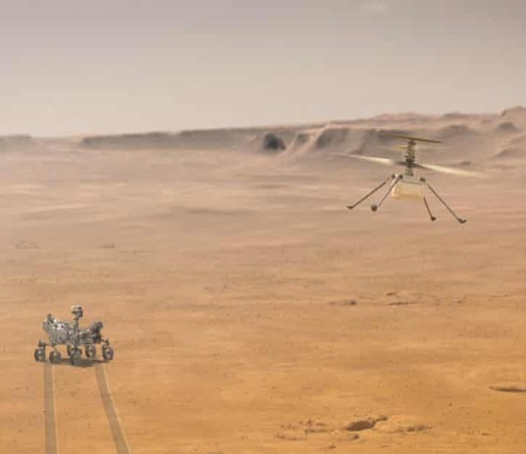

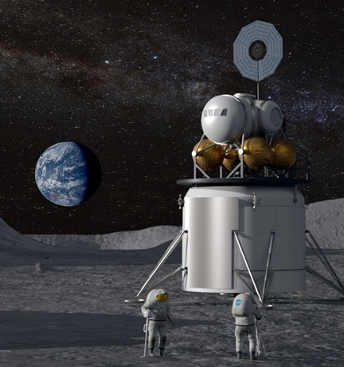

Why Digitally Transform NASA?
Enduring
Bold
Mission…
…now in a Changing World
Increasingly bold & complex missions
Increasingly partnered
Increasingly fast
Increasingly affordable
Increasingly transparent
Increasingly inclusive
NASA DIGITAL
TRANSFORMATION

Slide 3



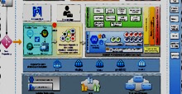
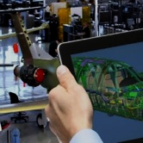

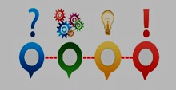











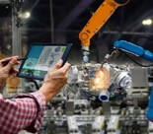


NASA’s DT Strategic Framework
NASA DIGITAL
TRANSFORMATION
3
4
5
6
7
+
FUTURE STATE
GOALS
TRANSFORMATION
TARGETS
DIGITAL
LEVERS
TECHNOLOGY
FOUNDATIONS
MISSION
OUTCOMES
Establish Interoperable Architectures
Intelligent Automation
Transform Discovery
Bolder, More Complex Missions
Transform Engineering
Transform Engineering
Faster, More Agile Processes
Transform Critical Processes
Artificial Intelligence/ Machine Learning
Seamless Partner Teaming
Model-Based Anything
Inspire & Engage Citizens
Maximize the Impact of our Data
Affordable Sustainable Operations
Transform Decision Making
Attract & Retain Workforce
Transform Operations
Adopt Common Tools
Zero
Trust
Architecture
Internet of Things
Extended Reality
Modern Future of Work
Strengthen Inclusive³ Teaming
One
Future NASA
NASA TM 20220018538

Slide 4
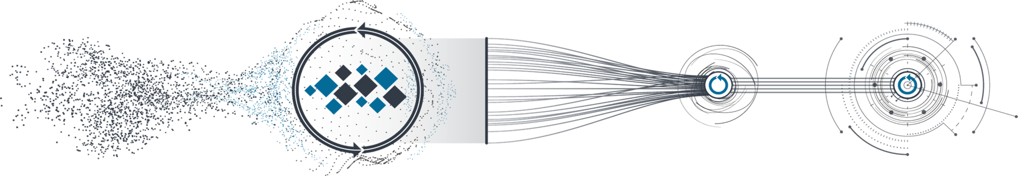

NASA’s DT Implementation Approach
We are here
Ignite Transformation
Facilitate Tx Target Community-owned Roadmaps & near-term priority actions to align DT intent & goals across NASA
Connect
Plans
Coordinate like Organizational DT Plans that respond to the DT Strategic Framework to synchronize DT intents
Integrate
Solutions
Analyze Integrated DT Solutions Portfolio vs. Roadmaps / priorities for redundancies & gaps to identify leveraging opportunities & inform investment decisions by OCIO, DT & other organizations
Facilitate
Adoption
Measure DT Progress on funded Org DT Plans vs. Roadmaps/Priorities; elevate & address cross-cutting barriers via DT Catalyst Projects; celebrate & share DT Successes & Exemplars
Dec 2022
Mar 2023
May 2023
Synchronize DT Plans & Catalyze DT Progress

Slide 5
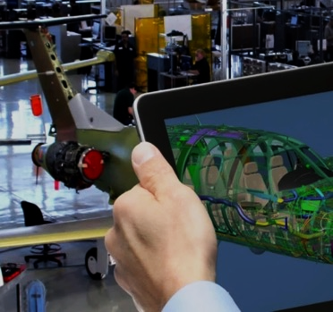
Transformation of Engineering – It Takes a Village
Transform Engineering
Contributions of the Centers
Lift & Shift from other Gov Agencies
NASA DT
Mission Directorates
CoPs
Office of Chief Eng.
NASA’s Digital Engineering Transformation Efforts
Notes:
Add role of exec sponsor own, execute their part & be exemplar/extend to others. description of each area needs to be revised/confirmed by sponsors

Slide 6
NASA’s Digital Engineering Need
…from Concept to Operations
Historically a change of Presidential administration or Congress means a change to our missions/priorities/budgets
Improve how the Agency Engineering Domain operates over the entire NASA lifecycle by effectively managing complexity, reducing cost and schedule, and improving product integrity via the integration of processes, digital tools, and techniques along with seamless flow of information throughout the engineering system development life-cycle (concept development, design, testing and validation, manufacturing and operations).

Slide 7
Year 1 (FY22) Digital Engineering Activities
NASA Centers at COVID-19 Stage 3
FY22
MBSE @ Inter-Agency Working Group 11/16/21
MBE DT Brief to OCE 5/19/22
MBE Re-Org 6/07/22
MBE Site visits with JPL, SpaceX, Aerospace Corp., & NRO 8/01-04/22
Sep. 22
Integrated MBE Kickoff 1/31/22
MBE / MBSE Merger
Named Terry Hill – MBE Lead
12/15/21
MBE Funding 1/5/22
MBE Baselining as Integrated Team 2/17/22
NASA SE Workshop 4/04-08/22
NRO Brief of MBSE Infusion Effort 7/08/22
NRO Annual Summit 9/16/22
MBSE Brief to SELP
1/11/22
Summer Faculty Support for MBE Scope Refinement & Traceability to NGOs & Processes
Integrated MBSE into MBE and reorganized to DE to encompass whole lifecycle of engineering.
Multi-center PLM in NASA cloud Pilot
Orion DT completion of EPS
APPEL Tier 4 training available to workforce
Modeling of NPR 7123, 7120.5/.8 & 8705
NASA MBSE Modeling Handbook released
Agency benchmarking of toolchain capabilities
MBE
Navy 2/02/22
GSFC XRISM / JAXA Modeling 1/24/22
Sandia NL 2/22/22
MLT briefing to Navy/NAVSEA MBSE Modeling CoP. 3/20/22
Idaho NL 4/20/22
MBE Task 5
Cloud-Based Multi-Center PLM Pilot
DT Transforming
Eng. Sprint
ATP 5/10/22
Kickoff 5/25/22
MBE Task 1
Draft toolchain “architecture” 9/30/22
SOW Devel.
Benchmark Agency Toolchains and ident. Interoperability reqs. (WYE)
Presented Data Flow Concept to MB PM
11/03/21
Presented @ Transformation Tue
11/16/21
Leverages E-APMB survey data
Final product 11/15/22
Devel. & baseline of MBSE 3-Phased Plan w/resources needed
ATP 5/12/22
Kickoff 6/06/22
Piloting Complete 8/08/22
Modeling Initial Pass Complete 9/30/22
MBE Task 3
MBSE / MBE Data Flow Concept Development (FTE)
SOW Devel.
Model 7123 / 7120.5 & integrate with MB MA 8705 models (WYE)
Planning/Prep
Init. Model Arch.
Process Modeling
Model Integration
Finalize Modeling Drill Down & Plan for Process Optimization
Aerojet Rocketdyne 6/17/22
Northrop Grumman 5/25/22
GE Aviation 7/15/22
Pratt & Whitney 5/13/22
APPEL Mod. Requs for Tier 1-3 MBSE Training to use MagicDraw & align with Tier 4 Training
Booze-Allen 7/08/22
MBSE
Institute for Digital Enterprise Advancement Training and Development 7/08/22
APPEL Tier 4 MBSE Training Pilot
APPEL Tier 4 MBSE Training Available to NASA
MBE Task 2
MBSE External Training Benchmarking Activities (FTE)
MBSE NASA Handbook NASA-HDBK-1009 (FTE) Development and internal review
Agency-wide review 6/23-7/21 ‘22
Expect OCE to Sign by 9/30/22
Orion Demo to Orion Chief Engineer & VIO Office 11/12/21
Development of proposal for management of NASA-specific Standards in data-centric approach (FTE)
MBE Task 4
Presented @ Transformation Tue 11/16/21
Orion Demo to JSC Center Director 6/02/22
Transformation Tue Update 6/14/22
Demo to NRO 8/04/22
Orion Demo to MBSE CoP 5/25/22
Orion Digital Twin (FTE/WYE)
Blue Text - represents training benchmarking
Orion Demo to MB MA / OSMA w/ideas of how to generate fault trees 5/24/22
Orion Demo to Artemis MBSE Working Group 6/10/22
Demo to Gateway Management per request 7/29/22

Slide 8
Year 2: FY23 DE Project Schedule
DE Plan Presented at PTC LiveWorx 5/16 – 19/23
Orion DT Demo to NRO MBSE CoP 4/25/23
FY23
Sandy Friedenthal talked SysML 2.0 at MBSC CoP 11/03/22
DE Plan to Houston Space Port Conference 2/13/23
DE Plan to NASA SE Workshop 4/19/23
DE/OCIO Architecture Workshop 8/1-4/23
MLT Final Scope Planning Retreat 1/19/23
DE/DoD Planning for Fall Face to Face 3/10/23
DE Midpoint Review to DT 3/30/23
NRO Training Tag
10/07/22
Digital Transformation Workshop (Gov only) @ LaRC
10/25-27/22
NASA/DE/Microsoft Collaboration Event 3/21/23
EMB Face-to-Face where DE plan was briefed 11/30/22
MLT Leadership Transition to Trish Nicoli 1/25/23
DE Qtr w/OCE 3/14/23
Sandia NL DE Workshop 5/8-12/23
EMB DE Status 6/13/23
INCOSE IS 2023 7/17-20/23
RFI for how to do DE with NASA to Industry 9/XX/23
DE/NRO Face2Face 3/15/23
Support to DT Tx Engineering Workshops
NASA-NG DT Maturity Follow-up12/12/22
NASA/NG DT Brief 2/06/23
Monthly MBSE/NRO Tag
Orion DT Demo to MSFC Eng. Management 2/06/23
Agency Institutional SE&I Leadership Face2Face 4/17/23
DE Brief at Gateway Retreat 12/07/22
DE Support to SBIR Reviews 4/24 – 5/05/23
DE
DE Task 5
Named DE PLE Lead 3/29/23
Definition of what DE means for NASA: NGO’s to Capabilities
Engagement with DoD, DoE, Intelligence and FAA on DE
Continued modeling & Data-centric analysis of NPR 7123, 7120.5/.8 & 8705
Agency benchmarking of toolchain capabilities concluded
Focus on Design to Manufacturing
RFI to Industry
Interoperability / data exchange standards for engineering data thread
Build Governance and Business Plan
Cloud-Based Multi-Center PLM Agency Enterprise Solution Model Development (Governance, sustainable business model, Agency licensing model, sustaining plan, etc.
DE Task 1
Found DE Toolchain Lead 4/12/23
Draft toolchain whitepaper 9/30/22
Work on data visualization
Understand lift-&-shift ops w/DoD
Benchmark Agency Toolchains and ident. Interoperability reqs. (WYE)
Build recommended DE Architectures w/short list of best of breed, Interoperability reqs., & needed investment opportunities
Funded toolchain investment activities – likely at Center level if reserves are available.
Final Benchmarking Report 12/15/22
JSC D2M Pilot Kickoff 1/20/23
D2M Current Thermal Tile Cap. Demo @ KSC 3/06/23
D2M Cap. Needs Plan per Center 9/01/23
Design to Manufacturing (D2M)
D2M Plan First Draft 11/30/22
D2M Cap. TIM 5/16/23
D2M Plan 2nd Draft 2/23/23
Center's DTM accomplishments to date, needs, and plans for the future
JSC In-house D2M Pilot
Status Brief at NESC SE TDT Meeting 12/07/22
Status Brief to OCE Leadership 4/26/23
Addtl. funding approved to model NPD 7120.4 8/04/23
Begin Update NASA-HDBK-1004
DE Task 3
Begin Update NASA-HDBK-1009
Model 7123 / 7120.5 & integrate with MB MA 8705 models (FTE & WYE)
Stakeholder Review ‘As Is’ modeled NPRs
4/11 – 5/20
Provide Recommendations for update of NPRs 09/xx/23
Finalize Modeling Drill Down & Plan for Process Optimization
Analysis of Models for data-centric changes
DE Task 2: Workforce Training
Devel APPEL Tier 5 MBSE Training Requirements
APPEL Tier 5 MBSE Training Pilot
MBSE
DE Task 6
MBCA 2.10 Interface Definition and Management
MBCA 4.1 CM Plan for Models
MBCA 6.6 User Interface (UI), Viewpoint/Views, and Visualization standard template, Development of viewpoint definitions and instantiate examples.
Development of proposal for management of NASA-specific Standards in data-centric approach allowing tailoring & SysML integration. (FTE)
FTE Lead was pulled away for higher day job responsibilities – trying to fine new lead. In the meantime, using JSC contributed WYE on effort at low level.
Review within OCE and NESC and go-forward decision (FTE)
DE Scope Kick-off 1/15/23
DE NGO Modeling Approach Review 3/02/23
Agency Review of DE NGOs 5/01-15/23
DE Task 4
Devel DE Capability Requirements & Map to current and future funded Activities at Agency & Centers to inform EMB DE Progress Metrics & Budget Planning
EMB wants def. of success
DE Scope Definition and Strategic Plan (FTE & WYE)
DE Scope Modeling & Review Approach w/MLT and DE 3/28/23

Slide 9
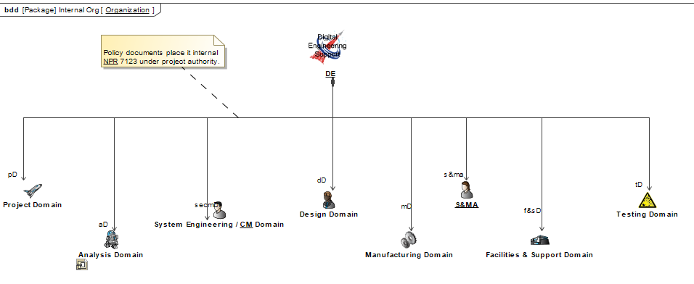
Engineering Project Lifecycle
Define the Scope and Capabilities of what Digital Engineering Means to NASA
NPR’s – provide Agency procedural requirements
Needs
Goals
Objectives
Capabilities
Center’s / Engineering Directorate’s NPR derivative documents
Digital Engineering
Model-Based Systems Engineering
Formulation and Requirement Development
Early Design & Mod/Sim
Design to Manufacturing
Test & Verification
Cert.
Project/Program Operations and Sustaining
Decommissioning
Produced by MBSE Leadership Team – Led by Trish Nicoli (Jan. 15 – May 30)

Slide 10
Digital Engineering Needs, Goals, & Objectives
Need
DE Environment
Explore Design Space
Conduct Trade Studies
Select Architectures
Engineering Communication
V&V
Improved Agility
Improved Quality
Improved Efficiency
V&V Usage
Improve how the Agency Engineering Domain operates over the entire NASA lifecycle by effectively managing complexity, reducing cost and schedule, and improving product integrity via the integration of processes, digital tools, and techniques along with seamless flow of information throughout the engineering system development life-cycle (concept development, design, testing and validation, manufacturing and operations).
Clear decision-making process - increase in decision velocity
Method for evaluating the health & status of the Agency implementation
Deployment strategy for DE implementation across the Agency
Auditing method utilizing CM best practices to ensure to ensure mission objectives.
Goals
Standardized Development
Standardized Integration
Standardized Usage
Standardized Central Data
Common Policies
Guidelines
Tool Standards
Tool Interoperability Standards
Tool Procurement/Development
DE Terminology
G1 Lifecycle: Establish a Digital Engineering (DE) strategy that can be integrated throughout the entire Engineering Life Cycle, aligning with NASA’s mission objectives.
G2 Deployment: Develop an interoperable, tailorable, and scalable deployment strategy for the Digital Engineering Ecosystem across the Centers including implementation options and methods.
G3 Guidance: Establish the guidance for model development, tool integration and deployment, and formulation of data threads while ensuring alignment with the industry standards advocated by DE.
G4 ASoT: Establish an approach providing stewardship, governance, security, traceability, and management of the engineering Authoritative Sources of Truth (ASoT), while ensuring the data within the ASoT are curated.
G5 Configuration/Change Management: Evolve existing CM approaches for data-centric management of engineering baselines which enable teams to manage and track changes made throughout the entire product lifecycle.
G6 Digital Threads: Develop strategies for Digital Threads/Ecosystem that improve collaboration, data exchange, design formulation, data-centric processes and workflows, operations, and insight, and data-informed decision making.
G7 Culture and Workforce: Evolve NASA Culture and the Workforce by creating a demand for adoption of DE techniques, providing training, and cultivating a digital engineering community.
Objectives
Integrate model libraries while also maintaining ASoT.
Establish a Governance for ASoT.
Method for integrating Engineering Data.
Method for Configuration Management (CM) of ASoT to be shared with internal entities.
Method for CM of ASoT to be shared with external entities.
Process for data & IT security to be implemented across the DE domain.
CM Strategy
Number of PLM systems
Approval of PLM systems
PLM for Acquisition
PLM for Execution
PLM for Lifecycle Development
PLM for Workflow Management
PLM For Inventory Management
Maintain PLM Licensing
PLM Sustainment
CM Processes For systems
CM status accounting data for systems
Integrate NPRs into processes.
Environment for managing similar sets of data.
Environment for integrated data.
Strategy for toolchains.
Protocols for IT to enable collaboration.
Provide IT the tools to enable collaboration.
Inform changes to the NPRs.
Establish outreach programs including training development activities
Organize professional DE roles
Establish outreach programs developing DE expertise
Organize professional DE role responsibilities
Create a policy for systematic adoption
Establish a DE community

Slide 11
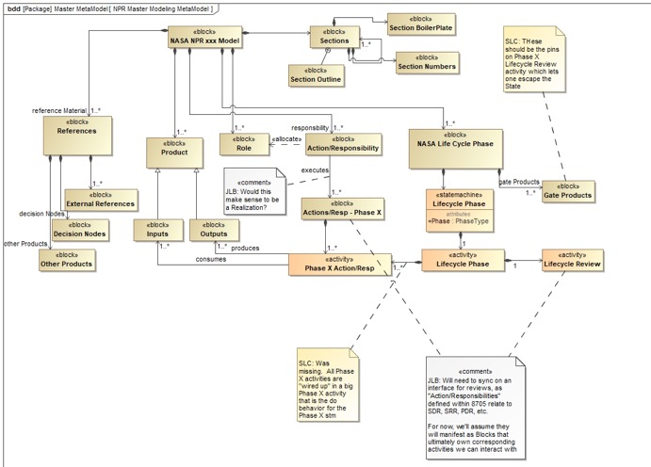
Engineering Project Lifecycle
Engineering Domain
NPR 7120.5/.8 NPR 7123 NPR 8705
NPR’s – provide Agency procedural requirements
✓
✓
Center’s / Engineering Directorate’s NPR derivative documents
Logically decomposed current NPR document to understand the intended processed flow
Created Common Document meta-model framework so all the NPR models would be structured consistently
Digital Engineering
Model-Based Systems Engineering
Formulation and Requirement Development
Early Design & Mod/Sim
Design to Manufacturing
Test & Verification
Cert.
Project/Program Operations and Sustaining
Decommissioning
✓
Support Centers as they update their derivative processes to be more data-centric as part of their transformation.
Data-Centric analysis of the process models and provide recommendations for updates to the NPRs.
Agency-wide peer review of the As-Is NPR modeling ‘trifecta’.

Slide 12
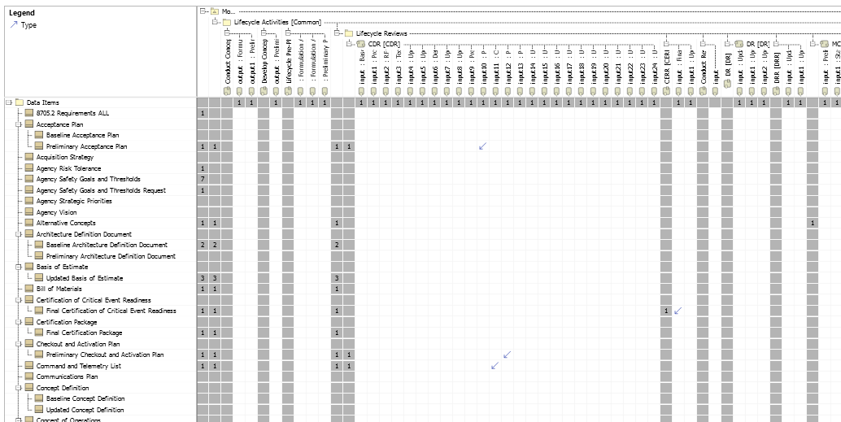
NASA Procedural Requirements (NPR) Analysis Process
Data and Product Characterization
Requirement
Re-write
Integrate Processes, Explore Utilization, Etc.
Recommend NPR Changes to OPRs
Data and Product Characterization by Topic (cost/schedule, authority, etc)
  Differentiate between data items and deliverables
  Data Hierarchy and consolidation (preliminary, update, baseline)
Review associated topic requirements and implement Easy Approach to Requirement Syntax (EARS) compliance
  Remove multiple continuances, vague words, etc.
  Re-write (possibly multiple statements)
  Ensure roles and responsibilities are clear
Integrate Processes
  Ensure data item traceability into deliverables
  Ensure activities that produce deliverables have a responsible role for execution
Provide recommendations to NPR book managers
In parallel – Model Usage and Documentation
  Programs/projects – ease compliance burden
  Technical Authorities – mapping into Center processes
  Systems Engineering – Support lifecycle reviews

Slide 13
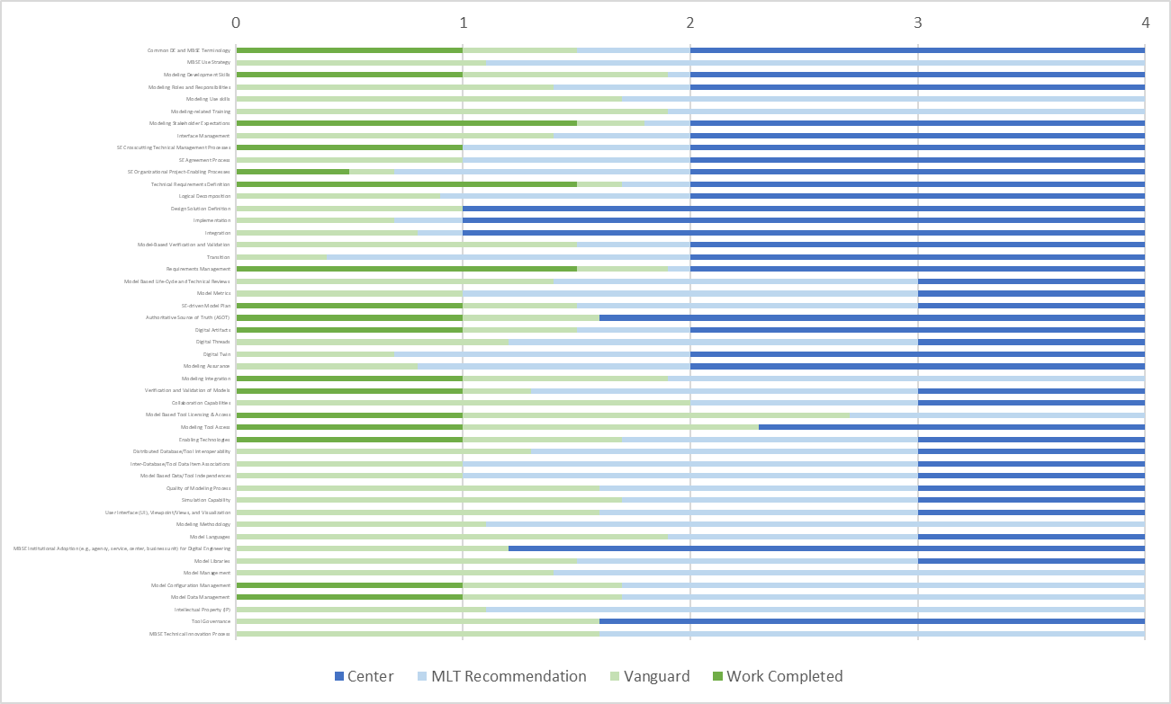
Model Based Systems Engineering Capability Assessment
Modified INCOSE model* for NASA
Third NASA assessment completed
  Previous baseline was Summer of 2021
Provides a Roadmap
  Where we are
  Where we’re going
  Transition points from MLT to Center
– Modification Completed June 2023
– Summer 2023
Workforce/
Culture
SE Processes
Program/Project
Processes
Model Based
Effectiveness
IT
Infrastructure
Modeling Tool
Construction
Model Use
Modeling Policy
* Hale, J. and Hoheb, A. INCOSE Model-Based Capabilities Matrix (MBCM) and User's Guide, INCOSE-MBCM-2020-001.1, Version 1, Jan. 01, 2020.

Slide 14
Model Based Systems Engineering Capability Assessment
Modified INCOSE model* for NASA
Third NASA assessment completed
  Previous baseline was Summer of 2021
Provides a Roadmap
  Where we are
  Where we’re going
  Transition points from MLT to Center
– Modification Completed June 2023
– Summer 2023
* Hale, J. and Hoheb, A. INCOSE Model-Based Capabilities Matrix (MBCM) and User's Guide, INCOSE-MBCM-2020-001.1, Version 1, Jan. 01, 2020.

Slide 15
Number of Models & Users by Mission Directorate and Program (FY23)
Deployed Agency-level MagicDraw license server and Teamwork Cloud (model management) in 2019
Program | User Count
ARMD Transformative Aero Concepts Program | 3
ARMD Integrated Aviation Systems Program | 60
ARMD Airspace Operations and Safety Program | 17
ARMD Advanced Air Vehicles Program | 3
ESDMD Human Landing System | 29
ESDMD Adv Cislunar and Surface Capabilities | 45
ESDMD Gateway | 173
ESDMD Orion Program | 13
ESDMD Space Launch System | 12
SOMD Human Research Program | 108
SOMD Launch Services | 41
SOMD Space Communications & Navigation | 55
STMD Technology Demonstration | 16
SMD Earth Earth Systematic Missions | 11
SMD Planetary Mars Sample Return | 36
SMD Planetary New Frontiers | 2
SMD Joint Agency Satellite Program starting in FY 22 - Space Weather Observations Program | 3
Unknown | 65
Total | 692
Program | Resource Count
ARMD Transformative Aero Concepts Program | 3
ARMD Integrated Aviation Systems Program | 106
ARMD Airspace Operations and Safety Program | 9
ARMD Advanced Air Vehicles Program | 6
ESDMD Human Landing System | 17
ESDMD Adv Cislunar and Surface Capabilities | 11
ESDMD Gateway | 201
ESDMD Orion Program | 10
ESDMD Space Launch System | 15
SOMD Human Research Program | 211
SOMD Launch Services | 26
SOMD Space Communications & Navigation | 71
STMD Technology Demonstration | 35
SMD Earth Earth Systematic Missions | 9
SMD Planetary Mars Sample Return | 18
SMD Planetary New Frontiers | 4
Space Weather Observations Program | 3
Unknown affiliation | 578
TOTAL | 1333
Reflects count of models since the beginning of the capability in 2019

Slide 16
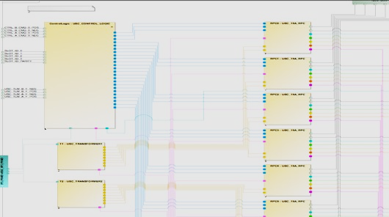
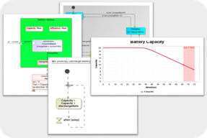
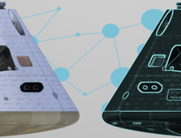
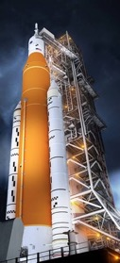
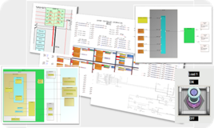
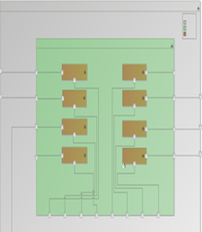

Orion Digital Twin Project 2021-2022 Activities
FY2021
2022
March
April
May
June
July
August
September
October
November
December
January
February
March
April
May
June
July
August
September
EPS Schematics
  Block Definitions
  Hierarchy
  Interfaces
  Schematic Integration
  June – Board interfaces & “Switch” details
  July – Loads
  Aug+ - Board internals
Development
  Prototype
  Depth Trade
  Domain Research
EPS Simulation
  Define Sim Scenario
  Define behavior model
  Develop GUI for live mission scenario
EPS Twin Integration
  Telemetry Interface
  Operational Data Interface
  Parameter Definition
Artemis I Test Case
  Feedback from live mission use by EPS engineering team
Further Subsystem Development
  Multi-Domain Simulation
  Tool Integration
  Comprehensive Digital Twin Framework
EPS Digital Twin Validation/Evaluation
  Model-Based Review
  Live Reviews
  Automated Audits
10 months of modeling and 8 months of validation.
Over 9,000 components represented
~6000 elements of definition reused
Over 130 hyperlinks to schematics database integrated into SysML Model
Over 4,500 interfaces defined between components
2,208 ports imported ready for CD&H/Avionics/GNC subsystems
Over 500 loads integrated into EPS architecture
Automated syncing and validation of data and architecture to authoritative sources
Simulation utilizing built architecture and imported component specifications
Package for Agency Wide Use
  Lessons Learned
  Sanitized Model
  Script Library
  Reusable Components
2023 INCOSE IS Best Paper in Mod/Sim Category

Slide 17
Integrated Digital Engineering Framework per Lifecycle of a Project
Spans the lifecycle of project
Complex until you know how
Build slow, steady & smartly – don’t have to eat the elephant on day one.
Tailorable to specific program/project
Less errors in engineering (found in manufacturing & testing)
Increase speed of develop & delivery of missions
System Eng.
Digital thread and integrated data flow is represented via arrows

Slide 18


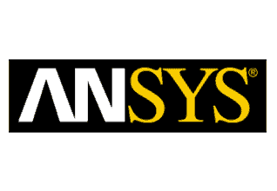
















Toolchain Pilot: Phased Integration of Commonly Used Engineering Tools w/in NASA Engineering Domain
✓
Code repository
Code Management
Trick
MONTE
✓
✓
Post2
VX Works (WSTS)
SysML Model Management
GN&C Software & Sim
SysML Modeling
Analytics
Requirements Management
Integrated System Goals
Purpose: Understand how to deploy integrated toolchains
Understand needed interoperability / data exchange protocol standards
Utilizes federated credentialing to provide ability for domestic gov and industry partners can connect into our system for collaboration.
Multi-center, cloud-based enterprise license management
PLM
OCIO
PTC
✓
Federated IDP Credentialing (Access Control)
ET2TC
✓
Phase II
Multi-Center PLM Pilot
ET2TC
ET2TC
Cloud License Management
✓
✓
✓
ECAD PLM
ECAD
SPDM
SPDM
On Premise /
MCAD
Served from Cloud
On Premise /
Served from Cloud
SPDM – Simulation Product Data Management
Trade names and trademarks are used in this report for identification only. Their usage does not constitute an official endorsement, either expressed or implied, by the National Aeronautics and Space Administration.
ET2TC - Exiting tool to tool connector

Slide 19
Design, Manufacturing & Inspection: Capability Definitions
Agreed-to Capabilities | Definitions
Integrated PDM Tool | Repository for collecting on-going data package where all project plans, requirements & technical models are accessible by Reviewers/Approvers/Stakeholders; Seamless integration with Reviewer’s Tools, such as Analysis & Manufacturing Tools; Capable of review/approve workflows; Maintains traceability via numbering & versioning control through lifecycle of all product models
MB/PDM CM | Configuration Management is built in to the PDM Tools because CM requirements on the tools will be adopted by the tools; Traceability maintained during the full lifecycle; Provides release and revision aspects of MB workflow
MB ICD | Paperless Documentation. Interfaces captured in a model instead of 2D document. Model-based ICD can be linked directly to CAD models for interface control.
MB Design | Standalone 3D CAD Model*, full Model-Based Definition; Compliant with ANSI Y14.41 Compliant; Seamless Export/Import of 3D CAD to/from Discipline Integrated PDM Tool; Seamless Export/Import to/of FEA Tools and Other Discipline Tools for Review/Comments/Markups. (Downstream users (generally non-CAD users) need varying viewing formats.)
MB Analysis | Seamless Retrieval of latest 3D CAD Model from Integrated PDM Tool; No need to create a copy of 3D CAD Model; Can build FEA directly off 3D CAD Model; Can Export space saving FEA model digitally and seamlessly to PDM. Leverages direct interoperability between CAD and FEA enabling near automated updates upon revision.
MBD Review/Approve | Integrated PDM capable of review and approve workflows of the MBD; automatic routing and notifications to reviewers; 3D mark up capabilities.
MB Mfg. | Seamless Retrieval of 3D CAD Model; Paperless manufacturing; Monitors/computers/network access at needed equipment, mobile devices such as iPads or laptops for viewing/reviewing models and work orders; Fully digital work orders; Digital stamping; Automated generation of customer number and work order; Automated
MB Inspection | Seamless Retrieval of as-built product information, digital and physical as needed; Product scanning capable; Automated comparison to as-designed product information with capability to digitally output discrepancies; Seamless exchange of information from Inspection to manufacturing to design
Trade names and trademarks are used in this report for identification only. Their usage does not constitute an official endorsement, either expressed or implied, by the National Aeronautics and Space Administration.

Slide 20
Design, Manufacturing & Inspection: Agreed-to Common Capabilities & Maturity (Summer 2023)
In Place does not mean all activity utilizes the capability. MBD, if In Place, is generally non-flight/non-critical.
Center | PDM Tool | MB/ PDM CM | MB ICD | MBD Cap. | MBD Review | MB Analysis | MB Mfg. | MB Inspection
GRC |  |  |  |  |  |  | N/A | N/A
GSFC
KSC
JPL
LaRC
JSC
MSFC
SSC
= In Place = Limited Capabilities = Activity = Plan
= Without Capability
DE = Digital Engineering
MB = Model Based
MBD = Model Based Definition
ICD = Interface Control Document
CM = Configuration Management
PDM = Product Data Management

Slide 21
NASA MBSE Tiered Capability Training Requirements

Slide 22
NASA DE Training Development To Date
In the first quarter of CY24 the NASA DE Leadership Team will make available approximately 840 online digital engineering training modules and digital books
  Aligned with the NASA definition of digital engineering mapping of desired skill capabilities
  Via COTS training platform
Content area Managers identify and curate digital engineering resources from APPEL, other government learning providers, and private sector off-the-shelf courses and training videos
Collecting these resources in one location provides a helpful entry point for personnel learning basic skills as well as those with more DE experience who need support to understand a particular tool or practice.
In the first four months of being available without any internal communication there have been 464 topic sessions used across 212 DE topic courses.

Slide 23
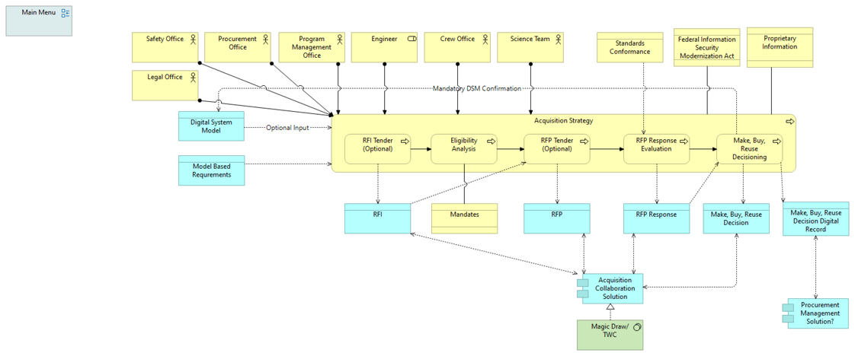
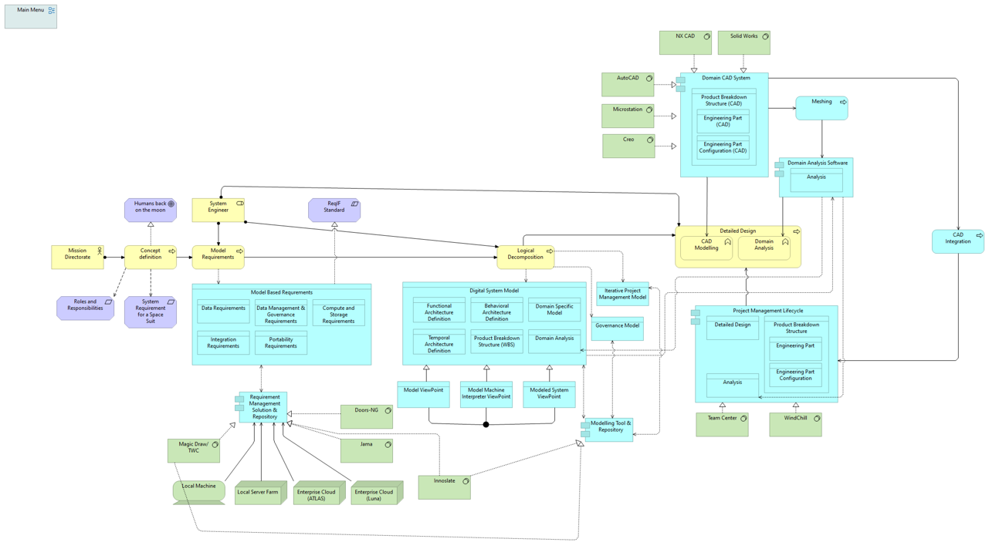
OCIO-DE Collaborative Strategic Planning Examples
Acquisition Strategy
Requirement Modelling and Logical Decomposition
Taking a Use-Case/Requirements based approach for identifying needed infrastructure transformation/investment.
Working with OCIO to shape how service line offerings are reformulated and integrate into Need-By dates and planning with DE.

Slide 24
Going Forward
Enterprise-level Eng. software license management.
Increased IdP/federated credentialling approaches for enhanced integration with partners.
Continue toolchain/digital thread development/understanding.
Implementation of Zero-trust cybersecurity methodologies.
Continue investigating where AI/ML can enhance engineers – does not replace engineers.
Continue partnering with other US Gov agencies and domestic industry partners to development common/consistent DE approaches.

Slide 25
The Asks to Industry
Software Vendors
  Work closely with US government agencies in determining which existing industry standards are needed to support digital toolchains to form needed digital engineering threads, and/or which need to be created.
  Be compliant with said standards a.s.a.p.
Aero/Defense Industry Partners
  Work with/partner with US government agencies to determine the best way to collaborate (engineering and data exchange) while protecting IP so that solutions can be identified and put into place a.s.a.p.

Slide 26






REACH
NEW
HEIGHTS
NASA DIGITAL
TRANSFORMATION
REVEAL
THE
UNKNOWN
BENEFIT
ALL
HUMANKIND
Questions?

