Slide 1
Environment Adversarial Reinforcement Learning
John R. Cooper
NASA Langley Research Center
AIAA SciTech, January 2024
Notes:
Shorten examples

Slide 2
Introduction
Contribution: a method for improving performance of reinforcement learning agents
Gradually make agent’s task more difficult over the course of training – update environment parameters as an adversary to the agent
Inspired by human learning – start with simplified version of new skill, build up to more difficult versions as proficiency is developed
Difficulty defined relative to agent – agent’s predicted return from environment

Slide 3
Related Work
Curriculum Learning
Update parameters from easy solvability towards desired environment
Curriculum design an open problem
Model-Agnostic Meta-Learning
Increase agent generalizability by randomizing task during training
Agent then easily fine-tuned for specific tasks
Deep Reinforcement Learning Self Play
An agent can achieve superhuman performance in 2-player games when trained against itself
How can this fact be leveraged for real world applications?

Slide 4
Environment Adversarial Reinforcement Learning (EARL)
Break up reinforcement learning (RL) training into multiple iterations
After each iteration, collect performance data by running trained agent with randomized environment parameters
Train performance prediction network – predicted return as a function of environment parameters
Update environment parameters in direction of negative gradient to decrease predicted performance
Continue RL training
Loss function for training performance predictor: $L\left(φ\right)=\frac{1}{n_{b}}\sum_{j=1}^{n_{b}}{{\left(R_{j}−𝒫_{φ}\left(θ_{j}\right)\right)}^{2}}$ (1)
Environment parameter update law: $μ←μ−α_{e}∇_{ θ}𝒫_{φ}\left(μ\right)$ (2)

Slide 5
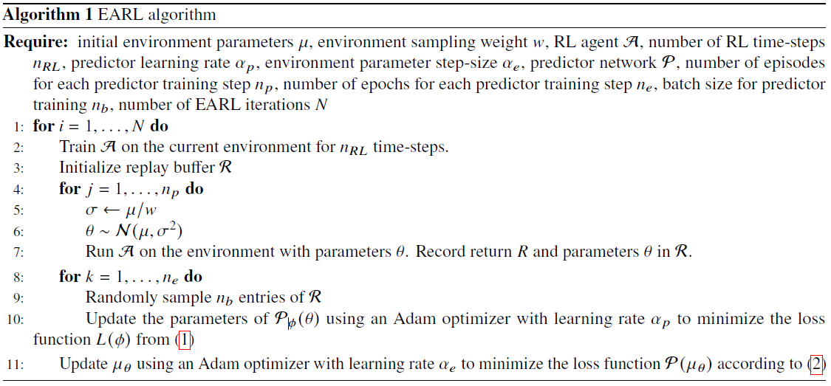
Algorithm

Slide 6
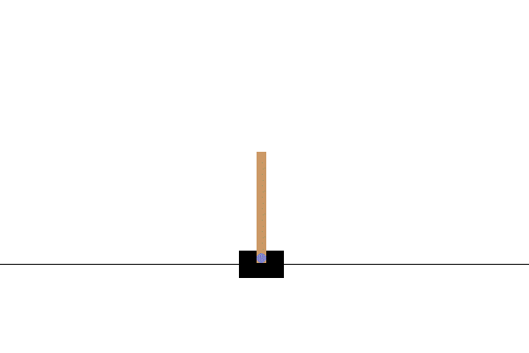
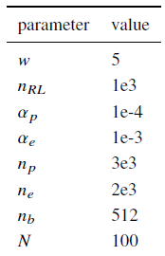
Experimental Setup
Tested on continuous CartPole environment from OpenAI gym
Environment parameters:
Cart mass, initial value = 1
Pole mass, initial value = 0.1
Pole length, initial value = 0.5
Gravitational acceleration, initial value = 9.8
RL algorithm: TD3 from Stable Baselines library with default parameters
3 training configurations:
EARL
Baseline trained on easy environment
Baseline trained on hard environment
Predictor network:
Multilayer perceptron
2 hidden layers, 128 units each, ReLU activation
Output layer: linear combination of final hidden layer
1e6 environment samples for each training run

Slide 7
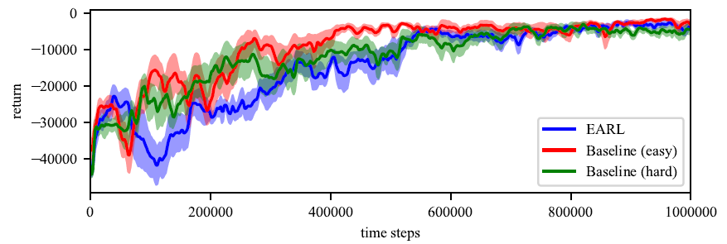
Learning Curves
Solid lines: mean return
Shaded area: +/- 1 standard deviation
Baseline trained on easy converges first
EARL converges with baseline trained on hard
Baseline achieves higher return early in training
EARL converges to higher return

Slide 8
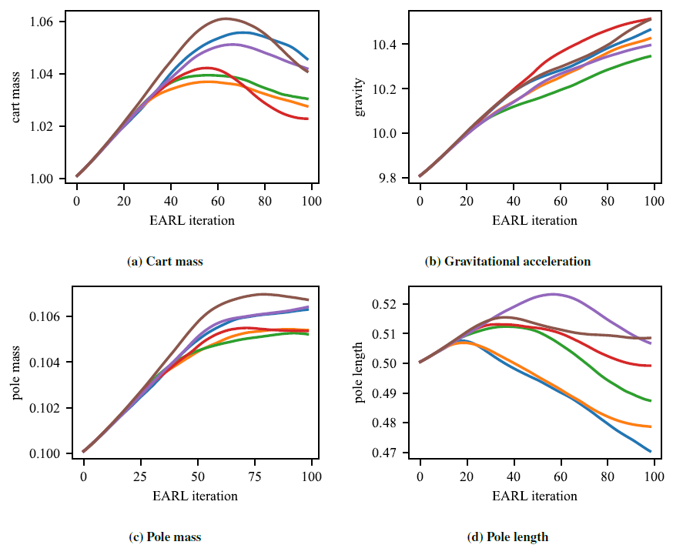
Parameters Trajectories

Slide 9
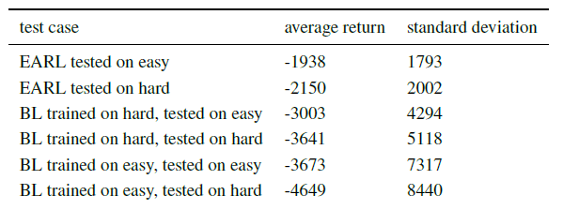
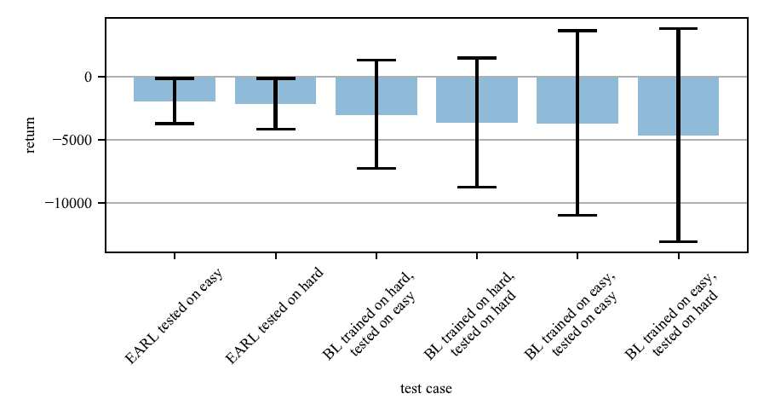
Results
After training, each agent tested for 100 episodes on both easy and hard environments
Since each run results in a different hard environment, the baseline agents trained the easy environment are tested on all hard environments from each of the six runs
EARL outperforms all other test cases

Slide 10
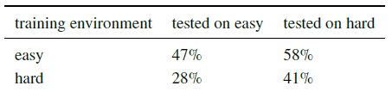
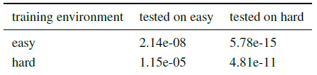
Results
EARL improvements over baseline algorithm
P-values for EARL vs. baseline comparison

Slide 11
Conclusions
Experimental results show performance increase compared to standard RL across all variations of training environment when using adversarial training
Gradient of performance predictor is effective for updating the environment in an adversarial manner
EARL could be used to learn policies for complicated tasks
Method presented for increasing difficulty, but decreasing difficulty is an open question
Future work will test EARL on more environments with other baseline RL algorithms for the inner-loop

Slide 12
Thanks!
John R. Cooper
Autonomous Integrated Systems Research Branch
NASA Langley Research Center
john.r.cooper@nasa.gov

