Slide 1
ASDC Distribution and Services of TEMPO Data
Hazem Mahmoud, Daniel Kaufman, Matt Tisdale, Georgina hays-Crepps, Alexander Radkvich
01/29/2024
Notes:
Monitoring of North America’S Air Quality From Space
The Tropospheric Emissions: Monitoring of POllution (TEMPO) instrument represents a groundbreaking advancement in remote sensing technology, providing real-time and high-resolution measurements of atmospheric pollutants and air quality monitoring. This presentation will highlight the significance of TEMPO and its data distribution by NASA’s Atmospheric Science Data Center (ASDC) to facilitate the analyses by the research and end user communities. TEMPO's geostationary orbit allows for continuous and high-resolution measurements of key atmospheric pollutants, including nitrogen dioxide (NO2), ozone (O3), and formaldehyde (HCHO). As a result, researchers can investigate the distribution patterns of these pollutants on an hourly basis, providing valuable information for understanding regional and temporal variations in air quality. Furthermore, this presentation will highlight the usability of TEMPO data in complementing ground-based air quality monitoring networks. ASDC distribution services and tools facilitate efficient data handling and analysis to support research and application uses of TEMPO data. As part of NASA’s Earthdata ecosystem, TEMPO will be available through Earthdata Search and Worldview, as well as have variable and spatial subsetting capabilities. This presentation will provide an overview of data access and services available for TEMPO data.

Slide 2
ASDC Overview
Data Products
Data Distribution Tools and Services
TEMPO
Earth Data Forum
Discussion

Slide 3
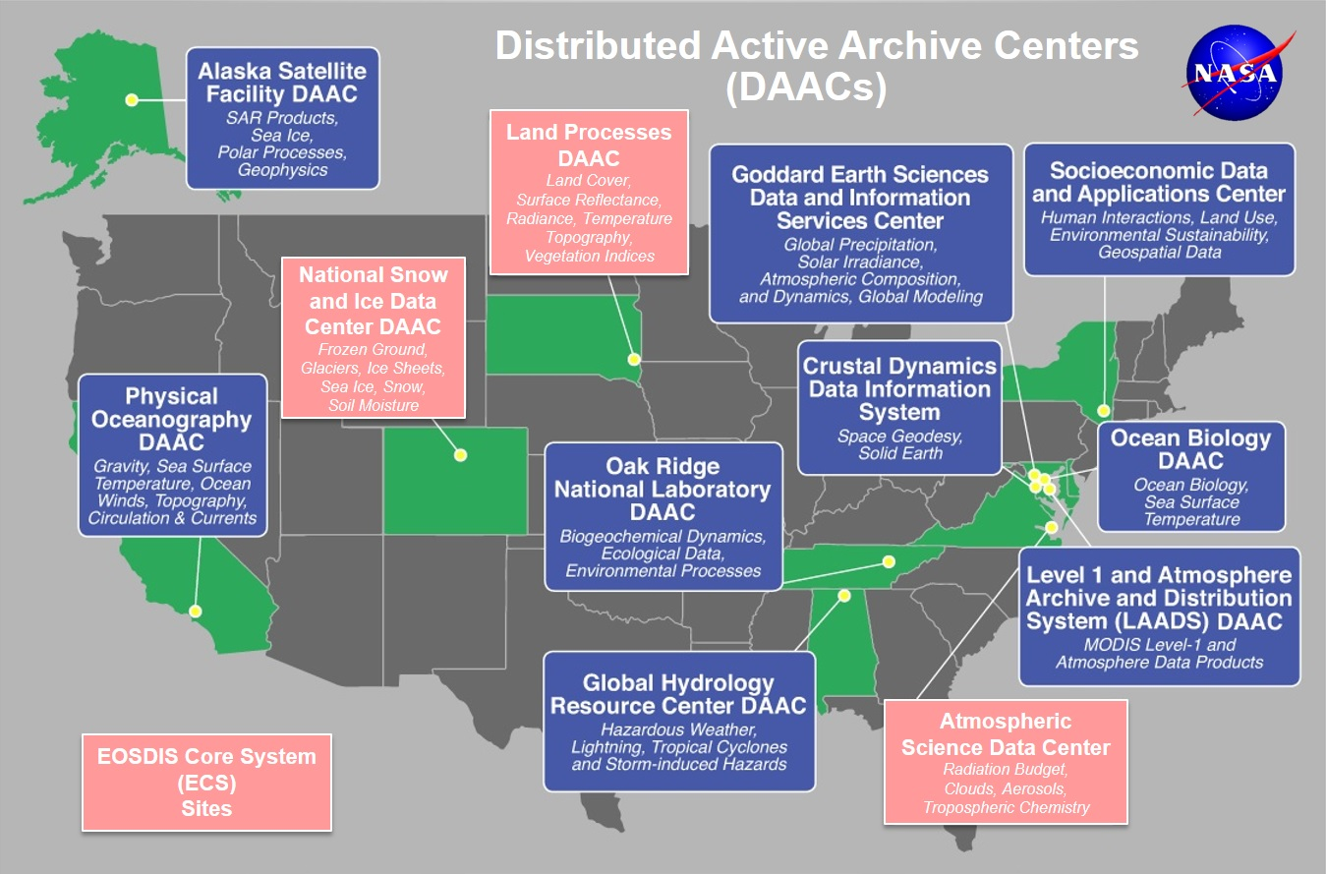
Earth Observation System Data and Information System EOSDIS
EOSDIS data centers process, archive, and distribute thousands of data products to the global user community. The primary services provided by EOSDIS are data archive & management, distribution, information management, product generation, and user support. It is comprised of multiple components including:
Distributed Active Archive Centers (DAACs)
Science Data Processing Segment (SDPS)
Science Investigator-led Processing Systems (SIPS)
Common Metadata Repository (CMR)
Earthdata
Global Imagery Browse Services (GIBS)
more

Slide 4

ASDC Vision
"To be a leading provider of atmospheric science data products and services to the science community through agility, innovation, and technical excellence“

Slide 5
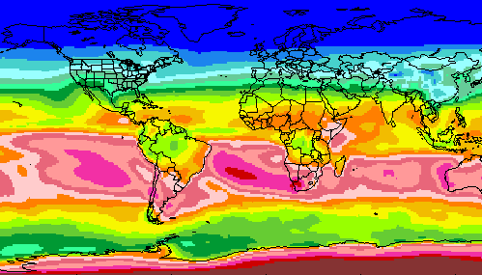
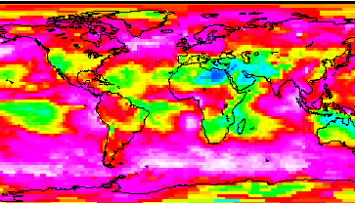
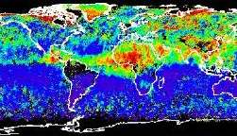
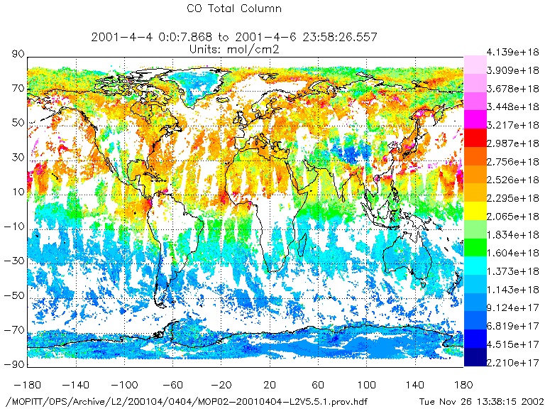
RADIATION BUDGET
CLOUDS
ASDC at a glance
44+ Science projects
  ⚬ MISR ⚬ MOPITT ⚬ MAIA ⚬ TEMPO ⚬ CERES
  ⚬ CALIPSO → RSIG (EPA)
  ⚬ Airborne field campaigns
  (KORUS AQ, DISCOVER AQ, FIREX AQ)
1100+ unique science products
Data usage
  ⚬ 2,061 Terabytes ⚬ 160,000 users
  ⚬ 158 countries
Data archive
  ⚬ 5.8 Petabytes ⚬ 141 million files (4,400 TB) on high-speed disks
Data in cloud (ongoing)
  ⚬ Data and services in the cloud
  ⚬ Scalable infrastructure
AEROSOLS
TROPOSPHERIC COMPOSITION
Primary Functions of ASDC
Ingest receive data from data provider
Archive preservation & provenance
Distribute tools and services
Process create higher level products
Outreach & Support research community

Slide 6
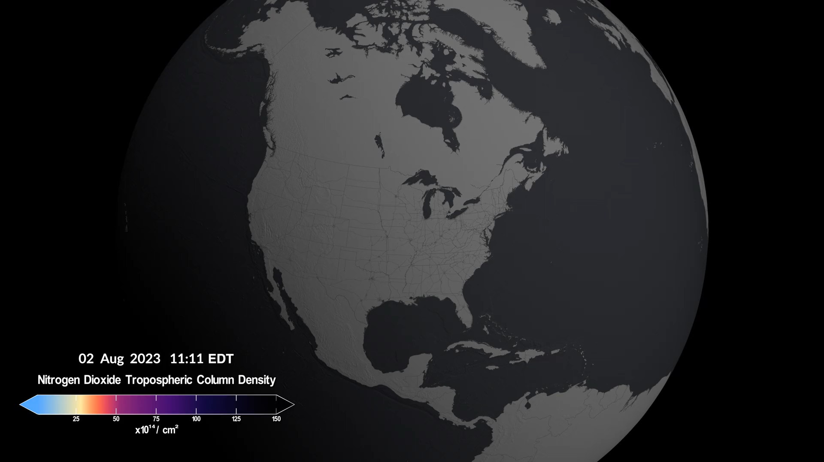
TEMPO
Notes:
April 7th TEMPO was launch from Cape Canaveral operated with Intelsat 40e onboarding a Falcon 9 rocket . Tempo is scanning from a geostationary orbit with 290-740nm a spectral resolution 0.57 nm. East to west north to south hourly scans with a spatial resolution of 2x4km. To measure atmospheric composition, enhance forecasting of air quality and to see air quality impact on the society and environmental justice. It will measure primarily aerosols, Ozone, Nitrogen dioxide and formaldehyde

Slide 7
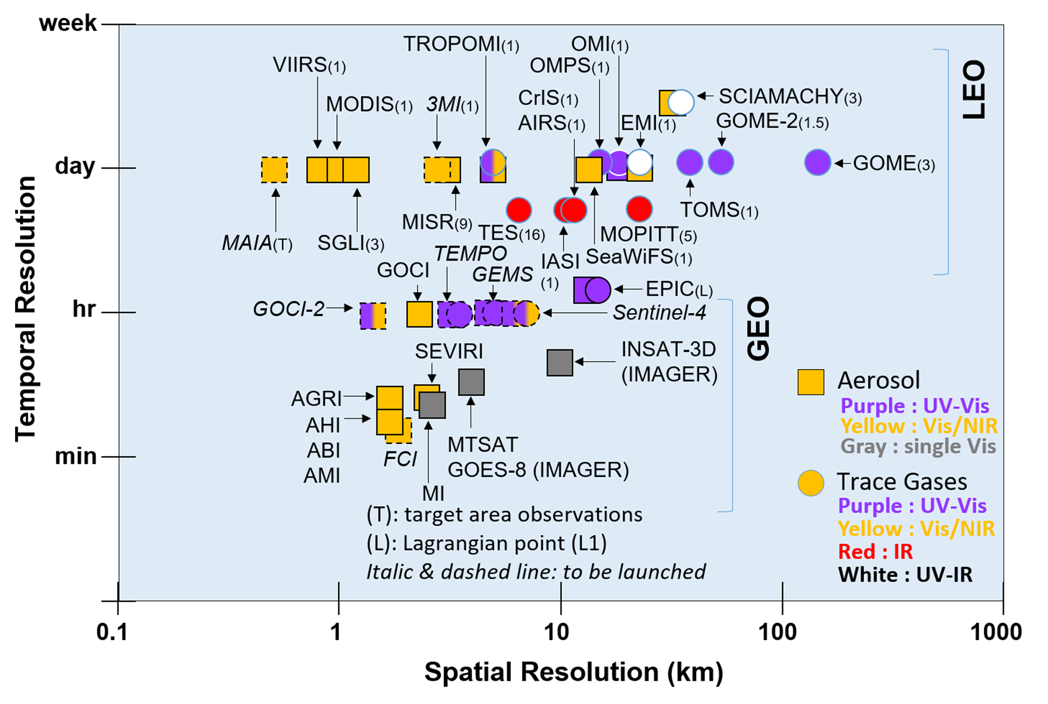
AQ from Space
TEMPO is the only geostationary mission dedicated to measure aerosols and trace gases over North America.
TEMPO boasts the highest temporal and spatial resolution for measuring trace gases.
TEMPO achieves the highest geostationary spatial resolution.
Kim et al. (BAMS 2020)

Slide 8
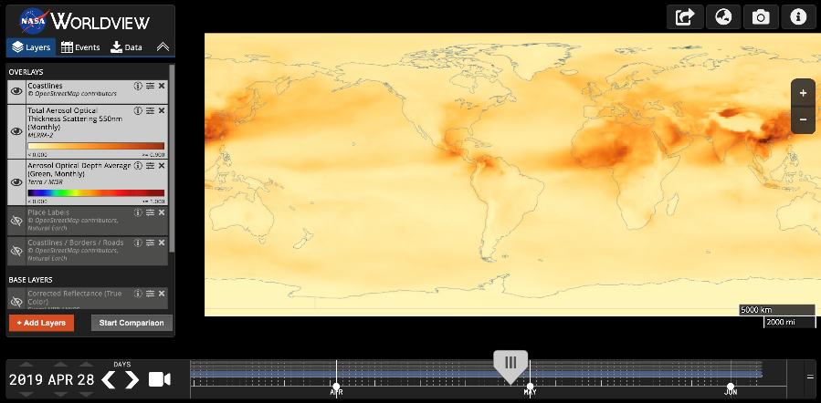





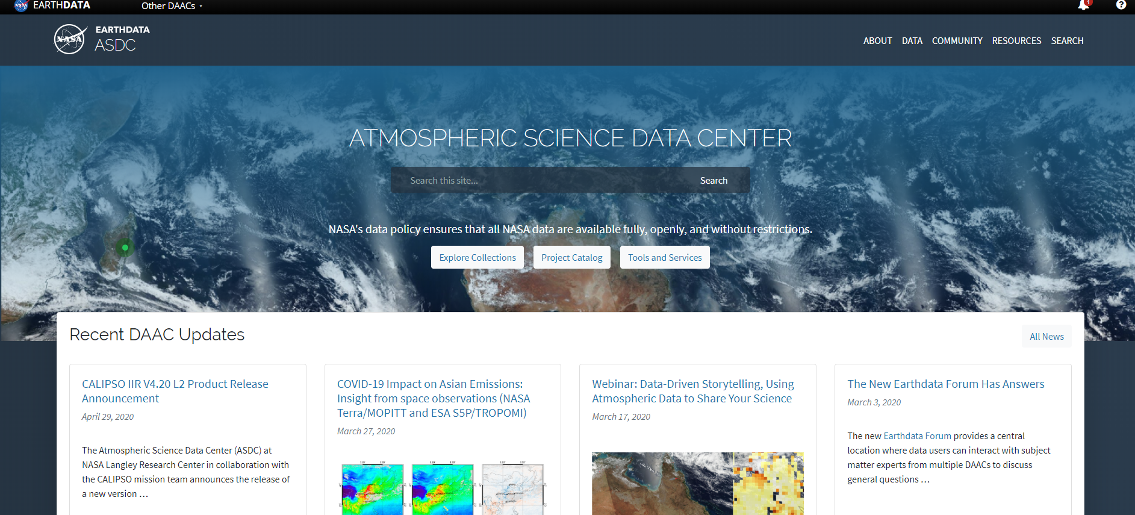
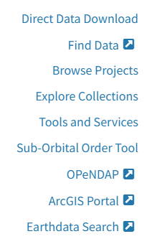



ASDC Data Distribution: Tools and Services
NASA Earthdata Search
  ⚬ metadata ⚬ browse ⚬ download
  ⚬ customize ⚬ HTTPS and AWS S3 direct data access
NASA Earthdata WorldView
  ⚬ visualize ⚬ GIBS API
NASA Earthdata Harmony
  ⚬ transform ⚬ subset ⚬ reformat
NASA Earthdata GIS
  ⚬ ArcGIS Image & Feature Service
  ⚬ OGC WMS, WFS & WCS
OPeNDAP
  ⚬ transform ⚬ subset ⚬ reformat
ASDC Subsetters
  ⚬ subset ⚬ aggregate
User Support and Other Resources
Example scripts
  ⚬ Python/Jupyter Notebook ⚬ R scripts
  ⚬ contributed tutorials/scripts
Earthdata Forum https://forum.earthdata.nasa.gov/
ASDC User Support support-asdc@earthdata.nasa.gov
https://asdc.larc.nasa.gov/
Notes:
Earthdata Login https://urs.earthdata.nasa.gov
WCS Web Coverage Services
WMS Web Mapping Services

Slide 9
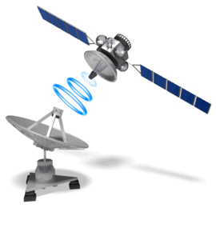


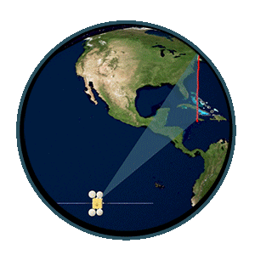



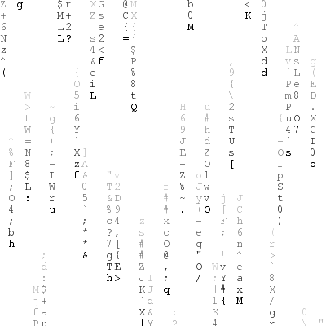







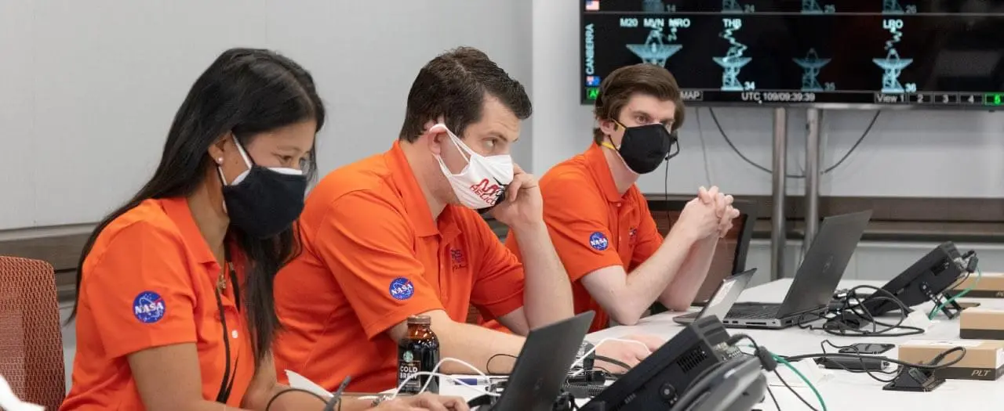

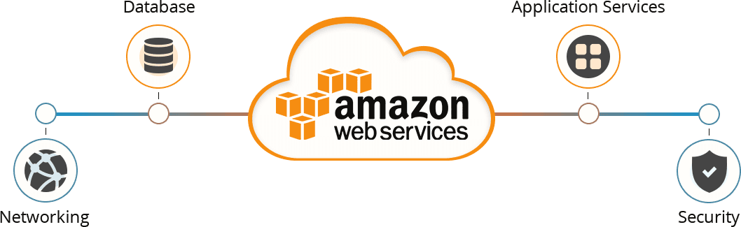
> 100 Gbps
+/- 30 Mbps

Slide 10
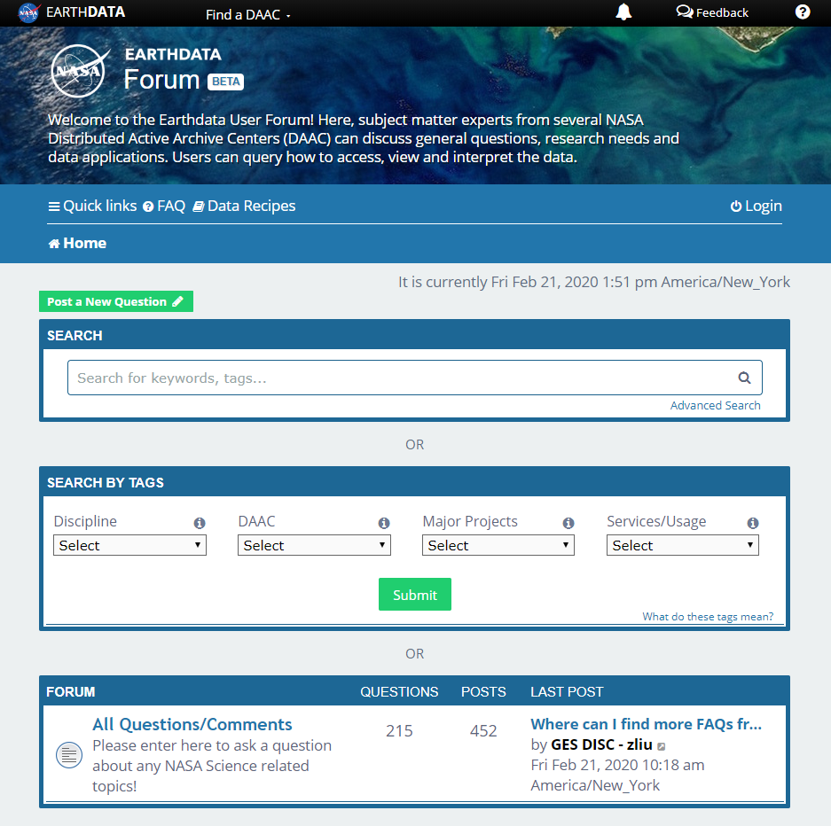
Earthdata Forum
Science Data Users can seamlessly search for information even if they do not know which DAAC the data belongs to.
Scientists & Data Providers can effectively assist their user community in more accurately using their products.
DAACs & Subject Matter Experts (SMEs) can quickly link users to existing resources.
DAAC User Services can swiftly provide inquirers with an authoritative source related to DAAC data products & services.
https://forum.earthdata.nasa.gov/
Notes:
The Earthdata Forum is our new online resource for staff members and subject matter experts from several NASA Distributed Active Archive Centers (DAACs) assist inquirers with questions about their NASA Earth science data. General questions, research needs, and data applications can all be subjects here. Members of the NASA scientific user community are encouraged also provide insights and collaborative assistance.​

Slide 11
Atmospheric Science Data Center
NASA Langley Research Center
Hampton, Virginia (USA)
https://asdc.larc.nasa.gov/
Hazem.mahmoud@nasa.gov

