Slide 1
Evolution of cFS (core Flight System)
Enabled by HPSC
Goddard Space Flight Center
Flight Software Systems Branch
Code 582
Rich Landau
Associate Branch Head
Richard.D.Landau@nasa.gov

Slide 2
Outline
What is cFS?
cFS Usage and Impact
Long-term vision and objectives
cFS App Store
Proposed cFS development:
  Direct HPSC Support
  Improved Multithreading
  Multi-System Support
  Deterministic Autonomy
  AI Inferencing
  Zero-Trust Architecture
  Security and Cryptography
Examples

Slide 3
What is cFS?
NASA 2020 Software of the Year Award winner!
Flight Software (FSW) - the “brains” of the spacecraft:
Controls instruments, thermal, electrical, attitude, etc.
Ensures safety during anomalies
Provides autonomy, guaranteed response time, determinism, reliability, maintainability
cFS - a TRL 9 FSW framework, providing:
A dozen modular software applications for common functions (limit checker, file transfer, memory mgmt, etc.)
Portability via processor and OS abstraction
Supporting tools (unit test framework, performance, ground system simulator, etc.)
FSW with cFS
Faster/cheaper development with 100% re-use of common services (time management, event notification, dynamic configurability, …) and applications (CFDP, Checksum, File Manager, …)
Plug-n-play capability via the consistent interface for common and mission-specific applications
Project Responsibility
cFS Team Responsibility
Third Party
FSW with cFS
Application
EDAC Scrubber
Command Ingest
Telemetry Output
1553 Bus Support
SpaceWire
Tools
Attitude Control
Data Ingest
Orbit Models
Solar Array
High-Gain Antenna
Instrument Mgr.
CFDP
Checksum
Data Storage
File Manager
Housekeeping
Health/Safety
Ground System Sim
Limit Checker
Memory Dwell
Memory Mgr.
Scheduler
SB Network
Stored Cmds.
Application
Generator
Core Flight
Executive
Core Flight Executive API
Core Flight Executive
Performance
Tools
Table Services
Event Services
Executive Services
Time Services
Platform
Abstraction
OS Abstraction API
Platform Support Package API
Performance
Analyzer
RTEMS
VxWorks
Linux
Mcp750-VxWorks
Other Platforms
Custom Platform (optional)
Unit Test Framework
RTOS / Boot
Real Time OS
Build System Framework
Board Support Package
PROM Boot FSW
cFS commonizes core services, allowing project teams to focus on project-specific development

Slide 4
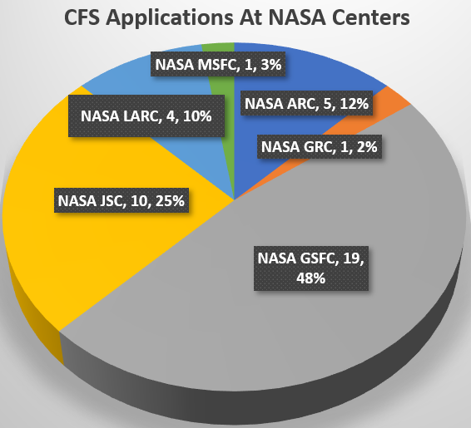
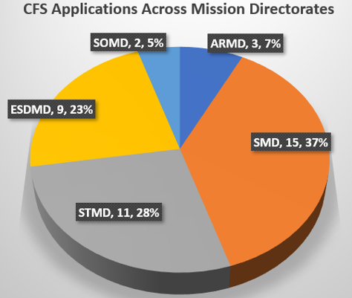
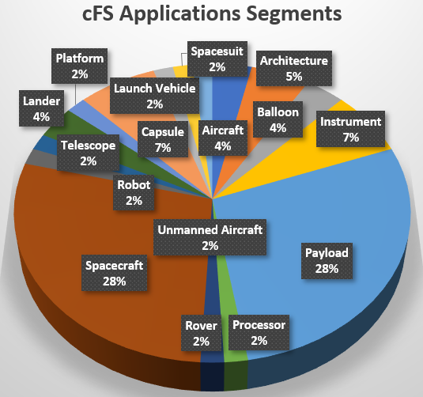
cFS Usage and Impact At NASA
cFS is used at 6 NASA Centers!
cFS is across mission directorates and on 40+ projects historically including RST, CCRS, MAV, LRO, Gateway, Artemis, and many more!
cFS is on embedded systems that span the space ecosystem.
cFS has become the dominant FSW framework at NASA and is likely the most used FSW system in the world

Slide 5

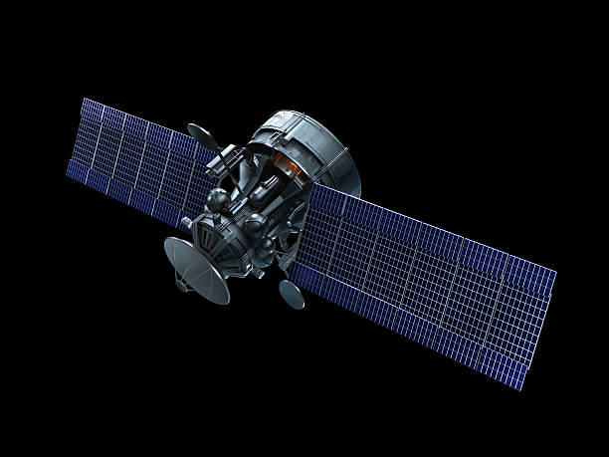

The Current Paradigm
Cmd
Cmd
Raw Science
Cmd
Tlm
Tlm
Tlm
Raw Science
Raw Science

Slide 6
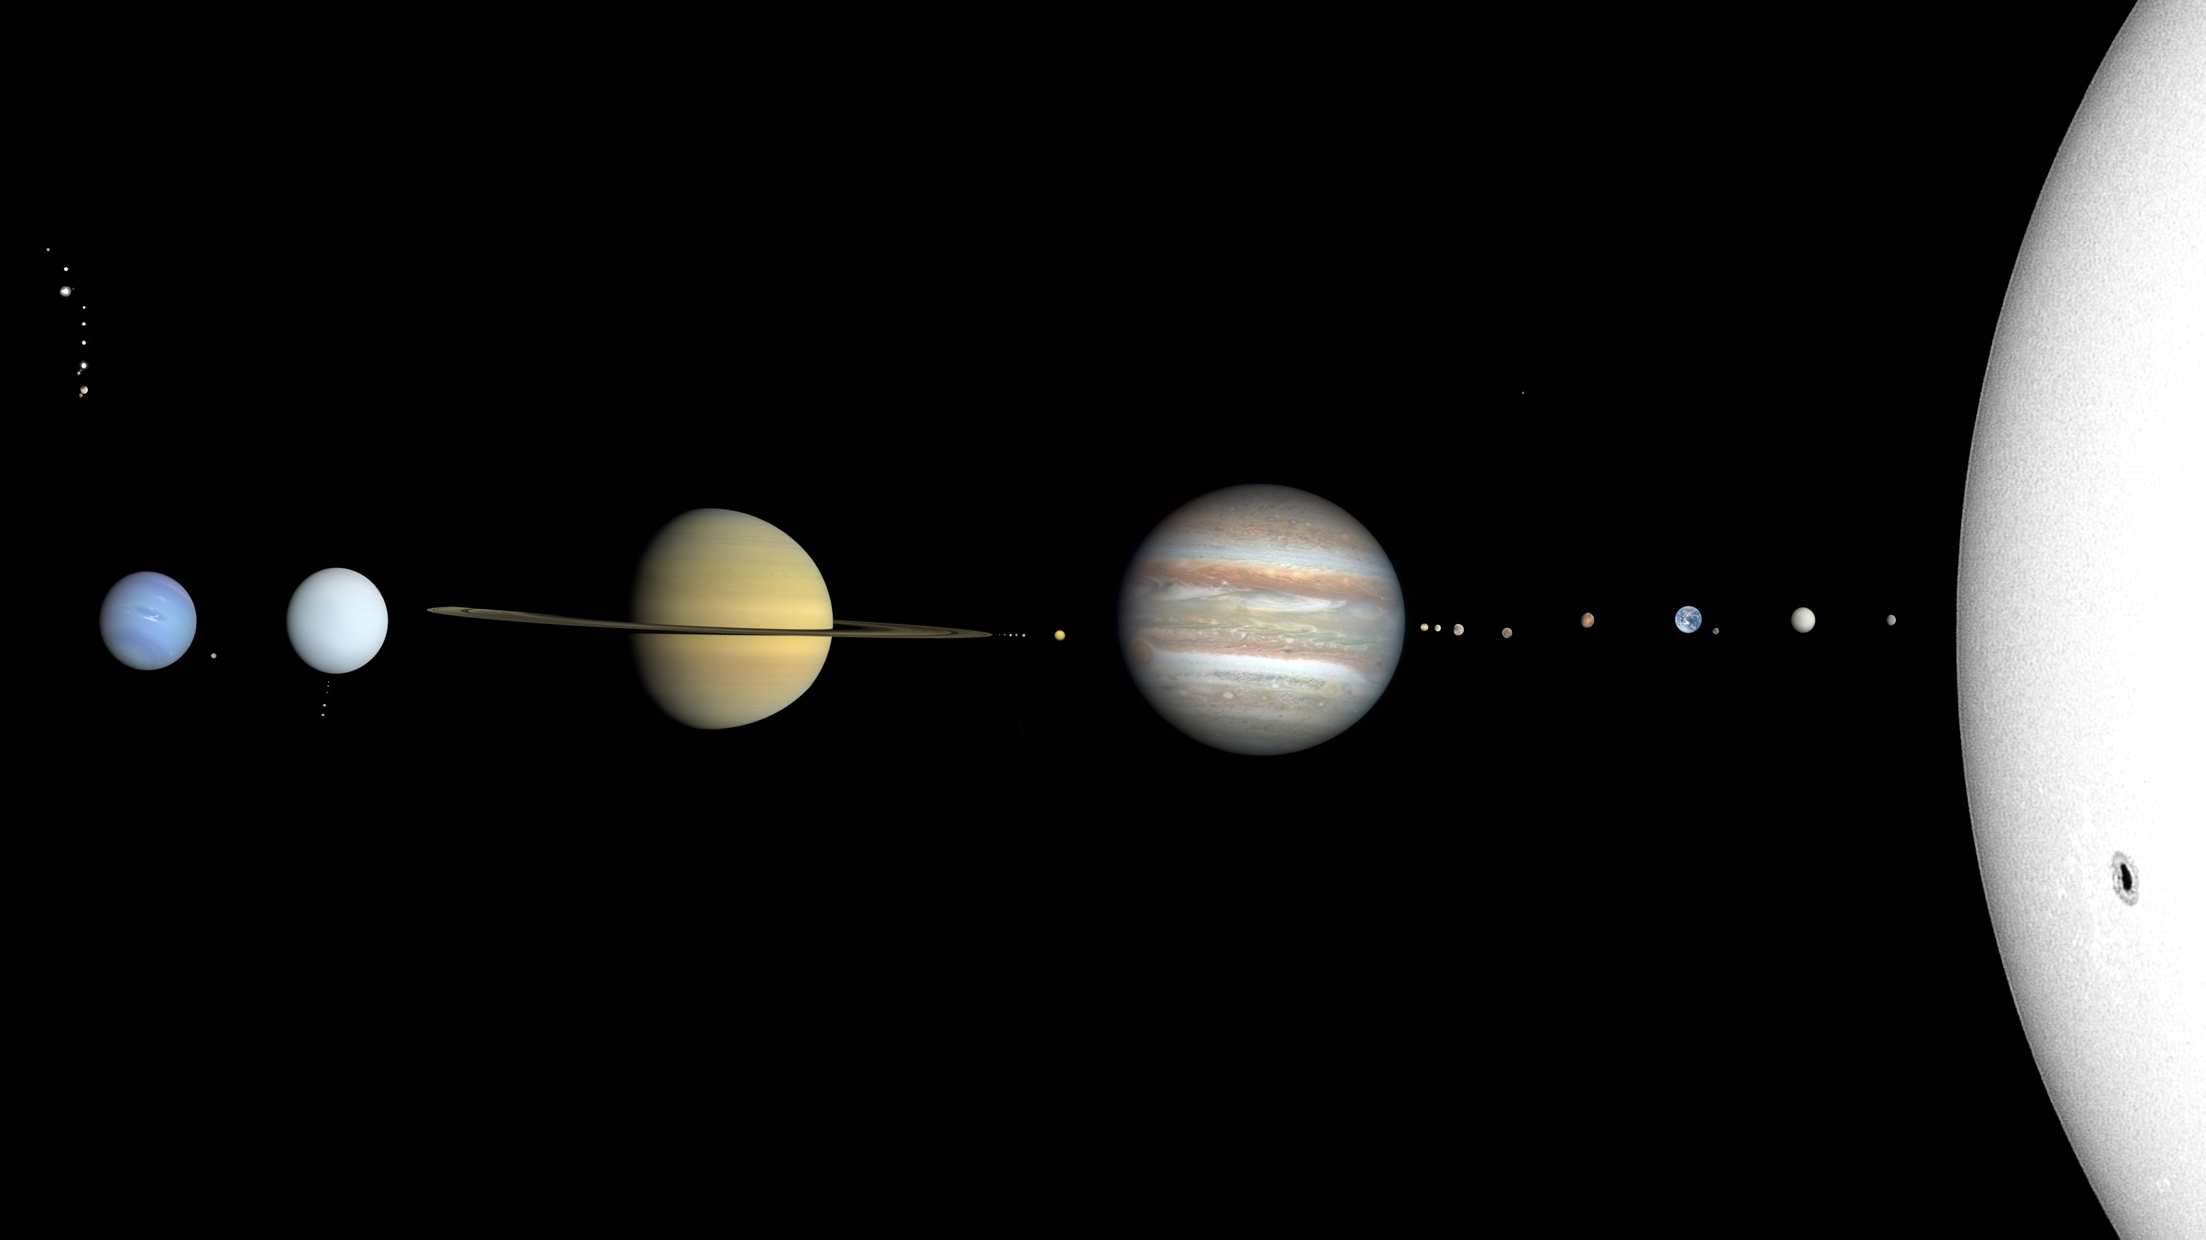
But as we explore…
Daily science objectives
• Onboard decision making
• Collection prioritization
• GNC adjustments
• Self diagnostics and repair
• Cyber threat monitoring
• Onboard science processing
Processed science results
~6 hour round trip communication
Driven by AI/ML!

Slide 7
Objectives
Add cFS support for HPSC, including support for new capabilities
Improve cFS capabilities for deep space missions
Enable edge computing and reduce reliance on Earth-space links
Futureproof capabilities industry and academia will need via their use of cFS
Protect our assets from adversaries
Note: Concepts in this package are notional and preliminary, and subject to change

Slide 8
cFS App Store
GSFC / Code 582 develops and maintains core cFS functionality with community involvement
Mission teams can pick and choose which functionality they need for their missions based on requirements and hardware capabilities
Goal is to add capability both to support cFS on HPSC and utilize platform to improve core capabilities
cFS App Store
Platform Support Packages (PSPs)
Operating System Abstraction Layers (OSALs)
Shared Libraries
HPSC-Linux
HPSC-VxWorks
Linux
RTEMS
Inference Engine
Encryption
Add To Mission
Add To Mission
Add To Mission
Add To Mission
Add To Mission
Add To Mission
HPSC-RTEMS
GR740-RTEMS
VxWorks
RMAP
DMA
Add To Mission
…
Add To Mission
Add To Mission
…
Add To Mission
…
Add To Mission
Apps
Limit Checker
Data Storage
Memory Dwell
Lua Scripting
Add To Mission
…
Add To Mission
Add To Mission
Add To Mission
Stored Command
Software Bus
AI Inference
Software Bus Network
Related to or enabled by HPSC
Add To Mission
Add To Mission
Add To Mission
Add To Mission

Slide 9
Track 1: Direct HPSC Support
Get cFS running on HPSC
Create base PSP for HPSC-RTEMS support
  Basic board support including startup, reset, exception, watchdog, timer, and file system logic
Create base PSP for HPSC-Linux support
Enhance HPSC-Linux PSP with HPSC features
  Support for real-time configurable kernel modes
    Set core clustering modes
    Set performance characteristics (adjustable per mission phase via scripting or autonomy)
  Include interface support for AI/ML between cFS apps and implementing libraries
  Provide abstracted app layer access to user crypto
Enhance HPSC-RTEMS PSP with HPSC features
  Full access to HPSC configurability and crypto, but reduced emphasis on AI/ML features
Create PSPs for other OS configurations (such as VxWorks)
  Full-featured, leveraging lessons learned from initial work
Get multiple cFS instances running on HPSC hypervisor partitions and communicating with each other as a cohesive system
  Requires some other updates listed in this package

Slide 10
Track 2: Improved Multithreading
Current baseline has tasks hard-coded bound to the first core
Tasks can then create child tasks on their same core
Need ability for complex tasks to utilize multiple cores and take full advantage of HPSC’s application cluster (as well as other multi-core processors) but keep real-time processes deterministic
Desired Updates:
  Add ability to specify core affinity per task in cFS task config file
      This has been done by flight projects and needs to be made common
  Allow apps to more easily execute across multiple threads/cores
  Examine SB bottleneck on multiprocess communication, improve if possible
HK
SB
SCH
…
ACS
Complex Processing App (CP)
Core 1 Core 2 Core 3 Core 4
GR740 EXAMPLE

Slide 11
Track 3: Multi-System Support
Missions will need the ability to run multiple cFS instances as one cohesive system
  Take full advantage of hypervisor running disparate operating systems
Need the ability to extend the software bus across two systems
  Connected via socket or another interface
Opens potential for more cohesive distributed system architecture designs
Software Bus Network (SBN) app already exists
Desired Updates:
  Integrated and tested against current baseline,
  pulled into active management by cFS team
App A
App B
App C
Inter-app Message Router (Software Bus)
SBN
SBN
Inter-app Message Router (Software Bus)
App D
App E
App F

Slide 12
Track 4: Deterministic Autonomy
While apps handle specific functions, high level mission control is historically done by the ground
For deep space and increased efficiency, move some decisional mission logic to the flight system via dynamic scripting
Desired Updates:
  Develop Lua scripting app to receive telemetry, send commands, and make decisions
      Requires onboard knowledge of message formats
  Explore benefits of embedding Python as an alternative when resources allow
      Unlock familiarity of Python and access to cutting-edge AI libraries

Slide 13
Track 5: AI Inferencing
Provide platform for running AI inference using ground-trained models for purposes such as:
  General spacecraft autonomy
  Onboard data processing
  Cyber threat detection
  Self diagnostics and repair
  Much, much more
Desired Updates:
  Develop AI Inference app (and associated library) to load a model and perform inference using live data with a standardized cmd/tlm API
      Standard API will wrap open source library such as Tensorflow Lite or OpenXLA
      Needs ability to run on HPSC X280 cores or offload to GPU/FPGA
      Custom apps can use the library directly when data throughput through SB is a problem
Input from system
Trained model
Output to system

Slide 14
Track 6: Zero-Trust Architecture
Currently, any app can send or receive any message on the software bus
Need ability to control which app can send and receive which messages to allow “sandboxing” of low-TRL apps such as AI Inferencing or anything using it
Also a critical feature for cybersecurity to prevent rogue apps from hijacking the system or receiving sensitive data
Desired Updates:
  Add ability to control which apps can send and receive particular messages
      Detailed design discussions and trade between internal/external implementations required
      Ideally in the form of a library, so it can plug into SB easily and also be usable on other architectures
Thruster Control
Malicious App
Command Ingest
AI Inference
Telemetry Output
Inter-app Message Router (Software Bus)

Slide 15



Track 7: Security and Cryptography
Efforts in work at GSFC to perform link and on-board encryption among other cybersecurity focus areas
Tie encryption capability to HPSC’s user crypto through HPSC PSPs
App B
Command Ingest
Telemetry Output
App A
Inter-app Message Router (Software Bus)
Security Abstraction Layer
SW-Based Security
Security Manager
HPSC User Crypto

Slide 16

Example: Simple Spacecraft C&DH
HPSC
RTOS
FM
C1
ES
C1
EVS
C1
TBL
C1
TIME
C1
MM
C1
ACS
C2
CI
C1
SCH
C1
TO
C1
Inter-app Message Router (Software Bus)
CF
C1
LC
C1
HS
C1
SC
C1
HK
C1
SPWR
C1
DS
C1
LUA
C3-C4
cFE
Core
cFS App

Slide 17
Example: Instrument Data Processing
HPSC
Linux
FM
C1
ES
C1
EVS
C1
TBL
C1
TIME
C1
MM
C1
CI
C1
SCH
C1
TO
C1
Inter-app Message Router (Software Bus)
CF
C1
LC
C1
HS
C1
SC
C1
HK
C1
SPWR
C1
AIF
C2-C8
DS
C1
Inference Engine
Data Processing Models
cFE
Core
cFS App
Library

Slide 18
Example: Entire Complex Mission Solution
HPSC
RTOS
FM
C1
ES
C1
EVS
C1
TBL
C1
TIME
C1
MM
C1
ACS
C2
CI
C1
SCH
C1
Inter-app Message Router (Software Bus)
TO
C1
CF
C1
HS
C1
SC
C1
HK
C1
SBN
C1
DS
C1
LUA
C3-C4
LC
C1
SPWR
C1
Linux
SBN
C5
Inference Engine
AIF
C5-C8
Inter-app Message Router (Software Bus)
Autonomy / Processing Models
Cyber Monitoring Models
HS
C5
ES
C5
EVS
C5
TBL
C5
TIME
C5

Slide 19
Conclusion
HPSC provides a generational hardware upgrade that will enable science and technology not historically possible in space systems
cFS was designed from the start with evolution and adaptability in mind to provide a software platform for cutting edge capability
The cFS team is interested in partnering with HPSC and implementing enabled capabilities rather than waiting for a flight project to adopt it, funding permitting
  Goal to achieve a hardware + software package of TRL 6 or higher for major project adoption
Improved cFS support for HPSC reduces barriers for adoption

Slide 20
Questions?

