Slide 1
The State of CryptoLib The Open-Source Satellite Cryptography Library
Cody Cutright
System Engineer
TMC Technologies
NASA IV&V's JSTAR Program
GSAW 2024
© 2024 by NASA. Published by The Aerospace Corporation with permission.

Slide 2
Who is NASA IV&V?
NASA Katherine Johnson Independent Verification and Validation Program
Ensuring Class A Mission success since 1993
Full Development Lifecycle
Software Requirements, Design, Code, Test, I&T
Located in West Virginia
JSTAR Team
The Jon McBride Software Testing & Research Laboratory
Named for WV’s first and only astronaut
Specialized subset of IV&V Facility
Experts in modeling, simulation, and digital twins of NASA missions

Slide 3
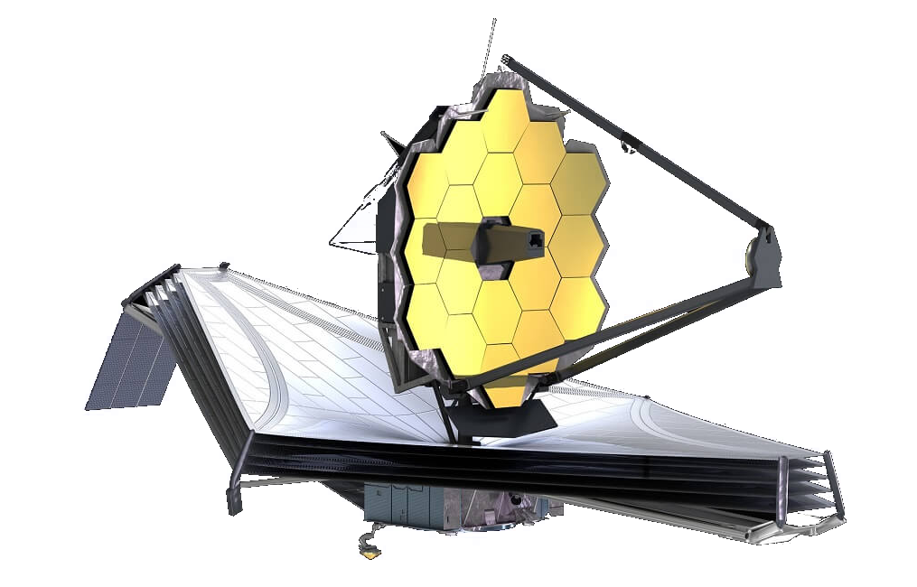
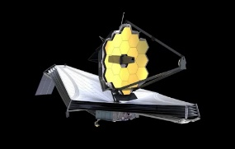
What Does JSTAR Do?
Experts in software only simulation of hardware
Experts in hardware emulation
We provide simulated hardware so flight binaries can be executed, unmodified, on commodity hardware
This enables unique, challenging, and otherwise difficult to create test cases
Virtual testbeds allow development to proceed without immediate access to a flatsat
In some cases, code can essentially be finalized prior to hardware integration
Shortens development timelines
FSW, Physics, Avionics

Slide 4
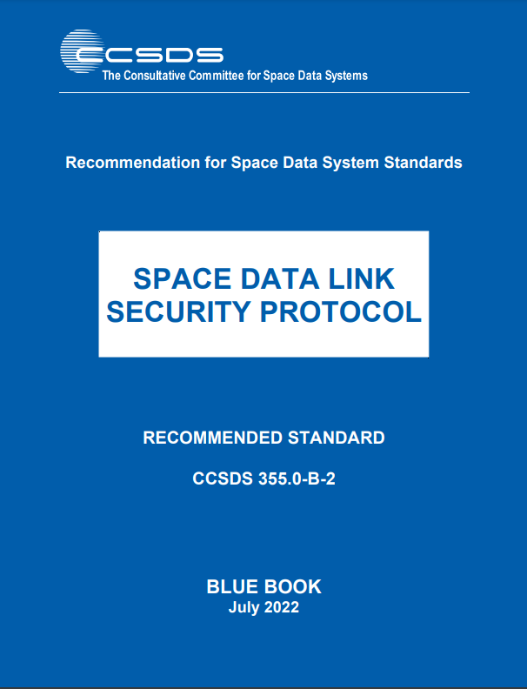
What is CryptoLib?
CryptoLib is an open-source implementation of the CCSDS Space Data Link Systems (SDLS) and SDLS-Extended Procedures (SDLS-EP) Standards, the original implementation by John Lucas at IV&V
Encrypts & decrypts Transfer Frames:
Telecommand (TC)
Telemetry (TM)
Advanced Orbiting System (AOS)
Open-sourced library
C Based
Utilizes LibgCrypt by default
Support for WolfSSL
Support for JPL’s KMC (Bouncy castle)
https://github.com/nasa/CryptoLib
*From ccsds.org

Slide 5
Why CryptoLib?
CubeSats - Missions are not exempt based on size or budget
CCSDS Protocols already in use
Telecommand and telemetry protocols are in wide usage
Additional standards provide guidance for encryption / authentication
An unencrypted command link has implications for other missions
No PhD Required – Minimal Encryption Knowledge necessary!
Open-Source - No black box, transparent handling of the process
No Vendor Lock in
Save $$$
NASA-STD-1006A

Slide 6
NASA-STD-1006A
"Programs/projects shall protect the command stack with encryption that meets or exceeds the Federal Information Processing Standard (FIPS) 140, Security Requirements for Cryptographic Modules, Level 1. "
[…] iii. Deep space missions may choose to limit controls applied to the space link if certain controls (e.g., encryption and authentication) pose significant burden to operability or mission success, and if the threat to the space link is low.
iv. Category 3/Class C or Class D missions may authenticate without encryption if they have no propulsion.

Slide 7
High Level Overview
Unencrypted Command
Encrypted Command
CryptoLib
CryptoLib
Encrypted Command
Unencrypted Command

Slide 8
CryptoLib: Standalone Configuration
Ground Station
CryptoLib Standalone
Spacecraft
Ground Station Software
CryptoLib
Software Bus
App 1
Apply Security
CI
Process Security
App 2
Process Security
TO
Apply Security
…
App N
Tables
Tables

Slide 9
CryptoLib: KMC Integration
Ground Station
Spacecraft
Ground Station Software
KMC-CryptoLib
CryptoLib
Software Bus
App 1
Apply Security
CI
Process Security
App 2
Process Security
TO
Apply Security
…
App N
Tables
Tables

Slide 10
KMC: External Keystore
AMMOS KMC
Cryptography Keys
CryptoLib
Command Encryption Processing
Ground System Software

Slide 11
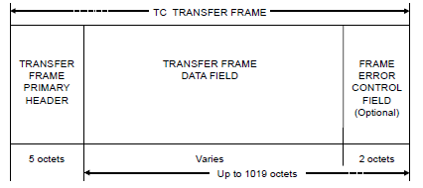
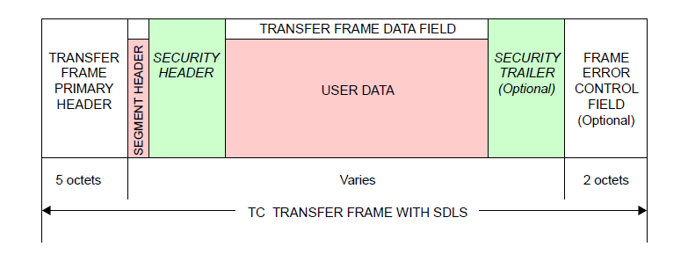
Telecommand Transfer Frames
ProcessSecurity
ApplySecurity
*From CCSDS 232.0-B-4

Slide 12
Current Status
Functional Telecommand Uplink
CCSDS Telecommand (TC) Transfer Frames
Functional Telemetry Downlinks
CCSDS Telemetry (TM) Frames
CCSDS Advanced Orbiting Systems (AOS) Frames
Security Options
Authentication
Encryption
Authenticated Encryption
Plaintext
Implemented algorithms
AES GCM 256
AES CBC 256
AEC CCM
SHA 256/512 Hashing

Slide 13
Current Status
Standalone Module
Integration with NASA’s core Flight System
Integration with JPL’s Key Management & Cryptography
Integration with NASA Operational Small Satellite Simulator (NOS³)
https://github.com/nasa/nos3
Supports WolfSSL
Interoperability tested with JPL's Lunar Trailblazer and SunRISE

Slide 14
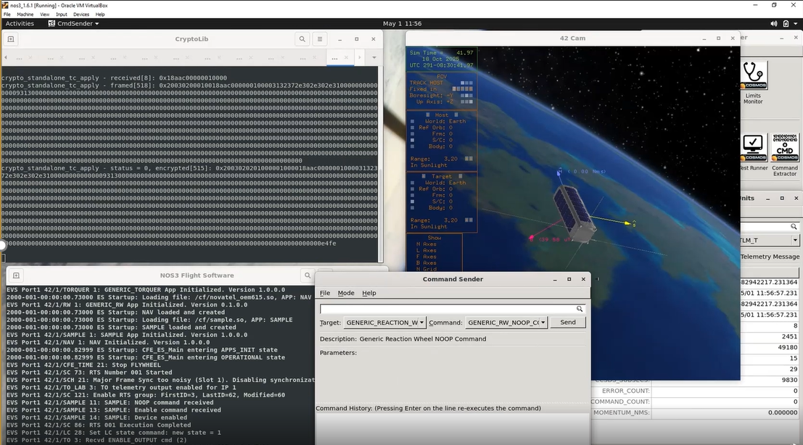
NOS³

Slide 15
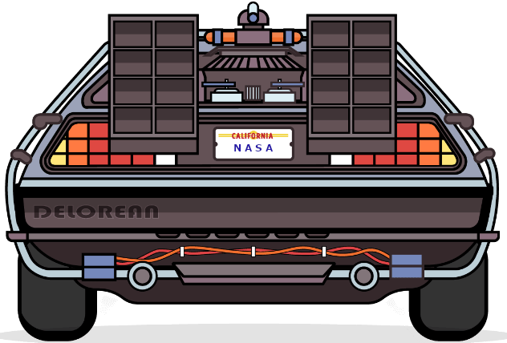
The Future
Increasing Unit Test Coverage to 100%
Reducing Cyclomatic Complexity
Addition of Extended Procedures
Over The Air Rekeying (OTAR)
Key lifecycle management
Security Association Management
Integration with additional ground systems
ASIST / FEDS
ITOS
COSMOS

Slide 16
Major Contributors
Robert Brown, Systems Engineer, NASA IV&V, Robert.J.Brown@nasa.gov
David "Cody" Cutright, Systems Engineer, NASA IV&V, David.C.Cutright@nasa.gov
John Lucas, Systems Engineer, NASA IV&V, John.P.Lucas@nasa.gov
Michael Pajevski, AMMOS Architect, NASA JPL, Michael.J.Pajevski@jpl.nasa.gov
Scott Zemerick, Chief Systems Engineer, NASA IV&V, Scott.A.Zemerick@nasa.gov
Ibraheem Y Saleh, Software Engineer

Slide 17
Questions / Answers

