Slide 1
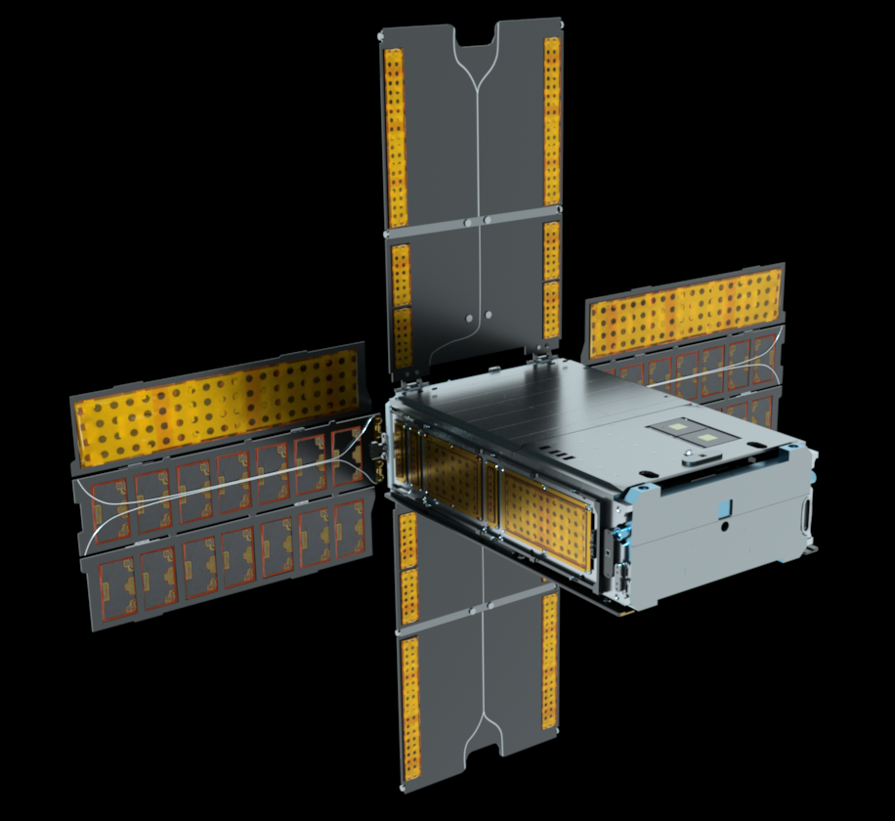
Flight Experience and Lessons Learned from BioSentinel:
A 6U Deep Space CubeSat
Jesse Fusco – ADCS Lead, Mission Operation Manager
Terry Stevenson – Propulsion Lead, Flight Director
Robert Nakamura – Fault Management Lead, Flight Director
NASA Ames Research Center
NASA/Daniel Rutter

Slide 2
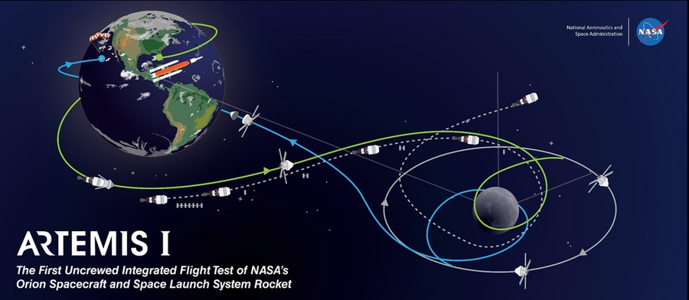
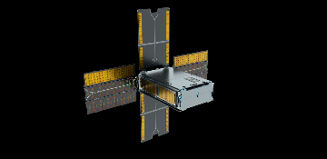


BioSentinel Mission
Objective: Study the biological effects of the space radiation environment and demonstrate technology for deep space CubeSats
NASA’s first biological study in interplanetary deep space:
  Combines bio studies with autonomous capability & dosimetry beyond Low Earth Orbit (LEO)
  Beyond the protection of Earth’s magnetosphere
  Compare radiation environments (deep space, LEO, Earth)
  Payload:
  No attitude pointing requirement
  Heliocentric orbit chosen
Heliocentric Orbit
Lunar
Fly-by
Secondary Payload
Deployment

Slide 3
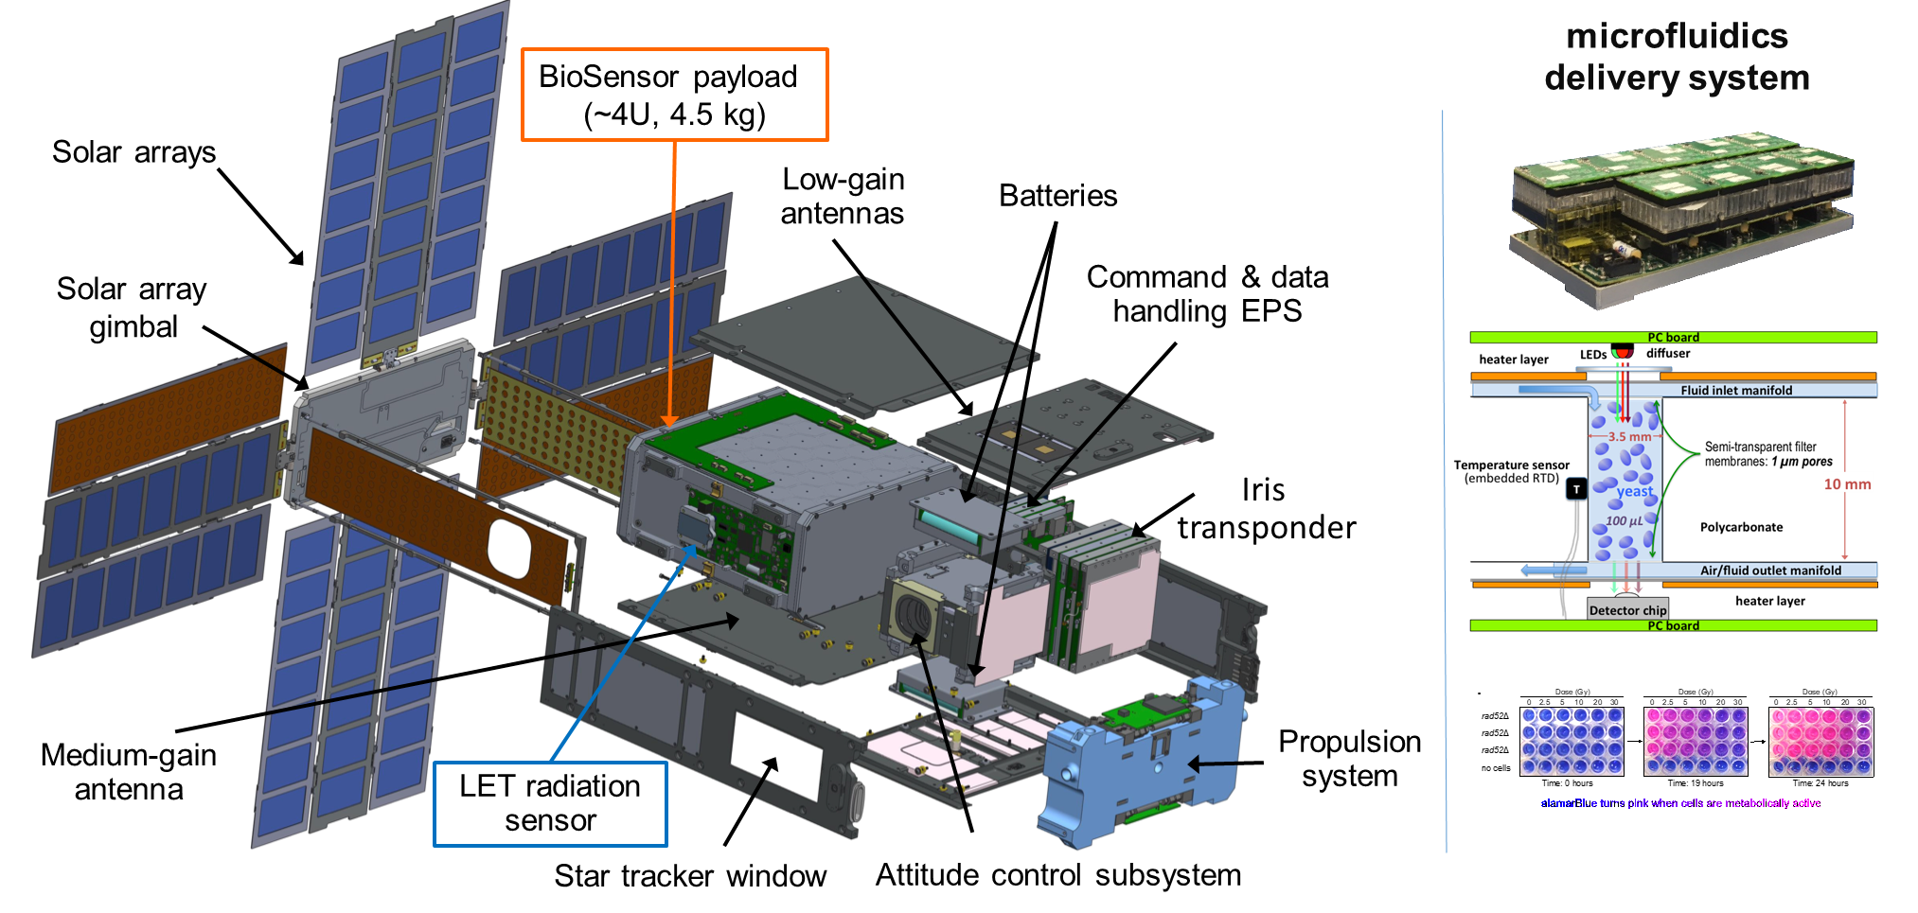
BioSentinel: A 4U Experiment in a 6U CubeSat
Notes:
Points to make:
payload gets lots of space!
antenna 90d from solar array
ST 90d from both
Prop system at far end
Eps is all COTS and has been error free!

Slide 4
ADCS Overview
Four autonomous closed-loop controllers
  Nominal Operations:
    Nominal Pointing
    Momentum Management
  Off-Nominal Operations
    Rate Reduction
    Safe Mode
Nominal operations use an Extended Kalman Filter to fuse star tracker and IMU measurements
Safe mode controller independent of star tracker and Kalman filter
Star Tracker
Nominal Pointing Controller
Extended Kalman Filter
Reaction Wheels
IMU
Momentum Management Controller
Propulsion Thrusters
RW
Tachometer
Rate Reduction Controller
Sun Sensor
Safe Mode Controller

Slide 5










Sun Safe Mode Design
Independent of star tracker and Kalman filter
Orients solar panels to the sun (spacecraft +X axis)
Rotate around sun vector for communications and momentum accumulation
  Accurate rate control essential
  Gyro bias estimation required since could be similar magnitude as commanded rotation rate
$$K_{i}$$
$$\frac{1}{S}$$
Sun Vector
Sun Sensors
$$\hat{S}$$
LGA
Hemispherical
Coverage
X
$$K_{p}$$
$${\hat{S}}_{cmd}$$
$$θ$$
Earth
$$ω_{cmd}∙{\hat{S}}_{cmd}$$
Body Rates
3 Axis Rate Gyro
$$ω_{imu}$$
$$ω$$
RW Rates
Bias Estimation
$$\tilde{b}$$

Slide 6
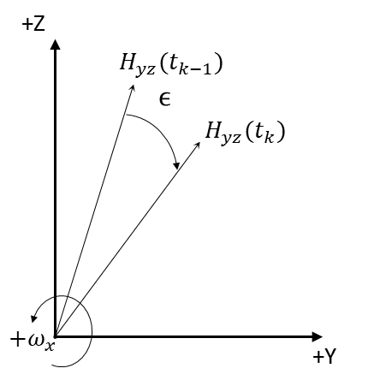

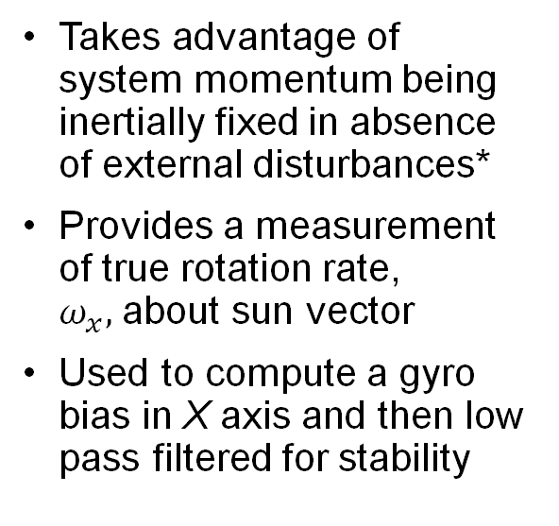


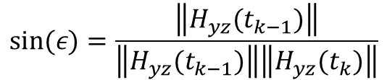
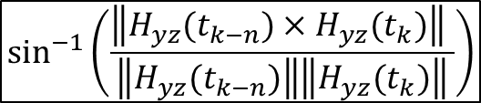



Safe Mode Bias Estimation
YZ Momentum
RW Rates
$$I_{rw}$$
$$\sin^{−1}\left(\frac{\left\|H_{yz}(t_{k−n})×H_{yz}(t_{k})\right\| }{\left\|H_{yz}(t_{k−n})\right\|\left\|H_{yz}(t_{k})\right\|}\right)$$
$$\frac{1}{Δt }$$
$$b$$
$$\tilde{b}$$
Takes advantage of system momentum being inertially fixed in absence of external disturbances*
Provides a measurement of true rotation rate, $ω_{x},$about sun vector
Used to compute a gyro bias in X axis and then low pass filtered for stability
X
LPF
$$sign(H_{yz}\left(t_{k−n}\right)×H_{yz}\left(t_{k}\right))$$
0
Gyro X Rate
> Minimum YZ Momentum
AND
Attitude Error
< Minimum Attitude Error
$$ω_{x}=\frac{−ε}{Δt}$$
$$sin⁡(ε)=\frac{\left\|H_{yz}(t_{k−1})\right\|}{\left\|H_{yz}(t_{k−1})\right\|\left\|H_{yz}(t_{k})\right\|}$$
*Kristin L. Bourkland, Scott R. Starin, and David J. Mangus. “The Use of a Gyroless Wheel-Tach Controller in SDO Safehold Mode,” Flight Mechanics Symposium, 2005.

Slide 7
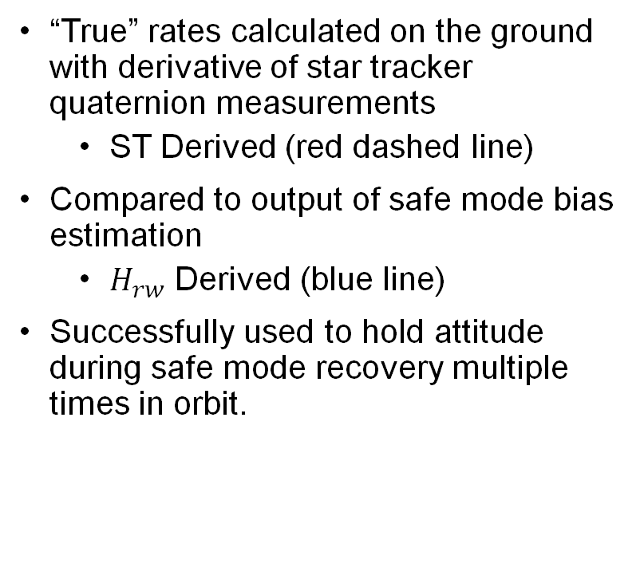
Safe Mode Bias Estimation (In Flight Performance)
“True” rates calculated on the ground with derivative of star tracker quaternion measurements
  ST Derived (red dashed line)
Compared to output of safe mode bias estimation
  $H_{rw}$ Derived (blue line)
Successfully used to hold attitude during safe mode recovery multiple times in orbit.

Slide 8
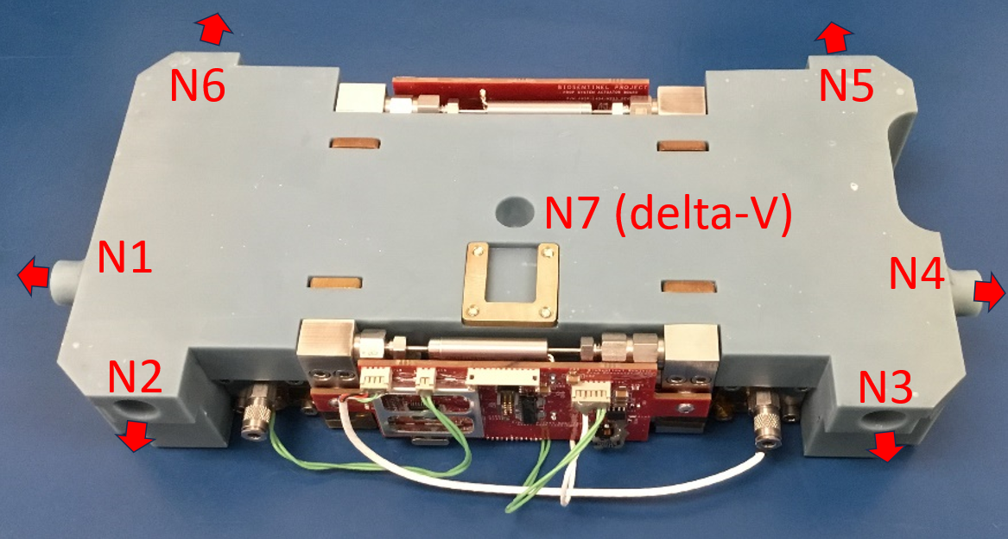
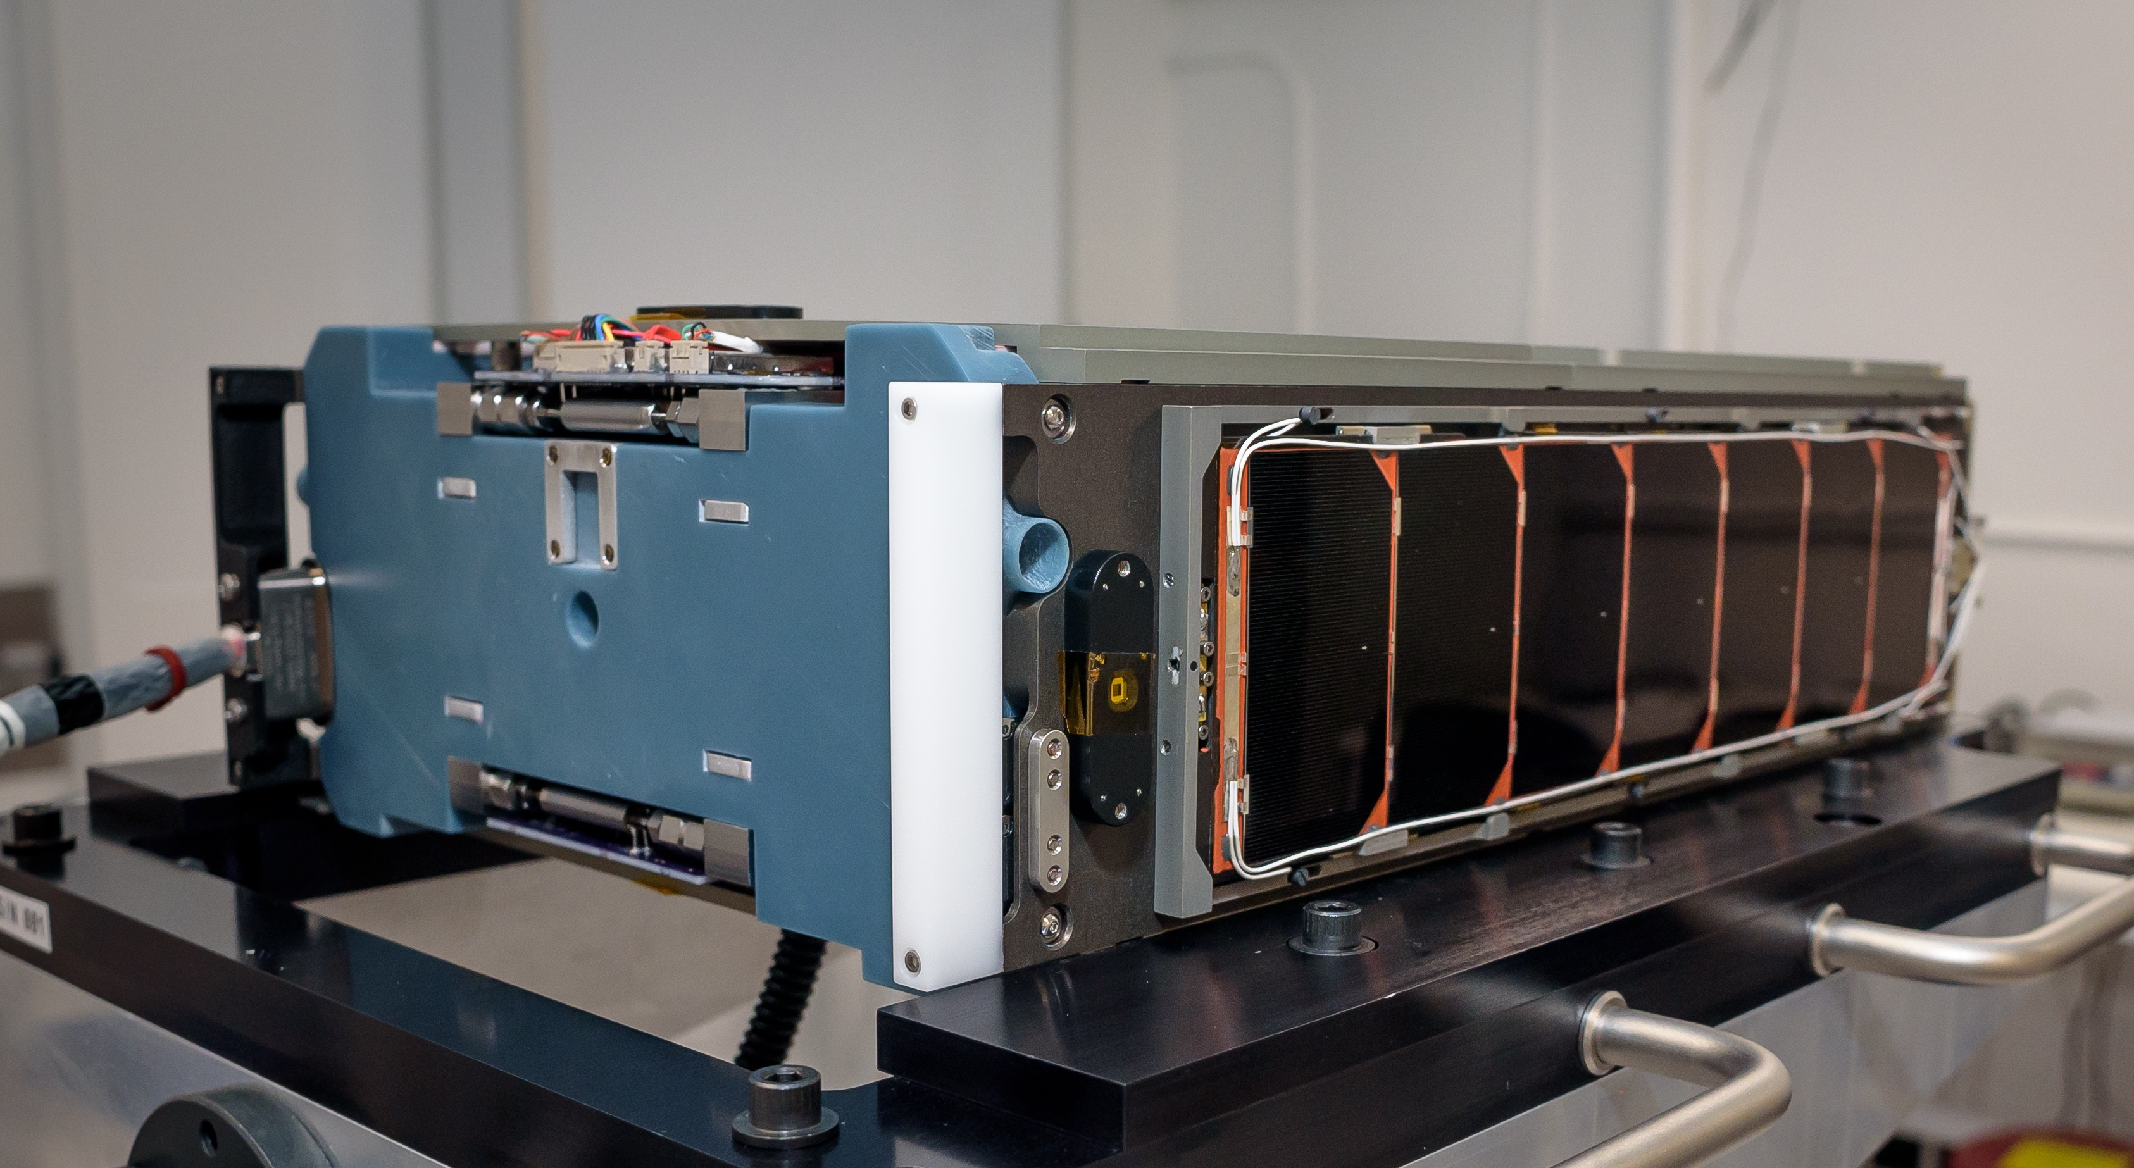
Propulsion System
Unlike many CubeSats in LEO, propulsion system required for deep space operation
  Detumble after deployment
  Momentum unloading throughout mission
  Delta-V technology demonstration
7-thruster cold gas system
  Full 3-axis control, but not redundant
Mostly 3D printed structure
  Efficient use of restricted space
    Total volume: 21 x 11 x 4 cm
    Includes: Two propellant tanks, eight valves, propellant state sensors, driving electronics
  Lower cost to manufacture
Thrust measurements in flight agree with ground measurements, no performance degradation yet observed
Propulsion system with nozzles and exhaust directions
Propulsion system (left) integrated with EDU spacecraft

Slide 9
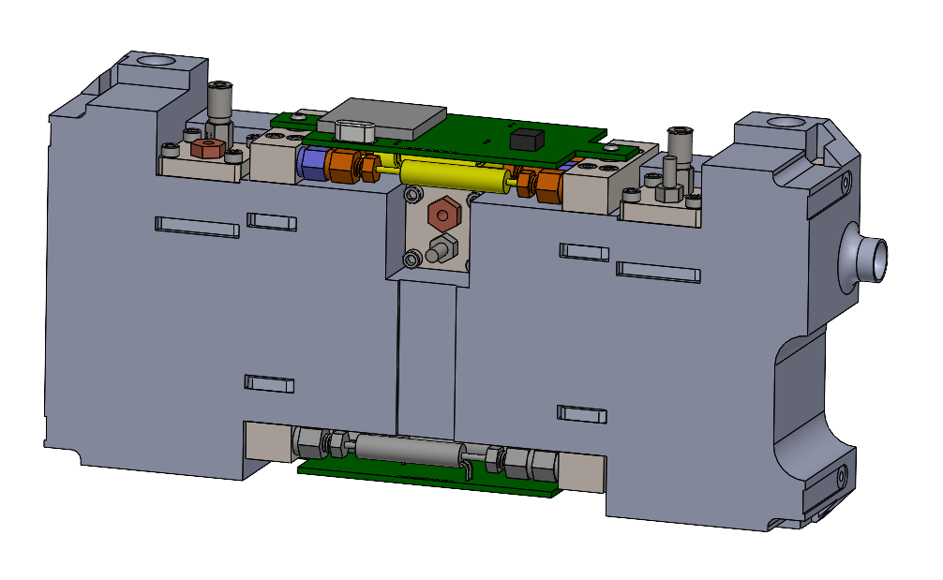
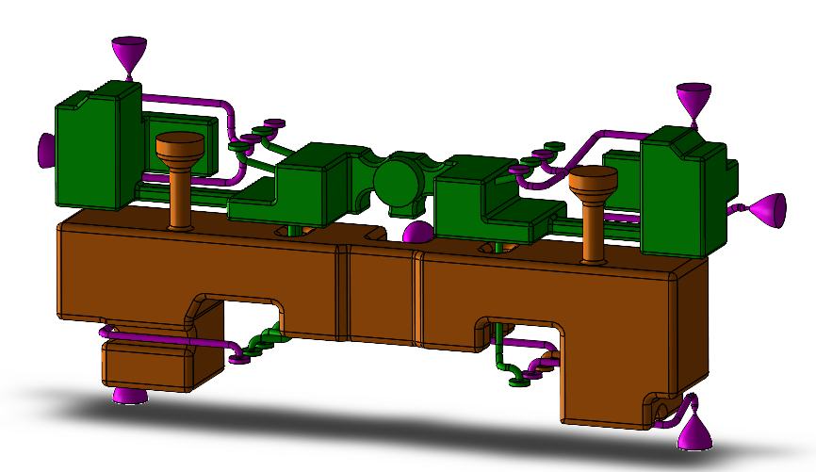
Propulsion System
Two propellant tanks
  Most propellant stored in main tank
    Saturated liquid/vapor
  Expanded into the plenum
    Nominally vapor-only
  Plenum feeds thrusters
Two refill modes
  Closed-loop: uses pressure sensor feedback
    However, sensors unreliable during I&T and mode not planned in flight
  Dead reckoning: timer-based only
No detectable leaks from either tank >1 year into the mission
CAD image of assembled prop system
Same angle, printed structure negative view
Main tank in orange, plenum in green

Slide 10
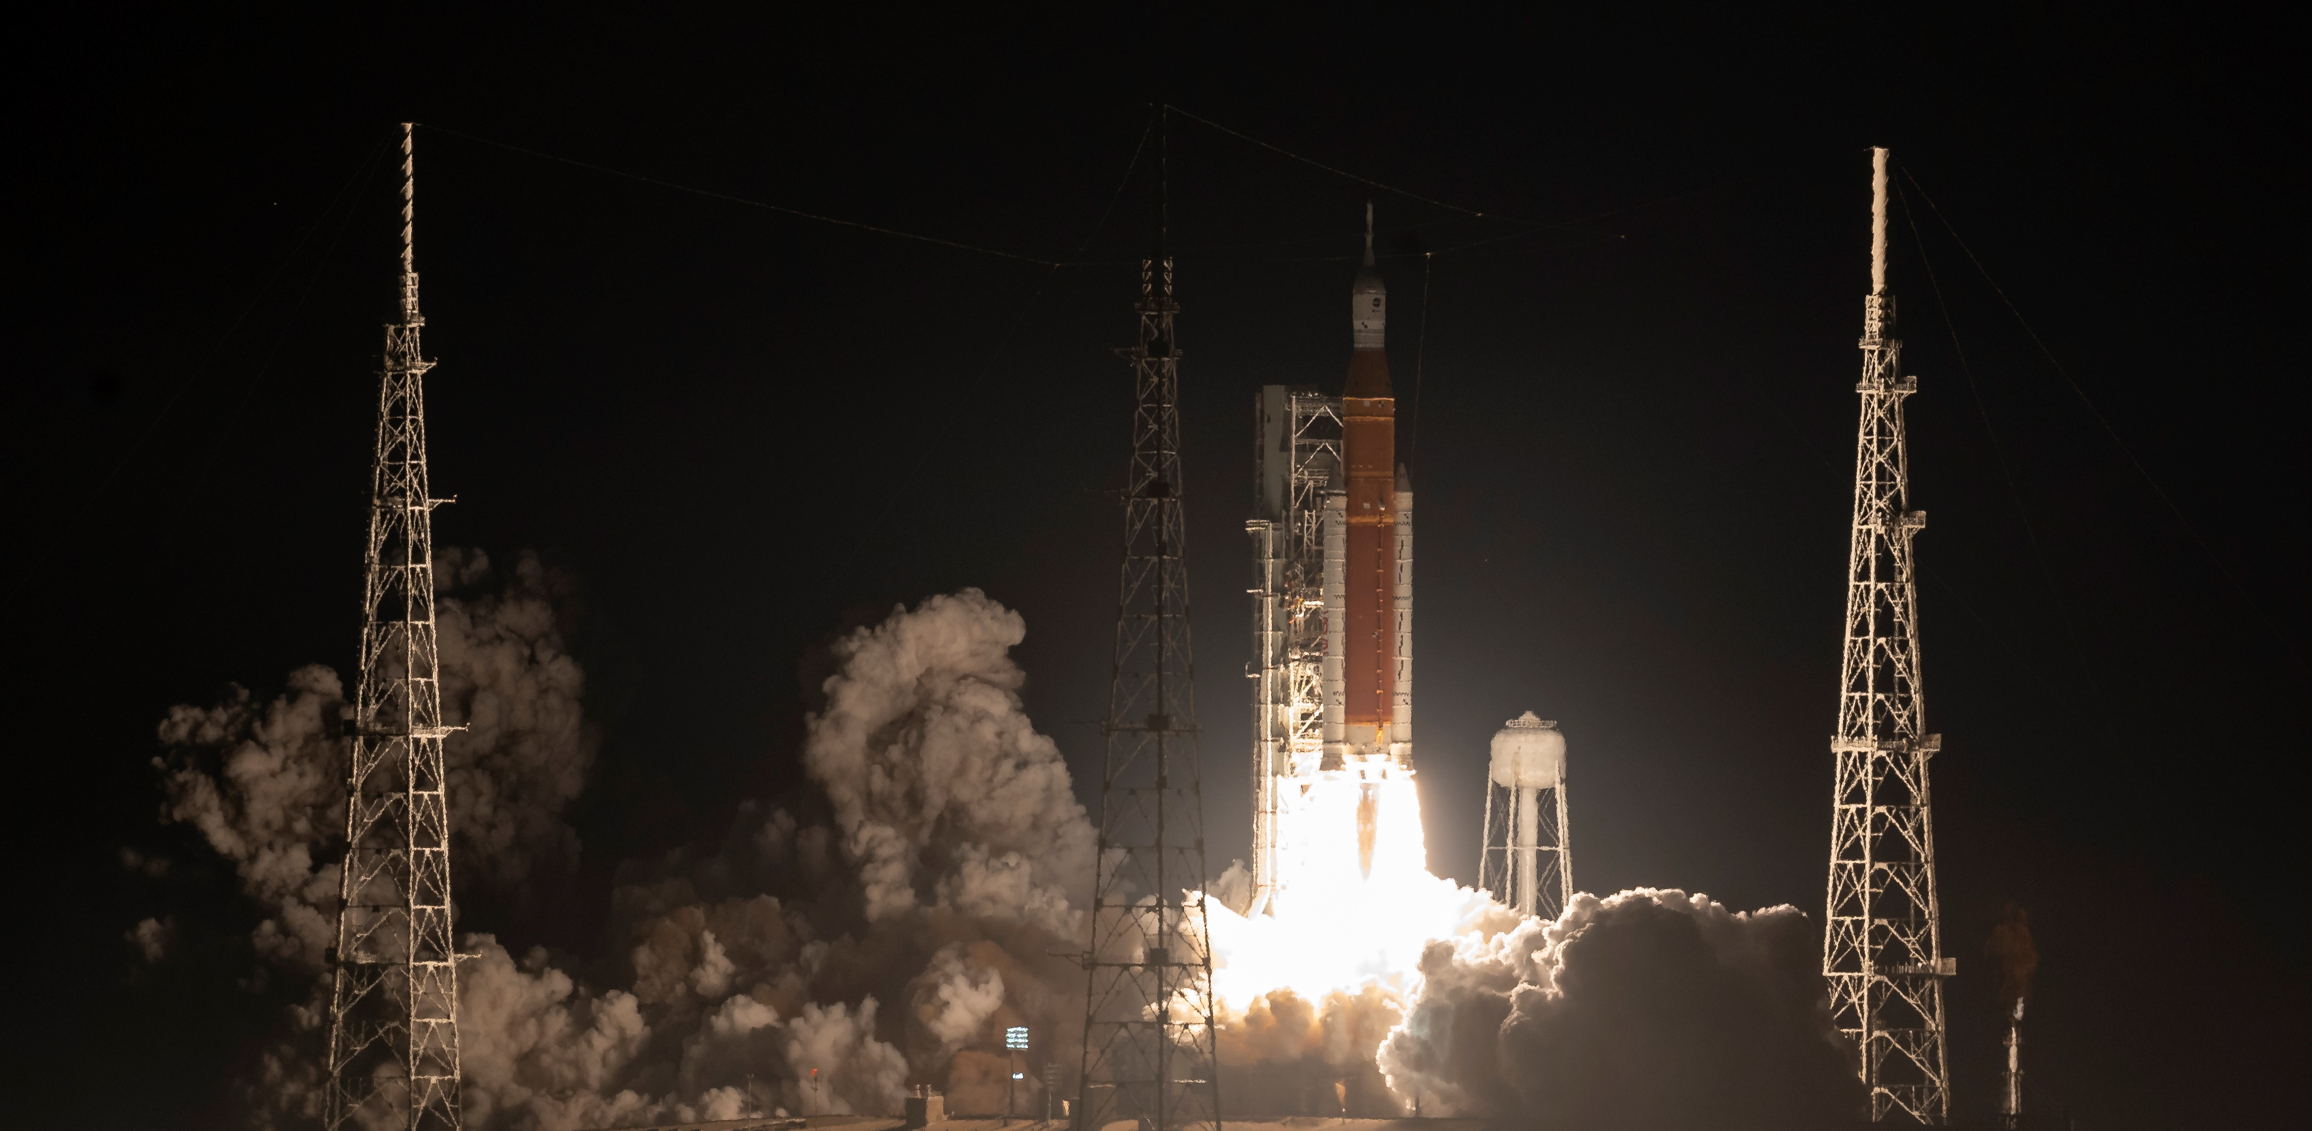
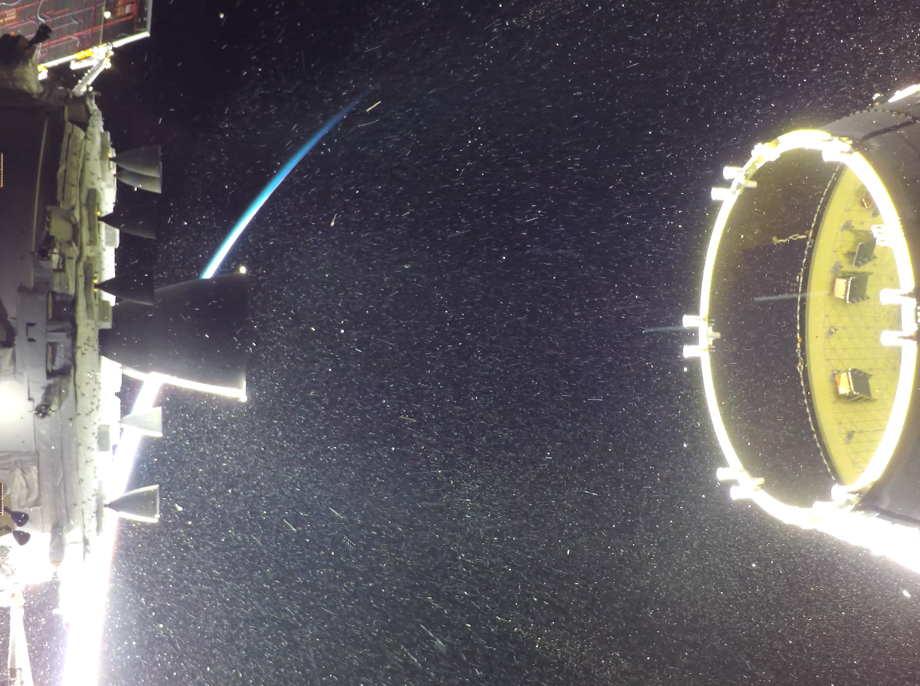
Launch and Deployment: November 16, 2022
NASA/Bill Ingalls

Slide 11
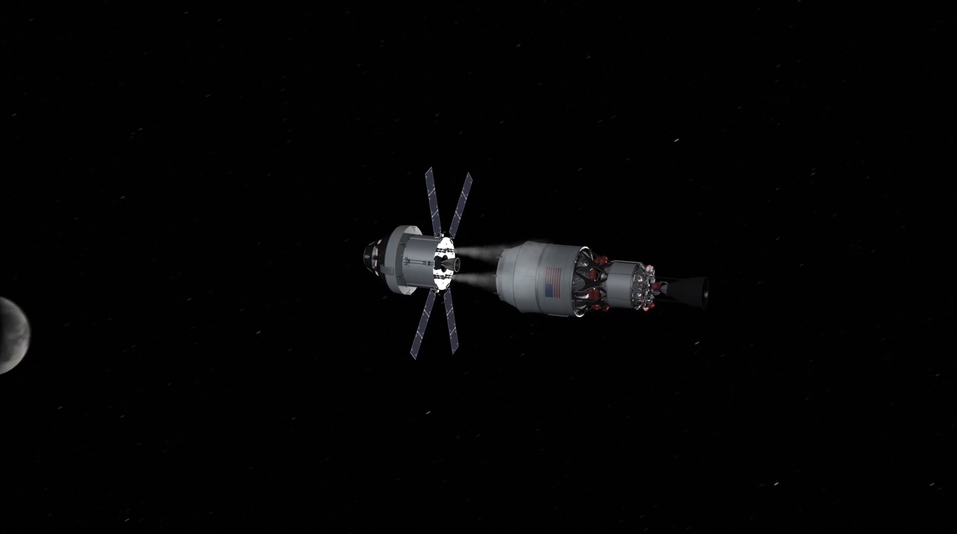
Mission Summary
Successfully operating for over a year and
  Completed the science phase and currently in extended mission
  >27 million km from Earth with no mission ending anomalies
  LET radiation detector still collecting valuable science data
All subsystems in good shape
  ADCS has performed fabulously – high performance, no errors
  Prop system has overcome some issues but maintains very high propellant margins (94% remain!)
  FSW/CDH had some early hiccups, but has stabilized with a patch applied to fix most bugs
    No unexplained or radiation-drive processor reset
  EPS has incurred no anomalies from deep-space environment
    Excellent performance through 34min eclipse
    SA and Batteries show better than predicted degradation over time, maintaining large margins
  Comm subsystem has operated as expected
    Downlinked >24,000 files (50/50 payload/bus)
    Link margins supporting highest data rates w/ MGA
    Supported DSN beacon tone test
    Thermal constraints limit transmitter on time to 3hrs
NASA

Slide 12
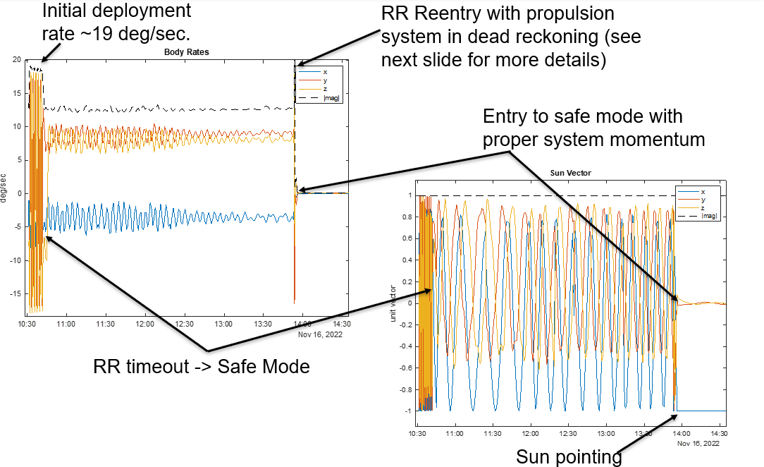
Initial Deployment – Tumbling Anomaly
Tumbling on Deployment

Slide 13
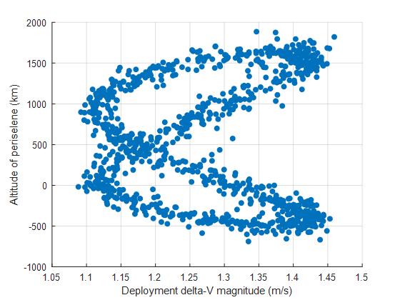
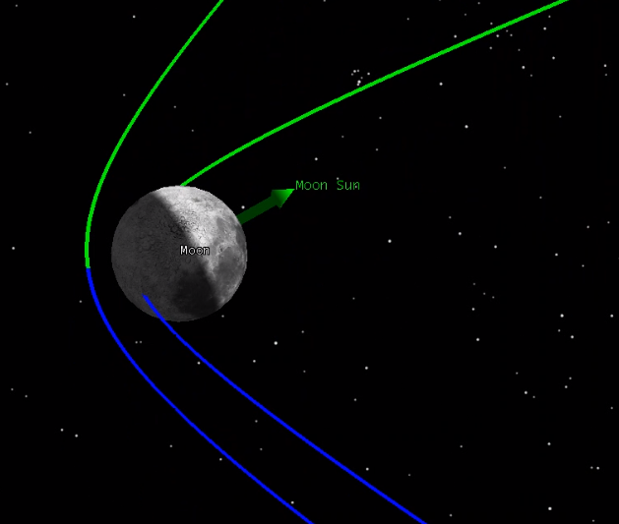
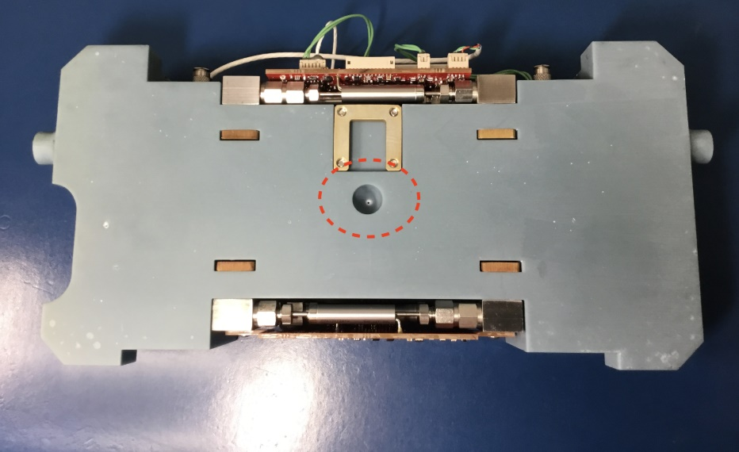
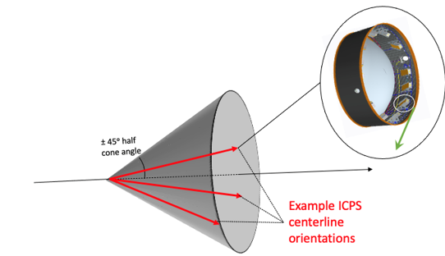
Lunar Impact Risk – Example Analysis
Trajectory Uncertainty
Baseline CONOPS did not have a dV maneuver planned.
Initial lunar impact risks of <10% was deemed an acceptable.
As launch dates moved, so did probability of lunar impact:
Aug 29th - 30%, Sept 2nd - 54%, Sept 5th - 56%, Nov 16th - 14%
Prop Subsystem capable of dV ~4.2 m/s thanks to large propellant margins and rear nozzle technology demonstration.
dV maneuver required shortly after deployment (<1day)
  - Waiting longer increased required dV beyond capability
Lunar Impact
August 29th Launch Deployment Variability
  Propulsion Rear nozzle
Image: Terry Stevenson
Notes:
Luckily the Nov 16th (actual launch date) had a lower probability and our trajectory nominally flew past the moon and no dV was required

Slide 14
Propulsion System Thruster Failure
First momentum management attempt timed out
  Unable to reduce H to the exit threshold
  Thruster 5 providing no thrust
Individual RCS Checkout confirmed
  No momentum effect from Thruster 5
  Other five thrusters nominal
Thruster 5 valve electrically normal, but stuck closed
Thruster use has been currently locked out
  Attempts to free it were unsuccessful
  Risk of sticking open if the solenoid is damaged
  Workaround for momentum management
Unable to reduce X/Z further
without thruster 5
MM Starts
Manual MM Abort
N1
N2
N3
N4
N5
N6

Slide 15
Propulsion System Liquid Accumulation
Momentum unloading on Day 28 showed overperformance
  One impulse roughly 3x expected
  Observed on next two unloadings
Determined to be due to Liquid accumulation
  Plenum colder than expected
  Plenum filling was conducted too often, allowing the vapor to condense in the cold parts
  Liquid droplets fed to thrusters cause unpredictable performance
Refilling cadence reduced to keep plenum pressure below saturation temperature
Actively heating the plenum would prevent this entirely (Successfully implemented as lesson learned on Starling mission)
Nominal impulses
Impulse too large
Main tank
(saturated liquid/vapor)
Plenum
(vapor)
Nozzles

Slide 16
Momentum Accumulation
Primary disturbance torque is Solar Radiation Pressure (SRP)
Momentum accumulation in communication attitude cannot be unloaded without failed thruster
Solution: Bias the attitude when sun pointing to load momentum in axes that can be unloaded

Slide 17
SRP Torque Modeling
Accurate models of the SRP torques needed to plan attitude offset
A detailed lookup table developed from observed data in flight

Slide 18

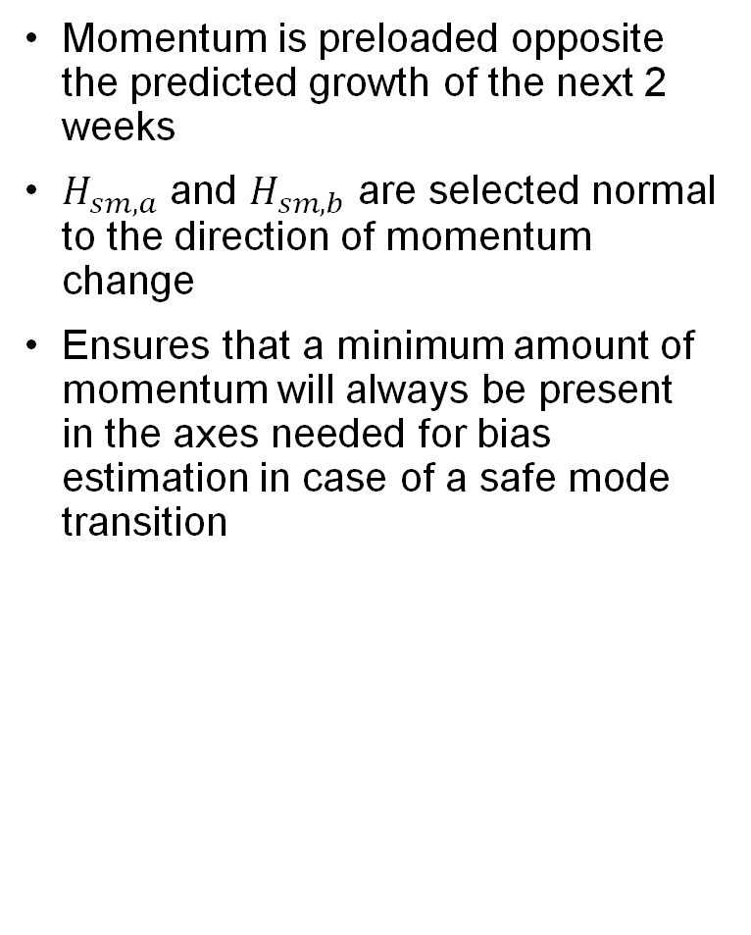


Momentum Preload
Momentum is preloaded opposite the predicted growth of the next 2 weeks
$H_{sm,a}$ and $H_{sm,b}$ are selected normal to the direction of momentum change
Ensures that a minimum amount of momentum will always be present in the axes needed for bias estimation in case of a safe mode transition
$$H_{predict}$$
$$H_{sm,b}$$
Command B Vector
1.5 mNms
Commanded Preload
$$H_{sm,a}$$
Command A Vector
Sun Normal Plane

Slide 19
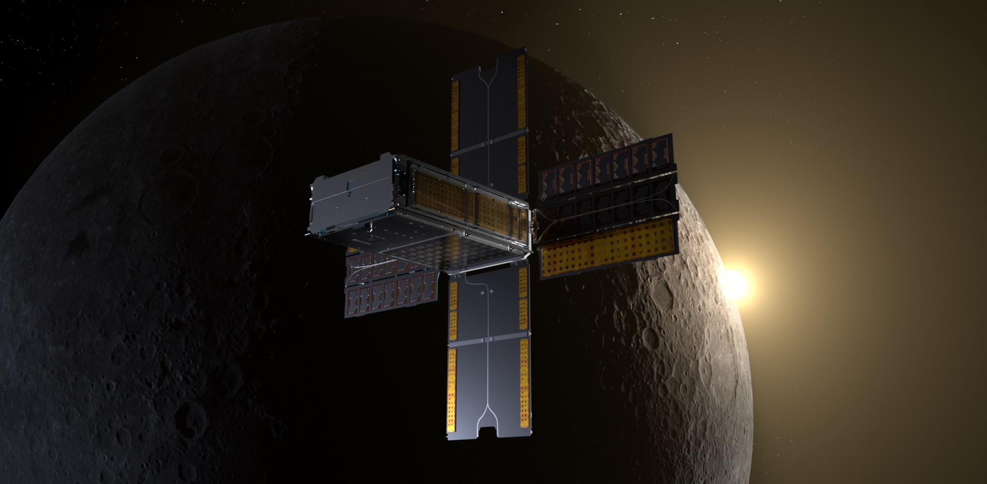
Questions?
NASA/Daniel Rutter

Slide 20
Backup!

Slide 21
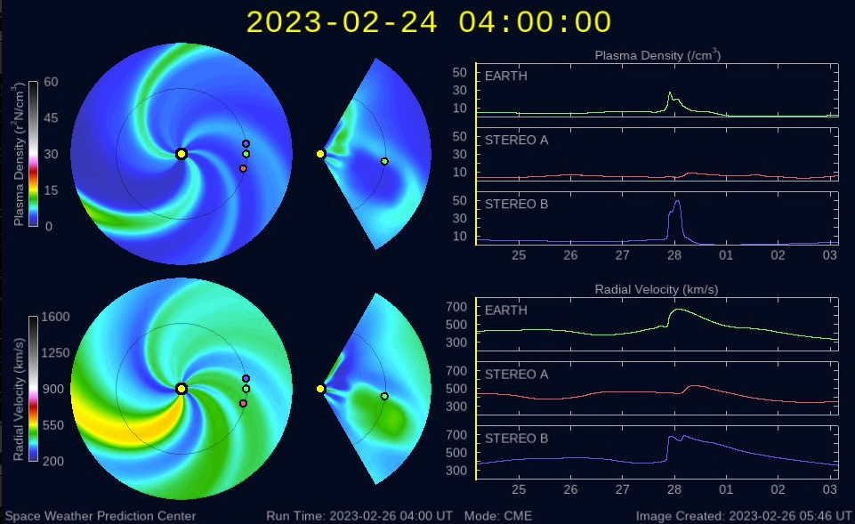
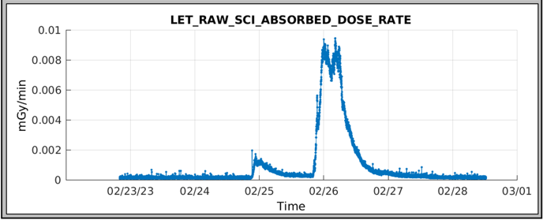
Deep Space Science Operations
  BioSensor Payload
  Performed 4 sets of biology experiments on the spacecraft. No growth observed in cell samples and similar results were observed on the ground control unit. The cell viability was affected by long exposure to increased humidity inside the BioSensor.
  The BioSensor payload technology was demonstrated in deep space and learnings will be utilized in future mission including CLPS project, LEIA.
  Linear Energy Transfer (LET) Spectrometer Payload
  Continues to gather radiation dosimetry
  Has captured solar events including coronal mass ejections
  Flux measurements from the GOES satellite (top) and BioSentinel LET spectrometer (bottom) recorded for a pair of Coronal Mass Ejection events on Feb. 24 and 25, 2023

