Slide 1
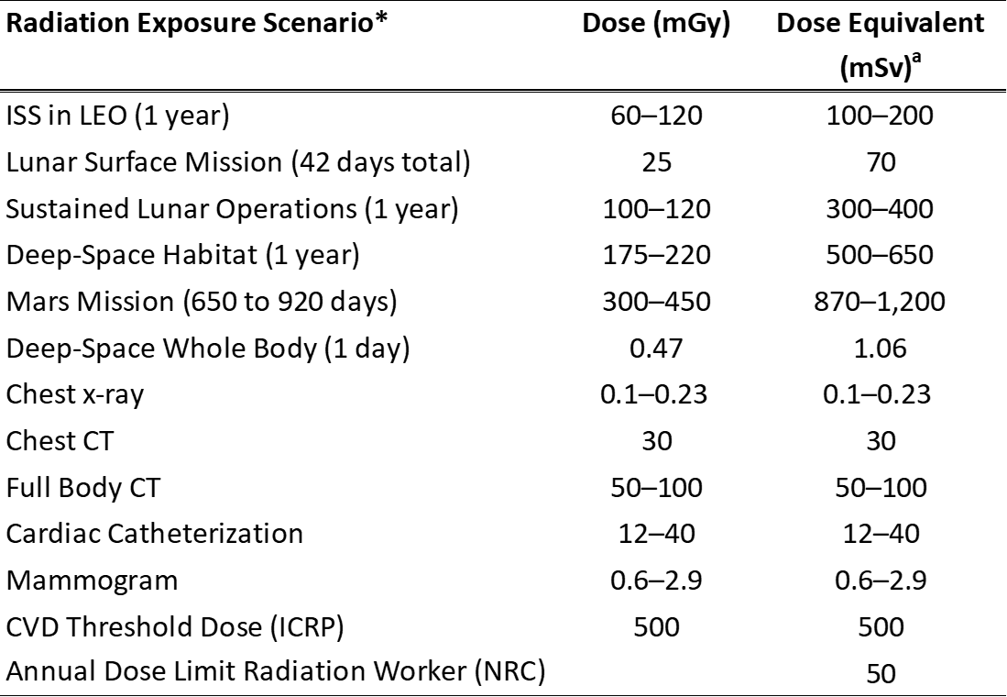
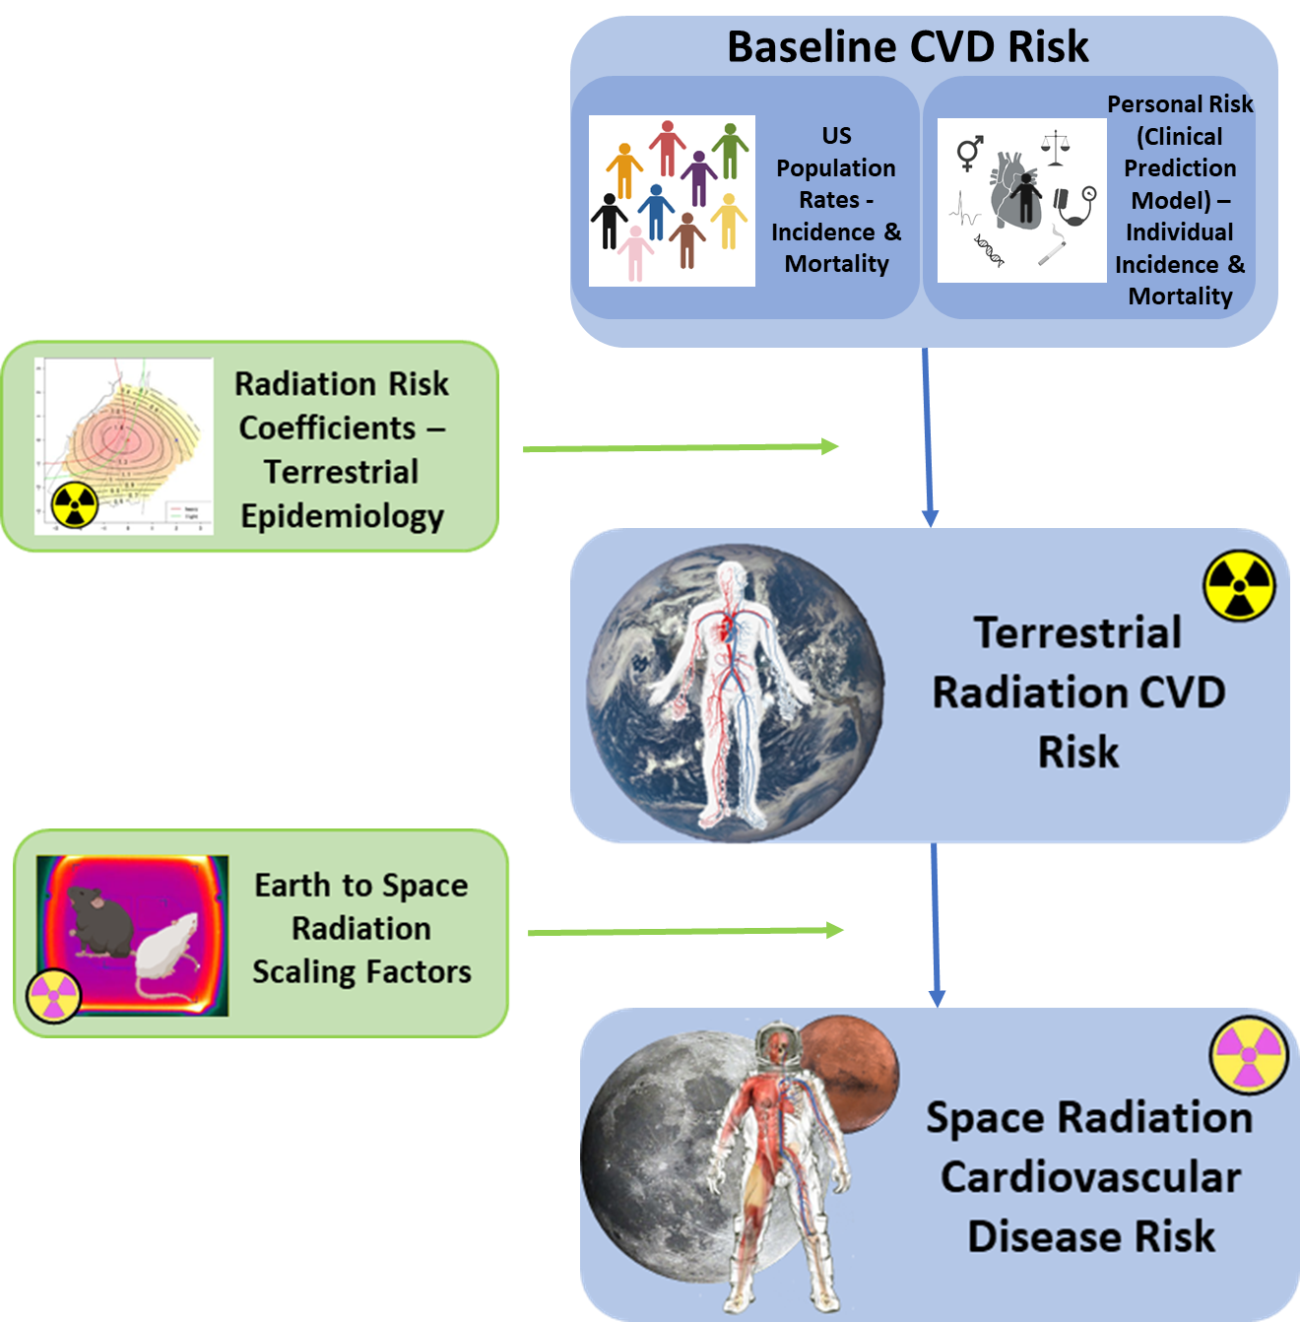
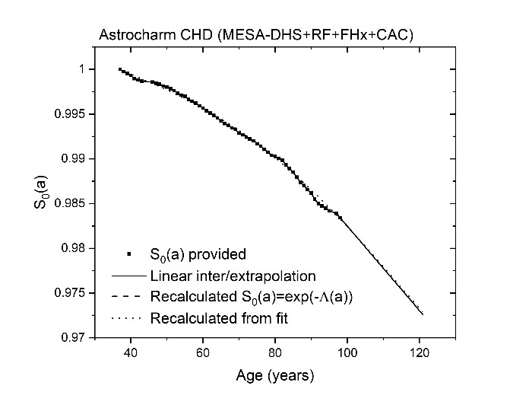
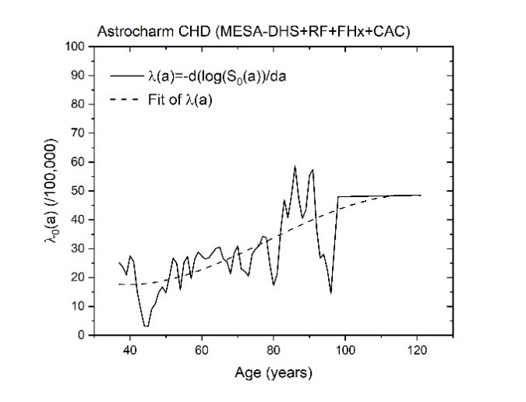

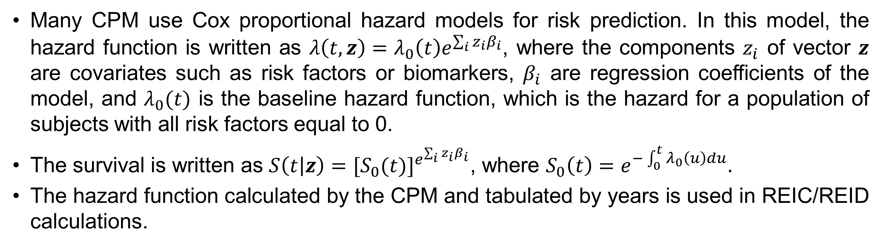
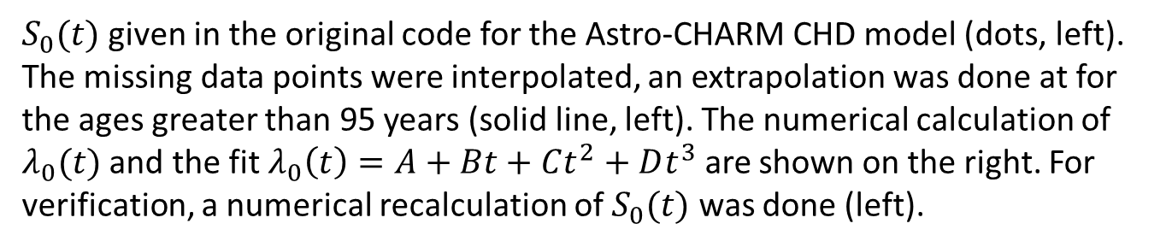
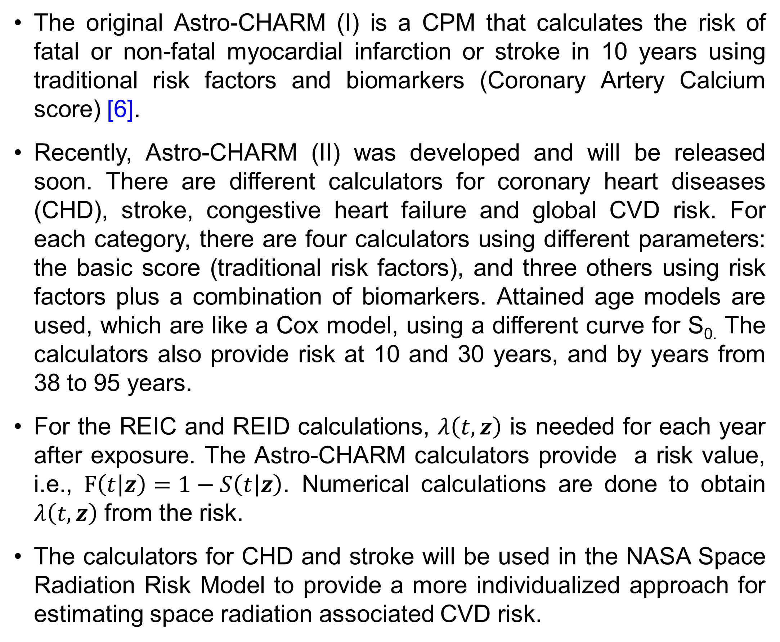
Integration of the cardiovascular risk model Astro-CHARM in the NASA Radiation Risk Model
Ianik Plante¹, Steve R. Blattnig², Amit Khera³, Ryan B. Norman², Zarana S. Patel^{#1,4}, Janice L. Huff²
¹KBR, 2400 NASA Parkway, Houston 77058, ²NASA Langley Research Center, Hampton, VA 23681, ³University of Texas Southwestern Medical Center, Dallas, TX 75390, ⁴National Institute of Health, Bethesda, Maryland, MD 20892.
Introduction
Calculation of REIC and REID
Exposure to space radiation may pose a risk for cardiovascular diseases (CVD) during and after spaceflight [1].
The CVD risk should be quantified to plan future long-duration space missions such as the manned flight to Mars.
In the NASA Space Radiation Risk Model, the risk of exposure-induced cases (REIC) and risk of exposure-induced death (REID) are used to quantify the risk attributable to radiation over a lifetime after exposure [2].
An individual’s risk of CVD is strongly influenced by factors such as family history, blood pressure, and lipid profiles, and these factors may impact CVD risk following space radiation exposure [3].
An approach to incorporate individual CVD risk profiles calculated by clinical prediction models (CPM) into the NASA risk framework is presented, which will allow a more accurate assessment of CVD risk associated with space radiation exposure.
The REID for a specific cause of death (or tissue) T is calculated by folding $S_{0}(a|a_{E},H_{T})$, the conditional probability of surviving to age, a, for a population with radiation exposure $H_{T}$ given that one was alive at age of exposure $a_{E}$, with the instantaneous radiation-induced specific disease mortality rate $λ_{T}^{M}$, integrated over the remainder of a lifetime (i.e., until $a_{max}$):
${REID}_{T}(a_{E},H_{T})=\int_{a_{E}}^{a_{max}}{{daλ_{T}^{M}(a,a_{E},H_{T})S}_{0}(a|a_{E},H_{T})}$
The REIC is calculated similarly, using the specific disease incidence rate $λ_{T}^{I}$:
${REIC}_{T}(a_{E},H_{T})=\int_{a_{E}}^{a_{max}}{{daλ_{T}^{I}(a,a_{E},H_{T})S}_{0}(a|a_{E},H_{T})}$
In both cases, $S_{0}\left(a | a_{E},H_{T}\right)=S_{0}\left(a | a_{E} \right)e^{−\sum_{T}{duλ_{T}^{M}(u,a_{E},H_{T})}}$, where $S_{0}\left(a | a_{E} \right)=\frac{{\tilde{S}}_{0}\left(a\right)}{{\tilde{S}}_{0}\left(a_{E}\right)}$, and ${\tilde{S}}_{0}\left(a\right)$ is the background survival rate.
The incidence and mortality rates are
$λ_{T}^{M}\left(a,a_{E},H_{T}\right)=ν_{T}{ERR}_{T}\left(a,a_{E},H_{T}\right)λ_{T}^{M}+R_{T}^{M}(1−ν_{T}){EAR}_{T}\left(a,a_{E},H_{T}\right)$,
$λ_{T}^{I}\left(a,a_{E},H_{T}\right)=ν_{T}{ERR}_{T}\left(a,a_{E},H_{T}\right)λ_{T}^{I}+R_{T}^{I}\left(1−ν_{T}\right){EAR}_{T}\left(a,a_{E},H_{T}\right)$, where $ν_{T}$ are the tissue specific weights, and $R_{T}^{M}$ and $R_{T}^{I}$ are the mortality/incidence and incidence/mortality ratios.
The excess relative risk (ERR) and excess absolute risk (EAR) are given by tissue-dependent parametric equations.
For CVD, an ERR risk model with a constant coefficient is used [4].
*Space-based dose estimates are average rates external to the body inside spacecraft with 20 gm/cm² of aluminum shielding during solar minimum conditions. ªDose-equivalent value (mSv) is the product of the absorbed dose (mGy) and the radiation quality factor. For medical diagnostic exposures, the quality factor is 1. Abbreviations: ISS (International Space Station); LEO (Low-Earth Orbit); CT (Computed Tomography); ICRP (International Council on Radiation Protection); NRC (Nuclear Regulatory Commission).
Radiation-induced CVD risk calculations contain three components. The first component is the baseline incidence and mortality rates, derived either from the U.S. population or from an integrated clinical prediction model (CPM) for individualized risk. The second component is the calculation of the excess radiation-induced CVD risk from Earth-based exposures. The third component is the extrapolation of this risk to the spaceflight environment using radiation scaling factors that account for the potentially more biologically damaging nature of space radiation.
Clinical prediction models
Astro-CHARM
Parameters used in the Astro-CHARM II model for CHD.
Cardiovascular risk factors were introduced by the Framingham Heart Study investigators in the 1960s [5].
High blood cholesterol levels, elevated blood pressure, smoking, and electrocardiographic abnormalities were associated with an increased risk of incident coronary heart disease over a 6-year follow-up of the Framingham cohort.
Their findings have been confirmed by numerous studies, and many other modifiable and non-modifiable CVD risk factors have since been identified.
The original Astro-CHARM (I) is a CPM that calculates the risk of fatal or non-fatal myocardial infarction or stroke in 10 years using traditional risk factors and biomarkers (Coronary Artery Calcium score) [6].
Recently, Astro-CHARM (II) was developed and will be released soon. There are different calculators for coronary heart diseases (CHD), stroke, congestive heart failure and global CVD risk. For each category, there are four calculators using different parameters: the basic score (traditional risk factors), and three others using risk factors plus a combination of biomarkers. Attained age models are used, which are like a Cox model, using a different curve for S_{0.} The calculators also provide risk at 10 and 30 years, and by years from 38 to 95 years.
For the REIC and REID calculations, $λ\left(t,z\right)$ is needed for each year after exposure. The Astro-CHARM calculators provide a risk value, i.e., $F\left(t | z\right)=1−S\left(t | z\right)$. Numerical calculations are done to obtain $λ\left(t,z\right)$ from the risk.
The calculators for CHD and stroke will be used in the NASA Space Radiation Risk Model to provide a more individualized approach for estimating space radiation associated CVD risk.
Parameter | Coefficient | Standard error |  | χ² | p-value | Hazard Ratio* | Low 95% CI | High 95% CI
Male Sex | 0.39063 | 0.10297 | 14.3912 |  | 0.0001 | 1.478 | 1.208 | 1.808
Race
- Black | 0.2063 | 0.11216 | 3.3832 |  | 0.0659 | 1.229 | 0.987 | 1.531
- Hispanic | 0.27215 | 0.12109 | 5.0511 |  | 0.0246 | 1.313 | 1.035 | 1.664
- Other | 0.20156 | 0.1687 | 1.4275 |  | 0.2322 | 1.223 | 0.879 | 1.703
Total Cholesterol | 0.0014 | 0.00113 | 1.5327 |  | 0.2157 | 1.001 | 0.999 | 1.004
HDL-C | -0.00759 | 0.00365 | 4.3222 |  | 0.0376 | 0.992 | 0.985 | 1
Systolic BP | 0.01051 | 0.00206 | 25.9358 |  | <.0001 | 1.011 | 1.006 | 1.015
HTN Med | 0.0777 | 0.10347 | 0.5639 |  | 0.4527 | 1.081 | 0.882 | 1.324
Smoking | 0.35343 | 0.11198 | 9.9616 |  | 0.0016 | 1.424 | 1.143 | 1.773
Diabetes | 0.36918 | 0.11262 | 10.7467 |  | 0.001 | 1.447 | 1.16 | 1.804
Statins | 0.1761 | 0.11869 | 2.2012 |  | 0.1379 | 1.193 | 0.945 | 1.505
Fam history MI | 0.3852 | 0.09207 | 17.5029 |  | <.0001 | 1.47 | 1.227 | 1.761
Ln CAC | 0.23488 | 0.02144 | 120.0074 |  | <.0001 | 1.265 | 1.213 | 1.319
The Ten Most Common Variables Included in CPMs predicting the development of incident CVD [7].
Modifiable
Non-Modifiable
Spaceflight-Specific Stressors
Social Determinants of Health
Age, Sex, Family History, Ethnicity, Genetics, Medical History
Socioeconomic Position, Physical Environment, Education, Social Connections/Support
Radiation, Microgravity, Isolation & Confinement, Closed & Toxic Environment, Distance from Earth
Blood Pressure, Total Cholesterol & HDL, Smoking, Diet, Blood Sugar, BMI, Physical Activity Level
Many CPM use Cox proportional hazard models for risk prediction. In this model, the hazard function is written as $λ\left(t,z\right)=λ_{0}\left(t\right)e^{\sum_{i}{z_{i}β_{i}}}$, where the components $z_{i}$ of vector $z$ are covariates such as risk factors or biomarkers, $β_{i}$ are regression coefficients of the model, and $λ_{0}(t)$ is the baseline hazard function, which is the hazard for a population of subjects with all risk factors equal to 0.
The survival is written as $S\left(t | z\right)={[S_{0}(t)]}^{e^{\sum_{i}{z_{i}β_{i}}}}$, where $S_{0}\left(t\right)=e^{−\int_{0}^{t}{λ_{0}\left(u\right)du}}.$
The hazard function calculated by the CPM and tabulated by years is used in REIC/REID calculations.
$S_{0}(t)$ given in the original code for the Astro-CHARM CHD model (dots, left). The missing data points were interpolated, an extrapolation was done at for the ages greater than 95 years (solid line, left). The numerical calculation of $λ_{0}(t)$ and the fit $λ_{0}\left(t\right)=A+Bt+Ct^{2}+Dt^{3}$ are shown on the right. For verification, a numerical recalculation of $S_{0}(t)$ was done (left).
Results
Tissue/Endpoint | Mission dose (Gy) | Mission dose equivalent (Sv) | Tissue/Endpoint | Mission dose (Gy) | Mission dose equivalent (Sv)
BFO | 0.3326 | 0.4454 | Brain | 0.3267 | 0.8430
stomach | 0.3326 | 0.7994 | Thyroid | 0.3301 | 0.8212
Colon | 0.3349 | 0.8006 | Skin | 0.3335 | 0.9576
Liver | 0.3325 | 0.7973 | Remainder | 0.3327 | 0.7996
Bladder | 0.3342 | 0.7907 | Prostate | 0.3337 | 0.7854
Lungs | 0.3292 | 0.8248 | CHD | 0.3326 | 0.5444
Esophagus | 0.3308 | 0.7993 | Stroke | 0.3326 | 0.5444
Oral cavity | 0.3301 | 0.8212
Conclusion
Mission scenario:
Exposure: 2-years exposure, year 1977, shield of aluminum, water material. The spherical shield thickness is 20 g/cm².
Risk factors: 40 years white male, non-smoker, total cholesterol: 141 mg/dL, HDL: 67 mg/dL, no family history, no medication for hypertension, no statin.
The effect of individual risk factors (SBP, diabetes, HDL, and others) on the risk and REID is substantial.
Protecting the cardiovascular health of the astronauts before, during, and after spaceflight is vital for mission success and to ensure long-term quality of life.
This comprehensive CVD risk assessment framework will inform:
  Personalized/individualized radiation risks for astronauts
  Operational management of radiation risks
  Crew and flight surgeons of clinical impact of spaceflight radiation exposure through individualized risk metrics
  Health care monitoring and treatment decisions post-flight to prevent/mitigate space radiation associated health risks
SBP
Diabetes
HDL
References
[1] Patel ZS, Brunstetter TJ, Tarver WJ, Whitmire AM, Zwart SR, Smith SM, & Huff JL (2020). Red risks for a journey to the red planet: The highest priority human health risks for a mission to Mars. NPJ Microgravity, 6(1), 33.
[2] Cucinotta FA, Kim MHY & Chappell LJ (2013). Space radiation cancer risk projections and uncertainties – 2012 (NASA Report No. TP-2013-217375).
[3] Huff JL, Plante I, Blattnig SR, Norman RB, Little MP, Khera A, Simonsen LC, & Patel ZS (2022). Cardiovascular Disease Risk Modeling for Astronauts: Making the Leap from Earth to Space. Frontiers in Cardiovascular Medicine, 9.
[4] Cucinotta FA, Kim MHY, Chappell LJ, & Huff JL (2013). How safe is safe enough? Radiation risk for a human mission to Mars. PloS One, 8(10), e74988.
[5] Kannel WB, Dawber TR, Friedman GD, Glennon WE, & Mcnamara PM (1964). Risk Factors in Coronary Heart Disease. Annals of Internal Medicine, 61(5_Part_1), 888–899.
[6] Khera A, Budoff MJ, O’Donnell CJ, Ayers CA, Locke J, de Lemos JA, Massaro JM, McClelland RL, Taylor A, & Levine BD (2018). Astronaut Cardiovascular Health and Risk Modification (Astro-CHARM) coronary calcium atherosclerotic cardiovascular disease risk calculator. Circulation, 138(17), 1819–1827.
[7] http://pacecpmregistry.org/data-visualization/index-conditions-top-variables/
Acknowledgements
This work was supported by NASA Human Health and Performance (HHPC) contract number NNJ15HK11B (IP), and by the Human Research Program under the Human Exploration and Operations Mission Directorate at NASA (SRB, JLH, RBN).
# This work was prepared while ZS Patel was employed at KBR/NASA JSC. The opinions expressed in this work are the author's own and do not reflect the view of the National Institutes of Health, the Department of Health and Human Services, or the United States government.

