Slide 1


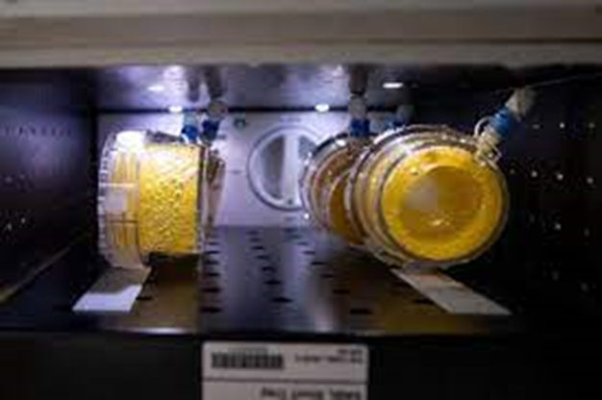
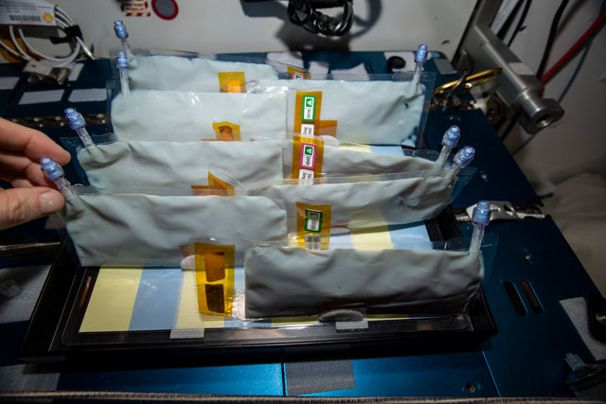
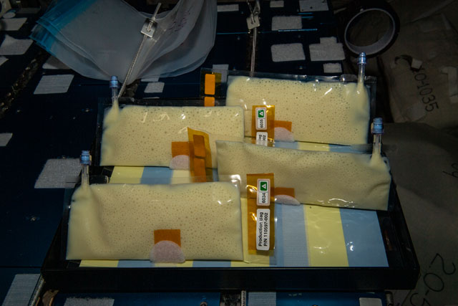
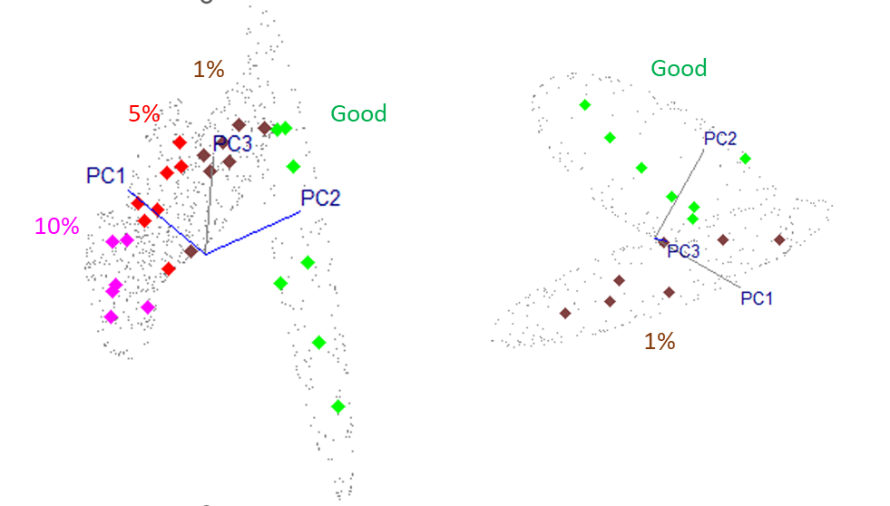
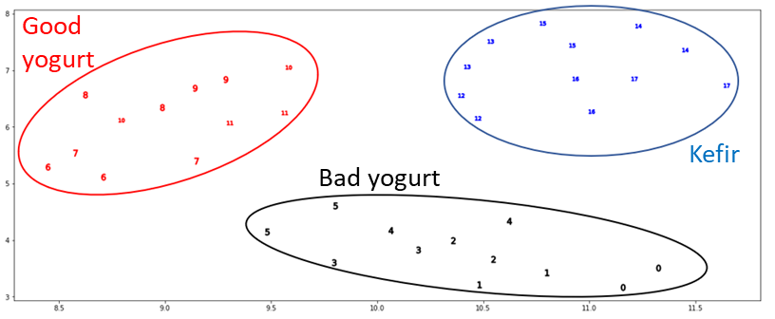
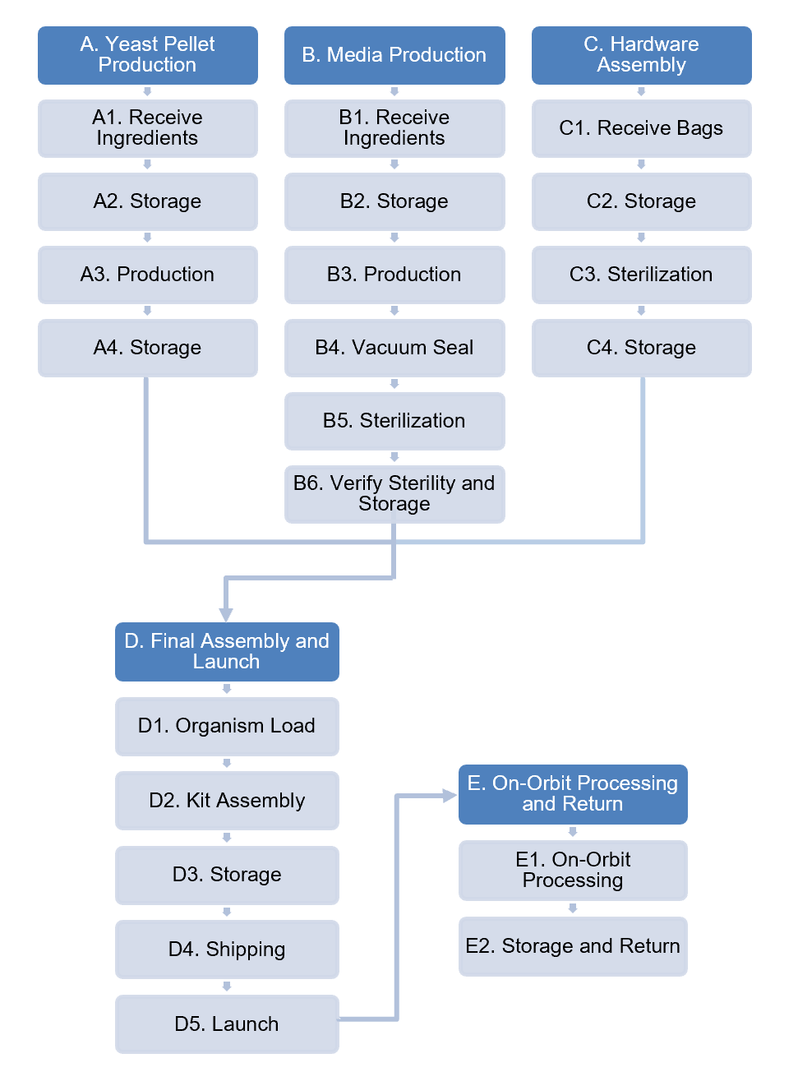
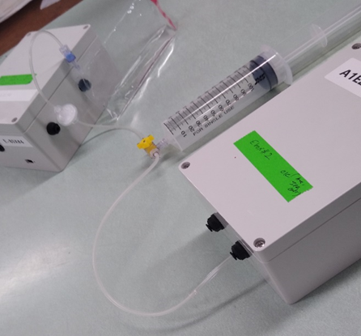
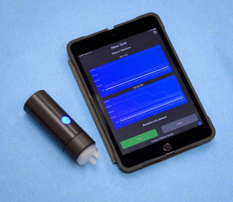
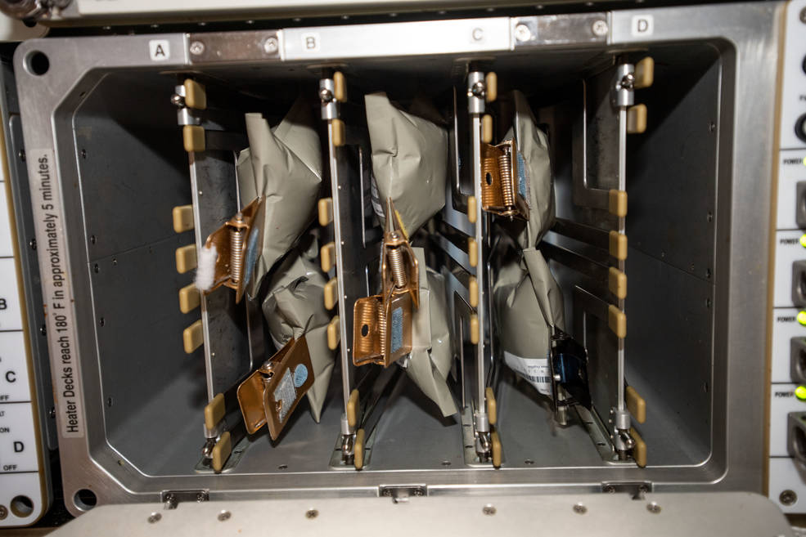

Strategies for Determining Safety of Fermented Foods Produced in Space
Natalie Ball¹, Sadie Downing¹, Ami Hannon¹, Hiromi Kagawa², Jing Li³, Hami E. Ray⁴, Oscar Roque¹, A. Mark Settles⁵, Kevin Sims¹, Sandra Vu¹, and Frances M. Donovan⁵
¹KBR; ²SETI Institute; ³Entry Systems and Vehicle Development Branch, ⁴Flight Systems Implementation Branch and ⁵Bioengineering Branch; NASA Ames Research Center, Moffett Field, CA 94035
Synthetic Biology Project
Game Changing Development Program
Science and Technology Mission Directorate
Abstract
Eurofins Food Safety Analysis
E-Nose Discrimination Models
The BioNutrients payload series examine the feasibility of using microbially produced foods – yogurt, kefir, fermented food products – to supplement the current prepackaged food system to provide freshly synthesized nutrients and genetically engineered protein therapeutics to support crew health for sustainable and long duration crewed exploration. Safety of the products must be established as direct consumption of such products is a risk due to potential contamination with pathogenic organisms. Identifying pathogen contamination is particularly challenging as the fermenting cultures can mask the presence of contaminating organisms. Here we consider current methods of detecting coliforms, aerobic colonies, non-lactic acid bacteria, molds (yeasts), and specific pathogens including Staphylococcus aureus and Salmonella species (spp.). We also consider alternate and additional testing including sequencing, quantitative PCR, and the use of the E-Nose developed by NASA Ames Research Center. This portable device senses volatile organic compounds in real time and can be trained to recognize “good” uncontaminated products from contaminated ones as a means of predicting food safety. Finally, we consider methods of in-flight pasteurization to increase safety and decrease overall microbial load of these products. This presentation will summarize testing status and outline the strategy that will be employed in the BioNutrients-3 ISS fermented foods experiment.
Three categories of milk products (good yogurt, Kluyveromyces marxianus contaminated yogurt, and kefir) were tested with six (6) samples/category. For each sample, two (2) technical replicate sensor response peaks were used for linear support-vector machine (SVM) modeling.
  Leave-one-out cross-validation of individual technical replicates showed 100% identification accuracy.
A total of 27 samples from four different categories (100% good, 1%, 5%, and 10% contaminated yogurt) were tested to learn E-Nose detection limits in identifying K. marxianus contaminated samples.
  Linear SVM leave-one-out identification showed 100% sensitivity for all samples, and 100% specificity accuracy for 5% and 10% contaminated samples.
  One out of seven good yogurt was misidentified as 1% contaminated yogurt which resulted in 86% specificity.
  37 CFU/ml (1.3 x 10³ CFU/35 ml of bag) of the intentional contaminant was successfully detected in the 1% contaminated yogurt.
Credits: NASA
Product 1, yeast drink: Single strain of Saccharomyces cerevisiae; pictured here in the BN-1 production pack hardware.
Product 2, yogurt: containing two strains, Lactobacillus bulgaricus and Streptococcus thermophilus. Commercial yogurt starter purchased from Dairy Connection (YO-MIX 151); in BN-2 production pack hardware.
Product 3, kefir: Proprietary mix of probiotic organisms and yeast.
Commercial kefir starter purchased from Dairy Connection (C-Fir); in BN-2 production pack hardware.
Background and Introduction
Test Applicability Matrix
A
B
Establishing Production of Safe Food Products for Crew Consumption: Minimize food safety risks by developing food safety procedures for microbially rich food products.
Hazard Analysis and Critical Control Point (HACCP) and Good Manufacturing Practices.
Federal Drug Administration (FDA) approval for crew consumption of novel food items.
Pathogen Detection and Microbial Monitoring: Below are considered current methods for detecting food microbes and reducing microbial content:
Eurofins food safety analysis for microbial monitoring of fermented food products.
E-Nose (developed by NASA Ames Research Center), a portable device that senses volatile organic compounds in real time which can be trained to recognize “good” uncontaminated products from contaminated ones as a means of predicting food safety on-demand.
In-flight pasteurization to decrease overall microbial load of products.
*
*
Contaminated yogurt
*
*
HACCP Plan Development
*Note: Tests to compensate “failed” tests were 1) yeast identification sequencing to confirm single strain, 2) shotgun metagenome sequencing to confirm only two yogurt strains present, and 3) shotgun metagenome sequencing and yeast identification sequencing for Kefir.
(A) Uniformed Manifold Approximation and Projection (UMAP) plot showing discrimination of three different groups: Good yogurt (red), K. marxianus contaminated yogurt (black), and Kefir (blue). (B) Principal Component (PC) analysis 3D scatterplots showing the first three PCs discriminate good yogurt (green) relative to contamined groups: 1% (brown), 5% (red), and 10% (purple).
Test Results
E-Nose Interface Requirements and Approach
Requirements:
A minimum flow rate of 80 mL/minute.
No fluid exposure.
Contaminate-free sampling.
Approach:
Use of a 120 mL syringe.
Use of a 3-way stop-cock to direct flow.
Use of a 0.22 µm hydrophobic filter and autoclavable tubing and components in a closed-loop system.
Food safety compliance and testing suitability analysis for S. cerevisiae (yeast), L. bulgaricus / S. thermophilus (yogurt), and kefir performed by Eurofins Microbiology Los Angeles Laboratory. Results shown above as predicted; results of compensatory tests (shotgun metagenome sequencing and yeast identification sequencing for Kefir) are still pending.
E-Nose for Food Safety
Mock E-Nose Interface for Measurements. Credits: Oscar Roque
Multi-chemical sensor array technology allows rapid detection of a wide range of indicator chemicals.
The system is “trainable” and may be able to learn signatures of specific microbe growth and their products.
E-Nose technology has been flight-tested.
In-flight Pasteurization
Currently NASA crew members are not permitted to consume fermented food products, probiotics, or live microorganisms. An alternative approach to microbial control is to include a heat inactivation step to render the microorganisms non-viable. Pasteurization can also provide a level of biocontainment for nutrient production by genetically modified microbes.
Flow-diagram part of the BioNutrients HACCP plan to ensure that the necessary protocols are in place to mitigate potential food safety hazards in the entire food production pipeline. The flow-diagram helps to identify potential hazards that can be introduced or enhanced at specific steps in the food production process which allows for implementation of necessary control points to reduce or eliminate risk.
Path to FDA Approval
FDA has processes for approval of new foods and new food additives for consumption by the public.
NASA is working with the FDA to establish a NASA specific, limited use approval process to allow for human testing of novel foods for potential future crew consumption. We will be pursuing the standard approval process for new food and food additives for the time being, unless a NASA specific process is put in place and is better suited for continued development of these products for NASA use.
Initial target being investigated will be commercial yogurt cultured on the ISS as a readily available food and nutrient source for crew meal and dietary needs.
The HACCP plan, appropriate prior publications, and independent pathogen test results will be used in support of our application.
We are in initial discussions with the FDA on content and requirements for a successful application.
NASA Ames Research Center developed E-Nose system. Credits: NASA/Ames Research Center/Dominic Hart
ISS Galley Food Warmer. Credits: NASA
Future Direction
POC: Frances Donovan, Synthetic Biology PM/PI, NASA ARC, frances.m.donovan@nasa.gov
What is BioNutrients?: https://www.nasa.gov/general/what-is-bionutrients/
Space Synthetic Biology website: https://www.nasa.gov/space-synthetic-biology-synbio/
Next steps: HACCP plan for BN-3, E-Nose discriminant analysis, pasteurization testing, and flight con-ops for safety testing, pathogen detection, FDA approval process (standard or NASA limited use), and petition crew office/advanced food systems for human taste testing. While Earth-based contamination testing can begin to demonstrate effectiveness of risk mitigation strategies like HACCP, space-based technologies for on-demand testing will be required for deep-space missions.
Synthetic Biology Project | Game Changing Development: https://www.nasa.gov/stmd-game-changing-development/

