Slide 1
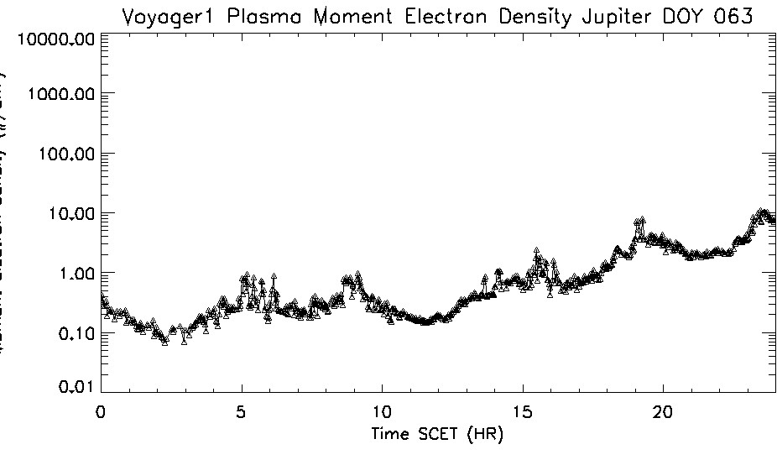
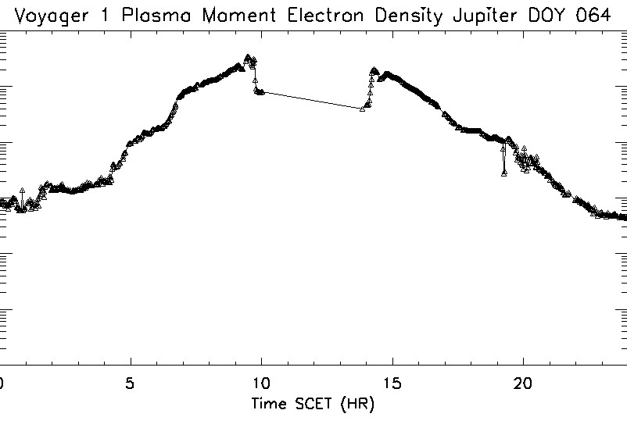
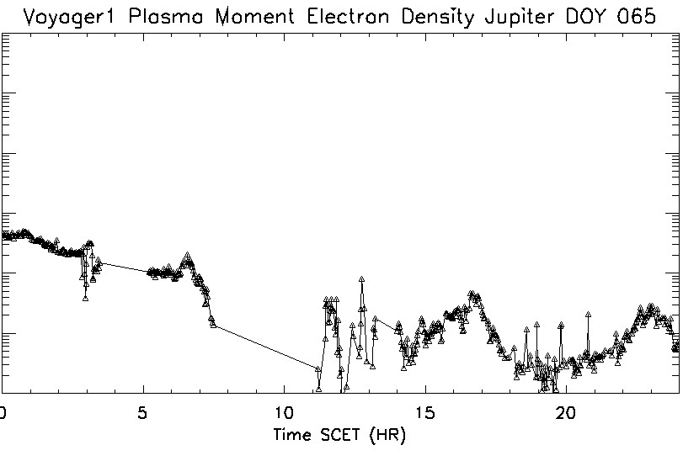
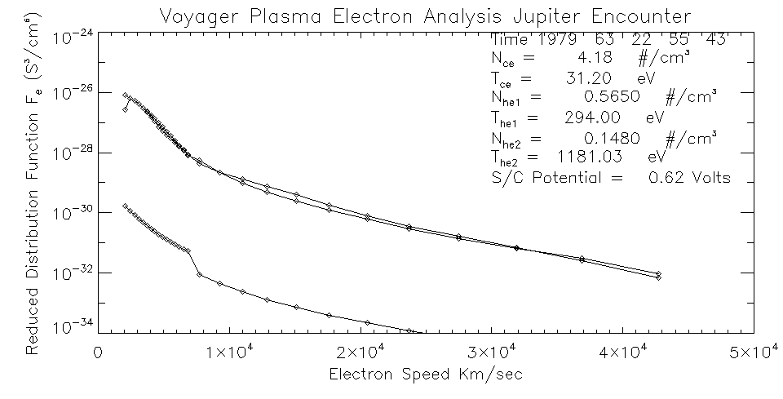
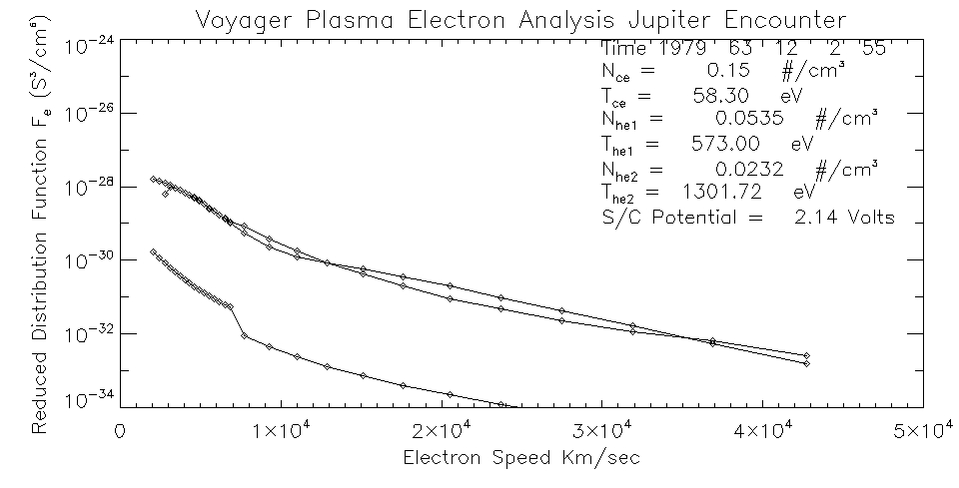
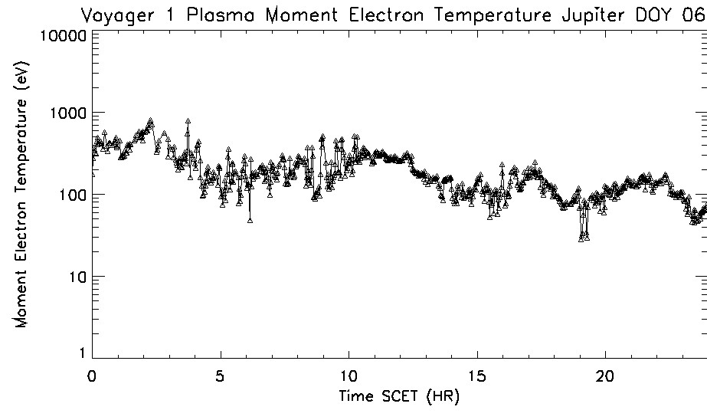
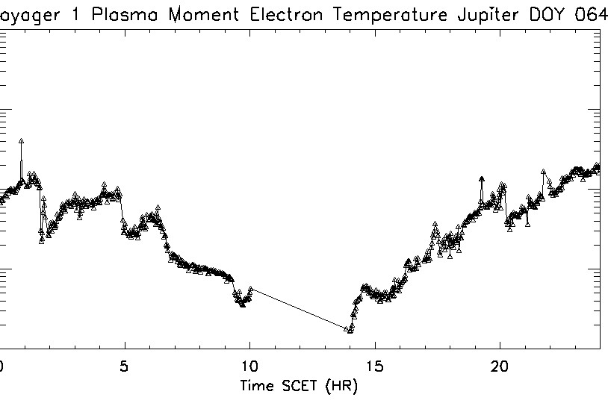
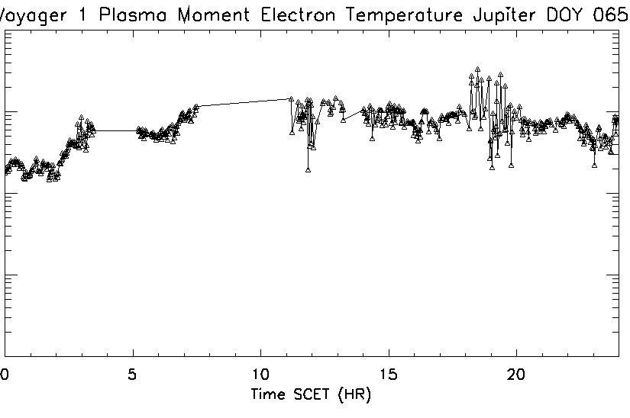
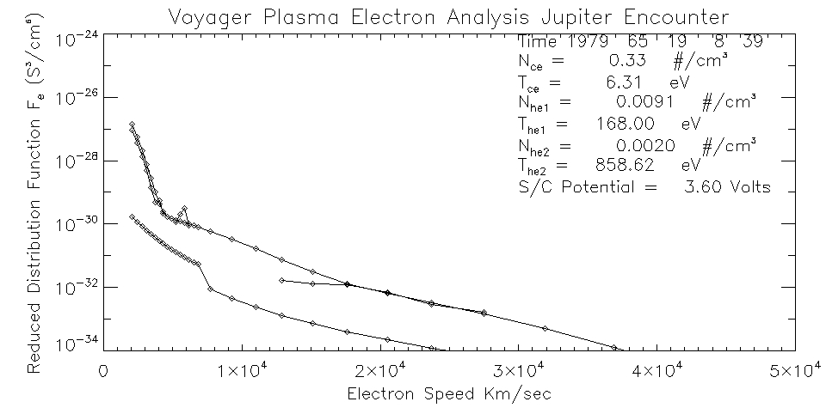
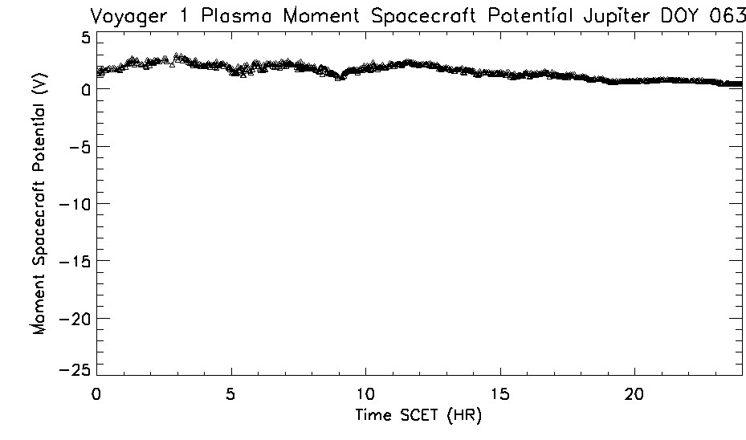
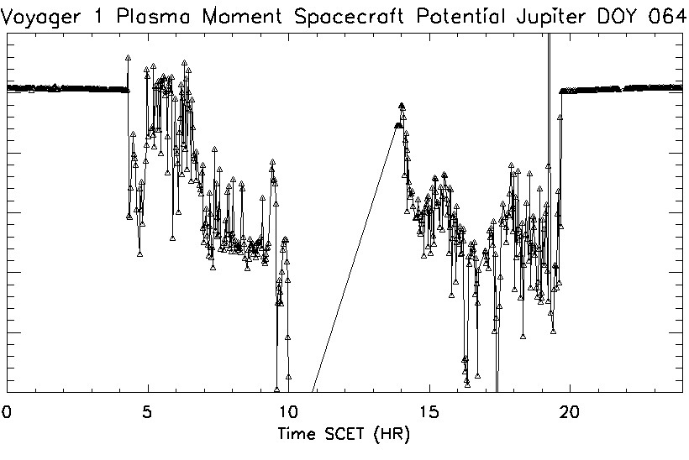
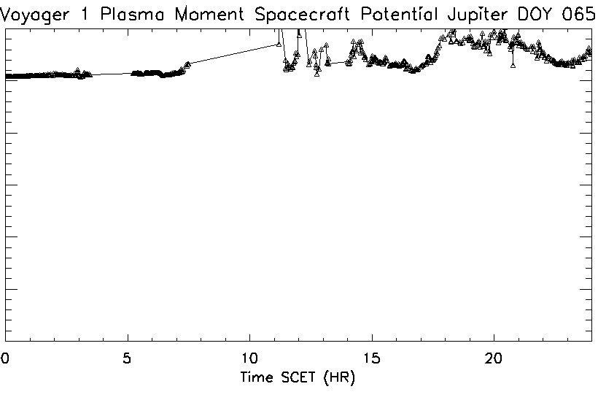
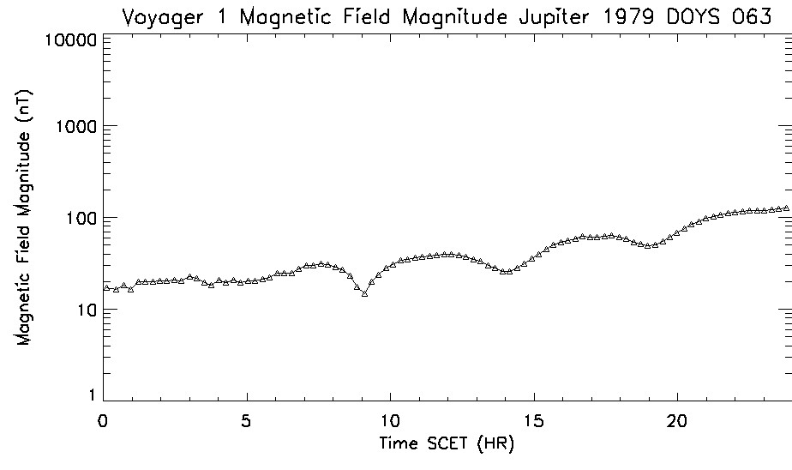
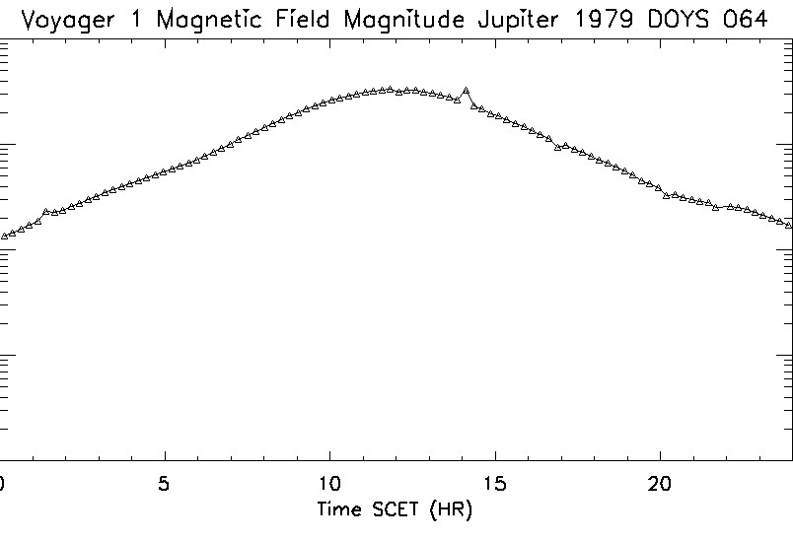
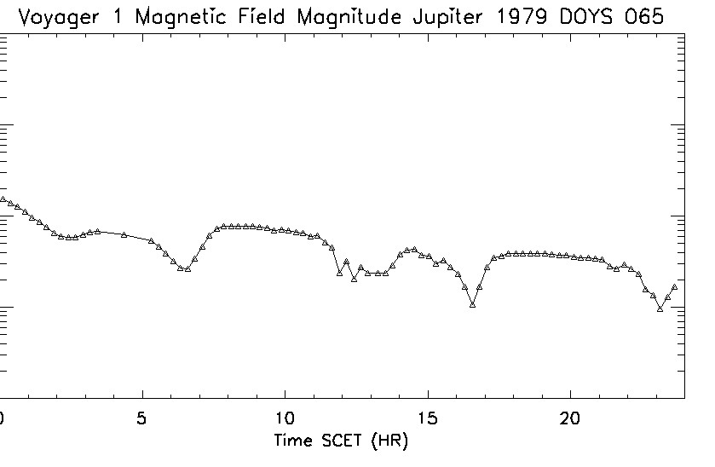
Recovery of Voyager Plasma Electron Observations at Jupiter
E. C. Sittler Jr^{.1}, W. R. Paterson¹, M. Samara¹, R. G. Michell¹, D. J. Gershman¹, D. G. Simpson¹, J. F. Cooper², and J. W. Belcher³
NASA Goddard Space Flight Center, Geospace Physics Laboratory, Greenbelt, MD, USA, 2. NASA Goddard Space Flight Center, Solar Wind Physics Laboratory, Greenbelt, MD, US, 3. Massachusetts Institute of Technology, Physics Department, Cambridge, MA, USA
A
A
Moment Electron Density (#/cm³)
B
C
B
Moment Electron Temperature (eV)
C
Photoelectrons before removal.
Summary of Events
Here we show present level of analysis of the Voyager Plasma Electron Observations for the Two Voyager encounters with Jupiter. For this poster we just show the Voyager 1 data.
The beginning of Day 1979 63 and end of Day 1979 65, respectively, extend beyond the orbit of Callisto but plan to cover inbound Bow Shock to Outbound BS.
We get good comparison with the Sittler and Strobel, 1987 paper for the Io Torus. For the inbound pass we have all the data to complete the feedthrough corrections to the suprathermal electrons and will add the electron density and temperature for the cold torus around closest approach as done by Sittler and Strobel 1987 who used the ion data and assumed thermal equilibrium.
No SEDR files for outbound passes but fortunately the project converted to ckernals for which we have a lot of experience from Cassini.
Recently we have integrated the Magnetometer Data to our plasma electron data for the Goddard Data Center. We obtained the magnetometer data from the PDS.
All our software is in Fortran for the data processing, while IDL routines are used for plotting lines plots, diagnostic of fits to reduced distributions functions, which are then used to compute the electron velocity distribution functions fe(v).
Presently working on color energy-time spectrograms of the differential energy flux of electrons.
For Day 79 65 there are photoelectrons from 17:45 to 20:10 SCET which were removed post-analysis for this poster. For these periods the data tends to have a higher noise level.
For the outbound pass we have no ion data but can use our return current relationship along with the MAG data (current sheet vs lobe filed lines) to determine if photoelectrons are present.
We have also processed some solar wind data upstream of Jupiter for the SW16 near Monterey CA, for which we preliminarily show evidence of keV electrons coming from Jupiter’s bow shock, but still need to do more work for confirmation.
This work will put us in a good position to analyze the Voyager 2 Uranus plasma electron observations for which we showed evident of a plasma ion-electron interaction during the ring plane crossing. We have discussed this with members of the Voyager PLS Team. .
For a future mission to Uranus, we showed the need for an IMS with very low noise levels to measure the composition of the rings and moons of Uranus?
For Europa the V1 outbound post L shell crossing showed sudden drop of keV electron which could be caused by a cryovolcanic event? During the time of Voyager, the importance of Europa was not known. Bill Paterson and I have discussed comparing Voyager and Galileo suprathermal electron observations.
We have done some runs with the Voyager 2 data and are now in a good position to complete that analysis.
We plan to compare our analysis of the Voyager 2 data with the results presented in the Scudder, Sittler and Bridge, JGR 1981 paper.
We note Sittler et al., JGR, 1987 paper of Jupiter’s distant magnetotail > 6000 RJ where they discovered hot heavy ions T ~ 87 keV with downstream flow speeds ~ 200 km/s. These ions provide the missing pressure needed to support the tail. Here we see photoelectrons > 140 eV.
Moment Spacecraft Potential (Volts)
Magnetic Field Strength (nT)

