Slide 1


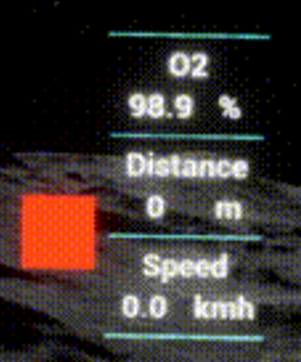
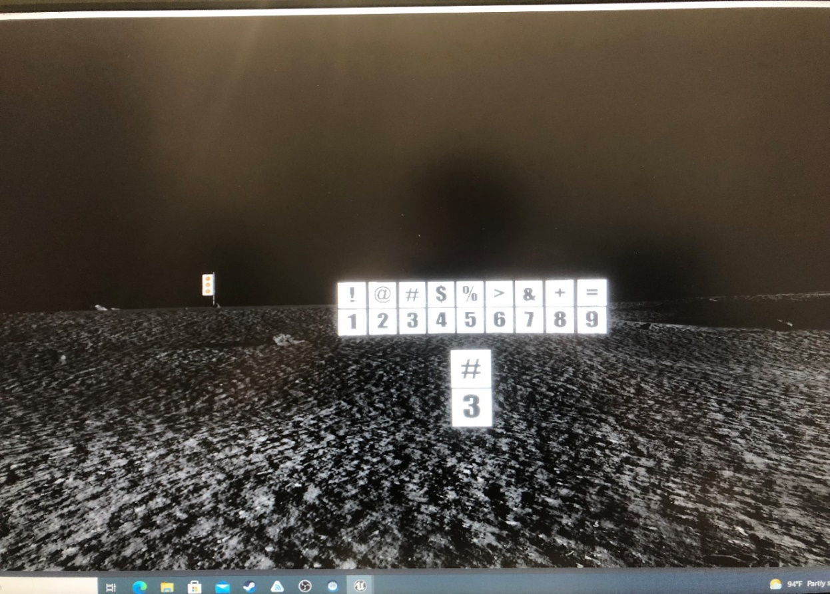
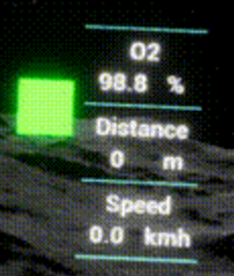
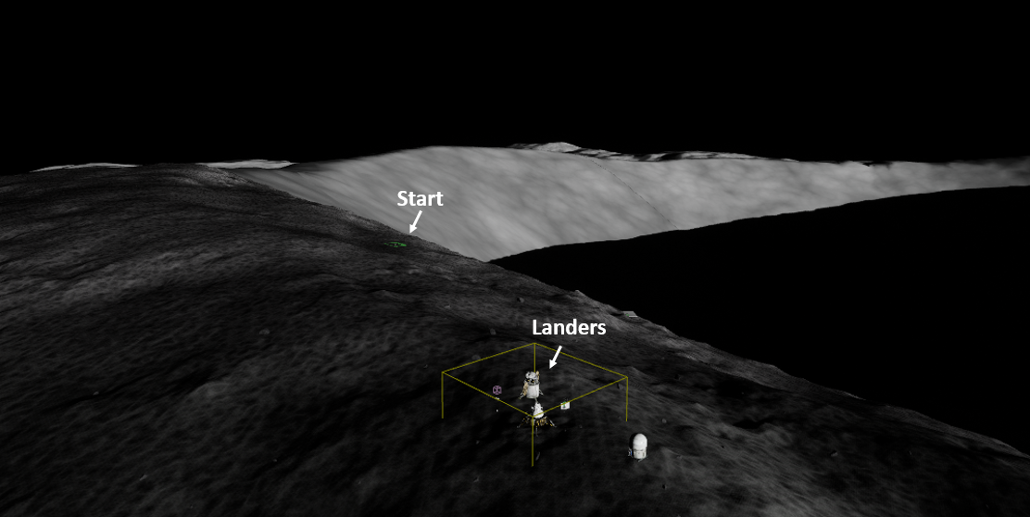
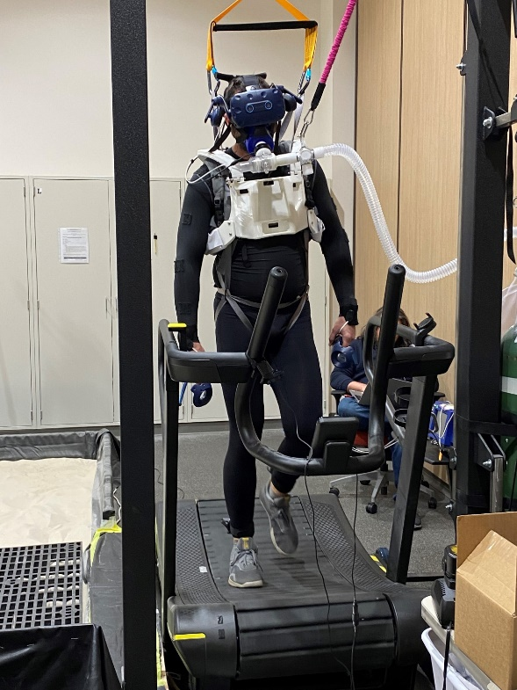
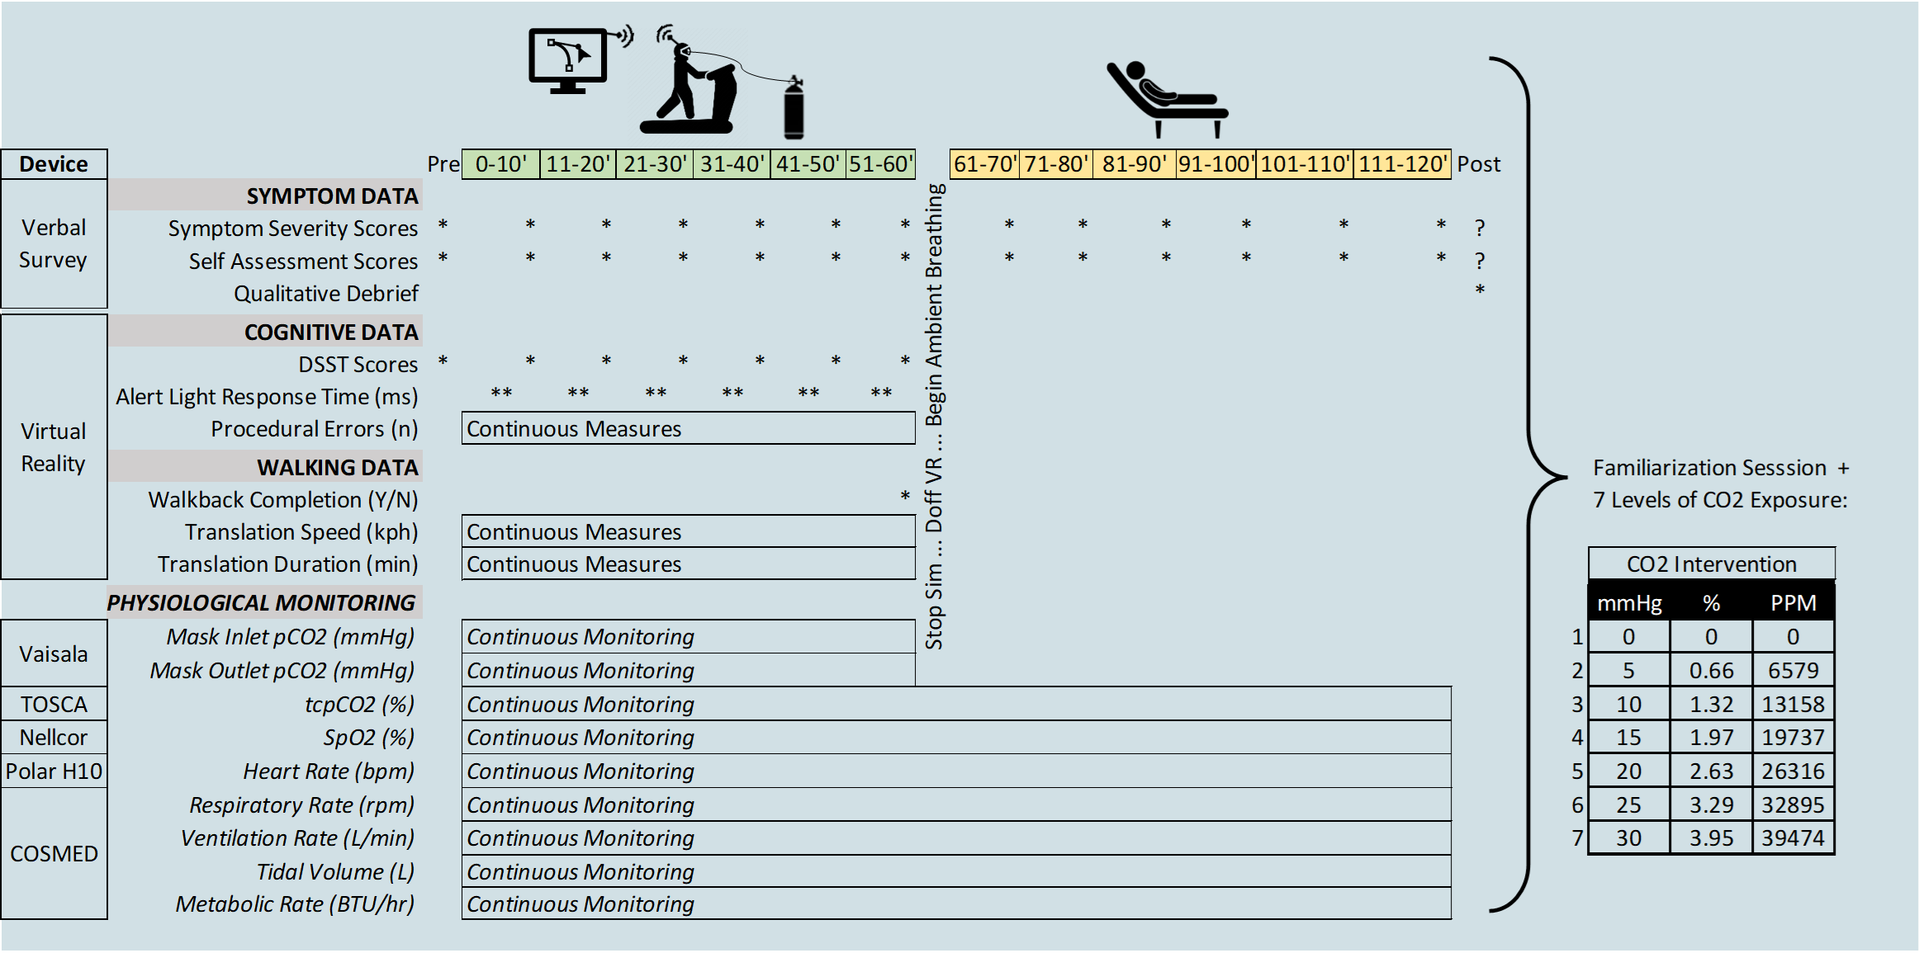
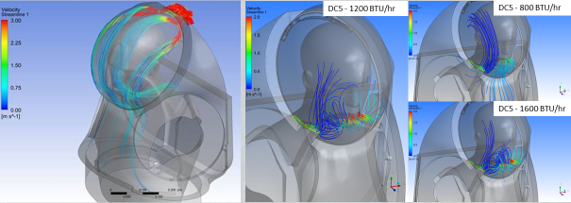
EFFECT OF CARBON DIOXIDE EXPOSURE ON PHYSICAL AND COGNITIVE PERFORMANCE IN A SIMULATED SPACEFLIGHT CONTINGENCY SCENARIO
A. Garbino¹; B. Siders²; N. Keller³; R. Scully³; B. Levine⁴; T. Babb⁴; J. Pawelczyk⁵; M. Basner⁶; A. Baughman¹; K. Marshall-Goebel⁷; A. Abercromby⁷
¹GeoControl Systems; ²Aegis Aerospace, Inc; ³KBR; ⁴University of Texas Southwestern; ⁵Penn State University;
⁶University of Pennsylvania; ⁷NASA Johnson Space Center
Abstract
As currently designed, there are potential failure modes in which future exploration suits would violate this 15mmHg CO₂ contingency limit. Meeting the 15mmHg CO₂ requirement could ultimately require a redesign of the suits, potentially leading to significant cost and schedule overruns.
The purpose of this study is to characterize cognitive and physical performance decrements and symptom severity when subjected to elevated inspired CO₂ levels. This study will determine the maximum inspired CO₂ level that still enables crewmembers to complete a simulated 1-hour contingency EVA walk back within acceptable functional performance limits.
INTRODUCTION: Carbon dioxide (CO₂) produced by suited astronauts can accumulate to levels that affect health and performance. The human health and performance risk associated with different levels of CO₂ exposure in the flight environment remains an area of debate.
PURPOSE: Characterize the limit of acceptable cognitive and physical performance decrements and symptom severity for mission operations when subjected to elevated CO₂ levels during contingency EVA scenarios.
METHODS: This study will simulate an EVA contingency “walk back to habitat” scenario. Subjects walk on a treadmill while breathing partial pressures of CO₂ of 0, 5, 10, 15, 20, 25, or 30 mmHg for 1 hour, while incorporating a virtual reality (VR) simulation of a lunar EVA. Cognitive, physical, and self-assessment of symptoms will be measured.
RESULTS: Next steps for this research study include data collection and analysis. Data collection is planned for calendar year 2024.
DISCUSSION: This study will provide information regarding how various partial pressures of CO₂ exposure impact cognitive and physical performance during simulated lunar EVA. This information will be vital in the assessment of overall risk associated with current hardware (vehicle and suit) design for upcoming exploration missions and informing future standards and requirements.
Figure 4: Screen shot of virtual reality heads-up display demonstrating the lunar environment with an example Digit Symbol Substitution Test superimposed. Insets: red/green light reaction time tests and nominal heads-up telemetry display.
Methods
This study will be conducted using a total of 15 subjects. The order in which subjects are exposed to each of the different carbon dioxide partial pressures will be randomized and the subjects will be blinded to the CO₂ levels.​
Cognitive performance will be quantified using the Digit Symbol Substitution Test (Basner, et al., 2015, see Figure 4), and operationally relevant measures of functional task performance embedded within the APACHE environment (Wusk, Abercromby, & Gabler, 2019). Physical performance will be measured by evaluating the distance translated. Additionally, metabolic (VO₂, VCO₂, VE, RER, etc.), heart rate, transcutaneous CO₂, and pulse oximetry (SpO₂) data will be collected.
​Symptom severity related to CO₂ exposure (headache, dizziness, nausea, numbness, tingling, shortness of breath, air hunger, fatigue, euphoria) will be quantified via survey prior to the testing session, at 10-minute intervals during the testing session, and immediately following the testing session.
To better characterize post-exposure recovery, symptoms will also be collected every 10 minutes for one hour after walking cessation.
A hybrid reality EVA simulation environment (APACHE at NASA JSC) will provide a physically and cognitively realistic simulation of a 1-hour contingency EVA walk back, incorporating a passive treadmill, a simulated space suit hard upper torso, and a fully immersive virtual reality simulation (see Figure 2). Each subject will be exposed to 7 different partial pressures of CO₂ (0, 5, 10, 15, 20, 25, 30 mmHg) for 1 hour, each on a different day to provide sufficient time for washout of exposure.
Introduction
Carbon dioxide (CO₂), produced through astronaut metabolism inside space suits, will accumulate to levels that affect health and performance if the suit system does not provide adequate CO₂ removal. During certain suited contingencies (i.e., off-nominal emergencies such as failure of the CO₂ removal system), a purge valve is opened, venting gas, which in turn affects the efficiency at which CO₂ is removed from the helmet (see Figure 1). This contingency mode would allow the crewmember up to 60 minutes to return to the airlock before their emergency oxygen supply is exhausted.
There is a paucity of data for PiCO₂ exposures greater than 15mmHg (Cutler, et al., 1964; Glatte, Motsay, & Welch, 1967; Menn, Sinclair, & Welch, 1970; Shykoff & Warkander, 2012), resulting in uncertainty and inconsistency within the existing ground-based data on the performance impacts of these elevated CO₂ levels, especially when combined with exercise. Some studies (Glatte, Motsay, & Welch, 1967; Cutler, et al., 1964; Menn, Sinclair, & Welch, 1970) suggest that CO₂ levels of 20mmHg or higher are tolerable without major performance impacts, while other studies (Shykoff & Warkander, 2012) suggest that these CO₂ levels could cause unacceptable impacts. Thus, risks associated with CO₂ exposure in the range of 15 to 20mmHg or higher remain an area of debate. Given that the health and performance implications of contingency levels of CO₂ are uncertain, the overall risk trade associated with design modifications to exploration space suits vs. keeping the current design is unclear.
NASA-Standard-3001 Volume 2 Rev D includes a standard for inspired CO₂ during nominal suited operations (NASA Space Flight Human-System Standard., 2023). In the absence of a contingency CO₂ standard, exploration EVA suits use the upper bound of the nominal PiCO₂ requirement (15 mmHg) as the contingency requirement.
Results
Figure 2: Perspective view of the virtual reality simulated lunar terrain of Shackleton Crater showing the traverse starting point and lunar lander destination. Inset: Test subject walking on the treadmill, fully donned with the thermal base layer, simulated space suit hard upper torso, mask with breathing system, and virtual reality headset.
This study currently has approval from NASA’s Institutional Review Board and has completed the Test Readiness Review process. In addition, multiple sub-system and system-level engineering analysis tests have been performed on study hardware and software, as well as multiple integrated dry run tests. Test subjects have been recruited and have begun baseline data collection. Next steps for this research study include data collection and analysis. Data collection is planned for calendar year 2024.
Subjects walk on a passive treadmill in VR for 1 hour at a predetermined pace while breathing one of seven concentrations of carbon dioxide and ambient air mixture. During the 1 hour of exposure, the subjects will breathe 21% oxygen compressed air (+CO₂) via oronasal facemask at sea-level pressure. Physiological, cognitive, and self-reported symptom data are collected continuously or every 10 minutes. After the hour, subjects recover for 1 hour and self-report CO₂ symptoms every 10 minutes (Figure 3).
Discussion
This study will provide valuable information regarding how various partial pressures of carbon dioxide exposure impact acute cognitive and physical performance, subjective self-reported symptoms, as well as the ability to complete mission objectives.
Furthermore, as this study will include the physiologic, symptomatic, and performance effects of CO₂ at nominal partial pressures of PiCO₂ in addition to contingency levels, this study will also provide data to inform and clarify overall risk of elevated CO₂ exposure.
Figure 1: Computational Fluid Dynamics modeling of helmet airflow with purge valve open demonstrating turbulent airflow at various metabolic rates (BTU/hr). (Credit: Norcross, et. al.; 2020)
References
Cutler, R. G., Robertson, W. G., Herlocher, R. E., McKenzie, F., Ulvedal, J., & Welch, B. E. (1964). Human response to carbon dioxide in the low-pressure, oxygen rich atmosphere. Aerospace Med, 317.
Glatte, H. A., Motsay, G. J., & Welch, B. E. (1967). Carbon Dioxide Tolerance Studies. AD664899, School of Aerospace Medicine, Brooks Air Force Base, TX.
Menn, S. J., Sinclair, R. D., & Welch, B. E. (1970). Effect of Inspired PCO2 up to 30 mm Hg on Response of Normal Man to Exercise. J Appl Physiol, 663-671.
NASA Space Flight Human-System Standard. (2015). NASA-STD-3001, VOLUME 1, Crew Health - Rev. D.
Norcross, J., Abercromby, A. F., & Alexander, D. (2020). Maximum xEMU CO2 During Emergency Abort. Joint BRESCB/SMOCB Forum.
Shykoff, B. E., & Warkander, D. E. (2012). Exercise carbon dioxide (CO2) retention with inhaled CO2 and breathing resistance. Undersea Hyperb Med, 815-828.
Figure 3: Conveys a single experimental protocol timeline within showing pre-exposure data collection, 1-hour CO2 intervention, and 1-hour post data collection. The first hour of the protocol (in green) requires subjects to ambulate at a defined pace corresponding to an individualized fixed metabolic workload while breathing elevated CO₂. The second hour of the protocol (in yellow) will collect measures during a recovery period.
This study is funded by the NASA Human Research Program

