Slide 1
ORION ARTEMIS I DESCENT AND LANDING PERFORMANCE
Brian D. Bihari
Mark A. Kane
Marina M. Moen
NASA JOHNSON SPACE CENTER
46th AAS GUIDANCE, NAVIGATION, AND CONTROL CONFERENCE
BRECKENRIDGE, COLORADO, FEBRUARY 2024

Slide 2
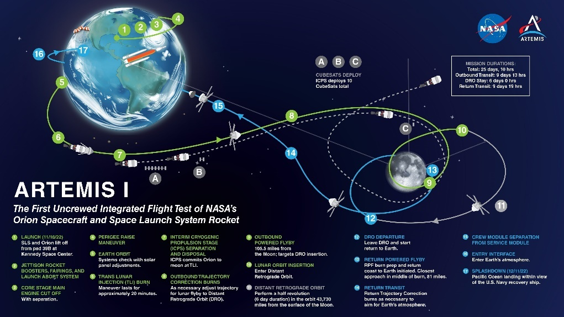
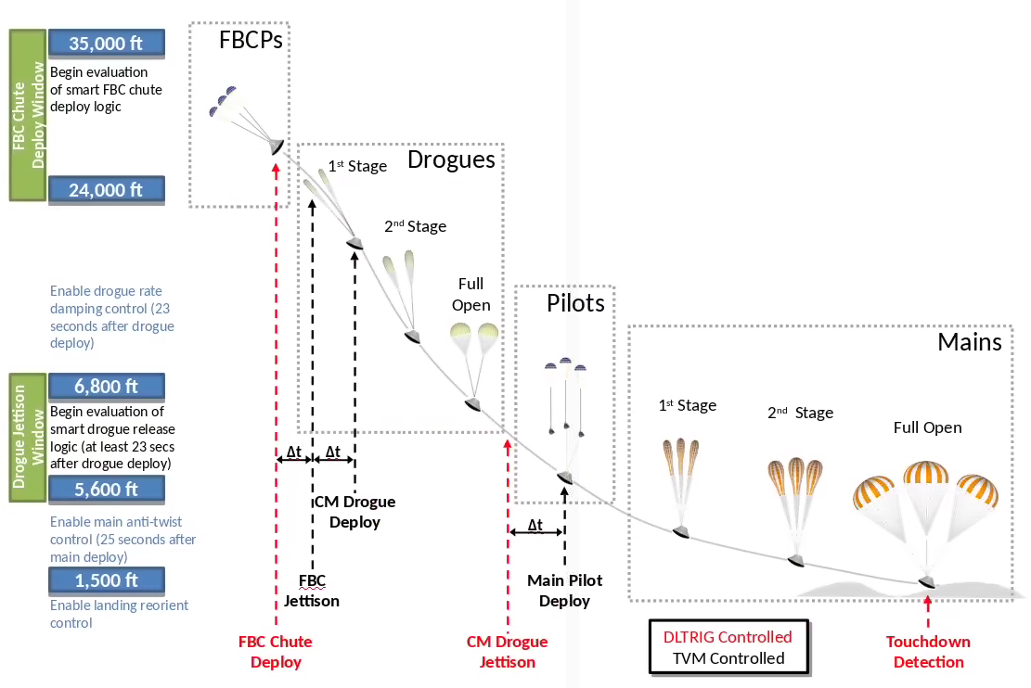
ARTEMIS I
Descent is the time under parachutes
Three control modes during decent:
Drogue Rate Damping
Main Anti-twist
Landing Reorientation
Launched: November 16, 2022 at 1:47 am
Mission Duration: 25 days, 10 hours, 53 minutes
After Entry Interface (16) three primary events occur in the trajectory:
Forward Bay Cover (FBC) Jettison and Drogue Deployment
Drogue Chute Jettison and Main Chute Deployment
Splashdown

Slide 3
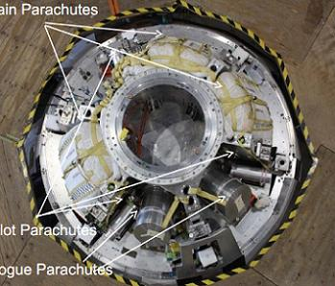
Capsule Parachute Assembly System (CPAS)
CPAS is stowed in the Crew Module (CM) Forward Bay:
Three 7 ft reference diameter (D_{o}) Conical Ribbon Forward Bay Cover Parachutes (FBCPs)
Two 23 ft D_{o} Variable Porosity Conical Ribbon (VPCR) drogue parachutes
Three 9.85 ft D_{o} Conical Ribbon main pilot parachutes
Three116 ft D_{o} Quarter Spherical Ringsail main parachutes
Drogue and main risers are attached through the Fairlead and Riser Attach Assembly
Forward Bay Cover parachutes (FBCPs) are attached to the Forward Bay Cover (FBC) and are mortar deployed
Drogue parachutes are mortar deployed
Main pilot parachutes are mortar deployed and are attached to the main parachute extraction bags for extracting the main parachutes
Main parachutes have three reefing stages
Main Parachutes
Main Pilot Parachutes
Drogue Parachutes
Riser Attach Assembly

Slide 4
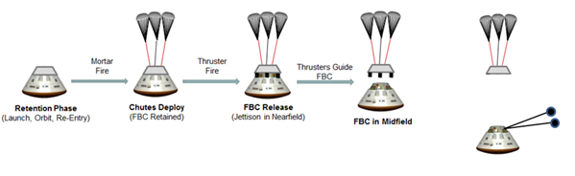
FBC and Drogue Deploy
The Descent and Landing Triggers (DLTRIG) Computer Software Unit (CSU) is responsible for setting flags that initiate parachute deployment events and mode control during descent operations.
Flag | Description
FBC_Chute_Deploy_Cmd | Command to initiate the drogue deploy sequence. (includes Forward Bay Cover (FBC) parachute deploy, FBC jettison, and drogue parachute deploy)
Drogue_Jettison_Main_Deploy_Cmd | Command to initiate the sequence that jettisons the drogue chutes and deploys the main chutes
Touchdown_Detected | Flag indicating detection of CM touchdown (inhibits CM RCS control and initiates transition into post-landing activities)
CM_Touchdown_Cntrl_Mode | Flag indicating current touchdown control mode (modes between Drogue Rate Damping, Main Anti-twist, and Landing Reorientation control mode)
FBC Jettison and Drogue Deploy
Starts with FBCP mortar fire ejecting three mortar lids and three FBCP sabots which deploy the parachutes.
FBC parachutes are inflated and held for 1.4 sec
FBC is jettisoned
Drogue mortar fire is initiated 2.0 sec after FBC jettison
Mortar lids and drogue sabots and drogue bags are ejected
Drogue parachutes are deployed

Slide 5
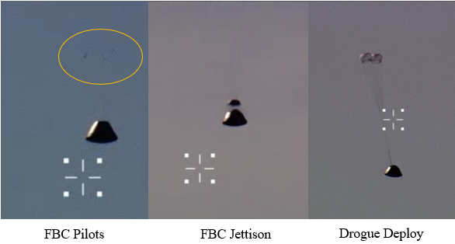
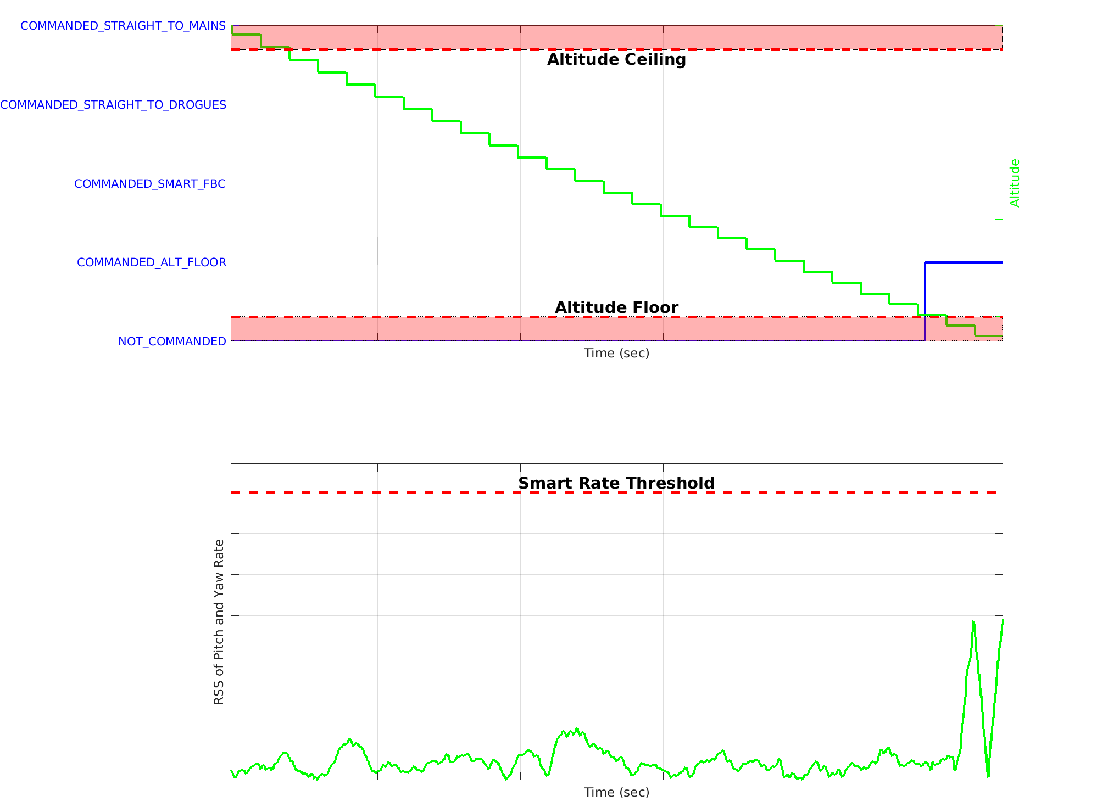
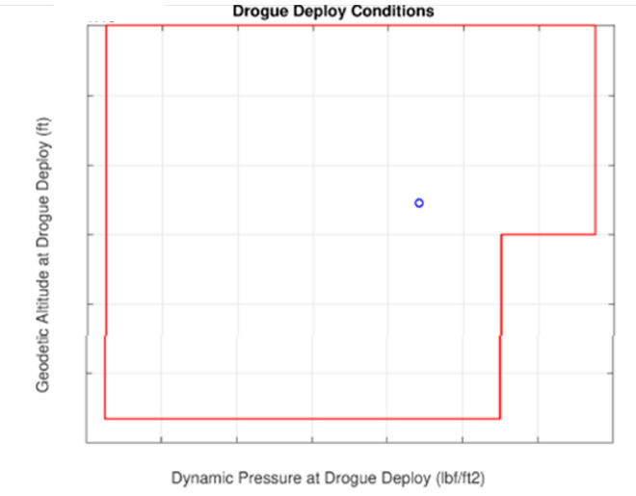
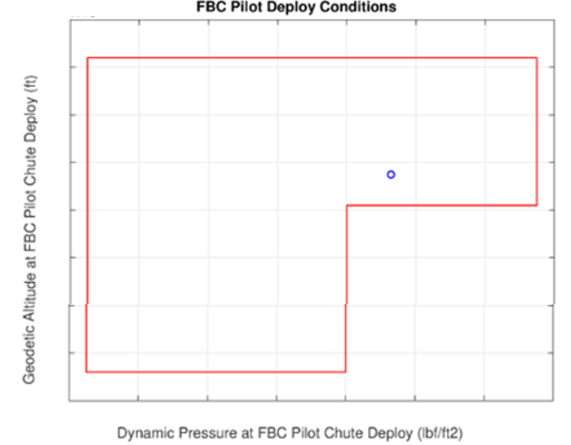
Artemis I FBC Jettison and Drogue Deployment
Drogue deployment initiation is nominally triggered by an altitude floor.
It is desired to actively guide the vehicle for as long as possible to achieve precision landing at the desired landing target
After parachutes deploy the vehicle trajectory becomes a function of environmental winds.
To protect against CM tumbling due to reduced stability in subsonic flight, FBC deploy may be triggered early after a minimum altitude threshold has been met by Smart FBC chute deploy logic.
Imagery confirmed successful FBC jettison and drogue parachute deployment
Altitude
FBC pilot and drogue parachuted deploy conditions fell within the design envelopes
The FBC jettison sequence was initiated at the altitude floor for Artemis 1
RSS of Pitch and Yaw Rate

Slide 6
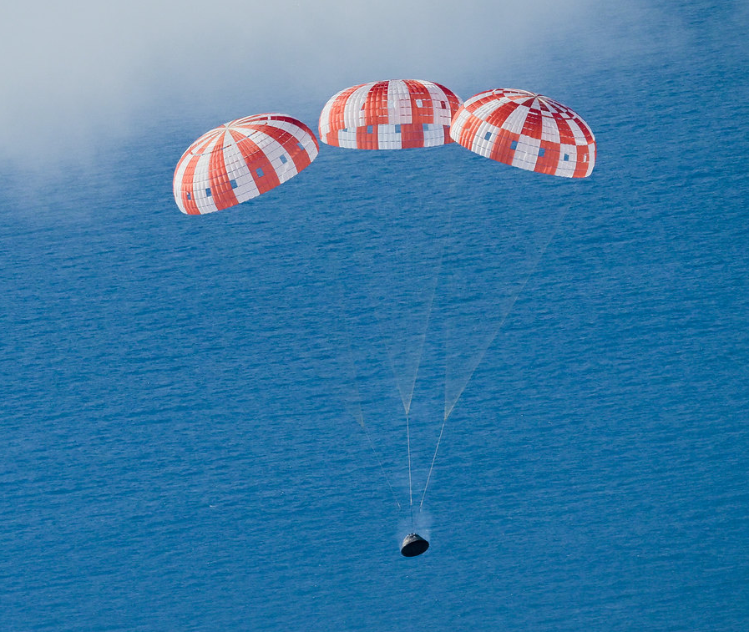
Drogue Jettison and Main Deploy
Drogue Jettison and Main deploy initiation is nominally triggered by Smart Drogue Release (SDR) logic
After a maximum altitude threshold is reached SDR logic monitors body angular rates and attempts to release drogues when angular rates are at a minimum to decrease the risk of tumbling
In off nominal situations, such as a loss of a drogue parachute, angular rates may remain high and main deploy is initiated after an altitude floor has been reached
Main Deployment Involves
Cutaway of drogue parachutes
Main pilot chute mortar fire
Ejects 3 mortar lids and 3 pilot sabots with bags
Pilot parachutes deploy
Main bags extracted ~4.3 s later
Three main parachutes deploy
Main parachutes are sized such that they can decelerate the CM safely even if one of the parachutes fails to deploy.
Drogue parachutes are only allowed to be jettisoned after the configurable minimum time under drogues.
Drogue jettison and main deploy has an altitude ceiling and floor.

Slide 7
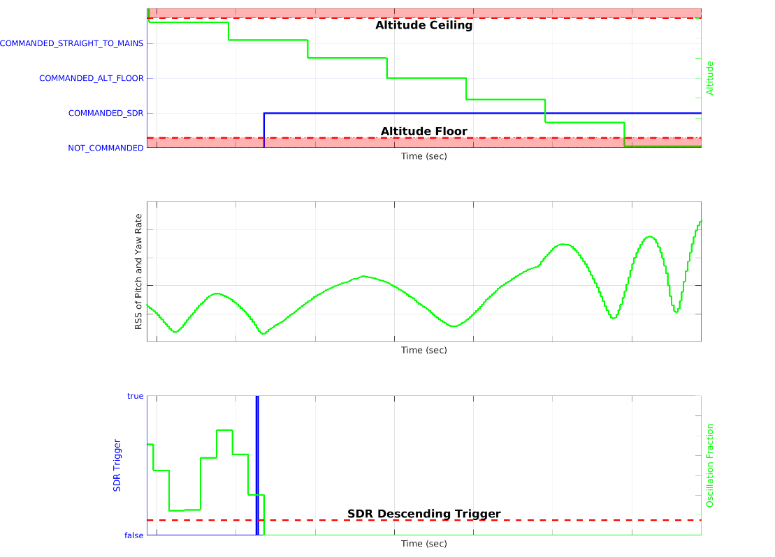
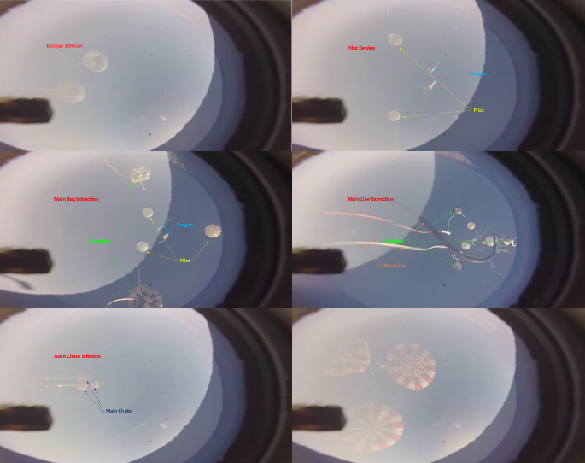
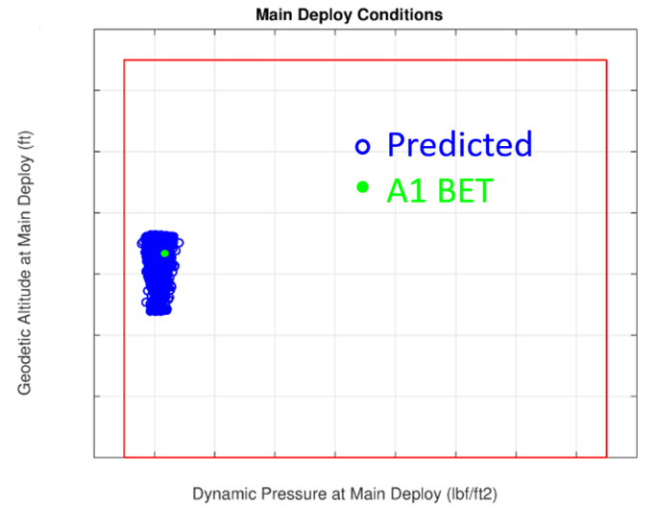
Artemis I Drogue Jettison and Main Deploy
Altitude
Drogue Jettison
Main Pilot Deploy
RSS of
Pitch and Yaw Rate
Main Bag Extraction
Main Line Extraction
SDR Trigger
Oscillation Fraction
Main Chute Inflation
Guidance Software commanded the drogue jettison and main deploy sequence per SDR logic when oscillation was decreasing as desired
Main deploy conditions were within the deploy envelope and in-family with Monte Carlo simulation results
Imagery confirms successful jettison of drogue parachutes and deploy of main parachutes.

Slide 8
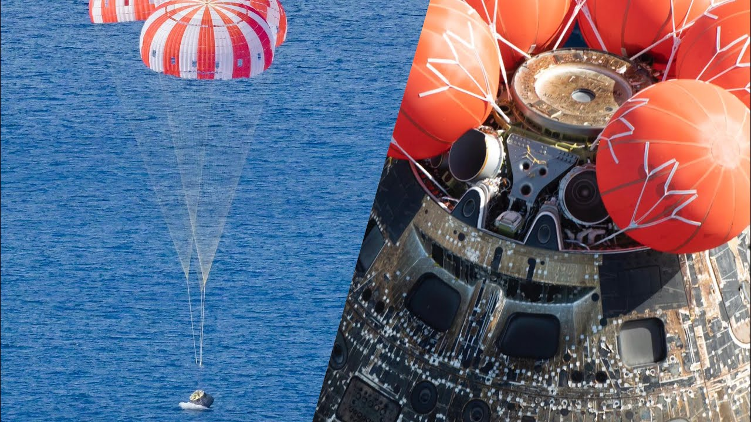
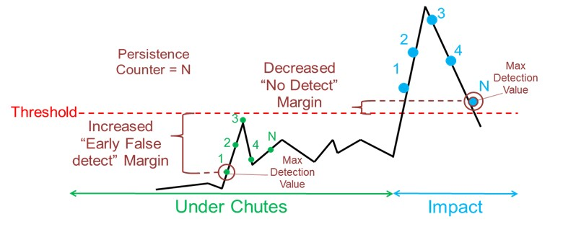
Touchdown Detection
Touchdown (TD) detection is critical to the mission as it:
Ensures the shutdown of CM RCS at touchdown preventing RCS thrusters from firing while submerged
Transitions the vehicle into post-landing activities that cut the main risers and deploys the CM uprighting system (CMUS)
Artemis II+ missions there is a delay between touchdown and main cutaway to allow time for crew to confirm that touchdown occurred prior to sequencing transitioning into post-landing activities.
TD detection logic:
Senses CM splashdown based on 200 Hz acceleration data from the IMU.
Is evaluated once a specified time since main pilot chute deploy has elapsed to prevent main deploy and inflation dynamics from causing false touchdown detection and
If navigated altitude accuracy indicates that altitude is valid, CM must also be below an altitude threshold

Slide 9
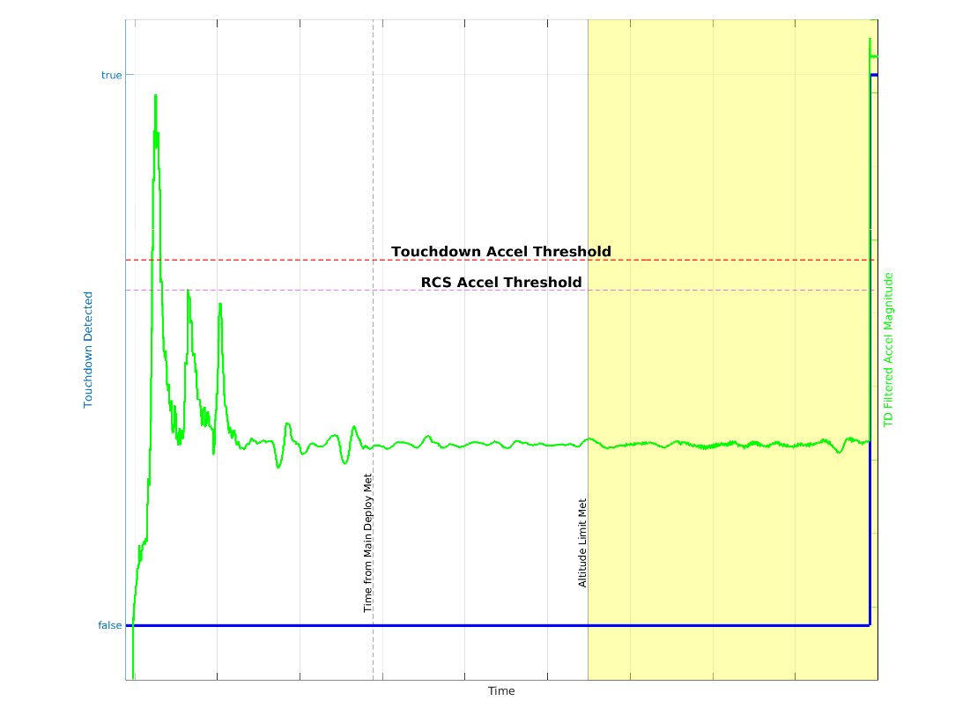
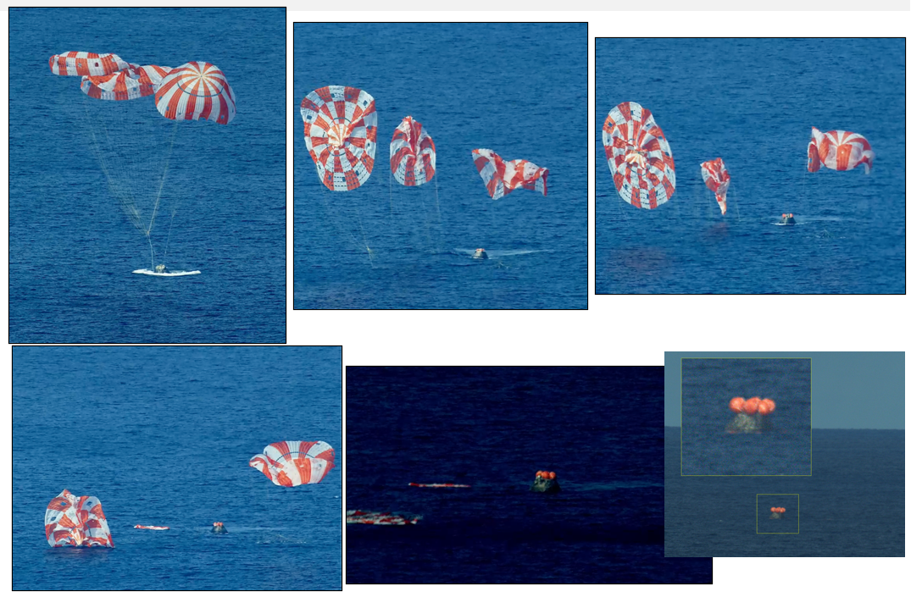
Artemis I Touchdown Detection
Main Deploy
Splashdown
TD Detected
Main Cutaway
Main Disreefing
CMUS Fully Deployed
TD Detection Allowed

Slide 10
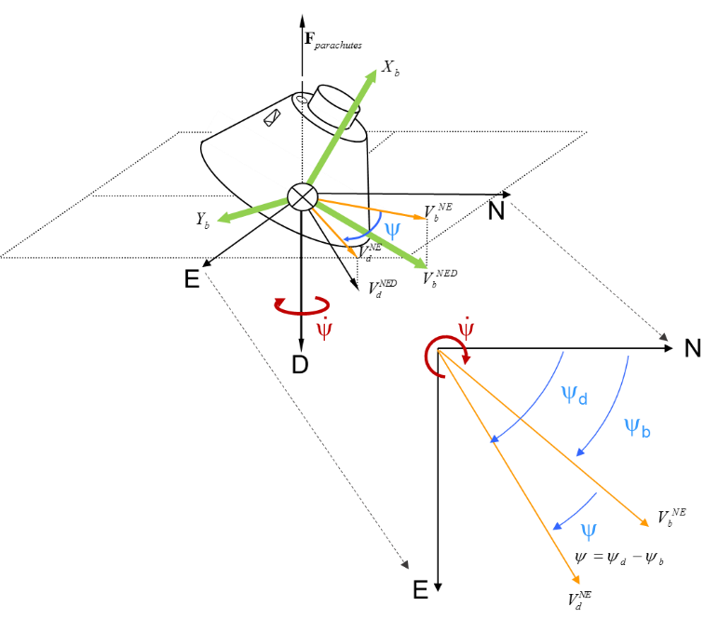
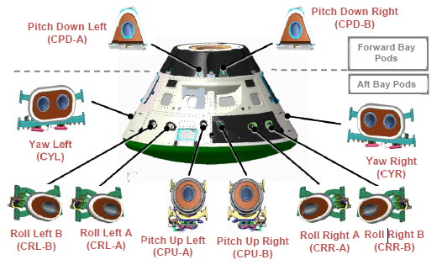
Crew Module Reaction Control System (RCS)
Crew Module Reaction Control System (RCS)
Attitude control is achieved by commanding reaction control thrusters that produce torque about the vehicle body axis
Two fully redundant strings of thrusters
Six thrusters per string
Each thruster produces a nearly pure torque in one direction about the primary body axis
Under parachutes the free rotation axis is about the local vertical direction
Thruster commands are generated using heading error, heading error rate, and heading error acceleration
During drogue parachute decent the roll thrusters are commanded to damp rates, however, due to the hang angle observed under main parachutes the roll and yaw thrusters are fired simultaneously to produce a torque about the local vertical axis

Slide 11
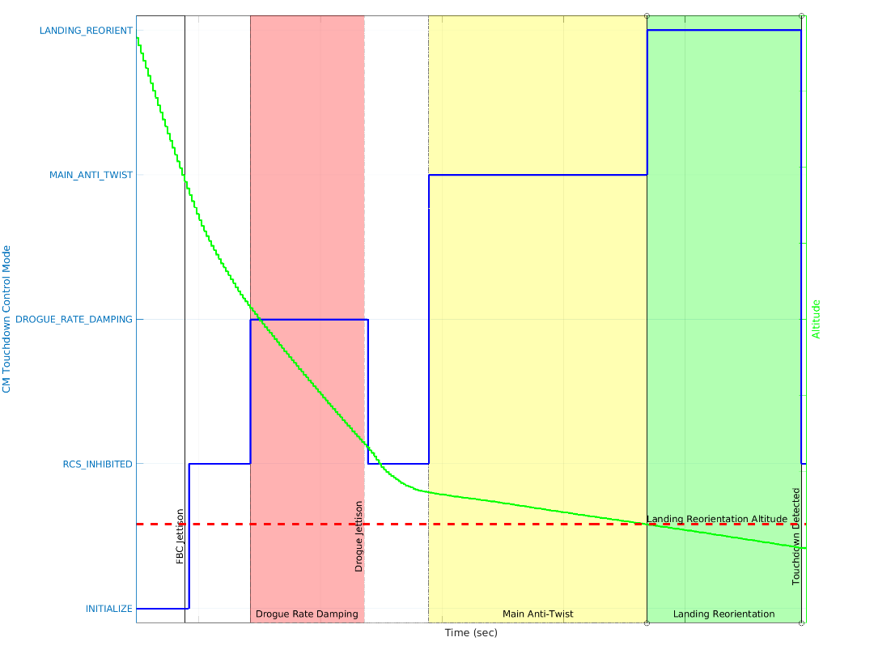
CM Touchdown Control Mode
CM RCS is inhibited during drogue and main parachute deploy to allow for the parachutes to properly inflate.
Three main control modes while under chutes: Drogue Rate Damping, Main Anti Twist, and Landing Reorientation
Artemis I CM Touchdown Control Mode
Drogue Rate Damping control keeps the vehicle from spinning excessively around the drogue chute attach point prior to main chute deployment.
Main Anti Twist and Landing Reorientation are mutually exclusive and are active after main pilot chute deploy and before TD
Logic allows the control mode to switch back and forth between main anti-twist and landing reorient depending on the current altitude
Main Anti Twist prevents the vehicle from twisting up the parachute lines and reducing the ability of the control system to properly orient the vehicle at landing due to line twist-torque
Landing Reorientation ensures that the vehicle is pointed towards the correct heading at touchdown
Altitude
Enumeration | Definition
INITIALIZE | Default initialization value.
RCS_INHIBITED | Inhibit CM RCS control.
DROGUE_RATE_DAMPING | Perform drogue rate damping control.
MAIN_ANTI_TWIST | Perform main anti-twist control.
LANDING_REORIENT | Perform landing reorientation.

Slide 12
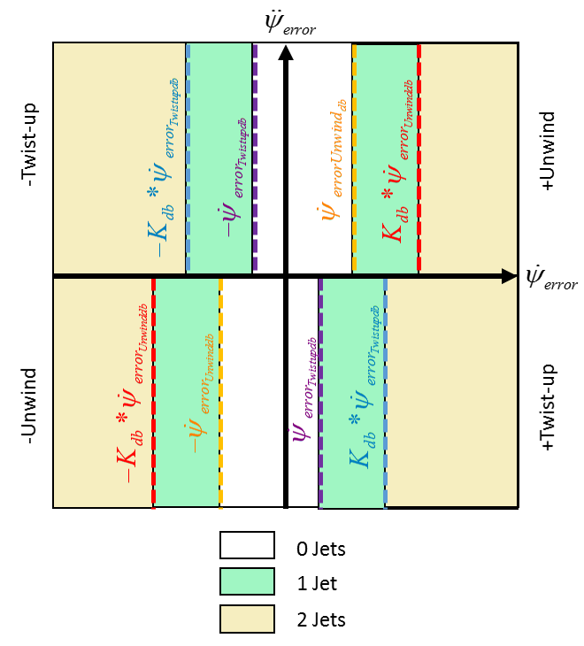
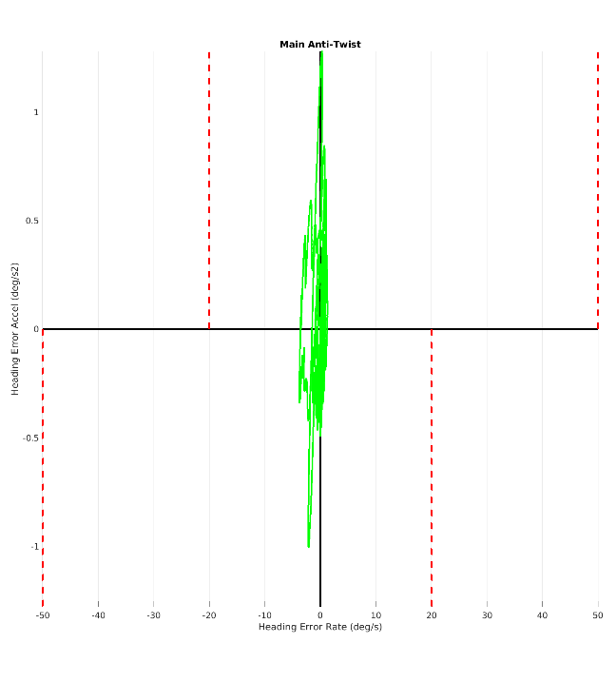
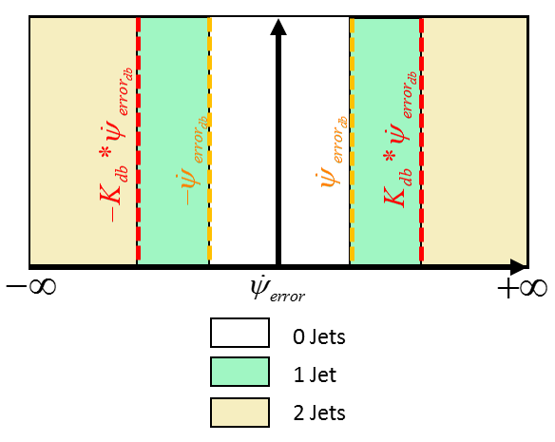
Drogue Rate Damping and Main Anti Twist
Primary purpose of drogue rate damping is to restrict angular rate to meet main deploy constraints
Implemented as a bi-level algorithm
Rates observed under drogue parachutes during the Artemis I mission did not exceed the rate threshold necessary to trigger a thruster firing
Mian Anti Twist control is used to limit the heading rate under the main parachutes while allowing parachute line twist to unwind
Implemented as a bi-level algorithm
Dynamics during the ride under main parachutes were benign and did not cause any CM RCS firings to occur during the Artemis I mission
Heading Error Acceleration
Drogue Rate Damping Control Logic
Heading Error Rate
Main Anti-twist
Artemis I Main Anti-twist

Slide 13
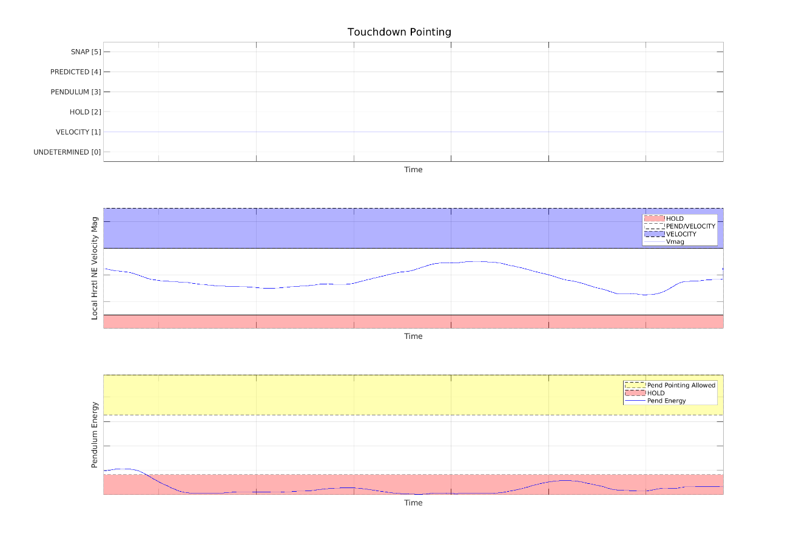
Landing Reorientation
Landing reorientation is used during the final phase of descent to maneuver the vehicle such that the body alignment axis is aligned in the desired direction to reduce touchdown impact loading on the crew.
Pointing Direction Modes:
Pendulum
Point perpendicular to the swing plane.
Used when the horizontal velocity magnitude is below a specified threshold and when large pendulum swing amplitude is detected.
Once the pendulum mode is selected it is not allowed to change to the velocity pointing direction.
This is to prevent rapid swapping of the desired pointing direction. Down modes (Hold/Predicted) are preserved.
The pendulum pointing mode is inhibited until the touchdown control mode indicates that landing reorientation is being performed.
Velocity
Point towards the direction of travel in the local horizontal plane.
Hold
Point toward the last known “good” value.
Used when:
Velocity magnitude is very low
The pendulum mode has been activated and the observer diverges.
The pendulum mode has been activated and the pendulum energy is low.
Predicted
Point towards a predicted direction based on the weather forecast for landing winds
Used when GPS fails.
Artemis I Selected Touchdown Pointing Direction
Time from Drogue Jettison Initiation
Local Hrztl Velocity Mag
Time from Drogue Jettison Initiation
Pendulum Energy
Time from Drogue Jettison Initiation
The Artemis I touchdown pointing direction was constant and in the direction of horizontal velocity.

Slide 14
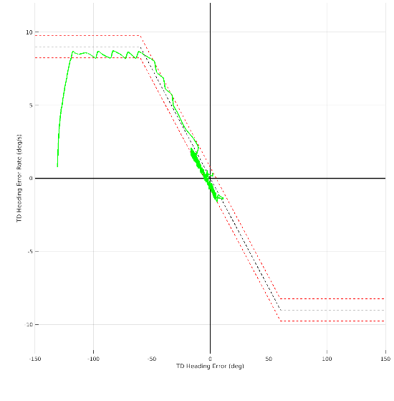
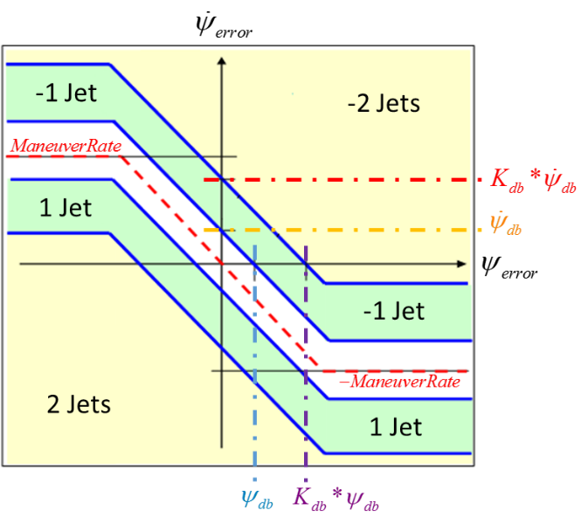
Landing Reorientation
Landing reorientation control logic is a bi-level phase plane defined by the heading dead band , heading rate dead band , and the maneuver rate limit
Outer dead band is the inner dead band multiplied by a scale factor
Heading Error Rate
Heading Error Rate
Control Law Switch Curves in the Attitude Error Phase Plane
Artemis I Landing Reorientation Phase Plane

Slide 15
CONCLUSION
Artemis I successfully triggered all deployment events
FBC Jettison, drogue deploy, and drogue cutaway were fully successful
Artemis I successfully detected touchdown
Main cutaway and CMUS deployment were fully successful
Touchdown control moding was as expected
Touchdown control successfully reoriented the vehicle prior to splashdown in the direction of horizontal velocity
Acknowledgements
All current and former Entry MODE team members
We would also like to thank our families for their support and encouragement!

