Slide 1
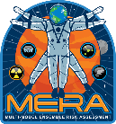
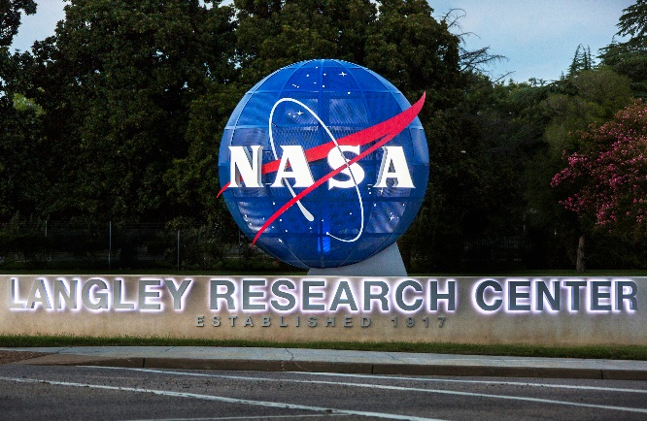
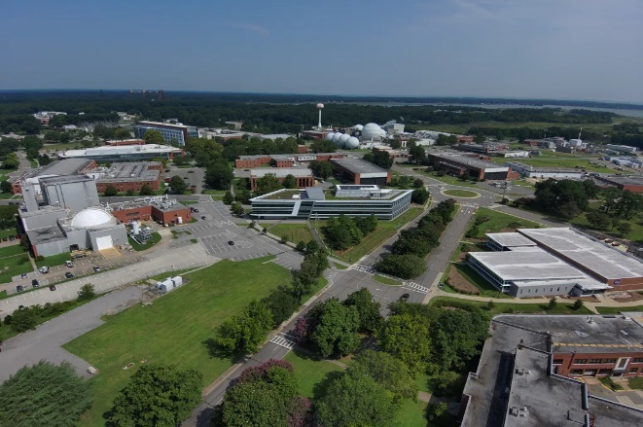
SPACE RADIATION RISK MODELING –
THE MULTI-MODEL ENSEMBLE RISK ASSESSMENT (MERA) PROJECT
Tony Slaba
on behalf of the MERA team
NASA Human Research Program Investigator’s Workshop
February 12, 2024

Slide 2
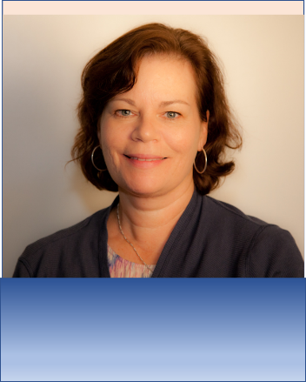



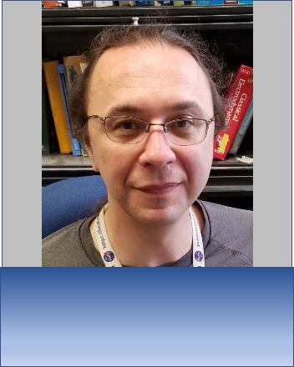

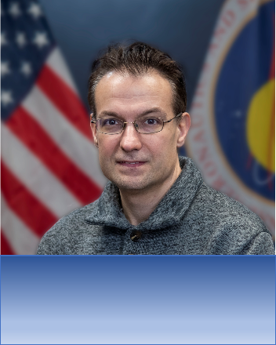
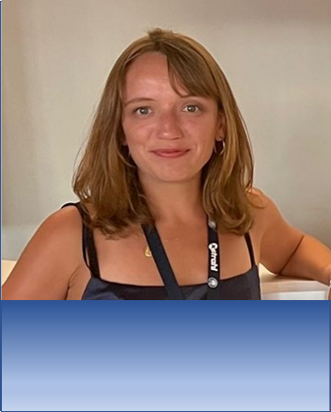
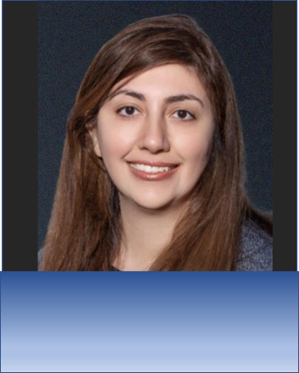

The MERA Team:
MERA Team Members:
125+ years of space radiation research experience
Janice Huff
Ryan Norman
Tony Slaba
Charles Werneth
Steve Blattnig
MERA Project Scientist
Individual risk assessment
MERA Project Manager
Lung cancer
Cancer ensemble risk model
Galactic cosmic ray simulator design
Medical countermeasure &
Mitigation assessment
Biologically-based risk models
CVD risk models
Late CNS risk assessment
Combined spaceflight risks
Shirin Rahmanian, PhD
Martha Clowdsley
Floriane Poignant
Shirin Rahmanian
Xiaojing Xu
(Sharon)
Ianik Plante
MERA Project Manager
Engineering design
Track structure & biophysics
CVD clinical prediction models
CNS risk modeling
Chromosome aberration modeling
Track structure & biophysics
Risk communication
Radiation transport
Dose response modeling

Slide 3
Space Radiation Major Health Risks
Carcinogenesis
Cardiovascular Diseases (CVD)
Neurodegeneration (Late CNS)
Solid cancers (lung, breast, colon, stomach, esophagus, liver, ovaries, bladder, skin, brain) and leukemias
Accelerated atherosclerosis, ischemic heart disease, and stroke
Changes in cognition, motor function, behavior, and neurodegenerative disorders such as Parkinson’s disease, vascular dementia and Alzheimer’s disease
Current space radiation risk models are population-based and extrapolate from terrestrial data
Level of evidence in terrestrial data correlates with maturity of risk assessment models
Acute Radiation Syndromes
LSS, accidental exposures
Cancer
LSS, MPS, INWORKS, radiotherapy
CVD
LSS, nuclear
workers, radiotherapy
Late CNS
MPS,
radiotherapy
The NASA cancer risk model is the most mature model of the three risk areas
  Uses data from the atomic bomb survivor Life Span Study (LSS)
  Scales LSS for mixed field and low dose rate space radiation using experimental animal and cell culture data
  Used to set PELs and communicate risks to crewmembers and other stakeholders
CVD risk models are not used operationally but are currently in development
  Currently scaling from low linear energy transfer (LET) exposures
  Individualized risk models for primary prevention and medical management
  Approaches for assessment of multiple spaceflight hazards
No risk models are available for CNS effects at this time
  Research underway to determine whether space radiation poses a significant risk in humans
INWORKS – International Nuclear Workers Study MPS – Million Person Study PEL – Permissible Exposure Limit CNS – Central Nervous System

Slide 4
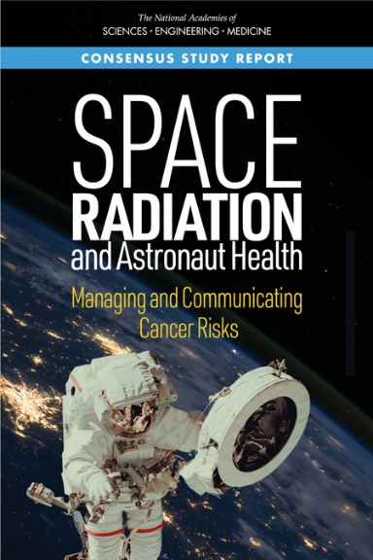
MERA Project Goals
To develop robust and accurate tools for evaluating space radiation health risks to support mitigation strategies, informed consent, and operations
Ensemble risk assessment models
Methodology for assessing medical countermeasures (MCM) and other mitigation approaches
Individualized risk assessments supporting primary prevention and medical management
Assessment of combined spaceflight hazards
Risk communication
Research activities guided by and aligned with
Human Research Program (HRP) space radiation element
Agency roadmaps and gaps
External advisory panel recommendations
NASEM (2021) Space radiation and astronaut health: managing and communicating cancer risks https://www.nap.edu/download/26155
NASEM – National Academies of Sciences, Engineering, and Medicine

Slide 5
Risk Assessment Model Framework
Personalized risk factors
Countermeasure modifications
PEL Evaluation
Epidemiological data from terrestrial radiation exposure
Multiple stressors
Unexposed background population data
Risk communication
Radiation quality factor
Dose-rate factor
Ensemble of models including NSCR
Notional diagram of space radiation risk model framework to assess and communicate the increased risks of radiogenic cancers, cardiovascular disease, and late neurogenerative diseases from mission exposures.
NSCR – NASA Space Cancer Risk Model

Slide 6

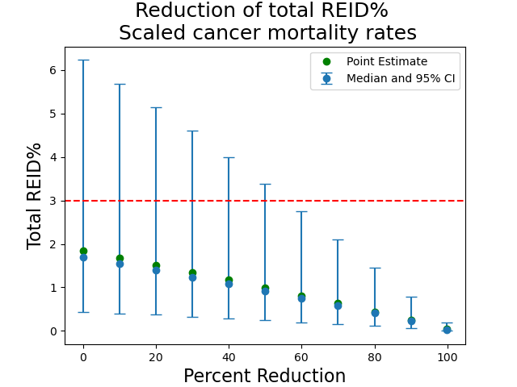
Quantitative Evaluation of Medical Countermeasures
Develop methodologies to quantify impact of medical countermeasures
Support agency goals of space radiation risk mitigation
Initial demonstration considering aspirin* or warfarin*
* Proof of Concept Study - Does not reflect endorsement of these drugs for use in spaceflight
Additional sensitivity study performed to scope MCM requirements needed to reach PELs for Mars missions
It is unlikely these types of MCM will allow PELs to be met for Mars missions
  Need to consider if MCM benefits outweigh possible health detriments
  MCM should be considered as part of holistic approach to risk reduction
NASA STD-3001 PEL
Updated just after publication
Recent Publications:
Werneth, Slaba, Huff, Patel, Simonsen, Medical Countermeasure Requirements to Meet NASA’s Space Radiation Permissible Exposure Limits for a Mars Mission Scenario. Health Physics 123, 116 (August 2022)
Werneth, Slaba, Blattnig, Huff, Norman, A Methodology for Investigating the Impact of Medical Countermeasures on the Risk of Exposure Induced Death. Life Sci Space Res 25, 72 (May 2020)

Slide 7
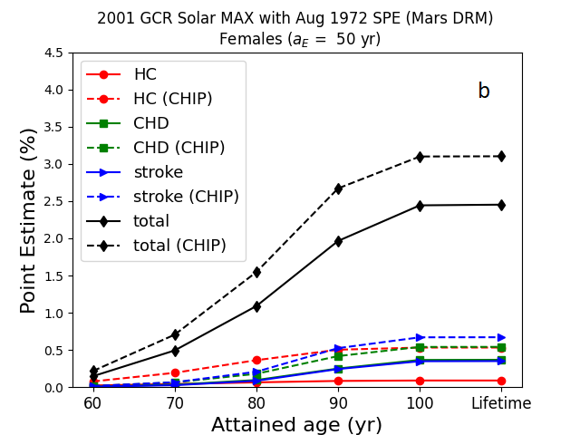
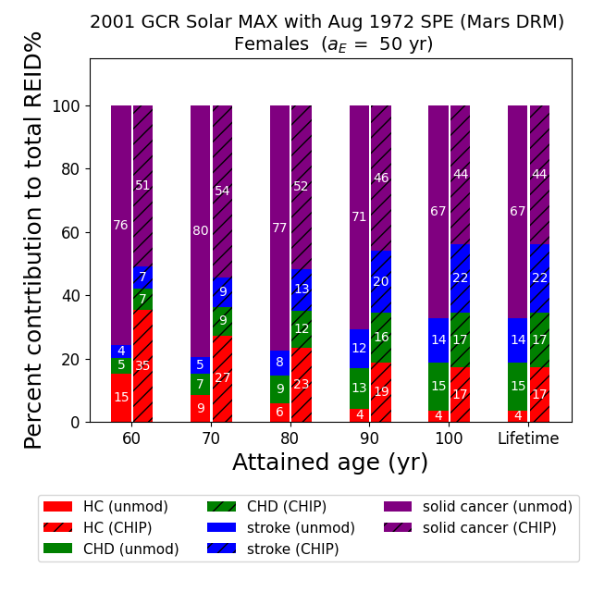
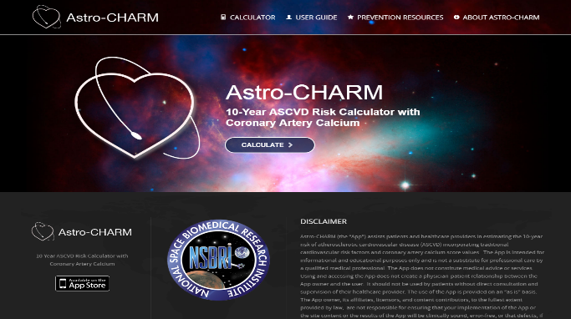
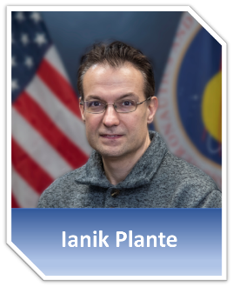
Toward Personalized Risk Models
Develop methodologies to incorporate and evaluate personalized risk factors
Consideration of clinical tools along with modifiable and non-modifiable risk factors
Clonal Hematopoiesis of Indeterminate Potential (CHIP)
Astro-CHARM Clinical CVD Model Integrated with NSCR
Common age-related blood condition in older individuals
Large increase in the total lifetime REID for CHIP carriers compared to average US population
Identifying individuals with higher risk profiles provides opportunities for tailored interventions
Astronaut cardiovascular health and risk modifications (Astro-CHARM)
Calculates risk factor and biomarker-based individualized disease rates from Astro-CHARM and combined with baseline population rates
Extends risk modeling capability to support primary prevention and medical management
161947 - INTEGRATION OF THE CARDIOVASCULAR RISK MODEL ASTRO-CHARM IN THE NASA RADIATION RISK MODEL
Wednesday February 14
Exhibit Hall A 2:45 PM
Poster Session B
Werneth, Patel, Thompson, Blattnig, Huff, Considering Clonal Hematopoiesis of Indeterminate Potential in Space Radiation Risk Analysis for Hematologic Cancers and Cardiovascular Disease.” Communications Medicine, In press (2024)
REID – Risk of Exposure Induced Death
https://astrocharm.org (Khera et al. Circulation 2018)

Slide 8
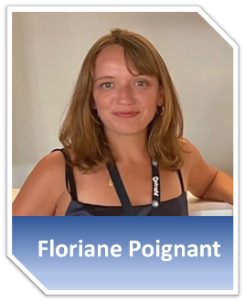


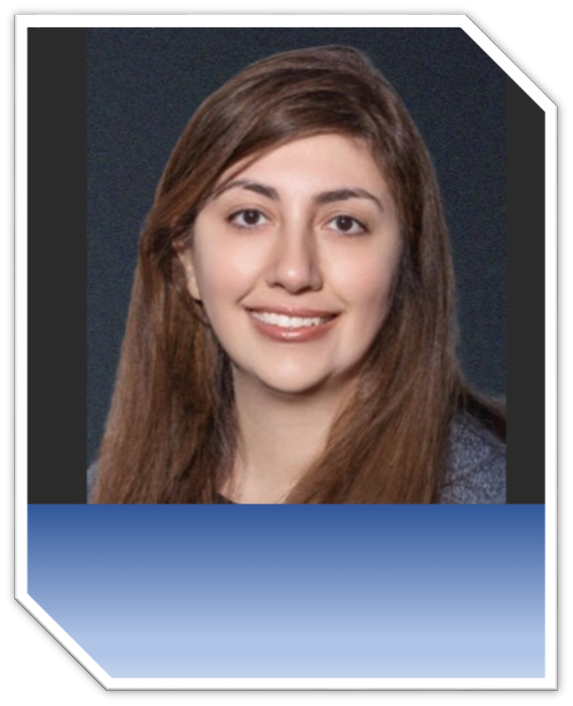
Scaling Terrestrial Exposures to Space
Improve capability to extrapolate limited experimental data to complex space radiation environment
Address main drivers of uncertainty in cancer risk projections – radiation quality and dose-rate
Ensemble Dose Response and Quality Factor
Track Structure and Biophysical Modeling
Develop computational models to simulate initial damage, repair processes, and intermediate surrogate endpoints
Track structure and chromosome aberration models
Models will inform dose response and quality factor research
Leveraging existing data sets and empirical models
Developing new models
  Statistical approach (Xu et al.)
  Microdosimetric approach (Rahmanian et al.)
Prepared for GCRsim dose response data
Robust uncertainty quantification
Statistical weighting of ensemble dose response models
Recent Publications:
Poignant, Plante, Patel, Huff, Slaba, Geometrical Properties of the Nucleus and Chromosome Intermingling Are Possible Major Parameters of Chromosome Aberration Formation. Int J Mol Sci 23, 8638 (2022).
Poignant, Plante, Crespo, Slaba, Impact of Radiation Quality on Microdosimetry and Chromosome Aberrations for High-Energy (>250 MeV/n) Ions. Life (Basel) 12, 358 (2022).
Plante, Poignant, Slaba, Track Structure Components: Characterizing Energy Deposited in Spherical Cells from Direct and Peripheral HZE Ion Hits. Life (Basel) 11, 1112 (2021).
Plante, I. A review of simulation codes and approaches for radiation chemistry. Phys Med Biol 66, 03TR02 (2021).
1642088 - PREDICTING CELL SURVIVAL, CHROMOSOME ABERRATIONS AND THEIR TRANSMISSIBILITY
Thursday February 15
3:15 Exhibit Hall B
1646319 - A GENERALIZED MICRODOSIMETRIC DOSE RESPONSE MODEL
Wednesday February 14
Exhibit Hall A 2:45 PM
Poster Session B
1619480 - SIMULATION OF RADIATION-INDUCED DNA DAMAGE SHOWS HISTONE PROTECTION
Thursday February 15
3:55 PM - 4:05 PM
Exhibit Hall B
Shirin Rahmanian

Slide 9
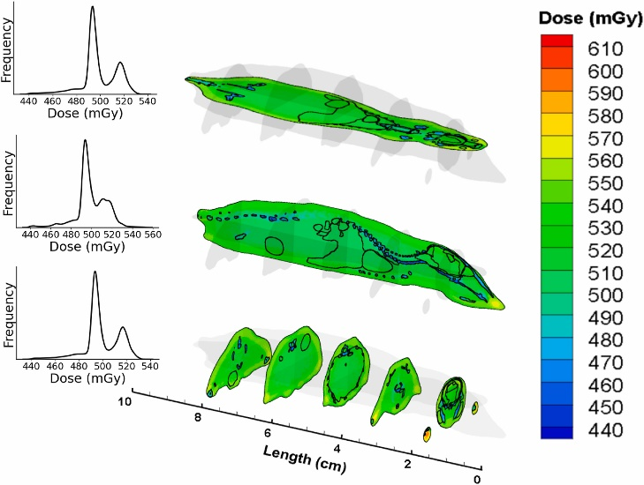
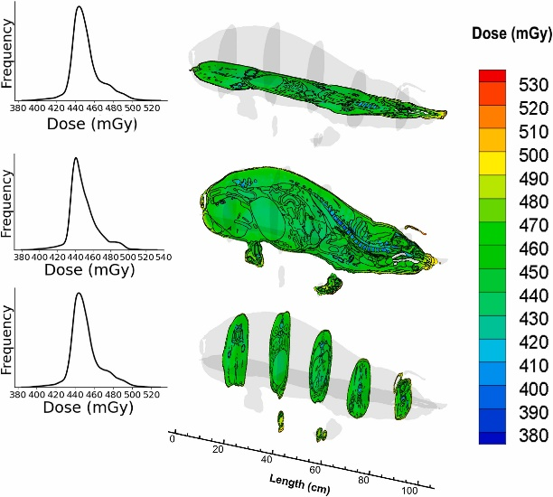
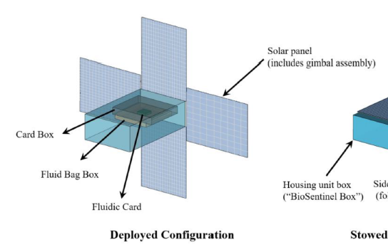
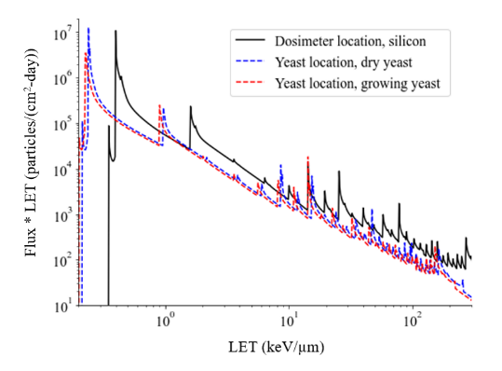
GCRsim and Space Environment Modeling
Validation of GCRsim for multiple experimental platforms at NSRL
Provide GCR environmental prediction capabilities for space-based experimental platforms
GCRsim Beam Analysis
BioSentinel Exposure Prediction
A
B
Geometry set up of the BioSentinel nanosatellite in HZETRN2020
Flux spectrum for the deployed configuring at the dosimeter location
Voxel dose distribution (dose contour) in (A) Digimouse and (B) Digipig models exposed to the GCR beam.
Recent Publications:
Rahmanian, Slaba, Applicability of the NASA galactic cosmic ray simulator for mice, rats, and minipigs. Acta Astronautica 208, 111–123 (2023)
Rahmanian, Slaba, Braby, Santa Maria, Bhattacharya, Straume, T. Galactic cosmic ray environment predictions for the NASA BioSentinel mission. Life Sci Space Res. 38, 19–28 (2023)
Huff, Poignant, Rahmanian, Khan, Blakely, Britten, et al. Galactic cosmic ray simulation at the NASA space radiation laboratory – Progress, challenges and recommendations on mixed-field effects. Life Sci Space Res. 36, 90–104 (2023)
Shirin Rahmanian

Slide 10
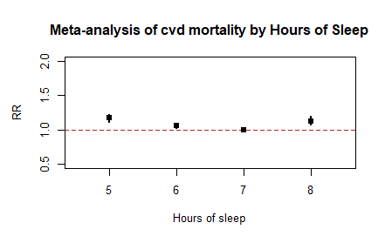


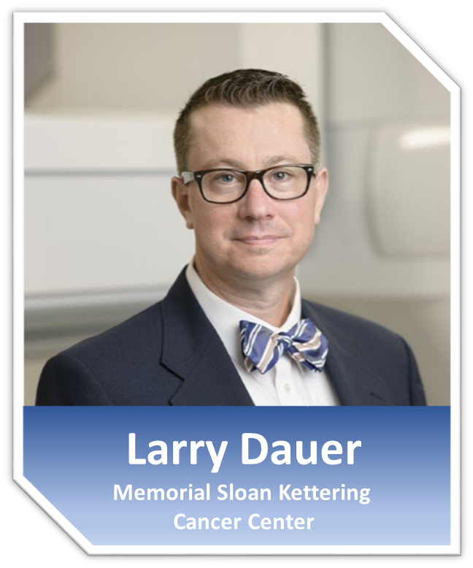
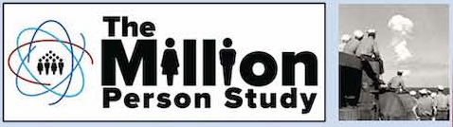
CNS and Combined Spaceflight Hazards
Evaluate combined risks for multiple spaceflight hazards using human data
Investigate potential for CNS hazard due to space radiation exposure using human terrestrial data
Sleep Deficiency CVD Risk for Astronauts
MPS evaluation of CNS and Multi-Stressors
Short sleep duration is a known risk factor for CVD on Earth
CNS
  Large number of workers who received both low and high linear energy transfer (LET) exposures
  Cohorts being evaluated for dementia and cognitive decrements
  Linkage between career exposures and recorded diagnoses, neuropsychological test scores, and mortality
Multi-stressor
  MPS has begun studying submariners to evaluate hazards for astronaut-like population experiencing a multi-stressor environment analogous to space
Barger et al. Lancet 13: 904-912; 2014.
Sleep deficiency is pervasive among crewmembers
Average 6 hours/night – shuttle, long-duration ISS crew members
Significant sleep deficiency during preflight intensive training
1643947 - THE U.S. MILLION PERSON STUDY OF LOW-DOSE-RATE HEALTH EFFECTS: INNOVATIONS IN EVALUATING COGNITION AND MULTIPLE STRESSORS
Tuesday February 13th
Exhibit Hall B 3:35 PM
Reynolds, Butler, Blattnig, Norman, Patel, Flynn-Evans, Werneth, Huff, An Approach to Quantitative Risk Assessment for Combined Radiation and Spaceflight Hazards: Preliminary Findings of the Potential Impact of Sleep Durations on Space Crew Cardiovascular Health, In preparation; 2023.
Steve Blattnig

Slide 11

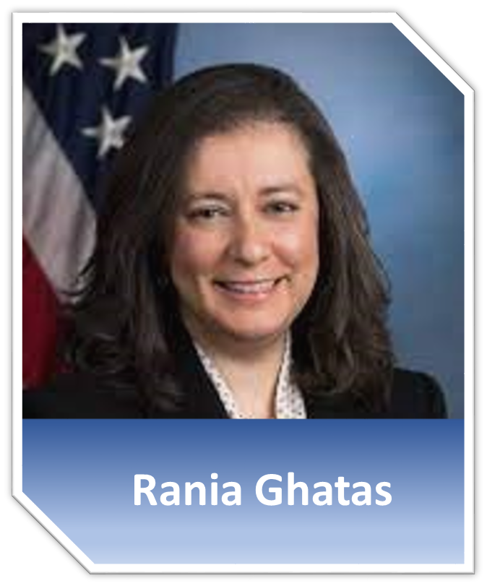
Risk Communication
Space radiation induced health risks must be effectively communicated to a diverse audience of stakeholders
The need for more effective communications was highlighted in recent NASEM report
NASEM (2021) Space radiation and astronaut health: managing and communicating cancer risks https://www.nap.edu/download/26155
  Surveying NASA flight surgeons and retired astronauts via questionnaire
    Better understand key information that stakeholders need to make decisions regarding radiation exposure risks
  Additional risk metrics will be added to the MERA framework
    International partner risk metrics
    Metrics accounting for quality of life
    Potentially incorporate available 5-year survival data
Shirin Rahmanian

Slide 12
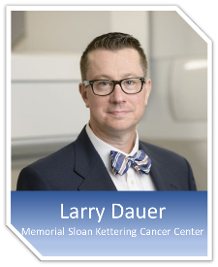
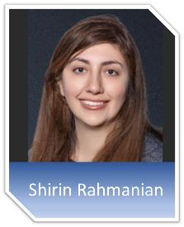
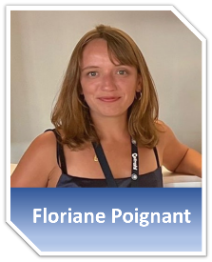

Summary
MERA Goal: To develop robust and accurate tools for evaluating space radiation health risks to support mitigation strategies, informed consent, and operations
Research activities guided by and aligned with
HRP space radiation element
Agency roadmaps and gaps
External advisory panel recommendations
Ongoing and future work
Updated ensemble quality factor model for evaluation in cancer risk model accounting for multiscale and biophysical modeling inputs
Development and implementation of additional risk metrics beyond lifetime incidence and mortality
Forthcoming initial personalized risk estimates for space radiation induced CVD (Astro-CHARM)
Continue initial characterization of space radiation CNS hazard/risk through MPS
Evaluation of cancer clinical prediction tools to enable more personalized risk assessment
1643947 - THE U.S. MILLION PERSON STUDY OF LOW-DOSE-RATE HEALTH EFFECTS: INNOVATIONS IN EVALUATING COGNITION AND MULTIPLE STRESSORS
Tuesday February 13th
Exhibit Hall B 3:35 PM
1646319 - A GENERALIZED MICRODOSIMETRIC DOSE RESPONSE MODEL
Wednesday February 14
Exhibit Hall A 2:45 PM
Poster Session B
1642088 - PREDICTING CELL SURVIVAL, CHROMOSOME ABERRATIONS AND THEIR TRANSMISSIBILITY
Thursday February 15
3:15 Exhibit Hall B
1619480 - SIMULATION OF RADIATION-INDUCED DNA DAMAGE SHOWS HISTONE PROTECTION
Thursday February 15
3:55 PM - 4:05 PM
Exhibit Hall B
161947 - INTEGRATION OF THE CARDIOVASCULAR RISK MODEL ASTRO-CHARM IN THE NASA RADIATION RISK MODEL
Wednesday February 14
Exhibit Hall A 2:45 PM
Poster Session B

