Slide 1


VALIDATION OF A SENSORIMOTOR DISORIENTATION GROUND ANALOG
S.C. Moudy, B.T. Peters, T.K. Clark,
M.C. Schubert, Y. De Dios, A. Bollinger, S.J. Wood
2024 Human Research Program
Investigators’ Workshop

Slide 2
Background
Simulating the sensorimotor disorientation effects of gravity transitions after prolonged stays in microgravity is exceedingly challenging on Earth
In a previous study¹, a Sensorimotor Disorientation Analog (SDA) was developed based on subjective feedback from previously flown astronauts
¹Moudy et al. 2023 IWS Proceedings

Slide 3
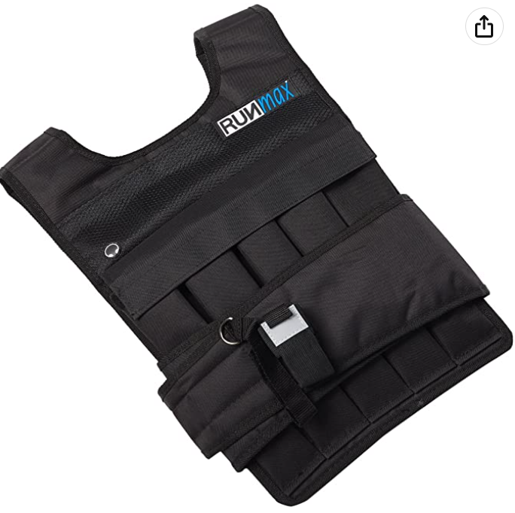
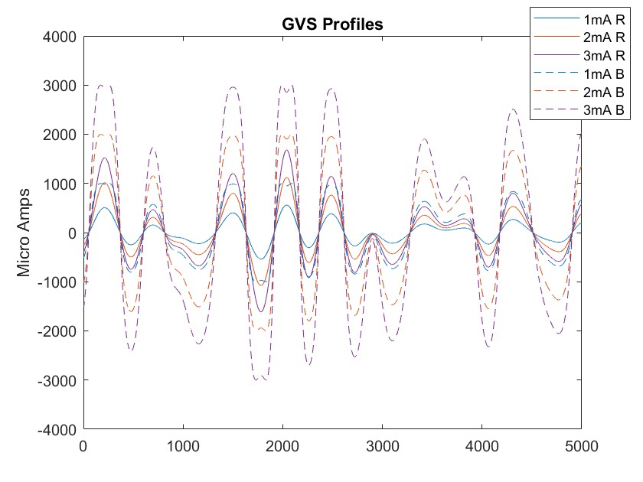
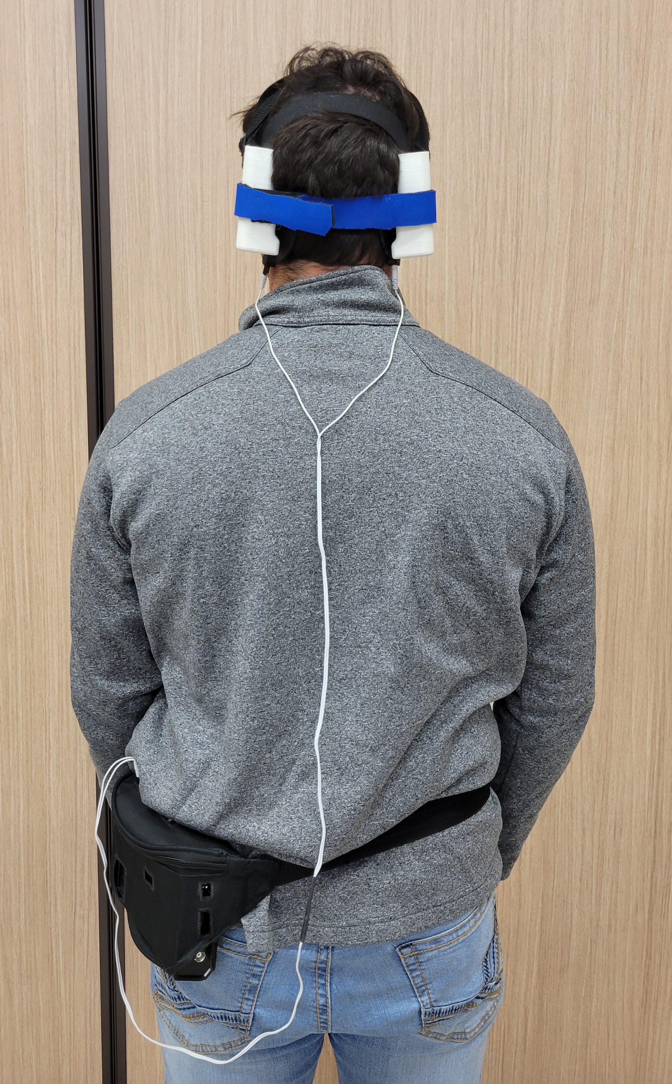
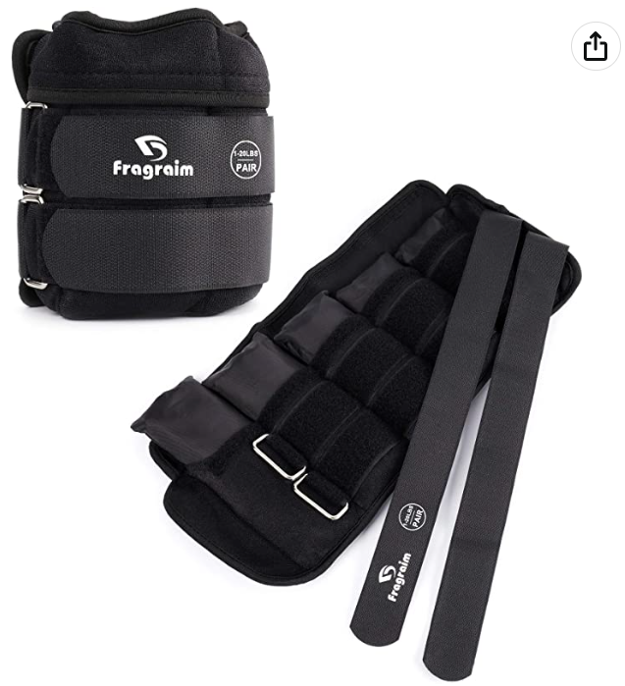
Sensorimotor Disorientation Analog (SDA)
Galvanic Vestibular Stimulation (GVS)
Random sum-of-sines
Frequencies: <0.3Hz
Peak Amplitudes:
  Low: 2mA
  High: 3mA
Contains:
Mimics:
Galvanic Vestibular Stimulation
Weighted Suit
Astronaut postflight performance at
R+0-4 hours (High)
R+24-48 hours (Low)
Trade names and trademarks are used in this report for identification only. Their usage does not constitute an official endorsement, either expressed or implied, by the National Aeronautics and Space Administration.

Slide 4
Sensorimotor Disorientation Analog (SDA)
Weighted Suit
Subjective heaviness and proprioceptive disruption
Weight distributed anthropometrically to trunk, wrists, and ankles
  Low: 15% bodyweight
  High: 30% bodyweight
Crew Feedback
Subjectively rated the SDA to replicate ~85% of postflight experience and impact on performance
Performance between SDA and postflight were consistent and encompassed the large range of variability seen in crewmembers
Contains:
Mimics:
Galvanic Vestibular Stimulation
Weighted Suit
Astronaut postflight performance at
R+0-4 hours (High)
R+24-48 hours (Low)
Trade names and trademarks are used in this report for identification only. Their usage does not constitute an official endorsement, either expressed or implied, by the National Aeronautics and Space Administration.

Slide 5
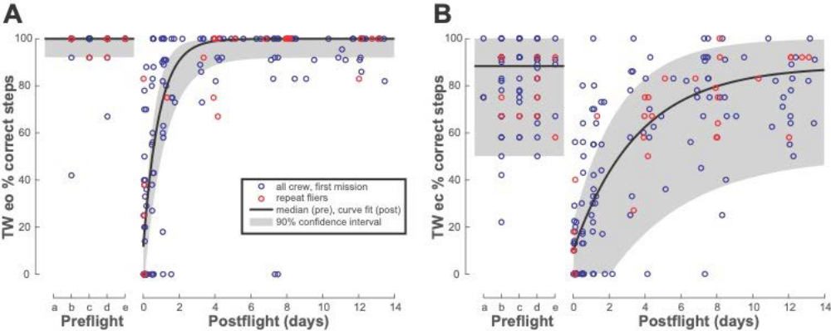
Previous Data
Purpose: To validate this SDA by comparing performance in tasks that have a wealth of spaceflight data against task performance while using the SDA.

Slide 6
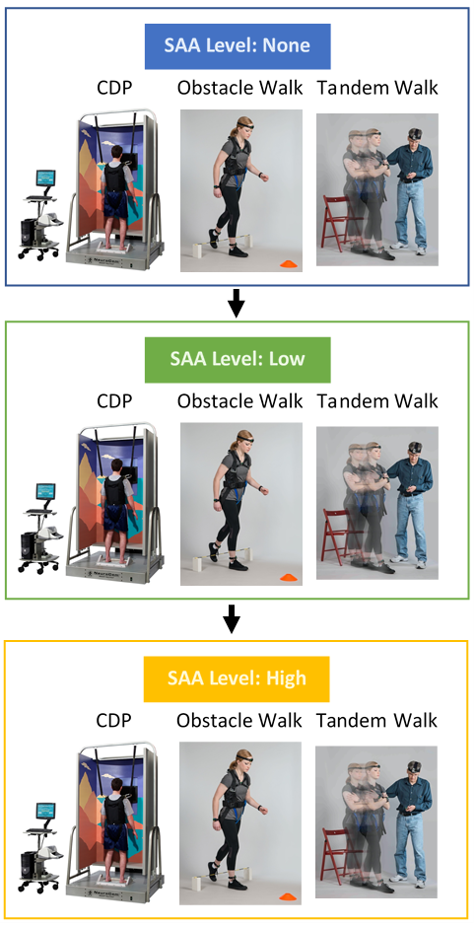
Methods
30 subjects participated
Task order was consistent
Analog level was counter-balanced
SDA Level: None
Protocol | Age (years) | Height (in) | Weight (lbs) | Women/ Men
None-Low-High | 32.8 ± 7.7 | 68.8 ± 3.9 | 168 ± 32 | 5/10
None-High-Low | 34.2 ± 6.9 | 67.3 ± 2.7 | 160 ± 19 | 8/7
SDA Level: Low
SDA Level: High
No significant differences between groups (p>0.23)

Slide 7
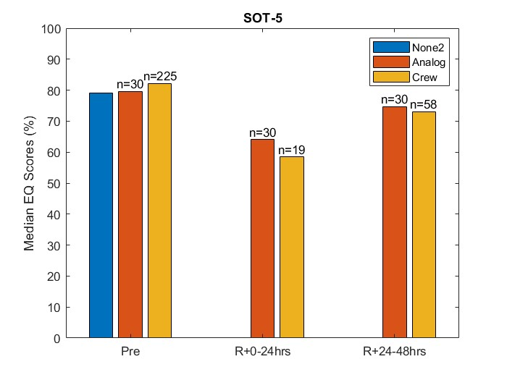
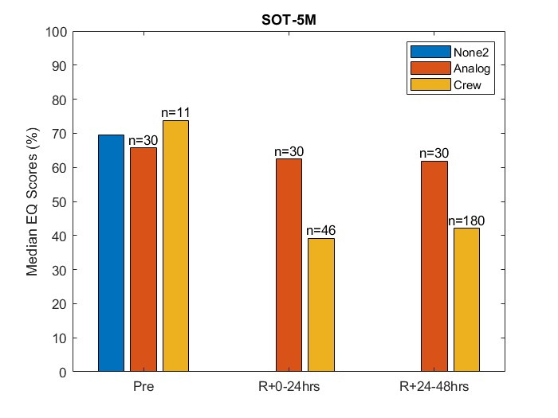
Results: Posturography
SOT-5 and SOT-5M involved eyes closed on a sway-reference support
SOT-5M included head pitch at ±20°
Notes:
SOT-5 analog looks like crew with minimal learning effect; SOT-5M analog has small learning effect and not consistent with crew data
Head pitch movement helped cancel ML GVS disturbance or added cognitive effort allowed for sensorimotor re-weighting to ignore vestibular disruption

Slide 8
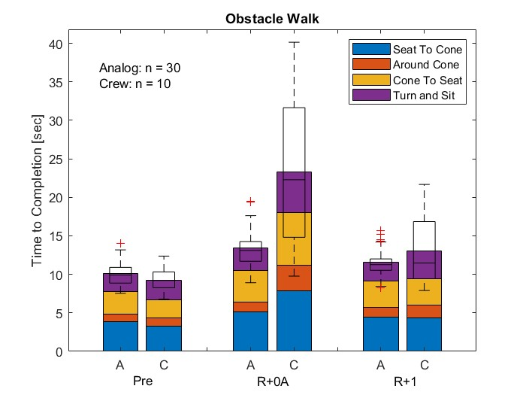
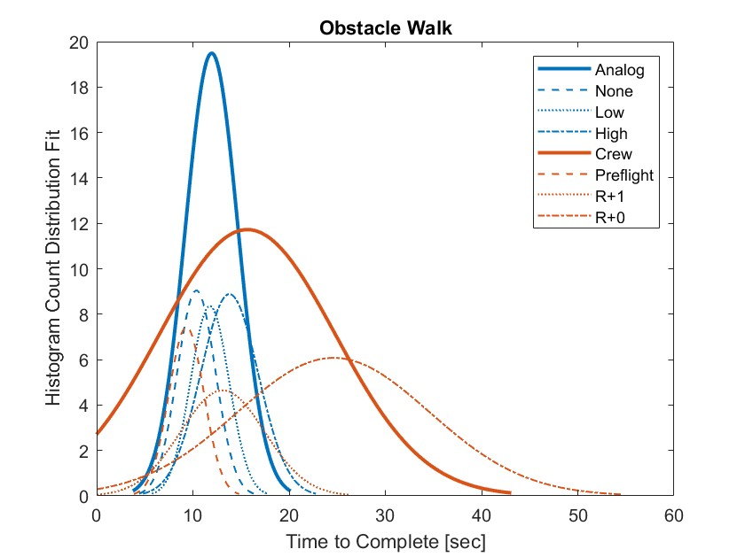
Results: Obstacle Walk
SDA able to replicate R+1
High SDA level unable to capture the large variability in crew postflight performance
Notes:
Disruption due to change in orientation for cone turn or turn to seat is not being replicated in this analog
Other disruptions like dehydration, fatigue, visual disorientation, increase in vestibular disorientation during change in orientations not replicated

Slide 9
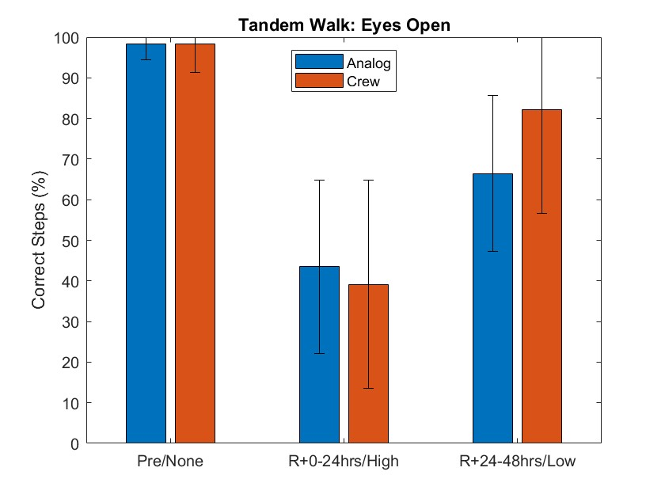
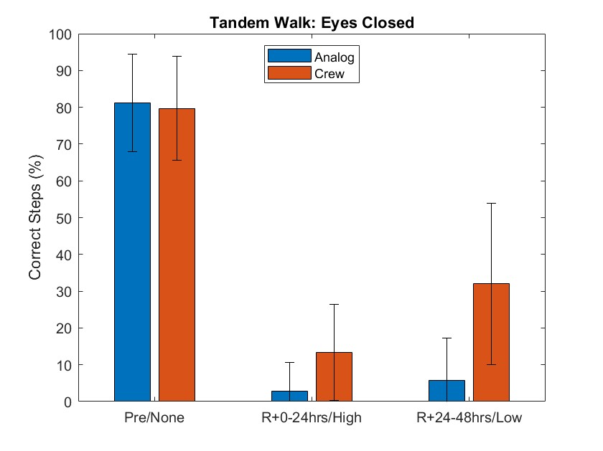
Results: Tandem Walk

Slide 10
Discussion
Immediately post-landing, astronauts experience a multi-system response to return to 1G including motion sickness, dehydration, fatigue, orthostatic intolerance, illusory sensations, lumbar pain, etc.
The response varies widely across astronauts and, as such, it was not unexpected that the extreme ends of responses for R+0 were the most difficult to replicate.
Overall, the SDA can elicit distinct performance groupings and, although not able to perfectly replicate R+0, the SDA did replicate a large range of performance after return to Earth

Slide 11
Thank you!
Funding: Human Research Program Directed Study

