Slide 1
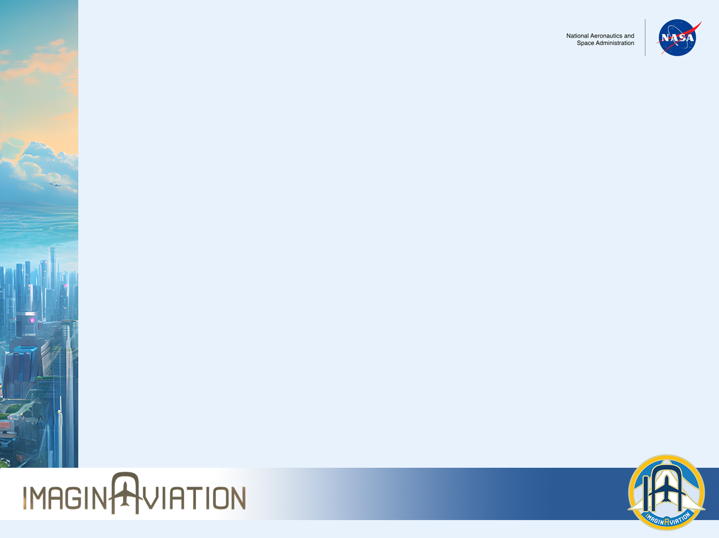
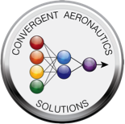
Solid-state Architecture Batteries for Enhanced Rechargeability and Safety (SABERS)
Beyond Li-Ion: Technology to Enable Sustainable Electric Aviation
Challenge
Electric aviation will become a revolutionary leap in sustainable aviation
Current battery technology does not meet the strict aerospace performance and safety metrics
Can we exceed 400 Wh/kg in specific energy and operate safely at a rate of 1C and beyond?
Expected Impacts
Expand the missions served by electric aviation with a safe battery operating at twice specific energy of current SOA Li-ion batteries
Reduce waste in the environment through recyclability: recovering solid lithium and sulfur components, and reprocessing the electrolyte
Reduce waste in the environment by using a waste byproduct of oil refining, Sulfur - the active component in SABERS cells
Solutions
Develop a solid-state bipolar battery stack based on novel Li-S/Se chemistry and a non-flammable electrolyte to produce a battery that enables sustainable electric aviation
Design SABERS cells to exceed 500 Wh/kg, operate up to 150ºC, are 1 to 4C capable, and inherently non-flammable
Satisfy system level needs such as non-flammability, energy density, discharge rate, packaging, and scalability
Results
Improved design optimization with computational modeling of the cathode microstructure based on experimental results
Achieved electrochemical-level specific energy of greater than 500 Wh/kg in coin cells
Achieved high-temperature (up to 150ºC), high rate (up to 4C pulse; ultrahigh current density >30 mA/cm2) all-solid-state cells
Demonstrated successful scale-up to small format pouch cells
Investigated various processing techniques for pouch cells
Demonstrated feasibility of fabricating bipolar stack coin cells
Motivation and Solution
A Combined Experimental and Computational Approach
Next Steps
Employ ultra-thin reinforced sulfide and polymer solid electrolytes (SE)
Improve cycle life by Li-anode and solid electrolyte interface engineering
Improve reproducibility of pouch cells to increase production rate
Fabricate SABERS bipolar stack pouches
High Performance and Scale-Up
Partners and/or Participants
- NASA Glenn Research Center (GRC)
NASA Langley Research Center (LaRC)
NASA Ames Research Center (ARC)
Argonne National Lab
Pacific Northwest National Lab
Georgia Tech University
POC: Rocco Viggiano, GRC Co-PI: Yi Lin, LaRC and Donald Dornbusch, GRC
Notes:
Structured poster template being used for the university poster sessions, provided as an example

