Slide 1
Leveraging Earth Observation Data to Study Interdependence of Water, Energy, and Food Systems
Binita KC¹, Ranjay Shrestha ² Mukul Sonwalkar³
¹ NASA Goddard Earth Sciences Data and Information Services Center (GES DISC)
² NASA Black Marble Science Team, ³ NASA Applied Sciences
February 1, 2024
AMS 104th Annual Meeting
Baltimore, MD
Notes:
Joint Session 15A - Satellite Data Products and Evaluation for Operational and Research Use I (Joint between the Second Symposium for Future of Weather, Forecasting, and Practice, the 20th Annual Symposium on Operational Environmental Satellite Systems, and the 26th Conference on Satellite Meteorology, Oceanography, and Climatology)

Slide 2
Motivation
Water, Energy and Food (W-E-F) are interconnected and are at the heart of United Nation’s Sustainable Development Goals (SDGs)
  Climate change impact on Water-Food-Energy system
Increasing demand in Nepal for Water, Food and Energy
  Urbanization (207.6 km² in 2022), rising population, economic growth
  Agricultural country - primarily rainfed agriculture
  96.2% Energy from hydropower
  Nepal’s water security is among the weakest in Asia and the Pacific (ADB, 2016)
  Adverse impacts of climate change - Eg. extreme and frequent flooding, landslide.
Notes:
Goal 2- Zero Hunger, Goal 6: Clean Water and Sanitation , Goal 7: Affordable and Clean Energy
Asian Development Bank. (2016). Asian water development outlook 2016. Manila: Author.
[Google Scholar]

Slide 3
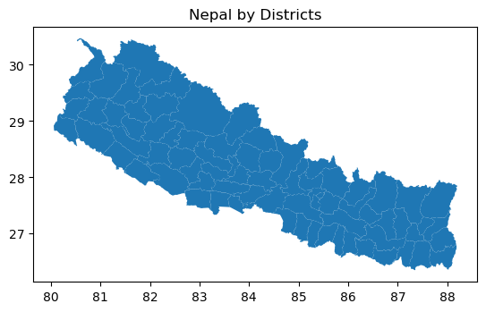
Study Area and Challenges on W-E-F Nexus Study
Sparse data coverage
  Ground-based datasets are either sparse, extremely challenging to obtain, or unavailable.
Limited long-term observations for climate impact studies
  Gaps in datasets and lack of long-term observations
Lack of Reproducible science
  Lack of access to data, data quality barrier
China
India

Slide 4
Data and Metrics
Theme | Variables | Collection Name | Temporal span | Spatial Resolution | Frequency | Format | Source
Temperature | Tair_f_inst | GLDAS_NOAH025_M | 2000-01-01 to-date | 0.25 degree | Monthly | NetCDF4 | NASA GES DISC
Water Availability | Rainf_f_tavg
 | Evap_tavg
 | SoilMoi0_10cm_inst
Energy Consumption | Annual Composite NTL | VNP46A4 | 2012-01-01 to date | 15 arcsec (~500 m) | Yearly | HDF5 | NASA LAADS
Demographics | Population density |  | 2020 | District | Yearly | GeoTIFF | NASA SEDAC
 | Cereal Production Area |  | 2021 | District | Yearly | excel | Government of Nepal: National Statistics office-National Population and and Housing Census
 | Population in Agriculture, forestry fishery |  | 2021 | District | Yearly | excel
Crop Yield | Cereal Crop Area |  | 2020/21 | District | Yearly | pdf | Government of Nepal: Ministry of Agriculture & Livestock Development Statistical Information on Nepalese Agriculture
 | crop production |  | 2020/22 | District | Yearly | pdf
Energy Production | Available energy of hydropower MWh |  | 2021/2022 | Hydropower station | Yearly | pdf | Nepal Electricity Authority--Annual Report

Slide 5
Access Data in Cloud
Subset
Analysis
Access data from the Earthdata Cloud (Amazon S3 Bucket)
GLDAS_NOAH025_M 2.1 (Temp, Precip, Soil Moisture, Evaporation)
VNP46A4 (Nighttime Light)
Download and clean the demographic data
Subset data by administrative boundary (district)
Calculate area-averaged mean by districts
Extract the Historical Electricity Generation of 19 Hydropower stations
Correlation and Regression to study the relationship between hydrometeorological data and demographics

Slide 6
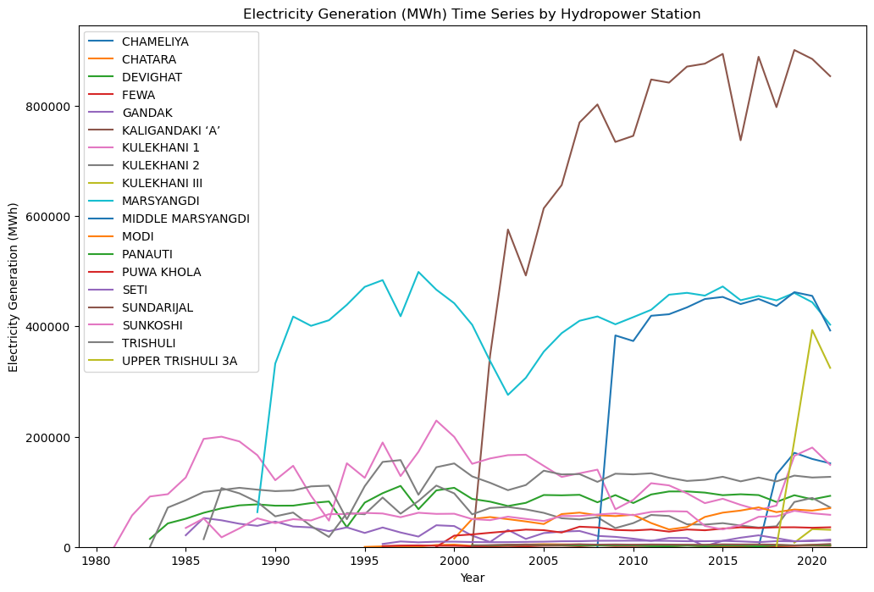
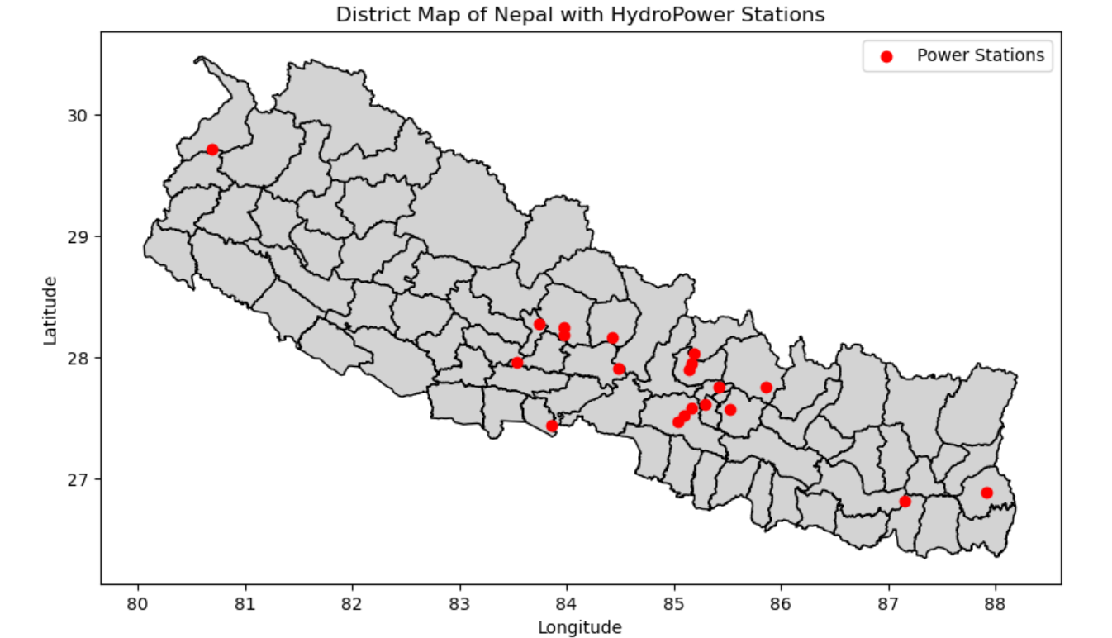
Energy Generation

Slide 7
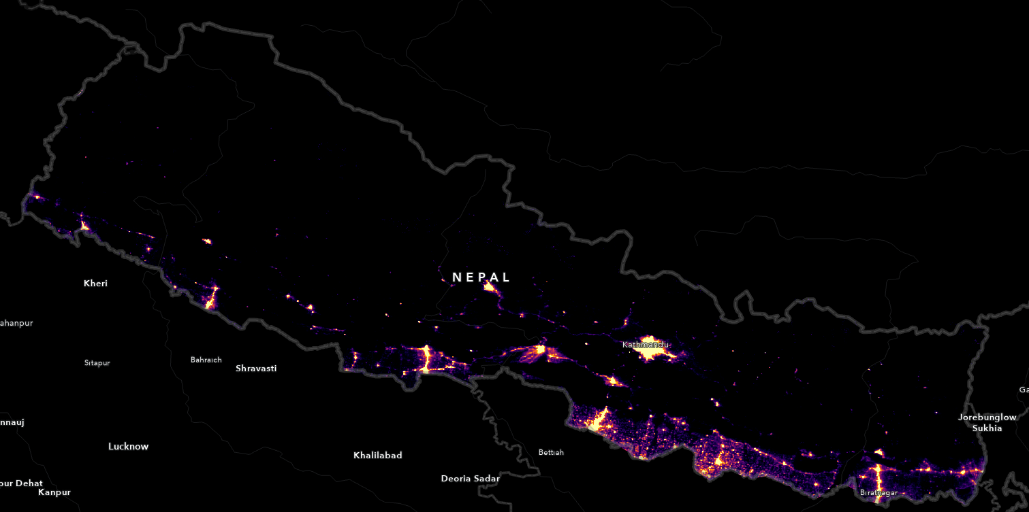
Datasets - NASA’s Black Marble Annual Composite - VNP46A4
Global suite of routine operational products that represent the current state-of-the-art in nighttime lights (NTL)
Visible Infrared Imaging Radiometer Suite (VIIRS) Day/Night Band (DNB), aboard the Suomi-NPP and NOAA-20 satellites
Cloud-free nighttime radiances that have been corrected for atmospheric, terrain, lunar BRDF, airglow, snow, and straylight effects
Available Daily, Monthly, and Annually
2023 Annual Composite Nighttime light over Nepal
0
>=6
nW cm-2 sr -1

Slide 8
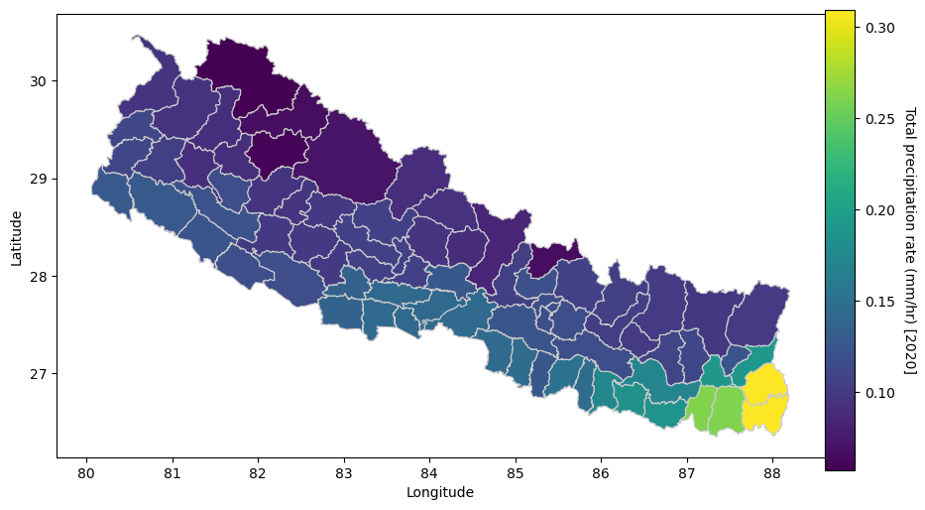
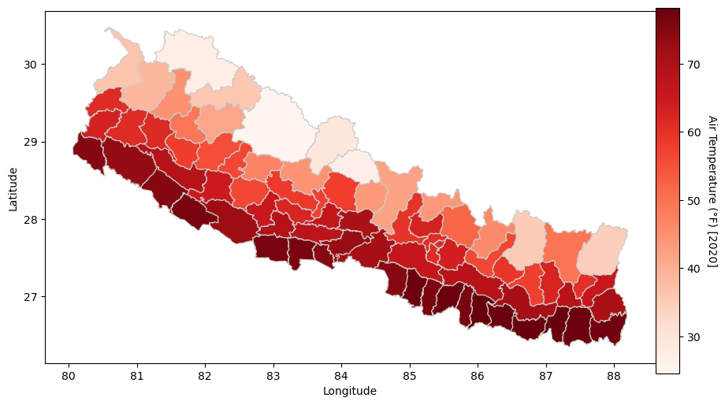
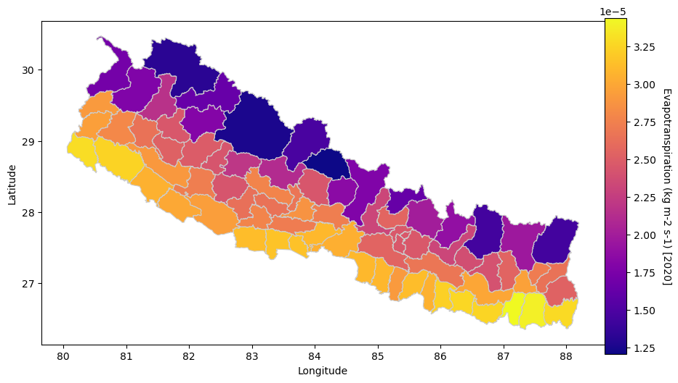
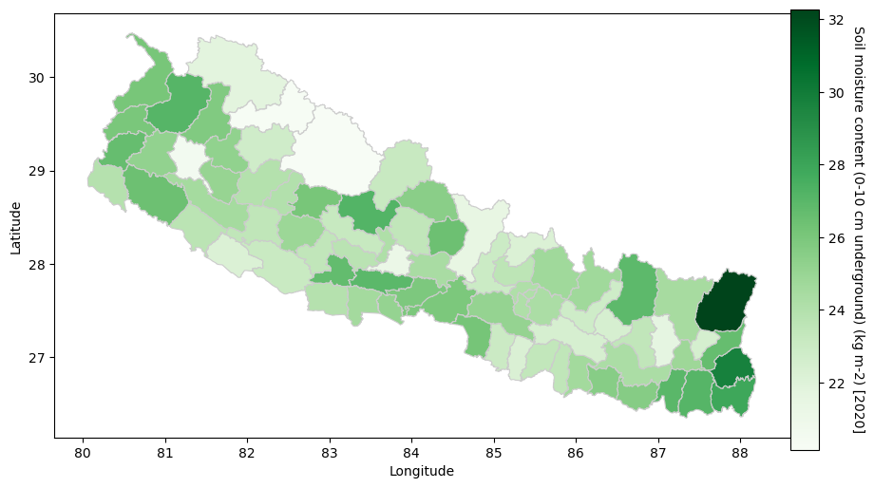
Datasets- NASA Global Land Data Assimilation System Version 2
Wetter in Southeast region, dryer in northwest
Warmer temperature in the Southern belt
Moist soil in the Southern belt

Slide 9
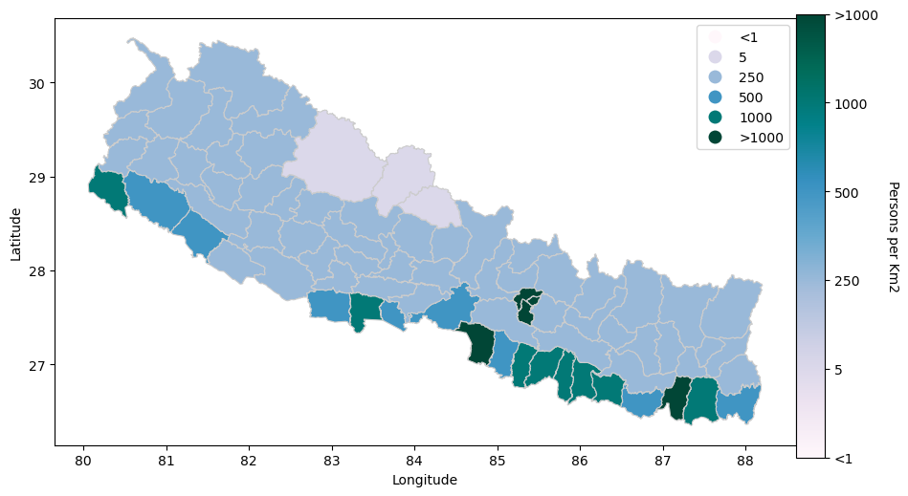
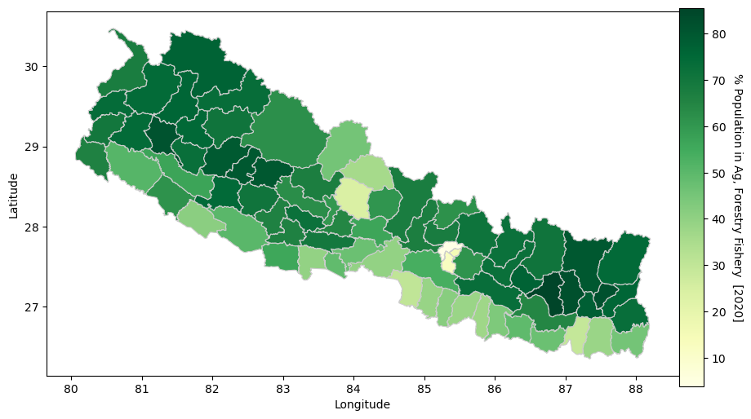
Datasets- Demography
High Population density in the capital and Southern cities

Slide 10
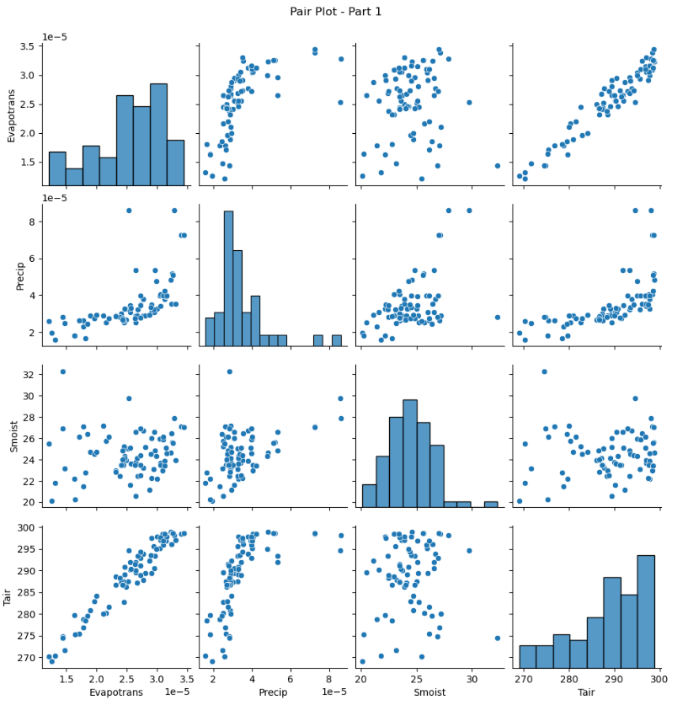
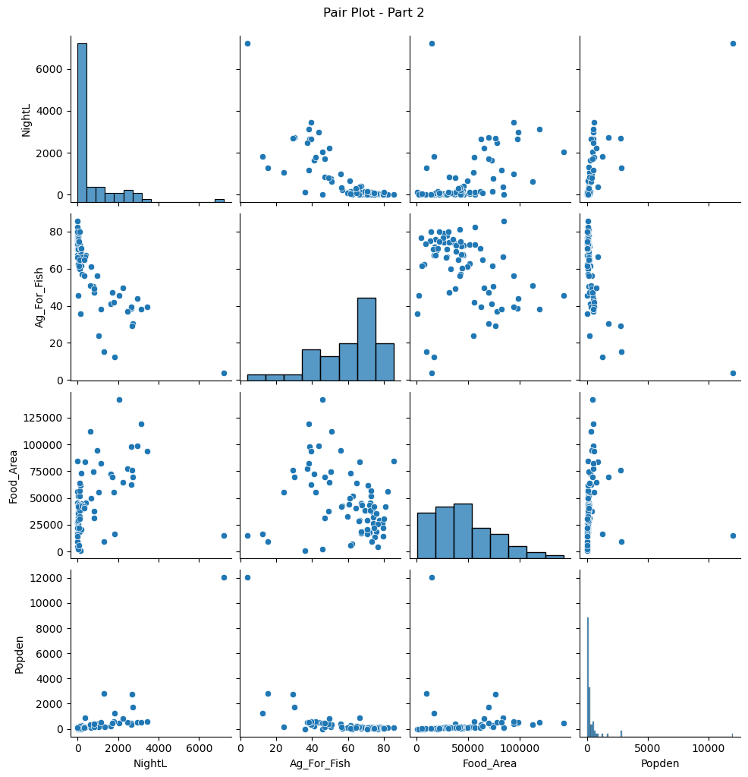
Correlation between Variables

Slide 11
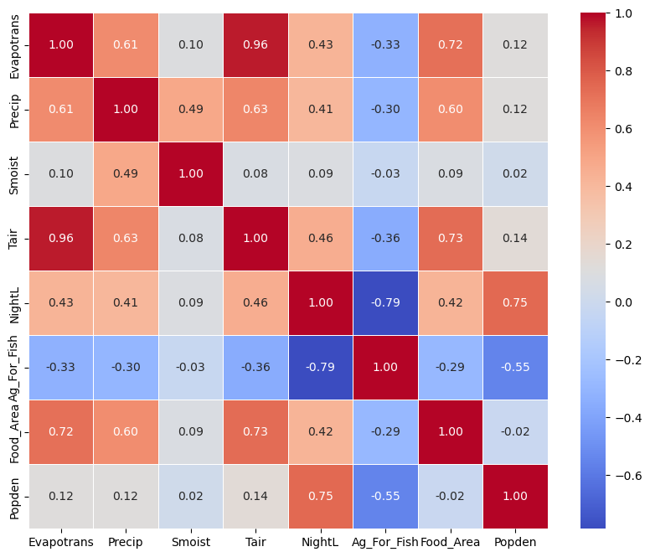
Correlation Heatmap
Variables [2020]
Evapotranspiration (kgm-2s-1) [Evapotrans]
Precipitation (kgm-2s-1) [Precip]
Soil Moisture (kgm-2) [Smoist]
Air Temperature (K) [Tempair]
Nighttime Light (nW cm-2 sr -1) [NightL]
Cereal Production Area (Hectare) [Food_Area]
Population Density [Popden]
Population in Agriculture, Forestry and Fishery [Ag_For_Fish]

Slide 12
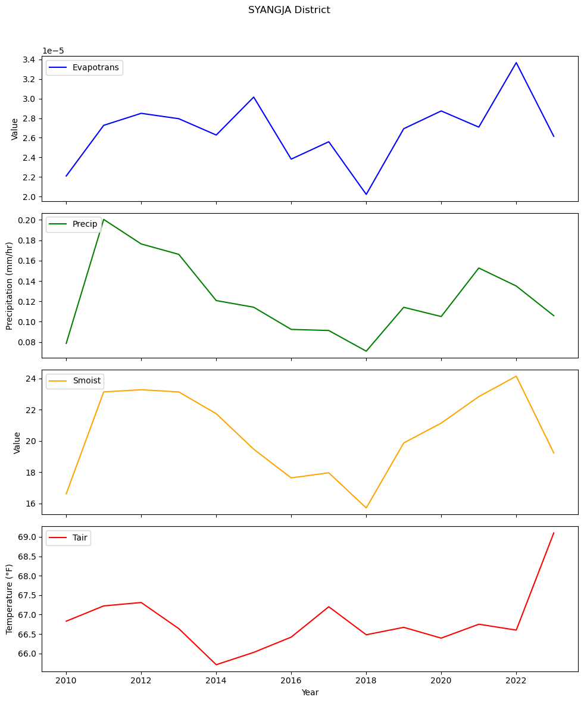
Summary Conclusion
Study impact of climate change
  Include more Earth Science Data
  Long-term data
Driving factor behind the energy production
Energy consumption vs production
Kg/m2s
Kg/m2

Slide 13
Questions
binita.kc@nasa.gov

