Slide 1
NASA’s Laser Communications Relay Demonstration (LCRD) Experiment Program: Characterization And Initial Operations
David J. Israelª, Bernard L. Edwardsª, Richard L. Butlerª, John D. Moores^{b}, Sabino Piazzolla^{c}, Jonathan Woodward^{d}, Alan Hyltonª, Nic Du Toit^{e}, Lena E. Braatz^{f}
30 January 2024
ªNASA Goddard Space Flight Center
^{b}MIT Lincoln Laboratory
^{c}Jet Propulsion Laboratory, California Institute of Technology
^{d}Space Coast Aerospace Services
^{e}McCallie Associates, Inc.
^{f}Booz Allen Hamilton, Inc.

Slide 2
Outline
Introduction
Experiment and availability statistics
Session operations and telemetry examples
Lesson learned - highlights
Experiments and telemetry analysis highlights to date
Sampling of upcoming experiments
Conclusions
Acknowledgments

Slide 3
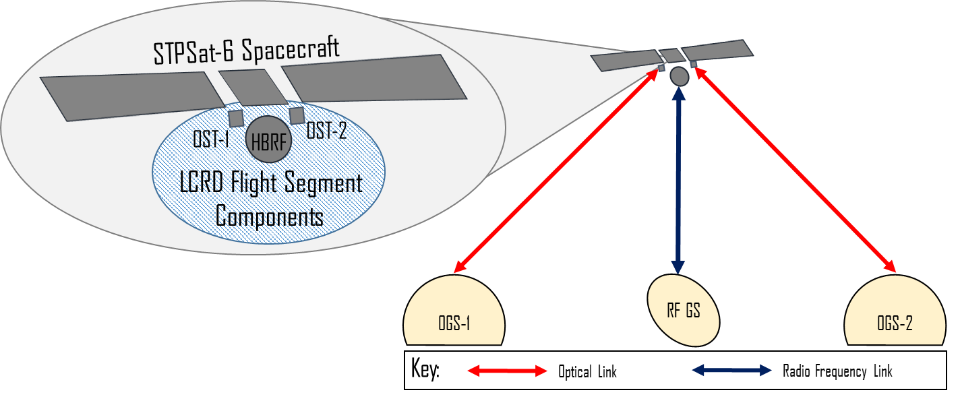
LCRD Mission Experiment Architecture
The Laser Communications Relay Demonstration (LCRD) launched in December 2021 and experiments began June 2022
Flight segment is on board the Space Test Program Satellite-6 (STPSat-6) spacecraft in geosynchronous Earth orbit (GEO)
  Two optical space terminals (OST), OST1 and OST2
  High-bandwidth Radio Frequency (HBRF) terminal
  Data switch
The ground segment
  Optical Ground Station 1 (OGS-1) in Table Mountain, California
  Optical Ground Station 2 (OGS-2) in Haleakalā, Hawaii
  Radio frequency ground station (RF GS) in White Sands, New Mexico

Slide 4
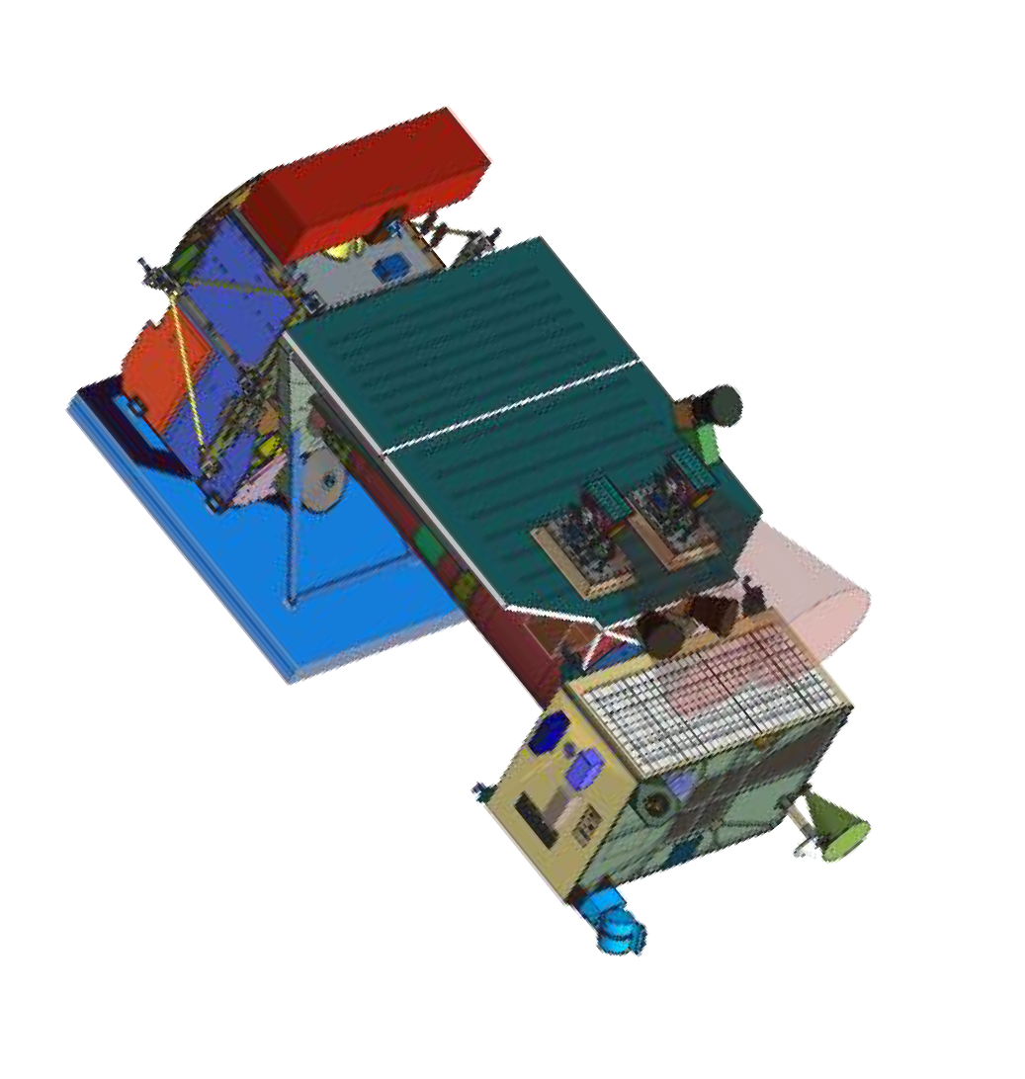
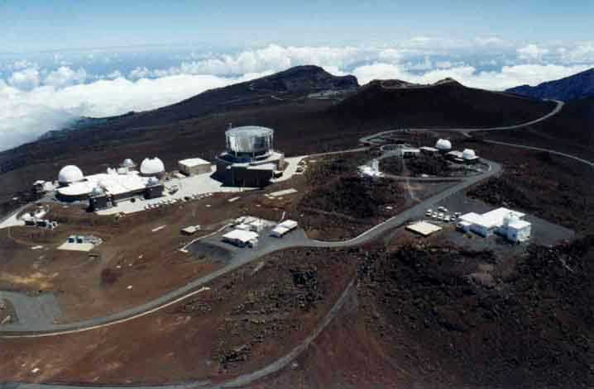
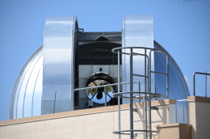
LCRD Optical-Optical Relay Scenario
OGS-2 located at Haleakalā, Maui (HI): 3.3 km asl
Receive aperture of 0.6 m with adaptive optics
Uplink aperture of 15 cm (single aperture)
Uplink/Downlink information rate up to 1.24 Gbps DPSK
Uplink beacon for acquisition
OGS-1 located at NASA/JPL’s Table Mountain Facility (CA): 2.2 km asl
Receive aperture of 1m with adaptive optics
Uplink comm beam of 20 urad divergence (single aperture)
Uplink/Downlink information rate DPSK up to 1.24 Gbps; PPM up to 311 Mbps
Uplink beacon for acquisition
Operated by JPL
LCRD GEO Relay:
2 apertures of 10cm
and data switch
OGS-2
Terminals support simultaneous bidirectional operations with independent data rates
OGS-1

Slide 5
Statistics: Experiment Sessions and Availability
LCRD Experiment Sessions
Data Time Span |  |  |  |  |  | Experiment Session Success
 |  |  |  |  |  | Scheduled | Session Results (Counts) |  |  | Session Results (Pct)
Time Frame | First Date | Last Date | First DOY | Last DOY | Calendar Days |  | NS Weather | NS Technical | Successful | NS Weather | NS Technical | Successful
Most Recent Week (Mon. - Sun.) | 11/20/23 | 11/26/23 | 324 | 330 | 7 | 10 | 3 | 0 | 7 | 30% | 0% | 70%
Most Recent Whole Month (28-35 Days) | 10/16/23 | 11/19/23 | 289 | 323 | 35 | 162 | 16 | 22 | 124 | 10% | 14% | 77%
Total Since Operations Started (6/10/22) | 06/10/22 | 11/26/23 | 161 | 330 | 535 | 1418 | 280 | 306 | 832 | 20% | 22% | 59%
1418 experiment sessions scheduled; 832 successfully completed
Number of experiment sessions that are attempted but not run for either weather (Not Successful [NS] Weather) or technical (NS Technical) reasons are tracked
The LCRD team tracks availability of the various elements of the LCRD architecture during the 40 hours/week of operations
  Payload: 99.3%
  Optical Ground Station 1: 57.8%
  Optical Ground Station 2: 40.5%
  RF Ground Station: 99.2%
Overall availability also accounts for other elements:
  Spacecraft unavailability due to spacecraft maneuvers or other activities
  Ground system maintenance, calibration, and weather outages

Slide 6
LCRD Operations: Acquisition to Coarse Track
OGS-1 uplink beacon: 4 beams of full divergence > 200 μrad
LCRD payload quadrant ("quad") detector is used to acquire the uplink beacon
LCRD payload adjusts pointing to aim downlink beam toward OGS-1
Example of OGS-1 Loopback link
OGS-1: using two-line-element set file
to derive El/Az, OGS-1 illuminates the payload with its uplink beacon
When LCRD detects the beacon, it transitions to ‘Coarse Track’ status
OGS-1
OGS-1 Uplink Beacon

Slide 7
LCRD Operations: Downlink Acquisition
LCRD downlink is monitored by a 20 cm co-aligned telescope and by a calibrated Adaptive Optics Wave Front Sensor high speed camera
The AO system parameters are optimized
OGS-1 Downlink signal is acquired by
Large-FoV acquisition camera
OGS-1 1-m aperture telescope aligns with the downlink beam direction
The telescope control is off-loaded to the adaptive optics (AO) system
OGS-1

Slide 8
LCRD Operations: Fine Track
The uplink comm beam is enabled, and an independent tip/tilt control actively corrects the uplink beam pointing
The uplink beam is detected and the LCRD proceeds into ‘Fine Track’ status
The downlink comm begins, with the OGS AO system coupling the downlink signal into the Rx modem
OGS-1
OGS-1 Uplink Comm
OGS-1 Uplink Beacon

Slide 9
LCRD Atmospheric Optical Channel Monitoring
OGS-1 actively monitors the atmospheric optical channel during the link to correlate optical comm performance with the variability of atmospheric channel
Atmospheric coherence length (Fried parameter) is monitored via LCRD downlink and derived by the modulation transfer function (MTF) of the point spread function (PSF) at the acquisition camera
  The diurnal variation of the Fried parameter has the largest effects on the final signal coupling efficiency obtained by the AO system
Optical turbulence strength in the boundary layer is continuously monitored by a boundary layer scintillometer
An all-sky thermal infrared camera constantly monitors the OGS-1 cloud coverage
Sky radiance in the 1550nm range is monitored along the OGS-1 to LCRD line of sight
MET conditions are continuously monitored, including local aerosol concentration
Atmospheric Optical Channel telemetry is collected in real time, broadcast to mission operations, and archived
Dawn
Noon

Slide 10
Examples of Operational Lessons Learned
Ephemerides and two-line element sets with GEO satellites
  Ephemeris data comes in differing formats and precisions. Two-Line Element sets work well for RF pointing or LEO missions. The uncertainty is much higher for GEO missions. Orbital Ephemeris Messages (OEMs) have proven more accurate and can include predicted maneuver plans. The overall pointing margins are much tighter than the older formats were designed for.
Wavelength and pointing calibrations
  The wavelength and pilot laser tuning process can be time consuming. It has been beneficial to anticipate drift and update based on performance trends prior to performance degradation.
  Maintaining a narrow temperature profile for the Optical Modules is important for keeping the terminal appropriately pointed. Any deviations from the normal operating band cause alignment issues and impact overall performance and may prevent laser links.
Star tracker placement
  Attitude sensors need to be situated near the Optical Modules. Vehicle or component flexure can be greater than the field of view of the acquisition sensors, overcoming any pointing margin
Performance of lasercom links through vehicle maneuvers
  Lasercom links can be maintained (or with minor disruption) through short duration momentum unload thruster maneuvers
  Station-keeping or orbit correction maneuvers are much more energetic, and disrupt the link for a significant duration, until the satellite settles and recovers

Slide 11
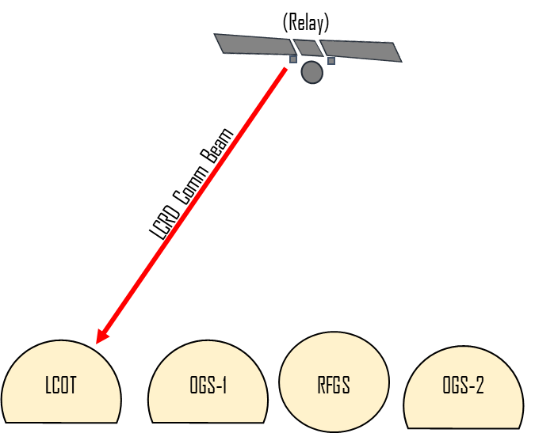
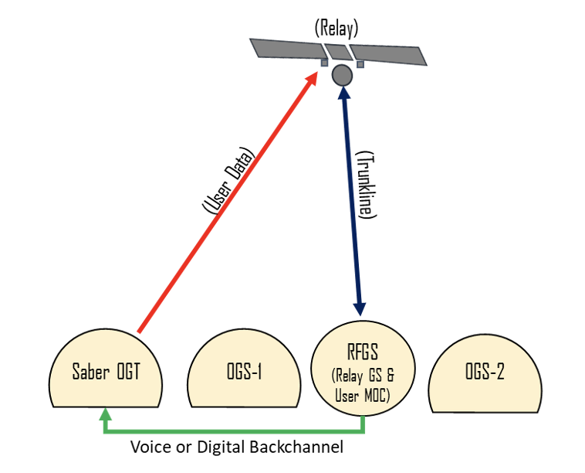
External User Experiments
Low-Cost Optical Terminal (LCOT)
  A series of LCRD sessions involving the Low-Cost Optical Terminal (LCOT) built by GSFC have been planned
  Phase 1—calibration with far-field laser source—occurred in fall 2023
    The LCRD OST open-loop pointed to LCOT and illuminated the ground station with the communications beam
    LCOT team members used an infrared camera to capture video of the communications beam, achieving "first light" with LCRD
  Further experiments are planned for this year (2024)
Saber Ground Terminal
  The Saber optical ground-terminal built by The Aerospace Corporation demonstrated an optical communication uplink with the LCRD payload without the assistance of any optical downlink signal
  Further information available in:
    Rose, T., et al, “Ground-to-space optical communications experiment with LCRD using open-loop pointing,” SPIE Photonics-West, San Francisco, California, United States, 12877-10 (2024)

Slide 12
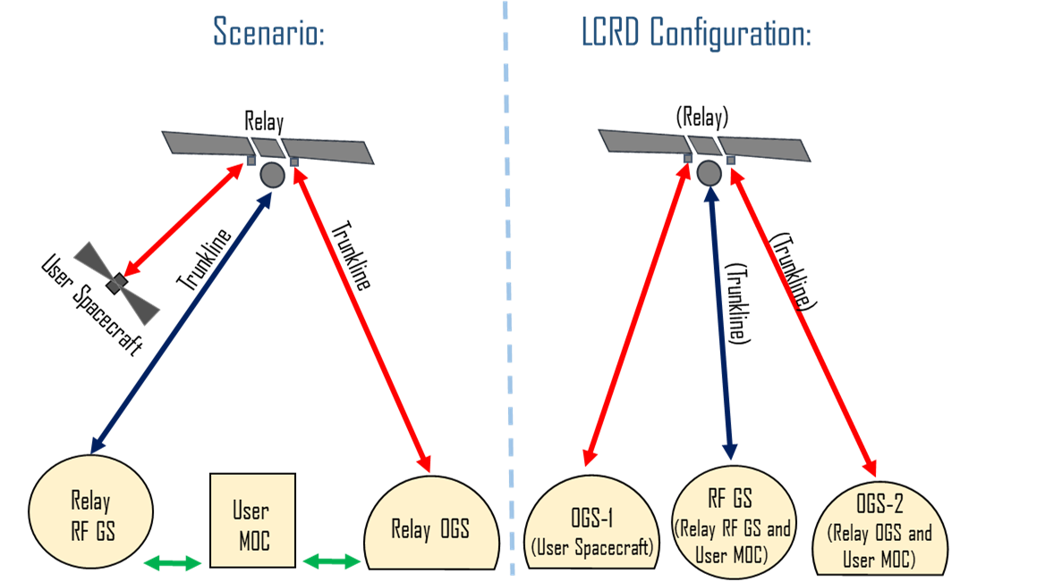
Relay Service Provider Experiments and Operational Demonstrations
A series of experiments have been defined to go beyond link investigations and operate the system as a lasercom relay service provider
  Data Services Using Optical Links (LCRDEX-156) – demonstrate providing variety of bitstream to link layer frame services over different data rates
  LEO Simulation (LCRDEX-101) -- test tools, processes, and configurations for performing links with parameters and schedule based on a representative LEO spacecraft
  Delay/Disruption Tolerant Networking (DTN) (LCRDEX-60) – demonstrate and characterize the provision of DTN bundle protocol services over the relay link
These configurations provide the foundation for follow-on experiments that will build in increasing complexity

Slide 13
Sampling of Upcoming Experiments
Large File Transfer with MIT Haystack Observatory (LCRDEX-171) – explore transmitting real-world Very Long Baseline Interferometry (VLBI) data via lasercom
Handover Operations (LCRDEX-217) – demonstrate handovers between ground stations and explore ways to streamline and optimize handover operations
Link Budget Characterization (LCRDEX-195) – measure performance to validate and/or update the estimated LCRD link budgets created before launch
ILLUMA-T (LCRDEX-27) – support experiments with first orbital user, the Integrated LCRD Low Earth Orbit User Modem and Amplifier Terminal (ILLUMA-T) on the International Space Station (ISS)

Slide 14
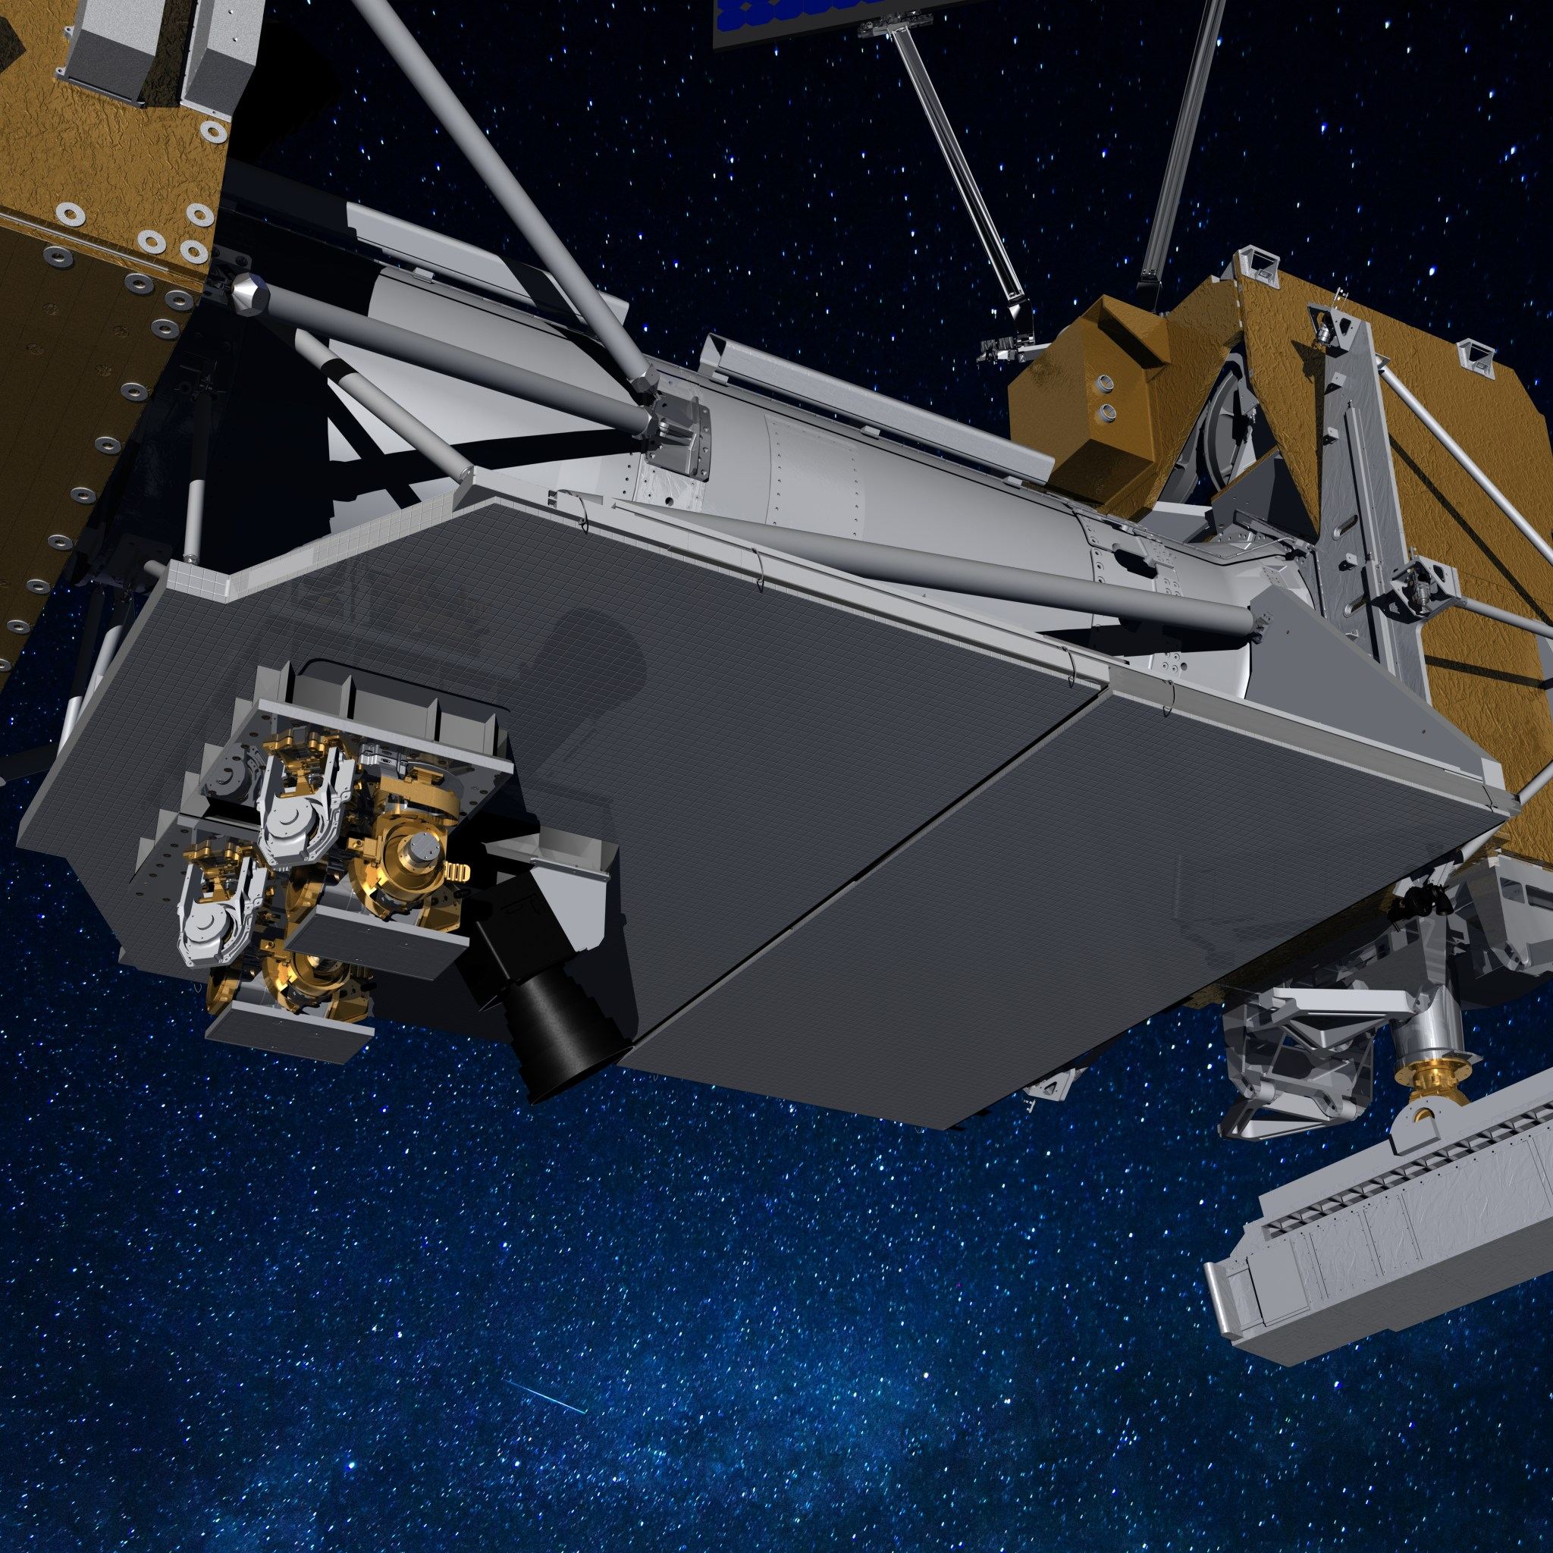
Conclusions
First year-and-a-half of LCRD experiment operations has been busy and productive with many lessons learned and with much data collected
Flight hardware has performed very well, with very high availability
More than two ground stations built for regular operations would be required, to meet the >99% availability usually expected of a communications provider
Following the completion of the two-year experiment
phase in June 2024, the LCRD payload will continue
to execute characterization and operations studies
  The LCRD Guest Experiment Program will remain open
  More information about the LCRD experiment program is
  available on the NASA Opportunities for Experimenters web page

Slide 15
Acknowledgments
NASA-GSFC | Jean-Pierre Chamoun, Nick Cummings, Andrew DeAbreu, David Hahn, Lori Jones, Karen Keadle-Calvert, Dutch Lamberson, Matt McGinnis, Greg Menke, Bill Muscovich, Tim Singletary, Mark Sinkiat, John Smith, Kenny Sterling, Paul Swenson, Miriam Wennersten
LCRD Mission Operations Center (LMOC) (NASA-WSC): | Joshua Blair, Rick Blair, Frank Chavez, Jacob Cohn, Scott Crosier, Julian Hayes, Adam Isleib, Miguel Saenz, Scott Stephens, Jose Talamantes
OGS-1 (JPL-OCTL) | Mark Brewer, William Buehlman, Christine Chen, Preston Hooser, Kittrin Matthews, Huy Nguyen, Gerardo Ortiz, Tom Roberts
OGS-2 (AMOS): | Cheron Fernandez, Steven Spenser
A portion of this research was carried out at the Jet Propulsion Laboratory, California Institute of Technology, under a contract with the National Aeronautics and Space Administration.

