Slide 1
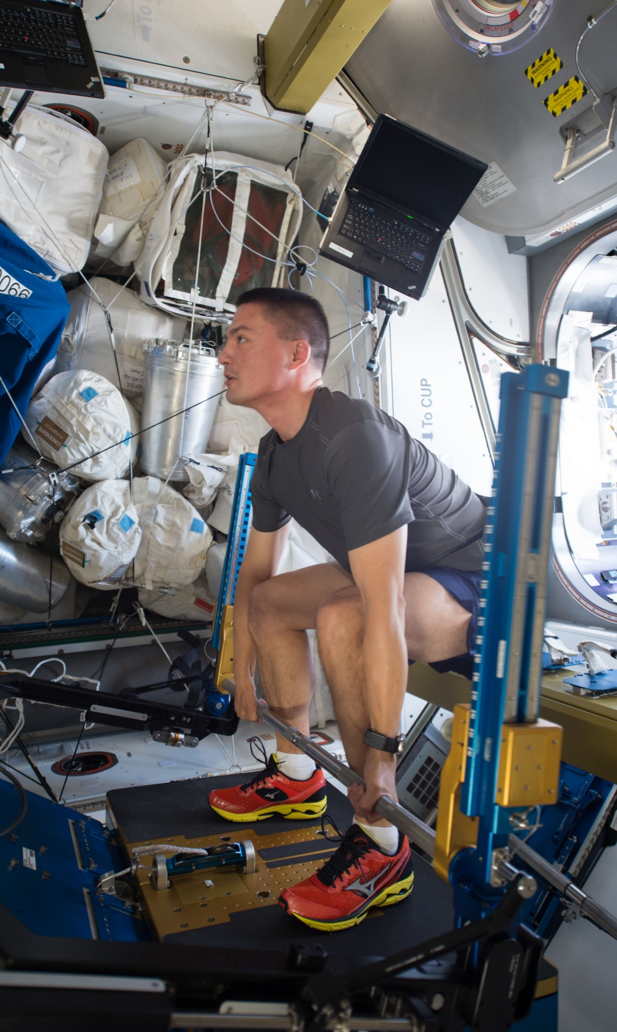
Post-Flight Reconditioning
Danielle N. Anderson DPT, DSc, OCS, CSCS, FAAOMPT
Musculoskeletal Medicine and Rehabilitation Lead
Major, United States Air Force
Corey A. Twine, SCCCa
Astronaut Strength, Conditioning, and Rehabilitation
KBR Human Performance Contract
This Photo by Unknown Author is licensed under CC BY-SA

Slide 2
Agenda
Neurovestibular effects and considerations
Orthostatic intolerance considerations
Assessment and exercise planning
Spine effects and
considerations
Segmental and muscular change characterization
Progression of reconditioning
Mobility/Flexibility considerations
Isolated and multi-joint importance
Mobility through range under load
Gaze stability training, proprioception, and somatosensory training

Slide 3
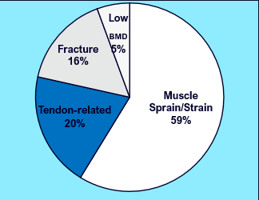
MSK Injuries Post-Flight
  Postflight injuries most common (92%)
  Large proportion of injuries (49.6%) occurred within 1 year of landing
    7.3% within 1 month
    8.1% between 1-3 months
    9.2% between 3-6 months
    25% between 6-12 months
  Fewer injuries reported in females, but higher prevalence
    F: 39 injuries in 20 astronauts
      1.95 injuries per female
      20% of female injuries occurred in flight
      Low BMD diagnoses in 15% of females
    M: 244 injuries in 131 astronauts
      1.86 injuries per male
      4% of injuries occurred in-flight
      Low BMD diagnosed in 4% male astronauts
Notes:
Due to the multisystem involvement and multiple impairments related to spaceflight, it is not uncommon to observe injuries in the post flight phase. The soft-tissue structures appear to most common and we see things like knee sprains, gastroc strains, etc.

Slide 4
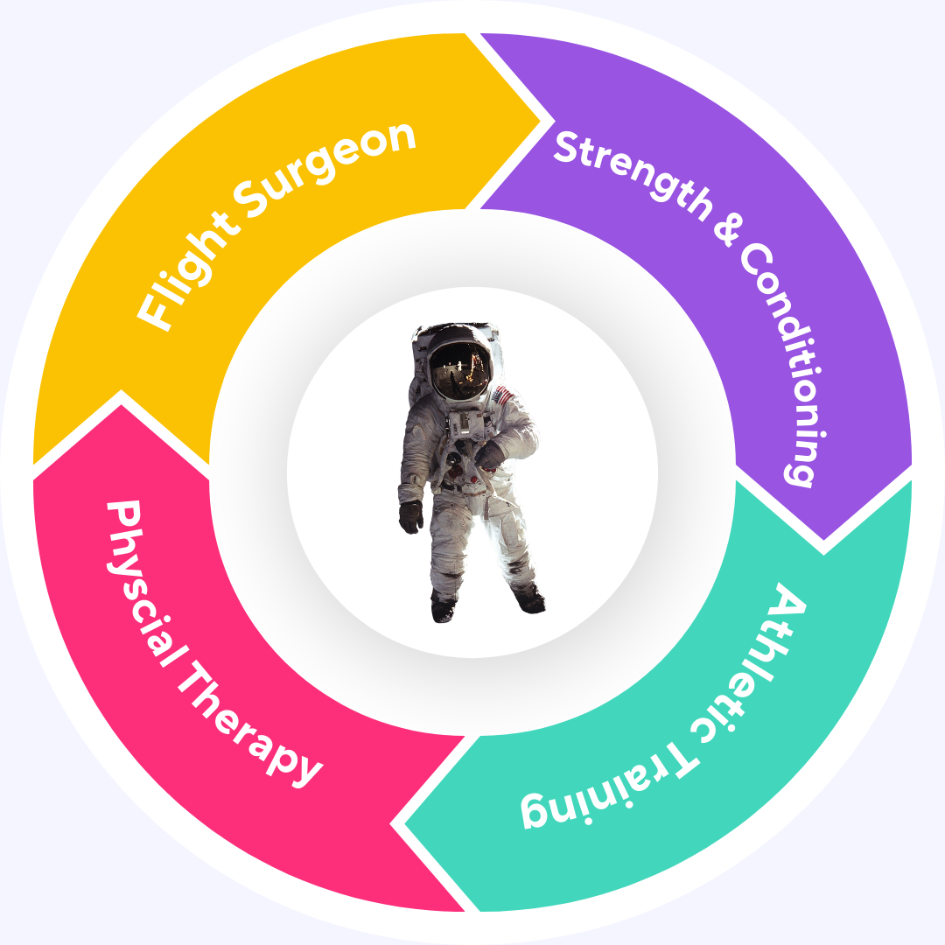
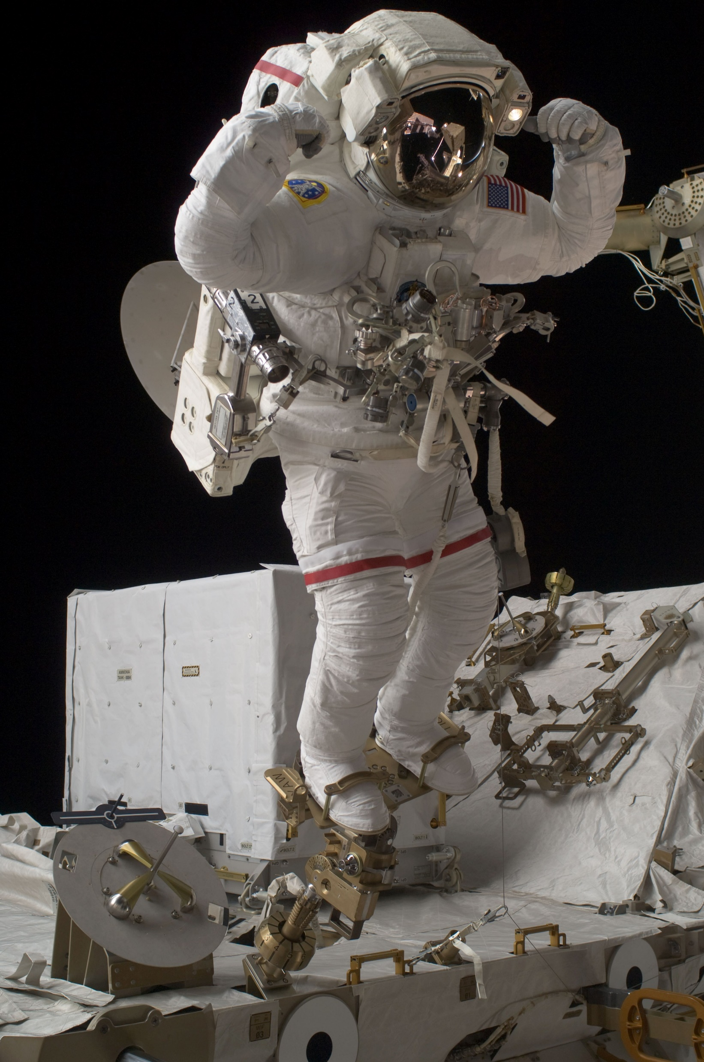
30,000 Foot View
Team Approach
Progressively load impairments of the multisystem degradation to enhance safe and effective re-adaptation and return to prior level of function and individualized goals
Continual monitoring and adjustments to programming based on individual system priorities and response to stimuli

Slide 5


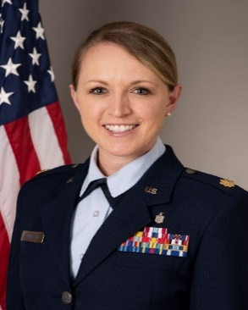

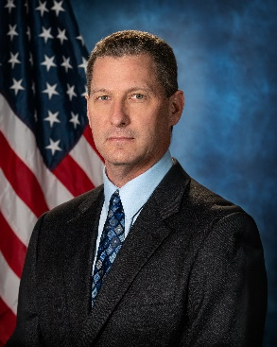
Astronaut Strength, Conditioning and Rehabilitation
Corey Twine
Strength and Conditioning Coach Certified- SCCCa
Certified Strength and Conditioning Specialist (CSCS)
Certified Mobility Specialist FRc
USA Weightlifting, Level 1
Danielle Anderson, Maj, USAF
Doctor of Physical Therapy/Doctor of Science in PT (DPT/DSC)
Orthopedic Certified Specialist (OCS)
Fellow of the American Academy of Orthopedic Manual PT (FAAOMPT)
Certified Strength and Conditioning Specialist (CSCS)
Christi Keeler
Certified Athletic Trainer (ATC)
Texas Licensed Athletic Trainer (LAT)
Certified Orthotist Assistant (COA)
Certified Mobility Specialist FRc
Graston Technique Certified
Bruce Nieschwitz
Certified Athletic Trainer (ATC)
Texas Licensed Athletic Trainer (LAT)
USA Weightlifting, Sports Performance Coach (USAW)
Certified Mobility Specialist FRc
Notes:
Introduce team members. Mention years as ATC, years in ASCR group, work with Shuttle and ISS program support.
Discuss intent of presentation is overview. Mention – will be discussing the equipment and how exercise is administered inflight, and the postflight Recon process.

Slide 6

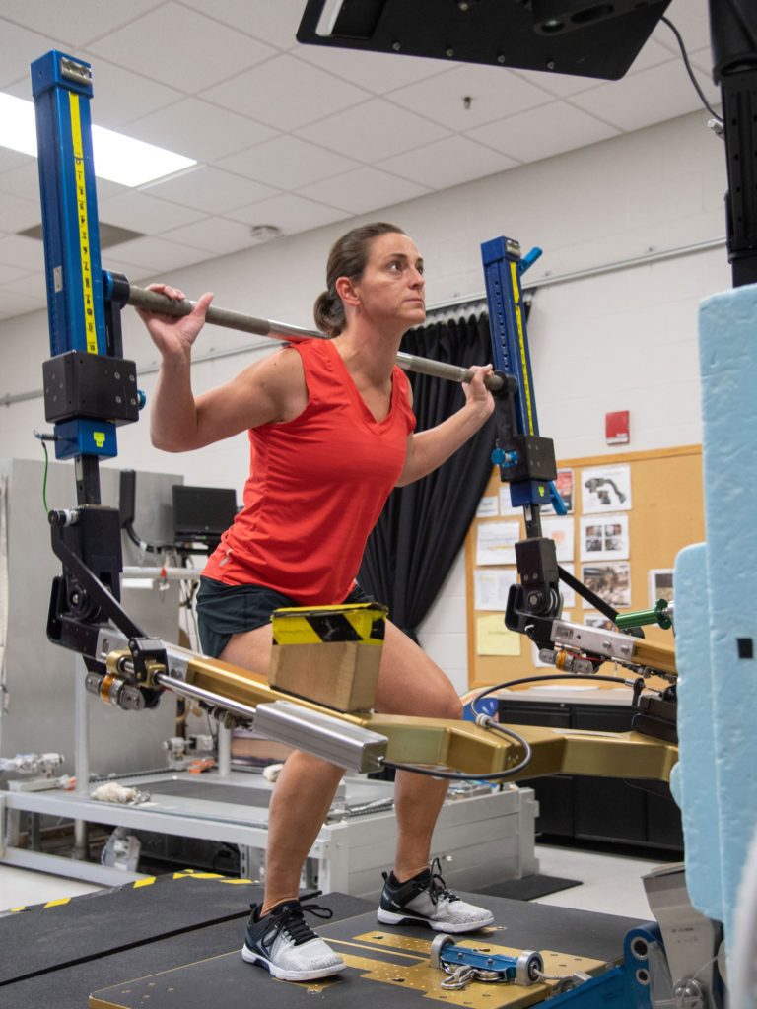

Post-Flight Reconditioning Considerations/Progressions
Strength, Endurance, Coordination, Mobility, Speed
Neurovestibular Re-Integration
Proprioception
Power
Motion
Strength
Skilled Activity
Motor Control
Endurance
Full Activity
Orthostatic Intolerance
Considerations
Coordination
1.) Physiologic Effects of Space Flight
2.) Functional Abilities
3.) Crew Members Goals and Training Desires
4.) Other demands (operational, research, etc)
Notes:
Because of the multifaceted risk to the MSK system post flight our group utilizes a progressive model during the early phases of reconditioning to target all of the known impairments. Our primary goals fall under the 5 biomotor abilities of strength, endurance, coordination, mobility and speed but there is emphasis placed on the impairment based model targeting the neurovestibular system, motion and motor control in the acute phase of reconditioning. Our goal is that by normalizing gaze stability, effective and efficient movement patterns of the spine, and enhancing proximal motor control in the very early phases we can progressively integrate higher level activities safely and strategically.
Neurovestibular integration- Cawthorne-Cooksey gaze stabilization exercises, awareness of orthostatic intolerance (avoidance of head down positions (may limit some testing),
Motor control- speak to multifidus, motion issue, etc

Slide 7
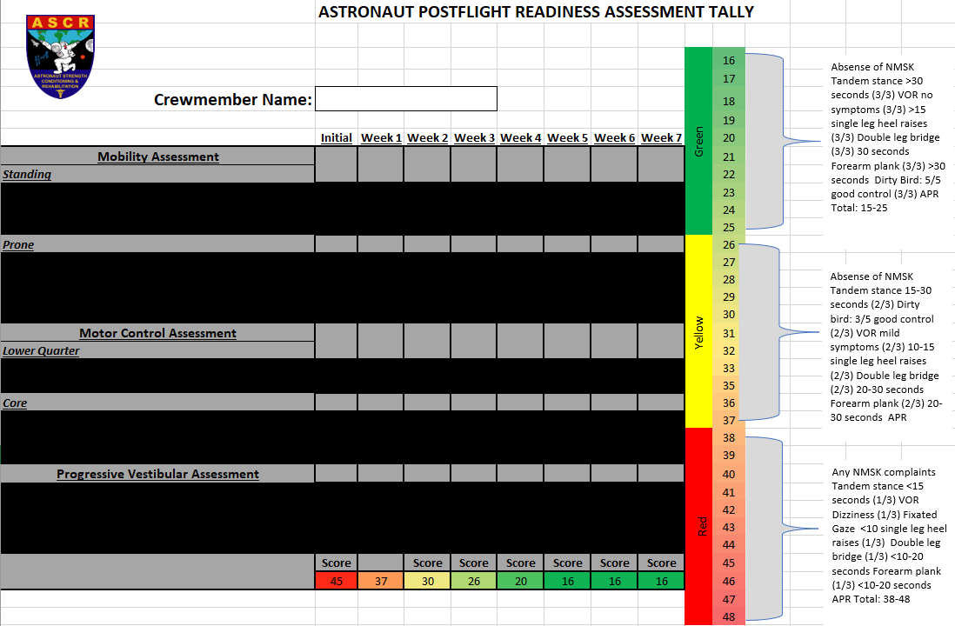
On-going Assessment
Red Criteria:
Any NMSK complaints
Tandem stance <15 seconds
VOR Dizziness
Fixated Gaze
<10 single leg heel raises
Double leg bridge <10-20 seconds
Forearm plank <10-20 seconds
Red Criteria:
Any NMSK complaints
Tandem stance <15 seconds
VOR Dizziness
Fixated Gaze
<10 single leg heel raises
Double leg bridge <10-20 seconds
Forearm plank <10-20 seconds
Yellow Criteria:
Absence of NMSK
Tandem stance 15-30 seconds
Drinking bird: 3/5 good control
VOR mild symptoms
10-15 single leg heel raises
Double leg bridge 20-30 seconds
Forearm plank 20-30 seconds
Red Criteria:
Absense of NMSK
Tandem stance 15-30 seconds (2/3)
Dirty bird: 3/5 good control (2/3)
VOR mild symptoms (2/3)
10-15 single leg heel raises (2/3)
Double leg bridge (2/3) 20-30 seconds
Green Criteria:
Absence of NMSK
Tandem stance >30 seconds
Asymptomatic VOR test
>15 heel raises
Double leg bridge 30 seconds
Forearm plank 30 seconds
Drinking bird 5/5 good control
Notes:
Because of the multiple impairments that are involved, we have an on-going assessment that combines the systems in to a snap shot of overall functional status. On a weekly basis we assess mobility, motor control of the core and lower quarter and a progressive vestibular assessment. This continual monitoring, in addition to the subjective feedback from the crew member, and tolerance and ability with the other activities through their day and the reconditioning period allow us to make objectively informed decisions around returning to higher levels of activities. In addition to considering the individual impairments, we also have to consider the spaceflight effects on soft-tissue structures including cartilage and tendons that is not entirely understood in humans.

Slide 8
30,000 Foot View
Physical Medicine
Strength and
Conditioning

Slide 9
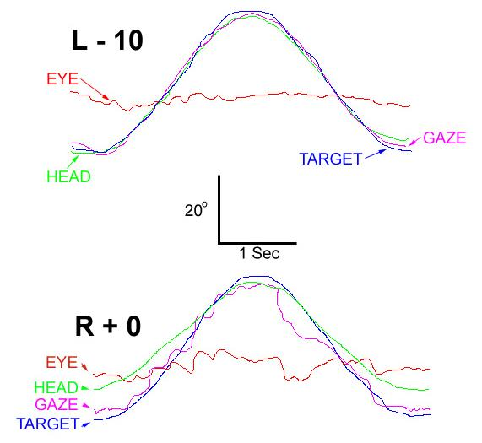
Neurovestibular Evidence
Central Nervous System adaptations to space flight → reinterpretation of vestibular and somatosensory inputs
Excessive postural sway, decreased proprioception,
and locomotor control
Altered gaze stability
Alterations in muscle activation
Alterations in head-trunk coordination
Impaired cognitive and somatosensory dual processing
Macaulay, et al, Front Syst Neurosci, 2021
Notes:
including decreased extensor muscle tone, suppressed muscle spindle activation, decreased motor control accuracy, and increased excitability of the soleus spinal reflex

Slide 10
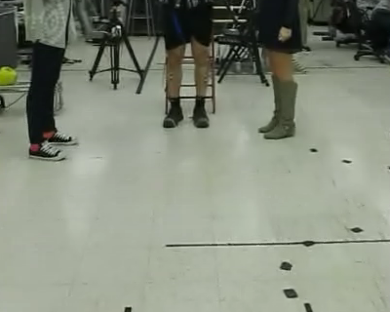
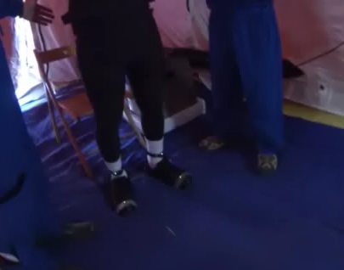
Neurovestibular Evidence
Macaulay, et al, Front Syst Neurosci, 2021
Notes:
including decreased extensor muscle tone, suppressed muscle spindle activation, decreased motor control accuracy, and increased excitability of the soleus spinal reflex

Slide 11
Neurovestibular Considerations
Phase 1:
Gaze stabilization exercises on stable surface (ex. Smooth pursuits, saccades, etc)
Stable surface standing and sitting balance
Active multi-joint training
Passive interventions (tactile cues, taping ques, etc)
Phase 2:
Gaze stabilization exercises on unstable surfaces
Unstable surface balance training-reactive balance training
Dual-tasking added where appropriate for visual and/or cognitive
Phase 3:
Dual-tasking training with unstable or moving platform training
Agility based training
Notes:
Gaze stabilisation exercises are a mainstay of vestibular rehabilitation (VR). They are frequently prescribed to patients with vestibular hypofunction with the aim of improving the gain of the vestibular ocular reflex, improving visual acuity during head movement, and reducing the symptoms of dizziness and vertigo. This review will examine current evidence that has evaluated the efficacy of gaze stabilisation exercises on VOR gain, dynamic visual acuity and oscillopsia. In addition, recent experimental studies that have employed digital technologies and newer forms of gaze stabilisation exercises will be reviewed. The implications for future clinical practice and research in the area of VR will be discussed.
Early gaze stabilization exercises include: smooth pursuits, saccades, VOR training, head on body movements in line with Cawhorne Cooksey’s concepts to readjust the gain of the vestibular reflexes when there is a distribution in equilibrium and to encourage vestibular adaptation
Proprioceptive and somatosensory training: progressive proprioceptive training can lead to significant improvements in both proprioception and motor function across the range of healthy and clinical populations, active movement of the trainee is most beneficial to encourage sensorimotor performance, but in the case of severe alterations, passive and more hands on techniques may be required such as taping or manual cueing from a provider. In the beginning phase, balance training occurs on stable surfaces are utilize with several verbal and tactile cues to normalize posture and joint position sense. Active multi-joint movements are also initiated early one with goals overlapping to normalize joint position sense, posture, motor control, and regaining mobility and flexibility.
Progression of gaze stability, dual-tasking, and somatosensory and proprioception encourage combining impairments by incorporating various surfaces, reactive training, and incorporation of potential cognitive challenges and overlaps with motor control progression in to agility based training which Corey will discuss in the later part of this discussion

Slide 12
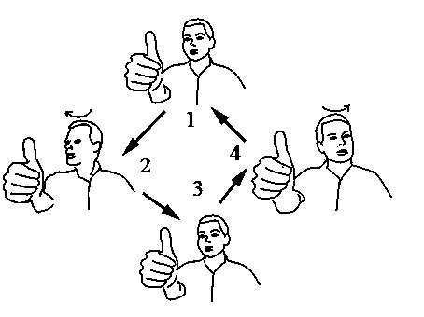
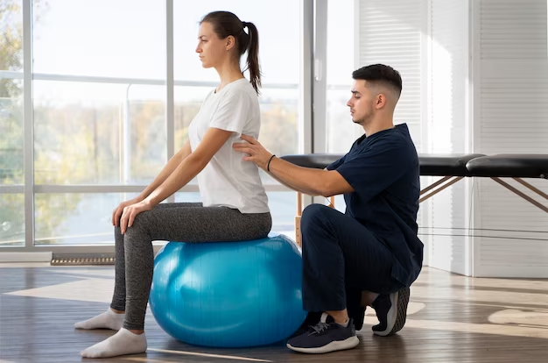
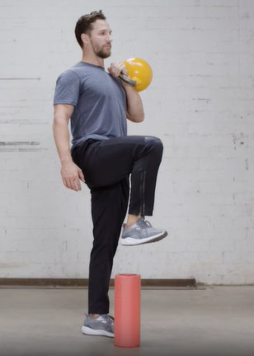

Neurovestibular Considerations- Phase 1
Goals: normalize gaze stabilization, integrate vestibular, somatosensory and visual systems for balance, normalize proprioception and somatosensory system
PHASE 1
Notes:
Phase 1:
Gaze stabilization exercises on stable surface (ex. Smooth pursuits, saccades, etc)
Stable surface standing and sitting balance
Active multi-joint training
Passive interventions (tactile cues, taping ques, etc)
Gaze stabilisation exercises are a mainstay of vestibular rehabilitation (VR). They are frequently prescribed to patients with vestibular hypofunction with the aim of improving the gain of the vestibular ocular reflex, improving visual acuity during head movement, and reducing the symptoms of dizziness and vertigo. This review will examine current evidence that has evaluated the efficacy of gaze stabilisation exercises on VOR gain, dynamic visual acuity and oscillopsia. In addition, recent experimental studies that have employed digital technologies and newer forms of gaze stabilisation exercises will be reviewed. The implications for future clinical practice and research in the area of VR will be discussed.
Early gaze stabilization exercises include: smooth pursuits, saccades, VOR training, head on body movements in line with Cawhorne Cooksey’s concepts to readjust the gain of the vestibular reflexes when there is a distribution in equilibrium and to encourage vestibular adaptation
Proprioceptive and somatosensory training: progressive proprioceptive training can lead to significant improvements in both proprioception and motor function across the range of healthy and clinical populations, active movement of the trainee is most beneficial to encourage sensorimotor performance, but in the case of severe alterations, passive and more hands on techniques may be required such as taping or manual cueing from a provider. In the beginning phase, balance training occurs on stable surfaces are utilize with several verbal and tactile cues to normalize posture and joint position sense. Active multi-joint movements are also initiated early one with goals overlapping to normalize joint position sense, posture, motor control, and regaining mobility and flexibility.
Progression of gaze stability, dual-tasking, and somatosensory and proprioception encourage combining impairments by incorporating various surfaces, reactive training, and incorporation of potential cognitive challenges and overlaps with motor control progression in to agility based training which Corey will discuss in the later part of this discussion

Slide 13
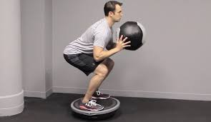
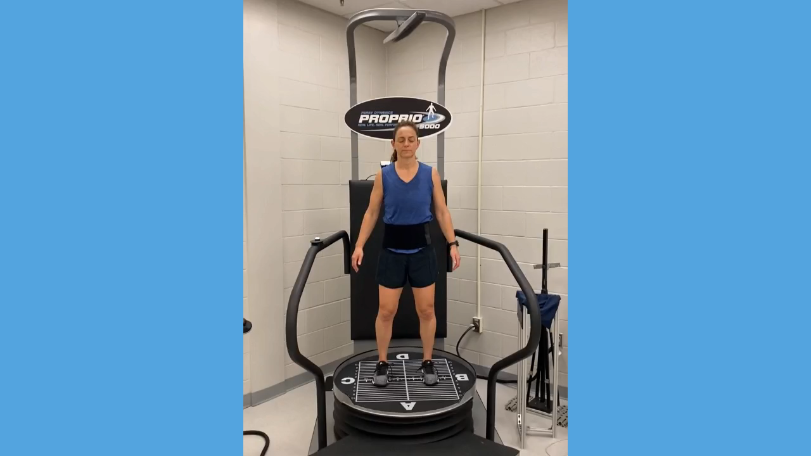
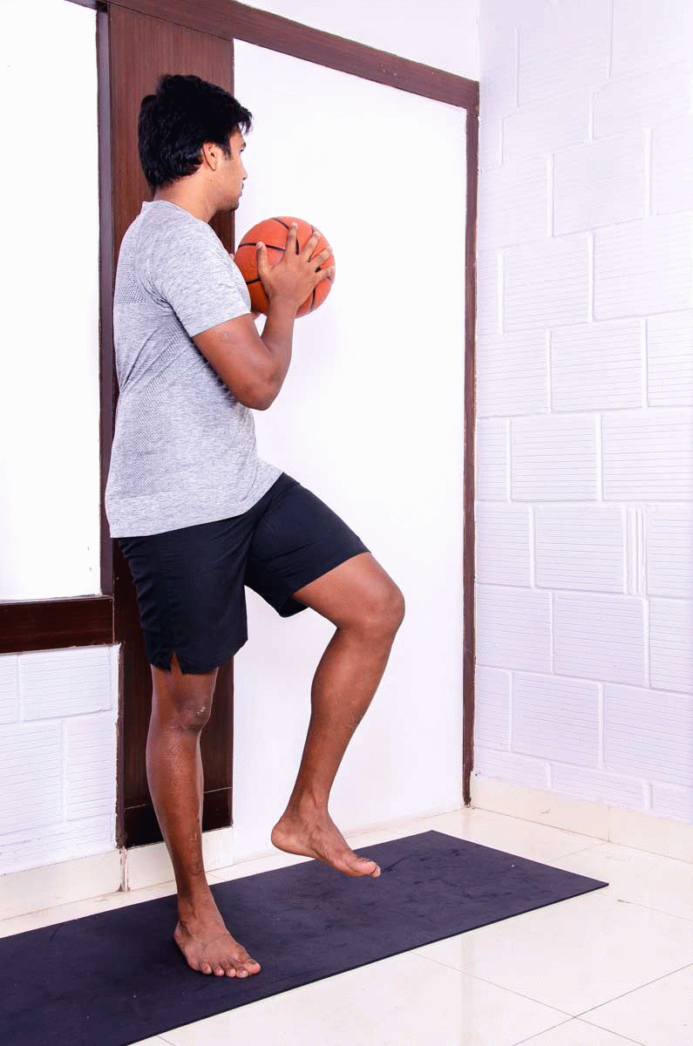
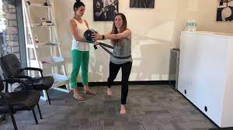
Neurovestibular Considerations- Phase 2
Goals: progress gaze stability exercises to unstable surface, reactive and varying surface training, and gradual addition of dual-tasking
PHASE 2
Notes:
Strength is balance and balance is strength! Talk, eyes open, eyes closed, head movements, etc
Phase 2:
Gaze stabilization exercises on unstable surfaces
Unstable surface balance training-reactive balance training
Dual-tasking added where appropriate for visual and/or cognitive

Slide 14
Neurovestibular Considerations- Phase 2
Goals: progress gaze stability exercises to unstable surface, reactive and varying surface training, and gradual addition of dual-tasking
Notes:
proprio5000

Slide 15
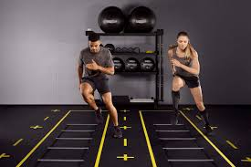
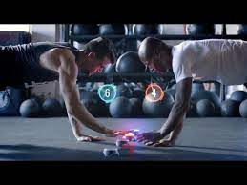
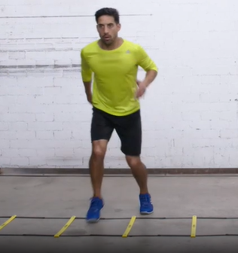
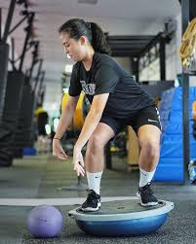
Neurovestibular Considerations- Phase 3
Goals: progression to dual-task training with varying intensity and surfaces, progression of coordination and agility
PHASE 3
Notes:
Dual-tasking training with unstable or moving platform training
Agility based training

Slide 16

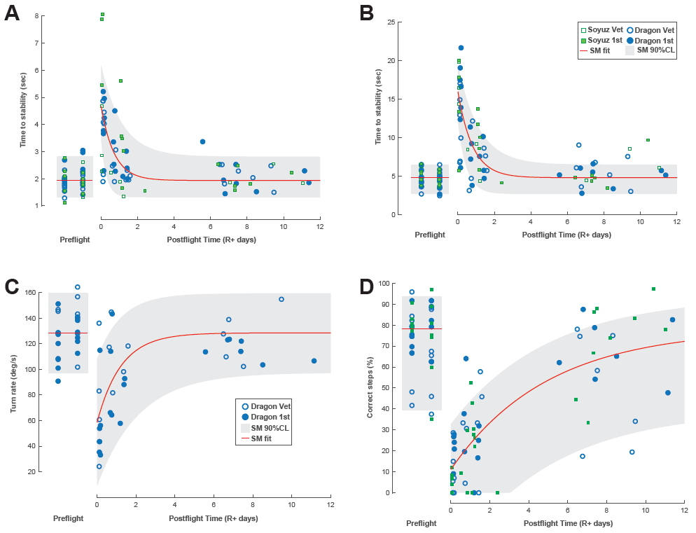

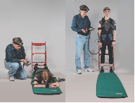
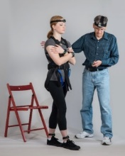
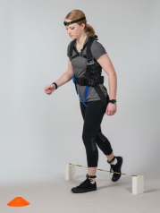
State of Knowledge:
Balance/Ability to Respond to Environmental Signals (Sensorimotor Risk)
Sit-to-stand
Recovery from fall
Tandem Walk Eyes Closed
Functional task performance was significantly impaired during initial R+0 testing.
Some decrements persisted during R+1 testing. The recovery timeline varied with task complexity.
Walk
and turn
Courtesy of neurolab at JSC

Slide 17
Orthostatic Intolerance Evidence
Orthostatic intolerance post flight is multifactorial → decreased cardiac filling pressure, decrease stroke volume during orthostatic stress due to decreased plasma volume, adrenergic function, and dysfunction of the sympathetic nervous system
When assessed during quiet standing or utilizing a tilt table, crew members experienced more orthostatic intolerance compared to functional and ambulatory positions (calf pump!)
During quiet positions and transition motions, orthostatic intolerance ranges from R+0- R+14 with great individual variability
Qi Fu, et al. AHA Circulation, 2019
Notes:
In simple form orthostatic intolerance is the inability to stand up right with out symptoms of lightheadedness, palpitations, fatigue, blurred vision, dizziness, exercise intolerance, chest discomfort, cognitive impairment, and occasionally syncope
Reason simplified: Postflight orthostatic intolerance likely results from changes in volume status and adaptation of the autonomic nervous system to weightlessness. In a recent study, it was identified that orthostatic intolerance after space flight can be attributed to decreases of cardiac filling pressure and stroke volume during orthostatic stress due to a decreased blood volume. Many of the initial studies were performed in static positions and indicate that .
In contrast with results from previous studies that used tilt tables or stand tests, no astronaut experienced orthostatic intolerance/hypotension during activities of daily living before or after spaceflight. Also, 24-hour systolic BP decreased in space (120±10 mm Hg before spaceflight versus 106±9 mm Hg during spaceflight; P<0.01), but it returned to normal upon landing (122±13 mm Hg). Diastolic BP was unchanged during and after spaceflight. Systolic and diastolic BP variability remained the same before, during, and after spaceflight (both P>0.05). The skewness of systolic BP increased in space (0.74±0.51 versus 1.43±1.00; P=0.001), indicating that signal fluctuations became asymmetrical; however, it returned to preflight levels after landing (0.51±0.42). The kurtosis increased in space (5.01±7.67 versus 11.10±11.79; P=0.010), suggesting that fluctuations concentrated around the mean with a narrow distribution; however, it also returned to preflight levels (2.21±2.56) after return to earth.
Conclusions:
Given current countermeasures including in-flight exercise training and volume resuscitation on return, no astronauts experienced orthostatic hypotension or intolerance during routine (for landing day) activities in the initial 24 hours after landing following 6 months in space. Prolonged exposure to spaceflight had little impact on systolic BP variability and its distribution, although the latter showed a transient change in space (accompanied by mild relative hypotension), all of which returned to preflight values after return to earth.

Slide 18
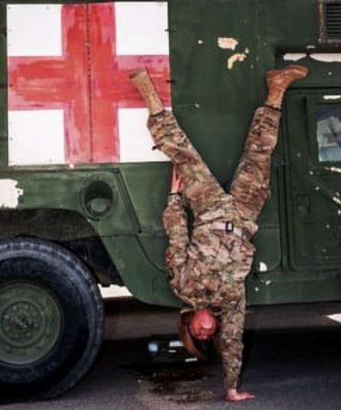
Orthostatic Intolerance Considerations
Assessment and Exercise Planning Considerations:
Avoidance of assessing and exercising in positions causing valsalva, head down or dependent positions, and minimizing time spent transitioning from supine to stand, prone to stand, etc.
In consultation with Flight Surgeons, consider compression garments for more severe or lingering cases
X
Notes:
In the beginning phases

Slide 19
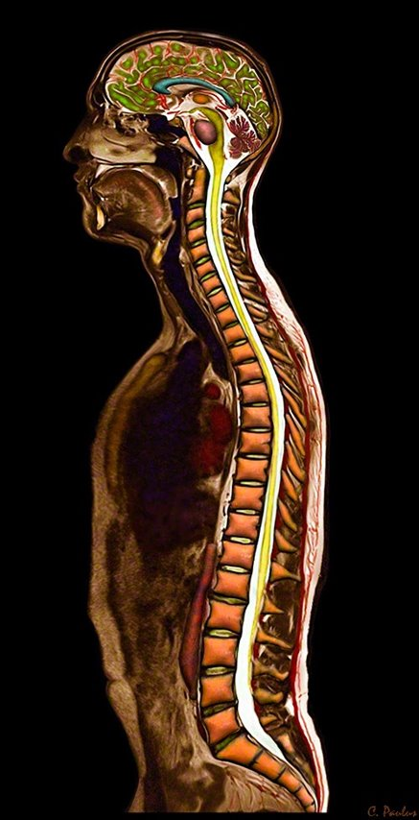
Spine Evidence
2021 NASA Human Research Program​: Biomechanics of the lumbar spine following spaceflight and incidence of post-flight disc herniation
N=12 subjects (10 males, 2 females)
Evaluation:
  3T MRI for facet arthropathy, endplate irregularities, HIZ, disc herniation, degeneration, water content and multifidus CSA, mCSA, m%
  Spine segment kinematics max flexion-extension/lateral flexion/translation ROM per segment
  Time points: pre-flight, R+2-7 (after 6 mos) and R+30-60
Bailey et. Al, IWS, 2021

Slide 20
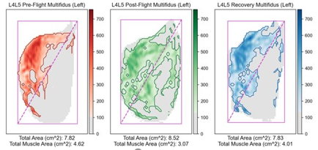
Spine Evidence
2021 NASA Human Research Program​: Biomechanics of the lumbar spine following spaceflight and incidence of post-flight disc herniation
Results:
  50% (6 out of 12) of crew members returned from space with a symptomatic disc protrusion/herniation
  Decreased ROM → upper lumbar spine
    Associated with endplate irregularities
  Lower pre-flight average multifidus % and higher asymmetry
  Decreased average multifidus % and increased asymmetry → lower lumbar spine
  Water content, muscle CSA, other spinal pathology did not associate
​
Bailey et. Al, IWS, 2021

Slide 21
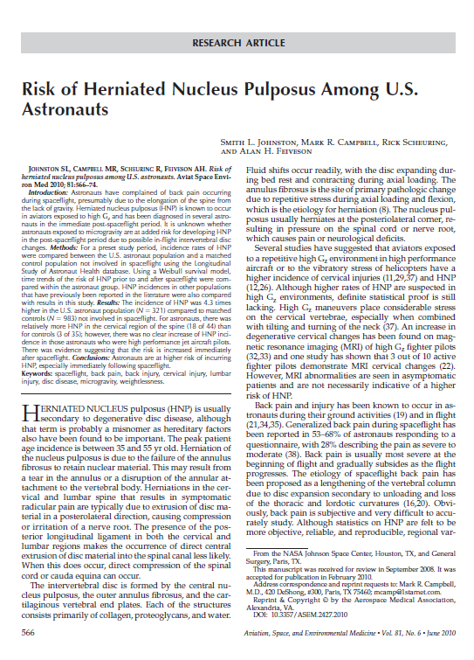
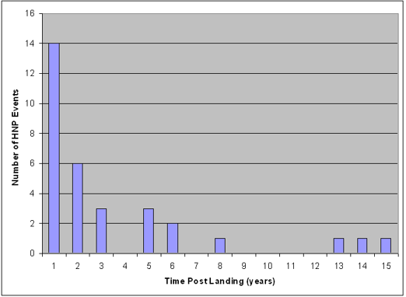
Spine Evidence
Occurrence of symptomatic HNP greatest in first 2 weeks post flight
Johnston, et al. Aviat, Space, Env med, 2010
Notes:
Speak to importance of no axial loading early on and focus on the intersegmental mobility, motor control, and progressive load

Slide 22
Spine Considerations
Phase 1:
Active and passive intersegmental and multi-joint mobility
Manual therapy PRN for adaptation pain
Avoiding axial loading early phases
Neuromuscular re-education, joint position sense, and motor control
Phase 2:
Progression of multi-joint mobility
Advancing neuromuscular control to functional patterns
Advancing load through spine and lower extremity to progress strength and endurance
Phase 3:
Multi-joint mobility while with external load
Progression of strength, power, skilled activity, and agility
Build spinal resiliency!
Notes:
Phase 1:
Active and passive intersegmental and multi-joint mobility
Manual therapy PRN for adaptation pain
Avoiding axial loading early phases
Neuromuscular re-education, joint position sense, and motor control

Slide 23
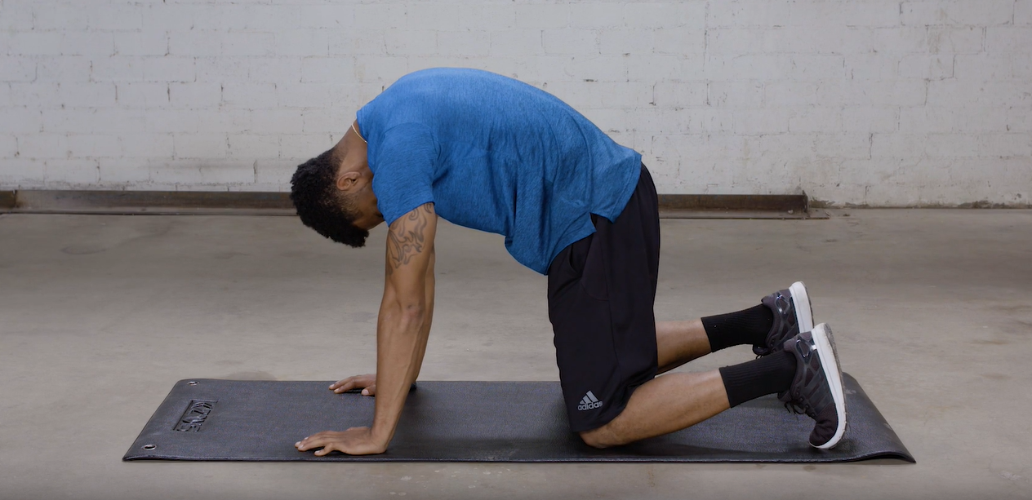
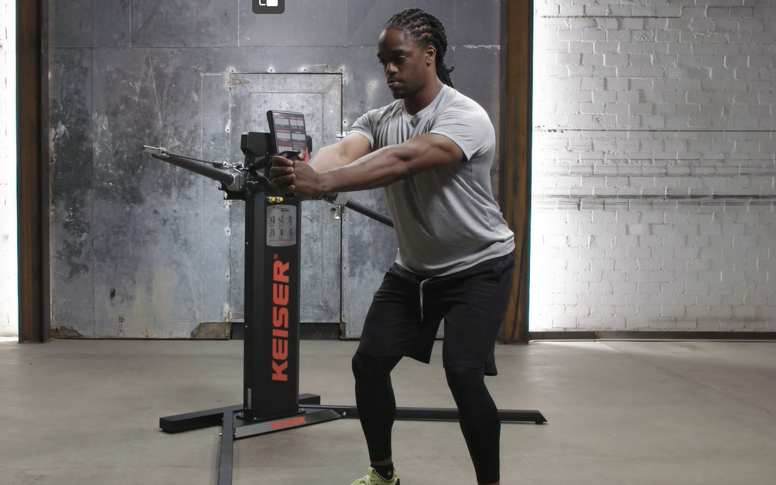
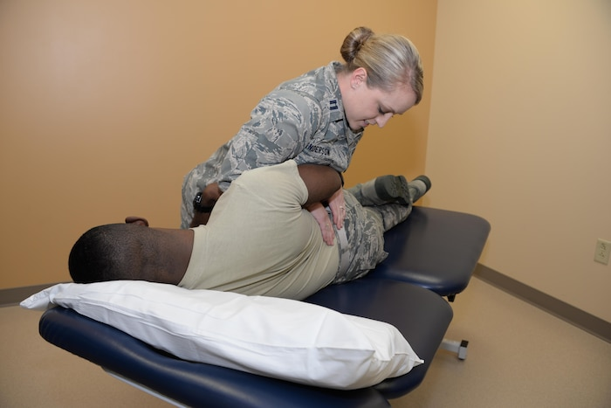
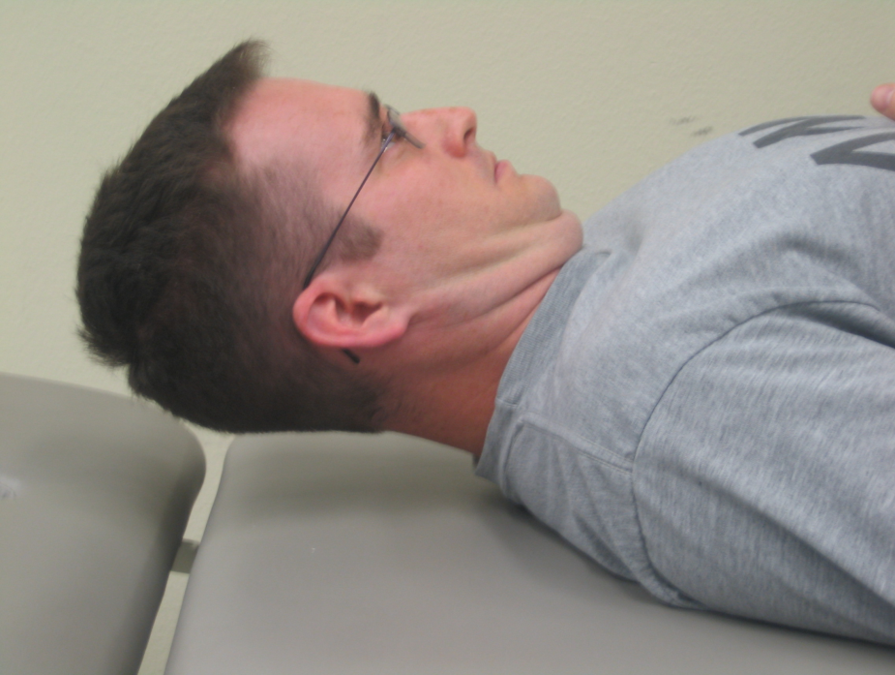
Spinal Considerations- Phase 1
Goals: Reduce adaptation pain, enhance intersegmental mobility, restore normal firing patterns of deep core stabilizers, and improve joint position sense
PHASE 1
Notes:
Phase 1:
Active and passive intersegmental and multi-joint mobility
Manual therapy PRN for adaptation pain
Avoiding axial loading early phases
Neuromuscular re-education, joint position sense, and motor control

Slide 24
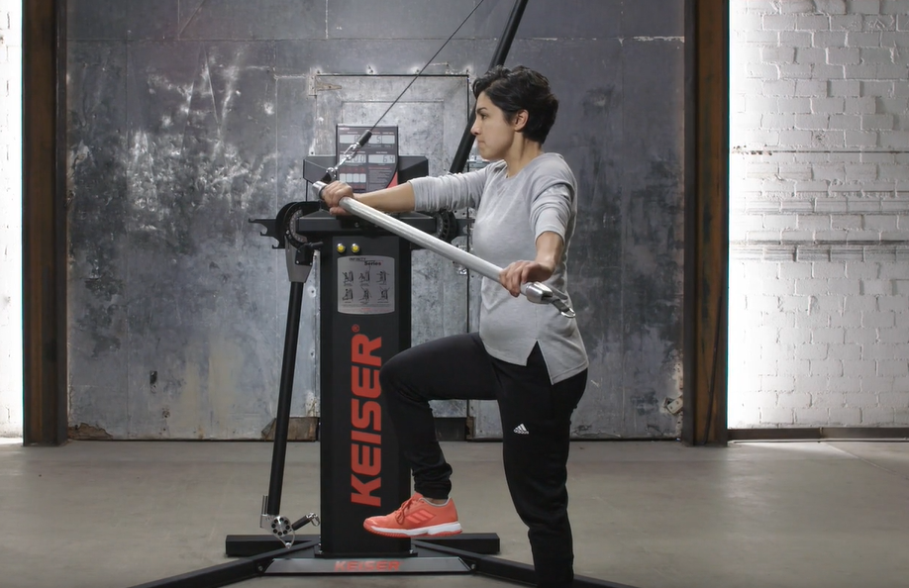
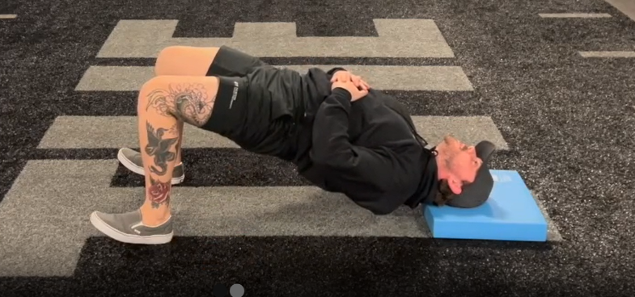
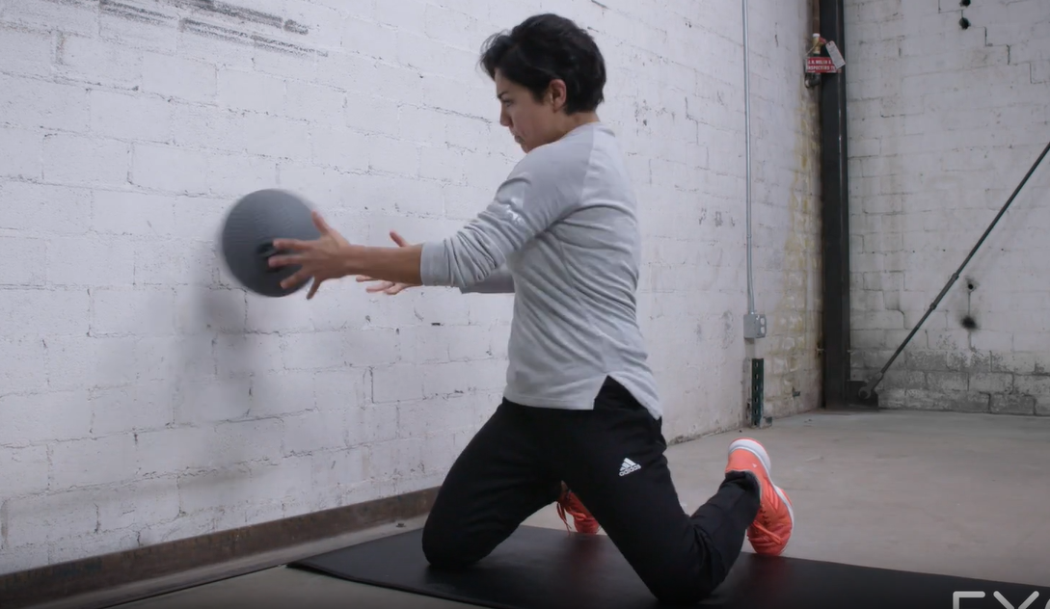
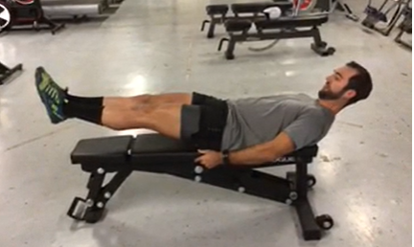
Spinal Considerations- Phase 2
Goals: progress intersegmental and multi-joint mobility, advance neuromuscular re-education to multi-axial movements, progressively begin loading the spine
PHASE 2
Notes:
Phase 2:
Progression of multi-joint mobility
Advancing neuromuscular control to functional patterns
Advancing load through spine and lower extremity to progress strength and endurance

Slide 25
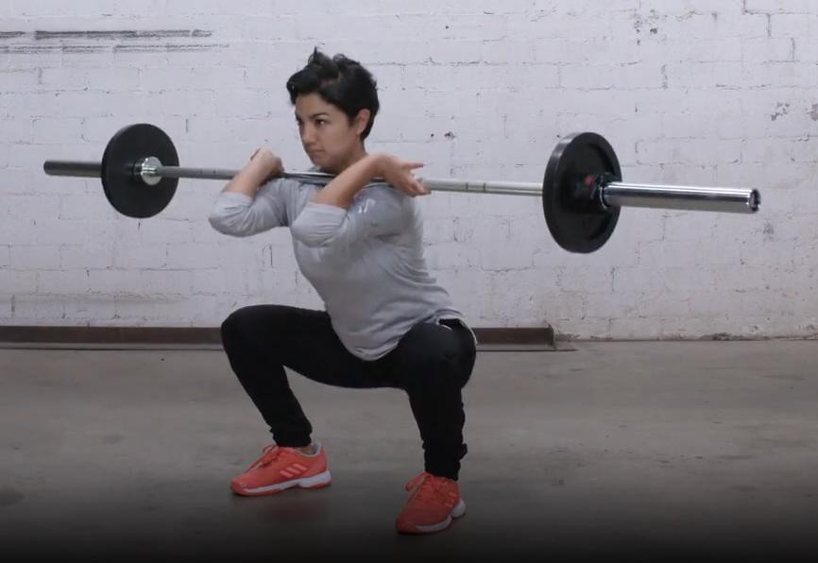
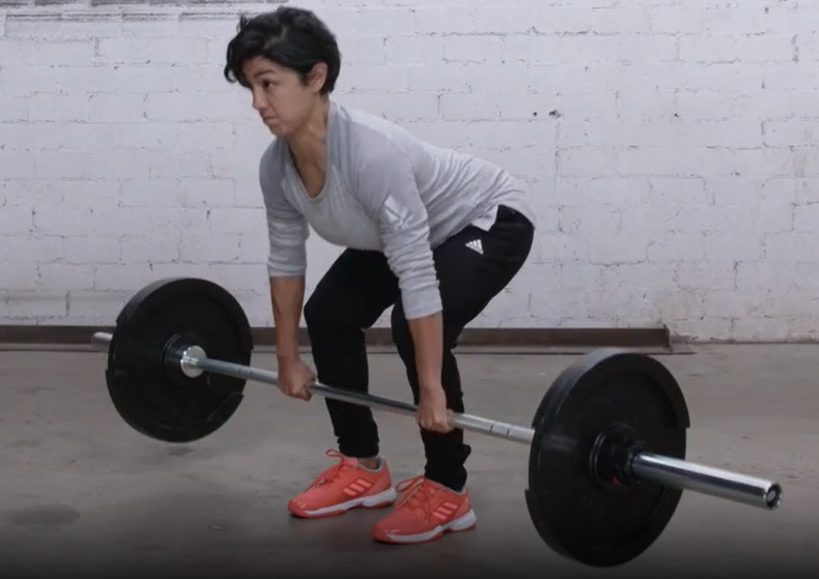
Spinal Considerations- Phase 3
Goals: progression of multi-joint mobility with load, advance strength and power, development of skilled and functional activity… build spinal resiliency!!
PHASE 3
Notes:
Phase 3:
Multi-joint mobility while with external load
Progression of strength, power, skilled activity, and agility
Build spinal resiliency!

Slide 26
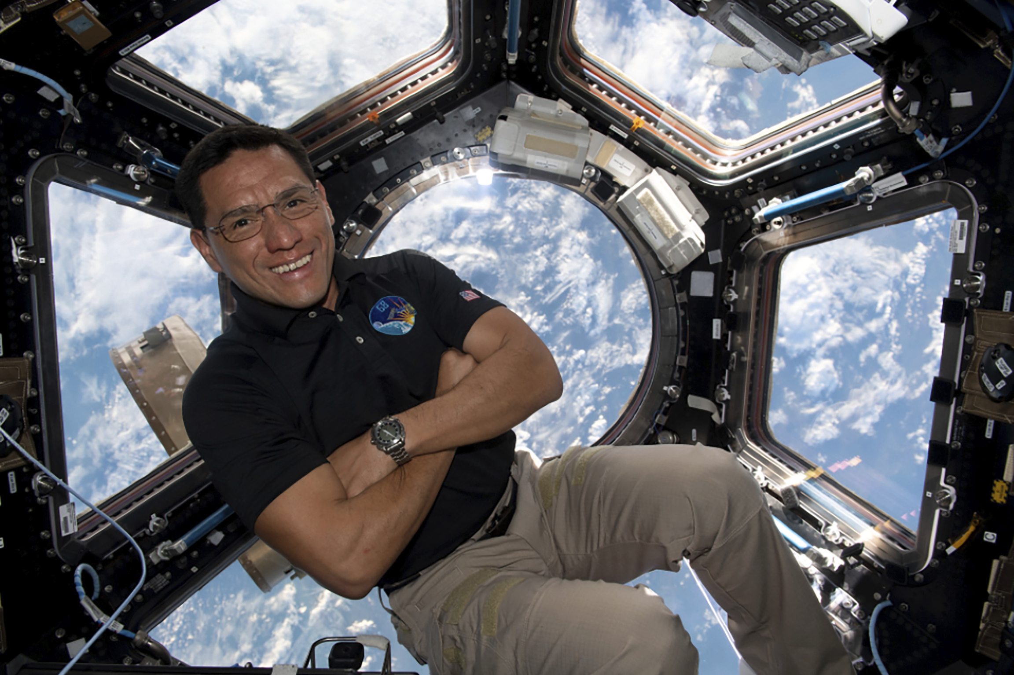
Mobility/Flexibility
Common Mobility Restrictions due to Inflight Positioning:
Impaired spinal mobility across all regions and ranges
Hip: hip flexor resistance over extensor, rotational limitations
Shoulder: shoulder flexion resistance over extensor, rotational limitations
Ankle dorsiflexion over plantar flexion
NASA Stock Photo, pulled 1.11.2024

Slide 27
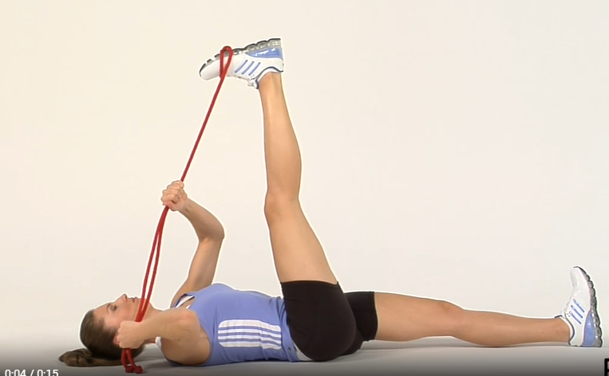
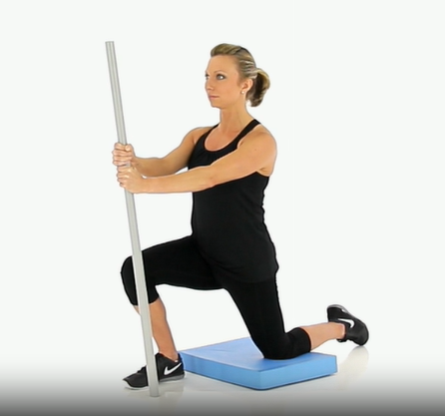
Mobility/Flexibility
Approach:
Progression of single joint (isolated) and multi-joint motion through passive, active, and manual therapy techniques where appropriate
Progressing multi-joint motion under load to optimize functional activities
Continual monitoring with daily and weekly evaluations

Slide 28
30,000 Foot View
Strength and Conditioning
Physical Medicine

Slide 29
Agenda
Overview - First days of Post-flight Reconditioning
Resistance Training Considerations
Strength Expression
Power Expression
Cardiovascular / Cardiorespiratory Fitness
Based on Maximum Oxygen uptake
Endurance
Agility - as it applies
Acceleration
Deceleration
Assessment
Develop Plan
Execute Plan

Slide 30

Post-Flight Considerations
Post-flight Reconditioning Framework
  45 Days
  2 Hours Per day
Challenges
  Scheduling Demands
  Life Demands
  Desire to return to a prior level of function and fitness may cause fatigue or risk of injury.
  Fatigue or illness
  Preference - Individual desires may not match an evidence-based approach to appropriate training

Slide 31

MEDB. (MRID) Functional Fitness Assessment
Previous Functional Fitness Assessment
  Cone Agility: Fastest time through course (3 trials)
  Hand Grip: Highest of 3 trials
  Push Ups: Max 2 minutes
  Sit and Reach: Highest of 3 trials
  Pull Ups: Max completed
  Sliding Crunches (Abdominal): Max 2 minutes
  Single Leg Stork Stand: 15 seconds bilateral
  Leg Press: 1 Rep Max
  Bench Press: 1 Rep Max
Current Functional Fitness Assessment
  Body Mass
  Hand grip
  Squat Jump
  Countermovement Jump
  Cone Agility
  Isometric Mid-Thigh Pull
  Isometric Bench Press
  Pull ups
  Hand Release Push-ups
R+5-7, R+30
MED B = Medical Evaluation Document (Group B)
MRID = Medical Requirements Integration Document

Slide 32
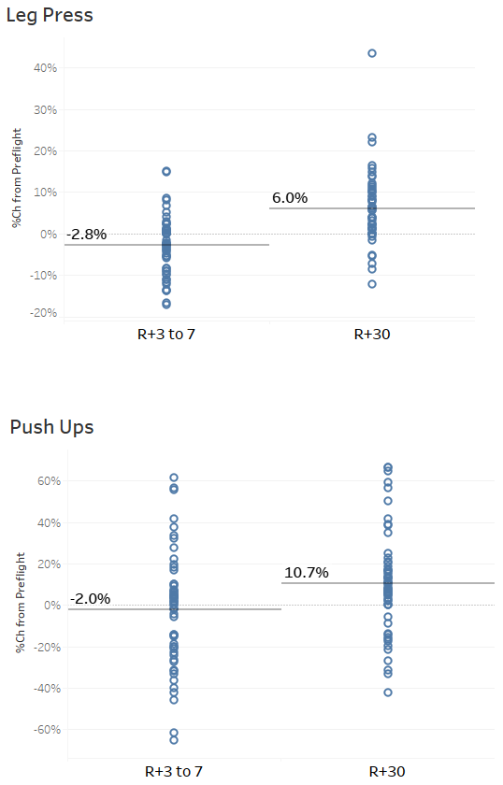
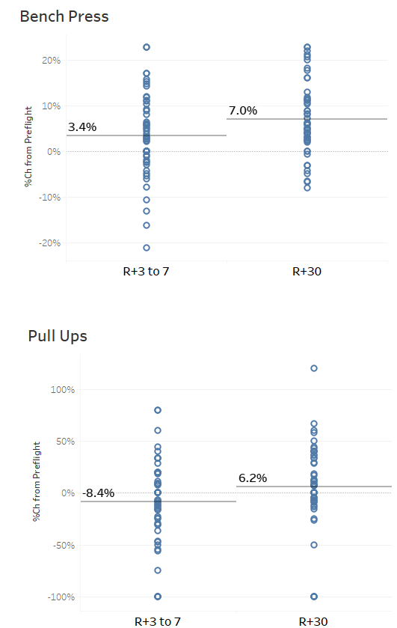
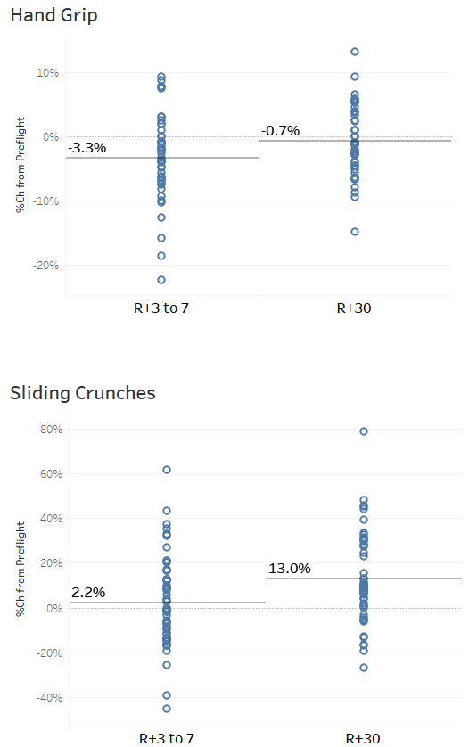
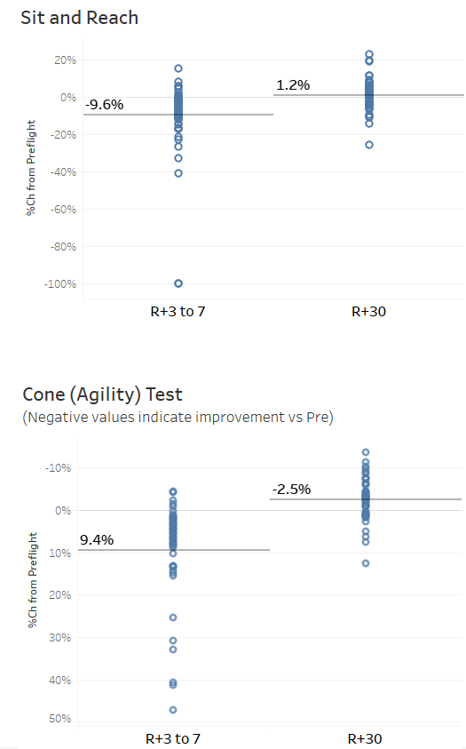
Meb B. Functional Fitness Assessment
Changes in Functional Fitness after Long-Duration Spaceflight and 30d of Recovery (%Change from Preflight, n=93)
Functional Fitness Assessment

Slide 33
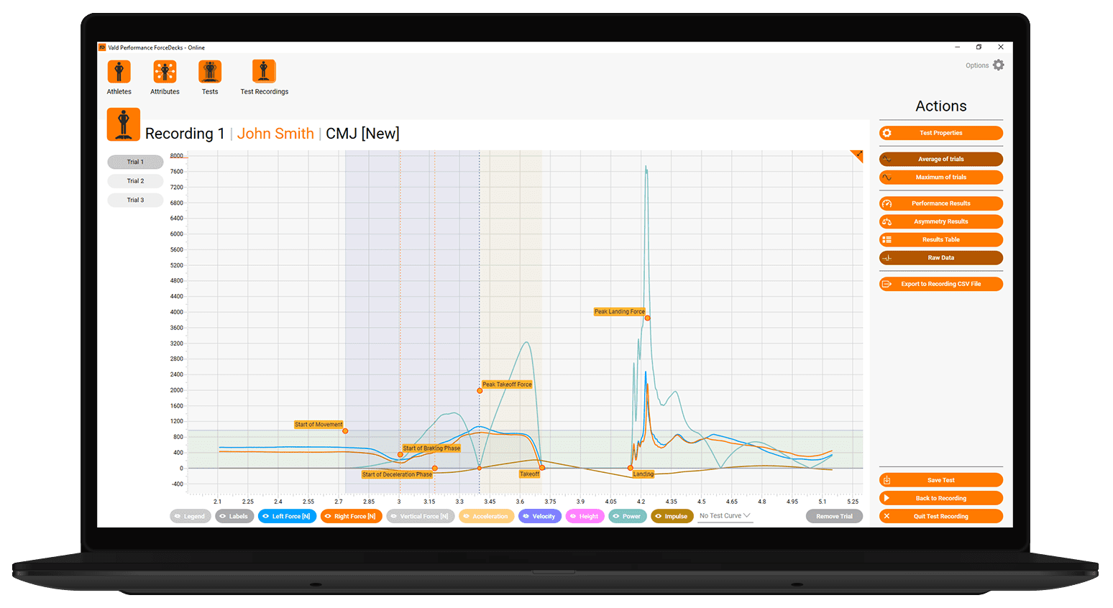
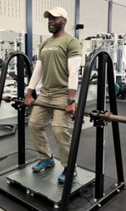
Monitoring Capabilities: Muscular Strength and Power
IMPT
Squat Jump
Countermovement Jump
Jump Height
Peak Force
Rate of Force development
Time to decel
Jump height
Time to decel
Power
Power

Slide 34


Post-flight Reconditioning- First Steps
Assess / Monitor
Develop Plan
Train
*Primarily Subjective monitoring
”Scientists and coaches must acknowledge the exceptional ability of the human neurobiological system to integrate abundant amounts of personal and environmental data and convey it through a straightforward score.”
Notes:
Fatigue = Expected fatigue vs unexpected fatigue

Slide 35


Post-flight Reconditioning: Developing the Plan
Needs
Priorities
Evidence-based approach
Preference (potential conflict)
Mostly lies in perceived ability vs true ability
Known Priorities for every Crew member
Neuromuscular Reeducation
Cardiovascular / Cardiorespiratory Fitness

Slide 36

Motor Learning and Neuromuscular Reeducation
Motor Learning
Motor learning is defined as 'a change in a person’s capability to perform a skill that must be inferred from a relatively permanent improvement in performance as a result of practice or experience' (Magill and Anderson, 2007).
Motor learning involves learning a skilled task and practicing with a goal in mind until the skill is executed automatically (Schmidt & Wrisberg 2007).
Neuromuscular reeducation
Deals with retraining the brain and spinal cord in voluntary and reflex motor activities.
The primary aim is to restore the proper firing of spinal and peripheral nerves to improve the following: Range of Motion, Strength Expression, Strength Endurance, Power, and Coordination.
Skills
A Skill is a learned ability that individuals acquire through training and practice. Skill may be defined as the ability to perform at a high standard effectively and efficiently.

Slide 37


Running in 3 different environments
Types of Skills
Gross Motor Skills - Require the usage of our larger muscles located in the torso, legs, and arms to perform tasks (e.g., Running, Jumping).
Fine Motor Skills - Our hands and wrists can execute intricate movements using the smaller muscles. + tasks that require timing (e.g., Hitting a baseball, Pitching, Golf swing).
For example,
Running barefoot needs to be practiced before proper execution.

Slide 38



Learned Skill / Disruption
Skill Execution / Expression
Poor Coaching or Practice
Pain or Injury
Spaceflight
Anything that interrupts the dialogue within the neuromuscular system. More
*Typically, these skills are only impaired if they are hampered by discomfort, injury, inadequate coaching or practice, or spaceflight - essentially, anything that interferes with neuromuscular connections.
Layne, Chuck & McDonald, P. & Bloomberg, Jacob. (1997). Neuromuscular activation patterns during locomotion after space flight. Experimental brain research. Experimentelle Hirnforschung. Expérimentation cérébrale. 113. 104-16

Slide 39



Neuromuscular Reeducation and Deconditioning Across 3 Pillars
Resistance Training
Cardiovascular / Cardiorespiratory
Agility (as it applies)

Slide 40

Resistance Training - Phase 1
Primary Focus: Neuromuscular reeducation
Isometric Exercise
Stabilization
Anti-Rotation
Low intensity 50% 1RM compound ground-based movements (benefit of free weights)
Restrictions
Axial Loading
Velocity-specific exercises that require timing (i.e., weightlifting)

Slide 41

Resistance Training – Phase 2
Phase 2 Primary Focus: Strength Expression, Power Expression
Basic Ground-based Muti-joint movements
Free weights are beneficial
Low intensity 50% 1RM compound ground-based movements (benefit of free weights)
Stability + Force Production
Still Learning
Restrictions
Axial Loading

Slide 42

Resistance Training Phase 3
Power Expression - VBT
Lower Force / High Power output
Jump Squats
Med Ball Throws
Traditional VBT
Restrictions
Individual, performance-dependent

Slide 43


Cardiovascular Deconditioning
Monitoring of Cardiovascular fitness based on VO2max
Maximal oxygen uptake (.VO(2,max)) is a physiological characteristic bounded by the parametric limits of the Fick equation: (left ventricular (LV) end-diastolic volume--LV end-systolic volume) x heart rate x arterio-venous oxygen difference.” (Stroke Volume)
Stroke Volume - the volume of blood pumped out of the heart’s left ventricle during each systolic cardiac contraction.
Phycological and Biochemical changes
Left Ventricular hypertrophy
Decrease Plasma Volume
Increased Heart Rate
Levine BD. .VO2max: what do we know, and what do we still need to know? J Physiol. 2008 Jan 1;586(1):25-34. doi: 10.1113/jphysiol.2007.147629. Epub 2007 Nov 15. PMID: 18006574; PMCID: PMC2375567.

Slide 44


Cardiovascular Training Phase 1
Primary Focus: Aerobic Exercise that does not cause issues
Restrictions
Calf Intensive Exercises
Typical Modalities
Recumbent Bike
Hydroworks
AlterG Treadmill
Incline Treadmill walking
Running at body weight
Any exercise that could require unexpected reaction.

Slide 45



Cardiovascular Exercise Phase 2, 3
Phase 2 + Phase 3 Primary Focus: Aerobic / Anaerobic exercise that does not cause issues!
Restrictions
Calf intensive
Running at body weight
Any exercise that could require an unexpected reaction
Incline Treadmill walking
Protocol
Aerobic Exercise 60%-70% + about 20% of the allotment at the time spent in the 80% or above range
Running On a Treadmill is ideal (control of the environment and volume and intensity)
Modalities
Treadmill
Hydorworks
AlterG (progress in the percentage of body weight)
  ” Recognizing the muscular endurance that naturally develops from living in a 1 G environment is crucial.” Corey Twine

Slide 46

Agility as it applies
Closed Skills - require an athlete to perform a pre-programmed pattern of movement(s) using cones or other implements.
Restrictions
Speed
AlterG (progress in the percentage of body weight)
Skill
Load
(Successful demonstration of skill)
Open Skills – Reactive, Decision making
Phase 2 + Phase 3 Primary Focus: Aerobic / Anaerobic exercise that does not cause issues!

Slide 47


Sample Post-Flight Reconditioning Template
Assessment
Assessment
Assessment
Due to individual crewmembers' specific needs and or preference

Slide 48

Sample Post-Flight Reconditioning Weekly Template
Resistance Training Template
Vestibular
Mobility
Shoulder
Hip
Spine
Neuromuscular Re-education
Progressive Vestibular / Balance
Specific Warm-up
Main Resistance Training Exercise
Push
Pull
Primary Leg
Cool down / Recovery
Agility and Conditioning Template
Active Recovery Template
Vestibular
Mobility
Shoulder
Hip
Spine
Neuromuscular Re-education
Progressive Vestibular / Balance
Dynamic Warm-up
Vestibular
Mobility
Shoulder
Hip
Spine
Neuromuscular Re-education
Progressive Vestibular / Balance
Specific Warm-up
Light Cardio 20-25min
Cool down / Recovery
Main Agility Training Exercise
A-skips
Conditioning
Bike, or
Running
Cool down / Recovery

Slide 49
Post-Flight Lessons Learned
Summary / Lessons Learned
Functional Fitness Assessment
Assess and Monitor
Develop Plan
Train
  Daily fatigue assessment and total volume understanding (only so much in the tank)
  Pointed and clear guidance on activity outside of the post-flight reconditioning timeframe
  Quality over quantity
  Consider web-based platforms to train crew if on travel
  Previous injury and prior functional status considerations
  Creativity is a must during the entire 45 days...have fun!
Notes:
Speak to crew testimony

Slide 50
Questions?
Danielle N. Anderson DPT, DSc, OCS, CSCS, FAAOMPT
Musculoskeletal Medicine and Rehabilitation Lead
Major, United States Air Force
Corey A. Twine, SCCCa
Astronaut Strength, Conditioning, and Rehabilitation
KBR Human Performance Contract
This Photo by Unknown Author is licensed under CC BY-SA

