Slide 1
ORION ARTEMIS I ENTRY PERFORMANCE
JEREMY REA
LUKE MCNAMARA
MARK KANE
NASA JOHNSON SPACE CENTER
46th AAS GUIDANCE, NAVIGATION, AND CONTROL CONFERENCE
BRECKENRIDGE, COLORADO, FEBRUARY 2024

Slide 2
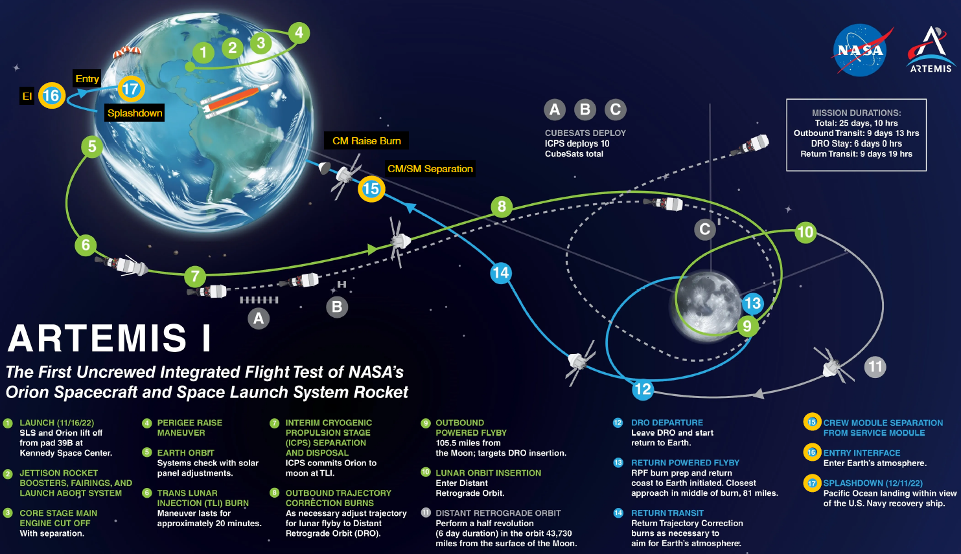
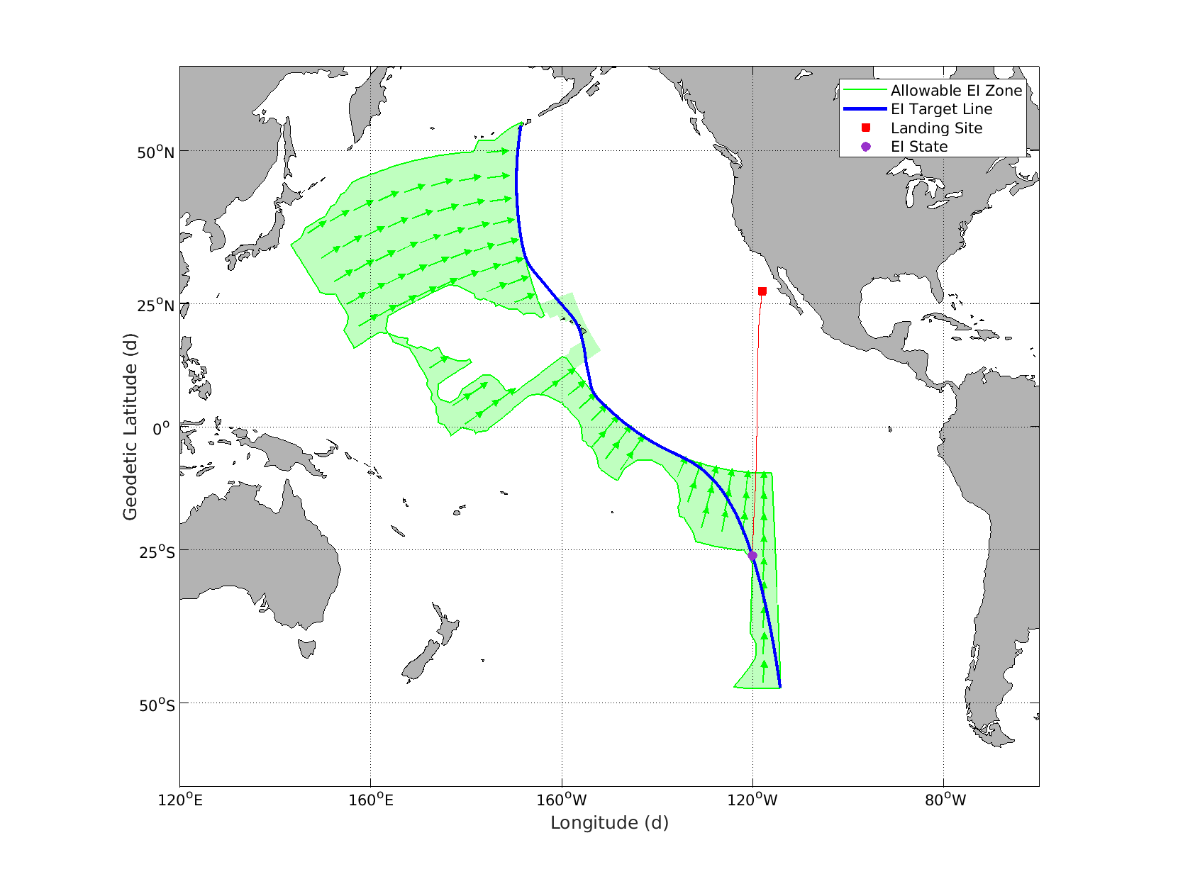
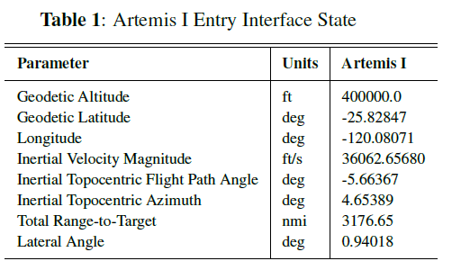
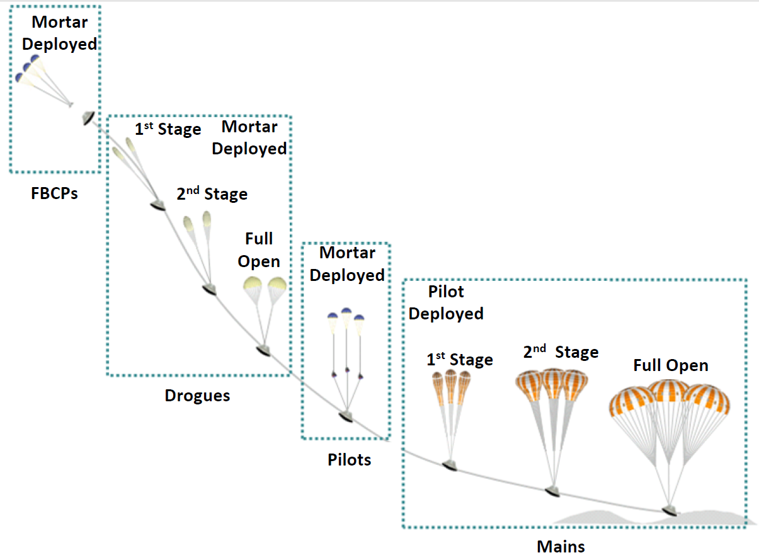
ARTEMIS I
Launched
November 16, 2022 at 1:47 am
Mission Duration
25 days, 10 hours, 53 minutes
Primary landing zone near San Diego
Skip entry allows access across lunar month
Artemis I shifted 300 nmi south due to weather
EI to splashdown range ~3200 nmi

Slide 3
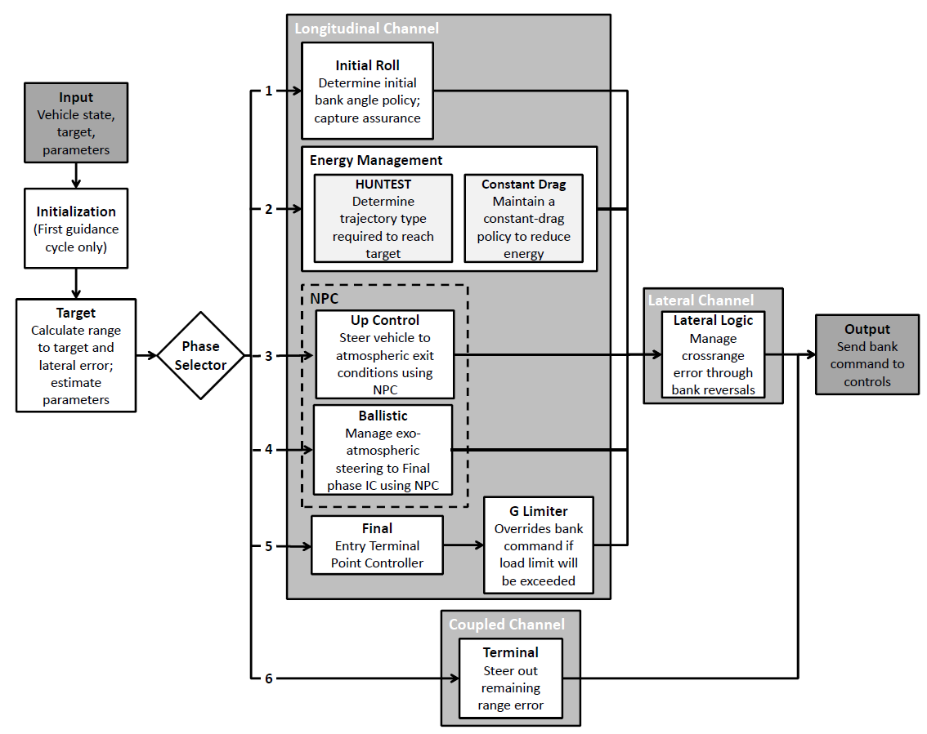
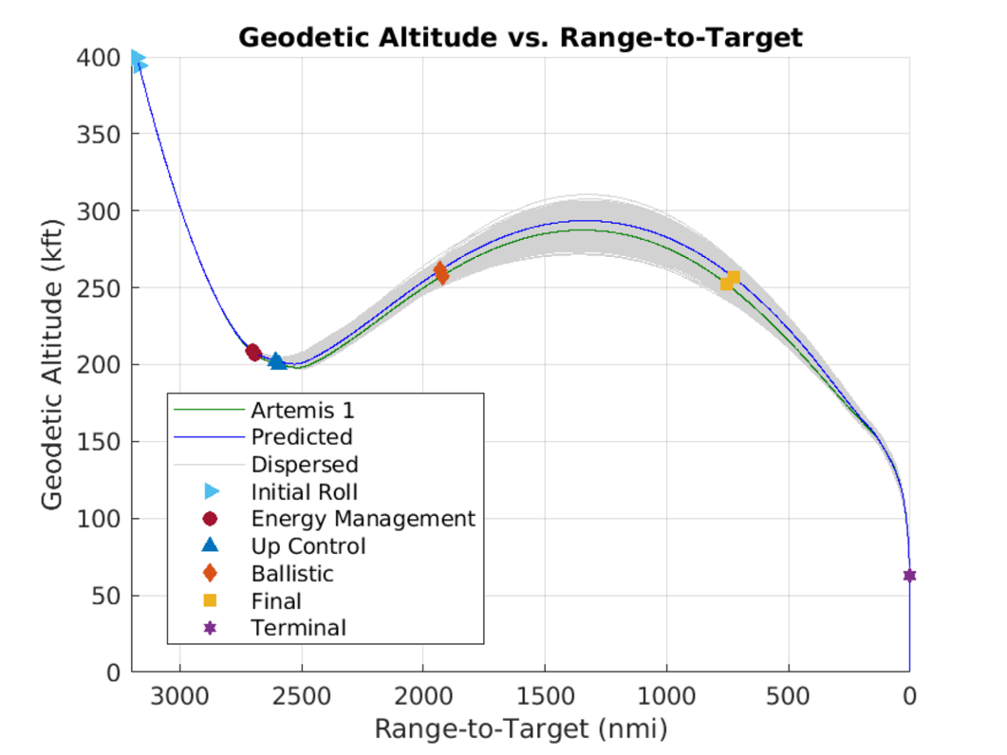
PREDGUID ENTRY GUIDANCE
Generates bank command to achieve target
Based on Apollo entry guidance, with changes only where needed to improve performance
Numerical Predictor-Corrector (NPC) for range prediction, rather than analytic methods, in early entry guidance phases
In-flight estimation of atmospheric density and vehicle lift-to-drag ratio (L/D)
Interpolation of the Final phase reference trajectory, rather than nearest-neighbor
Addition of Terminal phase steering
Decoupled downrange and crossrange channels
NPC taken from Aeroassist Flight Experiment
Propagates constant bank angle solution
Iterates on bank angle to converge on range
Six phases

Slide 4
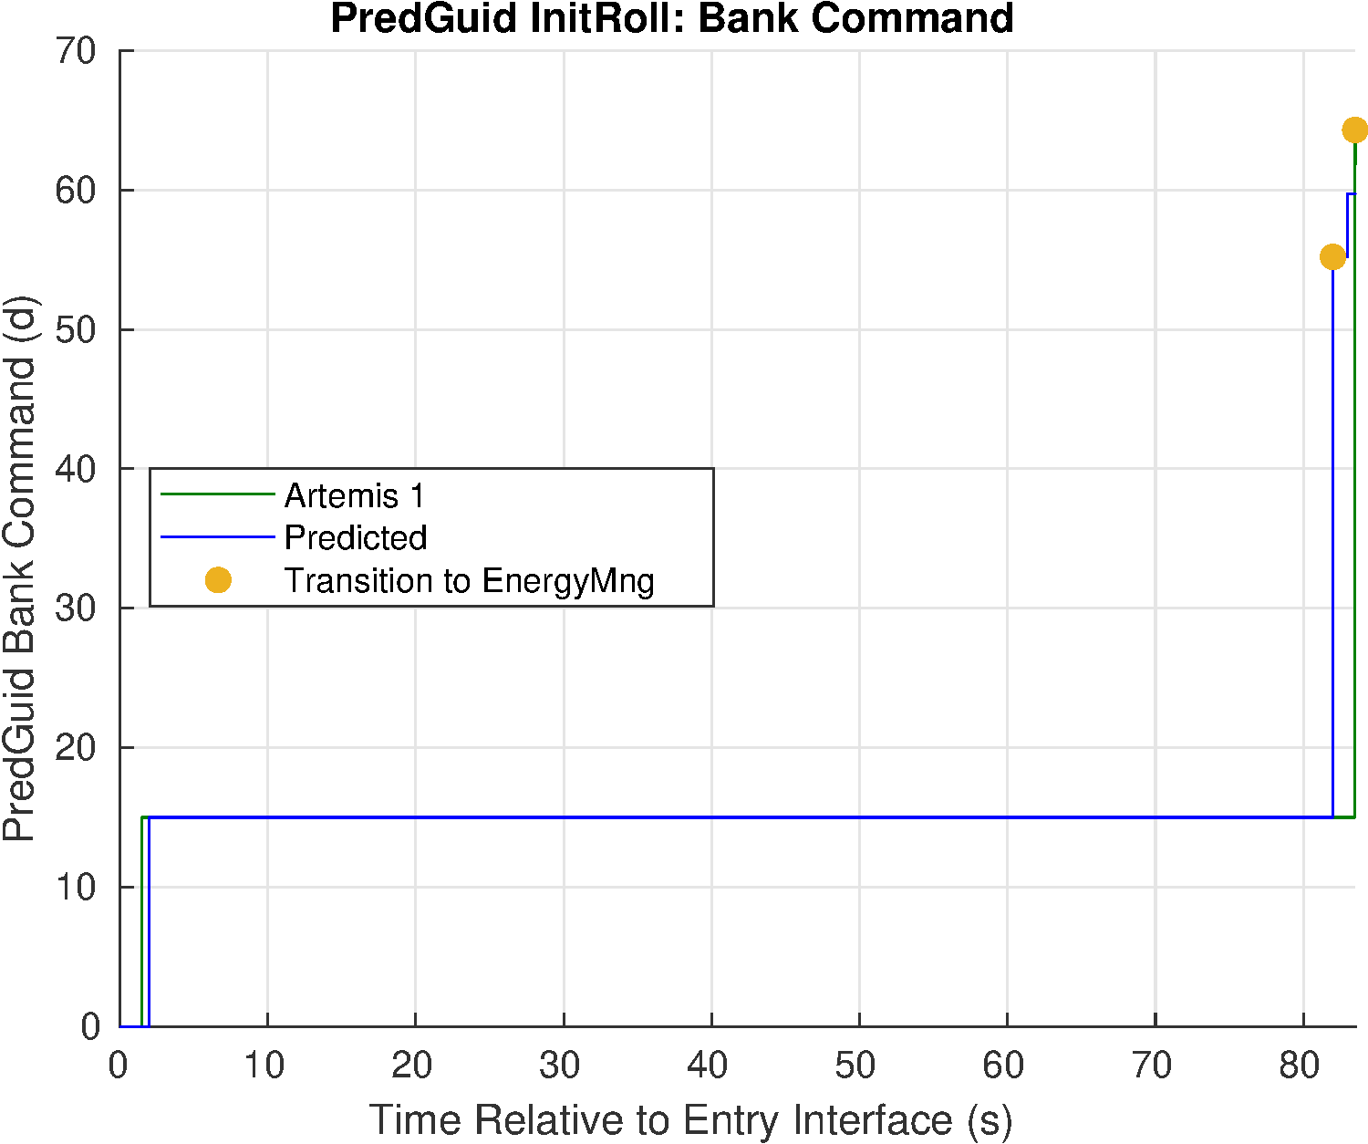
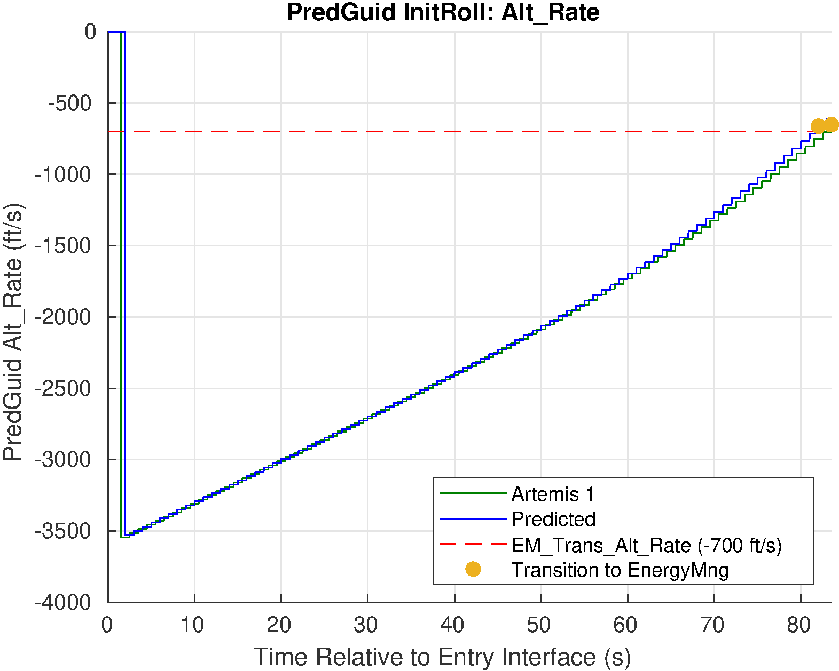
PREDGUID PHASE 1: INITIAL ROLL
Holds pre-selected bank angle
Includes skip out protection to command full lift-down if entry is too shallow
Skip out protection was not triggered during Artemis I
Transitions to Energy Management phase when altitude rate goes above -700 ft/s

Slide 5
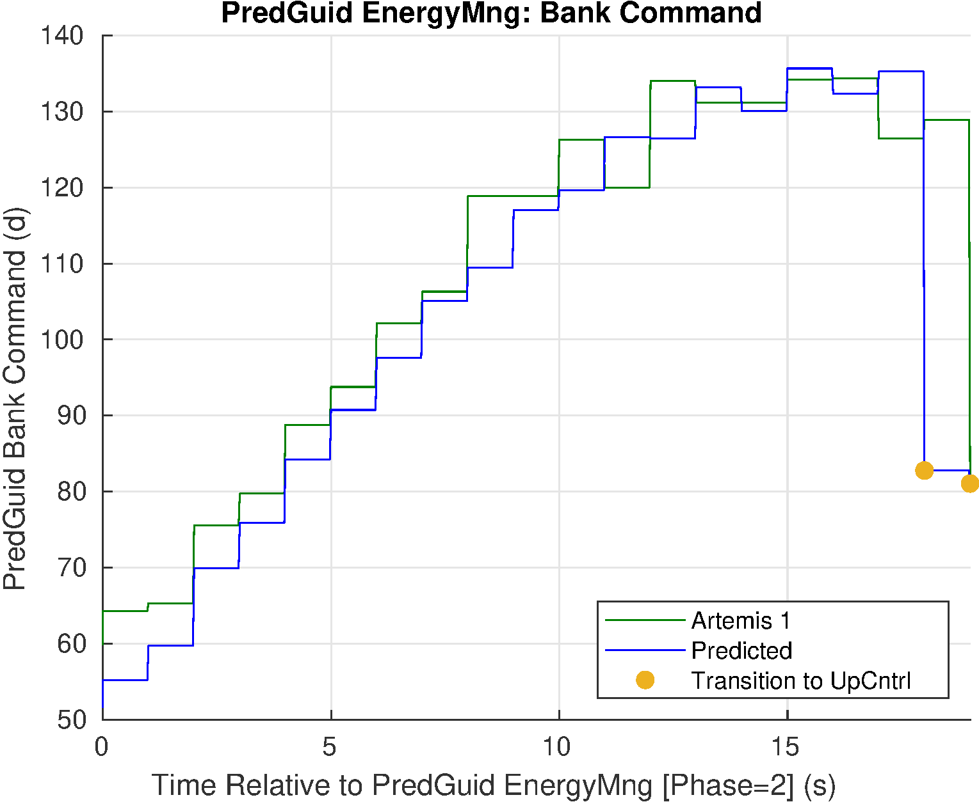
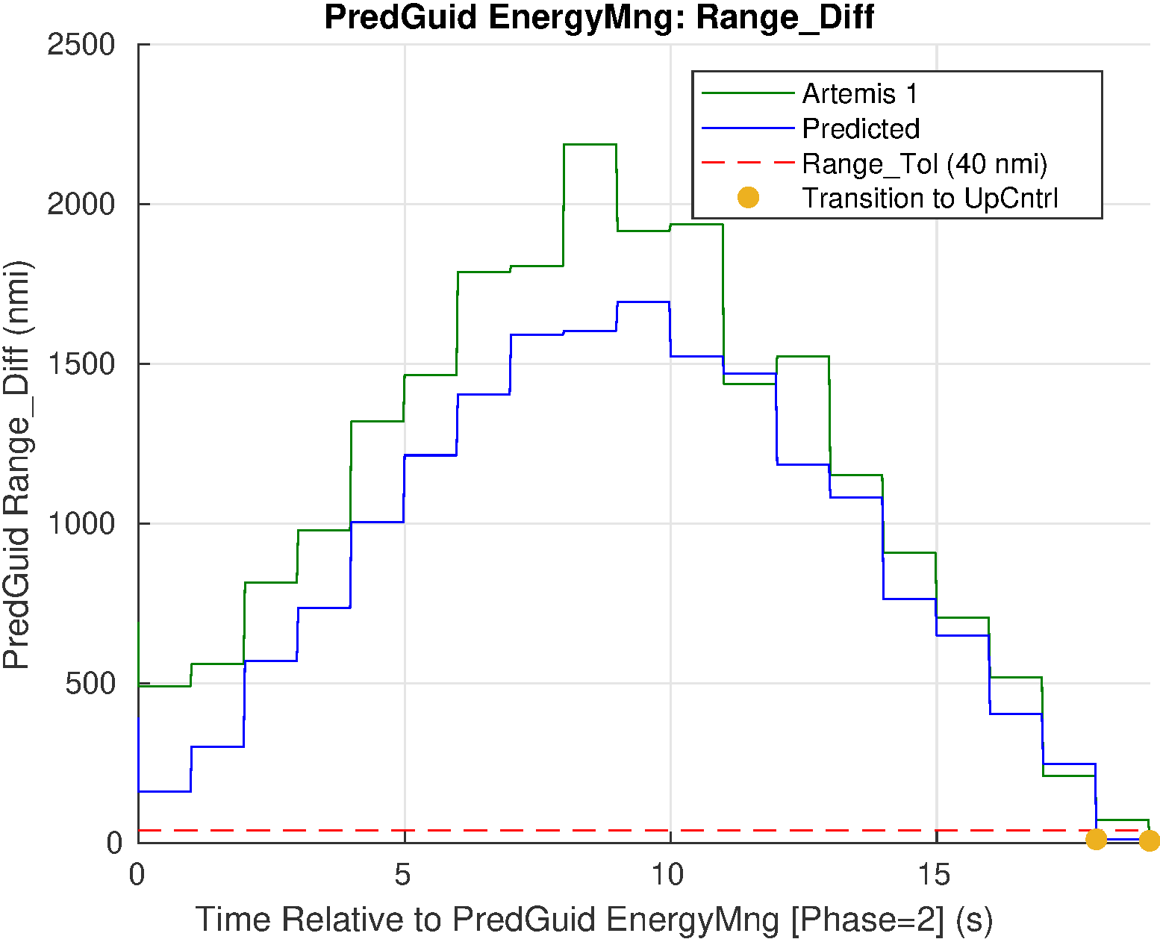
PREDGUID PHASE 2: ENERGY MANAGEMENT
Retains original Apollo formulation of analytic predictor-corrector
Two subphases
Huntest
Analytically propagates a constant vertical L/D to find the range between current state and the initiation of the Final phase
Iterates on speed to converge on the range
Constant Drag
Selects the bank needed to bleed off energy to achieve the speed
Transitions to Up Control when the range converges
Differences between the predicted and actual trajectories are due to atmospheric and vehicle variations

Slide 6
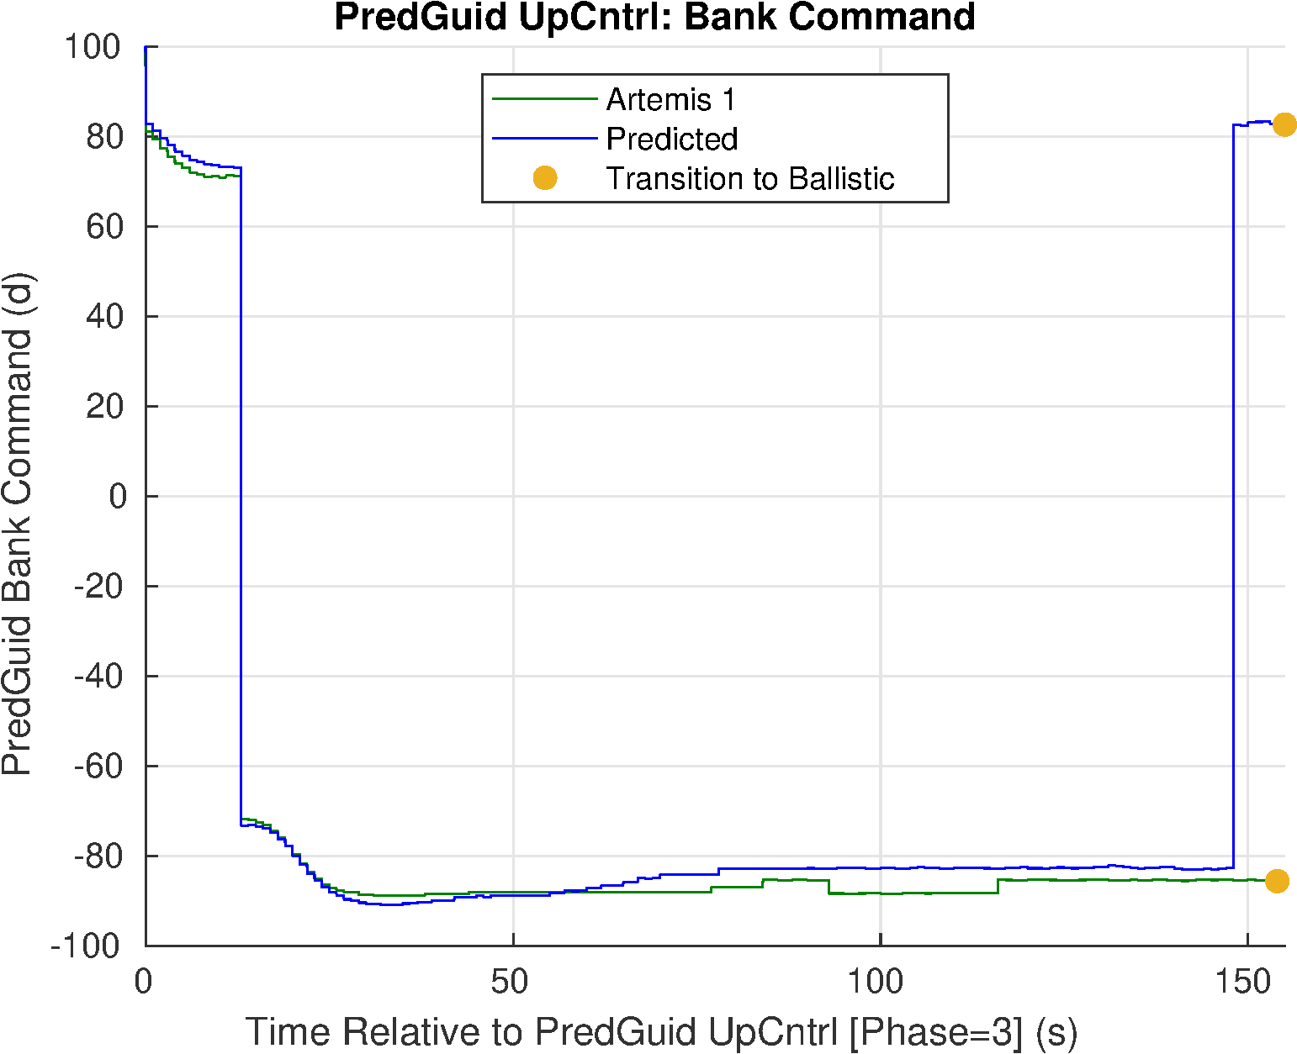
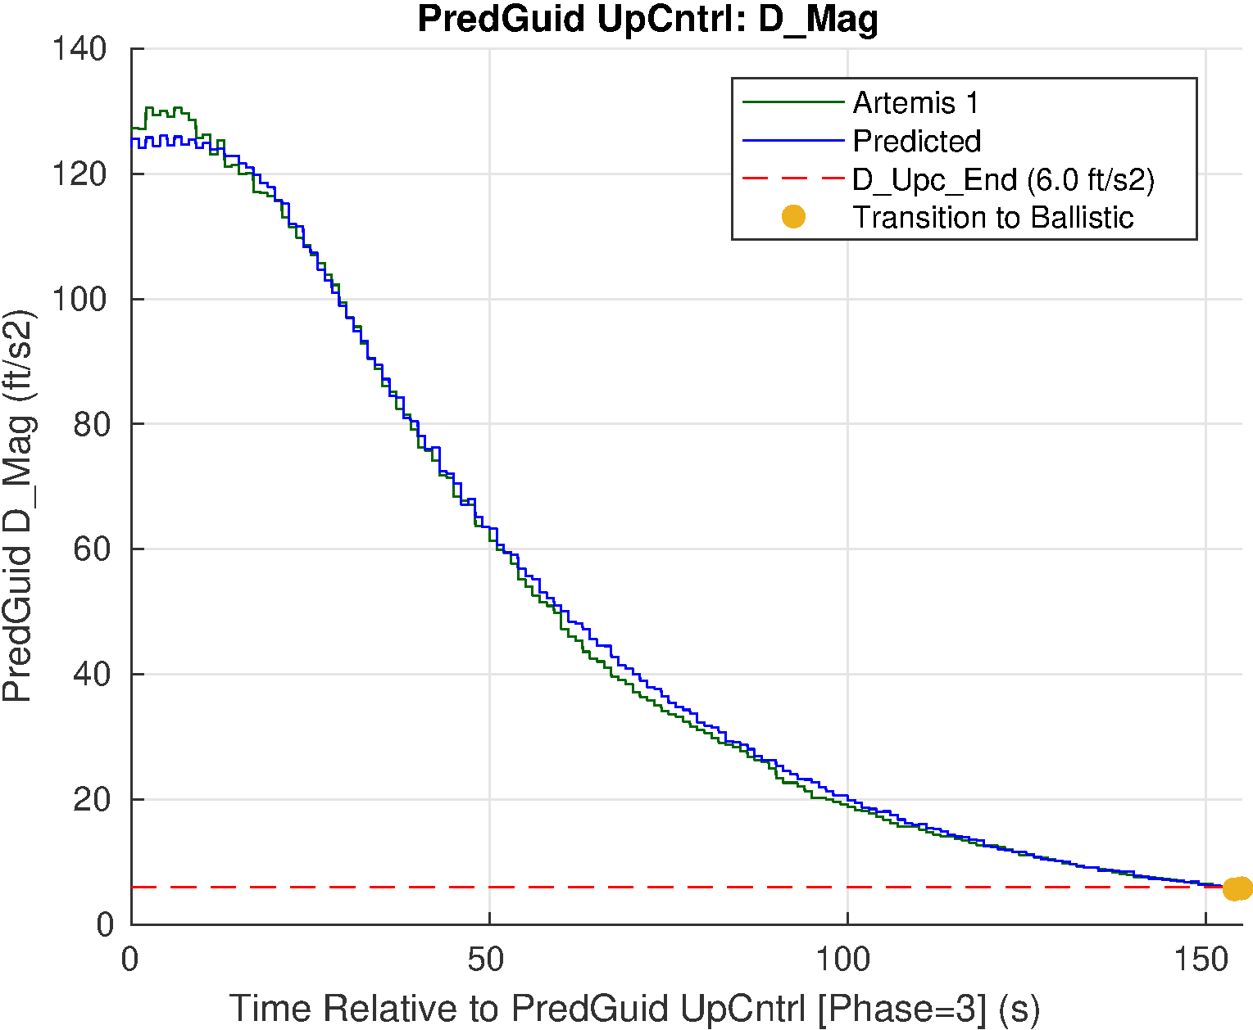
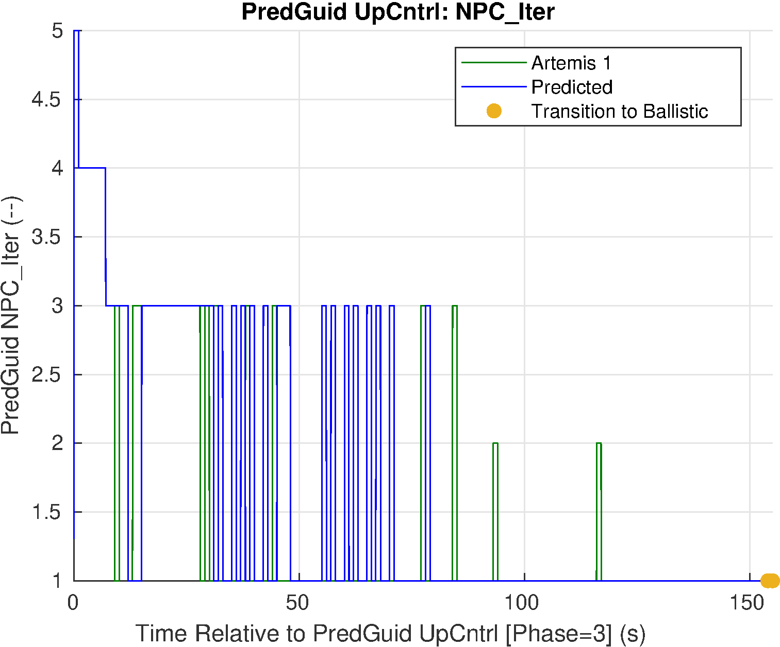
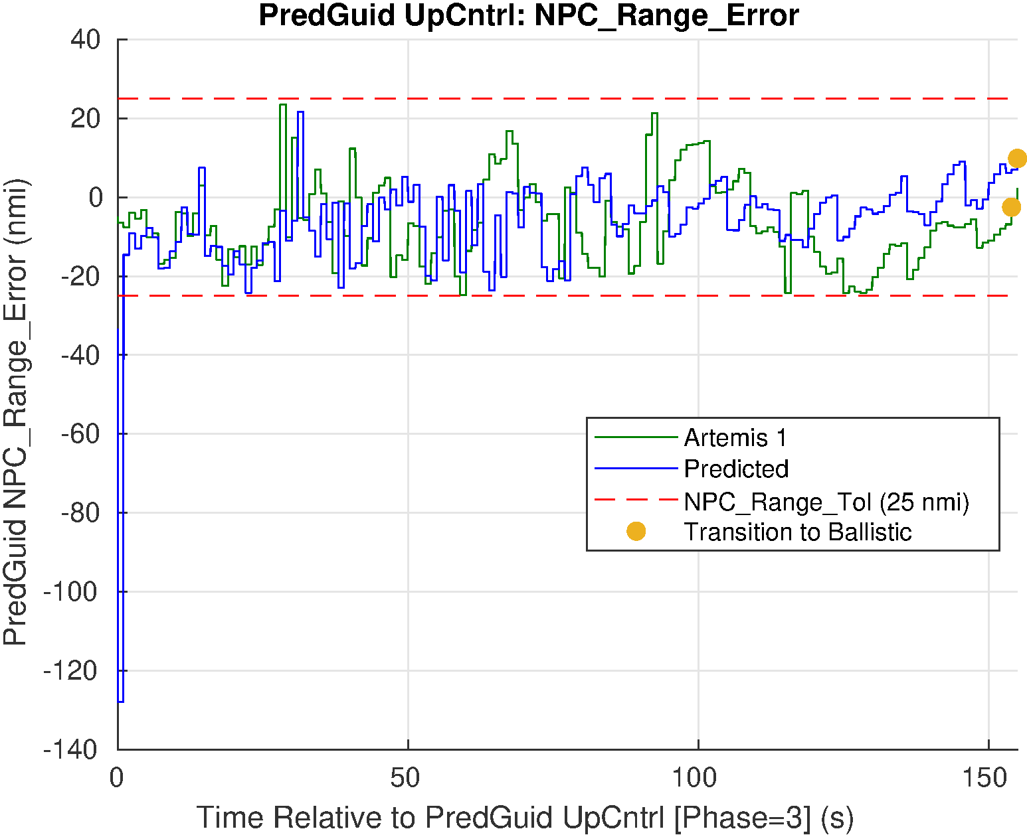
PREDGUID PHASE 3: UP CONTROL
Numerical Predictor Corrector
Uses in-flight estimated density and L/D
Transitions to Ballistic phase upon exit of sensible atmosphere

Slide 7
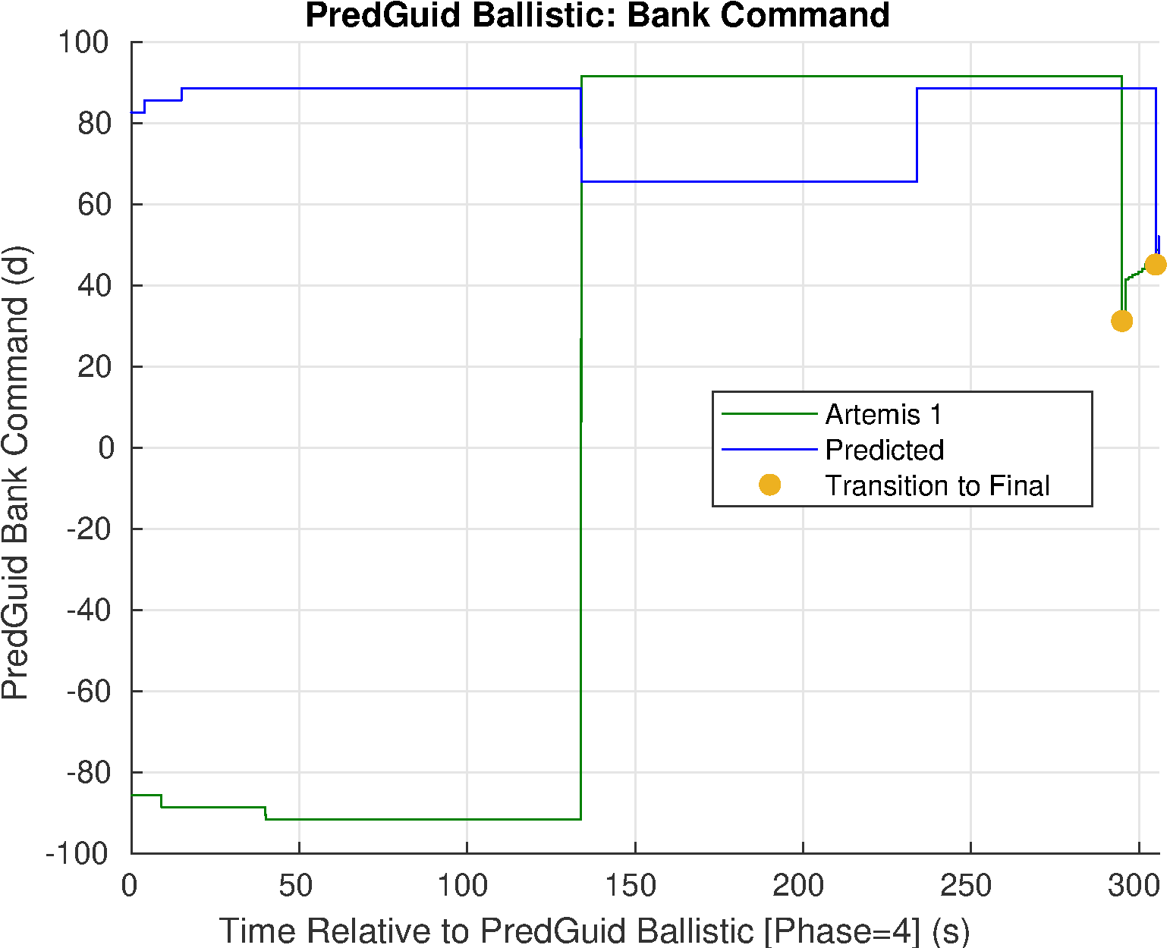
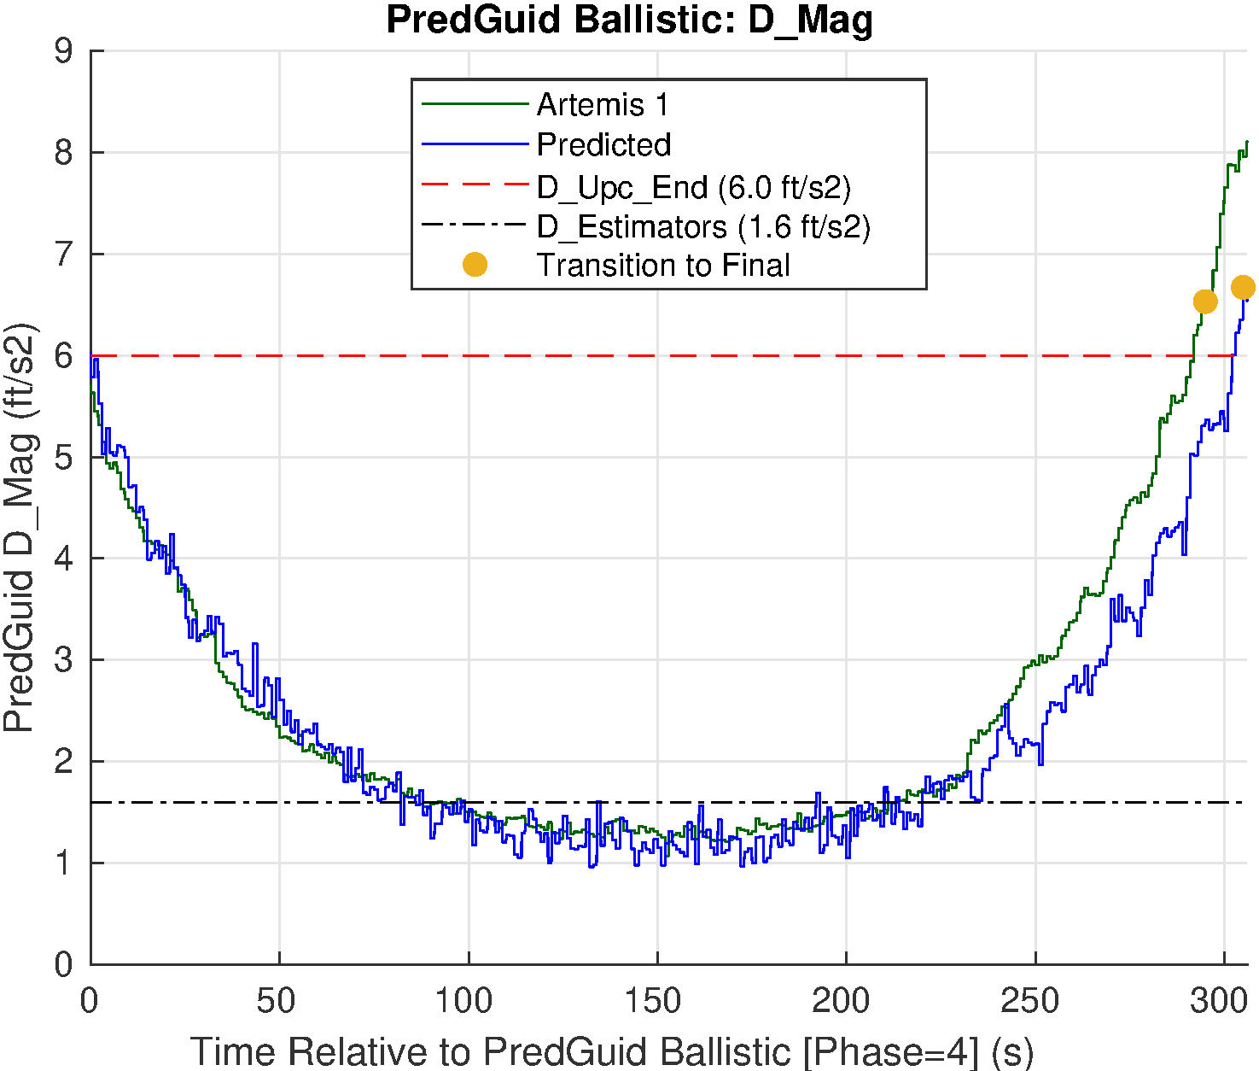
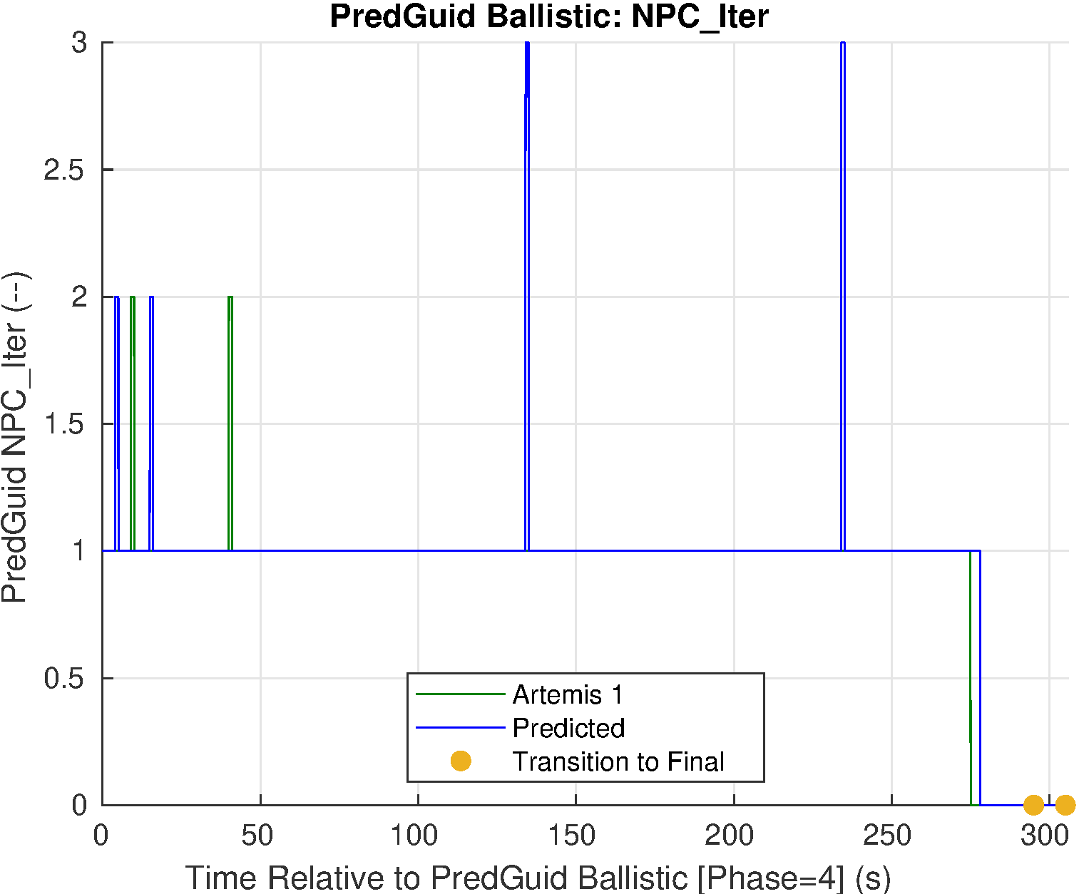
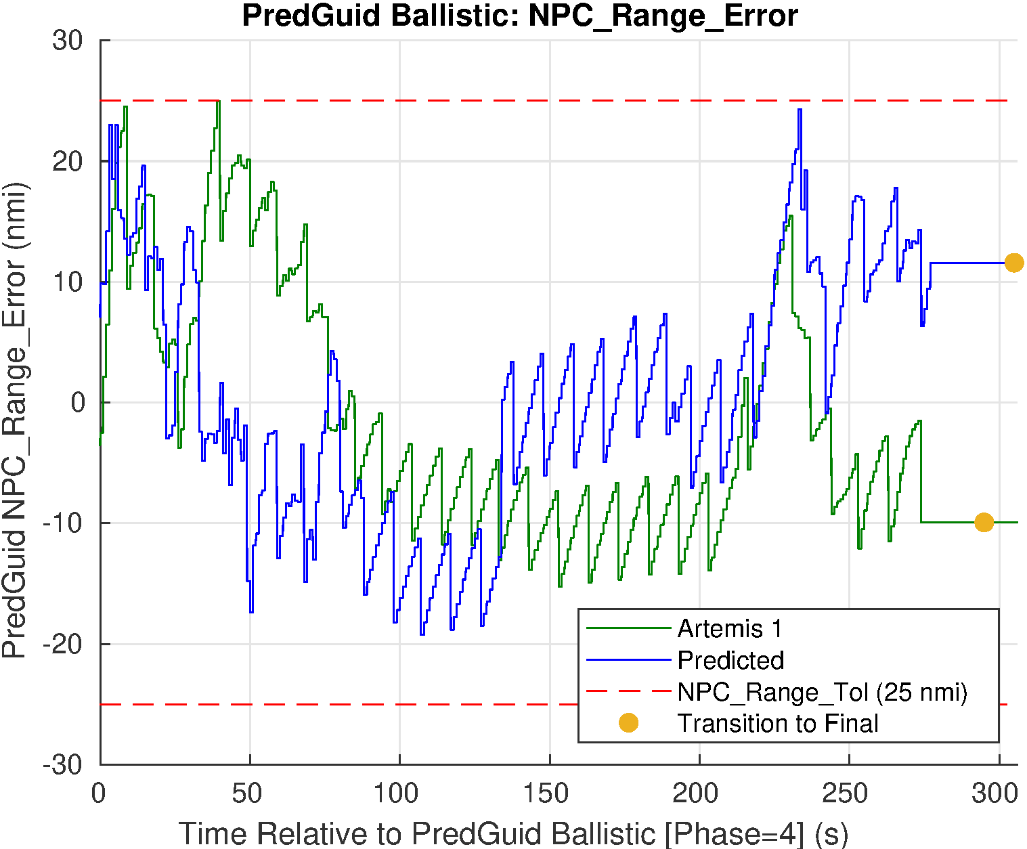
PREDGUID PHASE 4: BALLISTIC
Low drag phase of flight
Numerical Predictor Corrector
Continues to update guidance command
Uses in-flight estimated density and last estimated L/D before atmospheric exit

Slide 8
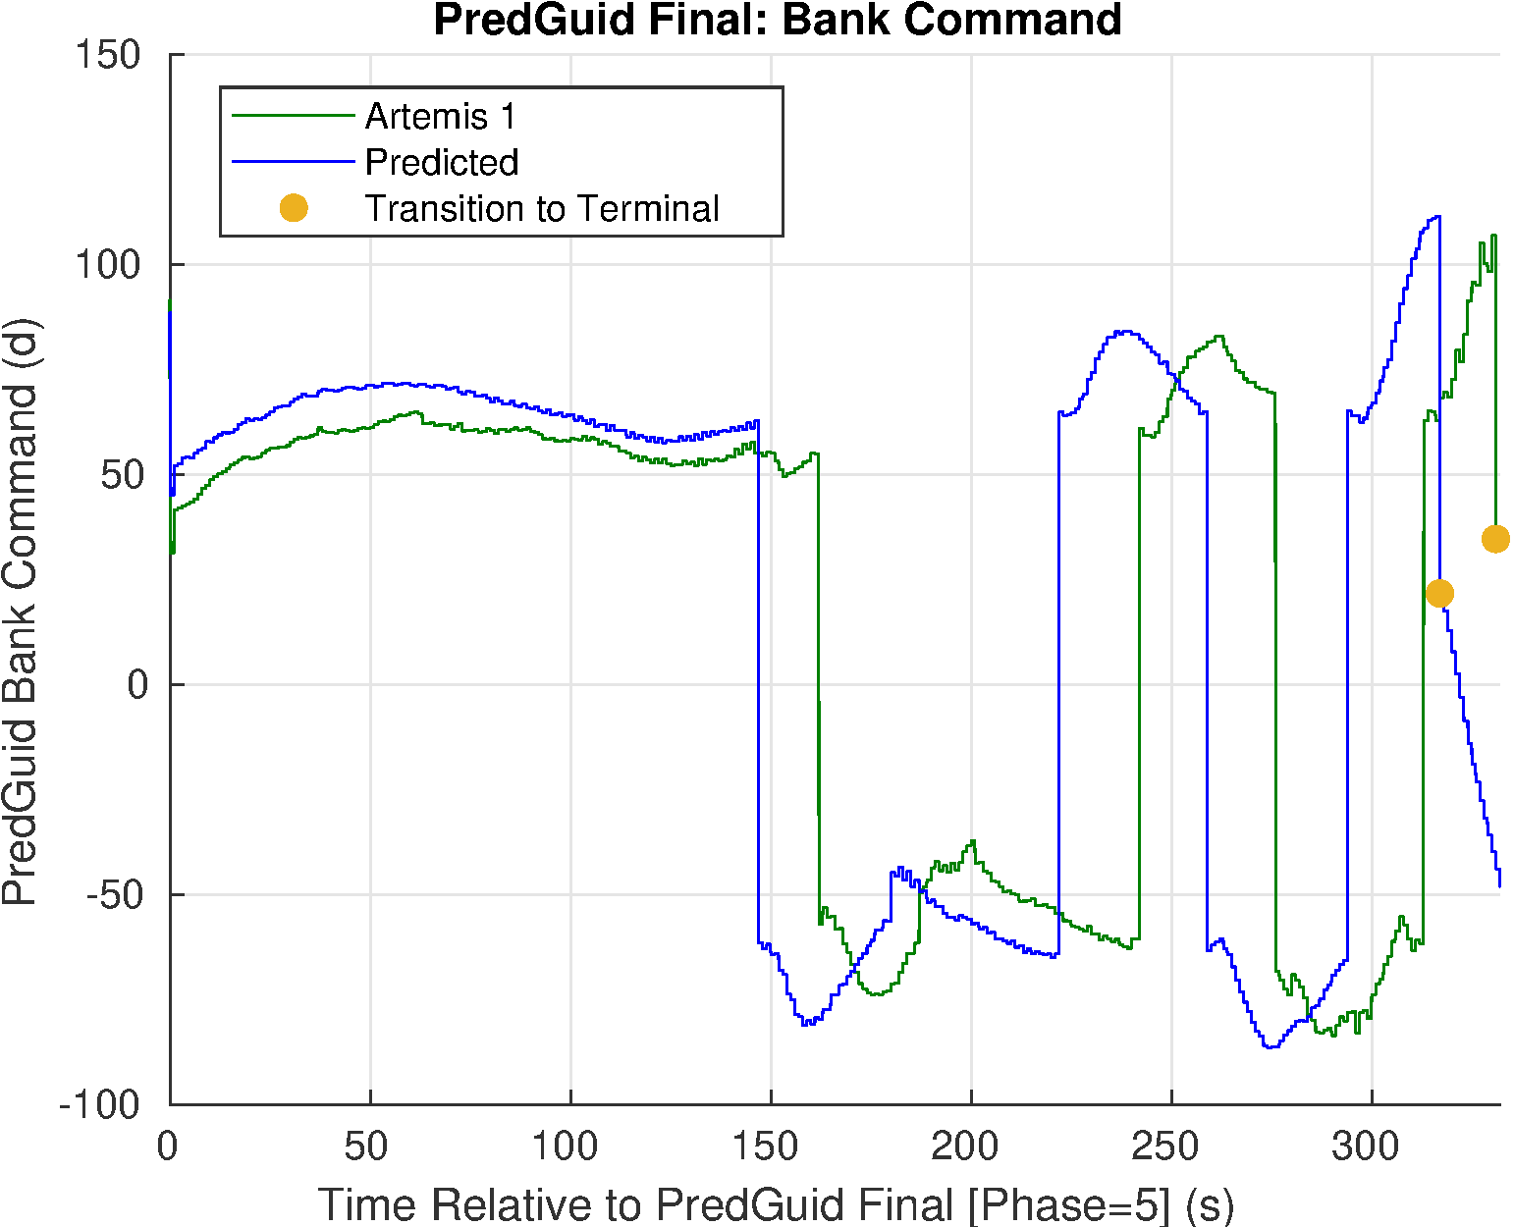
PREDGUID PHASE 5: FINAL
Uses Apollo formulation of Entry Terminal Point Controller
Stored reference trajectory and gains
Includes g-limiter to alter bank angle in high gload scenarios
G-limiter was not triggered during Artemis I
Transitions to Terminal phase when speed drops below 1000 ft/s

Slide 9
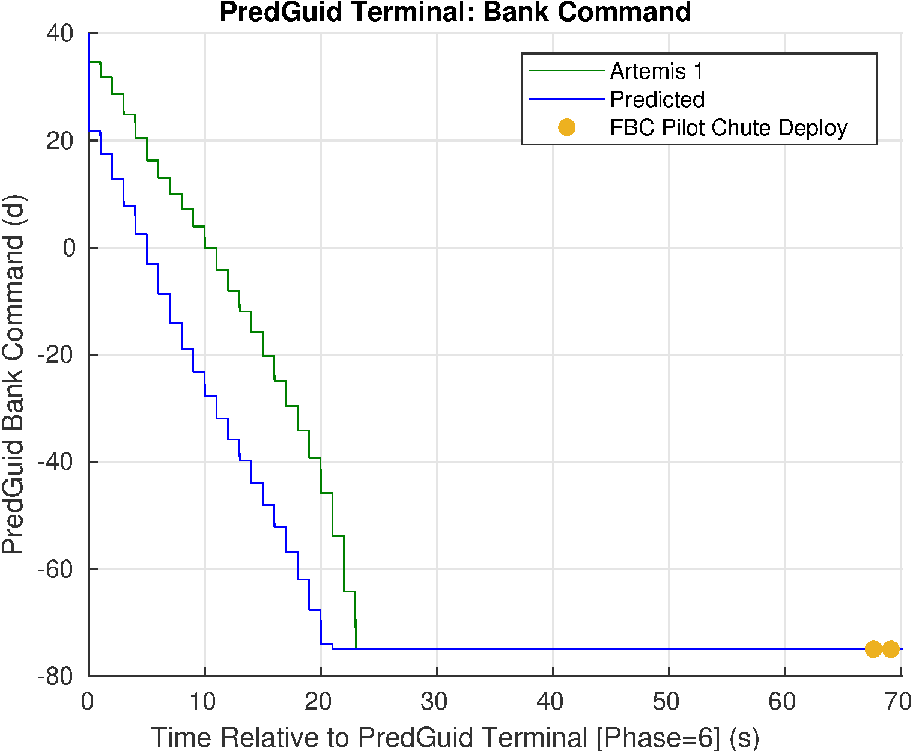
PREDGUID PHASE 6: TERMINAL
Simple proportional guidance based on heading error
Points at the target
Holds command if vehicle flies past target
Active guidance ends at beginning of chute sequence
Forward Bay Cover (FBC) pilot chute deploy

Slide 10
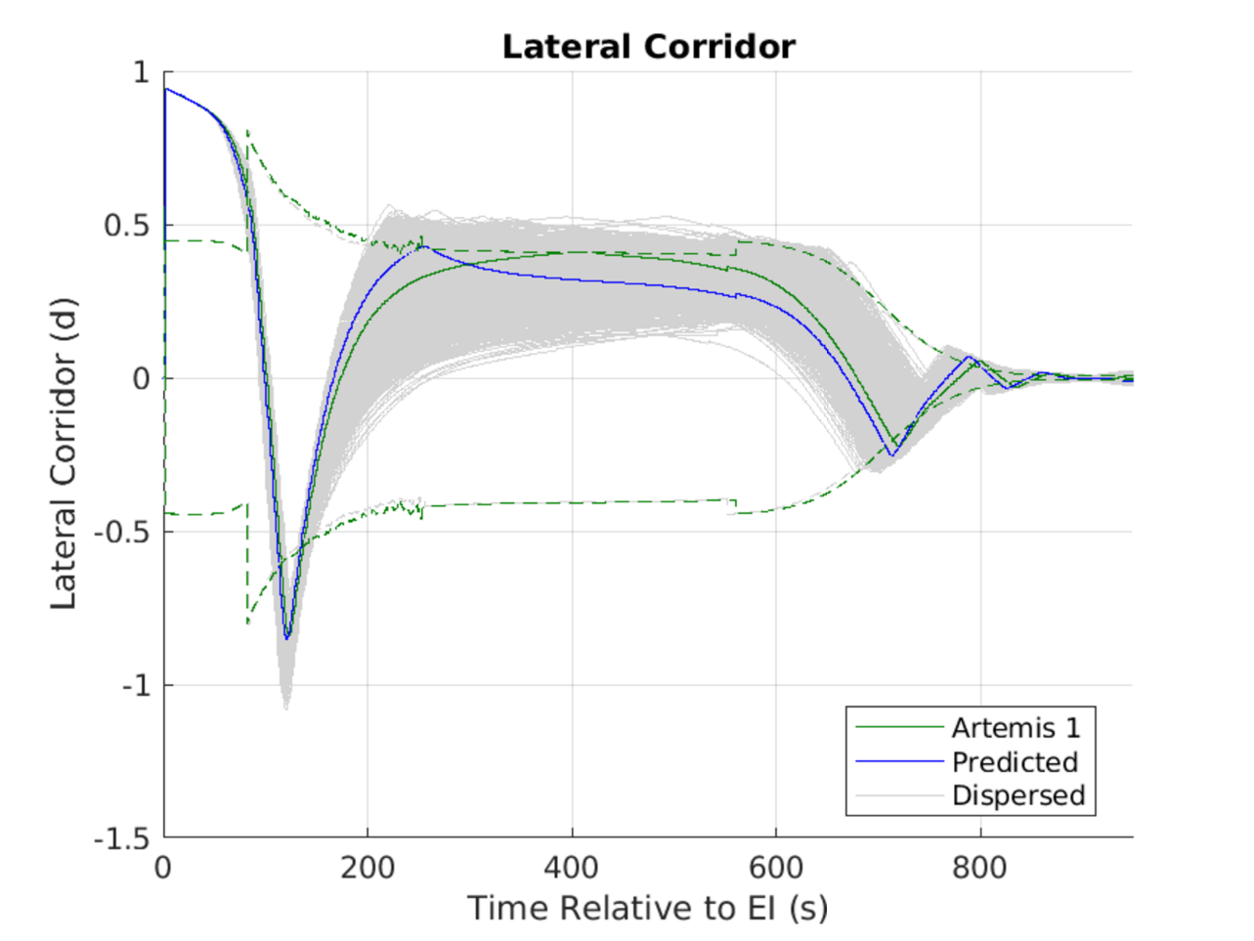
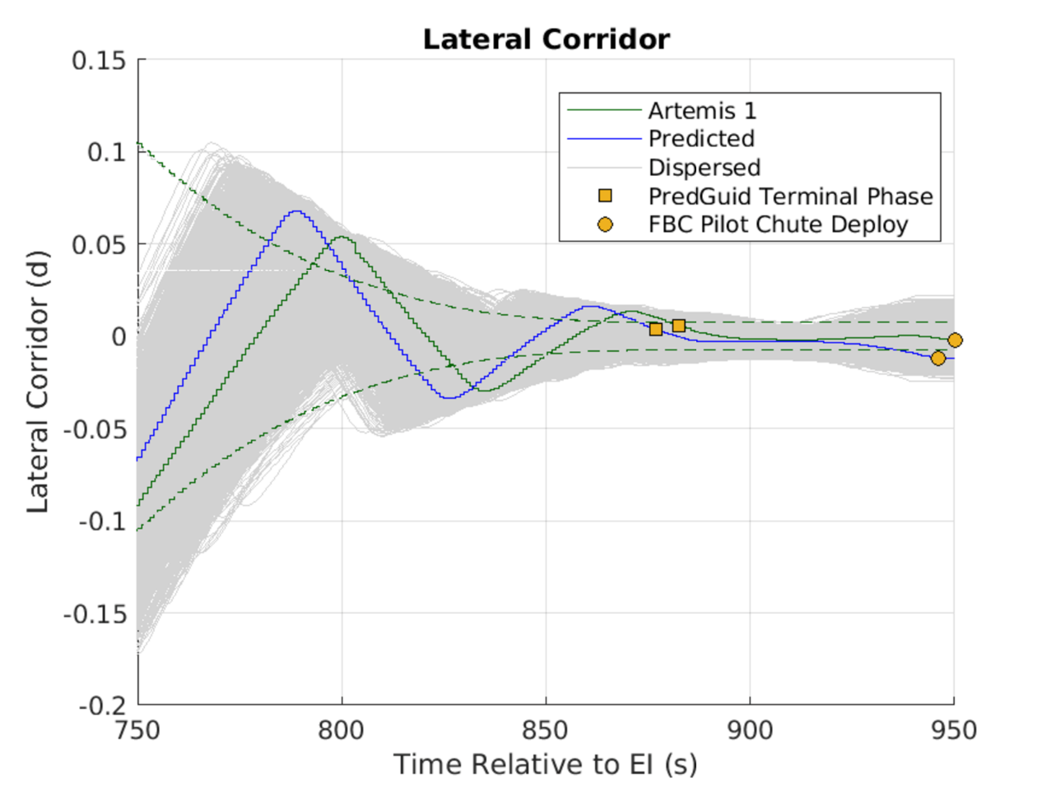
LATERAL CORRIDOR PERFORMANCE
Lateral channel controls crossrange using bank reversals
Lateral deadband based on speed and L/D
Guidance commanded 6 bank reversals during flight

Slide 11
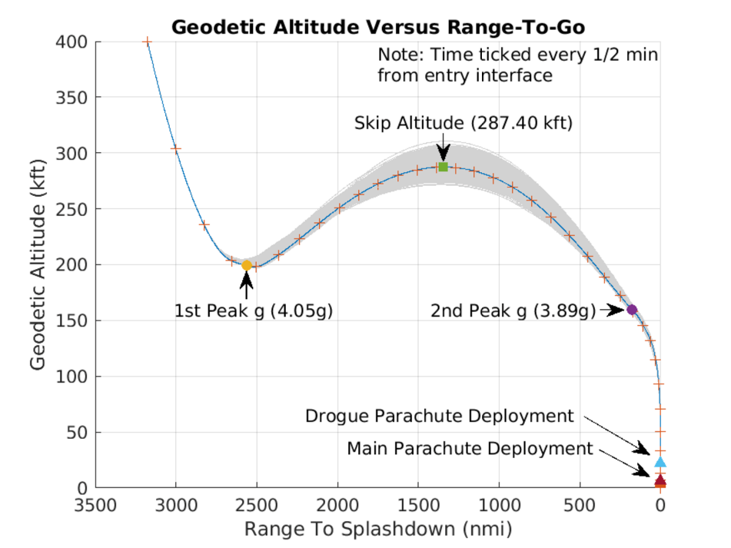
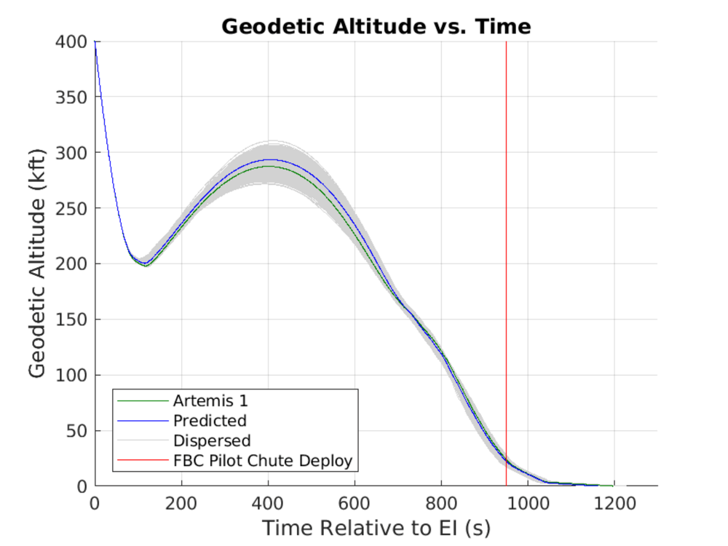
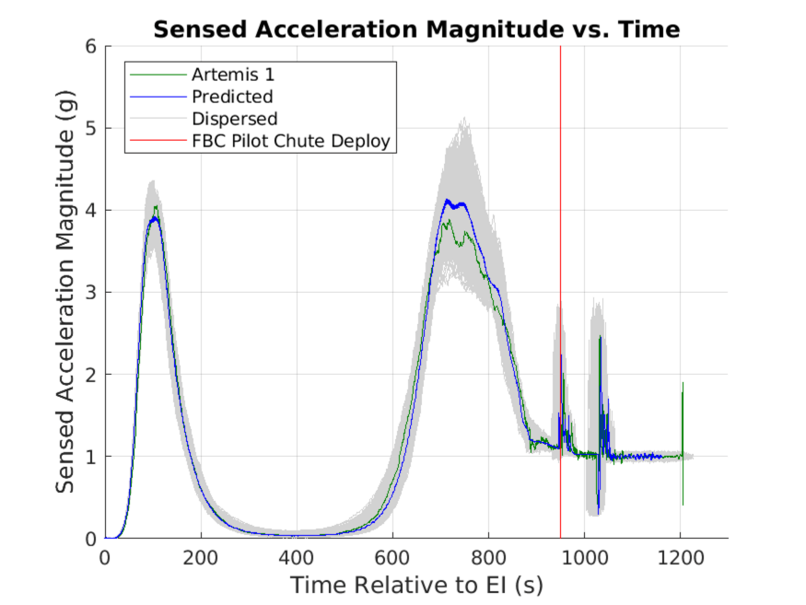
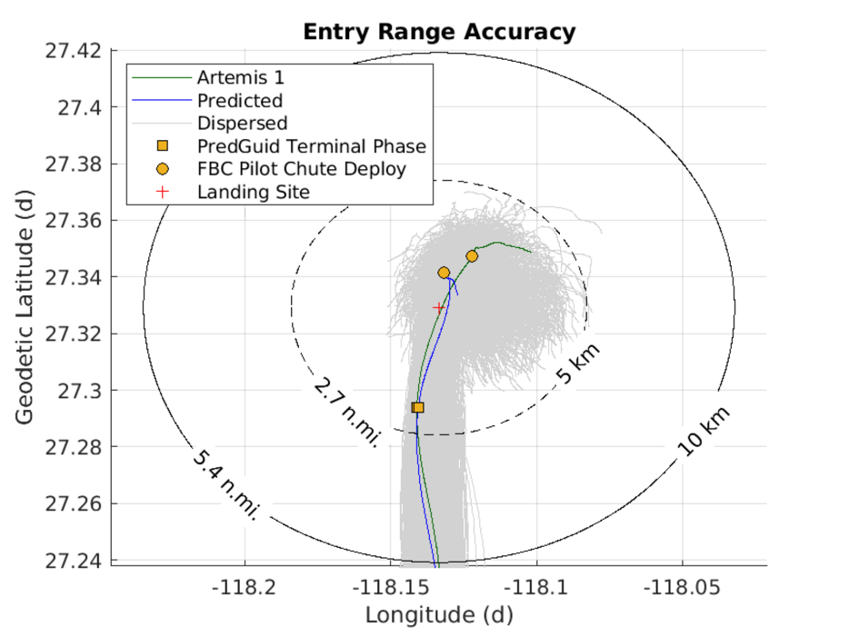
GUIDANCE RESULTS
During Artemis I flight, the Orion entry guidance operated as expected and achieved the targeted landing site within the required accuracy
The Artemis I flight did not skip as high as predicted
Predicted skip apogee: 293.5 kft
Actual skip apogee: 287.4 kft
Likely due to a less dense atmosphere during the first pass and slightly less lift-to-drag (L/D) than predicted.
This data shows a successful skip entry

Slide 12
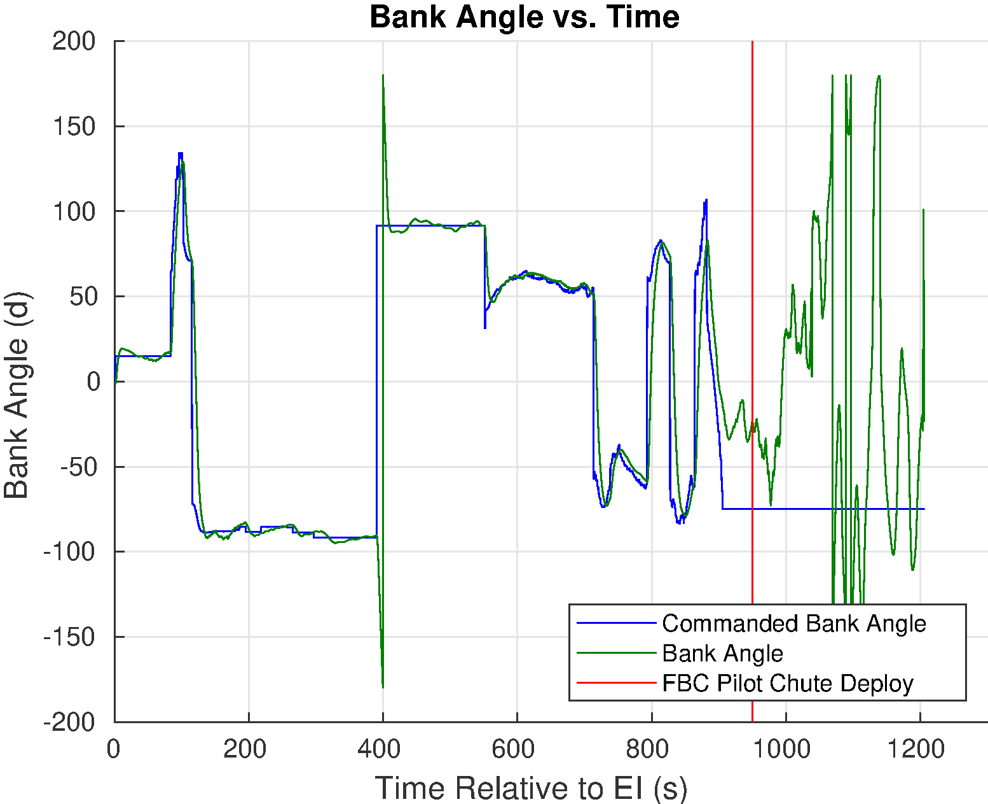
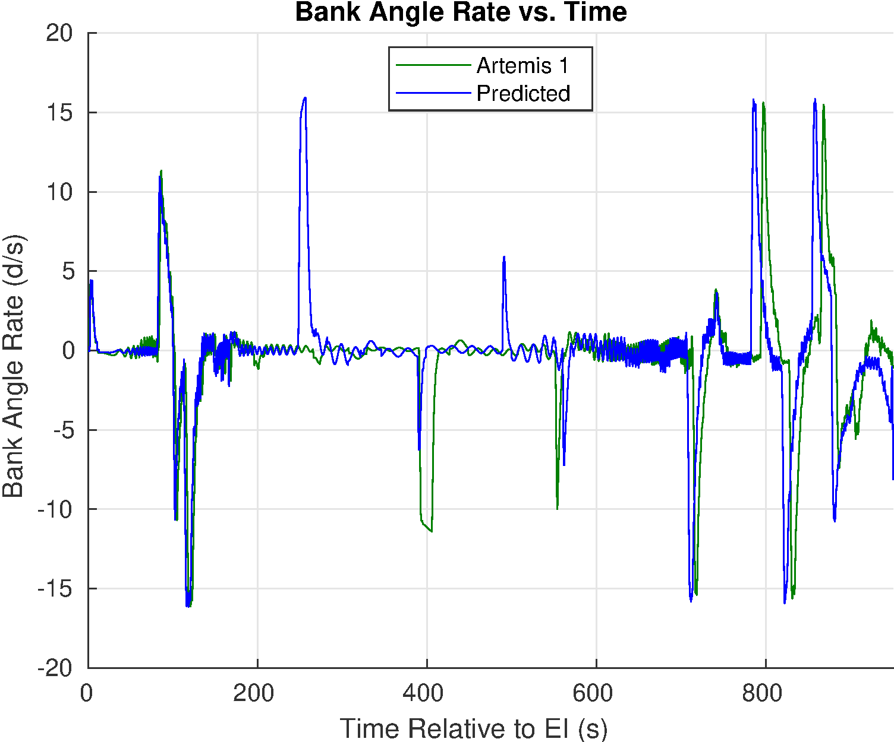
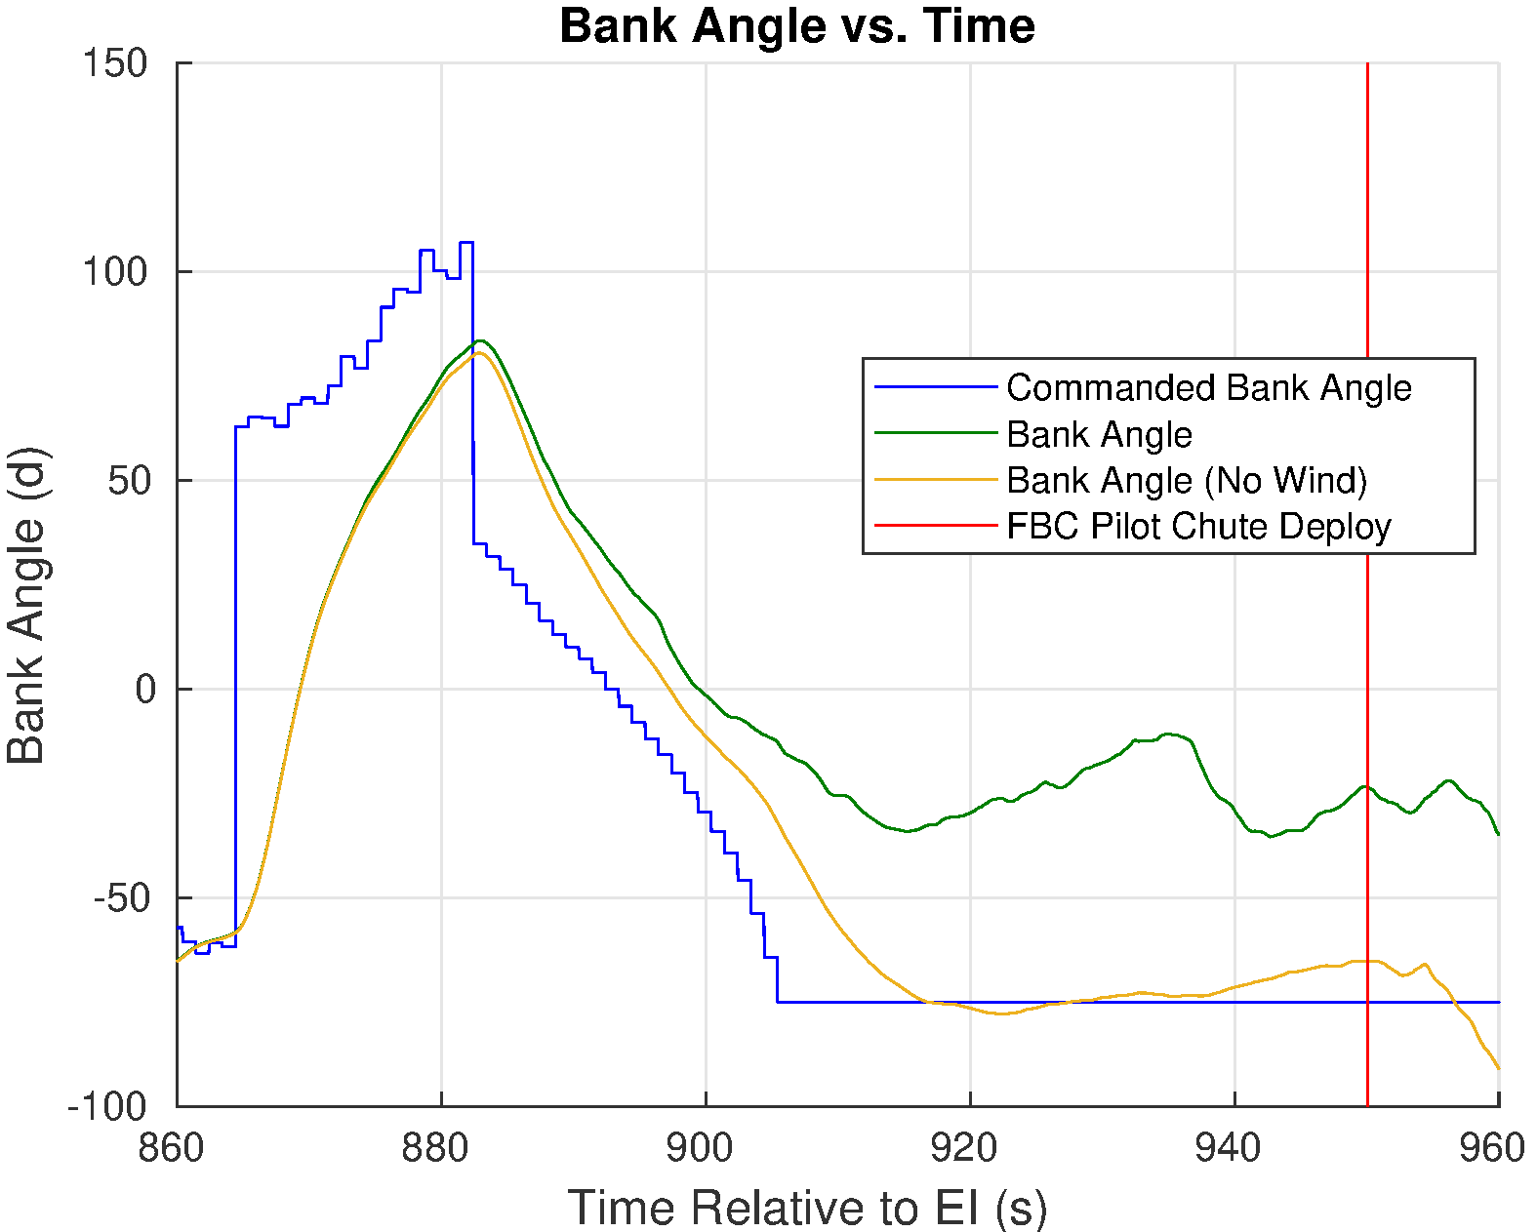
BANK ANGLE
Navigated bank angle tracks commanded bank angle very well until the last 90 seconds of guided flight
Navigated bank angle assumes no wind
As the vehicle slows down, the wind speed becomes significant relative to the speed of the vehicle
Assumption to ignore wind in the on-board computation of bank angle breaks down
Contributing factor to the miss distance at chute deploy

Slide 13
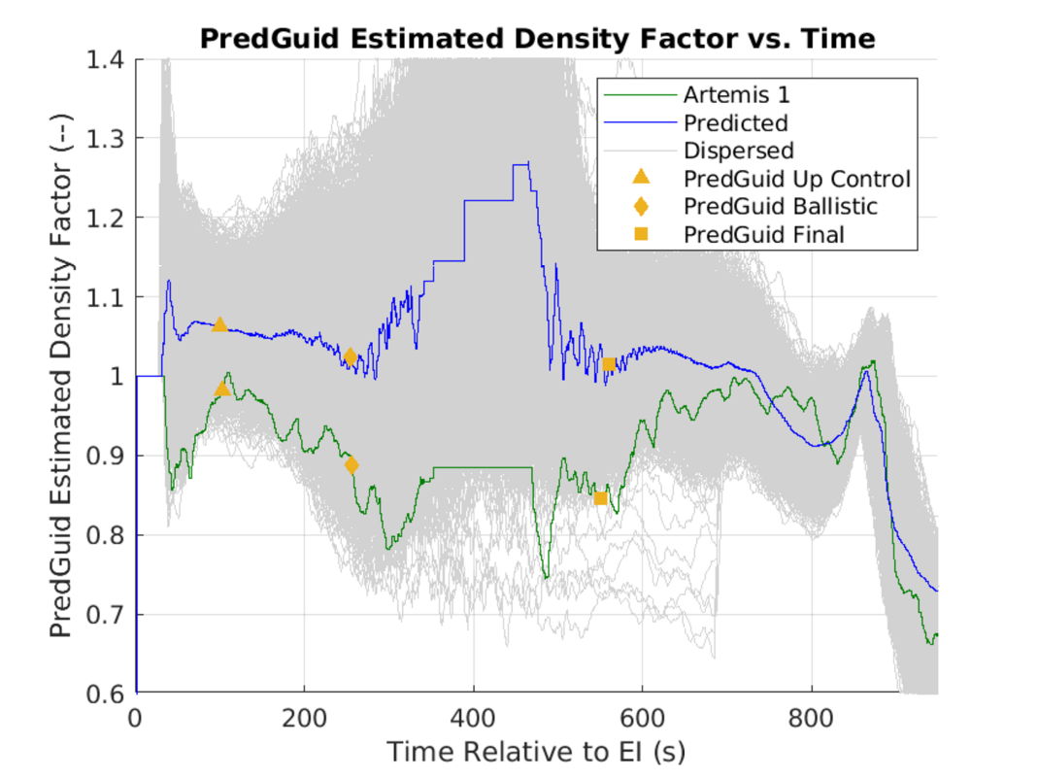
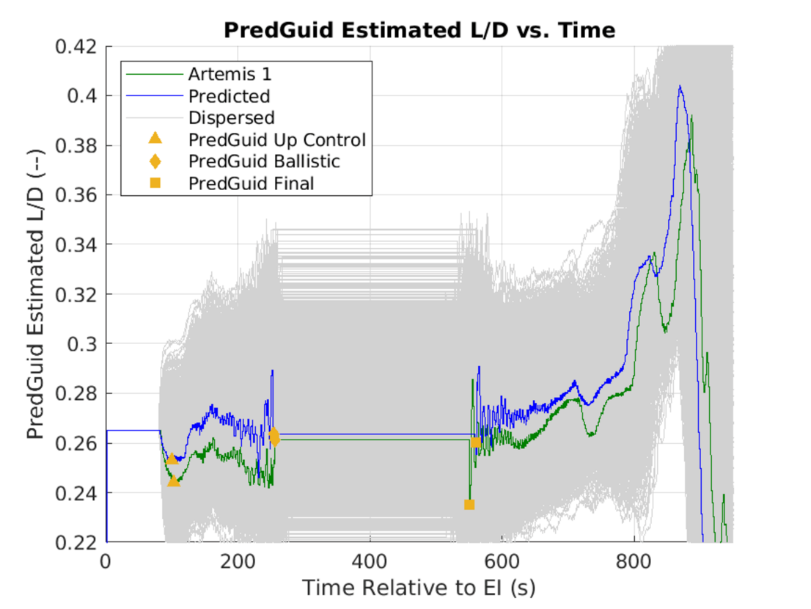
DENSITY AND L/D ESTIMATOR PERFORMANCE
Measured acceleration used to estimate:
Density scale factor applied to on-board 1976 standard atmosphere
Lift-to-drag ratio
Artemis I flight experienced ~10% less dense atmosphere and ~5% less L/D than predicted
Within expected dispersion envelope
Most likely cause of differences between predicted and actual flight

Slide 14
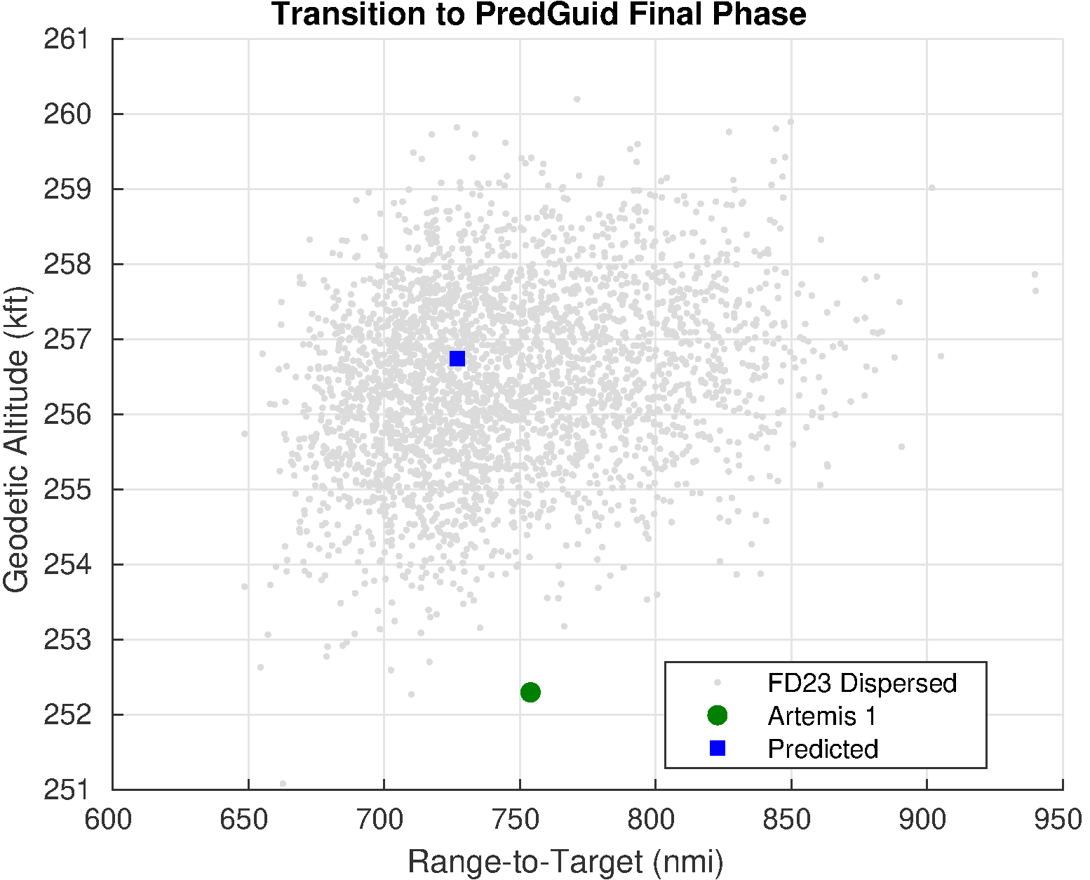
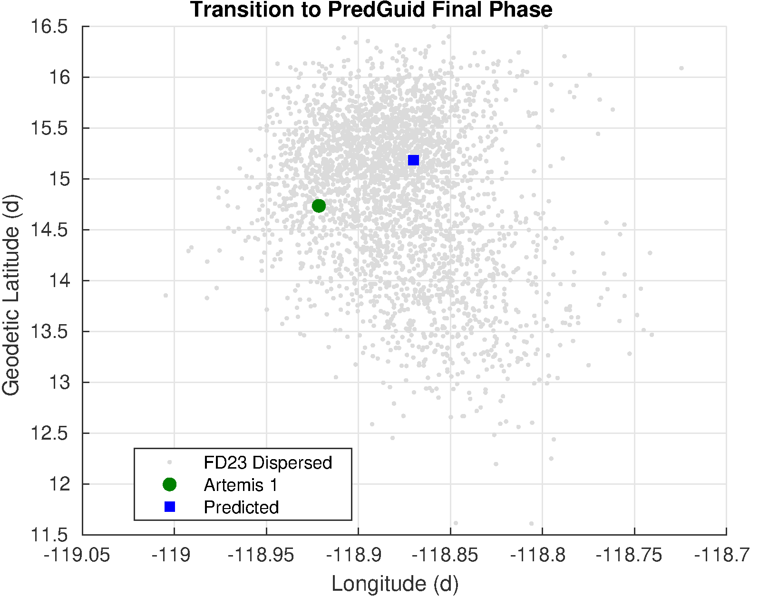
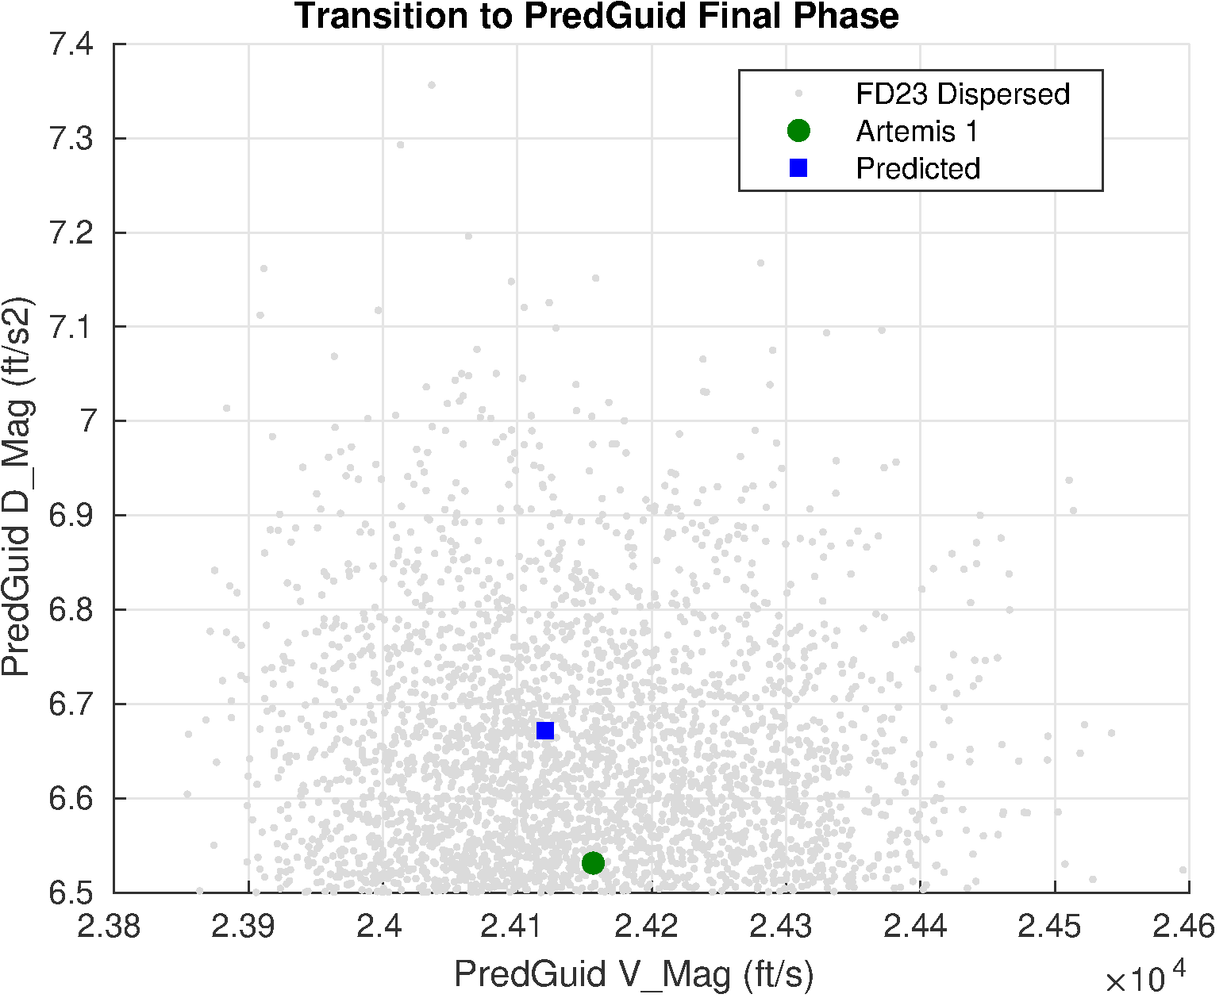
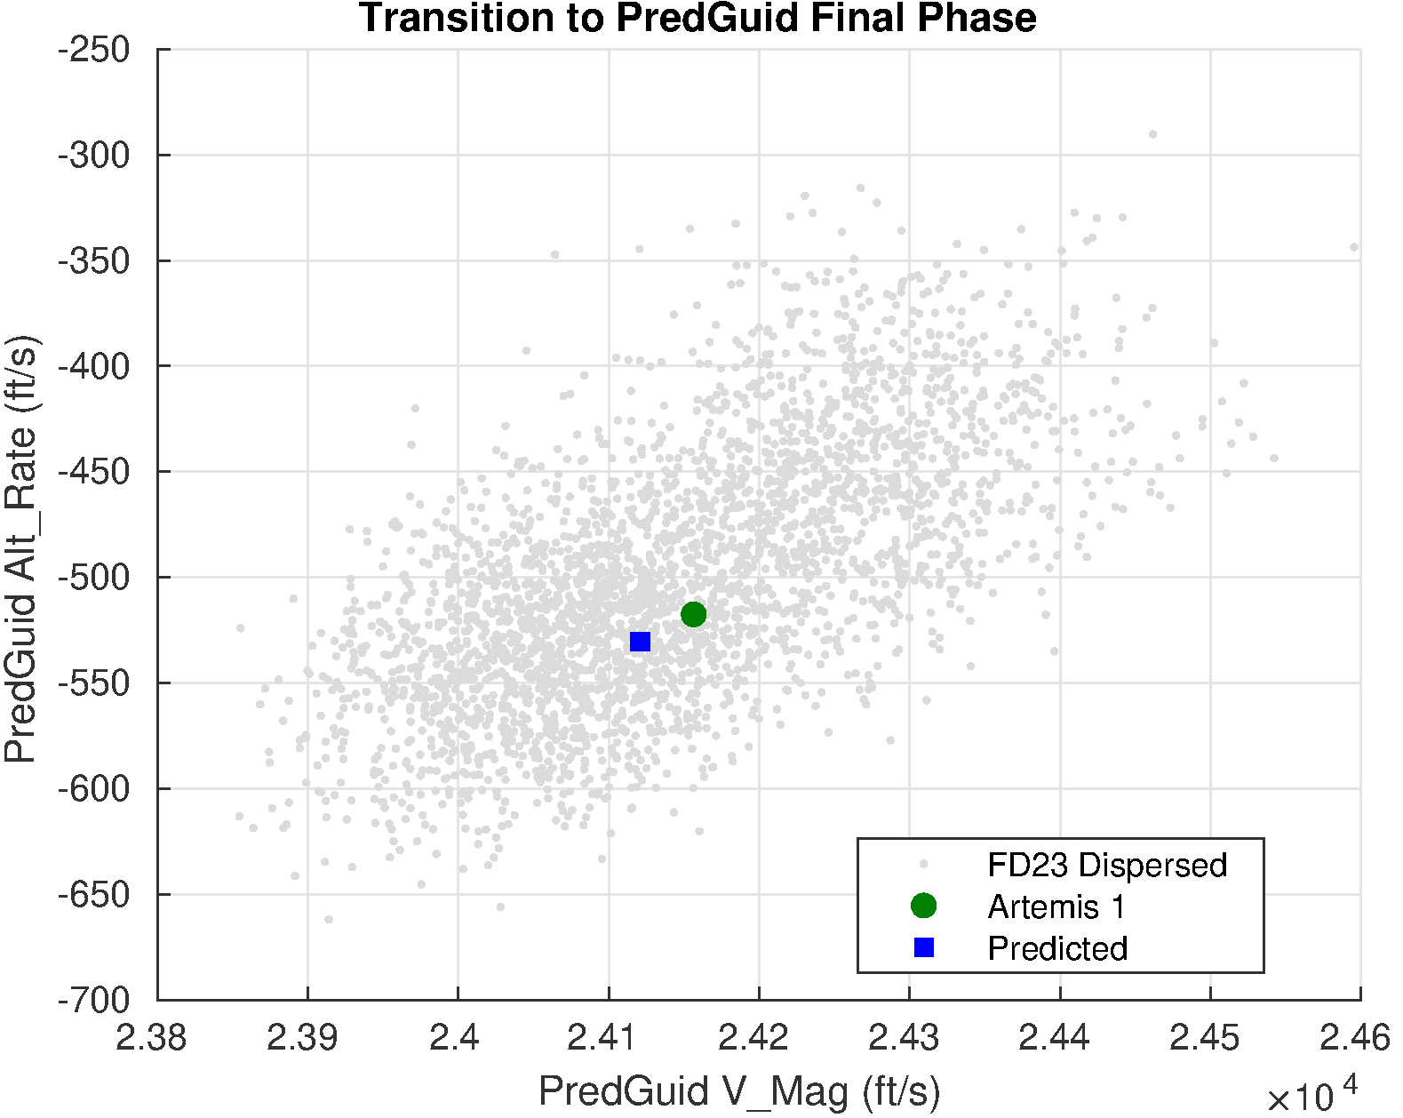
TRANSITION TO FINAL PHASE
Transition to Final phase is an important measure of the guidance performance
Effectively at the second atmospheric entry since this is the point where the drag acceleration begins to increase
As noted, the Artemis I flight did not skip as high as predicted
Geodetic altitude is not used during the Final phase and thus does not impact performance

Slide 15
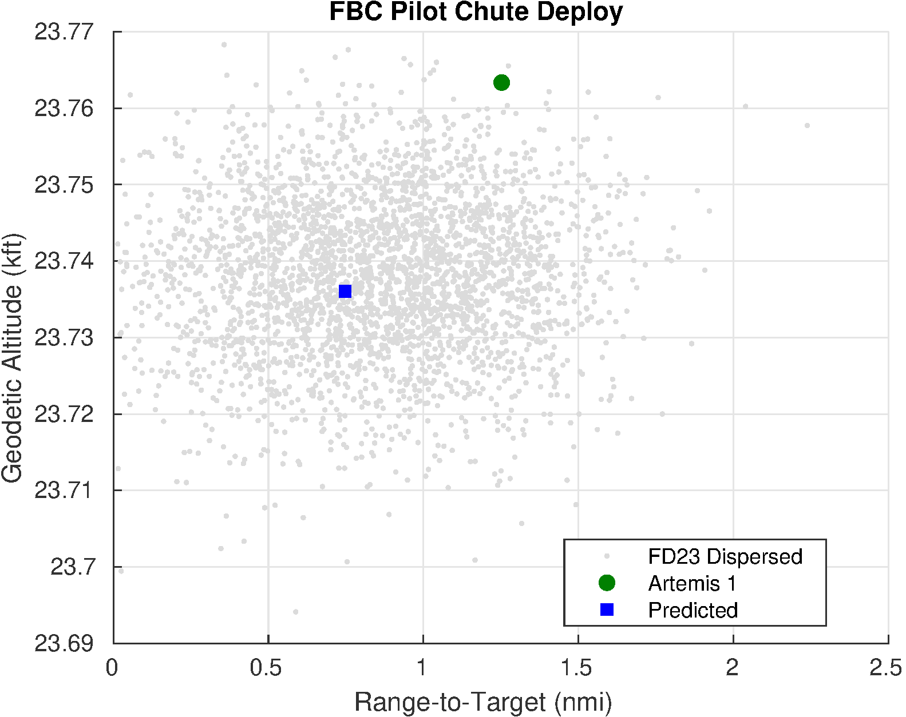
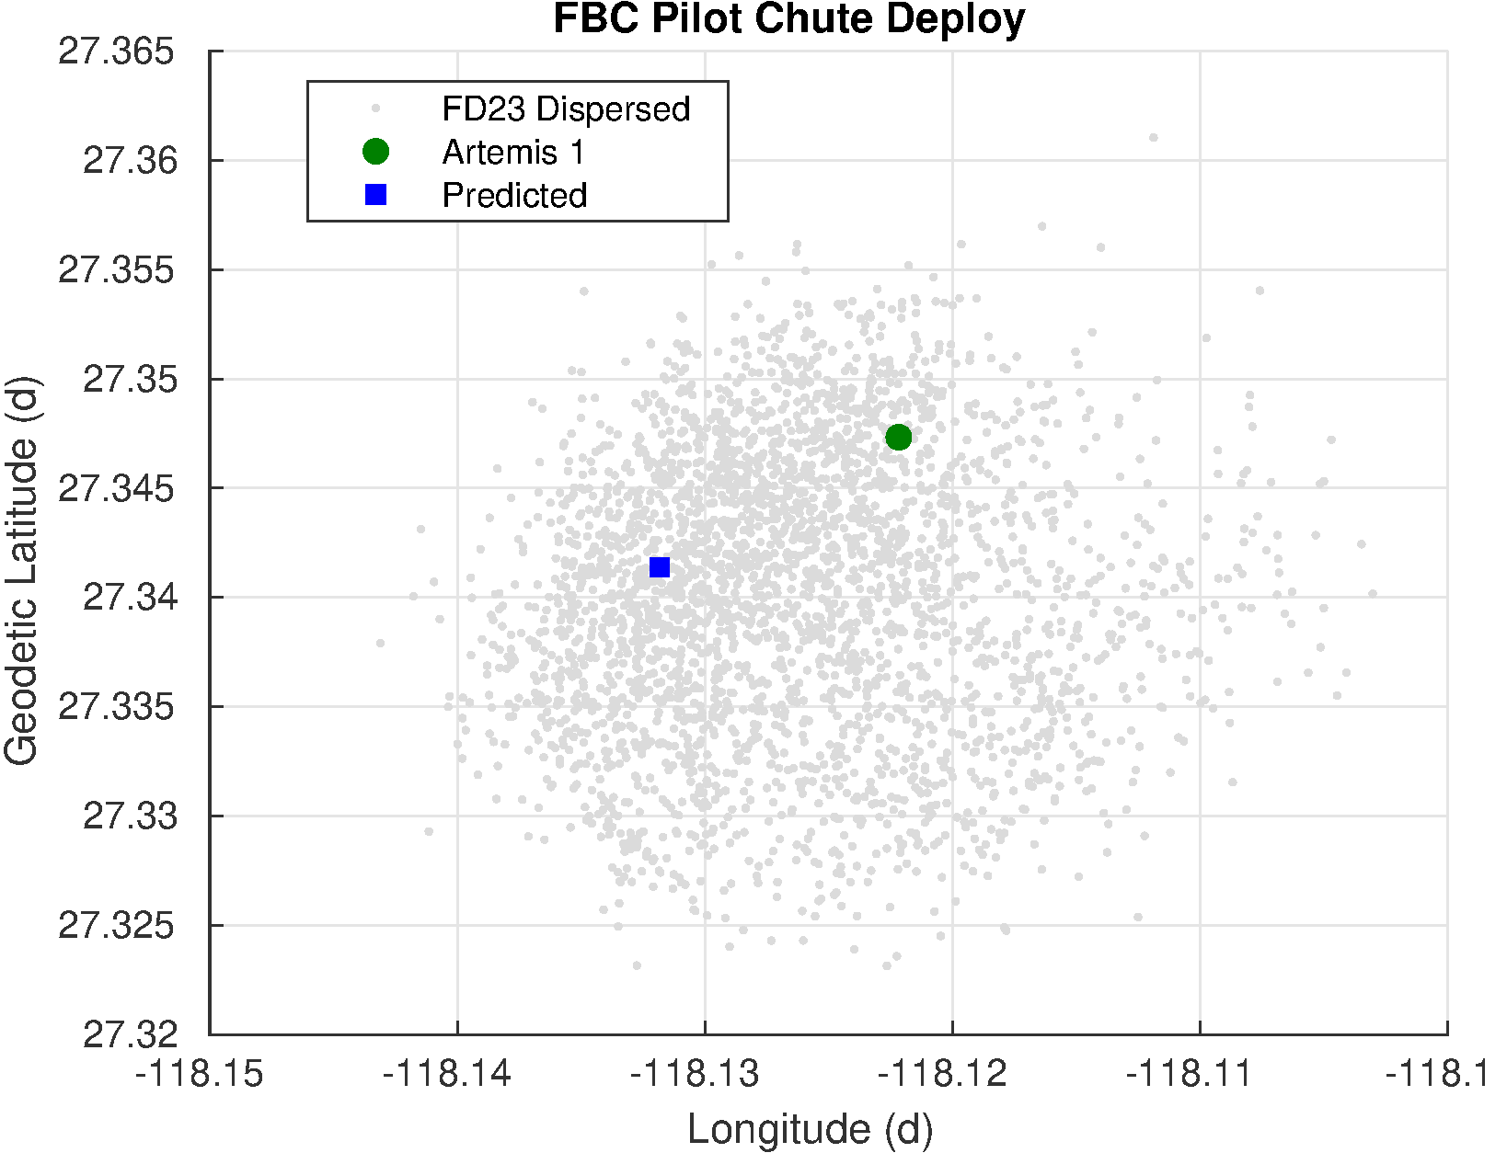
FORWARD BAY COVER PARACHUTE DEPLOY
Forward Bay Cover (FBC) parachute deploy is the end of active entry guidance

Slide 16
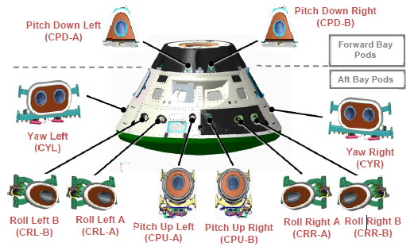
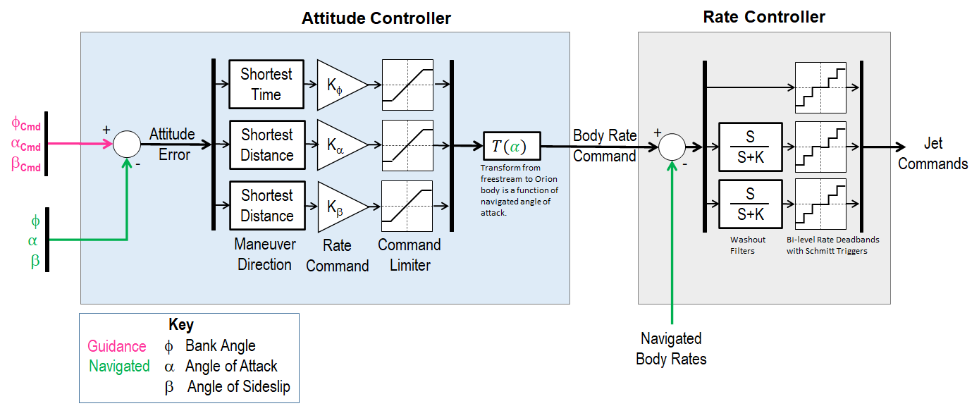
ENTRY CONTROL OVERVIEW
Crew Module Reaction Control System (RCS)
Attitude control is achieved by commanding reaction control thrusters that produce torque about the vehicle body axis
Two fully redundant strings of thrusters
Six thrusters per string
Each thruster produces a nearly pure torque in one direction about the primary body axis
Control Design
The Crew Module control system (CNC) is a digital controller that operates at 40Hz
3-axis attitude control is performed during exo-atmospheric flight
Transition between exo-atmospheric and atmospheric gains is scheduled on acceleration magnitude
Attitude maneuvering in atmosphere is limited to bank
Angle of sideslip and angle of attack are aero stabilized
Atmospheric control gains are scheduled on velocity magnitude and are tailored for hypersonic, supersonic, transonic, and subsonic phases of flight

Slide 17
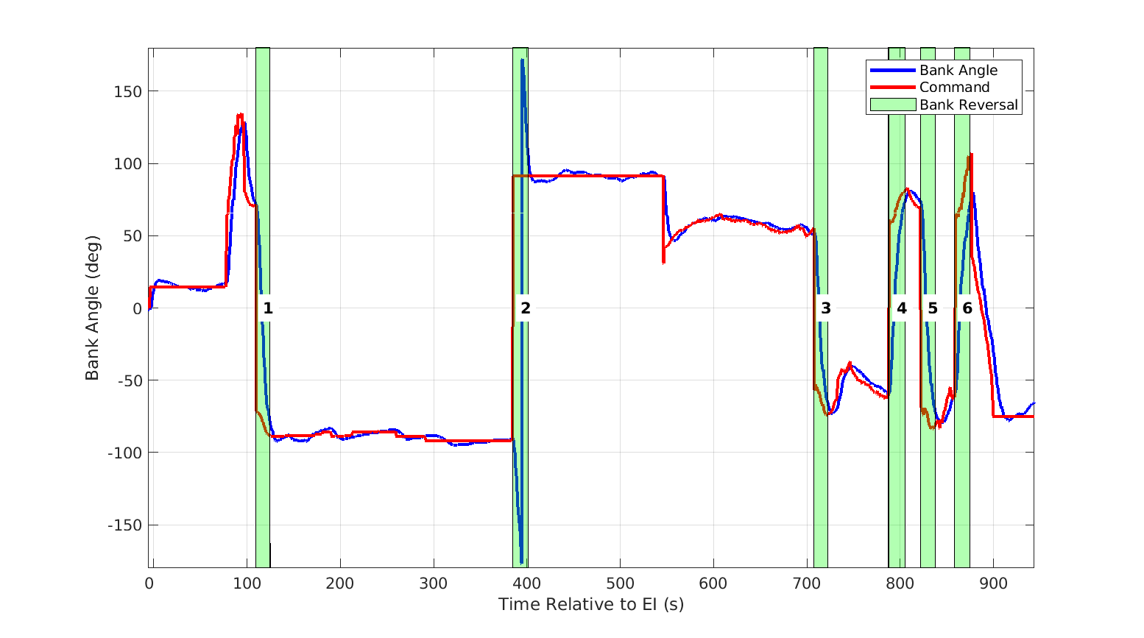
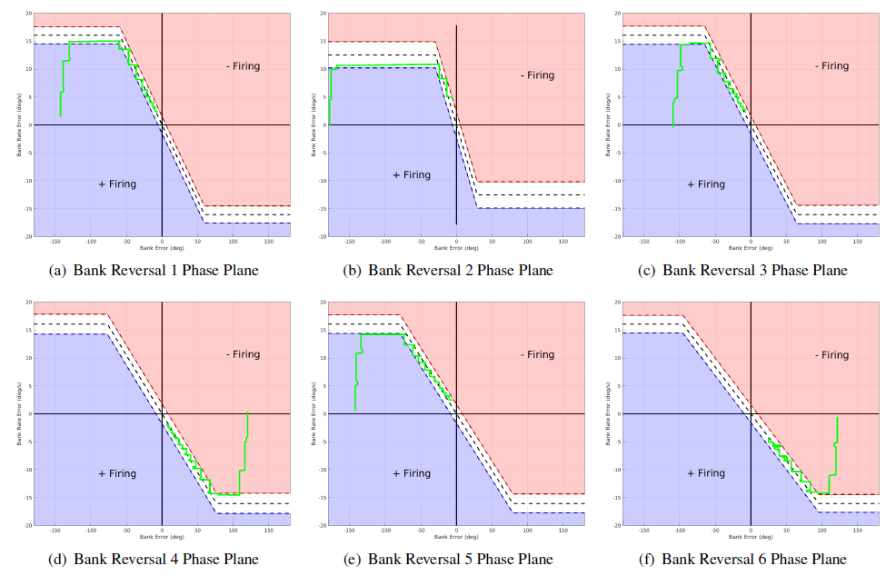
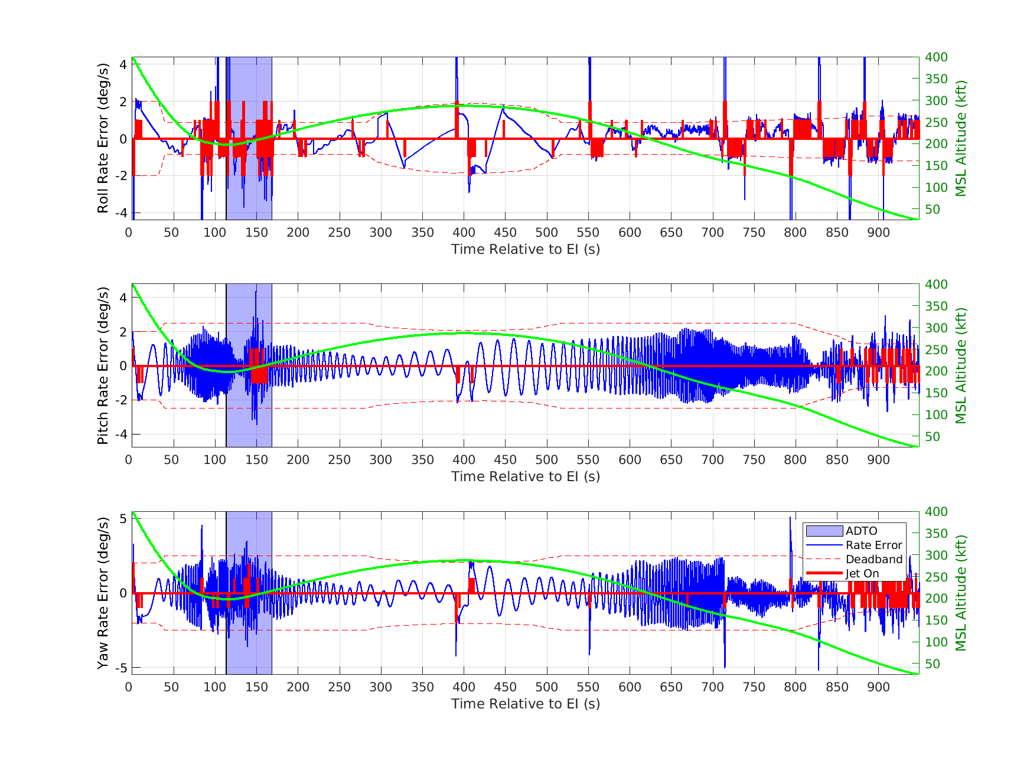
ENTRY CONTROL PERFORMANCE
Entry control tracked the bank angle command well during flight
Attitude rates required little correction to stay within deadbands
Aero stability decreases during subsonic flight requiring more control corrections near the time of Forward Bay Cover (FBC) jettison
Bank reversal maneuvers were well behaved and followed the control phase plane indicating CM RCS thrusters performed as expected
Atmosphere
Exo
Atmosphere
Hypersonic
Sub
Period of Aerothermal Detail Test Objective (ADTO) Activity

Slide 18
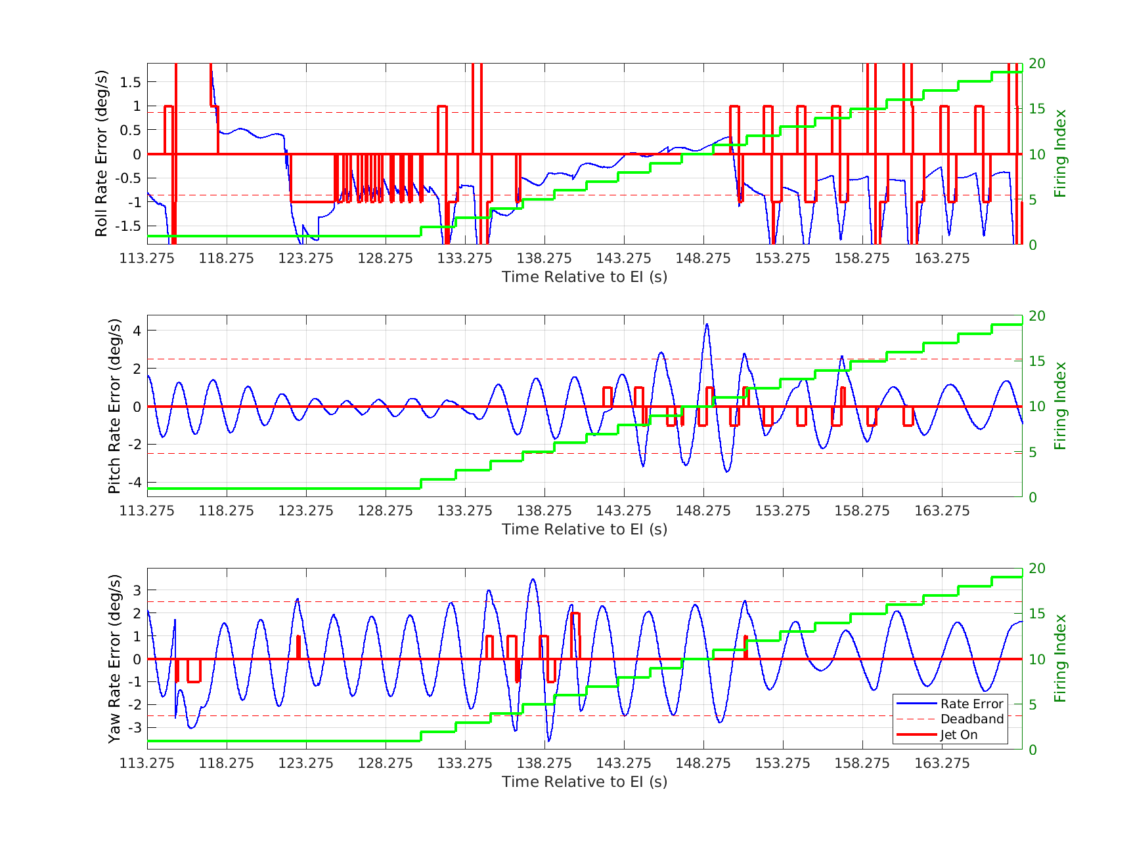
AEROTHERMAL DETAILED TEST OBJECTIVE
Aerothermal Detailed Test Objective (ADTO)
Series of RCS commands executed during hypersonic flight in the atmosphere
Temperature sensors included on the CM back-shell measured the effect of RCS firings on heating for aerothermal model validation
Unique to the Artemis I mission
Open-loop firings
Prior to the firing a quiescent period is enforced
Post firing the control system corrects resulting disturbance
Firings are suspended by bank reversals or if significant attitude or rate disturbances are detected
The ADTO was suspended due to the 1st bank reversal
Attitude and attitude rate was well behaved during the ADTO. Minor excursions occurred due to ADTO firings but did not result in further suspension of the ADTO
ADTO Suspended due to 1st bank reversal
ADTO Completes all pre-planned firing patterns with no further interruptions

Slide 19
CONCLUSION
Artemis I flight was within the predicted dispersed flight envelope
Differences between flight and best prediction due to 10% less dense atmosphere and 5% less L/D from predictions
Even with these differences, the flight was close to the pre-flight predictions
Artemis I is the first successful demonstration of a skip entry for a human rated vehicle
Acknowledgements
Original Apollo engineers
Former team members Tim Crull, Mike Tigges, Gregg Barton, Zach Putnam, Andy Barth, and Travis Bailey

