Slide 1

VEG-05 Tomato Crop Testing on the International Space Station
Gioia D. Massa¹, Mary E. Hummerick², Christina L. Khodadad², LaShelle E. Spencer², Raymond M. Wheeler¹ , Ani Dixit², Cory J. Spern², Millennia Young³, Grace L. Douglas³
NASA, Kennedy Space Center 2. LASSO II, Kennedy Space Center 3. NASA, Johnson Space Center
NASA Human Research Program Investigators Workshop, 2024

Slide 2
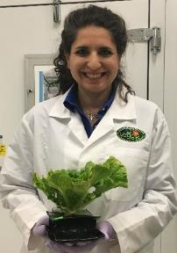
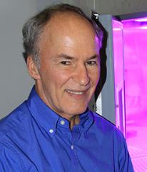
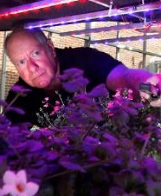
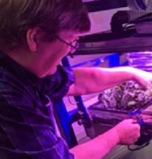
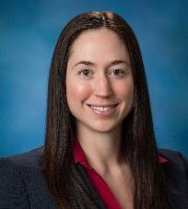
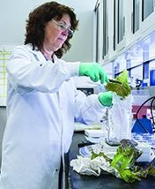
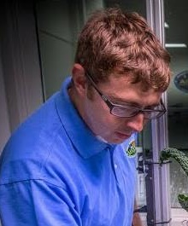

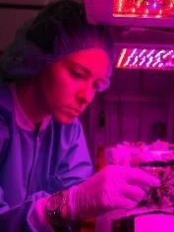


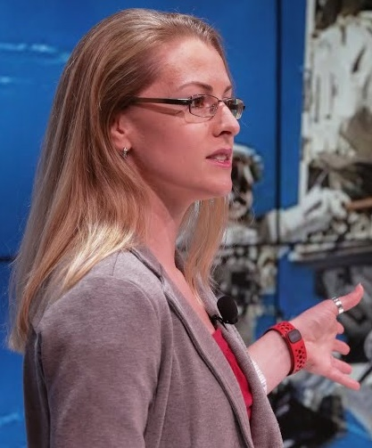
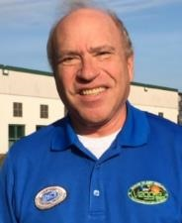
Gioia Massa
NASA KSC, PI
Raymond Wheeler
NASA KSC, Co-I
Cary Mitchell
Purdue University, Co-I
Robert Morrow
Sierra Space, Co-I
Grace Douglas
NASA JSC, Co-I
Mary Hummerick
KSC, Co-I
Matt Romeyn
NASA KSC, Co-I
LaShelle Spencer
KSC, Co-I
Jess Bunchek
KSC/DLR, Co-I
Millennia Young
NASA JSC, Co-I
Suzanne Bell
NASA JSC, Co-I
Lauren Landon
JSC, Co-I
Ed Rosenthal
Florikan E.S.A, Consultant

Slide 3
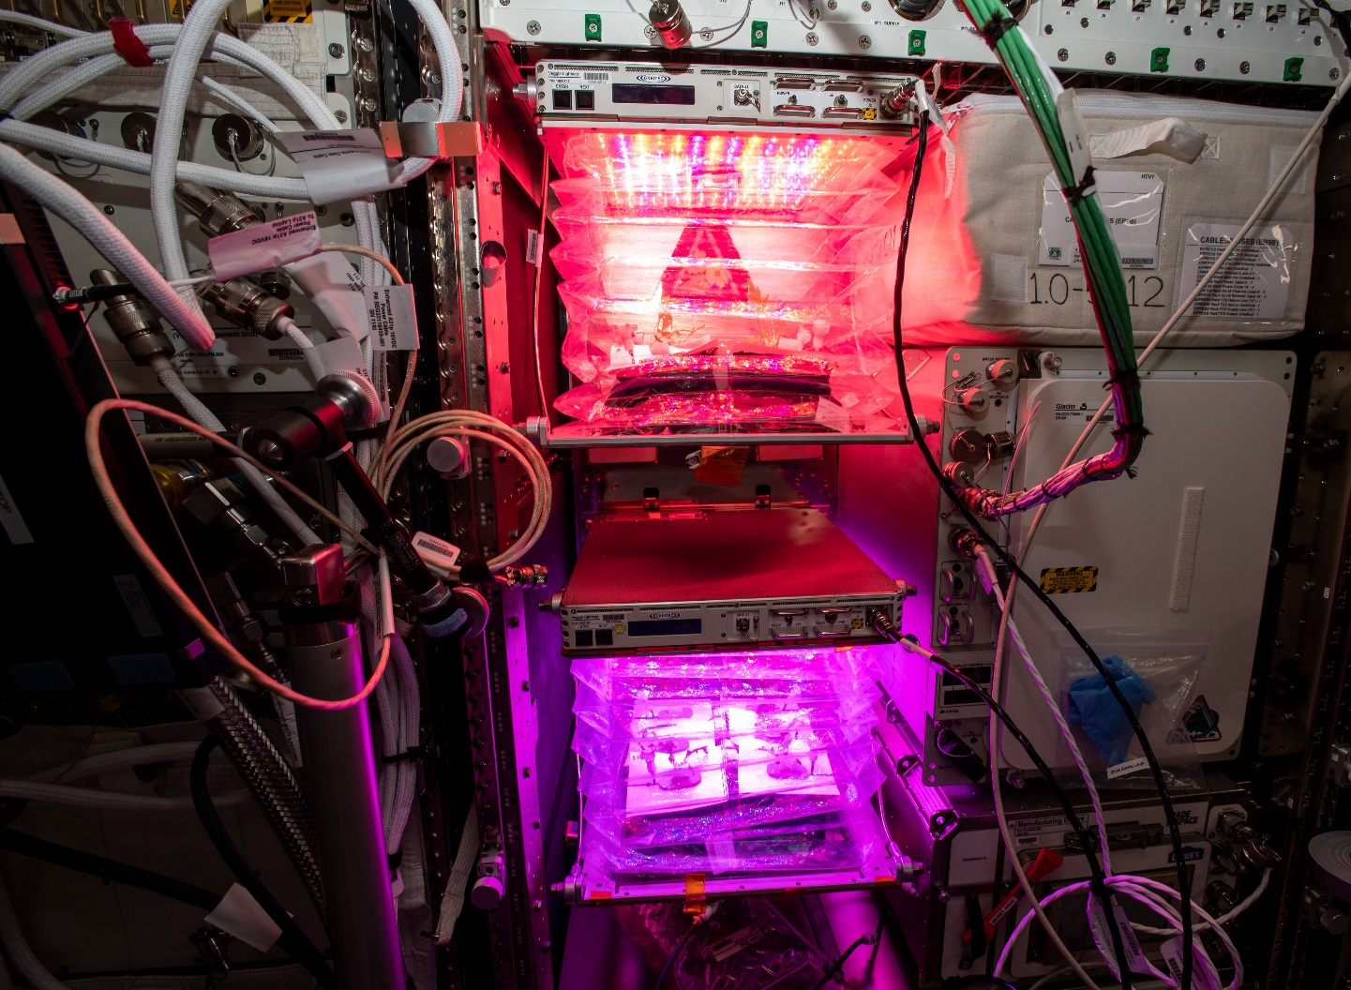
Pick-and-eat salad-crop productivity, nutritional value, and acceptability to supplement the ISS food system*
Aim: To examine light quality and fertilizer formulation on crop morphology, edible biomass yield, microbial food safety, sensory acceptability, nutritional value, and behavioral health benefits.
Team Components:
KSC: Crop Testing, Microbiology
JSC: AFT, BHP, Statistics
Purdue: Crop Testing
Sierra Space: Testing, Lighting, Software
Florikan: Fertilizer Consultants
Veggie plant chambers currently on ISS in the Columbus module
* Co-Funded by HRP and Space Biology, MTL#1075

Slide 4
Experiment Summary
An earlier component of this project, VEG-04 in 2019, flight tested Mizuna mustard leafy salad greens. VEG-05 is testing ‘Red Robin’ dwarf tomato.
Plants are grown with two light treatments with different red-to-blue ratios.
Crewmember subjects perform:
  crop growth, maintenance, and harvests
  self-report surveys
    Profile of Mood States – Short Form (POMS-SF)
    Veggie-specific questionnaire pre-flight, in-flight, and post-flight
  planned sensory evaluation of tomatoes at harvest
Planned Goal:
  Half of the tomato samples with mass measured on ISS prior to crew consumption
  Half the produce frozen and returned to Earth for post-flight microbiological and nutritional analysis

Slide 5
Preflight Experiment Verification Test

Slide 6
VEG-05 Flight Experiment Timeline
Launched on SpaceX-26 on 11/26/2022
Lights assessed and calibrated on 12/1
Experiment initiated on 12/9-12/14
Ground control initiated on 12/16

Slide 7
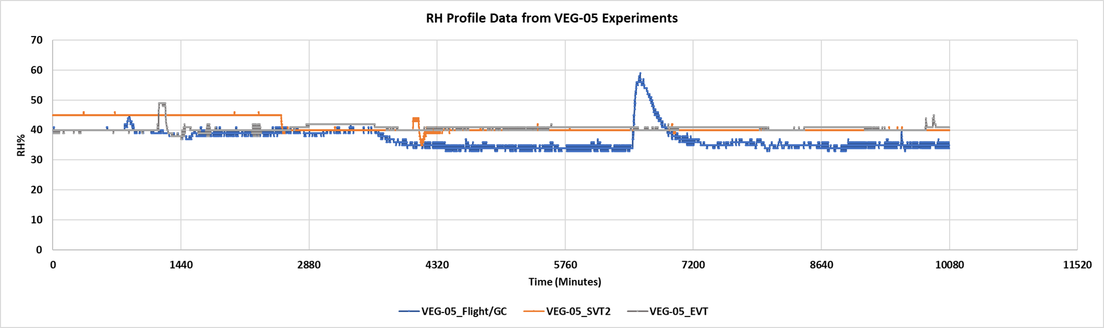
VEG-05 Flight and Ground Control Issue
Pillows and Wicks dried earlier than anticipated (between DAI 3 and 6) both on ISS and on the ground. This led to poor germination, especially in ground pillows where gravity pulled water down and seeds were positioned above the water table.
Most likely cause: Low humidity in critical growth period.
Consequences:
  Flight plants continued to grow with reduced sample number.
  Ground control terminated on DAI 30 and restarted 2/1 with modified watering strategy.

Slide 8
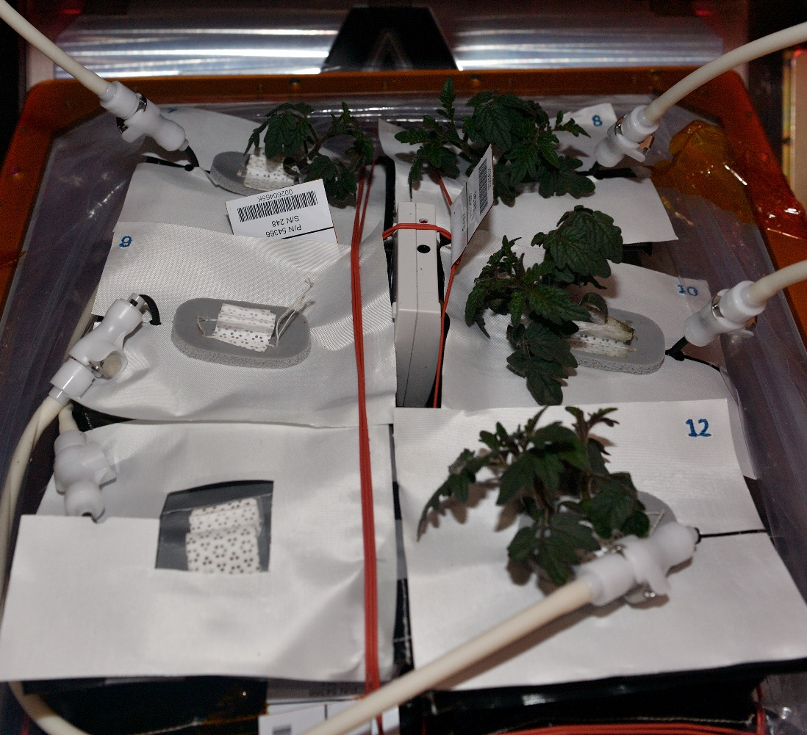
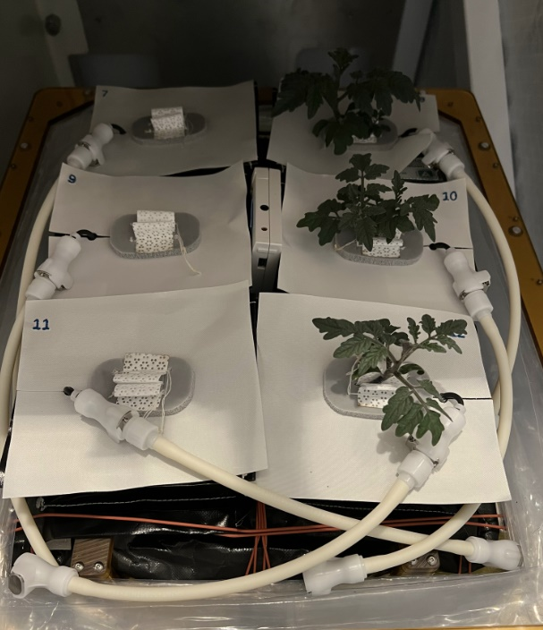
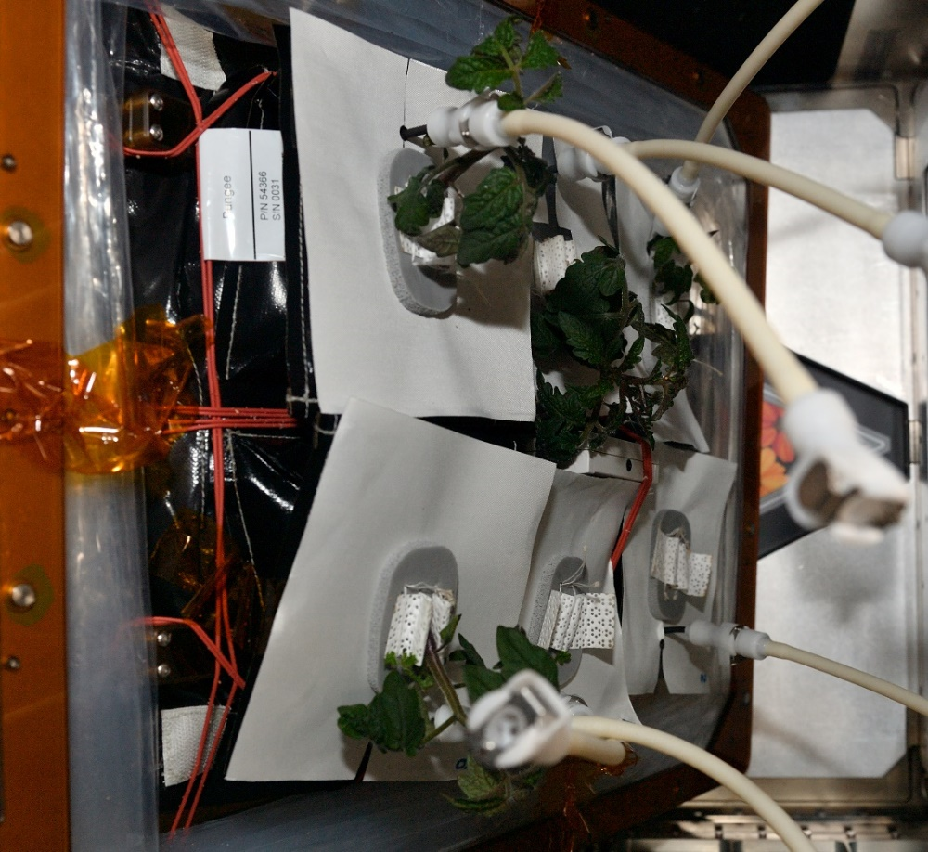
Flight and Ground Control Plants – 24 days old
Flight plants 1-6 at 24 DAI 1/7/23
Flight plants 7-12 at 24 DAI 1/7/23
Ground Control Plants 8,10,12 at 24 DAI 1/9/23

Slide 9
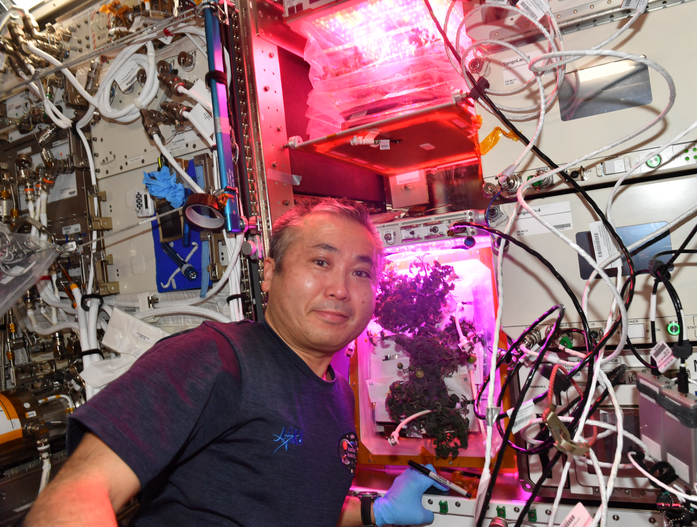
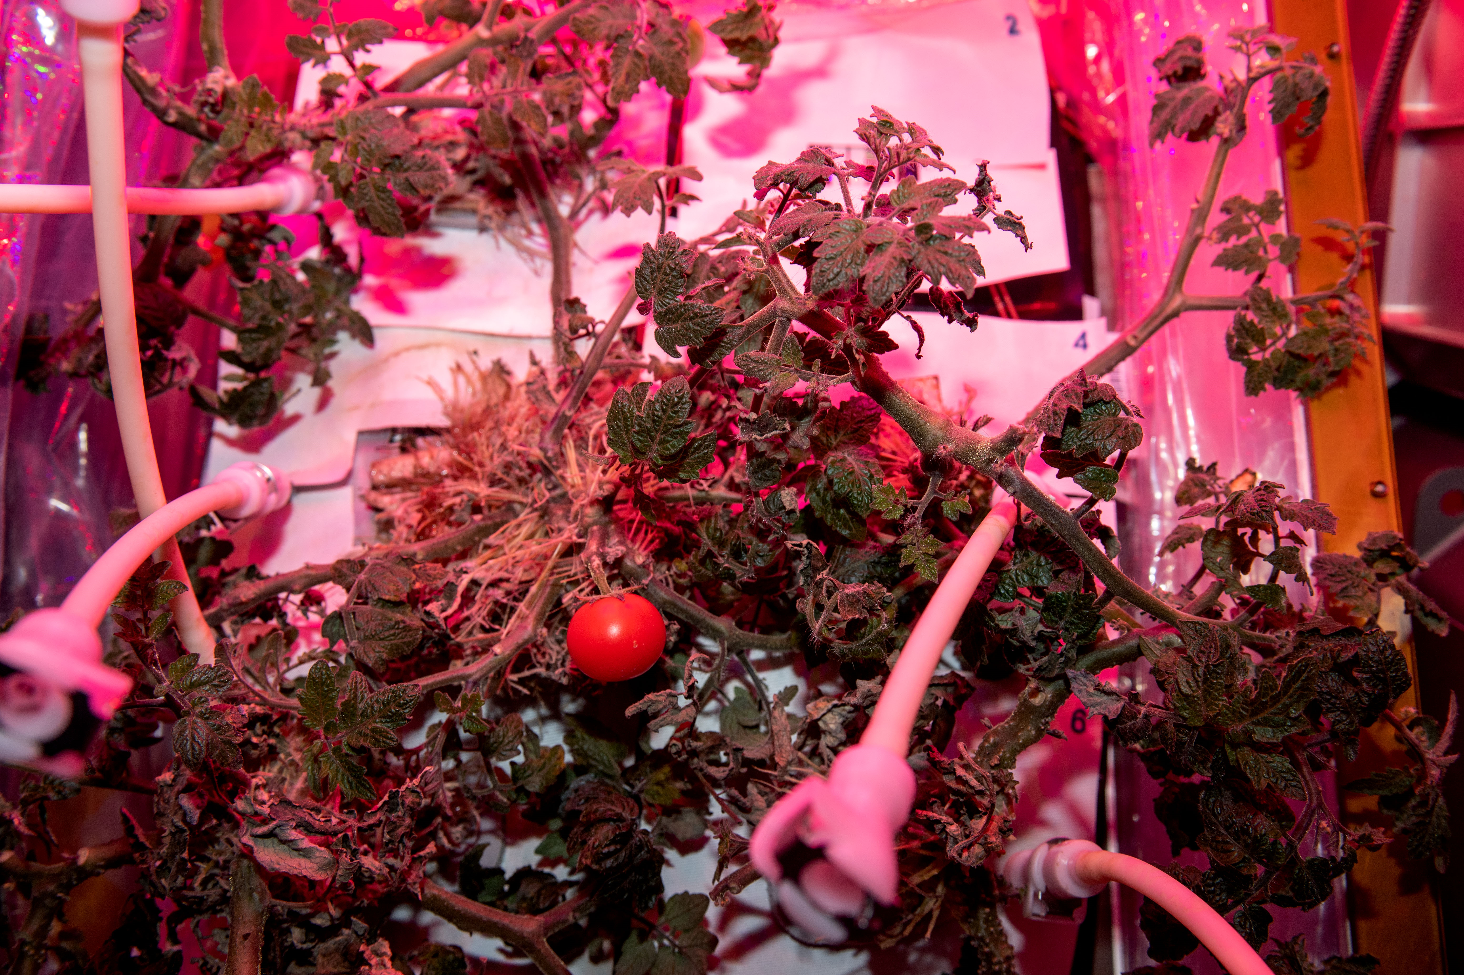
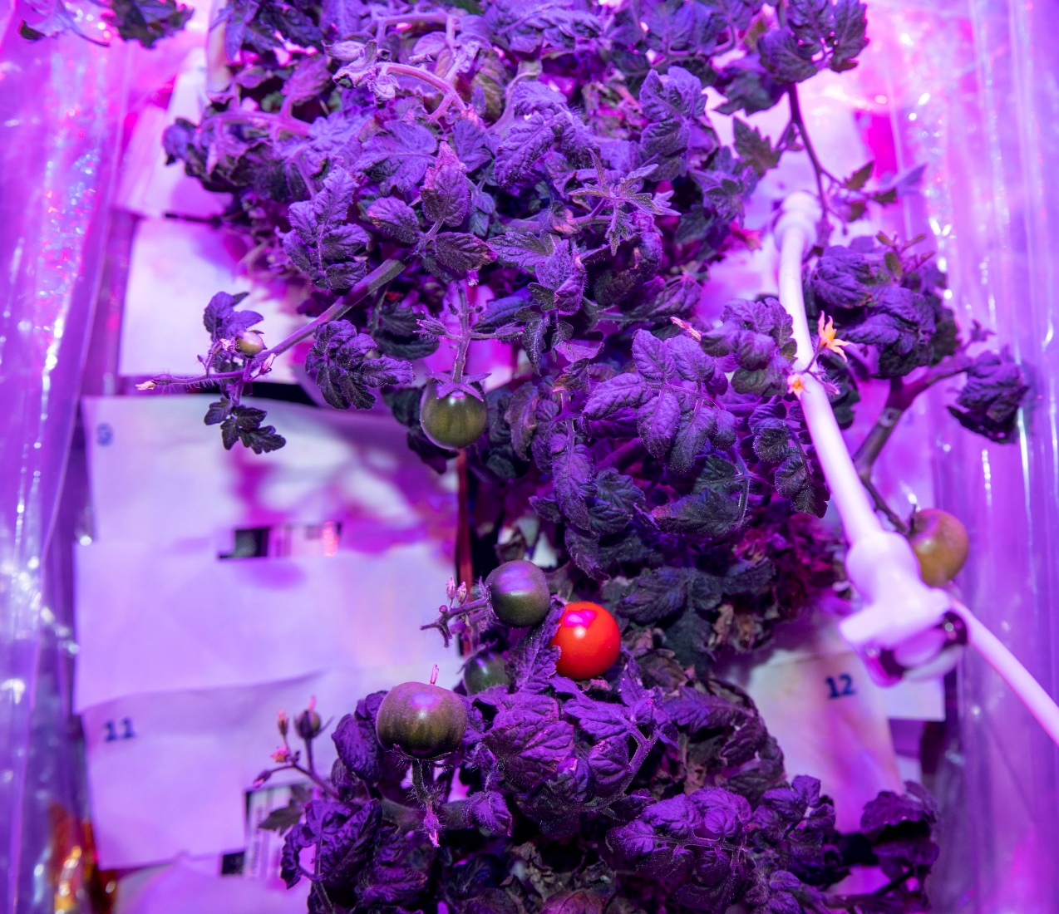
VEG-05 Flight Plants
Flight Plants at 79 DAI

Slide 10
VEG-05 Flight Experiment Timeline
Launched on SpaceX-26 on 11/26/2022
Lights assessed and calibrated on 12/1
Experiment initiated on 12/9-12/14
Ground control initiated on 12/16
Second ground control initiated 2/1/2023
Flight experiment final harvest 3/24
Ground control #2 final harvest 5/12
Samples returned 6/30-7/5
Analyses: Food safety, Nutrient content, Microbiome, Transcriptome
Fruit Samples
Total Number of Fruit | Flight |  | Ground
 | Red-rich | Blue-rich | Red-rich | Blue-rich
Ripe | 5 | 6 | 40 | 57
Green | 0 | 4 | 6 | 14
Other samples taken:
Leaf and adventitious root samples from all plants
2 pillows per Veggie (roots, wicks, substrate)
Swabs
Water samples

Slide 11
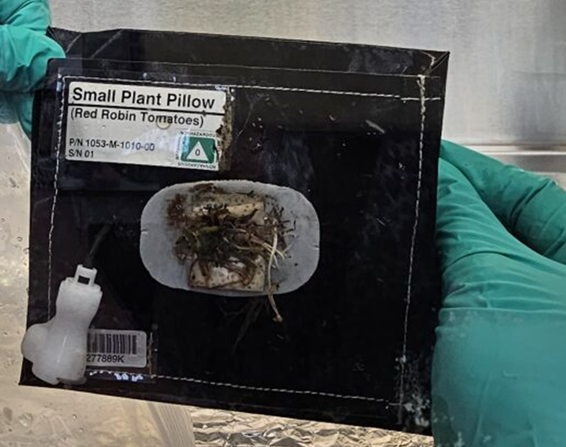
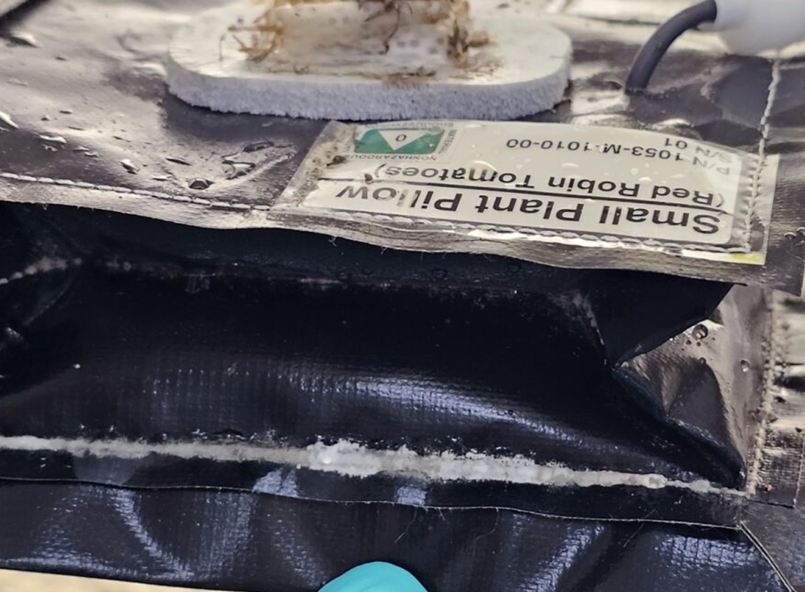
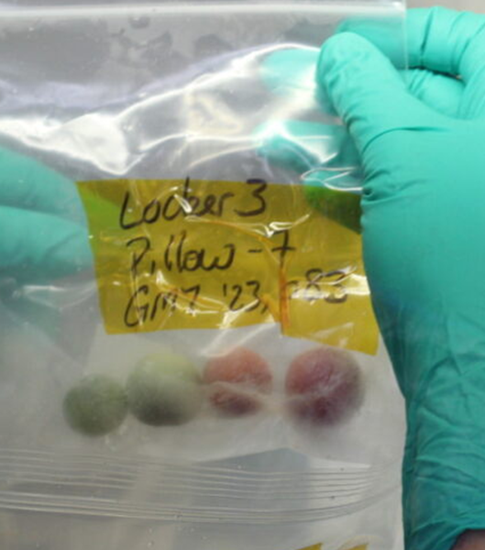
Microbiological/Molecular Analyses Methods
  Total Culturable Microorganisms
  Aerobic Plate Counts (APC)/Bacteria
  Total Yeast and Mold Count
  Specific pathogens
  Generic E. coli/Coliforms (Petrifilm)
  Salmonella sp. (enrichment/selective media)
  Staphylococcus aureus (Petrifilm)
  Isolate Identification
  Biolog MicroID system
  MicroSEQ fungal and bacterial gene sequencing ID
  Community sequencing
      16S rRNA gene for bacterial taxonomic identification ( QIIME 2.0 with Silva)
      ITS for fungal taxonomic identification (KRAKEN2 with UNITE database)
  Transcriptomics
      Leaf and adventitious roots (GeneLab RNA-Seq Consensus Pipeline-RCP)

Slide 12
Bacterial (APC) and Fungal Counts
No difference between red-rich and blue-rich treatments in bacterial and fungal CFUs in flight samples.
The red-rich ground control surface swabs and adventitious roots had significantly lower bacterial counts than the blue-rich treatment, while the fungal counts were lower in the red-rich wicks, leaves, and adventitious roots.
Blue-rich fruit samples, surface swabs and leaves were lower in the ground controls than in the flight samples for both bacteria and fungi.
Error bars are SEM

Slide 13
Cultured Isolates
Bacteria- Flight | Bacteria-Ground | Fungi-Flight | Fungi-Ground
Bacillus safensis/pumilus Microbacterium sp CDC/A-4/A-5 Pantoea agglomerans Curtobacterium flaccumfaciens Burkholderia contaminans Methylorubrum sp Dyadobacter sp Cellulomonas hominis Paenibacillus tundrae Brevibacillus sp Rhizobium radiobacter Bacillus megaterium Rhodococcus fascians | Bacillus safensis/pumilus Microbacterium sp Burkholderia pyrrocinnia/cepacia Rhizobium rhizogenes Leifsonia poae Streptococcus vestibularis Sphingobacterium thalpophilum Sphingomonas sp Streptomyces sp Paenibacillus xylanilyticus Methylobacterium exotorquens Curtobacterium pusillum Paenibacillus provencensis Bacillus cereus/thuringiensis Neisseria sp Microbacterium luteus E Bacillus atrophaeus/subtilis B Fictibacillus arsenicus Staphylococcus saprophyticus | Penicillium sp Paecilomyces sp Fusarium solani Penicillium citrinum Penicillium decumbens Rhodotorula mucilaginosa | Penicillium sp Paecilomyces sp. Fusarium sp Aspergillus sp Fusarium oxysporum Purpureocillium lilacinum Aspergillus versicolor Aspergillus ustus
Green text shows microbes common between flight and ground controls.
Screening for selected pathogens yielded negative results. Confirmed by community 16S and ITS sequencing.

Slide 14
Microbiome
Differences between flight and ground
Root and adventitious root samples had higher community diversity than leaf or fruit samples

Slide 15
Transcriptome: Percent Distribution of Differentially Expressed Genes (DEGs)
Numbers inside each of the bars represents up or down-regulated genes at an adjusted P-value cutoff of ≤ 0.1
Notes:
Leaf and root tissue in BLUE ENRICHED LIGHTING showed higher percent of DEG’s

Slide 16
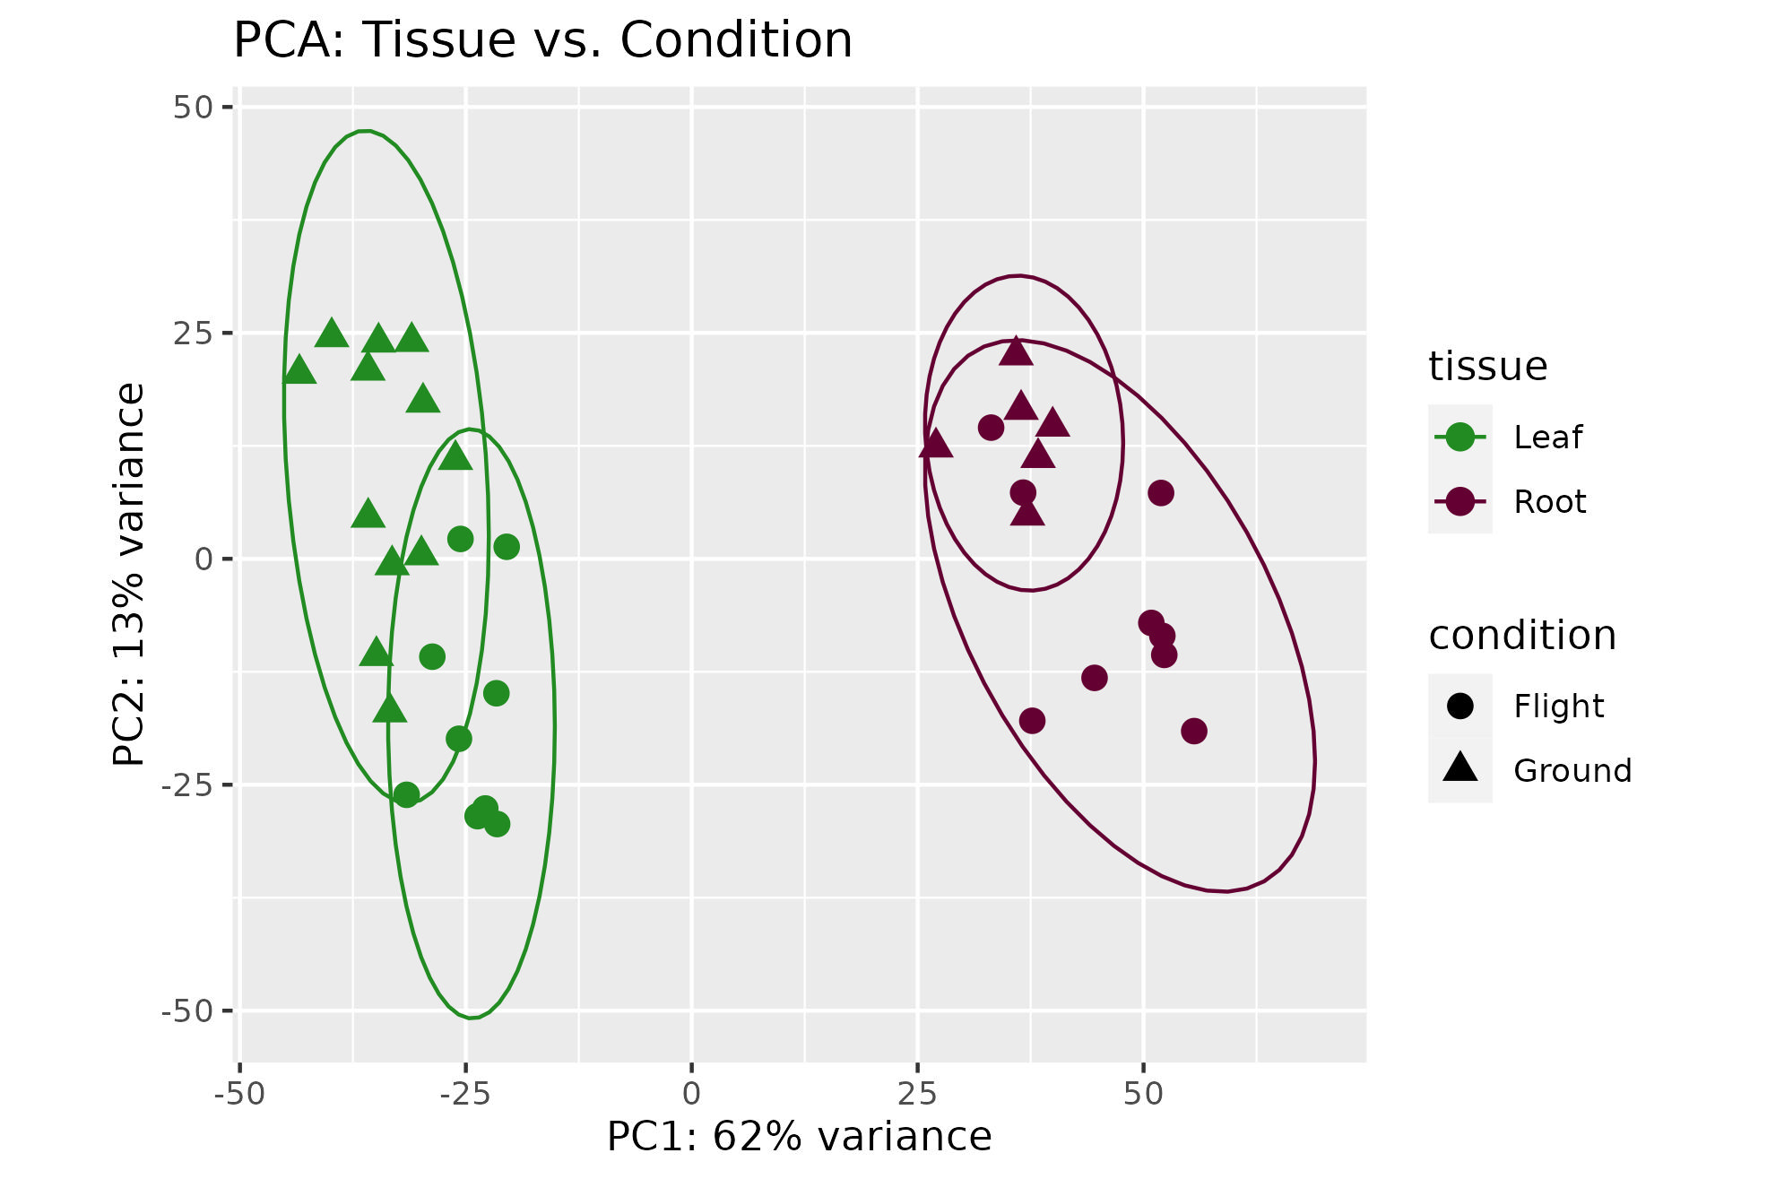
PCA plot for combined blue-rich and red-rich plant samples
Notes:
Leaf and root clustered based upon condition (flight versus ground)
Gene expression completely separated based on tissue type, but there is overlap in both tissue types between flight and ground.

Slide 17
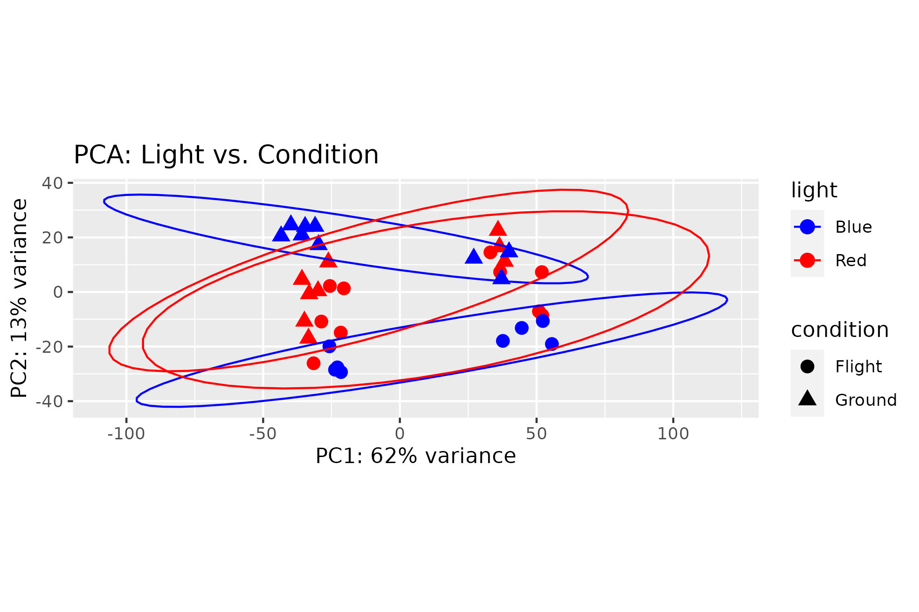
PCA plot for combined leaf and
adventitious roots samples

Slide 18
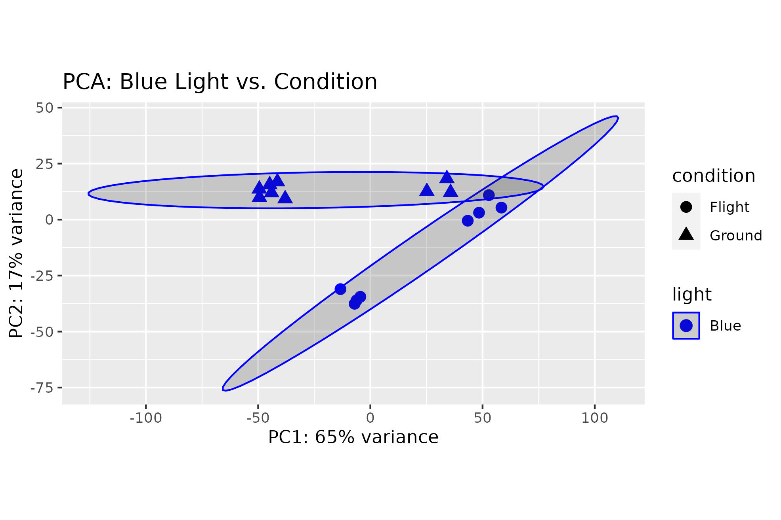
PCA plot for combined leaf and
adventitious roots exposed to blue-rich light

Slide 19
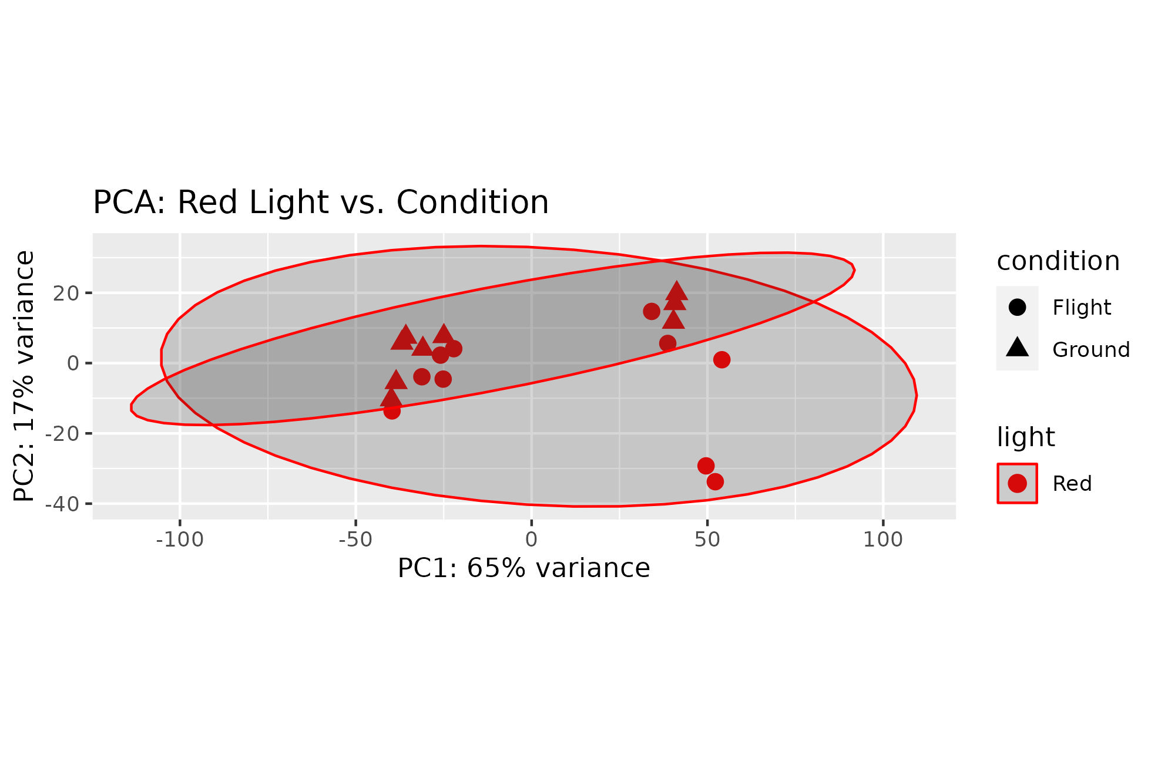
PCA plot for combined leaf and
adventitious root exposed to red-rich light

Slide 20
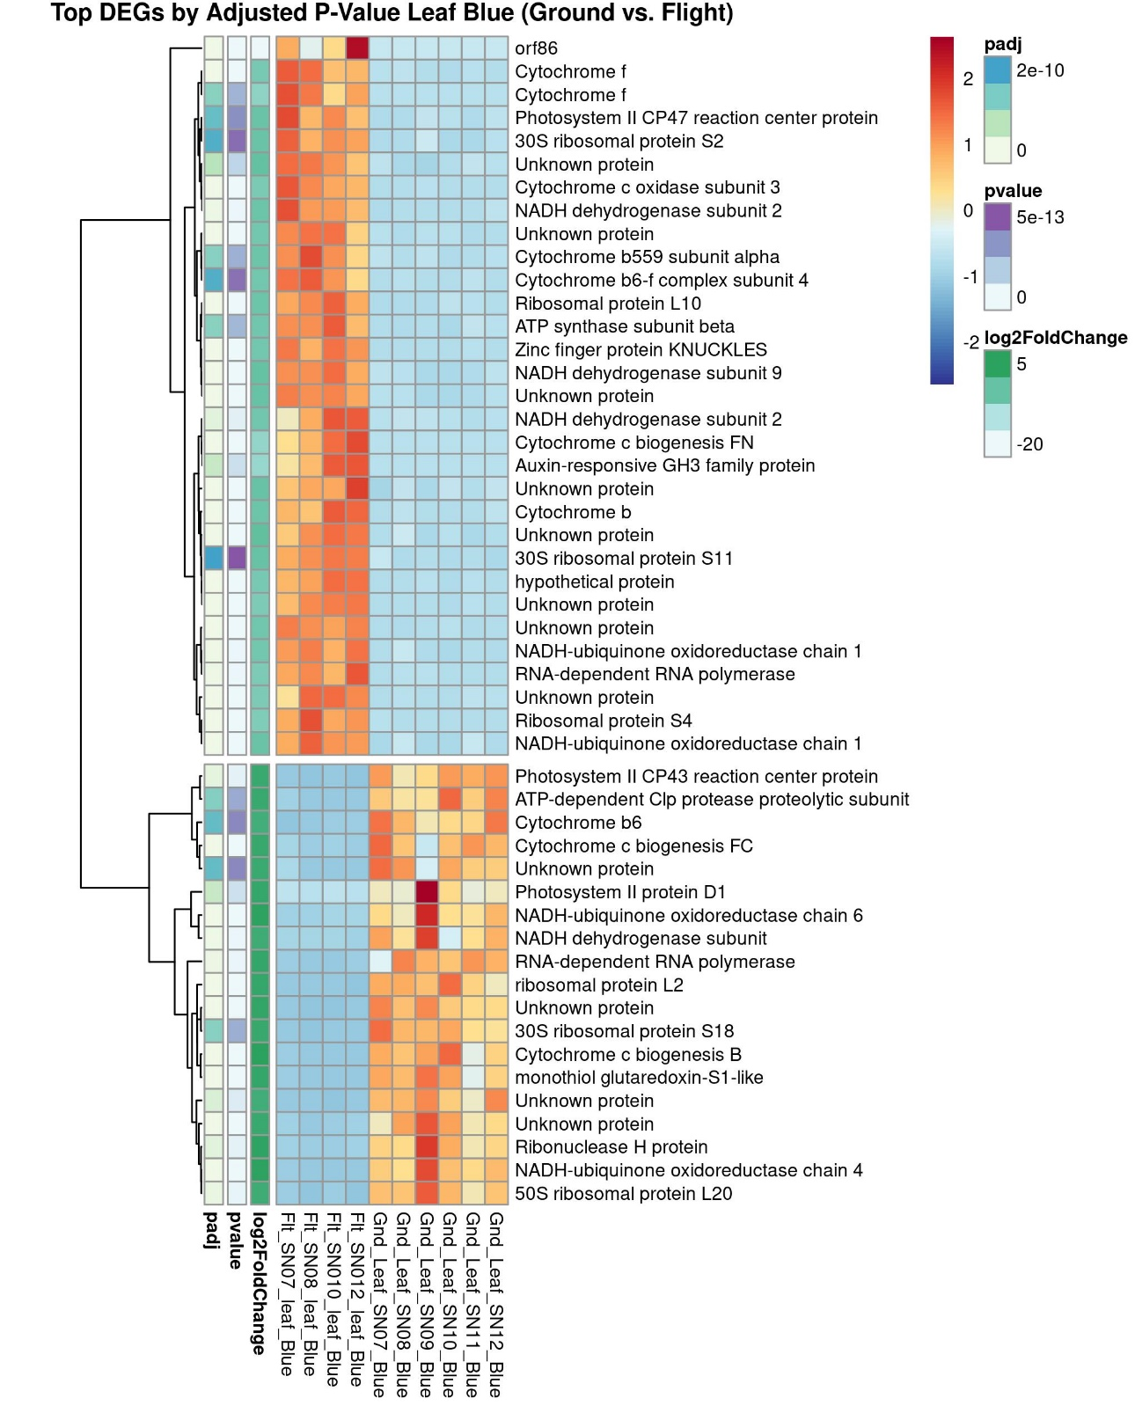
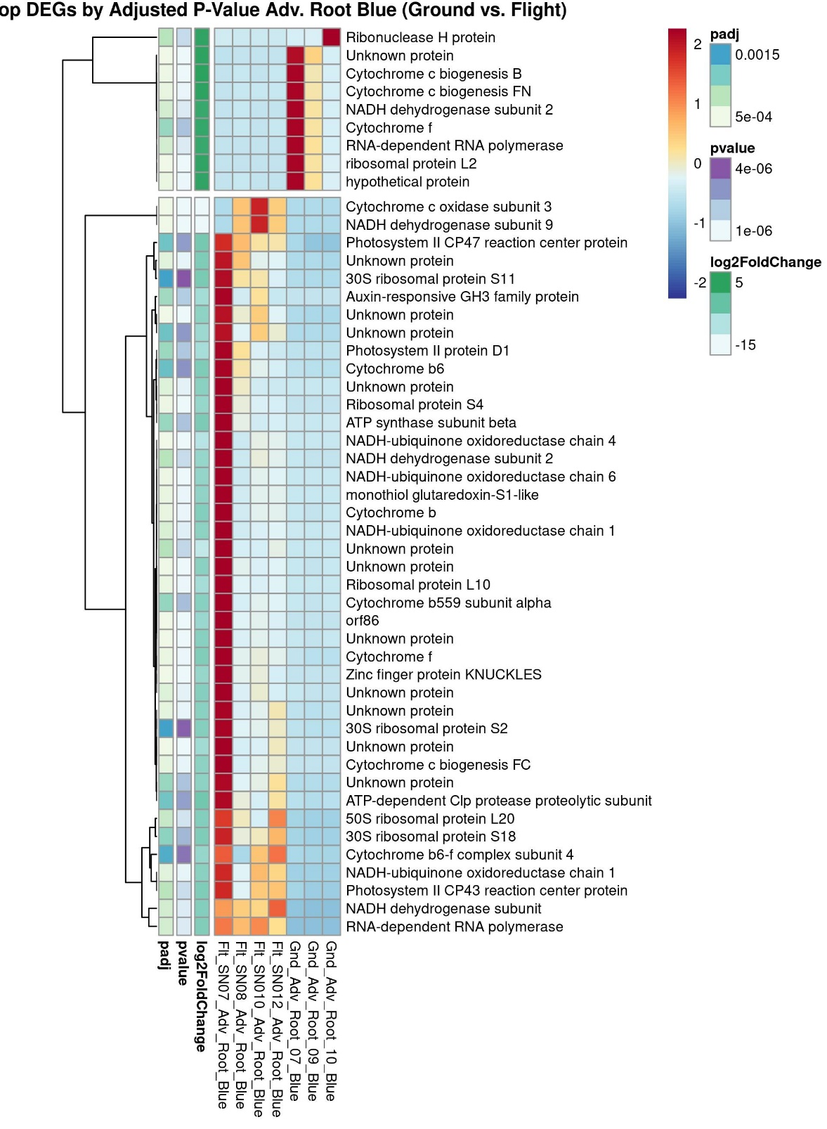
Heatmaps of DEGs ordered by Adjusted P-value
Blue-Rich
Heatmaps represent up or down-regulated genes at an adjusted P-value cutoff of ≤ 0.1. Top 50 genes only.
Leaf
Advent. Root
Notes:
Leaf (left) there is strong differential regulation of genes in blue light samples in flight
Biological processes such as light harvesting photosystem I, cell division and protein regulation
There is a different group of upregulated genes in blue light ground leaf samples.
Cell cycle regulation, protein biosynthesis
Similar responses that we saw in the leaf tissue. Photosynthesis, ATP energy production and protein biosynthesis.
NOTE: the Adventitious roots did contain some chlorophyll and therefore this is not unexpected.

Slide 21
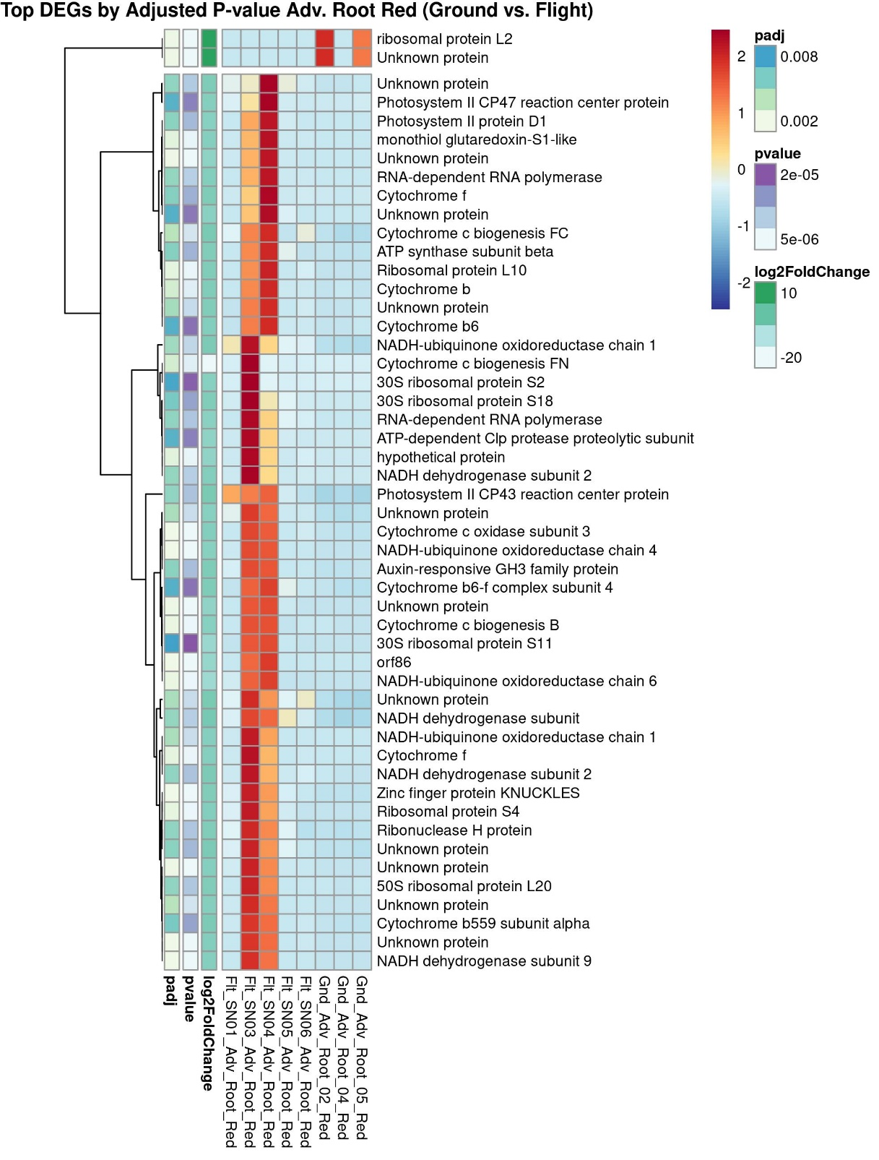
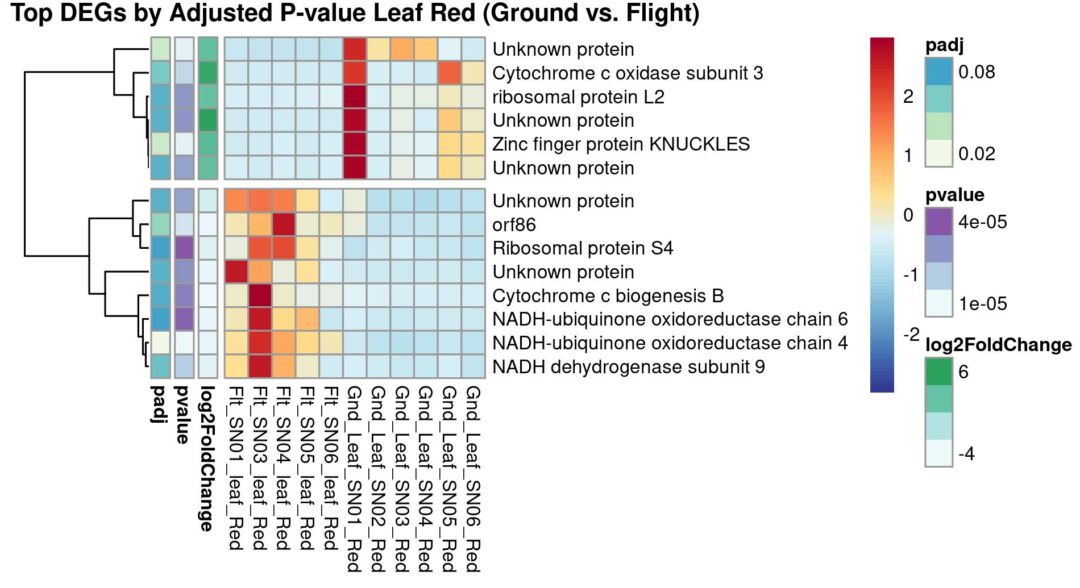
Heatmaps of DEGs ordered by Adjusted P-value
Red-Rich
Leaf
Heatmaps represent up or down-regulated genes at an adjusted P-value cutoff of ≤ 0.1
Advent. Root
Notes:
Fewer differentially regulated genes
Respiration, mitochondria and energy production
Electron transport – energy production
Adventitious roots
DEG’s are showing that these are responding to red-light differential regulation in photosynthesis and energy production, protein biosynthesis.

Slide 22
Gene Ontology (GO) enrichment plot for DEGs from flight leaf samples exposed to blue-rich light. GO:MF (terms associated with molecular function). GO:BP (terms associated with biological processes).
Notes:
Leaf
These consolidate the function categories were enriched in flight leaf samples treated with blue light.
NOTE: you could highlight or circle those that are clearly indicated on the heatmaps.

Slide 23
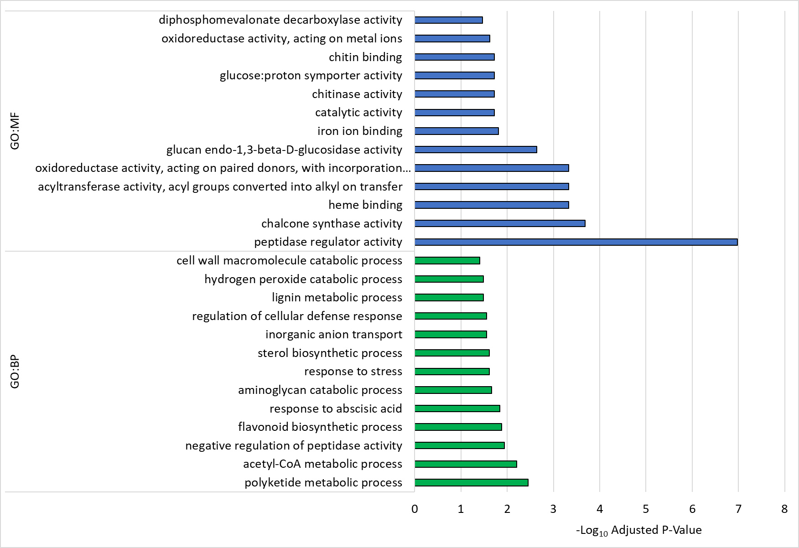
Gene Ontology (GO) enrichment plot for DEGs from flight adv. root samples exposed to blue-rich light. GO:MF (terms associated with molecular function). GO:BP (terms associated with biological processes).
Notes:
There are similar responses seen in the leaf but also see responses to stress, hydrogen peroxides catabolic process or REDOX Stress.

Slide 24
Transcriptome Summary and Future Work
There appear to be more DEG’s in leaf and adventitious root samples in blue-rich light compared to red-rich light
Functional enrichment analysis of DEG’s showed similarities between leaf and adventitious root samples (as expected)
Some of the hallmarks of spaceflight were detected in flight samples (stress response, lignin, radiation stress, hydrogen peroxide catabolic processes)
More work to come:
  Digging into these data to better understand interactions of spectrum and stress response
  Analyzing plant chemistry
  Looking at BHP impacts and comparing with experiments when plants were consumed

Slide 25
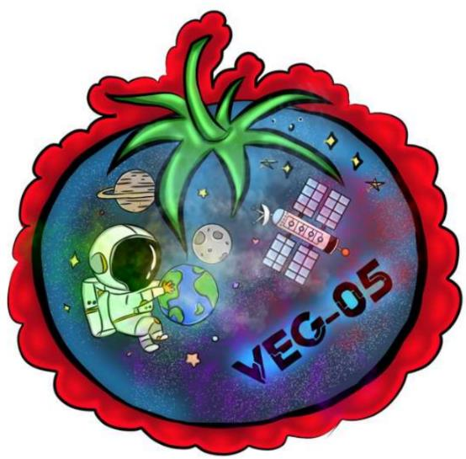
Thank you!
VEG-05 Patch Challenge Winner!
Monica G. Hialeah Gardens MS
Veggie and VEG teams at KSC, JSC, MSFC, and Sierra Space
Astronauts who cared for the VEG-05 plants
Payload Operations and Integration Center
This research was co-funded by NASA’s Human Research Program and Space Biology in the ILSRA 2015 NRA call. MTL #1075

