Slide 1



How to effectively generate an Additive Manufacturing Control Plan (AMCP) documenting compliance, method of implementation and tailoring rationale to NASA Technical Standard NASA-STD-6030.
Tim Poe, MSFC EM42
Andrew Glendening, GSFC-3730
February 21, 2024

Slide 2
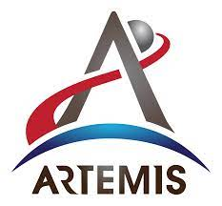


Agenda and Objectives
Objectives
Introduction to Additive Manufacturing at NASA
Overview of the overarching NASA-STD-6030 Methodology
  Foundational Process Control Requirements
  Part Production Control Requirements
  Robust and Comprehensive Quality Management System
Description of what an Additive Manufacturing Control Plan is and why it is important
  It communicates what you do
  It documents for review and approval by NASA the requirements you don’t meet (i.e., “tailoring”), and what you will do instead.
  It makes you think about how and why you do the things you do
How to write an AMCP
Discussion of requirements “Tailoring”
Provide examples of Good tailoring and Non-optimal tailoring
As Flight Programs begin adopting NASA AM Standards, we are entrusted with the responsibility of certifying and trusting AM parts

Slide 3
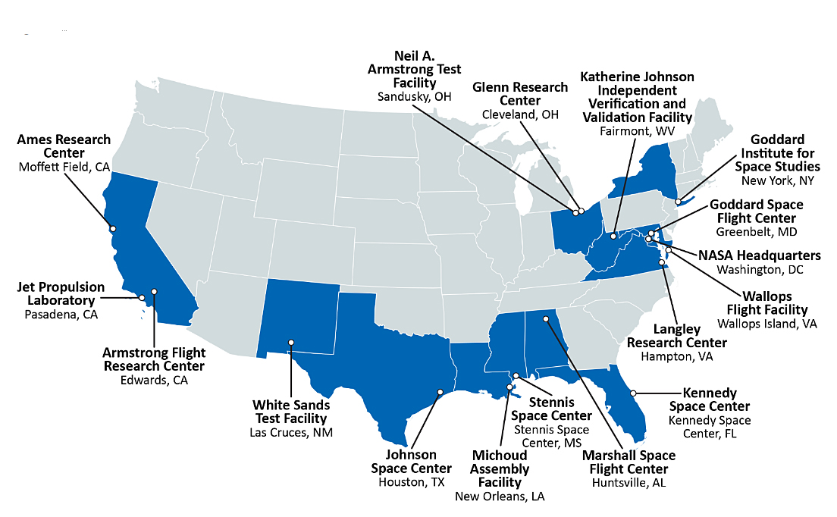
Additive Manufacturing at NASA
Fully embraces advantages of AM…
  Cost/lead time/part count reduction, new design and performance opportunities, rapid design-fail-fix cycles
…while fully understanding the challenges
  Especially in delivering high value, high performance AM hardware
“NASA is a user of AM” means…
  NASA engineers utilizing AM processes to make hardware = NASA has the design authority
  NASA procuring sub-system (rocket engine) or system (lunar lander spacecraft) from a commercial vendor/partner = NASA does not have the design authority; vendor does
Centers involved in AM
End goal → Safe and successful missions

Slide 4
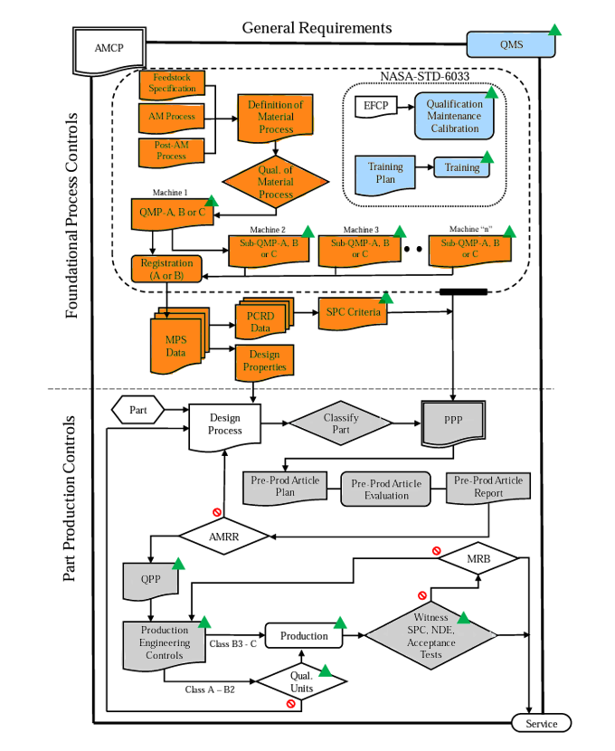
Brief Introduction to NASA-STD-6030
General requirements in the AMCP govern engineering and production practice and are paralleled by a Quality Management System (QMS).
Process control requirements provide the basis for reliable part design and production and include:
  Qualified Material Processes (QMPs)
  Equipment Controls, Personnel Training (covered by NASA-STD-6033)
  Material Property development
Part Production Control requirements are typical of aerospace operations and must be met before placing a part into service.
IQ (Installation Qualification): Establishment by objective evidence that all key aspects of the process equipment and ancillary system installation adhere to OEM approved specification and that recommendations of the supplier of the equipment are suitably considered.
OQ (Operation Qualification): Establishment by objective evidence that the process control limits and action levels which results in product that meets all predetermined requirements.
PQ (Performance Qualification): Establishment by objective evidence that a process consistently produces result of product meeting its predetermined requirements

Slide 5
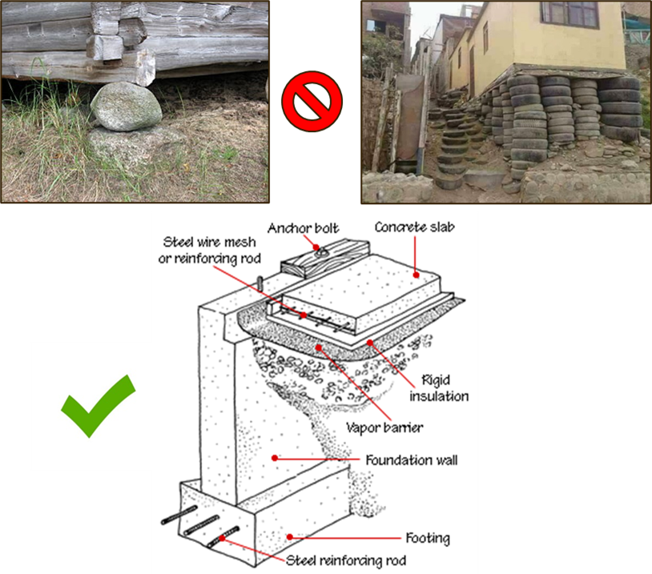
What is an Additive Manufacturing Control Plan (AMCP)
What is an AMCP?​
The AMCP is the backbone of NASA-STD-6030 compliance​
  It documents and communicates “how you do additive” ​
  Responses to 115 unique requirements address degree of compliance, method of implementation, proposed tailoring (and rationale thereof)​
  Types of Responses:
    Implementation only: meets the Additive Manufacturing Requirement (AMR) as written
    Tailoring: rewrites the requirement, but meets the intent and/or is baseline risk
    Elevated Risk Tailoring: rewrites the requirement and doesn't meet intent
  Example formats for an AMCP
    Book Form​
    Excel Format – Compliance Matrix​
The Generation of an AMCP​
Developing an effective AMCP starts with looking at the overall process and not with specific parts in mind.​
For pre-existing AM Programs, first begin by just writing down what you currently do and compare it to each AMR​
  Mature AM programs that have been evaluated by NASA to date have been largely compliant right out of the gate.​
  NASA-STD-6030 was explicitly designed to be adaptable to the widest possible (reasonable) range of (known) manufacturing practices
AMCP's are the Roadmap for successfully running an AM program.
Notes:
The AMCP is the foundation upon which your entire AM Program is built…
Or at least it documents how you built it
An AMCP, first and foremost, is a communication tool
It includes specific “self contained” responses to 115 unique requirements, and for each of those requirements, it describes:
Degree of compliance,
Method of implementation,
Proposed tailoring (Subject to review and approval by NASA)
Detailed rationalee for that tailoring​
Your AMCP can be the “one document to rule them all” within your organization
But it probably shouldn’t be
Ideally, your AMCP is communicating to NASA how you’ve already documented the way you implement your AM Program
Referencing your internal documentation is HIGHLY encouraged
You don’t have to deliver all of the referenced documents, but you do have to make them available for review
Note: It’s still important to at least provided a summary of the relevant details, especially if you’re requesting tailoring
If you’re relatively new to AM, writing an AMCP helps you plan out how you’re going to build your AM Program
If you’ve been using AM for years, it forces you to think about how you do additive, and why you do the things you do.
Because “that’s just the way we’ve always done it” isn’t always the best justification…
The AMCP is also a mechanism to document
All the ways you don’t meet NASA-STD-6030
All the things you do instead
Your rationalee for doing the things you do
Once approved by a NASA program, the AMCP becomes the governing document by which your additive program, and the parts you produce, are measured (i.e., it replaces NASA-STD-6030)

Slide 6
Introduction to Tailoring an AMR
What is Tailoring an AMR?
Tailoring Definition: The process of creating revised shall statements to a NASA-STD-6030 AMR.
How to Start the Tailoring Process?
Understand the current approach to AM at your organization or within your project
When does tailoring occur?
  Program Tailoring: prior to NASA-STD-6030 being levied
    Prior to program kick off
  Cognizant Engineering Organization (CEO) Tailoring: Prior to Implementation
    CEO tailors the as-levied requirements for custom approach to implementation
What is required for Tailoring
  Rationale on why the proposed tailoring meets the intent of the AMR
  A revised or alternate shall statement compatible with the tailoring
  Implementation Method
When do AMR’s require tailoring?
NASA AM Certification SMEs have found that mature aerospace AM programs can meet the intent of most NASA-STD-6030 AMRs as written without the need for tailoring when evaluating the AMRs individually
The AMCP documents the as-tailored requirement with rationale and implementation methods for each AMR listed in NASA-STD-6030.
Tailored
NASA-STD-6030
AMR*
NASA-STD-6030 AMR
Current Process
Rationale for tailoring
Implementation
Method
NASA Program Consultation
*Still subject to NASA Program approval
The following discussion is directed towards the creation of AM space flight hardware components.

Slide 7
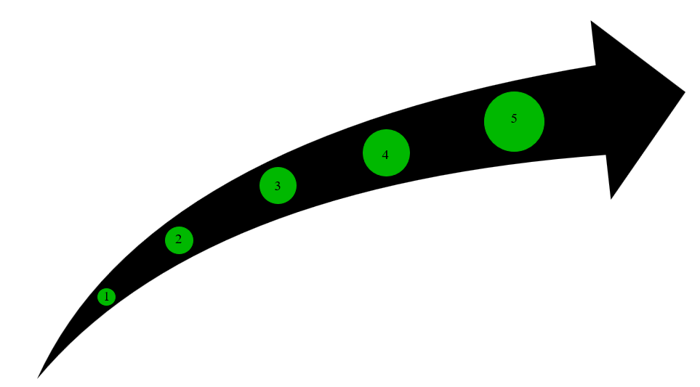
How do you write an AMCP
An AMCP is required when NASA-STD-6030 is levied on a program
7
Notes:
There is no one “right way” to write an AMCP
The simplest construction (though, admittedly not the shortest) is:
Reproduce the AMR as-written (so readers don’t have to flip back and forth between documents)
Describe the Degree of Compliance
Complies (i.e., we accept the requirement as written)
Tailored (i.e., we request a change to the requirement)
Does Not Apply (we don’t need a change to the requirement, we just don’t have a method of implementation to describe, because it doesn’t apply to us
Does Not Comply (i.e., go pound sand)
rationalee for why you need to tailor(i.e., why our way is better…or at least good enough)
Proposed Tailoring (i.e., alternate shall statement)
Method of Implementation (i.e., here are references to all our internal documentation we work to in order to be compliant with this specific requirement)
Bonus points if you reference specific section/head/page numbers
Look at each of the 115 AMR’s and respond with what you already do.
115 unique “shall statements” and 138 pages (not counting appendices) seems like a lot
But almost all of the AMRs were written to stand on their own.
NASA-STD-6030 was explicitly designed to be adaptable to the widest possible (reasonable) range of (known) manufacturing practices (when it was released)
The purpose of the AMCP is not to change the way you do things
Instead, the purpose of the AMCP is to document what you do, identify the gaps with 6030, (hopefully) negotiate a middle ground, and document it’s acceptance by a NASA Program
Please Note:​
An AMCP is NASA Program Specific.​
An approved AMCP does not grant “qualification” applicable to other NASA Programs​
It is certainly the hope of the NASA AM SMEs that the vast majority of AM processes and practices that are acceptable to one NASA program will be acceptable to most NASA Programs​
A formal NASA AM Certification Body is a dream, but not yet a reality​
PLEASE reach out to us if you are struggling, ​we do not want people to struggle in silence.

Slide 8
How do you write an AMCP
Reproduce the AMR as-written
An AMCP is required when NASA-STD-6030 is levied on a program
8
Notes:
There is no one “right way” to write an AMCP
The simplest construction (though, admittedly not the shortest) is:
Reproduce the AMR as-written (so readers don’t have to flip back and forth between documents)
Describe the Degree of Compliance
Complies (i.e., we accept the requirement as written)
Tailored (i.e., we request a change to the requirement)
Does Not Apply (we don’t need a change to the requirement, we just don’t have a method of implementation to describe, because it doesn’t apply to us
Does Not Comply (i.e., go pound sand)
rationalee for why you need to tailor(i.e., why our way is better…or at least good enough)
Proposed Tailoring (i.e., alternate shall statement)
Method of Implementation (i.e., here are references to all our internal documentation we work to in order to be compliant with this specific requirement)
Bonus points if you reference specific section/head/page numbers
Look at each of the 115 AMR’s and respond with what you already do.
115 unique “shall statements” and 138 pages (not counting appendices) seems like a lot
But almost all of the AMRs were written to stand on their own.
NASA-STD-6030 was explicitly designed to be adaptable to the widest possible (reasonable) range of (known) manufacturing practices (when it was released)
The purpose of the AMCP is not to change the way you do things
Instead, the purpose of the AMCP is to document what you do, identify the gaps with 6030, (hopefully) negotiate a middle ground, and document it’s acceptance by a NASA Program
Please Note:​
An AMCP is NASA Program Specific.​
An approved AMCP does not grant “qualification” applicable to other NASA Programs​
It is certainly the hope of the NASA AM SMEs that the vast majority of AM processes and practices that are acceptable to one NASA program will be acceptable to most NASA Programs​
A formal NASA AM Certification Body is a dream, but not yet a reality​
PLEASE reach out to us if you are struggling, ​we do not want people to struggle in silence.

Slide 9
How do you write an AMCP
Reproduce the AMR as-written
  Describe the Degree of Compliance
    Complies (i.e., we accept the requirement as written) – Skip to step 5
    Tailored (i.e., we request a change to the requirement)
    Does Not Apply (we don’t need a change to the requirement, we just don’t have a method of implementation to describe, because it doesn’t apply to us
    Does Not Comply (i.e., no intent to comply)
An AMCP is required when NASA-STD-6030 is levied on a program
9
Notes:
There is no one “right way” to write an AMCP
The simplest construction (though, admittedly not the shortest) is:
Reproduce the AMR as-written (so readers don’t have to flip back and forth between documents)
Describe the Degree of Compliance
Complies (i.e., we accept the requirement as written)
Tailored (i.e., we request a change to the requirement)
Does Not Apply (we don’t need a change to the requirement, we just don’t have a method of implementation to describe, because it doesn’t apply to us
Does Not Comply (i.e., go pound sand)
rationalee for why you need to tailor(i.e., why our way is better…or at least good enough)
Proposed Tailoring (i.e., alternate shall statement)
Method of Implementation (i.e., here are references to all our internal documentation we work to in order to be compliant with this specific requirement)
Bonus points if you reference specific section/head/page numbers
Look at each of the 115 AMR’s and respond with what you already do.
115 unique “shall statements” and 138 pages (not counting appendices) seems like a lot
But almost all of the AMRs were written to stand on their own.
NASA-STD-6030 was explicitly designed to be adaptable to the widest possible (reasonable) range of (known) manufacturing practices (when it was released)
The purpose of the AMCP is not to change the way you do things
Instead, the purpose of the AMCP is to document what you do, identify the gaps with 6030, (hopefully) negotiate a middle ground, and document it’s acceptance by a NASA Program
Please Note:​
An AMCP is NASA Program Specific.​
An approved AMCP does not grant “qualification” applicable to other NASA Programs​
It is certainly the hope of the NASA AM SMEs that the vast majority of AM processes and practices that are acceptable to one NASA program will be acceptable to most NASA Programs​
A formal NASA AM Certification Body is a dream, but not yet a reality​
PLEASE reach out to us if you are struggling, ​we do not want people to struggle in silence.

Slide 10
How do you write an AMCP
Develop rationale for tailoring
Answer these question:
Why do you need to tailor?
What do you need to tailor?
How does tailoring affect the way you do AM?
Reproduce the AMR as-written
  Describe the Degree of Compliance
    Complies (i.e., we accept the requirement as written) – Skip to step 5
    Tailored (i.e., we request a change to the requirement)
    Does Not Apply (we don’t need a change to the requirement, we just don’t have a method of implementation to describe, because it doesn’t apply to us
    Does Not Comply (i.e., no intent to comply)
An AMCP is required when NASA-STD-6030 is levied on a program
10
Notes:
There is no one “right way” to write an AMCP
The simplest construction (though, admittedly not the shortest) is:
Reproduce the AMR as-written (so readers don’t have to flip back and forth between documents)
Describe the Degree of Compliance
Complies (i.e., we accept the requirement as written)
Tailored (i.e., we request a change to the requirement)
Does Not Apply (we don’t need a change to the requirement, we just don’t have a method of implementation to describe, because it doesn’t apply to us
Does Not Comply (i.e., go pound sand)
rationalee for why you need to tailor(i.e., why our way is better…or at least good enough)
Proposed Tailoring (i.e., alternate shall statement)
Method of Implementation (i.e., here are references to all our internal documentation we work to in order to be compliant with this specific requirement)
Bonus points if you reference specific section/head/page numbers
Look at each of the 115 AMR’s and respond with what you already do.
115 unique “shall statements” and 138 pages (not counting appendices) seems like a lot
But almost all of the AMRs were written to stand on their own.
NASA-STD-6030 was explicitly designed to be adaptable to the widest possible (reasonable) range of (known) manufacturing practices (when it was released)
The purpose of the AMCP is not to change the way you do things
Instead, the purpose of the AMCP is to document what you do, identify the gaps with 6030, (hopefully) negotiate a middle ground, and document it’s acceptance by a NASA Program
Please Note:​
An AMCP is NASA Program Specific.​
An approved AMCP does not grant “qualification” applicable to other NASA Programs​
It is certainly the hope of the NASA AM SMEs that the vast majority of AM processes and practices that are acceptable to one NASA program will be acceptable to most NASA Programs​
A formal NASA AM Certification Body is a dream, but not yet a reality​
PLEASE reach out to us if you are struggling, ​we do not want people to struggle in silence.

Slide 11
How do you write an AMCP
Develop rationale for tailoring
Answer these question:
Why do you need to tailor?
What do you need to tailor?
How does tailoring affect the way you do AM?
Proposed Tailoring
Proposed “shall statement” that meets the intent of the NASA-STD-6030 AMR
Reproduce the AMR as-written
  Describe the Degree of Compliance
    Complies (i.e., we accept the requirement as written) – Skip to step 5
    Tailored (i.e., we request a change to the requirement)
    Does Not Apply (we don’t need a change to the requirement, we just don’t have a method of implementation to describe, because it doesn’t apply to us
    Does Not Comply (i.e., no intent to comply)
An AMCP is required when NASA-STD-6030 is levied on a program
11
Notes:
There is no one “right way” to write an AMCP
The simplest construction (though, admittedly not the shortest) is:
Reproduce the AMR as-written (so readers don’t have to flip back and forth between documents)
Describe the Degree of Compliance
Complies (i.e., we accept the requirement as written)
Tailored (i.e., we request a change to the requirement)
Does Not Apply (we don’t need a change to the requirement, we just don’t have a method of implementation to describe, because it doesn’t apply to us
Does Not Comply (i.e., go pound sand)
rationalee for why you need to tailor(i.e., why our way is better…or at least good enough)
Proposed Tailoring (i.e., alternate shall statement)
Method of Implementation (i.e., here are references to all our internal documentation we work to in order to be compliant with this specific requirement)
Bonus points if you reference specific section/head/page numbers
Look at each of the 115 AMR’s and respond with what you already do.
115 unique “shall statements” and 138 pages (not counting appendices) seems like a lot
But almost all of the AMRs were written to stand on their own.
NASA-STD-6030 was explicitly designed to be adaptable to the widest possible (reasonable) range of (known) manufacturing practices (when it was released)
The purpose of the AMCP is not to change the way you do things
Instead, the purpose of the AMCP is to document what you do, identify the gaps with 6030, (hopefully) negotiate a middle ground, and document it’s acceptance by a NASA Program
Please Note:​
An AMCP is NASA Program Specific.​
An approved AMCP does not grant “qualification” applicable to other NASA Programs​
It is certainly the hope of the NASA AM SMEs that the vast majority of AM processes and practices that are acceptable to one NASA program will be acceptable to most NASA Programs​
A formal NASA AM Certification Body is a dream, but not yet a reality​
PLEASE reach out to us if you are struggling, ​we do not want people to struggle in silence.

Slide 12
How do you write an AMCP
  Method of Implementation
  How you apply the tailored AMR to your current process
Develop rationale for tailoring
Answer these question:
Why do you need to tailor?
What do you need to tailor?
How does tailoring affect the way you do AM
Proposed Tailoring
Proposed “shall statement” that meets the intent of the NASA-STD-6030 AMR
Reproduce the AMR as-written
  Describe the Degree of Compliance
    Complies (i.e., we accept the requirement as written) – Skip to step 5
    Tailored (i.e., we request a change to the requirement)
    Does Not Apply (we don’t need a change to the requirement, we just don’t have a method of implementation to describe, because it doesn’t apply to us
    Does Not Comply (i.e., no intent to comply)
An AMCP is required when NASA-STD-6030 is levied on a program
12
Notes:
There is no one “right way” to write an AMCP
The simplest construction (though, admittedly not the shortest) is:
Reproduce the AMR as-written (so readers don’t have to flip back and forth between documents)
Describe the Degree of Compliance
Complies (i.e., we accept the requirement as written)
Tailored (i.e., we request a change to the requirement)
Does Not Apply (we don’t need a change to the requirement, we just don’t have a method of implementation to describe, because it doesn’t apply to us
Does Not Comply (i.e., go pound sand)
rationalee for why you need to tailor(i.e., why our way is better…or at least good enough)
Proposed Tailoring (i.e., alternate shall statement)
Method of Implementation (i.e., here are references to all our internal documentation we work to in order to be compliant with this specific requirement)
Bonus points if you reference specific section/head/page numbers
Look at each of the 115 AMR’s and respond with what you already do.
115 unique “shall statements” and 138 pages (not counting appendices) seems like a lot
But almost all of the AMRs were written to stand on their own.
NASA-STD-6030 was explicitly designed to be adaptable to the widest possible (reasonable) range of (known) manufacturing practices (when it was released)
The purpose of the AMCP is not to change the way you do things
Instead, the purpose of the AMCP is to document what you do, identify the gaps with 6030, (hopefully) negotiate a middle ground, and document it’s acceptance by a NASA Program
Please Note:​
An AMCP is NASA Program Specific.​
An approved AMCP does not grant “qualification” applicable to other NASA Programs​
It is certainly the hope of the NASA AM SMEs that the vast majority of AM processes and practices that are acceptable to one NASA program will be acceptable to most NASA Programs​
A formal NASA AM Certification Body is a dream, but not yet a reality​
PLEASE reach out to us if you are struggling, ​we do not want people to struggle in silence.

Slide 13
How do you write an AMCP
  Method of Implementation
  How you apply the tailored AMR to your current process
Develop rationale for tailoring
Answer these question:
Why do you need to tailor?
What do you need to tailor?
How does tailoring affect the way you do AM?
AMCP is Submitted to NASA Program for approval
Once approved by a NASA program, the AMCP becomes the governing document by which your additive program, and the parts you produce, are measured (i.e., it replaces NASA-STD-6030)
Proposed Tailoring
Proposed “shall statement” that meets the intent of the NASA-STD-6030 AMR
Reproduce the AMR as-written
  Describe the Degree of Compliance
    Complies (i.e., we accept the requirement as written) – Skip to step 5
    Tailored (i.e., we request a change to the requirement)
    Does Not Apply (we don’t need a change to the requirement, we just don’t have a method of implementation to describe, because it doesn’t apply to us
    Does Not Comply (i.e., no intent to comply)
An AMCP is required when NASA-STD-6030 is levied on a program
Notes:
There is no one “right way” to write an AMCP
The simplest construction (though, admittedly not the shortest) is:
Reproduce the AMR as-written (so readers don’t have to flip back and forth between documents)
Describe the Degree of Compliance
Complies (i.e., we accept the requirement as written)
Tailored (i.e., we request a change to the requirement)
Does Not Apply (we don’t need a change to the requirement, we just don’t have a method of implementation to describe, because it doesn’t apply to us
Does Not Comply (i.e., go pound sand)
rationalee for why you need to tailor(i.e., why our way is better…or at least good enough)
Proposed Tailoring (i.e., alternate shall statement)
Method of Implementation (i.e., here are references to all our internal documentation we work to in order to be compliant with this specific requirement)
Bonus points if you reference specific section/head/page numbers
Look at each of the 115 AMR’s and respond with what you already do.
115 unique “shall statements” and 138 pages (not counting appendices) seems like a lot
But almost all of the AMRs were written to stand on their own.
NASA-STD-6030 was explicitly designed to be adaptable to the widest possible (reasonable) range of (known) manufacturing practices (when it was released)
The purpose of the AMCP is not to change the way you do things
Instead, the purpose of the AMCP is to document what you do, identify the gaps with 6030, (hopefully) negotiate a middle ground, and document it’s acceptance by a NASA Program
Please Note:​
An AMCP is NASA Program Specific.​
An approved AMCP does not grant “qualification” applicable to other NASA Programs​
It is certainly the hope of the NASA AM SMEs that the vast majority of AM processes and practices that are acceptable to one NASA program will be acceptable to most NASA Programs​
A formal NASA AM Certification Body is a dream, but not yet a reality​
PLEASE reach out to us if you are struggling, ​we do not want people to struggle in silence.

Slide 14
How do you write an AMCP
Please Note:​
  An AMCP is NASA Program Specific.​
  An approved AMCP does not grant “qualification” applicable to other NASA Programs​
  It is certainly the hope of the NASA AM SMEs that the vast majority of AM processes and practices that are acceptable to one NASA program will be acceptable to most NASA Programs​
  A formal NASA AM Certification Body is a dream, but not yet a reality​
  PLEASE reach out to us if you are struggling, ​we do not want people to struggle in silence.
  Method of Implementation
  How you apply the tailored AMR to your current process
Develop rationale for tailoring
Answer these question:
Why do you need to tailor?
What do you need to tailor?
How does tailoring affect the way you do AM?
AMCP is Submitted to NASA Program for approval
Once approved by a NASA program, the AMCP becomes the governing document by which your additive program, and the parts you produce, are measured (i.e., it replaces NASA-STD-6030)
Proposed Tailoring
Proposed “shall statement” that meets the intent of the NASA-STD-6030 AMR
Reproduce the AMR as-written
  Describe the Degree of Compliance
    Complies (i.e., we accept the requirement as written) – Skip to step 5
    Tailored (i.e., we request a change to the requirement)
    Does Not Apply (we don’t need a change to the requirement, we just don’t have a method of implementation to describe, because it doesn’t apply to us
    Does Not Comply (i.e., no intent to comply)
An AMCP is required when NASA-STD-6030 is levied on a program
Notes:
There is no one “right way” to write an AMCP
The simplest construction (though, admittedly not the shortest) is:
Reproduce the AMR as-written (so readers don’t have to flip back and forth between documents)
Describe the Degree of Compliance
Complies (i.e., we accept the requirement as written)
Tailored (i.e., we request a change to the requirement)
Does Not Apply (we don’t need a change to the requirement, we just don’t have a method of implementation to describe, because it doesn’t apply to us
Does Not Comply (i.e., go pound sand)
rationalee for why you need to tailor(i.e., why our way is better…or at least good enough)
Proposed Tailoring (i.e., alternate shall statement)
Method of Implementation (i.e., here are references to all our internal documentation we work to in order to be compliant with this specific requirement)
Bonus points if you reference specific section/head/page numbers
Look at each of the 115 AMR’s and respond with what you already do.
115 unique “shall statements” and 138 pages (not counting appendices) seems like a lot
But almost all of the AMRs were written to stand on their own.
NASA-STD-6030 was explicitly designed to be adaptable to the widest possible (reasonable) range of (known) manufacturing practices (when it was released)
The purpose of the AMCP is not to change the way you do things
Instead, the purpose of the AMCP is to document what you do, identify the gaps with 6030, (hopefully) negotiate a middle ground, and document it’s acceptance by a NASA Program
Please Note:​
An AMCP is NASA Program Specific.​
An approved AMCP does not grant “qualification” applicable to other NASA Programs​
It is certainly the hope of the NASA AM SMEs that the vast majority of AM processes and practices that are acceptable to one NASA program will be acceptable to most NASA Programs​
A formal NASA AM Certification Body is a dream, but not yet a reality​
PLEASE reach out to us if you are struggling, ​we do not want people to struggle in silence.

Slide 15
Tailoring NASA-STD-6030 Example: Repair and Rework
NASA-STD-6030 AMR
[AMR-22] Explicit provisions controlling any operation used to repair or rework an AM part due to a defect (e.g., short feeds/fractures, cracks) or nonconformance (e.g., warping) shall be documented and implemented as follows for Class A and B parts:
Tailored Requirement
Rationale for Tailoring
NASA will be notified of repair/rework operations, but in order to maintain production schedules, such operations will be authorized by the cognizant M&P organization within [Company]. Repair and rework operations are controlled and implemented through [INTDOC-1234], which is available for NASA review upon request.
Repair and rework due to a defect or nonconformance shall be controlled, documented, and implemented per [INTDOC-1234], including:
a. Repair operations require prior written authorization…
Repair operations require prior written authorization from [Company] M&P. NASA shall be notified of the repair/rework.
All repair operations require full documentation as a nonconformance record…
Unplanned part operations not part of the QPP that constitute a repair or rework include…
b. All repair operations require full documentation as a nonconformance record…
c. Unplanned part operations not part of the QPP that constitute a repair or rework include…
d. All repair operations require validation on material manufactured using the same QMP.
All repair operations require validation on material manufactured using the same QMP.
NOTE: This example does not need an implementation statement because the tailored requirement also defines the implementation
Notes:
Have a statement for the what can be put in the PPP that we can accept

Slide 16
Tailoring NASA-STD-6030 Example: Section 5.4.1 Feedstock/ QMS System
NASA-STD-6030 AMR
[AMR-38] Feedstock to be used for a Candidate QMP shall be controlled by industry standard specifications or configuration-controlled material specifications that levy requirements, including tolerances when applicable, to ensure consistent performance in the process and govern, at a minimum, the aspects of virgin feedstock production and procurement defined … Tables 9-12: Require powder producers and distributors to operate under a QMS conforming to SAE AS9100, SAE AS9120, Quality Management Systems
Tailored
Requirement
Rationale for Tailoring
[Company] uses an ISO9001 Powder feedstock supplier and compliance to this AMR would require a change to an AS9100 approved feedstock supplier. For an ISO9001 certified supplier, evidence and rationale will be provided that establish a rigid quality management system (QMS) and robust feedstock controls that meets the intent of NASA-STD-6030. The ISO9001 supplier has been audited and continues to be audited on a three (3) year cycle. [Company]’s feedstock supplier has provided no issues with the quality of material being produced.
All feedstock shall be procured and controlled per approved [Company] feedstock specs.
Implementation
[Company] feedstock spec [INTDOC-1235] complies with NASA-STD-6030 AMR-38 with the exception of the AS9100 QMS feedstock supplier. [INTDOC-1235] allow for ISO9001 QMS for suppliers that have been audited and approved by the [Company].
Document the Tailored AMR, rationale and Implementation in the AMCP to be presented to NASA Program for approval.

Slide 17
Coming Soon!
A Full NASA AMCP with Tailoring to NASA-STD-6030 and NASA-STD-6033 Example EOY 24’
Tim Poe
Additive Manufacturing Engineer
NASA Marshall Space Flight Center
EM42 Advanced Manufacturing Branch
Materials & Processes Laboratory
Below is the email to reach out for NASA-STD-6030 and NASA-STD-6033 questions
GSFC-AMWG@nasa.onmicrosoft.com
Andrew Glendening
MPAE, NASA Goddard Space Flight Center
Materials and Process Assurance/
Sr. Metallurgist

