Slide 1

Experiences in Space Hardware Structural Dynamics Engineering and An Evolving New Light Weight Structural Design Methodology
J. Brent Knight
NASA Marshall Space Flight Center
Space Systems Department
Optical Systems Design and Fabrication Branch
February 9, 2024

Slide 2
Agenda
My background & Interest
Academics
Structural Dynamics – high level description
Projects supported and tasks performed
Current project/technology development

Slide 3
My Background & Interest
Grew up in Mississippi
Worked construction and farming in the summers
Throughout grade school, never considered college
After high school, continued construction
  Observed fairly young men with bad backs
    I enjoyed, and still enjoy, construction but didn’t want to blow out my back at a young age
    Decided to investigate college but wasn’t sure what I wanted to be
    I started college at a MS community college, transferred to Mississippi state,…, and am again in college now

Slide 4
My Background & Interest
My interests:
  Learning/understanding things
    Understanding the why is always of great interest to me
  Karate/Kobudo (Okinawan)
  Target shooting
  Fishing
  Hunting
  Wood working (Can’t get away from construction ☺)

Slide 5
Academics
BS - Mechanical Engineering, Mississippi State University 12/86
Master of Mechanical Engineering, Mississippi State University 5/88
  Emphasis on mechanical systems design
MS Biological Engineering, Clemson University, 8/99
  Instrumented forceps for scoliosis surgeries
PhD Candidate Mechanical Engineering, Mississippi State University
  Conservatism in structural designs

Slide 6
Structural Dynamics
Most of my work involves structural dynamics so a high-level description of that may be helpful
In my casual words, the discipline of structural dynamic analysis focuses on mathematically predicting the dynamic characteristics of structures
  How the structure responds to dynamic loads
    How does a building respond when the earth vibrates during an earthquake?
    How does a payload in a launch vehicle respond due to the vibrations associated with launch?
      Specifically, what are the forces that the payload “feels” throughout flight?
      Answer these types of questions is what structural dynamicist do

Slide 7
Structural Dynamics
Key concept:
  Natural frequency – the frequency at which a physical item naturally vibrates
    Potentially hazardous
    Can result in amplified structural loads and very large displacements
    Structural designs must be tailored to sustain or circumvent these conditions
Classic Example – Tacoma River Bridge (1940)
https://publicdomainmovie.net/movie/tacoma-narrows-bridge-collapse-sound-version-standard-43

Slide 8
Experiences in Space Hardware Structural Dynamics Engineering
Projects supported
Tasks performed
Projects
  Launch Vehicles (LV)
    Space Shuttle Main engines (SSME)
    Ares I
    Space Launch Systems (SLS)
LV Payloads
  International Space Station (ISS)
  SPACEHAB
Space Optics
  Habitable Exoplanet Observatory (HabEx) – Decadal study
  Lynx– Decadal study
  IXPE
Technology Development
  Mass Mitigation Project
Structural dynamic analyses
  Dynamic coupled loads analysis
  Micro-gravity assessments
  Component random vibration loads analysis
  Modal test pre-test & post-test analyses
  Space optics systems dynamic stability (“jitter”)
Test support
  Random vibration tests
  Sine dwell vibration test
  Modal tests
  Static stress tests
  Vibration emission tests

Slide 9
Experiences in Space Hardware Structural Dynamics Engineering
Dynamic Coupled Loads Analysis (CLA) – ISS Example
  ISS Lab module discussion
Space Optics – HabEX Example
  Dynamic stability discussion

Slide 10
Evolving New Light Weight Structural Design Methodology
Technology Development
  Mass mitigation via “frequency dependency of strain”
Within engineering development work, there are times when assumptions have to be made because, for example, some data does not exist, or a more rigorous approach is to time consuming
  This is not uncommon
  However, if an assumption is made and it works, meaning the hardware in question doesn’t break this generally indicates that the assumption interjected unnecessary conservatism in the design

Slide 11
Evolving New Light Weight Structural Design Methodology
It is very common to assume that dynamic loads are static within the engineering process that dictates how robust/heavy the structure will be
  This assumption works in that our hardware doesn’t break
  But, until recently there was no indication of how much unnecessary mass was in the design due to this assumption
Several tests have been performed that illuminates the potential conservatism associated with this long-standing engineering assumption

Slide 12
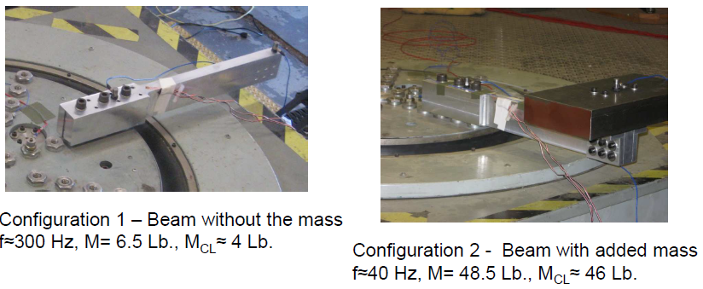
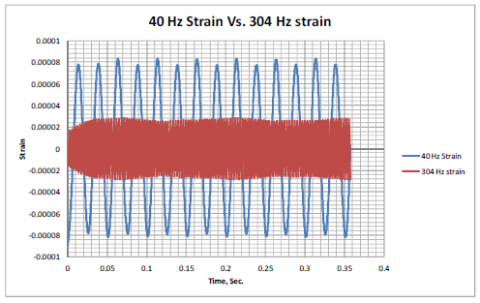
Evolving New Light Weight Structural Design Methodology
2012 Test
For practically an equivalent dynamic loading condition, approximately 3X more strain was measured at 40 Hz than at 300 Hz
This means is that higher frequency vibrations have less effect on a structure than lower frequency vibrations
  When we assume dynamic loads are static, we are assuming their frequency is zero which works but is costly

Slide 13
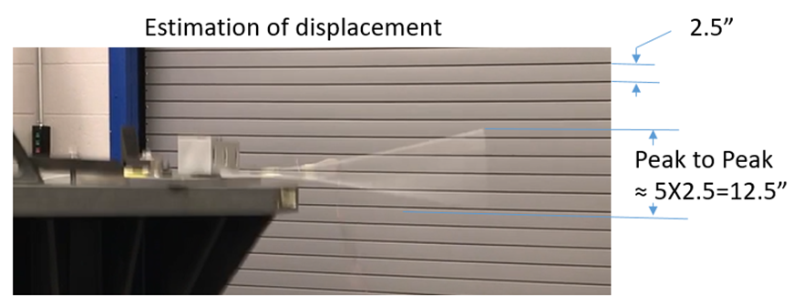
Evolving New Light Weight Structural Design Methodology
2019 Test
A beam was load statically to failure
It bent about 1” while loaded
The same type beam was attached to a
vibration shaker table and was excited at
its fundamental natural frequency – the beam bent +/- 6” w/o failure
This indicates that the beam can bend a lot more when the motion is dynamic vs. static
  This was an unexpected but very pleasant surprise

Slide 14
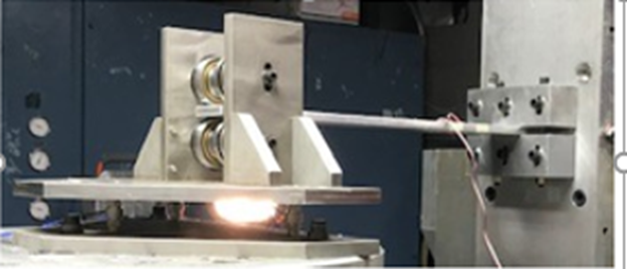
Evolving New Light Weight Structural Design Methodology
Test Setup
2020 Test
Tests were performed in which the force applied to the beam was measured
  In one case, at 40 Hz, 900 Ld was applied to the beam without structural failure
  In comparison, about 80 Lb. applied statically resulted in structural failure (plastic deformation)
Kinematic interface - bearings
Load Cell
Shaker Table
Fixed End

Slide 15
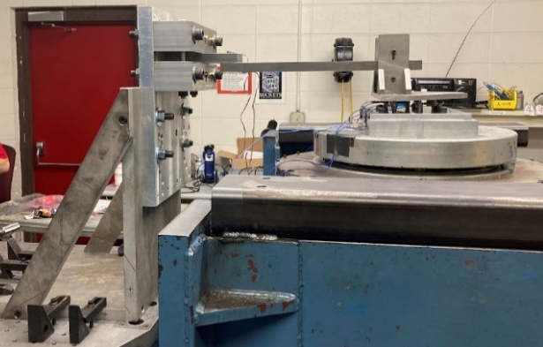
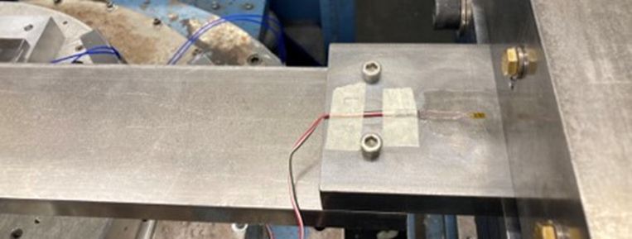
Evolving New Light Weight Structural Design Methodology
Test like the 2020 tests have been performed using a beam that was made via bolting together two pieces (lap joint) and again using a beam that was made via two pieces welded together
  To see if bolted and welded connections exhibited the same characteristic
  As expected, similar results were seen
Tests were performed to prove the concept and at least qualitatively demonstrate the magnitude of potential mass savings

Slide 16
Evolving New Light Weight Structural Design Methodology
Next Steps
  Perform centrifuge tests of an assembled box
  Perform tests and correlate that to fatigue analyses
Select a path forward to devise a new or modified way to assess structures for dynamic loads
  Save mass (structural designs will be lighter)
  Save time in the engineering development process

Slide 17
Evolving New Light Weight Structural Design Methodology
Thanks for having me here to speak
Questions and comments are very welcome

