Slide 1






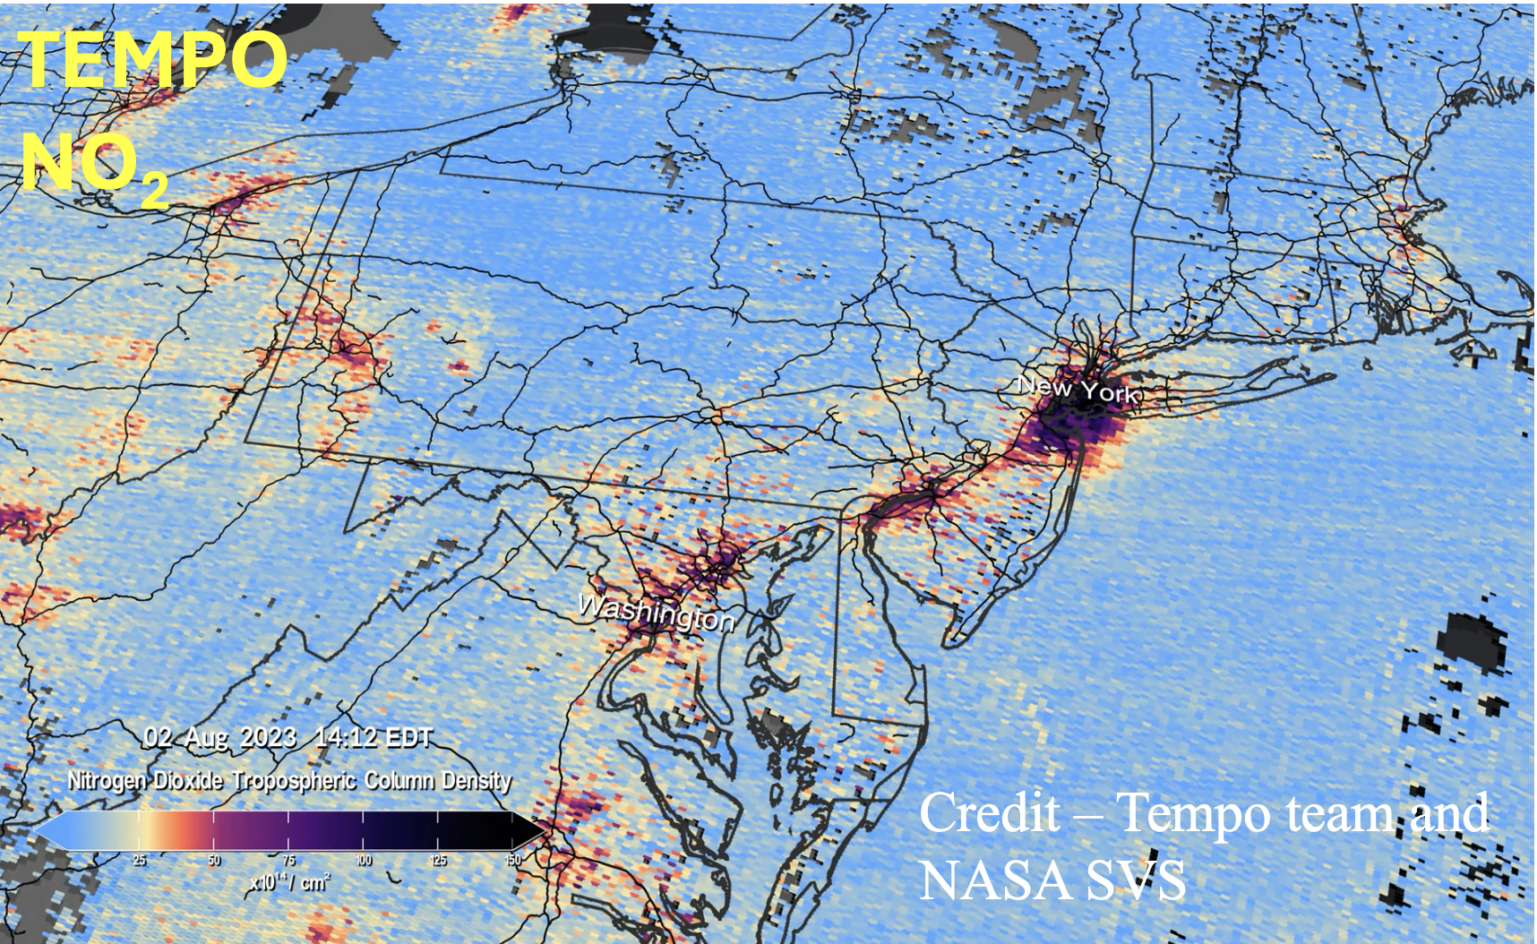
NASA Earth eXchange
Advancing Regional Air Quality and Atmospheric Composition Analysis: Introducing the TRACER-1 Tropospheric Regional Atmospheric Composition and Emissions Reanalysis
Aishwarya Raman^{1,6}, Arthur P. Mizzi^{1,2,6,7,9}, Chia-Hua Hsu^{7,9}, Colin Harkins⁷, Kazuyuki Miyazaki⁴ , Rajesh Kumar³, Matthew S. Johnson¹, Brian McDonald², Kevin Bowman⁴, K. Emma Knowland^{5,8} , Ian G. Brosnan¹
aishwarya.raman@nasa.gov
¹ NASA Ames Research Center, ² NOAA Chemical Sciences Laboratory, ³ National Center for Atmospheric Research, ⁴ NASA Jet Propulsion Laboratory, ⁵ NASA Goddard Space Flight Center, ⁶ Bay Area Environmental Research Institute, ⁷ CIRES-University of Colorado Boulder, ⁸ Morgan State University, ⁹ University of Colorado, Boulder, MEC-E.
Why Regional Reanalysis ?
TRACER-1 Overview and Setup
Available global chemical reanalysis – too coarse for air quality-relevant scales.
To build a high-resolution 20-year regional AC reanalysis (2005-2024) for the CONUS with chemical data assimilation (Chem-DA) and dynamic emission estimates, focusing on months April-September.
  NOAA’s WRF-Chem 4.2.2 with DART
    12 km up to 4 km
    3-6 h cycling
    51 vertical levels
Observations to be assimilated in TRACER-1
OMI, GOME-2, and SCIAMACHY. | Tropospheric NO₂ column retrievals
TES | O₃ nadir data
MOPITT | CO Total column TIR/NIR
MLS | O₃ and HNO₃
OMI | SO₂ PBL vertical column
*MODIS | AOD (*only if we see significant and correct improvements to aerosol properties).
*Surface MET and AQ | NCEP, AIRNOW CO, O₃, NO₂, SO₂, PM₁₀, PM_{2.5}
AQ pollutants – Sparse measurements and many species have short lifetimes and large geographical variability.
Credit – Tempo team and NASA SVS
  Emissions
    Anthropogenic: GRA²PES emissions
    Biomass burning: FINN
    Biogenic Emissions Inventory System (BEISv3.14)
  Gas-phase and aerosol chemistry
  RACM_ESRL_VCP and MADE/VBS
Regional Reanalysis System
WRF-Chem/DART Ensemble Adjustment Kalman Filter (EAKF)
Initial and boundary conditions (ICs/BCs)
Meteorology – NAM
Chemistry - TCR2
WRF-Chem/DART EAKF
Update prior ICs and BCs
TRACER-1 Accomplishments to Date
End User Applications
Modular WRF-Chem/DART – Faster, easier to integrate into new DART versions.
Includes the DART Quantile-Conserving Ensemble Filter Framework (work in progress).
  Ability to include non-gaussian distributions in EAKF; Important for the typical non-gaussian distribution observed in chemical species.
  Ensures positive definite analysis for chemical species.
Developed and tested TCR-2 - WRF-Chem/DART interface for IC/BC conditions.
Completed met and chem DA testing with old and the new WRF-Chem/DART.
All forward operators (in situ and satellite) needed for TRACER-1 observations (not already in WRF-Chem/DART) developed and tested on Pleiades.
Research community
Public health agencies
  Exposure modeling
  Exceptional events – retrospective impacts on health
  Provide initial and boundary conditions for AQ models
  Model Development
  Downscaling using various techniques including ML
  Linkages between AQ and climate
Prior Emissions
Analysis ensemble of mixing ratios
Updated emission ensemble
In situ meteorology and satellite AQ observations
Policy makers
  Long-term variations in AQ and emissions
  Cross-state pollution transfer
Forecasts for next cycle
Acknowledgements
The authors acknowledge the financial support from NASA’s Aura Science Team, Atmospheric Composition Modeling and Analysis Program (ACMAP). The authors thank the technical resources provided by NAS computing and NASA Earth eXchange (NEX) at
NASA Ames Research Center.
Evaluation against in situ and aircraft measurements

