Slide 1

Automation of
Geometric Accuracy Assessment Algorithm
Alana Semple^{1,2}
Bin Tan^{1,2}
Guoqing (Gary) Lin¹
1. NASA Goddard Space Flight Center, Greenbelt, MD
2. Science Systems and Applications, Inc., Lanham, MD
Sponsorship: NASA Commercial Smallsat Data Acquisition (CSDA) Program
JACIE 2023 Workshop
USGS Headquarters, Reston, VA
03/29/2023

Slide 2
Outline
Background
Geolocation Offsets Assessment Algorithm
Automatic Filtering Algorithm
Application of Algorithm
Summary

Slide 3
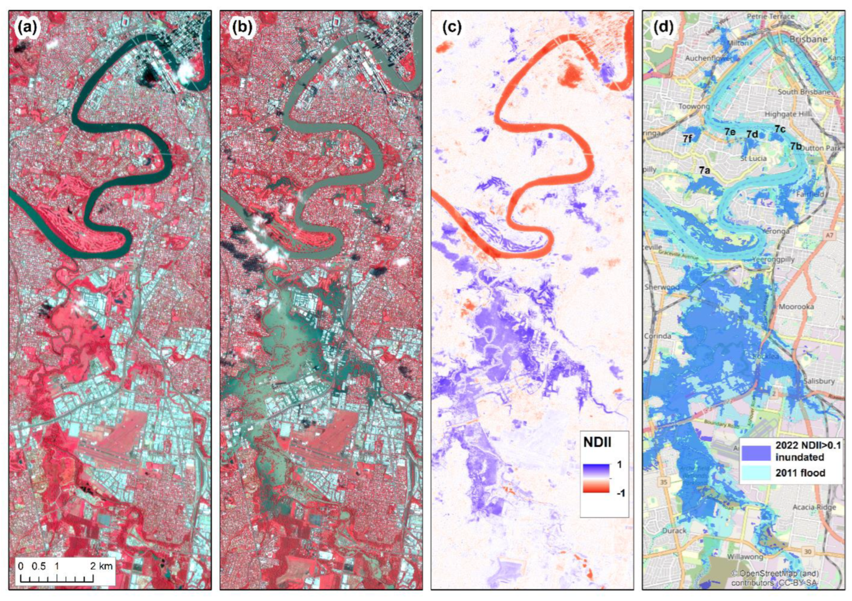
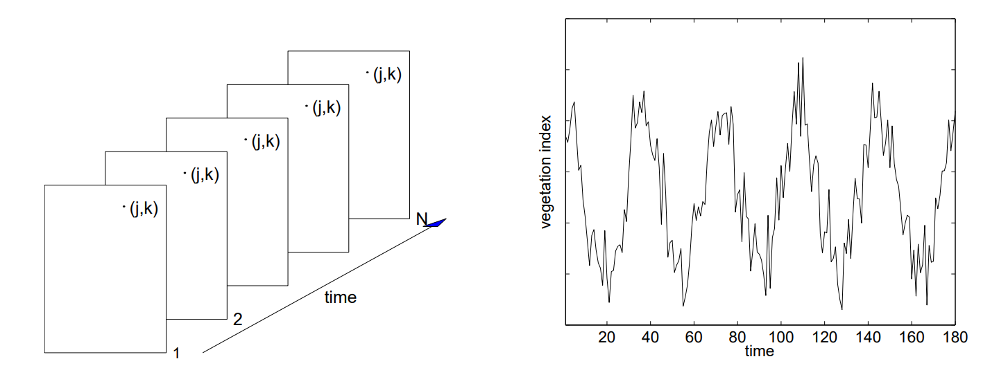
Geolocation Offsets Between Satellite Images
Characterize geolocation accuracy of satellite data for NASA’s Commercial Smallsat Data Acquisition (CSDA) program.
Necessary step in time series analysis of satellite imagery such as flood mapping and remotely sensed season changes.
Inter-sensor and inter-resource analysis
[2] N. Levin & S. Phinn, 2022
[1] L. Eklundh & P. Jönsson, 2017 TIMESAT manual
Notes:
Intro & motivation, ex: flood mapping, NDVI calculation

Slide 4
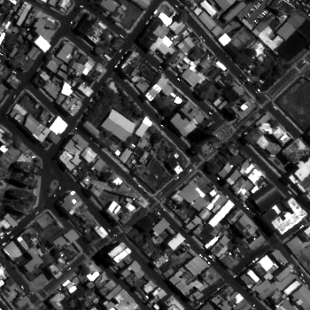
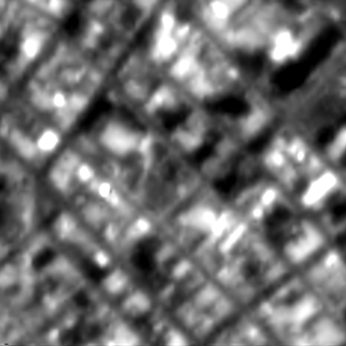
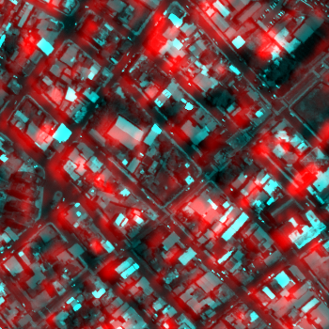
Geolocation Accuracy Assessment Algorithm
Example Case 1: MAXAR's Worldview 2 (0.8 m) red band (.63 - .69 µm) vs Planet’s SuperDove (3 m) red band (0.65 - 0.68 µm) over Manta, Ecuador.​
Determine area of overlap between images based on UTM coordinates.
Split overlapped region into 350 m x 350 m image subsets (chips).
Resample chips to common resolution with bicubic interpolation.
False color image visually showing initial offset between images.
WV image
Taken: 2021/04/19
PS image
Taken: 2021/12/24
R: PS image
G: WV image
B: WV image
Notes:
Image comparison and chips

Slide 5
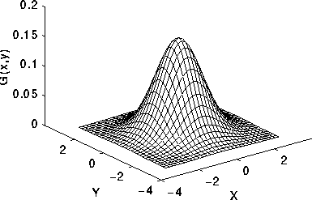
Calculate Chip Offsets
Impose offsets between chip pairs.
Calculate Pearson Cross Correlation Coefficient (PCC) at each offset.
Final chip offsets are those that give the best PCC between the images.
PCC
NS offset
EW offset
Ideal PCC map if offsets are 0 m in North-South (NS) and East-West (EW) directions
Chip pair with best PCC at offsets:
NS = -2.1 m
EW = -10.0 m
Notes:
PCC

Slide 6
Calculate Chip Match Quality
Correct chip offsets and calculate measurement uncertainty (MU) for quality check.
Find MU for all chips to preform the filtering step.
1
D
1
1
1
MU_{x} =
2
1
z_{pk}
(
)
PkSh_{x}
NM
2
c₁
c₂
PkSh_{x} : Peak sharpness
N and M : image dimensions
z_{pk} : refined PCC
c₁ & c₂: normalized contrast of two images
D: normalized contrast difference at overlap region
[3] F. De Luccia et al. 2016
Notes:
MU

Slide 7
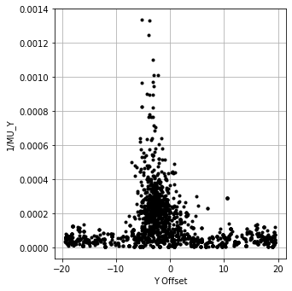
Apply Quality Filter: Previously Manually
Low quality can be caused by: Clouds water, building shadow, seasonality of dense vegetation cover, etc.
Low quality chips influence final image offsets and should be removed.
Chip Match Quality
North-South offsets (m)
Notes:
1/MU = gauss, previously manual

Slide 8
Apply Quality Filter: Previously Manually
Low quality can be caused by: Clouds water, building shadow, seasonality of dense vegetation cover, etc.
Low quality chips influence final image offsets and should be removed.
Removal was previously manual and based on a threshold quality (red line in example data), this was reasonable when few sensors were being assessed.
Chip Match Quality
MU is dependent on sensor properties, so each sensor will have a different ideal threshold value
North-South offsets (m)
North-South offsets (m)
Notes:
1/MU = gauss, previously manual,

Slide 9
Apply Quality Filter: Previously Manually
Low quality can be caused by: Clouds water, building shadow, seasonality of dense vegetation cover, etc.
Low quality chips influence final image offsets and should be removed.
Removal was previously manual and based on a threshold quality (red line in example data), this was reasonable when few sensors were being assessed.
Chip Match Quality
Can the Gaussian-like shape be used to automate threshold determination?
North-South offsets (m)
Notes:
1/MU = gauss, previously manual,

Slide 10
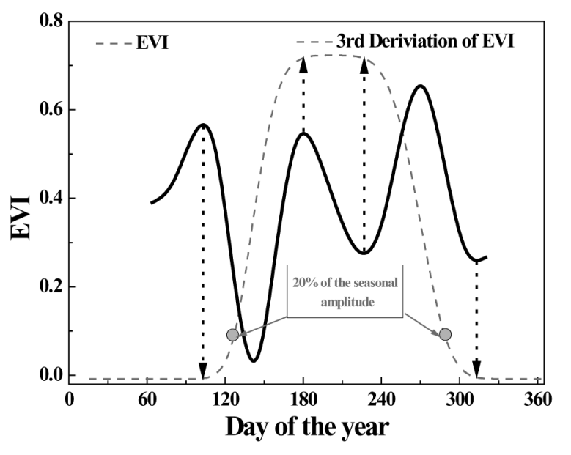
Automatic Determination of Threshold value
[4] Tan et al., 2011 determines growing season start and end based on derivatives of the Enhanced Vegetation Index (EVI) time series.
[4] Tan et al, 2011
Notes:
Timesat, 3rd derivative for auto cutoff

Slide 11
Automatic Determination of Threshold value
[4] Tan et al., 2011 determines growing season start and end based on derivatives of the Enhanced Vegetation Index (EVI) time series.
Geolocation assessment automation uses a similar approach to find the threshold quality value.
Chip Match Quality
North-South offsets (m)
[4] Tan et al, 2011
Notes:
Timesat, 3rd derivative for auto cutoff TIMESAT curve fitting

Slide 12
Preprocess data for Gaussian Approximation
Moving Window
Remove initial outliers based on moving average of chip match quality.
In the example, gold box shows approximate window size, and red points are those removed by this filter.
Chip Match Quality
North-South offsets (m)
Notes:
Step1, loose data filter

Slide 13
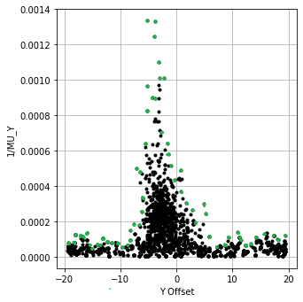
Extract Profile for Gaussian Approximation
Select the top most point (green in example) within a narrow moving window to construct data for line fitting.
Chip Match Quality
North-South offsets (m)
Notes:
Step 2, designate only outer pts

Slide 14
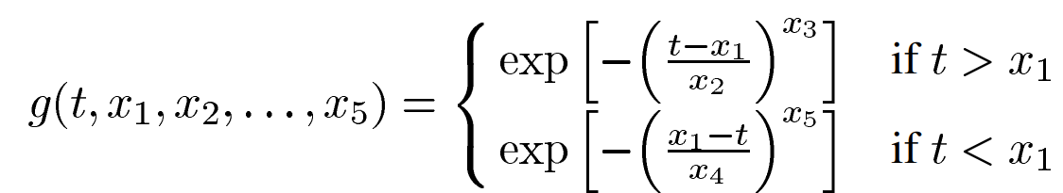
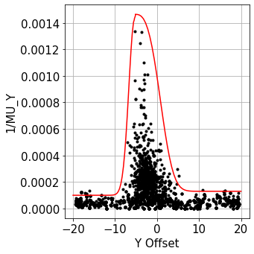
Least Squares Inversion of 1-sided gaussian
Left
Right
Data split to left side and right side based on maximum value.
Gaussian parameters determined by Python library SciPy’s least_squares function with initial guesses:
x₁ = position of data’s maximum quality
x₂ & x₄ = data’s standard deviation
x₃ & x₅ = 2
Chip Match Quality
North-South offsets (m)
[1] L. Eklundh & P. Jönsson, 2017
Notes:
Step 3, approximate 2 1-sided gaussians, TIMESAT

Slide 15
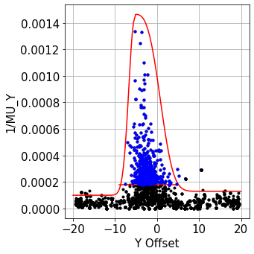
Threshold Value Calculated and Applied
Calculate solutions of the 3rd derivative.
Determine the threshold value by evaluating which solution returns a higher chip match quality.
Remove all matches of quality below the threshold (black points in figure).
Calculate mean offset between the images with the remaining filtered data (blue points in figure).
Chip Match Quality
Before Filter
# Chips: 2047
Mean offset: -0.7 m
Std Dev: 9.3 m
RMSE: 9.3 m
CE90: 23.3 m
After Filter:
# Chips: 403
Mean offset: -2.4 m
Std Dev: 2.1 m
RMSE: 3.1 m
CE90: 12.8 m
North-South offsets (m)
Notes:
Step 4: find 3rd derivative and use as cutoff,

Slide 16
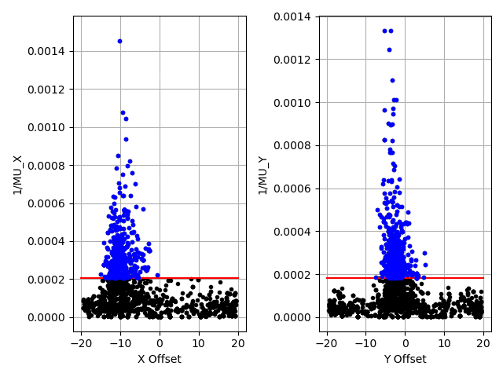
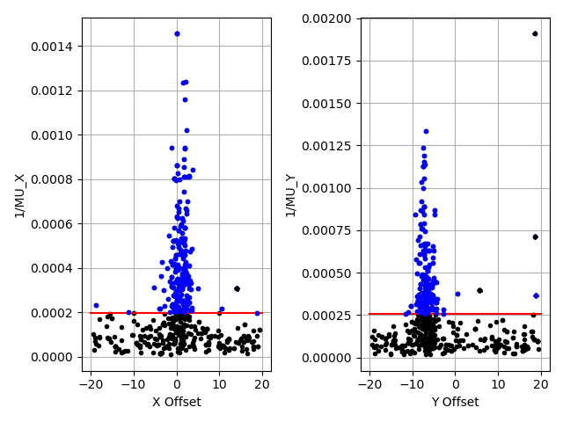
Automated Geolocation Accuracy Assessment
Examples of full application of the automated geometric assessment algorithm.
Blue points are those that passed all filters, black points were removed by either preprocessing or quality threshold, red line indicates the automatically determined quality threshold
Case 1, Manta, Ecuador
Case 2, Boston, MA, USA
Chip Match Quality
Chip Match Quality
East-West offsets (m)
North-South offsets (m)
East-West offsets (m)
North-South offsets (m)
Notes:
Effectiveness: mean and std

Slide 17
Application to Large Scale Assessment
Table shows results for running this automated algorithm on PS SuperDove images compared to a single WV image at each location.
A City Within: | # of PS Images | # of Chips | X Mean (m) | Y Mean (m) | X StdDev (m) | Y StdDev (m) | X RMSE (m) | Y RMSE (m) | CE90 (m)
California | 11 | 2257 | -2.2 | .3 | 1.7 | 1.8 | 2.8 | 1.9 | 3.5
New Mexico | 20 | 6072 | -.4 | -.3 | 1.9 | 1.4 | 1.9 | 1.5 | 3.2
Canada | 6 | 517 | 1.4 | 2.0 | 2.0 | 3.2 | 2.4 | 3.7 | 6.0
Mexico | 5 | 4361 | 2.0 | 1.0 | 1.5 | 1.4 | 2.5 | 1.7 | 4.4
Ecuador | 6 | 3301 | -5.6 | -7.6 | 1.6 | 2.3 | 5.8 | 7.9 | 11.3
Brazil | 6 | 6848 | -.9 | 3.3 | .9 | 1.6 | 1.3 | 3.7 | 5.1
Chile | 5 | 1023 | -4.6 | 3.8 | 1.2 | 1.6 | 4.8 | 4.1 | 7.6
Argentina | 7 | 1851 | -2.5 | -5.4 | 1.7 | 1.5 | 3.0 | 5.6 | 7.8
England | 6 | 2727 | -3.7 | 12.8 | 1.9 | 2.8 | 4.1 | 13.1 | 16.6
Ireland | 5 | 2668 | -1.1 | 10.3 | 1.4 | 1.5 | 1.8 | 10.4 | 12.3
Sicily | 5 | 2182 | -5.8 | 10.4 | 4.3 | 5.1 | 7.2 | 11.6 | 15.7
Turkey | 9 | 2901 | -22.0 | 12.2 | 2.4 | 1.9 | 22.1 | 12.3 | 28.1
Morocco | 5 | 1182 | 4.3 | 2.0 | 5.0 | 4.2 | 6.6 | 4.6 | 7.0
Angola | 6 | 4292 | 3.8 | .4 | .8 | 1.5 | 3.8 | 1.6 | 5.0
Somalia | 5 | 5244 | -1.2 | 1.0 | 1.3 | 1.2 | 1.7 | 1.5 | 3.3
South Africa | 6 | 4597 | -6.2 | .1 | 1.6 | 1.2 | 6.4 | 1.2 | 8.2
Cairns | 6 | 2758 | 1.7 | -.3 | 3.0 | 3.7 | 3.4 | 3.7 | 6.0
Melbourne | 6 | 2485 | -10.1 | 9.8 | 1.0 | 1.6 | 10.1 | 10.0 | 15.2
Perth | 6 | 3387 | -7.6 | -7.5 | 1.8 | 1.6 | 7.8 | 7.6 | 13.2
Singapore | 6 | 1169 | -.5 | 2.8 | 3.8 | 2.9 | 3.8 | 4.1 | 7.1
Total Data: | 137 | 61822
Notes:
Conclusions

Slide 18
Summary
Our geolocation accuracy assessment algorithm is now fully automated and can evaluate any imagery pair (WV, PS, NAIP, etc.) without manual intervention.​
Data filtering is needed for an appropriate image offset calculation.
Automation is needed for analysis involving a large number of individually built sensors.​
Effective automated data filtering is preformed based on the 3rd derivative of a Gaussian fit to determined offsets vs. chip match quality.
The automated assessment has been run on 2000+ image pairs since Dec 2022.
Notes:
Conclusions

Slide 19
References
[1] Eklundh, L., and P. Jönsson. "TIMESAT 3.3 with seasonal trend decomposition and parallel processing Software Manual." Sweden: Lund and Malmo University (2017).
[2] Levin, N., and S. Phinn. "Assessing the 2022 Flood Impacts in Queensland Combining Daytime and Nighttime Optical and Imaging Radar Data." Remote Sensing 14.19. doi:10.3390/rs14195009 (2022).
[3] De Luccia, F. J., Houchin, S., Porter, B. C., Graybill, J., Haas, E., Johnson, P. D., Isaacson, P. J., and Reth, A. D. “Image navigation and registration performance assessment tool set for the GOES-R Advanced Baseline Imager and Geostationary Lightning Mapper”, Proc. SPIE 9881, Earth Observing Missions and Sensors: Development, Implementation, and Characterization IV, 988119 (2 May 2016); doi: 10.1117/12.2229059 (2016).
[4] Tan, B., Morisette, J. T., Wolfe, R. E., Gao, F., Ederer, G. A., Nightingale, J., & Pedelty, J. A. "An Enhanced TIMESAT Algorithm for Estimating Vegetation Phenology Metrics From MODIS Data," in IEEE Journal of Selected Topics in Applied Earth Observations and Remote Sensing, vol. 4, no. 2, pp. 361-371, June 2011, doi: 10.1109/JSTARS.2010.2075916 (2011).

Slide 20
Questions?
Notes:
Conclusions

