Slide 1
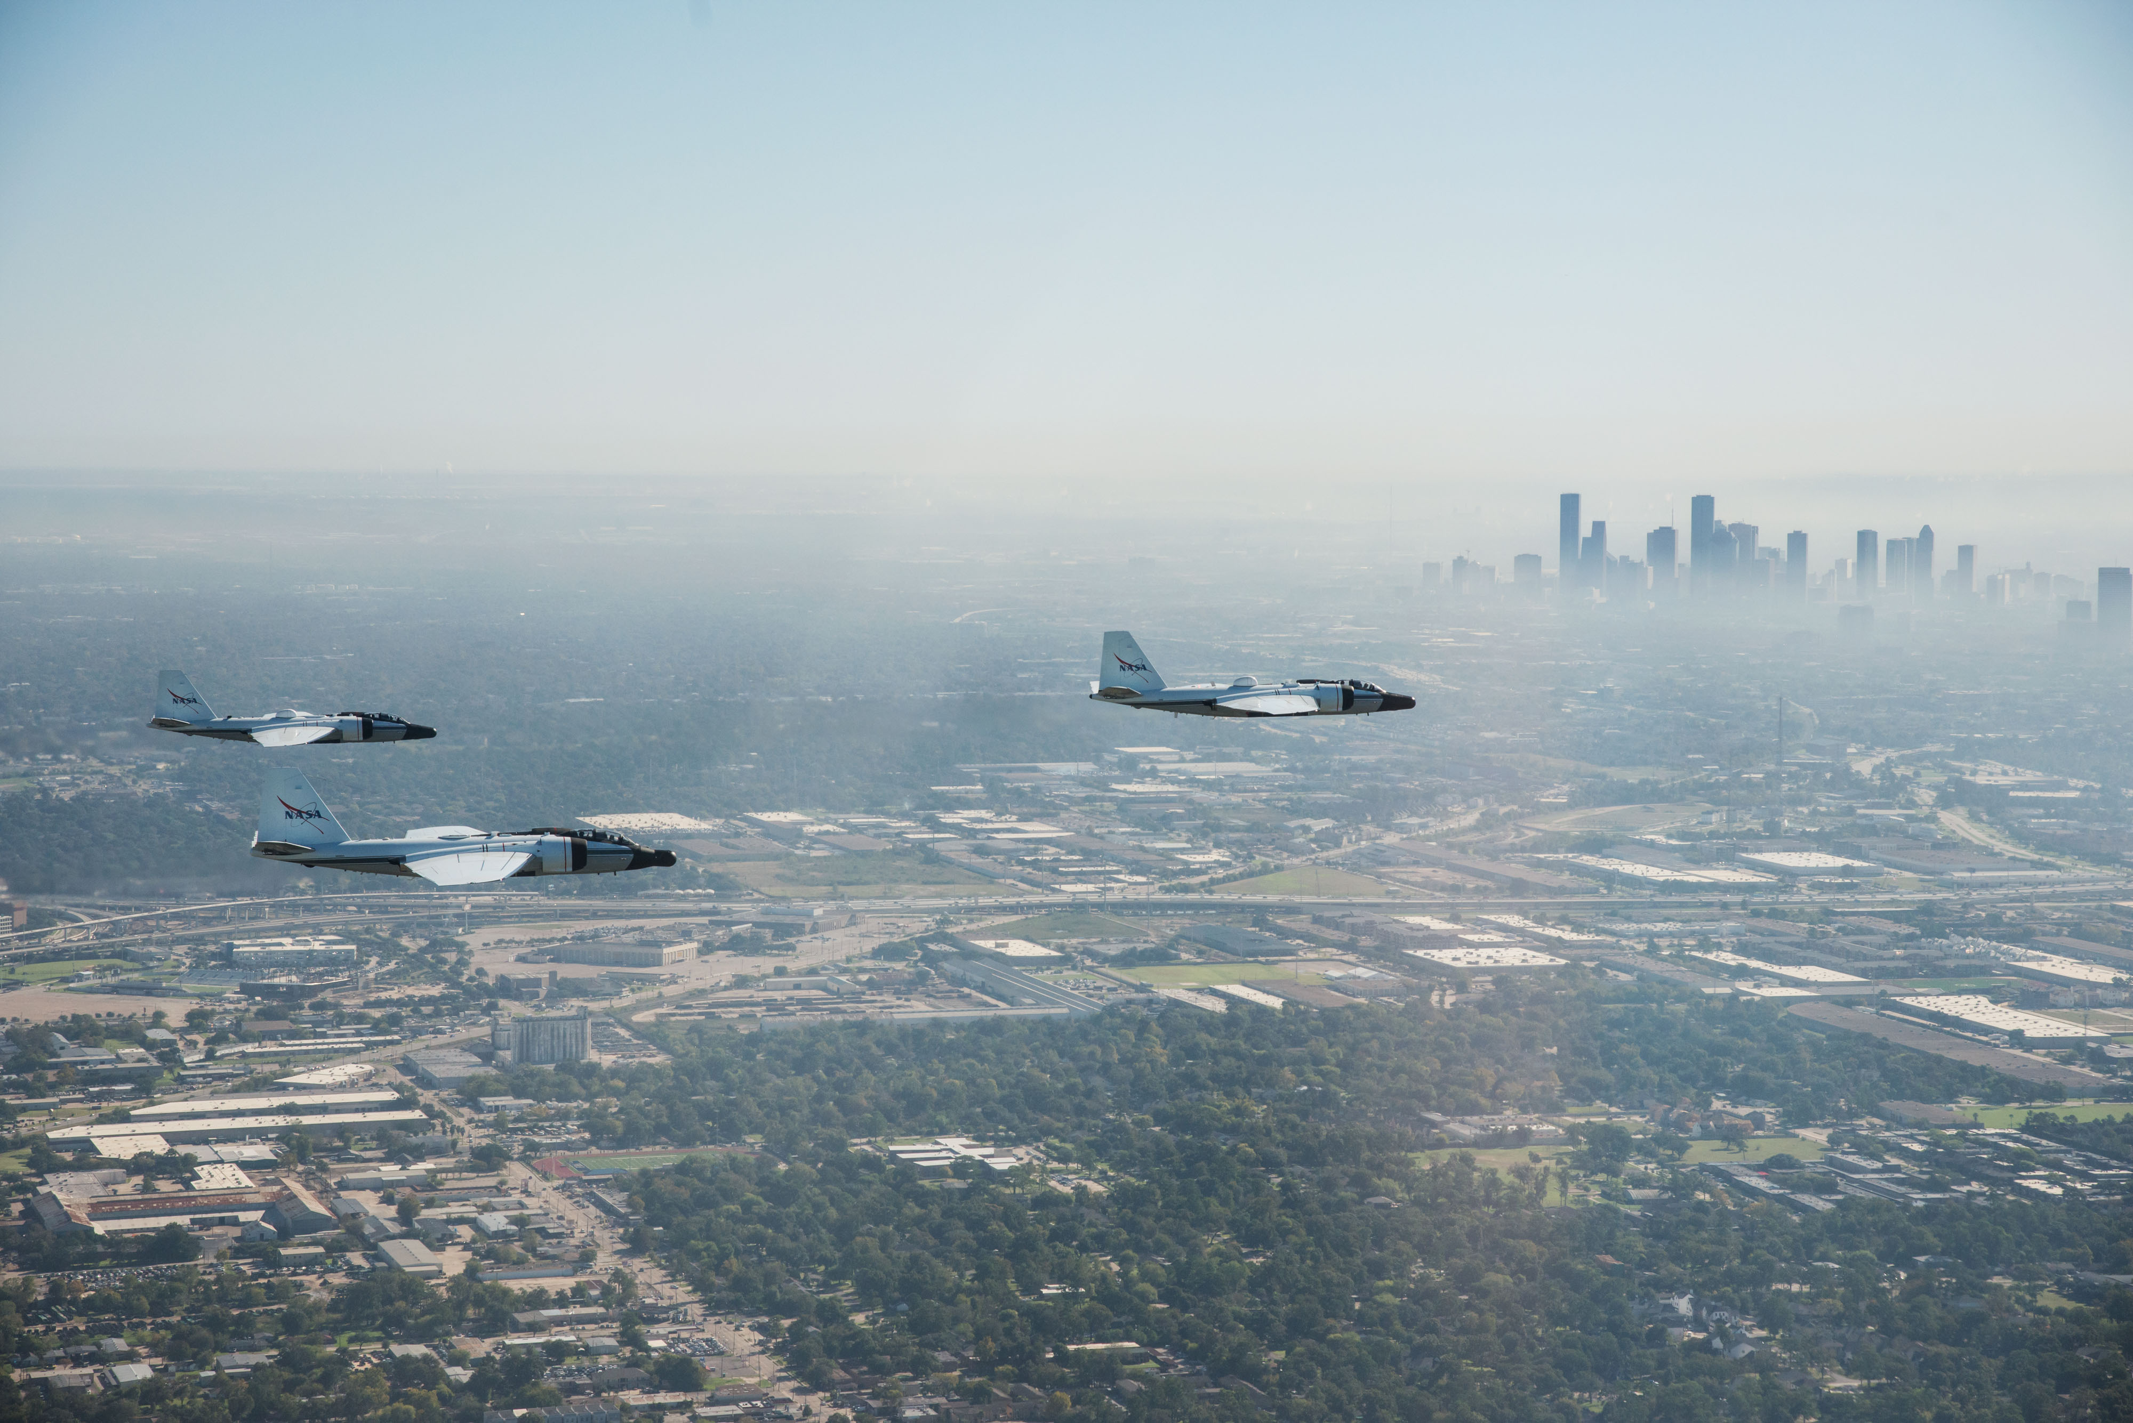

NASA WB-57
High Altitude Research Program
12 FEB 2024
Peter Layshock, Manager

Slide 2

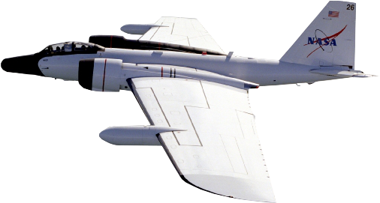
WB-57 Capabilities
Range (km)
1650
Time on Station (hrs)
Transit (hrs)
2:30
1300
1:00
2:00
930
2:30
1:30
3:30
550
1:00
4:30
PERFORMANCE
Aircraft ceiling | 20 km
Endurance | 6.5 hours
Range | 4,000 km
Max. payload | 4,000 kg
Airspeed @ 60kft | 410 knots (Max: Mach 0.8)
Aircrew | 2
Wingspan | 37 m
Deployable, medium-to-high altitude platform with unmatched range, speed, and sensor capacity.
Notes:
Marketing slide ☺

Slide 3
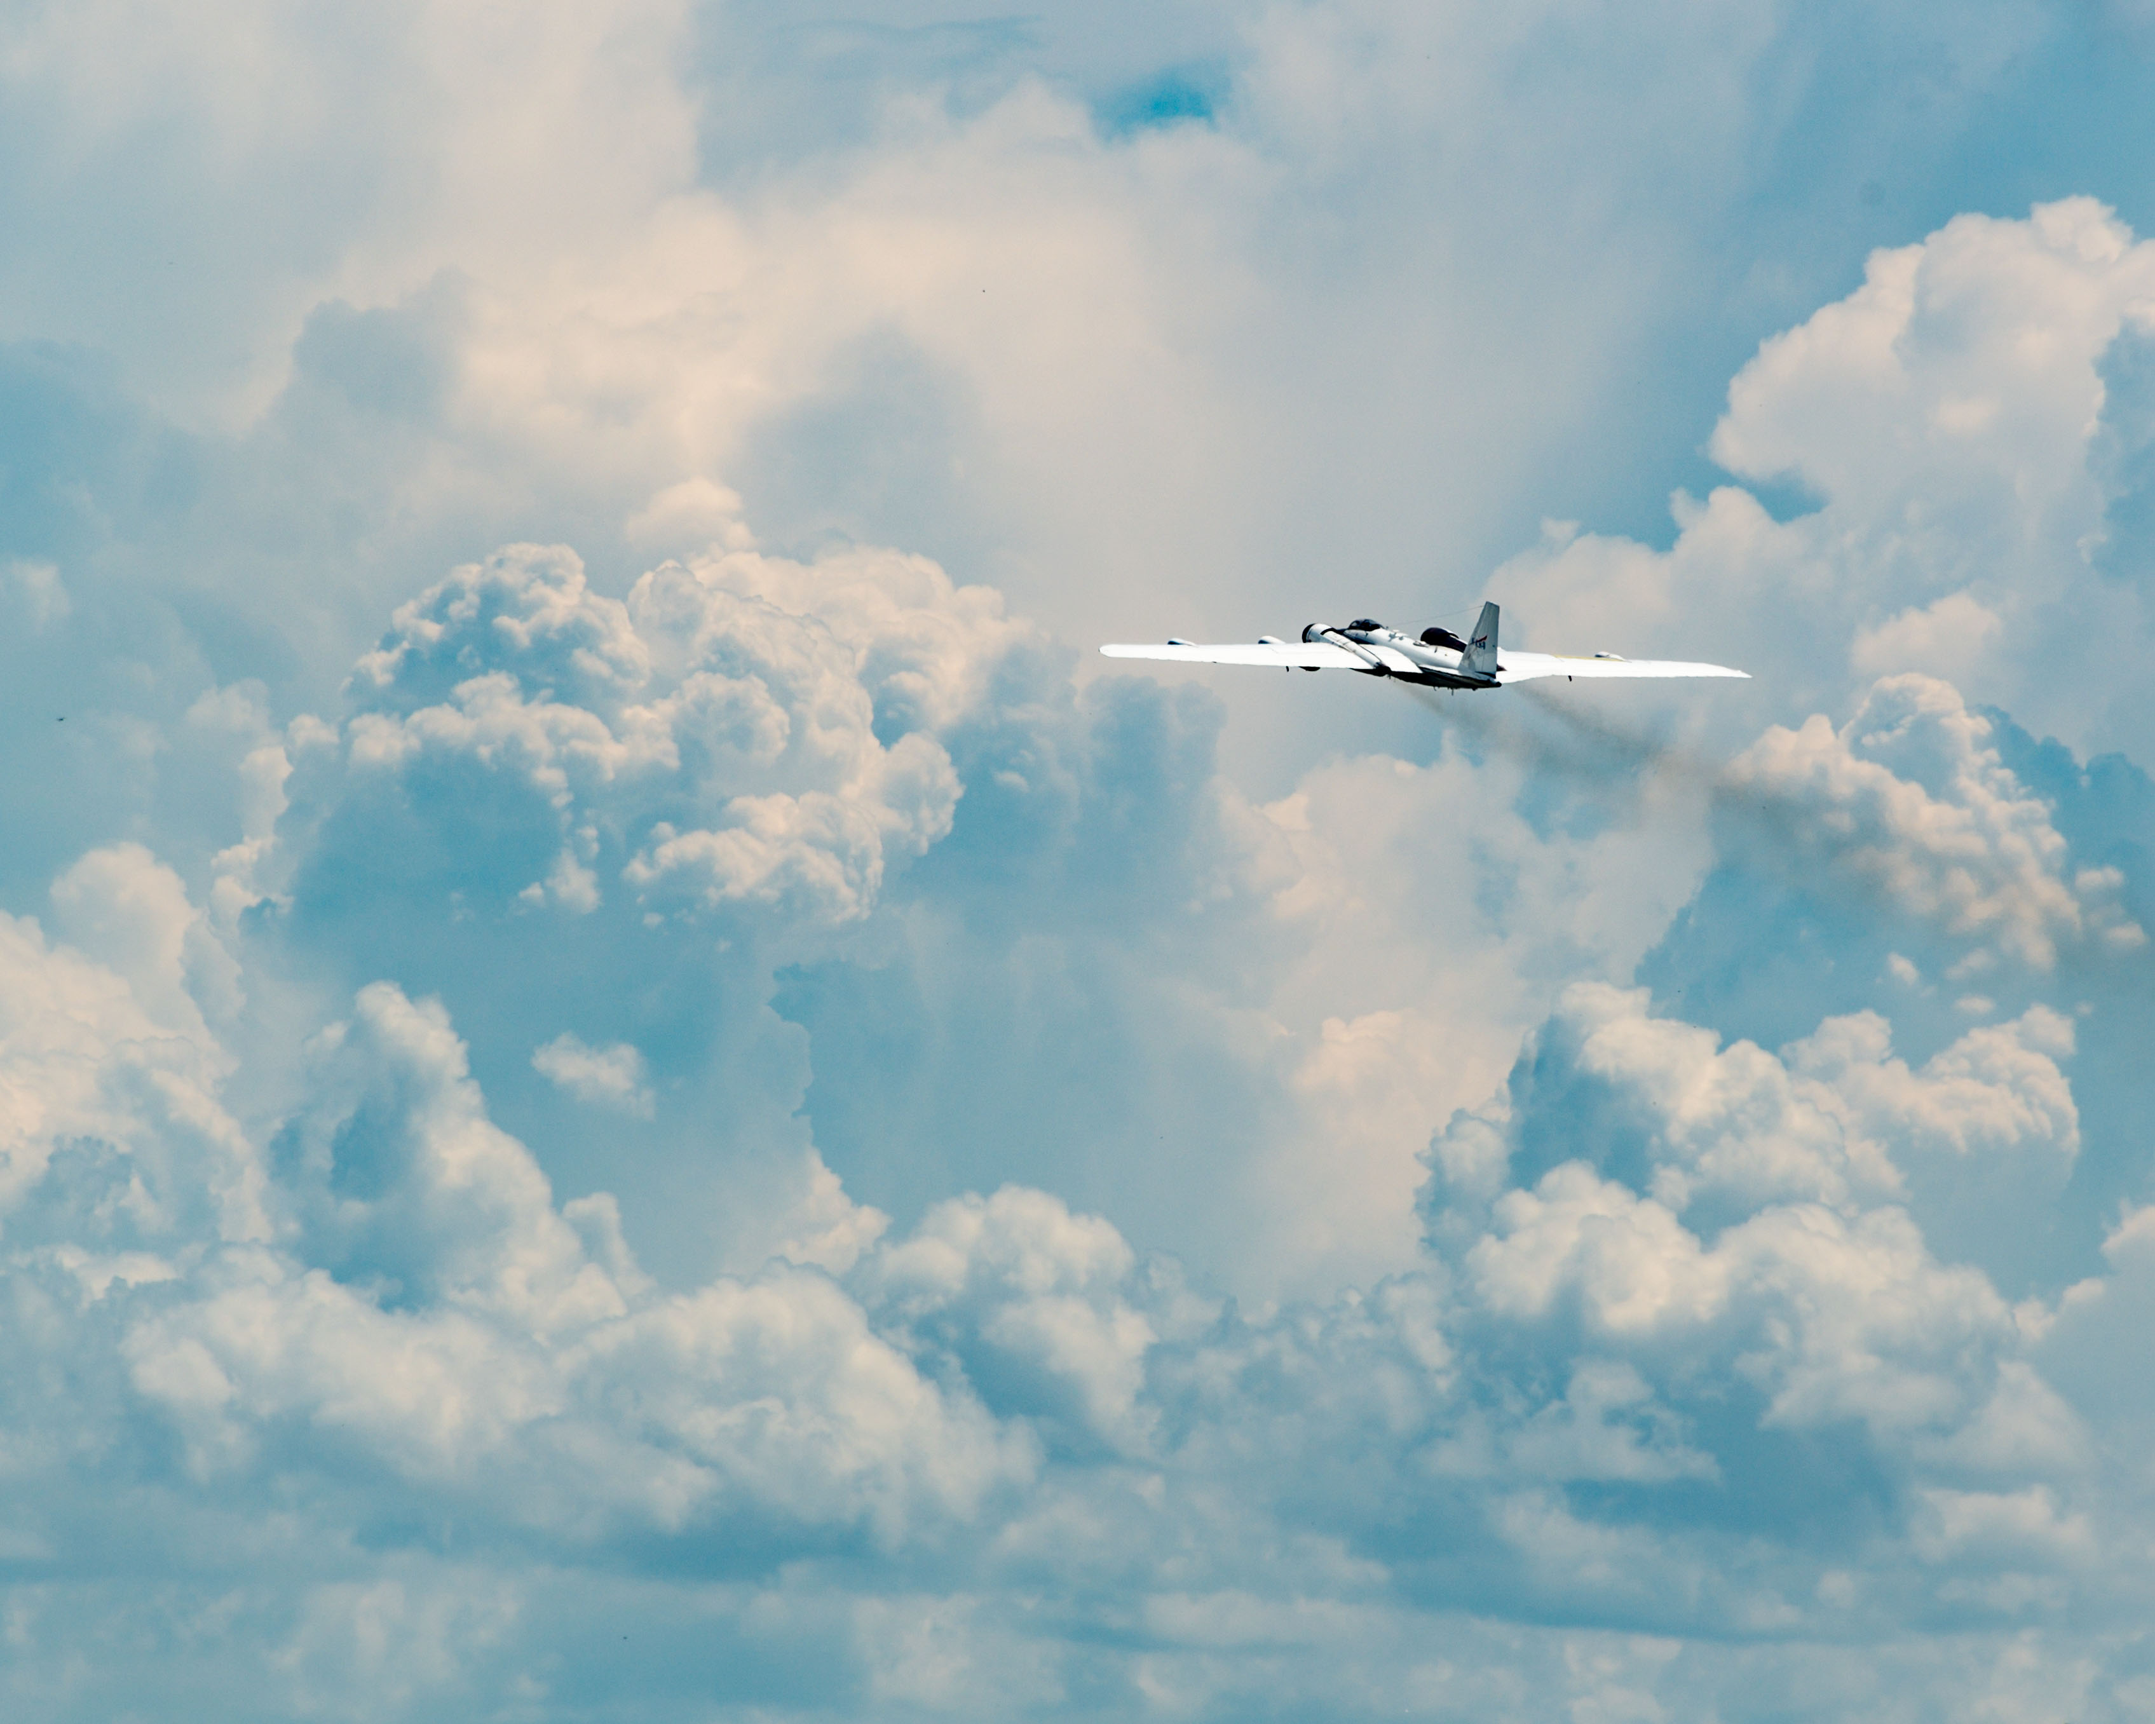
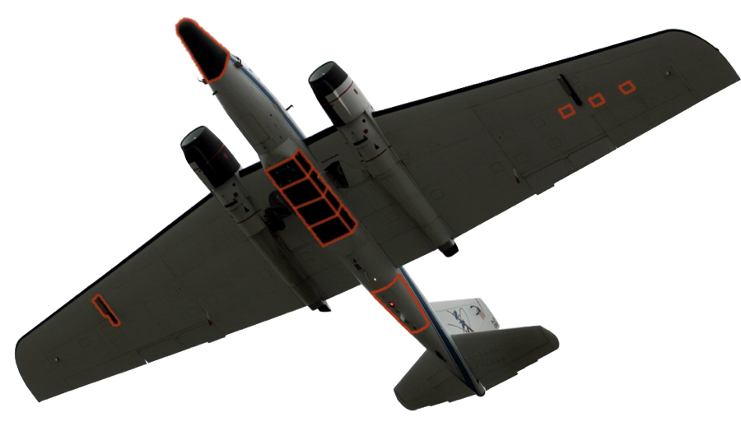
A
D
TAILORED SENSOR SOLUTIONS
Unique access to cutting-edge technologies across NASA / DoD / national agencies not currently available through existing service or industry platforms.
No “standard payload” constraints.
Sensor package(s) compiled to meet each mission’s requirements.
Platform capable of integrating, testing and employing customer sensors.
Multiple air-to-ground communication options: Voice, BLOS & LOS datalinks.
Multiple payload power options: 110V 400Hz, 110V 60Hz, & 28VDC.
B
C
E
SENSOR INTEGRATION OPTIONS
 | Reconfigurable/removable, pressurized nose cone
 | 4 hard points 2/wing; compatible with ER-2 SPEAR Pod, Super Pod and BRU’s;
 | 12’ bomb bay (3‘or 6’ Universal Pallet System); 1000lb capacity per 3’ space
 | 20x small sensor hatches; ten hatches per wing
 | Tail cone / upper equipment bay
A
B
C
D
E

Slide 4
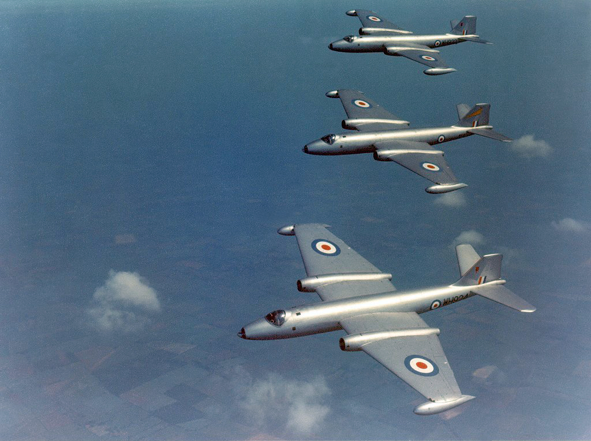
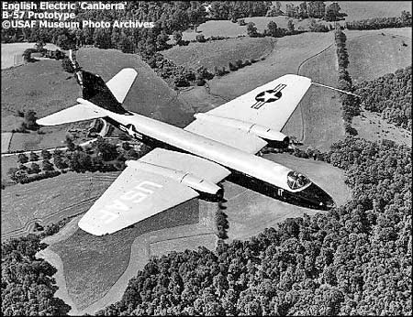
B.2 WD940, later re-designated 51-17352
Notes:
Originally designed in last days of WWII
Tactical jet bomber, to bridge gap between fighters and long-range, strategic bombers
USAAF conducted multi-aircraft evaluation to decide which tactical bomber to put into production to meet needs evident in Korean War
Martin XB-51
North American B-45
AJ-1 Savage
Avro Canada CF-100 Canuck
English Electric B.2 Canberra
Douglas B-26 (from WWII A-26) was the only comparable bomber and insufficient for US needs
English Electric sent two Canberra over Atlantic in 1951 as demonstrators in the fastest trans-Atlantic crossing at the time
They were the only aircraft of the 5 to have volume for night sensors and weapon release systems
These two became the first B-57A models (B.2 WD940 --> 51-17352 and WD932 --> 51-17387)
Glen L. Martin company of Baltimore, MD was awarded the contract by USAAF for license-built B.2s (to become B-57) in 1951
"Canberra" designation has mostly stuck despite initial rollout as "Night Intruder"

Slide 5
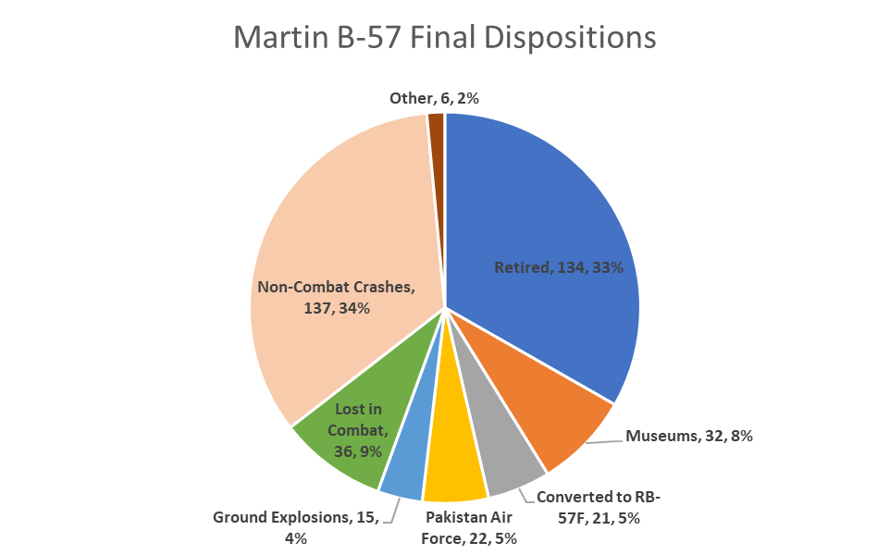
Total 403 aircraft

Slide 6
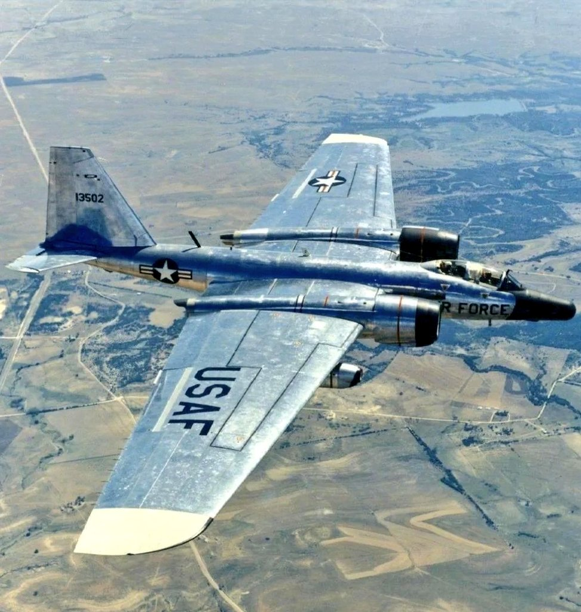
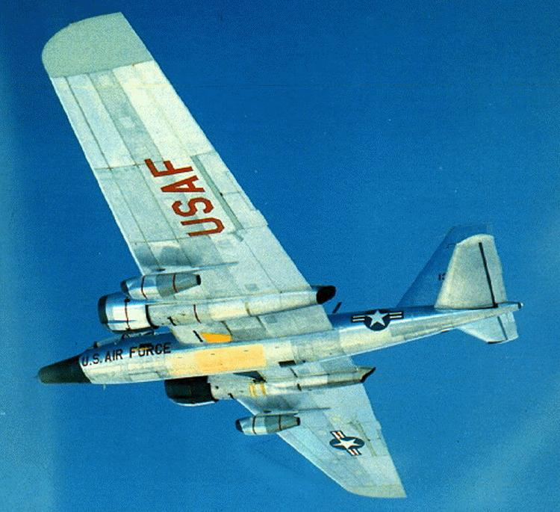
-F model operated by the 58 WRS out of Kirtland AFB, NM
Notes:
Initially conceived from Big Safari Project Peewee in OCT 1962/63 (see Pakistan page)
1963: "Peewee III": first 2 -F model prototypes delivered and operated in Pakistan, Peewee III-1 and -2
1963-64: "First Chip" (later Rivet Chip), next 12 units, all converted -B models (927 and 928 came from here, RC8 and RC11 respectively)
1965-66: "Second Slice" (later Rivet Slice), next 4 units, all converted from grounded -D models (925 and 926 were here, RS3 and RS2 respectively)
First Chip follow-on: final three a/c, all converted -A models
21 units produced, all from rebuilt a/c (3 from RB57-A's, 4 from RB-57 D's, and 14 from B-57B's)
Performed remote sensing/reconnaissance and in-situ sampling that had previously been performed by -D models
First flight in 1964, production continued until 1967
Redesignated from RB-57F to WB-57F in 1968
Last active squadron (58 WRS) at Kirtland was inactivated in 1974
Similar requirements as -D models, but with further refinements to mitigate wing spar limitations
New engine: P&W TF-33-P11 (plus detachable P&W J-60-P9s)
Fuselage, gear, and horizontal stabilizer were retained from legacy models. Wings, vertical stab, and cockpit all new
New wingspan 122.5 feet, wing area ~2,000 sq ft
All F models were originally assigned to one of 4 WR Squadrons:
55th WRS @ McClellan AFB, CA
56th WRS @ Yakota AB, Japan
57th WRS @ RAAF Avalon, Australia
58th WRS @ Kirtland AFB, NM
Losses:
Peewee III #2: lost over Black Sea in 1965, unclear whether from Russian anti-aircraft missile or mechanical failure
Rivet Chip 10: Crashed into Sandia Range on final approach to Kirtland in 1966
Rivet Chip 5: Experienced mach tuck over ABQ @ 50,000 ft in 1972, aircraft disintegrated

Slide 7
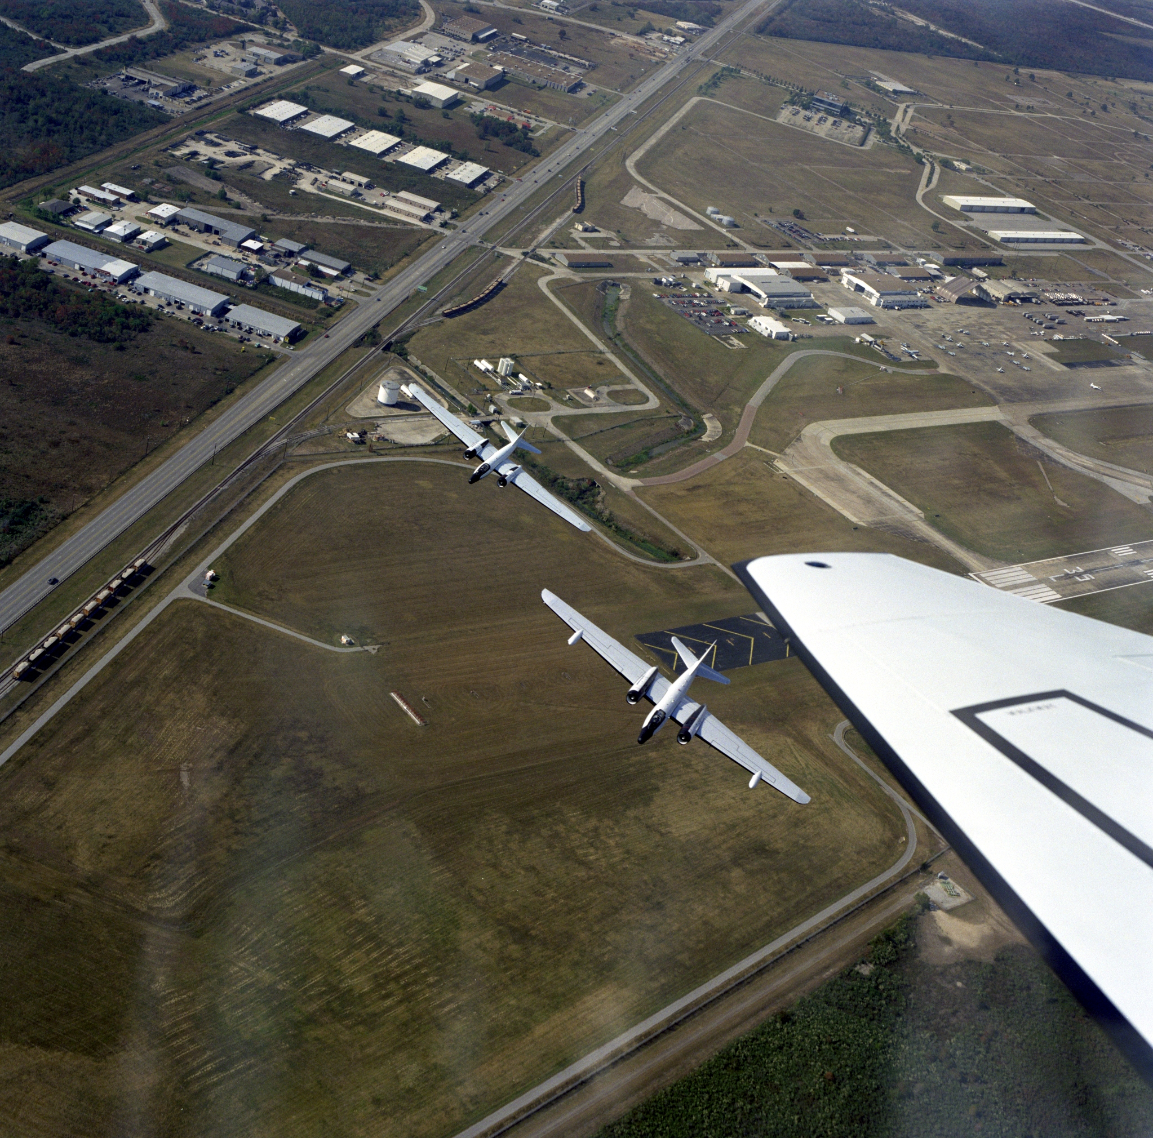
Aircraft upgrades:
F-15 landing gear/brakes
F-16 ACES-II ejection seats
Digital autopilot system
Gross weight increase, from 63,000 to 72,000 pounds
Notes:
Aircraft upgrades:
F-15 landing gear/brakes
F-16 ACES-II ejection seats
Digital autopilot system
Gross weight increase, from 63,000 to 72,000 pounds
For many years, the NASA WB-57 fleet has operated largely independent of major agency initiatives
Continually operated at Manned Spacecraft Center (now Johnson Space Center) since 1968, despite having very little direct association with human spaceflight
Dependent on partnerships with academia, industry, DOD, and other government agencies for continual sustainment and operation

Slide 8
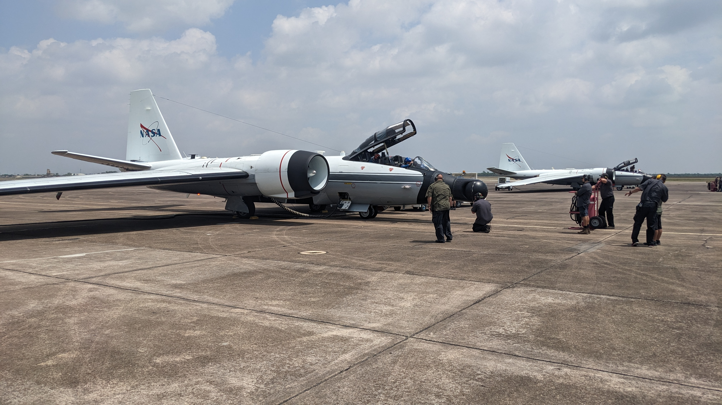
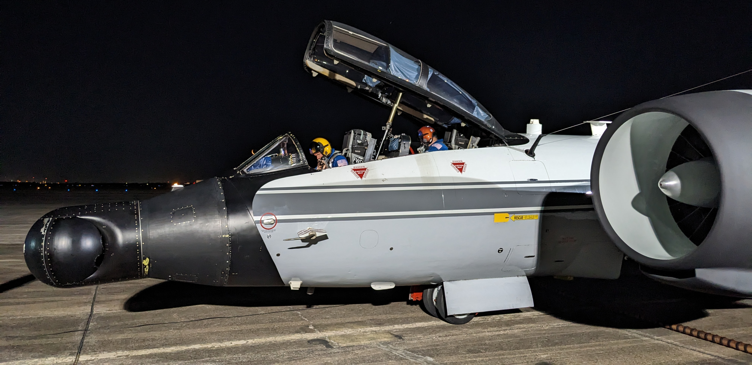
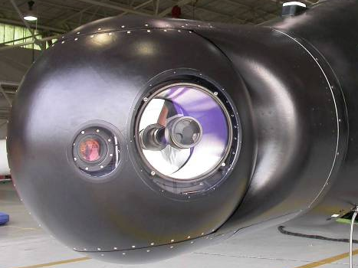
Missions: Airborne Imagery
Notes:
Bread and butter of missions today are a) imagery; and b) science partnerships. Also do instrument test & development and special research missions (Eclipse 2024, Hurricane research, etc)

Slide 9
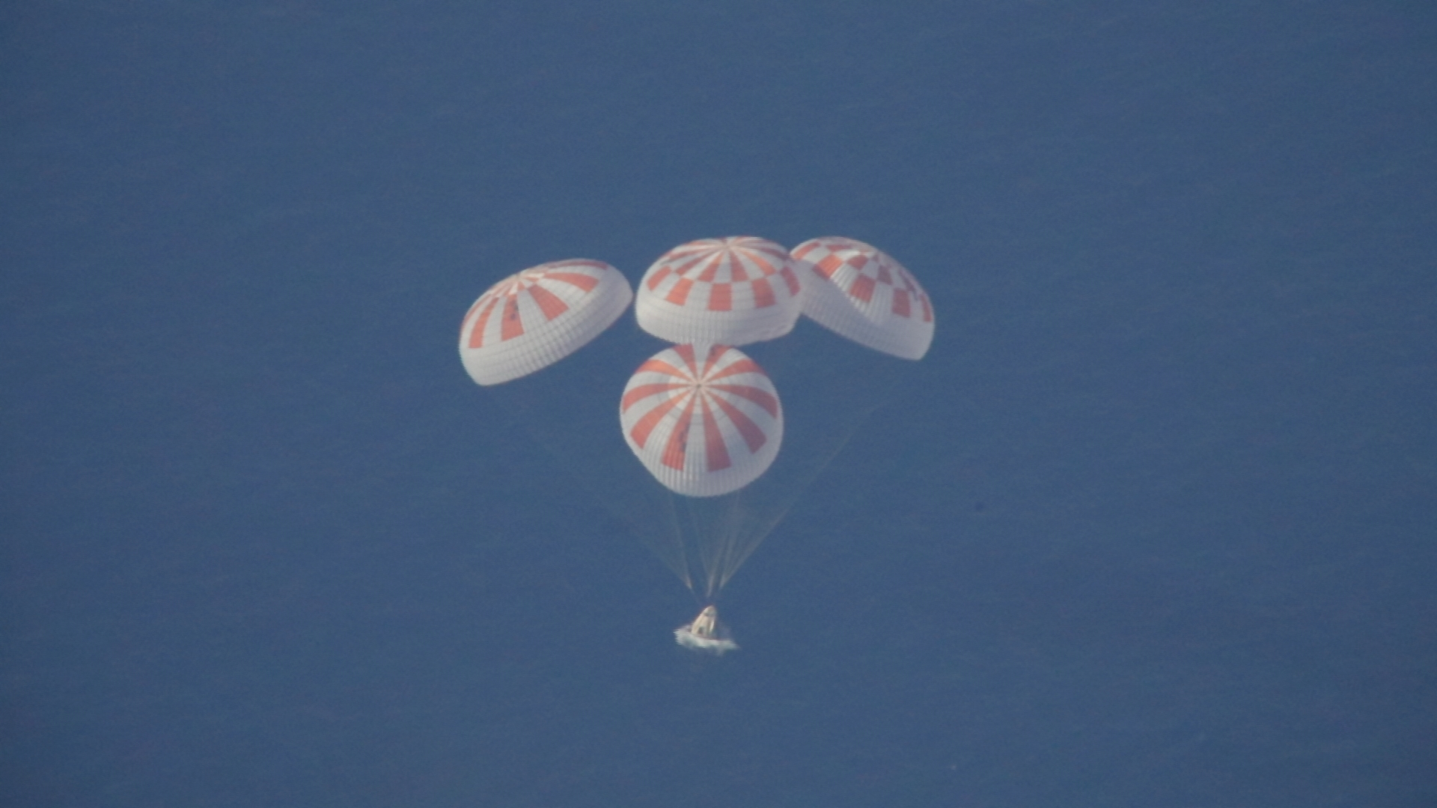
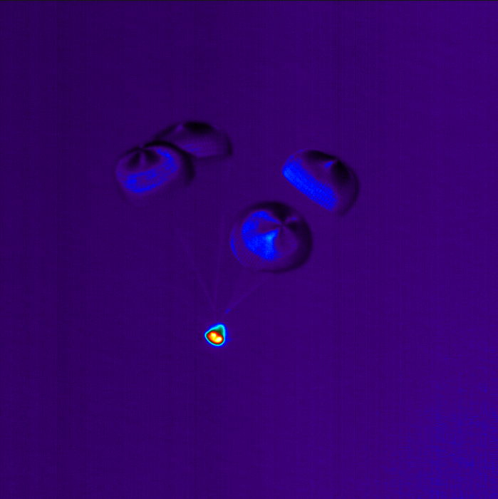
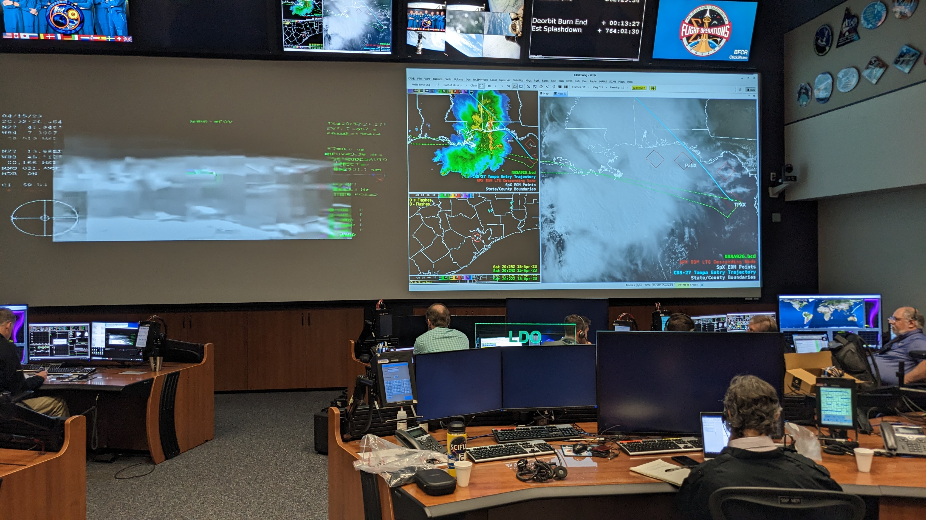
Notes:
Imagery Products

Slide 10
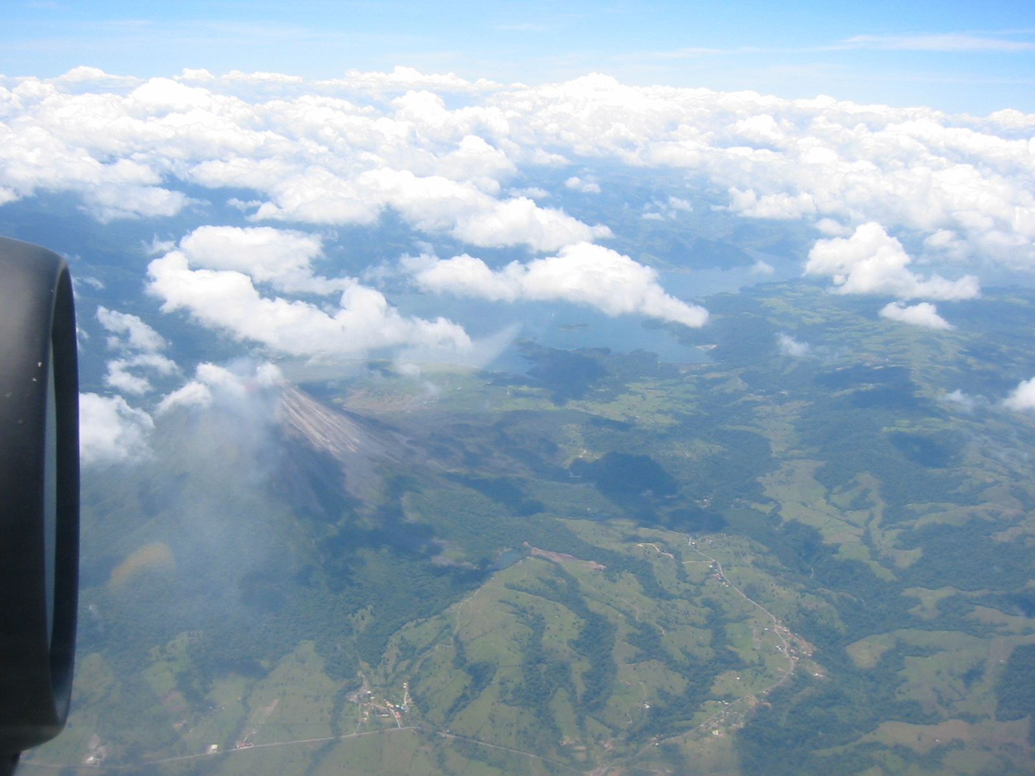
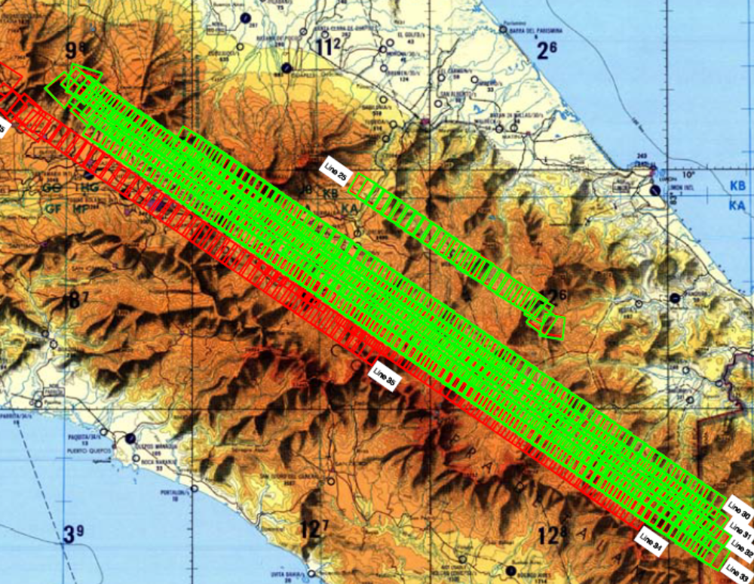
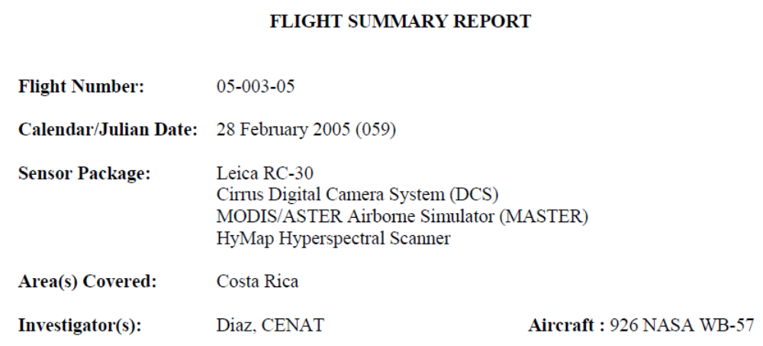
Missions: Remote Sensing
CARTA 2005 Final Summary Report, NASA/US Geological Survey/Department of Energy
Notes:
28 sorties mapping Cost Rica, 2005
established PRIAS to harvest, exploit and utilize all the data we collected in CENAT (their equivalent to our NSF)

Slide 11
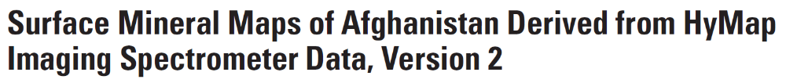
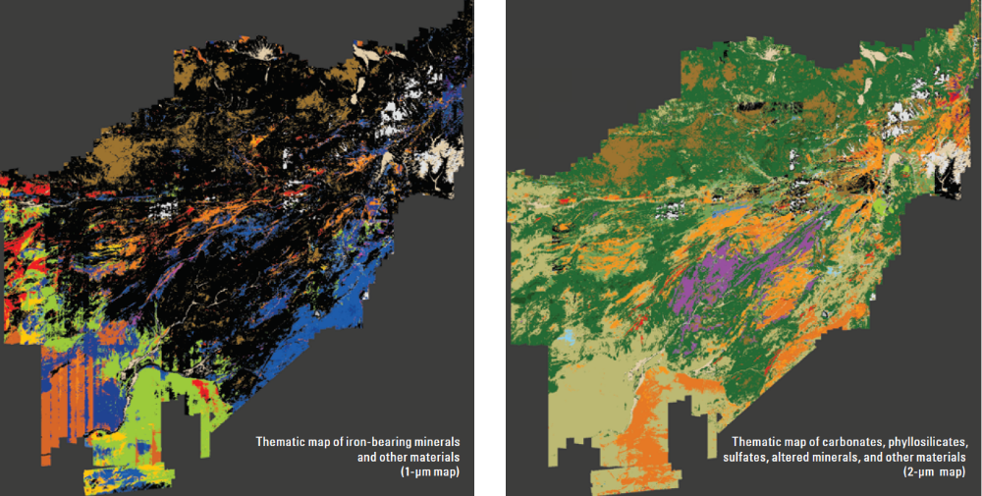
Data Series 787, USGS Afghanistan Project Product No. 186 (U.S. Geological Survey)
Notes:
Significant copper deposits found

Slide 12
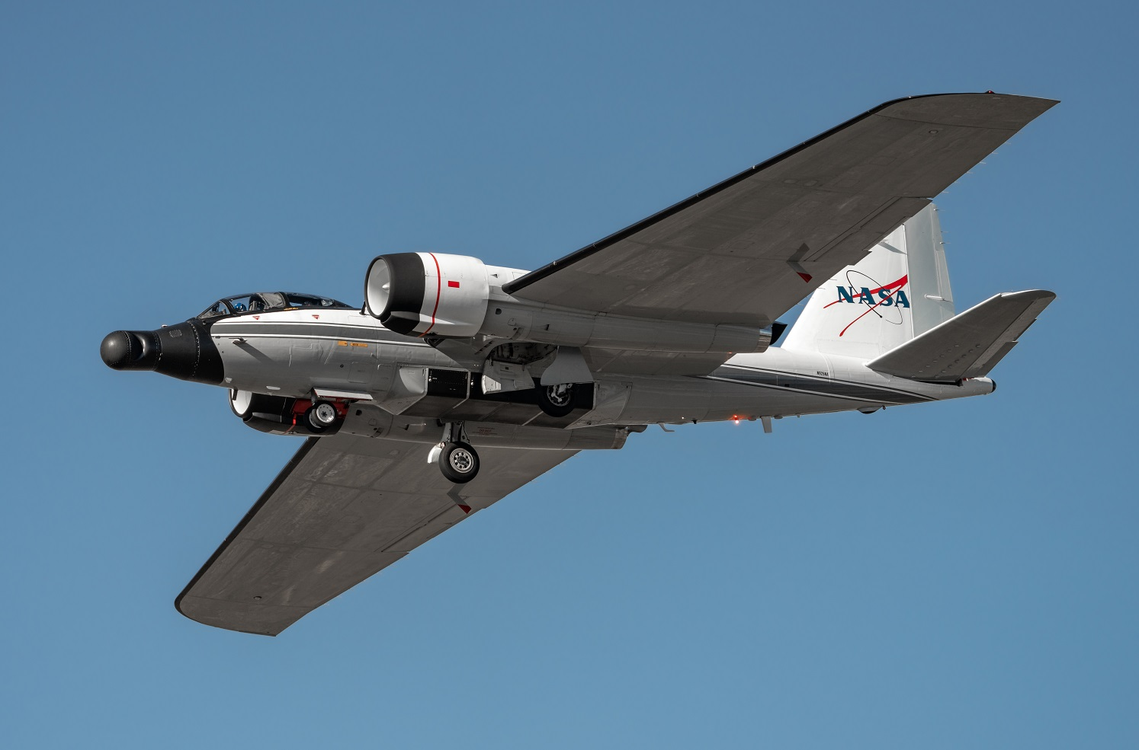
Missions: Telecommunications Testbed
The WB-57 served for many years as a test platform for the Battlefield Airborne Communications Node (BACN)
Real-time “universal translator” within conflict theatres for dissimilar tactical data links
Photo courtesy Mark Wood

Slide 13
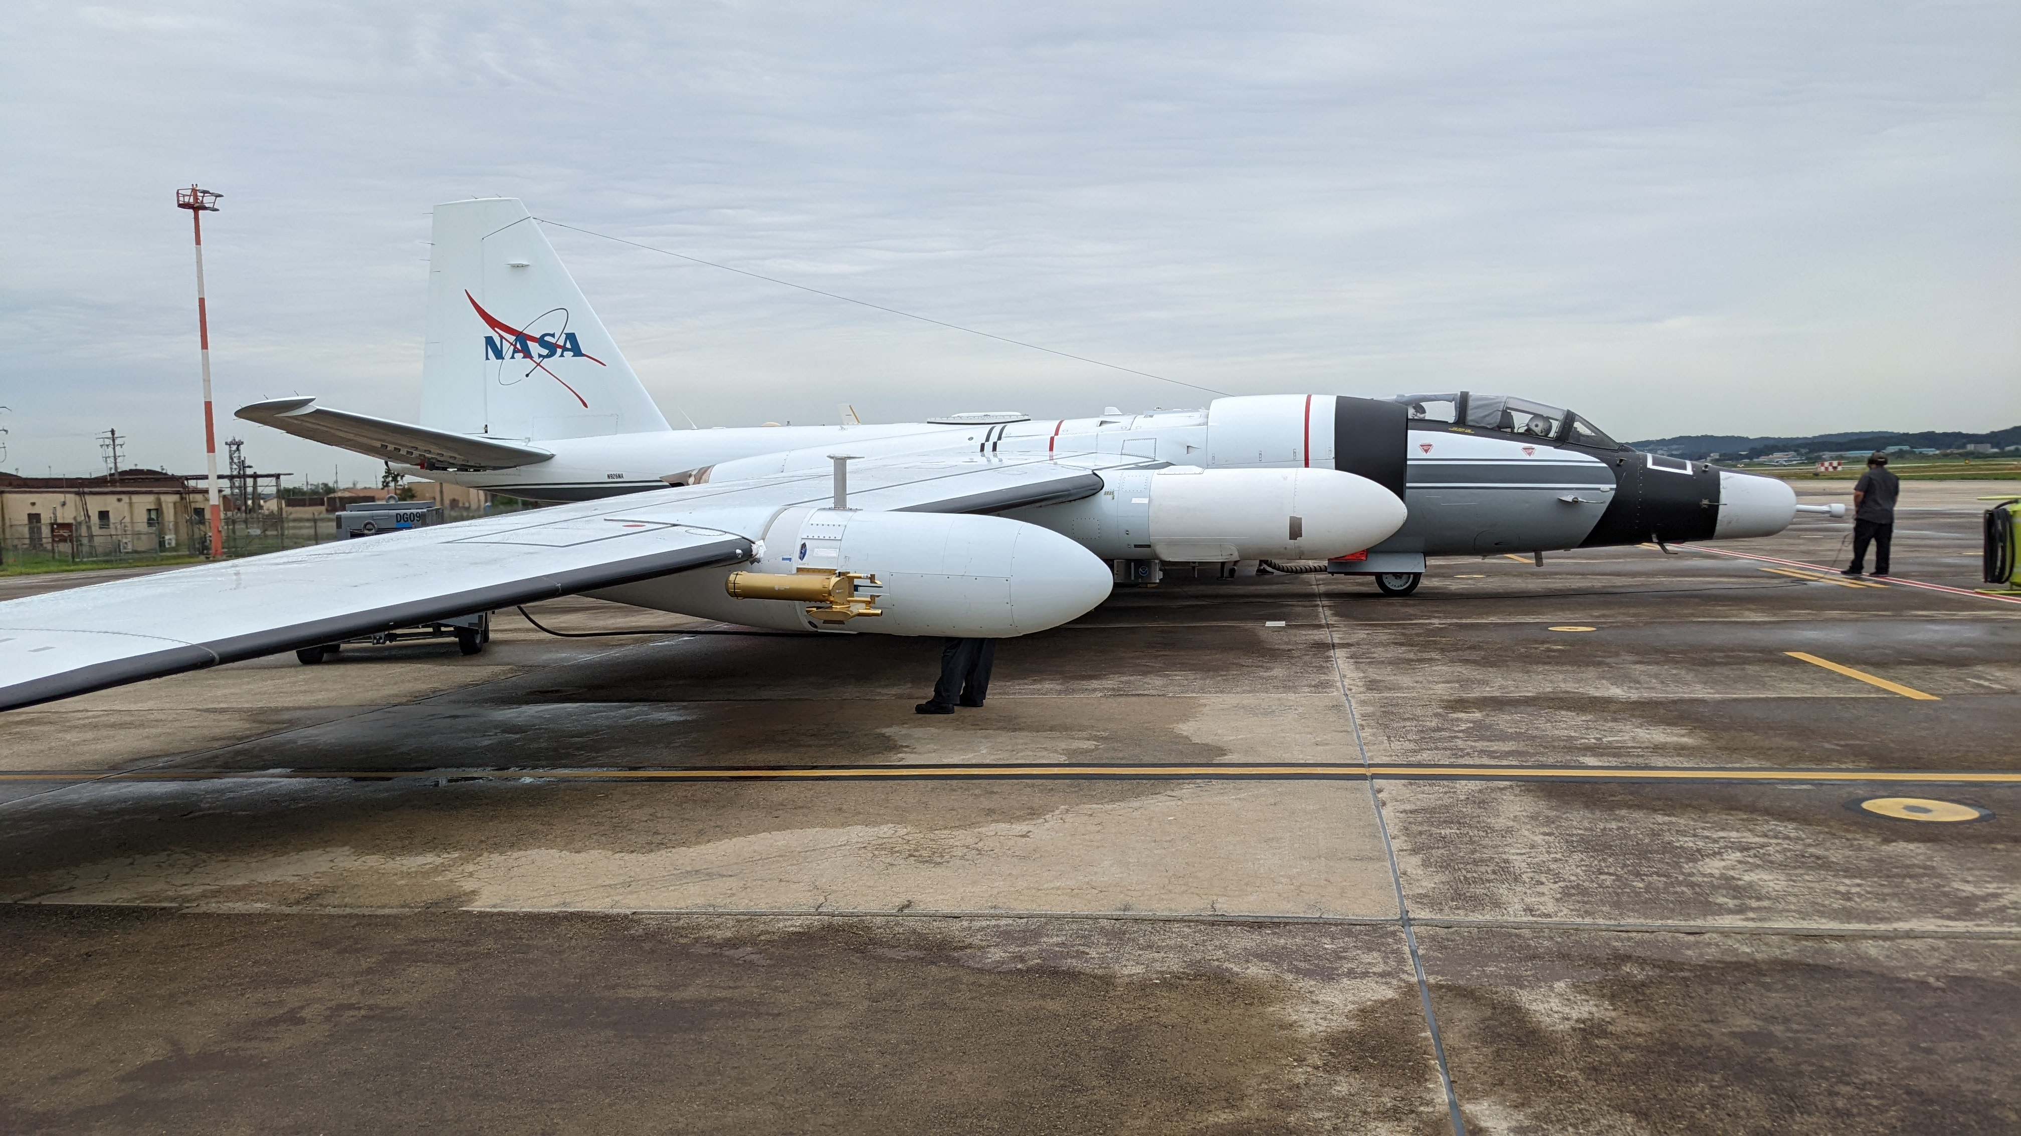
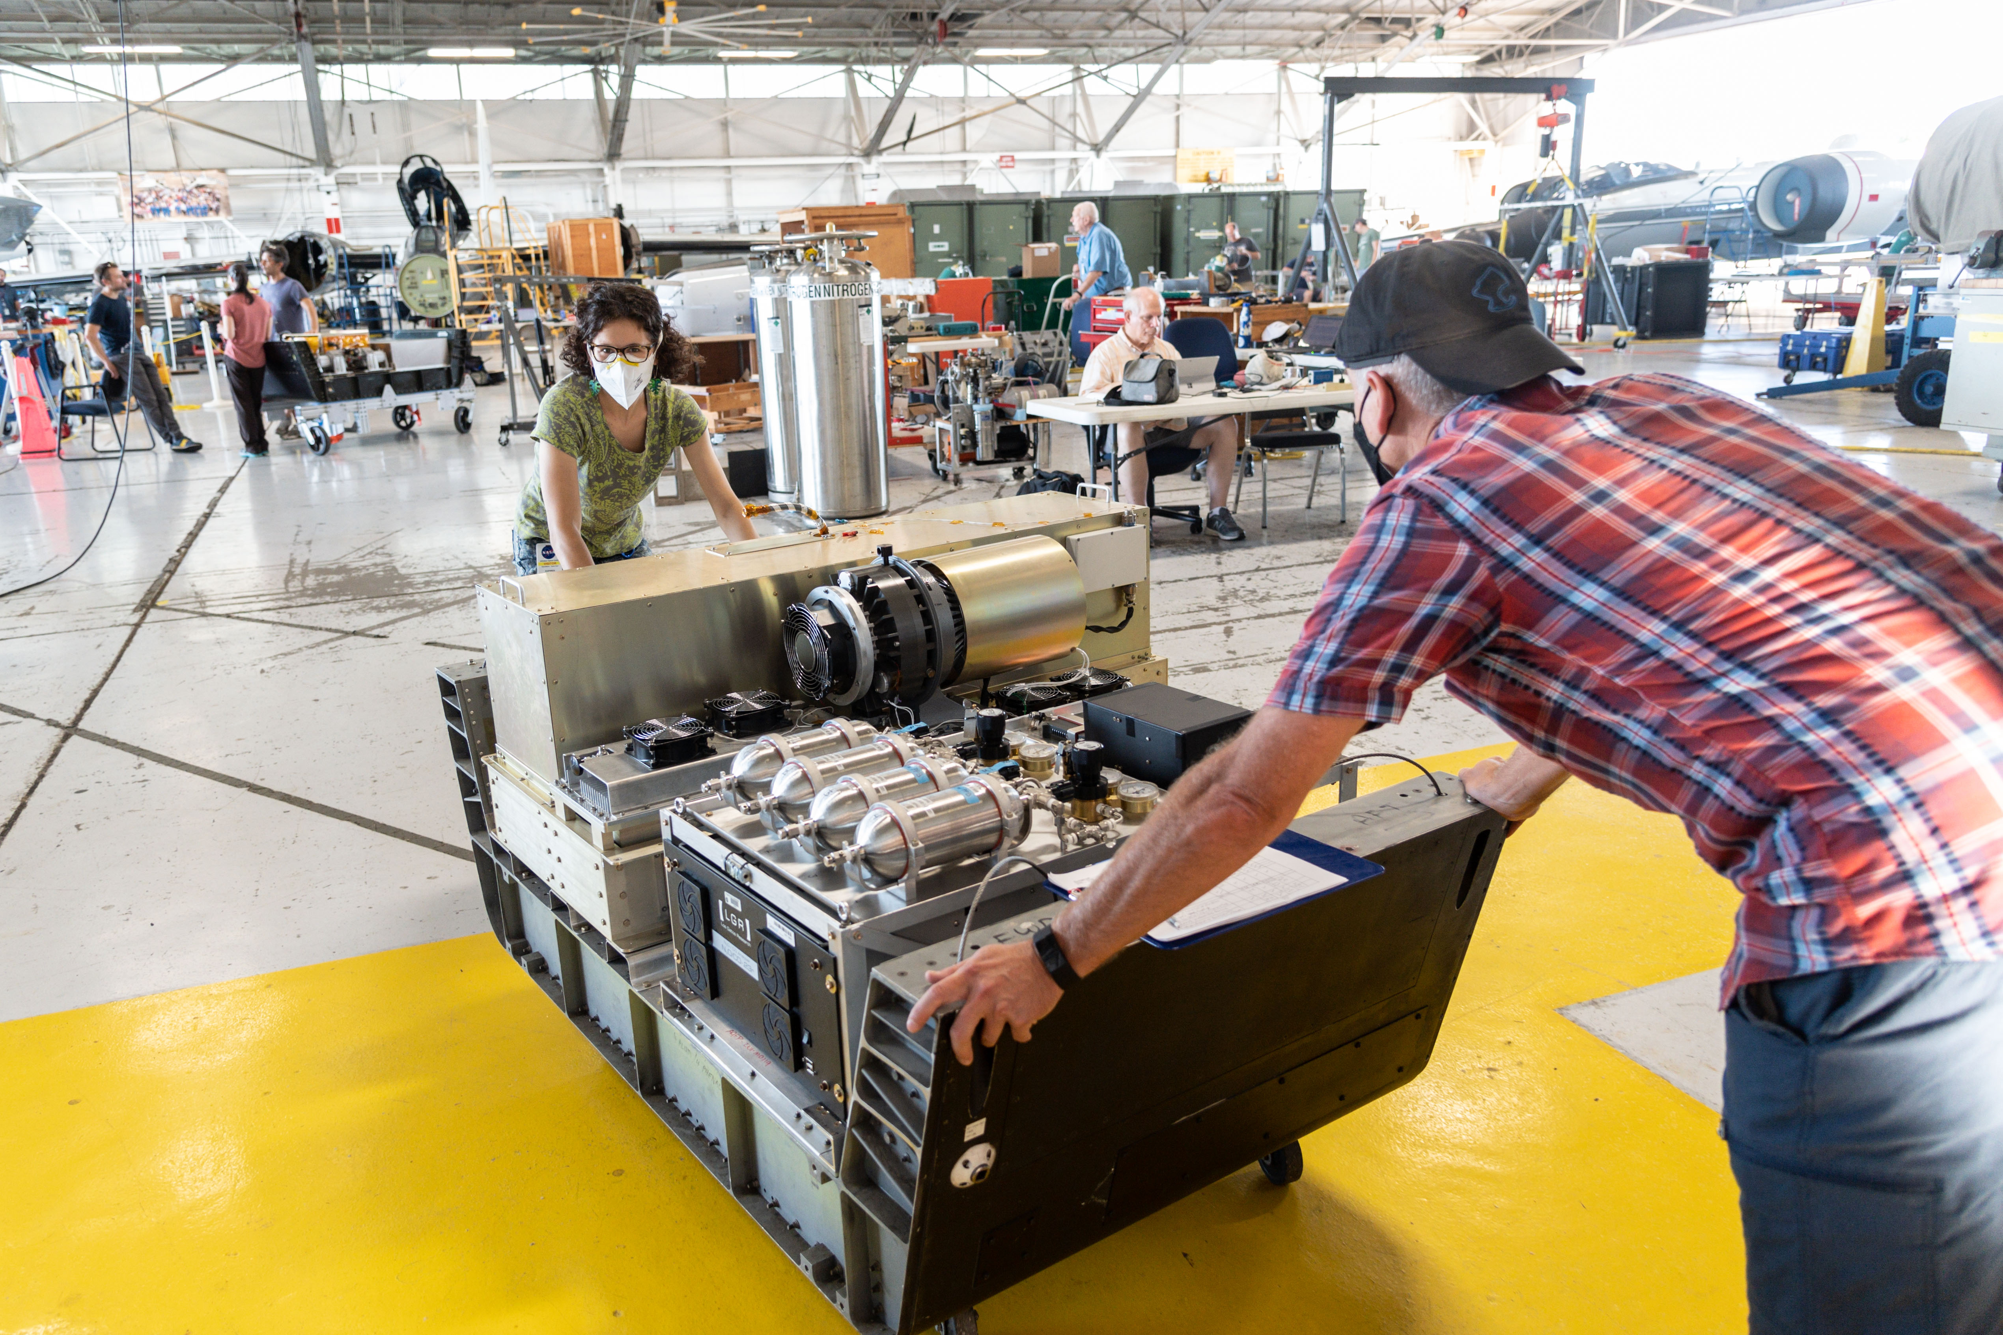
Missions: In-Situ Sampling
Aircraft configuration during ACCLIP campaign 2022, deployed to Osan Air Base, ROK
Notes:
ACCLIP, SABRE –
Multiple European instruments participated through collaboration with American research institutions
COLD2 – Consiglio Nazionale delle Ricerche - Istituto Nazionale di Ottica (CNR-INO)
CAPS – University of Vienna
Rocket plume sampling

Slide 14
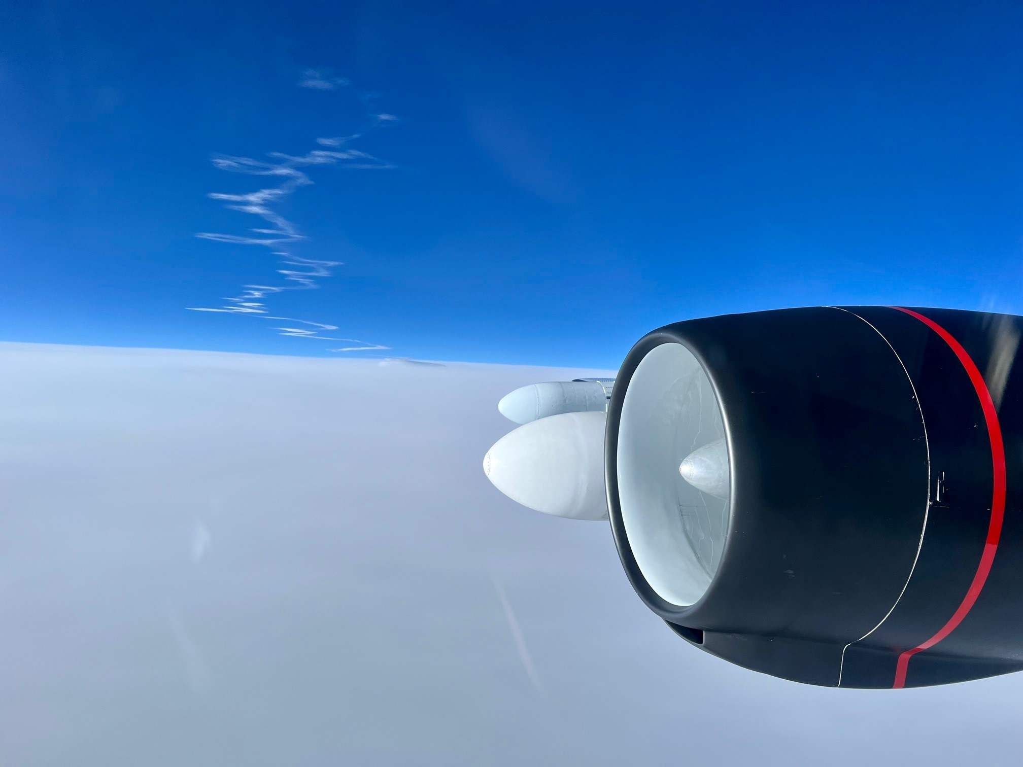
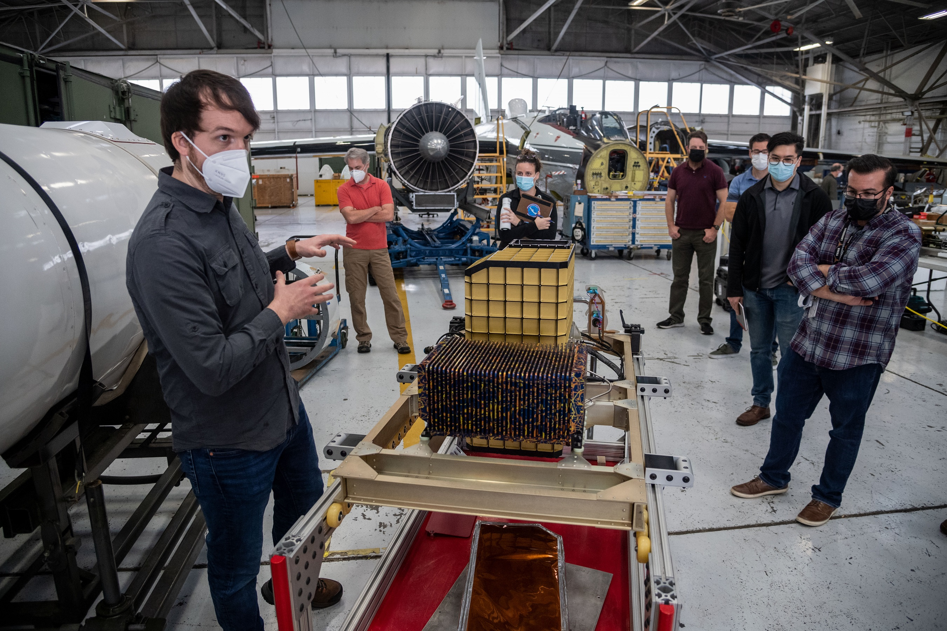
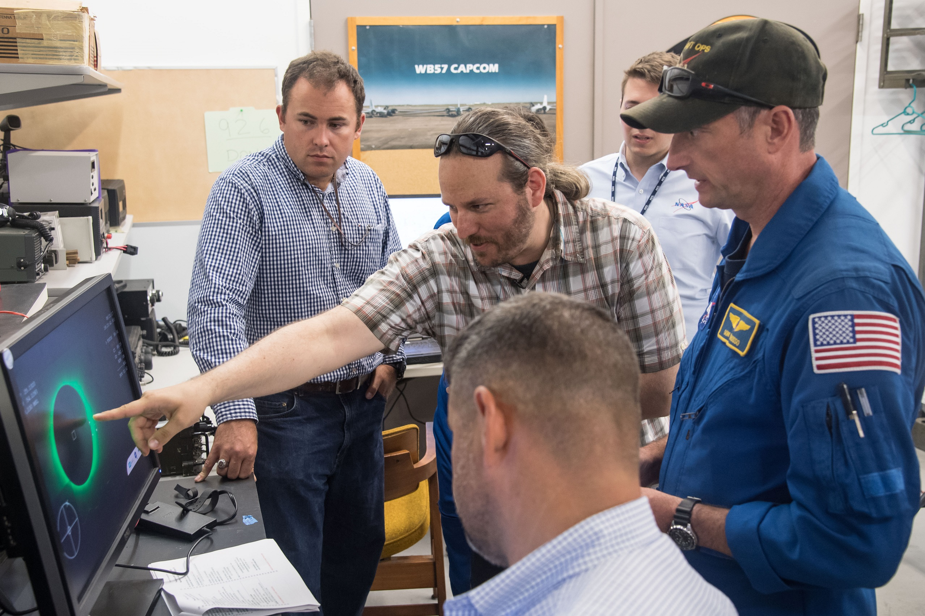
NASA maintains its own robust airworthiness authority, allowing the WB-57 program to bypass FAA and other regulatory bodies when designing new payload installations.

Slide 15
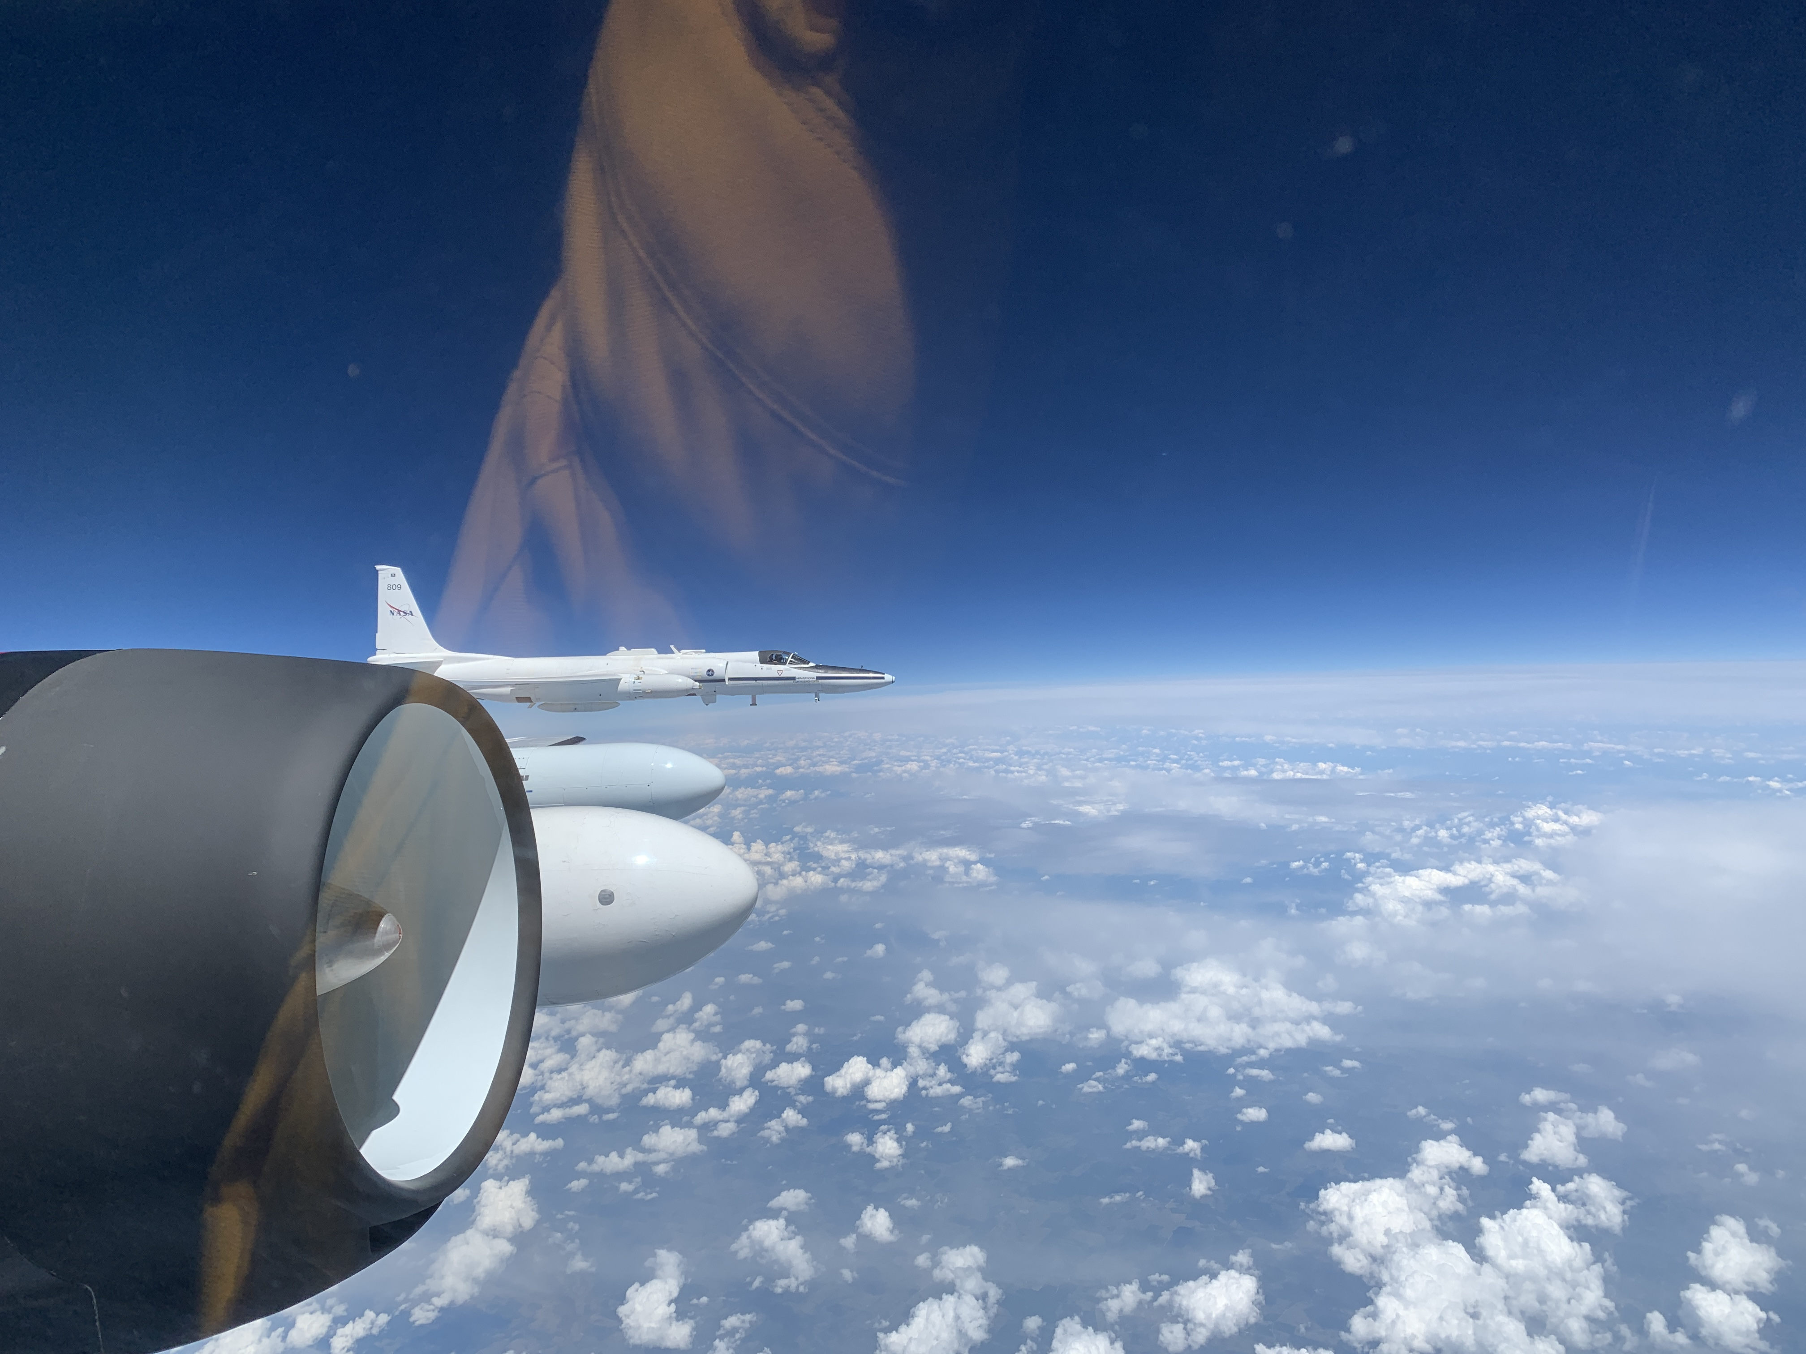
Partnerships are available between the NASA WB-57 Program and commercial entities (foreign and domestic), research institutions, and other government agencies
Formation flight with NASA ER-2 during the 2022 ACCLIP campaign, approx. 55,000 ft

Slide 16
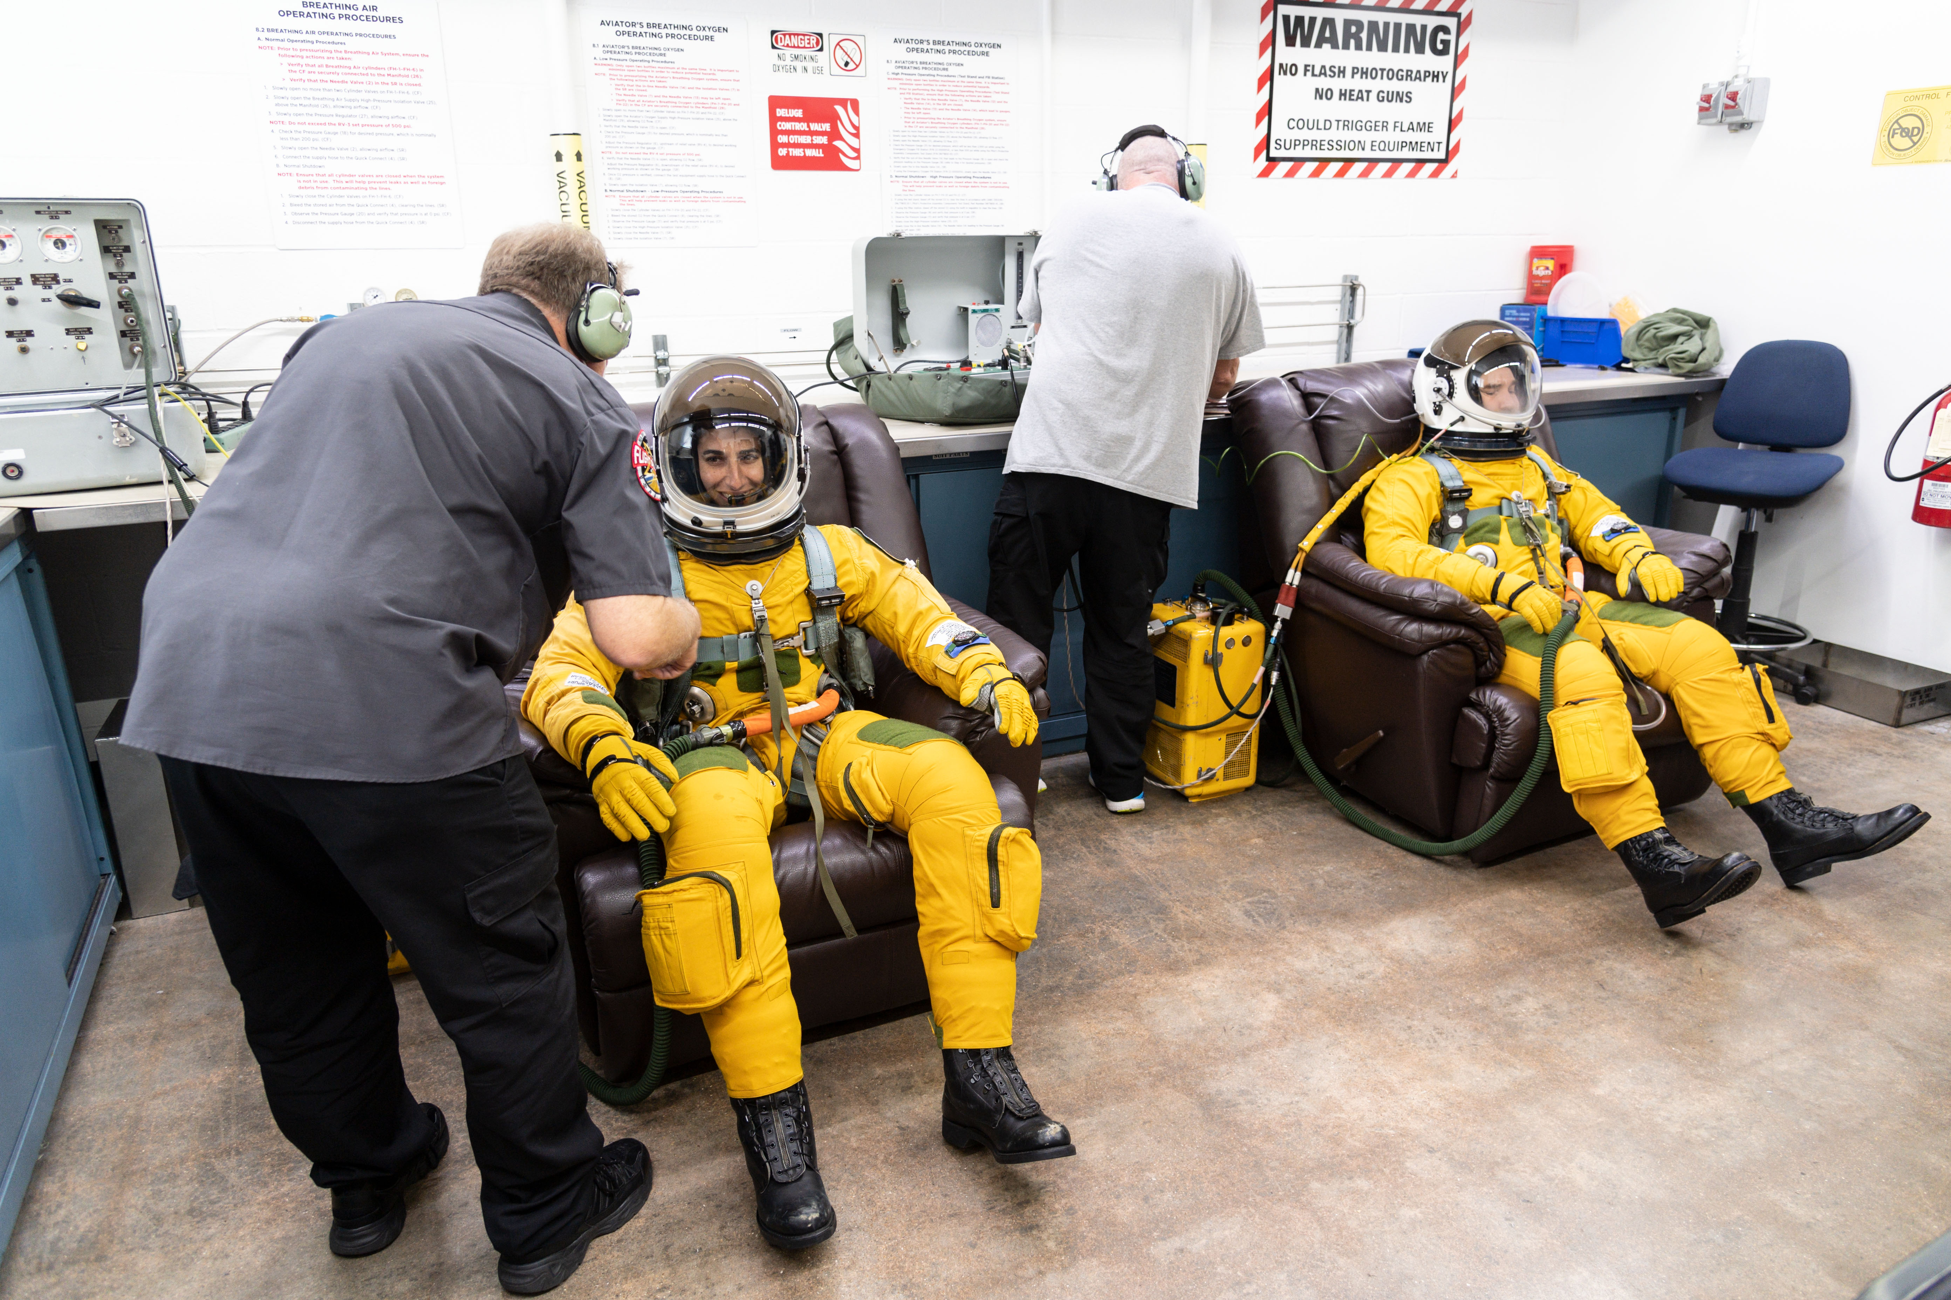
High-Altitude Spaceflight Readiness Training for US astronauts, 2021 (suit-up)

