Slide 1
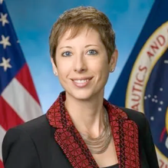
Moon-to-Mars Strategy Evolving Projects, Timelines, and Architectural Update
Nujoud Merancy
Deputy Associate Administrator
Strategy and Architecture
ASCENDx Texas
February 14, 2024

Slide 2
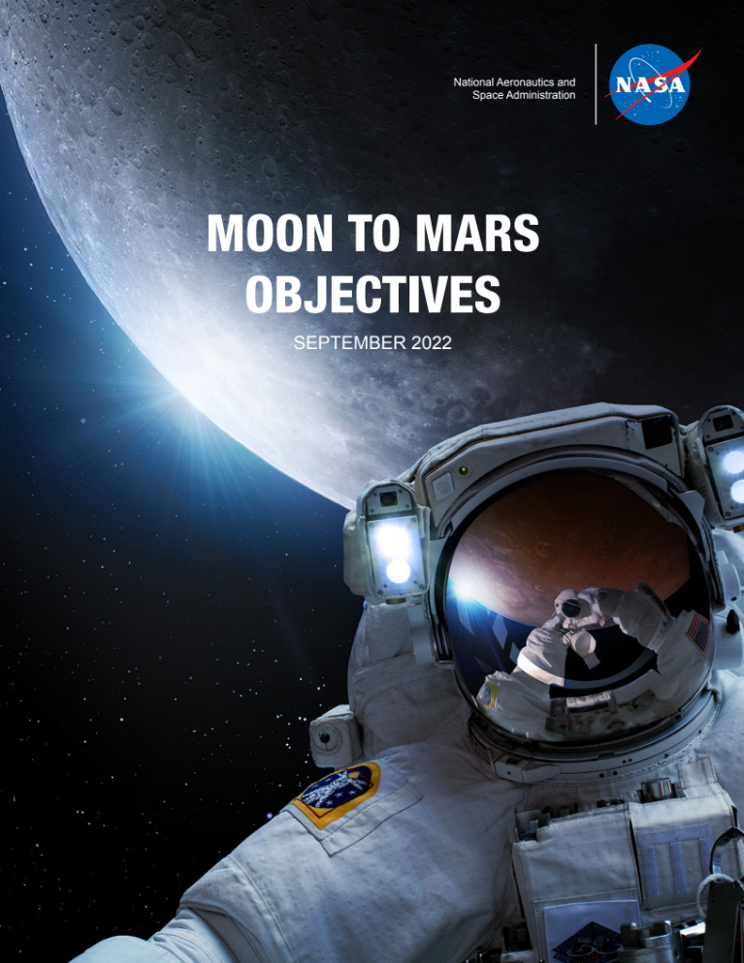
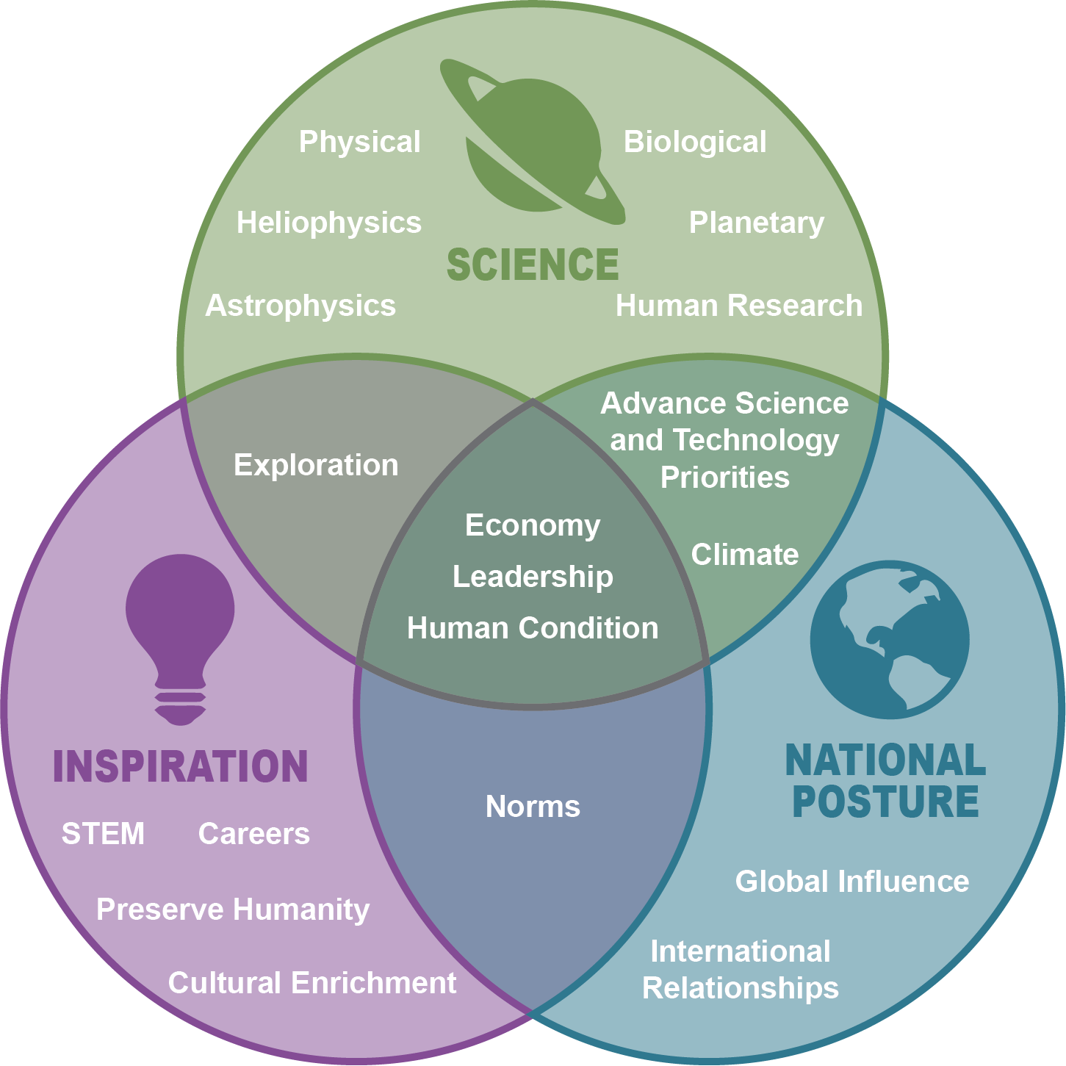
Background: Why Explore & Moon to Mars Objectives
Objectives-based Approach
Constancy of Purpose
Enhanced Communication and Engagement
Unity of Purpose
Architect from the Right
Execute from the Left

Slide 3
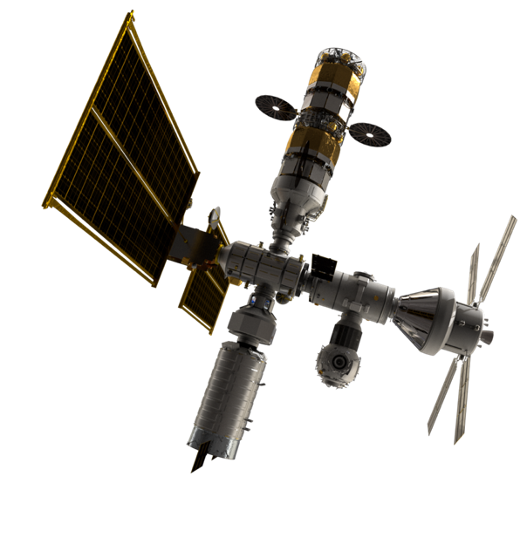
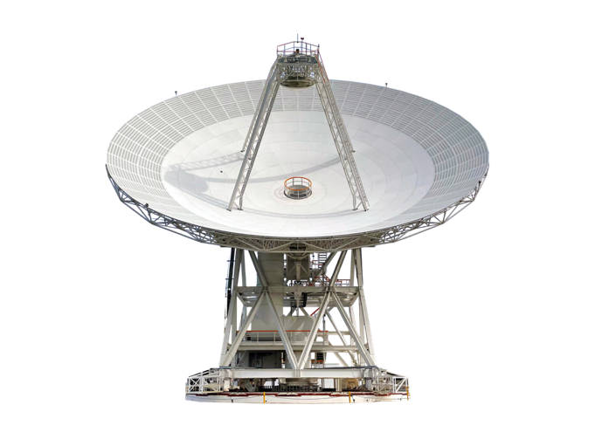
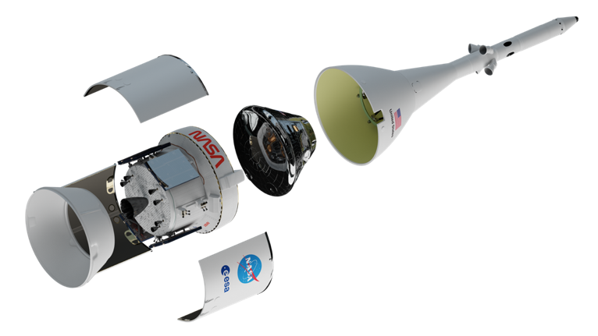
Architecture Components
Segments
A portion of the architecture that integrates sub-architectures and progressively increases in complexity and objective satisfaction.
Sub-Architectures
A group of tightly coupled elements, functions, and capabilities that work together to accomplish one or more objectives.
Elements
A notional exploration system that enables a set of functions.

Slide 4
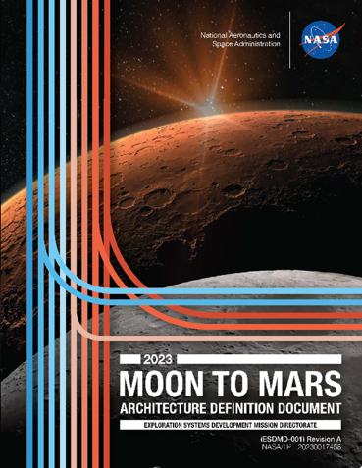
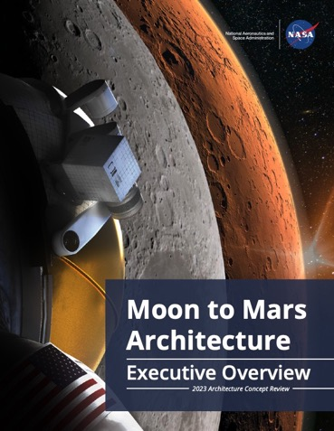
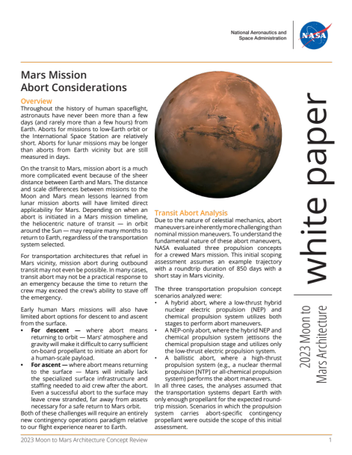

2023 Architecture Concept Review Products
Analytical Capabilities In-situ vs. Returned
Mars Surface Power Generation
Mars Mission Abort Considerations
Round Trip Mars Mission Mass Challenges
Human Health and Performance for Mars Missions
Exploration Lessons Learned from the Space Station
Mars Priority Decisions
Safe and Precise Landing at Lunar Sites
Lunar Site Selection
Lunar Communications and Navigation Architecture
Lunar Logistics Drivers and Needs
Surface EVA Architectural Drivers
Mars Communications Disruption and Delay
Architecture Definition Document
Revision A (ADD Rev-A)
Moon to Mars Architecture
Executive Overview
White Papers
(13 Total)
Suggestion from 2023
Architecture Workshops
Architecture
Resources
nasa.gov/architecture
White paper added after ACR23 Concurrence

Slide 5
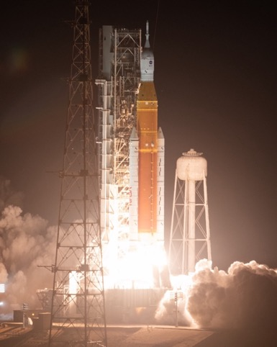

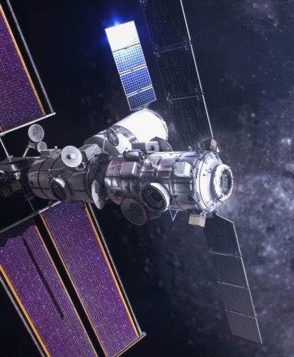
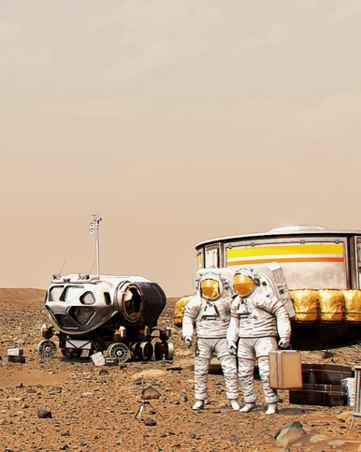
Architecture Segments
Future Segments
Human Lunar Return
Foundational Exploration
Sustained Lunar Evolution
Humans to Mars
Initial capabilities, systems, and operations necessary to re-establish human presence and initial utilization on and around the Moon
Expansion of lunar capabilities, systems, and operations supporting complex orbital and surface missions to conduct utilization and Mars forward precursor missions.
Enabling capabilities, systems, and operations to support regional and global utilization, economic opportunity, and a steady cadence of human presence on and around the Moon.
Initial capabilities, systems, and operations necessary to establish human presence and initial utilization on Mars and continued exploration.

Slide 6
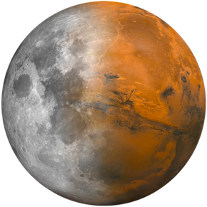


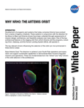
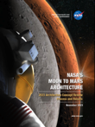
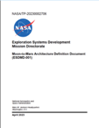

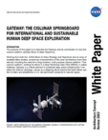
Architecture Approach
An Evolutionary Architecture Process
Formulating an Architecture and Exploration Strategy Based on Objectives
PRODUCT REVIEW
PRODUCT DEVELOPMENT REVIEW
MOON TO MARS OBJECTIVES
ARCHITECTURE DEFINITION DOCUMENT
ARCHITECTURE CONCEPT REVIEW
ARCHITECTURE CONFIRMATION
ARCHITECTURE DEFINITION DOCUMENT EXPANSION
ARCHITECTURE CONCEPT REVIEW
REVISED ARCHITECTURE
REFINED/EXPANDED ARCHITECTURE
ANNUAL CYCLE TO MATURE ARCHITECTURE
TRACEABILITY
Decomposition of Blueprint Objectives to executing Architecture elements
ARCHITECTURE FRAMEWORK
Organizational construct to ensure system/element relationships are understood and gaps can be identified
PROCESS AND PRODUCTS
Clear communication and
review integration paths for stakeholders
Notes:
Remove.

Slide 7
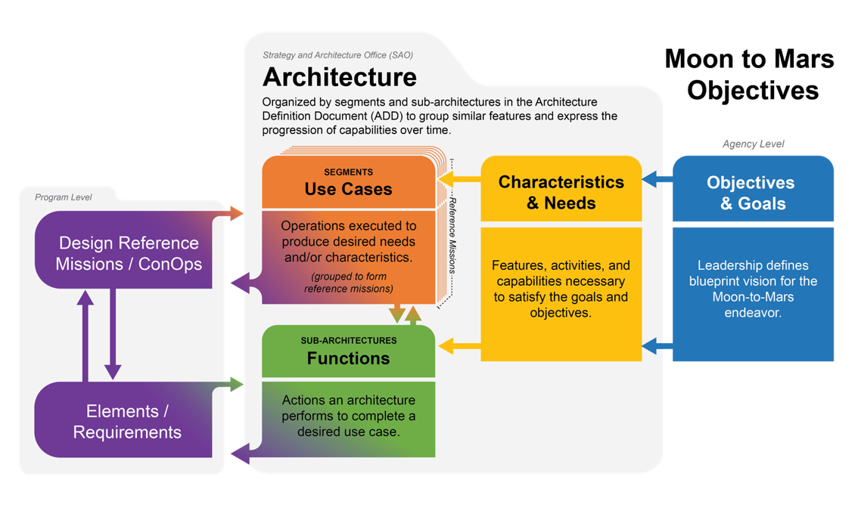
Architecting from the Right
The Architecture process requires a decomposition of Moon to Mars Objectives to element functions and mission use cases to complete the process of “architecting from the right.” This establishes the relationship of executing programs and projects to the driving goals and objectives.

Slide 8
Sub-Architectures
NEW for 2023
Communications, Navigation, Positioning, and Timing Systems
enable transmission and reception of data, determination of location and orientation, and acquisition of precise time.
Habitation Systems
ensure the health and performance of astronauts in controlled environments.
Human Systems
execute human and robotic missions; this includes crew, ground personnel, and supporting systems.
Logistics Systems
package, handle, transport, stage, store, track, and transfer items and cargo.
Mobility Systems
move crew and cargo around the lunar and Martian surfaces.
Power Systems
generate, store, condition, and distribute electricity for architectural elements.
Transportation Systems
convey crew and cargo to and from Earth to the Moon and Mars.
Utilization Systems
enable science and technology demonstrations.
Data Systems and Management
transfer, distribute, receive, validate, secure, decode, format, compile, and process data and commands.
In-situ Resource Utilization (ISRU) Systems
extract resources in space or on the Moon or Mars to generate products.
Infrastructure Support
includes facilities, systems, operations planning and control, equipment, and services needed on Earth, in space, and on planetary surfaces.
Autonomous Systems and Robotics
employ software and hardware to assist the crew and operate during uncrewed periods.

Slide 9
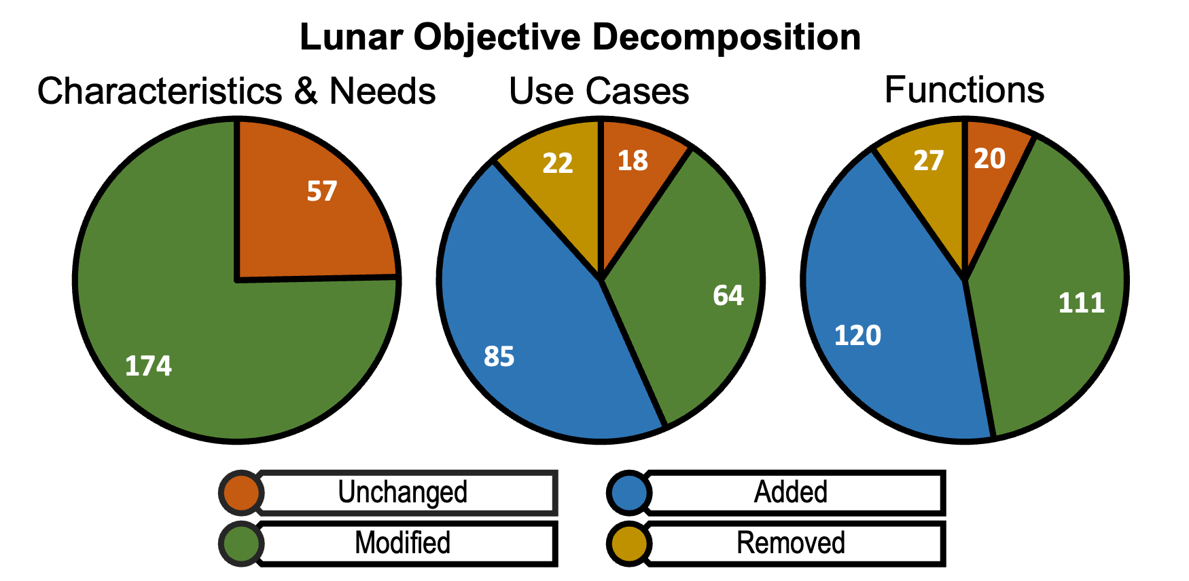
ACR23 Decomposition Updates
ADD Rev-A includes refined and expanded Moon to Mars objective decomposition, sub-architectures, and elements
Added, refined, removed, or modified characteristics and needs, use cases, and functions for lunar objectives
179 characteristics and needs added for Mars objectives

Slide 10





Mars Priority Decisions
NASA catalogued nearly 90 needed decisions for an initial crewed Mars mission and developed a decision roadmap. That process resulted in seven interrelated decisions needed to begin planning.
In 2024, NASA will begin the analyses needed to allow for informed decision-making by agency leadership.
Initial Human
Mars Segment
Target State
Initial Human Mars Segment Cadence
Mars Surface Power Generation Technology
# Crew to Mars Vicinity
Mars
Science Priorities
# Crew to Mars Surface
Mars Loss of Crew Risk Posture
WHY
we will
go
WHAT
we will
do there
WHEN
(how often)
we will go
WHO
will be
involved
HOW
we will get
home safely

Slide 11

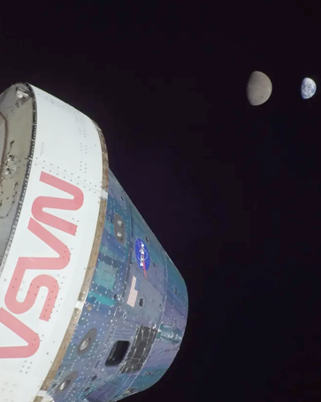

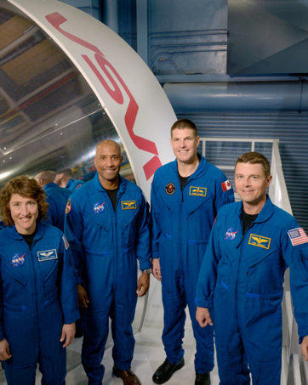
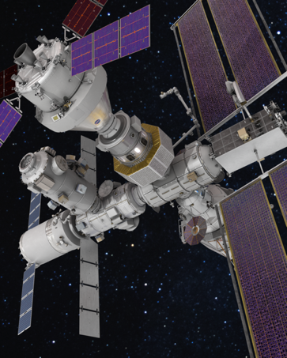
Artemis Updates
First Crewed
Mission
First Gateway
Assembly Mission
SEPTEMBER 2026
Artemis III
Artemis I
First Crewed
Lunar Landing
Artemis V
SEPTEMBER 2025
SEPTEMBER 2028
Uncrewed
Test Flight
First Mobile
Surface Exploration
Artemis II
Artemis IV

Slide 12

Beyond Artemis V
Growth in Lunar Utilization
How will the moon-to-Mars economy materialize, how far off is commercial viability, and what steps/technologies are needed to catalyze the industry?
Foundational Exploration
Sustained Lunar Evolution
Expansion of lunar capabilities, systems, and operations supporting complex orbital and surface missions to conduct utilization and Mars forward precursor missions.
Enabling capabilities, systems, and operations to support regional and global utilization, economic opportunity, and a steady cadence of human presence on and around the Moon.

Slide 13

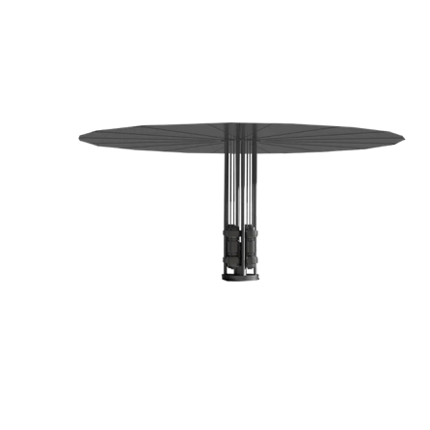
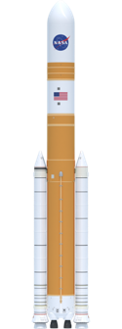
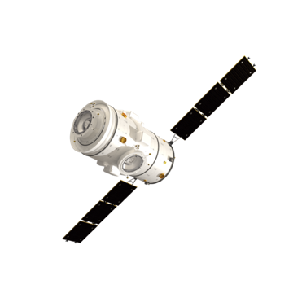
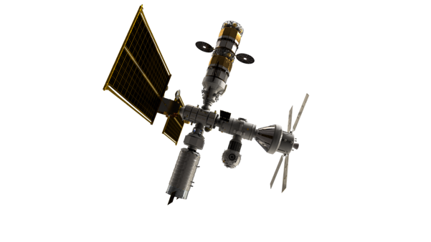
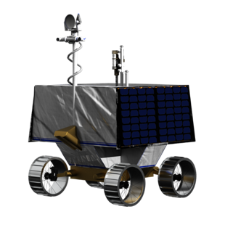
Addressing Gaps
National Priorities
Partnerships for Exploration
Lunar Science Priorities
Lunar Technology Priorities
Lunar Economic Development

Slide 14
Forward Work
National Priorities
Partnerships for Exploration
Lunar Science Priorities
Lunar Technology Priorities
Lunar Economic Development
The architecture is responsive to stakeholders and decision makers.
Initial infrastructure will set the stage for a future lunar ecosystem.
Lunar surface and orbital infrastructure support long-term human presence on the lunar surface.
  Unpressurized and pressurized crew rovers
  Habitation facilities, navigation, power
Sustained human presence on the lunar surface will enable extraordinary science.
If those opportunities are defined and built into the program from the early stages of program planning.
Invest in high-risk, high-reward technologies, collaborating with academia, industry, and international partners.
Stimulate a robust space economy.
Missions to the Moon prove technology can overcome the challenges of lunar exploration.
NASA’s planned infrastructure creates a basis for non-government-funded research and exploration.

Slide 15
ESDMD Pre-Formulation Elements
Element Initiation:
overt decision to proceed with maturation of concept assessed for Arch. priority, budget, and strategy
Mission Concept Review: To evaluate the feasibility of the proposed mission concept(s) and its fulfillment of the Architecture needs and objectives.
Acquisition Strategy Meeting: Transition to Moon to Mars Program for implementation, completion of project roles & responsibilities leading to contracting process (e.g. RFP)
M2M Obj.
ACR
EI
MCR
ASM
Arch. Studies
Gap Analysis/Concept
Mission /Concept Trades
Acquisition Plan
M2M Program Int.
ADD
EI
RFP
Studies
Industry BAA, RFI, etc.
MCR
Element Definition
Contracted Solution
Feasibility studies and collaboration identify potential concept
Mission refinement to optimize for strategic value and functional achievement, use of study mechanisms to better inform planning
Feedback incorporated into Architecture products as milestones occur
Document(s)
NASA Milestone
ESDMD Strategy & Architecture Office
ESDMD Moon to Mars Program
Collaboration Partner

Slide 16
Questions?
Architecture Products

