Slide 1
EVA Operations for the Artemis III Science Team
This document has been reviewed for Proprietary, SBU, and Export Control (ITAR/EAR) and has been determined to be non-sensitive. It has been released to the public via the NASA Scientific and Technical Information (STI) Process DAA #XXXXXXXX.
2/26/24
Jackie Kagey
Jaclyn.L.Kagey@nasa.gov

Slide 2
Topics
EVA FCR Big Picture
Practicalities and constraints affecting an EVA
  Flight Rules
  How those things may affect the resources available for science
Priorities
  Pre-flight
  Real-time
  Programmatic Changes
EVA Examples
Things to Remember

Slide 3
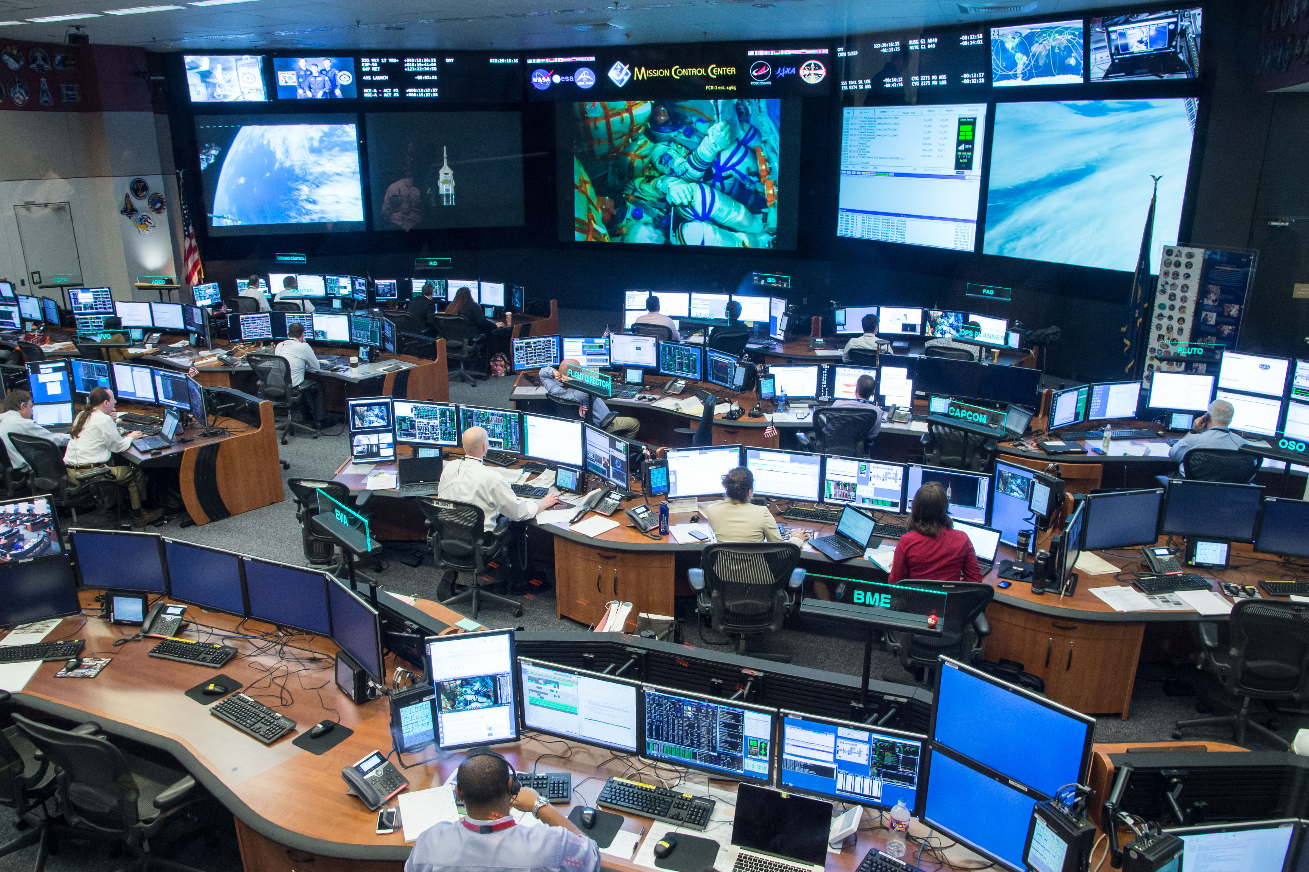
FOD – Training and Flight Control
The Flight Operations Directorate (FOD) is responsible for the training and mission control of the USOS ISS and Artemis crewmembers.
  The Flight Operations Directorate (FOD) at NASA’s Johnson Space Center touches every program and part of sending humans to space.
    Plan, Train, Fly
  https://www.nasa.gov/johnson/nasa-flight-operations-directorate/fod-who-we-are/
EVA is one discipline of FOD
  EVA or Extravehicular Activity can refer to an event (spacewalk), EVA team (ground team responsible), or the EVA Officer (certified position in MCC-H)
The “EVA FCR” is the person who sits in the “front room”
  Direct interface with Flight Director and person who talks to crew (CAPCOM)
Notes:
Photo – from NASA public website https://www.nasa.gov/johnson/jsc-mission-control-center/ therefore assumed to be already cleared for public release

Slide 4
EVA FCR Big Picture
FCR needs to factor back-room / expert status and recommendations along with vehicle SA to have a single unified forward plan
  Suit / Task recommendations may be opposing
Many parties vying for same resources
Overall priorities of EVA
  Crew safety
  Vehicle/suit/hardware safety
  Mission Success
    PAO, Payloads, Sampling, etc.
EVA FCR
Task
Science
Suit
Vehicle
Environment
Time
Program
Notes:
IVA Payload activities are not the same – if a vehicle emergency happens Payload team is no longer a major player. But for EVA we still have to figure out how to safe the worksite (ISS), get crew back inside and any deltas to the emergency. (or we are the emergency)

Slide 5
Practicalities and Constraints
Hardware Capabilities
  Comm/video range
  Emergency Return
  Real-time Suit health
OCADs and Flight Rules
  Governing documents that constrain operations; normally a safety of crew or vehicle condition
    Go/No-Go, EVA duration, distance allowed, failure response
    Violating or Waiving a FR is a big deal

Slide 6
Priorities & Objectives
FOD does not own the mission objectives; we implement them
  Objectives owned by controlling Program
Pre-flight
  FOD EVA (includes NASA Internal Science Team) will be handed a list of objectives/tasks in priority order and duration of EVA available
    Other factors will include hardware constraints, flight rules, etc.
    Process of vendors, disciplines submitting objectives, approval and prioritization to make this list is still being developed
  FOD EVA will utilize all resources to plan the safest, most efficient EVA with the goal of getting as many objectives as possible and focusing on the highest priority ones
    Expect ratio of science/utilization and other tasks vehicle/PAO to be set by program
  Iterative process to determine final EVA
    Unofficially (working level) and Officially at programmatic boards
      Includes objective owners, crew training, and hardware testing
Real-time
  Variations are possible but will need rationale
    We saw X at site A which makes site D a much higher priority
  Time deltas
    Pre-planned EVAs are estimates on times; sometimes accurate and sometimes not
      If ahead of timeline, we will have “Get Aheads” ready to do more tasks instead of coming in early
      If behind on the timeline, be prepared for us to start deleting tasks. Mostly based on priority but can also depend on location and other factors.

Slide 7
Pre-Planning Process
JOPs
Cribsheet meetings
  What is a “cribsheet”?
    Anything we (EVA community/hardware owners) can think of what will go wrong with pre-coordinated troubleshooting steps that can be executed immediately.
  A plan for when things don’t go according to plan – to speed up the process when operating outside of nominal.
Analysis
Testing/training events
Simulations
All before final approval of products
  Goal is to reduce the time spent real-time on conversations if things are agreed to discussed prior
Pre-planning is so important to drive a successful EVA

Slide 8
Real-Time EVA Examples
Cut Glove Terminate
  Crew reports potential cut in glove; EMU recommend terminate per FR
  Task wants to complete one additional task using unaffected crewmember
  FCR decides to terminate without additional task (loss of mission objective)
  Task categories are now defined to help team determine which tasks are important enough to complete (additional risk) and which do not justify a delay in terminate EVA
When the planets align
  EVA with a very experienced crew pair (known for some of the best/fastest work)
  Tasks go very smoothly, no issues and crew gets very far ahead of timeline
  EVA recommends and FD agrees to jump into planned EVA 2 during EVA 1
Bolded equates to console position

Slide 9
Products
FOD wide
  Daily Summary / Execute Package
  Mission Timeline
  Flight Notes, CHITs, Anomalies
EVA
  Briefing Package
  Procedures / EVA Timeline, Cuff Checklist
  “Cribsheet”
Shuttle and ISS use “Gateway” application to create/distribute Ops Products
  TBD for Artemis but we expect something similar
Most products baselined pre-mission, but expect real-time changes and adaptations

Slide 10
Items to Remember
Stated recommendation and rationale should be clear and concise
  Helps FCR put pieces together and take forward to FD and CAPCOM
Understand that any single position is not the only player
  There will be compromises! Know and communicate items that are absolute and where you can give some up.
A successful EVA is one that brings the crew back inside safely no matter time spent or objectives reached
  Although we all want the EVAs to complete as many objectives as possible be it a vehicle repair or a certain sample mass, crew safety remains first priority

Slide 11
Questions?
Jackie Kagey
Jaclyn.L.Kagey@NASA.gov
Johnson Space Center – FOD EVA (CX3)

Slide 12
Acronyms
CAPCOM
  Capsule Communicator
CHIT
  Abbreviation for a formal Mission Action Request between program/engineering/ops
EMU
  ExtraVehicular Mobility Unit
EVA
  ExtraVehicular Activity (Spacewalk)
FCR
  Flight Control Room
FCT
  Flight Control Team
FD
  Flight Director
FOD
  Flight Operations Directorate
FR
  Flight Rule
GW
  Gateway (lunar space station)
JOP
  Joint Operations Panel
  AOP – Artemis Operations Panel – not in charts but new name for Artemis
ISS
  International Space Station
OCAD
  Operational Control Agreement Database
PAO
  Public Affairs Officer, sometimes
SA
  Situational Awareness
STS
  Shuttle/Space Transportation System
USOS
  United States Operational Segment (US part of the ISS)

