Slide 1
Artemis Curation, Preliminary Examination, and preliminary catalog
Juliane Gross & Ryan Zeigler
Lunar Curation, ARES, NASA JSC

Slide 2
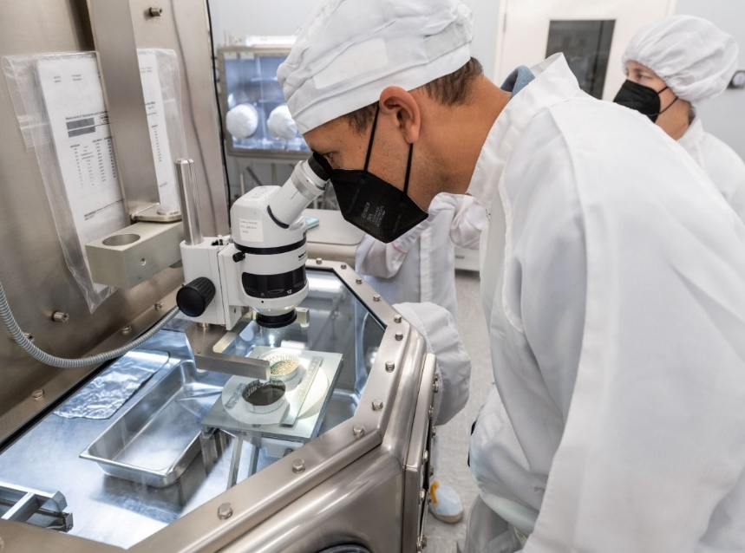
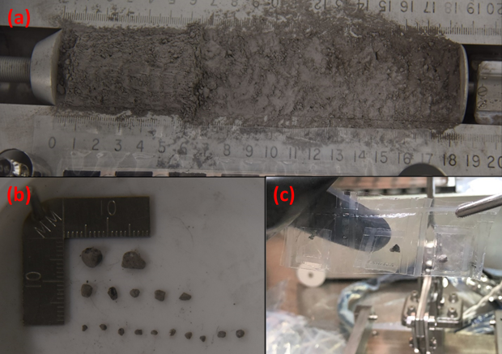
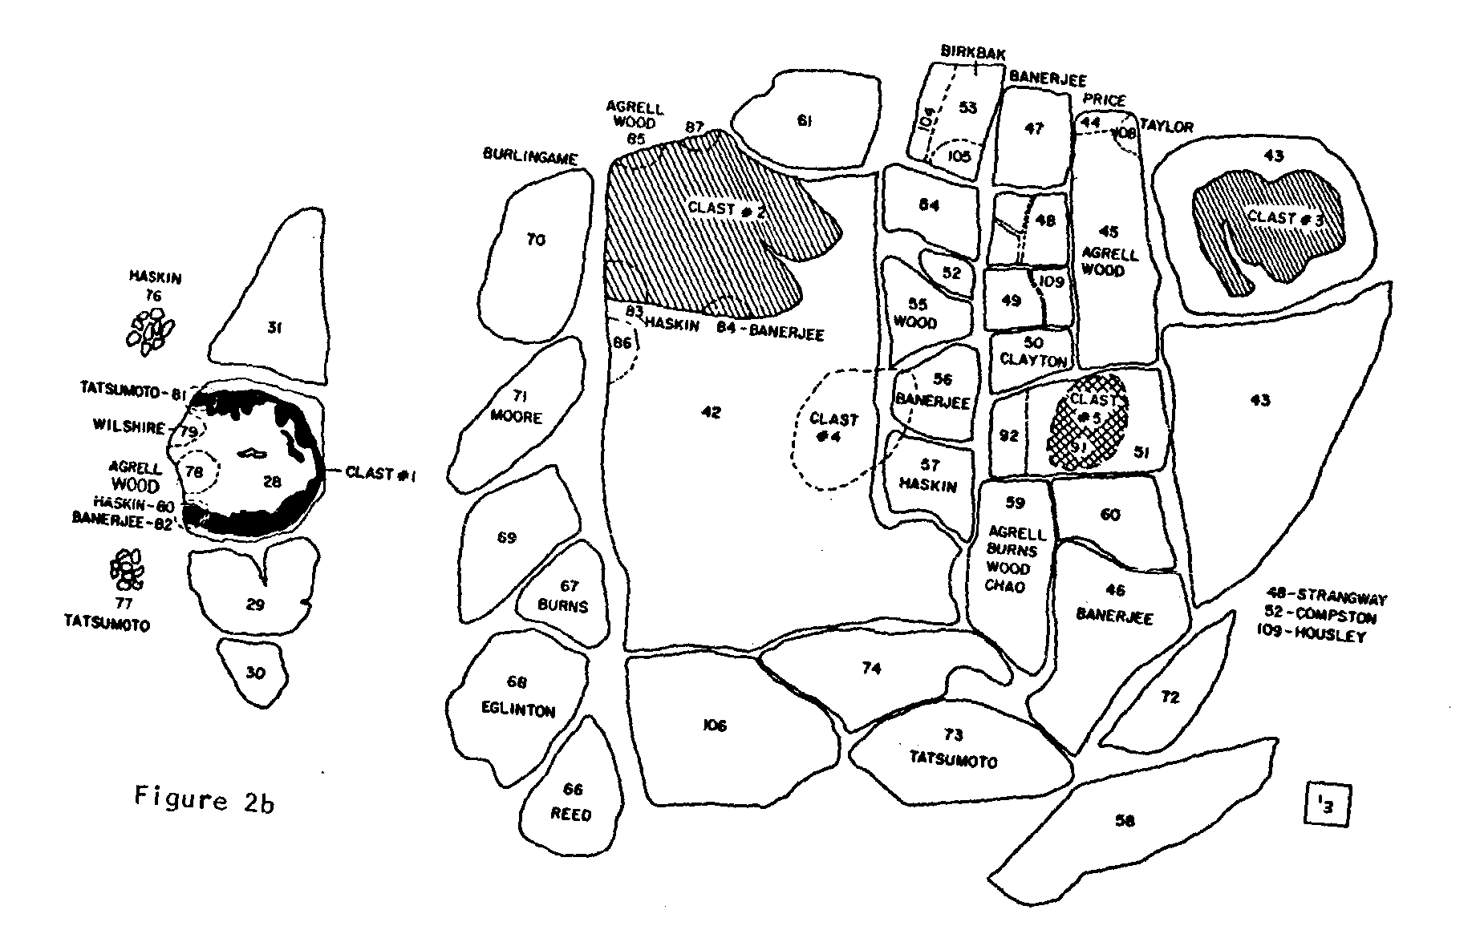
Importance of Curation
→ To maximize scientific return of samples (sample context,…)
To interpret data correctly (analyzed samples, what does it mean/tell us)
To ensure availability for future generations (preservation, protection, allocation)
When does curation start?

Slide 3
What is curation and where does it start?
pre-mission planning (J)
Long term curation (R)
facilities for storage, processors, etc. (w/Ryan), stakeholders of mission vehicles, training, FOD, etc.)
protection, preservation, and allocation
During active mission (J)
surface collection → astronauts = curators (build into crew training) (J)
PE (R&J)
Recovery and Transport (J)
initial (quick and dirty) characterization
documentation of environm. samples experienced
Notes:
Starts pre-mission (J) (facilities for storage (w/Ryan), stakeholders, training, FOD, etc.)
During missing → astronauts = curators (build into crew training) (J)
Recovery & transport (J) → documentation of environm. samples experienced
PE at JSC (J&R) → initial (quick and dirty) characterization
Post PE: Long term curation (R) → protection, preservation, and allocation

Slide 4
Difference between Artemis Curation Lead and Curation?
Defined by JSC management and HQ representatives
Artemis Curation Lead:
primary interface between the Astromaterials Curation Office, the Artemis Science Team, and other Artemis stakeholders
responsible for representing curation during the planning and execution stages of all Artemis missions that plan to return lunar samples until the end of PE for each Artemis mission; includes developing the pre-mission portions of an Artemis collection plan, the curation strategy plan for the campaign and curation plans for each individual Artemis mission
participates and assists in any Artemis Team discussions that pertain to lunar samples, including planning for and execution of sample collection, sample handling, sample transport, and sample storage.
will work with the Artemis Collection Curator to keep them informed about all activities that impact the long-term storage and health of the sample collection.
Artemis Curator:
has the responsibility to manage the samples that are returned for each Artemis Mission as well as managing the curatorial facilities in which Artemis samples are processed and curated.
→ includes all activities that relate to the samples from the point of completing PE, including the initial sample catalog for each Artemis sample return mission.
develops the portions of the Collection plan that pertain to the long-term operations of the collection, including the sample conservation plan; most parts of long-term curation plan, allocation plans, sample processing plan, etc.
will work with the Artemis Curation Lead to provide any information they have that is pertinent to the planning activities of the Artemis Science Team.
Preliminary Examination (rehearsals and execution)
Notes:
Curation lead: 3) incl. assisting Geology Teams to define a sampling plan that fits utilization constraints, assist the FOD team to mature sample collection conops, and help to ensure appropriate execution of sample collection during missions.
Curator: 1) activities include the preservation, conservation, inventorying, allocation, accessioning (or deaccessioning), and physical security of the Artemis samples, and other management functions associated with these activities.
PE: The Artemis Collection Curator and Artemis Curation Lead will work jointly to train the PE team, as well as plan and implement PE rehearsals prior to sample return.

Slide 5
Roles and Responsibilites/expectations
Role of Artemis Science Team:
AIST
Sample subteam help
A3GT
(from call and pip)
Notes:
Curation lead: 3) incl. assisting Geology Teams to define a sampling plan that fits utilization constraints, assist the FOD team to mature sample collection conops, and help to ensure appropriate execution of sample collection during missions.
Curator: 1) activities include the preservation, conservation, inventorying, allocation, accessioning (or deaccessioning), and physical security of the Artemis samples, and other management functions associated with these activities.
PE: The Artemis Collection Curator and Artemis Curation Lead will work jointly to train the PE team, as well as plan and implement PE rehearsals prior to sample return.

Slide 6
Curation Plan vs Collection Plan: Defined in NASA Procedural Requirement Document (NPR) 7100.5 (effective date 08/16/2023)
Curation Plan (responsibility of Curation Lead) includes:
Nature and mass of samples expected to be collected
Methods used to collect, monitor, and record contamination/degradation from mission inception to delivery to curation facility
Timeline, procedures, risk mitigation to transfer materials from point of collection on lunar surface to curation facility
Environmental conditions of lunar curation facility, and stowage and transport conditions for samples collected on crewed mission
Procedures required for storage, subsampling, documentation, distribution, and security
Timeline and procedures for initial examination of samples and preparation for sample catalog
Anticipated sharing with non-NASA partners
Schedule to announce and make samples available within six month of delivery to curation facility

Slide 7
Curation Plan: overlap with other documents
Methods used to collect, monitor, and record contamination
Timeline, procedures, risk mitigation to transfer materials
Stowage and transport conditions
Curation Plan
Sample Integrity Plan
Contamination Control Plan

Slide 8
Curation Plan vs Collection Plan
Collection Plan -long-term curation- (responsibility of Curator), includes:
Requirements for content of sample catalog and procedures of maintaining it over lifetime of the collection
Facility requ. for lunar labs including contamination control, approved, restricted material list, infrastructure requirements, access control requ., security requ.
General lab operation requirements
Sample processing requirements
Sample database requirements used to track and document samples
Minimum portion of collection stored and secured at secondary location
Sample conservation requirements
Clarification as to which types of loan agreements require peer review

Slide 9
Curation Plan vs Collection Plan
Procedures required for storage, subsampling, documentation, distribution, and security​
Timeline and procedures for initial examination and prep for catalog​
Anticipated sharing with non-NASA partners​
Schedule to announce and make samples available within six month
Collection Plan
Curation Plan
Sample Integrity Plan
Contamination Control Plan

Slide 10
Curation Facility
Current Lunar Facility (Apollo): [picture here of pristine side and vault)
  Clean room environment (pristine side vs return side)
  Sample vaults (pristine and return)
  Sample processing area with gloveboxes → N2 environment
  restricted materials (to minimize future science loss – with new technique development etc.)
  Build in the 1970s but still state-of-the-art
  Has space for Artemis III and IV

Slide 11
PE during Apollo
Returned mass vs EVA time vs individual samples during Apollo(?)
How is PE done currently on different sample types
  Initial catalog = bare minimum
  Basic description
  Photographs
  minor chemical analyses for some

Slide 12
Examples of Previous PE Catalogs
There have been many Apollo sample catalogs produced over the decades, most are scanned and posted on our website here.
Not all catalogs are applicable to what we are talking about here, the examples of the
Apollo 12 – Lunar Sample Information Catalog
Apollo 15 – Lunar Sample Information Catalog
Apollo 16 – Lunar Sample Information Catalog
Apollo 17 – Lunar Sample Information Catalog

Slide 13
A List of Apollo 17 Catalogs
Apollo 17 Lunar Sample Information Catalog, April 1973
Apollo 17 Coarse Fines (4-10 mm): Sample Location, Classification and Photo Index, Meyer, Jun 1973
Preliminary Data on Boulders at Station 6 Apollo 17 Landing Site, H. Grant et al, Oct 1973
Description, Classification and Inventory of 113 Apollo 17 Rake Samples from Station 1A, 2, 7 and 8, Keil et al., Apr 1974
Description, Classification and Inventory of Apollo 17 Rake Samples from Station 6, Phinney et al, Sept 1974
The Apollo 17 Drill Core: Characterization of the Mineral and Lithic Component (Sections 70007, 70008, 70009), Vaniman and Papike, June 1977
Drive Tubes 74002/74001: Dissection and Description, Nagle, Jan 1978
Chemistry and Petrology of Size Fractions of Apollo 17 Deep Drill Core 70009-70006, Laul et al., June 1978
Guidebook for the Boulders at Station 6, Apollo 17, W.C. Phinney, Mar 1981
Breccia Guidebook #8 72275, Salpas et al., Apr 1985
Apollo 17 Sample Catalog, Vols. 1,2,3,4, G. Ryder, 1993-1994

Slide 14
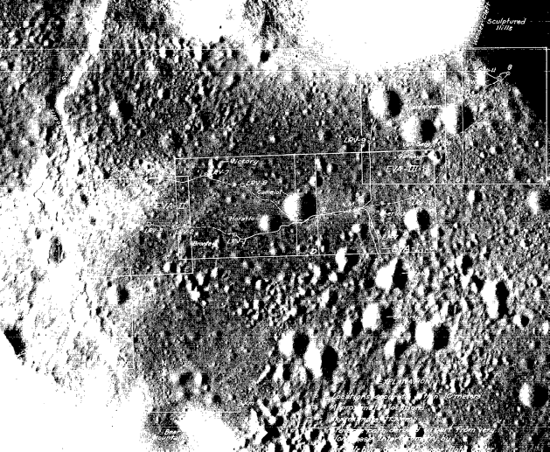
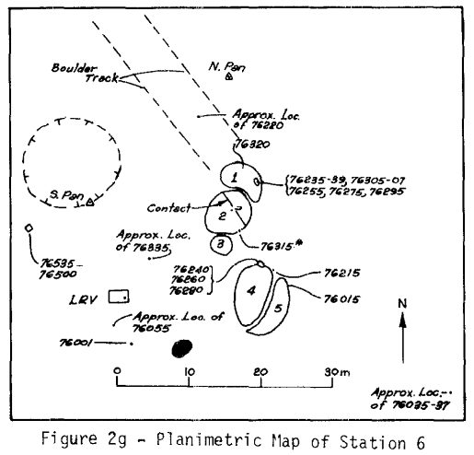
The Apollo 17 PE Catalog
Table of Contents of A17 PE Catalog
INTRODUCTION
SAMPLE LOCATIONS
SAMPLE RETURN ENVIRONMENTS AND CONTAINERS.
NUMBERING OF APOLLO 17 SAMPLES
SAMPLE PROCESSING
PROCESSING ENVIRONMENT
CHEMICAL ANALYSIS
EVOLVED GAS STUDIES
TOTAL CARBON ANALYSIS
CORES
SOIL SAMPLES
ROCK DESCRIPTIONS
Collection and transportation information
Laboratory conditions and handling information
Analytical information
Core Sample Details
Soil Sample Details
Rock Sample Details

Slide 15
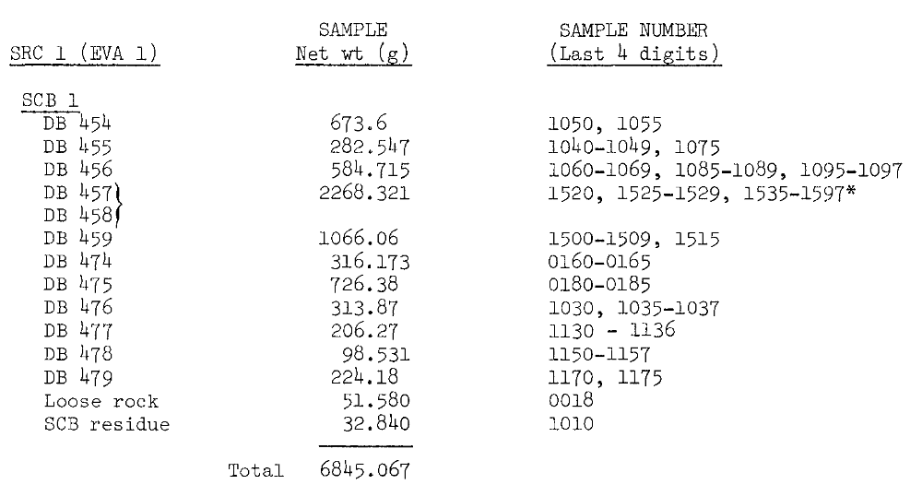
The Apollo 17 PE Catalog
Table of Contents of A17 PE Catalog
INTRODUCTION
SAMPLE LOCATIONS
SAMPLE RETURN ENVIRONMENTS AND CONTAINERS.
NUMBERING OF APOLLO 17 SAMPLES
SAMPLE PROCESSING
PROCESSING ENVIRONMENT
CHEMICAL ANALYSIS
EVOLVED GAS STUDIES
TOTAL CARBON ANALYSIS
CORES
SOIL SAMPLES
ROCK DESCRIPTIONS
Collection and transportation information
Laboratory conditions and handling information
Analytical information
Core Sample Details
Soil Sample Details
Rock Sample Details

Slide 16
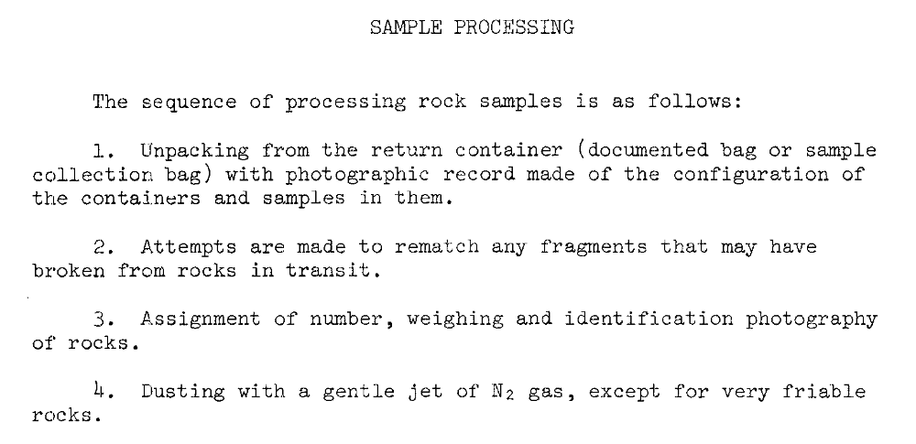
The Apollo 17 PE Catalog
Table of Contents of A17 PE Catalog
INTRODUCTION
SAMPLE LOCATIONS
SAMPLE RETURN ENVIRONMENTS AND CONTAINERS.
NUMBERING OF APOLLO 17 SAMPLES
SAMPLE PROCESSING
PROCESSING ENVIRONMENT
CHEMICAL ANALYSIS
EVOLVED GAS STUDIES
TOTAL CARBON ANALYSIS
CORES
SOIL SAMPLES
ROCK DESCRIPTIONS
Collection and transportation information
Laboratory conditions and handling information
Analytical information
Core Sample Details
Soil Sample Details
Rock Sample Details

Slide 17
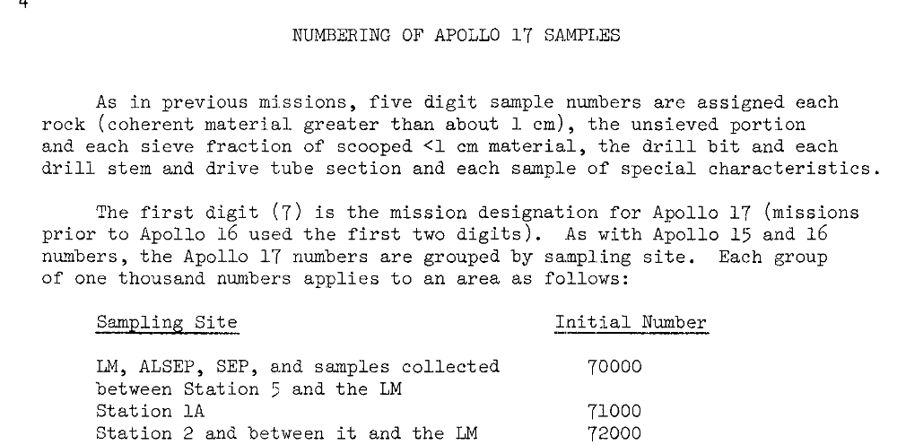
The Apollo 17 PE Catalog
Table of Contents of A17 PE Catalog
INTRODUCTION
SAMPLE LOCATIONS
SAMPLE RETURN ENVIRONMENTS AND CONTAINERS.
NUMBERING OF APOLLO 17 SAMPLES
SAMPLE PROCESSING
PROCESSING ENVIRONMENT
CHEMICAL ANALYSIS
EVOLVED GAS STUDIES
TOTAL CARBON ANALYSIS
CORES
SOIL SAMPLES
ROCK DESCRIPTIONS
Collection and transportation information
Laboratory conditions and handling information
Analytical information
Core Sample Details
Soil Sample Details
Rock Sample Details

Slide 18
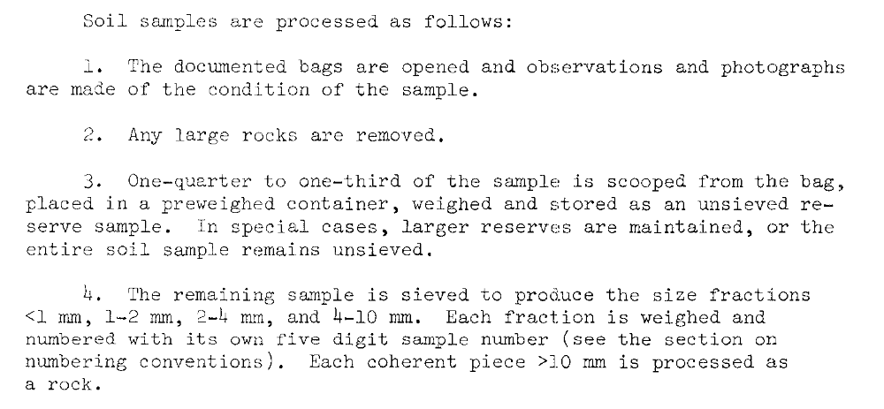
The Apollo 17 PE Catalog
Table of Contents of A17 PE Catalog
INTRODUCTION
SAMPLE LOCATIONS
SAMPLE RETURN ENVIRONMENTS AND CONTAINERS.
NUMBERING OF APOLLO 17 SAMPLES
SAMPLE PROCESSING
PROCESSING ENVIRONMENT
CHEMICAL ANALYSIS
EVOLVED GAS STUDIES
TOTAL CARBON ANALYSIS
CORES
SOIL SAMPLES
ROCK DESCRIPTIONS
Collection and transportation information
Laboratory conditions and handling information
Analytical information
Core Sample Details
Soil Sample Details
Rock Sample Details

Slide 19
Apollo samples requested vs sample type
Requested sample type diagram: type of sample that is important for community (drive tube intervals soils vs rock ships/particles vs regolith bulk soil samples (size fraction sieved vs unsieved, etc.) vs contact pads).
Types of Apollo samples returned (by relative mass across missions by type)
  (reflected in request –most folks want rocks, not drive tube soils!)

Slide 20
Artemis 3 PE Catalog – Managing Expectations
From the day that the samples arrive at JSC, we have 6 months to publish a catalog that will be used by the worldwide scientific community to request Artemis samples
That seems like a lot of time, but in reality it is ~120 working days
  We will not be working “2 shifts”; We will not be working weekends; we likely will not be working in the labs on alternate Fridays
  Individual processors will be limited to ~4 hours in the lab most days
  Not a matter of work ethic, but lessons learned from ANGSA and OREx about burn out, declining returns on work after long hours in the lab
There is enough non lab work that this is largely not an issue.
Also, since the catalog needs to come out on JSC arrival +6 months, there will be a deadline of a few weeks before that for “new data”

Slide 21
PE during Artemis
Calculation of time here: Assumptions is A14-15 (on foot (A14) and similar mass A15)
  A14 returned xxx samples which were represented by xxxx individual samples (rocks, chips, soils,…)
  6 months = 120 working days.
  Lessons learned from OREx and ANGSA: ~4-5hours of lab time; 3-4 hours of associated paperwork and catalog writing
  With 120 days (24 weeks), and ~120 samples ( = 1 sample per day (does NOT include build in time for unexpected situations)
  Sample handling: Curation Team
  Photography: Erika Blumenfelder + Team (nice high-res images)
  Sketches and descriptions: Curation Team with help of A3GT PE team
  Time permitting: XCT on selected subsamples; TS on selected samples (~3 TS per week??)
  Catalog: Artemis Curator & Curation Lead with the help of A3GT (as per call)

Slide 22
Artemis PE by sample type
Open bag
Puzzle (if broken)
Photograph/description
Rock/chip (incl. float):
Rake:
weight
Chip for XCT, TS
some
Open bag
Sort
weight
Photograph/description
Chip for XCT, TS
some
Notes:
Don’t handle more than we have to

Slide 23
Artemis PE by sample type
Open bag
weight
Split
sieve
some
Photo? Iso/FeO; size distribution
Bulk soil (incl. skim, trench, etc.):
Drive tubes:
Sealed samples:
Grain mounts for XCT, TS
some
Remove from bag
weight
Imaging inside
store
Remove from bag
weight
Secondary vacuum containment
Inspect seal
Notes:
Don’t handle more than we have to

Slide 24
Artemis PE
Talking points with A3GT:
  Heat sealing of bags inside cabinet
  Type of gloves we need (switch to something other than Neoprene?)
  Teflon bags only for curation tools (see ANGSA) after cleaning vs nylon (see Apollo)?
  Glass vs polycarbonate (glovebox windows for new cabinets
  Other points as we think of them

