Slide 1

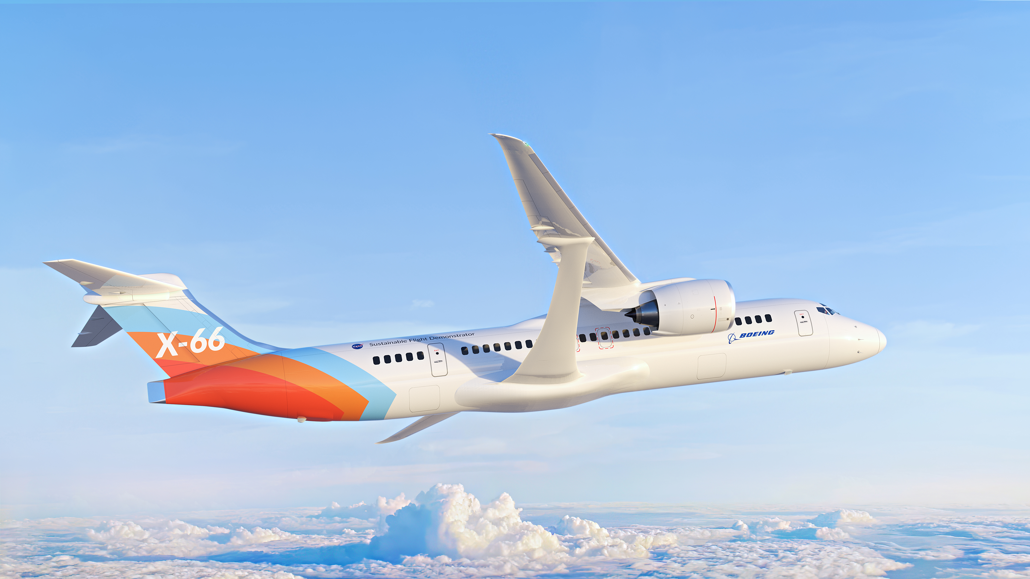
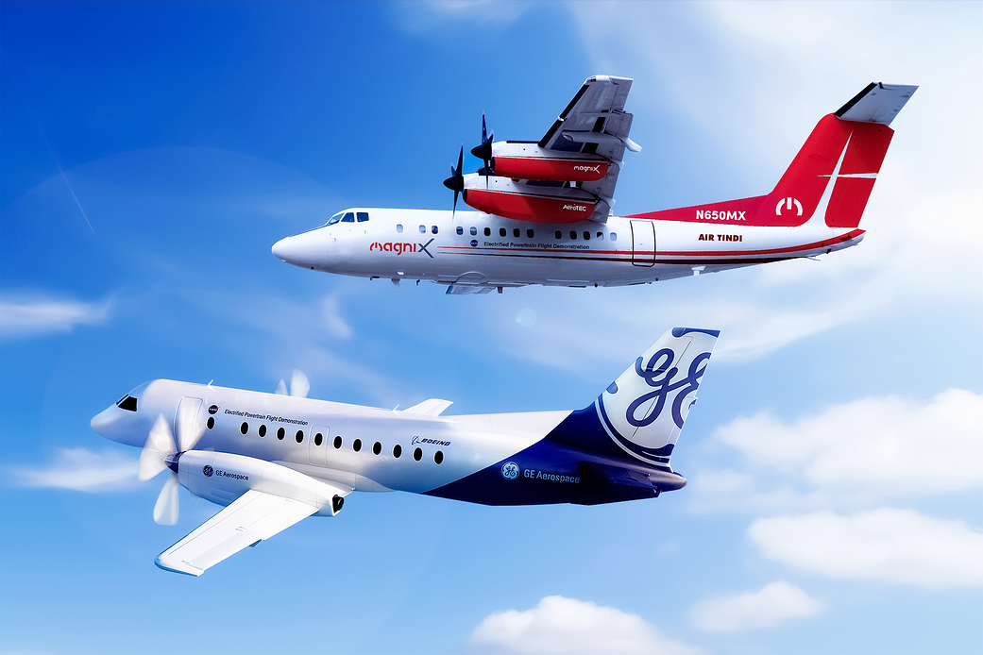
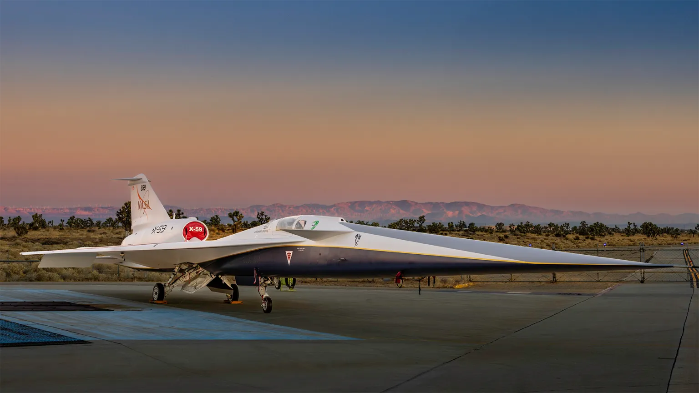
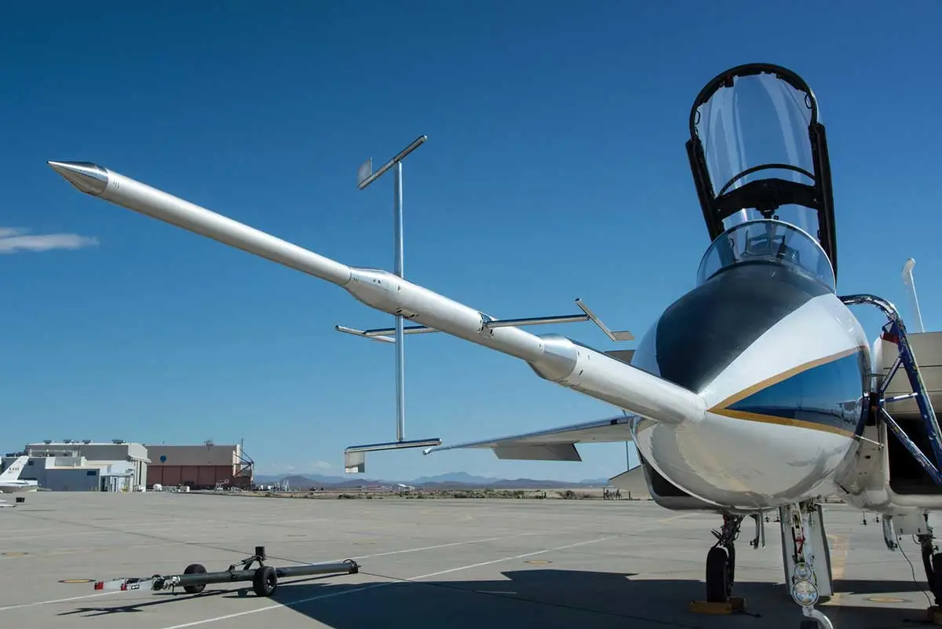
Benefiting Humanity through Flight Research of Advanced Technologies
Integrated Aviation Systems Program
Challenges
Global growth in aviation demand drives the need for faster, more efficient, safer, and sustainable aircraft for people and cargo
Practical and affordable commercial high-speed air travel to generate economic and societal benefits in a globally linked world
Achieving the U.S. Aviation Climate Action Plan goal of net-zero carbon emissions from aviation by 2050
Expected Impacts
Continue U.S. aviation global competitiveness by advancing new concepts and technologies and enabling new commercial markets (e.g., sustainable commercial supersonic flight over land)
Minimize environmental impact through reduced fuel burn and carbon dioxide emissions by accelerating commercial adoption of electric propulsion systems and advanced airframe configurations
Solutions & Next Steps
Conduct flight research to validate advanced concepts and technologies in a relevant environment to enable industry adoption
  Sustainable Flight Demonstrator project
    Build, test, and fly the X-66, an advanced, more efficient airframe utilizing a Transonic Truss-Braced Wing configuration, to obtain data that will inform the next-generation of single-aisle aircraft
  Electrified Powertrain Flight Demonstration project
    Ground and flight test hybrid electric powertrains on a modified Saab 340B and a modified DeHavilland Dash 7 to inform the development of new certification standards for next-generation single-aisle and regional hybrid-electric aircraft
  Low Boom Flight Demonstrator project
    Develop X-59 to enable flight research over U.S. communities to prove a sonic boom can be reduced to a sonic thump that is publicly acceptable
  Flight Demonstrations and Capabilities project
    Operate and sustain test capabilities and facilities necessary for flight research; conduct small-scale flight research demonstrations to accelerate technology development and reduce risk for larger flight demonstrations
Sustainable Flight Demonstrator project
X-66 artist concept | Credit: Boeing
Electrified Powertrain Flight Demonstration project
Dash 7 (top) & Saab 340B (bottom) aircraft
Credits: NASA, GE Aerospace, magniX
Results
Reduce technical risk and/or inform standards development that enables revolutionary technology adoption into commercial regional and single-aisle aircraft
Discover publicly acceptable noise limits for supersonic travel over land to inform changes in regulations that could lift the 1973 ban on commercial supersonic flight over land
Collaborators
NASA Sustainable Flight Demonstrator project
        Industry partner: Boeing
NASA Electrified Powertrain Flight Demonstration project
        Contractors: GE Aerospace & magniX
NASA Low Boom Flight Demonstrator project
        Prime contractor: Lockheed Martin Skunk Works
NASA Flight Demonstrations and Capabilities project
  Academia, U.S. industry, other government agencies
Low Boom Flight Demonstrator project
X-59 experimental aircraft | Credit: Lockheed Martin
Flight Demonstrations and Capabilities project
Modified F-15 with shock-sensing probe
Credit: NASA
Notes:
Structured poster template being used for the university poster sessions, provided as an example

