Slide 1
An infeasible interior-point arc-search algorithm for spacecraft trajectory optimization
Yaguang Yang, Robert Pritchett, Noble Hatten
INFORMS Optimization 2024/Houston/March 22-24, 2024
NASA Goddard Space Flight Center

Slide 2
Scope
Optimal trajectory design and interior-point method (IPM)
Why arc-search IPM?
The arc-search IPM
Numerical test for simple benchmark problems
Optimal spacecraft trajectory/orbit design applications
  Hohmann transfer between circular orbits
  Hohmann transfer between elliptical orbits
  Optimal orbit formation fly design
Conclusions

Slide 3
Optimal trajectory/orbit design
Optimal trajectory design for spacecraft is
  critical because it can lower the time or fuel required for achieving a mission’s objectives
  an optimal control problem but can be solved reliably by using nonlinear optimization algorithms
Two popular methods for solving the nonlinear optimization problem (NOP)
  the sequential quadratic programming (SQP) method
  the interior-point method (IPM)
IPM has been very successful
  For large scale linear programming (LP) problem, many IPM algorithms are polynomial!
  extended to solve nonlinear programming problem, and some algorithms, such as IPOPT, have become popular

Slide 4
Why arc-search IPM
People (e.g. [Todd02]) noticed a dilemma of IPM algorithms that use line search
  To improve efficiency, one should do the following
    use higher-order method
    search in a wide neighborhood
    start from an infeasible point
  Using any of the above strategies in line-search IPM algorithms impairs the polynomial bound
  Using a combination of the strategies in line search IPM deteriorates further the polynomial bound
  Using all these strategies in famous Mehrotra’s predictor-corrector (MPC) algorithm makes it hard to prove its convergence (there is still no convergence result for MPC)!

Slide 5
Why arc-search IPM
Achievements by introducing arc-search in IPM:
  Arc-search IPM algorithms for LP using higher-order method, or wide search neighborhood, or initial infeasible point, or a combination of the strategies improve the polynomial bounds of the corresponding line-search algorithms
  An arc-search IPM algorithm [YAN21] that uses all three strategies achieves the best polynomial bound and computationally competitive to MPC—the dilemma is resolved!
  Similar claims hold for algorithms designed for convex quadratic programming (CQP), linear complementarity programming (LCP), and semi-definite programming (SDP) (see the book—[YAN21] Y. Yang, Arc-search techniques for interior-point methods, CRC Press, 2021)

Slide 6
Why arc-search IPM
Most line search IPM algorithms for nonlinear optimization programming problem (NOP) is first-order method.
The first-order method is essentially a steepest descent algorithm, which is inefficient
Arc-search is a second-order method which approximate the central path better than the traditional line-search direction
Experience for LP, CQP, LCP, and SDP indicates that arc-search may improve line search first-order algorithms for NOP
Second-order method requires solving two linear systems instead of one, but the coefficient matrix is the same for both systems, meaning only one matrix decomposition is required (a trick that was used in MPC).
Most elements of the right-hand side vector of the second system are computed already during the assembly of the coefficient matrix

Slide 7
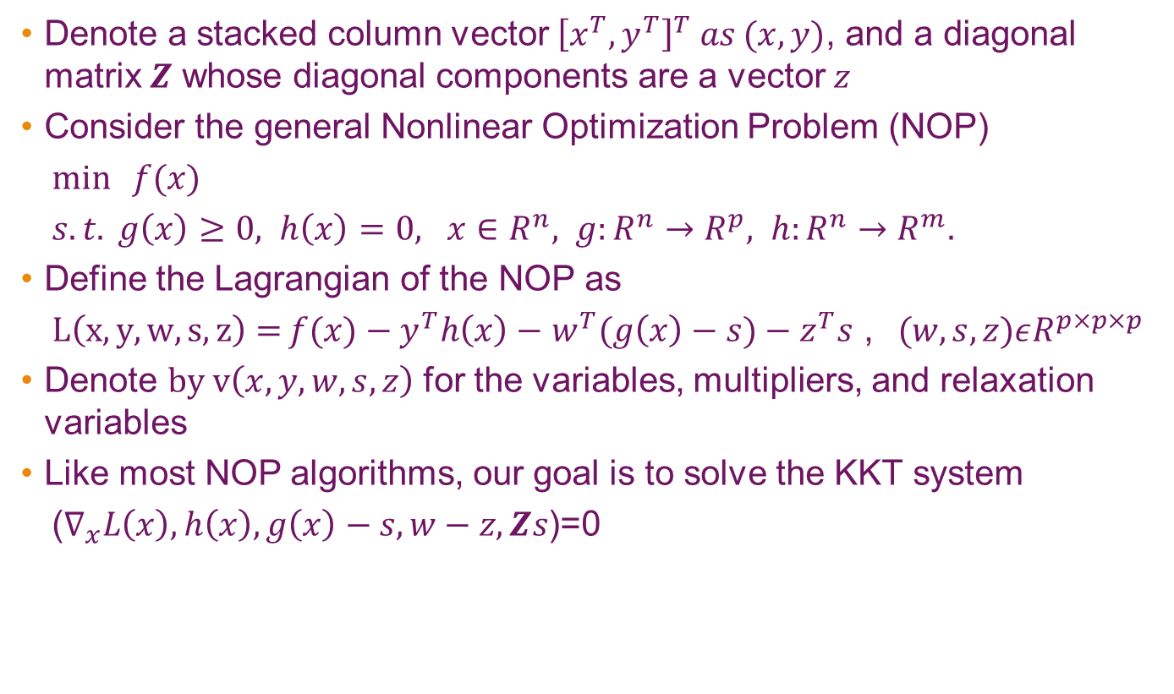
Arc-search IPM for NOP
Denote a stacked column vector ${\left[x^{T},y^{T}\right]}^{T} as (x,y)$, and a diagonal matrix $Z$ whose diagonal components are a vector $z$
Consider the general Nonlinear Optimization Problem (NOP)
$\min{ f(x})$
$s.t. g\left(x\right)≥0, h\left(x\right)=0, x∈R^{n}, g:R^{n}→R^{p}, h:R^{n}→R^{m}.$
Define the Lagrangian of the NOP as
$L\left(x,y,w,s,z\right)={f(x})−y^{T}h\left(x\right)−$ $w^{T}(g\left(x\right)−s)−z^{T}s$ ,$(w,s,z)εR^{p×p×p}$
Denote $by v\left(x,y,w,s,z\right)$ for the variables, multipliers, and relaxation variables
Like most NOP algorithms, our goal is to solve the KKT system
($∇_{x}L\left(x\right), h\left(x\right), g\left(x\right)−s, w−z, Zs$)=0

Slide 8
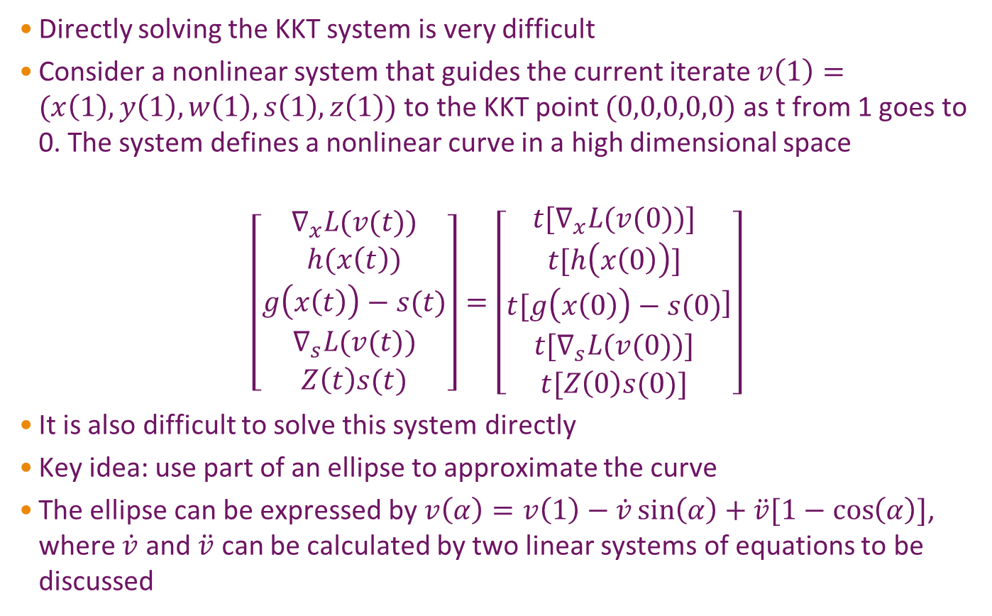
Arc-search IPM for NOP
Directly solving the KKT system is very difficult
Consider a nonlinear system that guides the current iterate $v\left(1\right)=(x\left(1\right),y\left(1\right),w\left(1\right),s\left(1\right),z\left(1\right))$ to the KKT point $(0,0,0,0,0)$ as t from 1 goes to 0. The system defines a nonlinear curve in a high dimensional space
$$\left[\begin{matrix}∇_{x}L(v(t)) \\ \begin{matrix}h(x\left(t\right)) \\ g\left(x\left(t\right)\right)−s(t)\end{matrix} \\ \begin{matrix}∇_{s}L(v(t)) \\ Z\left(t\right)s(t)\end{matrix}\end{matrix}\right]=\left[\begin{matrix}t{[∇}_{x}L(v(0))] \\ \begin{matrix}t[h\left(x\left(0\right)\right)] \\ t[g\left(x\left(0\right)\right)−s(0)\end{matrix} \\ \begin{matrix}{t[∇}_{s}L(v(0))] \\ t[Z\left(0\right)s(0)]\end{matrix}\end{matrix}]\right]$$
It is also difficult to solve this system directly
Key idea: use part of an ellipse to approximate the curve
The ellipse can be expressed by $v\left(α\right)=v\left(1\right)−\dot{v}\sin\left(α\right)+\ddot{v}[1−\cos\left(α\right)]$, where $\dot{v}$ and $\ddot{v}$ can be calculated by two linear systems of equations to be discussed

Slide 9
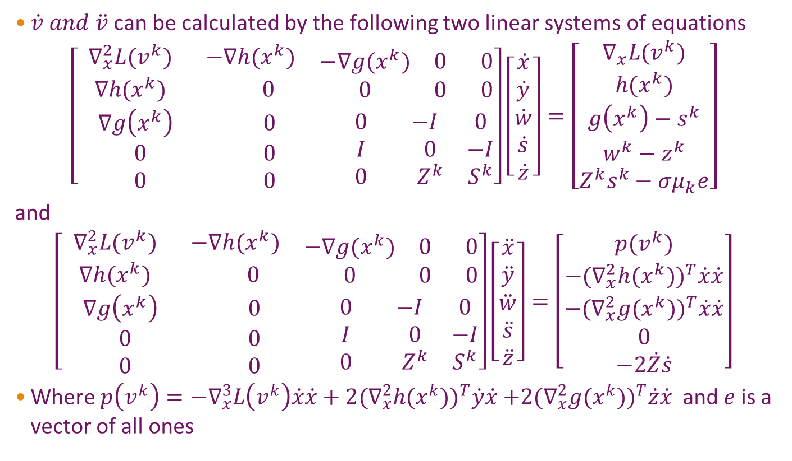
Arc-search IPM for NOP
$\dot{v} and \ddot{v}$ can be calculated by the following two linear systems of equations
$$\left[\begin{matrix}\begin{matrix}{ ∇}_{x}^{2}L(v^{k}) & −∇h(x^{k}) \\ ∇h(x^{k}) & 0\end{matrix} & \begin{matrix}−∇g(x^{k}) & 0 & 0 \\ 0 & 0 & 0\end{matrix} \\ \begin{matrix}∇g\left(x^{k}\right) & 0 \\ 0 & 0 \\ 0 & 0\end{matrix} & \begin{matrix}0 & −I & 0 \\ I & 0 & −I \\ 0 & Z^{k} & S^{k}\end{matrix}\end{matrix}\right]\left[\begin{matrix}\begin{matrix}\dot{x} \\ \dot{y}\end{matrix} \\ \begin{matrix}\dot{w} \\ \dot{s} \\ \dot{z}\end{matrix}\end{matrix}\right]=\left[\begin{matrix}\begin{matrix}∇_{x}L(v^{k}) \\ h(x^{k})\end{matrix} \\ \begin{matrix}g\left(x^{k}\right)−s^{k} \\ w^{k}−z^{k} \\ Z^{k}s^{k}−σμ_{k}e\end{matrix}\end{matrix}\right]$$
and
$$\left[\begin{matrix}\begin{matrix}{ ∇}_{x}^{2}L(v^{k}) & −∇h(x^{k}) \\ ∇h(x^{k}) & 0\end{matrix} & \begin{matrix}−∇g(x^{k}) & 0 & 0 \\ 0 & 0 & 0\end{matrix} \\ \begin{matrix}∇g\left(x^{k}\right) & 0 \\ 0 & 0 \\ 0 & 0\end{matrix} & \begin{matrix}0 & −I & 0 \\ I & 0 & −I \\ 0 & Z^{k} & S^{k}\end{matrix}\end{matrix}\right]\left[\begin{matrix}\begin{matrix}\ddot{x} \\ \ddot{y}\end{matrix} \\ \begin{matrix}\ddot{w} \\ \ddot{s} \\ \ddot{z}\end{matrix}\end{matrix}\right]=\left[\begin{matrix}\begin{matrix}p(v^{k}) \\ {{−(∇}_{x}^{2}h(x^{k}))}^{T}\dot{x}\dot{x}\end{matrix} \\ \begin{matrix}{{−(∇}_{x}^{2}g(x^{k}))}^{T}\dot{x}\dot{x} \\ 0 \\ −2\dot{Z}\dot{s}\end{matrix}\end{matrix}\right]$$
Where $p\left(v^{k}\right)=−∇_{x}^{3}L\left(v^{k}\right)\dot{x}\dot{x}+2{{(∇}_{x}^{2}h(x^{k}))}^{T}\dot{y}\dot{x}$ ${{+2(∇}_{x}^{2}g(x^{k}))}^{T}\dot{z}\dot{x}$ and $e$ is a vector of all ones

Slide 10
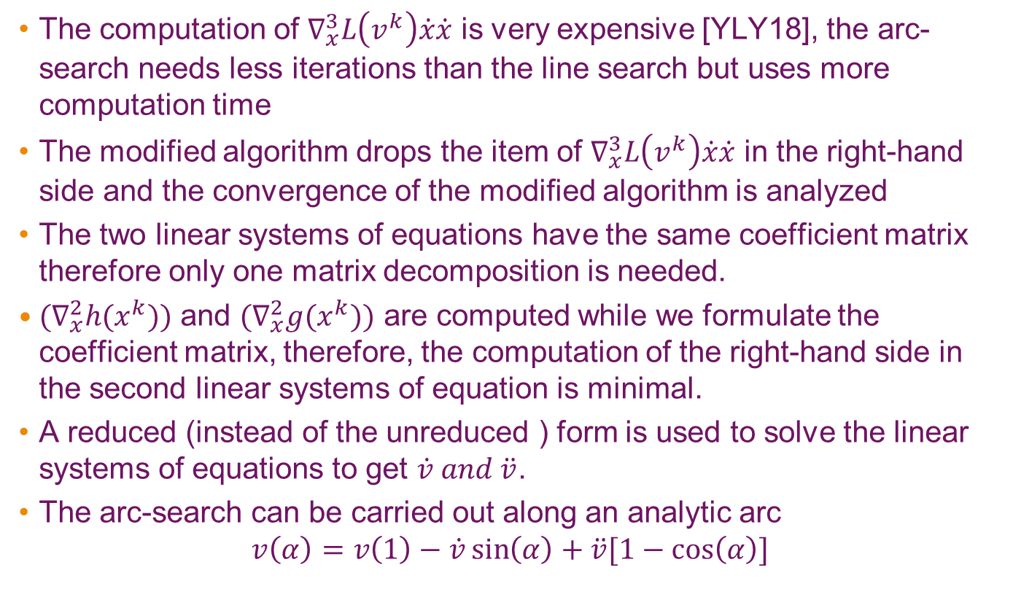
Arc-search IPM for NOP
The computation of $∇_{x}^{3}L\left(v^{k}\right)\dot{x}\dot{x}$ is very expensive [YLY18], the arc-search needs less iterations than the line search but uses more computation time
The modified algorithm drops the item of $∇_{x}^{3}L\left(v^{k}\right)\dot{x}\dot{x}$ in the right-hand side and the convergence of the modified algorithm is analyzed
The two linear systems of equations have the same coefficient matrix therefore only one matrix decomposition is needed.
${(∇}_{x}^{2}h(x^{k}))$ and ${(∇}_{x}^{2}g(x^{k}))$ are computed while we formulate the coefficient matrix, therefore, the computation of the right-hand side in the second linear systems of equation is minimal.
A reduced (instead of the unreduced ) form is used to solve the linear systems of equations to get $\dot{v} and \ddot{v}$.
The arc-search can be carried out along an analytic arc
$$v\left(α\right)=v\left(1\right)−\dot{v}\sin\left(α\right)+\ddot{v}[1−\cos\left(α\right)]$$

Slide 11
A simple example: Hock and Schittkowski-collection 19 and preliminary test
The constraints of problem HS-19 is shown above, which is between two curves in red lines. The ellipse passes the current iterate. Searching along the ellipse is better than searching any line-segment. The right most figure shows the iterates that approach to the optimal solution. The modified algorithm solves all Hock and Schittkowski-collection problems that failed by using the algorithm in [YLY18].
11

Slide 12

Application: Hohmann transfer between circular orbits
The initial orbit is the inner circle
with radius of $r_{1}$, the desired final
orbit (in yellow) is the outer circle
with radius of R. The problem
is to use the minimum fuel to
transfer a spacecraft orbit from
The initial orbit to the final orbit.
The arc-search IPM finds
the optimal solution in 30
iterations. The transfer orbit
is depicted by the red line

Slide 13
Application: Hohmann transfer between elliptical orbits
Consider orbit transfers between
elliptical orbits in three-dimensional
space. The initial orbit is the inner
ellipse and the final orbit is the outer
ellipse. The ellipses are inclined with
respect to the Earth’s equatorial plane,
but both ellipses lie in the same plane.
The objective is to find minimum
fuel consumption (or minimum Δv
in aerospace terminology) to achieve
this goal. The arc-search IPM finds the
solution in 12 iterations. The
transfer orbit is depicted in blue line

Slide 14
Application: formation fly orbit design
A group of spacecraft flying in formation might be helpful for some science missions
One example is three spacecraft flying in formation in different orbits
Consider the constraints that at any given time, the three spacecraft form the vertices of an (approximately) equilateral triangle, with the distance between any two spacecraft being close to a constant
The three orbits must be designed such that the deviation from the equilateral triangle is as small as possible
The arc-search IPM algorithm is applied to this type of orbit design problem which begins at the start of the mission’s science phase. The optimal solution found improves upon earlier science orbit designs computed in a Keplerian model (see [DNKV05], and [NKDV06])

Slide 15
Formation fly orbit design
The capri line is the desired distance between
any spacecraft pair. The blue lines are orbit
distances between spacecraft pairs of
[DNKV05] orbit design. The red lines are orbit
distances between spacecraft pairs of [NKDV06]
orbit design. The green lines are orbit distances
between spacecraft pairs of the optimal orbit
design. The solid lines are orbit distances
between spacecraft 1 & 2. The dashed lines
are orbit distances between spacecraft 1 & 3.
The dashed dot lines are orbit distances
between spacecraft 2 & 3. The maximum
deviation from the desired distance found by
the arc-search IPM is less than 30% of the
ones of baseline designs. The algorithm
found the optimal solution in one minute.

Slide 16
Conclusions
An arc-search interior-point algorithm is devised for NOP
A Matlab code implemented
The algorithm/code is tested against some NOP benchmark problems, and promising result is observed
The algorithm/code is applied to some optimal trajectory design problems and the optimal solutions are found
The algorithm/code is applied to formation fly orbit design problem and an optimal solution is found
The algorithm/code is considered to apply to formation fly orbit design problem
Continuous improvement of the algorithm/code will be a future project

Slide 17
References
[YAN21] Y. Yang, Arc-search techniques for interior-point method, CRC Press, 2021
[Todd02] M.J. Todd, The many facets of linear programming, Mathematical Programming, series B 91, 417-436, 2002.
[YLY18] M. Yamashita, E. Iida, and Y. Yang An infeasible interior-point arc-search algorithm for nonlinear constrained optimization, Numerical Algorithms, 12, 781–798, 2018.
[DNKV05] S. V. Dhurandhar, K.R. Nayak, S. Koshti, and J-Y Vinet, Classical and Quantum Gravity, 22, 481–487, 2005.
[NKDV06] K.R. Nayak, S. Koshti, S. V. Dhurandhar, and J-Y Vinet, Classical and Quantum Gravity, 23, 1763–1778, 2006.

