Slide 1
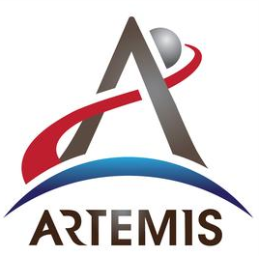
Agile Software Engineering in NASA’s Waterfall World
David Swartwout
GW Production Software Lead
20 February 2024

Slide 2
Overview
Agenda:
NASA Procedural Requirements
Lifecycles
Process Rigor
JSC Engineering’s Agile Process Evolution
Toolchain
Following the NPR Lifecycle
SRR to PDR
PDR to CDR
CDR to TRR
TRR to SAR
Closing Thoughts

Slide 3
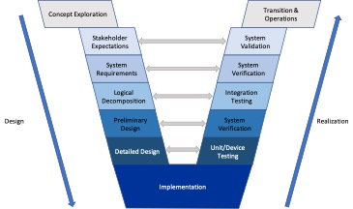
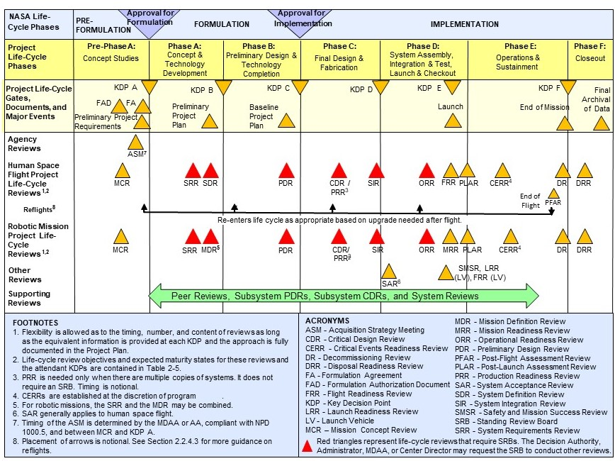
NASA Procedural Requirements
NASA projects are governed by NASA Procedural Requirements (NPR)
NPR 7120.5, NASA Space Flight Program and Project Management Requirements
NPR 7120.7, NASA Information Technology Program and Project Management Requirements
NPR 7120.8, NASA Research and Technology Program and Project Management Requirements
And the overarching Systems Engineering NPR
NPR 7123.1 NASA Systems Engineering Processes and Requirements
All of these NPRs describe a reasonably rigid Waterfall lifecycle
The Systems Engineering “V”
Milestone Gate Reviews
SRR, PDR, CDR, etc.
Tailorable Entrance/Exit Criteria
Products required at each review

Slide 4
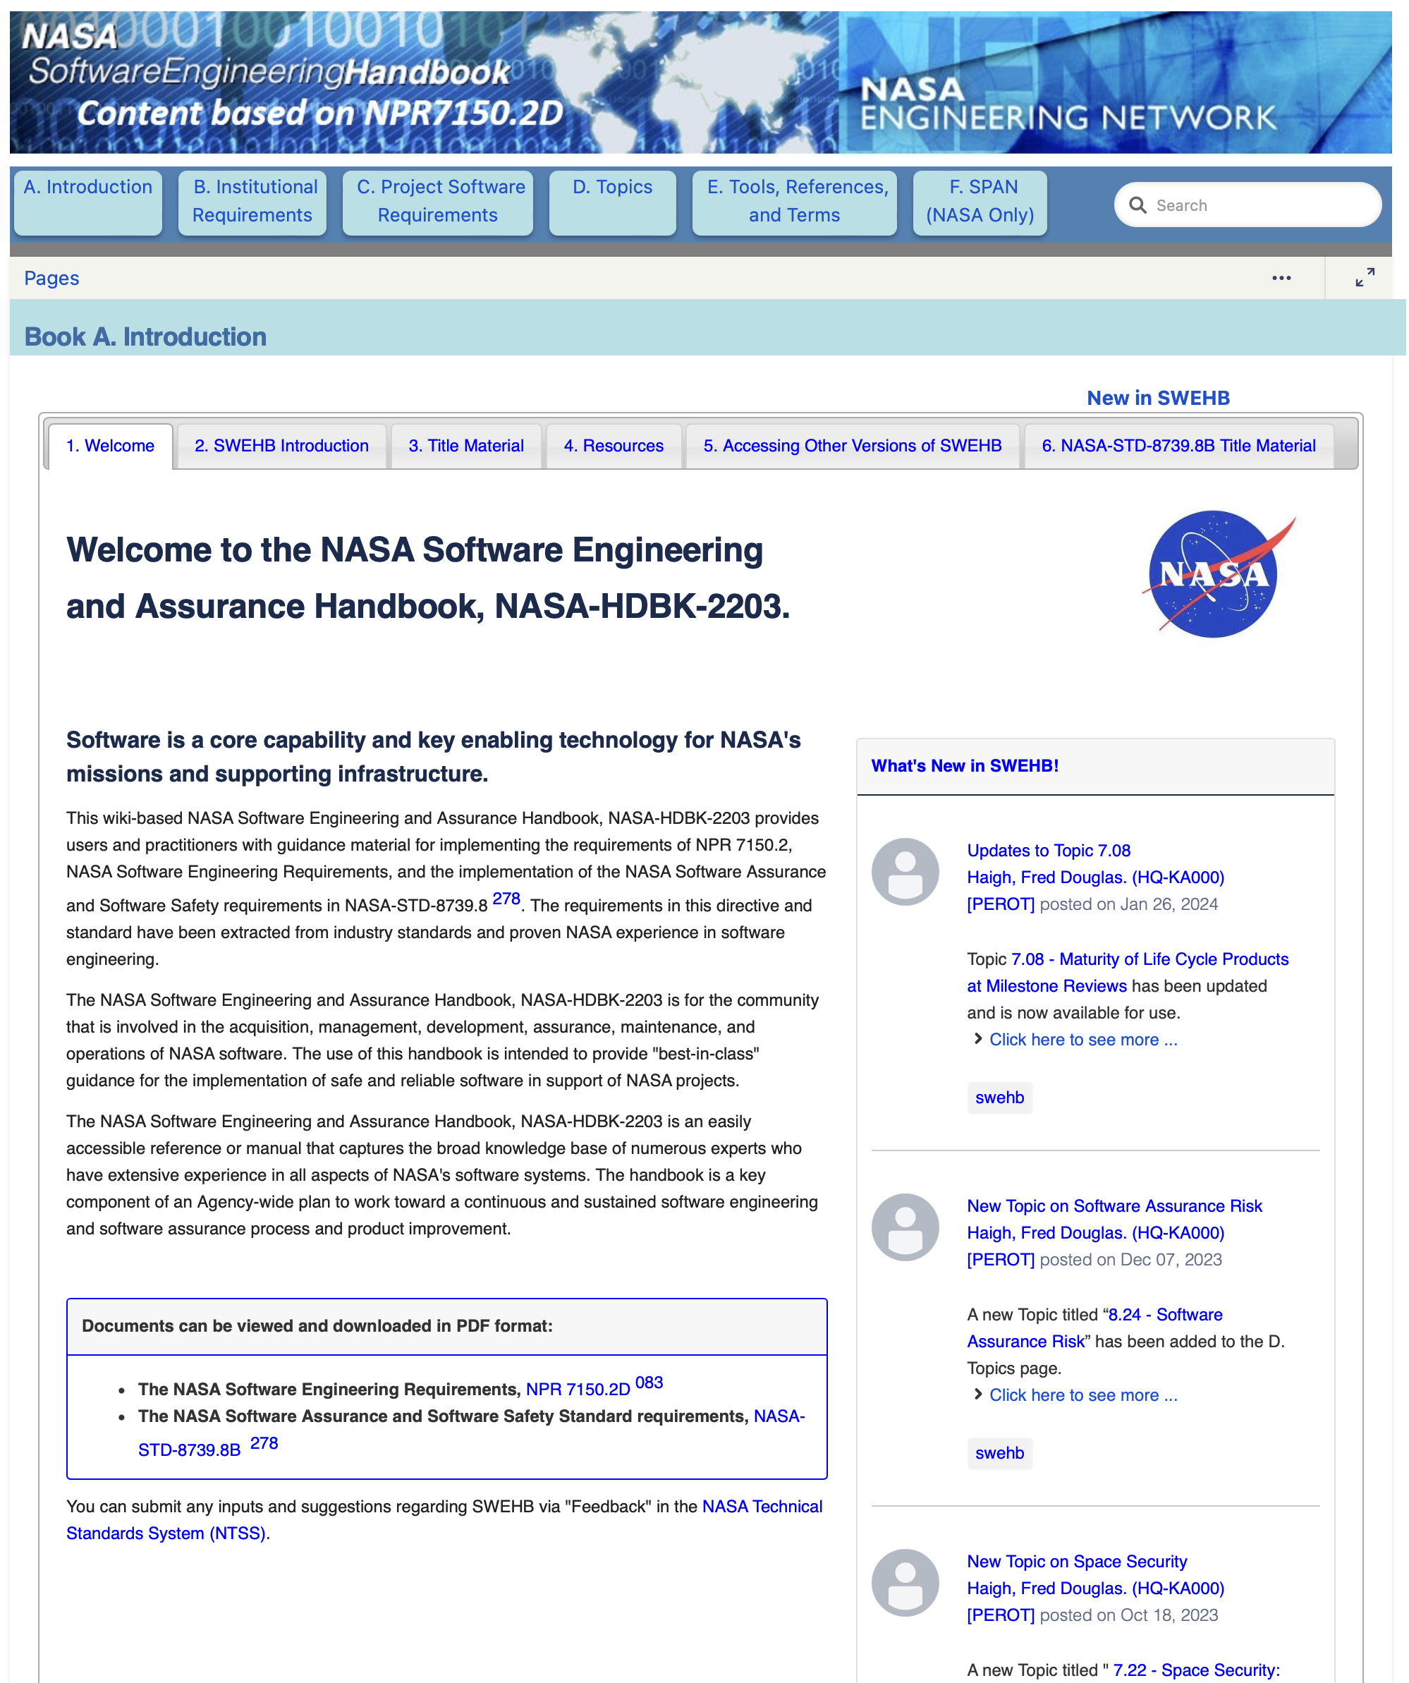
NASA’s Software Engineering Requirements
Software Engineering process and product requirements, as a component of the overall project execution are then detailed in
NPR 7150.2, NASA Software Engineering Requirements
Guidelines are described in
NASA Software Engineering and Assurance Handbook, NASA-HDBK-2203
NPR 7150.2 describes the “what” that has to get done
Document requirements
Document design
Perform testing
Etc.
But luckily, it doesn’t describe the “how”
Does not dictate format or templates
Though, NPR 7123.1 does tell you “when”
Milestone review entrance criteria describe what products are needed for each review
Software requirements at PDR
Software design at CDR
Etc.
Caution - some Centers may levy additional constraints via Center specific Procedural Requirements

Slide 5
The Waterfall Lifecycle
Some challenges and pitfalls of Waterfall
It assumes you got it right the first time
Going back to earlier cycles is nearly impossible
It takes a very long time to learn what you don’t know
Or what you didn’t get right in the previous cycles
Course corrections are hard
Feedback is slow

Slide 6
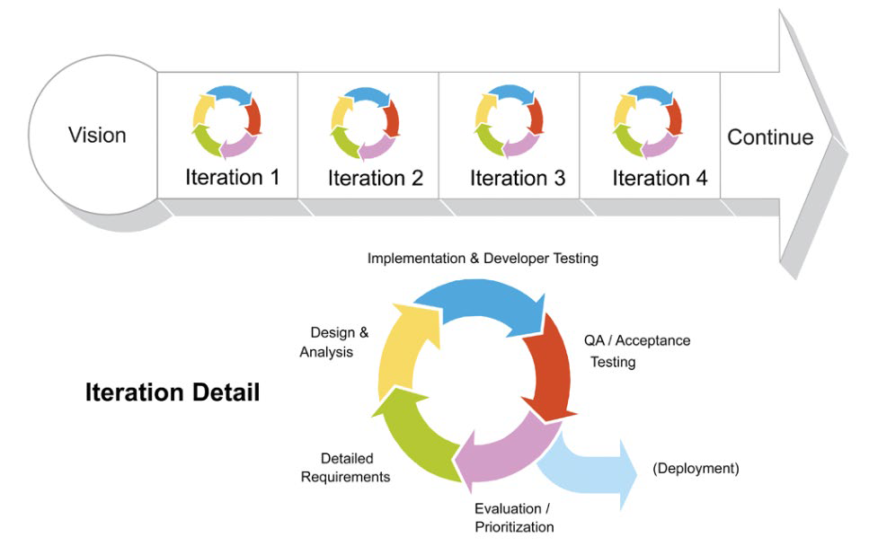
Agile
Industry experience has shown that Agile project management can be highly successful
Cyclic
Looking at all aspects each iteration
Faster to uncover issues and gaps
Burn down risk earlier
Quicker Feedback
Drive metrics for faster decisions
Fosters collaboration
Incremental growth of knowledge

Slide 7
How did we bridge the gap?
So, how did we achieve Agile software engineering within NASA’s NPR dictated waterfall lifecycle?

Slide 8
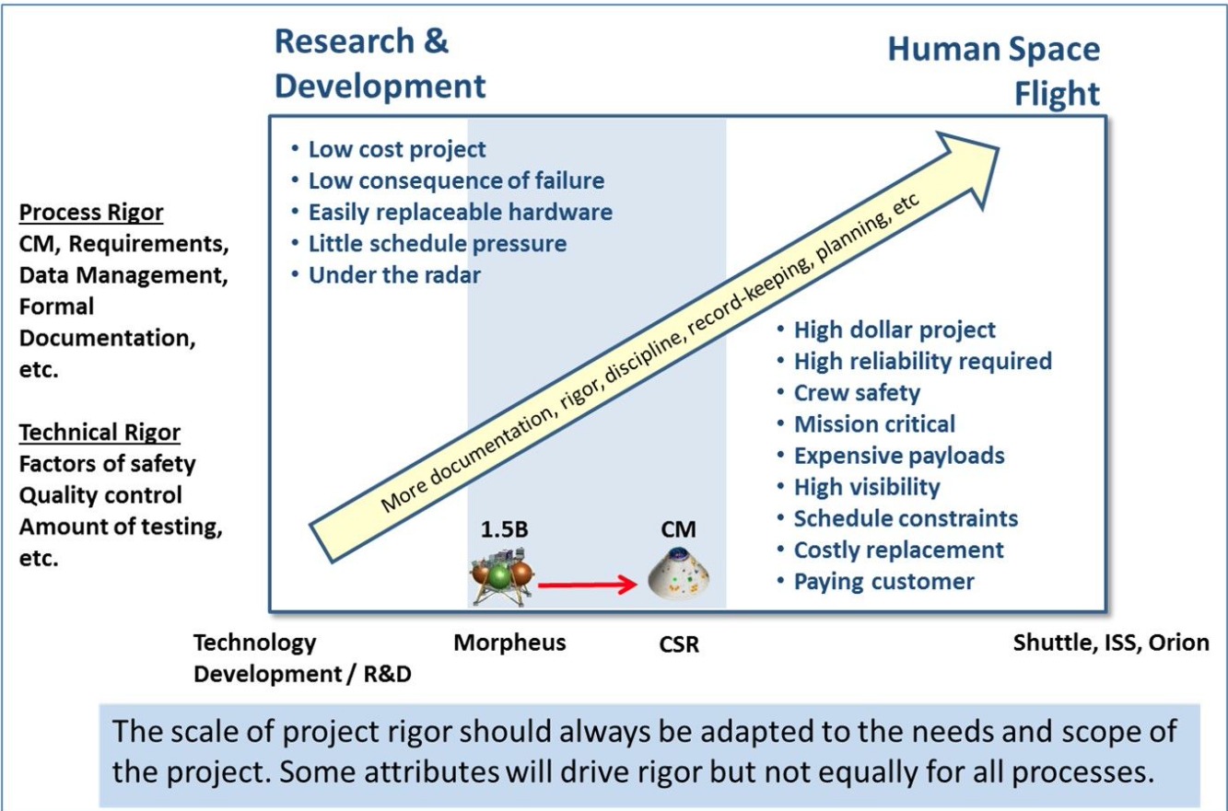
Apply process rigor when it is important
Process rigor is important
But only at the right time
The content of the artifacts detailed in the NPRs are important
Requirements
Design documentation
Test plans and procedures
Agile software engineering is not the “wild west” of project management
In my experience with Agile, there are more day to day process requirements than other non-Agile projects I have worked
Daily feedback loops
Metrics
,
Gateway
J. Devolites – Morpheus/AA2

Slide 9
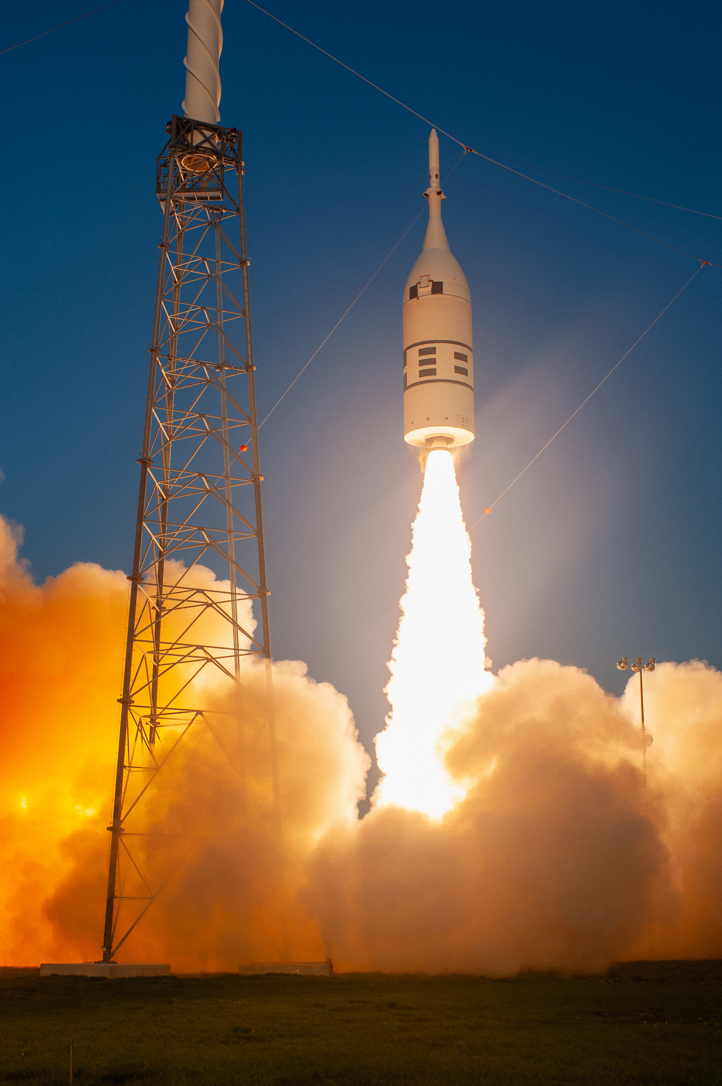
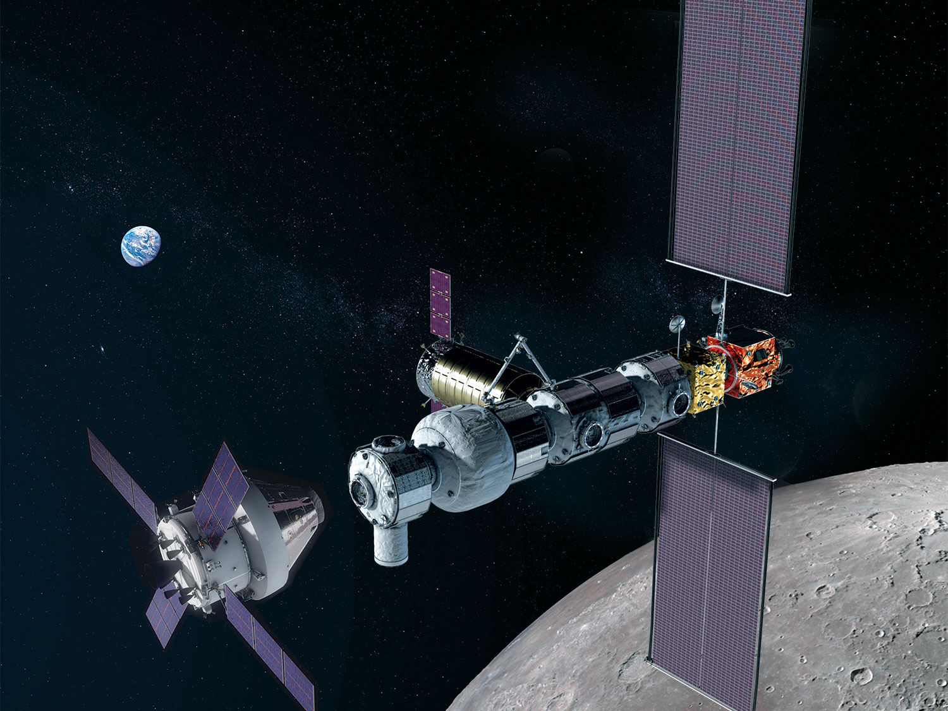
Evolution of JSC Engineering’s Agile Software Engineering Process
Gateway Lunar Outpost ~ 2019 - today
Multiple contractors, multiple teams
Class A safety critical software projects
CMMI ML 3
Morpheus Lander ~ 2010 - 2014
1st focused attempt with Agile
Highly successful R&D project
Class C software project
CMMI ML 2
Orion Ascent Abort – 2 ~ 2015 - 2019
Orion flight test of Launch Abort System
Class B safety critical software project
CMMI ML 3

Slide 10
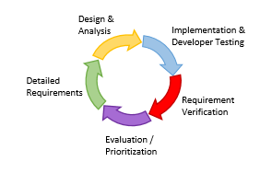
Our lifecycle focused Agile flow
Changing software team focus as project moves through 7123.1 lifecycle
Focus on meeting the intent of the milestone without spending wasted time writing documents
Make NPR required artifact development part of the standard development flow
Updating the design documentation is part of closing each code implementation story
Evolving definition of done for different story types as we move through development gates

Slide 11
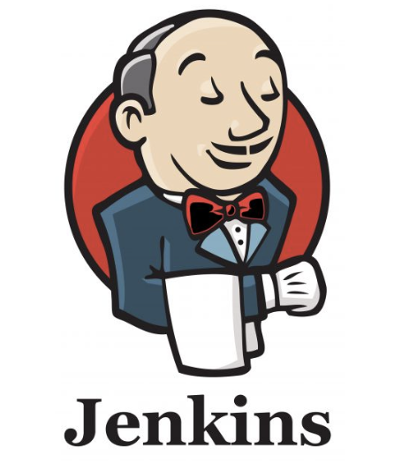
Our Solution Leverages Several Tool Ecosystems
Jira
TestRay plugin
Functional Requirements
Non-Functional Requirements
Test Cases
Test Plans
Test Automation
Stories – Work code
Epics – Use cases
Tasks – Design work
Scripting API back end for trace tables
Release management
Confluence
Design documentation
Use case management
Gitlab
Source code
Continuous integration pipeline
Doxygen
Design documentation
Jenkins
Automated testing
Home grown scripts to tie it all together

Slide 12
Team Focus: SRR to PDR
Requirements
Verification Planning
Architecture
Tool Chain
Use Case Based Advancement of System Capability

Slide 13
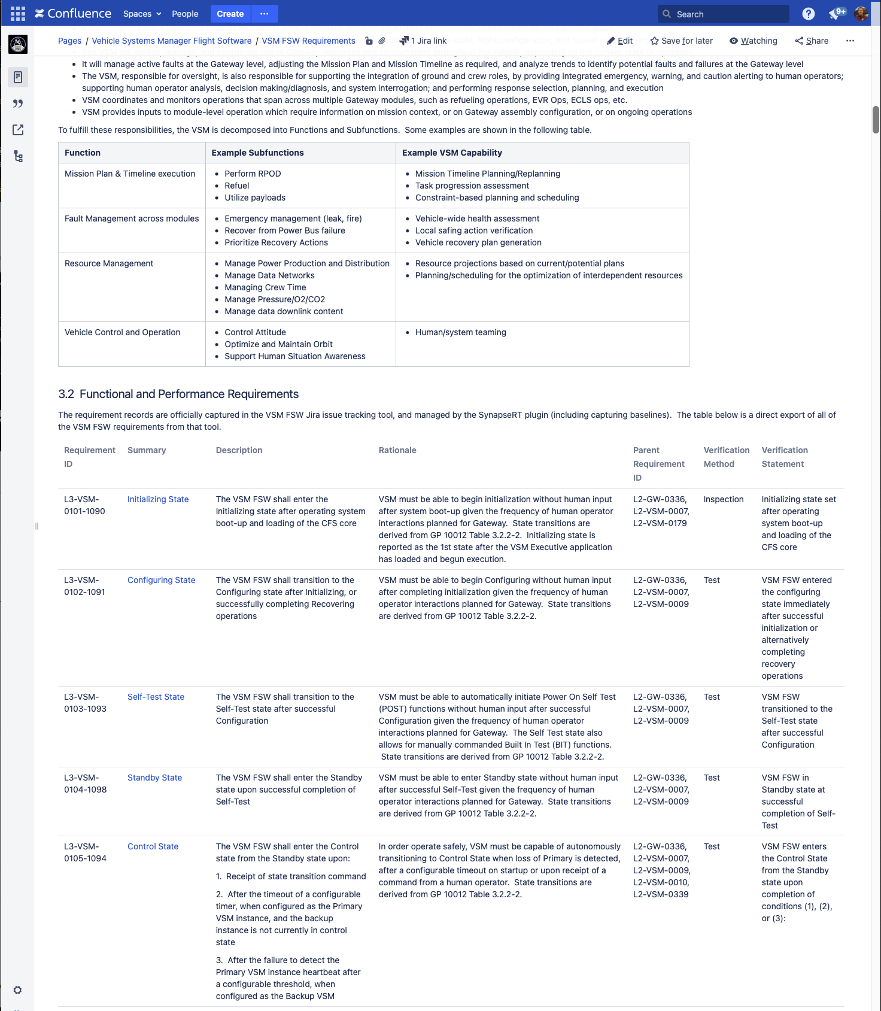
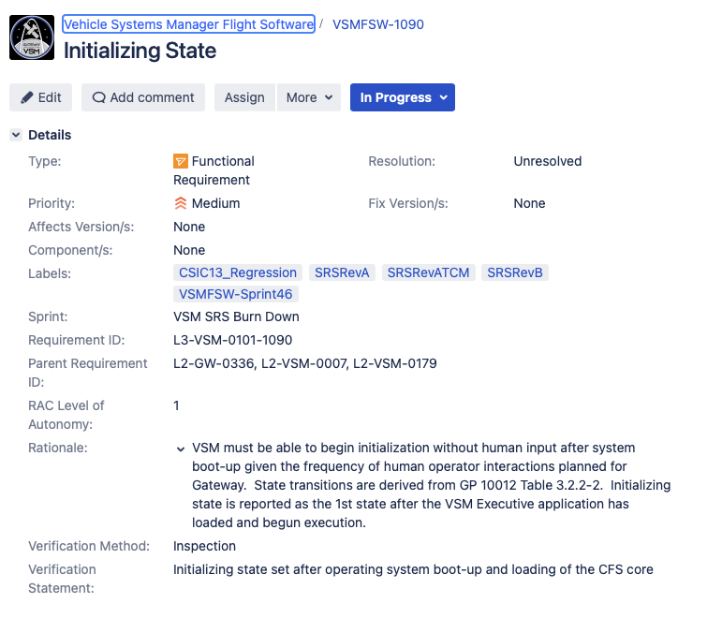
Development of Software System Requirements (SRS)
Use con ops and operational use cases to drive requirements
Higher level requirements
Computer Software Configuration Item (CSCI) requirements are defined in Jira
The box shall …
Utilizes new Jira ticket types from TestRay plugin
Stakeholders review and comment right in the tools
Enhances collaboration and feedback
The actual SRS is a confluence page with the embedded Jira tickets
Jira/TestRay allows management of requirements baselines
Export to a PDF to support a “baseline” for lifecycle reviews
Manage change traffic between versions using labels on the Jira requirements

Slide 14
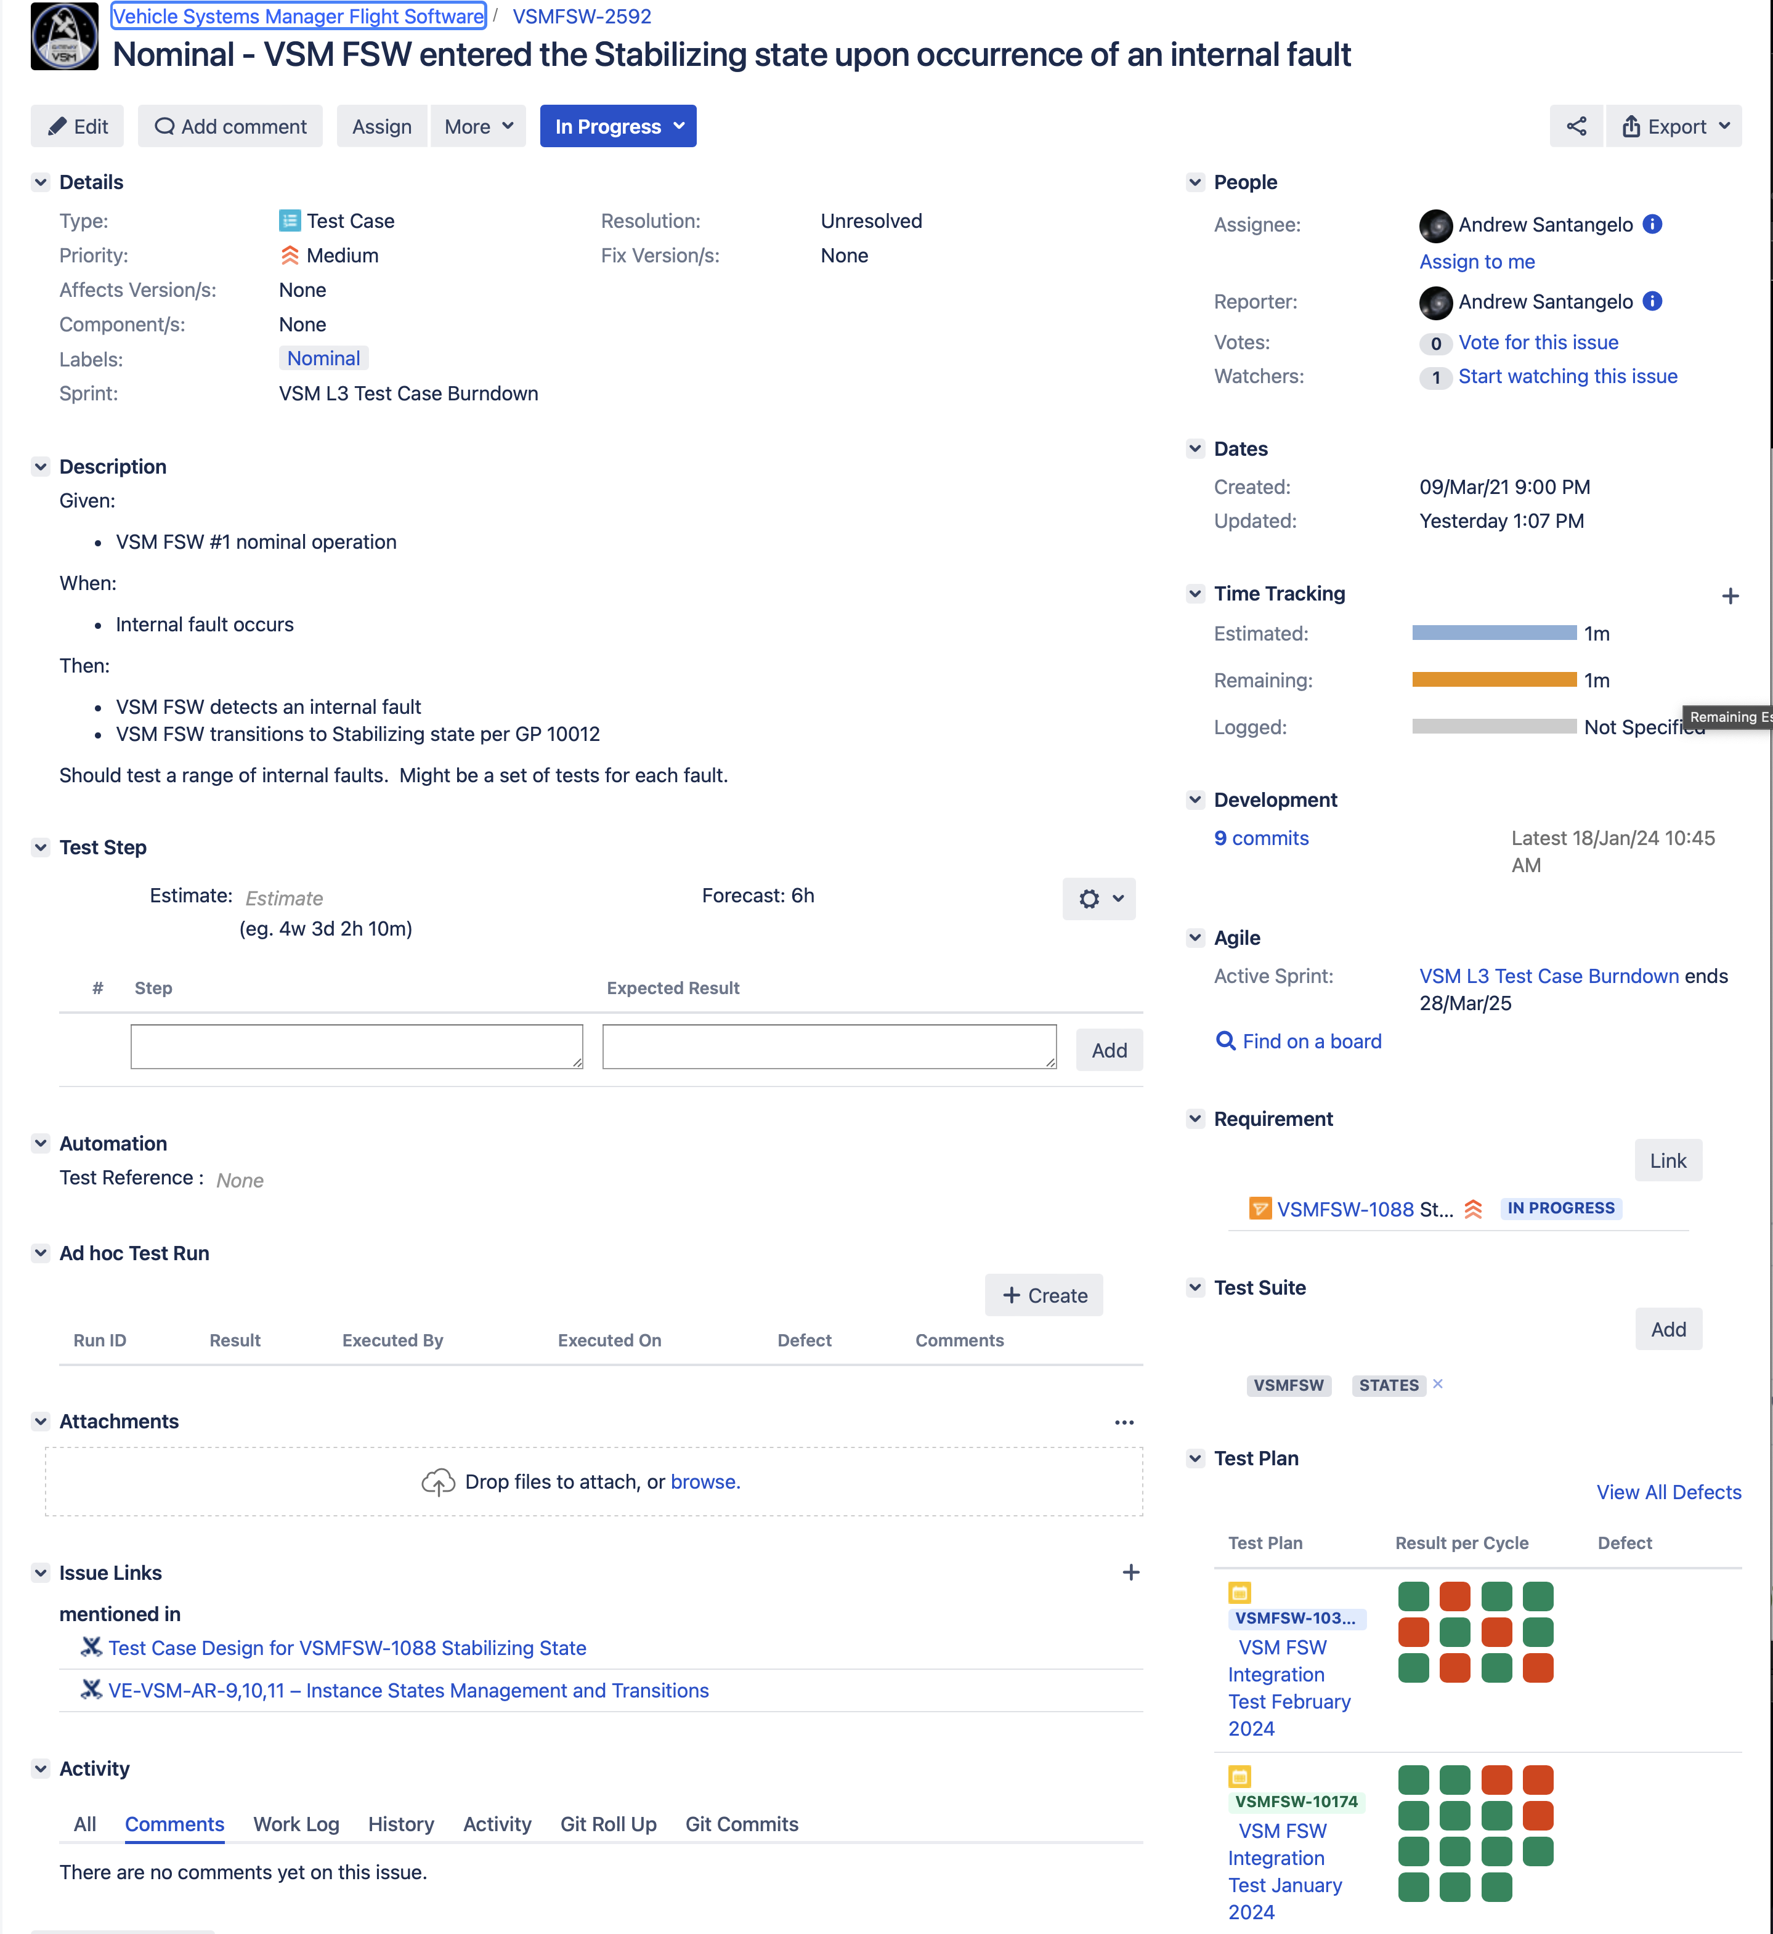
Test Planning and Development
Verification Statements are part of the Jira requirement ticket
Each requirement is broken down into one or more test cases
Nominal
Erroneous
Boundary
Etc.
Test cases are another Jira issue type from the TestRay tool set
Review and collaboration continue in Jira
PDF exports can be made as snapshot baselines for reviews
Plan automated testing architecture

Slide 15
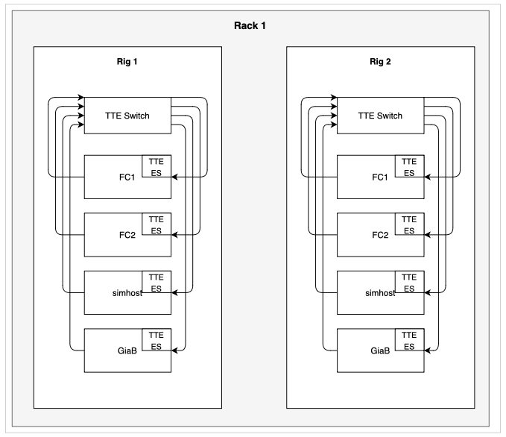
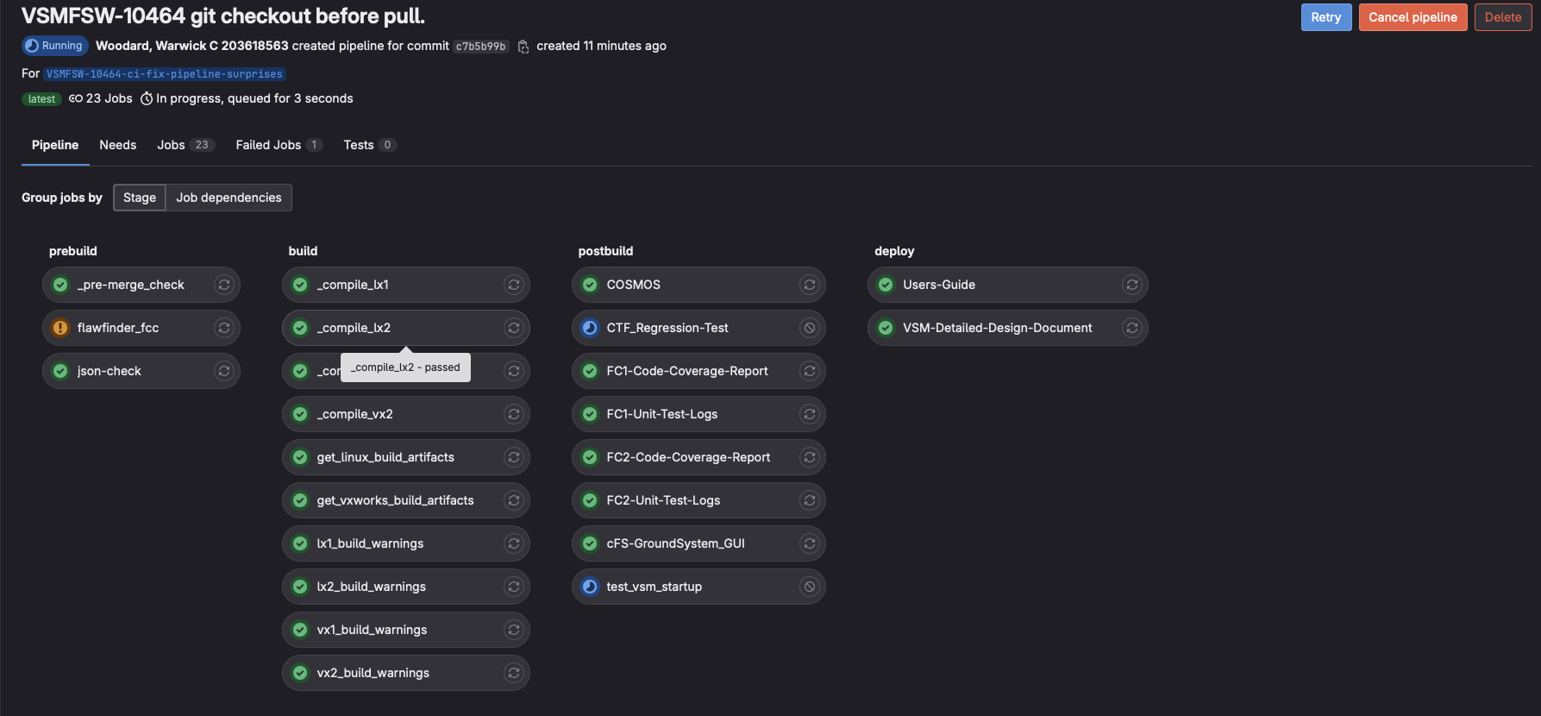
Software Architecture & Implementation
Even though there is a concentrated effort on requirements, we are still implementing capability
Stand up development environment
Toolchain
CI pipeline
Lab
Hardware in the loop – the earlier the better!
Emulators
Simulators
Desktop development
Virtual machines
Docker images
Implement preliminary architecture
All pieces of the architecture cycling in early development sprints

Slide 16
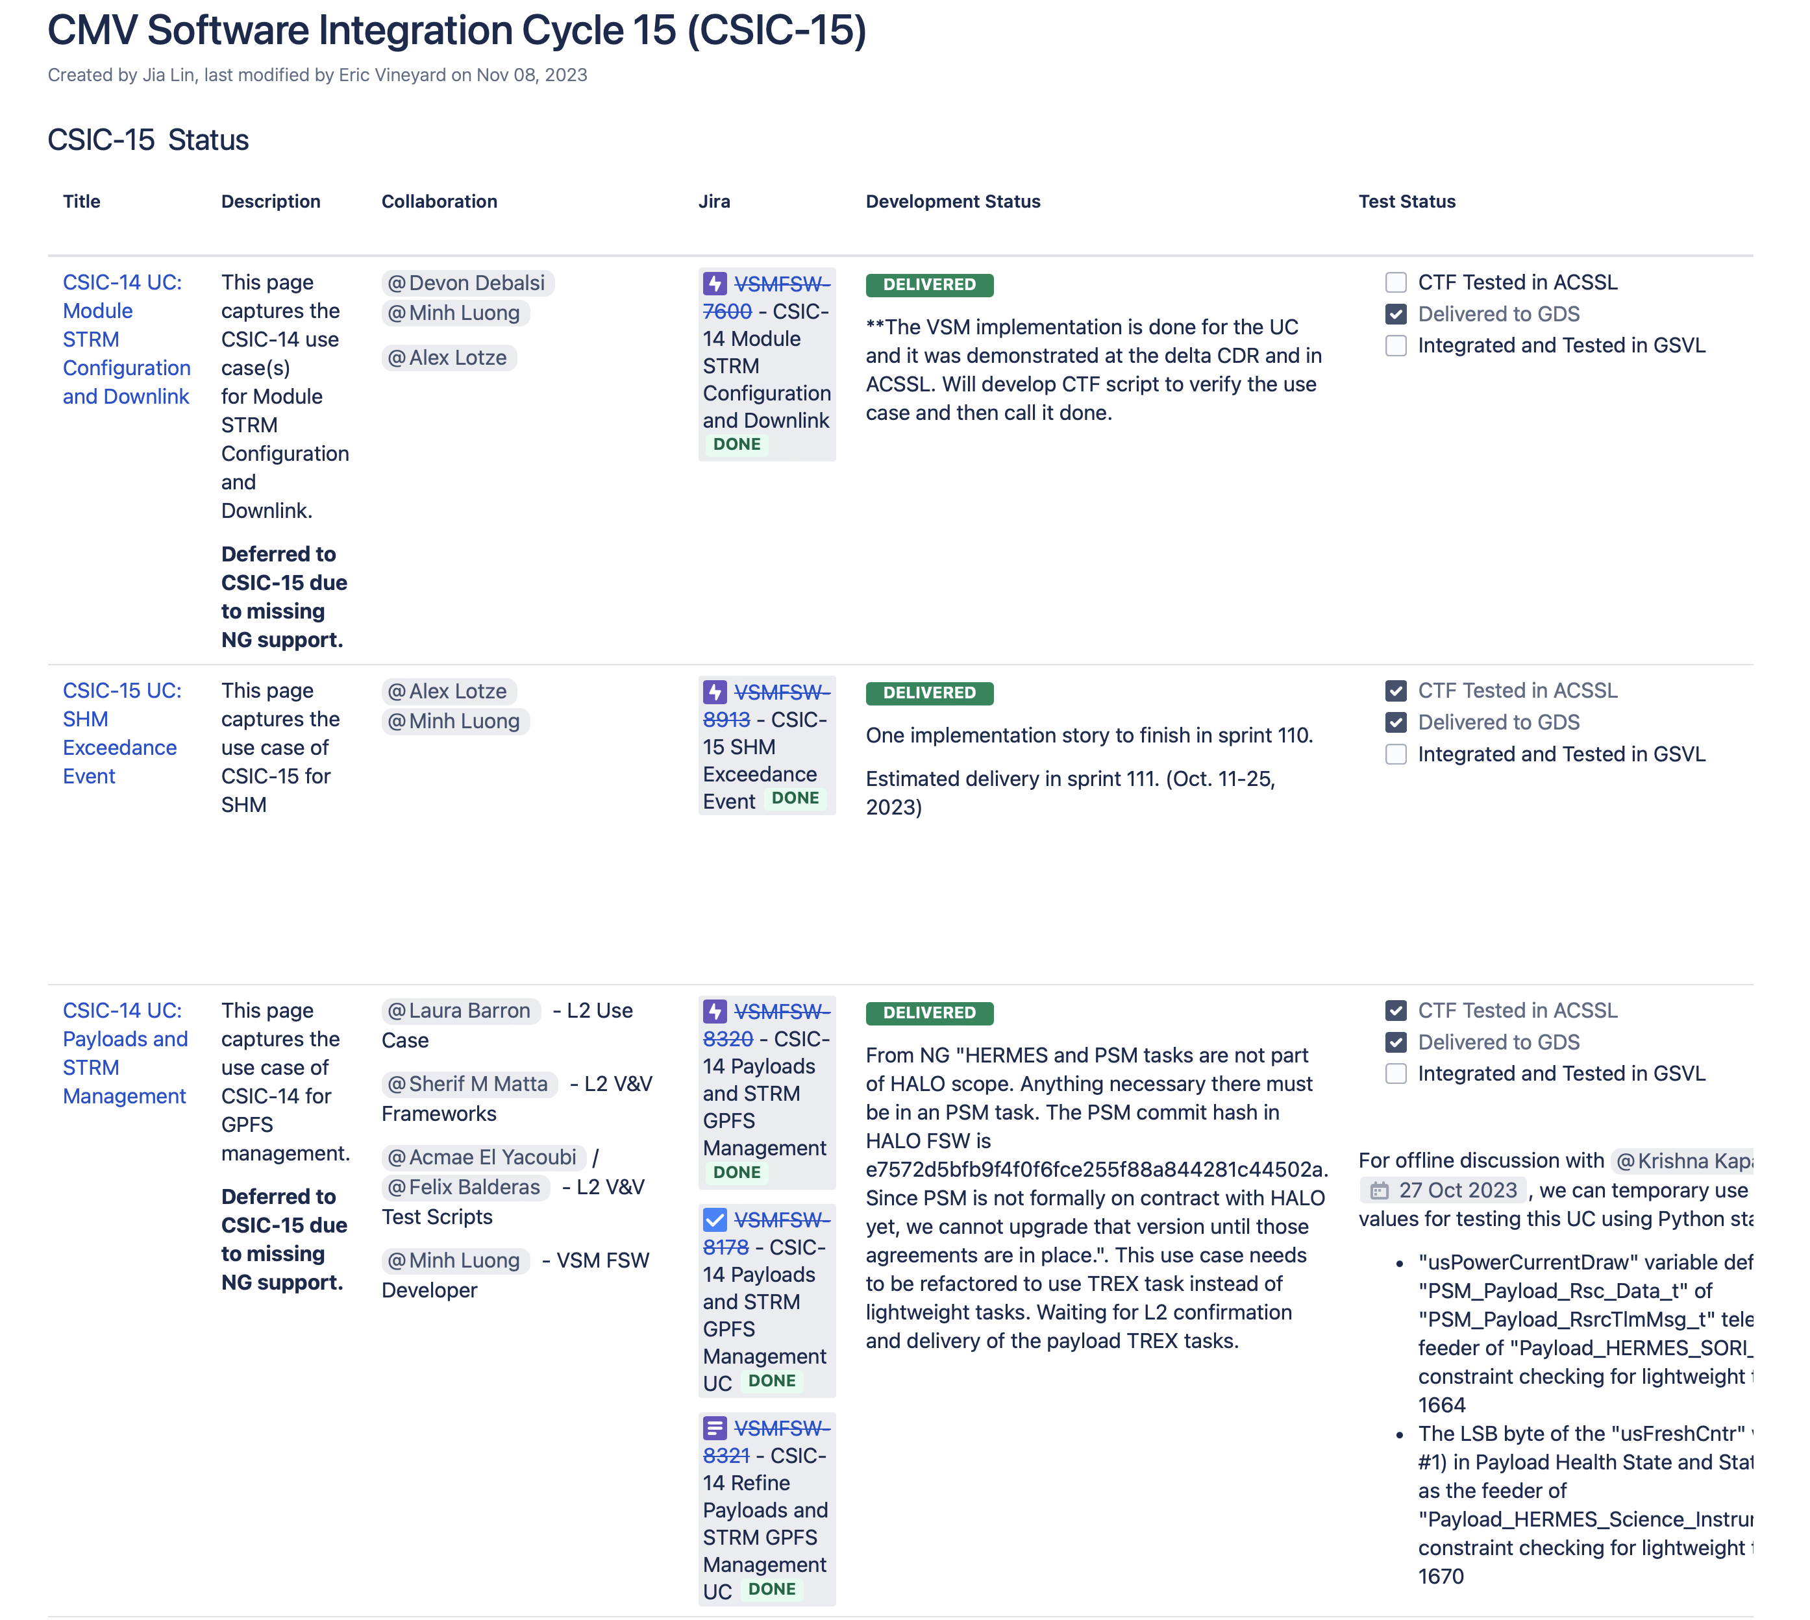
Use Case Based Advancement of System Capability
Working with product owners and relevant stakeholders
Determine list of operational use cases that can be reasonably developed and demonstrated at this phase of the lifecycle
Use cases are peer reviewed
Used for training and familiarization
Helps to flush out requirements
Helps to define interfaces
Advance hardware in the loop capabilities
Understand simulation and emulation requirements
Understand fidelity of hardware environment
Integrated demonstration of capabilities and regular cadence throughout the phase
We chose a three-month integration cycle
Based on a two-week team sprint cycle
Continuous Improvement of Tools and Processes
Enhancing CI pipeline
Development of emulators and simulators
Lessons learned from prior phases
Documenting process enhancements
Updating templates

Slide 17
Team Focus: PDR to CDR
Requirements Decomposition
Design Elaboration
Use Case Based Advancement of System Capability

Slide 18
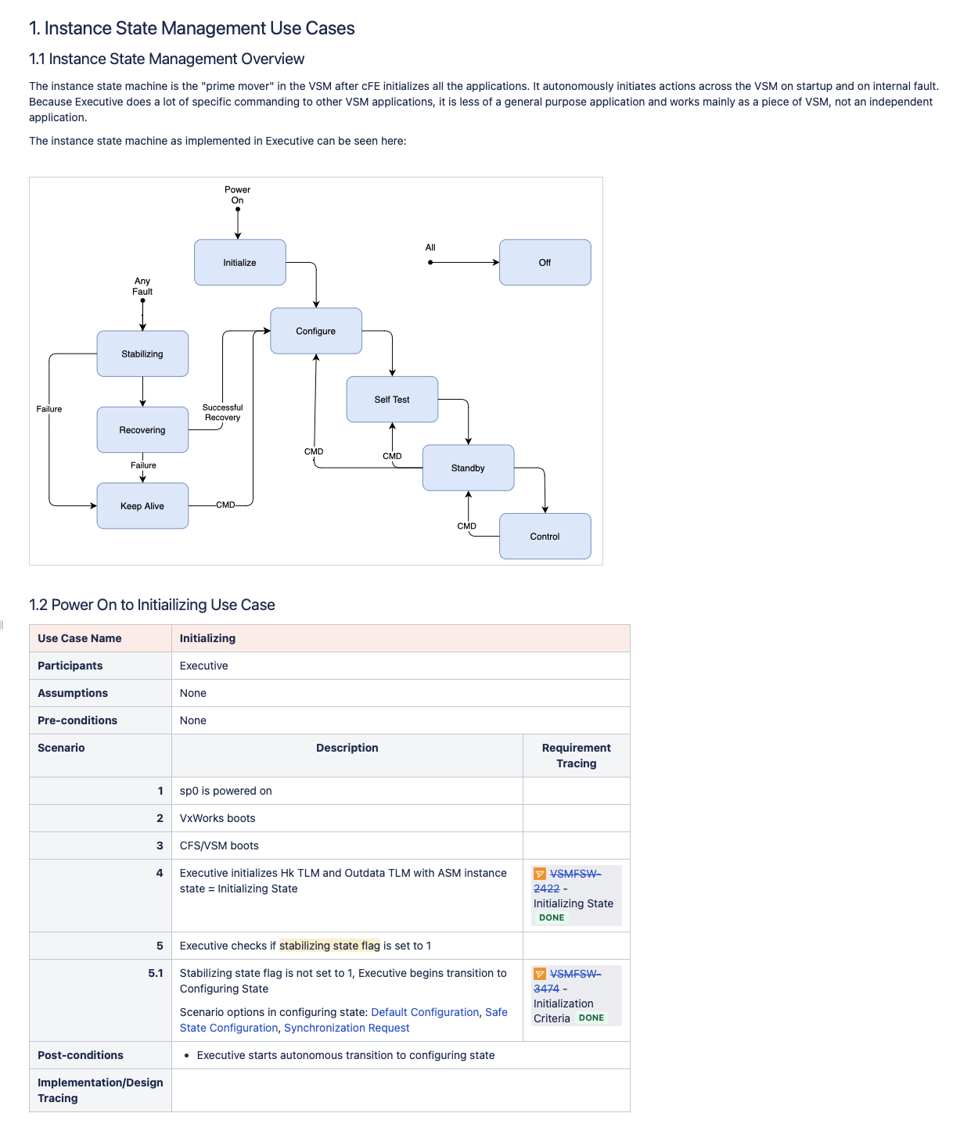
Application Requirements Decomposition
Structured design process to decompose box level CSCI requirements into multiple application-level computer software component (CSC) requirements
Requirements based use cases drive system capabilities
2nd tier requirements are also captured in Jira
Designs are documented via organized confluence pages
Structured templates to drive commonality
Jira requirements are linked into confluence design for traceability
Confluence allows for
Version control
Review / comments / collaboration
Flushing out interface design to both external and internal components

Slide 19
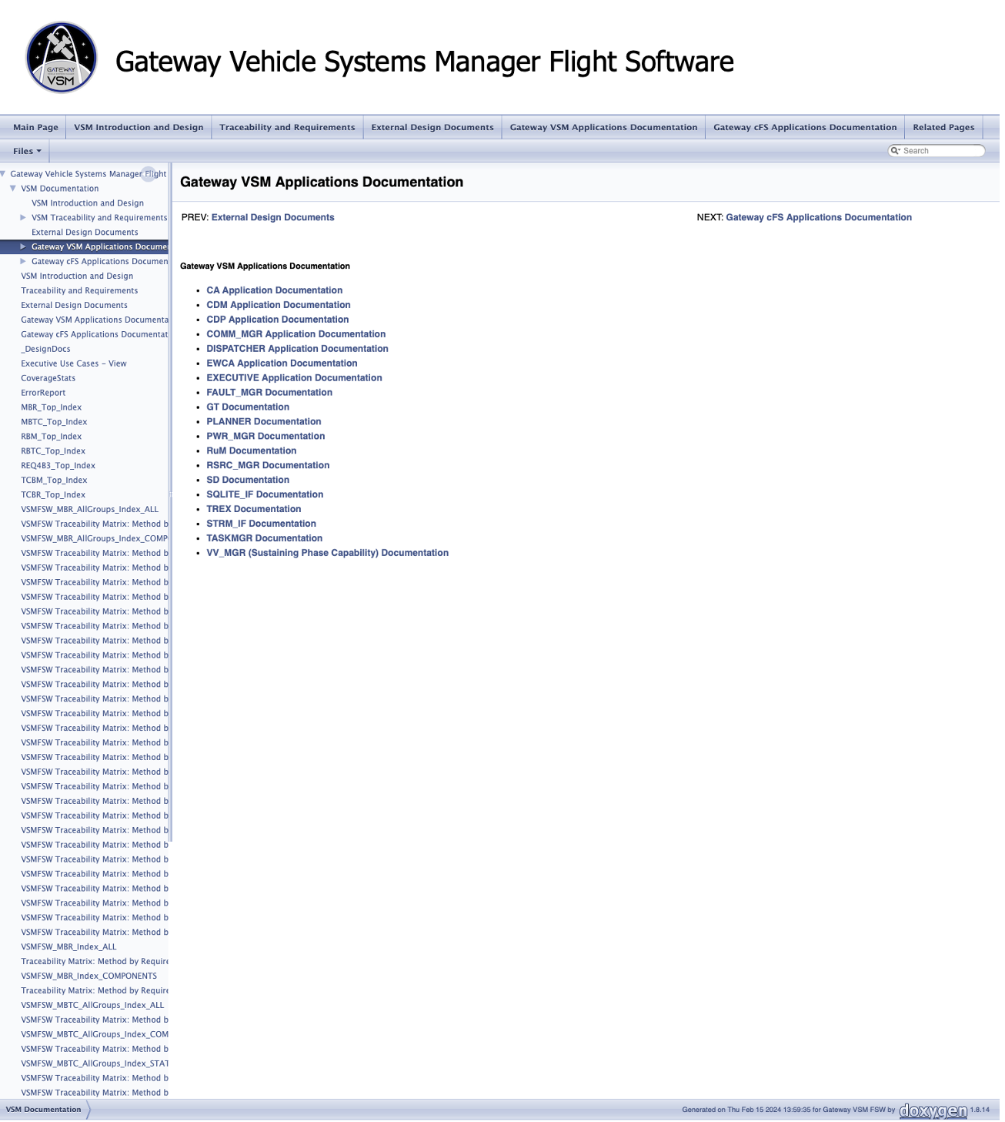
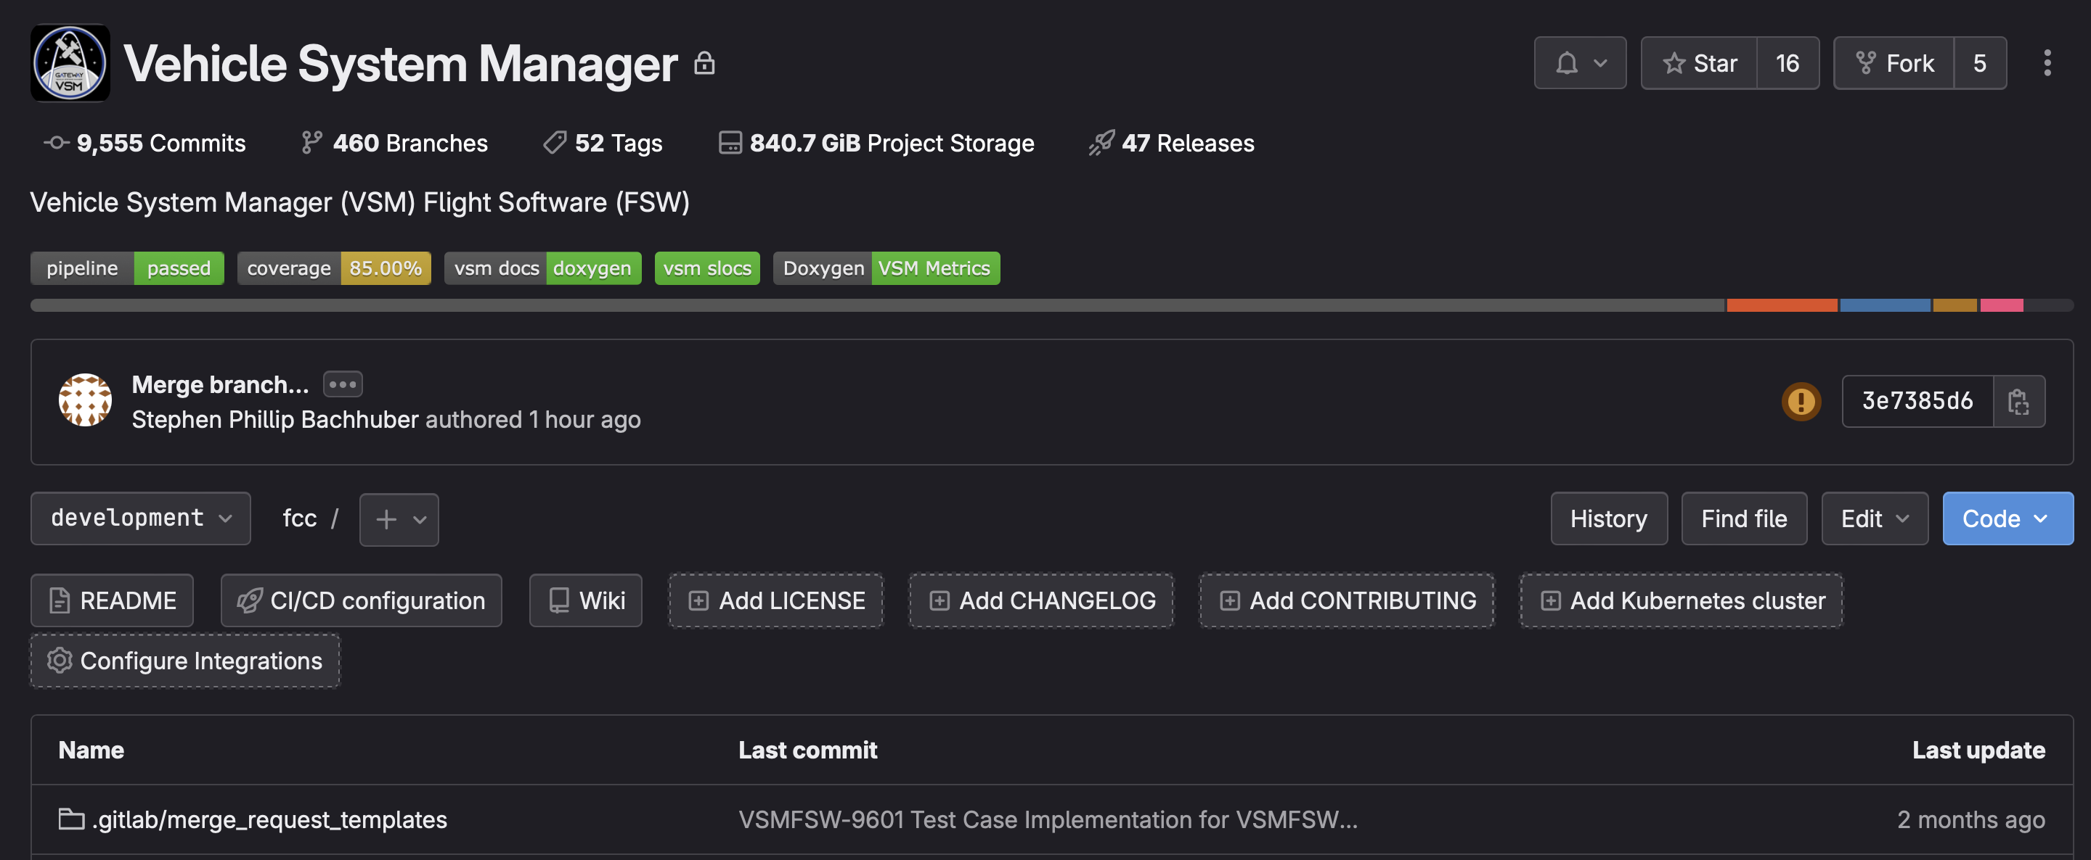
Design Products
All design artifacts are “organic” products that are created inline as part of the development process
We don’t stop what we are doing to make a big Word document and a bunch of PowerPoint slides
Utilize Doxygen, Confluence exports, and Jira scripting to create the design package
HTML based “clickable” package

Slide 20
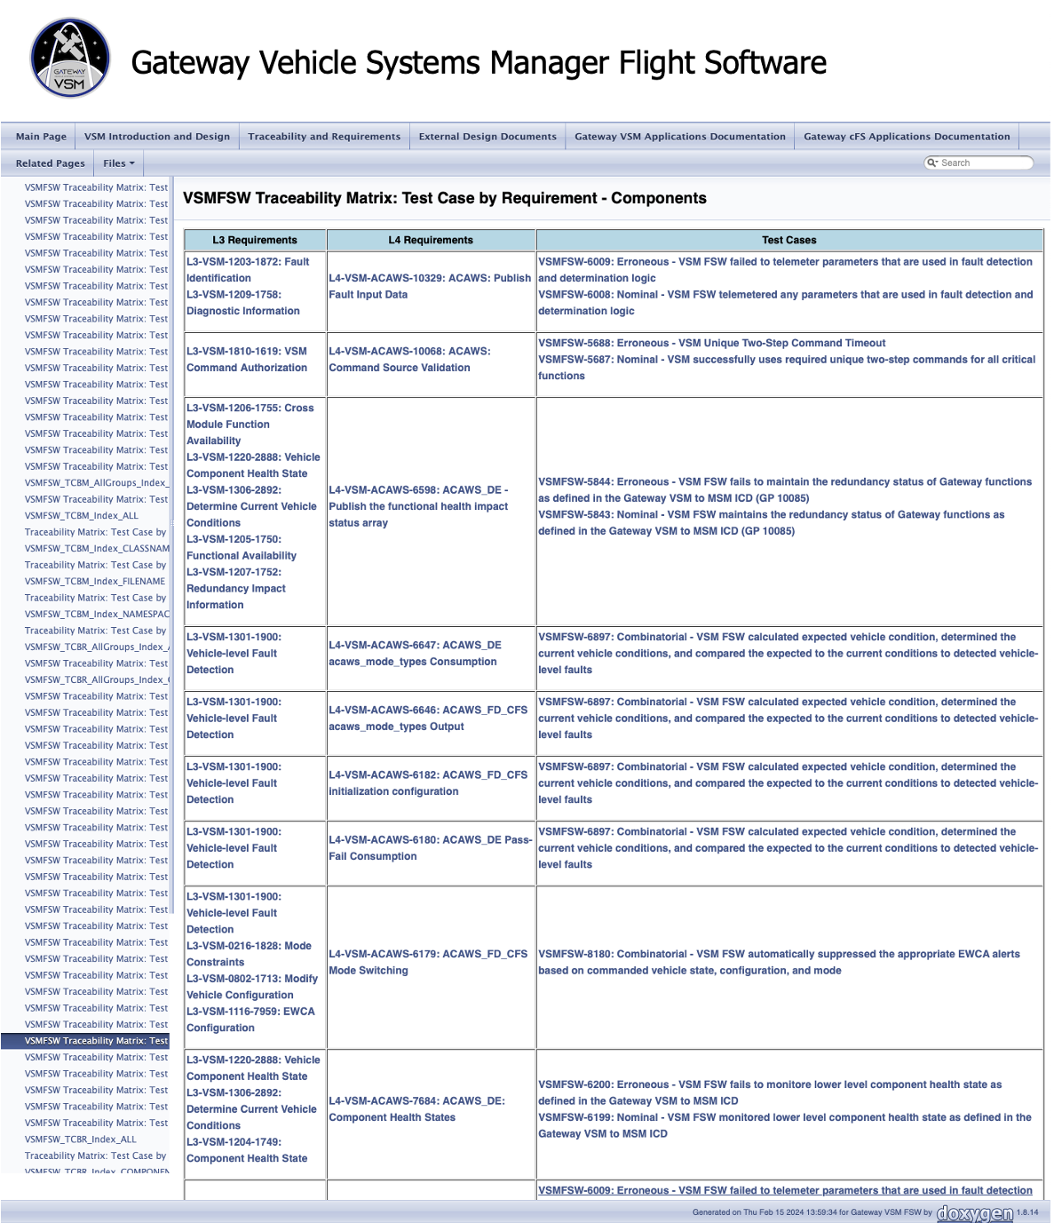
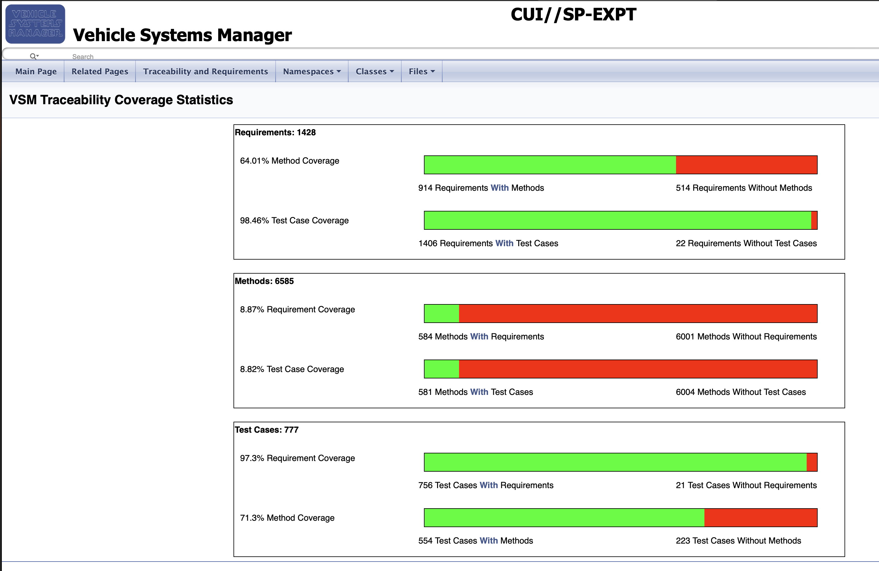
Trace Tables
NPR 7150.2 requires requirements and verifications traceability
Depending on software classification
Utilizing custom Doxygen tags in the source code, along with Jira scripting we can generate tables for bi-directional traceability
Requirement <–> Design <–> Code
Requirement <–> Code <–> Test

Slide 21
Use Case Based Advancement of System Capability
Working with product owners and relevant stakeholders
Determine list of operational use cases that can be reasonably developed and demonstrated at this phase of the lifecycle
Use cases are peer reviewed
Used for training and familiarization
Helps to clarify requirements
Helps to understand interfaces
Advance hardware in the loop capabilities
Develop simulation and emulation capabilities
Enhance fidelity of hardware environment
Integrated demonstration of capabilities and regular cadence throughout the phase
We chose a three-month integration cycle
Based on a two-week team sprint cycle
Continuous Improvement of Tools and Processes
Enhancing CI pipeline
Development of emulators and simulators
Lessons learned from prior phases
Documenting process enhancements
Updating templates

Slide 22
Team Focus: CDR to TRR
Final Implementation of Design
Test Script Development
Continuous Integration Pipeline
Use Case Based Advancement of System Capability

Slide 23
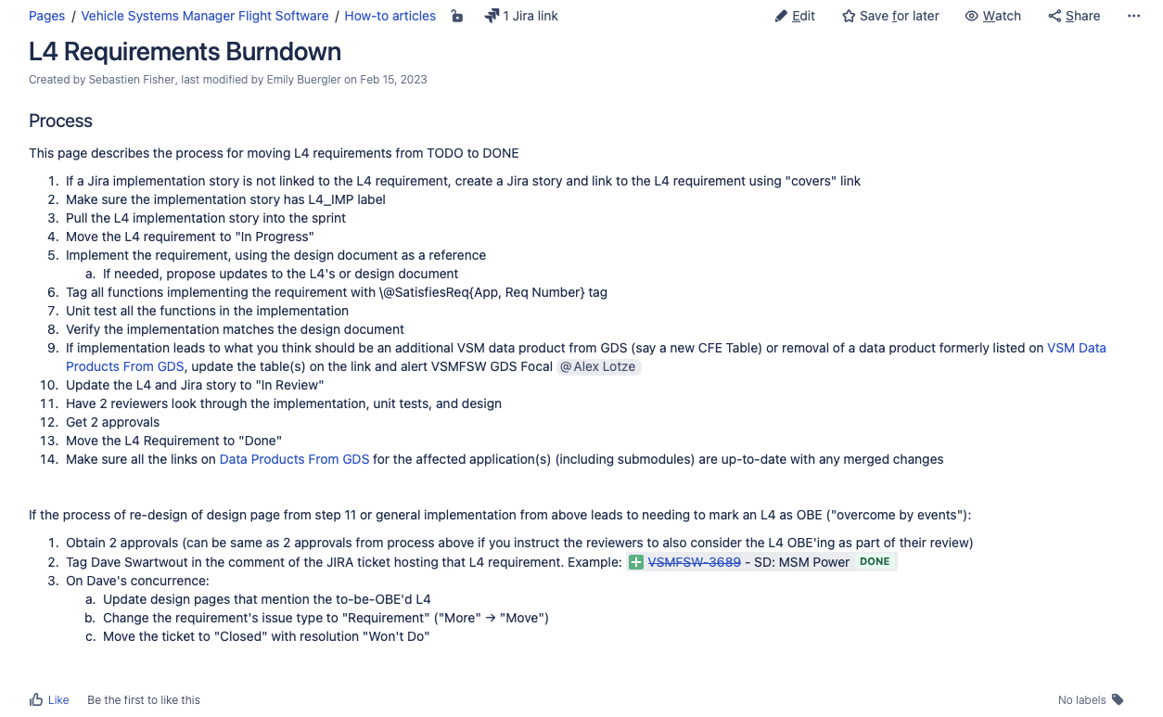
Closing Application Requirements
Implement the requirement, using the design document as a reference
Update the design page in Confluence if necessary
Tag all source code functions implementing the requirement with custom Doxygen tag
Unit test all the functions in the implementation
Verify the implementation matches the design document
Update associated data products
Table definitions
Commands
Telemetry
Peer Reviews

Slide 24
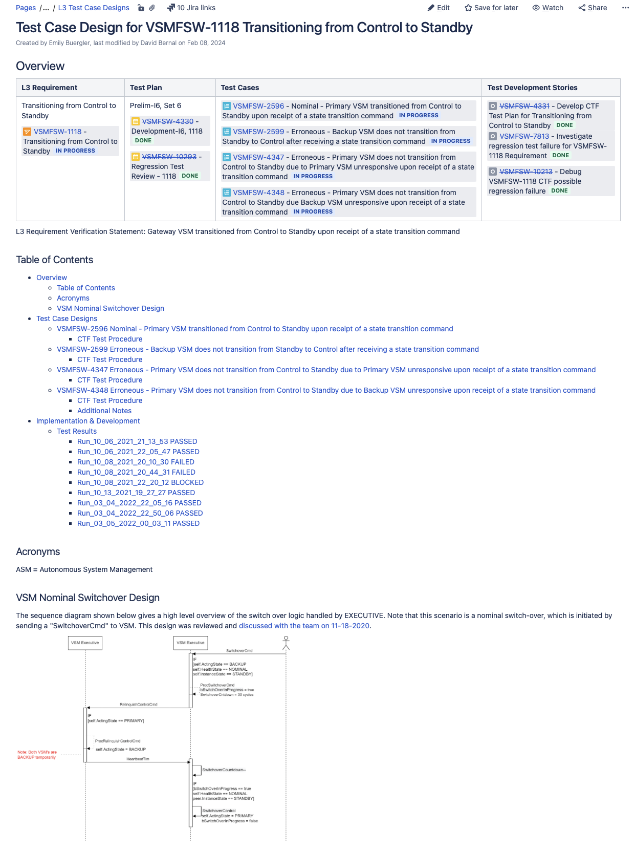
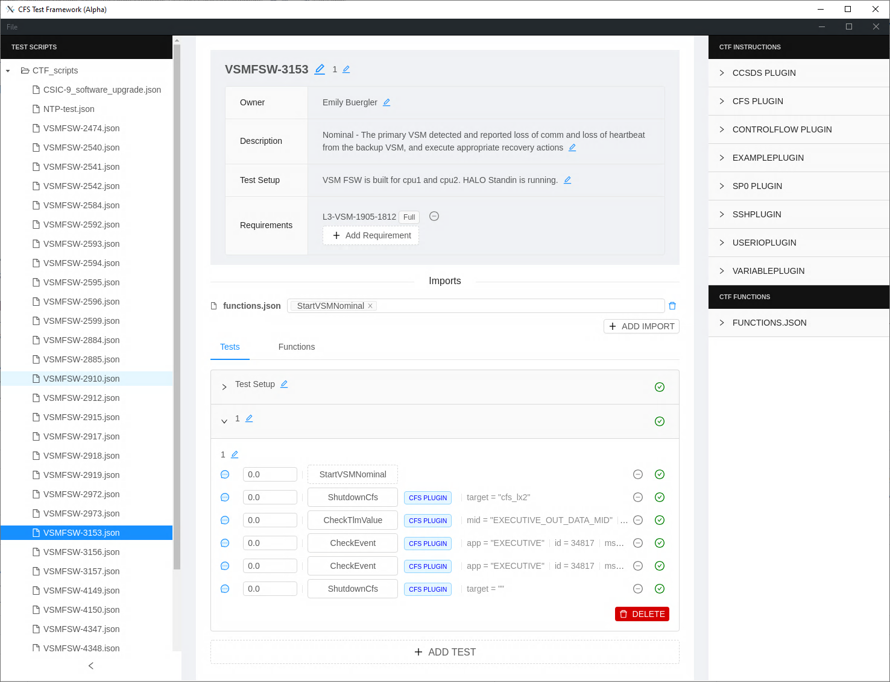
Test Script Development
Using test case statements defined in Jira/TestRay
Structured test case design process
Captured in Confluence
Test team collaborates with design team
Implement automated test script for each test case
Test development in parallel with system development
Flushes out requirements questions, inconsistencies, and confusions
Clarifies design
Uncovers foundational issues early

Slide 25
The Pipeline
Continuous Integration Pipeline for everything that can be automated
Static code analysis tools
Compilation warnings
Build errors
“Hello World” integrated tests
Generation of design package
Generation of release products
Required before code can be integrated (merged)

Slide 26
Use Case Based Advancement of System Capability
Working with product owners and relevant stakeholders
Determine list of operational use cases that can be reasonably developed and demonstrated at this phase of the lifecycle
Use cases are peer reviewed
Used for training and familiarization
Helps to finalize requirements
Helps to finalize interfaces
Advance hardware in the loop capabilities
Finalize simulation and emulation capabilities
Finalize fidelity of hardware environment
Integrated demonstration of capabilities and regular cadence throughout the phase
We chose a three-month integration cycle
Based on a two-week team sprint cycle
Continuous Improvement of Tools and Processes
Enhancing CI pipeline
Development of emulators and simulators
Lessons learned from prior phases
Documenting process enhancements
Updating templates

Slide 27
Team Focus: TRR to SAR
Formal Test and Verification

Slide 28
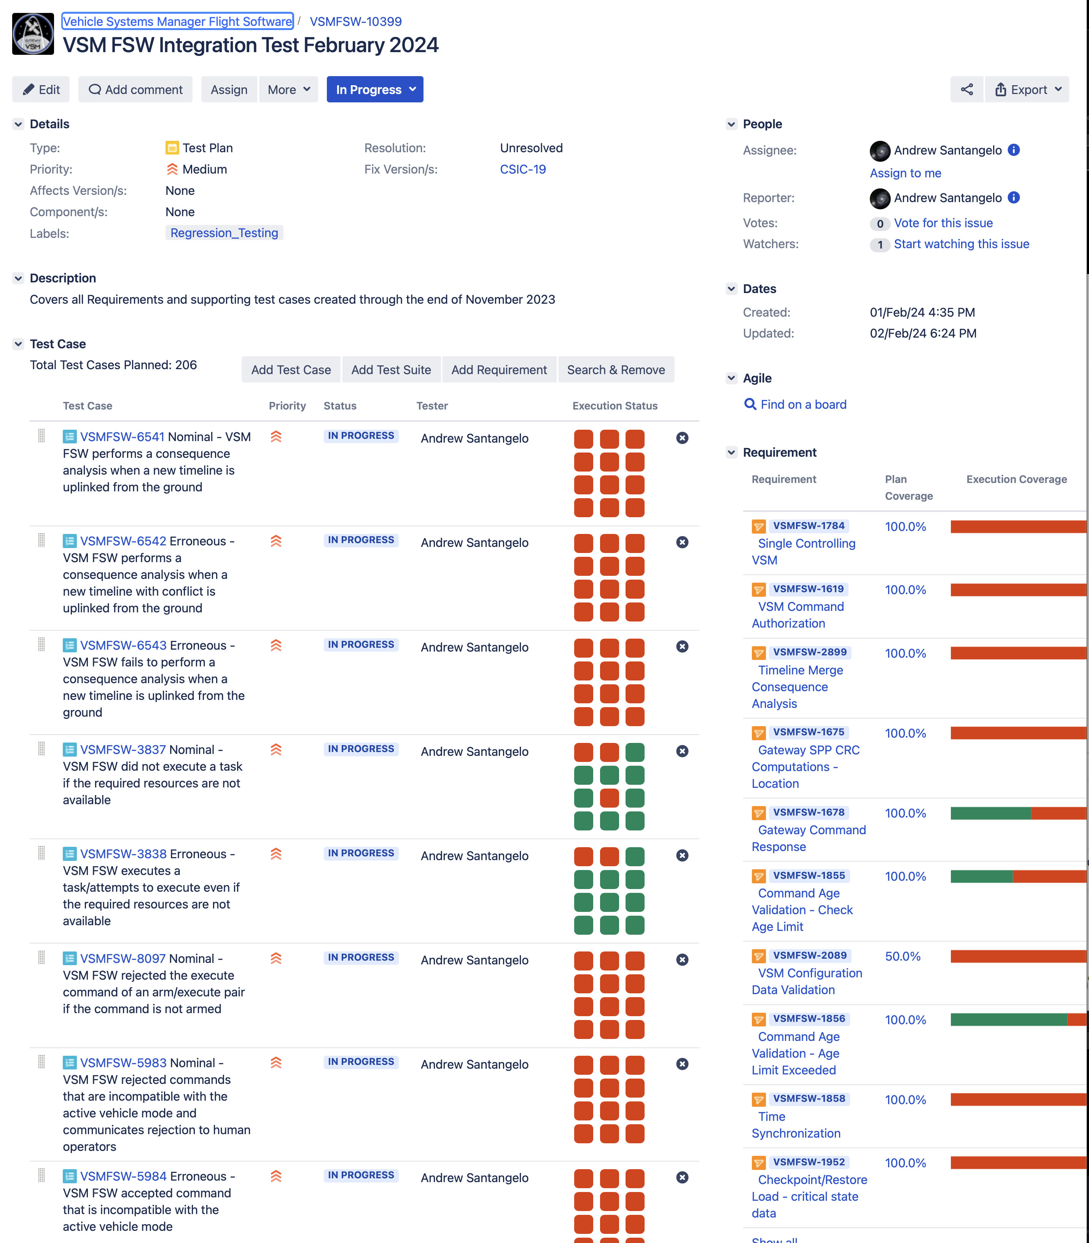
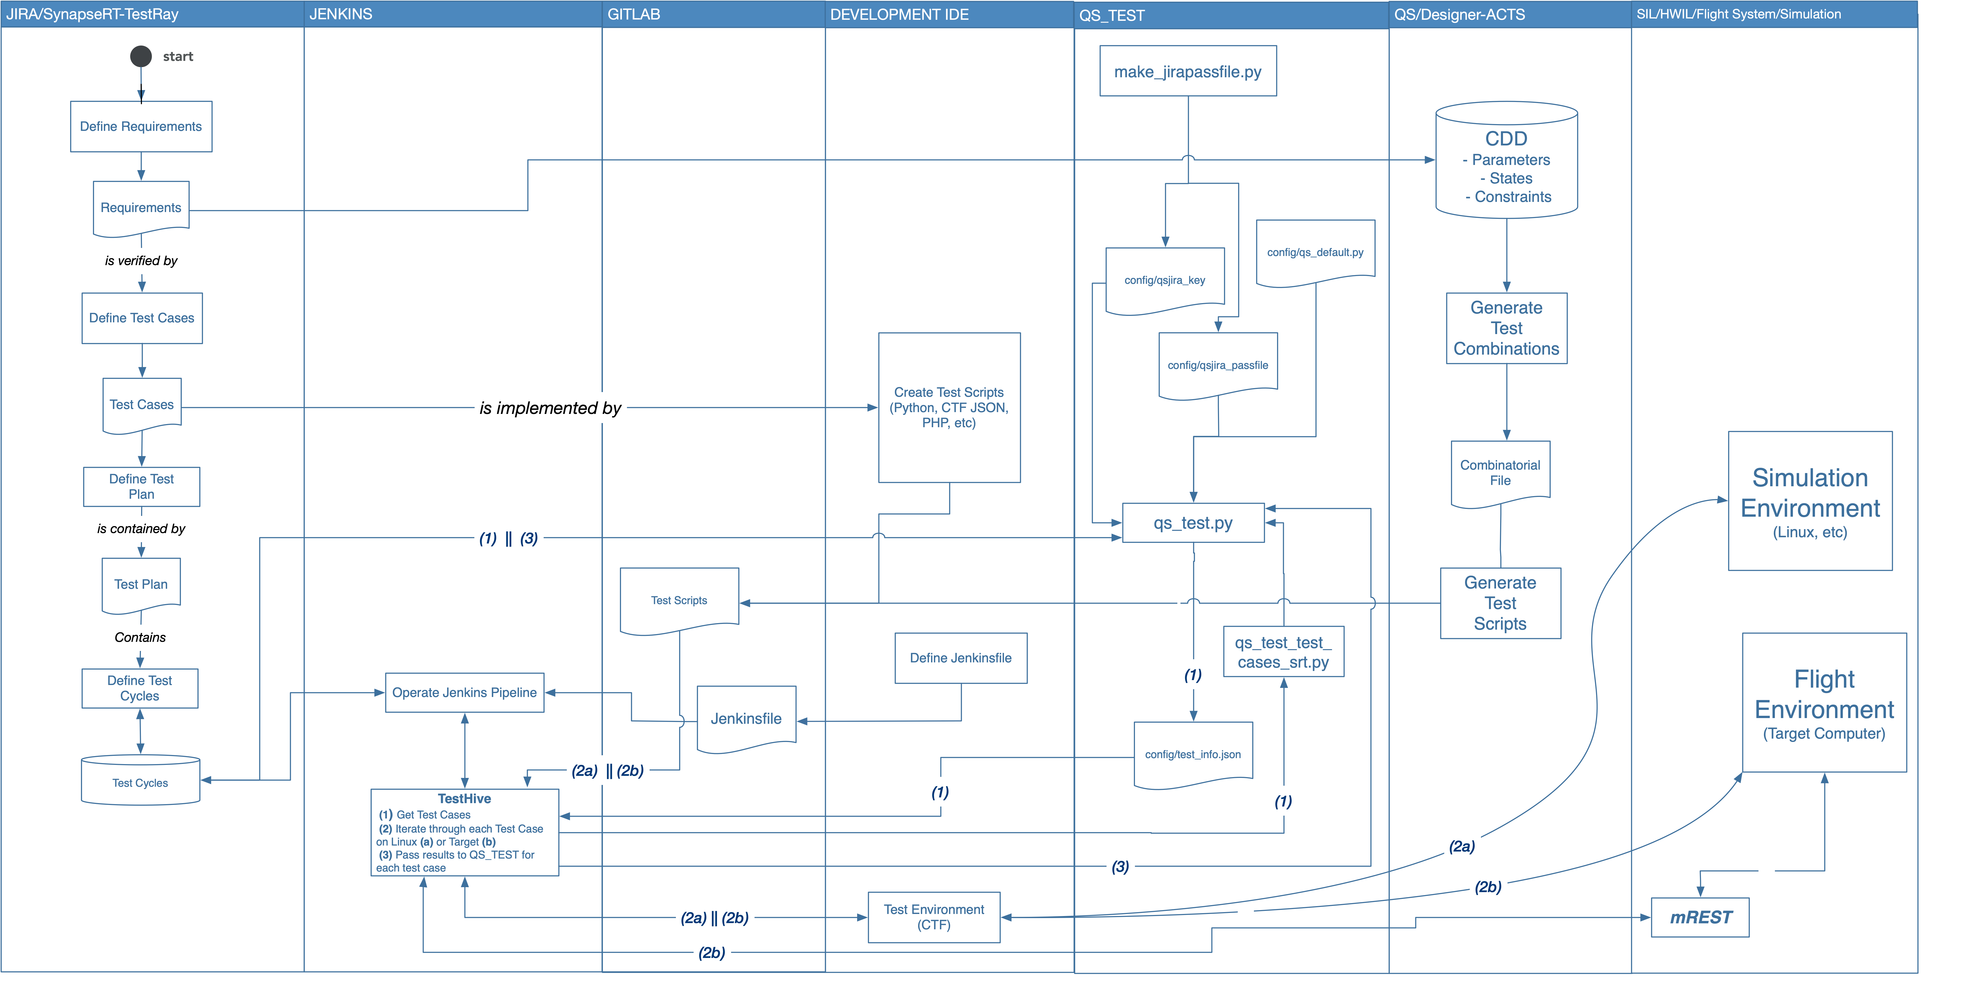
Automated Testing
Created around Jira/TestRay and Jira API scripting
TestRay allows creation of Test Plans
Grouping of test cases into test activities
Plans can be executed in batch
Jira back end communicates with Jenkins server for automated test execution
Test cycles executed
Development servers
Hardware in the Loop Rigs
Test results pushed back into Jira/TestRay
Test execution status tracked to completion
Defects documented

Slide 29
Across the Lifecycle
Cross Team Integration

Slide 30
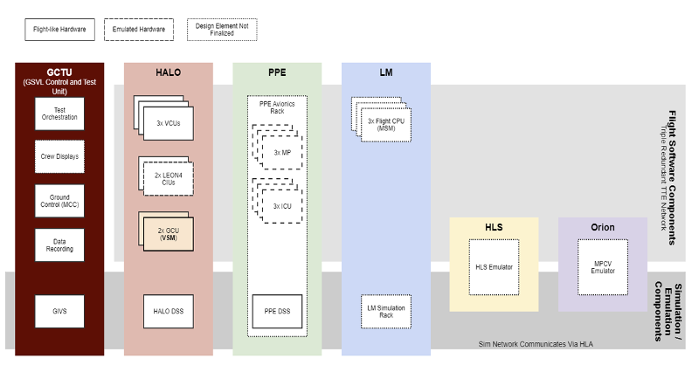
Program Wide Integration Cycles
Gateway is a large program – 11 software development teams (plus sub teams) working initial element launch
Several larger contractors
International Partners
Numerous NASA internal teams
Test & Verification Labs
Countless stakeholders
We had to find a way to bring these teams together early and often
Gateway Software Integration Cycles
Three month cadence
Quarterly planning
Essential for driving out interfaces and integrated system operations

Slide 31
Takeaways

Slide 32
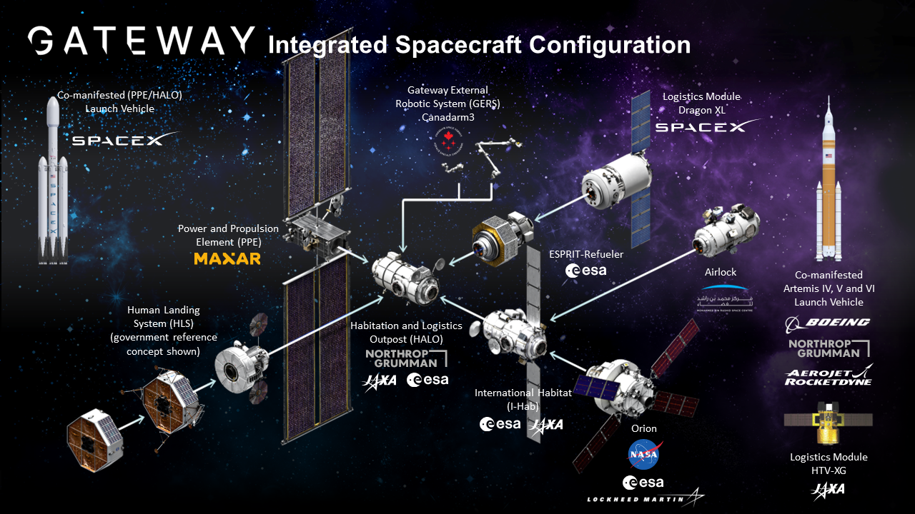
Closing Thoughts
On any evolving program where change is ongoing, agility is key
Continual learning is essential
Continual feedback and process improvement
We have to live within the NPR requirements
Don’t fight it, try to understand it
Tailor to what makes sense
Look for the intent
Why do we have this artifact or milestone review
Focus on the “what”, not the “how”
I have to have requirements, but I don’t need a 300 page Word document

