Slide 1


Elevated Temperature Mechanical Properties of L-PBF Niobium Alloy: C103
National Aeronautics and Space Administration
Justin L. Milner and Eric Brizes
NASA Glenn Research Center, Cleveland OH
TMS 2024 153RD ANNUAL MEETING & EXHIBITION
Orlando, FL March 3-7, 2024

Slide 2
Introduction
NASA Refractory Alloy Projects:
  STMD-GCD – Refractory Alloy Additive Manufacturing Build Optimization (RAAMBO)
  Hypersonic Technology (HTP) Project.
    Advance material characterization and prototypic testing allowing for critical data needed to demonstrate TRL advancement and for component flight qualification
    Enable national supply chain for refractory alloy feedstock essential for production of historical to custom alloys for R&D to component fabrication.
    Develop materials and processing for high performance in extreme environments enabling technologies for Moon to Mars missions.
  Alignment with NASA Projects:
  Fission Surface Power (FSP) – High temp. core and power conversion materials
  Nuclear Electric Propulsion (NEP) - Core, power conversion and thruster materials
  Nuclear Thermal Propulsion (NTP) - Extreme environment materials
  In-Situ Resource Utilization (ISRU) - High temp. materials for lunar systems
  Hypersonic Technology’s (HTP) - Ox-compatible refractory metals
  Lander ascent/descent and RCS nozzles
  This work:
  Focuses on AM process development for L-PBF C103
  Determine elevated temperature mechanical properties for L-PBF C103
  Microstructural evaluation of tested materials.
TMS 2024 153RD ANNUAL MEETING & EXHIBITION

Slide 3
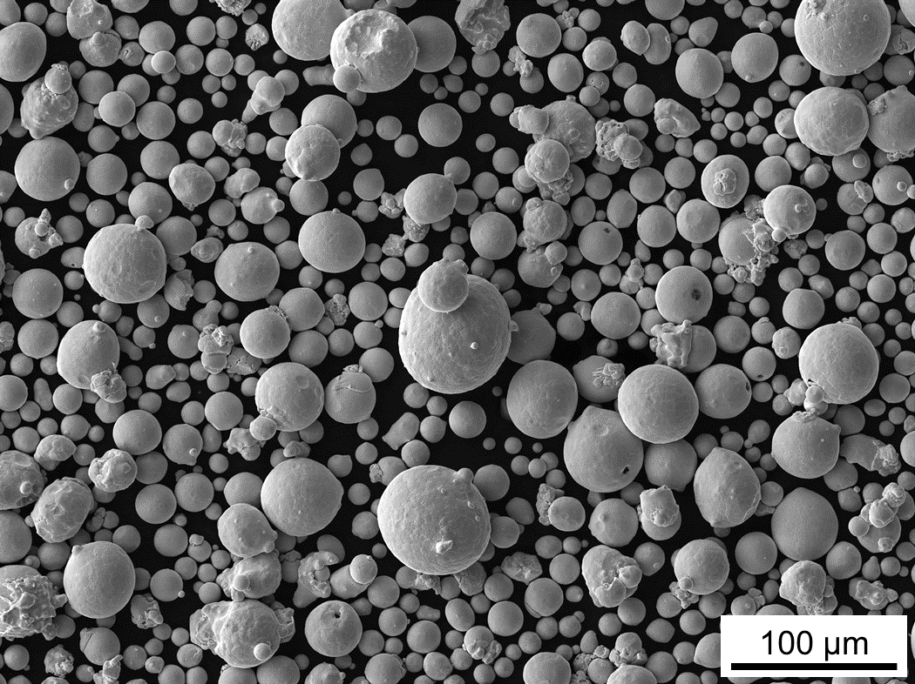
C103 Powder Feedstock
Chemical composition of C103 powder
Powder morphology of gas atomized Nb alloy, C103
C103 powder feedstock physical properties
TMS 2024 153RD ANNUAL MEETING & EXHIBITION

Slide 4
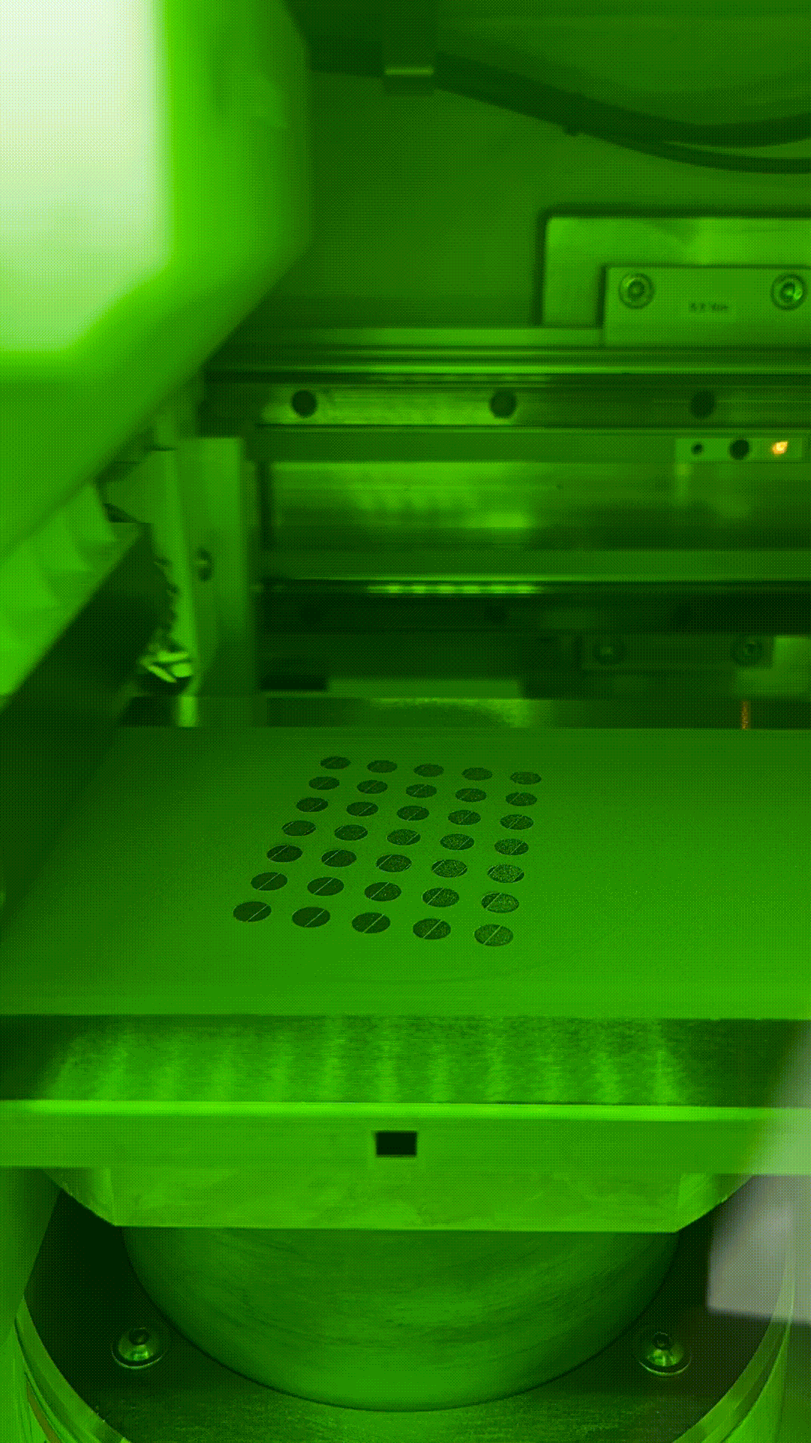
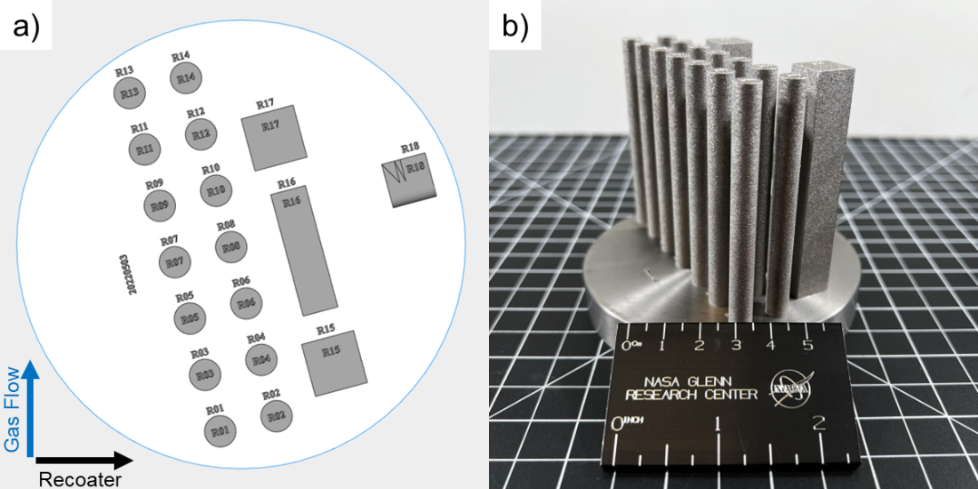
L-PBF of C103
EOS M100
Energy density of 10.1 J/mm³
Schematic of build layout
As-built C103 tension blanks
TMS 2024 153RD ANNUAL MEETING & EXHIBITION

Slide 5
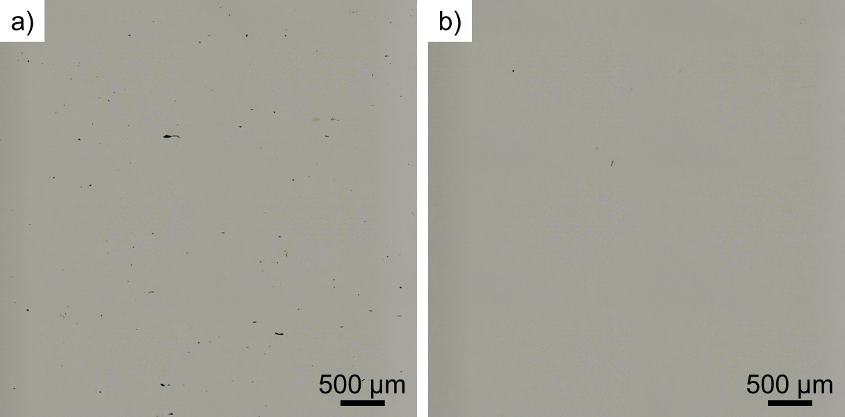
Density of L-PBF C103
As-Built
HIP
AM built C103 physical properties
TMS 2024 153RD ANNUAL MEETING & EXHIBITION

Slide 6
Chemical Composition
Chemical composition of C103 powder, AM C103, and wrought C103
TMS 2024 153RD ANNUAL MEETING & EXHIBITION

Slide 7
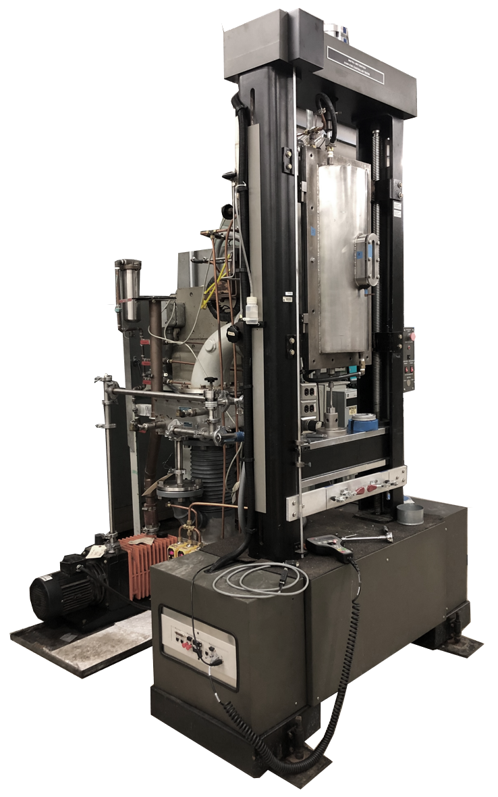
High Temperature High Vacuum Tension Testing Rig
Testing Procedure
Load Sample
3x argon purge
High vacuum (diffusion pump)
Heat up at 5x10⁻⁶ Torr or better at a rate of 17 °C/min
Soak at temperature for 20 minutes
Constant crosshead speed of 6.35x10⁻³ mm/s
TMS 2024 153RD ANNUAL MEETING & EXHIBITION

Slide 8
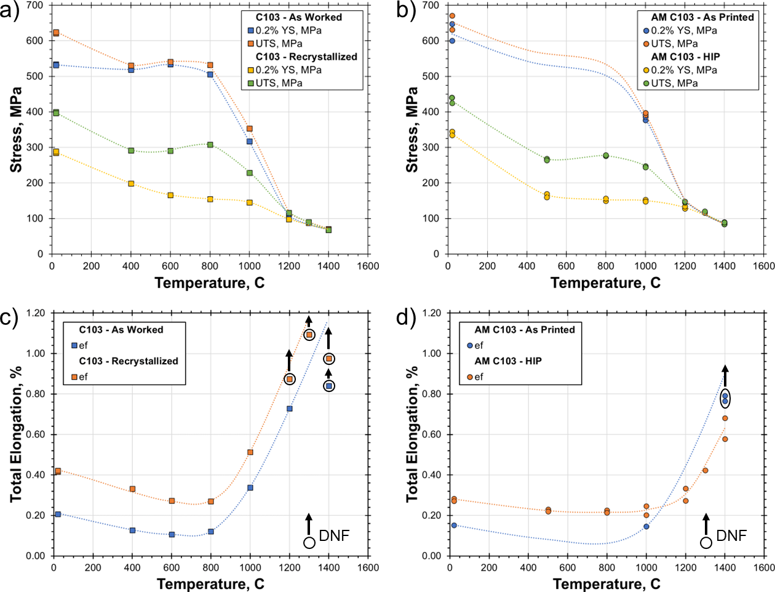
Tension of Wrought and AM C103
Wrought C103
AM C103
TMS 2024 153RD ANNUAL MEETING & EXHIBITION

Slide 9
Tension of Wrought and AM C103
Wrought C103
AM C103
DNF = Did not fail
TMS 2024 153RD ANNUAL MEETING & EXHIBITION

Slide 10
Tension of Wrought and AM C103
Wrought and additively manufactured C103 mechanical properties
TMS 2024 153RD ANNUAL MEETING & EXHIBITION

Slide 11
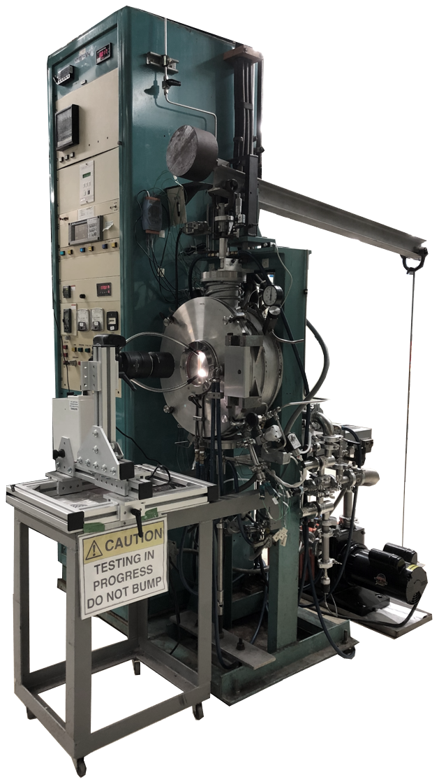
High Temperature High Vacuum Creep Testing Rig
Testing Procedure
Load Sample
3x argon purge
High vacuum (Turbo pump)
Cold sample measurement
Heat up at 5x10⁻⁶ Torr or better at a rate of 17 °C/min
Soak at temperature for 20 minutes
Hot sample measurement
Apply load
LVR and optical extensometer to track strain
TMS 2024 153RD ANNUAL MEETING & EXHIBITION

Slide 12
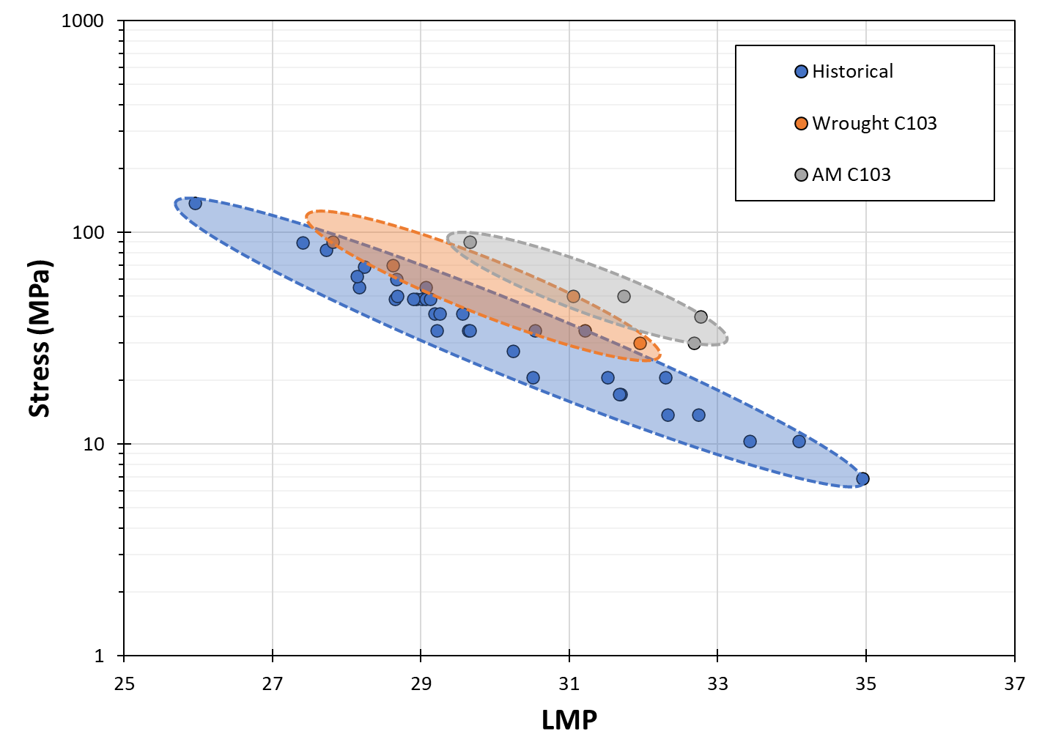
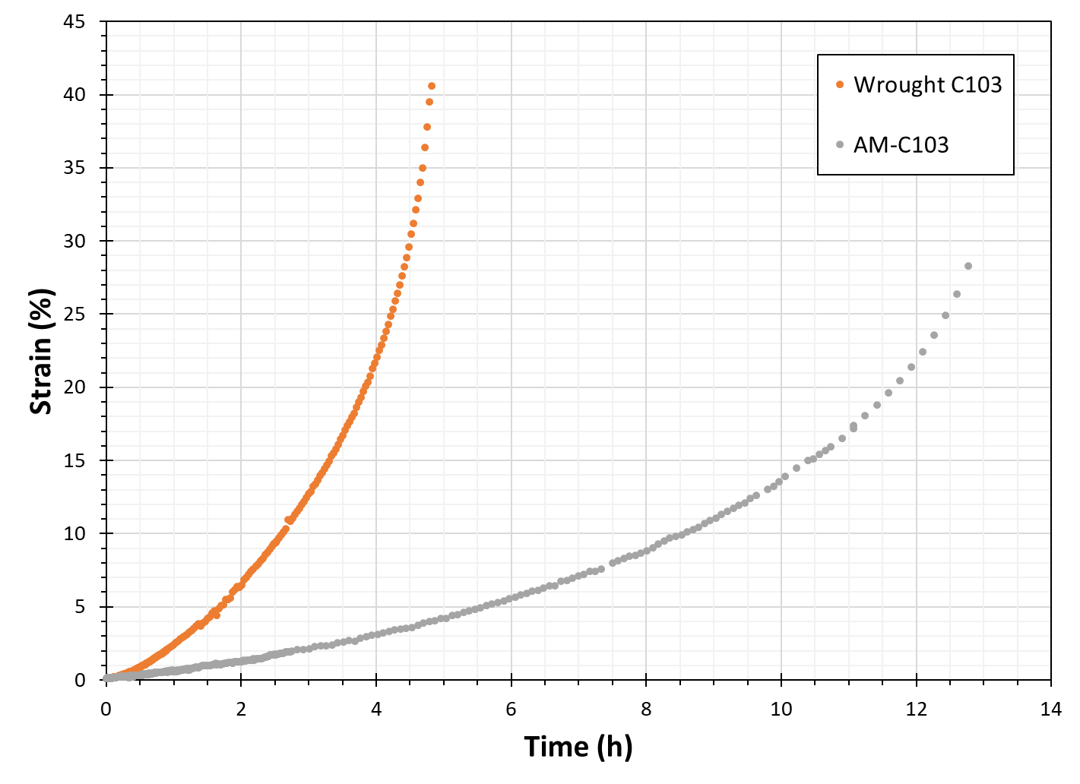
Creep of Wrought and AM C103
LMP of 1% Creep Strain
1300°C at 50 MPa
[1]
[1] R.H. Titran and W.D. Klopp, 1980
TMS 2024 153RD ANNUAL MEETING & EXHIBITION

Slide 13
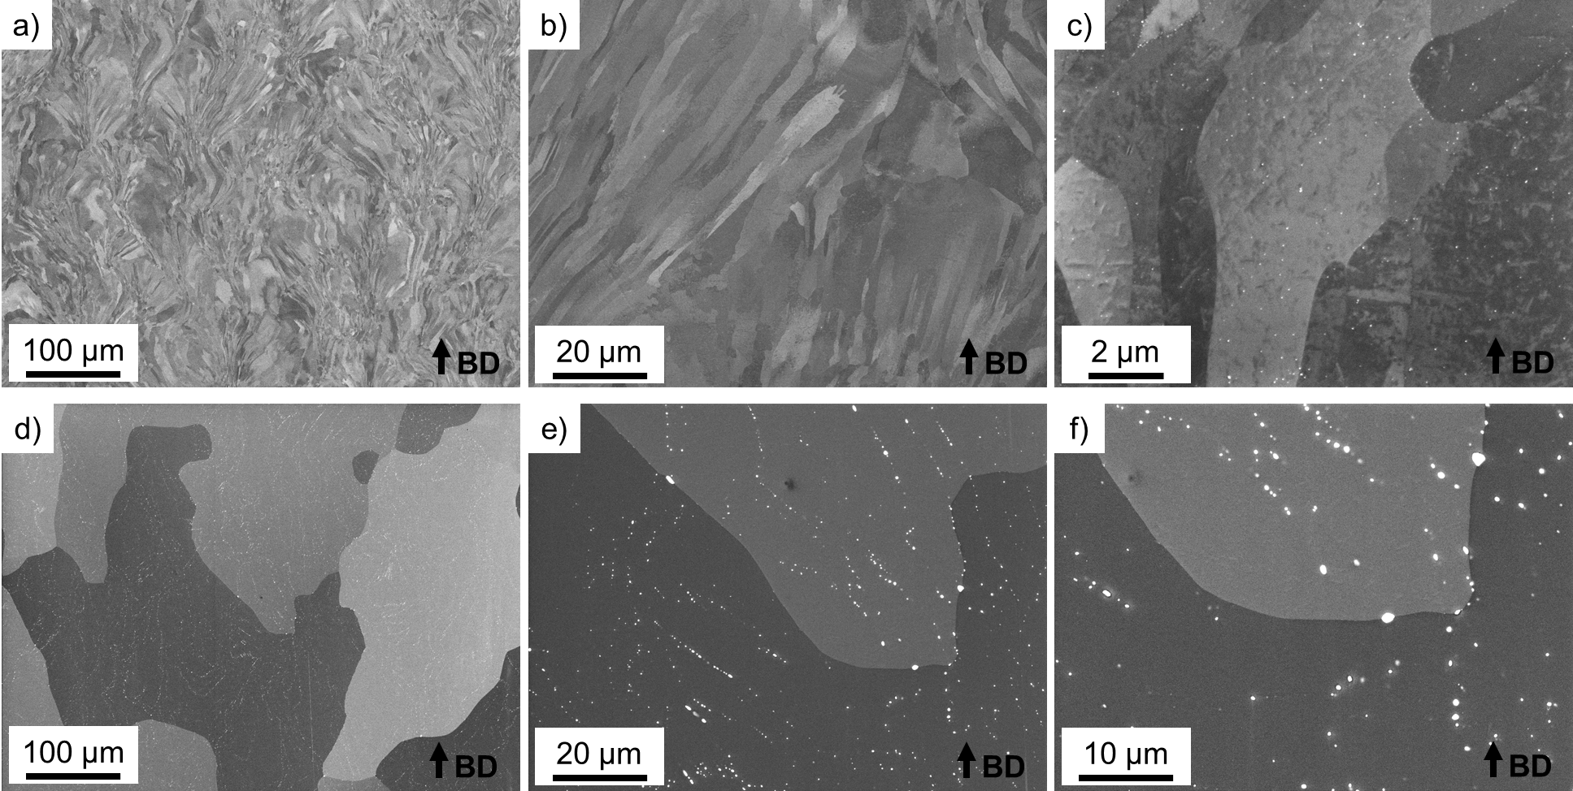
Microstructure of AM C103
As-Built
HIP
TMS 2024 153RD ANNUAL MEETING & EXHIBITION

Slide 14
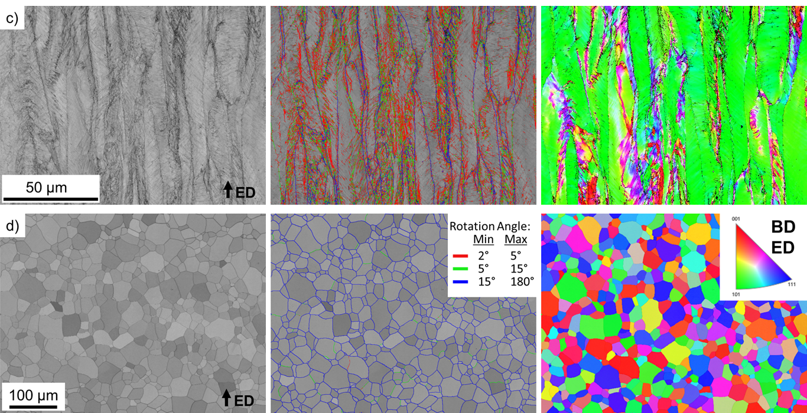
EBSD of Wrought C103
As-Worked
Recrystallized
TMS 2024 153RD ANNUAL MEETING & EXHIBITION

Slide 15
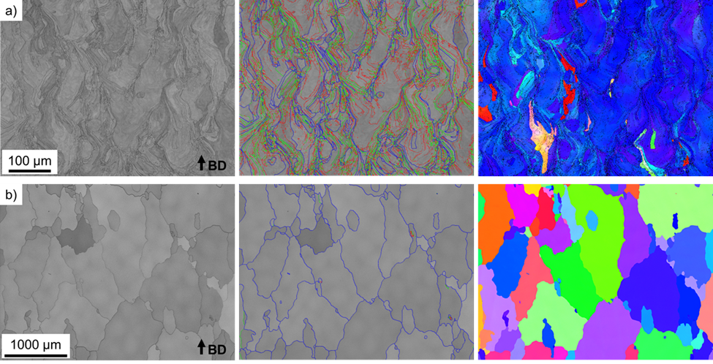
EBSD of AM C103
As-Built
HIP
TMS 2024 153RD ANNUAL MEETING & EXHIBITION

Slide 16
Conclusion
C103 spherical powder feedstock was able to be printed to high theoretical density by L-PBF. C103 samples were printed and tested at elevated temperature in tension and creep in the as-built and HIP conditions. Wrought C103 was also tested for comparison.
AM and HIPed C103 displayed large grain growth and oxide coarsening after processing. HIP parameters are not considered optimized for this material.
In general, AM C103 shows similar strength to wrought C103 when comparing AM as-built to wrought as-worked and AM HIPed to wrought recrystallized. Main takeaway is that AM C103 does exhibit slightly increased strength at elevated temperatures beyond 1000°C. And AM C103 exhibits decreased ductility over wrought C103. This may be attributed to 5-8x higher oxygen content in the AM C103.
Creep testing of AM and HIPed C103 displays increased creep performance over wrought recrystallized C103. This may be attributed to the larger grain size and 8x higher oxygen content of the AM C103.
TMS 2024 153RD ANNUAL MEETING & EXHIBITION

