Slide 1

High-Throughput Strategies that Encompass Experiments and Machine Learning to Predict the Mechanical Properties of Additive Manufactured Aerospace Alloys
National Aeronautics and Space Administration
Presentation to the Minerals, Metals, and Materials Society by: Zachary S Courtright^{a,b}
Co-Authors: Berkay Yucel^{c}, Aditya Venkatraman^{c}, Venkata Surya Karthik Adapa^{c}, Abel Diaz^{c}, Surya R. Kalidindi^{a,c}
ªSchool of Materials Science and Engineering, Georgia Institute of Technology, Atlanta, GA 30332-0245, USA
^{b}Marshall Space Flight Center, National Aeronautics and Space Administration, Huntsville, AL 35812, USA
^{c}George W. Woodruff School of Mechanical Engineering, Georgia Institute of Technology, Atlanta, GA 30032-0405, USA
www.nasa.gov
Notes:
Enter speaker notes here.

Slide 2
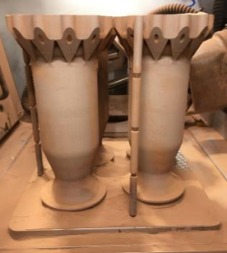
Research Motivation
AM process development is inhibited by conventional testing techniques (e.g. witness samples) and Edisonian trial-and-error data analysis approaches
Accelerate AM Development
  Increase experimental data: High-throughput (HT) testing
  Effective use of limited data: Machine Learning (ML)
Gradl et al., 2019
Siddhartha Pathak et al., 2015
[Materials Genome Initiative, 2011]
National Aeronautics and Space Administration
Notes:
Microindentation and Small Punch Test (SPT) are two mechanical testing techniques which are conducive to high-throughput
These indentation-type tests can also probe local properties more easily than conventional testing (areas of varied heat sink may be more easily assessed)
Explain the graph axes first (summarizes the effort required for specimen preparation and data analysis) – indentation analysis requires a more sophisticated approach than tensile testing
Guassian Process Regression (GPR) ML models are used to generate PSP linkages using microstructure data from microscopy images, AM processing data, and mechanical properties determined via high-throughput tests such as SPT.

Slide 3
Research Approach and Results
National Aeronautics and Space Administration

Slide 4
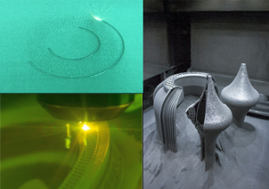
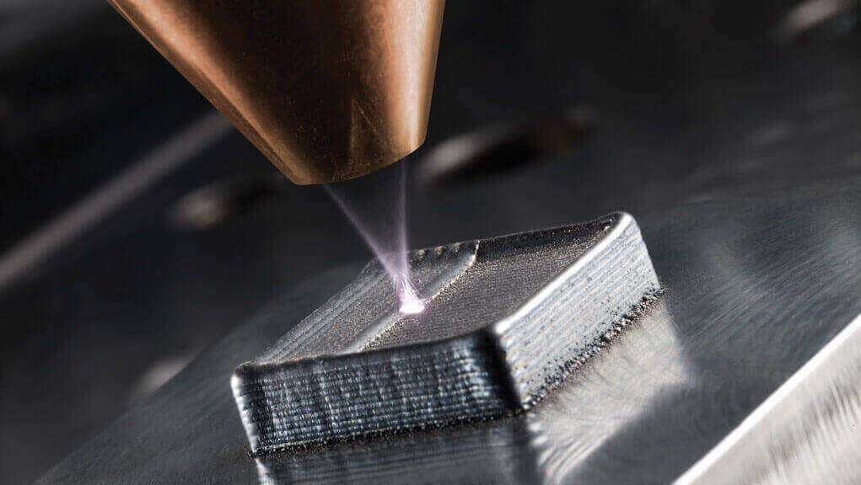
Additive Manufactured (AM) Sample Fabrication
AM Variables of interest:
  Build and heat treatment parameters
  AM process type
Laser Powder Bed Fusion AM
Blown Powder AM
Blakey-Milner, 2021
fabricatingandmetalworking.com
National Aeronautics and Space Administration

Slide 5
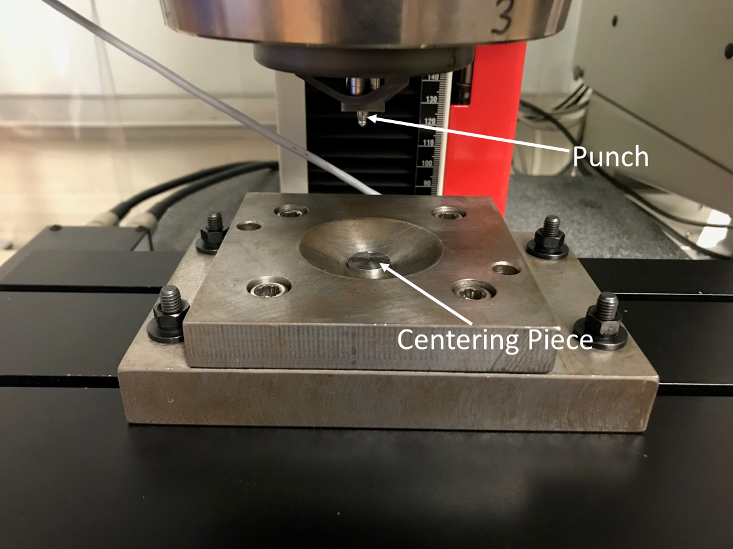
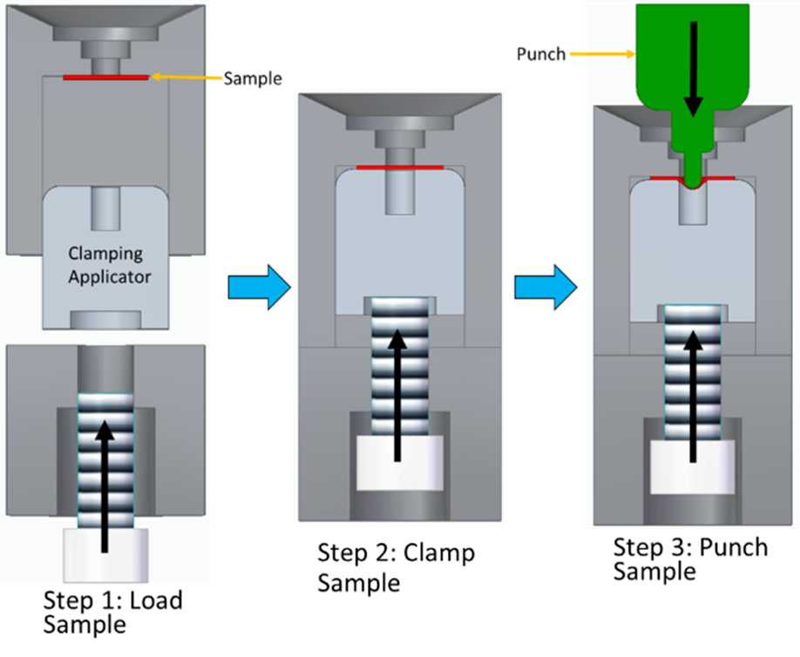
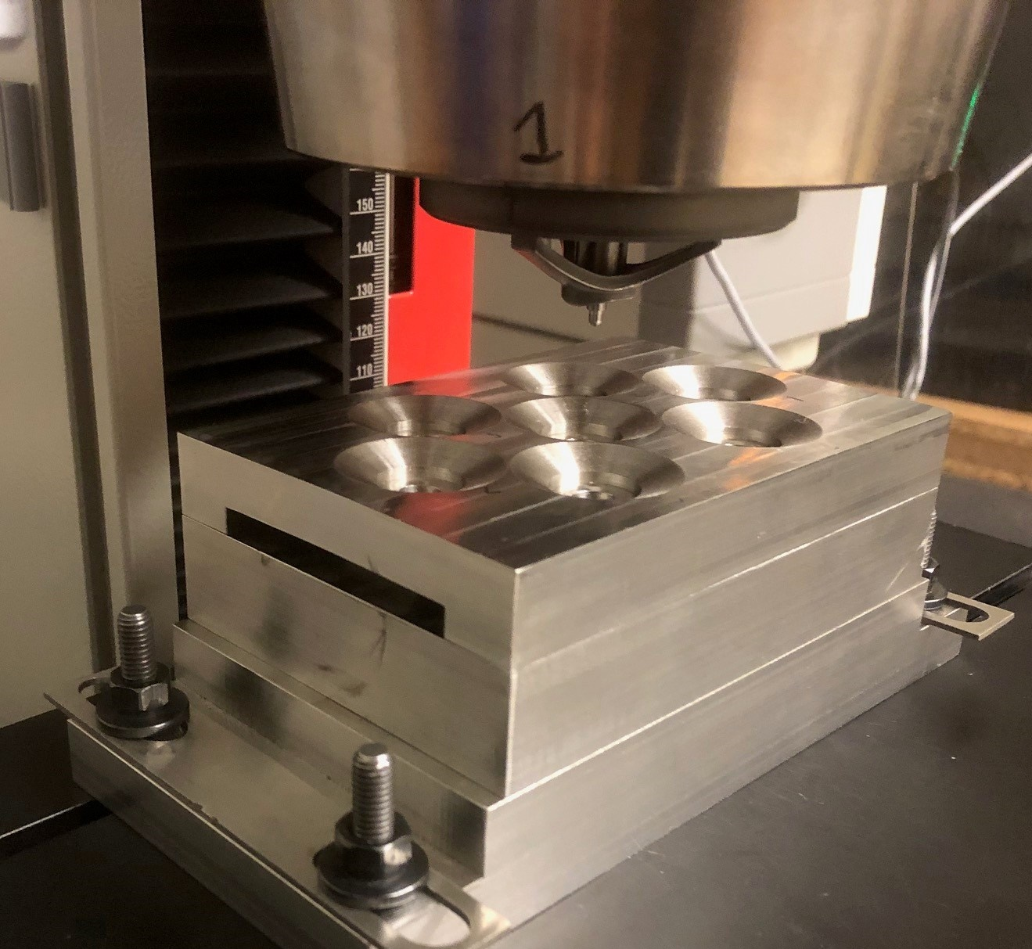
Small Punch Test (SPT) Overview
Fixture Iteration 1.0
Autonomous SPT Machine Patent Filed:
Title: UltraHigh-Throughput Small Punch Testing
Serial No.: 18/466,643
Filing Date: September 13, 2023
Fixture Iteration 2.0
National Aeronautics and Space Administration

Slide 6
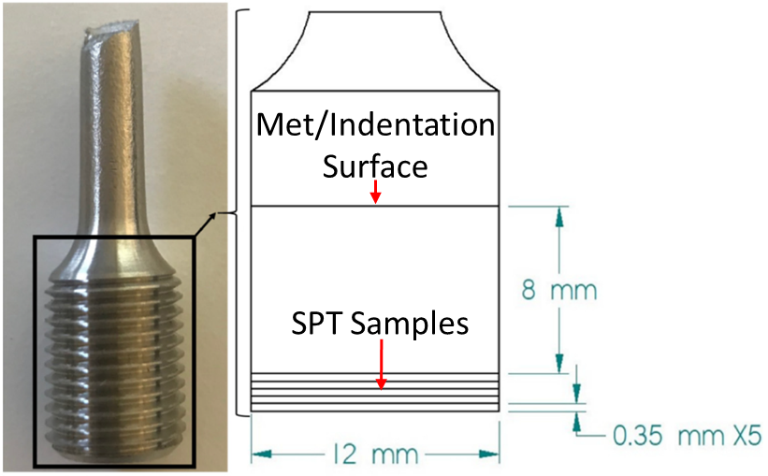
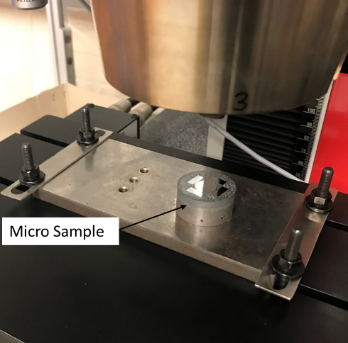
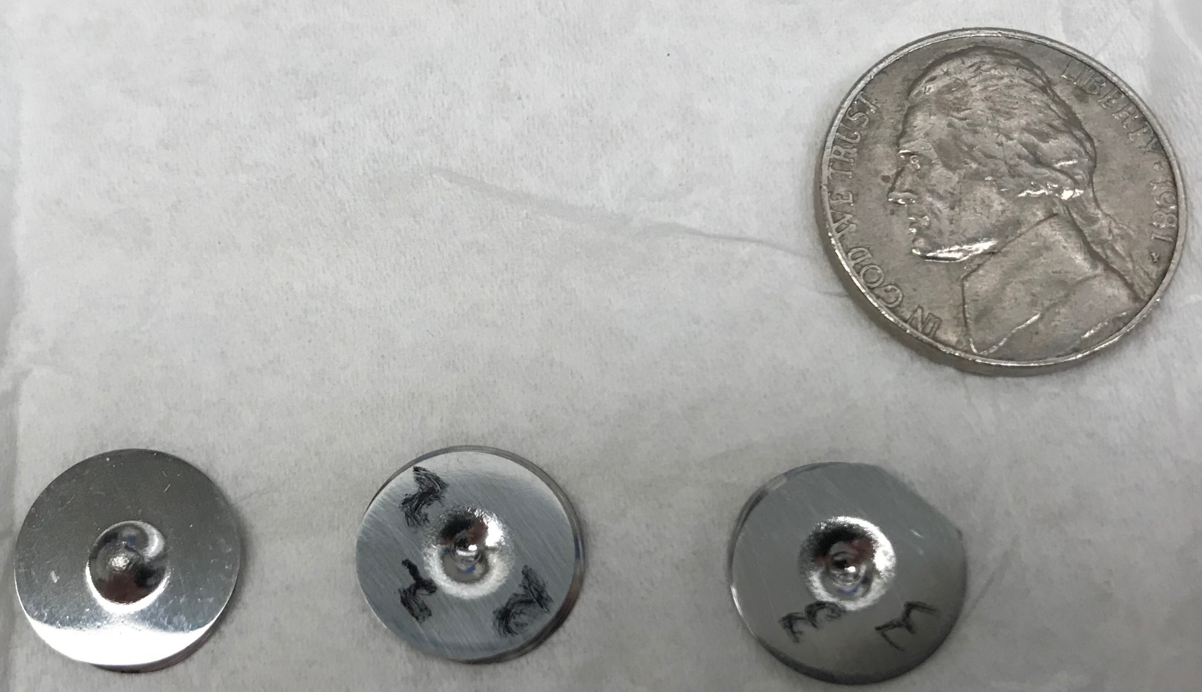
HT Testing Study: L-PBF Inconel 718
AM tensile bars with varied heat treatment
Tested SPT Samples
Courtright, 2021
National Aeronautics and Space Administration

Slide 7
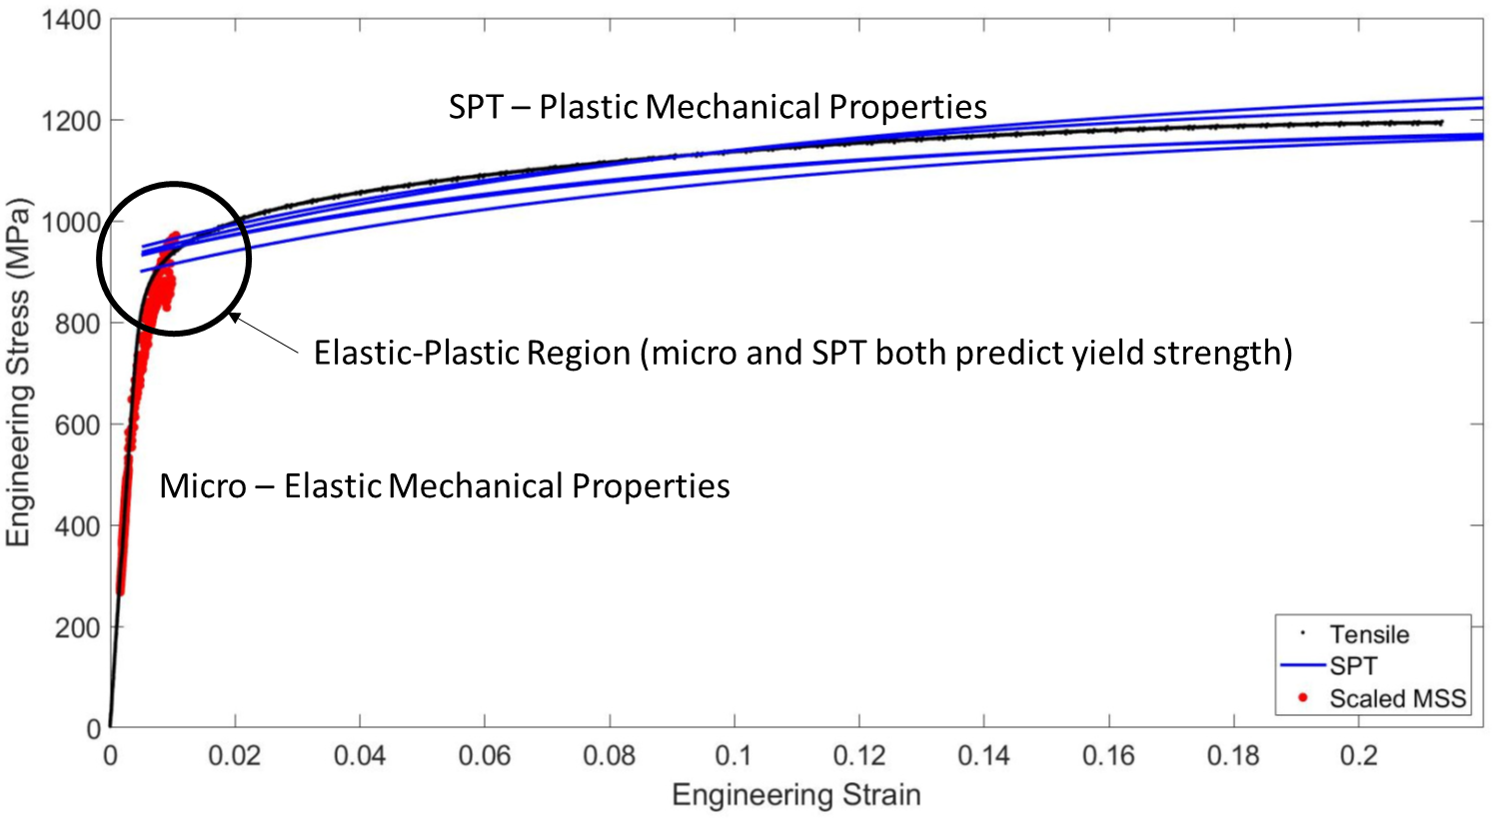
Combined Micro and SPT Data
Courtright, 2021
Previously established microindentation protocols for testing and analysis were applied to obtain these microindentation results
A simulation library approach was applied to obtain these SPT results
National Aeronautics and Space Administration

Slide 8
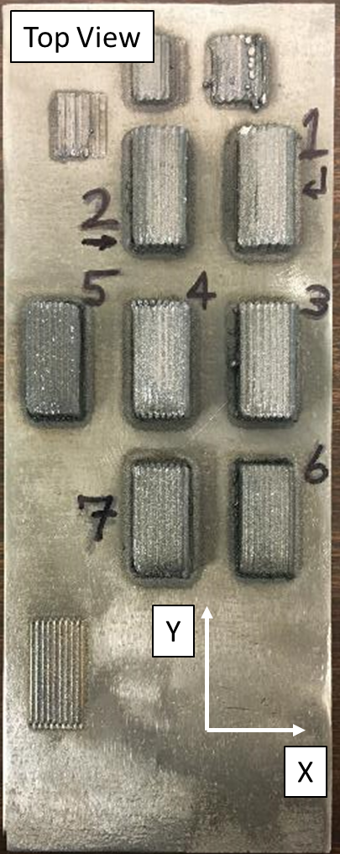
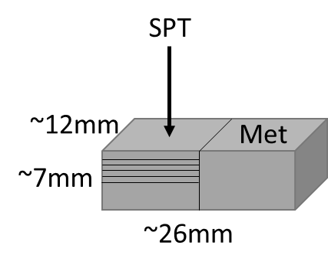
HT Testing with ML Study: Blown Powder DED Inconel 625
Varied build parameters (power, travel speed, powder feed rate)
  Stress relieved (1650F/2 hours)
  Sectioned, tested, and imaged
  ML applied to SPT analysis and the development of Process-Structure-Property (PSP) models
Sample | Power | Speed | Powder Feed Rate
 | W | mm/min | g/min
1 | 450 | 240 | 2
2 | 350 | 240 | 2
3 | 350 | 300 | 2
4 | 350 | 360 | 2
5 | 300 | 300 | 3
6 | 300 | 240 | 3
7 | 350 | 360 | 3
National Aeronautics and Space Administration
Notes:
Varied build parameters (power, travel speed, disc speed)
Stress relieved to allow SPT sample removal without “potato chipping” and to promote delta phase precipitation
Material = Inconel 625
Process = Blown Powder Directed Energy Deposition
Testing Techniques = Small Punch Test (SPT), Spherical Microindentation, and Uniaxial Tensile Testing
Imaging Technique = Scanning Electron Microscopy
Seven samples were additively manufactured using an Inconel 625 powder feedstock
Each sample used a different combination of build parameters
Samples underwent a stress relief heat treatment to remove residual stresses
Sample microstructures will be compared to mechanical test results to generate structure-property linkages

Slide 9
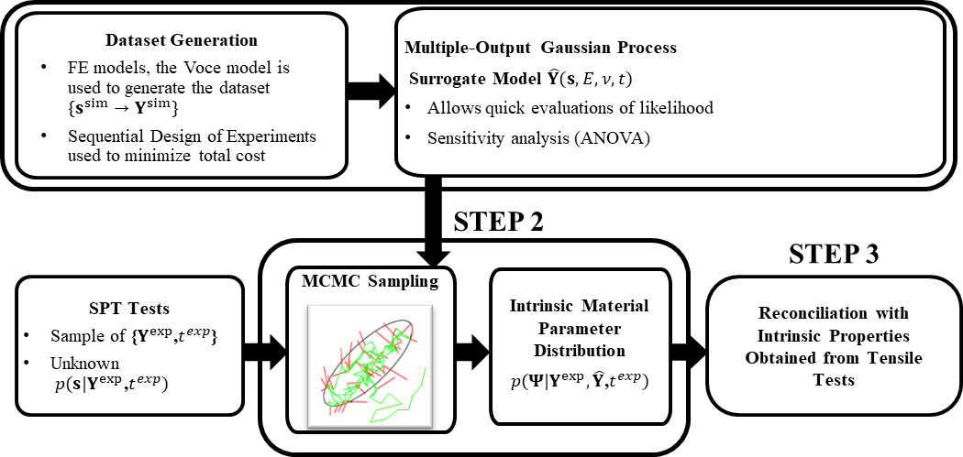
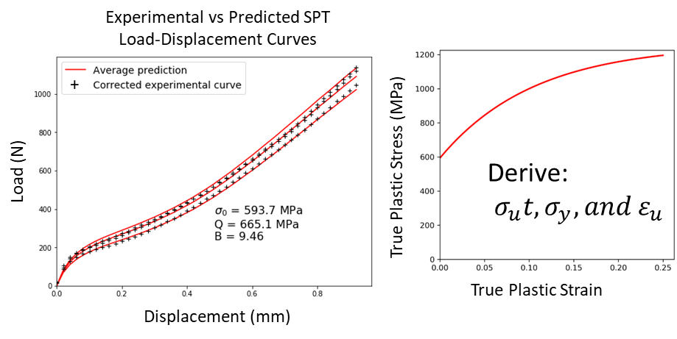

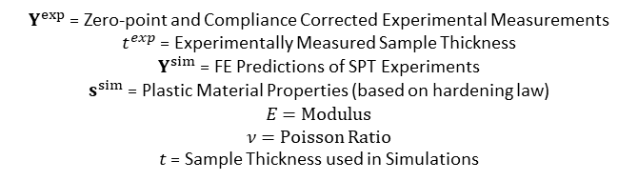

Overview of Bayesian Framework to Estimate Intrinsic Properties from SPT Tests
Swift Hardening Law
$$σ=K{\left(ε_{0}+ε_{p}\right)}^{n}$$
Voce Hardening Law
$$σ=σ_{0}+Q∗\left(1−exp\left(−B∗ε_{p}\right)\right)$$
SPT Results (Averages from >3 SPTs per Sample)
 | Yield (Mpa) | Ultimate (Mpa) | Uniform Elongation
Sample 1 | 557.04 | 905.05 | 21.75
Sample 2 | 472.53 | 886.12 | 18.99
Sample 3 | 510.21 | 910.94 | 22.2
Sample 4 | 604.46 | 922.12 | 19.5
Sample 5 | 469.13 | 792.49 | 18.36
Sample 6 | 511.11 | 782.07 | 17.56
Sample 7 | 561.09 | 858.53 | 18.44
$Y^{exp}$ = Zero-point and Compliance Corrected Experimental Measurements
$t^{exp}$ = Experimentally Measured Sample Thickness
$Y^{sim}$ = FE Predictions of SPT Experiments
$s^{sim}$ = Plastic Material Properties (based on hardening law)
$E$ = Modulus
$ν$ = Poisson Ratio
$t$ = Sample Thickness used in Simulations
National Aeronautics and Space Administration
Notes:
Step 1: Voce model is used to generate a dataset of LD curves from abaqus simulations of SPT. Inputs are the three Voce hardening parameters. Multi-output Gaussian Process surrogate models are used to emulate the FE-predicted SPT LD curves (they allow for three orders of magnitude acceleration in the prediction speed vs individual simulations). You can get away with performing far fewer simulations than would otherwise be necessary (helps make SPT analysis feasible).
Step 2: MonteCarlo Markov Chain sampling is used to estimate the hardening parameters by calibrating the surrogate model against a dataset of experimental SPT data (material agnostic)
Step 3: Optional validation step if tensile data is available
Mention that in addition to my paper on Inconel 625, there’s a paper in the works by Aditya that will cover this Surrogate model approach in detail
If asked about the applicability of the hardening law: generating a new dataset for a given hardening law is a one-time cost
can cover a wide class of materials using one surrogate model as long as we believe that the given hardening law is representative of the given material

Slide 10
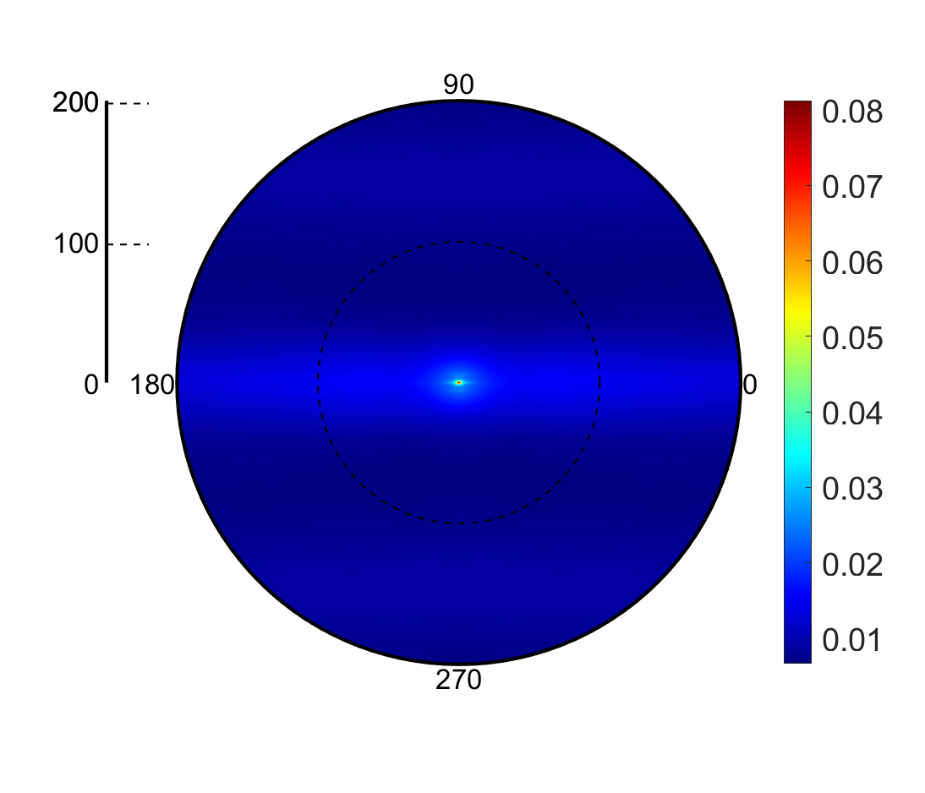
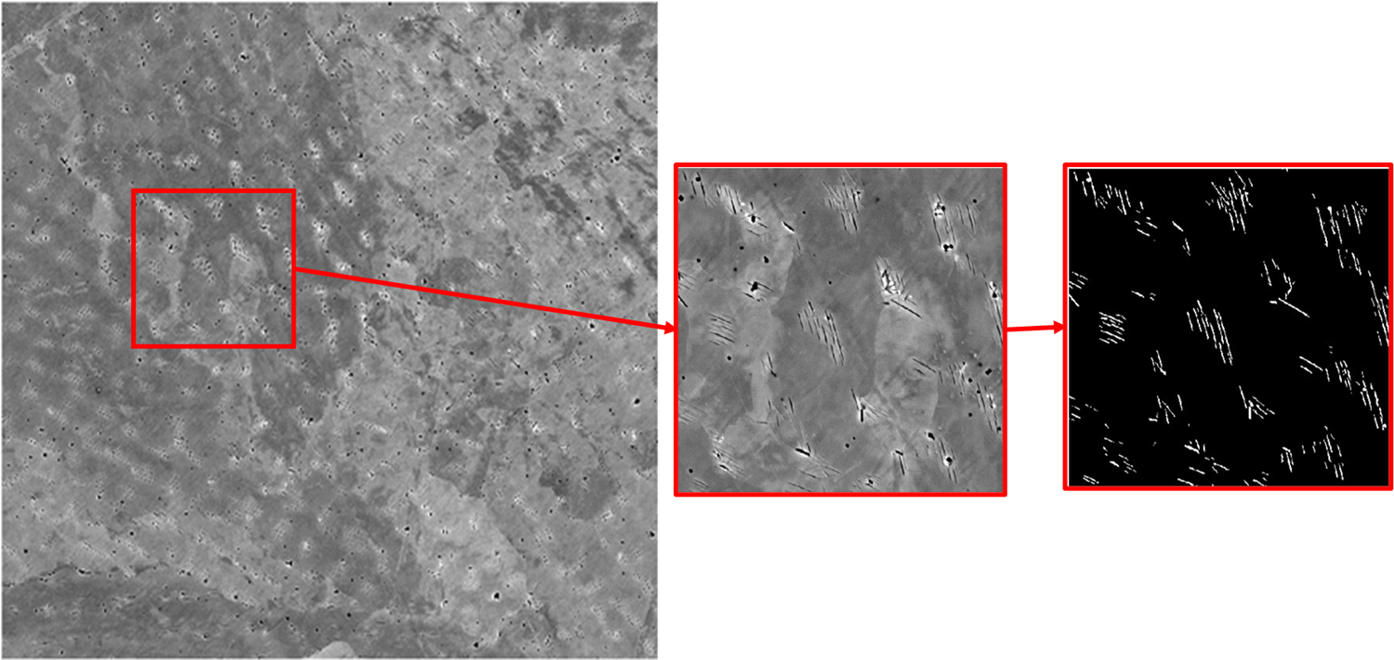
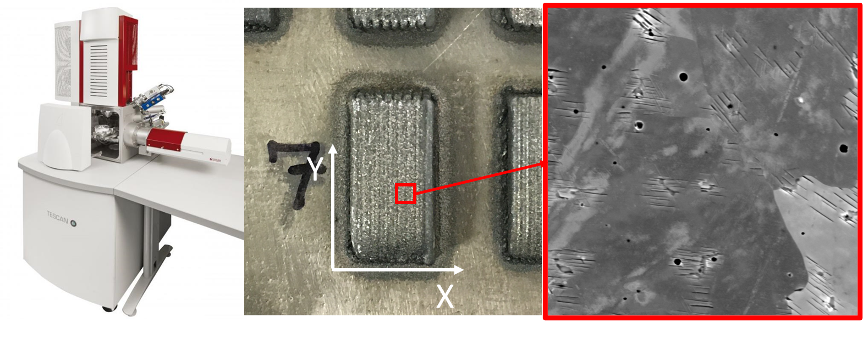
Microstructure Quantification
Rotationally Invariant 2pt Stats
Segmentation
Statistics
Imaging
Structure-Property Model
Imaging
Delta Phase Segmentation
National Aeronautics and Space Administration
Notes:
Three SEM images for each of the seven samples
Delta phase segmentation
Rotationally invariant two-point statistics to extract principal component scores

Slide 11
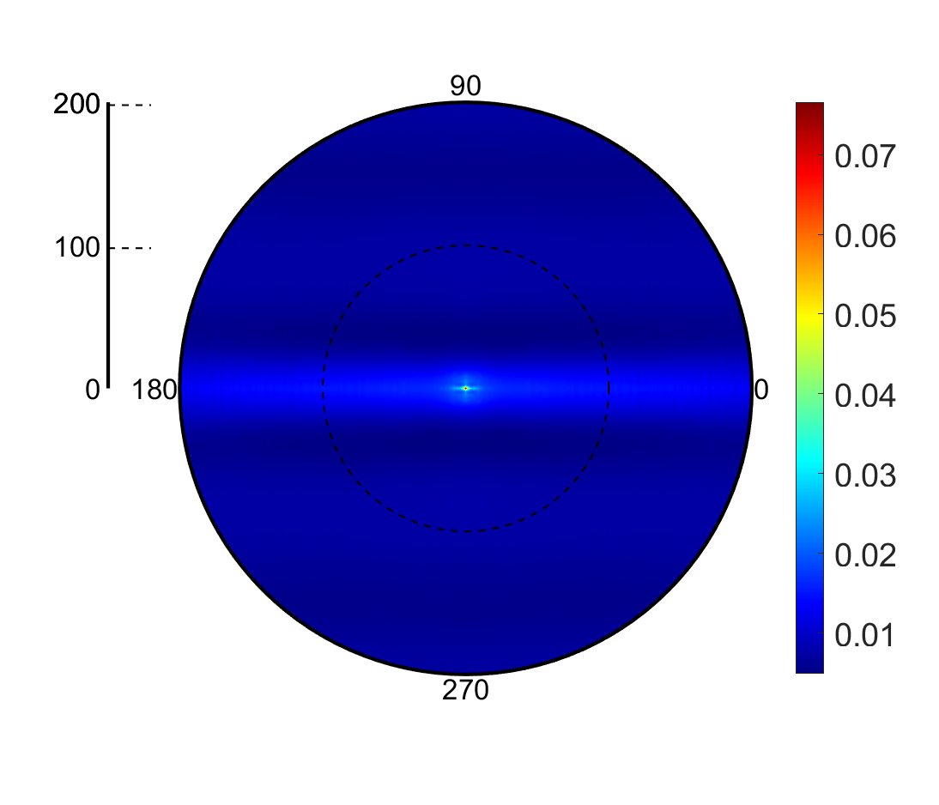
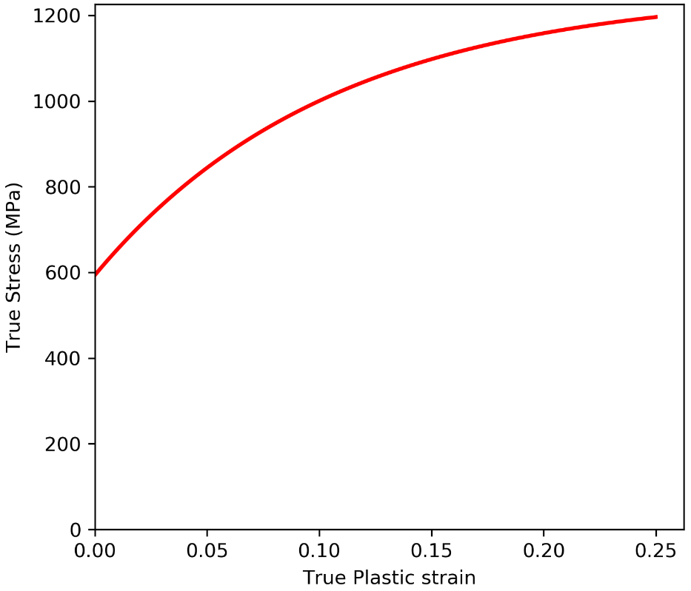
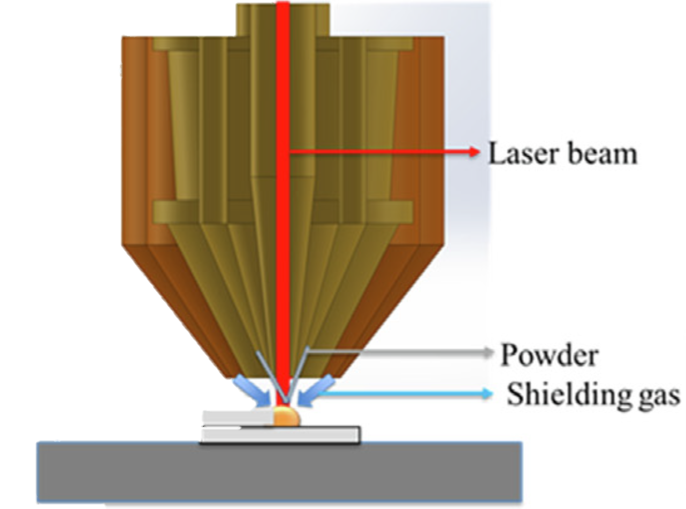
Model Building
Models | Inputs | Outputs
Process - Property | Power Speed Powder Flow rate | YS UTS
Structure - Property | PC1, PC2, PC3 | YS UTS
Process + Structure - Property | PC1, PC2, PC3 Power Speed Powder Flow rate | YS UTS
GPR Models
Microstructure Statistics (PC Scores)
AM Build Parameters
YS: Yield Strength
UTS: Ultimate Tensile Strength
Stress/Strain Prediction
True Plastic Stress (MPa)
Adapa et al, 2023
True Plastic Strain
National Aeronautics and Space Administration
Notes:
Use leave one out cross-validation to build seven models allowing all data from the seven samples to be used both as inputs and model validations.
Average the results of the seven models
Repeat this process to make PSP, SP, and PP models and compare
Seeking to make the argument that structure information brings value to certain scenarios but that in some situations, processing information may be sufficient to predict the desired properties.

Slide 12
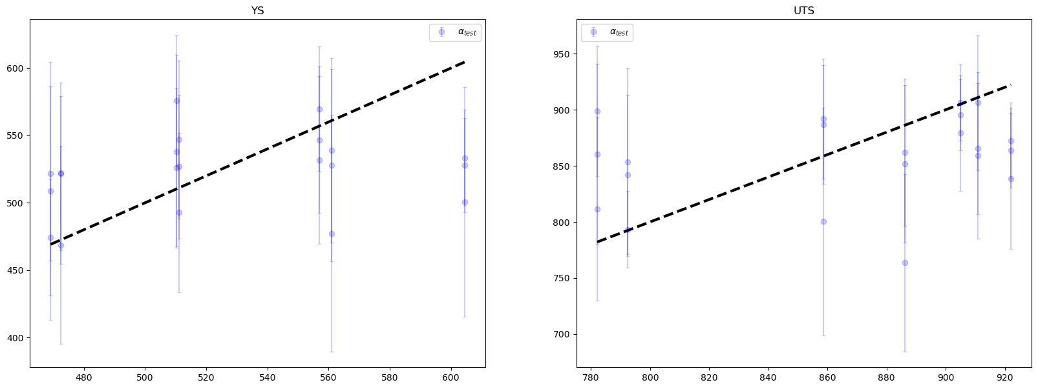
Figure Showing Model LOOCV Plots
1) Structure - Property
Inconel 625 Study Model Results
National Aeronautics and Space Administration

Slide 13
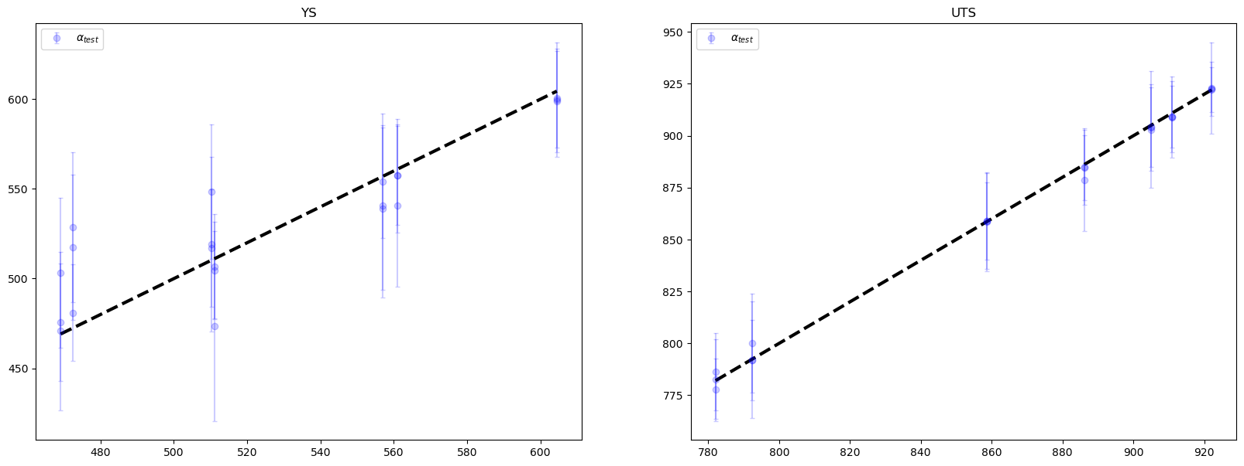
Figure Showing Model LOOCV Plots
2) Process - Property
Model Results Continued
National Aeronautics and Space Administration

Slide 14
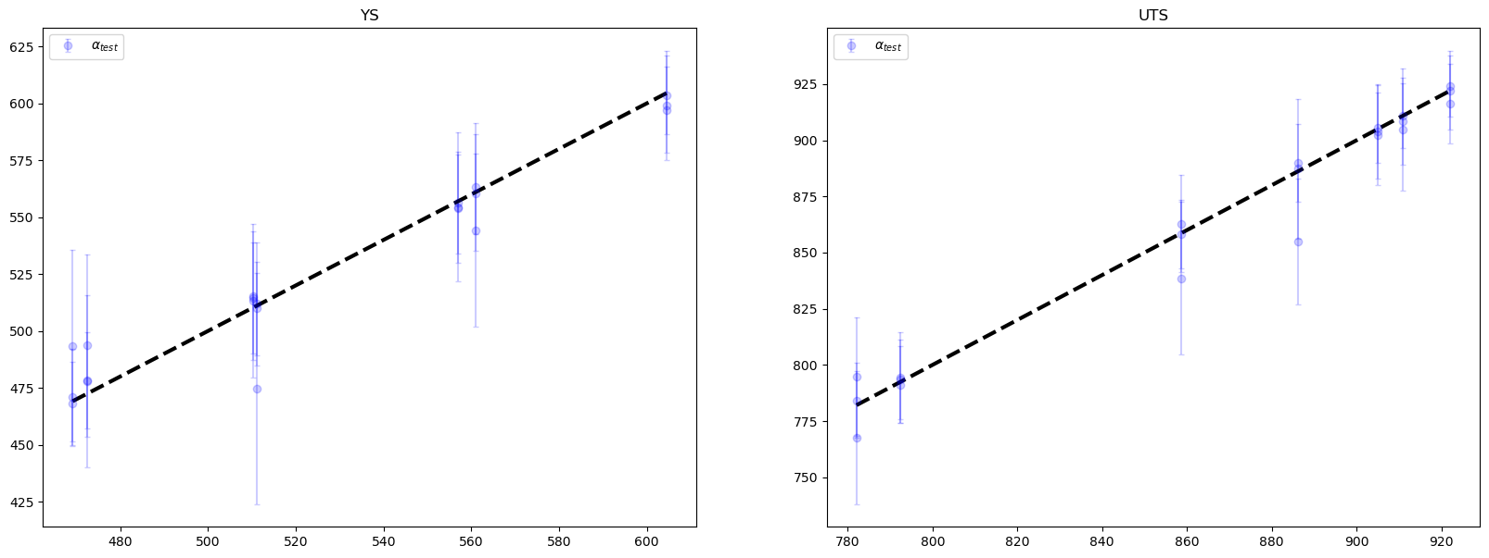
Figure Showing Model LOOCV Plots
3) Process+Structure - Property
Model Results Continued
National Aeronautics and Space Administration

Slide 15
Model Comparisons
Models | Inputs | Outputs | LOOCV MAE (YS) MPa | LOOCV MAE (UTS) MPa | LOOCV MAPE (YS) | LOOCV MAPE (UTS)
Process - Property | Power Speed Powder Flow rate | YS UTS | 15.8 | 1.91 | 0.031 | 0.002
Structure - Property | PC1 PC2 PC3 | YS UTS | 39 | 46.1 | 0.073 | 0.054
Process + Structure - Property | PC1 PC2 PC3 Power Speed Powder Flow rate | YS UTS | 7.15 | 5.5 | 0.014 | 0.006
LOOCV MAE: Leave-one-out cross-validation Mean Absolute Error
LOOCV MAPE: Leave-one-out cross-validation Mean Percentage Error
National Aeronautics and Space Administration
Notes:
Delta phase structure information reduces error for YS predictions but increases it for UTS predictions
Does this indicate that Delta phase has a stronger influence on YS while UTS is more greatly influenced by other structural features?
PP models show reasonable accuracy for both YS and UTS, so it capturing structure information worth the additional experimental and analysis efforts?
Depends on the accuracy required, the accuracy improvement enabled by structure information, and the cost/time associated with capturing/analyzing structure information
Multi-output GPR

Slide 16
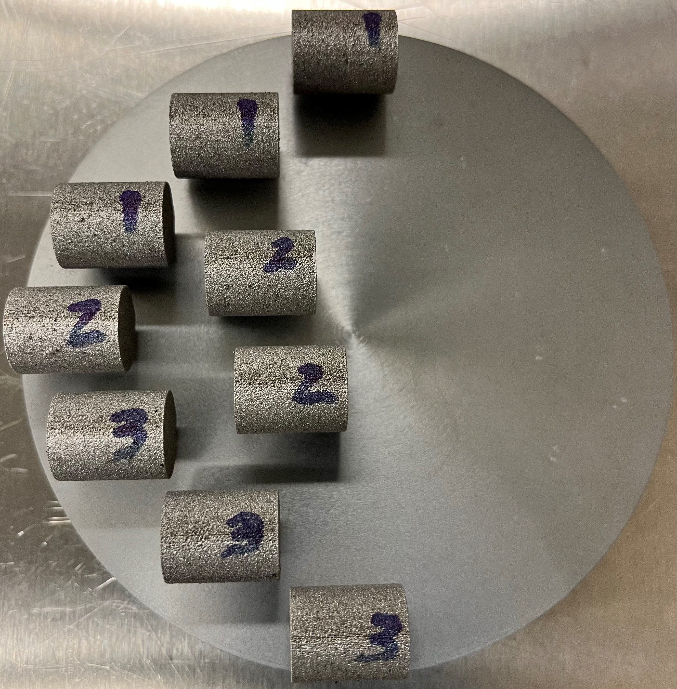
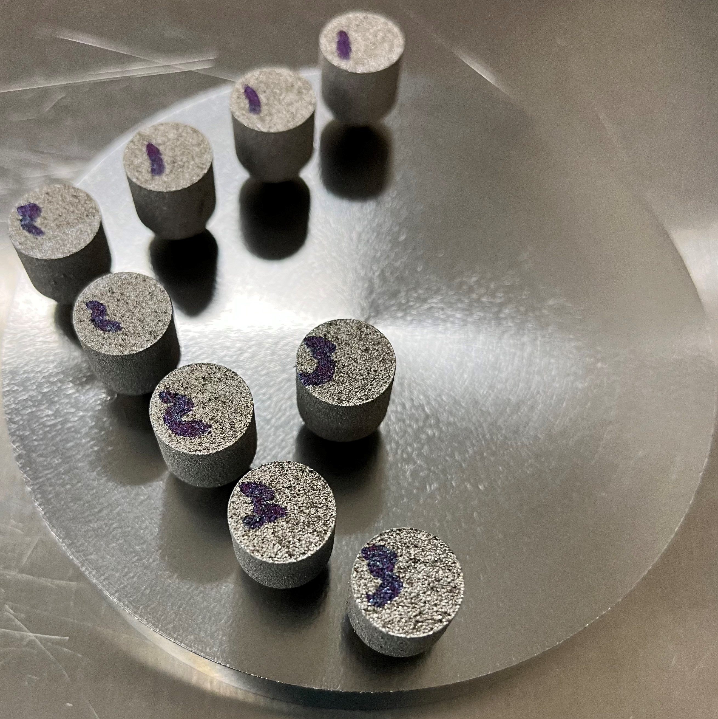
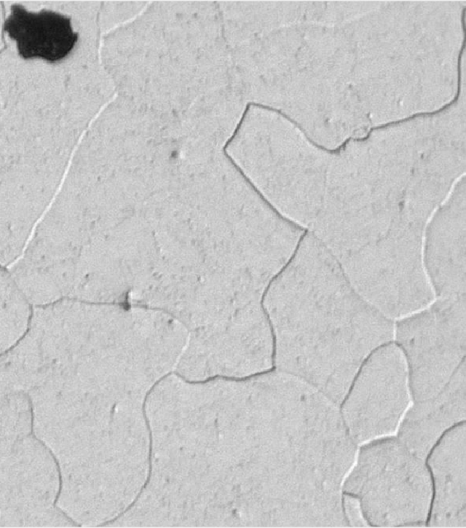
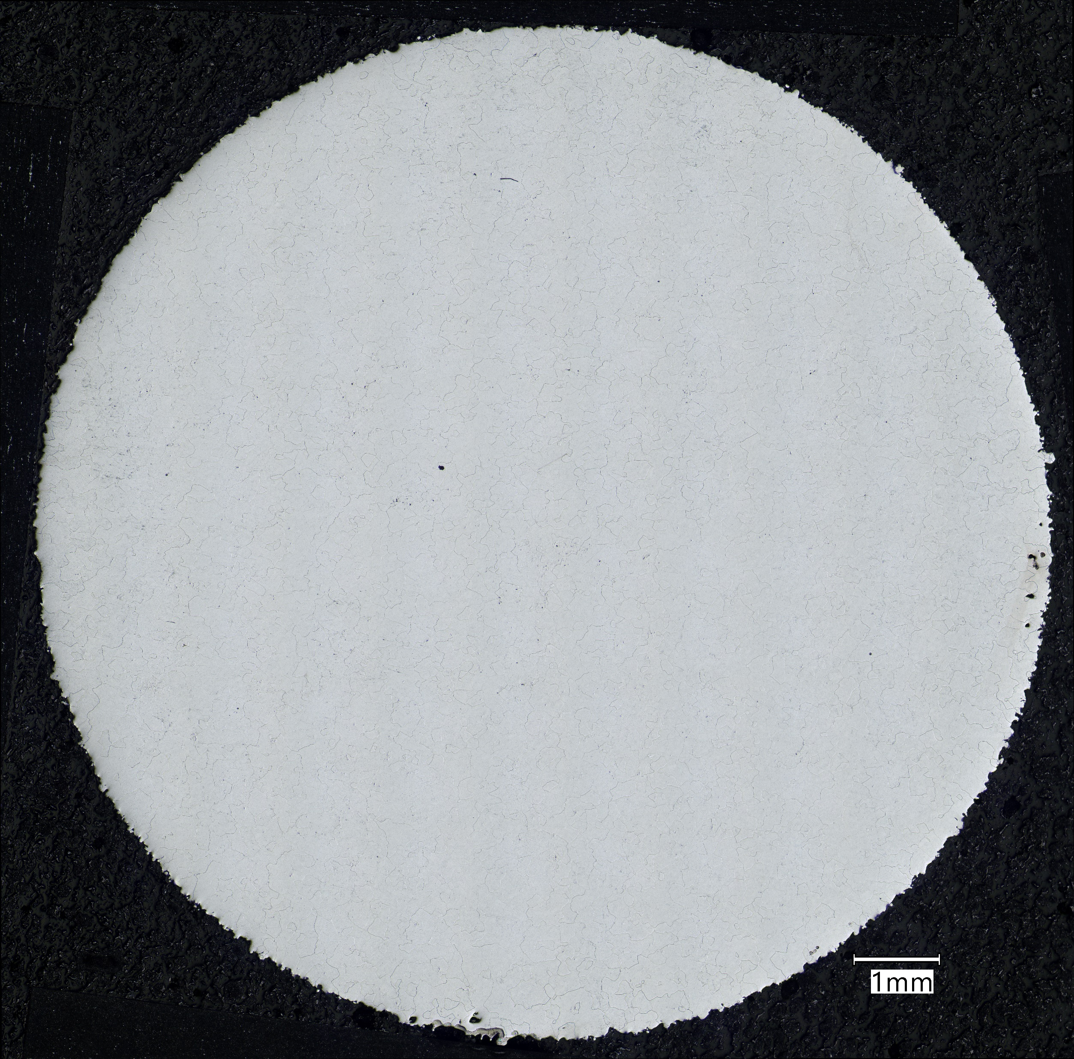



Ongoing Work: C103 Study
18 unique sample conditions (three build conditions, three heat treatments, and two build orientations)
Montage: 200X
AM Parameter Set # | Heat Treatment # | Testing Direction | Build Orientation
Energy Density #1 | HT 1 SR | Z | XY
Energy Density #1 | HT 2 HIP | Z | XY
Energy Density #1 | HT 3 HIP/Q | Z | XY
Energy Density #2 | HT 1 SR | Z | XY
Energy Density #2 | HT 2 HIP | Z | XY
Energy Density #2 | HT 3 HIP/Q | Z | XY
Energy Density #3 | HT 1 SR | Z | XY
Energy Density #3 | HT 2 HIP | Z | XY
Energy Density #3 | HT 3 HIP/Q | Z | XY
Energy Density #1 | HT 1 SR | X | XZ
Energy Density #1 | HT 2 HIP | X | XZ
Energy Density #1 | HT 3 HIP/Q | X | XZ
Energy Density #2 | HT 1 SR | X | XZ
Energy Density #2 | HT 2 HIP | X | XZ
Energy Density #2 | HT 3 HIP/Q | X | XZ
Energy Density #3 | HT 1 SR | X | XZ
Energy Density #3 | HT 2 HIP | X | XZ
Energy Density #3 | HT 3 HIP/Q | X | XZ
Grain Boundary Initial Segmentation Attempts
SR: Stress Relieved HIP: Hot Isostatic Press
HIP/Q: Hot Isostatic Press with Rapid Quench
National Aeronautics and Space Administration
Notes:
18 unique sample conditions

Slide 17
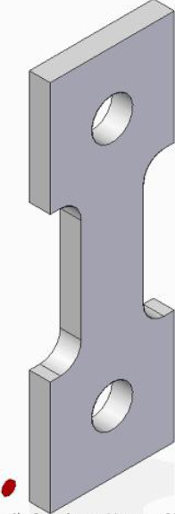
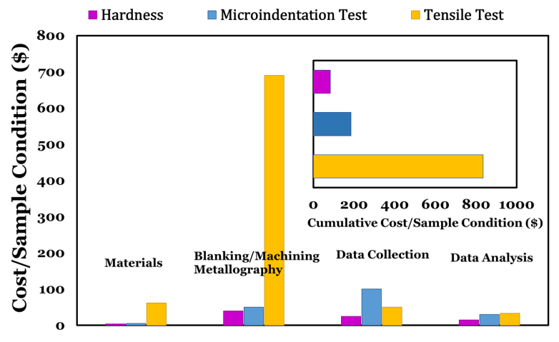
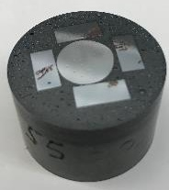
Cost and Time Advantages of HT Testing
Courtright, 2021
National Aeronautics and Space Administration
Parvinian, 2021

Slide 18
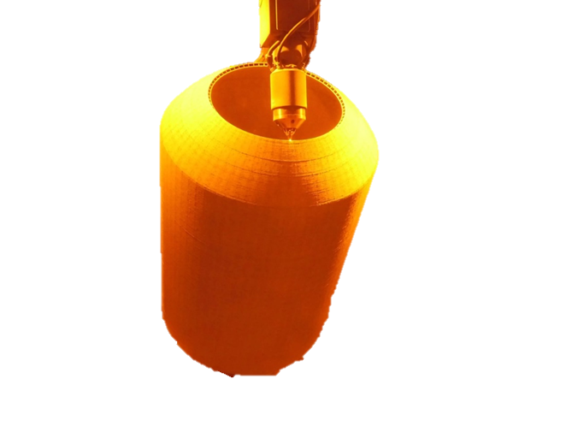
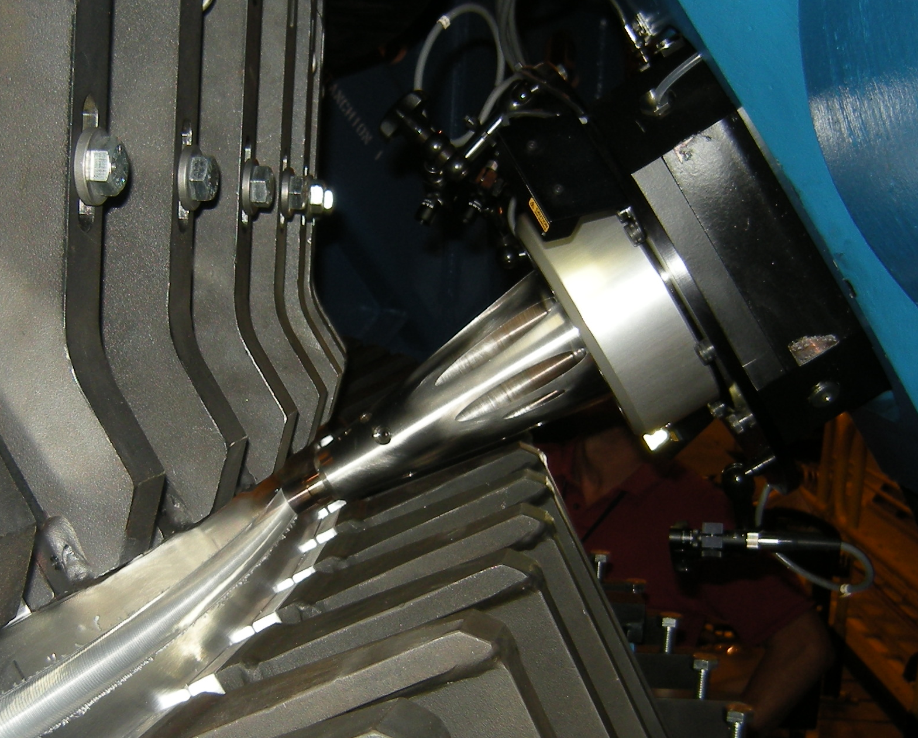
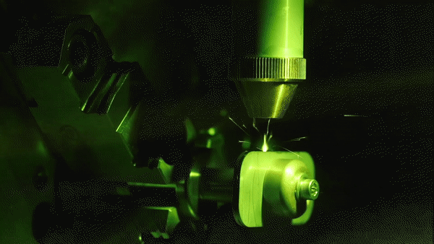
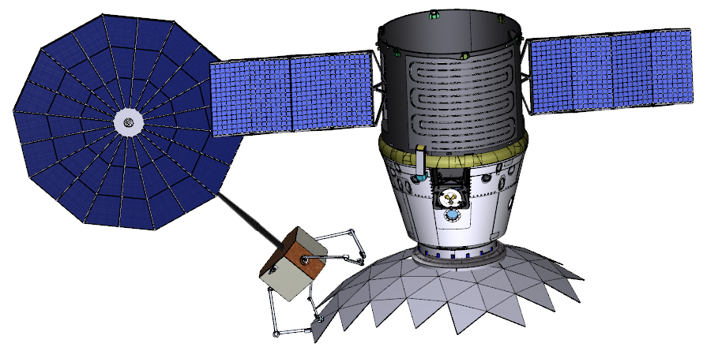
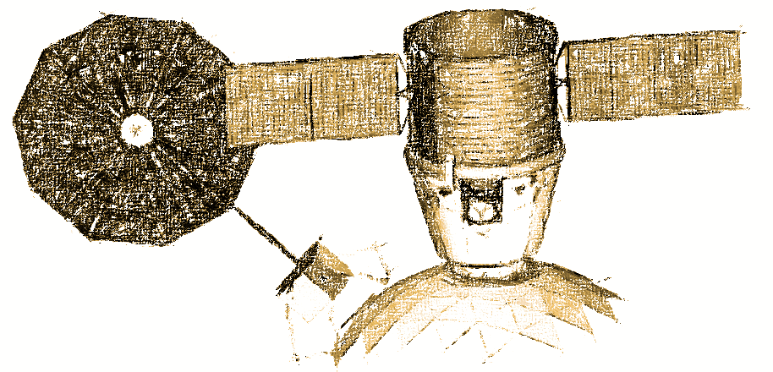
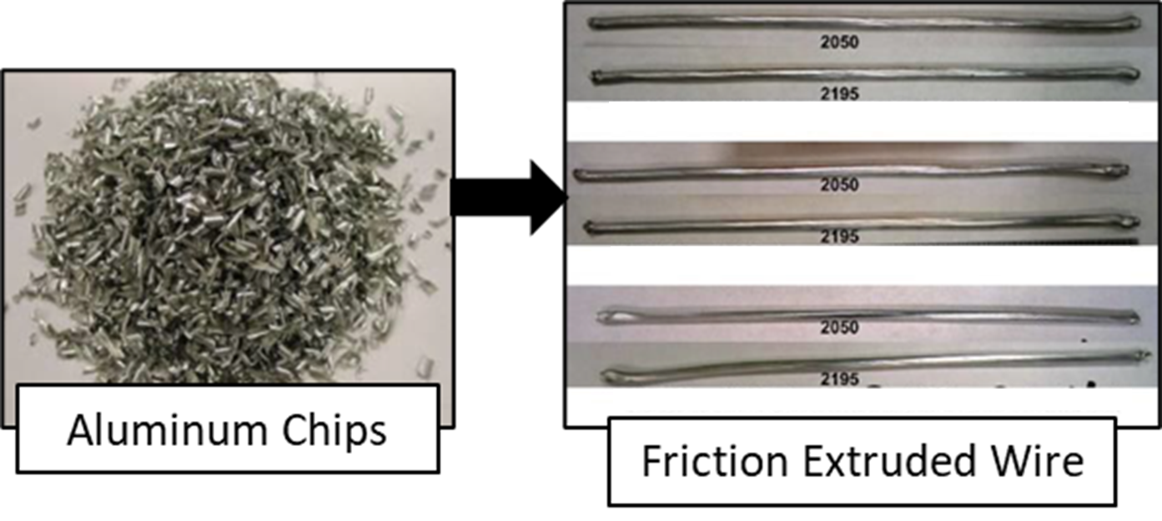
Applications to Advanced Manufacturing
Current manufacturing relies on hundreds of standardized samples and tests to optimize a process or material and thousands to qualify
Accelerated/Lower-cost Development
  New alloys
  Optimization of manufacturing processes
  Efficient use of test data (i.e. decreased destructive and nondestructive test cost/time burden)
In-Space Manufacturing
  Critical one-shot process risk reduction
  Materials Informatics to link ground and space-based data
DED Storage Tank
Friction Stir Welding
Laser Welding
Recycling
Digital Twin of Space Welding
National Aeronautics and Space Administration
Notes:
Benefits across all manufacturing industries for manufacturing process/material improvement and decreased cost burden
Welding, AM, Recycling, forming, casting, polymer processing, electronics design and optimization, etc;
Efficient use of destructive and nondestructive test data to minimize testing burden
Lower cost/time material and process optimization (compared to current Edisonian methods)

Slide 19
Acknowledgement
Committee members
  Dr. Brad L. Boyce Email: blboyce@sandia.gov
  Dr. Joshua P. Kacher Email: josh.kacher@mse.gatech.edu
  Dr. David L. McDowell Email: david.mcdowell@me.gatech.edu
  Dr. Richard W. Neu Email: rick.neu@gatech.edu
  Dr. Aaron Stebner Email: aaron.stebner@gatech.edu
  Dr. Naresh N. Thadhani Email: naresh.thadhani@mse.gatech.edu
Ms. Ellen Rabenburg, Mr. Matt Medders, Ms. Annette Gray, Dominic Renner and the NASA SPT CIF team
Dr. Sezen Yucel, Dr. Almambet Iskakov, Dr. Ali Khosravani, Dr. Soumya Mohan, Mr. Nicolas Leclerc, and Mr. Hyung Nun Kim
Financial support by
  National Aeronautics and Space Administration (Marshall Space Flight Center) – Full-time Degree Seeking Program
  Office of Naval Research (ONR)
Materials Provided by:
  NASA and Dr. Christopher J. Saldaña
National Aeronautics and Space Administration

Slide 21
Backup
National Aeronautics and Space Administration

Slide 22

About the Presenter
Zachary S. Courtright of the National Aeronautics and Space Administration and Georgia Institute of Technology
  NASA In-Space Manufacturing Portfolio Manager
  Materials Science and Engineering PhD Candidate at Georgia Institute of Technology
  BS/MS in Welding Engineering from The Ohio State University
  Two patents pending related to Additive Manufacturing and High-throughput Mechanical Testing
  VFR Pilot
Research interests:
  Additive Manufacturing, Welding, In-Space Manufacturing, High-throughput Testing, Materials Informatics
National Aeronautics and Space Administration
Notes:
Enter speaker notes here.

Slide 23
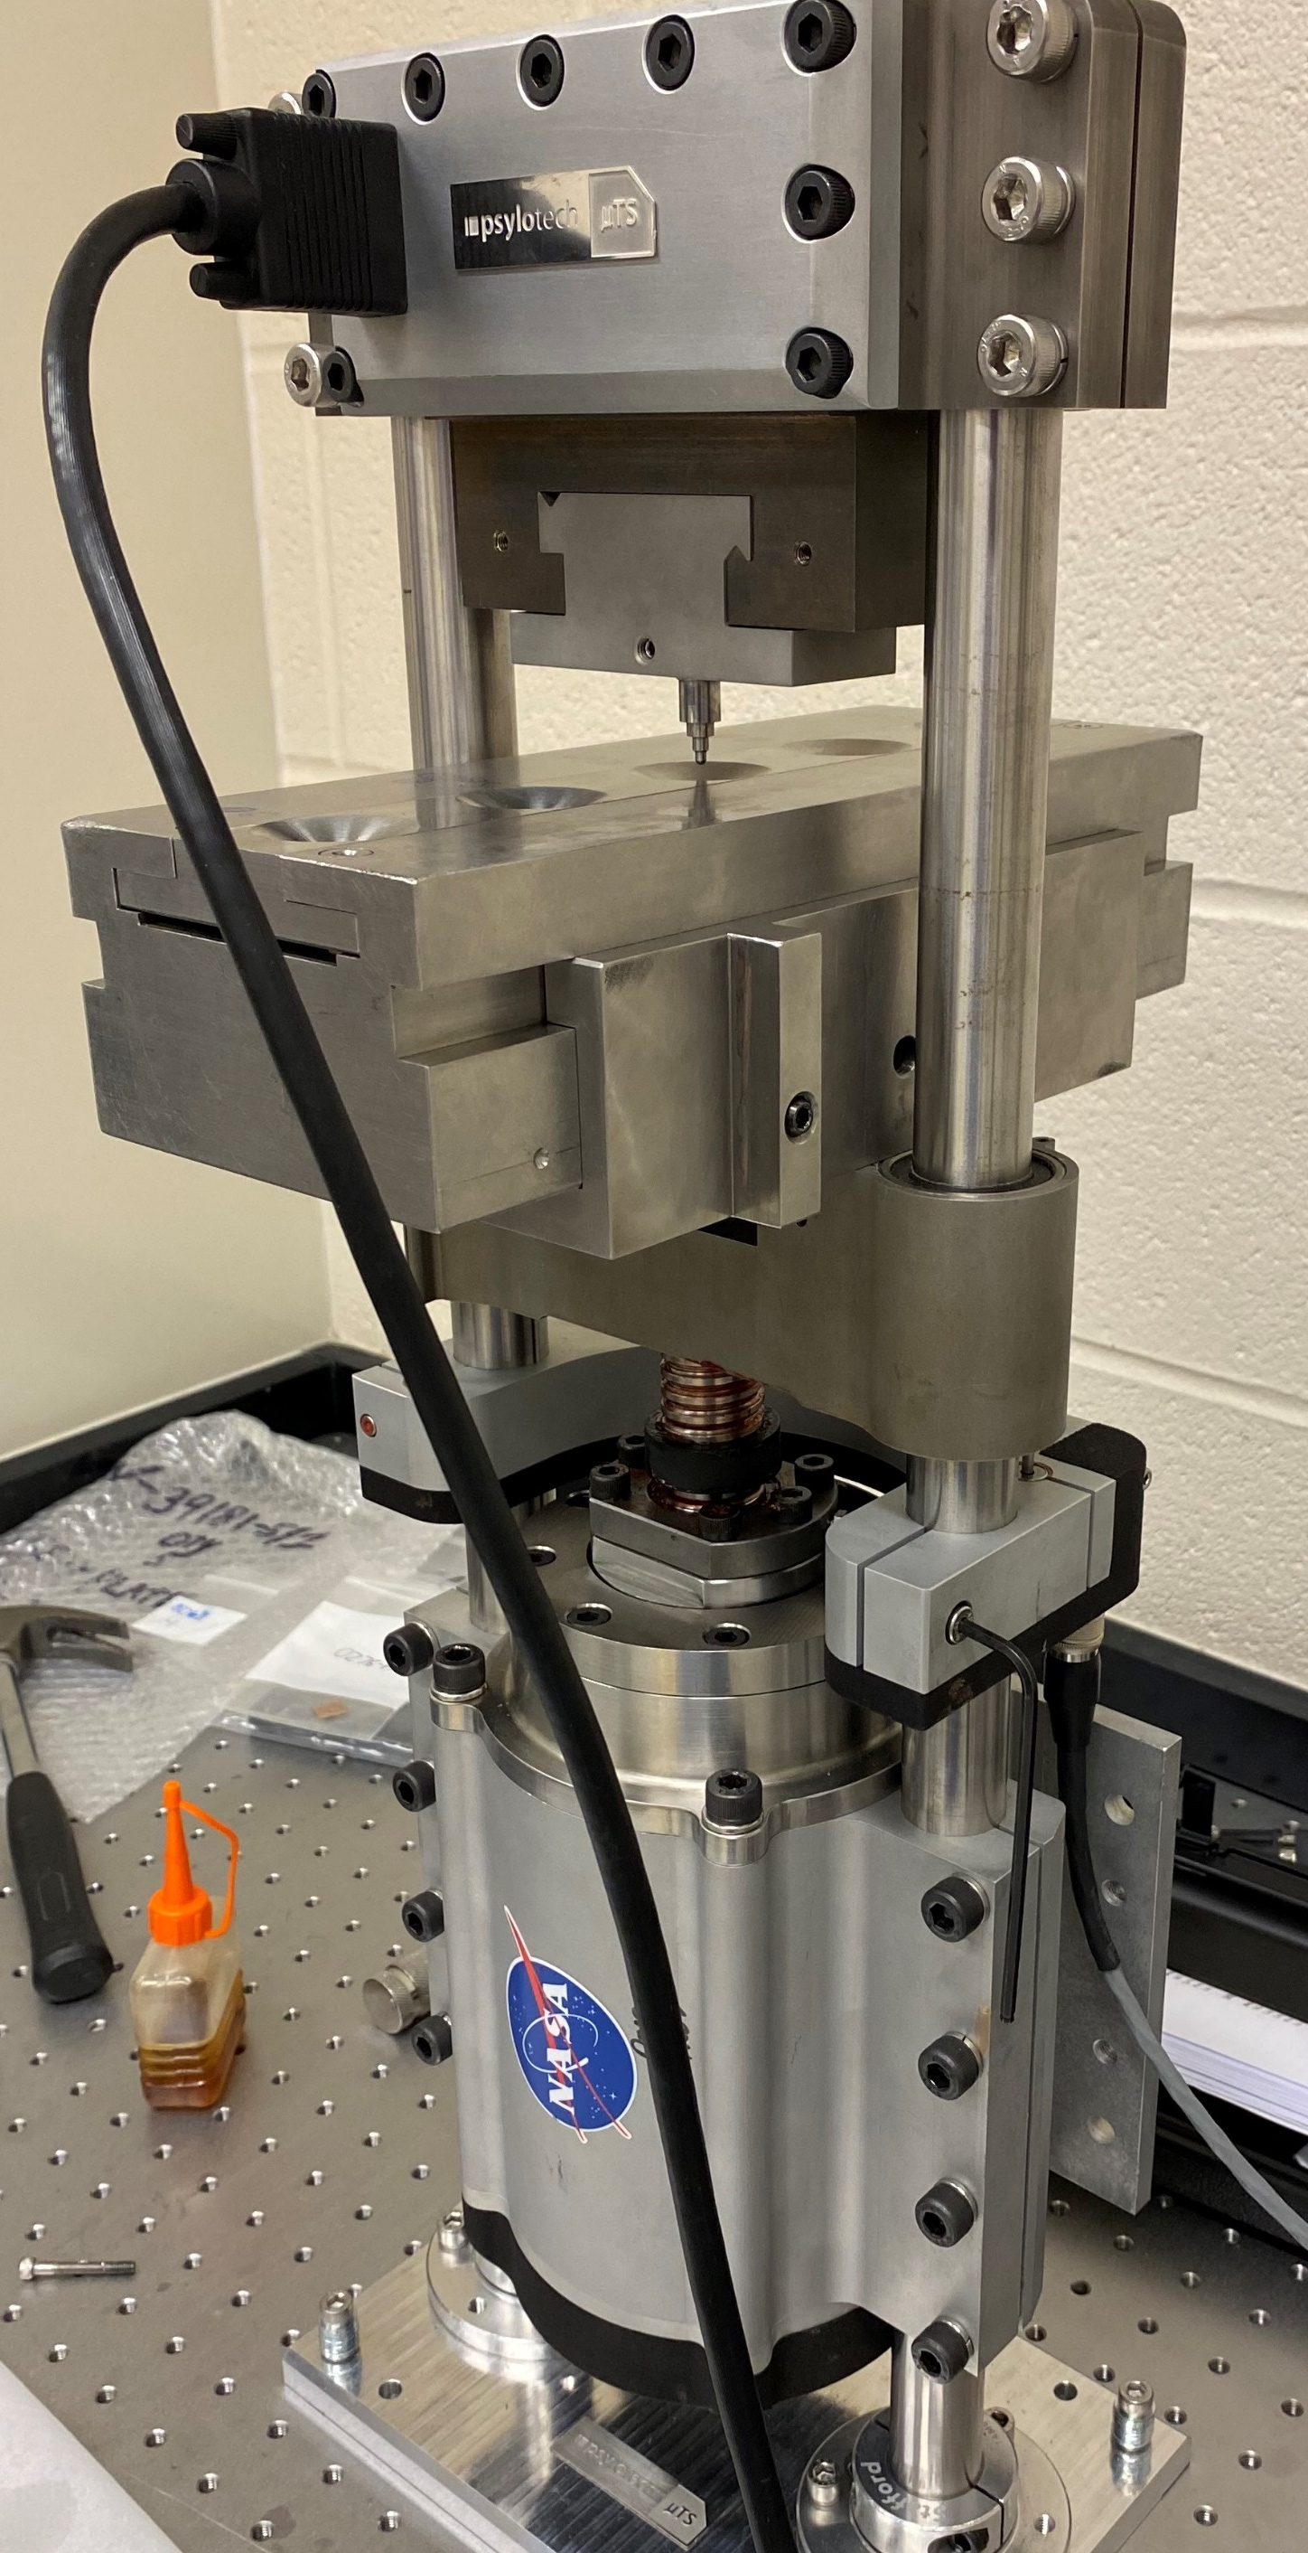
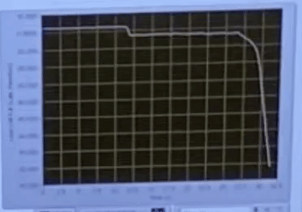
NASA SPT Machine Retrofit Study
Objective:
  Develop high-throughput SPT for advanced manufacturing development (enhance the existing capability towards the future goal of a fully automated testing system)
Tasks:
  Design and fabricate a new high-throughput SPT capability
  Test materials with known properties to calibrate the analysis for the new machine
  Perform SPT and microscopy on materials provided by Brian West/EM42 (GRCop-42), Jhonathan Rosales/EM32 (W-Mo), and Paul Gradl/ER13 (a Ni-based alloy)
  Analyze results and correlate SPT/Microscopy data
National Aeronautics and Space Administration

Slide 24
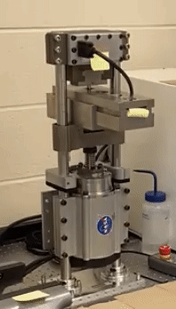
Fixture Iteration 3.0
Load frame retrofit for SPT
New high-throughput SPT fixture
National Aeronautics and Space Administration

