Slide 1
Based on charts taken from 3.1-MS-SEIA-TIM-AerodynamicsDraft4.pptx (March 25, 2022)
MLS Aerodynamics
Mark Schoenenberger
June 22, 2023

Slide 2
Aerodynamics: OUTLINE
Intro/Vehicle Configurations
Aerodynamic Tools
Basic Aerodynamic Database, Data and Interface with Simulation
Trajectory Considerations Assessment
Aero/RCS Interactions (Continuum and Rarefied)
Engine-On Aerodynamics
Uncertainty Modeling
Validation Wind Tunnel Test
Aero Environments for Systems Engineering
Line Loads, Aeroheating, Aeroacoustics

Slide 3
MLS Aerodynamics Team
LaRC Aerodynamics Lead:
Mark Schoenenberger (LARC-D205) mark.schoenenberger@nasa.gov
Aerodatabase:
Sam Shehata (LaRC-D205) hisham.m.shehata@nasa.gov
Ashley Korzun (LARC-D205) ashley.m.korzun@nasa.gov
Static CFD (static vehicle and RCS)
Bil Kleb (LARC-D305) bil.kleb@nasa.gov
Jan-Renee Carlson (LARC-D302) jan-renee.carlson@nasa.gov
Powered CFD (engine-on):
Craig Hunter (LARC-D301) craig.hunter@nasa.gov
Gabe Nastac (LARC-D302) gabriel.c.nastac@nasa.gov
Rarefied Aerodynamics:
Derek Liechty, (LARC-D305) derek.s.liechty@nasa.gov
Aerothermal:
Bill Wood. (LARC-D305) william.a.wood@nasa.gov
Drew Hinkle (LARC-D305) andrew.d.hinkle@nasa.gov
Unsteady Aero:
Dave Piatak (LARC-D308) david.j.piatak@nasa.gov
Craig Streett (LARC-D302) craig.l.streett@nasa.gov

Slide 4
Acknowledgements
The charts in this presentation were assembled from work products by the author and the following team members. Contact information on previous slide for those still with NASA at the time of presentation:
Chris Glass (retired)
Drew Hinkle
Craig Hunter
Bil Kleb
Ashley Korzun
Gabe Nastac
Sam Shehata
Craig Streett
Rick Thompson (retired)
Bill Wood

Slide 5
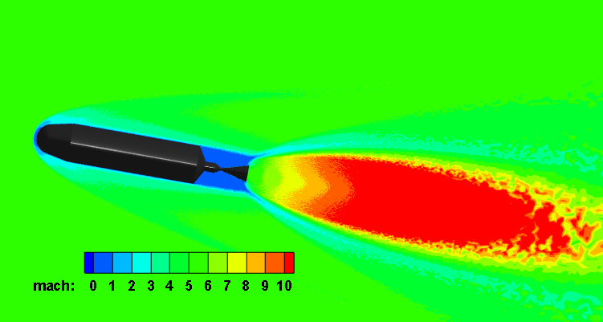
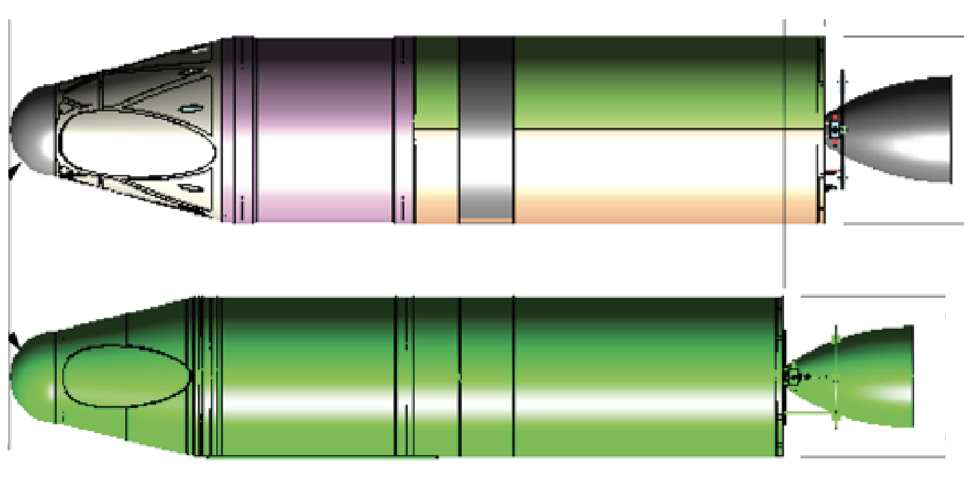
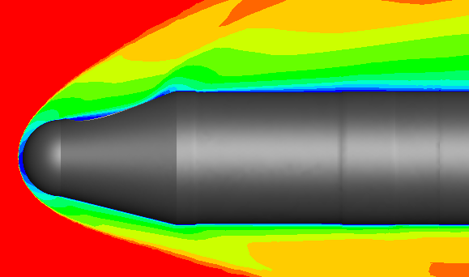
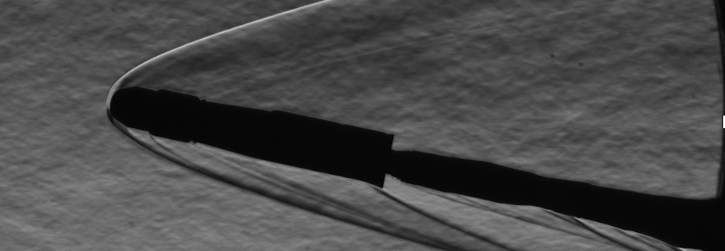
Aerodynamics Support
2015
NASA LaRC Aero team has provided aerodynamic data supporting DAC, SRC and PDC configurations (and earlier)
Assessing aero and helping perform geometry trades during those design cycles
Data products include
Static Aerodynamic Database
Shape trade studies (e.g. effects of ramps and fins on stability)
Line Loads
Aeroheating data
Preliminary Aero/RCS interaction calculations
SRM1 Engine-On Calculations
Aeroheating, Aeroacoustics and other environments
Wind Tunnel Test/CFD comparisons for V&V and uncertainty quantification
2016
SRC 2021
PDC,2022

Slide 6
Data Required for Analysis:
The following data is required as input for aerodynamic database analysis:
Watertight surface CAD model of OML
Reference trajectory including atmospheric conditions (updated iteratively as new aerodatabases are released to run new trajectories)
Mass Properties
  center of gravity as function of time along trajectory
  mass and moments of inertia history
RCS design
  CAD model of nozzle contour
  Chamber conditions
  Nominal thrust
  Location and pointing vectors

Slide 7
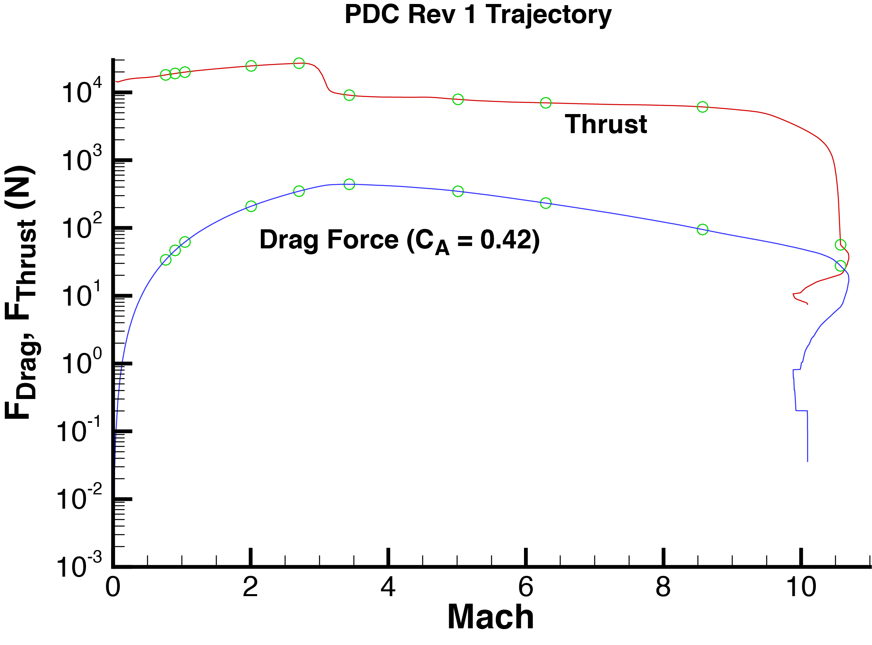
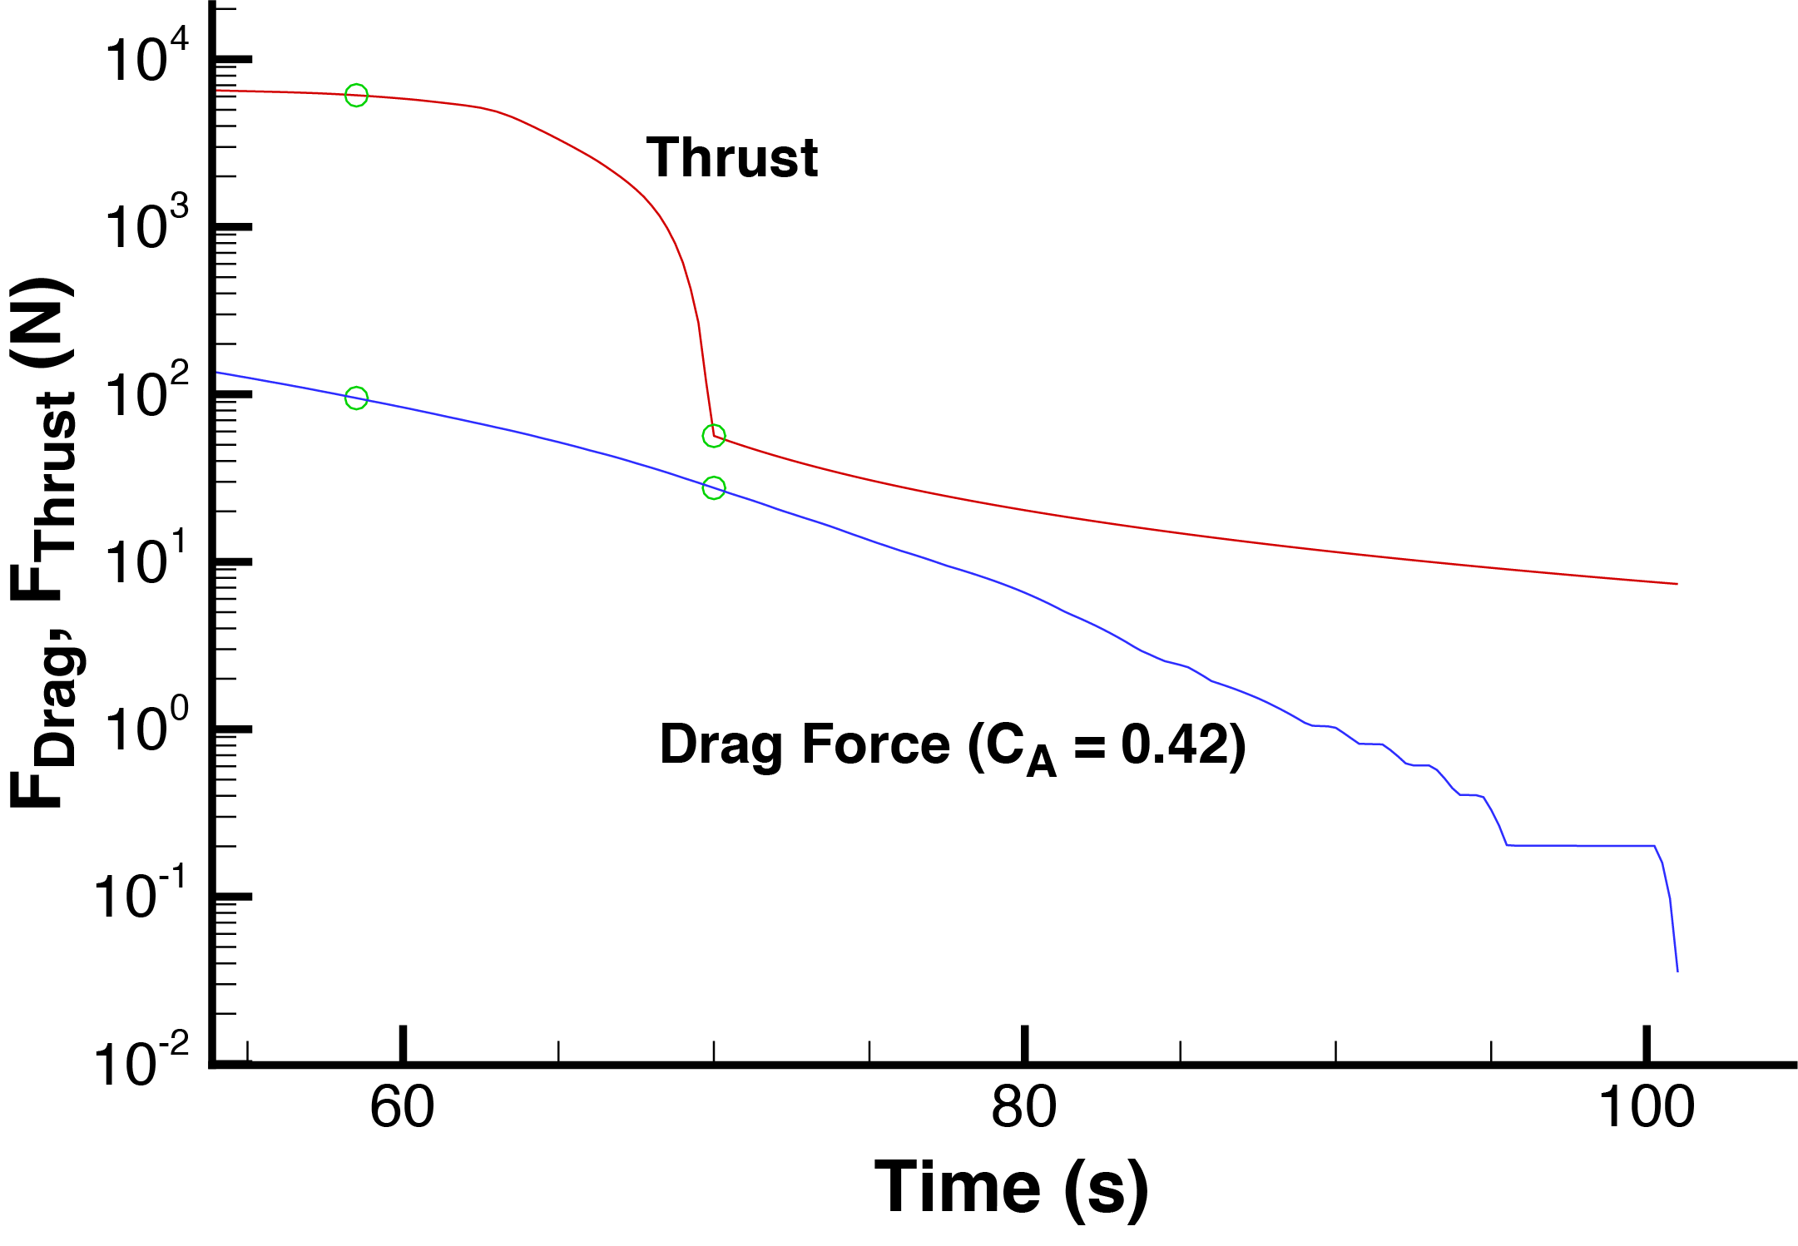
Reference Trajectory
At MECO, thrust and aero forces are changing rapidly. Trajectory may determine where RCS is active and if aft ramp is necessary
What is the variation in thrust fall-off of SRM1?
What is the variation dynamic pressure history (velocity, altitude and flight path angle) at MECO?
Current studies are investigating how flight performance is affected by aerodynamic considerations in this dynamic region
For ascent performance, Thrust dominates aerodynamic forces
Reasonable drag stability predictions and are sufficient for trajectory design
(Still pay attention to RCS interactions, roll torques from protuberances, etc.)

Slide 8
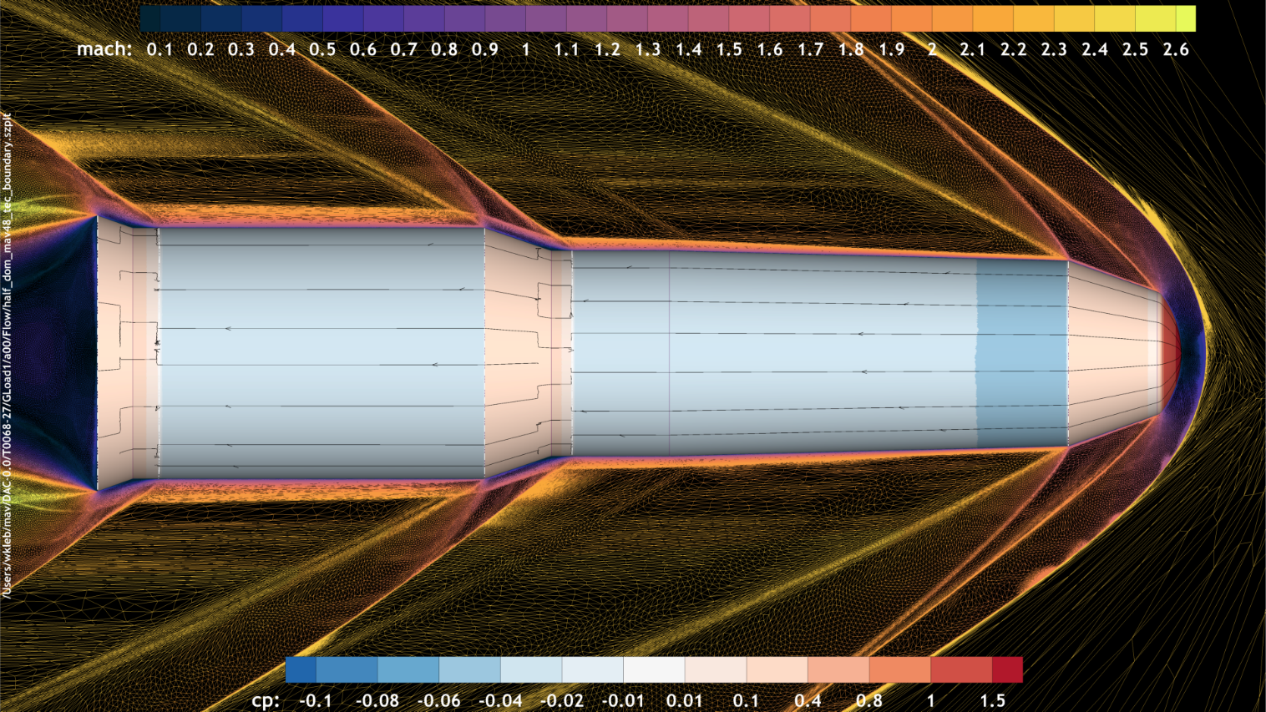
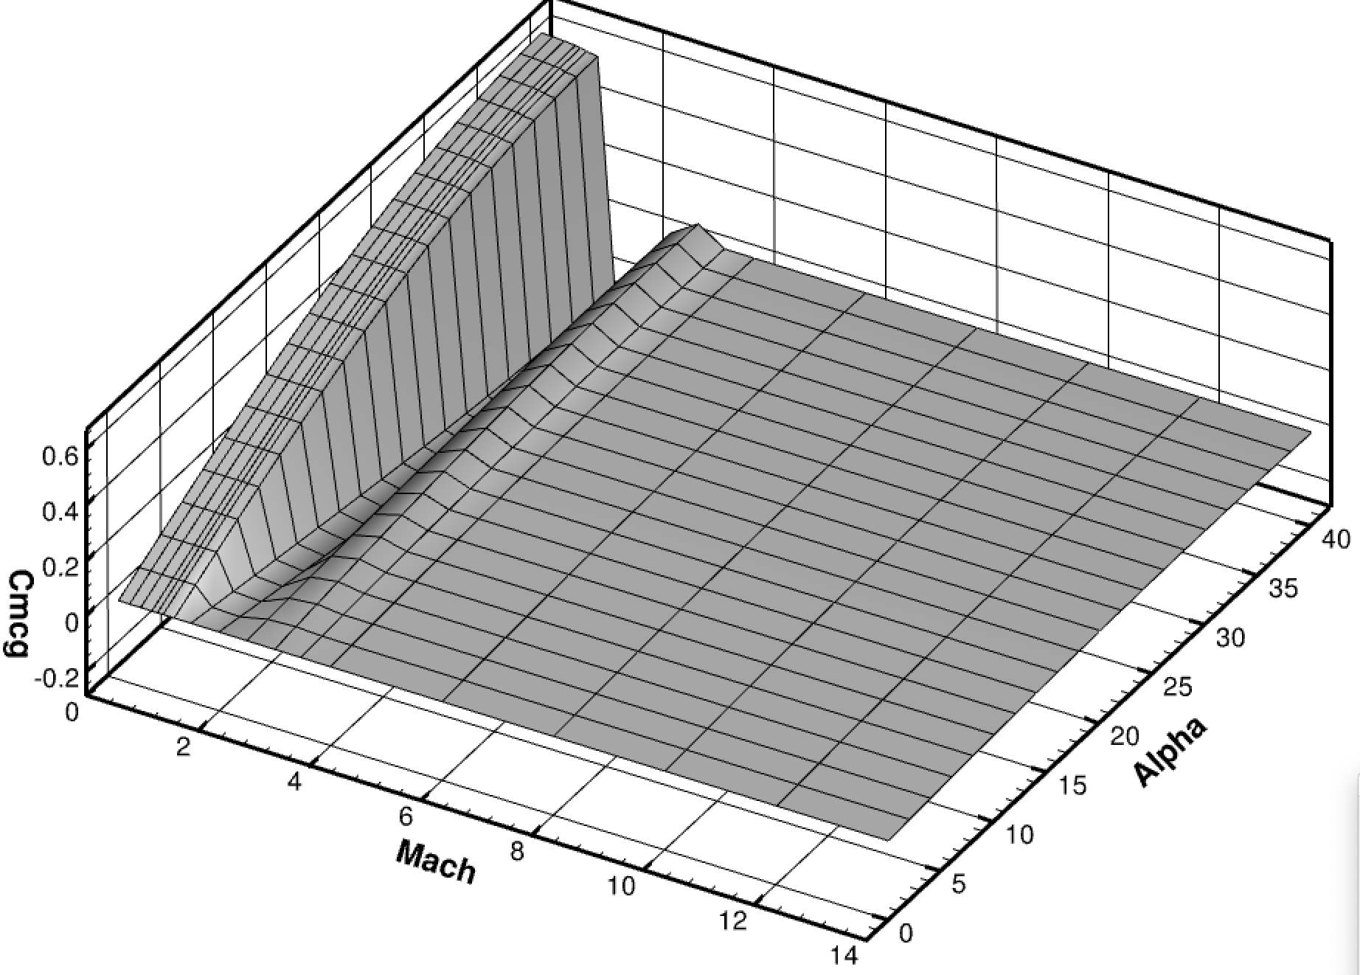
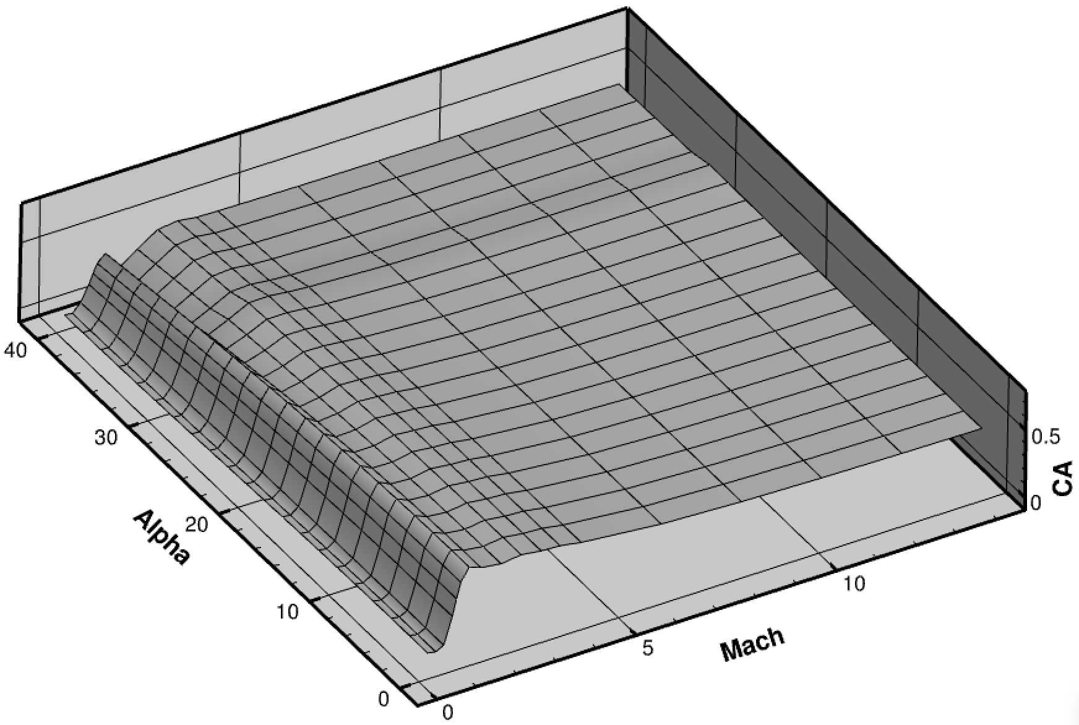
Aerodynamic Tools For Aerodatabase
Missile Datcom (phased out for most part)
Mach: Low subsonic through Hypersonic
Total angle of attack: 0°– 40°
Geometry based on key breakpoints of DAC 0.0 geometry
Aerodynamics based on engineering methods (Empirical charts or slender body theory for transonic or lower, modified Newtonian aerodynamics at high supersonic and hypersonic Mach)
Results sensitive to settings. Small vehicle features (like PLA sphere/cone transition) can have large ramifications on results
FUN3D (Sketch to Solution)
Navier-Stokes 3D unstructured grid flow solver
Currently running SA-RC-QCR2000 turbulence model
Thermally- and calorically-perfect gas (fixed γ = 1.293)
Agency workhorse tool for SLS ascent aerodynamics, including booster separation

Slide 9
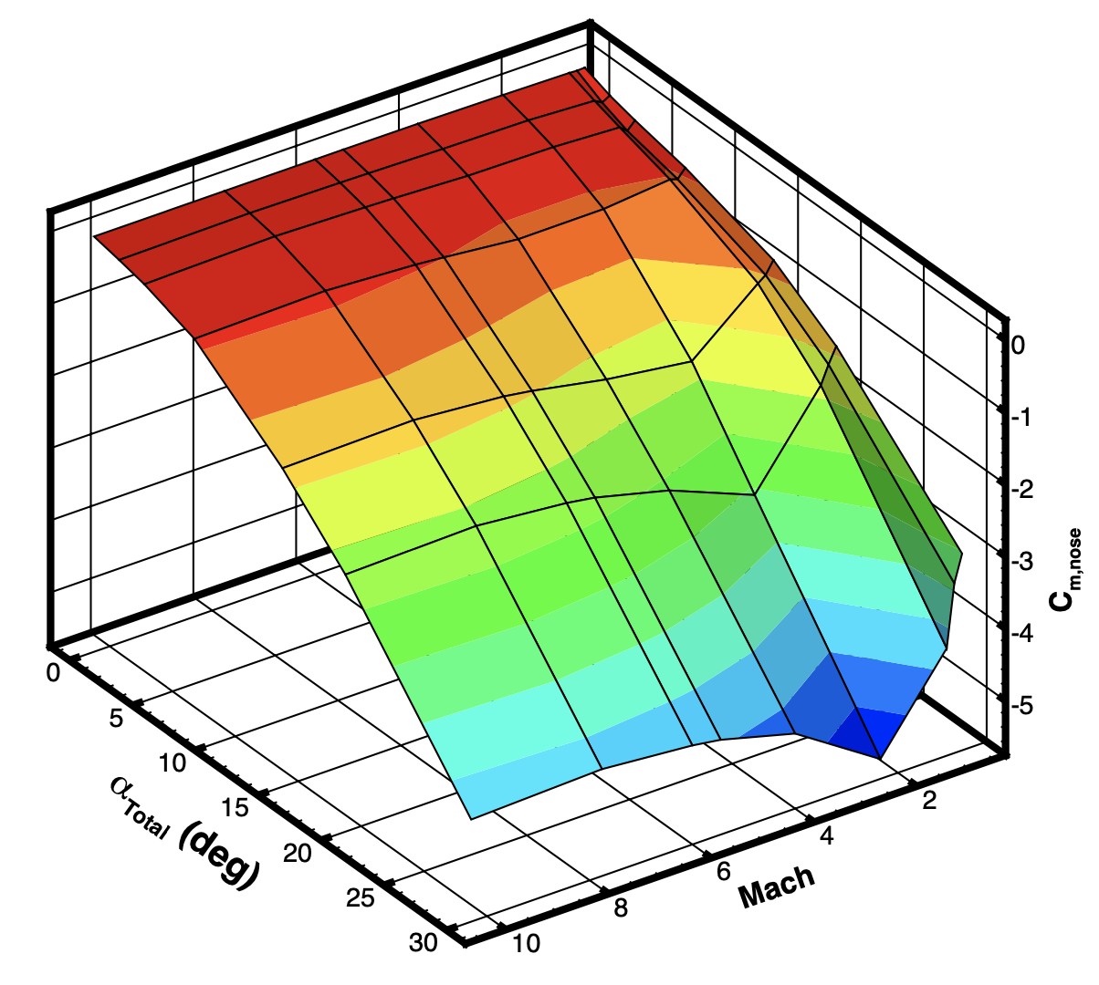
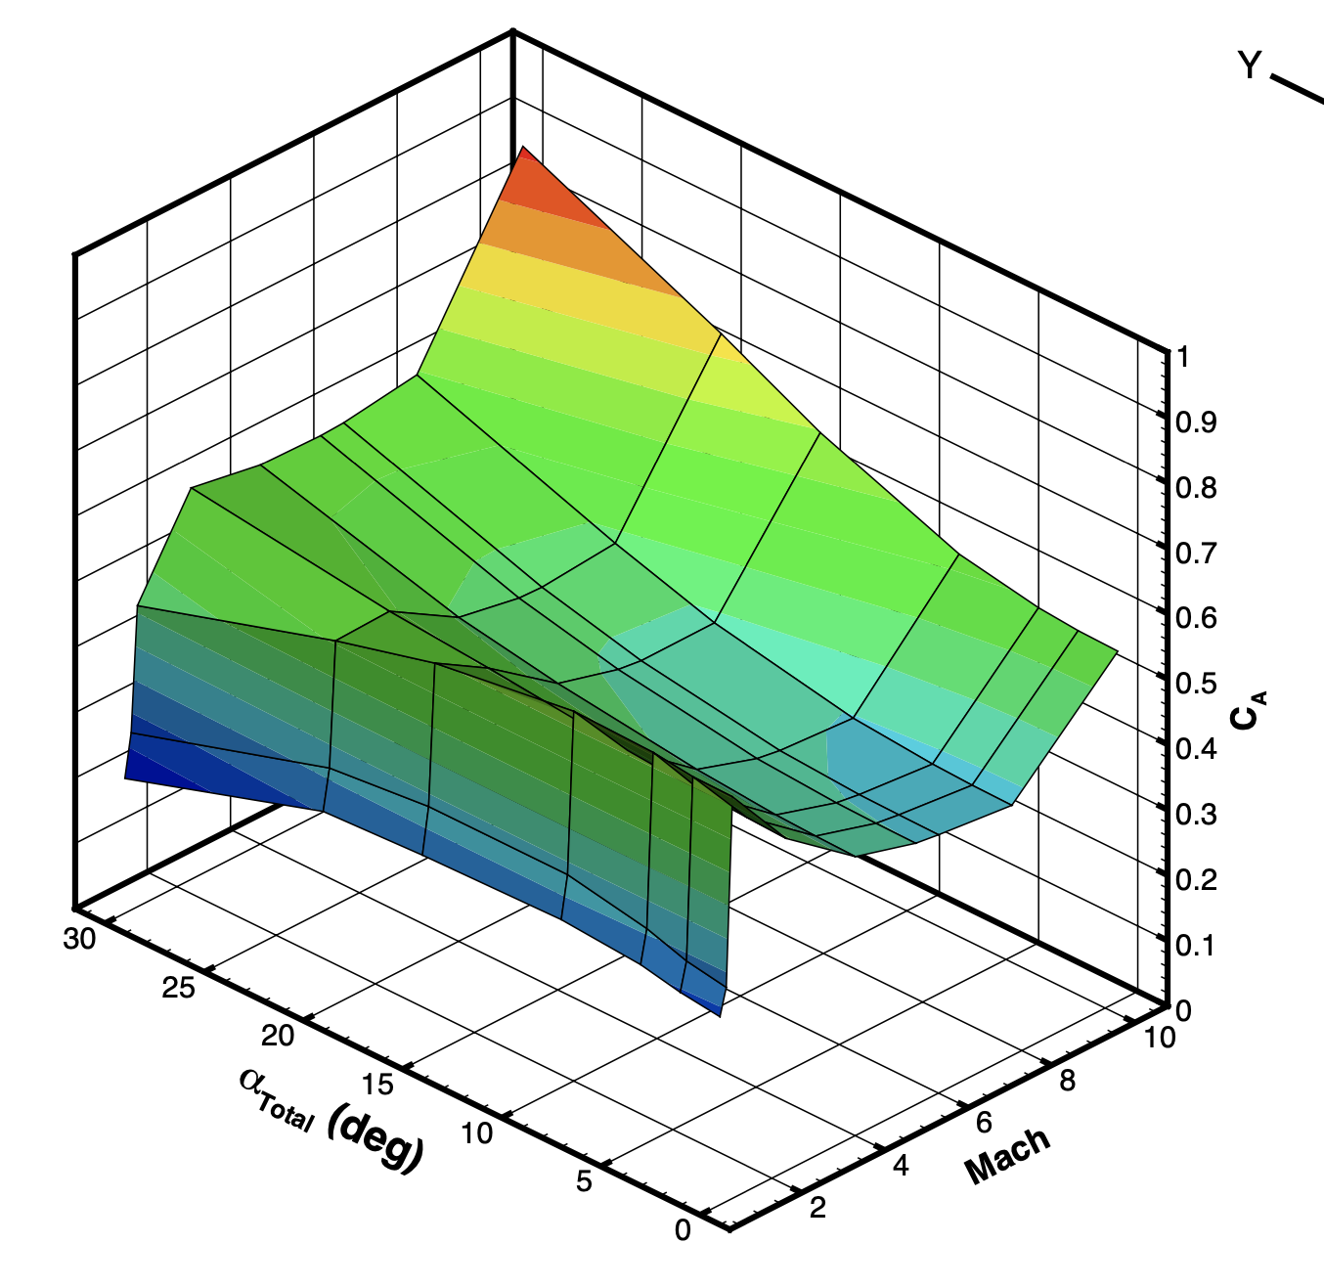
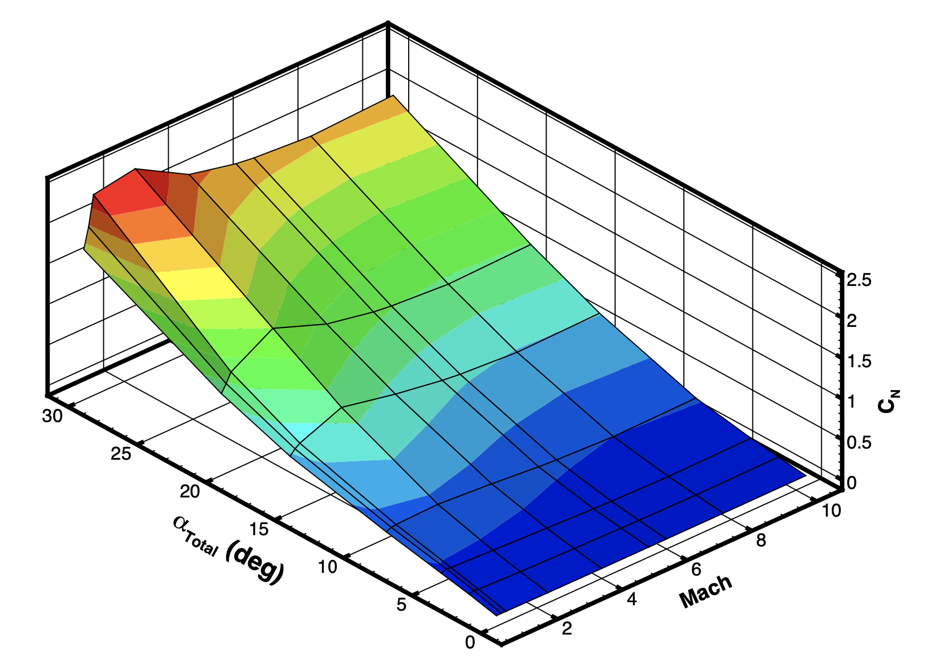
Aero Database/Simulation Interface: FORTRAN
FUN3D Aerodynamic Database
Higher fidelity data including Protuberances
Trajectory conditions taken from prior SRC Trajectory (01-25-2021) pending update for PDC vehicle
Mach = 0.75, 0.901, 1.050, 2.341, 4.002, 5.450 (Peak Q), 6.001, 7.760, 10.306
Total angle of attack: 0, 2, 8, 15, 20, 30
CFD run on PDC with protuberances and SRM1 Nozzle, modeled as axisymmetric (future releases will be function of total angle of attack and roll angle, output as 6-DoF coefficients in body coordinates)
FUN3D
Navier-Stokes 3D unstructured grid flow solver
Currently running SA-RC-QCR2000 turbulence model
Thermally- and calorically-perfect gas (fixed γ = 1.293)
Agency workhorse tool for SLS ascent aerodynamics, including booster separation

Slide 10
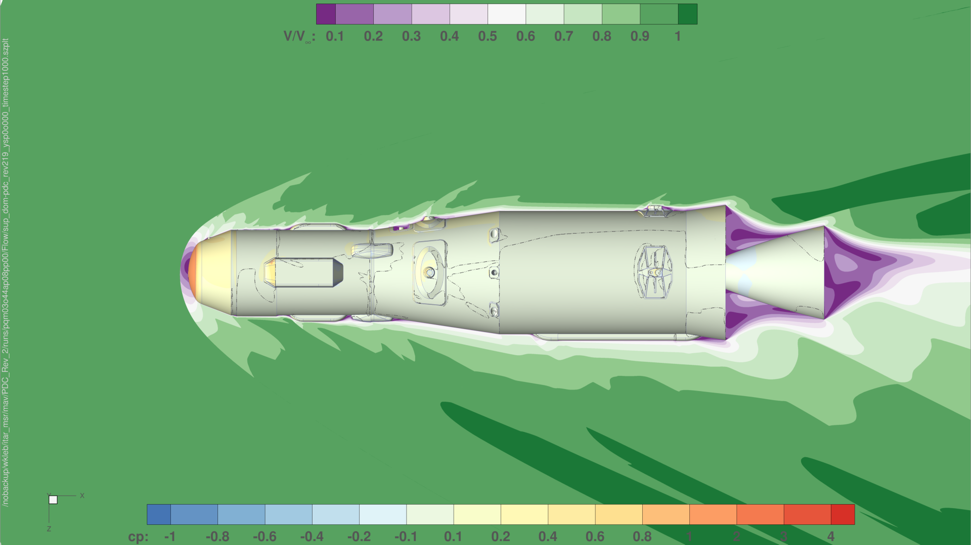
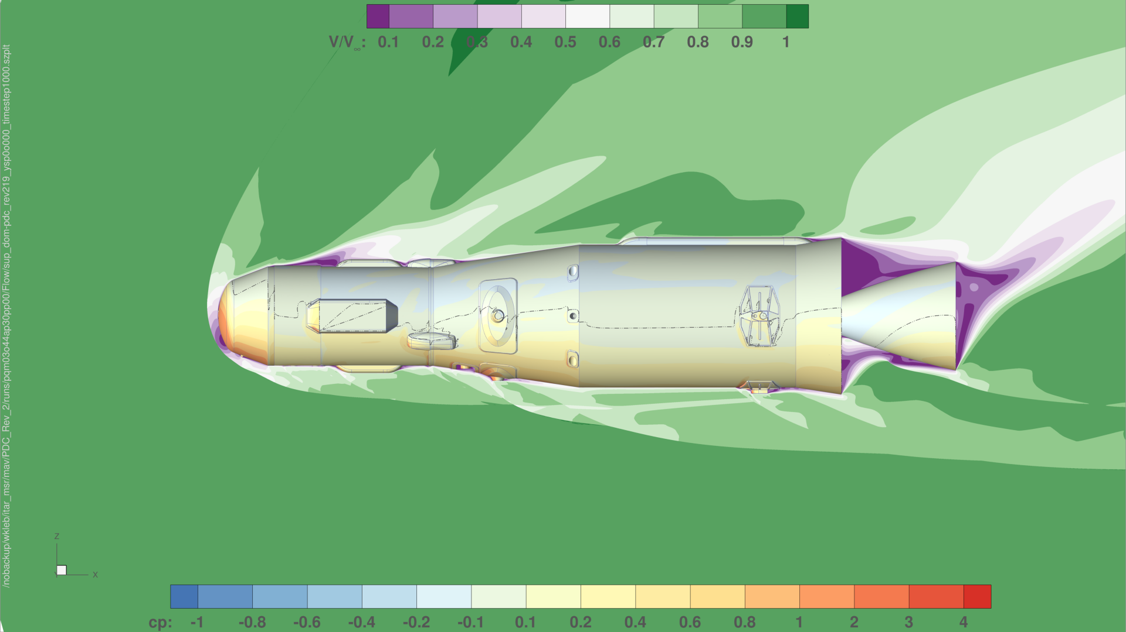
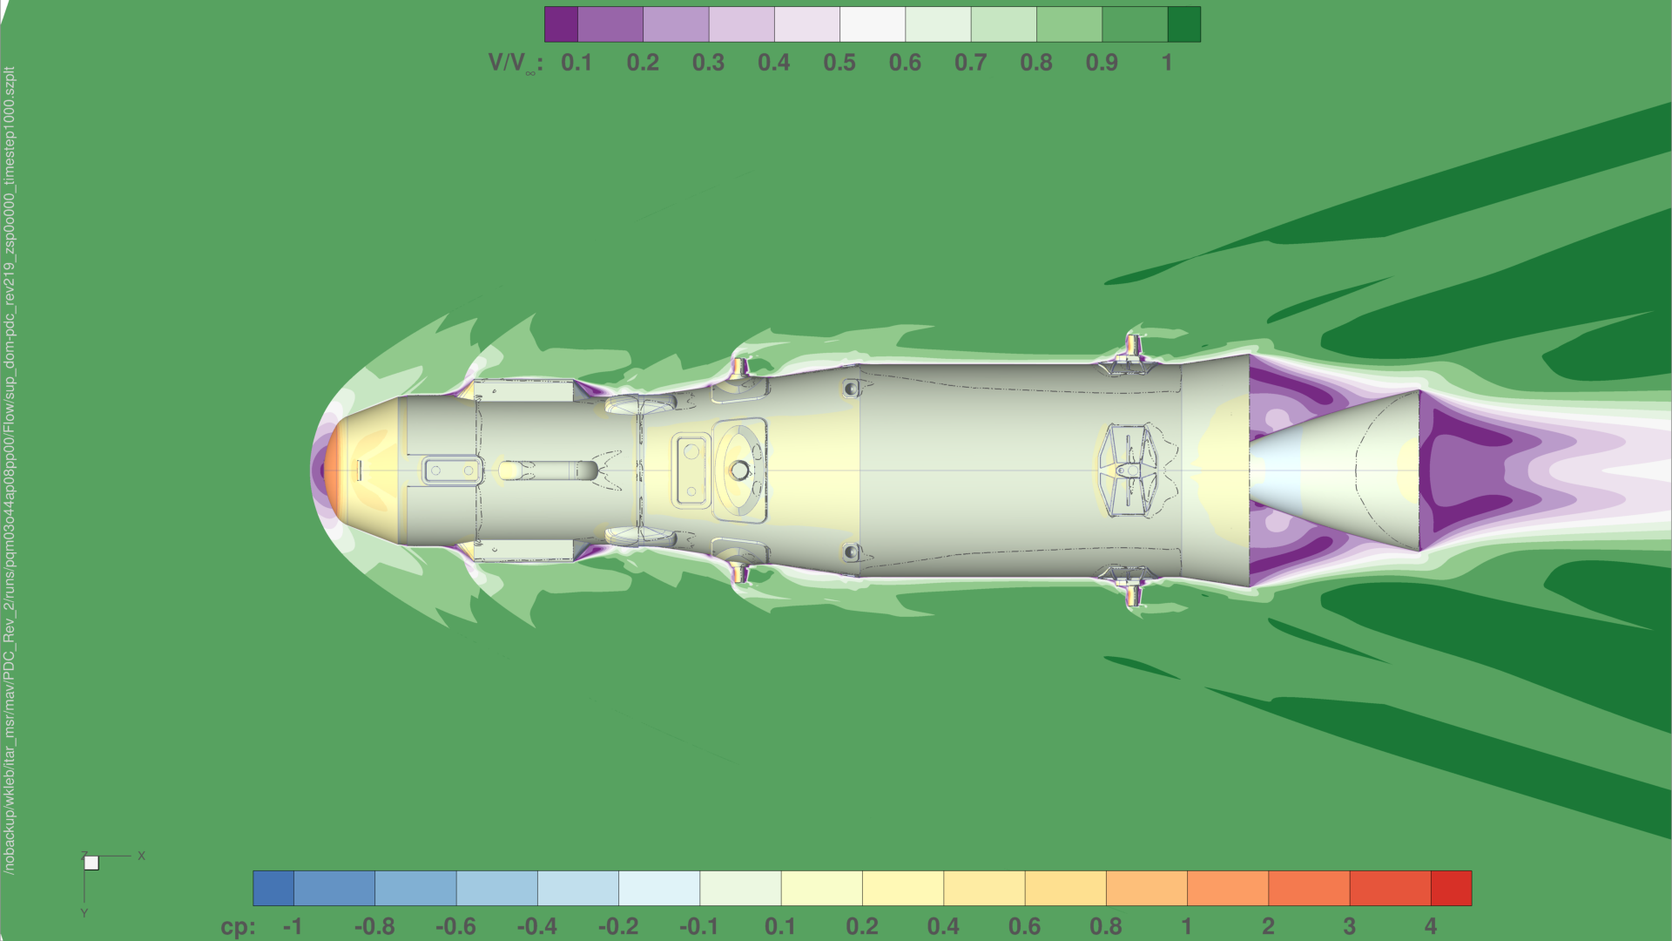
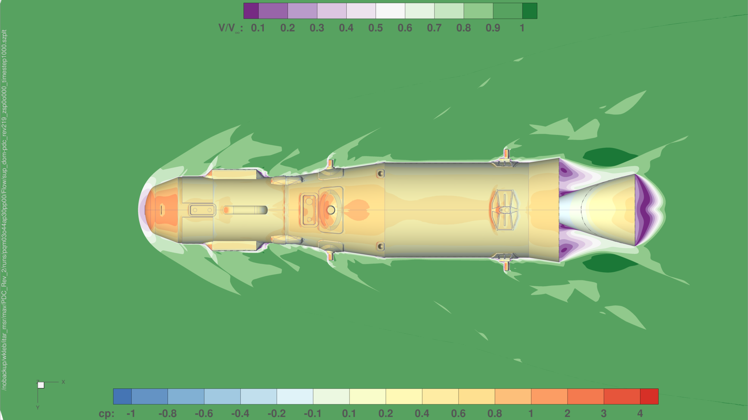
PDC Rev 2 FUN3D Aerodatabase Cases
Peak Dynamic Pressure, Alpha = 8
Peak Dynamic Pressure, Alpha = 30

Slide 11
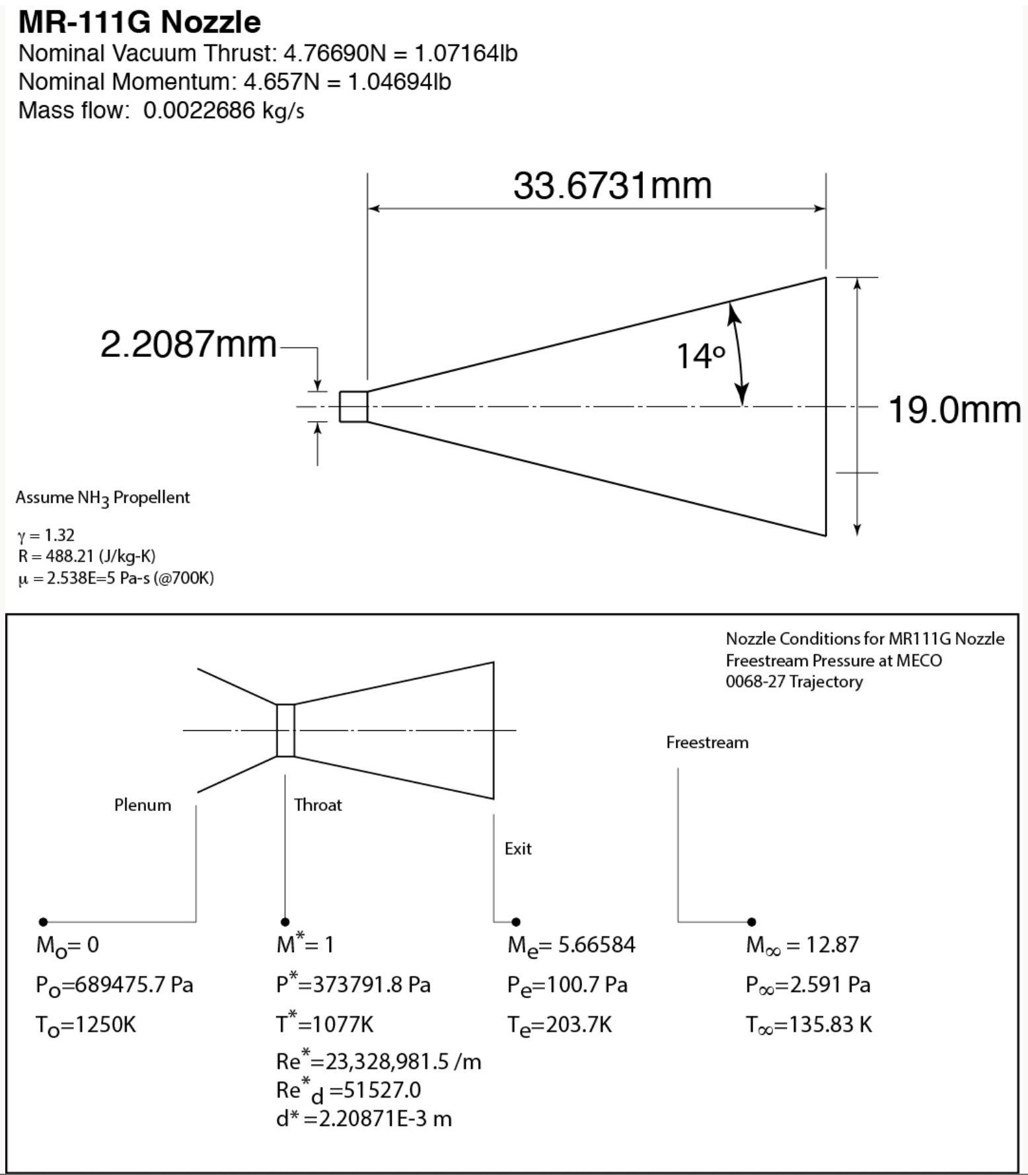
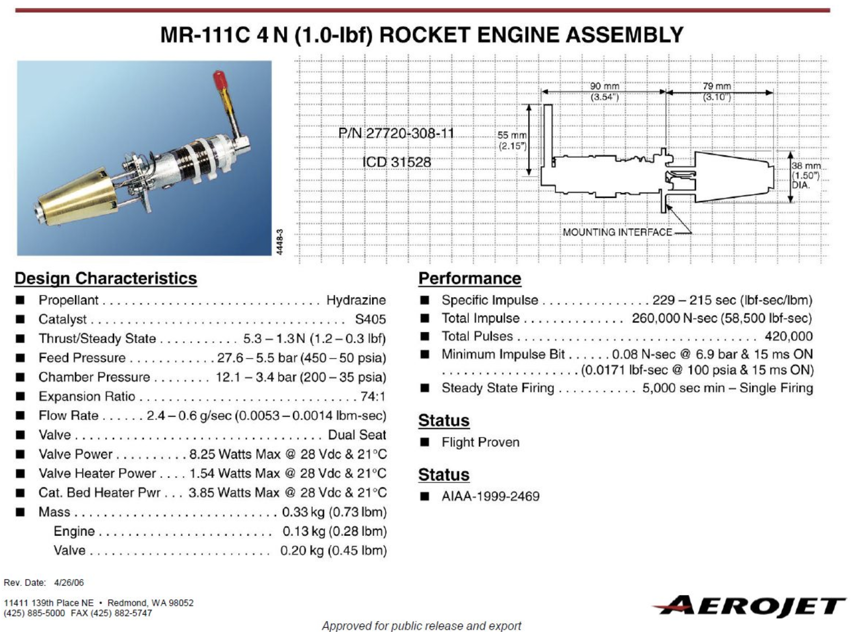
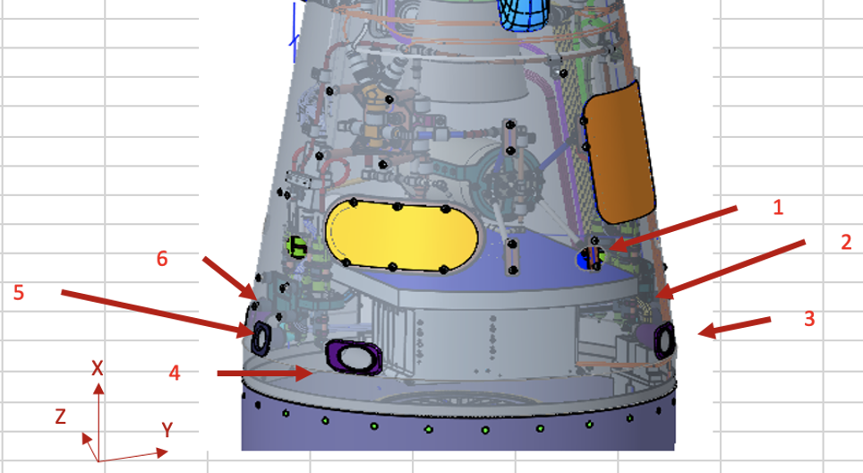
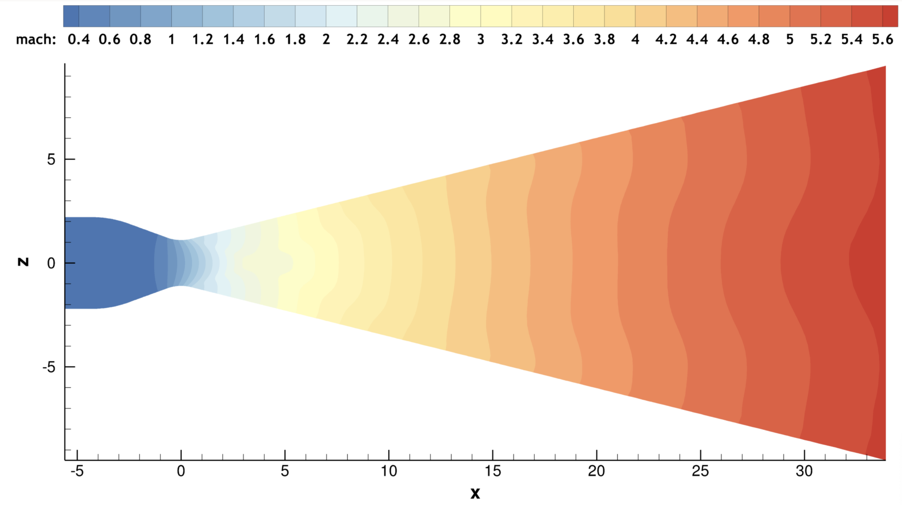
RCS Jet Interactions: Engine Simulation
Engine information on public website
First nozzle designed for FUN3D CFD, based on publicly available data (Aerojet website) for 4N engine
1-D Nozzle equations for chamber, throat and exit conditions in FUN3D solutions
Conditions modified to run with single gamma FUN3D solution
Standalone nozzle calculations agree with 1-D equations to within 1-2%
SRC 2.0 RCS Jet Interaction Cases have been run (interactions being calculated )
RCS engine have very large expansion
Aero team is investigating nozzle flow to assess confidence in exit flow and plumes
RCS interaction and engine flow findings will inform analysis on PDC vehicle, when RCS configuration is provided
FUN3D solution

Slide 12
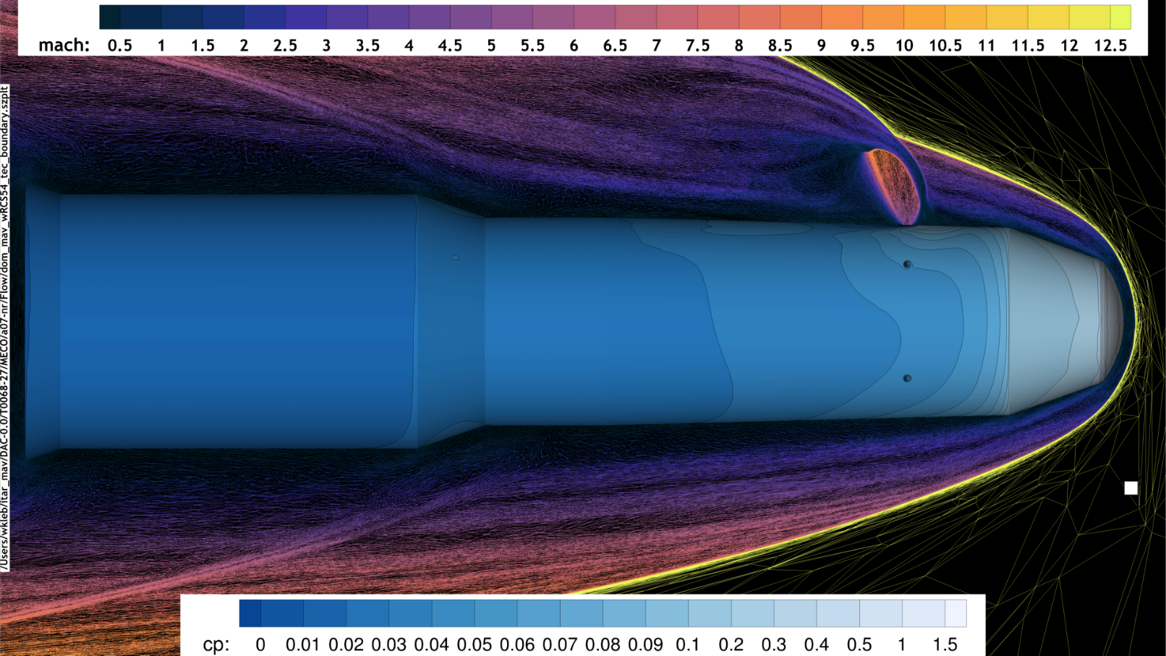
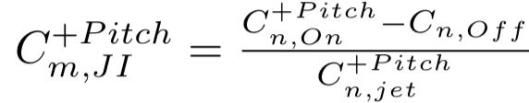
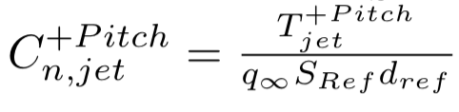
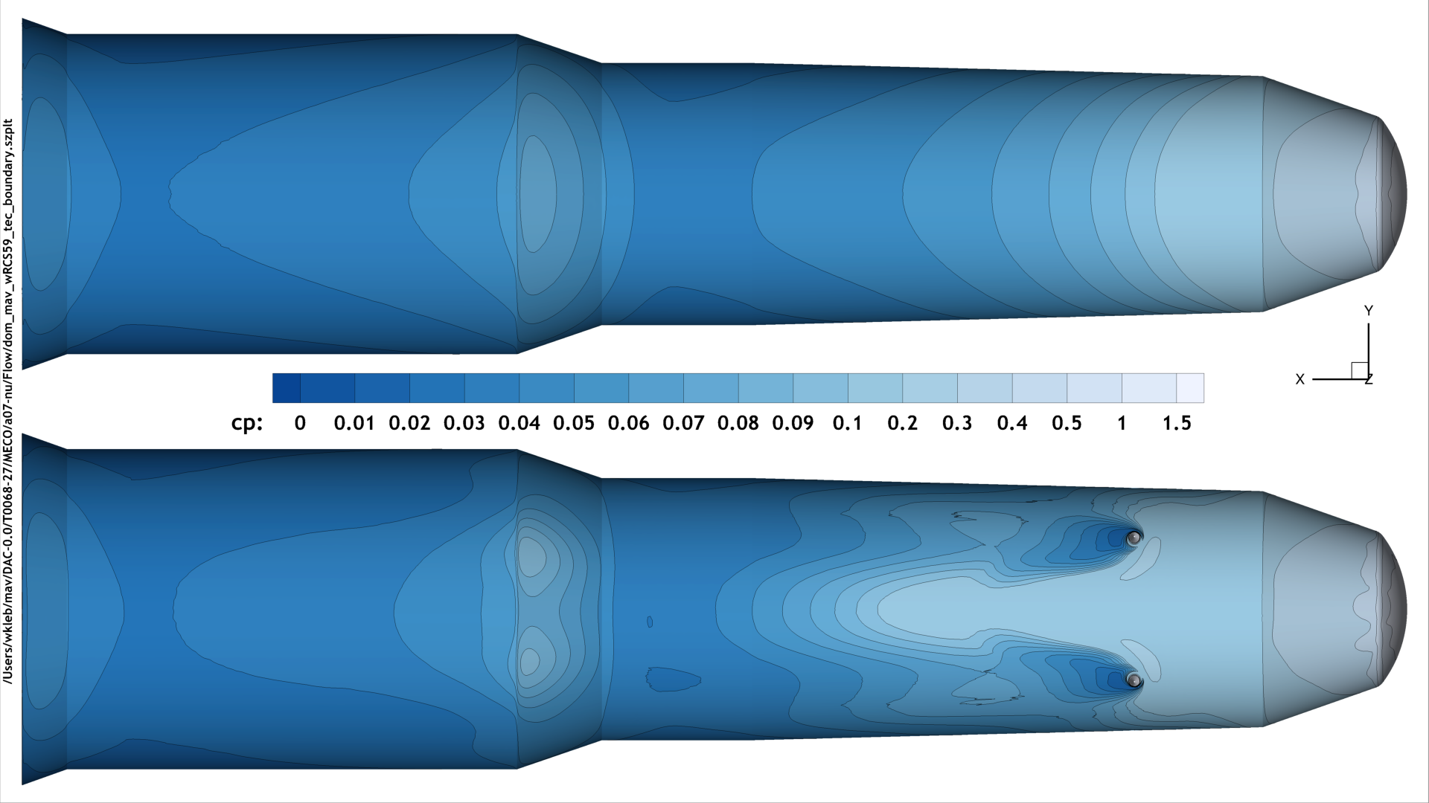

Aero/RCS Interaction Prediction/Calculation
Preliminary DAC 0 RCS cases run at MECO conditions,
α=0, 6.9°, Mach = 12.86, Q=257Pa
+Pitch, -Pitch, +Yaw (Nose Right), +Roll
Jet interactions described in terms of ideal jet authority
MECO, a = 7°
Nose-right jet
Plumes stagnate flow ahead of RCS and disrupt flow downstream
Example Jet Interaction Calculation
MECO, a = 7°
Jet interactions calculated to date all augment commanded authority
Augmentations range from +4% of commanded torque up to +40%, depending on jet and vehicle attitude
Pitch-up jets
Net high-pressure region ahead of cg augmenting RCS authority

Slide 13
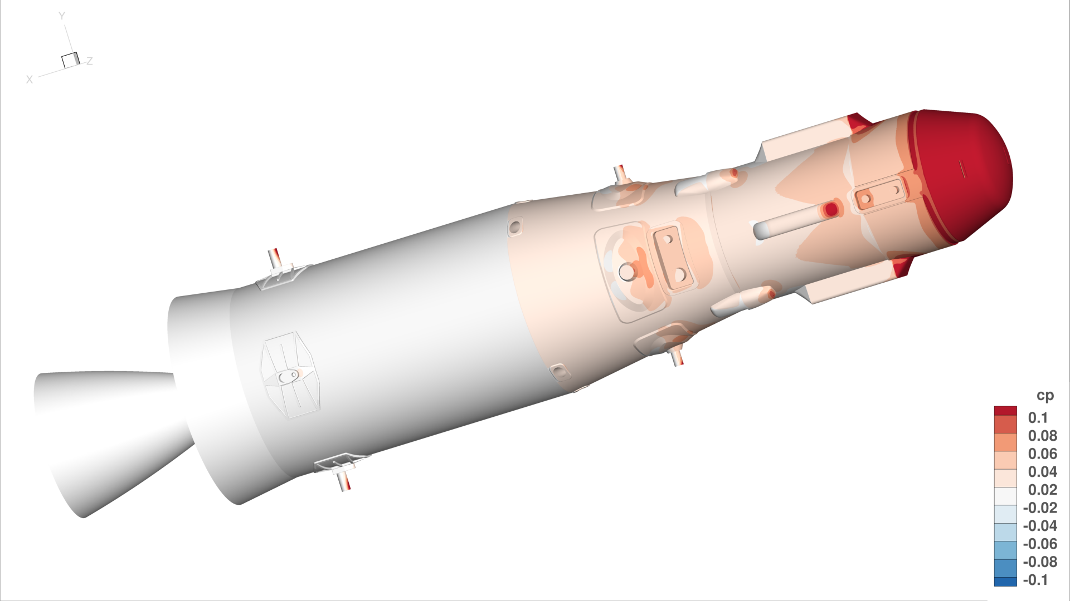
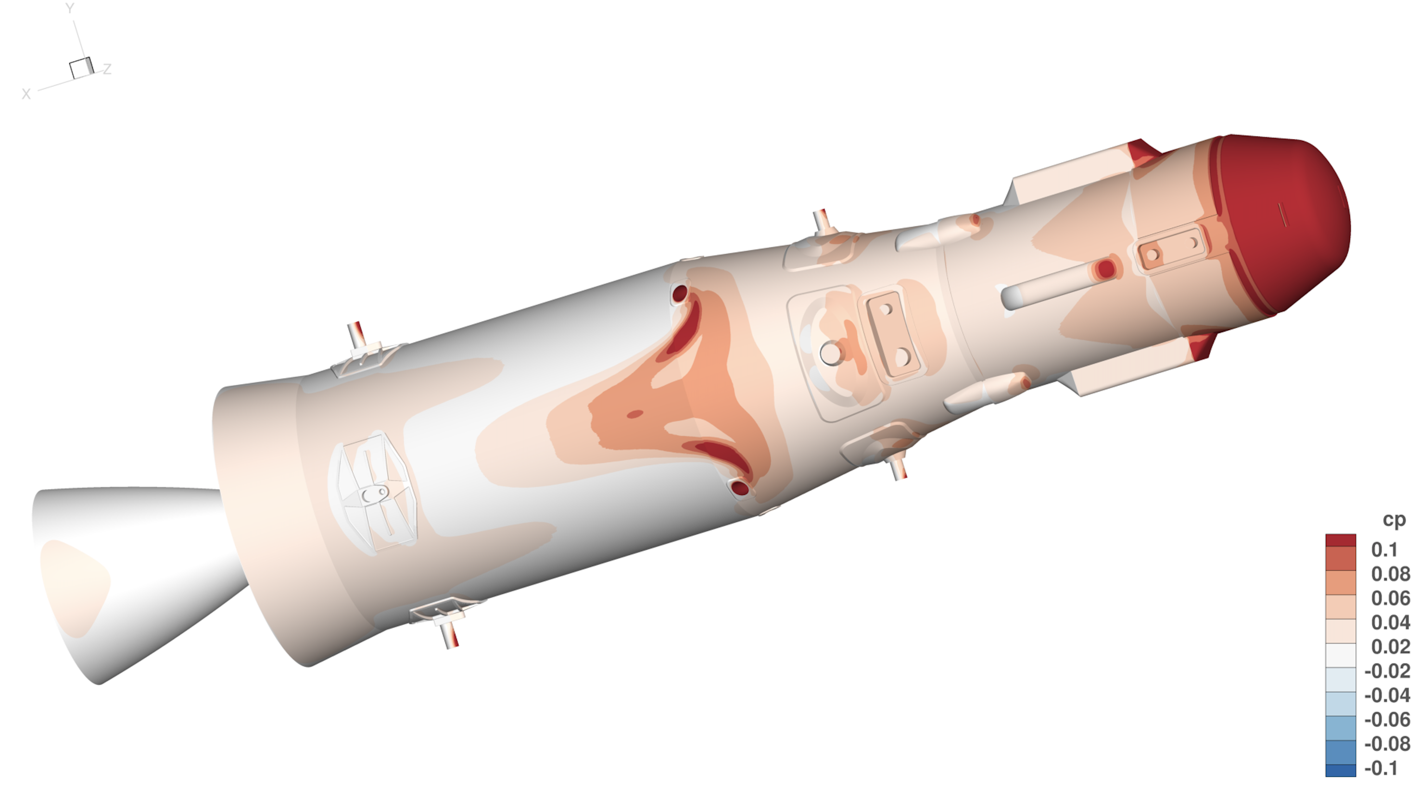
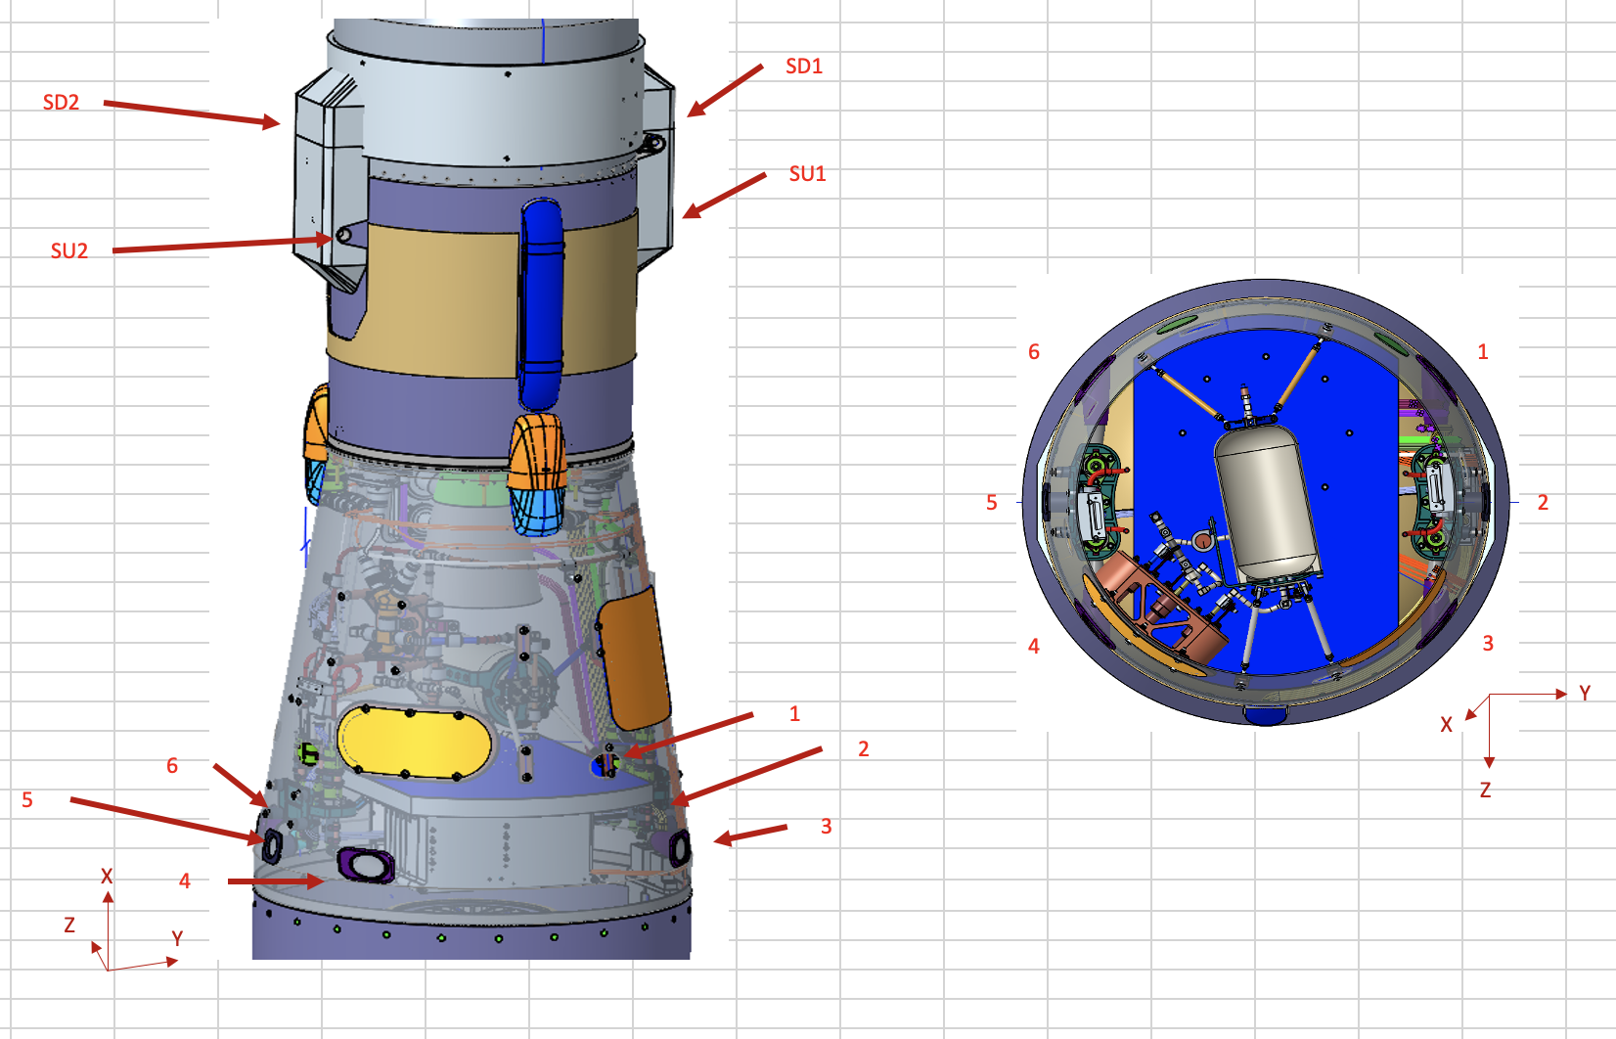
RCS Jet Interaction Calculations
FUN3D CFD analysis conducted to investigate aero/RCS Jet Interactions, compared to RCS torques
Jets Off
RCS Configuration
Notes:
Geometry assembled from sketches, drawings, and email exchanges, and codified in Engineering Sketch Pad file mav-dac0p0.csm

Slide 14
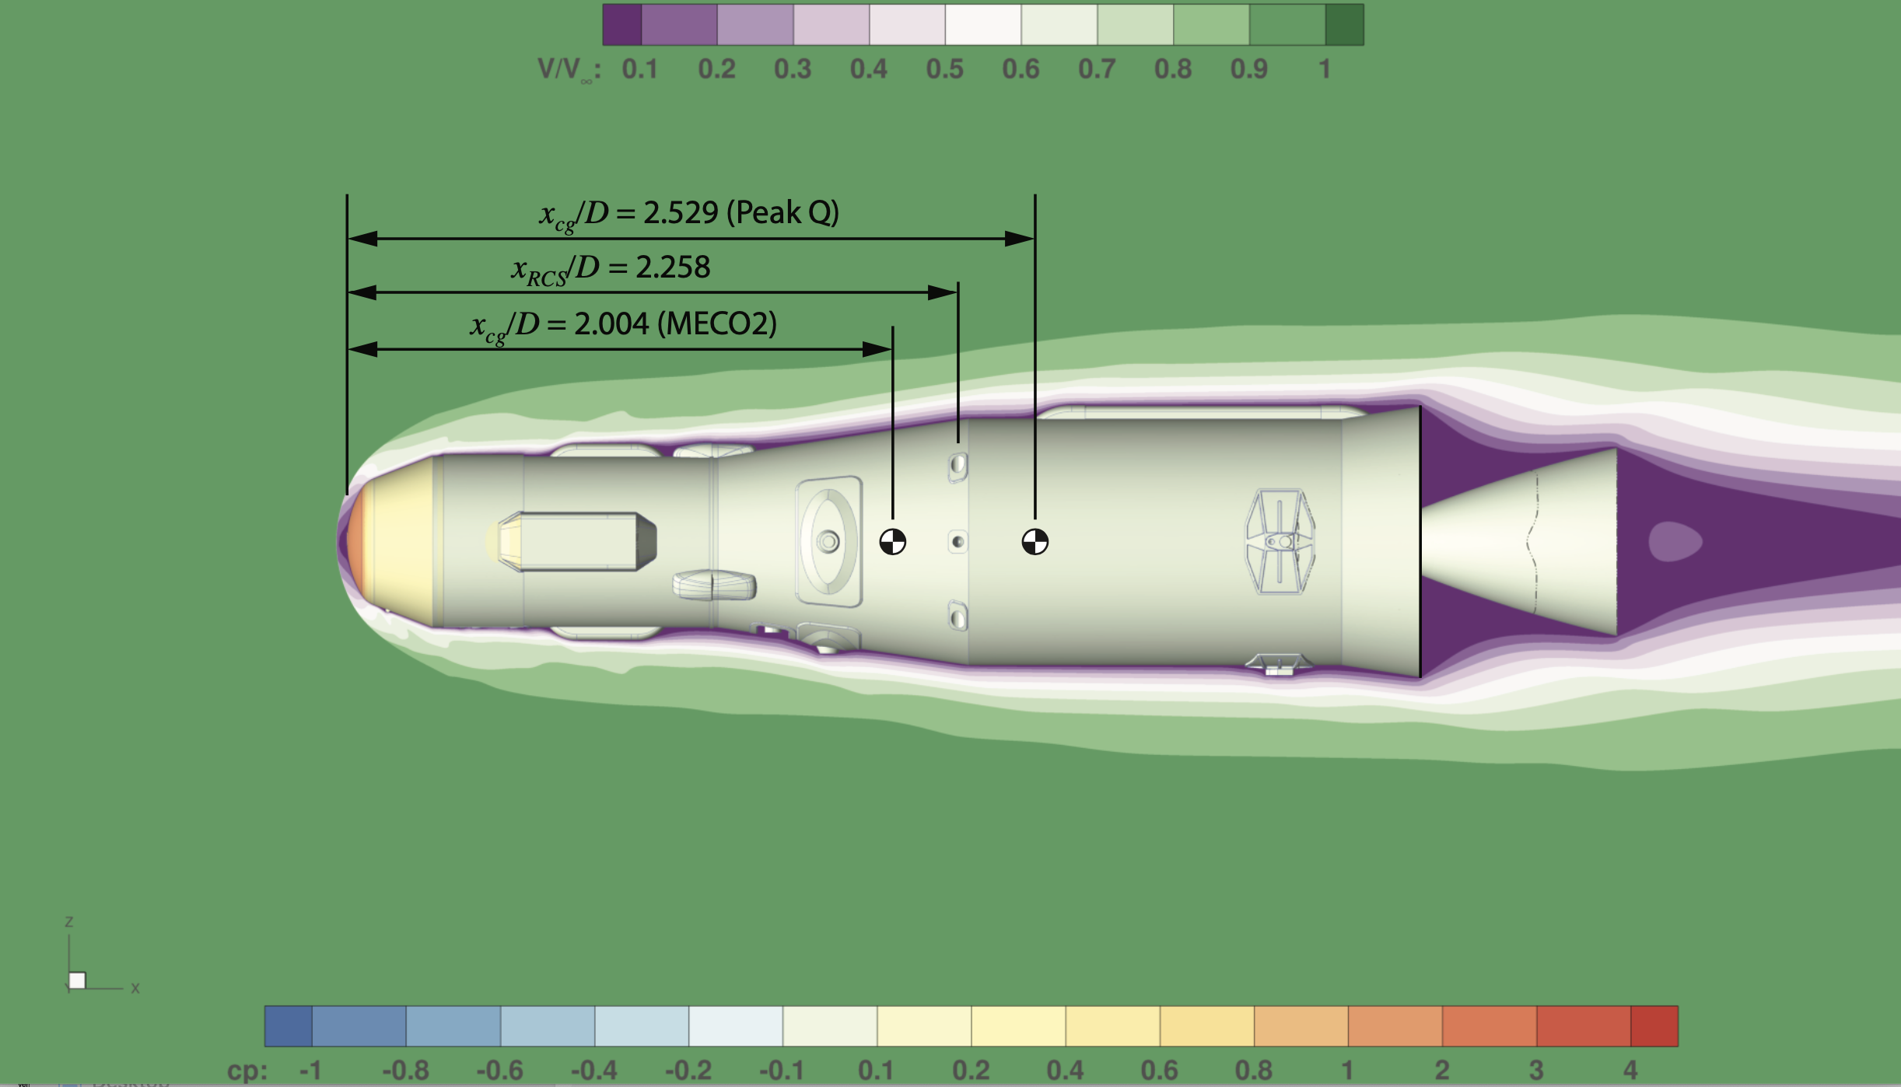
Center of Gravity Shift During SRM1 Burn
RCS configuration moves from aft of RCS jets to ahead of jets during burn
Pitch and Yaw jets are not nominally active during majority of this cg shift.
Final cg location provides small moment arm for pitch/yaw jets (~15cm)
Notes:
Geometry assembled from sketches, drawings, and email exchanges, and codified in Engineering Sketch Pad file mav-dac0p0.csm

Slide 15
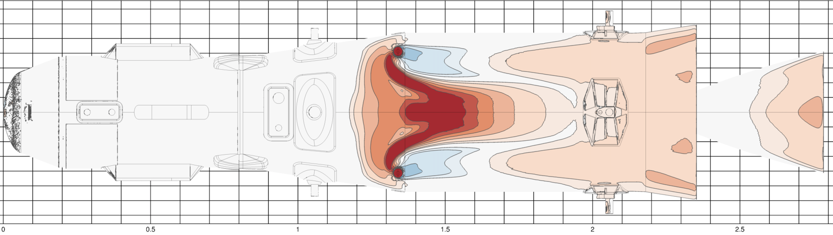
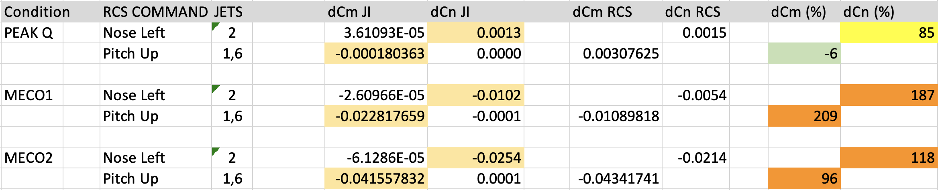
Jet Interaction Calculations from CFD
MECO2 Jets 1,6 PitchDown
Example contour plot of dCp = Cp(jet-on) – Cp (jet off)
Notes:
Geometry assembled from sketches, drawings, and email exchanges, and codified in Engineering Sketch Pad file mav-dac0p0.csm

Slide 16
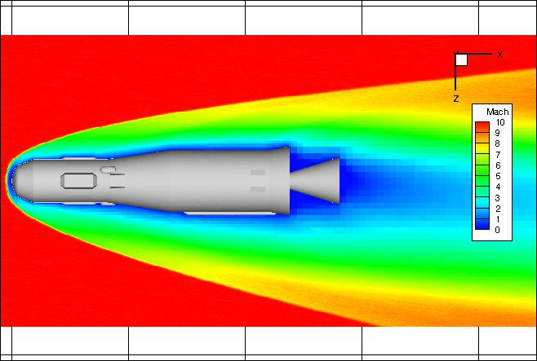
MSR MLS Rarefied Aerodynamics
Low Density Aerodynamics are Modeled using DSMC Methods (needed before MECO for some trajectories)
MAP DSMC Solver
  Morton Octree Cartesian grid for flow field; separate unstructured surface grid
  Dynamic adaptation (flow field grid, local time step, surface temperature)
  Nonequilibrium internal energy relaxation (rotation, vibration, electronic) and chemistry
Simulation Parameters
  X_{CO2} = 0.9537; X_{N2} = 0.0463 (total of 9 species; VSS parameters tuned to match LAURA transport props.)
Time (s) | α (deg) | ρ (kg/m³) | T (K) | V (m/s) | Kn_{D}
75.03 | 0,4,10 | 2.1915e-5 | 139.3 | 1927.2 | 0.0046
89 | 0,4,10 | 2.1588e-6 | 129.1 | 1842.7 | 0.0457
103 | 0,4,10 | 2.3030e-7 | 119.8 | 1814.3 | 0.4187
116 | 0,4,10 | 2.1647e-8 | 120.3 | 1791.7 | 4.460
129 | 0,4,10 | 2.0105e-9 | 148.4 | 1778.5 | 51.14
145 | 0,4,10 | 2.2482e-10 | 165.7 | 1762.0 | 472.6
166 | 0,4,10 | 2.2036e-11 | 170.4 | 1722.0 | 4863.0
194 | 0,4,10 | 2.2837e-12 | 171.5 | 1667.8 | 47007.7

Slide 17
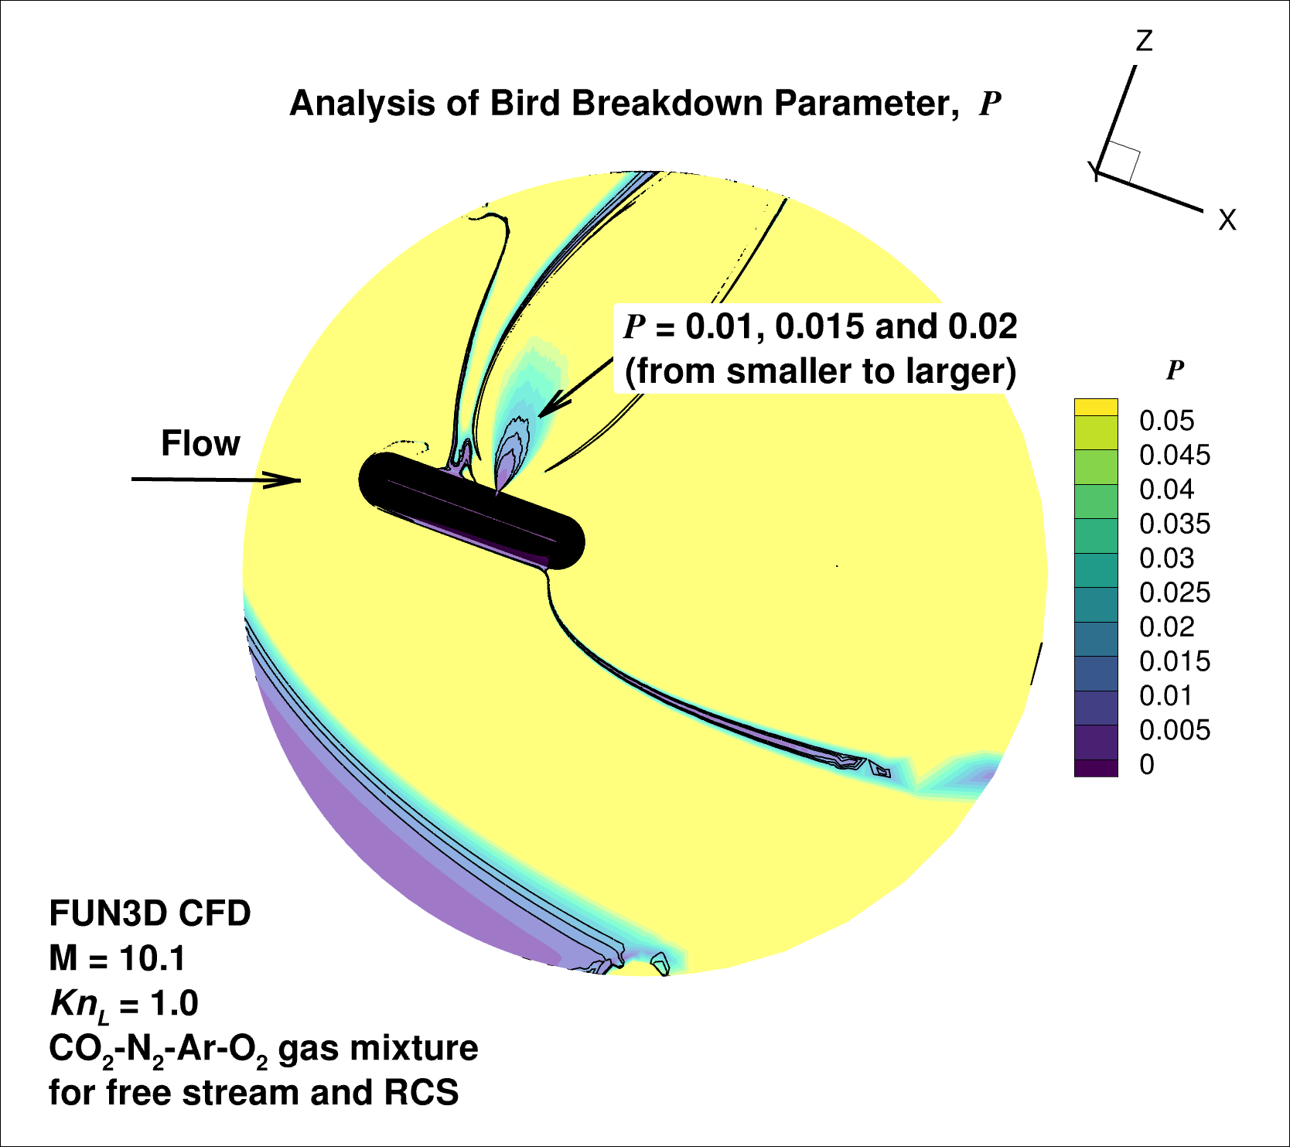
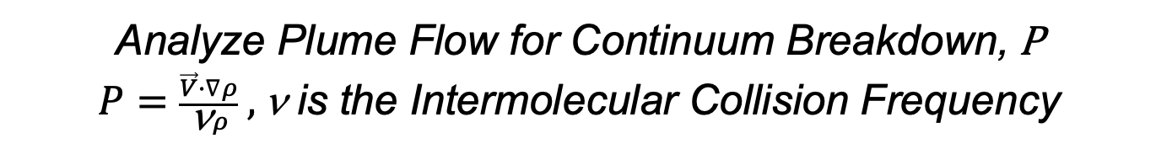
Analyze Plume Flow for Continuum Breakdown, P
$P=\frac{\vec{V}∙∇ρ}{\text{n}ρ} ,\text{n}$ is the Intermolecular Collision Frequency
Atypical Application, Usually Performed on a Freely Expanding Jet

Slide 18
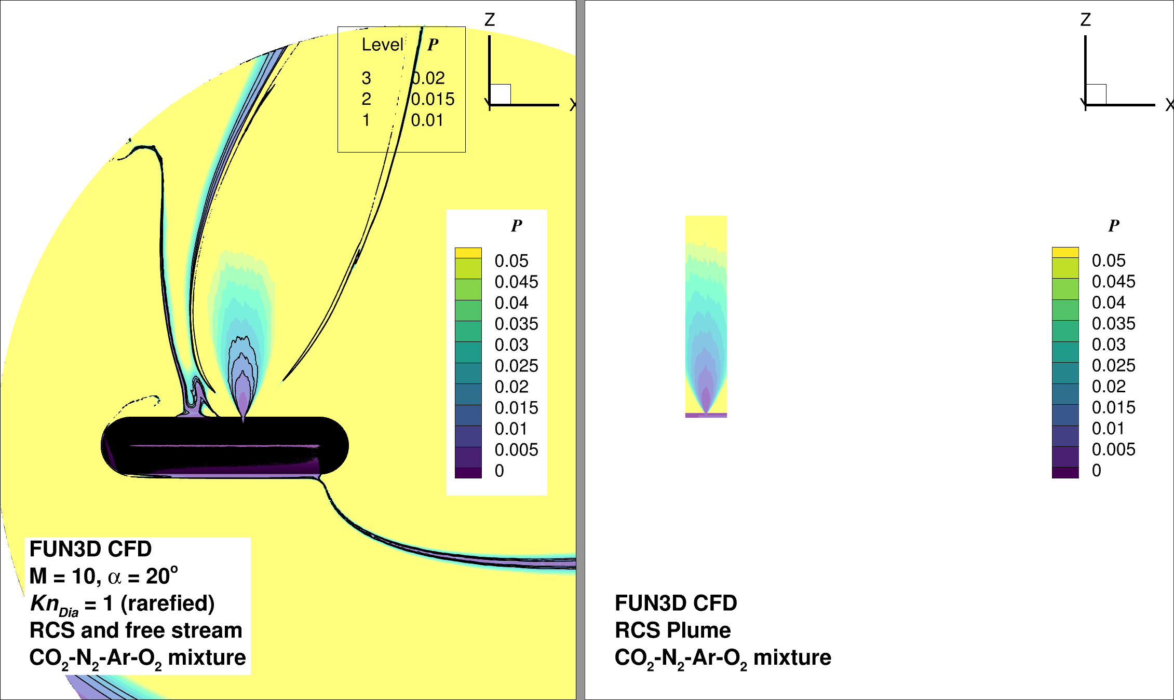
Separate Jet Plume from CFD solution
Nonuniform CFD solution
Separated Jet Plume
Notes:
Learning experience

Slide 19
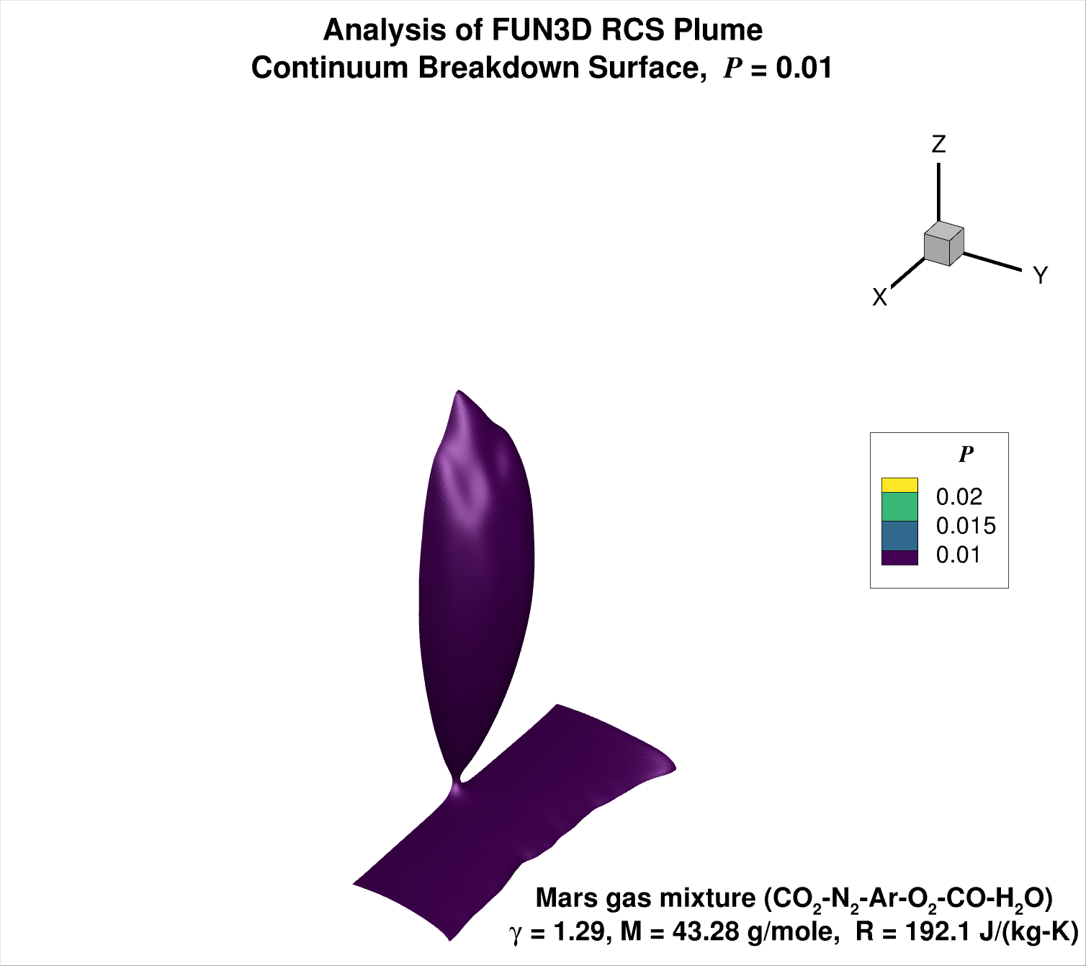
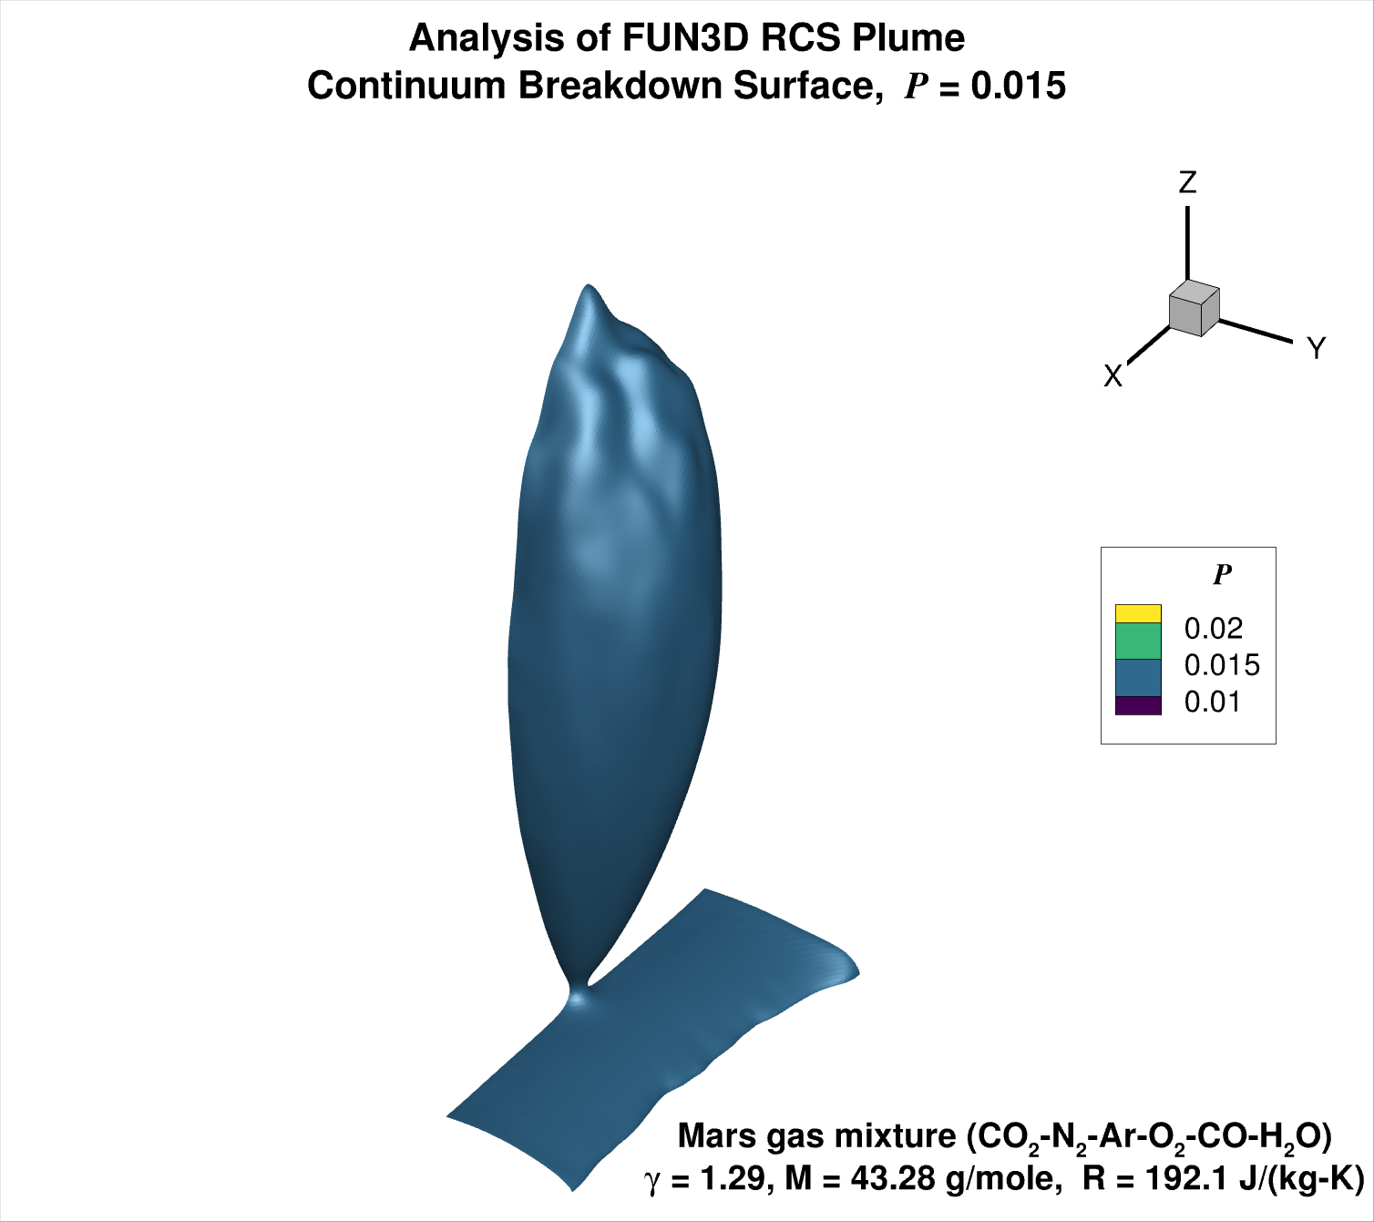
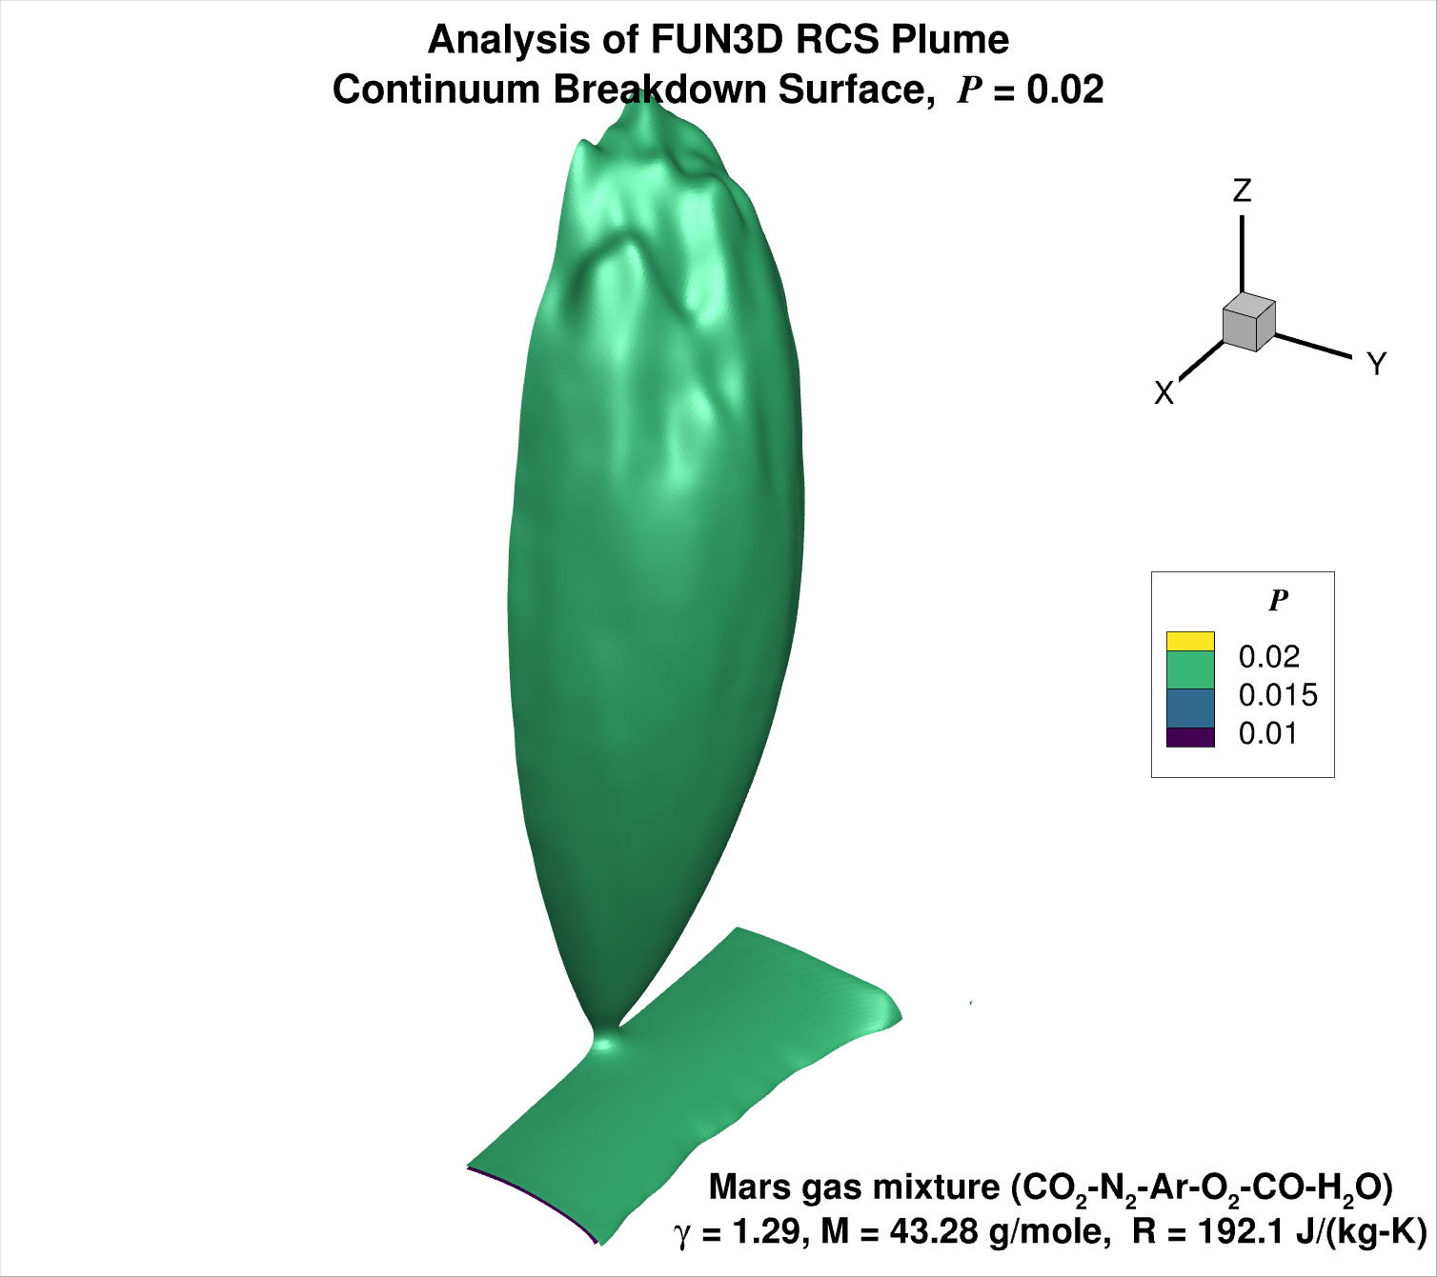
Analyze Jet Plume Flow and Identify
Continuum Breakdown Surfaces
P = 0.01
P = 0.015
P = 0.02

Slide 20
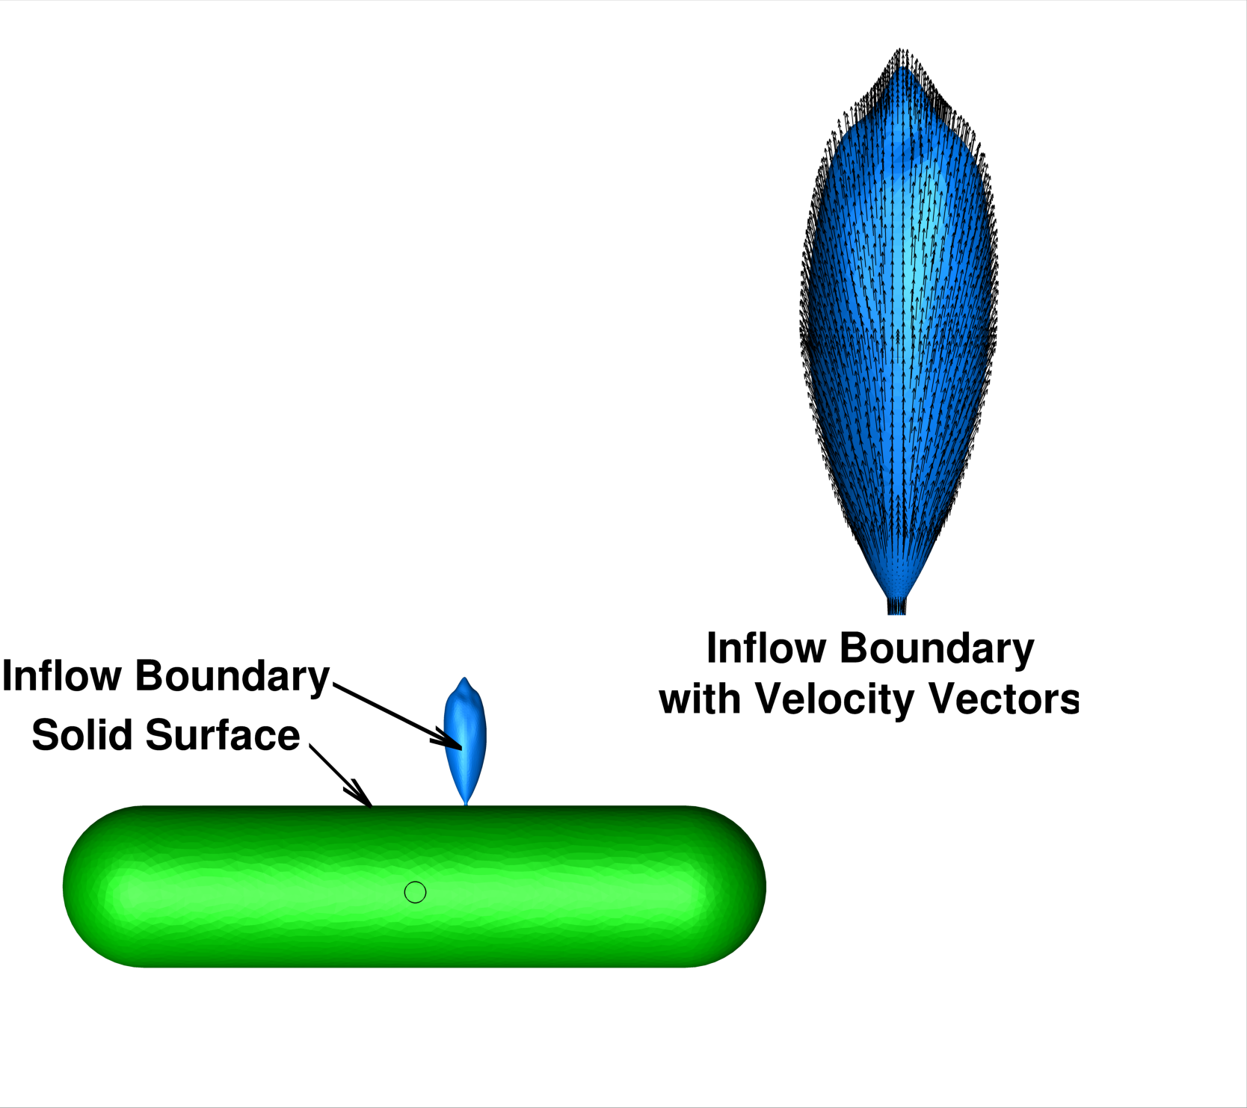

Modified DSMC file

Slide 21
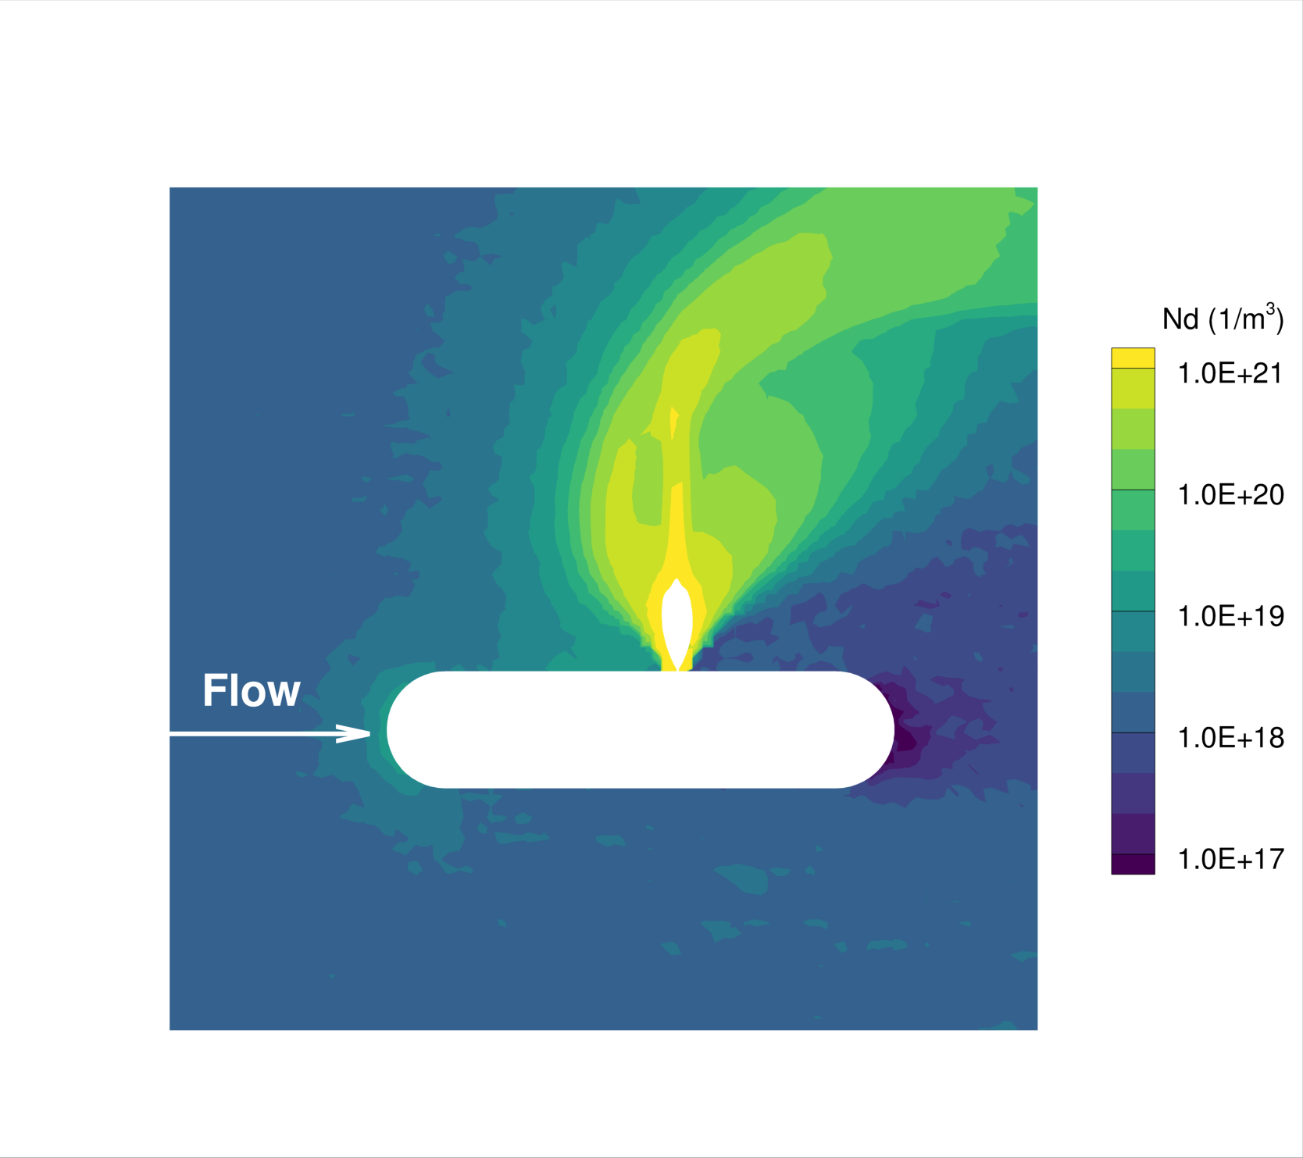
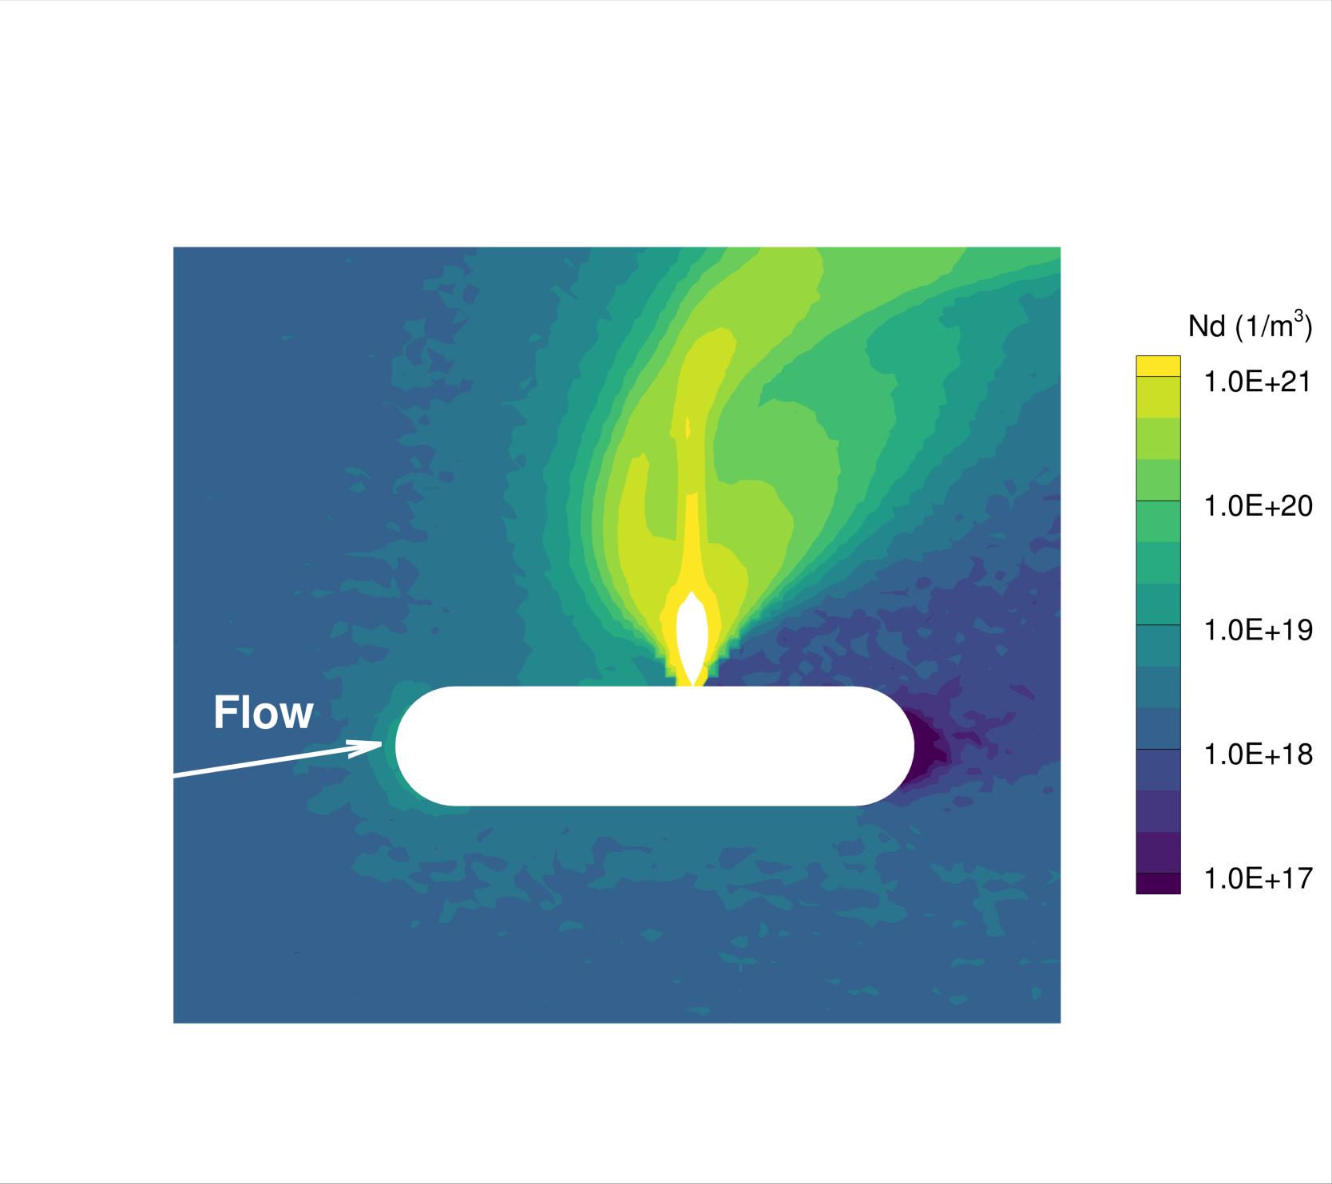
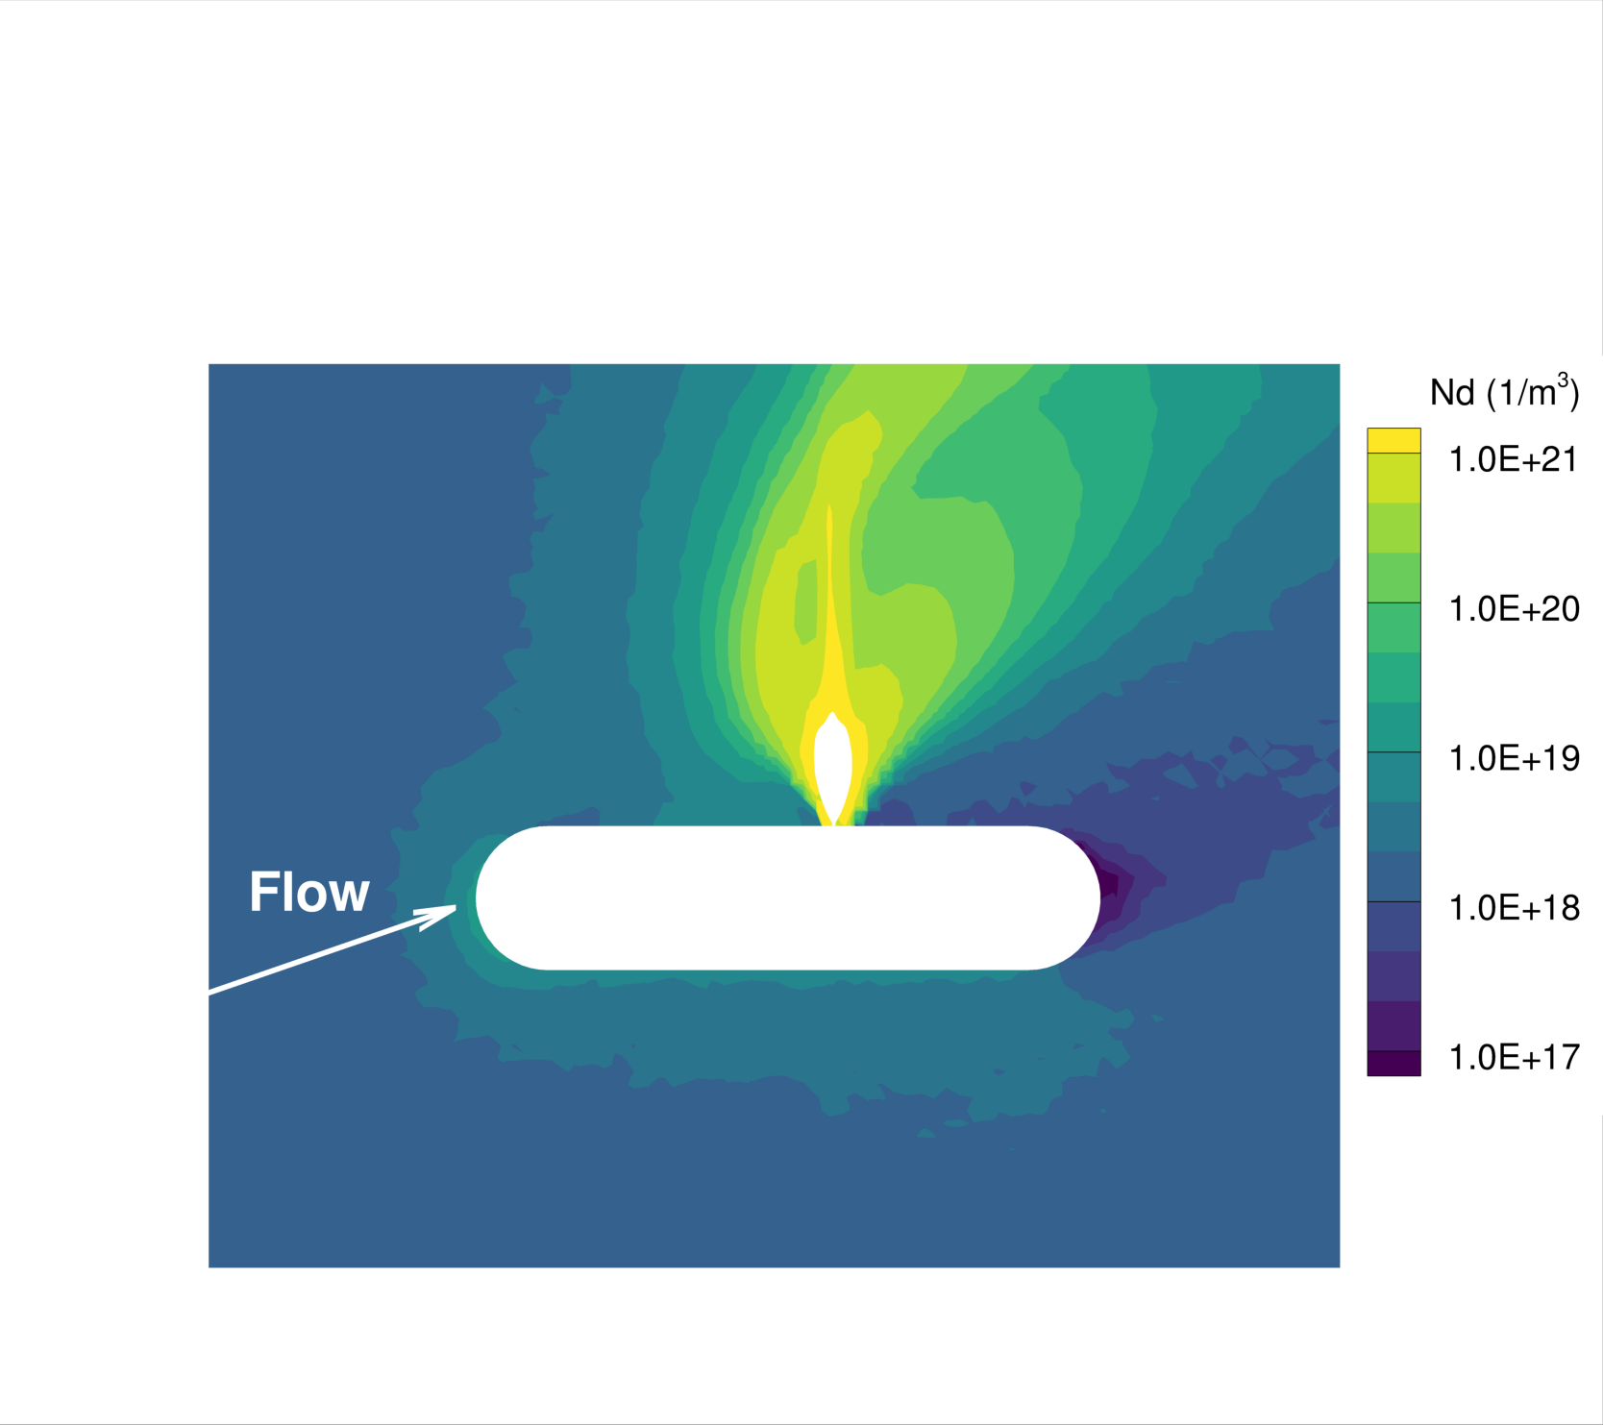
Perform DSMC on Capsule with Jet on
α = 0º
α = 10º
α = 20º

Slide 22
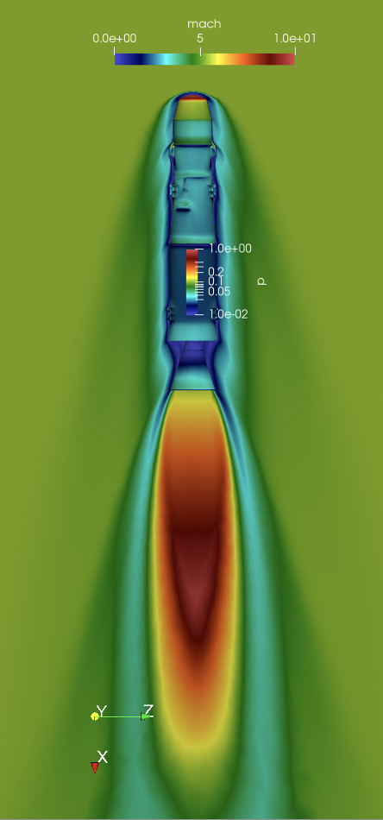
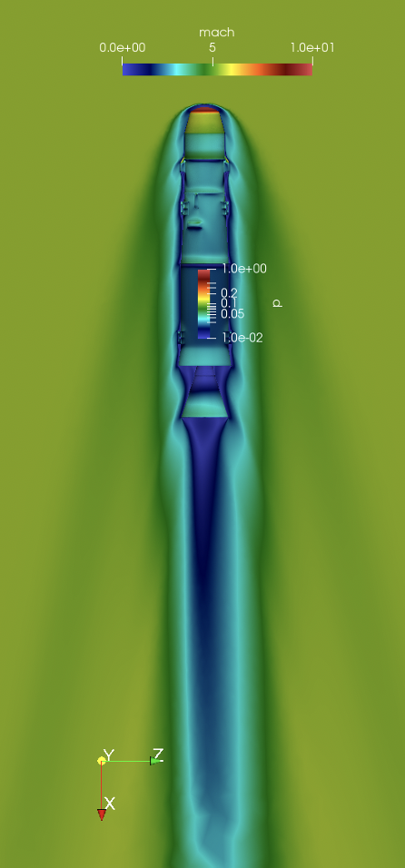
Engine-On Aerodynamics
REACTING FLOW
UNPOWERED
Craig Hunter and Gabe Nastac ran studies of powered vs. unpowered flight
Searching for:
Deltas to aero coefficients due to engine on effects
Variation of deltas with Mach number along ascent
Sensitivity of plume flow to gas chemistry modeling
Conclusions:
Noticeable engine effects at transonic conditions.
Negligible effects at hypersonic conditions
Gas chemistry assumptions do not affect plume significantly

Slide 23
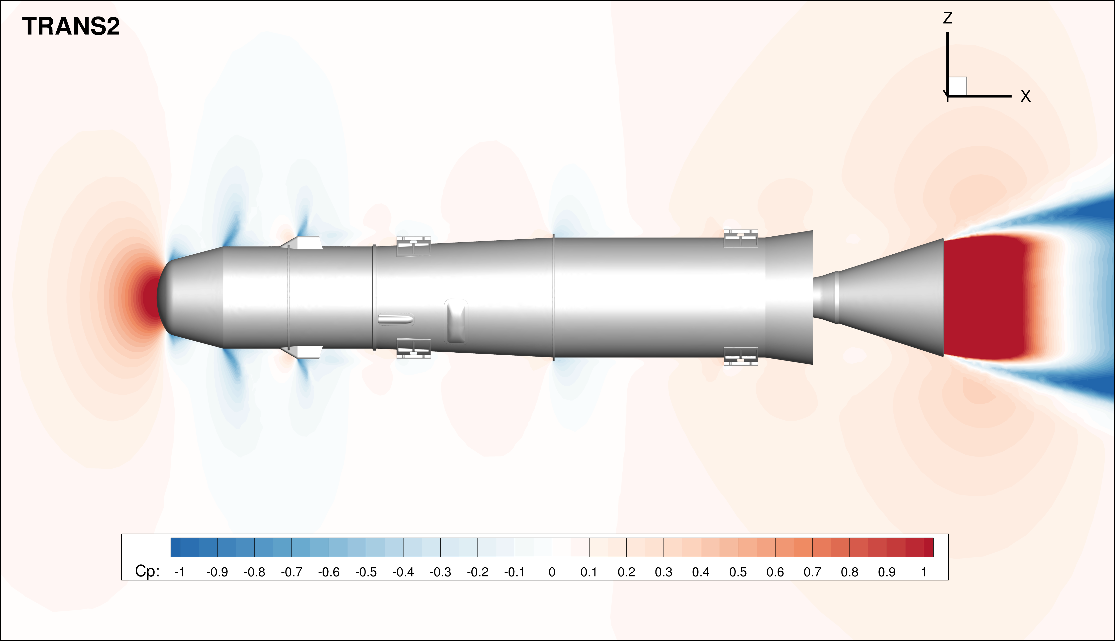
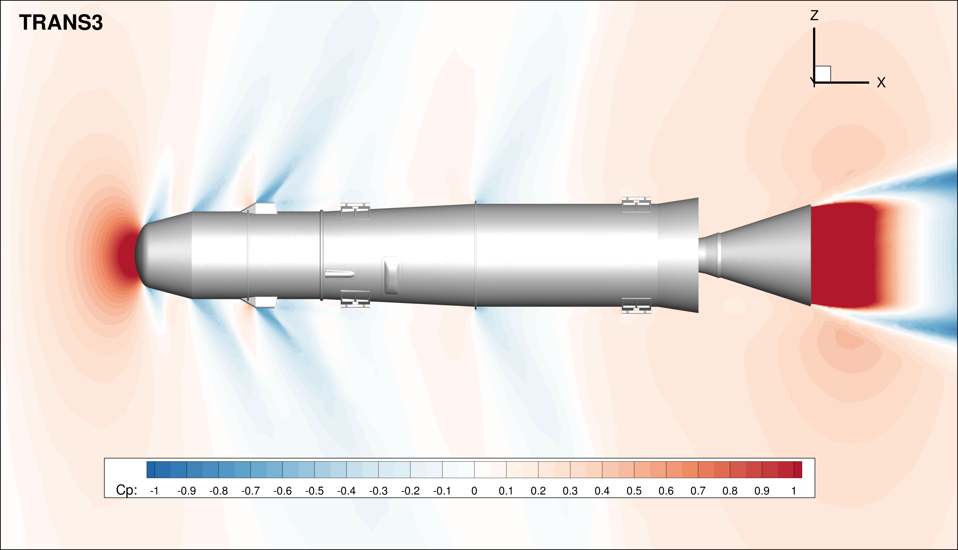
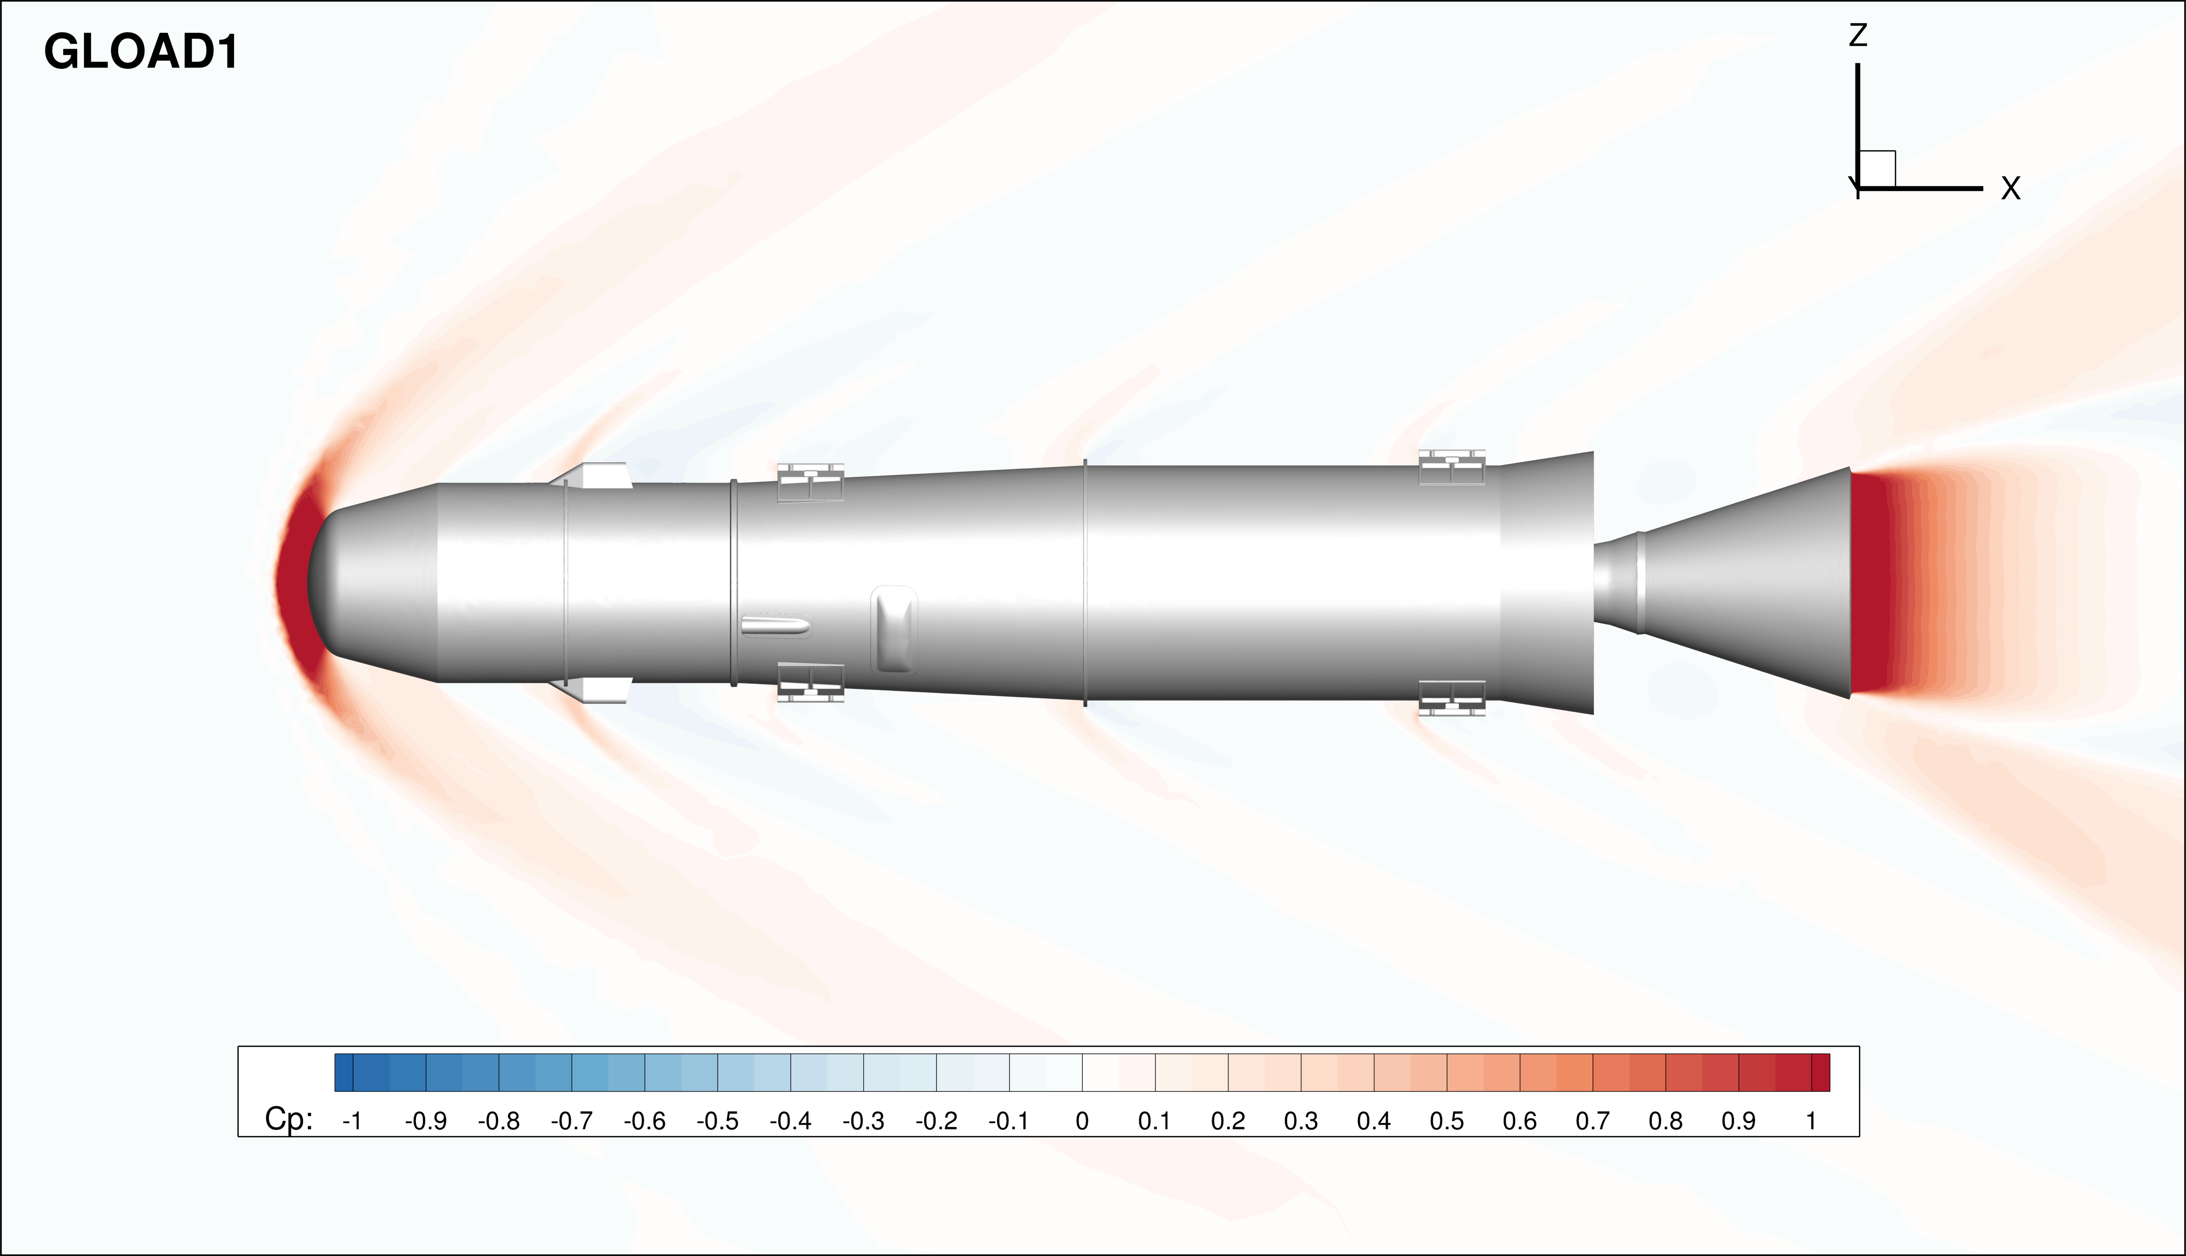
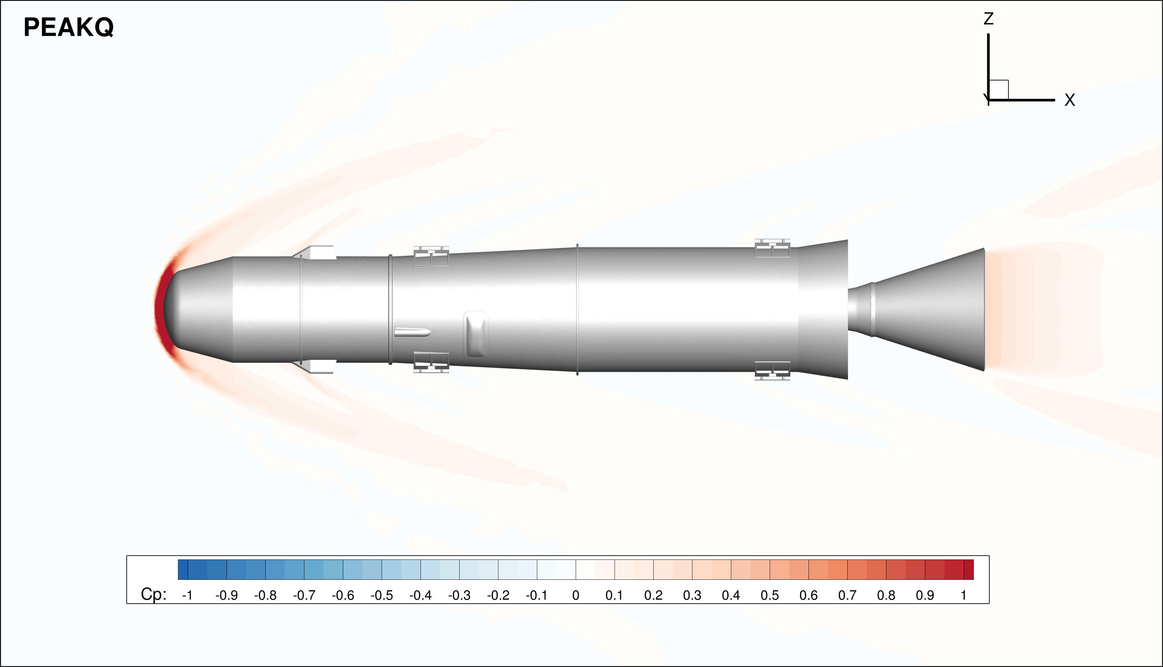
Engine-On Aerodynamics
M=0.90
M=1.05
M=2.34
M=5.45

Slide 24
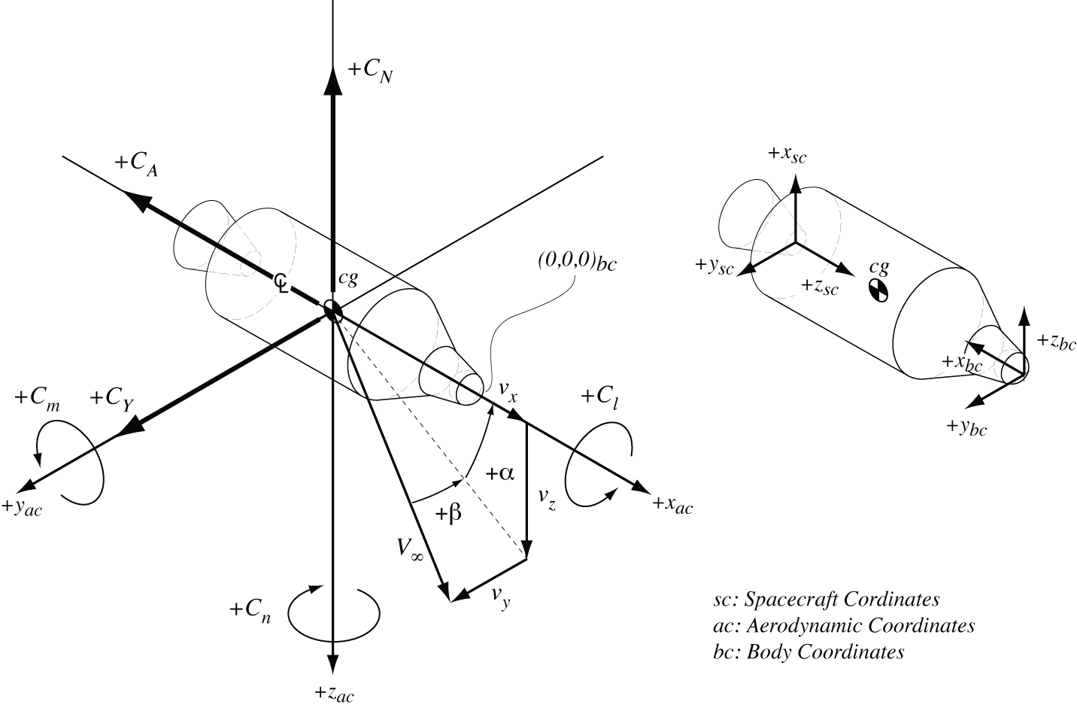
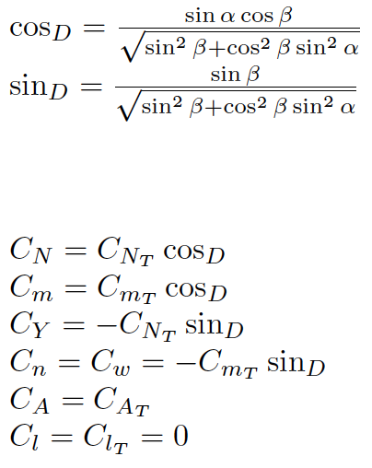
Coordinate Systems & Decomposition

Slide 25
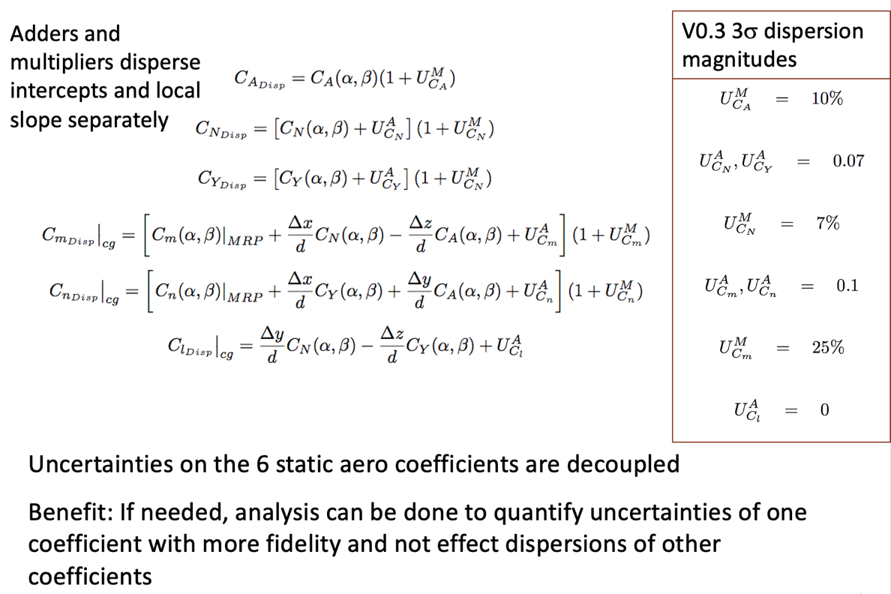



Uncertainty Modeling
Note: Wind tunnel data analysis will yield Cl dispersion to be added to model
Database maybe expanded as function of α_{Total} and roll angle (φ) for future releases to capture protuberance effects

Slide 26




FUN3D Early Code Validation
N2F1
C_{A}
C_{N}
FUN3D CFD code was run on NASA TN D-2853 geometries (N2F1 example shown here)
A number of sensitivities were explored (base contributions, turbulence, etc.)
Settings for MAV solutions were identified, good agreement with experiment
C_{m}

Slide 27


Wind Tunnel Scaling Considerations
Conditions Using SRC 1.0 3DoF Trajectory
Unlike many wind tunnel tests, matching Mars ascent conditions (Re) called for smaller than typical models
CF studies showed that protuberances were far more significant than Re effects of testing a larger vehicle
0.5” Balance was best option for MAV test: set model diameter
Can Match Flight Re in Supersonic Test section at all conditions with 1.000” Model

Slide 28







Skirt and Protuberance Model
SRC BASELINE F&M Model
SRC BASELINE Pressure Model
SRC Smooth F&M Model
With and without aft ramp
Pressure Model wil inform unsteady aerodynamics. Scheduled for follow-up test in late June 2022

Slide 29



Validation Wind Tunnel Test
MAV SRC model in MSFC 14” Trisonic Tunnel
October 2021
Mach 1.96, α_{Tot} = 2°, φ=0°
SRC 2.0 Geometry was selected for testing
Mach Range: 0.3 to 4.96
Angle of Attack Range: -1 to +17 deg
Roll Angles (0, 45, 90, 135, 180)
MACH 4.96
Run 417

Slide 30




Aerodynamics: Pitch Stability
x_{CG}/D = 2.680747 (D_{ref} = 1.00 in)
+3σ
-3σ
+3σ
-3σ

Slide 31


Aerodynamics: Rolling Moment
2021 Trisonic WT
Rolling moment increases between Mach 0.8 and Mach 1.96
Rolling moment increases rapidly for α_{T} > 8 deg, for specific orientations (φ)
Identification of favorable roll orientation and establishment of uncertainty in-work

Slide 32

Aerodynamics: Configuration Effects
2021 Trisonic WT Data – Mach 4.96
Clean w/o Ramp
Clean w/ Ramp
Protub w/o Ramp
Protub w/ Ramp
Phi = 0º
Phi = 90º
Phi = 180º

Slide 33


Environments
The AFESB Aerodynamics Team typically provides an aerodynamic database with dispersions to a flight project as the main data product.
While the aerodatabase is important for vehicle and trajectory design, for MLS the environments are also very important to characterize. Why?
The configuration has become more “dirty” aerodynamically
Line Loads
  The aerodynamic forces and moments provided as distrubutions along the length of the vehicle for mechanical engineers to design the vehicle structure
Aeroheating
  The heating environments during ascent are needed for thermal analysis, TPS sizing and design to ensure the vehicle structure, internal electronics, payload structure, etc. do not get too hot
Unsteady Aerodynamics
  The MLS vehicle is fairly “dirty.” It is important to characterize the noise (aeroacoustics) produced as transonic and supersonic flow move past the protuberances. The dynamic loads due to aeroacoustics must be considered as much or more than the static loads for this configuration.

Slide 34

PDC Rev. 2 Line loads

Slide 35



7) Aeroheating Analysis
Heating indicators constructed using CFD in trajectory simulation (replaces approximate method of Sutton-Graves)
Indicators provided for convective heat rate (and heat load) at 8 body points (Mar 2020)
Updated fits for recent (March 2020) 0068 trajectory
  Accounts for differences in ρ-V (trajectory)
  Prior LAURA-5 CFD solutions generated in May 2019
Previously scaled convective heat rate for varying nose radii and applied indicators to new ascent profiles (Dec 2019 and Mar 2020)
Negligible differences between laminar and turbulent solutions in prior analyses (2016, 2019)
High-fidelity aerothermal analysis is repeated for significant changes in configuration and ascent profiles
LAURA CFD distributions are used for MAV thermal analysis and TPS sizing
Nose Region Flowfield
0068 Trajectory
t = 55 s (peak heating)
α = 0°
High fidelity CFD on forebody (no protuberances)
  LAURA code with 8-species Mars atmosphere
  Fully laminar; 3D with angle of attack
  Chemical non-equilibrium shock layer
  Radiative equilibrium wall temperature
  Trajectory range through peak heating pulse

Slide 36


Examples of OS Aeroheating Analysis
Full-body solution obtained at peak heating (t=60 sec) and AOA=0 deg
  Unsteady flow
  Running for additional time-averaging
Internal Flow Analysis
M = 8.6
Symmetry
plane

Slide 37


Time-Accurate Flowfield Simulations
Use high-resolution time-accurate CFD to generate:
  Estimates of average surface fluctuating pressure (SFP) levels & spectra
  Estimates of space-time coherence of surface fluctuating pressure
  Axial distributions of fluctuating sectional forces
… for use in predictions of buffet & vibroacoustic structural response.
These simulations are performed in an accelerating frame, with varying freestream velocities to simulate trajectory including AoA variation.
  FUN3D; DDES mode; 166M pt mesh; CO₂ freestream
  0.70 < M∞ < 1.90; 5.8 sec; 45kHz time step

Slide 38



Mach Contours on y=0 Plane
Trajectory 0.70 < M∞ < 1.90
Time (sec)

Slide 39


Evolution of Windowed p’_RMS with Freestream Mach on unwrapped surface
Time (sec)

Slide 40
SUMMARY
Big Picture: How does aerodynamics analysis contribute to MLS success?
Provide loads and heating environments
Determine where, along trajectory, aerodynamics impact ascent performance/flight mechanics
Provide Aerodatabase with sufficient fidelity and bounding uncertainties
Support RCS system design
  Identify significant jet interactions
  Determine JI impact on system design (move jets? High fidelity JI aero model with extensive WT test plan?, determine no-RCS phases of flight?)
Provide aero loads and acoustic environments for structural design analysis
Additional aero support to achieve best MLS design
  Ramp/No Ramp
  Trajectory design

