Slide 1

Establishing More Robust Material Databases
Materials & Structures Workshop
The 3rd International Conference on High-Speed Vehicle Science and Technology
April 14-19, Busan, Korea
Bryan Kubitschek
NASA Langley Research Center, Hampton, VA 23681

Slide 2
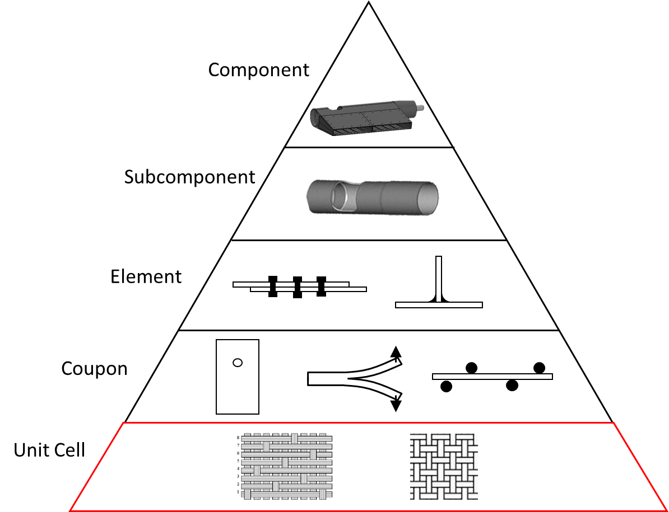
Establishing More Robust Material Databases
Goal
To reduce the quantity of material and the time it takes to create or update a material database for a more rapid material-to-structure building block approach (BBA)
Objective
Predict material properties using deep learning techniques on X-ray images of two-dimensional (2-D) composites
Approach
Process x-ray computed tomography (CT) images of the material through a deep neural network (DNN) framework to compare material properties with experimental tests
Range of Relevance
Up to 5 years when applied to current material databases
5-15 years when applied to new materials
This technique would not replace experimental data but could reduce the amount needed for B-basis material properties.

Slide 3
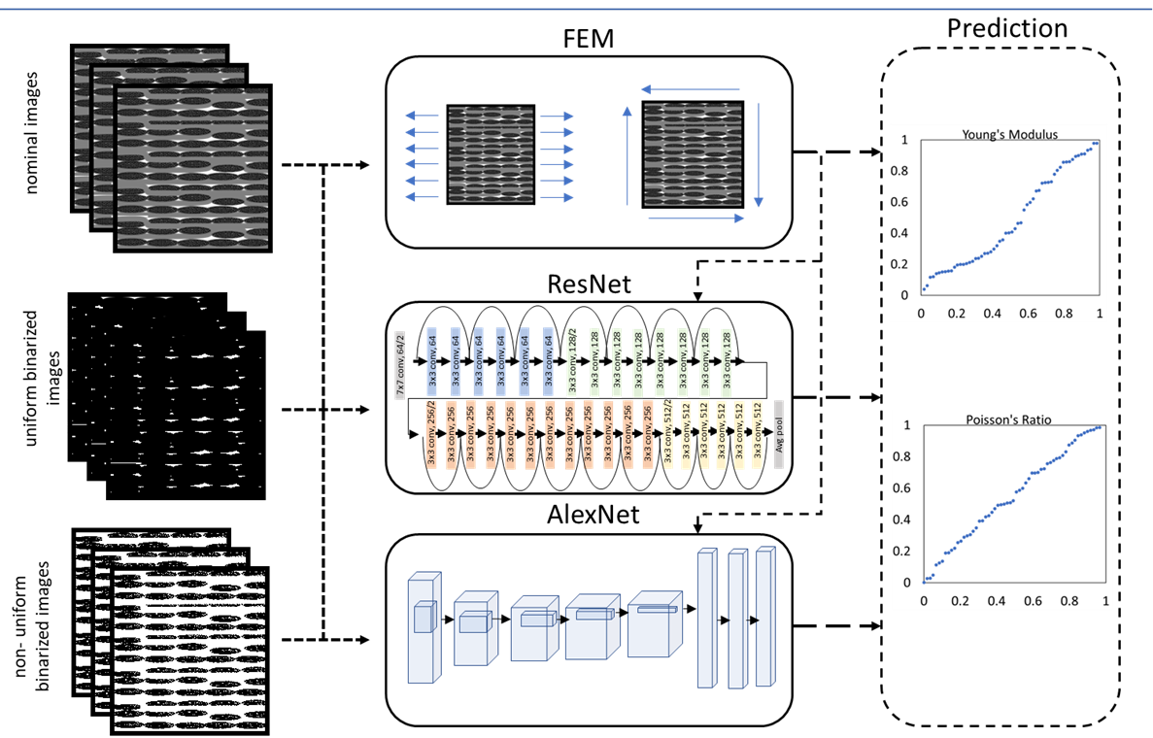
Using Deep Neural Network (DNN)
Process x-ray computed tomography (CT) images through a DNN framework to compare material properties with experimental tests [1]
1. Gholami K., Edge F., Barzegar R., “Prediction of Composite Mechanical Properties: Integration of Deep Neural Network Methods and Finite Element Analysis”, Journal of Composite Science Vol 7 (2), 2023

Slide 4
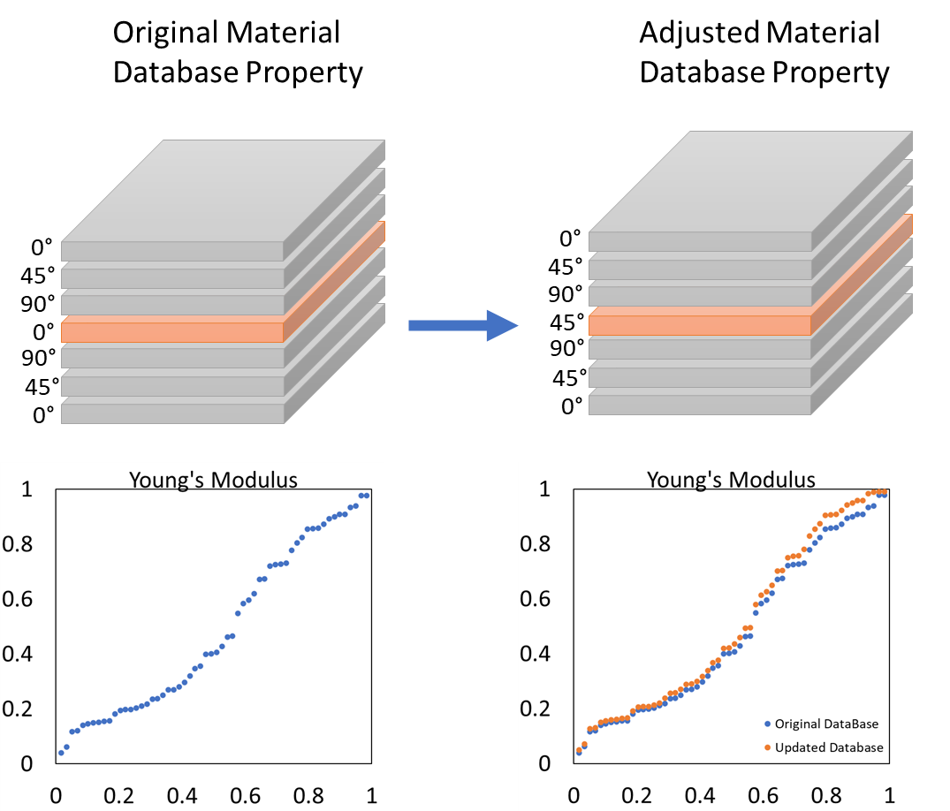
Example DNN Application
Material databases for 2-D composites are never complete, and they are always changing.
It may be necessary to repeat the material testing if the stacking sequence, fiber orientation, processing temperature, or any other material/processing feature changes, resulting in a substantial investment in time and money.
Example
A material design requires replacing a 0° ply with a 45° ply
Solution
The DNN’s predictive qualities can be used to reduce the number of experimental tests required to update a database from the original material property
Young Modulus
Young Modulus
Density
Density

Slide 5

Workshop Discussion
Material Databases require hundreds of tests for each material property
Can the community confidently rely on X-ray and DNN for material property prediction?
  If so, how many material tests can be reduced?
  How much money and time can be saved?
Can DNN only be used for material properties in the linear elastic range?
  Can nonlinear material properties be predicted?
What is the extent of the material properties that can be predicted?
  Can DNN be used to predict material properties that are difficult to measure precisely like thermal conductivity?
Can DNN help enable a damage tolerance design approach for 2-D composites?
How would private, academia, and national labs fit into a structure requiring DNN and X-ray CT images for material property prediction?
X-33 Single stage to orbit (SSTO)

