Slide 2
Upgrades to NASA’s Largest Cleanroom

Slide 3

Yingrui “Zao” Huang
Cleanroom Operations and Pressure Vessel Systems Team Lead
NASA Goddard Space Flight Center
Code 549 – Environmental Integration and Testing Branch

Slide 4
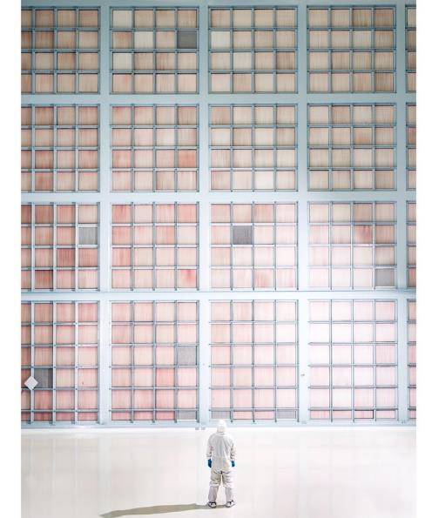

Spacecraft System Design and Integration Facility (SSDIF)
NASA’s largest cleanroom
Built in 1989
1.3 million cubic feet
Certified ISO 7 cleanroom
Originally designed to support 2 simultaneous shuttle missions
Served Hubble Space Telescope Servicing 3 and 4, James Webb Space Telescope
Roman Space Telescope being built currently
Photo Credit: NASA/Chris Gunn

Slide 5
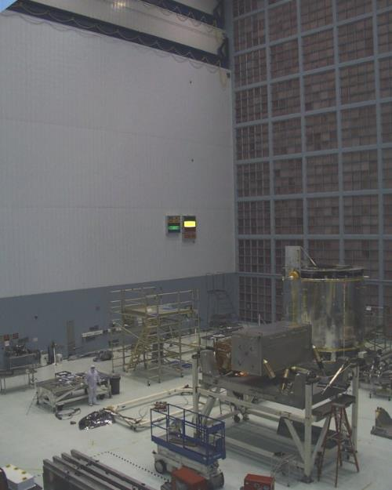
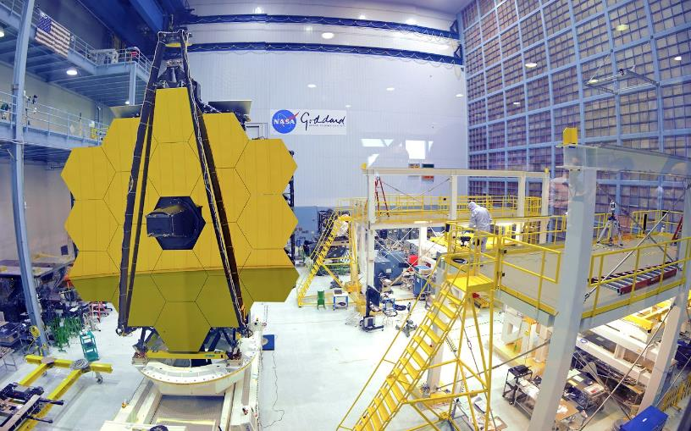
SSDIF Operations
Photo Credit: NASA/Chris Gunn
Photo Credit: NASA Archives

Slide 6
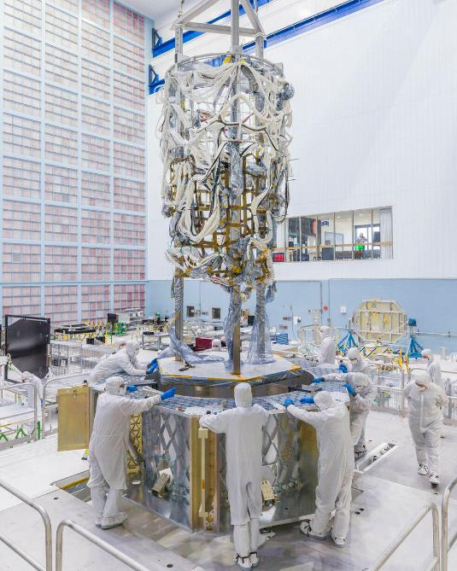
SSDIF Operations
Photo Credit: NASA/Chris Gunn

Slide 7
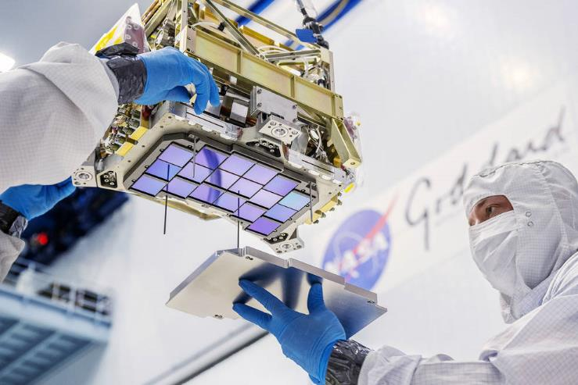
SSDIF Functional Requirements
ISO Class 7 cleanroom
Live particulate monitoring
Temperature: 68 +/- 2F
%RH: 45 +/- 5%
>0.1” water column room pressurization
Photo Credit: NASA/Chris Gunn
Photo Credit: NASA/Chris Gunn

Slide 8
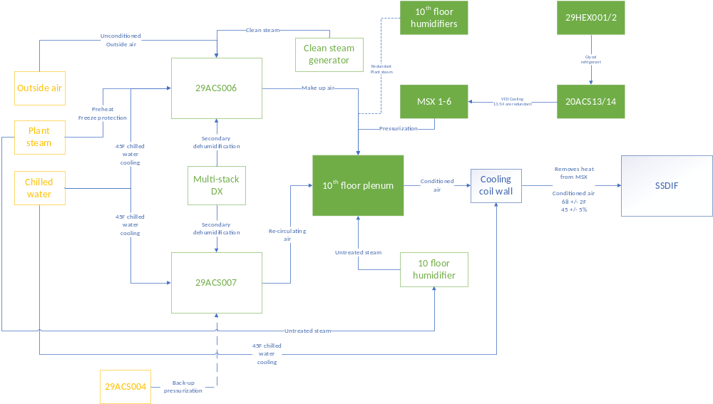
SSDIF Functional Block Diagram
2 air handlers providing 13500 cubic feet per minute (CFM) and 11000 CFM
Cooling provided by 43F center chilled water
15psi steam provides pre-heat
6x200hp belt driven pressurization fans heat the room
Secondary cooling wall removes heat from pressurization fan as needed
6 stages of HEPA filtration
Controls by Honeywell EBI
Cosmetic upgrades completed in 2018
Hardware upgrades started in 2019
Software upgrades started in 2022
=upgrades

Slide 9
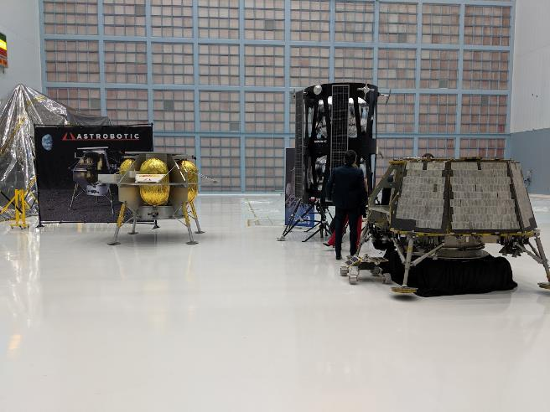
SSDIF Cosmetic Upgrade 2018
In 2018, the SSDIF shut down for the first time since 1989
Cosmetic upgrades were completed, including:
  New floors
  Maintenance on roll up doors
  Oil change for 2x 20T cranes
  Upgrade to LED lighting
Photo Credit: NASA/Zao Huang
Photo Credit: NASA/Chris Gunn

Slide 10
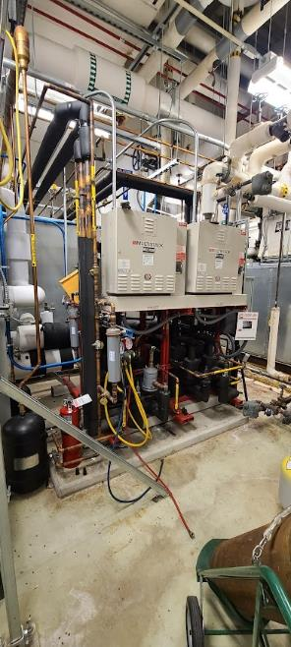
SSDIF Hardware Upgrades – Dehumidification
Multistack® Direct Expansion (DX) unit
2x compressors per air handler
Compressor run R410A
Compressors cooled by return chilled water from air handlers
Allowed us to raise chilled water to 45F
Provides redundancy and additional capacity for dehumidification
Photo Credit: NASA/Zao Huang

Slide 11
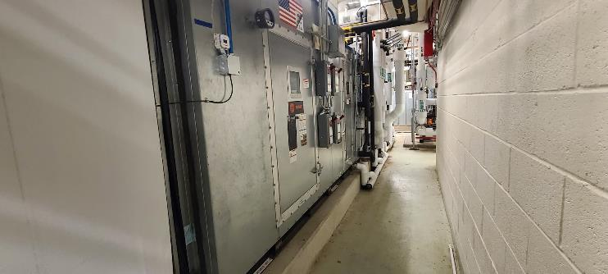
SSDIF Hardware Upgrades – Makeup Air Unit
Provides 13500 CFM of outside air
Upgraded to direct drive fans.
Automated outside air damper to open/close
Updated pre-heat operations for freeze protection
Easier serviceability
Updated to 2019 standards for HVAC, electrical, and fire safety
Photo Credit: NASA/Zao Huang

Slide 12
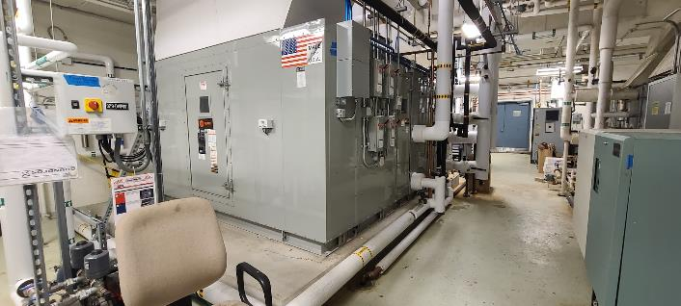
SSDIF Hardware Upgrades – Recirculating Air Unit
Provides 11000 CFM of recirculated air
Upgraded to direct drive fans
Allows for additional humidification tie-in
Easier serviceability
Updated to 2019 standards for HVAC, electrical, and fire safety
Photo Credit: NASA/Zao Huang

Slide 13
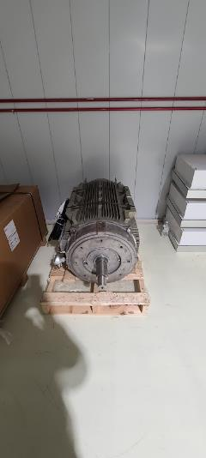
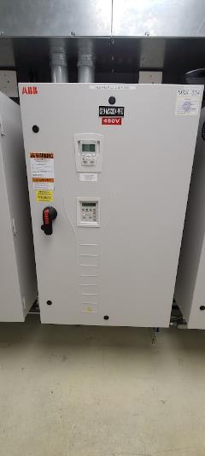
SSDIF Hardware Upgrades – Pressurization
Belt driven to direct drive
200hp motor powers an 8 ft fan
Allows for more consistent pressurization
Allows for ramp up/ramp down due to room changes
Allows for easier maintenance
Variable frequency drives (VFD) required independent glycol cooling units
Photo Credit: NASA/Zao Huang
Photo Credit: NASA/Zao Huang

Slide 14
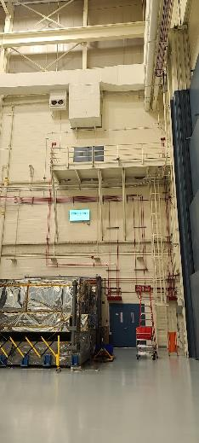
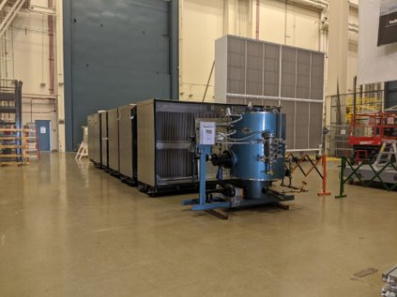
Hardware Upgrade Challenges
Breaking down large hardware to fit into standard double doors
Lifting and dropping hardware from ground floor to 4th floor
Coordinating activities with flight project activities
COVID restriction and shutdown
Photo Credit: NASA/Zao Huang
Photo Credit: NASA/Zao Huang

Slide 15
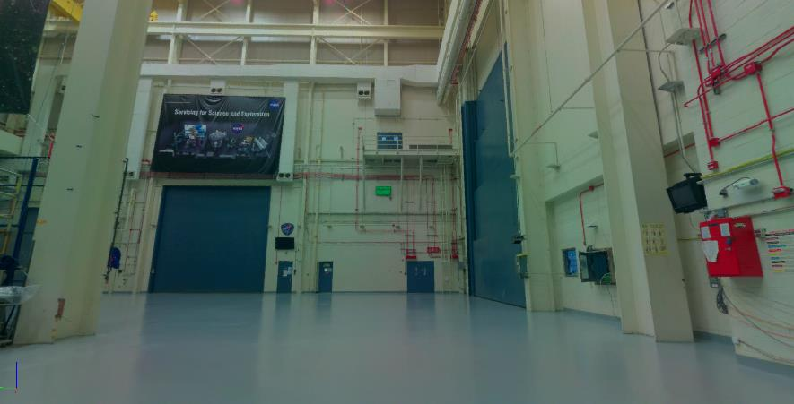
Hardware Upgrade Solutions
With no building occupancy, we received permission to 3D scan Integration and Testing (I&T) complex
Used a LEICA BLK360® scanner to make 3D scans down to +/- 0.5” accuracy at 10’ from the surface
Captured HD pictures and point cloud
LEICA JetStream Camera Capture

Slide 16
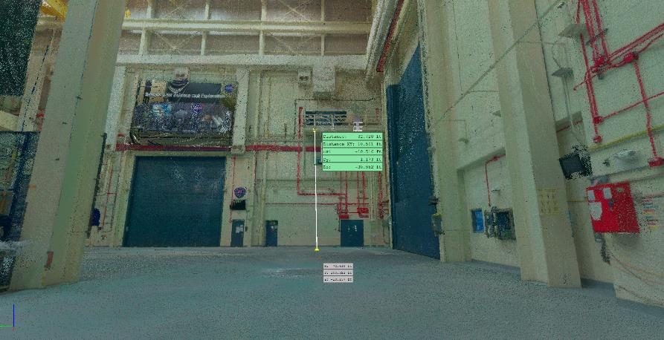
Hardware Upgrade Solutions
Point cloud allowed for dimension measurements and planning off-site
“Fly through” feature allowed demonstration of lifting and logistic operations
Cloud-base user interface (UI) allowed for off-site collaboration by multiple teams
LEICA JetStream Point Cloud

Slide 17
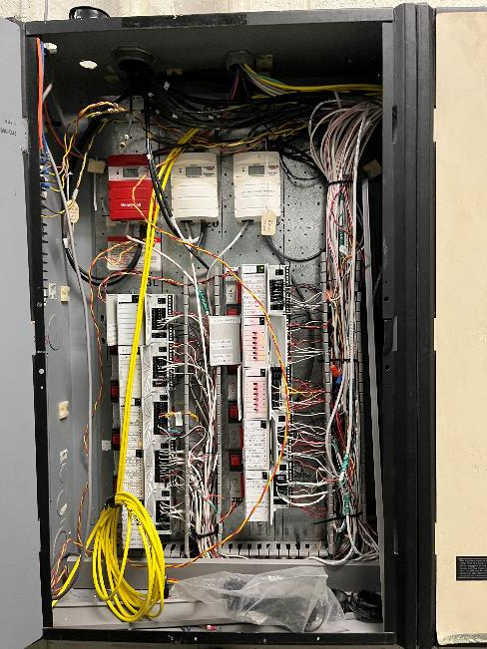
SSDIF Controls Hardware Upgrades
Proprietary Honeywell EBI® system
Relied on RS485 serial comms
Data averaging every 6 seconds
No back up power on the controllers
Lack of configuration management and constant patch work
Photo Credit: NASA/Nafeez Talukder

Slide 18
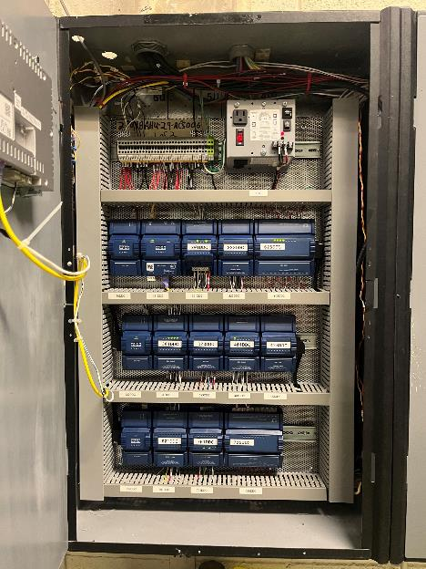
SSDIF Controls Hardware Upgrades
Open-source Tridium® system
Ethernet comms with constant data stream
Greater data redundancy
Improved alarming to 24/7 on call team
Photo Credit: NASA/Nafeez Talukder

Slide 19
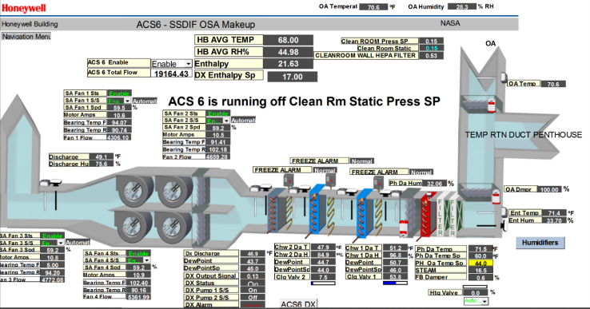
SSDIF Controls Software Upgrade
Moved to cloud-based UI from virtual machine access
Moved to Niagara® framework
Improved UI interface and data layout

Slide 20
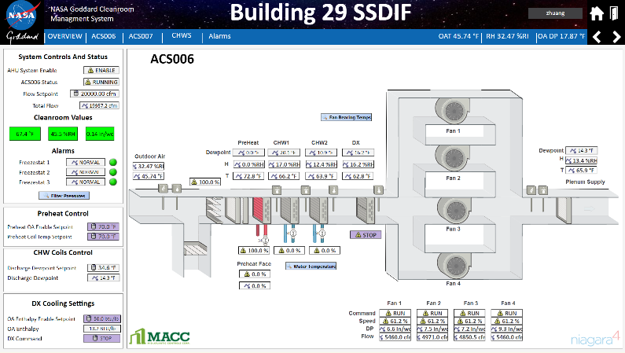
SSDIF Controls Software Upgrade
Federal Information Security Modernization Act (FISMA) compliant
Automated reporting and data reduction
Future scalability
Resolved Proportional-Integral-Derivative (PID) loop hunting for pressurization

Slide 21
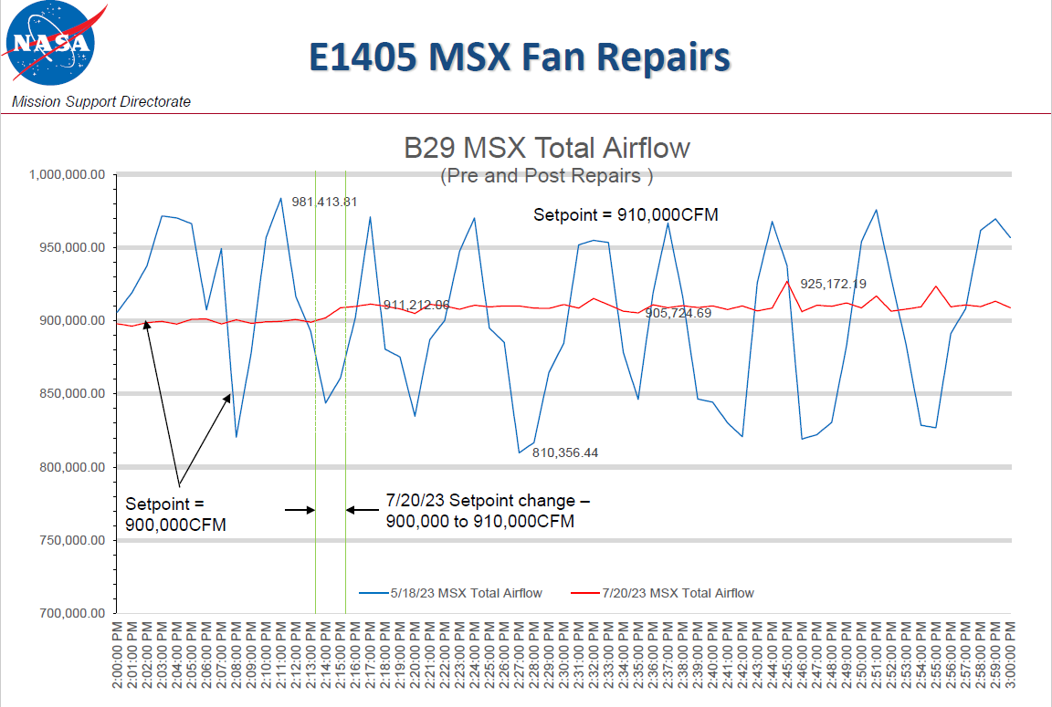
PID Resolution
Tuned PID loop paraments using Ziegler-Nichol tuning method
Allowed for more consistent air flow in the cleanroom
Lowered oscillations on individual VFD
PID tuning chart pre and post repairs
Credit: NASA/Todd Sanders

Slide 22
Future Challenges
NASA flight projects have increasingly stringent temperature and humidity control requirements
Floorspace is always at a premium
Material selections differ wildly depending on mission

Slide 23
Future Challenges
Lack of shutdown time prevents full system maintenance
Construction within the cleanroom must happen while flight projects continue work
Building maintenance moving towards predictive vs preventative time-based maintenance

Slide 24
Thank you!
Questions?
Yingrui.Z.Huang@NASA.gov

