Slide 1
Assuring and Securing Machine Learning
Alwyn E. Goodloe
NASA Langley Research Center

Slide 2
My Background
I work in the Safety-Critical Avionics Systems branch at the NASA Langley Research Center
Ph.D. in CIS from the University of Pennsylvania focusing on programming language and formal methods approaches to network security
  NASA aeronautics has a strong operational focus on security to secure work done at NASA, but does not conduct research in the area
  I haven’t been active in the area since 2009.
Among the research areas I focus on at NASA are distributed systems, runtime verification, and assurance of ML enabled systems.

Slide 3
Outline
Runtime Verification
  Overview
  Copilot
  Security
ML Assurance
  Overview
  Challenges
  Approaches
  Security

Slide 4
RV Motivation
Formal verification proves a correctness property correct for every execution of a program correct
  Most software is too large and requires very specialized workforce
Testing demonstrates correctness on specific test cases
Runtime verification (RV) detects if a correctness property is violated during execution and invokes procedures to steer the system into a safe state
  A form of dynamic system verification
  Can be done offline or online
Roots in the monitoring of system logs (1970s) and Simplex architecture (1990s)

Slide 5
Runtime Verification
Given a specification φ
  Specification logics: linear temporal logics (LTL), regular expressions, …
A trace τ obtained from a system under observation (SUO)
System must be instrumented to capture the trace
  This affects what properties you can specify
An RV monitor checks for language inclusion τ ∊ 𝔏(φ)
  Accept all traces admitting φ
RV frameworks such as Copilot generate monitors from a specification

Slide 6
Copilot
Copilot is a runtime verification framework aimed at hard real-time safety-critical systems
Employs sampling rather than extensive code instrumentation
  Appropriate for monitoring safety of CPS systems
Stream based specification language similar to Lustre
Implemented as a Haskell Embedded Domain Specific Language (EDSL)
Copilot specifications are translated into MISRA C99 monitors or to Verilog for implementation in FPGAs
Certified as a NASA (Class D) software engineering tool
Monitors can be certified as flight critical software (NASA Class C/B)

Slide 7
High-Assurance RV
Can RV safeguard a system that cannot be otherwise assured?
What is needed for a safety case?
  Validate the specification is correct
  Traceability from monitor to specification
  Verify that the monitors meet the specification
  Constant space/constant time
  Verify monitors are free of floating point overflows, etc.
Much of our effort on Copilot currently involves building assurance cases for the NASA software safety folks that Copilot monitors are trustworthy

Slide 8
RV for Machine Learning
RV can only be used to verify properties for which you have a formal specification that can be checked in real time
  Rules out checking many machine learning (ML) applications for which we don’t know how to formulate formal properties
Simplex architecture applies RV to ML enabled controllers
  Detecting violations of a property and switching to a conventional controller
Monitoring neuron activation patterns
Monitor robustness properties
Monitor to detect when the ML enabled system is off the learned distribution

Slide 9
Challenge of ML Assurance
The “sweet spot” for ML are applications we do not know how to formally specify such as perception
Build a classifier to recognize Persian cats
  How do specify “Persian cats”
Geometric Data Analytics has a research award from NASA to potential for topological data analysis to yield actionable specifications from high-dimensional data for use in safety-critical applications such as autonomous aircraft. (NeurIPS 2023)
  Algebraic topology, geometric topology, differential topology
Can the shape of the data serve as a basis for verifying that the model built from the data is correct

Slide 10
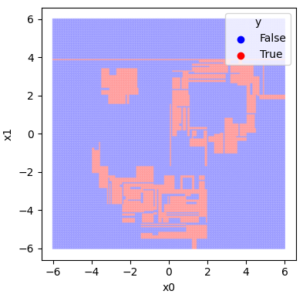
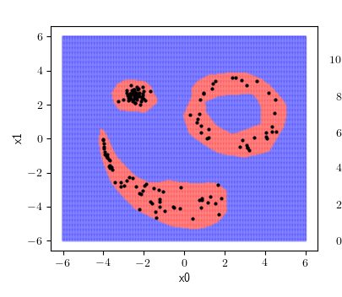
Specs from Data
data X ⊂ model K ⊂ ambient V.
K is the support of a function (classifier) k:V →{0,1}.
Statements of Principle:
K is a “good” model of the dataset X when highly persistent features in X
(from the perspective of V) are also present in K itself, and low-persistence features in X
are smoothed over by K.
Rips of X step-size t | X finds d-cycle | X lacks d-cycle
K finds d-cycle | Agree, there’s a void | K is overly sensitive to noise of size t
K lacks d-cycle | K is dangerously permissive, overruns lack of evidence | Agree, no obstruction to local movement.

Slide 11





Example: Utah “Jar”
Dataset consists of 4,000 images of rotated Utah teapot and 10,000 images of a rotated Utah teapot with spout and handle removed (Utah “Jar”).
True images:
We constructed a simple classifier that accepts any image within a Euclidean distance of 1.0 of the jar image dataset.
Parallax applied to the model shows it is overly sensitive to noise, prohibiting reasonable interpolations.

Slide 12
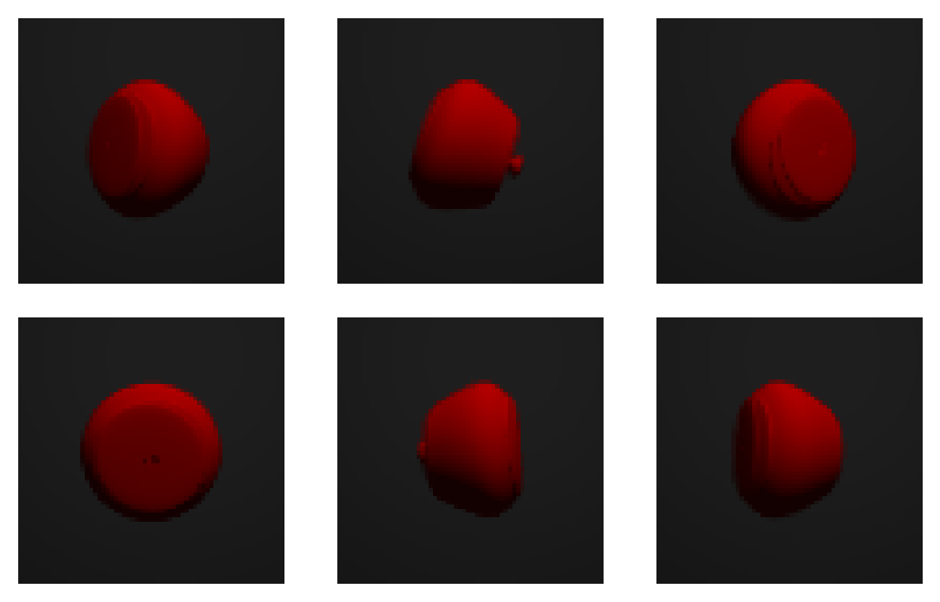
Example: Utah “Jar”
Parallax computes the model to have a very small scale of locality.
The model rejects the following interpolated images, which clearly resemble jars:

Slide 13
TDA Applied to Security
Geometric data analytics is pursuing applying topological approaches to the security of machine learning systems
  Funded by other agencies
Assuring that the model generated from the data is correct wrt the data should aide in assuring that security are not introduced in the models
Ongoing investigations funded by other agencies

Slide 14
Summary
RV is a dynamic verification approach that can be used when you have a formal specification you want to verify
RV has been applied to check for the violation of a number security properties
Assurance of machine learning enabled systems remains an open challenge
Techniques from topology and geometry are promising
GDA has applied these techniques to problems of securing ML enabled systems

Slide 15
Questions?
Contact Information:
Alwyn E. Goodloe
+1-757-864-5064
a.goodloe@nasa.gov

Slide 16
Sample Copilot Specification
Generating Fibonacci Sequence: 0,1,1,2,3,5,8,13,21,34,…..
fib :: Stream Word32
fib = [0,1] ++ (fib + drop 1 fib)

Slide 17
Copilot Language Operators
Stream language – constants and arithmetic operations are lifted to stream level
  Semantics of Haskell lazy lists
(++) :: [a] -> Stream a -> Stream a
xs ++ s - prepends list xs to stream s
drop :: Int -> Stream a -> Stream a
drop n s - skips the first n values in the stream
Special constructs for input (sampling) and output (triggers)
Copilot specs must be causal – stream values cannot depend on future values

