Slide 1
Mobile Laucher 2 - NASA
Pete Carrato
Joe Cartledge
Kevin MacLeod

Slide 2
PDH Code
######

Slide 3
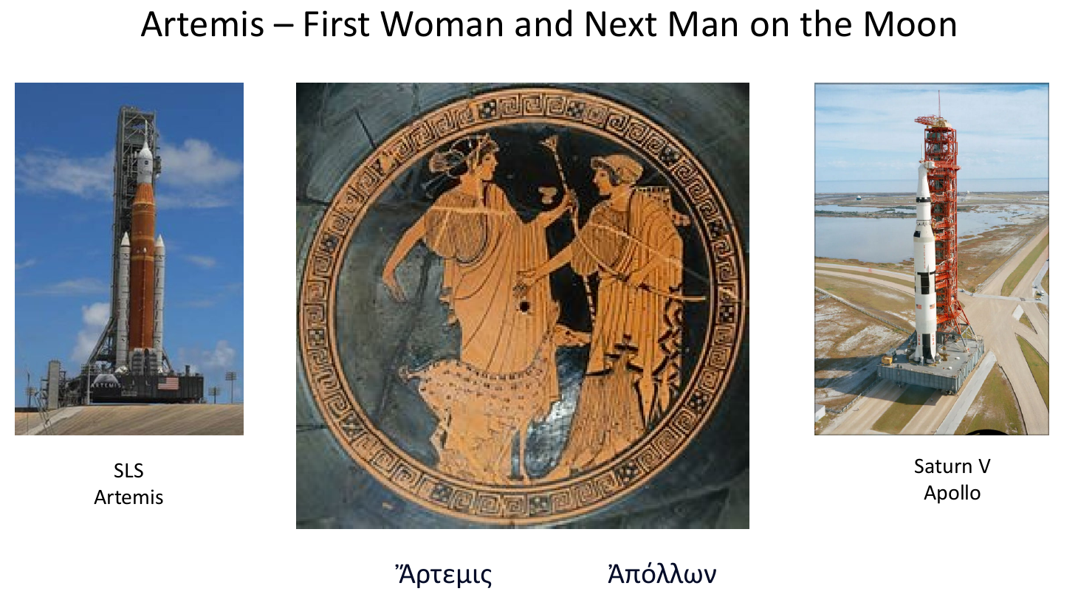
Misson
Pete Carrato

Slide 4
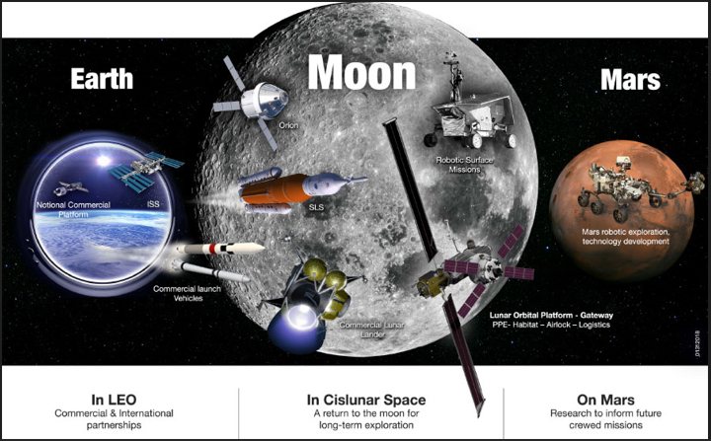
Misson
Pete Carrato
https://moon.nasa.gov/news/46/nasas-exploration-campaign-back-to-the-moon-and-on-to-mars/

Slide 5
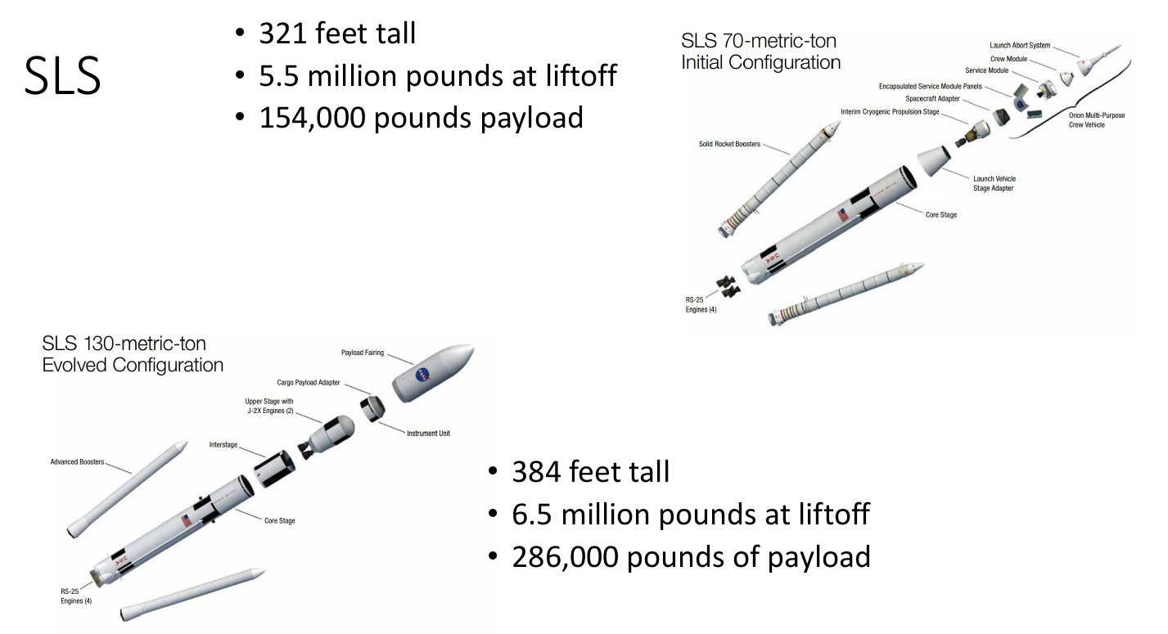
Misson
Pete Carrato
Artemis I-III (Block 1)
Artemis IV + (Block 2)
NASA Fact Sheet: NASA Space Launch System (usra.edu)

Slide 6
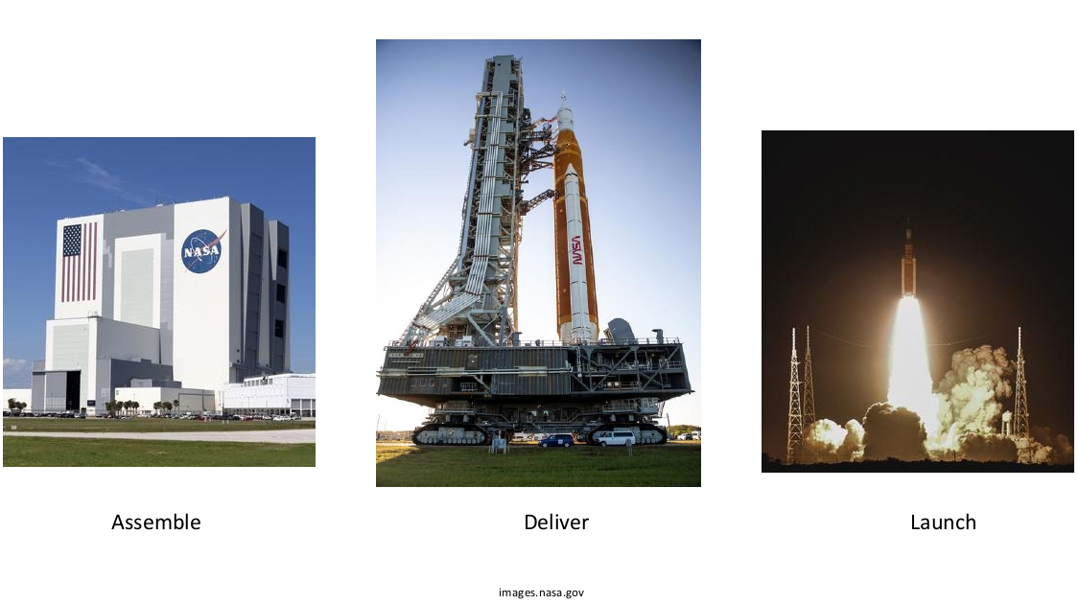
Misson
Pete Carrato

Slide 7








The Team
Pete Carrato
...and many more.

Slide 8
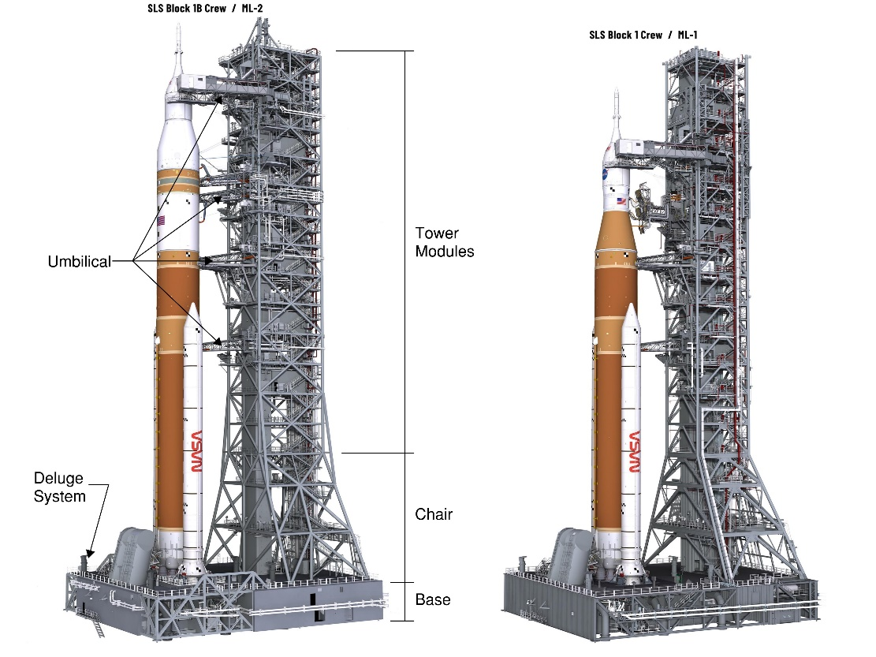
The ML2 Structure - Nomenclature
Joe Cartledge
Bechtel’s Vision – Extraordinary Teams Building Inspiring Projects.
Base
Tower
  Chair
  MOD04-MOD10
  Umbilical
    Mandatory Inspection Points (MIPS)
ML1 compared to ML2
  X-Bracing vs Chevron Bracing
  Plate Girders vs Trusses
  Tower Chair Integration
  Extended Trusses
  Increased height, vehicle weight, and plume loads

Slide 9
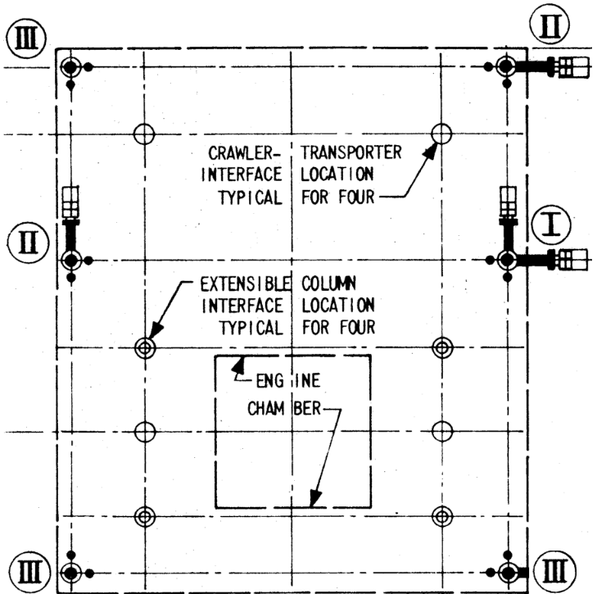
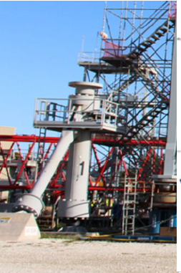
The ML2 Structure - Nomenclature
Joe Cartledge
  Six (6) Mounting Mechanisms (MM): At Park Site, VAB and Launch Pad
  Four (4) Extensible Columns (XCS): At Launch Pad
  Four (4) Crawler Transporter (CT) pick up point
Mount Mechanism

Slide 10
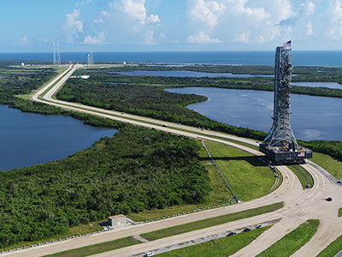
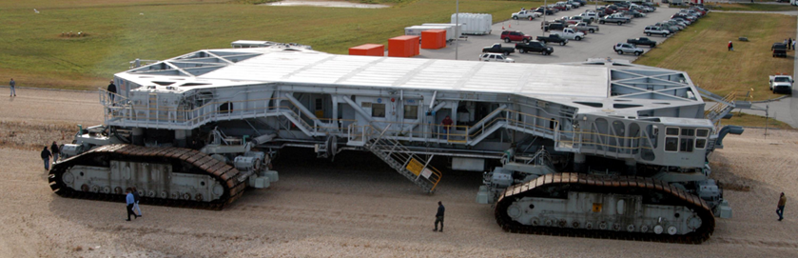
The ML2 Structure - Nomenclature
Joe Cartledge
  Crawler: Lifts Mobile Launcher from the MMs and transports from the Vehicle Assembly Building (VAB) to the Launch Pad.
  One of the largest self-powered land vehicles in the world. Upgraded in 2014-2016 to increase lifting capacity to 18 million pounds.
    Critical design requirements is weight, based on capacity of crawler.

Slide 11
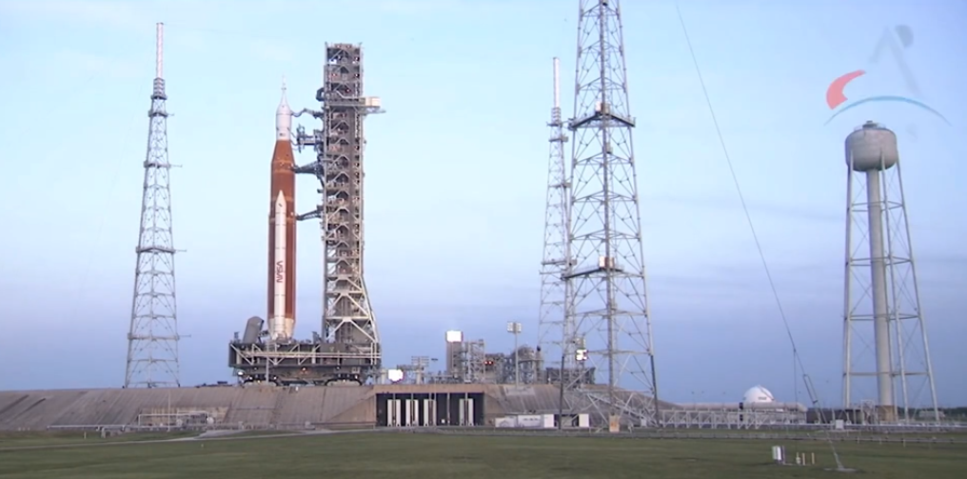
Rollout Video
Artemis 1 on Launch Pad - 39B

Slide 12
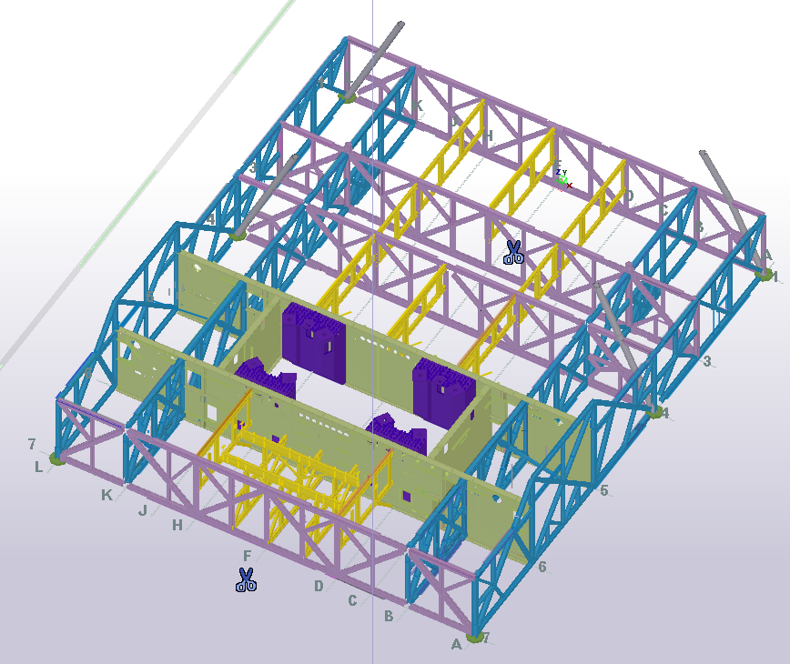
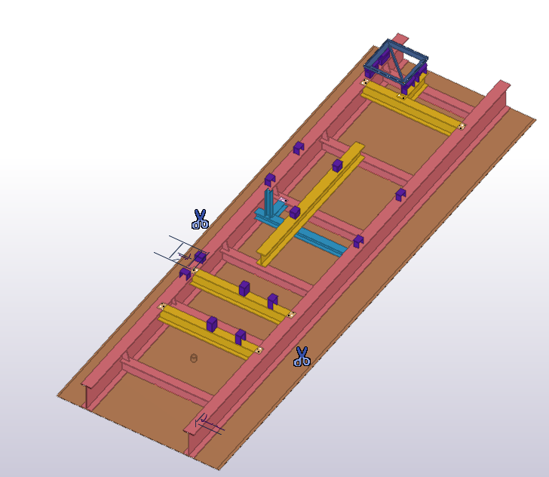
The ML2 Structure – Structural System
Joe Cartledge
Primary Base
  Deep Trusses
  Plate Girders
  Decks (0, A, B)
Secondary
  Commodity Supports
  Equipment Supports
    Stand-Offs
    Isolators
  Stairs
  Interior/Exterior Wall Panels
Side 3
Side 2
Side 4
Side 1
ML2 Base: Plate Girders Trusses
Deck B, Typical Floor Panel with Equipment Support Beams

Slide 13
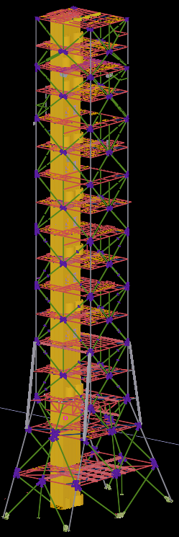
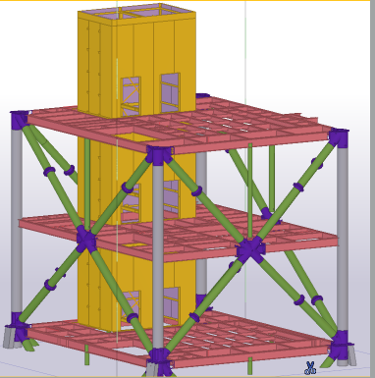
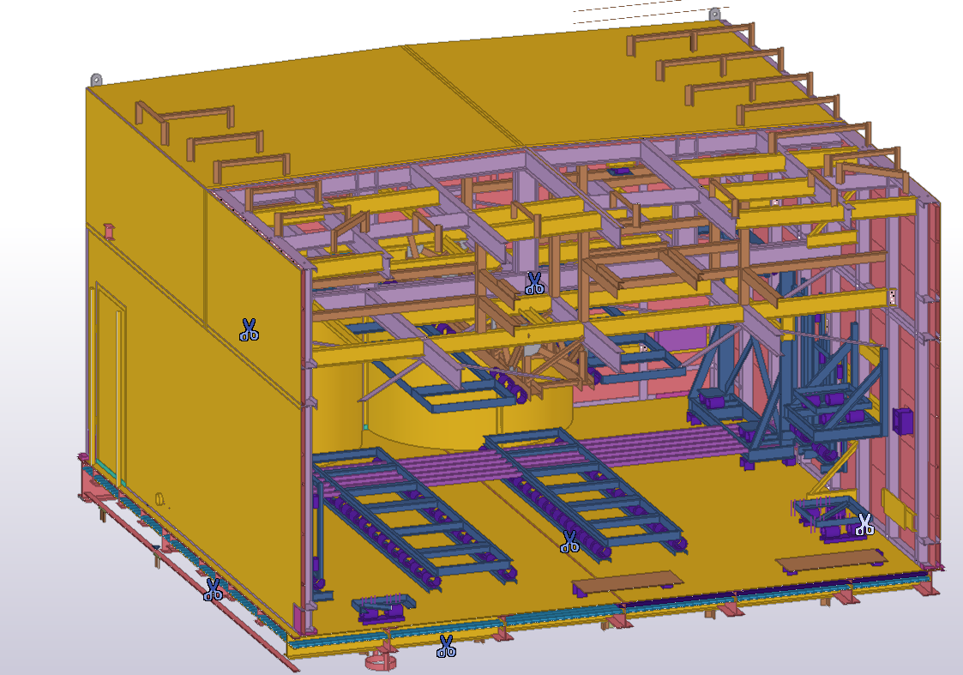
The ML2 Structure – Structural System
Joe Cartledge
Primary Tower
  Chair
  Modules
  API – Columns/Bracing
  Cast Connex
    104 Cast Connex Nodes
  Floor Framing
  Electrical Rooms
Secondary
  Elevator Shaft
  Umbilical Rails
    Adjustable Connections
  Commodity Chase
  Commodity Supports
  Equipment Supports
  Stairs
ML2 Tower: Columns, Bracing, Floor Framing, Elevator Shaft
Electrical Rooms

Slide 14
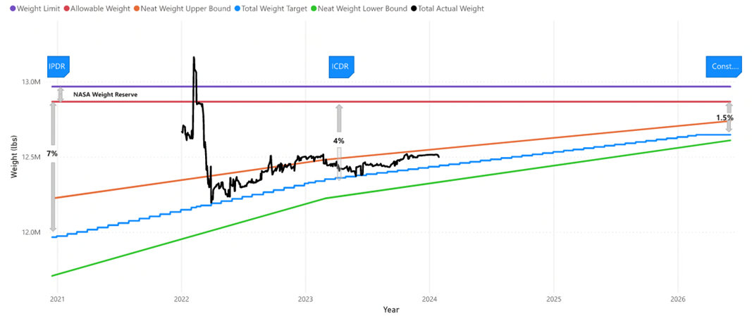
Design Constraints – Weight
Joe Cartledge
Weight Savings Study Executed
Weight Status | Weight (lbs.)
Total Weight | 12,499,057
Required Weight | 12,867,700
Weight Limit | 12,967,700
NASA Weight Reserve | 100,000

Slide 15
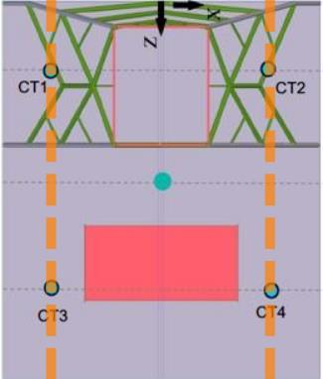
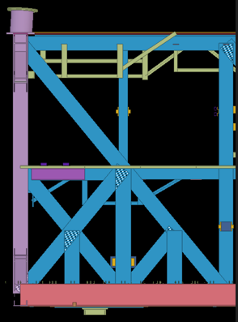
Design Constraints – Center of Gravity
Joe Cartledge
CG
Crawler pick-up point spacing is fixed
Stiffen section and truss within a truss provides flexibility to adjust pickup locations
Analysis allows for adjustment of pickup points (Z direction) from assumed COG
CT2
Center of Gravity

Slide 16
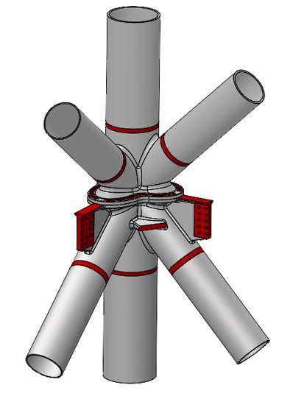
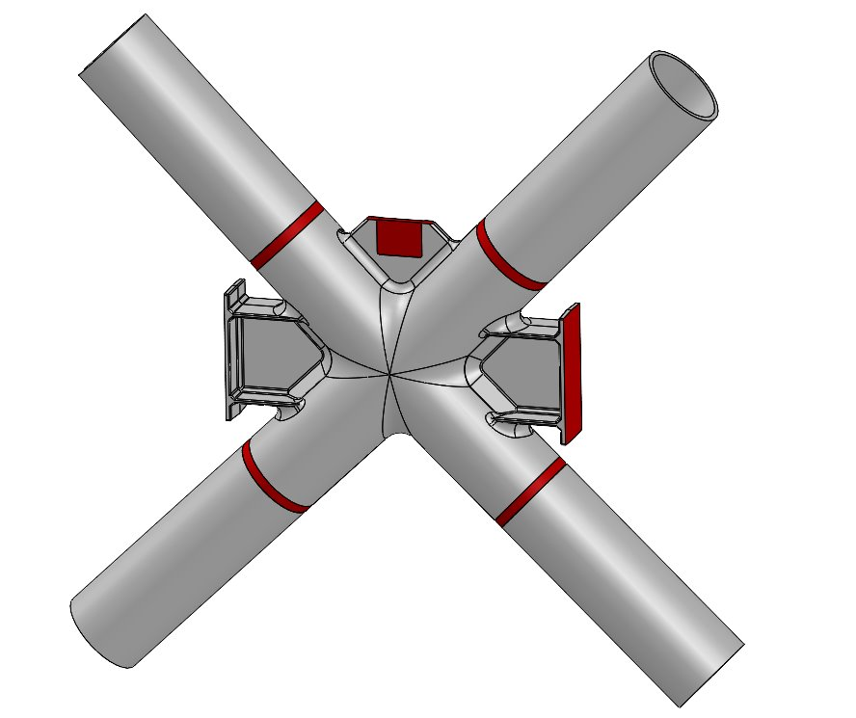
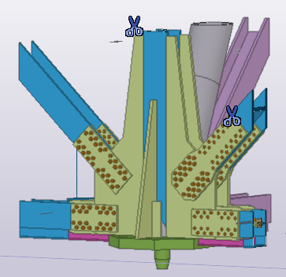
Structural Design, Connection Design, & Detailing
Joe Cartledge
Structural Design
  75 Calculations
  1000 IFC Drawings
Connection Design
  DOR
    Self-Performed Connections (Bechtel)
    Fabricator Performed Connections (CSD)
    Fabricator Performed Castings (Cast Connex)
  Bolting
    F3148 Grade 144, TNA
  Welding
    D 17.1 Requirements: Class A, B, C
      Class A (Critical) – 100% VI, 100% RT or UT, and 100% MT or PT
      Class B – 100% VI and 100% MT or PT
      Class C – 100 % VI
      Weld Map/Data
Detailing
  Dowco
  Clashes
Cast Connex, X-Node
Cast Connex, K- Node
Complex Connection MM5, Bechtel

Slide 17
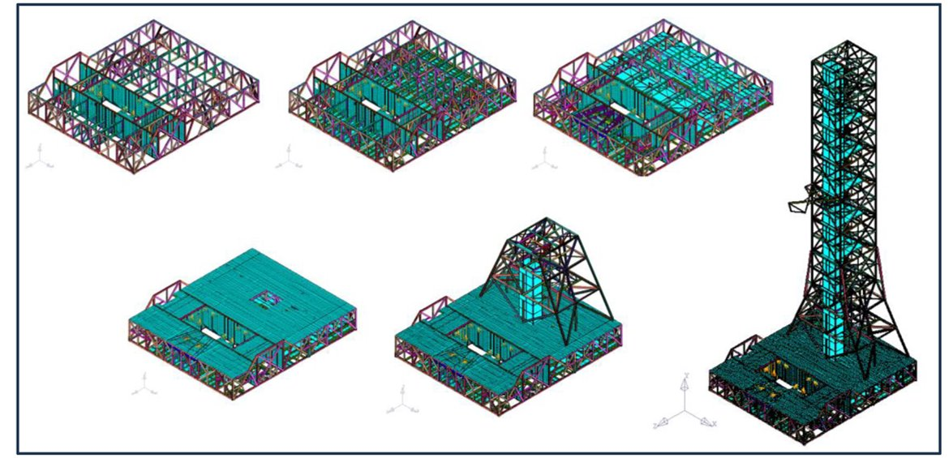
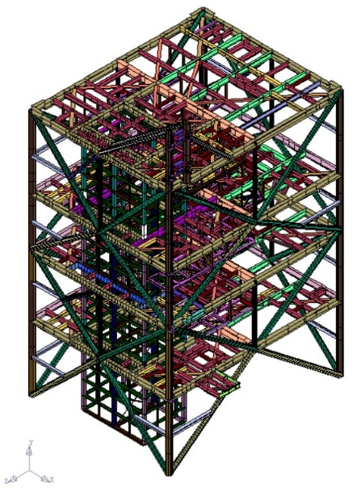
Analysis Models
Kevin MacLeod
Global Model
  Establish Geometries
  Baseline Load Combinations
  Macro Loading
  Construction Sequence
  Design of Trusses, Pre-Buy of API Pipe
  Force and displacement input to local models
Local Models
  Start from Basic Global Model Load Cases
  Refined Geometry
  Add concentrated/peak component loading
Stiffness Checks
  Global Model Geometry
Notes:
Build all possible geometry, BC, and load cases, then align and combine them

Slide 18
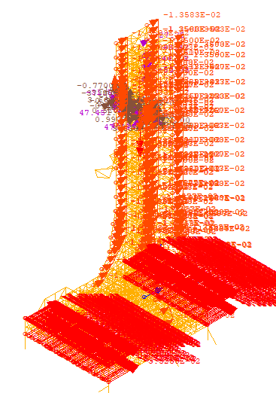
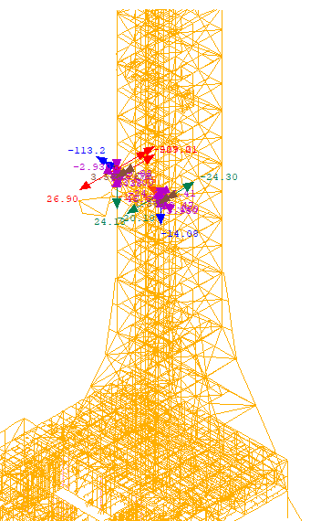
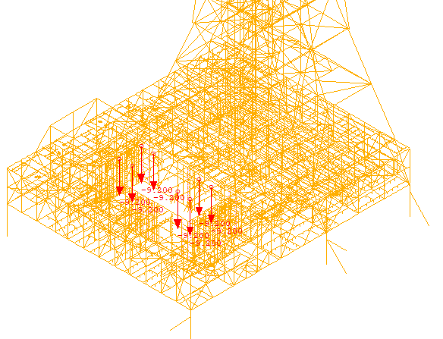
Loads and Load Combinations
Kevin MacLeod
Independent Load Cases (ILC)
  1500
Dependent Load Cases (DLC)
  String of ILC: 1500
Load Combinations
  String of DLC: 6300
DLC:
ILC(2):
ILC(1):
DLC: 'PLUME_1' FROM ILC 'PI_S_B' 1.0 'PI_TF_B' 1.0 'PI_IT_V' 1.0 'PI_FS_V' 1.0 'PI_VS_V' 1.0 'PI_EE_V' 1.0 'PI_VD_V' 1.0 'PI_CA_V' 1.0 'PI_CA_L' 1.0 'TSMPI_X' 1.0 'TSMPI_Y' 1.0 'PI_PGT1' 1.0
LOAD COMBINATION: 'PLUME_1' COMBINE 'DL_CON' 1.0 'DLA_PF6' 1.0 'IOP_WO' 1.0 'DLA_PI' 1.0 'PDB_1' 1.0 'PLUME_1' 1.0

Slide 19
Loads and Load Combinations
Kevin MacLeod
Operational Phases | Support Condition | Dead Load Adjustments | Vehicle Loads | Dynamic Loads | Wind Speed Spec | Additional Cases Considered ¹
Rollout | CT | Arms Extended | No Vehicle/ Unfueled Vehicle | Transport | DSNE | Multiple C.G. Support Locations
On Pad Stay | MM | Arms Extended | No Vehicle/ Unfueled Vehicle |  | DSNE | Min DL/Uplift
On Pad Operations | MM (+XCS) | Arms Extended, Deluge Filled | Unfueled Vehicle/ Fueled Vehicle (+XCS) |  | DSNE
Liftoff | MM+XCS | Arms Retracting T-0 | Fueled Vehicle | Engine Shutdown | DSNE
Plume | MM+XCS | Arms Retracted | No Vehicle | Thermal/ Vibration | DSNE | Max Base Driven and Tower Driven Loading
Hurricane | MM | Arms Retracted | No Vehicle |  | ASCE | Min DL/Uplift
1. MM Spherical Bearings Fixed and Pinned
Notes:
Live Load is local concern for member design, not impactful globally, high level of LLR.
Challenges: Controlling DL changes, aligning model weights to C.G. with SDL.
24 Lateral Cases aligning with ASCE 7 corner and eccentricity cases

Slide 20
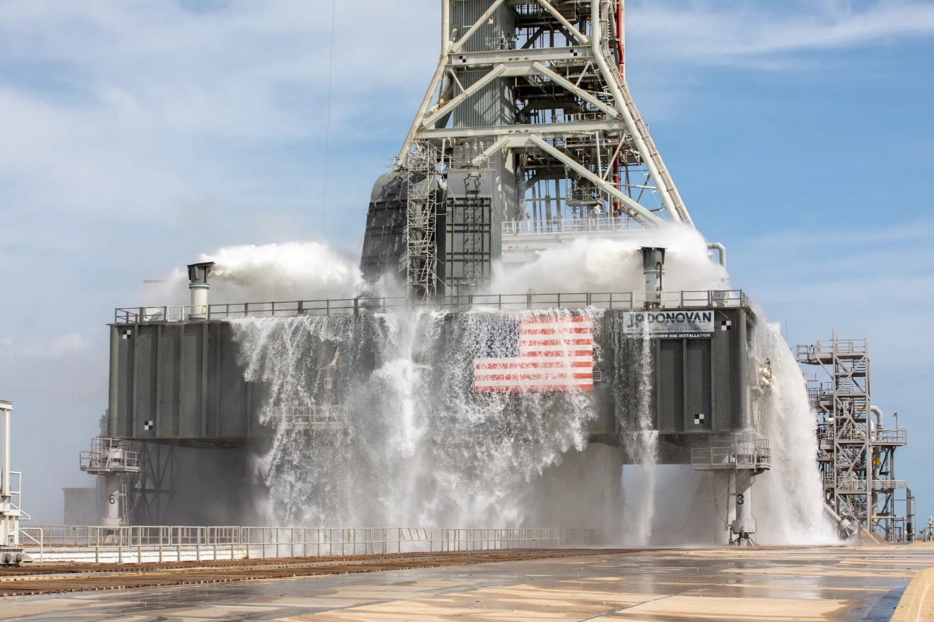
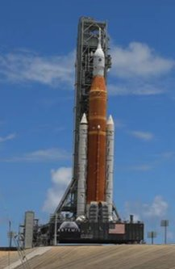
Dead Load and Vehicle Load
Kevin MacLeod
Deluge: 600 kip of Water
Max Vehicle Weight:
  Block 2 Empty: 4,100 kip
  Block 2 Fueled: 6,600 kip

Slide 21
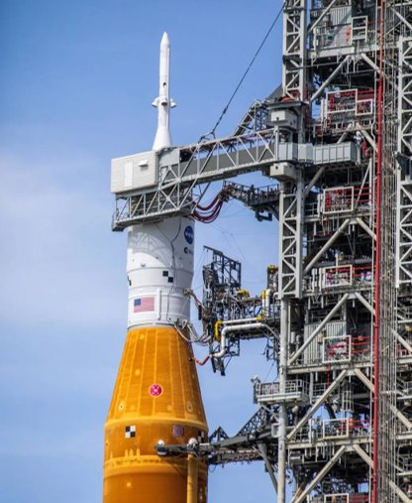
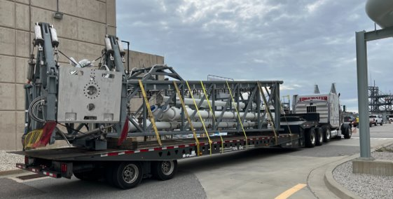
Dead Load and Vehicle Load
Kevin MacLeod
Arms and Umbilicals: ~30kip each
  Extending 40’ off MLT
https://www.nasaspaceflight.com/2021/11/sls-ml-2-update/
https://www.nasa.gov/image-article/birds-eye-view-of-sls-rocket-mobile-launcher/​

Slide 22
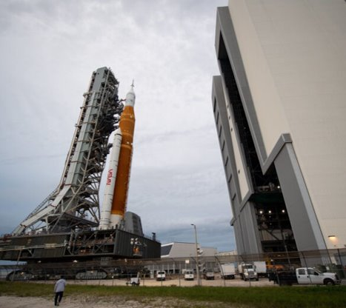
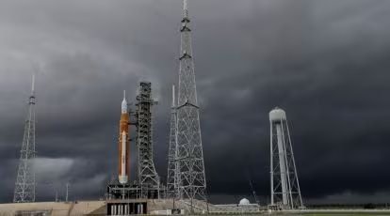
Wind/Hurricane Loads
Kevin MacLeod
Hurricane Ian September 2022
Operational Wind Consideration
Hurricane: ASCE 7, Risk Category I, Exposure D
Hurricane Nicole November 2022
https://indianexpress.com/article/technology/science/nasa-artemis-sls-rocket-hurricane-8267262/
https://www.geekwire.com/2022/nasa-artemis-sls-moon-rocket-weather/
Notes:
5 DSNE wind speeds determined to achieve NASA’s desired probability of occurrence for the duration of the operation. Treated as service level winds.
Design level hurricane per ASCE 7, ultimate level wind speeds assuming no vehicle.
Each of 6 speeds has 24 lateral cases, applied to each dead load configuration.

Slide 23
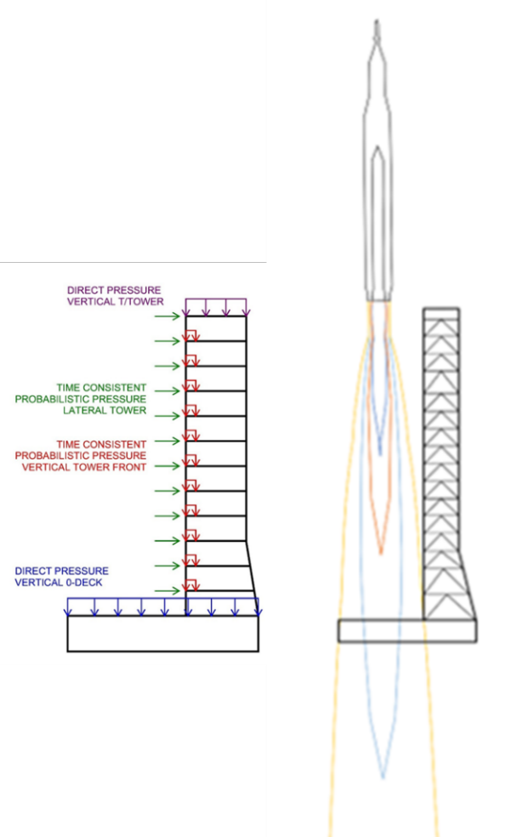
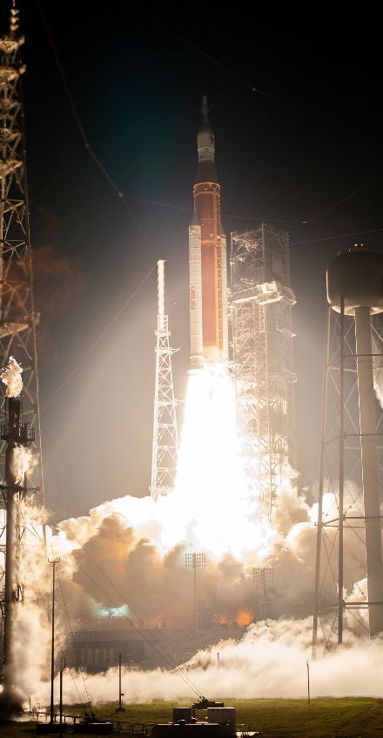
Launch Environment
Kevin MacLeod
Plume Impingement
Plume Load Development
Direct Pressures vs. Probabilistic Pressures
Base Driven vs. Tower Driven
  Time consistent Loading
Other Launch Environment Considerations
Vibration
Acoustic
Thermal
Notes:
5 GNC Data Sets, each with 2001 sims. Using Heavy Slow Measured Winds. Low Vehicle thrust to weight ratio statistically representative wind profiles. Simulates a magnitude and direction varying distribution of launch day winds which most closely represents the pad environment.

Slide 24
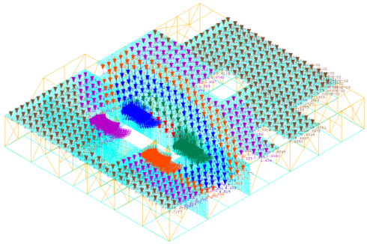
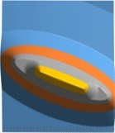
Plume Vertical Loads
Kevin MacLeod
Direct Pressures Applied to Top of Tower and 0-Deck
Haunch Loads
Time Consistent Probabilistic Pressures
Model Application
Pressure Contour
Notes:
9 Cases to capture different drift directions
Haunches 120-150psi

Slide 25
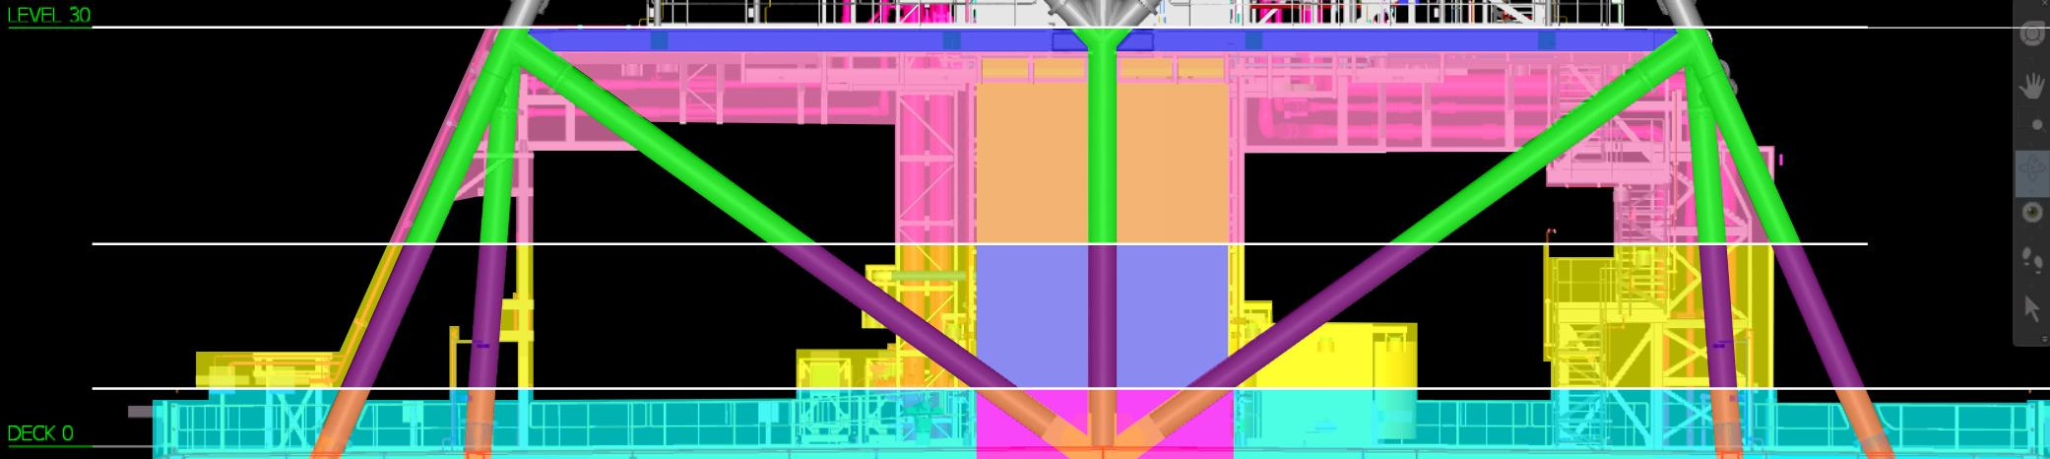
Plume Lateral Loads
Kevin MacLeod
Free Flowing Plume
Turned Flow

Slide 26
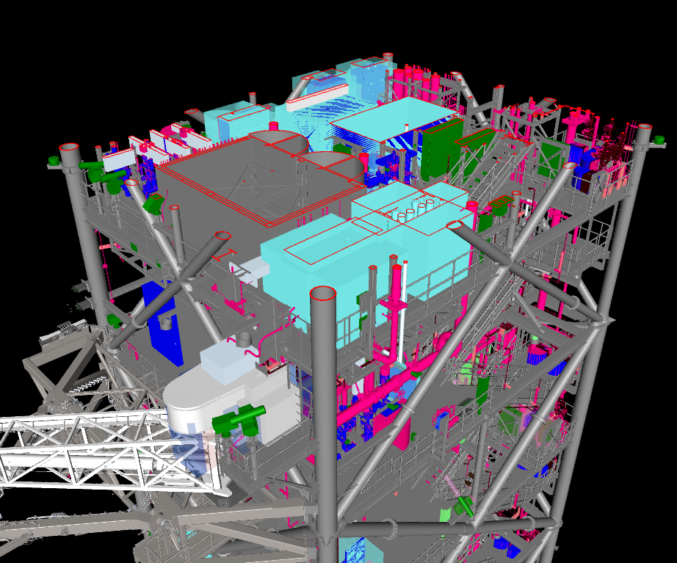
Combinations
Kevin MacLeod
Global Model
6300 Load Combinations
4800 Tons of Steel
Local Models
Elevator
Stairs
Electrical Rooms
Umbilical Rails/Attachments
Platforms
Equipment/Piping
Commodity Grids
Commodity Chase
Cameras

Slide 27
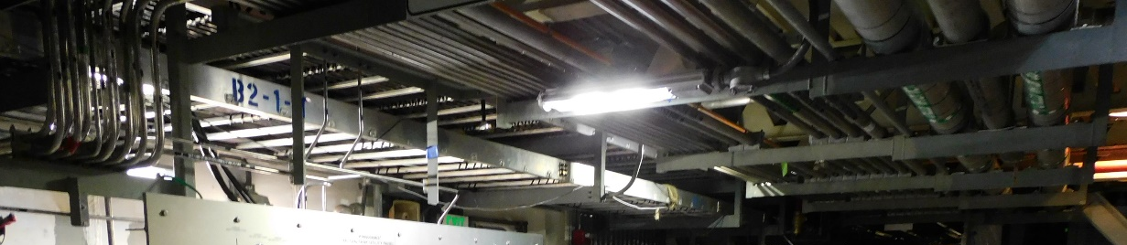
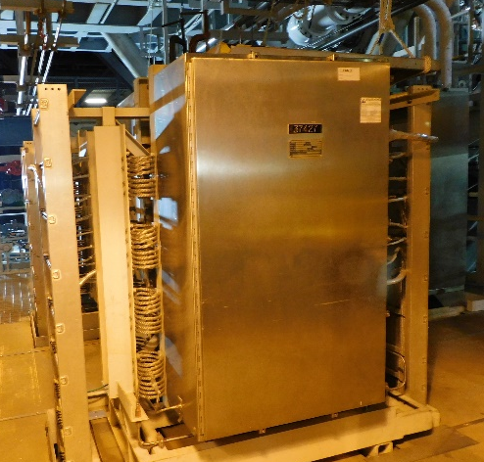
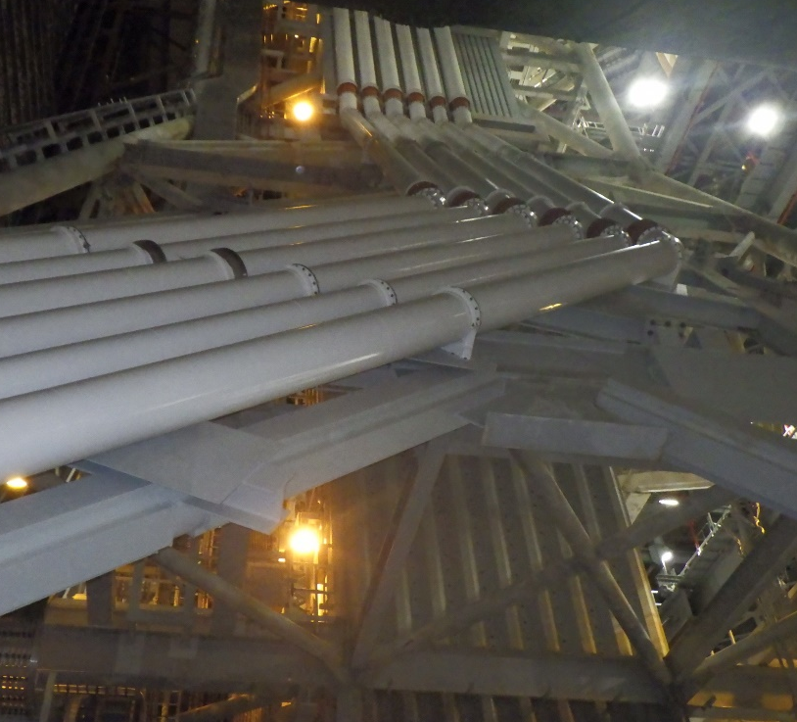
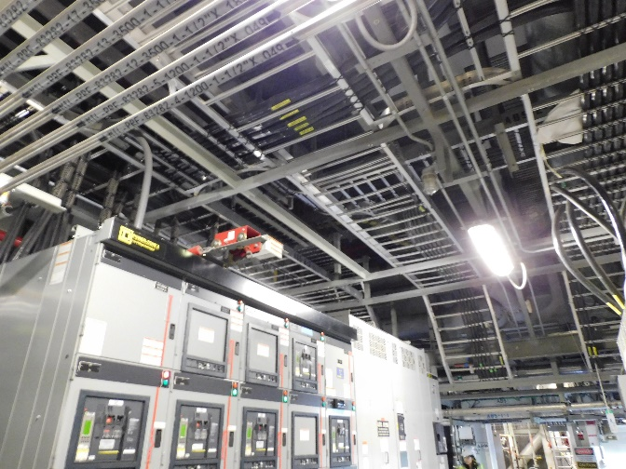
Local Loads
Kevin MacLeod
Equipment and Piping
23 Subsystems
Commodity Support Framing
  14,000 Pipe Supports
  50,000 LF of Piping
  25,000 LF Tubing
  650,000 LF Cables
Equipment Frames and Support
  1000 Pieces Framed/Skids
  1500 Minor Pieces/Censors

Slide 28
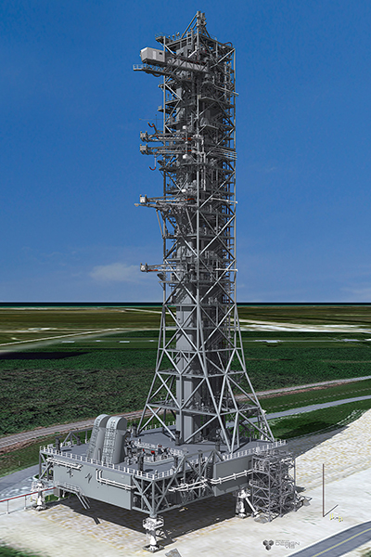
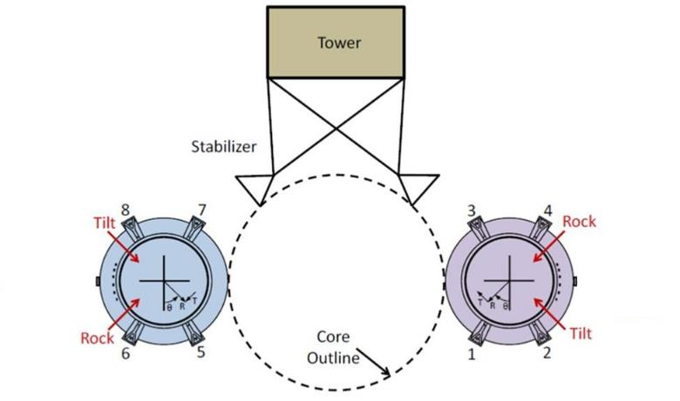
Stiffness Requirements
Kevin MacLeod
Developed from NASA Coupled Analysis
ML to Vehicle Interface Limits
Tower requirements
Horizontal displacements Vehicle Stabilizer (VS) and Vehicle Damping System (VDS)
  Unit Loads
  Emergency Egress System (EES) Loads
Base requirements
Vehicle Support Post (VSP) Displacement
  Vertical Displacement under Vehicle Loads
  Planarity and Relative Stiffness
Top of Vehicle Displacement
  Stacking operations
  Transition between support conditions
  Relative to tower
Notes:
Revolve around vehicle interface, VS/VDS/VSP
T/vehicle displacement after stack and BC transitions

Slide 29
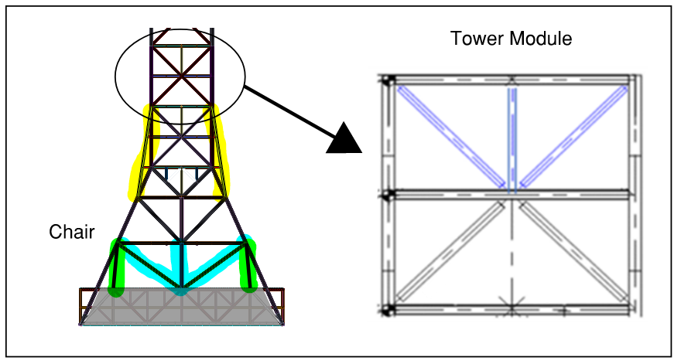
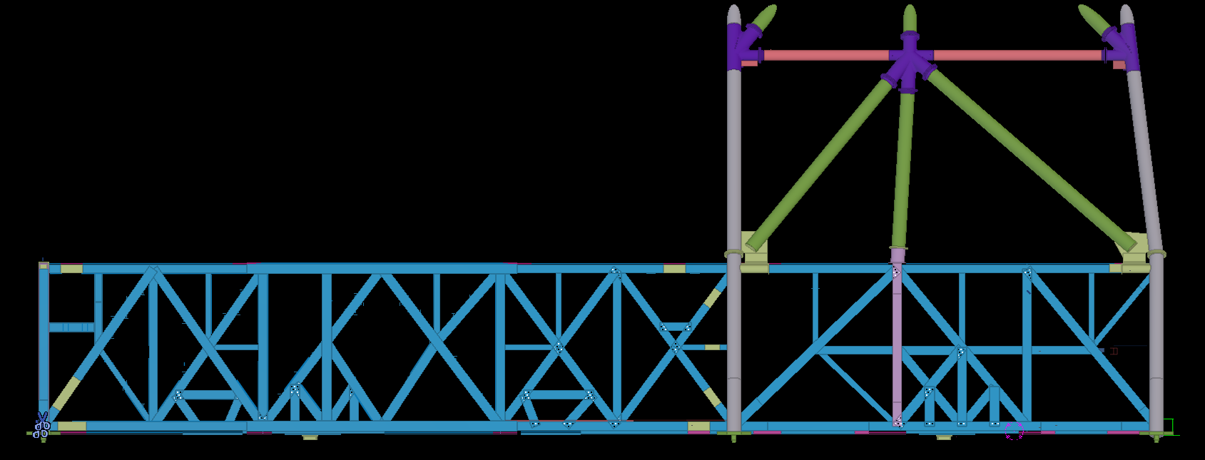
Stiffness Analysis
Kevin MacLeod
MLT Stiffness
Buttress Columns
Virtual Work to Optimize Critical Members
MLB Stiffness
Integrate chair and base trusses
Virtual Work to Optimize Critical Members for Stiffness
Notes:
Block 2 uses ring mount around VSP’s to control load to vehicle through VSP

Slide 30
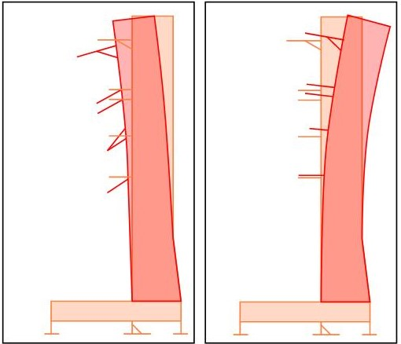
Design Constraints – Installation Tolerances
Kevin MacLeod
Mandatory Inspection Points (MIPs)
  Critical umbilical to vehicle interface
Umbilical Self-Weight and Extension Front Load MLT Causing Tower to Lean
Design Shim Plates Installed Between MLT Modules to Counter Tower Lean
  Simulate shims in analysis with concentrated axial distortion
  Utilize real time construction metrology data to refine model
Tower Deflection due to Self -Weight (left)
Tower Deflection due to Shimming (right)

Slide 31
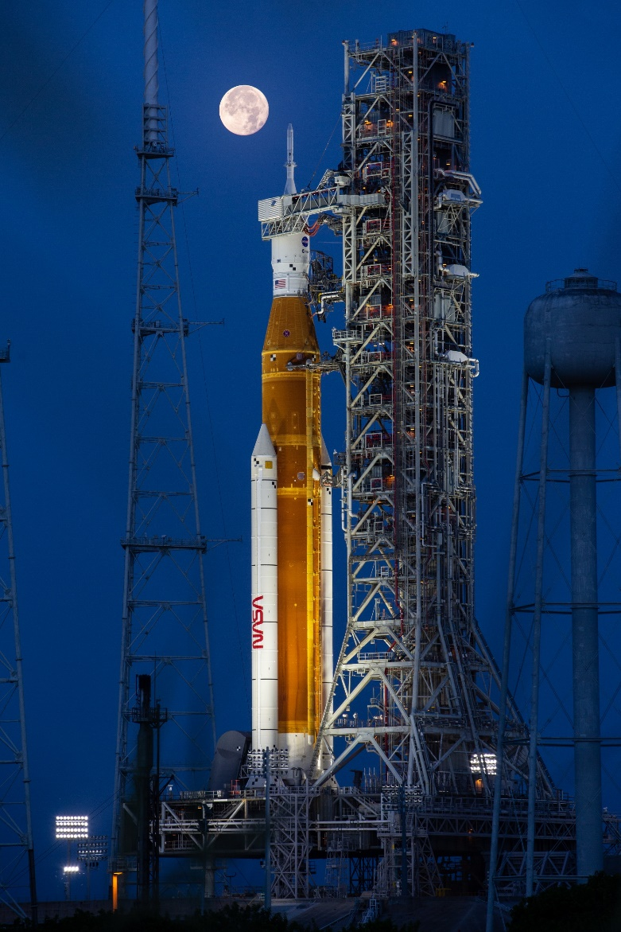
Conclusions
Kevin MacLeod
Designing a Mobile Launch platform is a unique engineering challenge.
  Meet stringent stiffness and weight limit requirements.
  Deal with a moving structure that has different operation needs and changing support conditions.
  Unique loads and code requirements that are outside of industry standards and handle thousands of load combinations to assess every possible scenario.
  Incorporate construction sequence and modular design needs to support construction schedule.
  Analyze critical temporary conditions through construction to monitor displacements and design countering measures to minimize risk of stringent installation tolerances.
  Management of numerous interfaces among the design team, and supplier.
Close coordination among the analysis team, engineering disciplines, construction planners, steel fabricators, and NASA is required to ensure mission success.

Slide 32
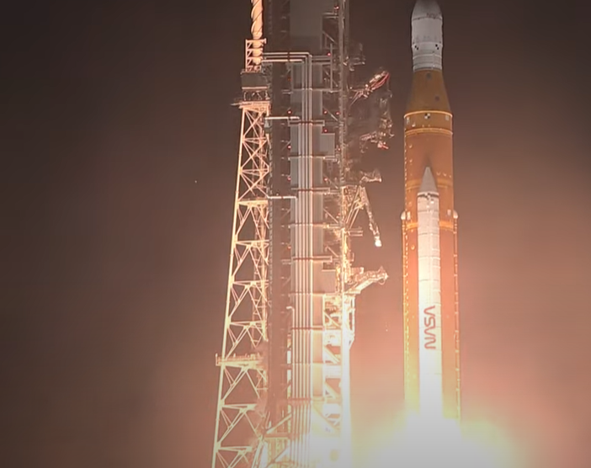
Launch
Kevin MacLeod

Slide 33
PDH CODE ######
CONTACT
Speaker
Email address
Phone #

