Slide 1


NASA Update
Fixed Wing Vehicle Executive Committee Meeting
March 13, 2024
Dr. Jim Heidmann, Deputy Director, Advanced Air Vehicles Program
NASA Aeronautics Research Mission Directorate

Slide 2
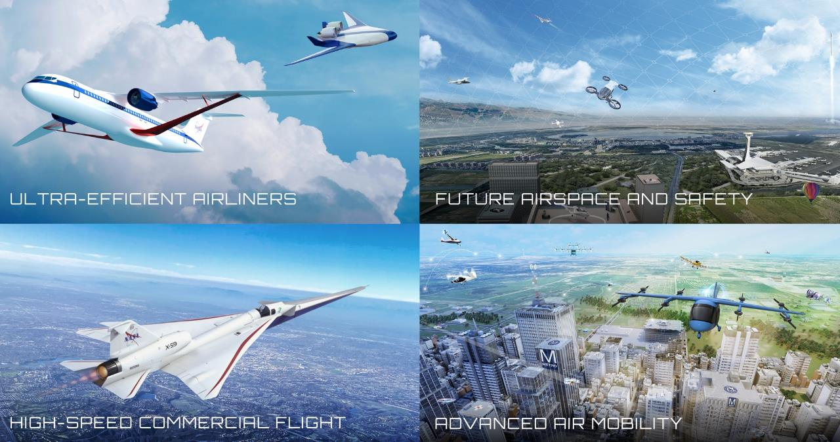
Four Transformations for Sustainability, Greater Mobility, and Economic Growth
Four Transformations for Sustainability, Greater Mobility, and Economic Growth
Notes:
Updated 5/30/23
NASA is leading transformation of aviation in four technical areas.
Each of these transformation areas is enhanced and advanced by a fifth transformational area, our Innovation Ecosystem, which produces new knowledge/ideas to lead to new transformation areas.
Ultra-Efficient Airliners: We are accelerating the ability of the next generation of large commercial aircraft to use less energy and use cleaner energy. Our work is a major contribution to the U.S. goal for net-zero greenhouse gas emissions by 2050.
Future Airspace and Safety: We are working with partner FAA to continue evolution of our national airspace system to safely integrate all types of air vehicles in an increasingly complex environment, and to do so more sustainably – using digital technologies on the ground and on board vehicles to enable more efficient trajectories that use less energy.
Advanced Air Mobility: With nearly 100 industry partners, we are working to enable an economically viable and safe system in which aircraft from drones to air taxis can fly new missions over the most rural countryside to the dense urban landscape – missions such as passenger transport, medical deliveries, utility inspections, disaster response. Our Advanced Air Mobility mission is working with the aviation community to solve challenges in vehicle development and operations, airspace design and operations, and community integration.
High-Speed Commercial Flight: We are potentially removing a key barrier to commercial supersonic flight over land by proving that we can get rid of the sonic boom, while also exploring solutions to local noise and emissions associated with supersonic flight. With our federal partners we are also investigating the potential of even higher speed flight such as high-supersonic and hypersonic speeds.

Slide 3
Aeronautics FY 2024 Budget Request
$ Millions | FY 2023 Enacted | FY 2024 | FY 2025 | FY 2026 | FY 2027 | FY 2028
Aeronautics | $935.0 | $995.8 | $1,015.7 | $1,036.0 | $1,056.7 | $1,077.8
Airspace Operations and Safety |  | 158.7 | 164.4 | 179.4 | 198.2 | 202.8
Advanced Air Vehicles |  | 295.2 | 311.6 | 305.0 | 273.6 | 257.5
Integrated Aviation Systems |  | 264.9 | 260.5 | 263.5 | 279.7 | 305.5
Transformative Aeronautics Concepts |  | 160.0 | 161.8 | 170.3 | 184.5 | 188.5
Aerosciences Evaluation and Test Capabilities |  | 117.0 | 117.4 | 117.7 | 120.7 | 123.5
FY 2024 Budget discussions continuing on the Hill. The House proposed $945M and the Senate proposed $935M.
FY 2024 operating under a Continuing Resolution (CR) proportional to FY2023 level. Current CR due to end on March 8, 2024.
FY 2025 Budget Request not yet released publicly. Anticipate March 11.
Notes:
Bill’s chart from the ARMD FY24 budget briefs on the Hill.

Slide 4
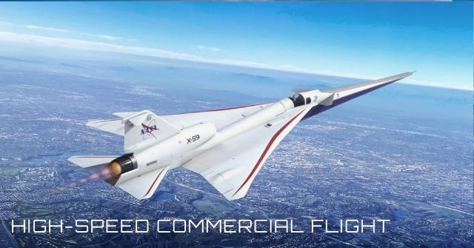
High-Speed Commercial Flight
Advanced Air Mobility – Vertical Flight
Ultra-Efficient Airliners
Notes:
C4
Starting with Supersonics - in particular - the efforts associated with gathering the necessary data to help inform the CAEP deliberations for low boom, overland flight - to move us collectively away from the current prohibition to overland supersonic flight.

Slide 5
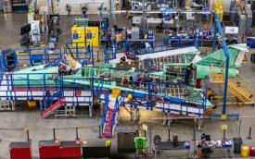

Quesst Mission Overview
Phase 1 – Aircraft Development
In progress (FY18-25)
  Design, fabricate a quiet supersonic research aircraft
  Prove performance in test range flights
  Prove safety for flights in normal airspace
Systematic Approach Leading to Community Testing
Phase 2 – Acoustic Validation
Preparation in progress (FY18-26), Execution FY26
  Prove the acoustic characteristics match design targets
  Detailed in-flight and ground measurements in test range
GPS
Phase 3 – Community Response Testing
Preparation in progress (FY19-27), Execution FY27-29
Conduct community tests
  Select communities
  Outreach and engagement (including STEM)
  Obtain necessary approval
  Plan surveys and recruit participants
  Collect ground measurements
LBFD Aircraft
Meteorological Data (balloon)
Communications & ADS-B
U.S. National Air Space
Mobile Operations Facility
Meteorological Data (ground)
Limited Ground
Microphones
Typical Community
Community Response Surveys
Notes:
Updated 3/23/23
Transformation Area: High-Speed Commercial Flight
The Quesst mission is comprised of three phases … build the aircraft, flight test the aircraft, fly the aircraft over communities to collect response data from residents to the flyovers. And then submit that data to the International Civil Aviation Organization.

Slide 6
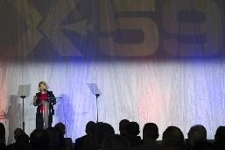
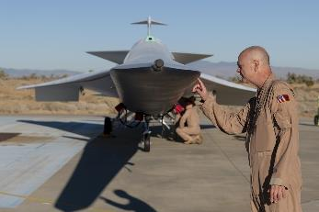
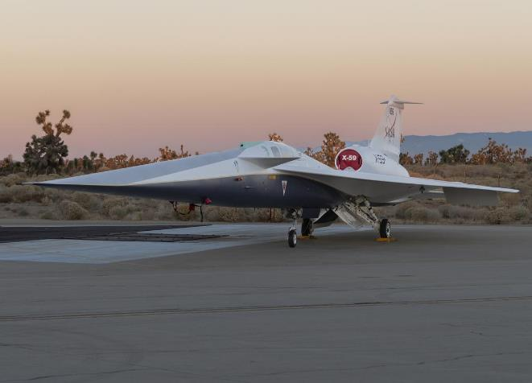
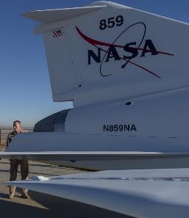
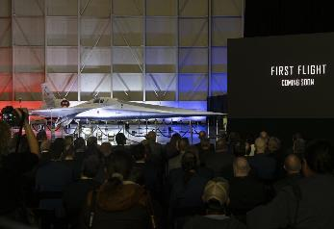
Phase 1 X-59 Aircraft Development
Photos: NASA
Steve Freeman
Progress continues, as do challenges
Resolved issues related to Vehicle Management Computer failures
“As built” X-59 laser scan for boom evaluation model complete
Roll-out ceremony milestone Jan 2024
Power-on System Checkouts in-work
Flight Readiness Review targeted for March
First flight planned 2024
Notes:
Transformation Area: High-Speed Commercial Flight
Photos; most recent starting left top clockwise:
Cover over ventilation inlet
Cockpit installation; showing external vision system
Landing gear installation
Engine installation
Head-on image of the X-59 before move to the flight line (June 2023)
X-59 moves to new hangar (white bldf at left) on flight line at Lockheed Martin Skunk Works (June 2023)

Slide 7
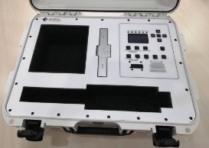
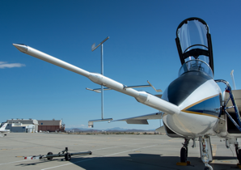
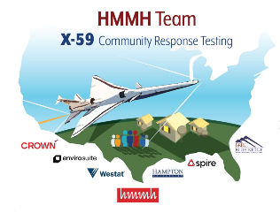
Quesst Mission - Phase 2 and 3 Status
Acoustic Measurement
Ground Recording System (GRS) being developed by Crystal Instruments, Inc
  Ruggedization issues resolved, initial deliveries (70 units) complete
Risk reduction test for Phase 2 logistics & GRS deployment completed in January
Progress continues on airborne acoustic measurement systems
Community Test Planning & Execution
Continued progress on test, exposure and survey plans
Airfield and community selection process ongoing
Test of survey methods completed in November
  Included recruitment approach & survey questionnaires
Addressing bias concerns in all levels of communication
GRS System
International Standards Development
Continued engagement with FAA/AEE, ICAO/CAEP &
international research community
CAEP Steering Group has accepted the recommendation to shift proposal of the enroute standard to the CAEP 15 meeting (2031)
Some progress on interest in community test outside of U.S.
Notes:
The working group 1 co-rapators will be presenting the working paper at the steering group meeting

Slide 8
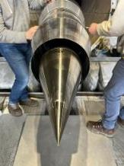
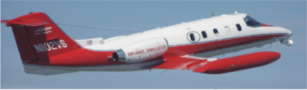
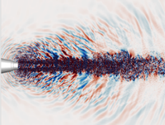

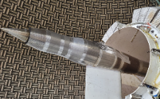
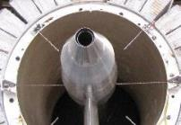
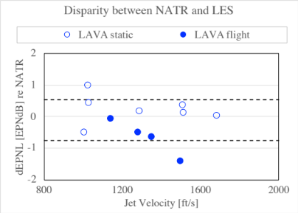
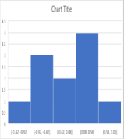
Commercial Supersonics LTO Noise & Prediction Uncertainty
Improvements to noise prediction models used in studies of a supersonic market.
  Models based on current OEM-based aircraft designs for representative near-term aircraft.
  Data obtained by physics-based simulations, validated by model-scale tests which are validated by flight tests
Recent activities
  Working with FAA ASCENT #59 team to track anomalous noise sources in internal mixer nozzles.
  Empirical models being refined using supersonic-specific noise database.
  Model-scale test hardware being prepared for follow-on validation testing.
Demonstration of >5EPNdB reduction in prediction uncertainty on track to complete this year
  Prediction uncertainty for supersonic-relevant designs will be reduced to a level comparable to those of current subsonic system level models
+σ
−σ
ΔEPNL (dB)
-2 0 2

Slide 9
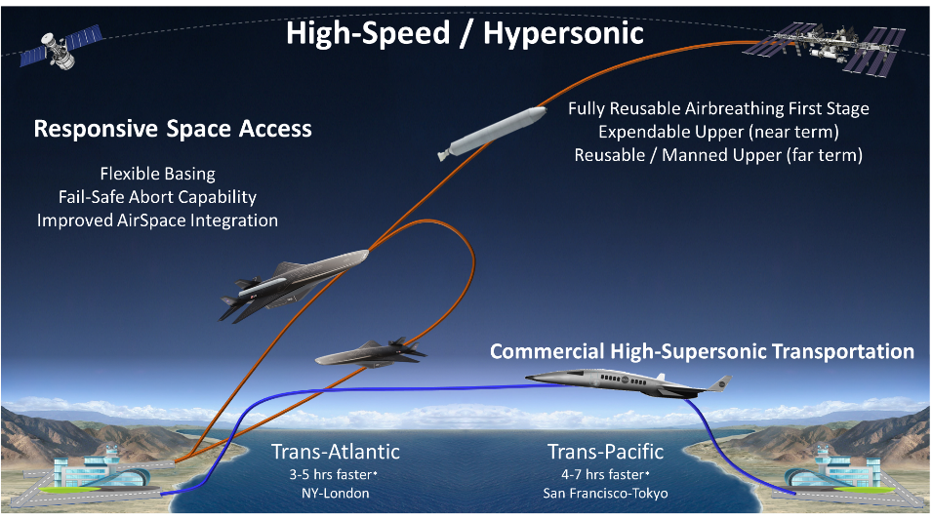
NASA Hypersonic Technology Project (HTP) Vision
Enable Routine, Reusable, Airbreathing Hypersonic Flight
*Mach 2-5 cruise vs subsonic
Overarching Strategic Goal: Develop technologies aligned to reusable hypersonic vehicle requirements

Slide 10
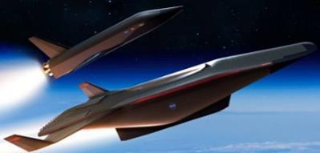
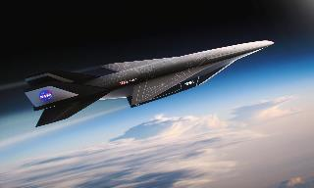
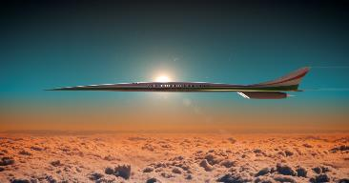
HTP Investment Areas: Challenges to Reusable Hypersonic Flight
RT-1: System-Level Design, Analysis, and Validation
Methods development / validation
System-level uncertainty quantification
Vehicle conceptual design studies
Fully-ReusableTwo-Stage-to-Orbit for Space Access
RT-2 / TC-2 / TC-3: Propulsion Technologies
Combined cycle mode transition
Scaling laws for dual mode ramjets
Propulsion control methods
Dual mode ramjets and scramjets
Turboramjet technologies
Advanced sensors technologies
Innovative, high-speed inlets and nozzles
Application of alternative fuels (SAF, H2,…)
First-stage of Two-Stage-to-Orbit for Space Access
RT-3: Vehicle Technologies
Vehicle flow physics (boundary layer transition)
Aero-heating effects
Non-intrusive (e.g., optics-based) instrumentation
=Technical Challenge (TC)
Mach 5 Commercial Transport
RT-4 High Temperature, Durable Materials
CMC heat exchanger
Static and dynamic high-temperature seals
Advanced metallic materials and manufacturing
Advanced CMC hot structures
Advanced structural instrumentation

Slide 11


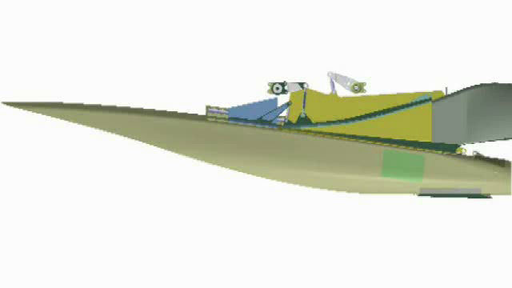

Turbine-Based Combined Cycle Propulsion Mode Transition
AAVP 21 – TBCC Propulsion Mode Transition
Turbojet (TJ) Engine
Integrated Inlet
Dual Mode RamJet (DMRJ)
Integrated Nozzle
Turbine-Based Combined Cycle (TBCC) Concept
Impact
Expanded Mach Operation
Control Algorithm Development and Automated Control Demonstration
Performance / Operability Assessment Methodology and Database Development
FY23 Progress
Combined Cycle Engine Phase 4 Simulation Test Completed Aug 2023
Delays in testing due to many factors, including equipment damage, facility repairs, calibration, and center priorities, delaying TC until FY25.
Combined-cycle inlet rig now ready to be integrated and tested with high-Mach turbine engine
11

Slide 12



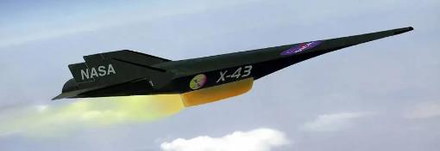
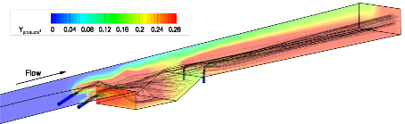
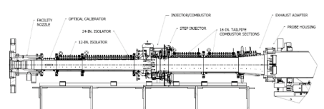
Development of Improved Combustor Scaling Laws for Dual-Mode Ramjets
AAVP 33 Development of improved Combustor Scaling Laws for DMRJ
Impact
Delivery of mathematical models, and associated validation test data with quantified uncertainty, to enable design of large-scale high-speed combustors inclusive of green fuels
NEW in FY23
FY23 Progress
CFD evaluated against existing data
Executed proof-of-concept UQ methodology for cavity flameholder using VULCAN-CFD package
Developed methodology for cavity residence time post-processor
Computational Analysis
Ground Testing
Optimize flameholding cavities in high-speed engines to enable fully reusable hypersonic vehicles
12

Slide 13
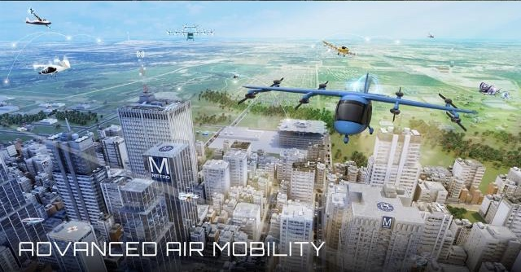
High-Speed Commercial Flight
Advanced Air Mobility – Vertical Flight
Ultra-Efficient Airliners
Notes:
C4
Starting with Supersonics - in particular - the efforts associated with gathering the necessary data to help inform the CAEP deliberations for low boom, overland flight - to move us collectively away from the current prohibition to overland supersonic flight.

Slide 14
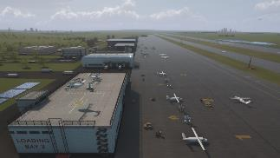
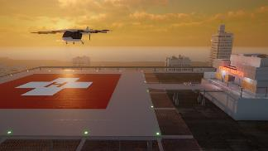
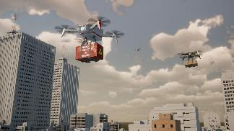
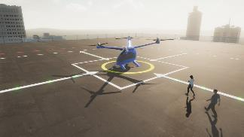
Advanced Air Mobility Mission – Vision & Framework
Automation
Airspace
Safety
Aircraft Design
Noise
Regional Transport
Public Good
NASA AAM Vehicle Objectives:
Integrated Design and Operations for Noise
Integrated Aircraft Propulsion System Performance and Reliability
Weather Tolerant Aircraft Technologies
Survivability in Off-Nominal Conditions
Cabin Acceptability
Consumer Enterprise Goods and Services
Local Passenger Transport

Slide 15


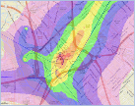

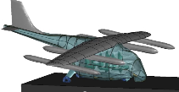
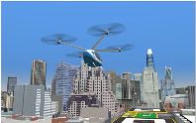
Revolutionary Vertical Lift Technology Project
Research Focus – Vehicle Noise and Safety
Tools to Explore the Noise & Performance of Multi-Rotor UAM Vehicles
Noise & Performance
Validation experiments
Efficiency & accuracy of conceptual design tools
Design & analysis tools to OGA & US community
UAM Operational Fleet Noise Assessment
Noise Power Distance (NPD) database for several UAM ref. configurations & trajectories
AEDT evaluation for UAM fleet noise assessments; provide feedback on findings & usage
Psychoacoustic tests to assess human response
UAM Fleet Noise
Electric Powertrain Reliability
Reliable & Efficient Propulsion Components for UAM
Electric power & powertrain experimental capabilities
Tools to assess electric motor reliability & new design concepts
Validated models & test guidelines for eVTOL propulsion & thermal components
Occupant Safety
Handling & Ride Qualities
UAM Crashworthiness & Occupant Protection
Acceptable Handling and Ride Qualities for UAM
    Full-scale & component level tests
    Test guidelines, modeling best practices, & vehicle technologies for crash mitigation
    Crash & impact data to consensus standards organizations
    Human subject testing to assess handling & ride qualities
    Handling & ride qualities guidelines for UAM vehicles
    Flight dynamics & control modeling tools for conceptual design
15
Notes:
15

Slide 16
Revolutionary Vertical Lift Technology Project
Research Focus – Vehicle Noise and Safety; Recent Progress
Tools to Explore the Noise & Performance of Multi-Rotor UAM Vehicles
Noise & Performance
Validation experiments
Efficiency & accuracy of conceptual design tools
Design & analysis tools to OGA & US community
Completed tiltrotor aeroelastic stability test. Comprehensive hover validation dataset released to the community to support tool validations and improved predictions
UAM Operational Fleet Noise Assessment
Noise Power Distance (NPD) database for several UAM ref. configurations & trajectories
AEDT evaluation for UAM fleet noise assessments; provide feedback on findings & usage
Psychoacoustic tests to assess human response
UAM Fleet Noise
Recommendations for AEDT modifications to better support UAM fleet noise assessments shared with FAA. Completed psychoacoustic test assessing masking effects on annoyance. Shared updates on NASA psychoacoustic studies with ICAO CAEP WG1.
Electric Powertrain Reliability
Reliable & Efficient Propulsion Components for UAM
Electric power & powertrain experimental capabilities
Tools to assess electric motor reliability & new design concepts
Validated models & test guidelines for eVTOL propulsion & thermal components
Provided test guidelines to the electrified aircraft community for high voltage sources and loads (SAE AS7499). Released draft of permanent magnet motor standard (SAE AS8411).
Occupant Safety
Handling & Ride Qualities
UAM Crashworthiness & Occupant Protection
Acceptable Handling and Ride Qualities for UAM
    Full-scale & component level tests
    Test guidelines, modeling best practices, & vehicle technologies for crash mitigation
    Crash & impact data to consensus standards organizations
    Human subject testing to assess handling & ride qualities
    Handling & ride qualities guidelines for UAM vehicles
    Flight dynamics & control modeling tools for conceptual design
Conducted Phase I impact testing of de-energized battery modules. Draft test standard for bird strike impact testing developed.
Completed buildup of ride quality simulator & preparing for next HQRQ Vertical Motion Simulator test
Notes:
16

Slide 17
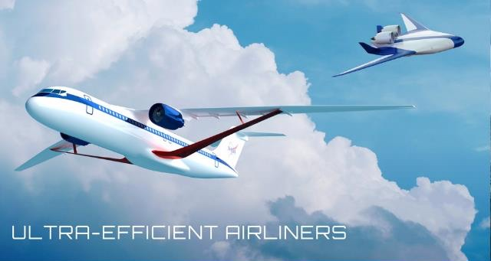
High-Speed Commercial Flight
Advanced Air Mobility – Vertical Flight
Ultra-Efficient Airliners
Notes:
C4
Starting with Supersonics - in particular - the efforts associated with gathering the necessary data to help inform the CAEP deliberations for low boom, overland flight - to move us collectively away from the current prohibition to overland supersonic flight.

Slide 18

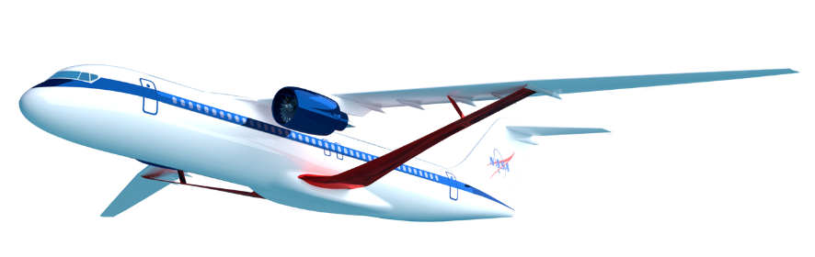
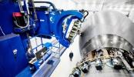


Subsonic Airliner Technologies
Ensure U.S. industry is the first to establish the new “S Curve” for the next 50 years of airliners
Integrated Aircraft System Efficiency
Propulsion Airframe Integration Opportunity
Aerodynamic Efficiency
Transonic Truss-Braced Wing
(5-10% fuel burn benefit)
Weight
High-Rate Composites
(4-6x manufacturing increase)
Electrified Aircraft Propulsion
~5% fuel burn and
maintenance benefit
Engine Efficiency
Small Core Gas Turbine
(5-10% fuel burn benefit)
Notes:
Transformation Area: Ultra-Efficient Airliners
NASA has identified four priority subsonic transport technologies that can have the greatest impact on the future sustainability of commercial aircraft fleet.
These priority technology areas were identified through research over the last twelve years, starting with Advanced Concept Studies in 2008 targeting aircraft with a 2030-35 entry into service.
NASA established aggressive goals targeting noise, emissions, and fuel burn, and worked with industry and academia to identify and drive innovation that can meet those goals. Over the years we’ve winnowed down to the most promising areas for NASA research to these four areas:
New vehicle level technologies such as the Transonic Truss Braced Wing can bring a 5-10% fuel burn benefit.
Small core gas turbine engines can also yield add 5-10% fuel burn benefit, and also serve as a critical enabling technology for future hybrid electric systems.
Electrified Aircraft Propulsion can yield another 5% fuel burn benefit and provide other efficiencies such as maintenance
High rate composite manufacturing – 4 to 6 times faster than current production rates – can reduce the weight of new aircraft, reducing fuel consumption, and opens up the design space to new types of structures and vehicles.
NASA has continued to mature these technologies from fundamental concepts and technologies through ground and flight tests, complemented by the Federal Aviation Administration's CLEEN research programs and continued industry innovation.
We are now at the beginning of the next new “S” curve for the next 50 years of commercial airliners. The promise of these priority technologies needs to be validated by the mid- to late-2020s so that they can form the foundation of the next generation of vehicles to enter service in the early 2030s.

Slide 19
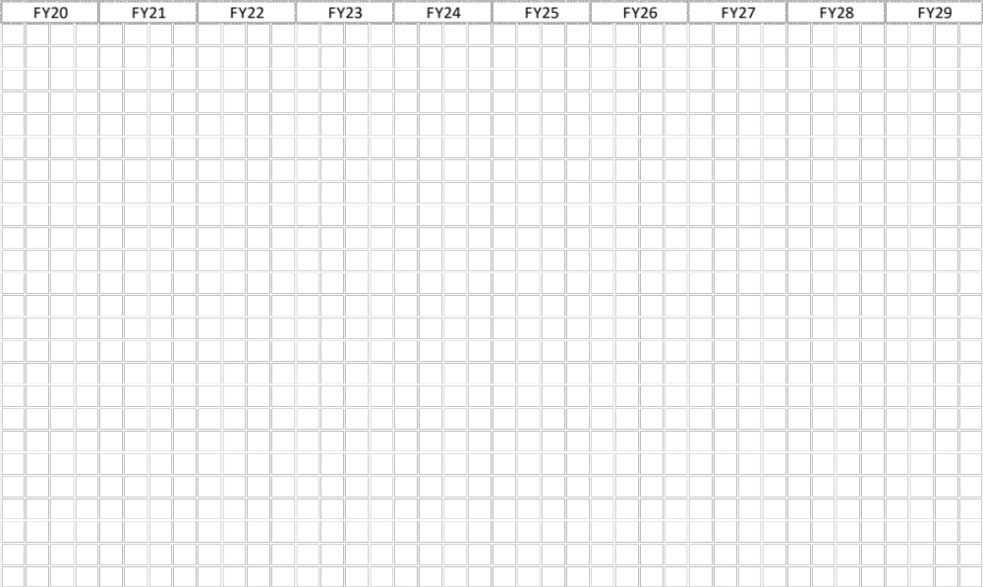
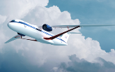



Subsonic Airliners: Integrated Technology Development
Sustainable Flight National Partnership (SFNP)
Technology Readiness Target
Model Based Systems Analysis & Engineering
Framework developed
“Digital Flight Test”
Partner
Selection
Sustainable Flight Demonstrator (SFD)
CDR
Flight Test
Transonic Truss Braced Wing (AATT)
Mid-Term Eval
TC Completion
Hi-Rate Composite Aircraft Manufacturing
(HiCAM)
Demo(s) Down-select
Mfg & Structural Demonstration
Hybrid Thermally Efficient Core (HyTEC)
Partner Selection
Core Demonstration
Power Extraction Test
Electrified Powertrain Flight Demonstration (EPFD)
Flight Tests
Partner Selection
Electrified Aircraft Propulsion
Technologies (AATT)
TC Completion
Achieve TRL 6 in time for industry product decision-making
Planned
MW Altitude Capability (NEAT)
Notional
Notes:
HiCAM
PBR24. TRL/MRL6 for likely wing, but TRL/MRL5 for likely fuselage
PBR25 updates with release in March 2024
EPFD
From Lee N email. 1/17/24 based on PPBE25 cycle and 1st flight dates
GE 1st flight spiral 2 – late Q2 Y26
magniX 1st flight – late q1 FY26. pdr 2024jan30
HyTEC. Phase 2 Core Demo awarded to GE on 12/14/23
PDR = Q1CY25 = 2Q FY25
CDR = Q4CY25 = Q1FY26
Engine test start (“1st burn”) = beginning CY28 so Jan 2028 Duration = 6 months roughly
SFD
milestones unchanged – budget shifts a little MS $ back to left.
AATT
TTBW TC … no change. Some discussion around moving ? 3 months to right (because resources used for SUSAN study)
EAP TC on track to finish end of FY24

Slide 20
Subsonic Airliners: Integrated Technology Development
Sustainable Flight National Partnership (SFNP)
Technology Readiness Target
Model Based Systems Analysis & Engineering
Framework developed
“Digital Flight Test”
EPFD:
GE Aviation and magniX USA Inc. contracts well underway to mature MW-class hybrid electric propulsion systems & demonstrate flight readiness for single-aisle & regional aircraft, respectively.
magniX’s overhauled D-7 aircraft ferried from Canada to Moses Lake, CA in Oct 2023; baseline characterization flights planned for late Feb 2024; magni650 EPU high power altitude testing at NASA NEAT initiated Jan 2024
GE CDR is on track for 2Q FY2024. The magniX PDR completed Feb 1, 2024.
Partner
Selection
Sustainable Flight Demonstrator (SFD)
CDR
Flight Test
Transonic Truss Braced Wing (AATT)
Mid-Term Eval
TC Completion
Hi-Rate Composite Aircraft Manufacturing
(HiCAM)
Demo(s) Down-select
Mfg & Structural Demonstration
AATT/Electrified Aircraft Propulsion:
Testing complete for Raytheon, GE, & Navy hardware under NASA EAP Fault Management contracts. TRL-6 achieved addressing critical industry need for MW-class EAP systems – results are informing industry development programs (GE, Raytheon)
Integrated systems test (spring 2024) - Navy fault management system & thermal management system
NEAT testing complete of U Wisconsin/Ohio State MW motor/inverter – demonstrated unique modular architecture for redundancy, fault tolerance, & lower voltage stress; smart resistor-based control improved stability in distributing power
Preparing for 2 additional tests at NEAT (magniX & 2 MW industry partner) followed by test support for ARPA-E ASCEND motors
Hybrid Thermally Efficient Core (HyTEC)
Partner Selection
Core Demonstration
Power Extraction Test
Electrified Powertrain Flight Demonstration (EPFD)
Flight Tests
Partner Selection
Electrified Aircraft Propulsion
Technologies (AATT)
TC Completion
Achieve TRL 6 in time for industry product decision-making
Planned
MW Altitude Capability (NEAT)
Notional
Notes:
HiCAM
PBR24. TRL/MRL6 for likely wing, but TRL/MRL5 for likely fuselage
PBR25 updates with release in March 2024
EPFD
From Lee N email. 1/17/24 based on PPBE25 cycle and 1st flight dates
GE 1st flight spiral 2 – late Q2 Y26
magniX 1st flight – late q1 FY26. pdr 2024jan30
HyTEC. Phase 2 Core Demo awarded to GE on 12/14/23
PDR = Q1CY25 = 2Q FY25
CDR = Q4CY25 = Q1FY26
Engine test start (“1st burn”) = beginning CY28 so Jan 2028 Duration = 6 months roughly
SFD
milestones unchanged – budget shifts a little MS $ back to left.
AATT
TTBW TC … no change. Some discussion around moving ? 3 months to right (because resources used for SUSAN study)
EAP TC on track to finish end of FY24
This graphic shows how NASA intends to mature these technologies over the next several years, culminating in core demonstrations in time for industry to make decisions about future products.
AATT/EAP:
Previous (fall 2022) The first effort is focused on advancing the MW-class components through component-level and powertrain ground testing. This is part of our Advanced Air Transport Technology - or AATT Project. In our AATT efforts, we have recently successfully completed a TRL4 demonstration of a MW-class circuit breaker in partnership with the Navy. This circuit breaker demonstrated:
100kW per kg specific power density,
an efficiency between 99.3 and 99.8%, and
a response time between 10-500 microseconds,
Further, it has an anticipated altitude capability of 35,000 ft or higher.
AATT/Electrified Aircraft Propulsion: Completed Altitude Integrated Test (AIT) (April 2022) with General Electric, demonstrating high-power, high-voltage EAP powertrain at altitude conditions. Completed MW-class circuit breaker technology with 3 partners (Navy, GE & Raytheon) as part of EAP Fault Management contracts - one of the key challenges for MW-class EAP powertrains.
EPFD: effort will take key components and integrate them for the purposes of in-flight demonstration.
This Electrified Powertrain Flight Demonstration - or EPFD Project is building off of previous successes in ground-tested components.
EPFD announced two contractual partnerships September 2021.
Key Public Dates:
EPFD Partner Selection: September 30, 2021 https://www.nasa.gov/press-release/nasa-issues-contracts-to-mature-electrified-aircraft-propulsion-technologies
GE PDR was fall 2022.,,, CDR on track for summer 2023
GE: First Flight Start: 2QFY26. → Complete: 3QFY26
magniX: pdr will be conducted after configuration trade studies which are expected by end of FY22 (I think this has occurred )
magniX: First Flight Start: 3QFY25 -→ Complete: 4QFY26
These contracts are to develop and test two electrified powertrain systems - in both cases NASA will be getting direct insight and data from the development efforts while the flight vehicles will remain the property of the respective contractor partners.

Slide 21
Subsonic Airliners: Integrated Technology Development
Sustainable Flight National Partnership (SFNP)
Technology Readiness Target
Model Based Systems Analysis & Engineering
Framework developed
“Digital Flight Test”
Partner
Selection
Sustainable Flight Demonstrator (SFD)
CDR
Flight Test
Phase 1 Small Core Technology Development contracts are progressing toward TRL 4/5 with most planned to complete in CY2024.
Phase 2 Engine Core Demonstration solicitation complete; contract awarded to GE Aerospace in Dec. 2023 for a core demonstration achieving TRL 6 in 2028.
Completed initial systems analysis modeling to predict the potential benefits of the Phase 1 technologies against technical performance targets - showing promising projections.
Transonic Truss Braced Wing (AATT)
Mid-Term Eval
TC Completion
Hi-Rate Composite Aircraft Manufacturing
(HiCAM)
Demo(s) Down-select
Mfg & Structural Demonstration
Hybrid Thermally Efficient Core (HyTEC)
Partner Selection
Core Demonstration
Power Extraction Test
Electrified Powertrain Flight Demonstration (EPFD)
Flight Tests
Partner Selection
Electrified Aircraft Propulsion
Technologies (AATT)
TC Completion
Achieve TRL 6 in time for industry product decision-making
Planned
MW Altitude Capability (NEAT)
Notional
Notes:
HiCAM
PBR24. TRL/MRL6 for likely wing, but TRL/MRL5 for likely fuselage
PBR25 updates with release in March 2024
EPFD
From Lee N email. 1/17/24 based on PPBE25 cycle and 1st flight dates
GE 1st flight spiral 2 – late Q2 Y26
magniX 1st flight – late q1 FY26. pdr 2024jan30
HyTEC. Phase 2 Core Demo awarded to GE on 12/14/23
PDR = Q1CY25 = 2Q FY25
CDR = Q4CY25 = Q1FY26
Engine test start (“1st burn”) = beginning CY28 so Jan 2028 Duration = 6 months roughly
SFD
milestones unchanged – budget shifts a little MS $ back to left.
AATT
TTBW TC … no change. Some discussion around moving ? 3 months to right (because resources used for SUSAN study)
EAP TC on track to finish end of FY24
Most Phase 1 small core technology development contracts (HPC/HPT/combustor liner) are progressing as planned to TRL 4/5 in 2023. Though some won’t reach TRL4/5 in 2023, they will in time to impact the core demo.
Additional award in Sept 2022 for Small Core Combustor Design and Sustainable Aviation Fuel (SAF) Compatibility technology development.
Phase 2 Engine Core Demonstration draft solicitation released in Jan 2023 with final release expected in March 2023.
In the Hybrid Thermally-Efficient Core - or HyTEC Project, the objective is to advance technologies for increasing the thermal efficiency of the gas turbine.
We have recently made awards of proposals solicited under a NASA Research Announcement (NRA) solicitation. These awards are for Phase 1 core technologies intended to advance the technologies to TRL 4/5 by 2023. List follows (if needed):
High Pressure Compressor/ GE Aviation
Ceramic Matrix Composite Combustor Liner/ GE Aviation
High Temperature Environmental Barrier Coatings (EBCs)/ GE Aviation
Ceramic Matrix Composite and EBCs/ Pratt & Whitney
High Pressure Turbine Advanced Aerodynamics/ GE Aviation and PW
Ultimately, the objective of the Project through its Phase 2 is to demonstrate core technologies in a ground-based core demonstration.
This is also an area where we value the coordination with the FAA - leadership of both CLEEN3 and HyTEC make a point of attending each others’ meetings and maintaining open communication.

Slide 22
Subsonic Airliners: Integrated Technology Development
Sustainable Flight National Partnership (SFNP)
Technology Readiness Target
Model Based Systems Analysis & Engineering
Framework developed
“Digital Flight Test”
Partner
Selection
Sustainable Flight Demonstrator (SFD)
CDR
Flight Test
Transonic Truss Braced Wing (AATT)
Mid-Term Eval
TC Completion
Hi-Rate Composite Aircraft Manufacturing
(HiCAM)
Demo(s) Down-select
Mfg & Structural Demonstration
Hybrid Thermally Efficient Core (HyTEC)
Partner Selection
Core Demonstration
Implementing Technology Development Phase to inform CY24 down-select
$54M (plus cost-match) in awards to 15 organizations in Advanced Composites Consortium to develop manufacturing processes and advanced composite materials for aircraft structures.
Conducting evaluation & development of next-generation thermosets, resin-infused composites, and thermoplastic composites at small scale, including experiments in material processing, assembly techniques, inspection, and structural performance.
Completing conceptual design of potential large-scale demonstrations
Power Extraction Test
Electrified Powertrain Flight Demonstration (EPFD)
Flight Tests
Partner Selection
Electrified Aircraft Propulsion
Technologies (AATT)
TC Completion
Achieve TRL 6 in time for industry product decision-making
Planned
MW Altitude Capability (NEAT)
Notional
Notes:
HiCAM
PBR24. TRL/MRL6 for likely wing, but TRL/MRL5 for likely fuselage
PBR25 updates with release in March 2024
EPFD
From Lee N email. 1/17/24 based on PPBE25 cycle and 1st flight dates
GE 1st flight spiral 2 – late Q2 Y26
magniX 1st flight – late q1 FY26. pdr 2024jan30
HyTEC. Phase 2 Core Demo awarded to GE on 12/14/23
PDR = Q1CY25 = 2Q FY25
CDR = Q4CY25 = Q1FY26
Engine test start (“1st burn”) = beginning CY28 so Jan 2028 Duration = 6 months roughly
SFD
milestones unchanged – budget shifts a little MS $ back to left.
AATT
TTBW TC … no change. Some discussion around moving ? 3 months to right (because resources used for SUSAN study)
EAP TC on track to finish end of FY24
With respect to our High-Rate Composite Aircraft Manufacturing - or HiCAM Project:
Received formal Agency approval to proceed full speed into implementation.
This project is leveraging a public-private partnership consortium that was formed under the previous Advanced Composites Project.
The current members of the consortium are engaged in activities such as assessing various technologies with respect to their effect on manufacturing rates.
In addition, HiCAM is also working closely with the FAA AIR-600 organization (Policy and Innovation Division) as well as with the Tech Center.
In fact, we are happy to have a Tech Center expert sitting on our consortium executive steering body.
March XX, 2023 NOTE: relative to the awards below - start dates span 1QFY23 to 2QFY23. Recall, each of the 14 companies received numerous ‘awards’ to participate in multi-company research teams. Some teams started sooner than others. Duration runs nominally from 1QFY23 thru 3QFY24. So the close out just beyond the down select
RELEASE 23-XXX
NASA Makes New Awards for Sustainable Aviation Composite Tech Development
NASA has issued $50 million in awards to 14 organizations that will work to develop advanced composite aircraft structures – green technologies with the potential to help reduce aviation carbon emissions.
The awards are from NASA’s Hi-Rate Composite Aircraft Manufacturing (HiCAM) project, which seeks to reduce the cost and increase the production rate of composite structures made in the U.S. With more lightweight, composite airframes in service, airlines will save fuel and reduce emissions, making commercial aviation more sustainable. Sustainability, cost, and production rate drive U.S. competitiveness in the commercial aircraft industry.
HiCAM works with a public-private partnership, the Advanced Composites Consortium, allowing partners to take advantage of each other’s expertise and increase the likelihood of the U.S. aviation industry adopting results. Organizations within the consortium that received funding through these latest awards will match NASA’s funding.
“By working together as a team, rather than as competitors, NASA and its partners will accelerate the development of technologies and the transition of those technologies onto the next generation of transport aircraft,” said HiCAM Project Manager Dr. Richard Young.
When NASA launched HiCAM, the project considered multiple materials and manufacturing techniques. The project established three manufacturing concepts with the potential to achieve HiCAM’s goal: next-generation thermosets, resin-infused composites, and thermoplastic composites. The new awards will support the evaluation and development of these concepts at small scale, including experiments in material processing, assembly techniques, inspection, and structural performance.
The Advanced Composites Consortium member organizations that received NASA funding through these latest awards are:
• Advanced Thermoplastic Composites, of Post Falls, ID
• Boeing, of St. Louis, MO
• CGTech, of Irvine, CA
• Collier Aerospace, of Newport News, VA
• Collins Aerospace, of Chula Vista, CA
• ElectroImpact, of Mukilteo, WA
• Hexcel, of Stamford, CT
• Lockheed Martin, of Palmdale, CA
• Northrop Grumman, of Clearfield, UT
• Solvay, of Alpharetta, GA
• Spirit AeroSystems, of Wichita, KS
• Toray Advanced Composites, of Morgan Hill, CA
• University of South Carolina, of Columbia, SC
• Wichita State University, National Institute for Aviation Research, of Wichita, KS
The additional members of the consortium, who will have the opportunity to apply for future funds, are Aurora Flight Sciences of Manassas, VA; Convergent Manufacturing Technologies – US of Seattle, WA; The Federal Aviation Administration, William J. Hughes Technical Center at the Atlantic City International Airport, NJ; GE Aviation of Evandale, OH; Mississippi State University of Mississippi State, MS; and NASA’s Langley Research Center of Hampton, VA.
At the conclusion of this development phase, HiCAM will select the most promising concepts for further development, after which will follow a full-scale demonstration of fuselage or wing components by Fiscal Year 2027.
In total, NASA plans to invest $140 million in HiCAM while partner organizations are expected to contribute $95 million, resulting in a total operating budget of $235 million.
HiCAM is part of NASA’s Sustainable Flight National Partnership (SFNP). Its support for public-private partnership in high-rate composite aircraft manufacturing is a key contributor to SFNP’s accelerating U.S. progress toward an environmentally and economically sustainable aviation future.

Slide 23
Subsonic Airliners: Integrated Technology Development
Sustainable Flight National Partnership (SFNP)
Technology Readiness Target
Model Based Systems Analysis & Engineering
Framework developed
“Digital Flight Test”
Partner
Selection
Sustainable Flight Demonstrator (SFD)
CDR
Flight Test
Transonic Truss Braced Wing (AATT)
Mid-Term Eval
TC Completion
Hi-Rate Composite Aircraft Manufacturing
(HiCAM)
Demo(s) Down-select
Mfg & Structural Demonstration
Sustainable Flight Demonstrator:
Completed Conceptual Design Review (Sept 2023) & Systems Requirements Review (Dec 2023/Jan 2024)
Second Airline Sustainability Coalition meeting held Nov 2023; included RTX/P&W (selected engine partner)
First flight of TTBW-based demonstrator aircraft with associated technologies on track for late Sept 2028
Hybrid Thermally Efficient Core (HyTEC)
Partner Selection
Core Demonstration
AATT/TTBW (risk reduction for vision system):
SUGAR TTBW Phase VI-A deliverables from Boeing arriving for detailed geometry & technology roadmap.
SUGAR TTBW Phase VI-B initiated Sept 2023. First activity is high-Rn, high-lift test in late CY 2024.
Deep Stall risk reduction test with existing NASA model in NASA Langley 12-Ft Tunnel Spring 2024.
TTBW Wing-Truss-Junction (WJT) model in fab for testing in NASA Glenn Icing Research Tunnel in early summer 2024.
Power Extraction Test
Electrified Powertrain Flight Demonstration (EPFD)
Flight Tests
Partner Selection
Electrified Aircraft Propulsion
Technologies (AATT)
TC Completion
Achieve TRL 6 in time for industry product decision-making
Planned
MW Altitude Capability (NEAT)
Notional
Notes:
HiCAM
PBR24. TRL/MRL6 for likely wing, but TRL/MRL5 for likely fuselage
PBR25 updates with release in March 2024
EPFD
From Lee N email. 1/17/24 based on PPBE25 cycle and 1st flight dates
GE 1st flight spiral 2 – late Q2 Y26
magniX 1st flight – late q1 FY26. pdr 2024jan30
HyTEC. Phase 2 Core Demo awarded to GE on 12/14/23
PDR = Q1CY25 = 2Q FY25
CDR = Q4CY25 = Q1FY26
Engine test start (“1st burn”) = beginning CY28 so Jan 2028 Duration = 6 months roughly
SFD
milestones unchanged – budget shifts a little MS $ back to left.
AATT
TTBW TC … no change. Some discussion around moving ? 3 months to right (because resources used for SUSAN study)
EAP TC on track to finish end of FY24
SFD Boeing
Award January 18 2023 1QFY23
CDR. Feb 24 2026 (2QFY26). PDR Nov 19 2024 (1QFY25)
First Flight Start: September 2028 (4QFY28). -→ Complete: June 2029 (3QFY29)

Slide 24
Subsonic Airliners: Integrated Technology Development
Sustainable Flight National Partnership (SFNP)
Technology Readiness Target
Model Based Systems Analysis & Engineering (MBSAE)
Framework developed
“Digital Flight Test”
Partner
Selection
Sustainable Flight Demonstrator (SFD)
CDR
Flight Test
Transonic Truss Braced Wing (AATT)
Mid-Term Eval
TC Completion
Systems Analysis & Integration:
NASA-internal MBSAE Working Group regularly meeting to integrate research progress across SFNP
MBSAE framework development progressing with integrations of propulsion, geometry, aerodynamics, structures, & cost disciplinary analysis tools completed and applied to a TTBW concept aircraft including mild-hybrid EAP
NASA Research Announcement (NRA) awards were made Fall 2023 to Boeing, M4 Engineering, Georgia Tech & Northrop Grumman to support development of the MBSA&E framework, methods, tools & models.
Hi-Rate Composite Aircraft Manufacturing
(HiCAM)
Demo(s) Down-select
Mfg & Structural Demonstration
Hybrid Thermally Efficient Core (HyTEC)
Partner Selection
Core Demonstration
Foundational supporting tools (Transformative Tools & Technologies Project):
Aviary v0.9.0 was publicly released in Dec. 2023 (https://github.com/OpenMDAO/Aviary) with development continuing to implement additional features
Aviary integrates previous disparate tools for vehicle sizing and mission analysis into a singular code base while retaining the capability to execute legacy tool input files.
Power Extraction Test
Electrified Powertrain Flight Demonstration (EPFD)
Flight Tests
Partner Selection
Electrified Aircraft Propulsion
Technologies (AATT)
TC Completion
Achieve TRL 6 in time for industry product decision-making
Planned
MW Altitude Capability (NEAT)
Notional
Notes:
HiCAM
PBR24. TRL/MRL6 for likely wing, but TRL/MRL5 for likely fuselage
PBR25 updates with release in March 2024
EPFD
From Lee N email. 1/17/24 based on PPBE25 cycle and 1st flight dates
GE 1st flight spiral 2 – late Q2 Y26
magniX 1st flight – late q1 FY26. pdr 2024jan30
HyTEC. Phase 2 Core Demo awarded to GE on 12/14/23
PDR = Q1CY25 = 2Q FY25
CDR = Q4CY25 = Q1FY26
Engine test start (“1st burn”) = beginning CY28 so Jan 2028 Duration = 6 months roughly
SFD
milestones unchanged – budget shifts a little MS $ back to left.
AATT
TTBW TC … no change. Some discussion around moving ? 3 months to right (because resources used for SUSAN study)
EAP TC on track to finish end of FY24
The Aviary team has released an initial version of the code internal to NASA in February '23, and started the process for a public release of the code.
This effort has integrated previous disparate tools for vehicle sizing and mission analysis into a singular code base while retaining the capability to execute legacy tool input files.
Verification for the Aviary code was completed with traceability back to legacy codes. Integration of higher fidelity modeling capabilities are underway (targeted completion August '23) which will feed into the larger MBSAE framework."

Slide 25
ARMD Future Look – Ongoing Strategy Studies
EAP Strategy Refinement
  Leads: Kate McMurtry, Jim Heidmann
  Objective: Develop update to the 2019 ARMD EAP strategy; coordinate with propulsion strategy team
Long Term Propulsion
  Leads: Tone Nerone, Dale Van Zante
  Objective: Develop a long term (2040+) propulsion strategic plan identifying technical barriers, future architectures, and technology maturation timelines leading to major propulsion technology demonstrations.
Long Term Materials, Structures, and Manufacturing
  Leads: Joyce Dever, Ed Glaessgen
  Objective: Develop a long term (2040+) MSM strategic plan identifying system level technologies ready for maturation and selection criteria including industry impact and the NASA role.
High-Speed Strategy
  Leads: Mary Jo Long-Davis, Lori Ozoroski
  Objective: Develop a high-speed strategic plan identifying technology, standards, regulation, sustainability, and partnership issues that need to be addressed for commercial high-speed aircraft (M2-5) and recommendations to adjust CST and/or HTP portfolios.
Future Flight Demonstrations and Experimentation
  Lead: Fay Collier
  Objective: Develop a pre-formulation plan for a Future Flight Demonstration (FFD) that begins as early as FY28, including assessments of candidate demonstrations, proposed selection process, potential industry demonstrator studies, and risk reduction activities.
Plan to infuse study findings into NASA ARMD budget planning this year and next.
Opportunity for new technology development and demonstrations in FY28+ timeframe as current suite of demo projects concludes
Interested in working with OGA, including DOD partners on common technology needs

Slide 26
Other Important Items
Challenge of achieving the aggressive 2050 climate goals requires approaches that complement and go beyond current activities.
  Collaboration with FAA/DLR/GE/others for ground and in-flight emissions & contrail measurements behind Boeing ecoDemonstrator using 100% SAF & NASA DC-8 aircraft as chase plane; Oct. 2023.
  Initiating a National Academies Study to develop a national research agenda to better understand contrails/aviation-induced cloudiness.
  Advanced Aircraft Concepts for Environmental Sustainability (AACES) 2050 study – Industry Day held Sep. 2023 & solicitation closed Feb. 7, 2024. Evaluation process underway with awards in May/June timeframe.
  Need to address noise and emissions from supersonic systems. Working foundational knowledge base while leveraging partner research in preparation for expanded internal effort.
ARMD research efforts well-synchronized with OGA and consistent with Administration’s priorities.
Overall support from key stakeholders continues to be strong. ARMD research efforts focused on environmental impact and US economic growth while supporting dual-use technology development.
Notes:
C22
Overall stakeholder support remains high - efforts are well aligned to those of the FAA (with both AEE and increasingly with AIR-600).
And it’s exciting to be supporting the environmental priorities.
Additionally, we want to acknowledge AEE - Jim and his colleagues - for their efforts on the Aviation Climate Action Plan. Developing such a comprehensive, documented approach was no small challenge.
Progress continues to be made with respect to both our large ground and flight demonstrations - affording us the opportunity to take key technologies to TRL6.
And while these large-scale demonstrations are exciting to bring into reality, we recognize that we cannot neglect the “seed corn” that lays the foundation for future advancements and demonstrations. NASA Aero remains committed to maintaining a balance along the spectrum between foundational research and technology demonstrations.
And - much credit has to go to our 4 research centers in Ohio, Virginia, and California. All Centers are in the process of moving back to near-normal operations. This means:
moving toward 75% on site staffing,
encouraged, but not required, teleworking
opportunities for face-to-face meeting on site

Slide 27
Thank you

