Slide 1

Lunar Command & Control Interoperability (LuCCI) Project Overview
Brian O’Hagan/Project Manager
Feb 29, 2024

Slide 2
What Is the LuCCI Project?
The Lunar Command & Control Interoperability (LuCCI) project was formed to address a gap in how Lunar Surface Systems (LSS) would interoperate across multiple programs, commercial partners, and international partners.
  The LuCCI team is composed of NASA experts from across the agency.
The project objective is to: Define, prototype, integrate, and evaluate an interoperable lunar command, control, data, and software reference architecture to enable autonomy and informatics capability through common standards across LSS.
  Define an operations concept to ensure all LSS needs are understood and addressed.
  Use current commercial, NASA, and international standards where feasible.
  Determine gaps, conflicting standards, and propose solutions.
  Prototype systems and software to assess interoperability and refine into a cohesive architecture.
  Publish an interoperability specification and flow to international standards, Interface Control Documents (ICD), program requirements, etc.
The intention is not to build the network or systems, but to instead determine what is needed and how interoperability should work without being too prescriptive.
  This leverages civil servant knowledge, skills, and experience while allowing for industry innovation and competition.
    A good historical example is the DARPA work on ARPA Net that led to the Internet as we know it today.
  Its out of scope to implement the software needed to utilize the architecture, but without understanding what this entails and how it would work, we can’t ensure the architecture can accommodate it.
  Future projects can utilize these products to implement the needed software, crew interfaces, automation & autonomy, network management, cybersecurity protections, etc.
We intend to leverage other existing or proposed plans and systems to create an integrated architecture needed for LSS.
  SCaN provided LunaNet communications network, Nokia proposal for a Long-Term Evolution (LTE) or 5G network, etc.
  Program provided vehicles and systems: Human Lander System (HLS), xEVAS, Lunar Terrain Vehicle (LTV), Pressurized Rover (PR), etc.
  Future commercial and international systems

Slide 3
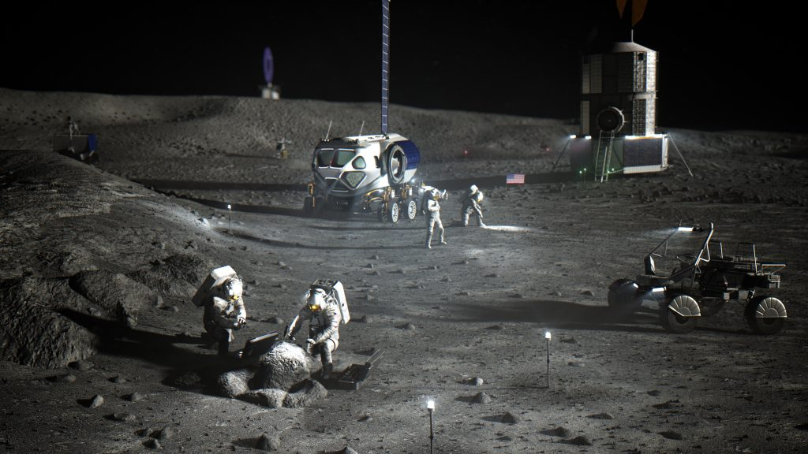
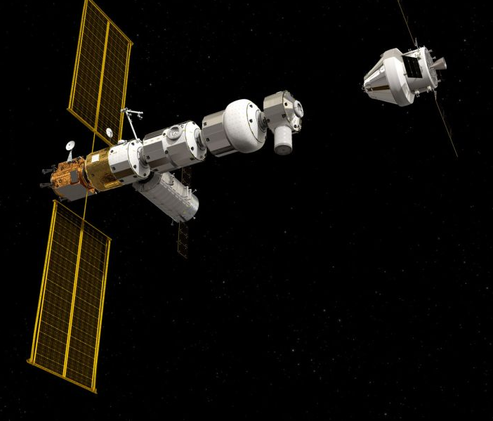
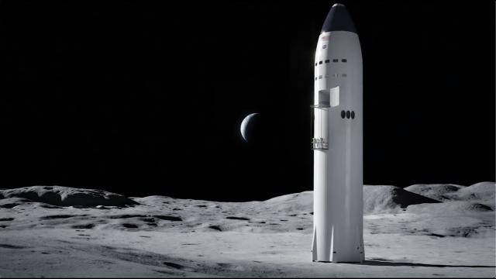
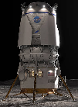
Problem Description
Artemis crews and autonomous systems will work in tandem to operate multiple Lunar surface elements on a single mission with each element designed by a different company or country with unique architectures, hardware, and interfaces.
Orion
Communication, Navigation & Timing
Gateway
ISRU, science experiments, payloads, lunar infrastructure, etc.
Human Landing System
Foundation Surface Habitat
Habitable Mobility Platform
Lunar Terrain Vehicle
Spacesuits & Tools
Near-term (Early Ops, Art II – IV)
Mid-term (Rovers, Art V – VII)
Long-term (Base Camp, Hab, Art VIII+)

Slide 4
Project Scope
The project scope includes the traditional command & control interoperability needs …
  Usual needs for robotic and human spaceflight:
    Command, telemetry, file transfers, voice, video, etc.
    Fault management, crew interfaces, automation & autonomy, etc.
    Remote access & control, security protections, etc.
  Recent key needs:
    Security must be built-in, but not prevent access to needed operability.
    Network architecture that can accommodate the Moon to Mars (M2M) program plans.
      Con Ops in lunar sortie mission to find where to place permanent equipment, bases, etc.
    Advanced crew interfaces to help the crew be more self-sufficient.
  Future needs:
    The architecture needs to be expandable and extensible to future vehicles, systems, users, etc.
    We want an architecture that will meet both NASA and future industry needs.
… and also, cross-cutting areas that support these needs.
  We use Model-Based systems Engineering (MBSE) to capture the architecture and its evolution.
  We plan to use cloud computing to host the tools, demos, etc. for development but also for ease of deployment and maintenance on the lunar surface.
  Assess use of advanced technology such as Artificial Intelligence, Machine Learning, etc. to determine where and when it can be useful for managing the architecture, handling faults, and crew notifications (i.e. advanced caution & warning), etc.

Slide 5
LuCCI Scope Areas
The LuCCI project scope consists of the following tech areas or topics:
Topic/Area | Description | Gaps (Starport id) | M2M Obj
Communications, Navigation, and Timing | Assess how best to utilize planned lunar communications networks and assets (LunaNet, 3GPP/LTE/5G, etc.). Determine how will we interface with navigation & timing. We won’t duplicate the work performed by others (SCaN, ICAN, etc.) to define the comm links and systems, but instead assess how best to utilize them and switch between them to achieve the goal of interoperability. | 1093, 1105, 1113, 1281, 1314 | LI-2, LI-3
Avionics & Network Systems | Define, assess, and prototype current and new avionics and network technologies such as High-Performance Spaceflight Computing (HPSC), Ethernet variants, etc. for use in LSS. Determine physical connectivity of LSS systems, which existing systems meet our needs, what are the integration options, and which should we recommend to LSS vendors? How will network management be performed? | 889, 992, 1113, 1157, 1312 | RT-7
Data Exchange and Formats | Define, assess, prototype, and integrate an interoperable system to exchange data between LSS systems using a common set of standards and data formats. This includes commands, telemetry, Caution & Warning, voice, video, etc. and is a key need for an interoperable architecture. | 1113, 1190, 1227, 1312 | OP-4, RT-7
Cybersecurity | Define, assess, prototype, and integrate a common set of security standards for exchanging data between LSS systems. This needs to be scalable based on system capabilities & needs, while being extensible for a changing security environment. This is key new need beyond what previous programs used. | 888, 894, 965, 1181, 1190 | OP-4, RT-7
Software | Prototype and provide a base software system for LSS GFE projects and vendors to use. Define and prototype a bridge between the Core Flight System and Core Flight Executive (cFS/cFE) and Space Robot Operating System (ROS) ecosystems. This is a key need for controlling the planned LSS systems. | 681, 660, 841 | OP-4, OP-5, OP-9, RT-7, TH-9, TH-10
Computer Human Interfaces (CHI) | Define, assess, and prototype a base CHI system to perform command, control, and monitor of LSS elements. Investigate human-automation interactions, need for crew situational awareness, portable displays, use of advanced technologies (AR/VR), etc. We’re not standardizing display technologies, but instead ensuring the crew can get the right data when they need it. | 873, 1069, 1093, 1070, 1108, 1311 | LI-9, OP-2, OP-4, OP-5, OP-10 RT-7, TH-9
Automation & Autonomy | Define, assess, and prototype a system to autonomously control the LSS architecture. Assess what should be manually controlled vs automated vs autonomous, centralized vs distributed control, and the best use of advanced anomaly detection and recovery. Autonomy will be essential for controlling the LSS systems, managing the network, responding to cybersecurity incidents, etc. | 681, 718, 795, 841, 916, 969, 980, 1054, 1094, 1106, 1070 | LI-9, OP-2, RT-4, TH-4
And the following cross-cutting areas:
Topic/Area | Description
Artificial Intelligence (AI) & Machine Learning (ML) | How best can we utilize AI and ML to achieve autonomy and security needs? Assess feasibility of using AI and ML in lunar systems rather than just in Earth-based systems. What infrastructure is needed to meet theses needs?
Cloud Computing | How best can cloud computing be used for architecture development, prototyping, demos, etc. Can containers be a way to CM and later update lunar infrastructure?
Model Based System Engineering (MBSE) | Utilize MBSE to model architecture, develop use cases, and assess completeness of ops con and interoperability requirements.
Internet of Things (IoT) | Applicability of IoT to lunar systems, how best to integrate, and how best to ensure architecture can support scaling up from IoT from equipment, science experiments, etc. to major systems like landers and habitats.

Slide 6
Team Members & Stakeholders
LuCCI team members are from most NASA centers:
  ARC
  GRC
  GSFC
  JSC
  KSC
  LaRC
  MSFC
  SSC
Other NASA and M2M Orgs:
  SCaN/LunaNet
  OCIO ATLAS
  Moon-to-Mars (M2M) SE&I
And M2M programs:
  EHP
  HLS
  Others as needed
Project stakeholders:
  M2M SE&I, other M2M teams
  Programs: HLS, EHP, future programs
  Others as needed
External organizations we are working with:
  Standards organizations
  Industry groups
    ROS and SpaceROS
  Other government agencies
    DARPA LunA-10 – Lunar Infrastructure
  And others as needed…

Slide 7
FY24 Products and Schedule
Trade Studies
  Identify needed trades, available standards, gaps, and other info needed to identify options.
  Perform analysis of options, down select, identify prototype & model needs, identify test facilities, and plan work.
  Perform prototyping, model analysis, reassess options, and down select to baseline.
Concept of Operations
  For each area/topic, what is needed, what can be reused, how will the architecture work, what else is needed, etc.
  Multiple cycles to iterate as trade studies, prototypes, models, etc. results and lessons learned are incorporated
Command, Control, Data, and Software Interoperability Specification
  Incorporate trade study results, write requirements, conduct reviews, assess programmatic impacts, plan releases
Requirements and Interface Specifications
  Assess current requirements, identify gaps, provide new or changed requirements to programs for CRs
Group | Description | 2023 |  |  | 2024
 |  | Oct | Nov | Dec | Jan | Feb | March | April | May | June | July | August | Sept
Meetings | Meetings | Start |  | Funded | Plan
 | F2F |  |  |  | F2F#1 |  |  |  | F2F#2
 | Final Outbrief |  |  |  |  |  |  |  |  |  |  |  | 9/24
 | Sync Points |  |  |  |  | #1 |  | #2 |  | #3 |  | #4
Con Ops | Work |  | Start |  |  | ⇓ |  |  | ⇓ |  |  | Finish
 | Con Ops draft |  |  |  |  | Development |  | Review | Delivery
 | Con Ops final |  |  |  |  |  |  |  | Development |  | Review | Delivery
Tech Teams | Work |  |  |  | Start |  |  |  |  |  |  | Finish
 | Trade Studies |  |  |  | Start |  | ⇓ |  |  | ⇓ | Finish
 | InterOp Spec draft |  |  |  |  |  | Development |  | Review | Delivery
 | InterOp Spec final |  |  |  |  |  |  |  |  | Development |  | Review | Delivery
Demos | Planning |  |  |  | Start |  |  |  |  | Finish
 | Initial |  |  |  |  |  |  |  |  |  | Initial
 | Dry-runs |  |  |  |  |  |  |  |  |  |  | Dry-Runs
 | Final |  |  |  |  |  |  |  |  |  |  |  | Final
  Define interface specifications for future LSS (by type of system)
Demonstration
  Evolve prototypes, models, and sims to show end-to-end flow of data in a representative architecture in test facilities
  Ideally have semi-annual demos with available architecture components
  7

Slide 8


Slide 9
Existing Interoperability Standards
 |  | Comm, Nav, Timing | Avionics & Networks | Data Formats & Exchange | Cybersecurity | Software | Computer Human Interfaces | Automation & Autonomy | Notes
HEOMD-003-01 | International Avionics System Interoperability Standards (IASIS) |  | TTGbE, Ethernet (802.3-2008 1000BaseT) |  |  |  |  |  | No routing, SNMP, security, etc.
HEOMD-003-02 Rev A | International Communication System Interoperability Standards (ICSIS) | CCSDS AOS, Encap, Wi-Fi (802.11n & 802.11ac), RFID, LTE (TBD) | IPv4, IPv6, LTP, TCP, UDP, DTN | CFDP, AMS, RTP, CCSDS 766.2-B-1, Voice and Audio Communications; CCSDS 766.1-B-2, Digital Motion Imagery | IPSec, AES (NIST SP 800-38D), Link-Layer (CCSDS 355.0-B-1) |  |  |  | LSS in work, Link Layer Sec won’t work for LSS, No NTP or PTP
HEOMD-003-07 | International External Robotic Interface Interoperability Standards (IERIIS) |  |  |  |  |  |  |  | HW only, no SW interop, no ROS
HEOMD-003-08 | International Software System Interoperability Standards (ISwSIS) | Encap |  | Space Packet, Big Endian, CCSDS 876.0-B-1 EDS, CCSDS 660.0-B-2 XTCE (v1.2) |  | cFE/cFS |  |  | No EWCA, COTS, Cmd & Tlm data
ACD-50028 Rev DRAFT | Artemis Extension for Space Packet Protocol Specification Document |  |  |  |  |  |  |  | Empty
ACD-40040 Rev Baseline | Artemis Campaign Development (ACD) Icon and Symbol Library |  |  |  |  |  | GUI
ACD-50040 Rev Baseline | Artemis Campaign Development (ACD) Graphical User Interface (GUI) Standard |  |  |  |  |  | GUI, Cmds & Tlm, Messages, EWCA
Gateway |  | GP 10002 | GP 10003 | GP 10098, GP 10100 |  | GP 10006 | GP 10007 | GP 10012
C3I Orion/ SLS/EGS | Command, Control, Communications, and Information (C3I) Interoperability Specification | CCSDS AOS, Encap | IPv4, UDP, ICMP, routing, DiffServ, TCP (limited) | RTP, G.729, H.264, CFDP, XTCE v1.1, DEM, NTP | AES (NIST SP 800-38D), Link Layer (CCSDS 355.0-R-4) | Cmd/Tlm fns | EWCA in Orion docs |  | DEM instead of Space Packet, No SNMP, IPv6, IPSec
https://www.internationaldeepspacestandards.com/

Slide 10
Example Products
Example/notional N2 Exchange data exchange matrix
  This shows the complexity of the architecture via the data exchanges needed for interoperability to work:
From: \ To: | xEVAS | Gateway | Hab | HDL | HLS | LTV | MCC, HSOC | MPH | PR | Robotics | SCAN | Science | Util Rov |  | Data Flow Legend | Symbol
xEVAS (EVA Suits) | A | A,T,V | A,T,V |  | A,T,V |  | A,T,V | A | A |  |  |  |  |  | Audio | A
Gateway | A | A,C,F,T,V | A,F |  | A,F? | C | A,F,T,V | A,C | A,C | C |  | C | C |  | Command | C
Hab | A,C,F | A,F | A,C,F,T,V | C | A,C | C,F | A,F,T,V | A,C,F | A,C,F | C,F |  | C,F | C,F |  | Files | F
HDL (Cargo Lander) |  |  | T,V |  |  |  | F,T,V |  |  |  |  |  |  |  | Navigation | N
HLS (Human Lander) | A,C | A | A,T,V |  | A,C,F,T,V | C | A,F,T,V | A,C | A,C | C |  | C | C |  | Pointing | P
LTV |  |  | T,V |  |  |  | F,T,V |  | A |  |  |  |  |  | Telemetry | T
MCC, HSOC, etc. (Earth Control Centers) | A,C,F | A,C,F | A,C,F,V | C,F | A,C,F,V? | C,F | -- | A,C,F | A,C,F,V? | C,F |  | C,F | C,F |  | Time | Z
MPH (Mini Pressurized Rover) | A,C | A | A,F,T,V |  | A |  | A,F,T,V | A,C,T,V | A | C |  | C |  |  | Video | V
PR (Pressurized Rover) | A,C | A | A,C,F,T,V |  | A | A | A,F,T,V | A,C | A,C | C |  | C | C
Robotic Systems (cranes, loaders, etc.) | T |  | F,T,V | T,V | T,V |  | F,T,V | T,V | T,V | T |  |  |  |  | Connectivity Legend
SCAN Comm, Nav, Pnt, Timing | N,P,Z | N,P,Z | Z | N,P,Z | N,P,Z | N,P,Z | N,P,Z | N,P,Z | N,P,Z | N,P,Z |  | T,Z | N,P,Z |  | RF | R
Science/Payload Equipment | T? |  | F,T,V |  |  |  | F,T,V |  |  |  |  |  |  |  | Hard-line | H
Utility Rover |  |  | F,T,V |  |  |  | F,T,V |  |  |  |  |  |  |  | Note: Notional, not baseline

