Slide 1


A Psychoacoustic Test on the Effect of Masking on Annoyance to Urban Air Mobility Vehicle Noise
Matthew Boucher, Andrew Christian,
Tyler Tracy, Siddhartha Krishnamurthy,
Durand Begault, Stephen Rizzi, Kevin Shepherd
NASA Langley Research Center, NASA Ames Research Center
186th Meeting of the Acoustical Society of America
Acoustics Week in Canada
May 14th, 2024

Slide 2
Outline
Background
Audibility and Annoyance
Psychoacoustic Testing Approach
Results

Slide 3

Urban Air Mobility and Noise
Safe, efficient and accessible transportation for passengers and cargo ^{[1]}
Noise concerns must be mitigated in communities where UAM operations take place ^{[2]}
Models of annoyance to UAM noise are needed ^{[3]}
[1] Thipphavong et al., “Urban Air Mobility Integration Concepts and Considerations,” 2018 Aviation Tech., Int., and Operations Conf., (2018)
[2] Hill et al., “UAM Vision Concept of Operations (ConOps) UAM Maturity Level (UML) 4’’, NASA (2020)
[3] Rizzi et al., “Urban Air Mobility Noise: Current Practice, Gaps, and Recommendations,” NASA/TP-2020-5007433 (2020).
Notes:
1st bullet:
Urban Air Mobility (UAM) operations offer an alternative to road and rail traffic for local and regional movement of people and goods.
The main goal of UAM is to provide…
2nd bullet:
Noise concerns will need to be overcome for large-scale UAM adoption.
For UAM operations to mature and be practical in a wide range of locations…
3rd bullet: A recent NASA white paper on UAM noise identified gaps and recommendations, such as…
Image on right:
New rotorcraft configurations -> new source of noise -> differences in sound quality
UAM noise will add to an existing soundscape. How will this background noise affect human response?
May induce a different human response than traditional vertical takeoff and landing vehicles.

Slide 4
Urban Air Mobility and Noise
Gap: Human response to UAM vehicle noise in the presence of background noise
  Noisy city environment
  Near existing transportation routes
How does audibility affect annoyance?
  Masking a UAM-like sound with background noise should reduce its annoyance
Audibility of UAM
Background
Noise
UAM +
Background Noise

Slide 5
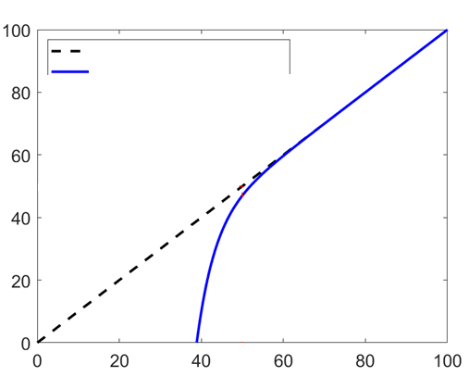

Hypothesis: Masking Reduces Annoyance ^{[4]}
High UAM noise level (rel. background):
  Annoyance to UAM noise is predicted by UAM noise level
Low UAM noise level (rel. background):
  No annoyance to UAM noise
UAM noise and background levels are similar:
  Annoyance to UAM noise is lower than predicted by UAM noise level alone
  Masking reduces annoyance
UAM noise partially masked
Annoyance w/o masker
Annoyance w/ masker
Annoyance to UAM noise
Level of UAM noise (dB)
[4] Christian, “The effect of background noise on human response,” NATO/STO-TR-AVT-314.
Notes:
Testing approach is based upon a proposed empirical model
Point out that this model is for the annoyance response to the signal only. It is possible that when the signal level is low, annoyance responses may contain a component due to perception of the masker. We are considering this as a potential complicating factor and our test design and analysis is able to see if this is important or not.

Slide 6
UAM-like sounds used in psychoacoustic test
Sound A
  Harmonic tone complex (80-320 Hz)
  Similar to rotor loading and thickness noise
Sound B
  Shaped broadband noise (300-2000 Hz)
  Similar to rotor self noise
Masker
  Designed to mask Sound A
  Equal amount of masking in 1/3 octave bands ^{[5]}
How is annoyance to Sound A reduced by masking?
[5] Sneddon et al., “Laboratory study of the noticeability and annoyance of low signal-to-noise ratios sounds” NCEJ, 51 (5), 2003.

Slide 7
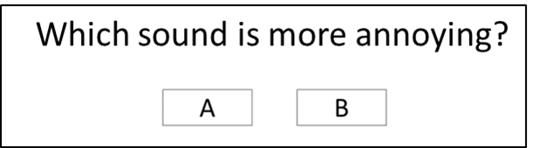
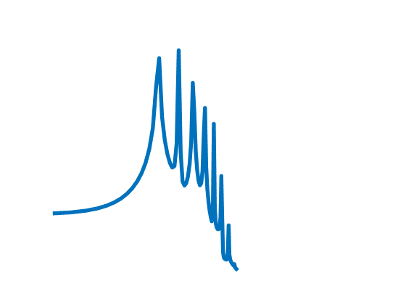
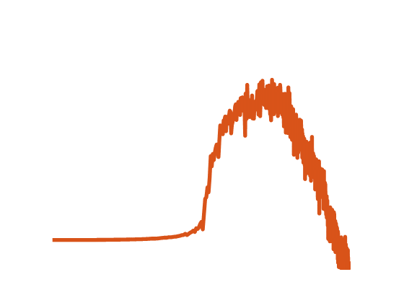
At what levels are Sound A and B equally annoying?
At what relative level is Sound A equally annoying to Sound B without the masker?
This gives an unmasked Equal Annoyance Point
  Relative difference in level where Sounds A and B are equally annoying
Sound A
Sound B
Sound Level
Sound Level
Frequency
Frequency

Slide 8
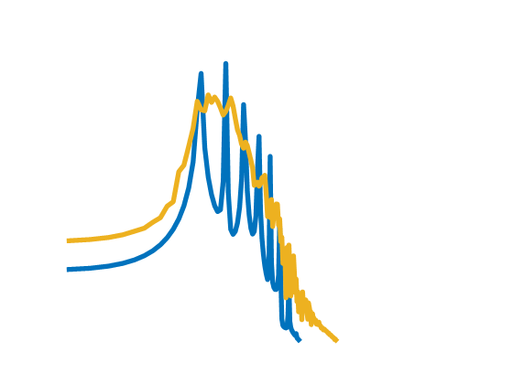
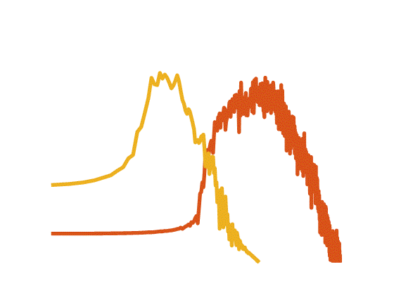
At what levels are Sound A and B equally annoying?
At what relative level is Sound A equally annoying to Sound B with the masker?
This gives a masked Equal Annoyance Point
Two possible results:
  Unmasked EAP = Masked EAP (masking does not affect annoyance)
  Unmasked EAP ≠ Masked EAP (masking affects annoyance)
Sound A with masker
Sound B with masker
Sound Level
Sound Level
Frequency
Frequency

Slide 9
Conditions Tested
Unmasked : Compare Sound A to Sound B
Masked 1-5: Compare Sound A to Sound B
Two ranges of Sound A and B: low and high
Three levels of Masker: low, medium and high
Notes:
Two levels of Sounds A and B: low and high
Three levels of Masker: low, medium and high
Get Equal Annoyance Points for various amounts of masking

Slide 10
Finding Equal Annoyance Point
Pr(A): probability sound A is more annoying than sound B
Unmasked
Unmasked Equal Annoyance Point
≈ 10-15 dB
Logistic regression is more accurate:
Unmasked Equal Annoyance Point = 12.7 dB

Slide 11
Shift in EAP with Masker at 48.1 dB
Pr(A): probability sound A is more annoying than sound B
Shift in EAP =
Masked EAP – Unmasked EAP = 5.2 dB
Meaning: level of Sound A should be increased by 5.2dB (rel. to unmasked case) to remain equally annoying to Sound B
Indication: Some masking reduces annoyance to Sound A
Shift in EAP > 0 Masking reduces annoyance
Unmasked Equal Annoyance Point = 12.7 dB
Masked Equal Annoyance Point = 17.9 dB

Slide 12
Shift in EAP with Masker at 58.1 dB
Pr(A): probability sound A is more annoying than sound B
Shift in EAP =
Masked EAP – Unmasked EAP = 10.8 dB
Meaning: level of Sound A should be increased by 10.8 dB (rel. to unmasked case) to remain equally annoying to Sound B
Indication: More masking further reduces annoyance to Sound A
Shift in EAP > 0 Masking reduces annoyance
Unmasked Equal Annoyance Point = 12.7 dB
Masked Equal Annoyance Point = 23.5 dB

Slide 13
Summary for 5 test subjects
Subject | 1 | 2 | 3 | 4 | 5
Average EAP shift (dB) | 10.7 | 6.2 | 0.0 | 0.4 | 8.2
Masking reduces annoyance for 3 of 5 subjects
Larger effect when A and B are at low levels
  More masking in Masked 1 and 2 conditions
Shift in EAP > 0 Masking reduces annoyance

Slide 14
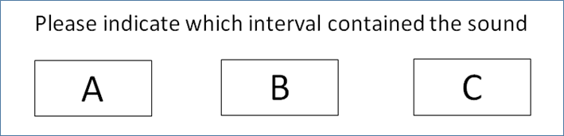
Path to model the shift in EAP ^{[6]}
Measured audibility thresholds for each subject (d’)
  3 Alternative Forced Choice adaptive staircase
Extrapolate audibility thresholds to determine d' at other relative levels
Measured other Equal Annoyance Points (A vs. M and B vs. M)
Modeling the shift is focus of upcoming NoiseCon talk/paper by Tyler Tracy
[6] Tracy, T. et al., "An annoyance model for urban air mobility vehicle noise in the presence of a masker," Noise-Con 2024, New Orleans, 2024.
Notes:
All 3 intervals have masker, only 1 interval has a target sound
3 down, 1 up from high end
2 down 1 up from low end
Detection Threshold of Masker at convergence level. Extrapolate d' to get at other gains
Annoyance comparisons: we need to know how well subject hears the sound so that we can measure effect of masking on annoyance.
Need to know d' at different levels of target sound relative to masker via relationship 2^(deltaG/3), where deltaG is the difference in gains of the target sound A and the masker
Y axis relabeled to A re: Masker

Slide 15
Conclusions
Shifts in Equal Annoyance Points (with and without masker) indicate that masking does have an effect on annoyance
Increase in masking reduces annoyance
Further psychoacoustic testing is necessary to extrapolate results to wider population
Other conferences later this year:
  Functional form of reduction in annoyance due to masking at NoiseCon 2024 (Tyler Tracy)
  Applications to UAM operations at Aeroacoustics 2024 (Steve Rizzi)
[7] Rizzi, S.A., Christian, A.W., Letica, S.J., and Lympany, S.V., "Annoyance model assessments of urban air mobility operations," 30th AIAA/CEAS Aeroacoustics Conference, AIAA-2024-3018, Rome, Italy, 2024..

Slide 16
Thank You
Work supported by NASA’s
Revolutionary Vertical Lift Technology Project
Questions?
matthew.a.boucher@nasa.gov

Slide 17
Call for papers for a Special Issue
Advanced Air Mobility Noise: Predictions, Measurements, and Perception
Potential topics
  Theoretical, numerical, or empirical predictions of noise characteristics
  Measurement of noise sources (components up to full vehicle)
  Human perception or psychoacoustic testing, Auralization techniques
  Aspects of noise certification, Passenger comfort and others
Joint with JASA and JASA Express Letters
Guest Editors: Matthew Boucher, Alexandra Loubeau, Beckett Zhou, Eric Greenwood, and Damiano Casalino
Submission Deadline: February 28, 2025
pubs.aip.org/asa/jel
pubs.aip.org/asa/jasa

