Slide 1
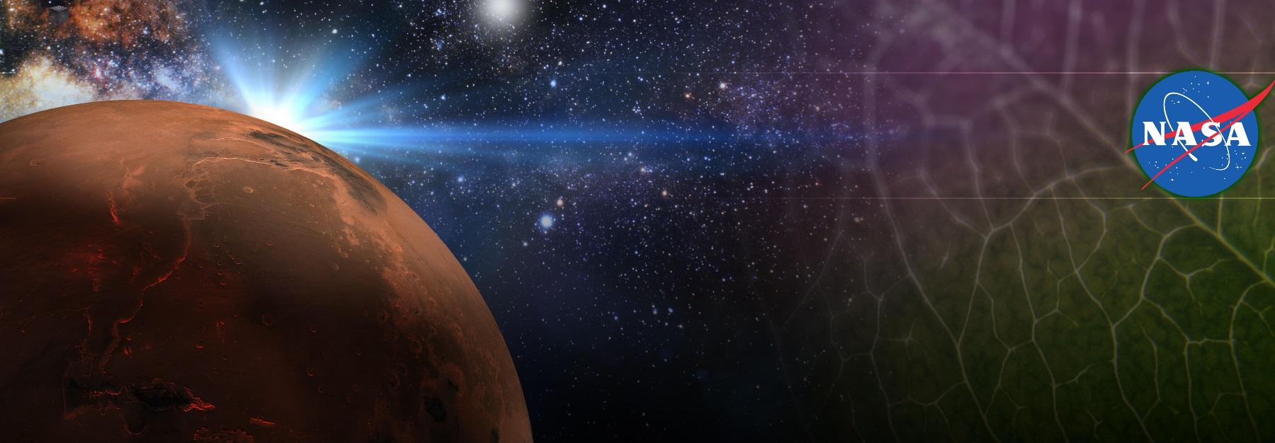
Adapting Plants to the Space Environment for Improved Crop Productivity and Safety
Gioia Massa, Trent Smith, Elison Blancaflor, Raymond Wheeler
Exploration Research & Technology Programs
NASA, Kennedy Space Center
Committee on Biological and Physical Sciences in Space
Adapting to Space

Slide 2
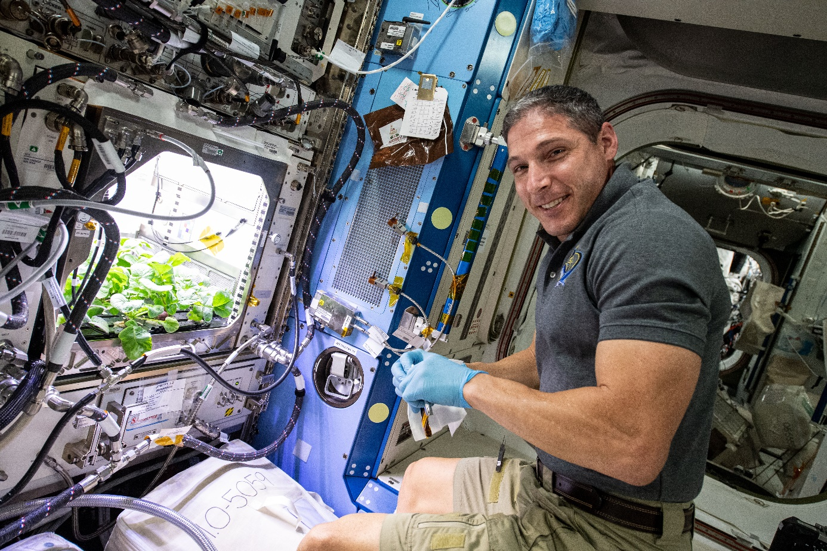
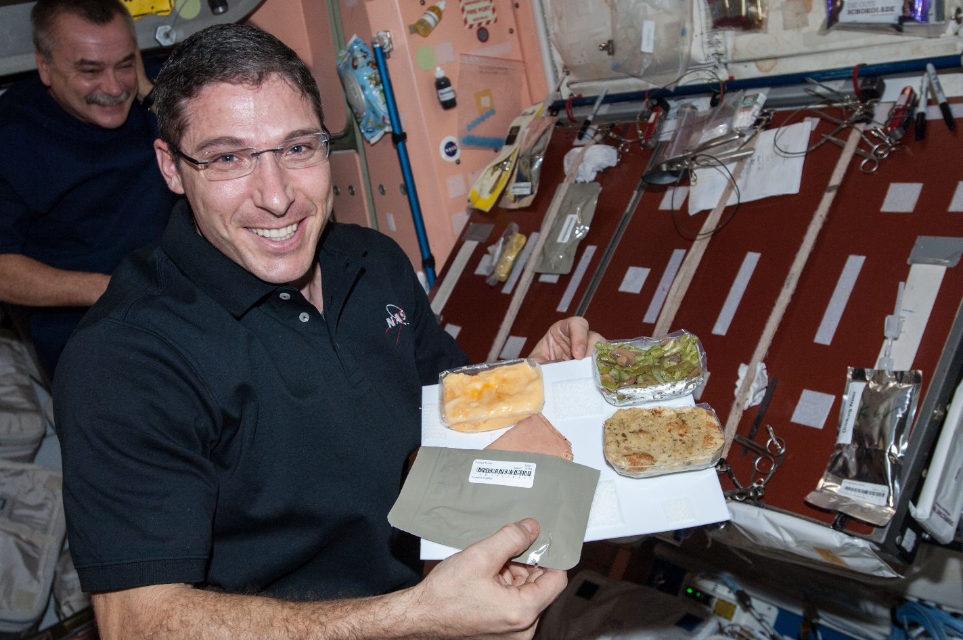
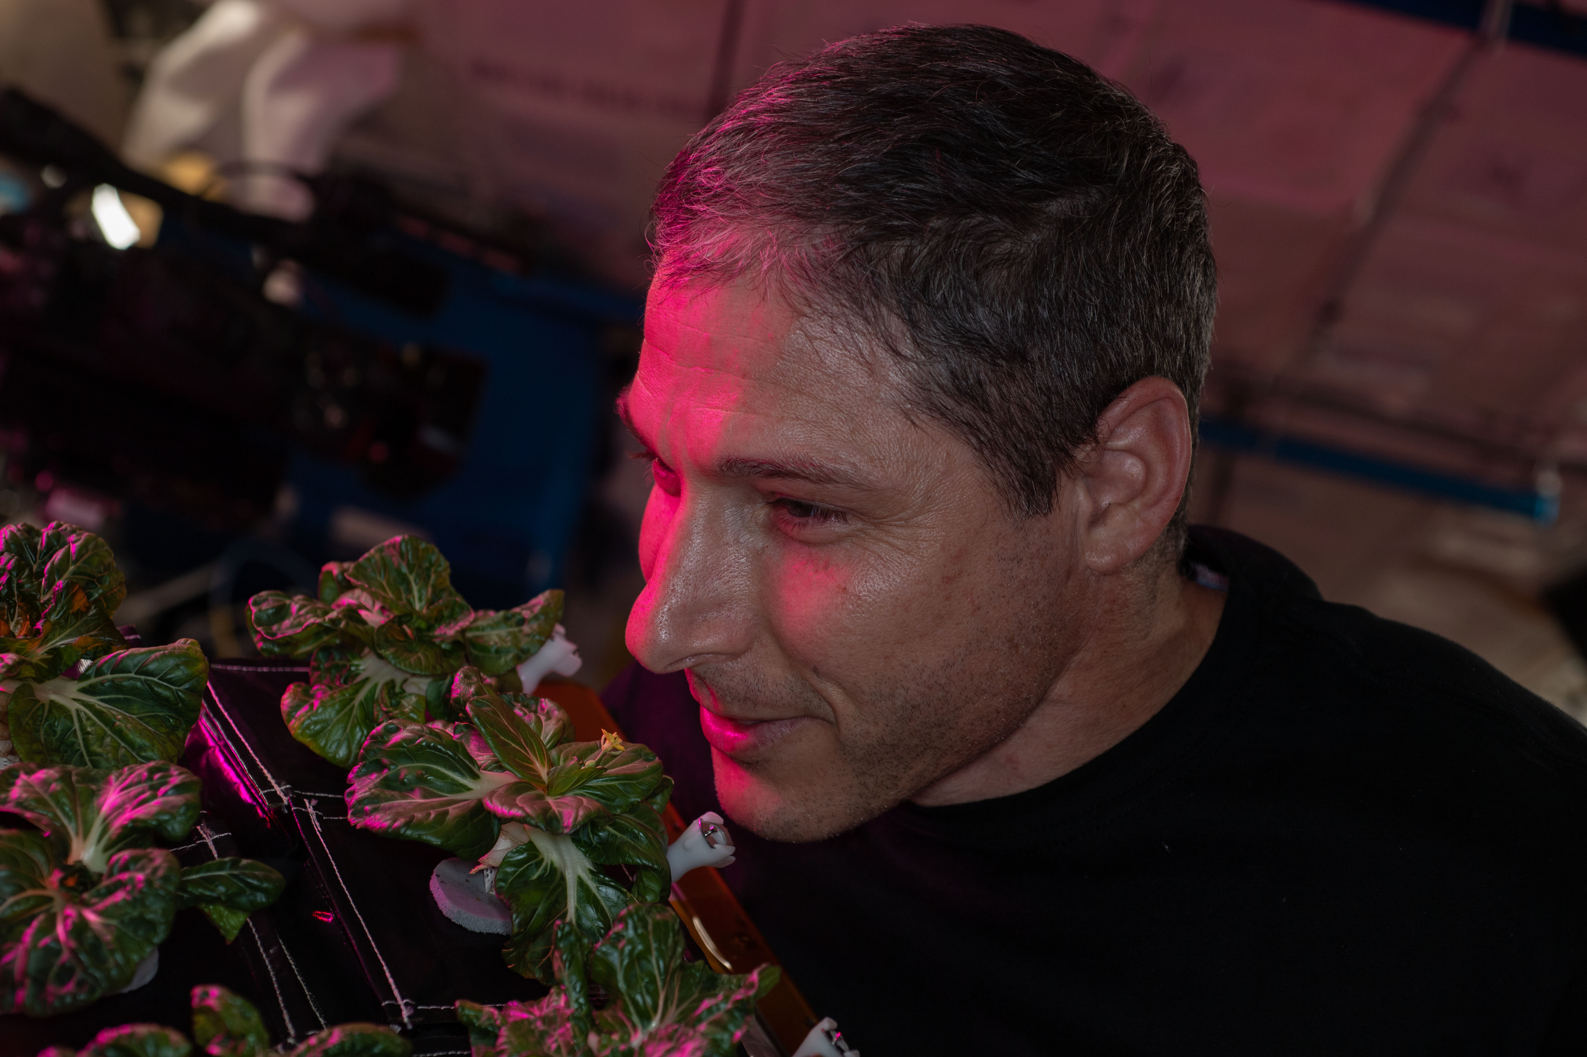
Why grow plants in space?
Food
Psychological well being
Atmosphere
Water

Slide 3
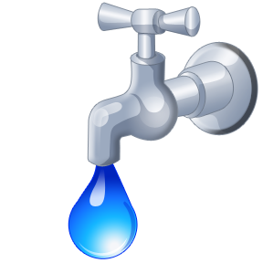
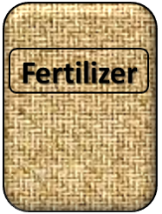

Cardinal Factors to Consider for Plants to Thrive in Space
O₂

Slide 4
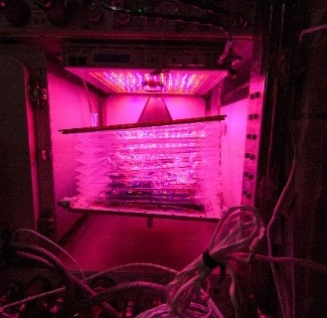
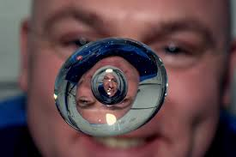

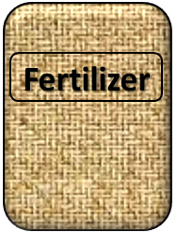
How these work in the Space Environment
Key plant characteristics may be modified with novel light recipes
No natural convection without gravity so need to mix the air
O₂
Water forms a ball, and water and air don’t mix well, and roots need both
Fertilizer is heavy to launch so we need to learn how to recycle plant (and other) wastes

Slide 5
Space Crop Production Challenges
LEO/Deep Space
Water
Recycling
Radiation
Pressure
Micrometeorites
Surface
Microgravity
Fluid movement
No convection
Dust
Regolith
Partial gravity
Plant Size
High CO₂
Food Safety & Microbiome
Nutrient output
Sustainability
Abiotic stresses
Vehicle resources
Crew time
Waste
Solving space crop production challenges requires a basic understanding of BIOLOGICAL and PHYSICAL processes
Productivity
Stress tolerance
Environmental optimization
Crop scheduling
Crop

Slide 6
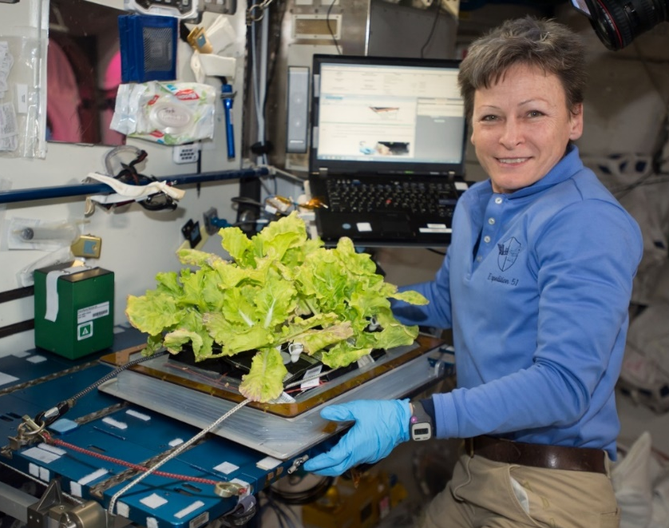
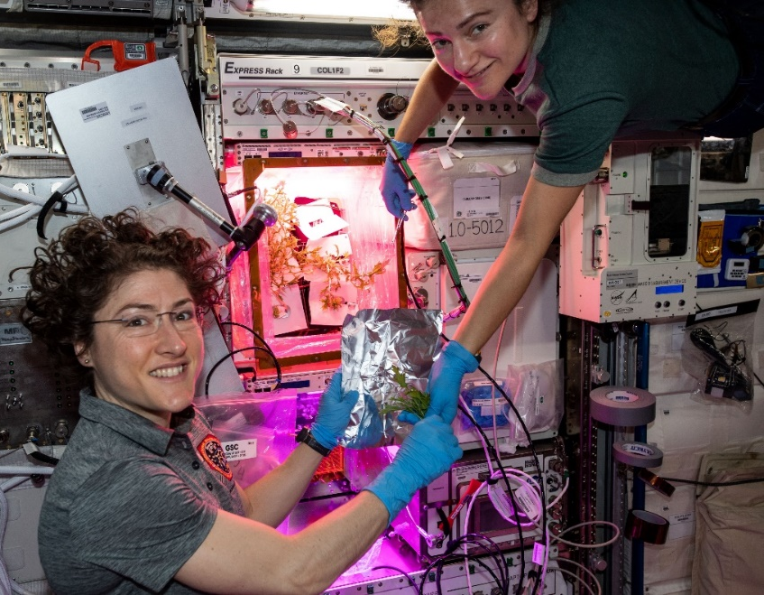
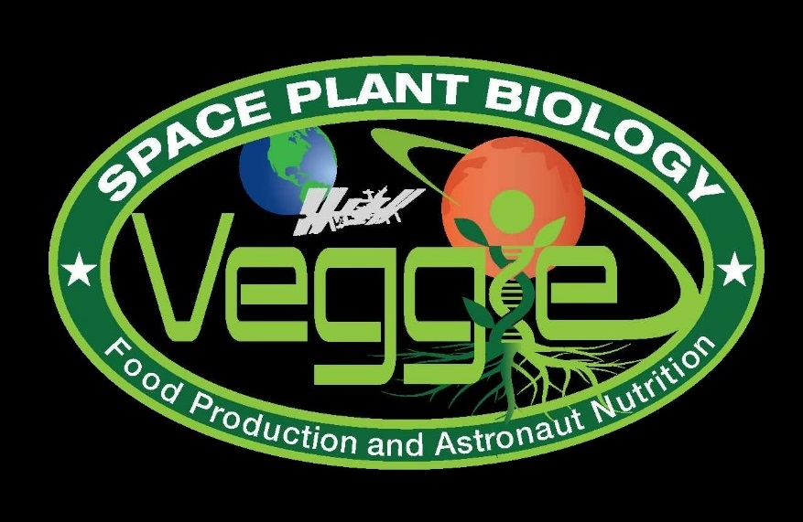
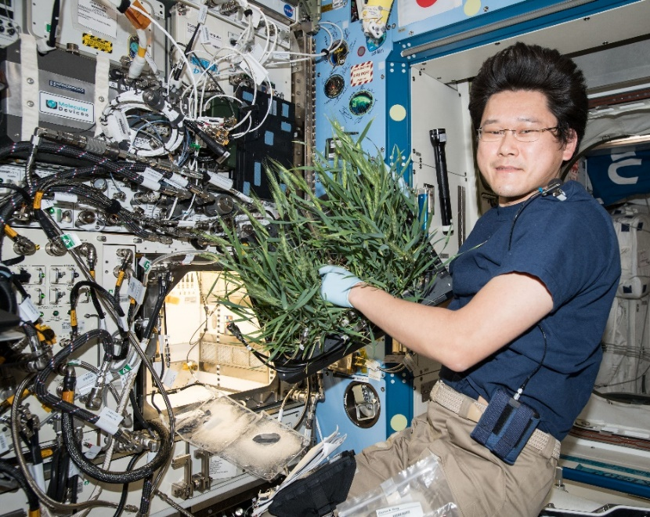
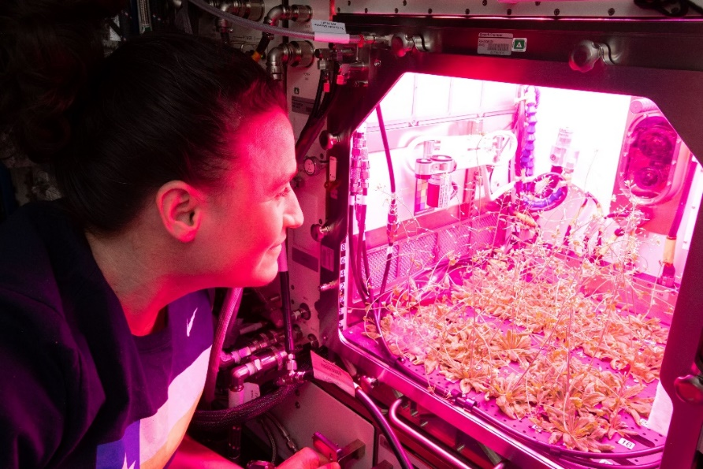
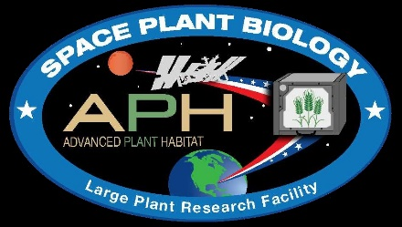
Hardware on ISS that Enables a Basic Understanding of Crop Adaptation to Space
Notes:
Veggie and the Advanced Plant Habitat

Slide 7
Assessing Crop Microbial Food Safety for Humans
NASA standards for non-thermostabilized food

Slide 8
Space and Ground Crop Microbiomes Differ with Time, Tissue Type, and Stress
Leaf Data
Root Data

Slide 9
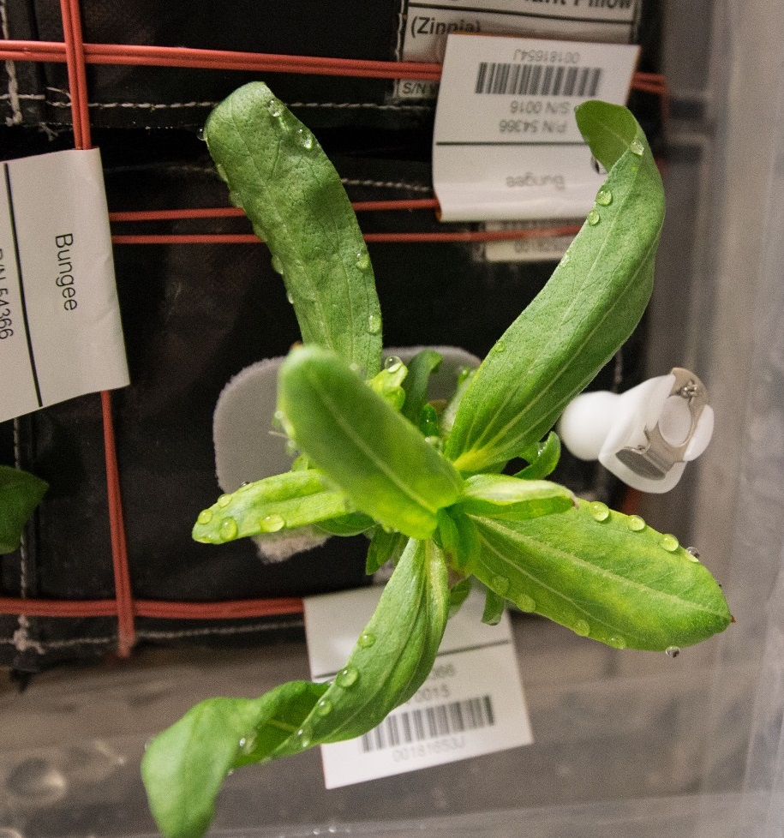
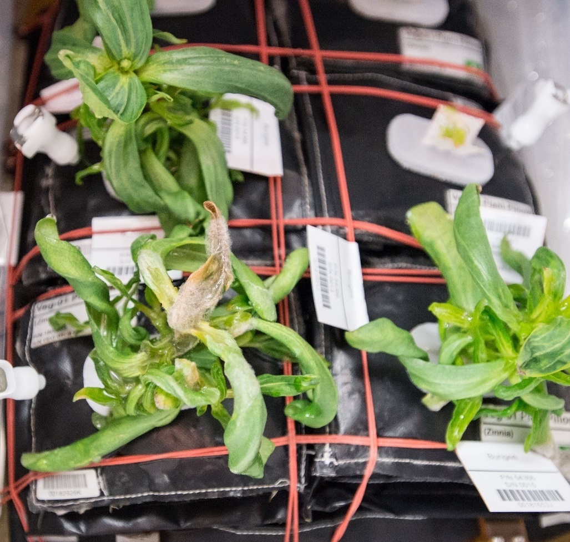
Ventilation and Water Issues & Consequences in Zinnia
Guttation and Leaf Curling
Fungal Development & Abnormal Growth

Slide 10
Key Crop Plant Takeaways
Data indicate astronauts enjoy growing and eating plants in spaceflight
Crop yield is similar between ground and flight when plants are not stressed¹
Some differences between ground and flight plant nutrient content, but these are not consistent between species or experiments ^{1, 2}
  Influenced by crop type, harvest scenario, other environmental conditions (e.g., light, stress)
Microbial counts and compositions vary between flight and ground-grown plants^{1, 2}
  Microbes typical of the space station environment are often associated with ISS-grown plants
  Human pathogens are rarely identified on space-grown plants and only below levels of concern to human health
Microbial communities vary between shoot and root tissues and but not as much between flight and ground ²
Plants adapt well to the space environment, and to date, space-grown crops are safe to eat, nutritious, and highly acceptable to astronauts ^{1,2}
Bunchek et al., 2024, Pick-and-eat space crop production flight testing on the International Space Station, J. Plant Interact.
Khodadad et al., 2020, Microbiological and Nutritional Analysis of Lettuce Crops Grown on the International Space Station, Front. Plant Sci.

Slide 11
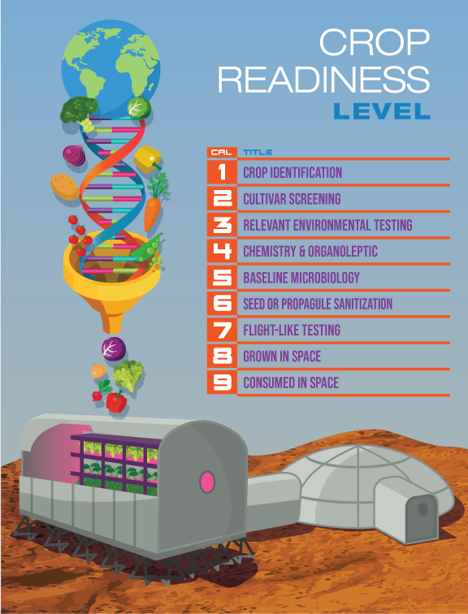
Key Science Questions under the “Adapting to Space” Theme help guide Crop Readiness Levels
Modified from Romeyn et al., 2019, Crop Readiness Level (CRL): A Scale to Track Progression of Crop Testing for Space

Slide 12
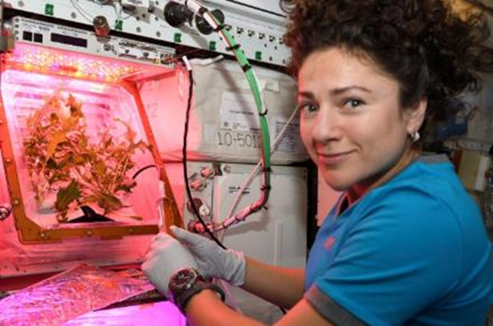
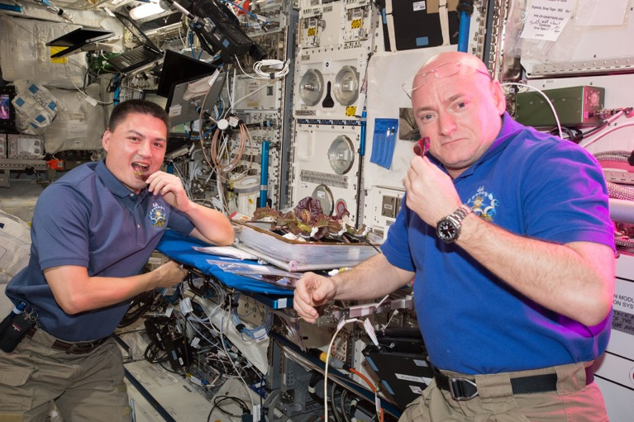
Examples of Knowledge Gaps for Space Crop Production
The library of crops tested is limited – we need to test a wider diversity of different crops and crop types for exploration
  One plant family should not make up >1/3 of the entire crop library
Plant Microbiome - Food Safety/Plant Health
  Crops will be grown hydroponically in space habitats near to mid-term. There are many unknowns on hydroponic water and nutrient delivery, and few data on the hydroponic microbiome.
  Plant performance in exploration atmospheres (reduced pressure) is largely unstudied, including plant-microbial interactions, responses to pathogens, etc.
Deep-space radiation impacts on seeds and plants remain unknown

Slide 13
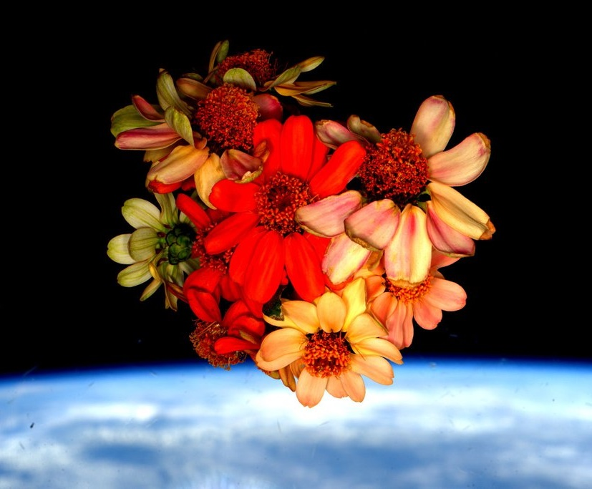
Thank you!
Veggie, APH, and Space Crop Production teams
NASA’s astronauts
NASA’s Biological and Physical Sciences Division, ISS Program, Human Research Program, Mars Campaign Office

