Slide 1
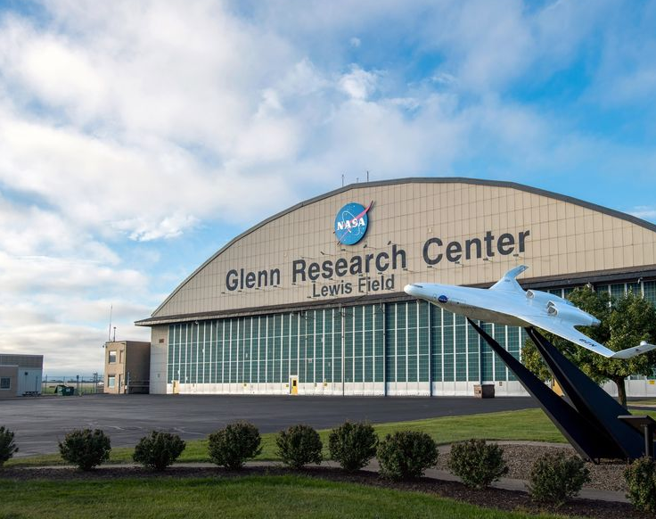

High Temperature Testing of Refractory Alloys
National Aeronautics and Space Administration
Justin L. Milner and Eric Brizes
NASA Glenn Research Center, Cleveland OH
Ultimate - 2024 Phase 2 Kick-Off & Annual Review Meeting
Atlanta, GA March 28, 2024

Slide 2
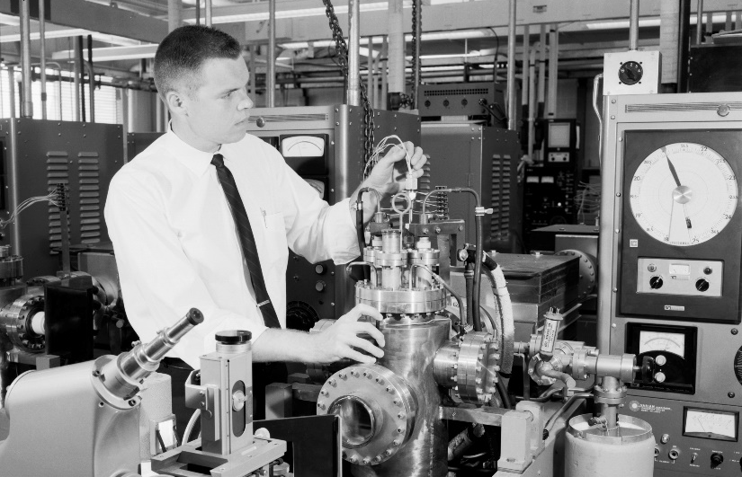
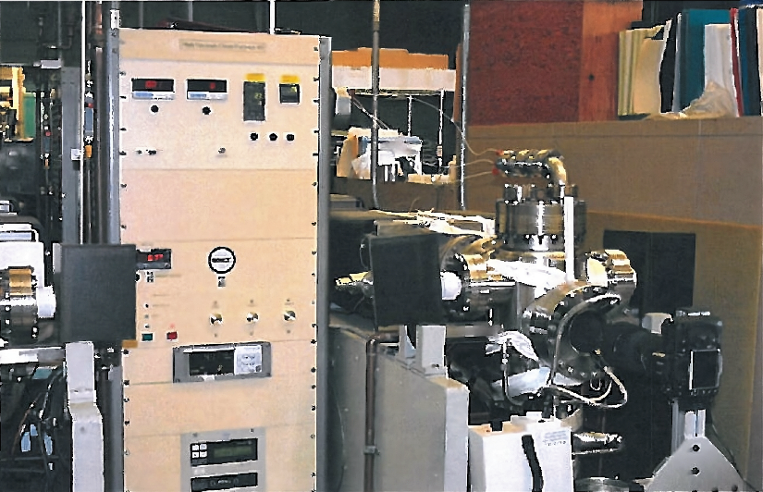
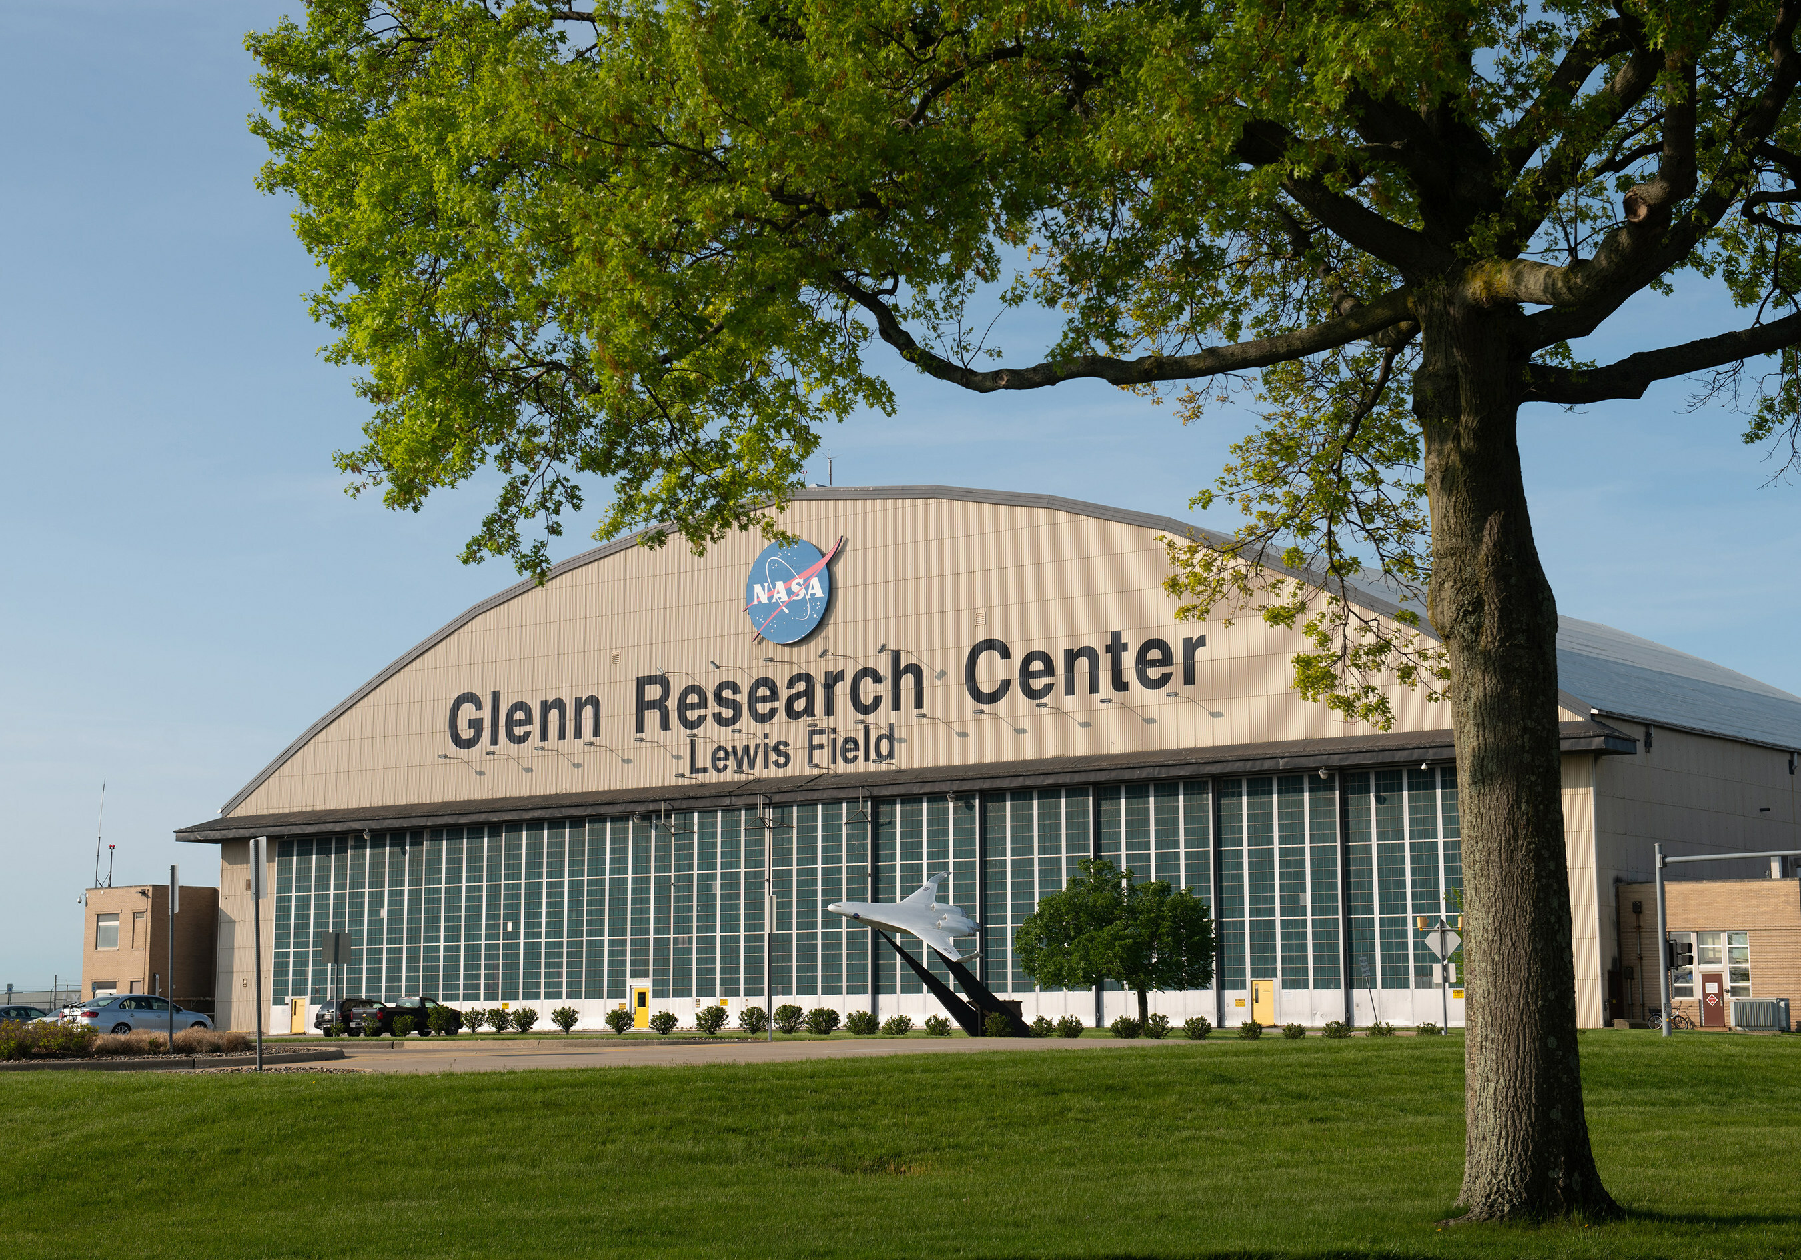
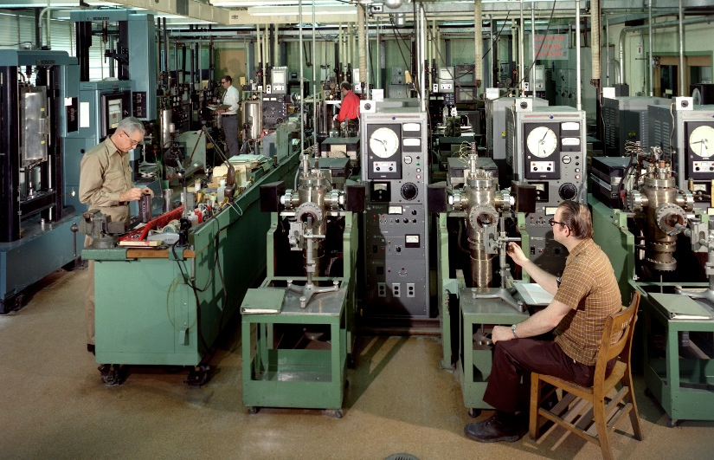
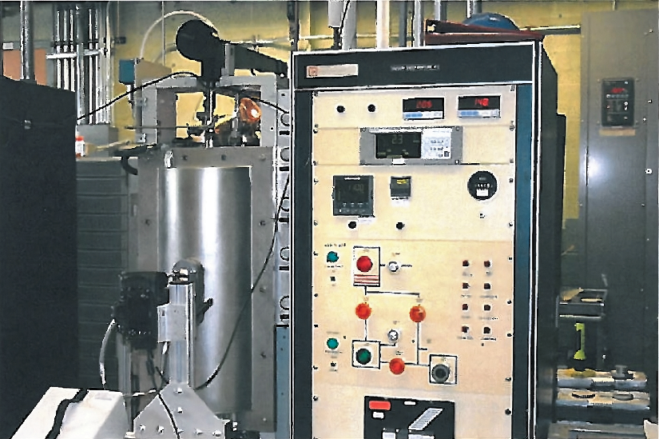
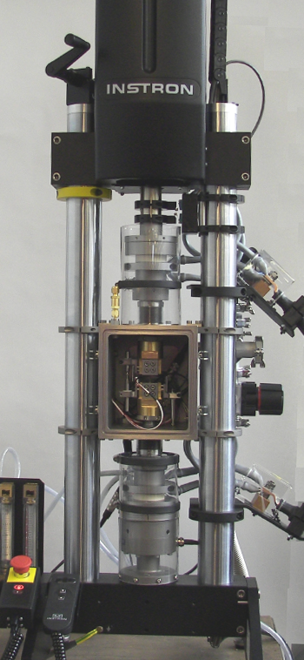
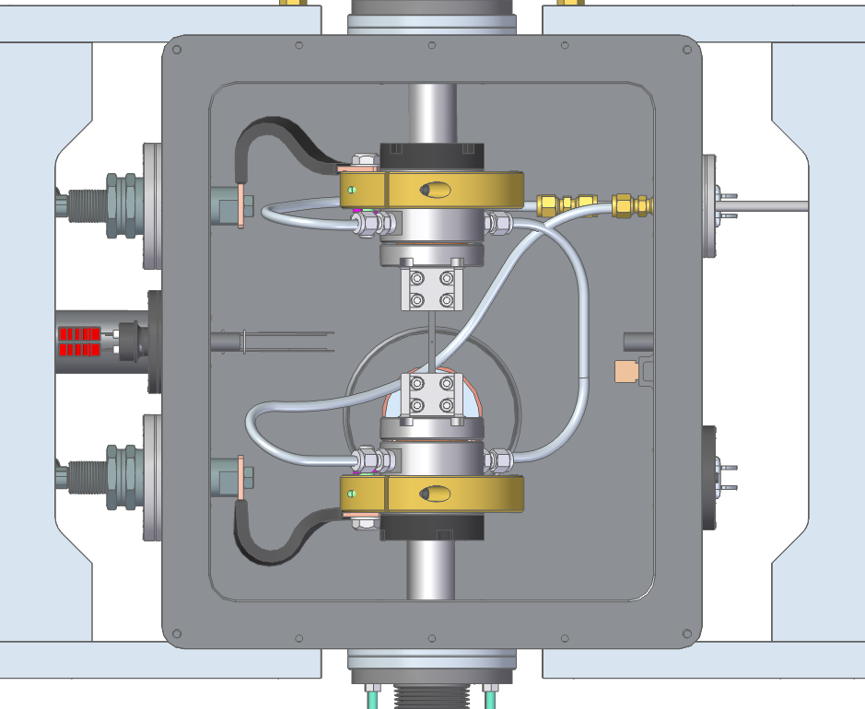
NASA Glenn (Lewis) Refractory Alloy Testing
1960s
2000s
Today
Ultimate - 2024 Phase 2 Kick-Off & Annual Review Meeting

Slide 3
Introduction
NASA Refractory Alloy Projects:
  STMD-GRC – Refractory Alloy Additive Manufacturing Build Optimization (RAAMBO)
  Hypersonic Technology (HTP) Project.
    Advance material characterization and prototypic testing allowing for critical data needed to demonstrate TRL advancement and for component flight qualification
    Enable national supply chain for refractory alloy feedstock essential for production of historical to custom alloys for R&D to component fabrication.
    Develop materials and processing for high performance in extreme environments enabling technologies for Moon to Mars missions.
  Alignment with NASA Projects:
  Fission Surface Power (FSP) – High temp. core and power conversion materials
  Nuclear Electric Propulsion (NEP) - Core, power conversion and thruster materials
  Nuclear Thermal Propulsion (NTP) - Extreme environment materials
  In-Situ Resource Utilization (ISRU) - High temp. materials for lunar systems
  Hypersonic Technology’s (HTP) - Ox-compatible refractory metals
  Lander ascent/descent and RCS nozzles
Ultimate - 2024 Phase 2 Kick-Off & Annual Review Meeting

Slide 4
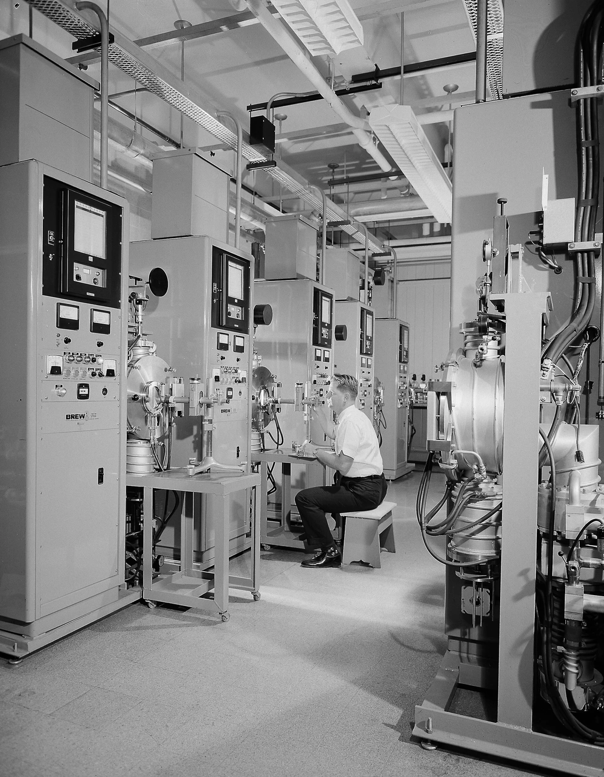
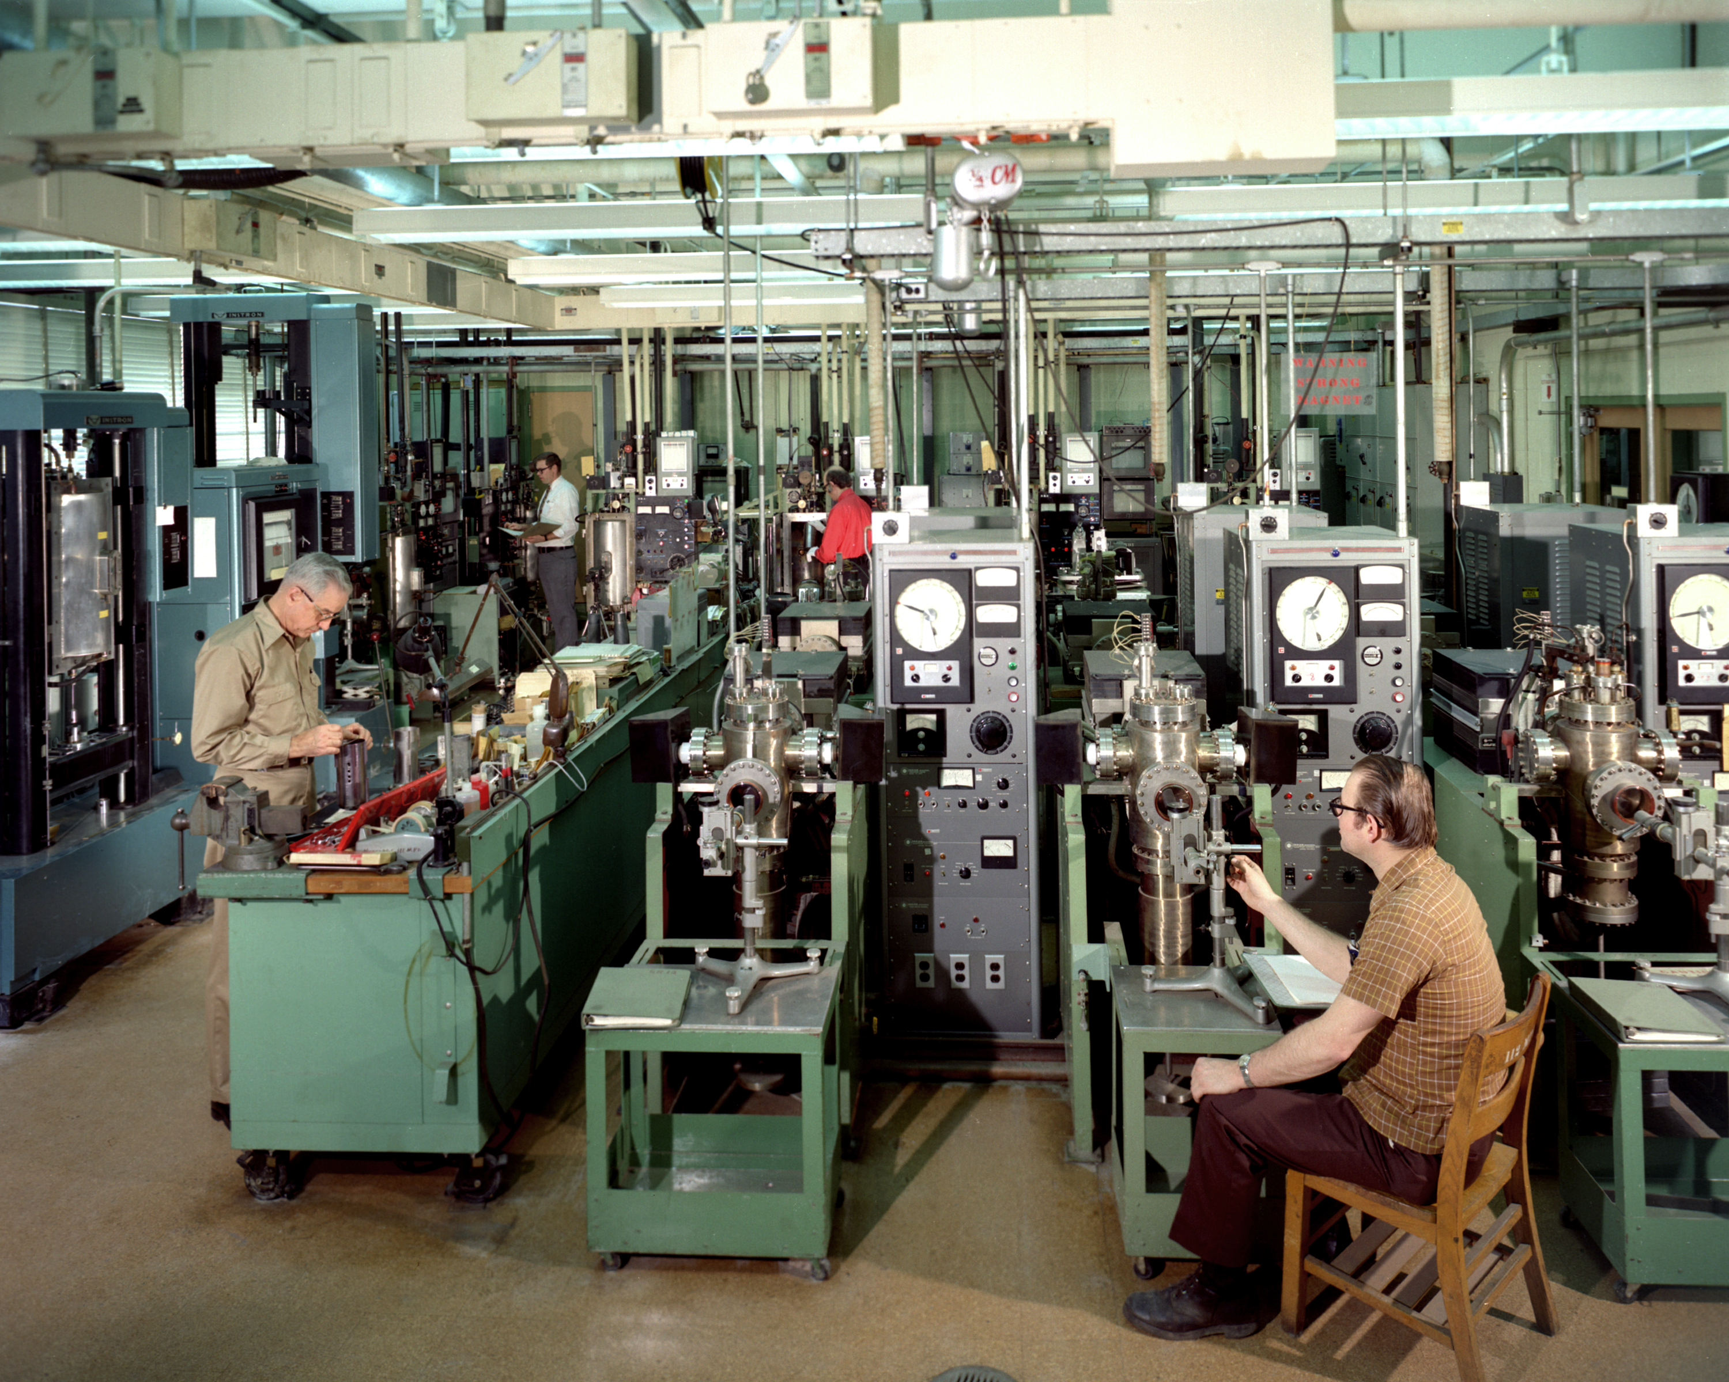
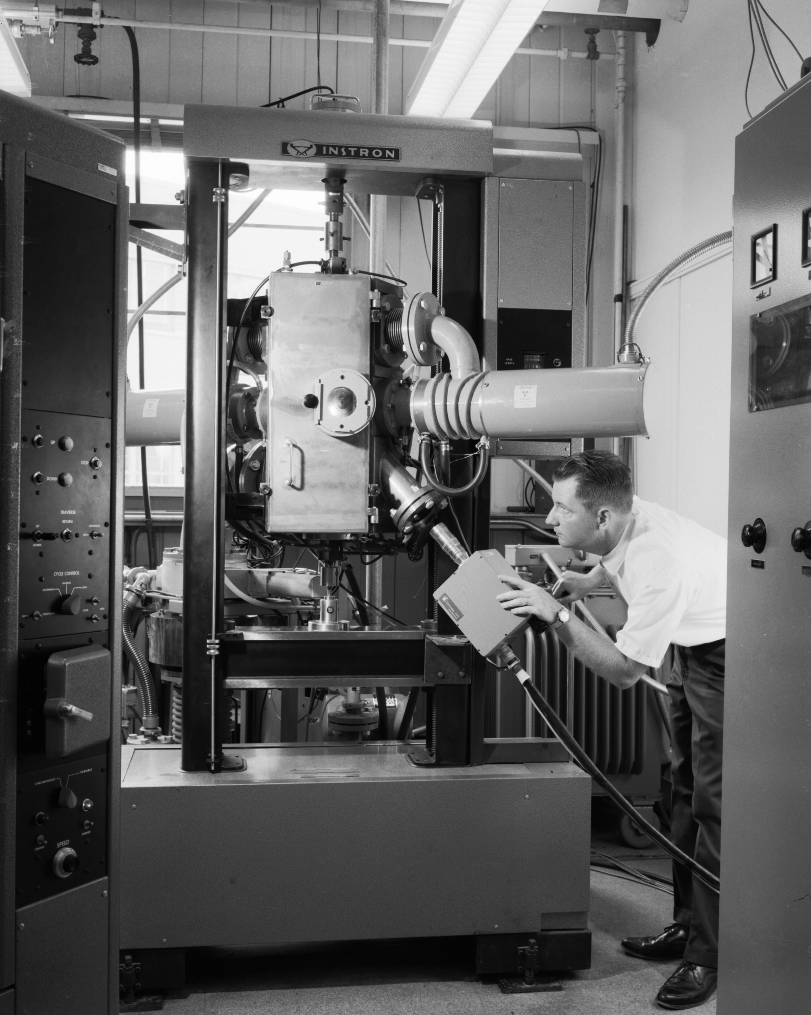
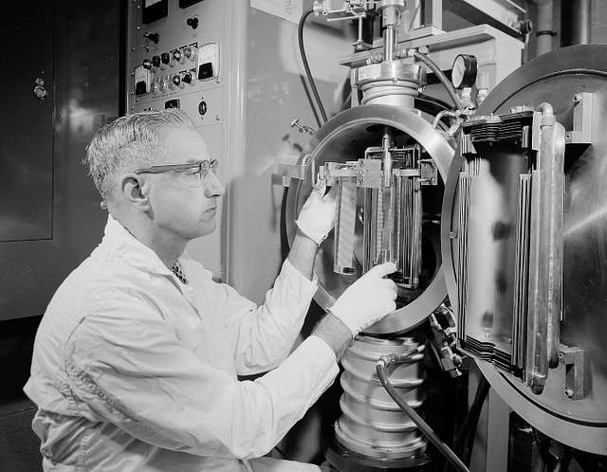
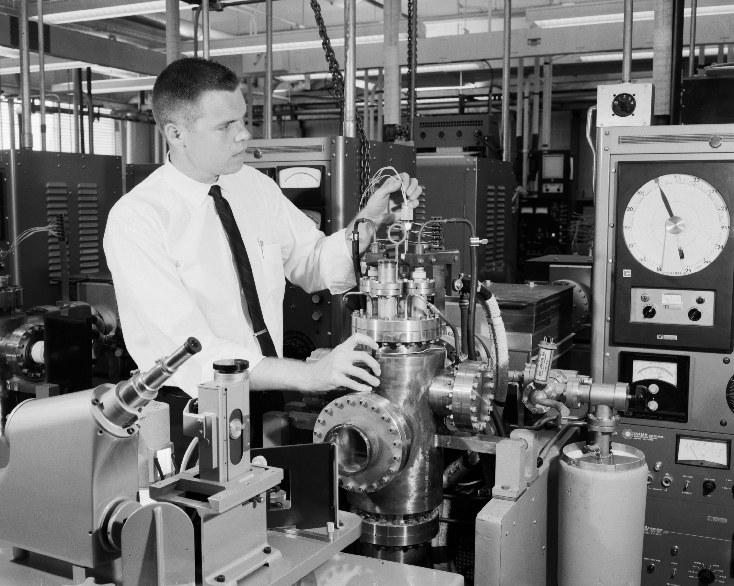
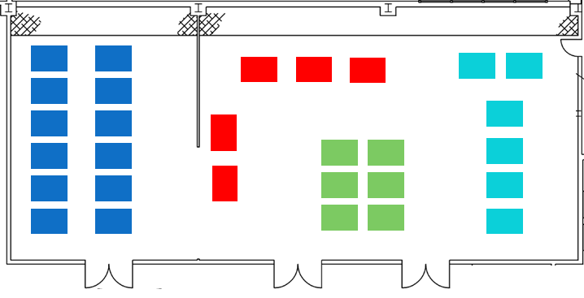
NASA Glenn (Lewis) Historical Expertise
Ultimate - 2024 Phase 2 Kick-Off & Annual Review Meeting

Slide 5
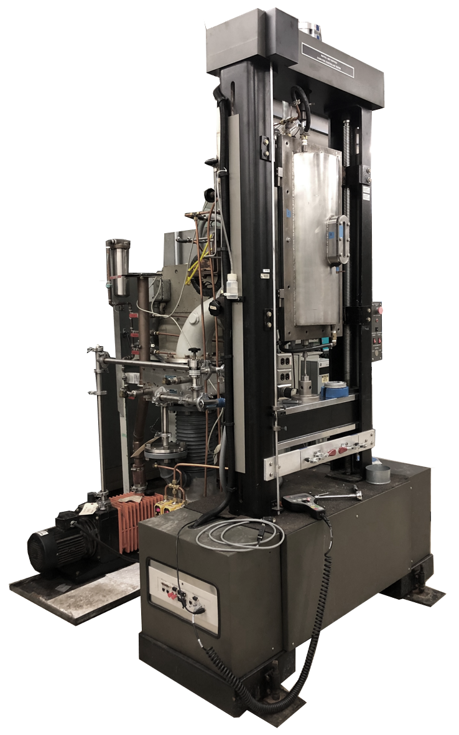
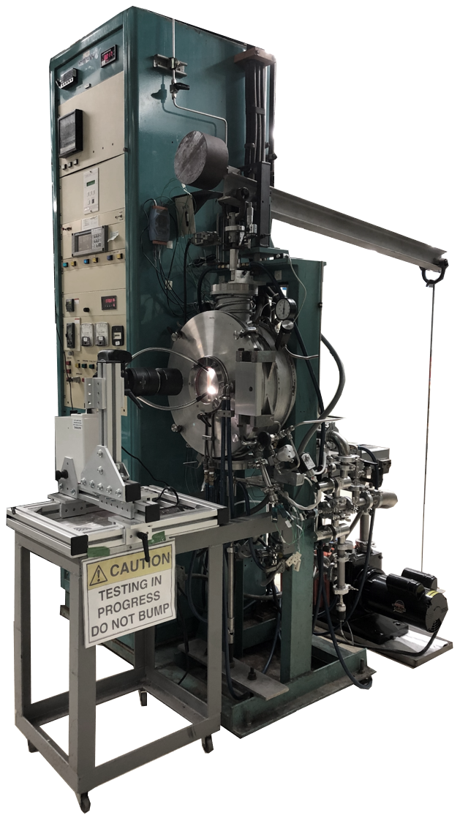
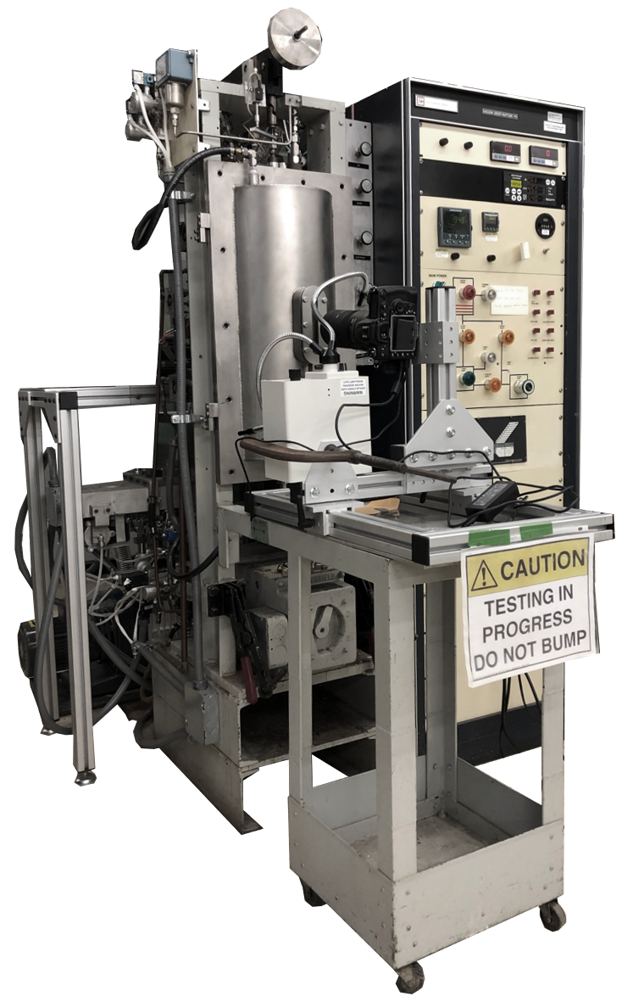
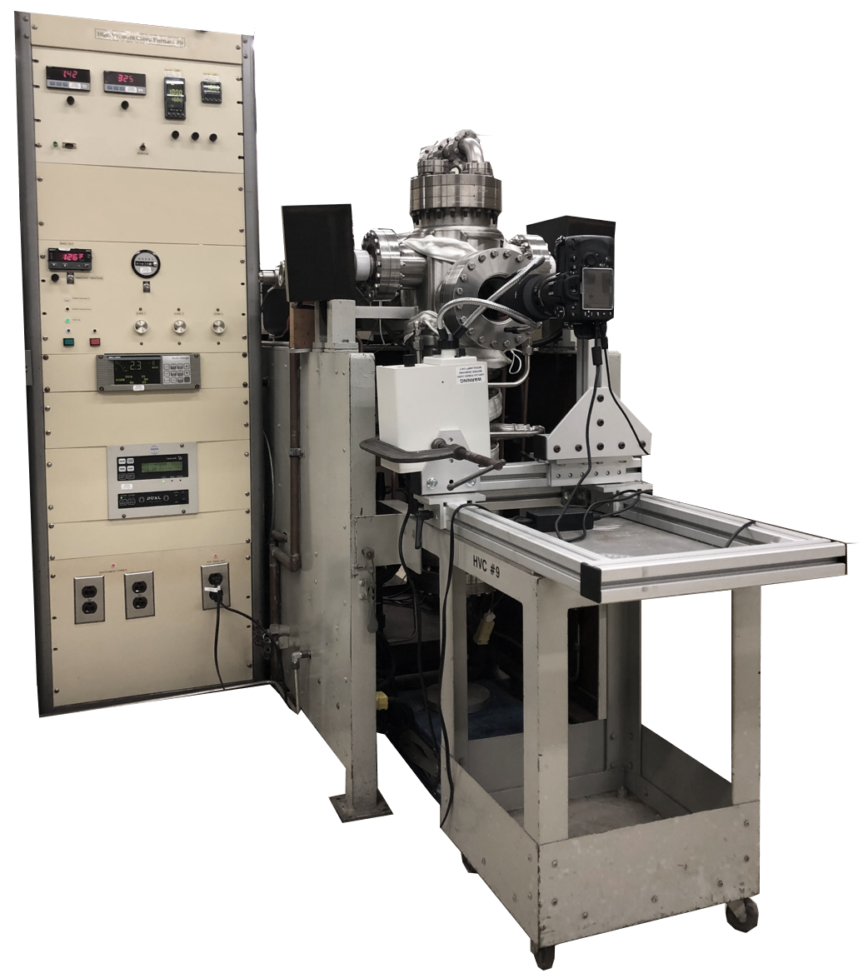
NASA Glenn (Lewis) Historical Expertise - Then
Uniaxial Tension/Compression
5 NASA Lewis tensile test system (Screw-driven)
  2000°C (Ta), 10⁻⁷ Torr (Diffusion)
Creep
12 BREW creep test systems (10:1,5:1 lever arm)
  2000°C (W), 10⁻⁷ Torr (Diffusion)
6 NASA Lewis creep test systems (5:1 lever arm)
  2000°C (Ta), 10⁻⁷ Torr (Diffusion)
6 NASA Lewis ultra-high vacuum creep systems (1:1 pan)
  1700°C (W), 10⁻¹¹ Torr (Ion)
Ultimate - 2024 Phase 2 Kick-Off & Annual Review Meeting

Slide 6
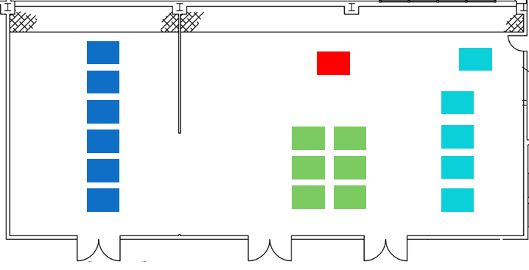
NASA Glenn (Lewis) Historical Expertise - Now
Uniaxial Tension/Compression
1 NASA Lewis tensile test system (Screw-driven)
  2000°C (Ta), 10⁻⁷ Torr (Diffusion)
Creep
6 BREW creep test systems (10:1,5:1 lever arm)
  2000°C (W), 10⁻⁶ Torr (Turbo)
4.5 NASA Lewis creep test systems (5:1 lever arm)
  2000°C (Ta), 10⁻⁶ Torr (Turbo)
6 NASA Lewis ultra-high vacuum creep systems (1:1 pan)
  1700°C (W), 10⁻¹¹ Torr (Ion)
*Optical Extensometry
Ultimate - 2024 Phase 2 Kick-Off & Annual Review Meeting

Slide 7
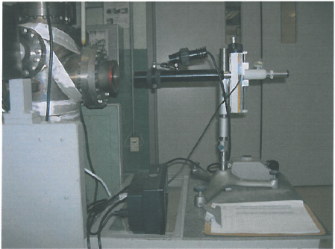
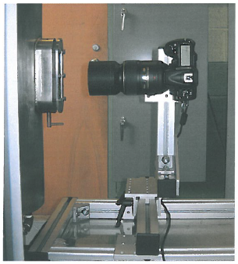
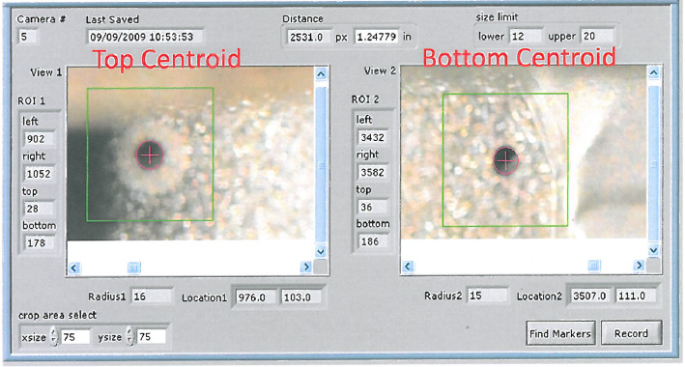
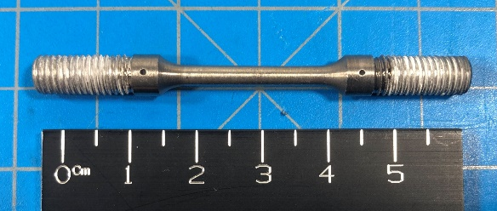
NASA Glenn (Lewis) Historical Expertise - Now
Cathetometer
Video Extensometer
Ultimate - 2024 Phase 2 Kick-Off & Annual Review Meeting

Slide 8
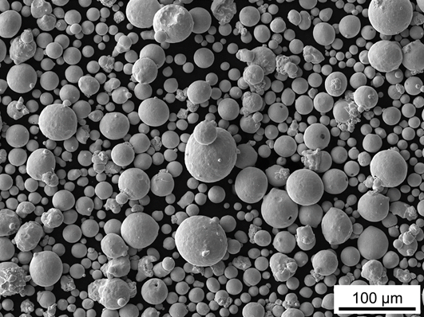
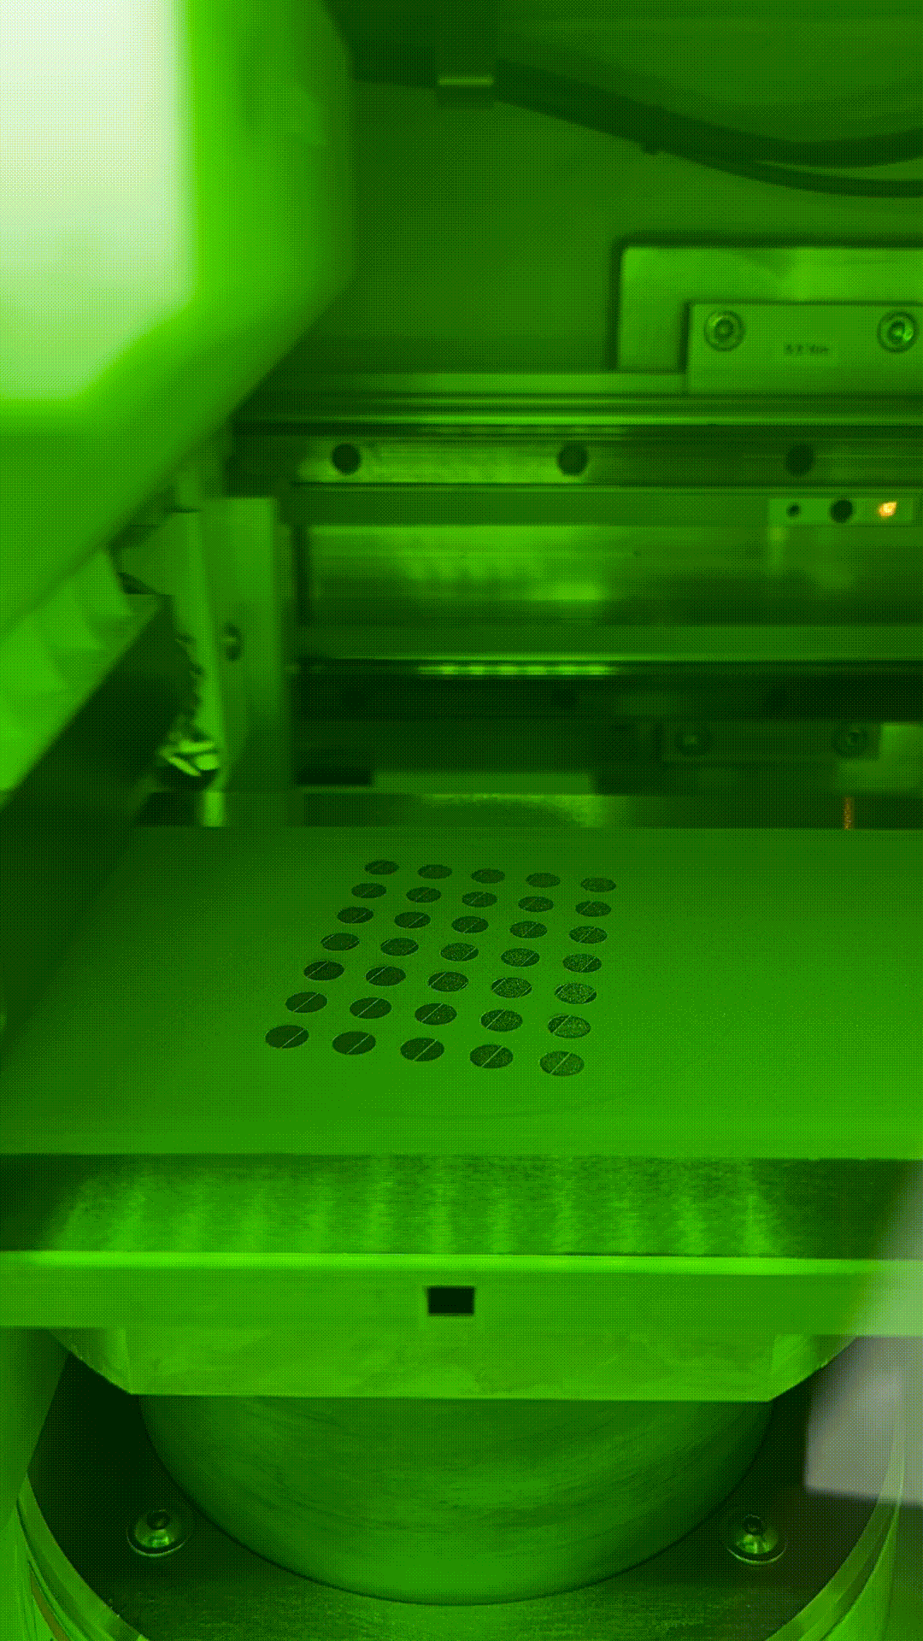
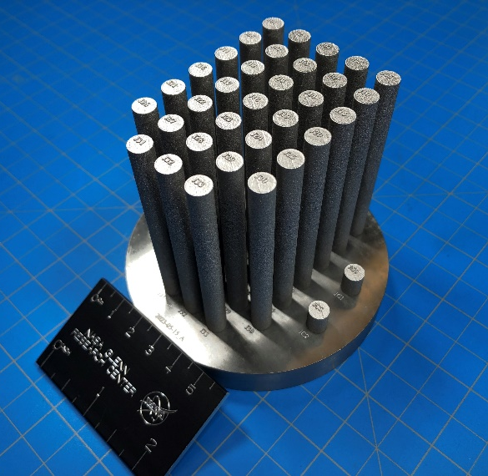
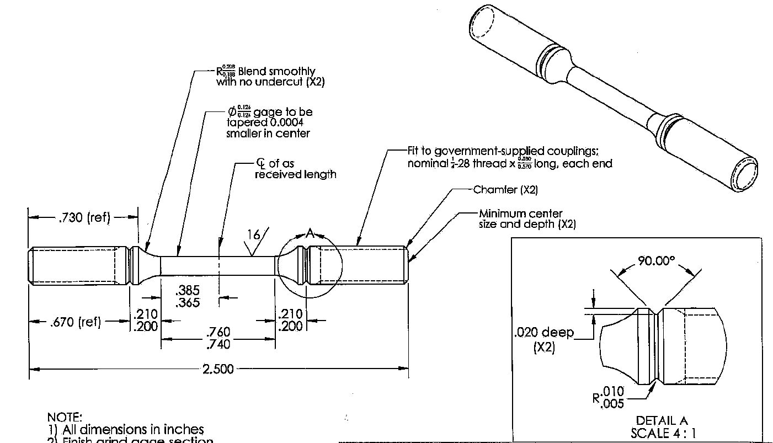

L-PBF of C103
Table 1. C-103 Powder Chemical Composition (ICP/LECO)
Table 2. C-103 L-PBF As-printed/HIP Chemical Composition (ICP/LECO)
Element | Concentration
Nb | Bal.
Hf | 9.77 [wt%]
Ti | 0.97 [wt%]
O | 430 [ppm]
N | 52 [ppm]
Element | Concentration
Nb | Bal.
Hf | 9.36 [wt%]
Ti | 0.92 [wt%]
O | 521/548 [ppm]
N | 22/39 [ppm]
Ultimate - 2024 Phase 2 Kick-Off & Annual Review Meeting

Slide 9
High Temperature High Vacuum Tension Testing Rig
Testing Procedure
Load Sample
3x argon purge
High vacuum (diffusion pump)
Heat up at 5x10⁻⁶ Torr or better at a rate of 17 °C/min
Soak at temperature for 20 minutes
Constant crosshead speed of 6.35x10⁻³ mm/s
Ultimate - 2024 Phase 2 Kick-Off & Annual Review Meeting

Slide 10
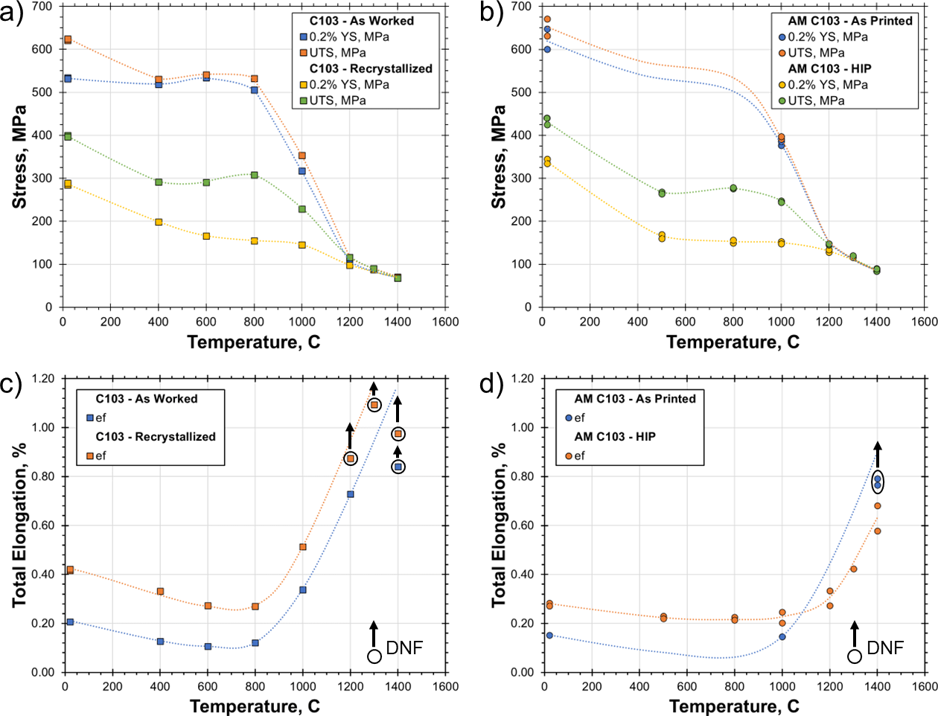
Tension of Wrought and AM C103
Wrought C103
AM C103
Ultimate - 2024 Phase 2 Kick-Off & Annual Review Meeting

Slide 11
Tension of Wrought and AM C103
Wrought C103
AM C103
DNF = Did not fail
Ultimate - 2024 Phase 2 Kick-Off & Annual Review Meeting

Slide 12
High Temperature High Vacuum Creep Testing Rig
Testing Procedure
Load Sample
3x argon purge
High vacuum (Turbo pump)
Cold sample measurement
Heat up at 5x10⁻⁶ Torr or better at a rate of 17 °C/min
Soak at temperature for 20 minutes
Hot sample measurement
Apply load
LVR and optical extensometer to track strain
Ultimate - 2024 Phase 2 Kick-Off & Annual Review Meeting

Slide 13
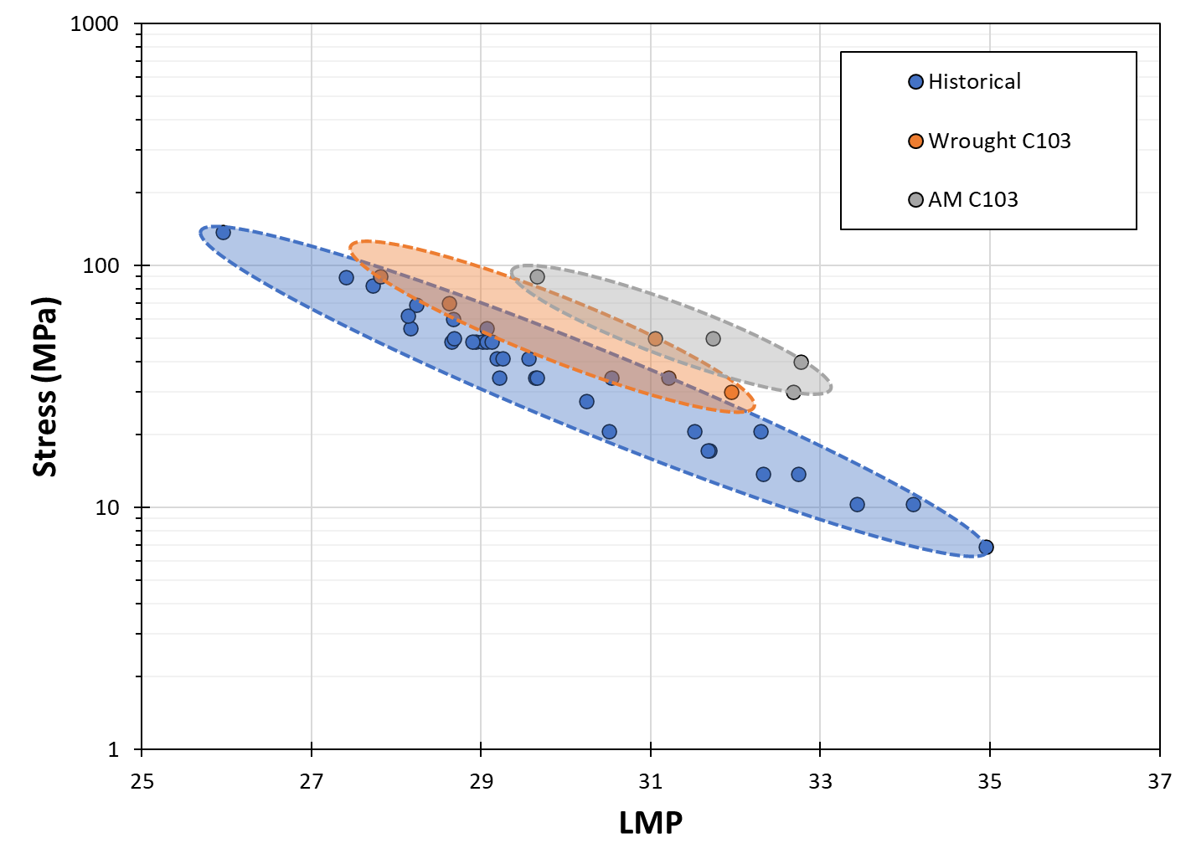
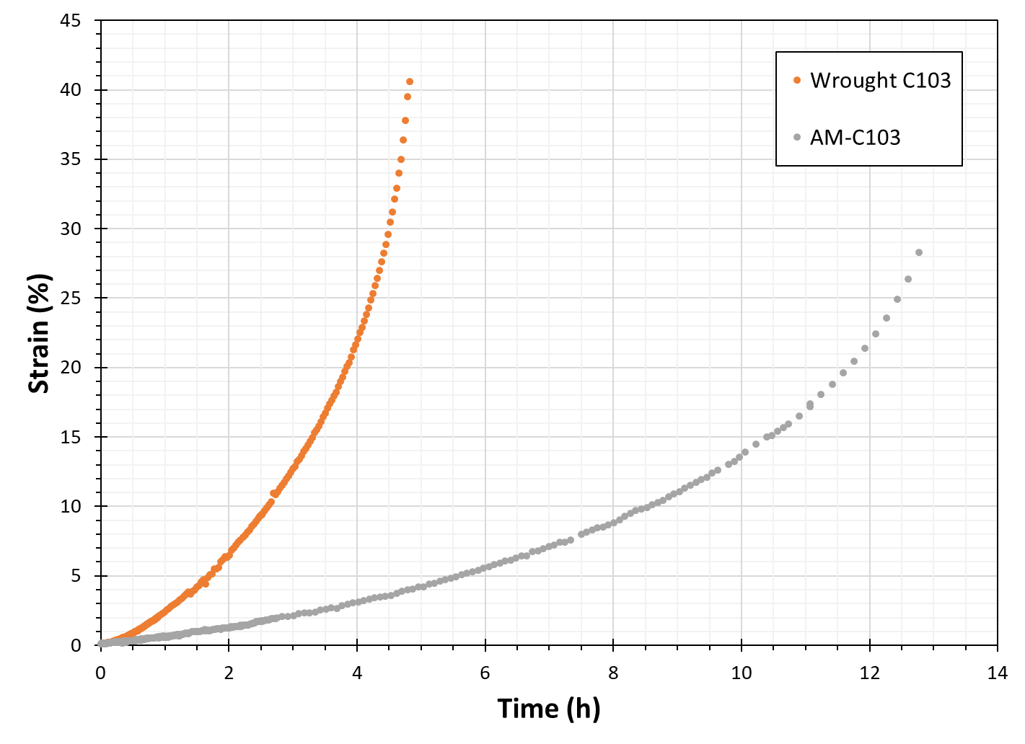
Creep of Wrought and AM C103
LMP of 1% Creep Strain
1300°C at 50 MPa
[1]
[1] R.H. Titran and W.D. Klopp, 1980
Ultimate - 2024 Phase 2 Kick-Off & Annual Review Meeting

Slide 14
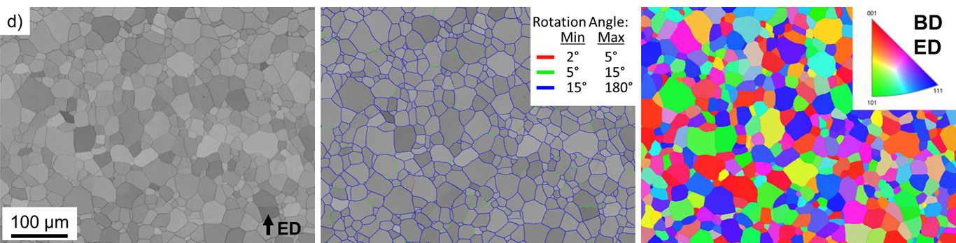
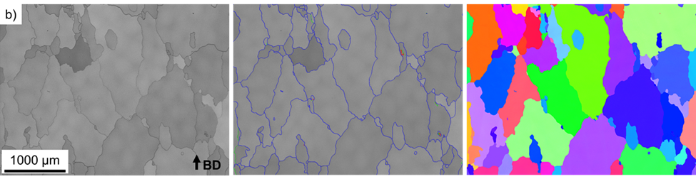
Microstructure of AM C103
Wrought C103 - Recrystallized
AM C103 –
HIP
Ultimate - 2024 Phase 2 Kick-Off & Annual Review Meeting

Slide 15
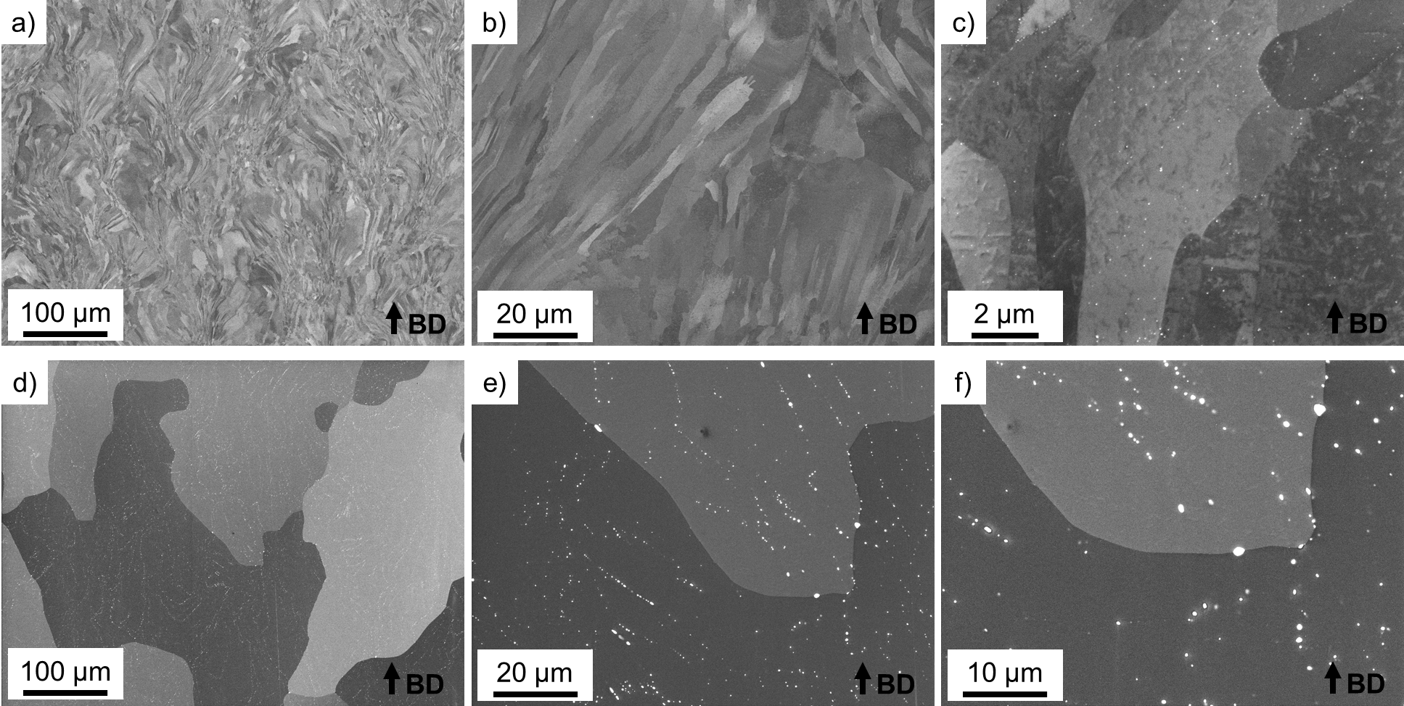
Microstructure of AM C103
As-Built
HIP
Ultimate - 2024 Phase 2 Kick-Off & Annual Review Meeting

Slide 16
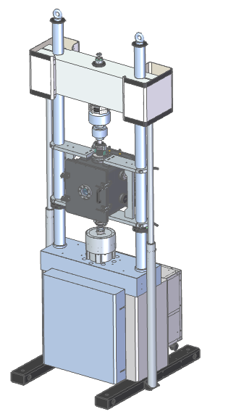
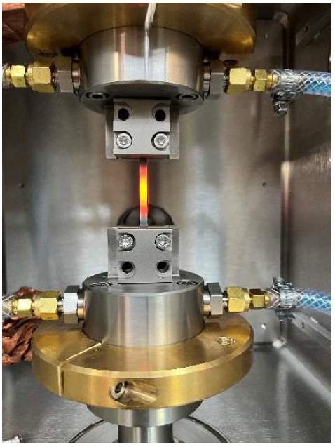
Moving Forward High-Throughput Testing
Meeting Testing Demand
Current Test Rate (High-Temp/Vac Tension): 1 sample per day
NASA GRC investment in New Test Rig with Rate: 3+ samples per day
  Direct Resistance Specimen Heating
  Vacuum: 10⁻⁷ Torr (Turbo)
Enables iterative/computational design of refractory alloys
TO-DO
Complete system installation and finalize subsystem integration
Determine specimen geometry and testing configurations for maximum throughput
Ultimate - 2024 Phase 2 Kick-Off & Annual Review Meeting

Slide 17
Moving Forward High-Throughput Testing
Meeting Testing Demand
Current Test Rate (High-Temp/Vac Tension): 1 sample per day
NASA GRC investment in New Test Rig with Rate: 1+ samples per day
  Tungsten furnace
  Vacuum: 10⁻⁷ Torr (Turbo)
Enables iterative/computational design of refractory alloys
TO-DO
Complete system installation and finalize subsystem integration
Determine testing configurations for maximum throughput
Ultimate - 2024 Phase 2 Kick-Off & Annual Review Meeting

