Slide 1
Adapting to Space
Jonathan Galazka, PhD
NASA Ames Research Center
March 21st, 2024
CBPSS Panel on Adapting to Space
Washington, DC

Slide 2
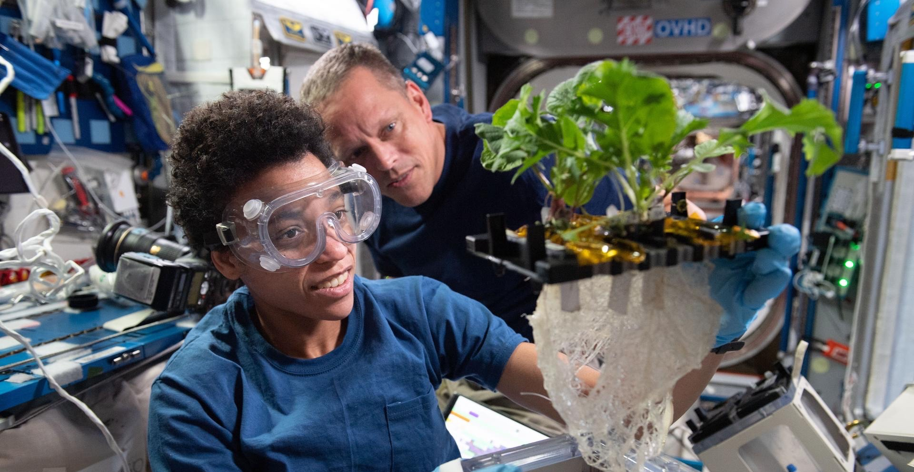
Adapting to Space
Fluid shifts
Unloading
Radiation
ISS Microbiome
Genetic background
Sex
Microbiome
Lifestyle
Life history
Jessica Watkins and Bob Hines, aboard the ISS. Credit NASA.
Notes:
Here we see an image of two astronauts, Jessica Watkins and Bob Hines, living and working aboard the International Space Station.
It is an inspiring gateway into the domain of Space Biology and for considering how living systems are impacted by spaceflight and how they adapt to it.
Both astronauts are experiencing fluid shifts, unloading of their muscle and bone, and increased rates of irradiation.
They are exposed to the varied and evolving microbiome on and within the ISS.
All of these factors are combined into a single experience we call Spaceflight.
How they respond to these combined factors will depend upon their genetic background, sex, personal microbiome, their life history and their life style during their stay in space.
All of this is true – not only for humans – but for all living system – be they microbes, vertebrates, invertebrates, or plants.

Slide 3
How Spaceflight Impacts Vision.
How Genetic Background Impacts Muscle Loss.
How Unloading and Irradiation Combine to Impact Muscle Loss.
How Open Science is Accelerating Discovery.
Notes:
Today I will discuss a set of recent Space Biology results that exemplify the progress we are making in understanding how organisms adapt to space.
The first is an investigation of how spaceflight impacts vision.
The next shows how genetic background impacts muscle loss.
The third shows how unloading and irradiation combine to impact muscle loss.
The final story shows how Open Science tools are accelerating the pace of Space Biology discovery.

Slide 4
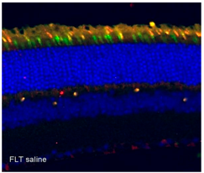
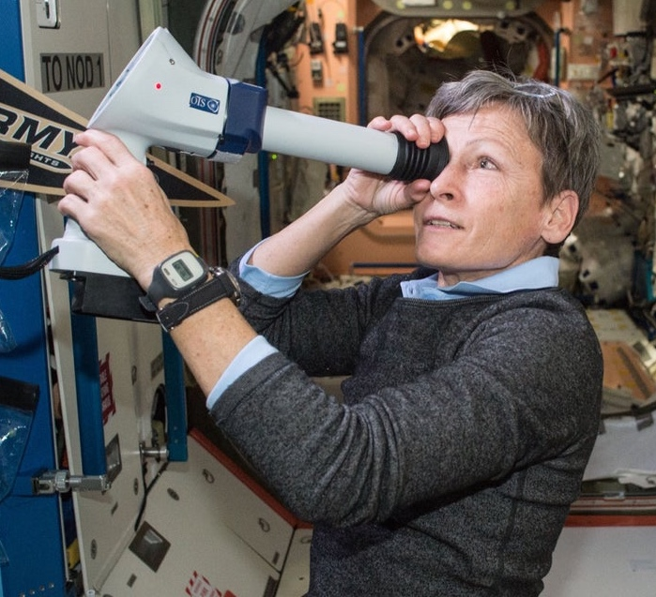
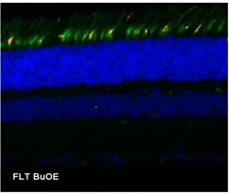
Evidence of Spaceflight-Induced Adverse Effects on Photoreceptors and Retinal Function in the Mouse Eye.
Spaceflight induces neuro-ocular changes in astronauts during and after space flight.
The RR-18 mission (PI Dr. Vivien Mao, Loma Linda U.) characterized acute oxidative damage in ocular structure and retinal function of mice and evaluated the efficacy of an antioxidant in reducing spaceflight-induced changes in the retina.
Postflight evaluations showed increases in retinal oxidative stress and apoptotic cell death after spaceflight and decreases in the amplitudes of alpha and beta waves.
Treatment with the antioxidant, BuOE (superoxide dismutase mimic), significantly reduced levels of oxidative stress, but levels of apoptotic cell death, and ERG metrics remained unchanged.
Peggy Whitson performing an eye check aboard the International Space Station. Credit NASA.
Flight induced oxidative stress in cones (yellow signal) which was mitigated by treatment with the antioxidant, BuOE.s
Citation: Mao, X.; Stanbouly, S.;Holley, J.; Pecaut, M.; Crapo, J. Evidence of Spaceflight-Induced Adverse Effects on Photoreceptors and Retinal Function in the Mouse Eye. Int. J. Mol. Sci. 2023, 24, 7362. Funding: Space Biology award NNX15AB41G to Dr. Vivien Mao.
Notes:
It is well established that Spaceflight induces neuro-ocular changes in astronauts during and after space flight.
Less is known about the molecular mechanisms that underly these changes.
In response, the RR-18 mission characterized acute oxidative damage in ocular structure and retinal function of mice and evaluated the efficacy of an antioxidant in reducing spaceflight-induced changes in the retina.
Postflight evaluations showed increases in retinal oxidative stress and apoptotic cell death after spaceflight and decreases in the amplitudes of alpha and beta waves.
Treatment with the antioxidant BuOE significantly reduced levels of oxidative stress, but levels of apoptotic cell death, and ERG metrics remained unchanged.

Slide 5
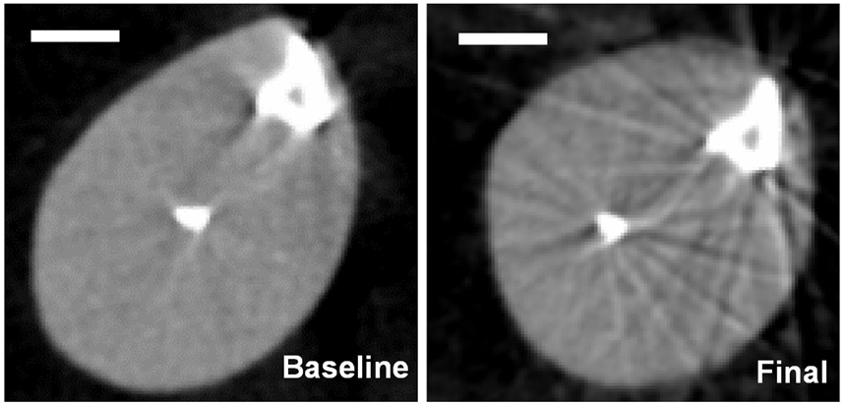
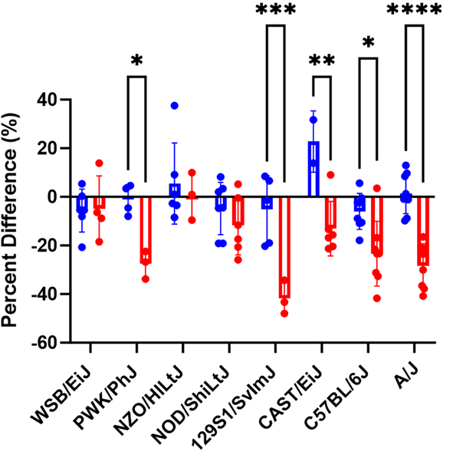
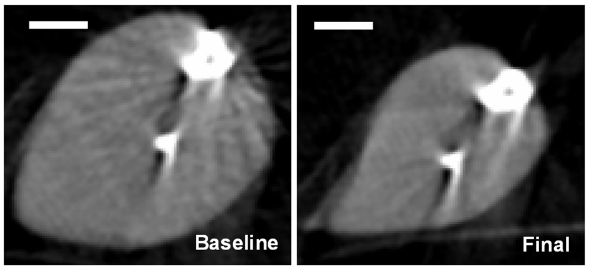
Genetic diversity modulates the physical and transcriptomic response of skeletal muscle to simulated microgravity in male mice
Blue is before unloading. Red is after.
Astronaut data shows considerable variation in muscle loss in response to microgravity¹.
Strength losses vary from 0–55% for missions between 30-380 days^{2,3,4}.
Study compared response of muscle in 8 mouse strains to 3 weeks of hind limb unloading (PI H. Donahue at VCU).
Saw substantial differences in muscle loss between strains.
Differences are reflected in the magnitude and pattern of changes within muscles from each strain.
NOD/ShiLtJ mouse
Astronauts aboard the ISS. Credit NASA.
A/J mouse
Red is unloaded. Blue is control. Adapted from Figure 3 of Zeineddine et al. 2023.
Citation: Zeineddine, Y., Friedman, M.A., Buettmann, E.G. et al. Genetic diversity modulates the physical and transcriptomic response of skeletal muscle to simulated microgravity in male mice. npj Microgravity 9, 86 (2023) Funding: Space Biology grant 80NSSC18K1473 (Gap Junctions and Microgravity Induced Bone Loss) to Dr. Henry Donahue at VCU.
Notes:
Different astronauts experience different levels of muscle loss in response to Spacefligth.
For example, strength losses can vary from zero to 55% for missions between 30 days and a year.
The reasons for this are not fully understood.
In response, a study was performed where 8 genetically distinct mouse strains were hind limb unloaded for 3 weeks.
After this period of disuse muscle loss was measured and substantial differences were seen between strains.
The red bars on this graph show the percent loss in cross sectional area after 3 weeks of unloading.
While NOD/ShiLtJ did not have significant muscle loss, A/J mice saw substantial loss.
Slide references:
1. Comfort, P. et al. Effects of spaceflight on musculoskeletal health: a systematic review and meta-analysis. Consid. Interplanet. Travel. Sports Med. Auckl. NZ 51, 2097–2114 (2021).
2. Antonutto, G., Capelli, C., Girardis, M., Zamparo, P. & di Prampero, P. E. Effects of microgravity on maximal power of lower limbs during very short efforts in humans. J. Appl. Physiol. 86, 85–92 (1999).
3. Lambertz, D., Pérot, C., Kaspranski, R. & Goubel, F. Effects of long-term spaceflight on mechanical properties of muscles in humans. J. Appl. Physiol. 90, 179–188 (2001).
4. Koryak, Y. A. Architectural and functional specifics of the human triceps surae muscle in vivo and its adaptation to microgravity. J. Appl. Physiol. 126, 880–893 (2019).

Slide 6
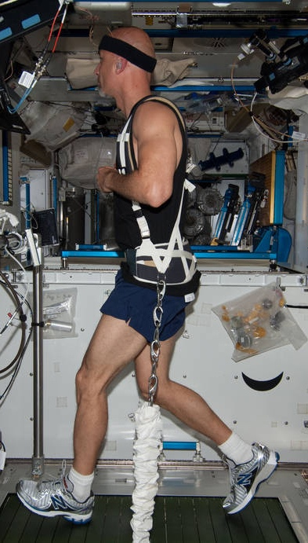
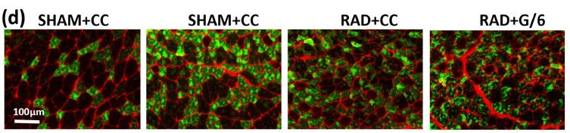
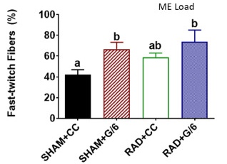
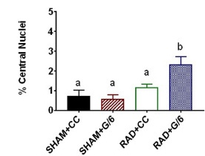
Combined effects of heavy ion exposure and simulated Lunar gravity on skeletal muscle
Mice exposed to a single 0.5 Gy ²⁸Si dose at a rate of 0.25 Gy min⁻¹ (similar to Mars mission) or sham treatment.
Mice then spent 21 days at 1 or 1/6 g.
Partial weight bearing causes muscle atrophy and fiber type switching.
Irradiation combined with unloading did not exacerbate muscle atrophy or fiber switching.
However, the proportion of fibers with central nuclei (indicative of muscle regeneration or repair) was impacted irradiation and there was a significant interaction between loading and irradiation.
Luca Parmitano on treadmill aboard the International Space Station. Credit NASA.
Citation: Wiggs et al. Combined effects of heavy ion exposure and simulated Lunar gravity on skeletal muscle. Life Sci Space Res (Amst). 2023 May;37:39-49. Funding: Space Biology grant 80NSSC19K0432 to Dr. Lawler.
Notes:
(d.) Representative images of fast-twitch fibers. Anti-Β-sarcoglycan (Red) is used to visualized sarcolemma. Anti-Type II myosin-heavy chain (green) was used to visualized fast twitched muscle fiber. Images were obtained using 16x objective (NeoFluar NA:0.5). (e.) Graphic representation of fast twitch fiber distribution as a percent showing that partial unloading and radiation resulted in more fast twitch fibers, but there was not an additive effect of radiation. Error Bars represent standard error. Two-way ANOVA results are listed above figures. Following pairwise comparisons, groups not sharing the same letter are statistically different (p<0.05).

Slide 7

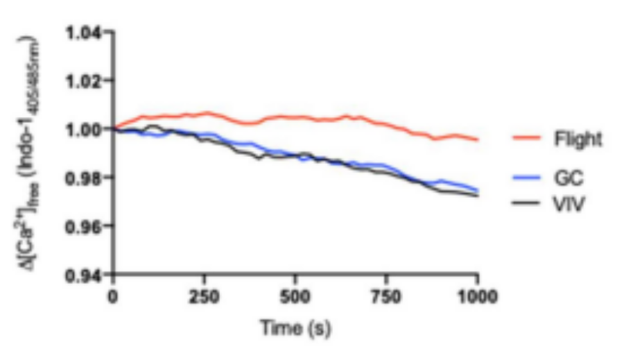
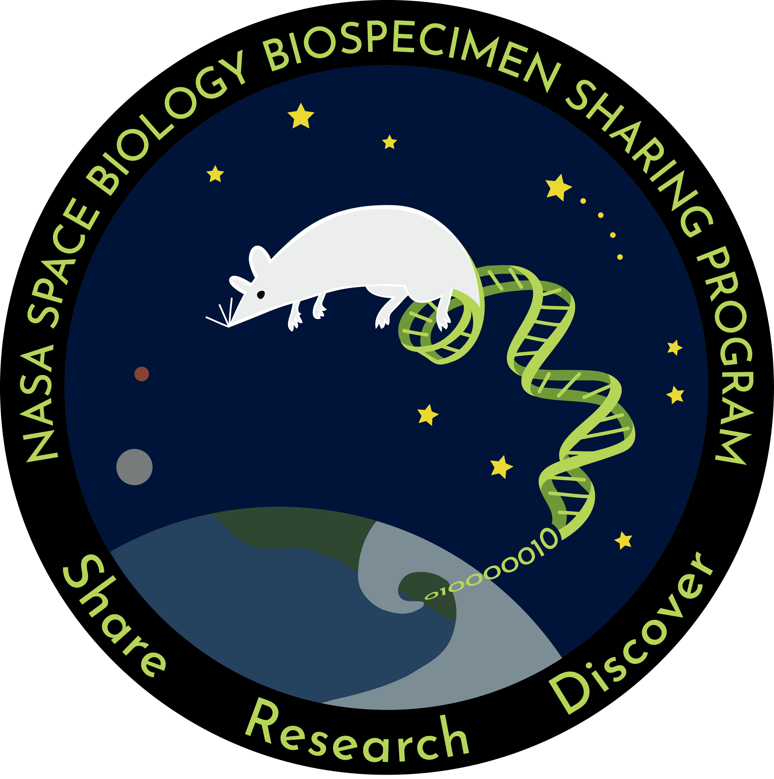

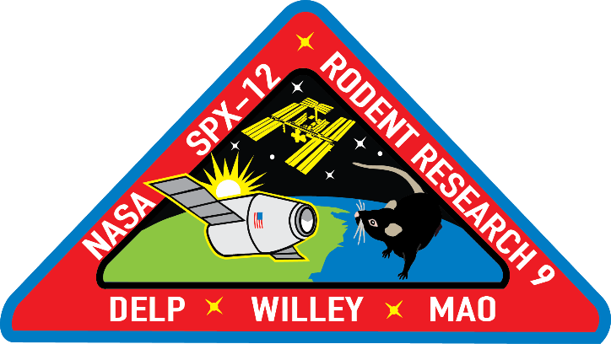
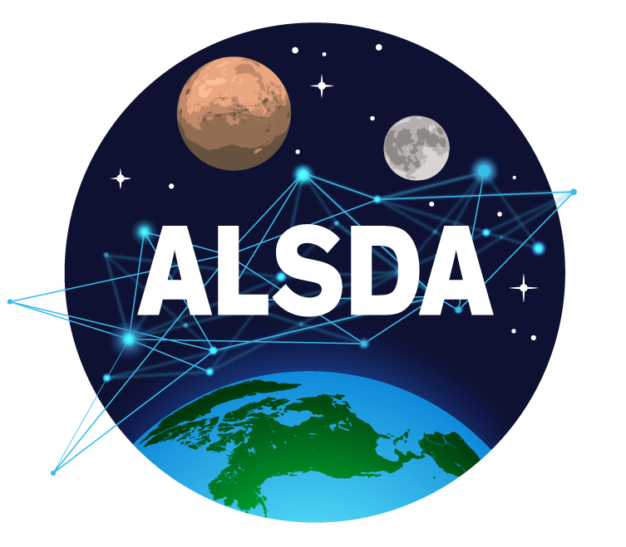
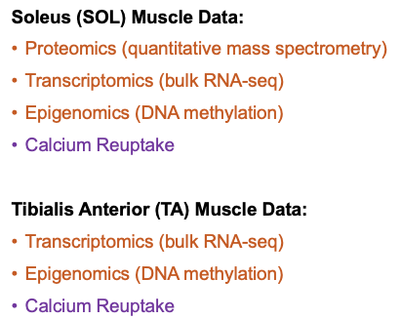
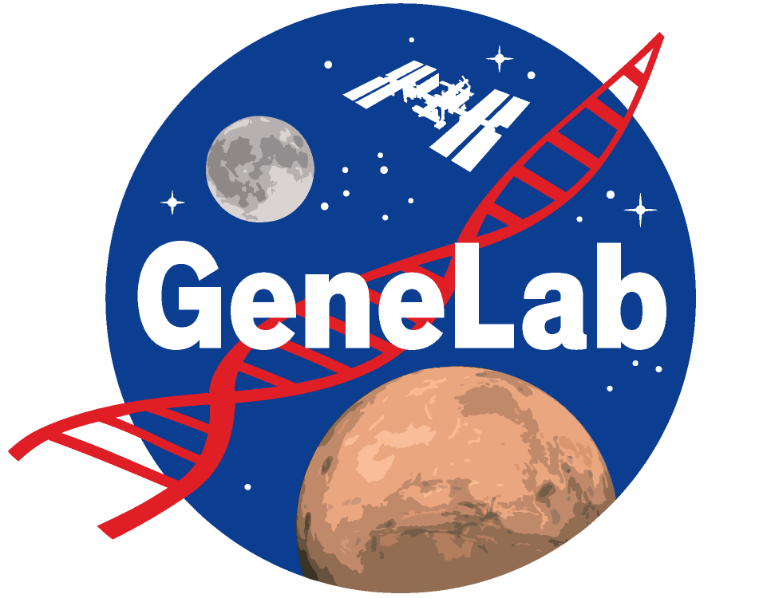
How Open Science is Accelerating Discovery
RR-1
Tissue collection
Archiving
Tissue request by PI
RR-9
Biospecimen Sharing Program
NASA Biological Institutional Science Collection
Braun, J.L.; Geromella, M.S.; Hamstra, S.I.; Messner, H.N.; Fajardo, V.A. Characterizing SERCA Function in Murine Skeletal Muscles after 35–37 Days of Spaceflight. Int. J. Mol. Sci. 2021, 22, 11764.
Primary data deposited
PI deposits secondary data
Explainable ML to identify genetic targets that explain patterns between flight and ground.
Team accesses primary and secondary data
Li, K., Desai, R., Scott, R.T. et al. Explainable machine learning identifies multi-omics signatures of muscle response to spaceflight in mice. npj Microgravity 9, 90 (2023).

Slide 8
Conclusion
Four examples of how Space Biology is advancing:
  How spaceflight impacts Vision.
  How genetic background impacts muscle loss.
  How unloading and irradiation combine to impact muscle loss.
  How Open Science is accelerating discovery.
These four examples are the “tip of the iceberg” in recent Space Biology advances:
  Spaceflight studies
  Ground studies
  Diverse model organisms
  Data science
  Open science
Thank you for your attention!

