Slide 1
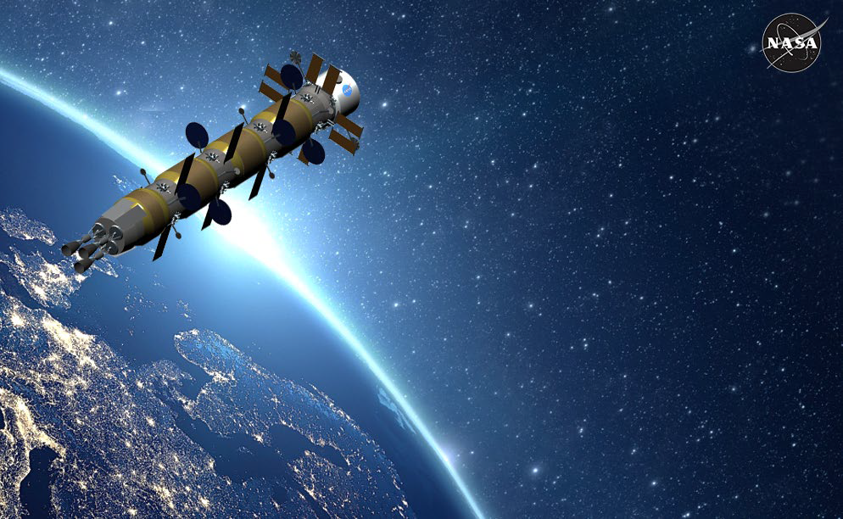

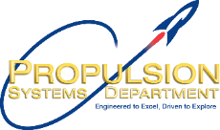




Space Nuclear Reactor Commonalities with Advanced and Small Modular Reactors
Michael G. Houts, PhD
NASA MSFC
michael.houts@nasa.gov
25 March 2024

Slide 2
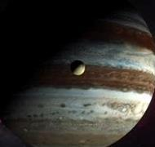
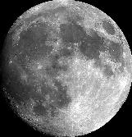


Space Nuclear Power and Propulsion Mission Spaces
Orbital Transfers, Loitering, and Maneuvering
Cis-Lunar Maneuvering and Transportation
Deep Space Exploration and Science
Mars Cargo and Crew Transit
Fission Surface Power
Advanced Missions

Slide 3
Space Nuclear Reactor Commonalities with Advanced and Small Modular Reactors
Opportunity for US “nuclear” leadership
Innovative approaches (NSPM-20)
Increased importance of mass and volume
Potential for Advanced Technologies / Capabilities
Summary

Slide 4
Opportunity for US Leadership
US falling behind in many “nuclear” areas.
  “Finland in Front: The World’s Likely First Spent Fuel Repository Moves Toward Licensing” (1 March 2024, Radwaste Solutions)
  “AFCONE and DeepGeo launch African nuclear initiative” (5 March 2024)
  “The Emirates Nuclear Energy Corporation announced last week start-up at its fourth nuclear unit at the Barakah plant in the UAE.” (6 March 2024, Korean-designed APR-1400)
  China’s HTR-PM began commercial operation late 2023. High-temperature, gas-cooled pebble bed, 210 MWe, additional 300 MW for process heat.
  “China’s new Linglong One reactor just one piece of nuclear expansion” (13 March 2024)
  Iran plans four new 1250 MWe nuclear power plants in next nine years, groundbreaking occurred February, 2024.
  Russia and China announce plan to build shared nuclear reactor on the moon by 2035, 'without humans’ (13 March 2024)
Space reactors plus advanced and small modular nuclear reactors are areas where the US may have opportunity to lead.

Slide 5
Innovative Approaches (NSPM-20)
NSPM-20
  NSPM-20 is a presidential memorandum that updates the process for launches of spacecraft containing space nuclear systems, such as radioisotope power systems and fission reactors. It establishes safety guidelines, launch authorization tiers, and roles and responsibilities for Federal Government and commercial entities involved in such launches.

Slide 6
Innovative Approaches (NSPM-20)
NSPM-20
Sec. 3. Safety Guidelines. (a) All United States Government entities involved in the launch of spacecraft containing space nuclear systems (including in the licensing of non-Government launches) shall seek to ensure safe operation. For any mission that includes a space nuclear system, mission planners and launch authorization authorities should, as appropriate, seek to ensure that:
(i) normal operation of the space nuclear system is consistent with applicable Federal, State, and local requirements;
(ii) an accident resulting in exposure in excess of 25 millirem but less than 5 rem total effective dose (TED), as that term is defined in section 835.2 of title 10, Code of Federal Regulations, to any member of the public is unlikely, such that the probability of such an event does not exceed 1 in 100; (iii) an accident resulting in exposure in the range of 5 rem to 25 rem TED to any member of the public is extremely unlikely, such that the probability of such an event does not exceed 1 in 10,000; and
(iv) the probability of an accident resulting in exposure in excess of 25 rem TED to any member of the public does not exceed 1 in 100,000.

Slide 7
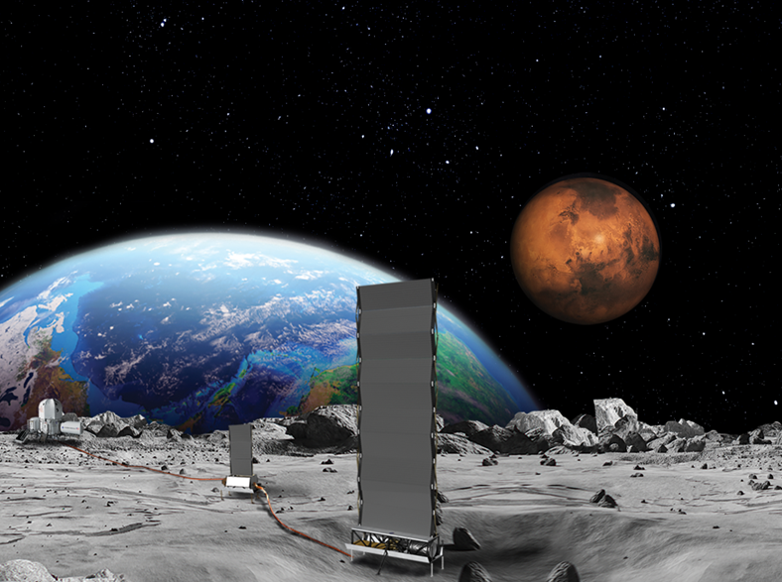
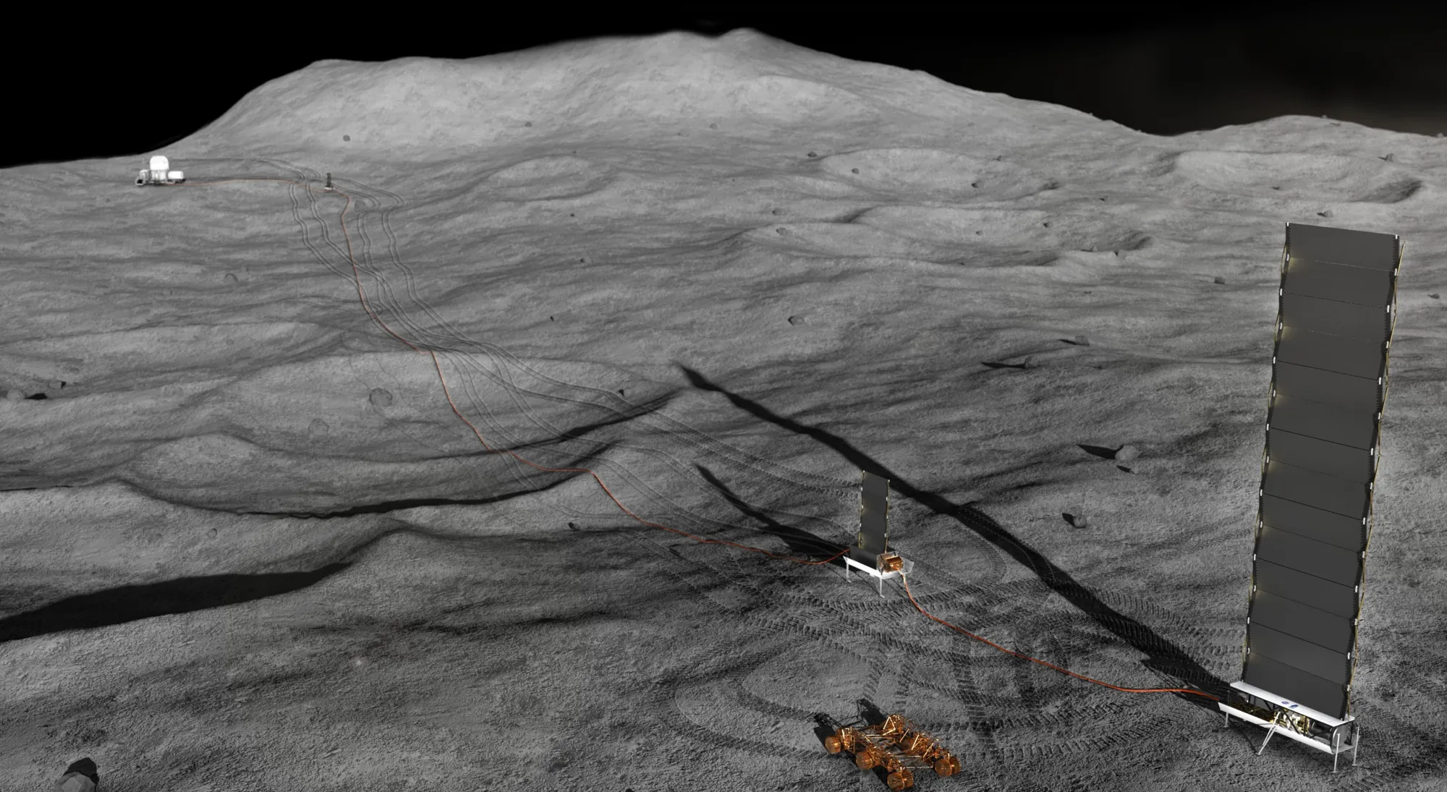
Increased Importance of Mass and Volume
Space reactors – mass and volume constraints of missions, launch vehicles, and (potentially) landers.
Small modular reactors – transportation of modules from factory and rapid/affordable installation at site.
Courtesy NASA GRC
Courtesy NASA GRC

Slide 8
Potential for Advanced Technologies / Capabilities
Autonomous or semi-autonomous operation.
Long life (> 10 years) with little or no maintenance or refueling.
High temperature fuel systems with low parasitic neutron absorption.
High temperature moderators and control systems.
High temperature / high efficiency power conversion.
Beneficial uses for “waste heat”.
Advanced waste heat rejection techniques.

Slide 9
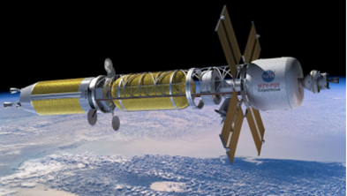
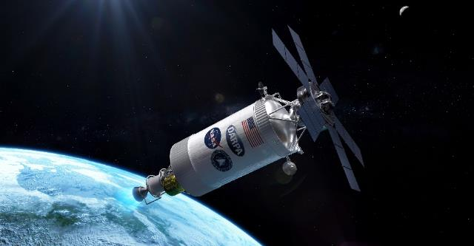
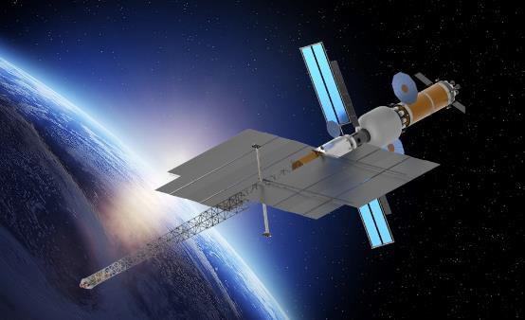
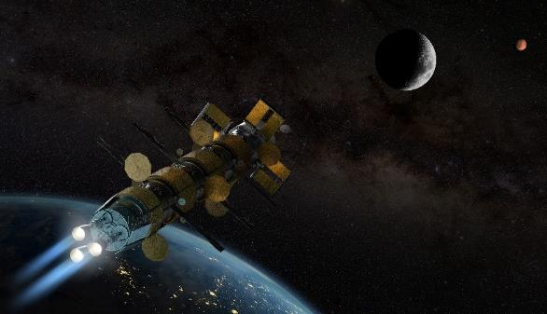
Summary
Space Nuclear Reactor Commonalities with Advanced and Small Modular Reactors
Opportunity for US “nuclear” leadership
Innovative approaches (NSPM-20)
Increased importance of mass and volume
Potential for Advanced Technologies / Capabilities
9

