Slide 1


Preliminary results from the Peregrine Ion-Trap Mass Spectrometer (PITMS)
B. A. Cohen¹, S. J. Barber², F. A. J. Abernethy², N. M. Curran¹, P. D. Driggers¹, W. M. Farrell¹, A. J. Gawronska¹, D. Heather³, C. Howe⁴, P. Landsberg², V. López-Días⁵, A. D. Morse², T. Morse⁴, M. J. Poston⁶, P. Prem⁷, S. Sheridan², R. Trautner³, O. J. Tucker¹, T. Warren⁸
¹NASA Goddard Space Flight Center, Greenbelt MD (barbara.a.cohen@nasa.gov), ²The Open University, UK, ³ESA/ESTEC, The Netherlands, ⁴STFC RAL Space, UK, ⁵LIST, Luxembourg, ⁶SwRI, San Antonio, TX, ⁷JHU APL, Laurel MD; ⁸Oxford University, UK.

Slide 2

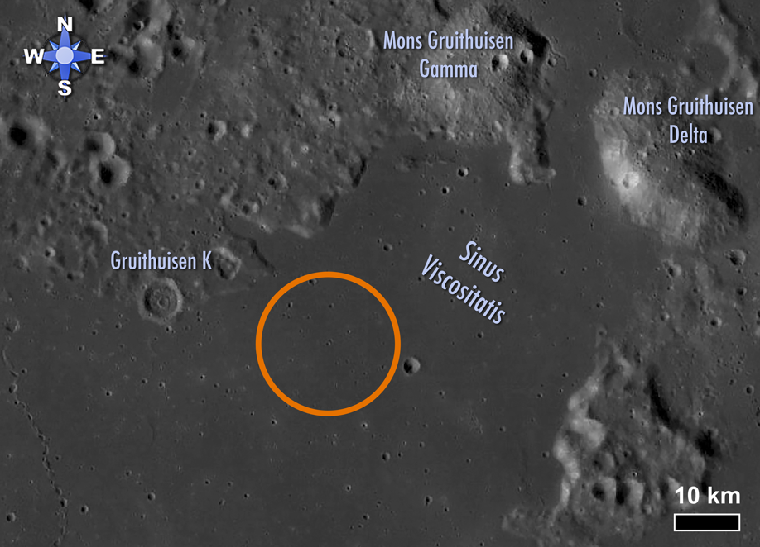
PITMS overview
Partnership: PITMS is a partnership between NASA Goddard Space Flight Center (GSFC), The Open University (OU), RAL Space, NASA HQ, and ESA.
Mission: Proposed to and selected by NASA Provided Lunar Payloads call in 2019. Instrument delivered in 2021. Manifested on Astrobotic Peregrine Lander. Flew in 2024.
Science: Characterize the lunar exosphere throughout the lunar day to understand the release and movement of volatile species of interest to both science and human exploration (water, noble gases, nitrogen, etc.)
Landing site: Sinus Viscositatis. See more in our POSTER Tuesday in the Lunar Remote Sensing session: Gawronska A. J.*, Cohen B. A., Lopez-Dias V., Poston M., Prem P., PITMS Science Team (2024) Sinus Viscositatis: Implications of Young, KREEPy Mare Eruptions for Lunar Volatile Abundances and Origins [#2791]

Slide 3
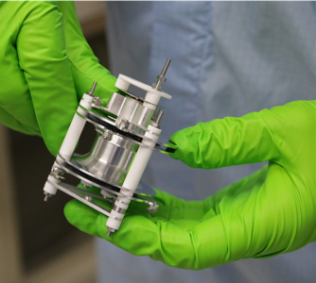
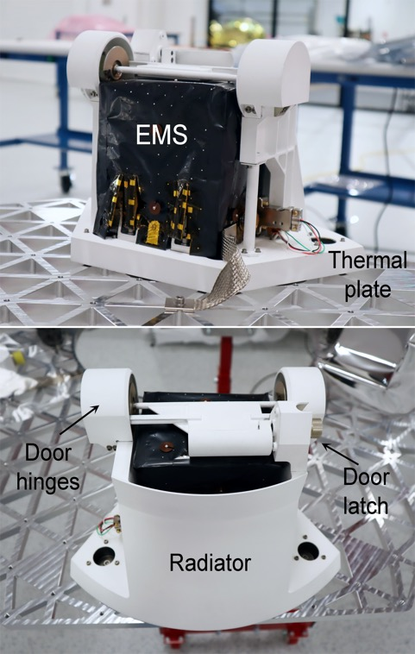
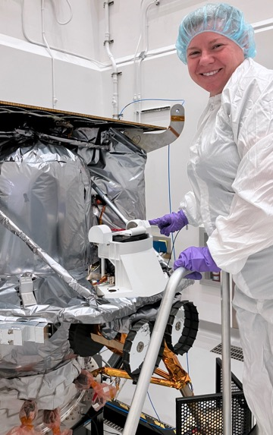
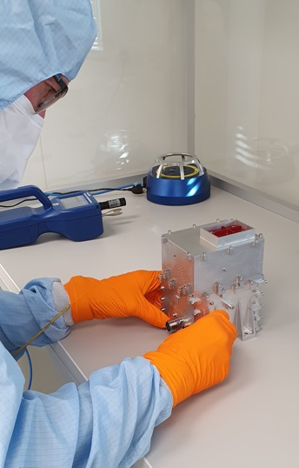
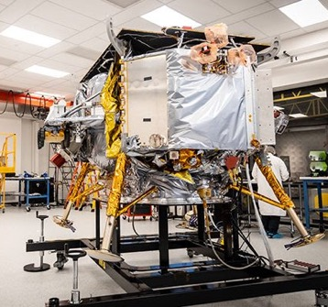
PITMS instrument
Instrument: PITMS consists of an ESA-provided mass spectrometer (sensor, electronics, controller, power supply boards) and a GSFC wrapper that provides structural elements, thermal control, and a deployable dust cover
Operation: Ambient gases enter PITMS and diffuse around the mass analyzer, ionized and trapped in a radiofrequency field, then sequentially detected to build a mass spectrum.
  Mass range 10 – 150 m/z
  Mass resolution ~0.5 amu
  Sensitivity ~E-8 to E-9 mbar

Slide 4

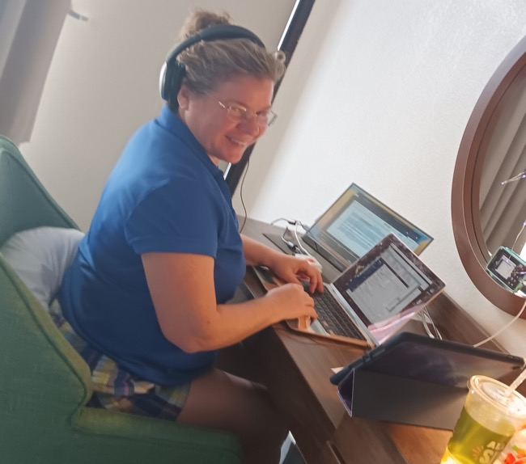
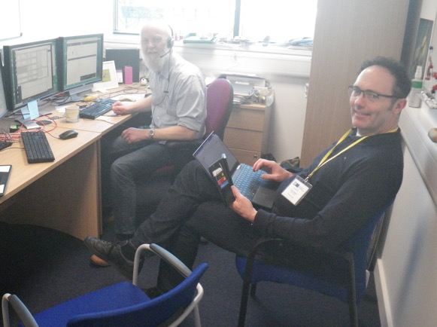
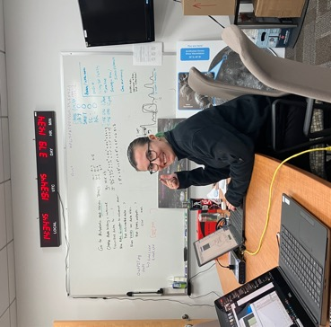
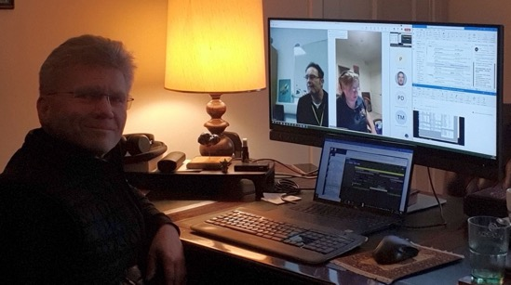
PITMS operation
PITMS operated in four sessions over the Peregrine mission
8.5 hrs instrument operation
Major successful operations
  turned on
  applied software patch
  functional test with filaments and detector off
  functional test with filament and detectors on
  acquired data with dust cover closed
  opened dust cover
  acquired data with dust cover open
  downlinked latent data

Slide 5
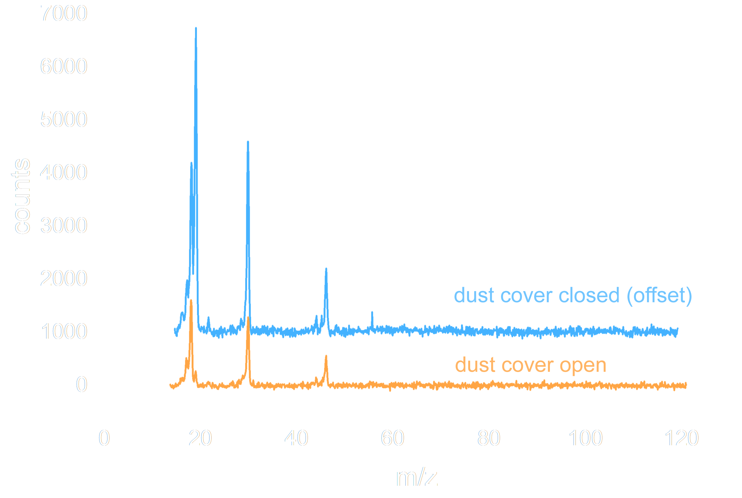
PITMS performance
Spectra acquired: 84 (80 complete, packet loss for others).
Spectral quality are excellent, with well-defined peaks and low noise
Strong peaks observed before dust cover deployment, weaker peaks after being opened to space

Slide 6

PITMS interpretations - Water
← Initial turn-on: a lot of water as the mass spectrometer degasses for the first time after terrestrial exposure, decreased the next time it is turned on
Dust cover opens and total pressure drops significantly
Measuring ambient conditions (?)
H₂O⁺→H₃O⁺ reaction in the trap is a proxy for pressure. Observed ratios indicate low E-5 to high E-6 mbar of water before the dust cover opened and low E-6 mbar water after the dust cover opened
Consistent with bringing water with us (white paint, atmospheric exposure), but could also include an outgassing contribution from the lander and other instruments

Slide 7
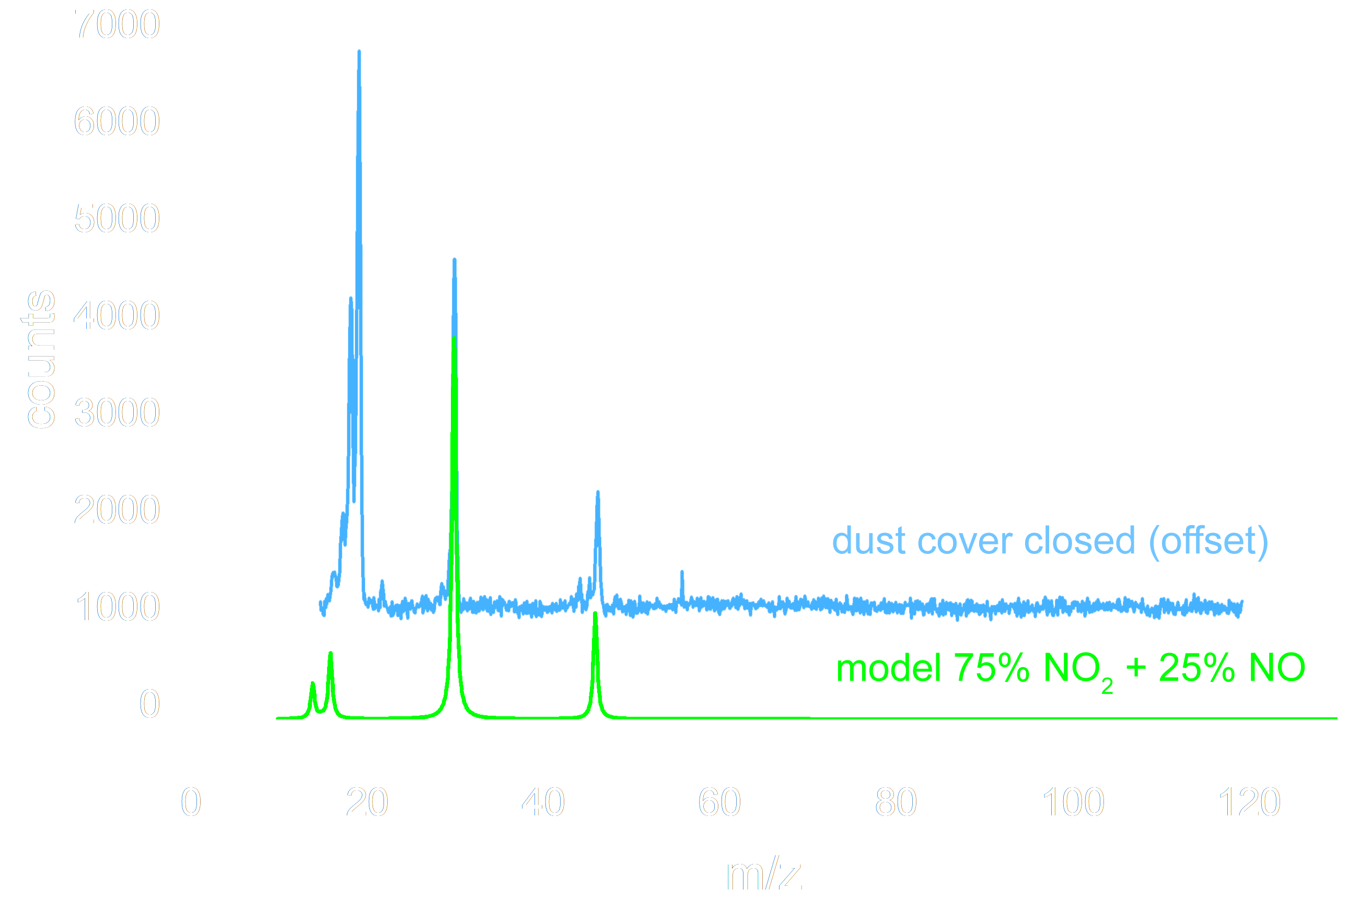
PITMS interpretations - Oxidizer
Spectrum includes MON-25 products NO and NO₂
  we tried to fit the spectra to CO/CO₂ instead but we could not make that work, so conclude these are correct
Consistent with thermodynamic predictions that oxidizer N₂O₄ decomposed into NO₂ at low P
  but uncertainties in the P,T and changing ratios aren’t yet fully understood
If linear sensitivity, the peak heights for NO and NO₂ imply ~half the partial pressure of water (low E-6 mbar)
  we are putting NO₂ into the GRM for additional info
Strongest peaks are observed prior to opening the dust cover
  pursuing simple modeling approaches to understand the implications for required external pressure

Slide 8
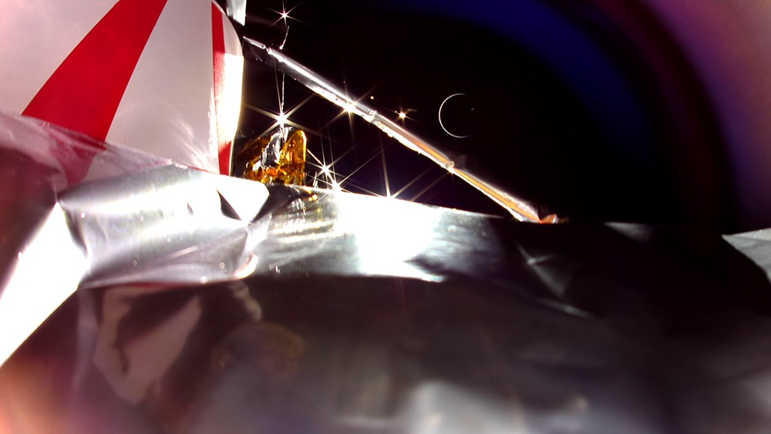
Summary & upcoming work
PITMS operated for 8.5 hrs and collected ~80 spectra of the Peregrine spacecraft environment
Complete raw database & preliminary interpretations – done!
Full data calibration and data interpretation ongoing
  We collected ”diagnostic” spectra that may help shed light on minor peaks - species and abundance.
  Ground Reference Model introducing gas mixes
  Modeling of spacecraft geometry and environment
  See me or Aleks Gawronska at her Tuesday poster for more details on data processing
Publications – more results at ELS (mid-June),
investigation planning paper (submitted),
interpretation papers (in work)
”Lessons learned" for us and for others
PDS and ESA archival 6 months from EOM
Project closeout: July 18, 2024
Thank you to the other payloads who shared
planning and operations with us, and thank you
to CLPS and Astrobotic for a wild ride

