Slide 1
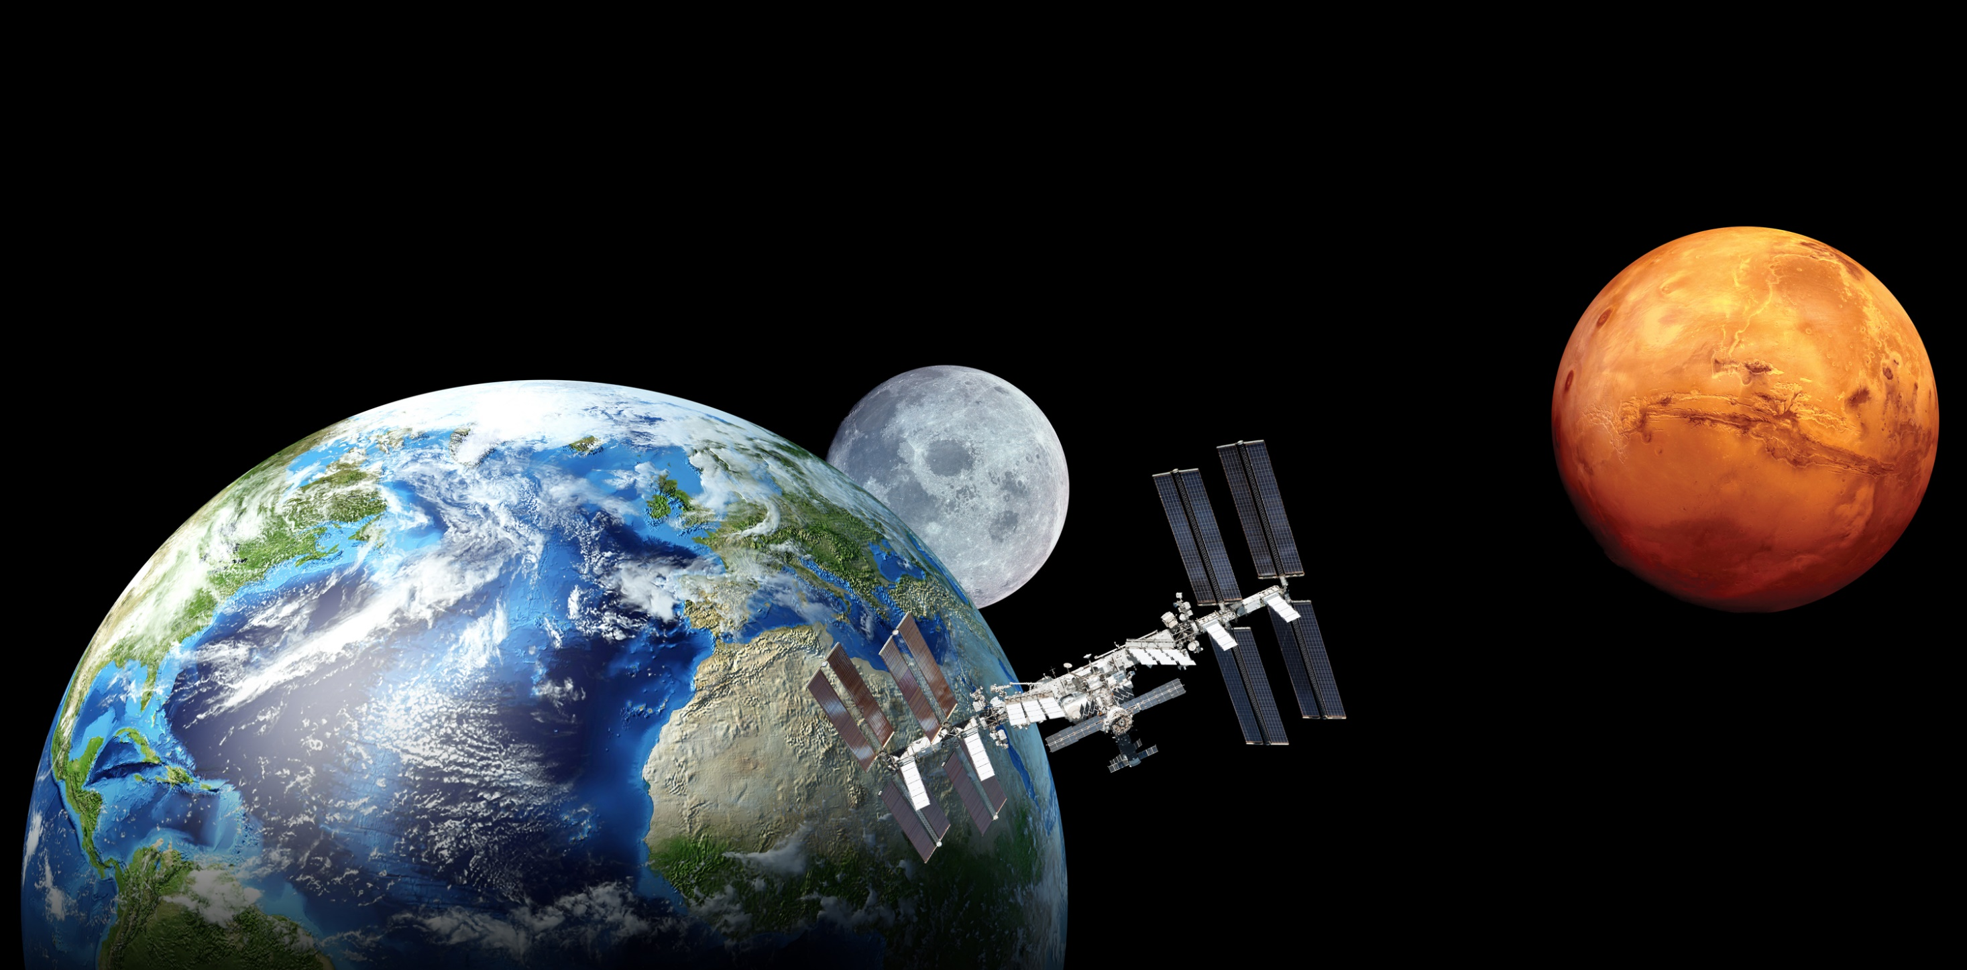


a
RESOURCE RECOVERY
from
LOGISTICAL SPACE TRASH
Annie Meier, PhD.
Exploration Systems & Development Office
NASA Kennedy Space Center
3/20/2024

Slide 2
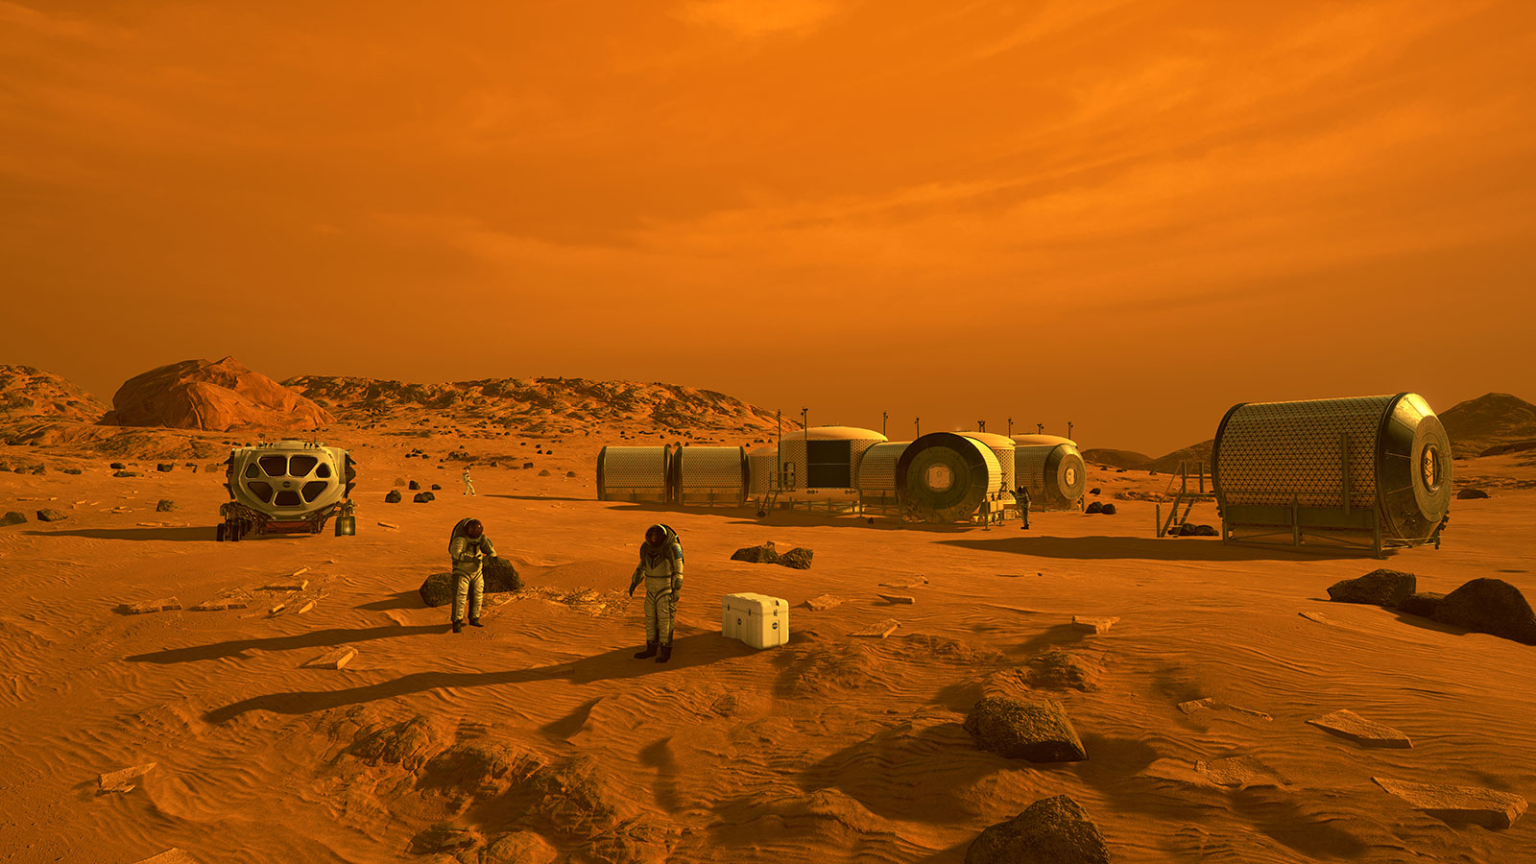
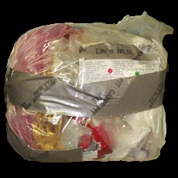
NASA’s Trash Strategy…
550 days (Mars mission)
800 kg of waste
2536 ‘footballs’
1 day
1.5 kg
5 ‘footballs’
30 days
43.5 kg
138 ‘footballs’
7 days
10 kg
32 ‘footballs’
Background image: NASA; Credits: Joel Olson, KSC

Slide 3
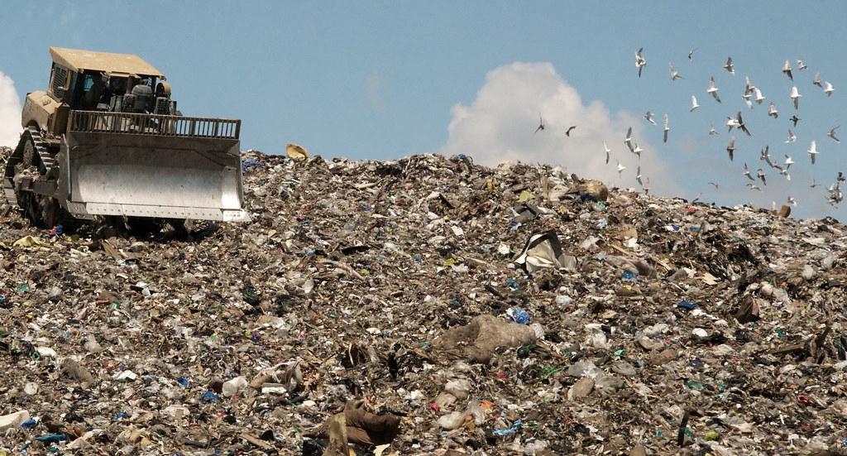
Notes:
-If we truly seek to be sustainable in the future of human spaceflight,
-Cradle to grave for trash is necessary.
-Team passionate for space visionary goal but also back to our home planet.
-We are in a climate crisis and one of our crises here on earth is
the management of waste and precious planetary resources
-We are ready to design for the mission of a crew of 4 that
considers all inputs and outputs of trash

Slide 4
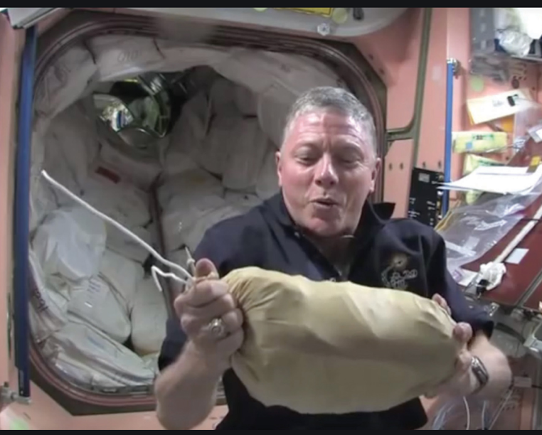

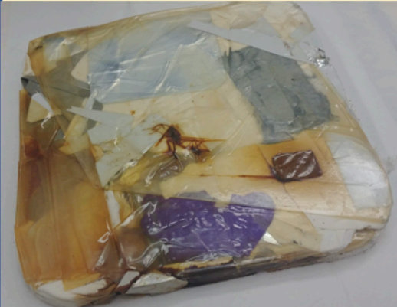
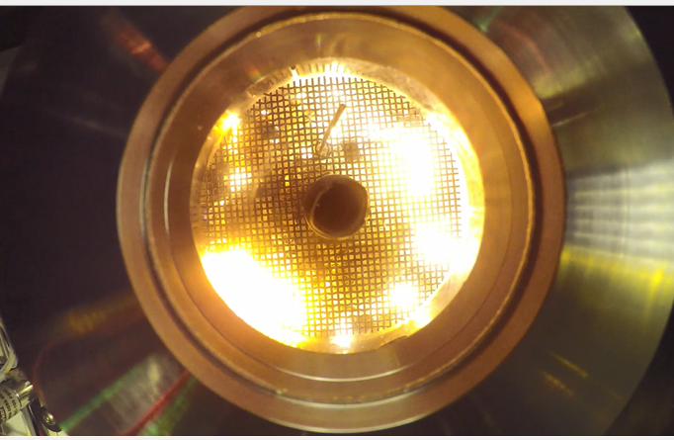
ESDMD Waste Strategy
Keep
Throw out
(Mass
Jettison)
Throw out
(Mass Venting)
Notes:
-If we truly seek to be sustainable in the future of human spaceflight,
-Cradle to grave for trash is necessary.
-Team passionate for space visionary goal but also back to our home planet.
-We are in a climate crisis and one of our crises here on earth is
the management of waste and precious planetary resources
-We are ready to design for the mission of a crew of 4 that
considers all inputs and outputs of trash

Slide 5
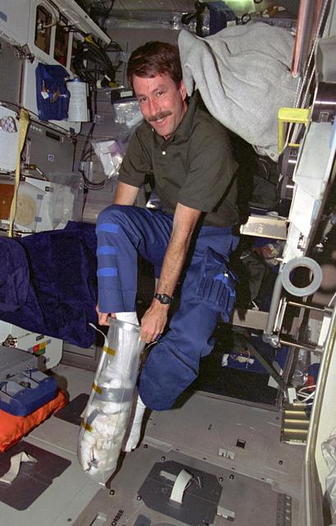
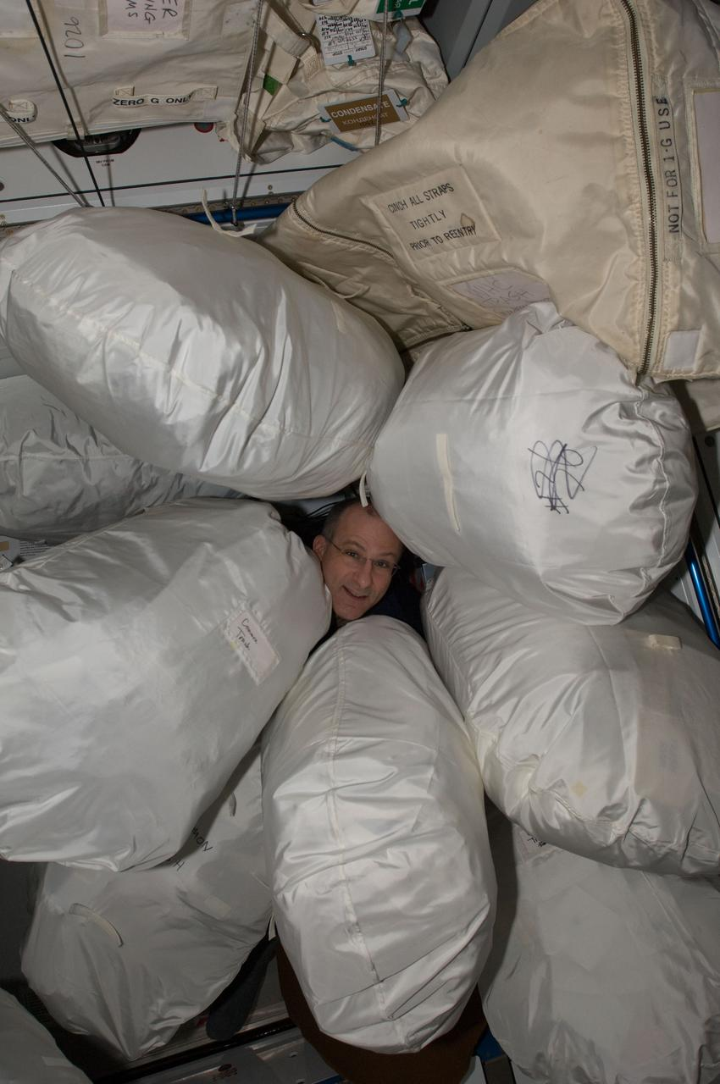
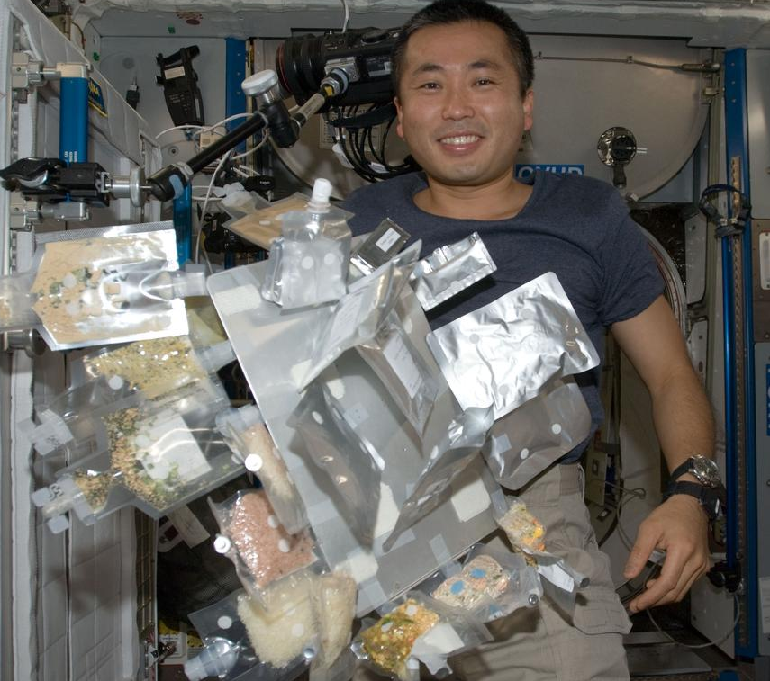
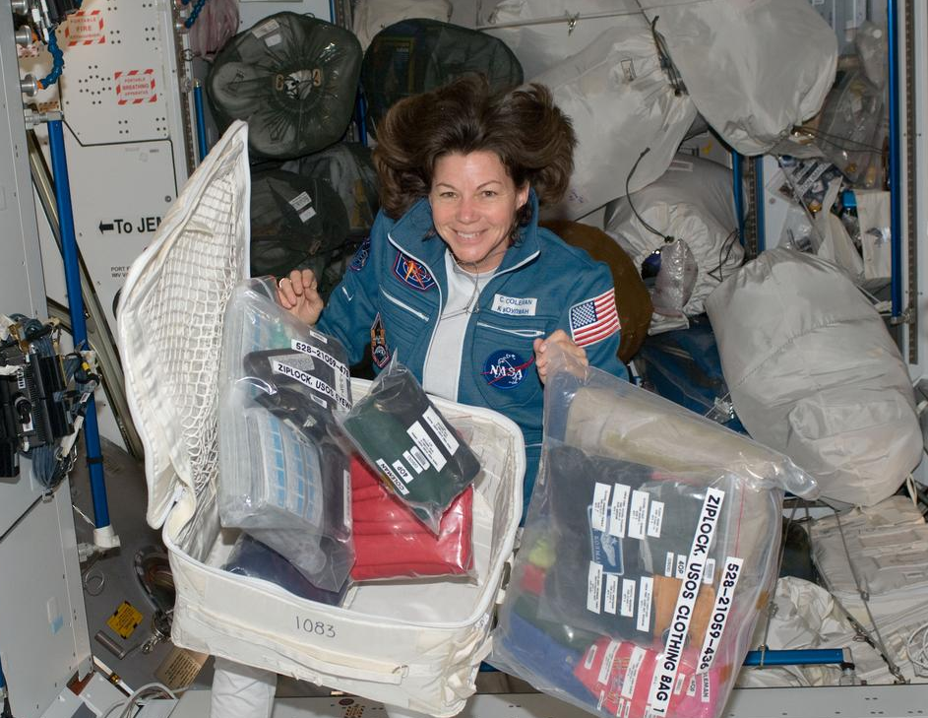
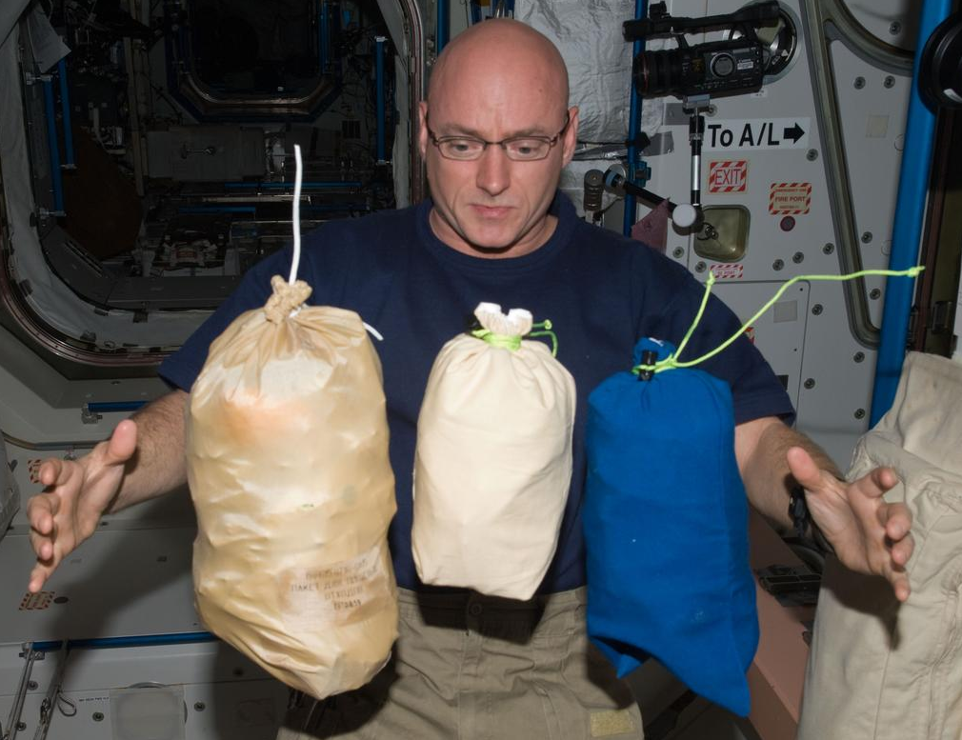
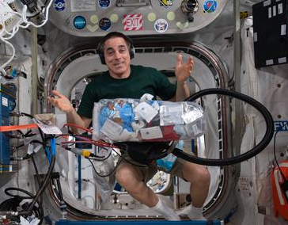
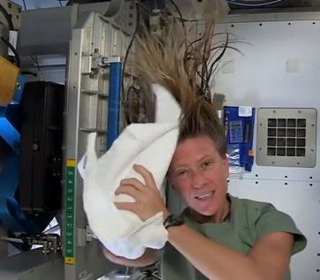

Notes:
NASA astronaut and Expedition 63 Commander Chris Cassidy collects trash for disposal during weekend housekeeping activities aboard the International Space Station.
NASA astronaut Scott Kelly, Expedition 25 flight engineer, is pictured near three stowage bags floating freely in the Unity node of the International Space Station.
Cady Coleman, Expedition 26 with a stowage container and its contents in the Harmony node of the ISS.
Left: STS073-356-018 -1995) - Kent V. Rominger, pilot, demonstrates an age-old trash-compacting method on the middeck of the Earth-orbiting Space Shuttle Columbia.
Right: ISS030-E-020706 - 2012) - Don Pettit, Expedition 30 flight engineer, is pictured among stowage bags in the Harmony node of the ISS.

Slide 6







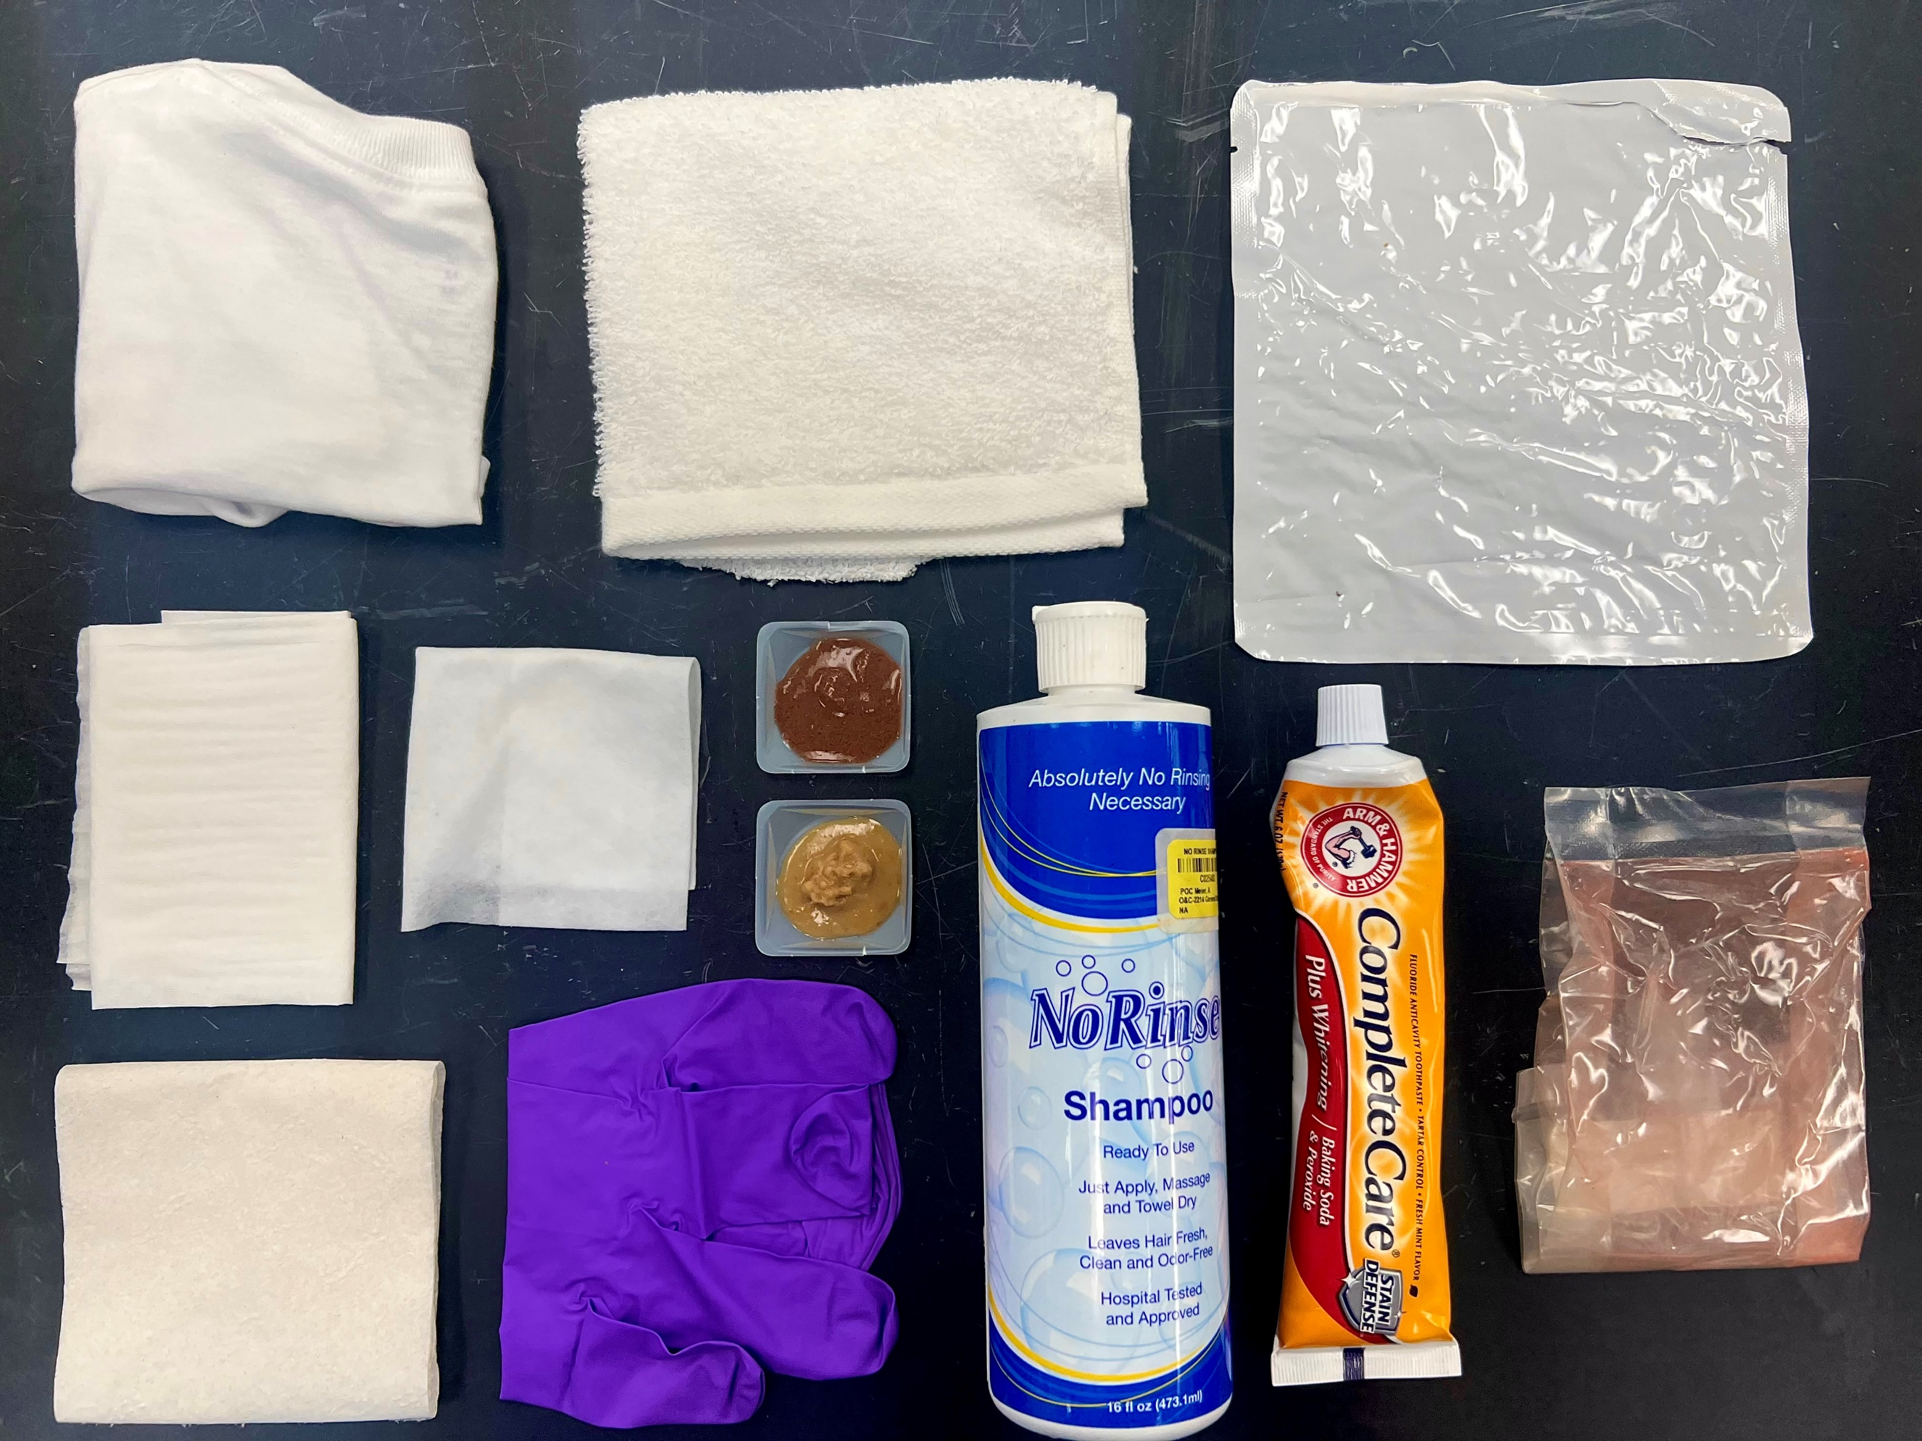
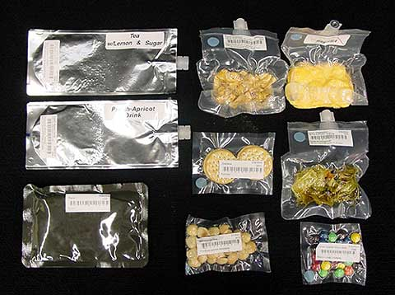
6.4 kg/day of trash
Crew of 4
Toothpaste
Nitrile Gloves
Shampoo
Clothing
Toilet Paper
Fecal Stimulant
Tech Wipes
Wet Wipes
Food Stimulant
Food Packaging
Notes:
-If we truly seek to be sustainable in the future of human spaceflight,
-Cradle to grave for trash is necessary.
-Team passionate for space visionary goal but also back to our home planet.
-We are in a climate crisis and one of our crises here on earth is
the management of waste and precious planetary resources
-We are ready to design for the mission of a crew of 4 that
considers all inputs and outputs of trash

Slide 7

6.4 kg/day of trash
Crew of 4
Toothpaste
Nitrile Gloves
Shampoo
Clothing
Toilet Paper
Fecal Stimulant
Tech Wipes
Wet Wipes
Food Stimulant
Food Packaging
Notes:
-If we truly seek to be sustainable in the future of human spaceflight,
-Cradle to grave for trash is necessary.
-Team passionate for space visionary goal but also back to our home planet.
-We are in a climate crisis and one of our crises here on earth is
the management of waste and precious planetary resources
-We are ready to design for the mission of a crew of 4 that
considers all inputs and outputs of trash

Slide 8
Conclusions
Trash Feedstock Simulant Recipes
Component of OWS | OWS (Mass %) | Component of HFWS | HFWS (Mass %)
Clothing/Cotton | 17.9 | Urine Brine | 21.3
Food Packaging (FP) | 13.4 | Polyethylene sheet | 16.2
FP Overwrap | 13.4 | Clothing/Cotton | 12.6
Hygiene towels | 9.5 | Fecal Simulant | 11.2
Tech Wipes | 3.6 | Food Simulant | 8.9
Toilet Paper | 3.6 | Hand/face wipes | 5.5
Nitrile Gloves | 1.6 | Tissues | 4.9
Fecal Simulant | 13.4 | Hygiene towels | 4.8
Hand/face Wipes | 10.8 | Nylon sheet | 4.6
Toothpaste | 1.2 | Shampoo | 2.4
Shampoo | 1.2 | Aluminum foil | 2.3
Food Simulant | 10.6 | Nitrile gloves | 2.1
Fecal Simulant | 11.2 | Toothpaste | 1.2
 |  | Paper | 0.6
 |  | Maximum absorbency garments (MAG) | 0.5
 |  | Disinfecting wipes | 0.4
 |  | Duct tape | 0.4
Clothing
Cotton
Fecal Stimulant
Food Packaging (FP)
Shampoo
Wet Wipes
Tech Wipes
Food Stimulant
FP Overwrap (Clear)
Nitrile Gloves
Toilet Paper
Toothpaste
8

Slide 9


NASA Sustainable Trash Processing
Sustainable Human Exploration
Gateway Deep Space Logistics
Lunar/ Martian Surface
Artemis Basecamp
Mars Transit Habitat
This work lays the framework for earnest spaceflight sustainability within next generation of human spaceflight & exploration.
Notes:
-City planning, public works, water and trash management
-Companies who seek commercialization for people and industry will turn to NASA to see what their state of the art is and follow suit.
-We’ve already begun analysis on the integration of recycling, mass jettison and other relatable technologies to make this approach the most impactful with respect to KKPs such as conversion%, O2 recovery, water recovery, and gas production.
-Continue to be that example and move forward with sustainable trash processing development.
-As stewards of this planet and trailblazers for space exploration.

Slide 10



Moon 2 Mars Objectives
Trash Conversion/ Trash-to-Gas considers NASA’s sustainable architecture for recycling/reuse of on-orbit M2M Objectives:
  OP-12: Establish procedures and systems that will minimize the disturbance to the local environment, maximize the resources available to future explorers, and allow for reuse/recycling of material transported from Earth (and from the lunar surface in the case of Mars) to be used during exploration.
  RT-5: Maintainability and Reuse: when practical, design systems for maintainability, reuse, and/or recycling to support the long-term sustainability of operations and increase Earth independence.
  RT-6: Responsible Use: Conduct all activities for the exploration and use of outer space for peaceful purposes consistent with international obligations, and principles for responsible behavior in space.
Notes:
-NASA astronaut Scott Kelly, Expedition 25 flight engineer, is pictured near three stowage bags floating freely in the Unity node of the International Space Station.
-Cady Coleman, Expedition 26 with a stowage container and its contents in the Harmony node of the ISS.
- NASA astronaut and Expedition 63 Commander Chris Cassidy collects trash for disposal during weekend housekeeping activities aboard the International Space Station.

Slide 11
Concept: Trash Processing & Reuse Systems / Trash-to-Gas+
Logistical Waste
+ Solid waste
Crop Waste (inedible biomass, H₂O, Off-gas)
Waste
Conversion /
Recycling
Commodity Supply (if required)
4

Slide 12
Concept: Trash Processing & Reuse Systems / Trash-to-Gas+
Logistical Waste
+ Solid waste
Crop Waste (inedible biomass, H₂O, Off-gas)
Waste
Conversion /
Recycling
Trash deflected from Waste Stream
Commodity Supply (if required)
Additive Manufacturing
Chemical Reprocessing
Crop Production/ microbes
5

Slide 13
Concept: Trash Processing & Reuse Systems / Trash-to-Gas+
Logistical Waste
+ Solid waste
Gas
Crop Waste (inedible biomass, H₂O, Off-gas)
Waste
Conversion /
Recycling
Trash deflected from Waste Stream
H₂O
Solids
Commodity Supply (if required)
Additive Manufacturing
Chemical Reprocessing
Crop Production/ microbes
Tile Production
5

Slide 14
Concept: Trash Processing & Reuse Systems / Trash-to-Gas+
Logistical Waste
+ Solid waste
Fuels
(Syngas, O₂)
Waste 2 Energy
Fertilizers
Construction/Manufacturing
Raw Materials (i.e. Al)
Gas
Crop Waste (inedible biomass, H₂O, Off-gas)
Waste
Conversion /
Recycling
Trash deflected from Waste Stream
H₂O
Solids
Commodity Supply (if required)
Additive Manufacturing
Chemical Reprocessing
Crop Production/ microbes
Tile Production
5

Slide 15


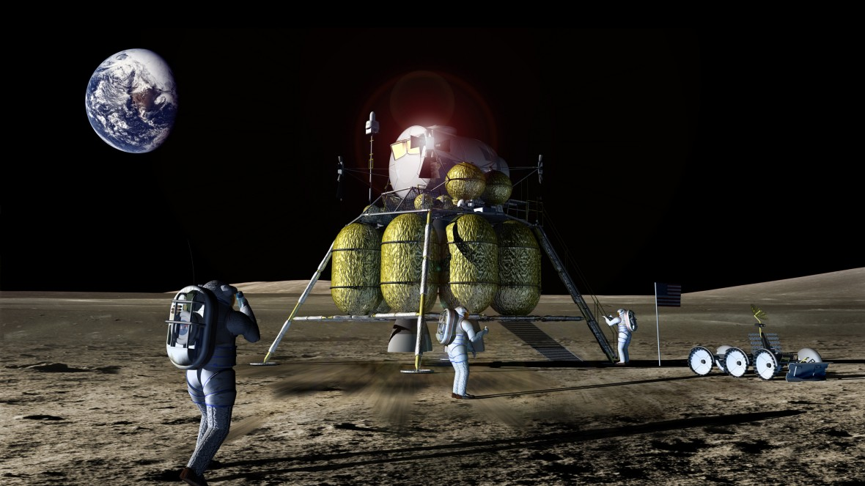




O₂
H₂O
To ECLSS
CO₂
H₂O
Logistical Trash
Urine & Fecal
Waste Collection
Fecal
Biological Waste
Solid Recovery & Recycling
H₂O
Brine
H₂O
Waste Conversion
Water Cleanup
Crop Nutrients
Electrolysis, Fuel Production,
Fuel Depot…
H₂O, Fertilizer
CH₄
CO
CO₂
_{Hydrocarbons}
CO₂
Crop Production
System
Food
Inedible Plant Biomass

Slide 16
O₂
H₂O
To ECLSS
CO₂
H₂O
Urine & Fecal
Logistical Trash
Fecal
Biological Waste
Solid Recovery & Recycling
H₂O
Brine
H₂O
Water Cleanup
Crop Nutrients
Electrolysis, Fuel Production,
Fuel Depot…
H₂O, Fertilizer
CH₄
CO
CO₂
_{Hydrocarbons}
CO₂
Crop Production
System
Food
Inedible Plant Biomass

Slide 17
Concept: Trash Processing & Reuse Systems / Trash-to-Gas+
Have flown sub-scale trash conversion unit. Other units need fundamental research for advancing the circular process.
Logistical Waste
+ Solid waste
Fuels
(Syngas, O₂)
Waste 2 Energy
Fertilizers
Construction/Manufacturing
Raw Materials (i.e. Al)
Gas
Crop Waste (inedible biomass, H₂O, Off-gas)
Waste
Conversion /
Recycling
Trash deflected from Waste Stream
H₂O
Solids
Commodity Supply (if required)
Additive Manufacturing
Chemical Reprocessing
Crop Production/ microbes
Tile Production
5

Slide 18

Resources Available for
Future Mission Scenarios in Trash
850-Day Mars Mission
Mission duration: 850 days
Mission location: Mars
Crew size: 4
Trash production rate: 1.607 kg/CM-d
Trash composition: OSCAR-FS
30-Day Lunar Mission
Mission duration: 30 days
Mission location: Moon
Crew size: 4
Trash production rate: 1.607 kg/CM-d
Trash composition: OSCAR-FS
Resources Available in (Crew Consumable) Waste Stream (kg) | Resources Available in Waste Stream (kg)
Mission Type | Trash Total | Oxygen | Water | Polyethylene | Polyester | Polypropylene | Nylon | Aluminum
850-Day Mars | 5463.8 | 1148.9 | 628.3 | 968.7 | 535.4 | 299.6 | 916.6 | 173.6
30-Day Moon | 192.8 | 40.6 | 22.2 | 34.2 | 18.9 | 10.6 | 32.4 | 6.1
R.Pitts et.al. “Development of a Predictive Model for In-Situ Resource Utilization of Space Exploration Waste”, ASCEND 2023

Slide 19
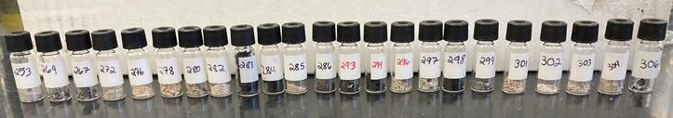
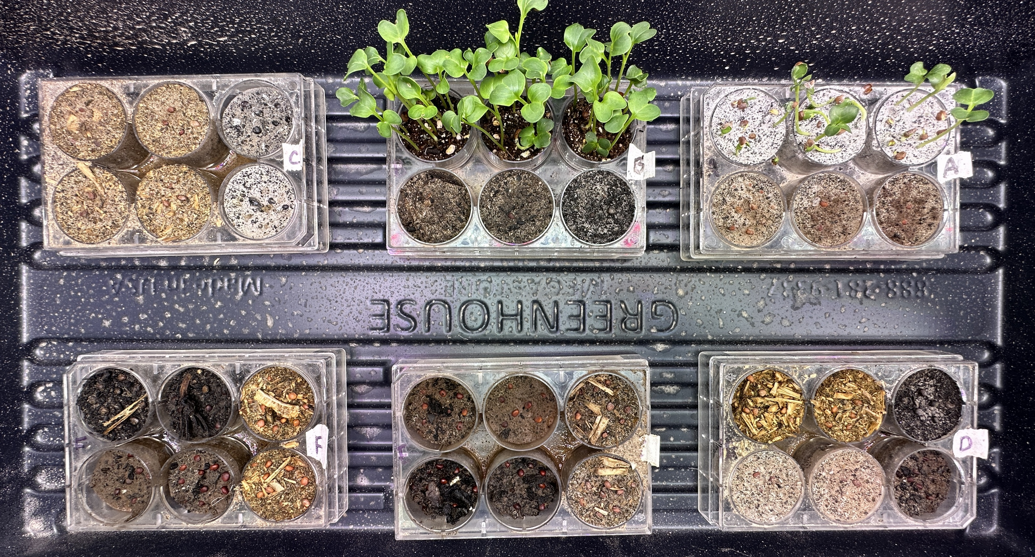
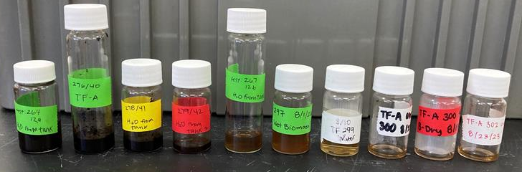
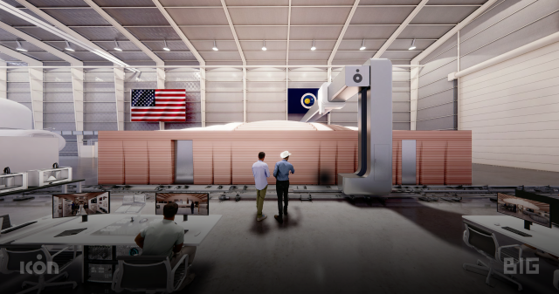
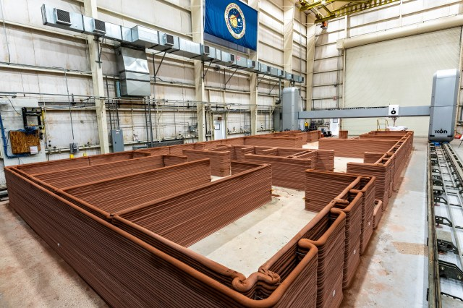
Innovations/Future Focus:
Large scale demonstrations
Integration into crop/LSS
Full Scale OSCAR/ Trash-to-Gas Demonstration
  OSCAR-Full Scale
  crew of 4 on 1 year mission
  ~6.5 kg/day for 30 days demo
  Large reactor to accept 1 kg / batch of trash.
Crop infusion with solids/ash nutrient tuning
Water, ash and gas recovery
Plasma VOC mitigation
High throughput plasma gasification system.
CHAPEA Mars Analog Habitat trash and data collection
Alternative material selection for logistics packaging
Additive manufacturing with polymers or recovered metals from logistics materials/packaging
Pending Publication ICES-2024-288
“Thermal Degradation and Rapid Composting of Inedible Biomass and Logistical Waste for Crop Production and Resource Recovery in Space Applications”

Slide 20
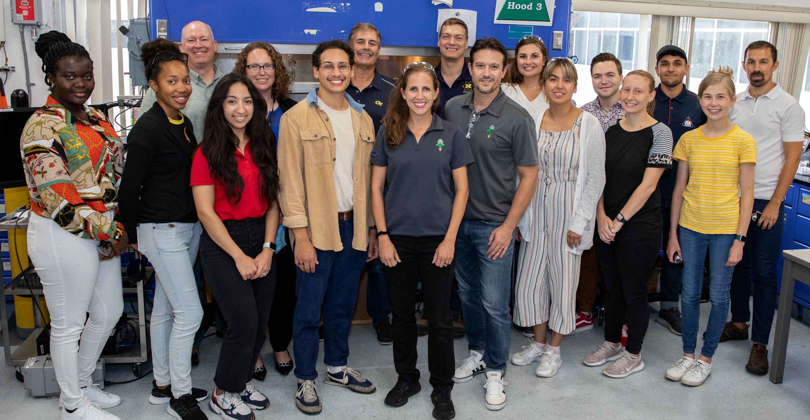

Slide 21
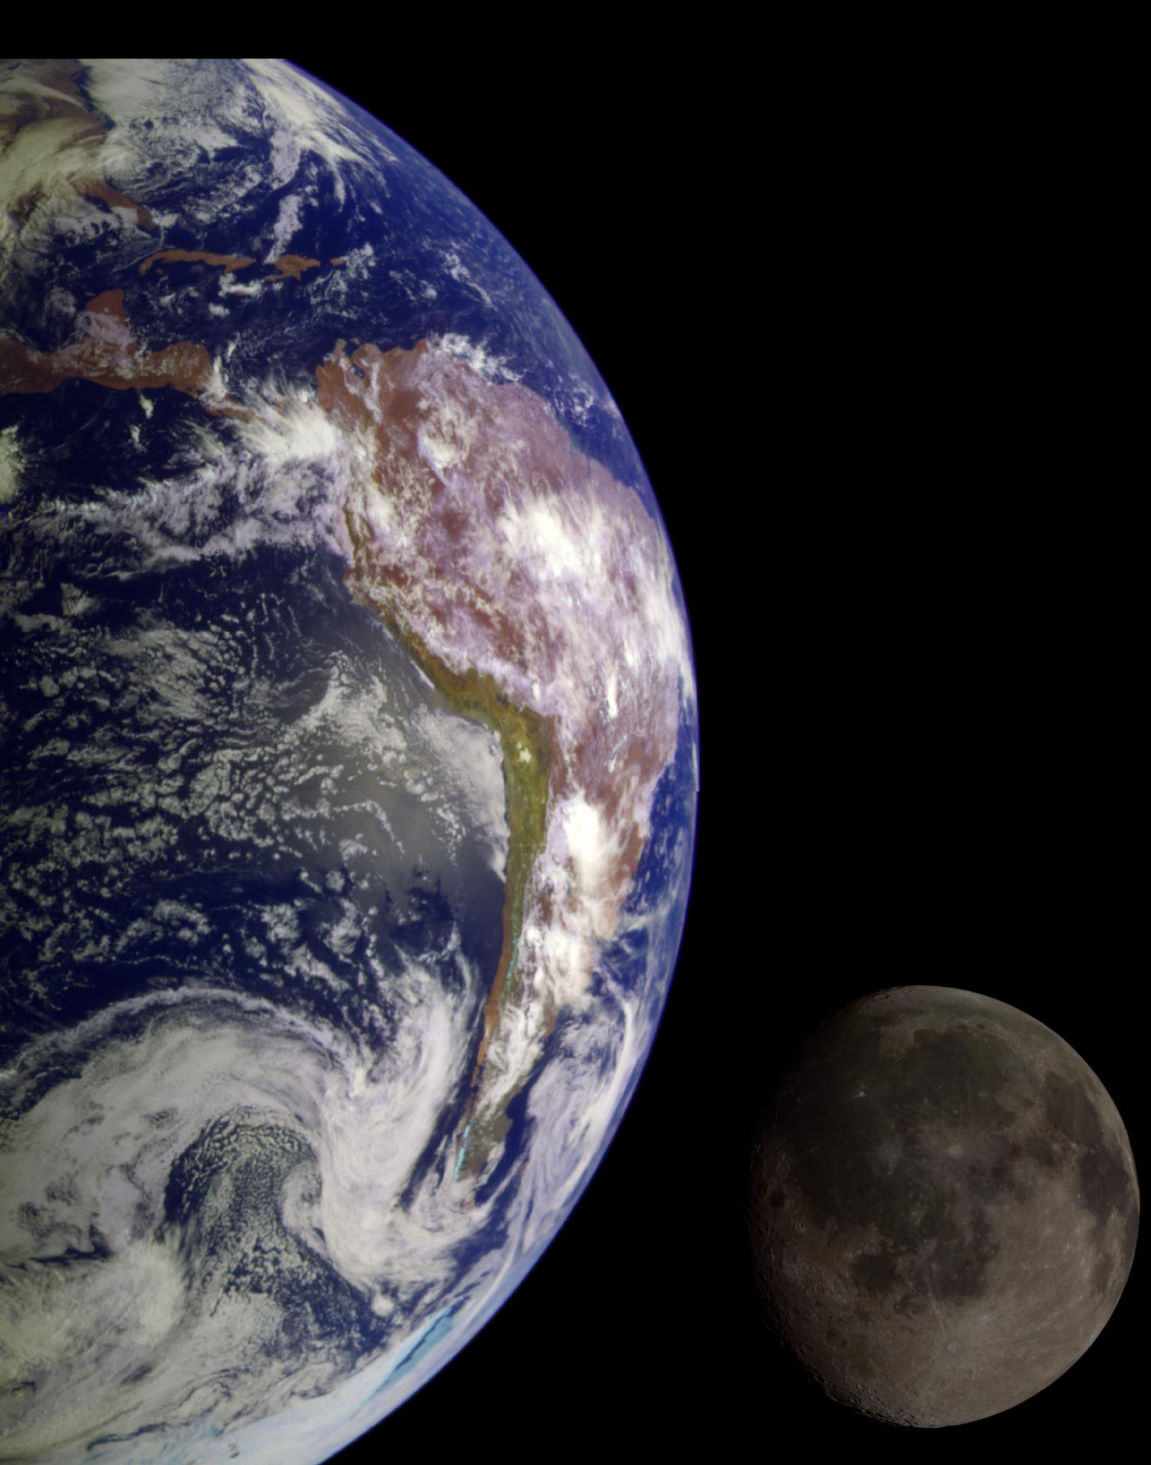
Anne.Meier@nasa.gov

Slide 22

BACKUP SLIDES

Slide 23
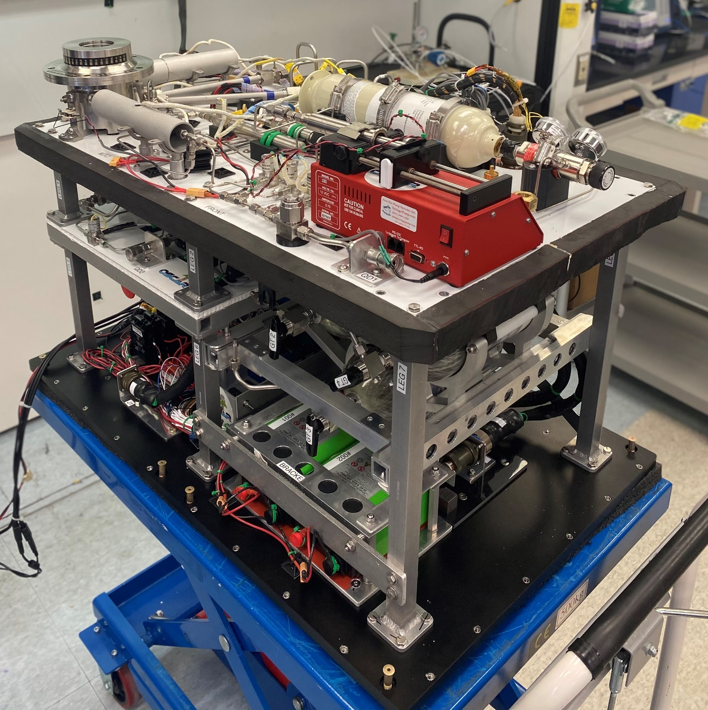
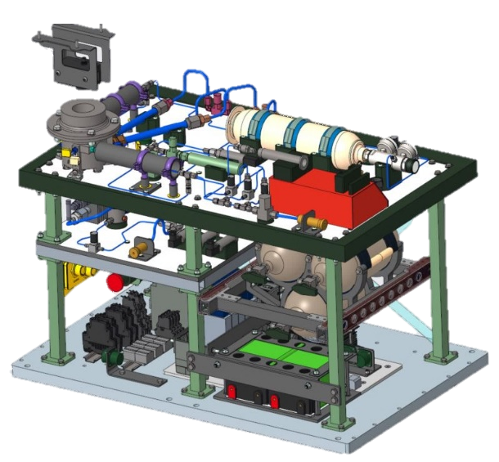
Trash Processing & Reuse Systems / Trash-to-Gas / OSCAR
Camera
Oxidizer Line Heaters
Injection tubes
Reactor
O₂ bottle
Tank3
HX
“OSCAR” (Orbital Syngas Commodity Augmentation reactor) was for suborbital flight subscale demonstration only.
  (15 min flight time with 3 minutes microgravity).
Sub-scale: 10g processed in 3 minutes.
0.5 L reactor w/trash injection tubes
100% O2 feed gas at 1 SLPM
308 kPa / 45 PSIG
Tank1
Tank2
OSCAR Sub-scale System for Suborbital Flight
Notes:
based on combustion data from the OSCAR system long duration ground tests, there will be an estimated 4% of irreducible inorganic ash and solids (in large part from food packing aluminum content). However, if the goal of 90% solid-to-gas conversion efficiency is attained, there may be 0.62 - 0.67 kg/day of solid product remaining, (~570 kg for the mission) for follow on use, or disposal.

Slide 24
Trash-to-Gas systems evaluated Mars transit propellant requirements
TtG System Name, Year of Operational Report | Thermal Process Technology | Total Vehicle Mass | Total Mass Reduction
 |  | (kg) | (kg)
Baseline (Stowage Model) | n.a. | 309,296 | --
NASA Incinerator/Gasifier | Incineration and Gasification | 303,074 | 6,222
(Inc-Gas), 2014 [23]
NASA Plasma Gasification [30] | Plasma-Induced Incineration and Gasification | 303,145 | 6,151
(Plas-Gas), 2019
Advanced Organic Waste Gasifier (AOWG), Pioneer Astronautics, Inc. (developed under NASA SBIR.) 2020 [23] | Oxygen-Enhanced Steam Reforming | 303,391 | 5,905
Orbital Syngas Commodity Augmentation Reactor (OSCAR), 2021 [28], [48] | Oxygen-Enriched Combustion | 303,141 | 6,155
Microwave Assisted Pyrolysis (MAP), (Advanced Fuel Research (AFR) Corporation (developed under NASA SBIR)) 2014 [23] | Microwave-Induced Pyrolysis | 303,430 | 5,866
(Plas-Pyro), 2020 [45] | Plasma-Induced Pyrolysis | 303,511 | 5,785
Torrefaction Processing Unit, (TPU), AFR Corporation (NASA SBIR), 2019 [40] | Torrefaction | 305,597 | 3,699
J. A. Olson, P. Chai, D. Rinderknecht, and A. J. Meier, “A Comparison of Propellant Requirements for Crewed Mars Missions Incorporating Different Waste Processing Technologies,” presented at the ASCEND, Las Vegas, Nevada & Virtual, 2021. doi: 10.2514/6.2021-4080.

Slide 25
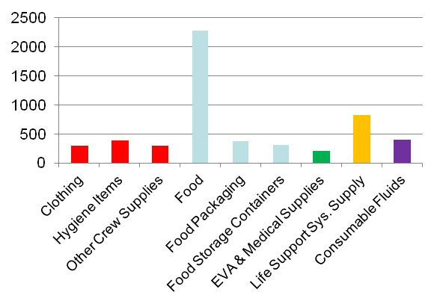
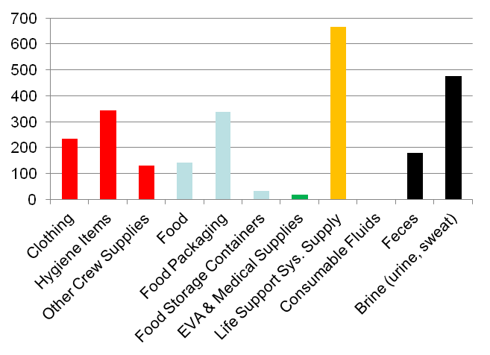
Logistics Waste Model – 1 year, 4 people
Launch Mass (kg)
Waste Mass (kg)
M. K. Ewert and J. L. Broyan, “Mission Benefits Analysis of Logistics Reduction Technologies,” in 43rd International Conference on Environmental Systems, 2013.

Slide 26
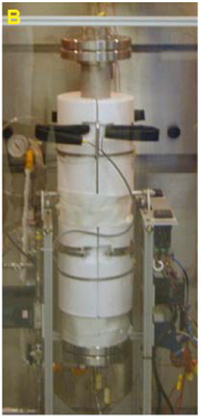
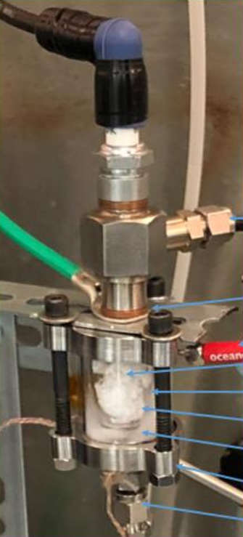
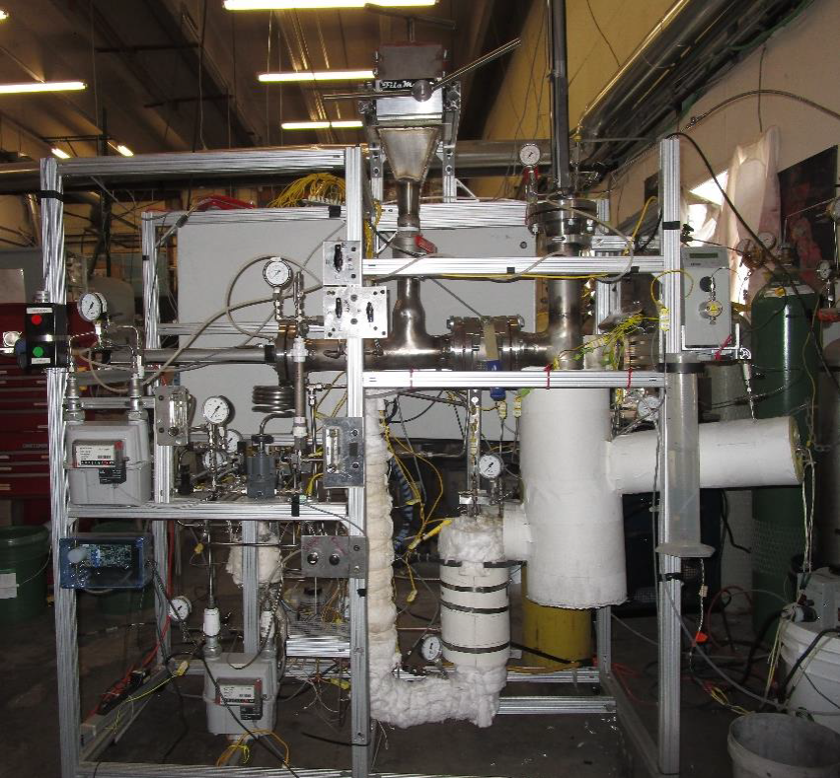

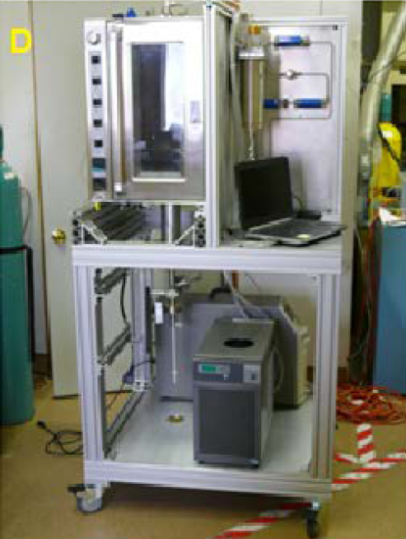
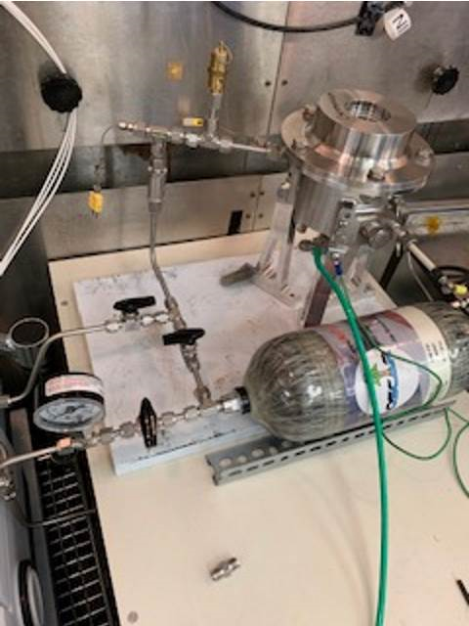
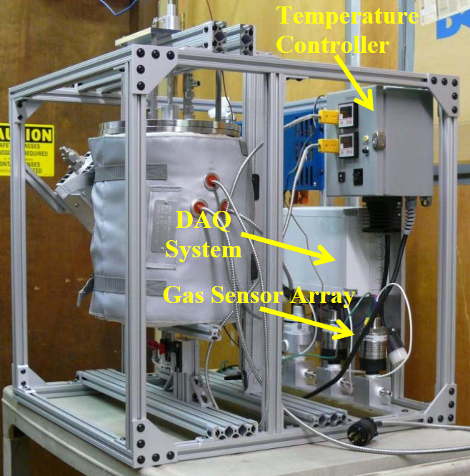
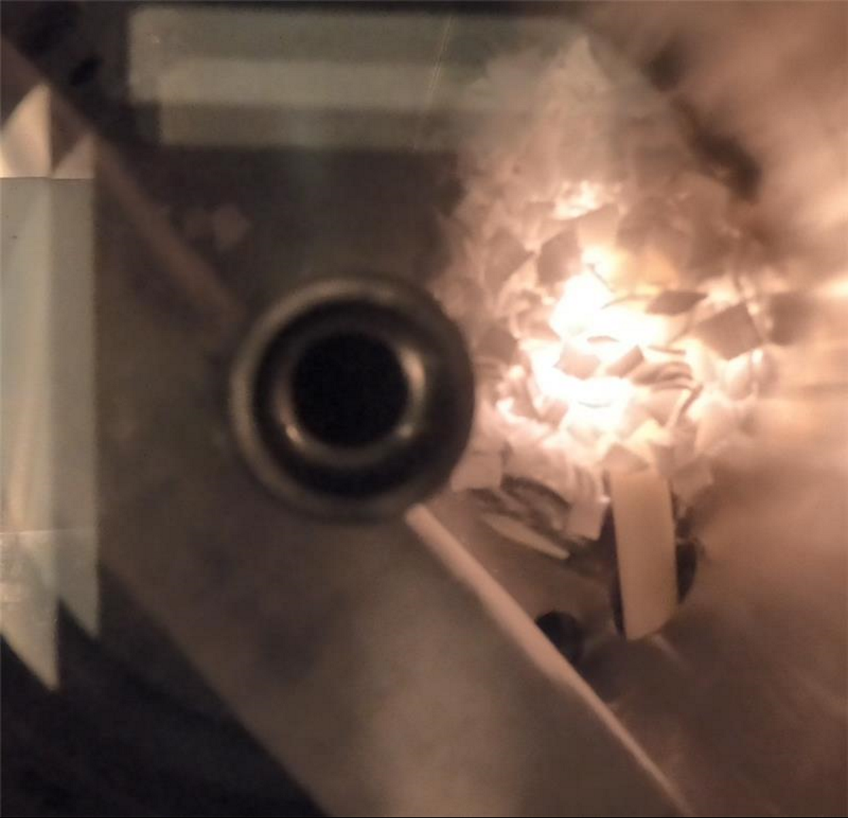
Evaluated Trash-to-Gas Systems evaluated in trade studies from 2020+
(does not include all from 2011-2019)
Incineration/gasification (Inc-Gas; NASA/KSC; Anthony and Hintze, 44th ICES, 2014, 016).
Plasma gasification (Plas-Gas; NASA/KSC).
Advanced Organic Waste Gasifier (AOWG); Pioneer Astronautics, Inc.).
Orbital Syngas Commodity Augmentation Reactor (OSCAR; NASA/KSC).
Microwave Assisted Pyrolysis (MAP; Advanced Fuel Research Corporation).
Plasma Pyrolysis (Plas-Pyro; NASA/KSC).
Torrefaction Processing Unit (TPU; Advanced Fuel Research Corporation).
Olson, J.; Rinderknecht, D.; Essumang, D.; Kruger, M.; Golman, C.; Norvell, A.; Meier, A. A Comparison of Potential Trash-to-Gas Waste Processing Systems for Long-Term Crewed Spaceflight. 2021.

Slide 27
Trash to Supply Gas – General Sys. Analysis
Waste Volume Reduction: 19 m³
  Equivalent to pressurized volume of one Orion Spacecraft.
Enough delta-V for yearly station keeping at Earth-Moon Lagrange point.
Production:
  ~800 kg of O_{2 ,}~900 kg of H₂O, 1,100 kg of CO₂
  ~800 to 1500 kg of CH₄/yr
Lunar:
    Enough to send one 200 kg payload from L2 to lunar surface each year.
Mars:
  Course Corrections (depending on spacecraft size).
C is limiting reagent.
If CO₂ used for CH₄ production → need a H₂ source.
Notes:
Steam reforming is considered the strongest technology for both TtSG and TtG scenarios, due to its high throughput, and complete conversion of carbon to product gases
Incineration/gasification is considered the second strongest technology for the TtSG scenario due to its high conversion of carbon to product gases
Pyrolysis is considered the second strongest technology for the TtG scenario due to its high throughput, water production rate, and trash volume reduction by producing char instead of product gases

Slide 28
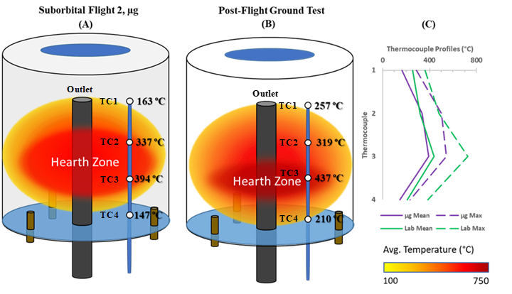
Results – Temperature
More efficient heat transfer in lab
Warmer TC2 due to torch behavior
Trash floating
Lab temperatures warmer overall
Notes:
To further detail the reactor temperature relationship, this figure shows the average temperature values for each of the four measurements in Flight 2 and analogous lab tests. The only temperature measurement that was determined to be warmer in microgravity was TC2 which was located on the plane of the oxygen ports where the flame torches were observed. The hearth zone, or the location where the majority of the combustion activity is taking place, is slightly different in microgravity compared to in the lab. This is largely influenced by the floating nature of trash in microgravity which is not subjected to the downwards gravitational force. Overall, temperatures in the lab were observed to be higher and with a smaller slope between temperature measurements which suggests more efficient heat transfer due to the presence of natural convection. Nonetheless, the thermal profiles are fairly comparable between the two environments which helps us conclude that the forced convective mixing that was performed during the microgravity experiments was successful in mixing the fuel and oxidizer.

Slide 29
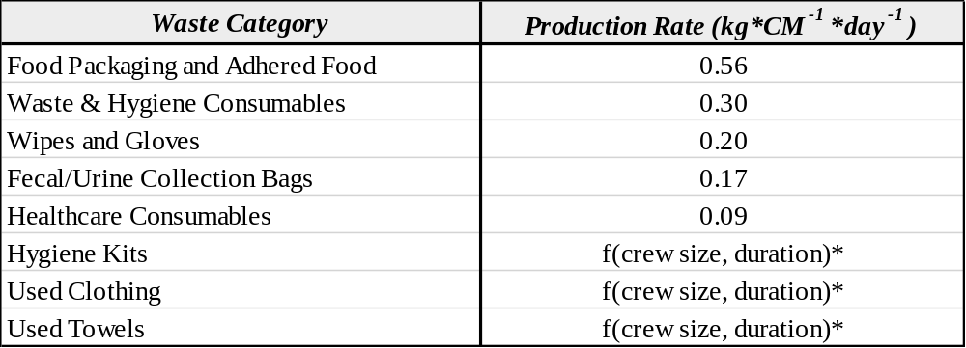
Expected Trash Production Rate for Exploration
6.4 kg/day of trash
Crew of 4
TOP DOWN
Estimate production rates of each high-level waste category (refer to “Logistics Rates and Assumptions for Future Human Spaceflight Beyond LEO” (AIAA Control ID: 3907708)
Notes:
* Hygiene kits, clothing, and towel waste productions vary per item and are a function of crew size and mission duration. Refer to the ELPG for discrete production rates for each item type.
Notes:
From Ray’s AICHE presentation 2023

Slide 30
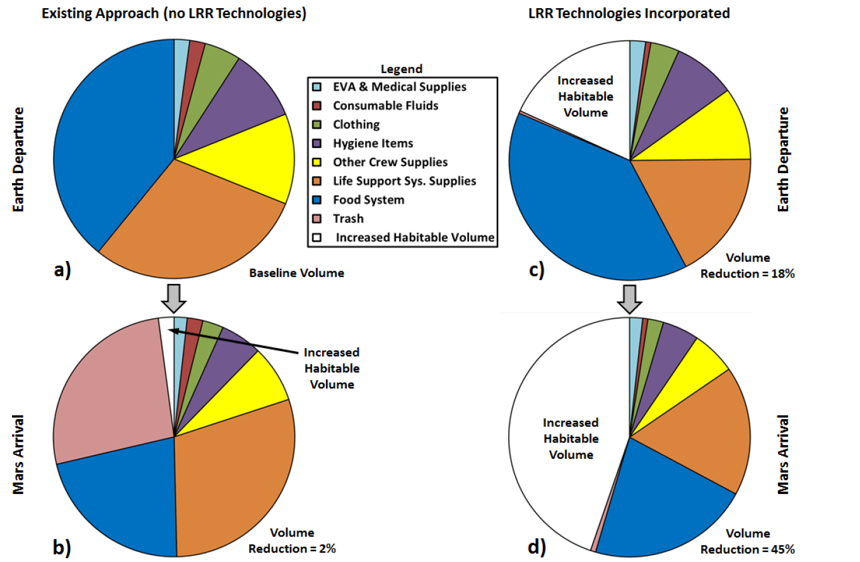
Logistics Reduction Mission Impacts - Volume
Trash
Life Support
Food
J. L. Broyan, et. Al, “Logistics reduction technologies for exploration missions,” presented at the AIAA SPACE 2014.
Notes:
Other Ideas w.Trash @ NASA.
impregnate regolith
feed mechanism
change food packaging
Bulk
Commercialization opportunities

Slide 31
Other papers for data on waste processing for space applications:
McKinley, M. K., Ewert, M. K., Borrego, M. A., Orndoff, E., Fink, P., Sepka, S., Richardson, J., and Meier, A. Advancements in Logistics Reduction for Exploration Missions. Presented at the 52nd International Conference on Environmental Systems, Calgary, Canada, 2023.
Olson, J. A., Chai, P., Rinderknecht, D., and Meier, A. J. A Comparison of Propellant Requirements for Crewed Mars Missions Incorporating Different Waste Processing Technologies. Presented at the ASCEND, Las Vegas, Nevada & Virtual, 2021.
Olson, J., Rinderknecht, D., Essumang, D., Kruger, M., Golman, C., Norvell, A., and Meier, A. A Comparison of Potential Trash-to-Gas Waste Processing Systems for Long-Term Crewed Spaceflight. Presented at the 50th International Conference on Environmental Systems, 2021.
Chen, T., et al. Benefits of Trash-to-Gas versus Jettison of Waste via Trash-Lock for Mars Transit. Presented at the 52nd International Conference on Environmental Systems, Calgary, Canada, 2023.
Linne, D. L., Palaszewski, B. A., Gokoglu, S. A., Balasubramaniam, B., Hegde, U. G., and Gallo, C. Waste Management Options for Long-Duration Space Missions: When to Reject, Reuse, or Recycle. Presented at the 7th Symposium on Space Resource Utilization, AIAA SciTech Forum, 2014.
Shah, M. G., Pitts, R. P., Benson, M. A., and Gleeson, J. R. Investigating Waste Preparation Methods for Trash-to-Gas Technologies. Presented at the 51st International Conference on Environmental Systems, St. Paul, Minnesota, USA, 2022.
Meier, A., Rinderknecht, D., Olson, J., Shah, M., Toro Medina, J., Pitts, R., Carro, R., Gleeson, J., Hochstadt, J., Forrester, E., Kruger, M., and Essumang, D. “Pioneering the Approach to Understand a Trash-to-Gas Experiment in a Microgravity Environment.” Gravitational and Space Research, Vol. 9, No. 1, 2021, pp. 68–85. https://doi.org/10.2478/gsr-2021-0006.

