Slide 1

Simulated Multipath Using Software Generated GPS Signals
DATAWorks 2024
Alexandria, VA
April 18th, 2024
Russell Gilabert, Julian Gutierrez, and Evan Dill
NASA Langley Research Center

Slide 2
Outline
Background
Experimental Setup
Results
Conclusions
Future Work

Slide 3


Background
Urban Canyon
GPS works very will in open environments
However, performance can significantly degrade in urban areas
  Buildings block and reflect signals
    Reduced availability
    Multipath
This can be the largest error contributing to GPS performance

Slide 4
Background
GPS 101
Fundamentally, GPS works by multilateration

Slide 5
Background
GPS Correlator
Fundamentally, GPS works by multilateration
Each satellite broadcasts a stream of known Pseudo-Random Numbers (PRN)
Receivers compare this to a local stream to determine the range measurement
Under ideal circumstances, this give a sufficient range estimate*
Broadcast PRN
101101011101000101001110101110101110001010001
Receiver PRN
101101011101000101001110101110101110001010001
11010001010011101011101011
On Time

Slide 6
Background
GPS Correlator
Multipath of the signal skews this measurement
Broadcast PRN
101101011101000101001110101110101110001010001
Bounce 1
101101011101000101001110101110101110001010001
Bounce 2
101101011101000101001110101110101110001010001
On Time

Slide 7
Background
GPS Correlator
Multipath of the signal skews this measurement
The receiver correlates on the composite of the measurements it receives
Varies greatly depending on conditions
Broadcast PRN
101101011101000101001110101110101110001010001
Bounce 1
101101011101000101001110101110101110001010001
Bounce 2
101101011101000101001110101110101110001010001
Receiver PRN
101101011101000101001110101110101110001010001
On Time
Delayed

Slide 8
Background
GPS Simulation
Simulation of multipath using generated signals can:
  Enable testing of receiver multipath resistance
  Gain insight on receiver’s operational limitations and behavior
  Assist in developing multipath mitigating technologies
Commercial GPS simulators exist but:
  Can be expensive
  Offer limited out-of-the-box tuning capabilities
Can cheaper, open-source tools be modified to add this capability?

Slide 9


Experimental Setup
GPS Signal Generation
GPS-SDR-SIM
Open-source command line tool that allows the user to generate GPS signals
  Input: ephemeris (satellite orbits), coordinates
  Output: binary file containing the generated signals
Generates a binary file of simulated RF data that a GPS receiver would see if at that location
Can be played back on a real or software receiver
Modifications
Added the ability to:
  Clone satellite PRN’s
  Delay PRN by variable amount
Simulate composite multipath signal
11010001010011101011101011
On Time
Delayed

Slide 10
Experimental Setup
Devices Under Test
Software
GNSS-SDR
Open-source software to implement software defined GNSS receiver
Can read .bin files of RF data that can be processed in software to generate pseudorange measurements and compute a solution
GNSS
SDR

Slide 11
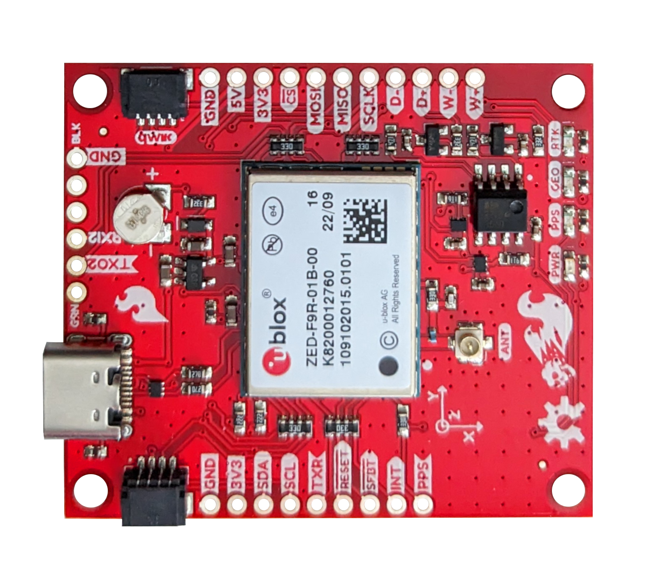
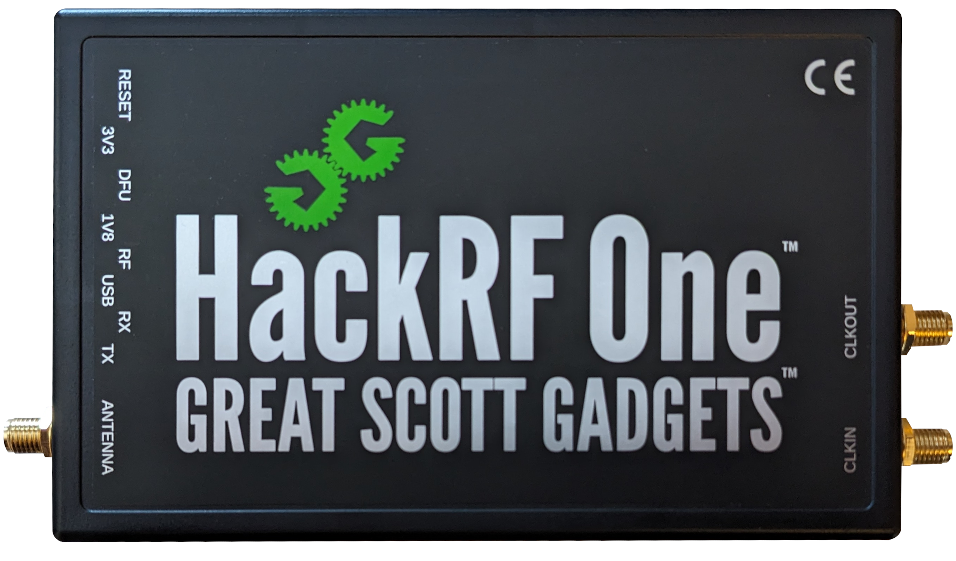
Experimental Setup
Devices Under Test
Software
GNSS-SDR
Open-source software to implement software defined GNSS receiver
Can read .bin files of RF data that can be processed in software to generate pseudorange measurements and compute a solution
Hardware
HackRF One
Software defined radio that can playback the .bin in real-time
u-blox F9R
GNSS receiver that is capable of outputting pseudorange measurements and computing a solution
GNSS
SDR
SparkFun u-blox F9R
HackRF One

Slide 12
Experimental Setup
Test Scenarios
Various scenarios tested to validate the added GPS-SDR-SIM capabilities:
  Delayed signal
  Synchronous signal
  Multipath signal
G01

Slide 13

Experimental Setup
Test Scenarios
Various scenarios tested to validate the added GPS-SDR-SIM capabilities:
  Delayed signal
  Synchronous signal
  Multipath signal
Another satellite was placed in a matching orbit to compare results
G01
G02
On Time
Delayed

Slide 14
Experimental Setup
Test Scenarios
Various scenarios tested to validate the added GPS-SDR-SIM capabilities:
  Delayed signal
  Synchronous signal
  Multipath signal
Another satellite was placed in a matching orbit to compare results
G01/G02
On Time
Delayed
Tested against software GNSS-SDR and physical u-blox F9R receiver

Slide 15
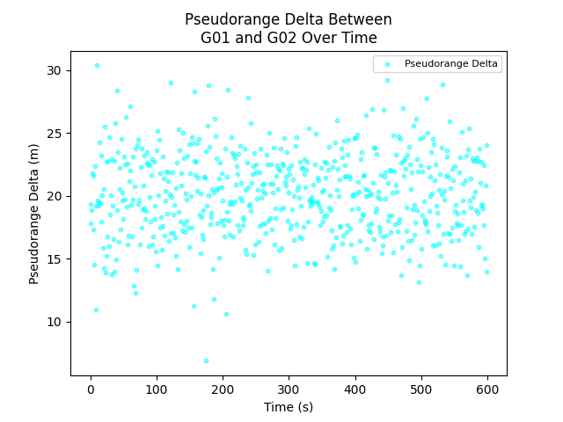

Simulation Results
Delayed Signal (GNSS-SDR)
20m delay on G01
No G01 cloned broadcast
Compared against G02 in same orbit

Slide 16
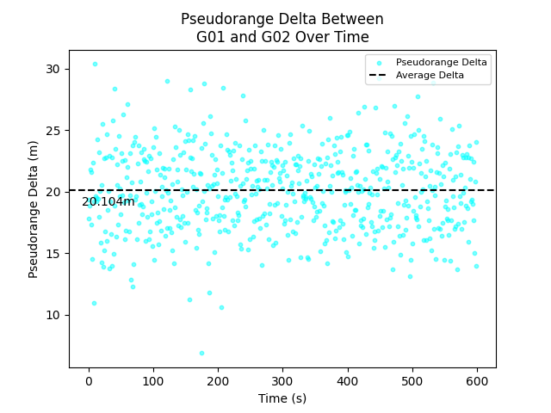
Simulation Results
Delayed Signal (GNSS-SDR)
20m delay on G01
No G01 cloned broadcast
Compared against G02 in same orbit
Average measured delay of 20.104m

Slide 17
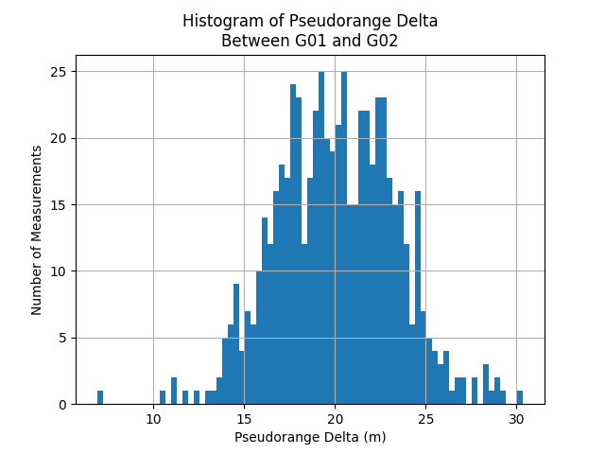
Simulation Results
Delayed Signal (GNSS-SDR)
20m delay on G01
No G01 cloned broadcast
Compared against G02 in same orbit
Average measured delay of 20.104m

Slide 18
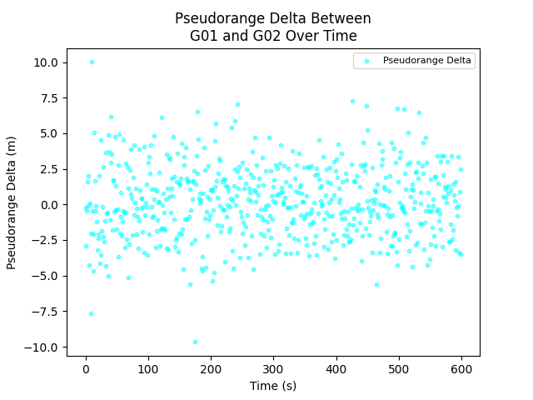

Simulation Results
Synchronized Signal (GNSS-SDR)
0m delay on G01
0m delay on G01 cloned broadcast
Compared against G02 in same orbit

Slide 19
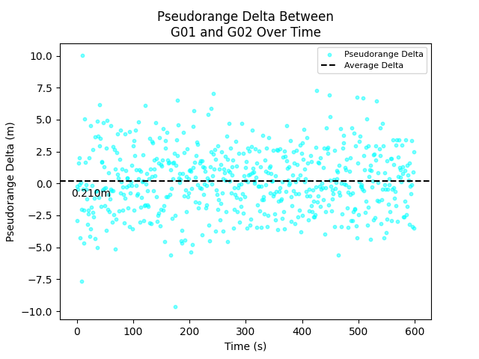
Simulation Results
Synchronized Signal (GNSS-SDR)
0m delay on G01
0m delay on G01 cloned broadcast
Compared against G02 in same orbit
Average measured delay of 0.210m

Slide 20
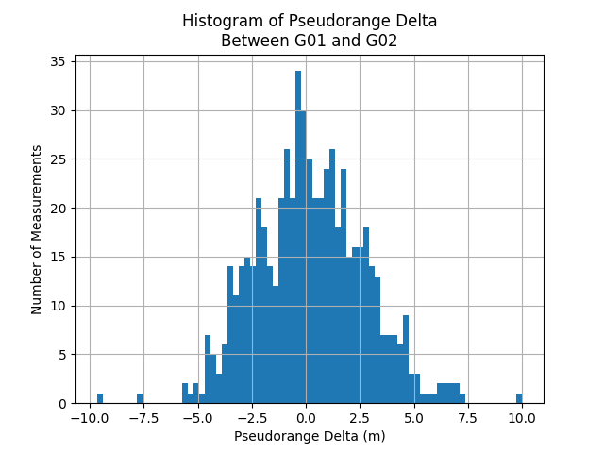
Simulation Results
Synchronized Signal (GNSS-SDR)
0m delay on G01
0m delay on G01 cloned broadcast
Compared against G02 in same orbit
Average measured delay of 0.210m

Slide 21
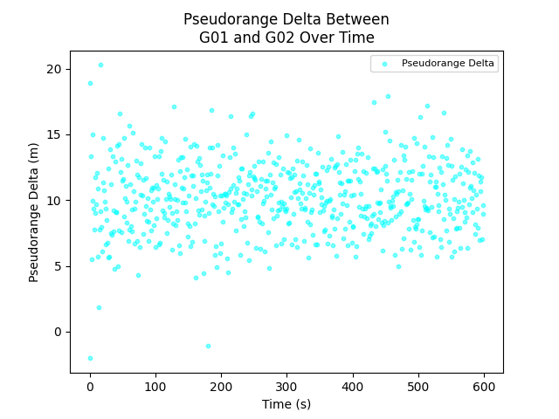

Simulation Results
Multipath Signal (GNSS-SDR)
0m delay set on G01
20m delay on G01 cloned broadcast
Compared against G02 in same orbit

Slide 22
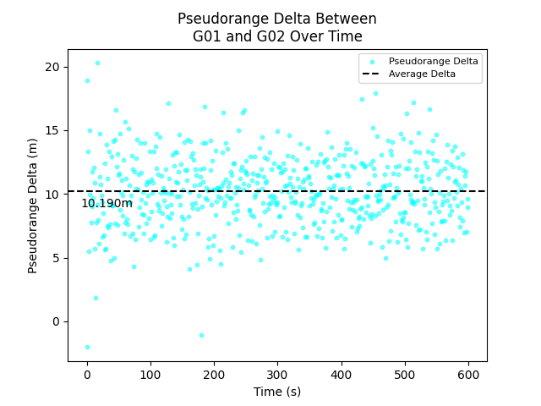
Simulation Results
Multipath Signal (GNSS-SDR)
0m delay set on G01
20m delay on G01 cloned broadcast
Compared against G02 in same orbit
Average measured delay of 10.190m
0m 10m 20m

Slide 23
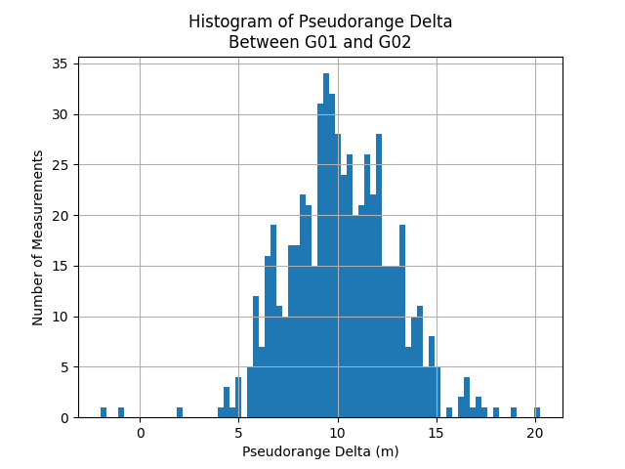
Simulation Results
Multipath Signal (GNSS-SDR)
0m delay set on G01
20m delay on G01 cloned broadcast
Compared against G02 in same orbit
Average measured delay of 10.190m
0m 10m 20m

Slide 24
Experimental Setup
Test Scenarios
Various scenarios tested to validate the added GPS-SDR-SIM capabilities:
Repeat tests in hardware
  Preliminary results!
  More nuance with hardware
G01/G02
  Delayed Signal
  Synchronous Signal
  Multipath Signal
On Time
Delayed
SparkFun u-blox F9R
HackRF One

Slide 25
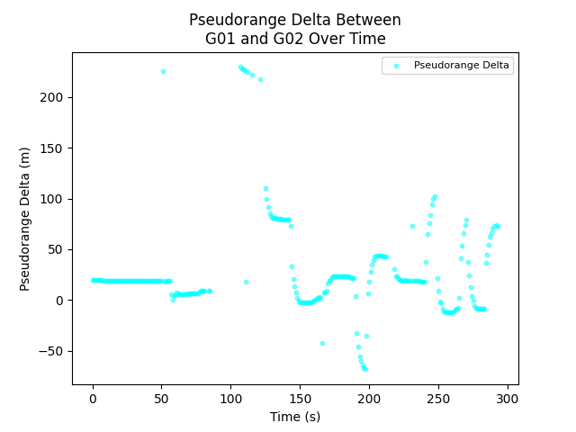
Hardware Results
Delayed Signal (uBlox F9R)
20m delay on G01
No G01 cloned broadcast
Compared against G02 in same orbit
Clock stability issues after 40-60 seconds…
  Limit analysis to the first 30 seconds

Slide 26
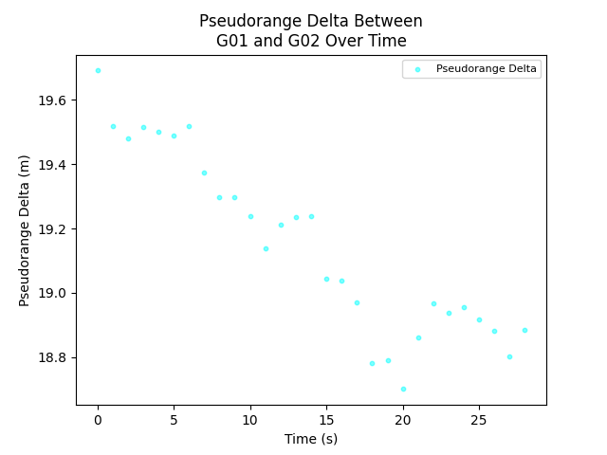
Hardware Results
Delayed Signal (uBlox F9R)
20m delay on G01
No G01 cloned broadcast
Compared against G02 in same orbit

Slide 27
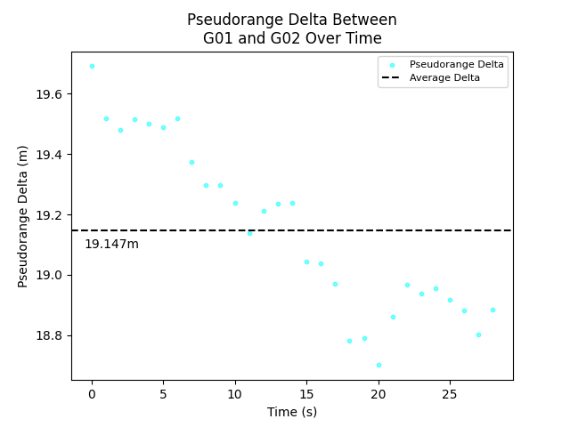
Hardware Results
Delayed Signal (uBlox F9R)
20m delay on G01
No G01 cloned broadcast
Compared against G02 in same orbit
Average measured delay of 19.147m

Slide 28
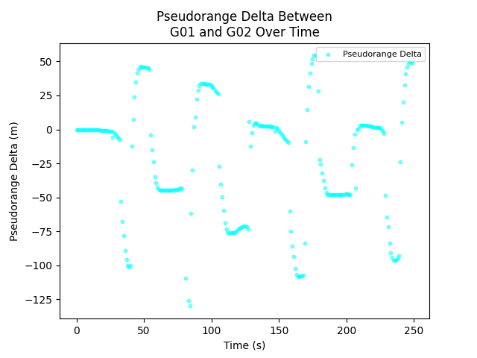
Hardware Results
Synchronized Signal (uBlox F9R)
0m delay on G01
0m delay on G01 cloned broadcast
Compared against G02 in same orbit

Slide 29
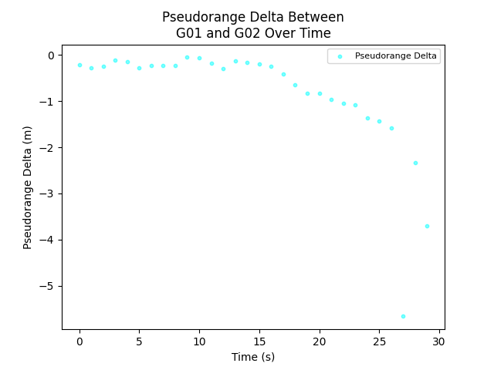
Hardware Results
Synchronized Signal (uBlox F9R)
0m delay on G01
0m delay on G01 cloned broadcast
Compared against G02 in same orbit

Slide 30
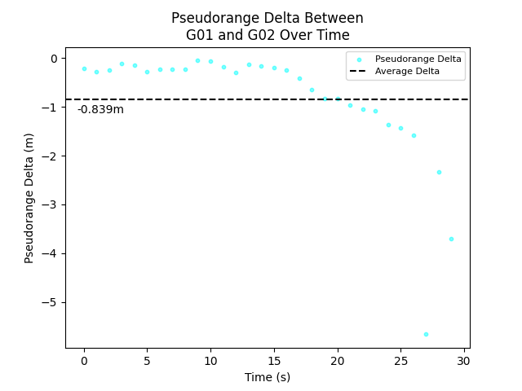
Hardware Results
Synchronized Signal (uBlox F9R)
0m delay on G01
0m delay on G01 cloned broadcast
Compared against G02 in same orbit
Average measured delay of -0.839m

Slide 31
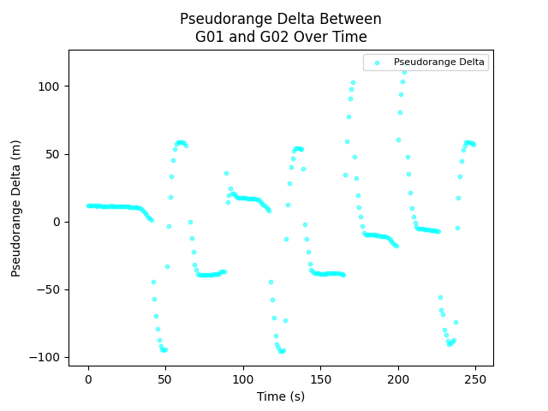
Hardware Results
Multipath Signal (uBlox F9R)
0m delay set on G01
20m delay on G01 cloned broadcast
Compared against G02 in same orbit

Slide 32
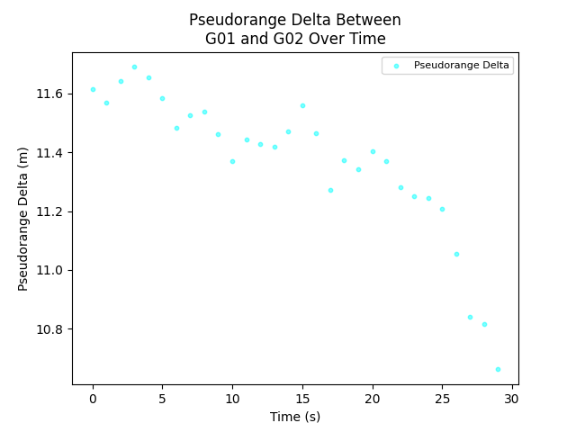
Hardware Results
Multipath Signal (uBlox F9R)
0m delay set on G01
20m delay on G01 cloned broadcast
Compared against G02 in same orbit

Slide 33
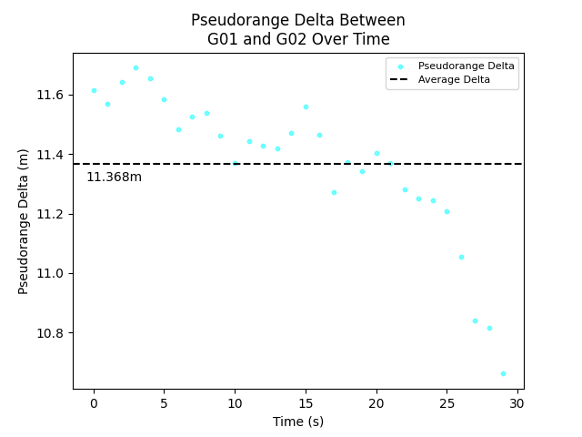
Hardware Results
Multipath Signal (uBlox F9R)
0m delay set on G01
20m delay on G01 cloned broadcast
Compared against G02 in same orbit
Average measured delay of 11.368m

Slide 34
Hardware Results
Multipath Signal (uBlox F9R)
0m delay set on G01
20m delay on G01 cloned broadcast
Compared against G02 in same orbit
Average measured delay of 11.368m
0m 10m 20m

Slide 35
Conclusions and Future Work
Conclusions
The modifications to GPS-SDR-SIM appear to be successful
Can duplicate PRN’s and add arbitrary bias
Simulation confirms the proof of concept
Hardware results show that the PRN signals produced are functional
  There appears to be clock stability issues
  The beginning of the playback seems to reproduce the simulation results
Future Work
Explore and implement methods for achieving better clock stability on the HackRF
Reassess the hardware performance
Evaluate the behavior of the receivers under various multipath conditions
G01/G02

Slide 36
Thanks!
Any questions?

