Slide 1

A Hybrid CFD/Engineering Model Tool for Lunar Lander Surface Erosion Prediction
Andrew Weaver, Thomas Shurtz, Peter Liever, Tim Dawson, Jason Howison
Jacobs Space Exploration Group
NASA Marshall Space Flight Center, Huntsville, Alabama
Jeffrey West
NASA Marshall Space Flight Center, Huntsville, Alabama
ASCE Earth and Space Conference
April 15-18, 2024

Slide 2
Outline
Introduction
Descent Interpolated Gas Granular Erosion Model (DIGGEM) engineering model tool for viscous erosion
Computational Fluid Dynamics (CFD) tool for plume flowfield
Time compression modeling approach to model vehicle descent
Demonstration on Apollo 12 Lunar Module (LM) Landing
Conclusions

Slide 3
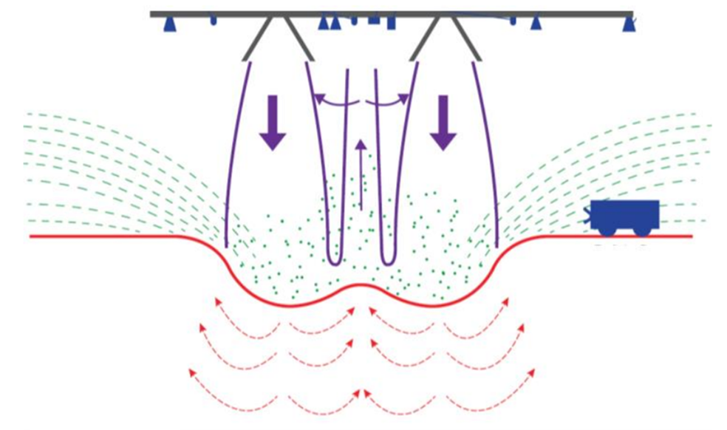
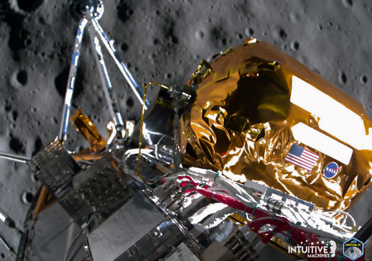
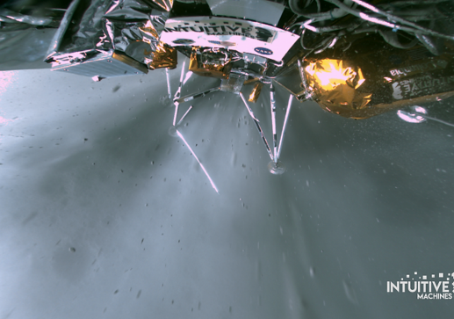
Introduction
Plume surface interaction (PSI) induced environments pose several risks to future Lunar and Martian landers:
  Forming a crater below the lander – potentially causing excessive tilting of the lander
  Obscuring view of Lunar surface below lander
  Eroding surface, potentially causing high-speed ejecta/debris impacts to the vehicle and/or nearby assets
Illustration of PSI Induced Environment (Credit: West et al. 2022)
IM-1 landing At ~30m Altitude and at TouchDown
(Credit: Intuitive Machines)
Need the capability to predict the PSI induced environment to address and mitigate its risks to landers, crew, assets, and landing missions in a timely manner

Slide 4
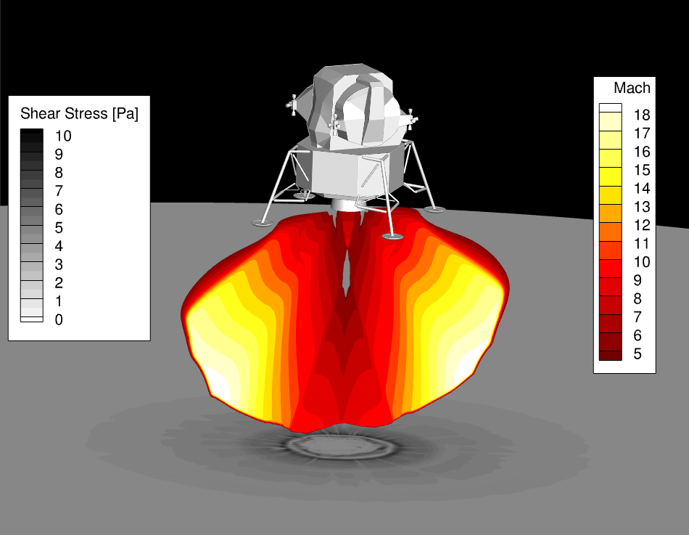
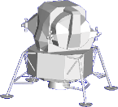
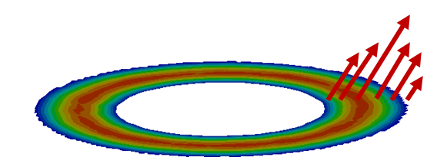
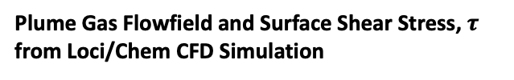


Background on Hybrid CFD/Engineering Model Tool Development
A cascade of PSI predictive simulation tools has been developed by the Fluid Dynamics Branch at NASA Marshall Space Flight Center, e. g.:
  Gas-Granular Flow Solver (GGFS): high-fidelity multi-phase flow tool that simulates plume gas interaction with granular media (regolith)
  Descent Interpolated Gas Granular Erosion Model (DIGGEM): Engineering model for viscous shear erosion cratering regime
  Loci/Chem-DIGGEM – Hybrid CFD/Engineering model tool that couples simulation of the plume gas flowfield and modeling of viscous shear erosion from impinging plume
Focus of this presentation
Plume Gas Flowfield and Surface Shear Stress, $τ$
from Loci/Chem CFD Simulation
Erosion from DIGGEM Engineering Model
Spatially varying mass flux
Based on shear stress, $τ$
Fully-Coupling Loci/Chem + DIGGEM
$${\dot{m”}}_{erosion}=f(τ)$$

Slide 5
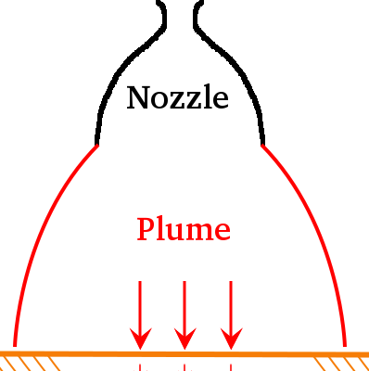
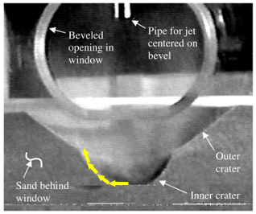
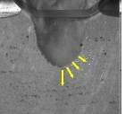
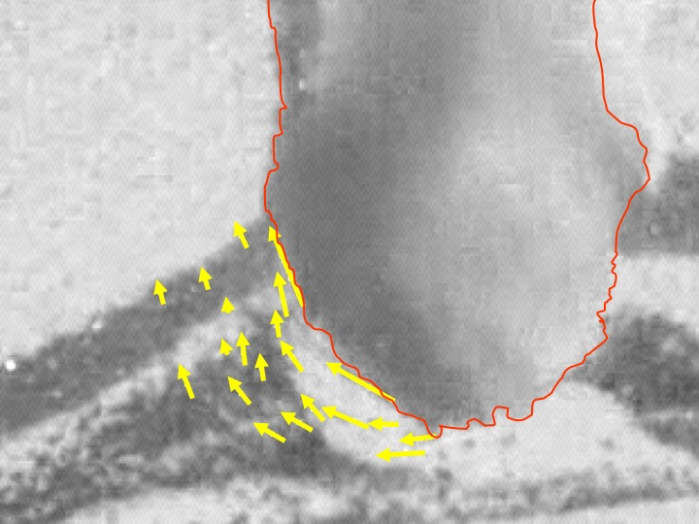
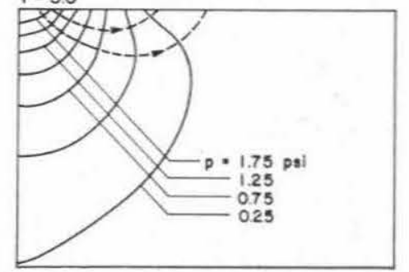
Background on DIGGEM Engineering Model: Viscous Shear Erosion Regime
Multiple different PSI cratering regimes have been identified previously¹⁻⁴ and are shown below (not exhaustive)
Viscous shear erosion (VSE) is shear stress driven
Bearing capacity failure, diffusion driven flow, and diffused gas eruption are all pressure driven
DIGGEM is formulated assuming cratering in the VSE regime
  Expect VSE to dominate at higher altitudes during landing (scouring of surface rather than deep cratering)
  VSE observed from erosion streaks in Apollo LM landing imagery
DIGGEM Model Assumption
Away from crater/after shut-down
Regolith Surface
Pressure Gradient Becomes Positive
Only Top Layer Eroded
Viscous Shear Erosion¹
Bearing Capacity Failure²
Diffusion Driven Flow³
Diffused Gas Eruption⁴

Slide 6
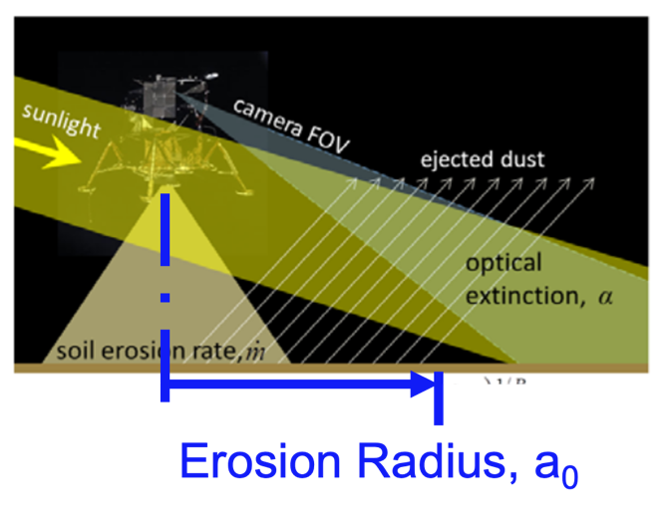
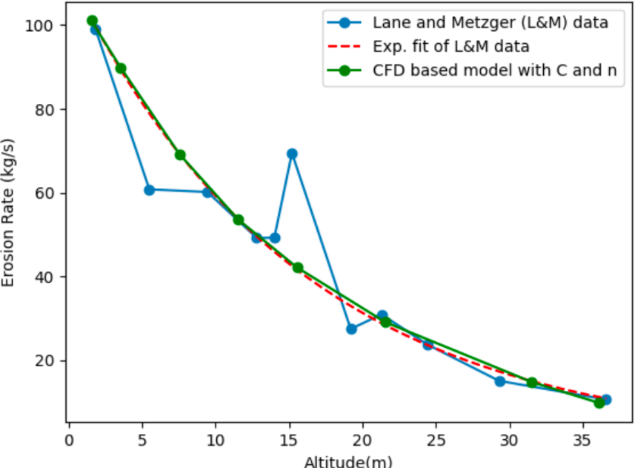
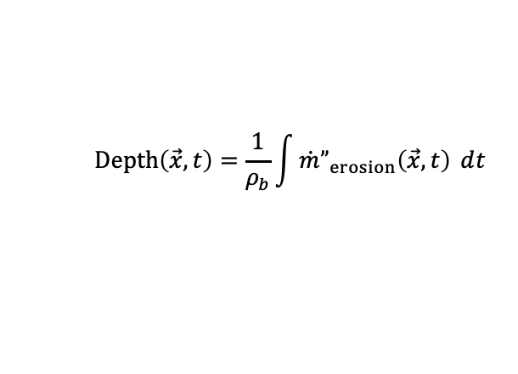
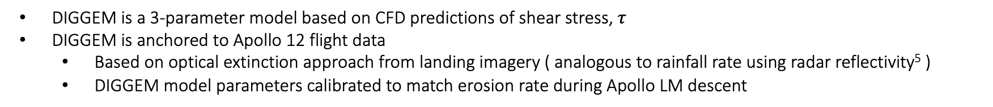


Background on DIGGEM Engineering Model
DIGGEM is a 3-parameter model based on CFD predictions of shear stress, $τ$
DIGGEM is anchored to Apollo 12 flight data
  Based on optical extinction approach from landing imagery ( analogous to rainfall rate using radar reflectivity⁵ )
  DIGGEM model parameters calibrated to match erosion rate during Apollo LM descent
Illustration of Optical Extinction Method for Apollo 12 (Credit: Lane and Metzger 2015⁵)
Calibration of DIGGEM Model Parameters to Apollo 12 Flight Data
DIGGEM Model:
$$\dot{m}”_{erosion}(\vec{x},t)=C{\left(τ(\vec{x},t)−τ_{c}\right)}^{n}$$
$$Model Parameters: C, τ_{c}, n$$
Evolving Crater Profile from Mass Flux Integration:
  $$Depth\left(\vec{x},t\right)=\frac{1}{ρ_{b}}\int{\dot{m}”_{erosion}\left(\vec{x},t\right) ⅆt}$$
Need predictions of shear stress to evaluate erosion mass flux – use CFD

Slide 7
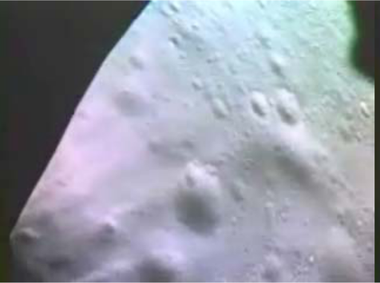
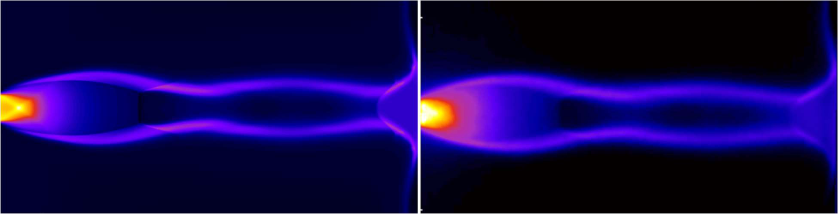
Background on Loci/Chem for Plume Flowfield
Loci/Chem is a validated tool to predict the plume flowfield and plume impingement pressure and shear stress that drive PSI-induced cratering (see left image below)
Validated Loci/Chem computational fluid dynamics (CFD) tool predicts the time-accurate plume flowfield Lunar surface impingement environment (see bottom right image)
Streaks of Eroded Regolith from Apollo LM (Credit: Metzger et al. 2010⁷)
Comparison of impinging plume between CFD (left) and experimental Planar Laser Induced Fluorescence (right) (Credit: Shurtz and West 2022⁶)
Apollo LM Plume Impingement Shear Stress
Couple Loci/Chem with DIGGEM to predict evolving plume and cratering simultaneously

Slide 8
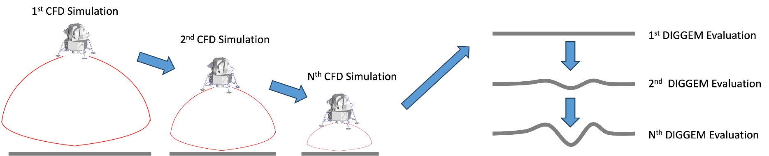
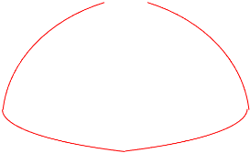
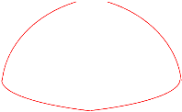
Coupling Loci/Chem with DIGGEM
DIGGEM model initially implemented with loose coupling with Loci/Chem – a serial process of:
  Simulating plume gas flow at discrete vehicle altitudes and a fixed Lunar surface geometry, then
  Modeling erosion mass flux at each altitude and interpolating shear stresses between CFD solutions
  Integrating DIGGEM erosion mass fluxes over descent duration to obtain evolving crater profile
Evolving crater profile from DIGGEM mass flux
CFD
Now Loci/Chem-DIGGEM is fully coupled between Loci/Chem and DIGGEM model for simultaneous plume and cratering predictions
Fully coupled Loci/Chem-DIGGEM process each simulation timestep
DIGGEM
DIGGEM
CFD

Slide 9
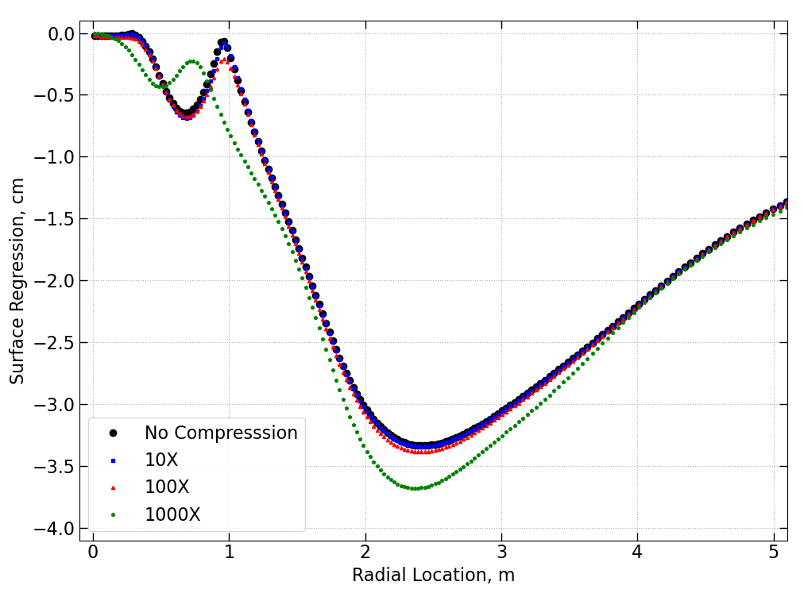
Time Compression
Fully-coupled Loci/Chem-DIGGEM simulation of a descending vehicle is still expensive – would require millions of timesteps to simulate tens of seconds needed for a descent simulation
Separation of dynamical time scales can be used to expedite the coupled CFD/engineering model simulations
  Plume gas flow: Order 10 microseconds
  Soil erosion: Order seconds
Model vehicle descending at a faster rate (time compression) due to significant separation of time scales
Time compression approach verified on an axisymmetric test case
~5 orders of magnitude difference in time scales
Sensitivity of Cratering to Amount of Time Compression Used
Axisymmetric test case demonstrates potential for significant computational savings (100x solution is approx. same as no compression)

Slide 10
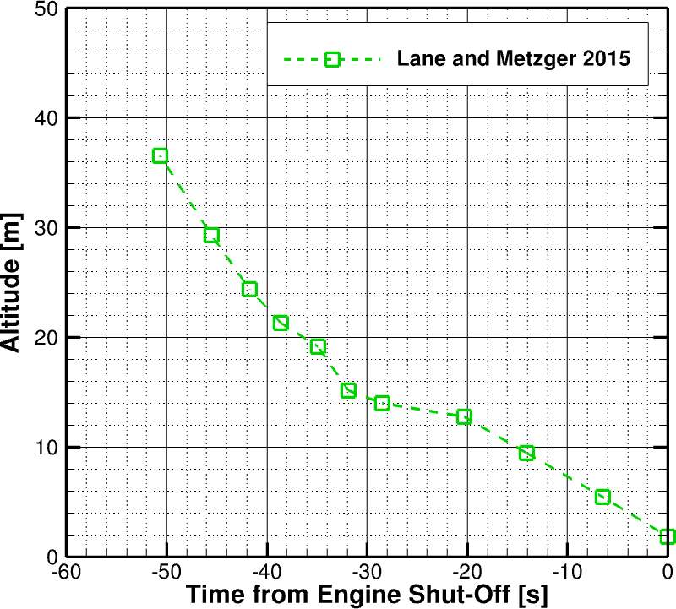
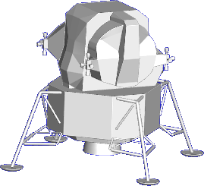
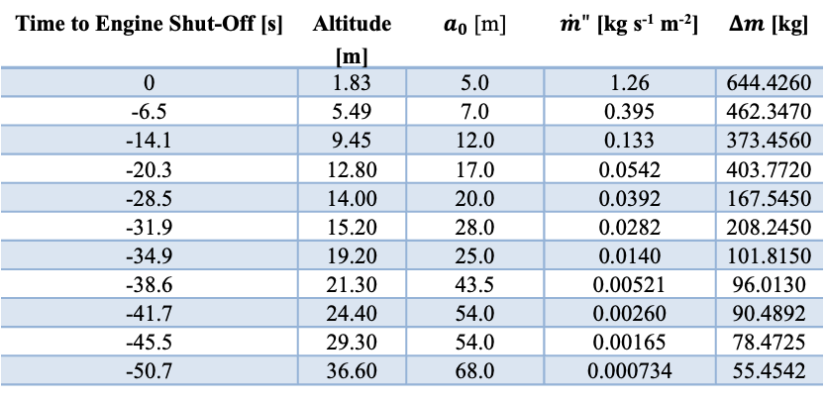
Apollo 12 LM Descent Details
Demonstrating fully-coupled Loci/Chem-DIGGEM simulation of Apollo 12 LM during descent
Using Apollo LM descent rates and altitudes based on cockpit voice recording of altitude⁵
Note the slower descent rates nearer to the Lunar surface, which allows more time for erosion at altitudes where erosion rates are higher
Lunar Soil Erosion Flux as a Function of Altitude for Apollo 12 LM (Lane & Metzger⁵)
Apollo 12 Descent Trajectory
Time to Engine Shut-Off [s] | Altitude [m] | $a_{0}$ [m] | $\dot{m}"$ [kg s⁻¹ m⁻²] | $Δm$ [kg]
0 | 1.83 | 5.0 | 1.26 | 644.4260
-6.5 | 5.49 | 7.0 | 0.395 | 462.3470
-14.1 | 9.45 | 12.0 | 0.133 | 373.4560
-20.3 | 12.80 | 17.0 | 0.0542 | 403.7720
-28.5 | 14.00 | 20.0 | 0.0392 | 167.5450
-31.9 | 15.20 | 28.0 | 0.0282 | 208.2450
-34.9 | 19.20 | 25.0 | 0.0140 | 101.8150
-38.6 | 21.30 | 43.5 | 0.00521 | 96.0130
-41.7 | 24.40 | 54.0 | 0.00260 | 90.4892
-45.5 | 29.30 | 54.0 | 0.00165 | 78.4725
-50.7 | 36.60 | 68.0 | 0.000734 | 55.4542
Modeled Apollo 12 LM Geometry
~1.4 m/s Descent
~0.6 m/s Descent

Slide 11
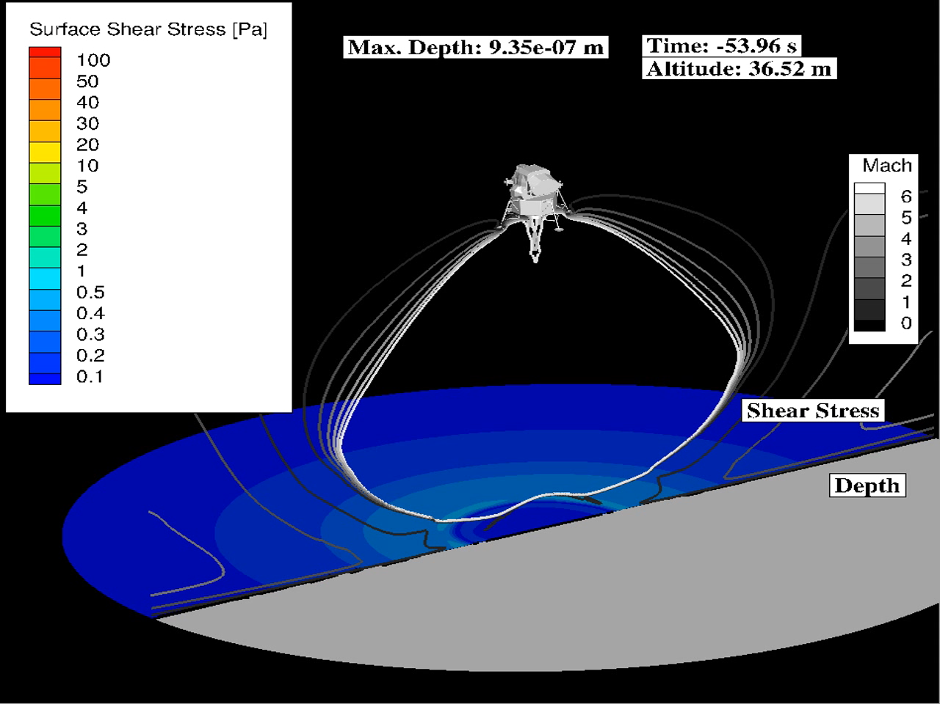
Apollo 12 LM Simulation with Loci/Chem-DIGGEM
Shown below is animation of Apollo LM descent with contours of Mach number, surface shear stress, and crater depth
At higher altitudes, plume expands more before impinging on Lunar surface
This explains the observed shrinking plume footprint and increasing shear stress as the vehicle descends
Most of the cratering occurs below 15 m altitude, as vehicle slows and erosion increases from increased shear stress
Ripples in the plume are observed as vehicle descends
  Originate from unsteady nature of plume/surface interaction now captured with fully coupled simulation
  See more details on next chart
Capturing coupled plume/cratering effects in prediction of viscous shear erosion during descent with practical resources

Slide 12
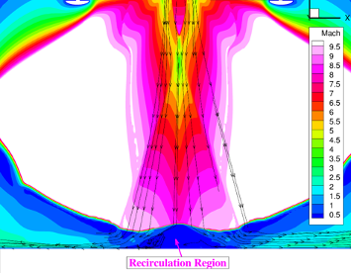
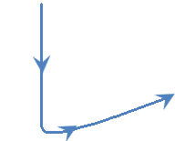
Apollo 12 LM Simulation: Coupled Plume/Cratering Effects
Fully-coupled approach of Loci/Chem-DIGGEM allows for continual feedback between the plume and evolving Lunar terrain
Bottom left image shows plume streamlines as ripples appear in animation
Images at right illustrate the coupled plume/surface effects more clearly
Illustration of Coupled Plume/Surface Effects
Plume Gas Streamlines Impinging on Evolving Lunar Terrain from Loci/Chem-DIGGEM Simulation
Schematic Plume Gas Streamlines (Initial)
Schematic Plume Gas Streamlines (After Cratering)
Rocket Nozzle
Rocket Nozzle
Unsteadiness of plume/surface interaction w/recirculating plume gases beneath vehicle leads to observed ripples
Coupling plume/cratering is especially important as crater grows in size (refer to diagrams at right)

Slide 13
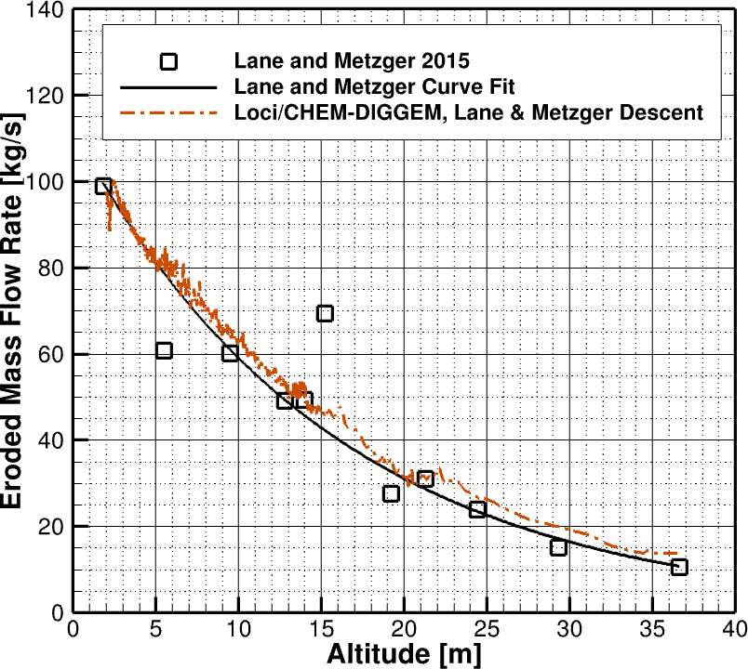
Apollo 12 LM Simulation: Erosion Rate
Erosion rate is obtained from the simulation through integration of DIGGEM model erosion mass flux over the Lunar surface
Simulated erosion mass flow rate is compared with flight data⁵ as a function of altitude below
Comparison of Erosion Rate from Loci/Chem-DIGGEM w/Calibration Data from Lane and Metzger⁵
DIGGEM model is calibrated to the Lane and Metzger curve fit
Comparison at left verifies that the calibration holds for the coupled Loci/Chem-DIGGEM tool
  Erosion rate within 30% of curve fit overall
  Erosion rate within 16% of curve fit below 15 m altitude where most of the erosion occurs
Verified that the DIGGEM model parameters remain valid with the newly developed, fully coupled approach

Slide 14
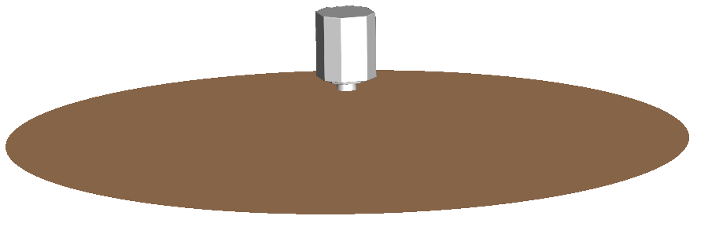
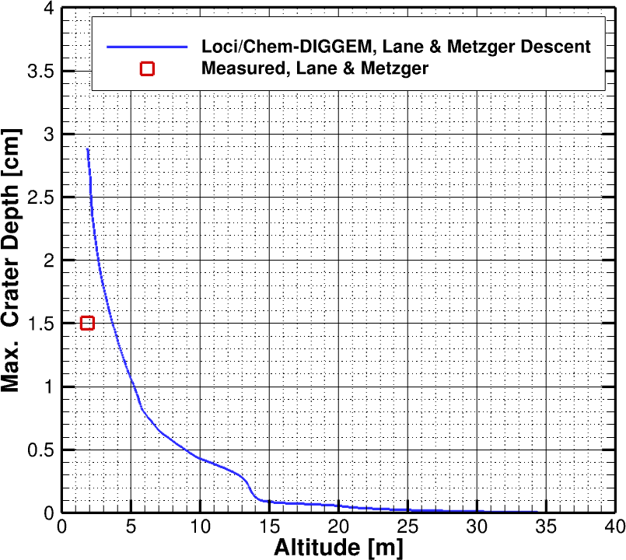
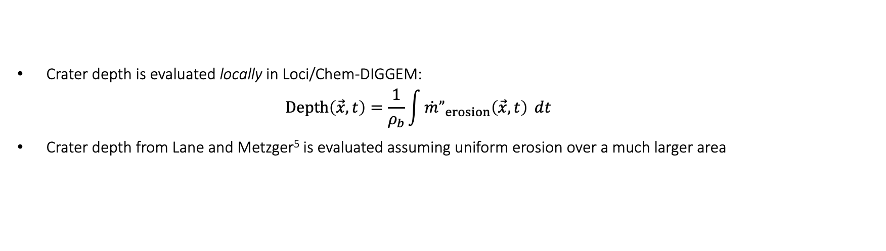

Apollo 12 LM Simulation: Crater Depth
Crater depth is evaluated locally in Loci/Chem-DIGGEM:
  $$Depth\left(\vec{x},t\right)=\frac{1}{ρ_{b}}\int{\dot{m}”_{erosion}\left(\vec{x},t\right) ⅆt}$$
Crater depth from Lane and Metzger⁵ is evaluated assuming uniform erosion over a much larger area
Crater Depth Calculations from Lane and Metzger
Max. Crater Depths Vs. Altitude from Loci/Chem-DIGGEM and Lane and Metzger⁵
Uniform Erosion Flux, m”
Local-based crater depth calculations in Loci/Chem-DIGGEM predict greater peak crater depths than area-averaged depth from Lane & Metzger⁵
Crater depth calculations assuming same, uniform erosion area results in only ~5% difference with Lane and Metzger approach
Erosion Radius, a₀
Crater Depth Calculations from Loci/Chem-DIGGEM
Difference in depths between
Averaged/local approaches
Spatially varying mass flux
Based on shear stress, $τ$
Verifying predictions against limited flight data for calibration – additional data from planned Lunar missions will be useful for validation

Slide 15
Summary
Plume surface interactions (PSI) continue to pose risks to landers and nearby assets during propulsive landings
Newly developed, Loci/Chem-DIGGEM tool is a useful tool that fits into the cascade of predictive simulation capabilities for PSI developed within Fluid Dynamics Branch at NASA Marshall Space Flight Center (MSFC)
With Loci/Chem-DIGGEM, we can:
  Provide predictions of crater depth in the viscous shear erosion regime with relatively quick turn-around time
  Capture Lunar terrain evolution effects on the plume and vis versa
  Simulate entire vehicle descent trajectories on the order of tens of seconds
Continue validation and recalibration of Loci/Chem-DIGGEM as flight data becomes available (such as from Commercial Lunar Payload Services missions)
Apply new predictive analysis capability to Lunar missions, Lunar site planning
Future Work

Slide 16
References
P. T. Metzger, R. C. Latta, J. M. Schuler, and C. D. Immer, “Craters formed in granular beds by impinging jets of gas,” AIP Conf. Proc., vol. 1145, no. 1, pp. 767–770, 2009.
P. T. Metzger, X. Li, C. D. Immer, and J. E. Lane, “ISRU implications for lunar and martian plume effects,” 47th AIAA Aerosp. Sci. Meet. Incl. New Horizons Forum Aerosp. Expo., January, AIAA Paper 2009-1204, pp. 1–19, 2009.
P. T. Metzger, C. D. Immer, C. M. Donahue, B. T. Vu, R. C. Latta, and M. Deyo-Svendsen, “Jet-induced cratering of a granular surface with application to lunar spaceports,” J. Aerosp. Eng., vol. 22, no. 1, pp. 24–32, 2009.
Scott, R.F. and Ko, H.-Y.., “Transient Rocket Engine Gas Flow in Soil,” AIAA J., 6(2), 1968, pp. 258-264.
J. E. Lane and P. T. Metzger, “Estimation of Apollo Lunar Dust Transport using Optical Extinction Measurements,” Acta Geophysica, vol. 63, no. 2, 2015, pp. 568-599.
T. Shurtz and J. West, “Simulating Underexpanded Plumes in Martian and Lunar Environments,” 2022 AIAA SciTech Forum, San Diego, CA, 2022.
P. T. Metzger, J. E. Lane, C. D. Immer, et al., “Scaling of Erosion Rate in Subsonic Jet Experiments and Apollo Lunar Module Landings,” ASCE Earth and Space 2010, 2010.

