Slide 1
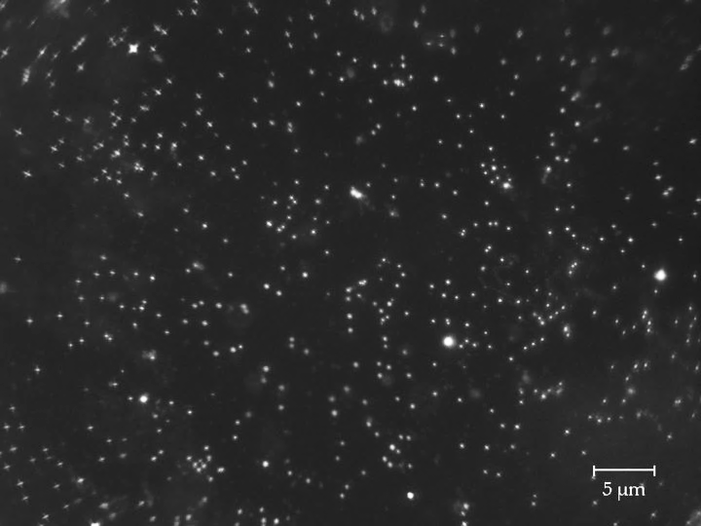

Microbes in Deep Space
Microbiology research
to facilitate human exploration
Jessica Audrey Lee
The GERMS lab
Gravitational Effects and Radiobiology of Microbes in Space
Space Biosciences Research Branch
NASA Ames Research Center

Slide 2
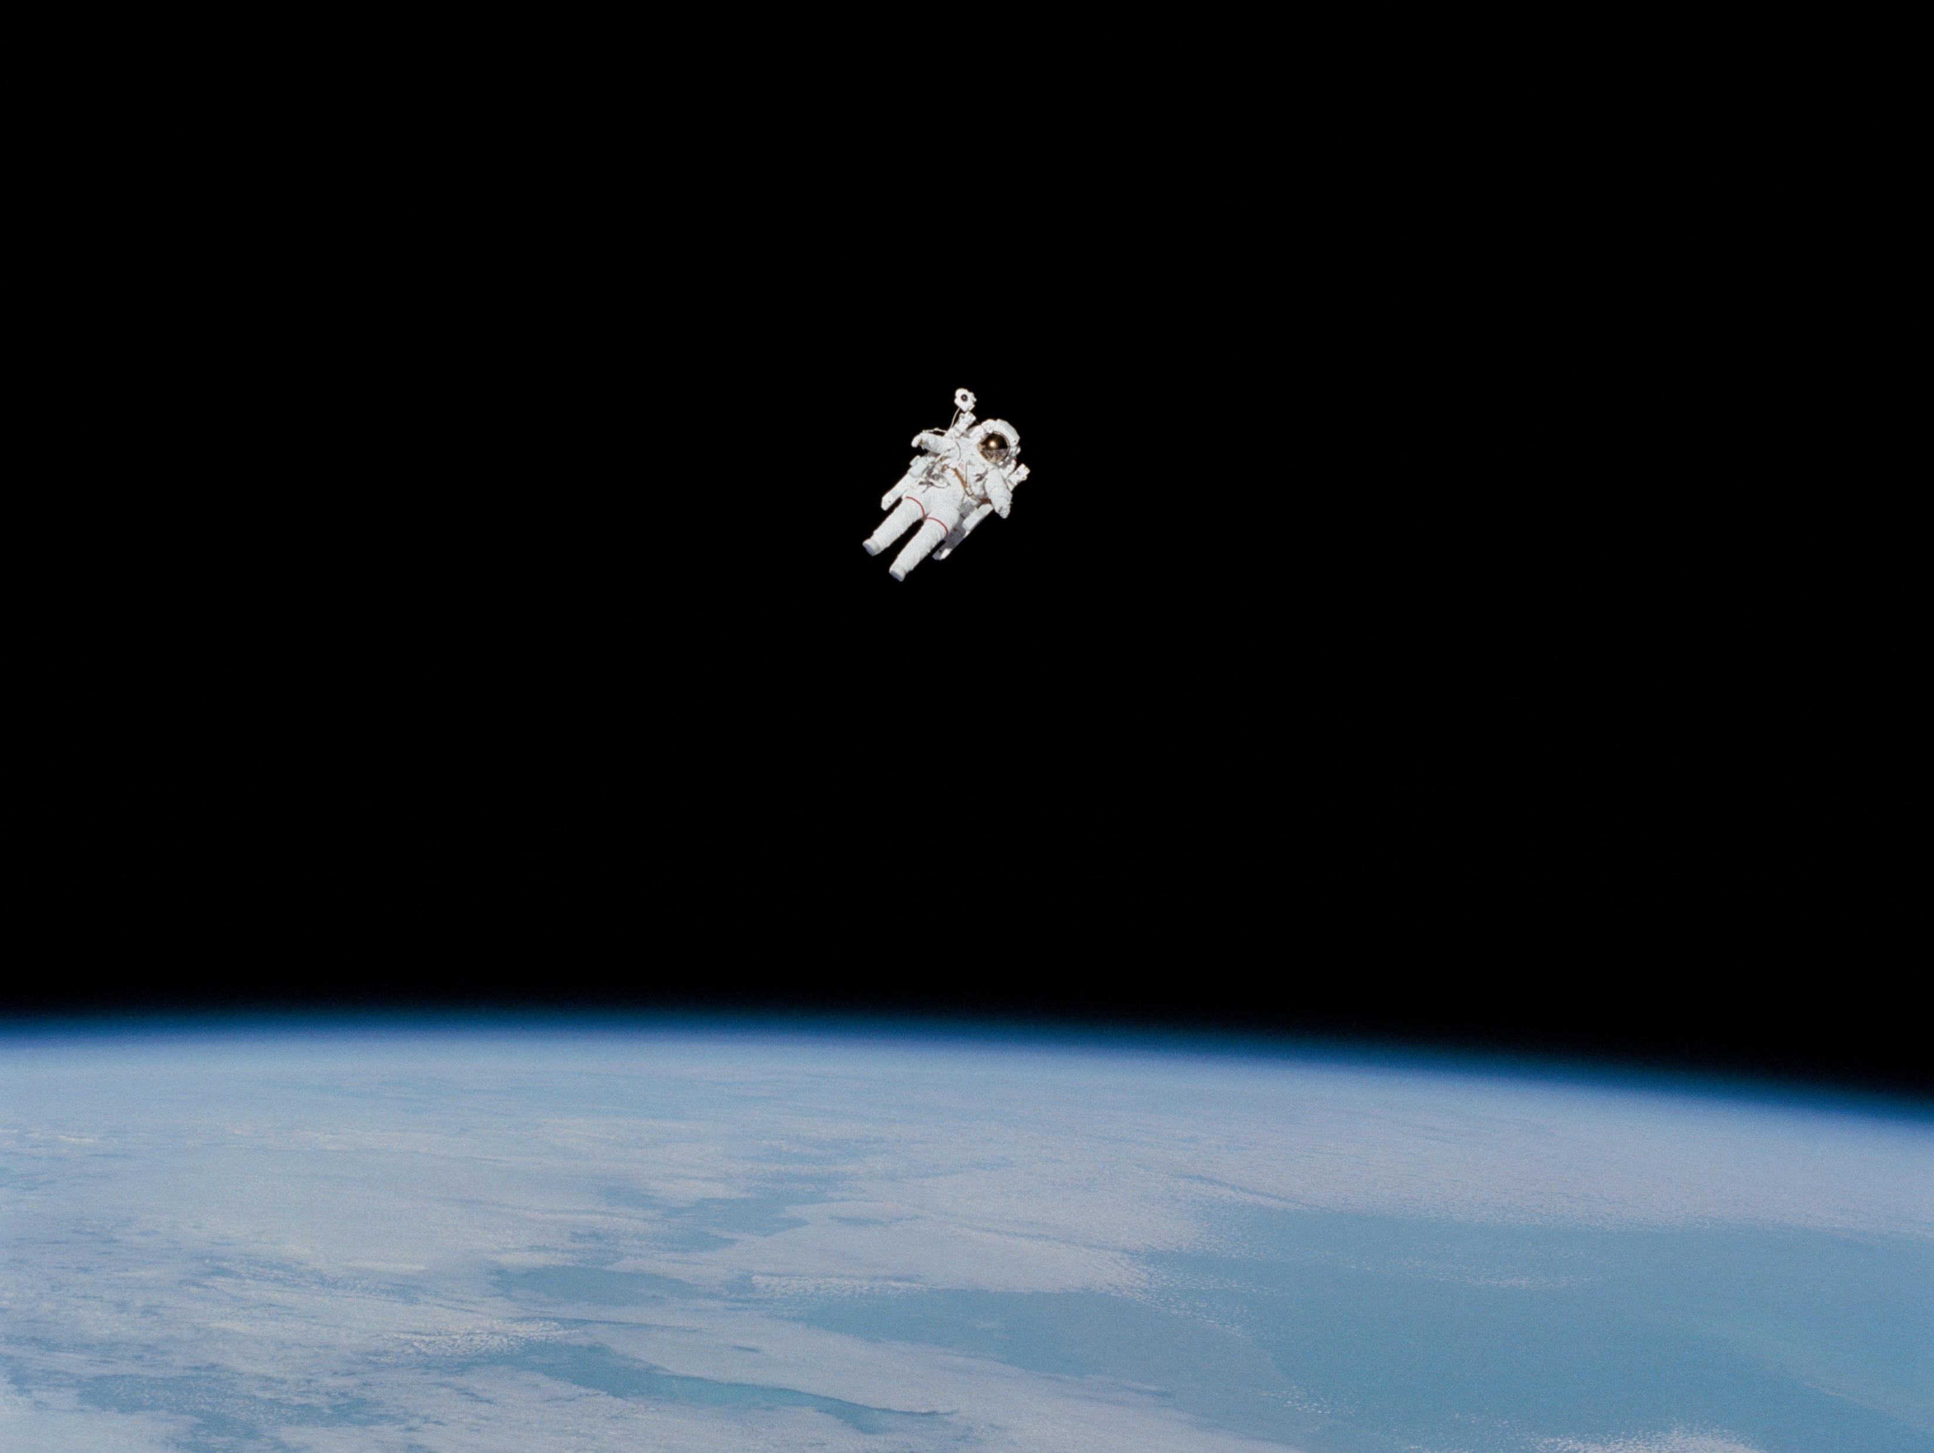
image credit: NASA
Notes:
https://www.nasa.gov/image-feature/nasa-celebrates-50-years-of-spacewalking

Slide 3
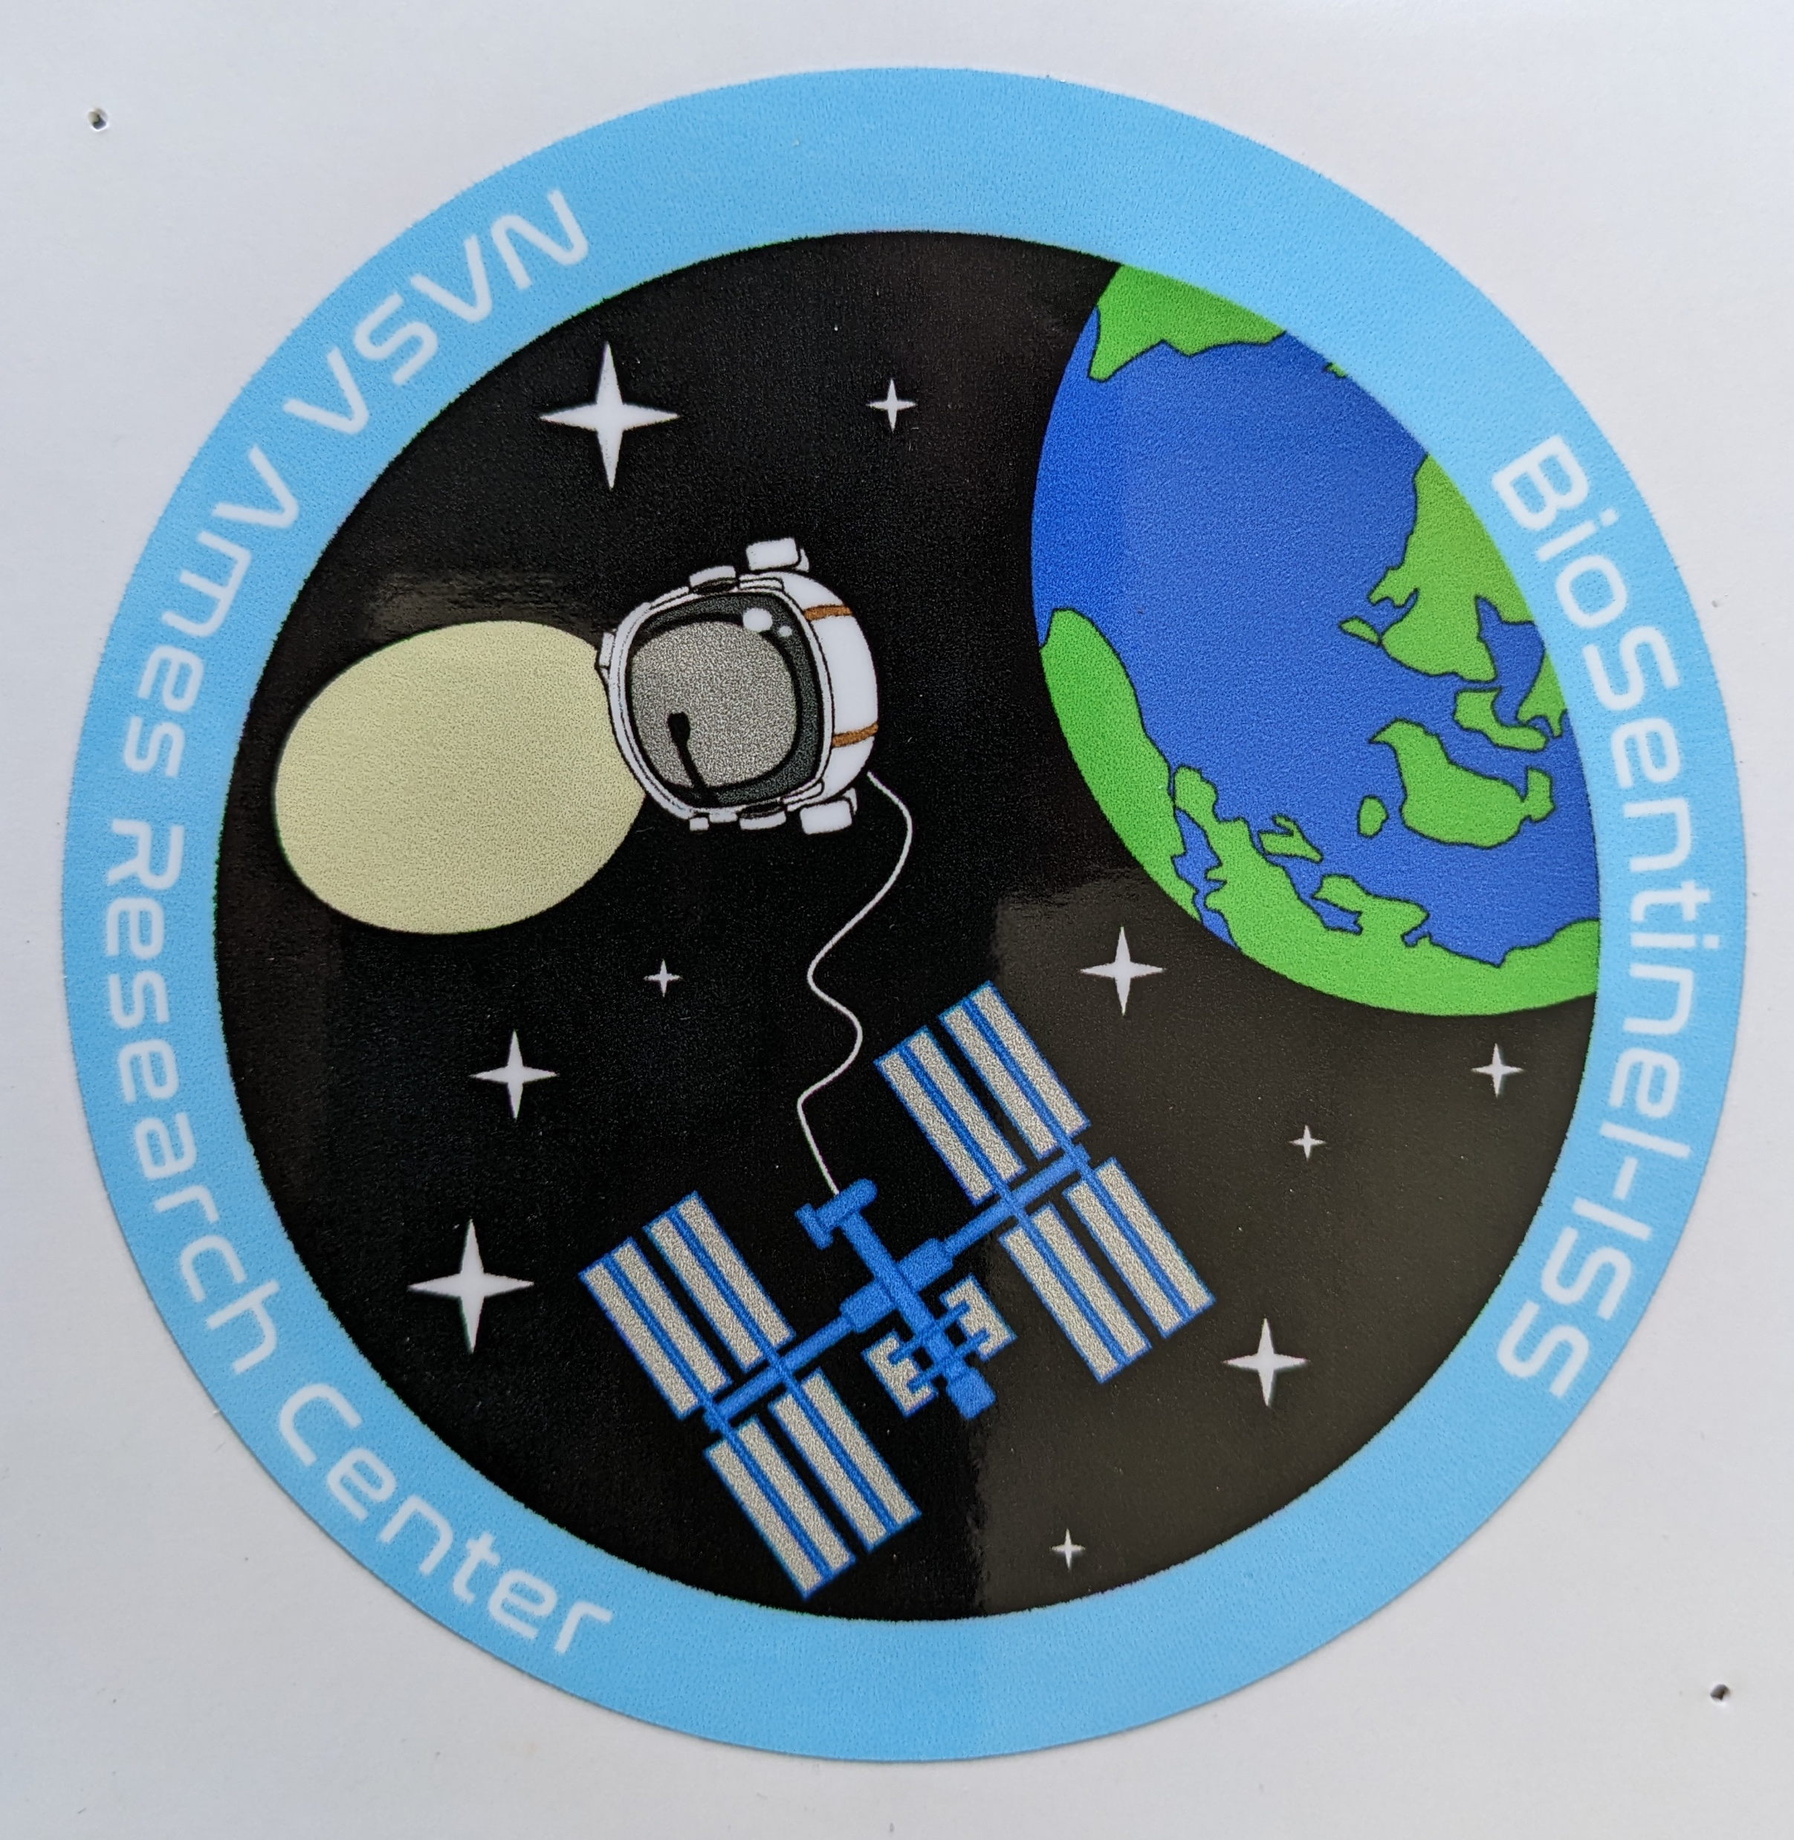

Slide 4
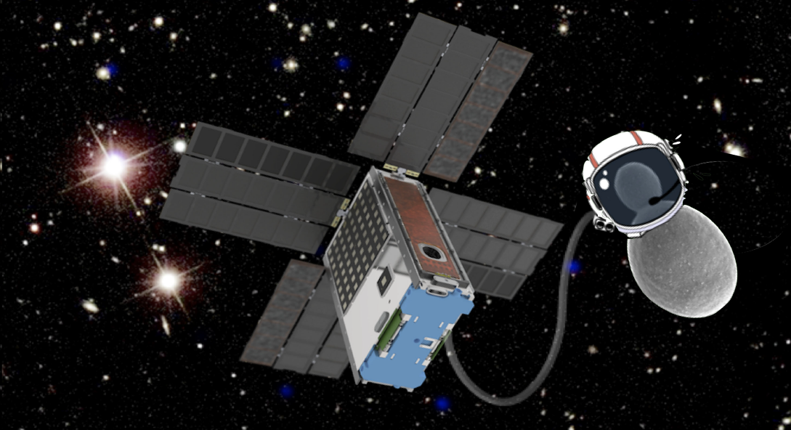
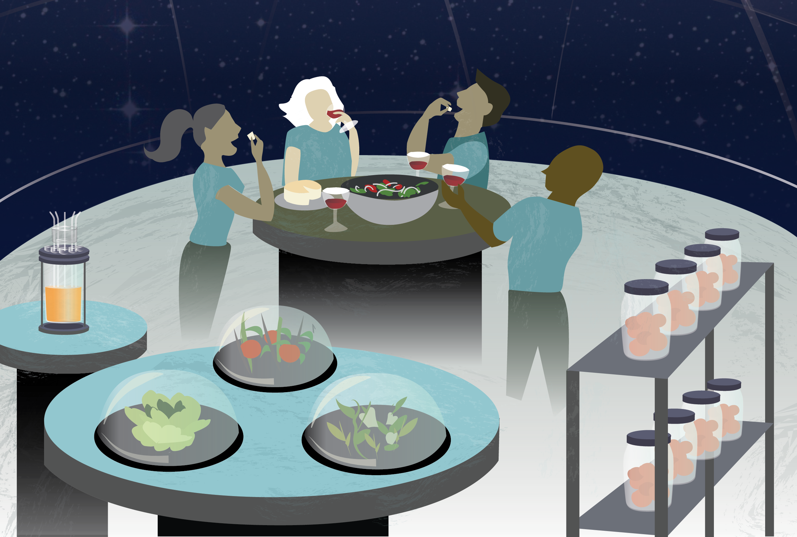
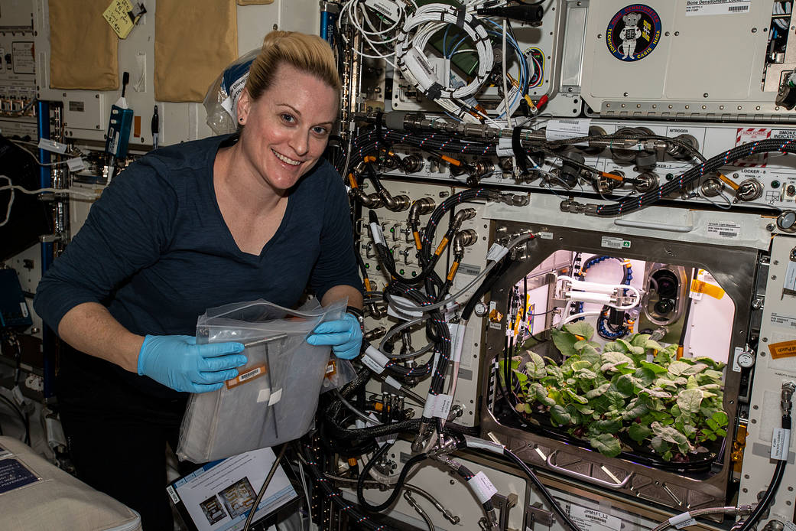
Microbes are essential
to space exploration
BioSentinel
Model organisms to investigate space effects on biology
Ricco et al. 2020 doi: 10.1109/MAES.2019.2953760
Potential to keep astronauts healthy through regenerative life support and microbial biotech
credit: Miki Hyunh, NASA
They're coming with us anyway: microbiomes of astronauts and spacecraft
credit: NASA
Notes:
note under "microbiomes" that this includes potential pathogens and biofouling agents, and contaminants in the search for life

Slide 5
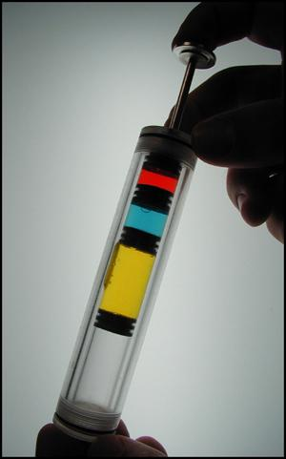
Fluid Processing Apparatus.
image credit: NASA
Notes:
https://www.nasa.gov/ames/research/space-biosciences/microbe-sts-115
see also https://journals.plos.org/plosone/article?id=10.1371/journal.pone.0164359

Slide 6
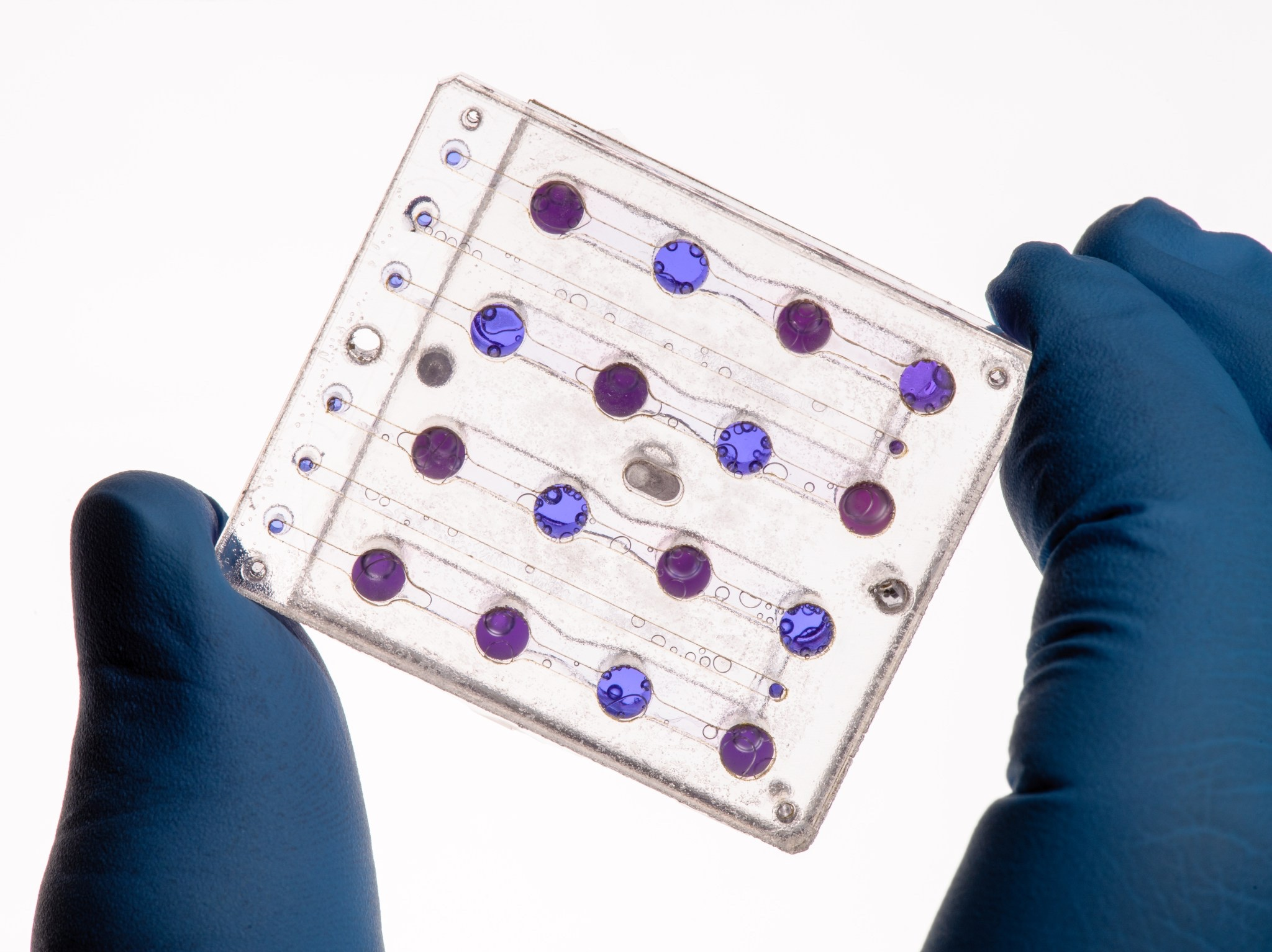
Fluidic card with yeast, BioSentinel mission.
image credit: NASA

Slide 7
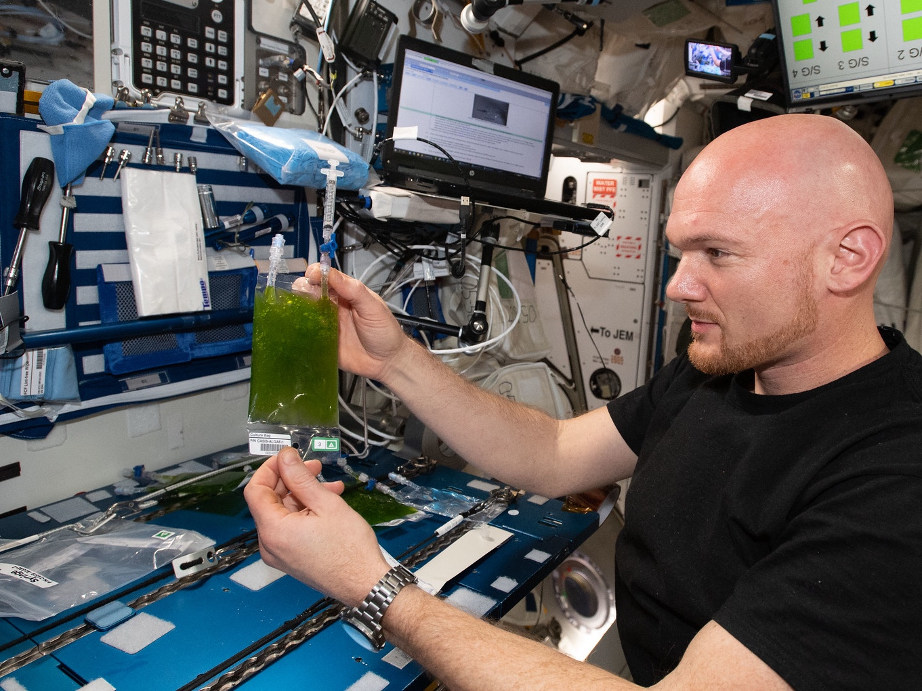
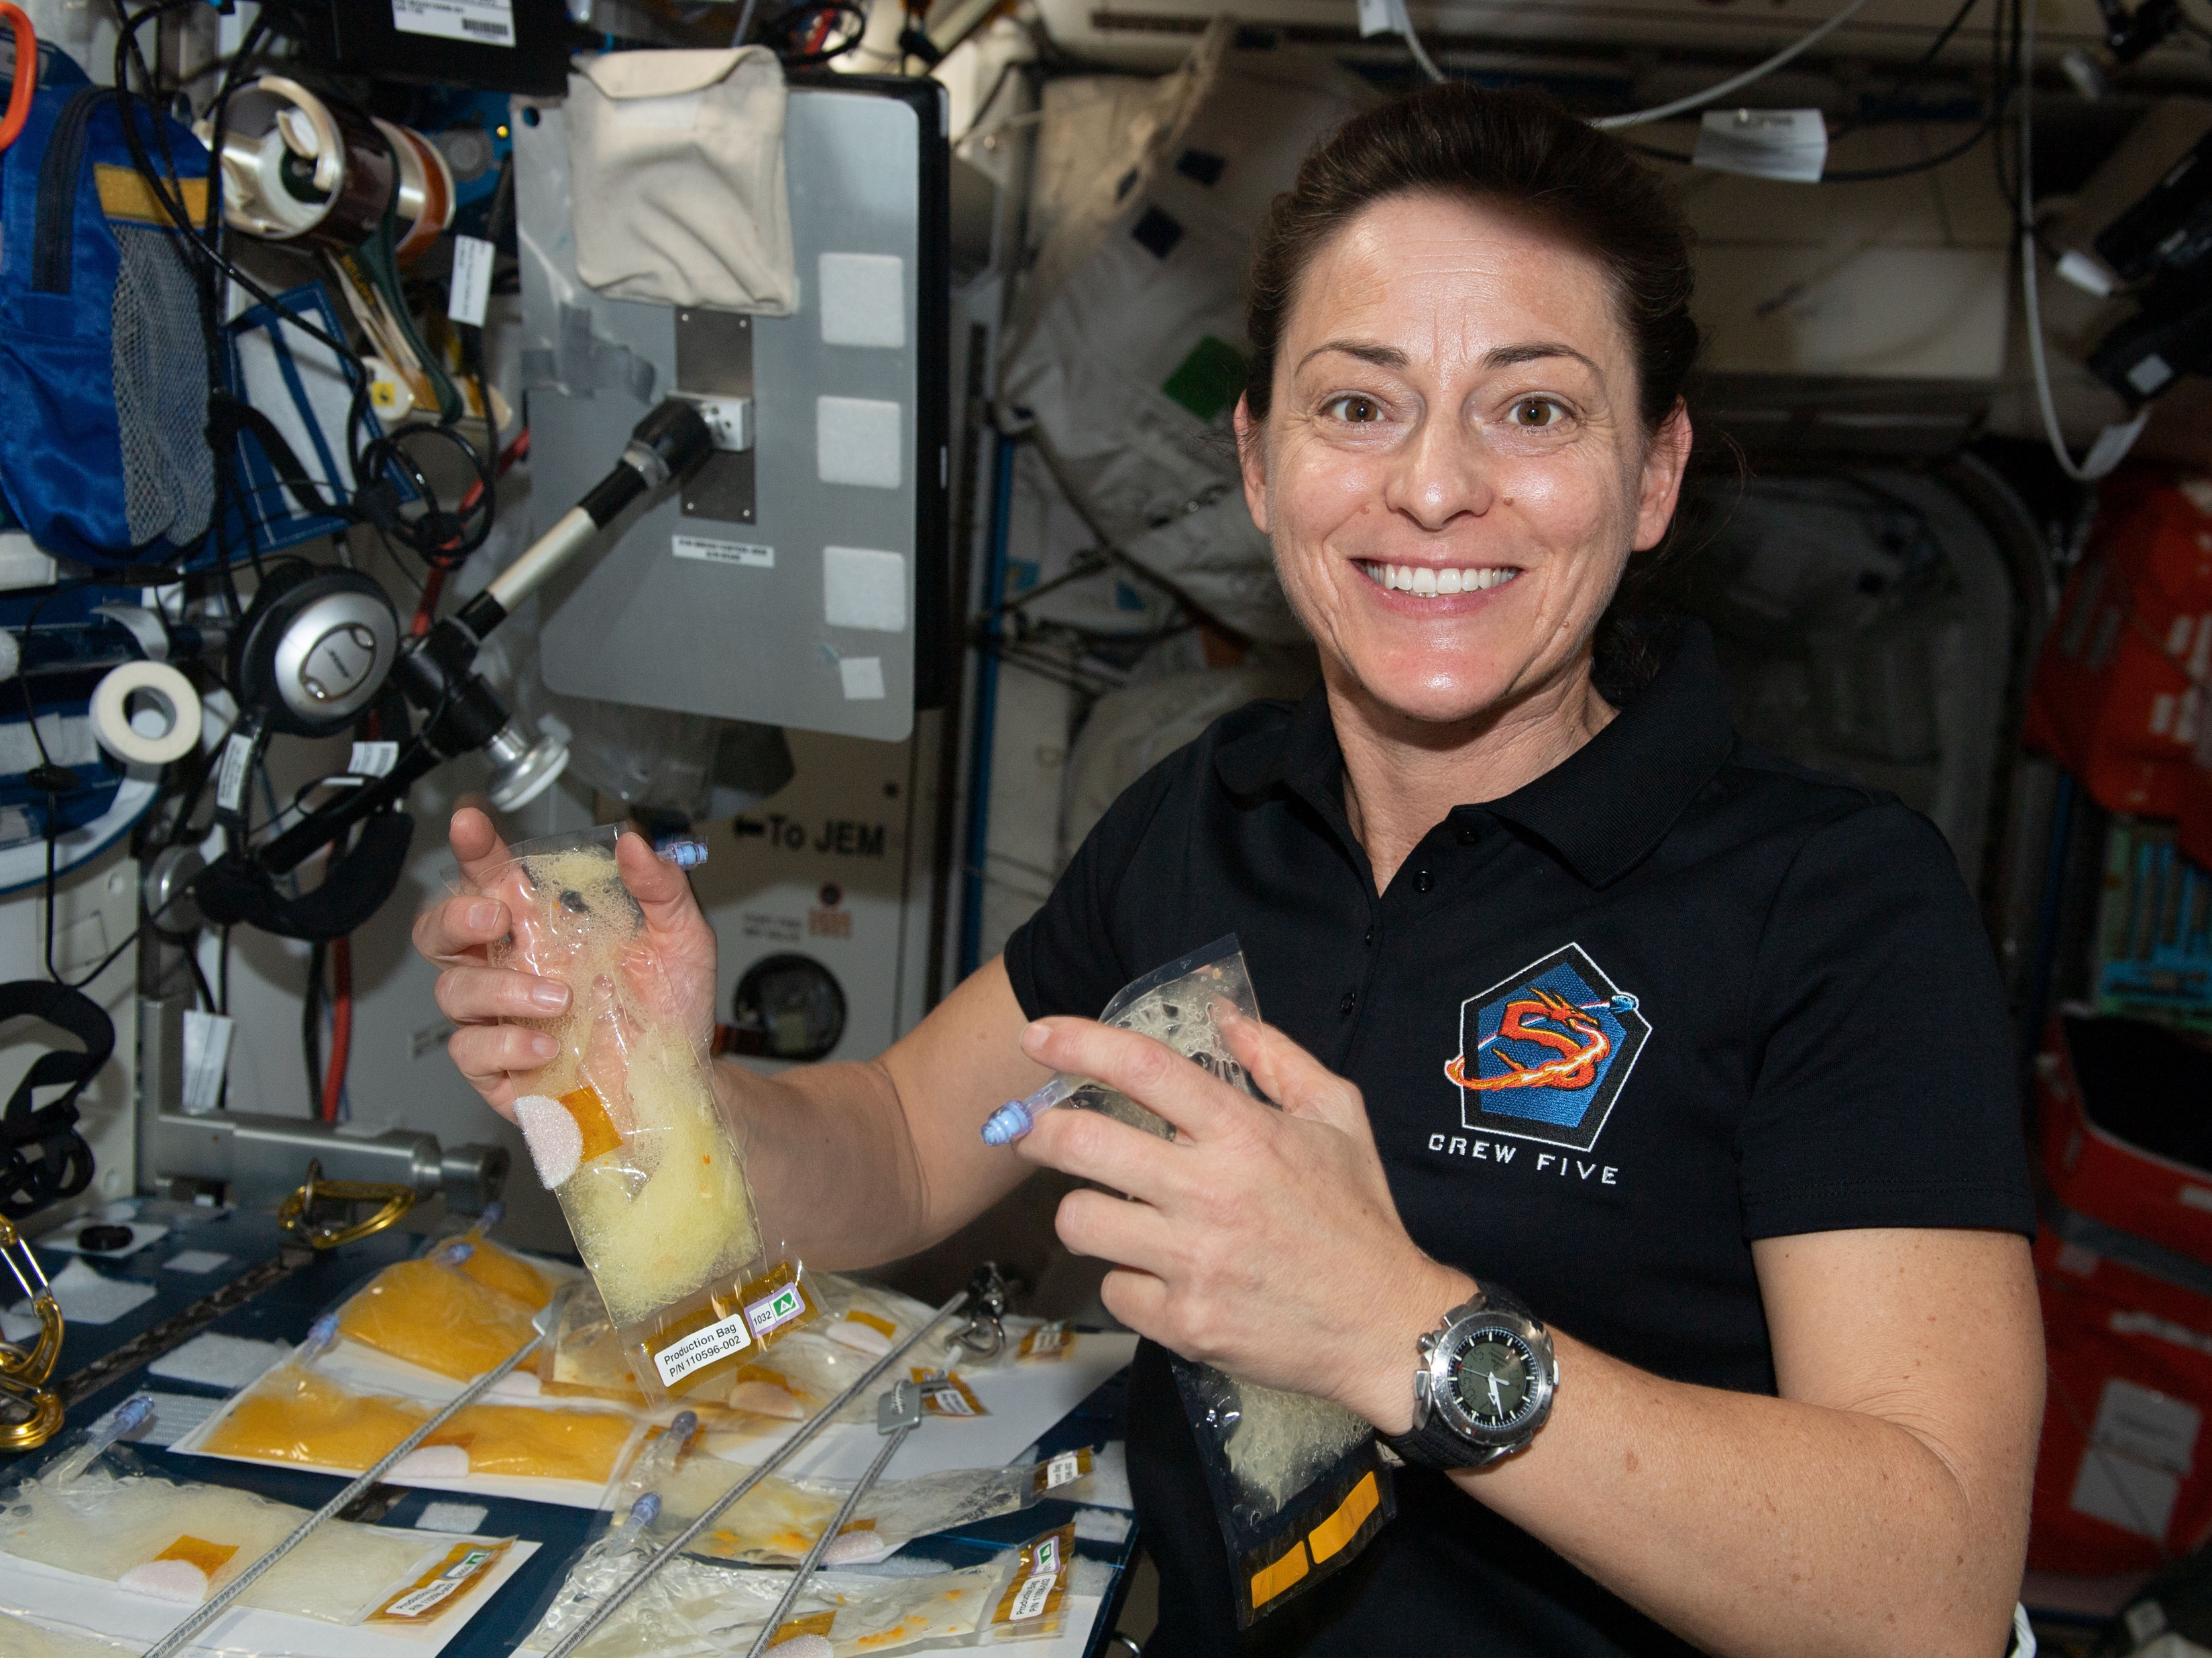
Space Algae.
BioNutrients. image credits: NASA
Notes:
https://www.flickr.com/photos/nasa2explore/44162926531/in/photostream/
https://www.nasa.gov/mission_pages/station/research/news/space-station-science-highlights-02jan23

Slide 8
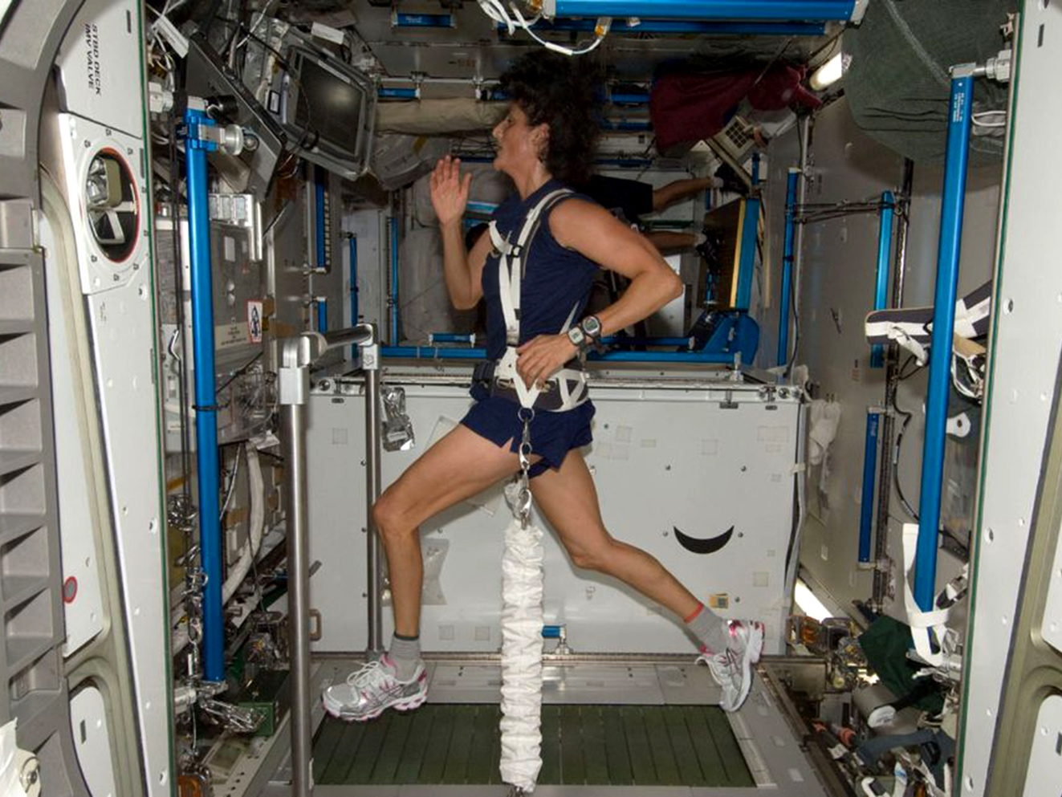
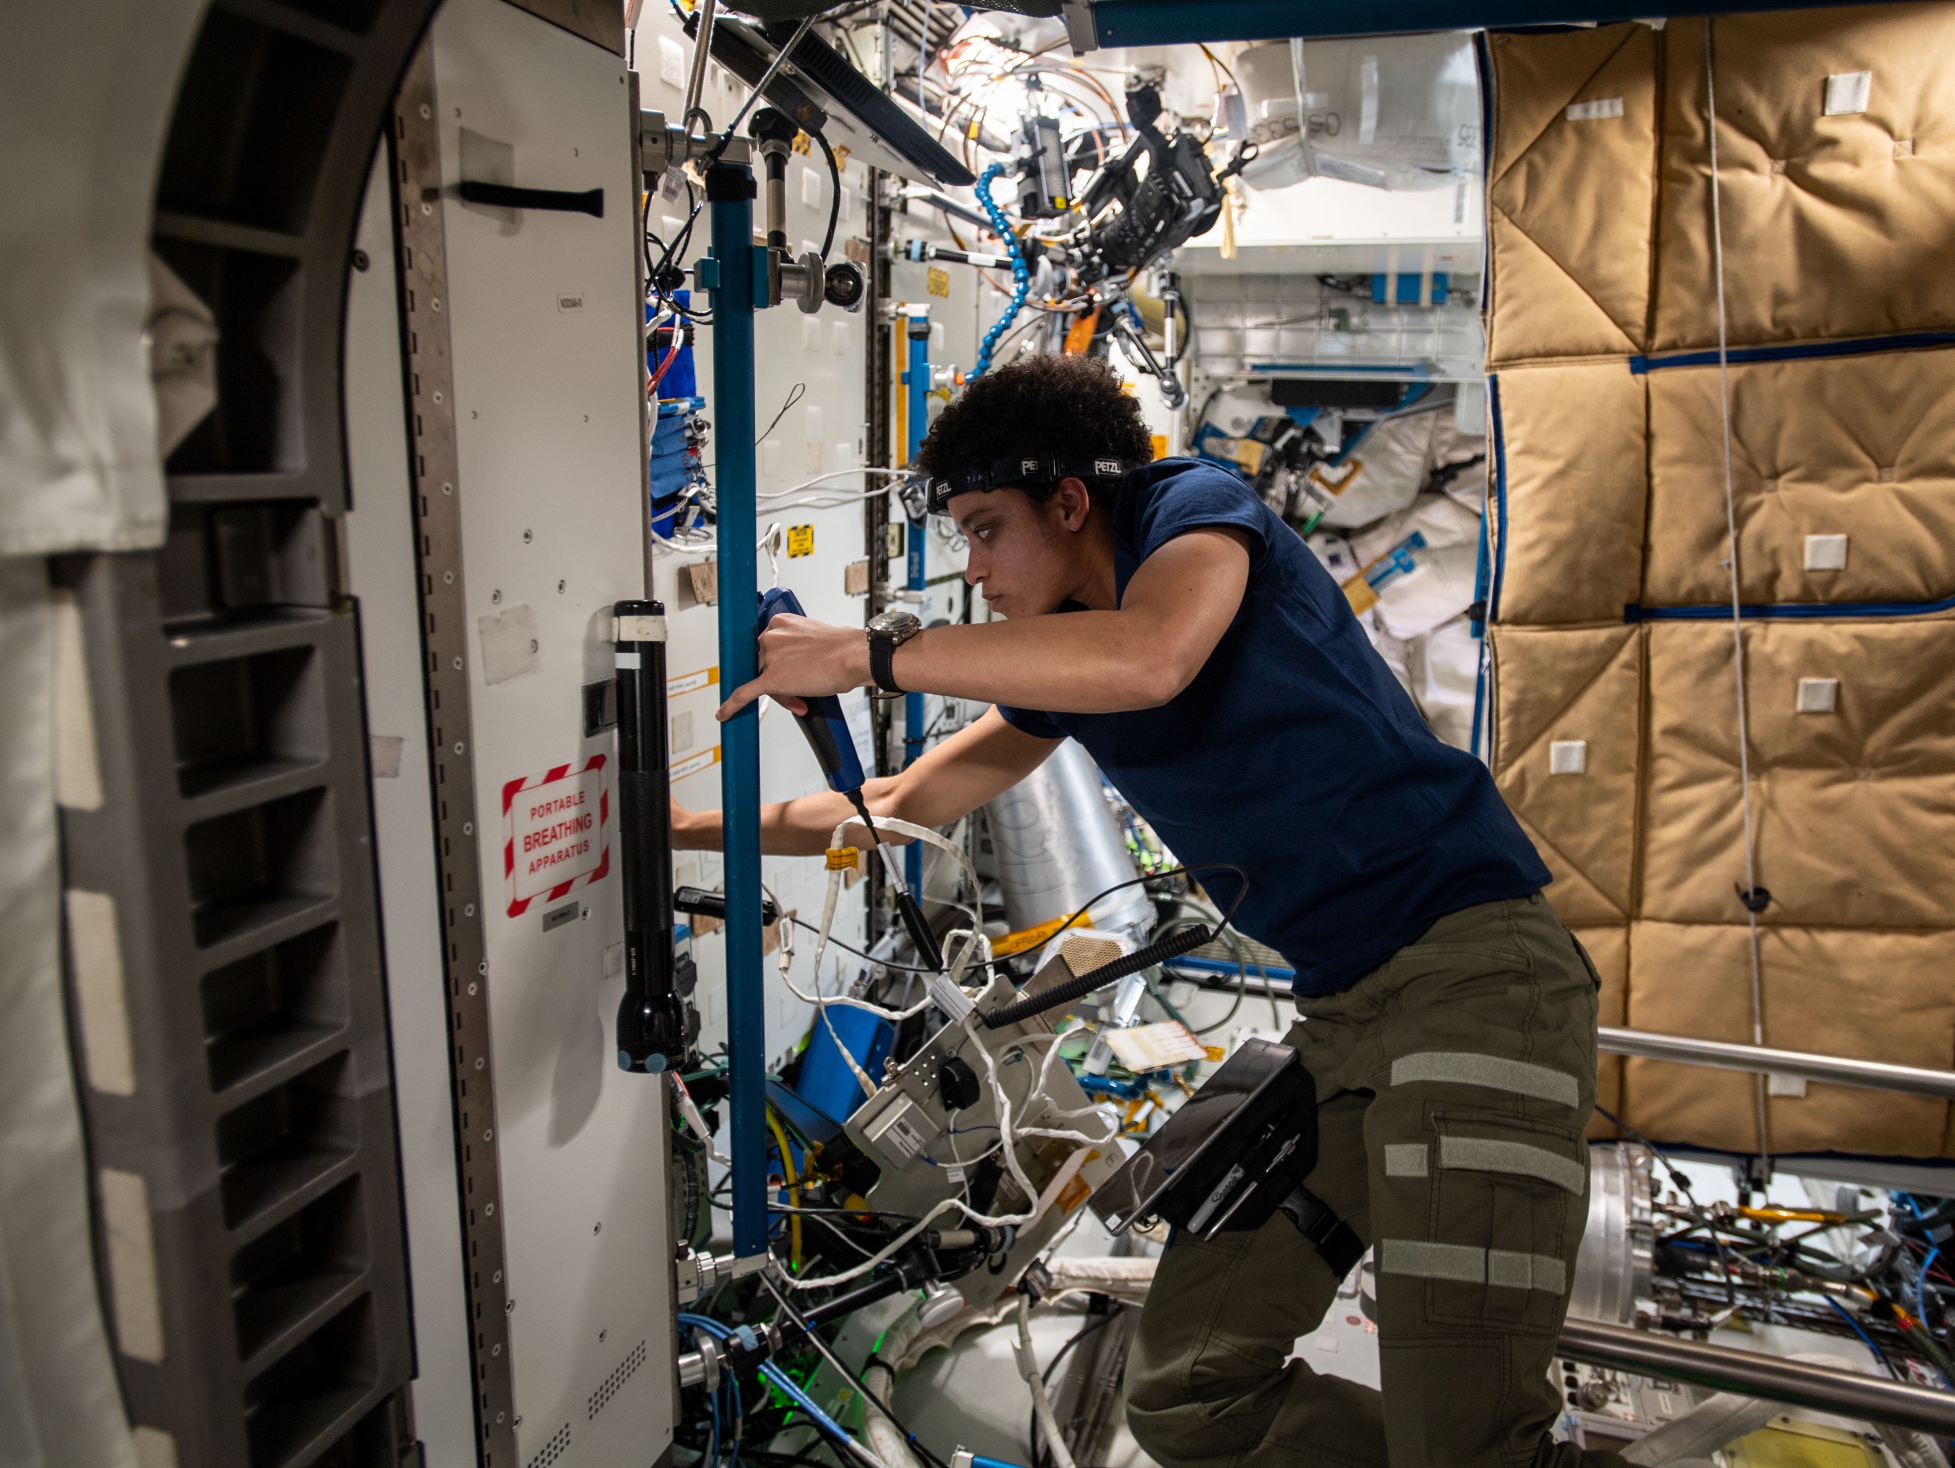
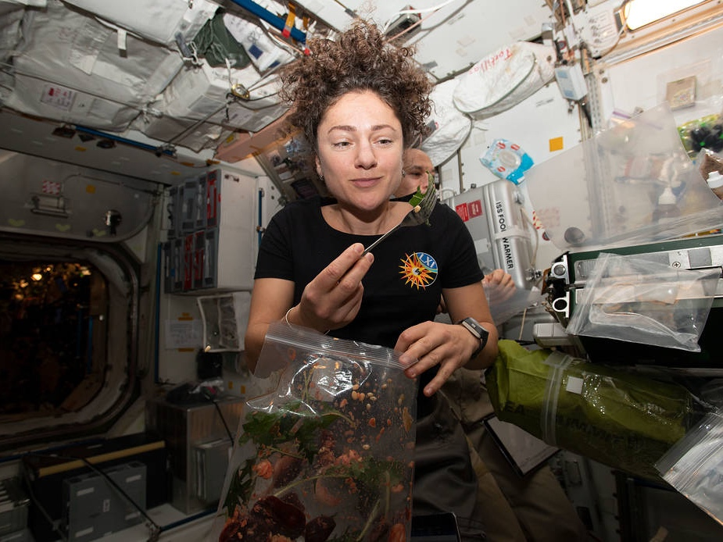
astronauts Sunita Williams, Jessica Watkins, Jessica Meir. image credit: NASA
Notes:
https://www.nasa.gov/content/astronaut-strength-conditioning-and-rehabilitation
Sunita Williams
https://www.nasa.gov/image-feature/nasa-astronaut-jessica-meir-dines-on-fresh-mizuna-mustard-greens
https://www.nasa.gov/image-feature/astronaut-jessica-watkins-is-pictured-during-maintenance-operations

Slide 9
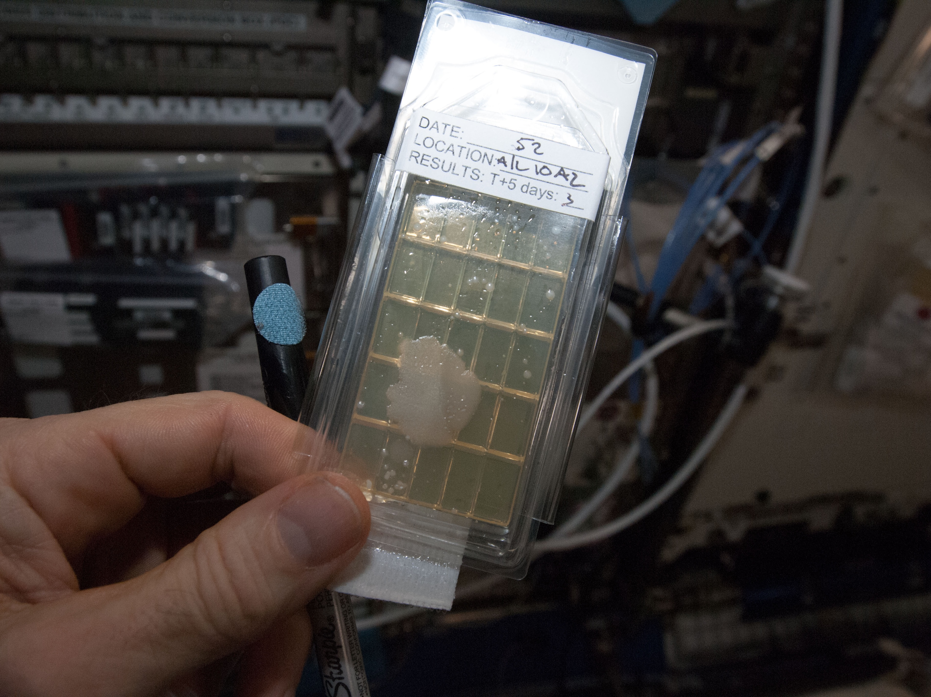
ISS surface sample. image credit: NASA
Notes:
https://www.nasa.gov/mission_pages/station/research/news/microbiology-101-space-station-microbes-research-iss

Slide 10
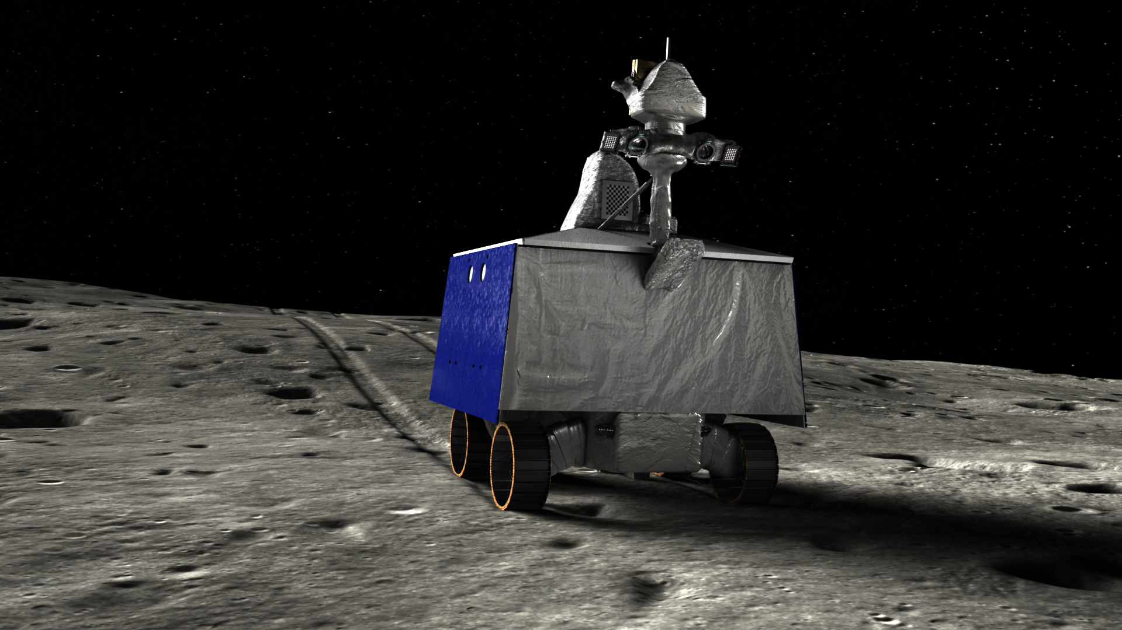
VIPER. image credit: NASA
Notes:
https://www.nasa.gov/image-feature/ames/be-the-first-to-see-new-life-size-viper-rover-model

Slide 11
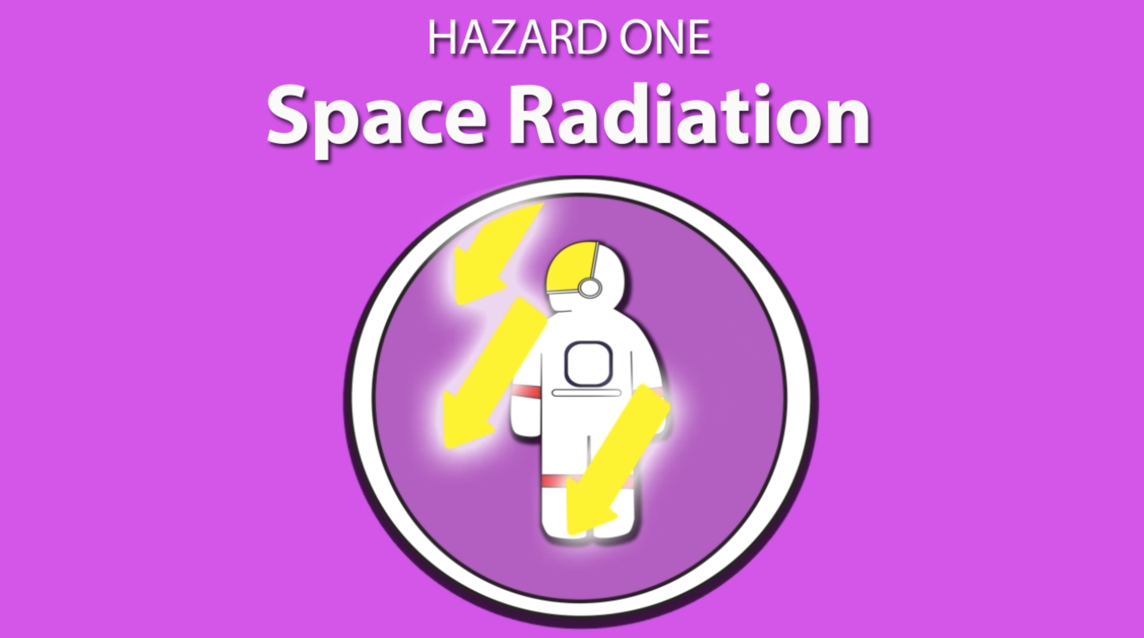
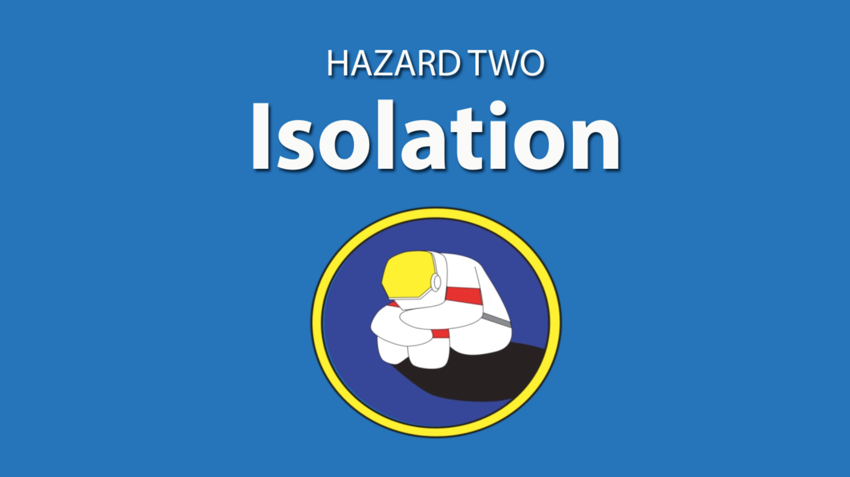
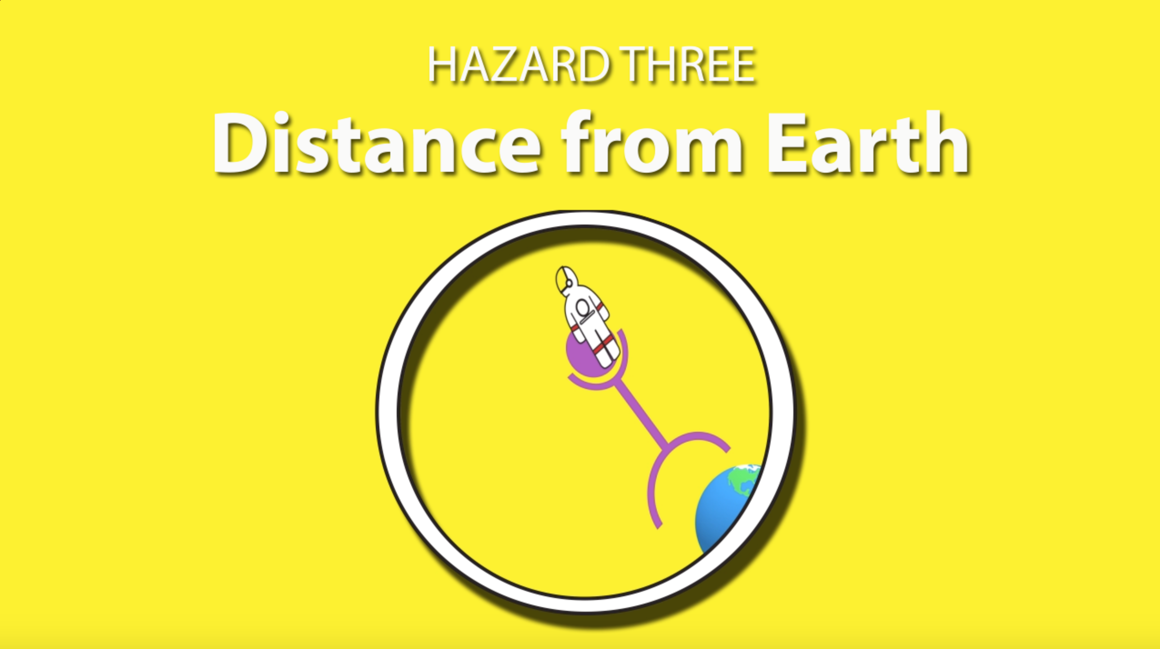

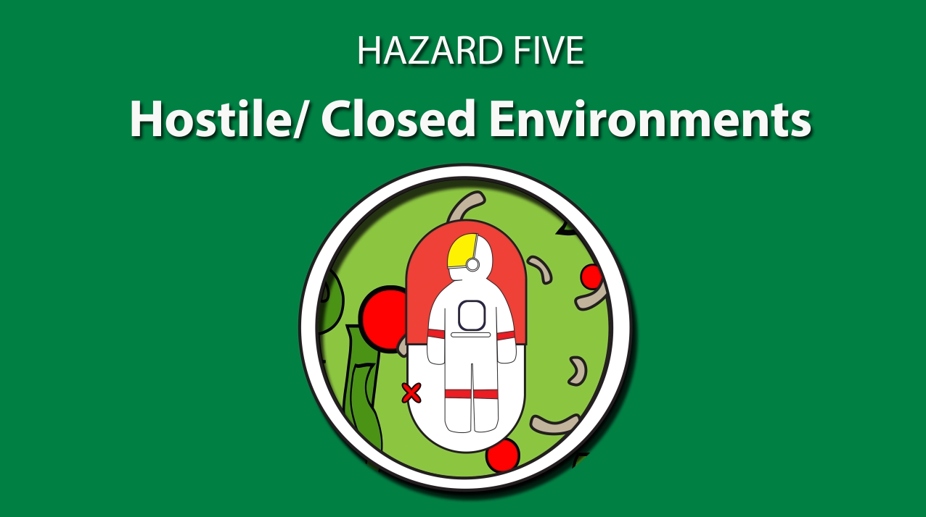
Space is dangerous for organisms
NASA hazards of human spaceflight
https://www.nasa.gov/hrp/5-hazards-of-human-spaceflight
Notes:
https://www.nasa.gov/hrp/5-hazards-of-human-spaceflight

Slide 12
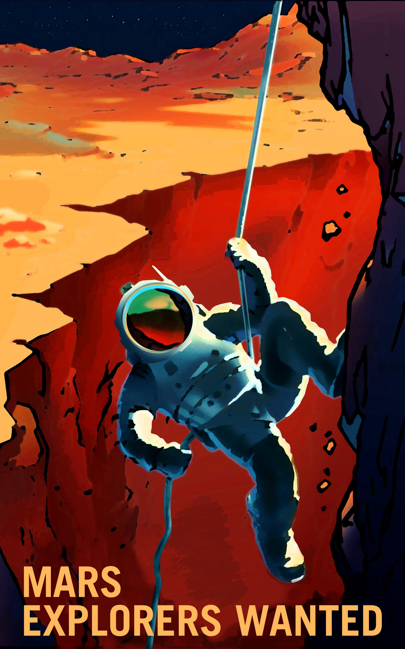
We are sending humans to the Moon... and beyond
But what do we know about how to help organisms thrive in deep space?
Most space biology research to date has been in Low Earth Orbit (LEO) or suborbital flight.
image credit: NASA

Slide 13
The deep space environment is different
Space radiation: different type and higher doses
Isolation and distance from Earth require developing greater self-sufficiency in food, life support, medicine
Gravity: not just microgravity, but also partial G on planetary surfaces
Planetary environments include challenges like dust / regolith
5 hazards of human spaceflight
https://www.nasa.gov/hrp/5-hazards-of-human-spaceflight

Slide 14
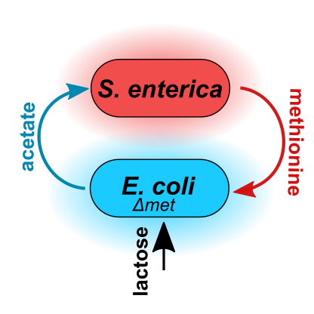
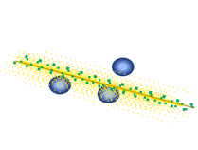
Space microbiology in the GERMS lab
Gravitational Effects and Radiobiology of Microbes in Space
Research topic
  Fundamental effects of space environment on microbes
Methods
  wet-lab research
  computational modeling
Specific focus areas
  Multispecies communities
  Evolutionary timescales
  Single-cell effects
Another research topic
  Development of sterilization methods for Planetary Protection

Slide 15
https://www.nasa.gov/hrp/5-hazards-of-human-spaceflight
Notes:
https://www.nasa.gov/hrp/5-hazards-of-human-spaceflight

Slide 16
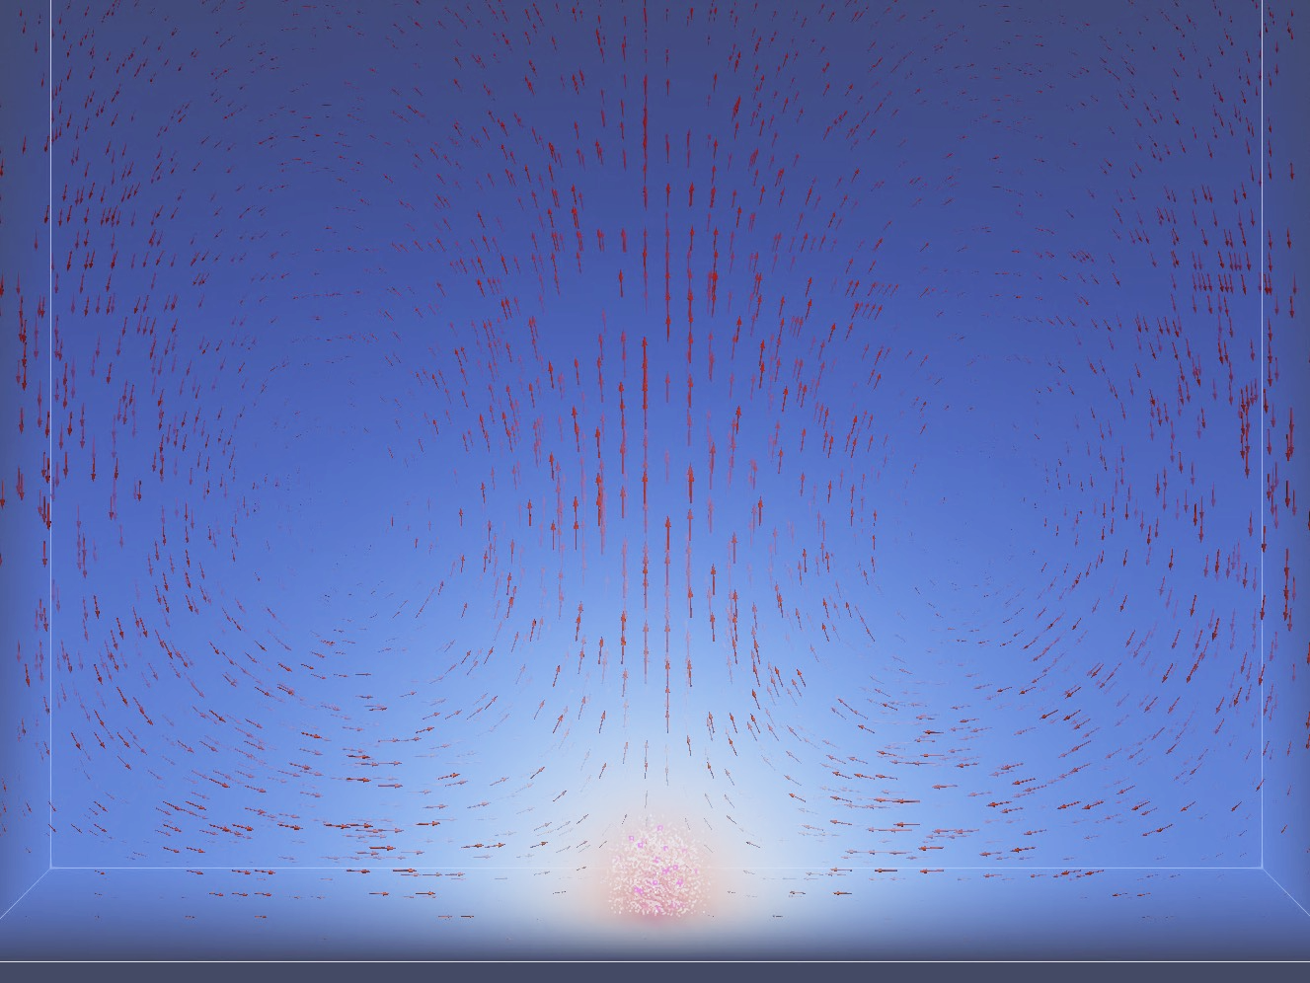
Microbes experience microgravity as an altered fluid environment
Notes:
Natural Convective Flow. A spherical biofilm placed on the simulation floor exhibits solute convective flows in 1g gravity condition. Red velocity arrows, in units of s⁻¹, are scaled up by 1,000x. The concentration field of acetate is depicted from high to low as red to blue. Fluid simulation boundaries are periodic except on the floor and ceiling of the box.

Slide 17
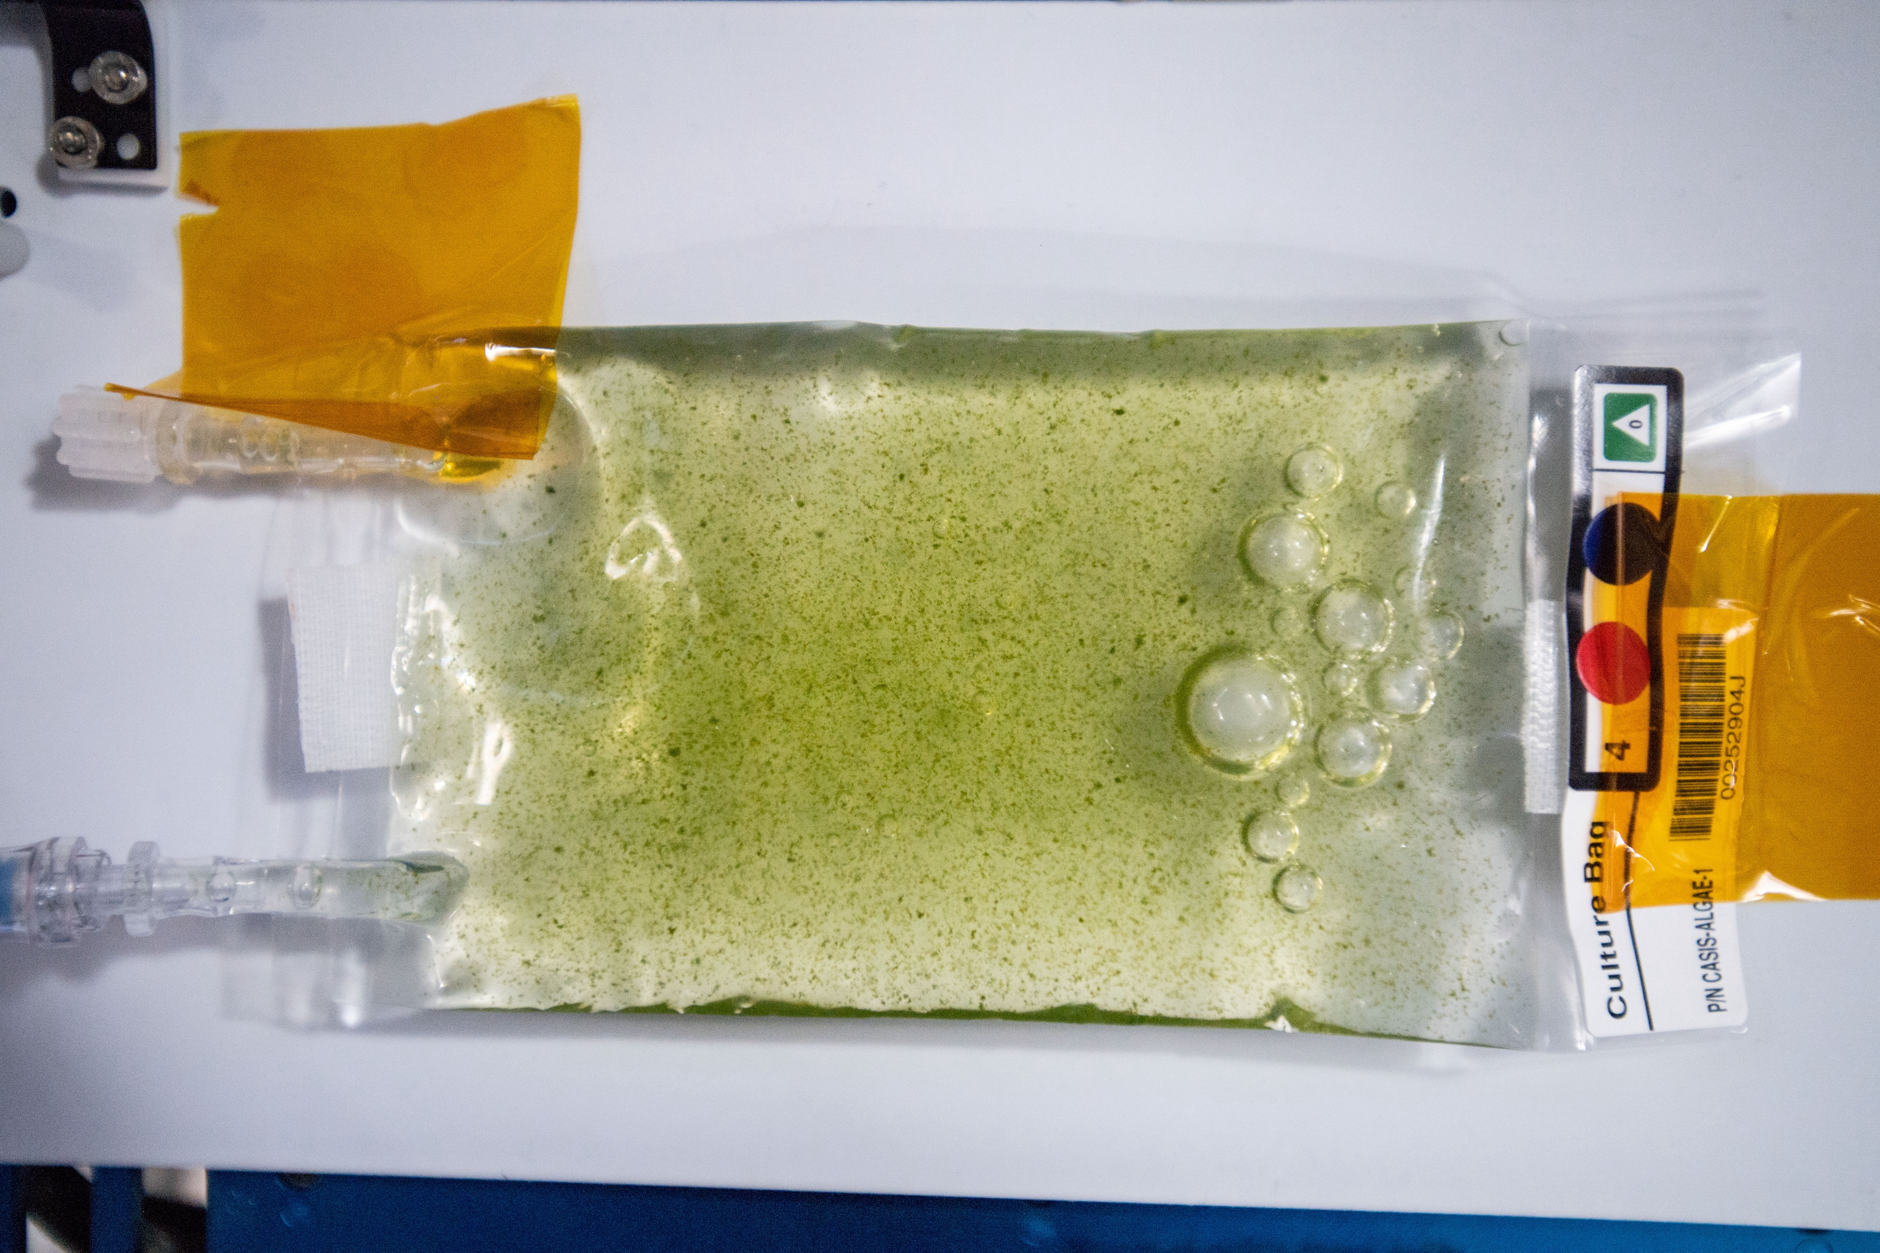
Microalgae. Image credit: NASA / NCAS
Notes:
https://www.nasa.gov/audience/foreducators/stem_on_station/ncas_microalgae/image_gallery/index.html
https://www.nasa.gov/audience/foreducators/stem_on_station/ncas_microalgae/about_microalgae/index.html
Haematococcus pluvialis

Slide 18
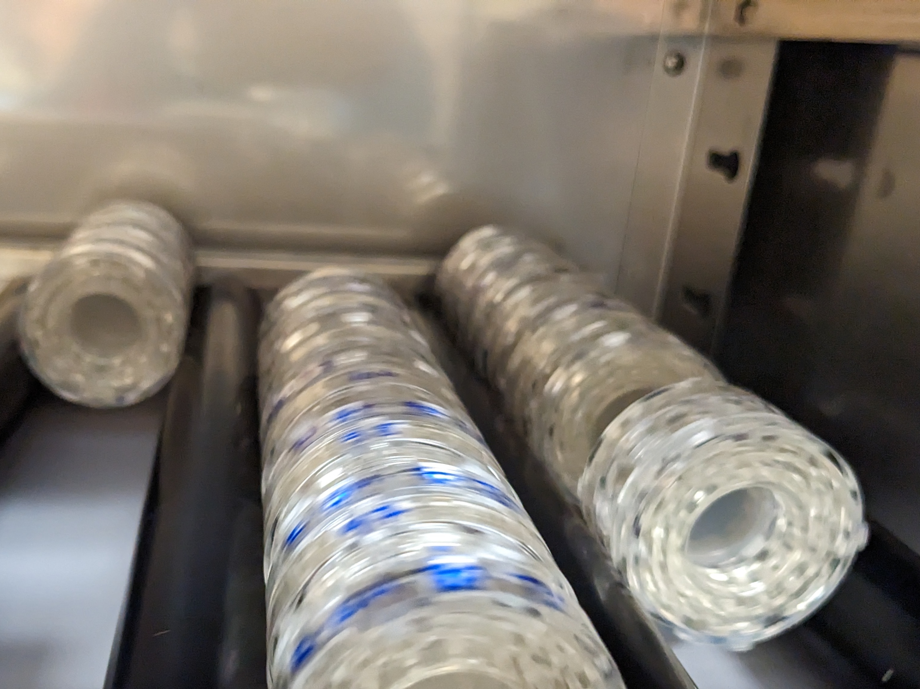
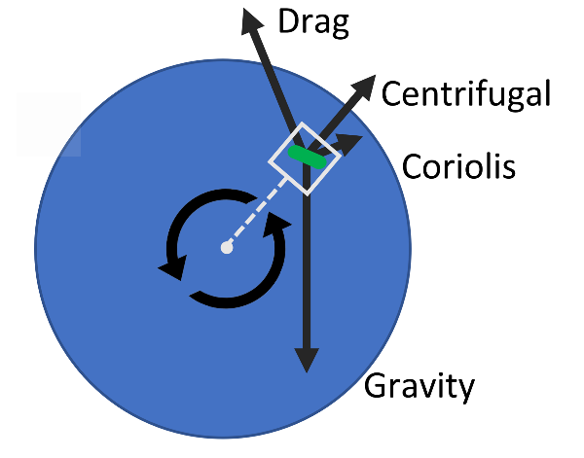
Rotational wall vessels
attempt to simulate
the microgravity fluid environment

Slide 19
A model cross-feeding bacterial community
organisms from W. Harcombe, U. Minnesota
Notes:
https://www.nasa.gov/feature/ames/nasa-s-biosentinel-team-prepares-cubesat-for-deep-space-flight

Slide 20
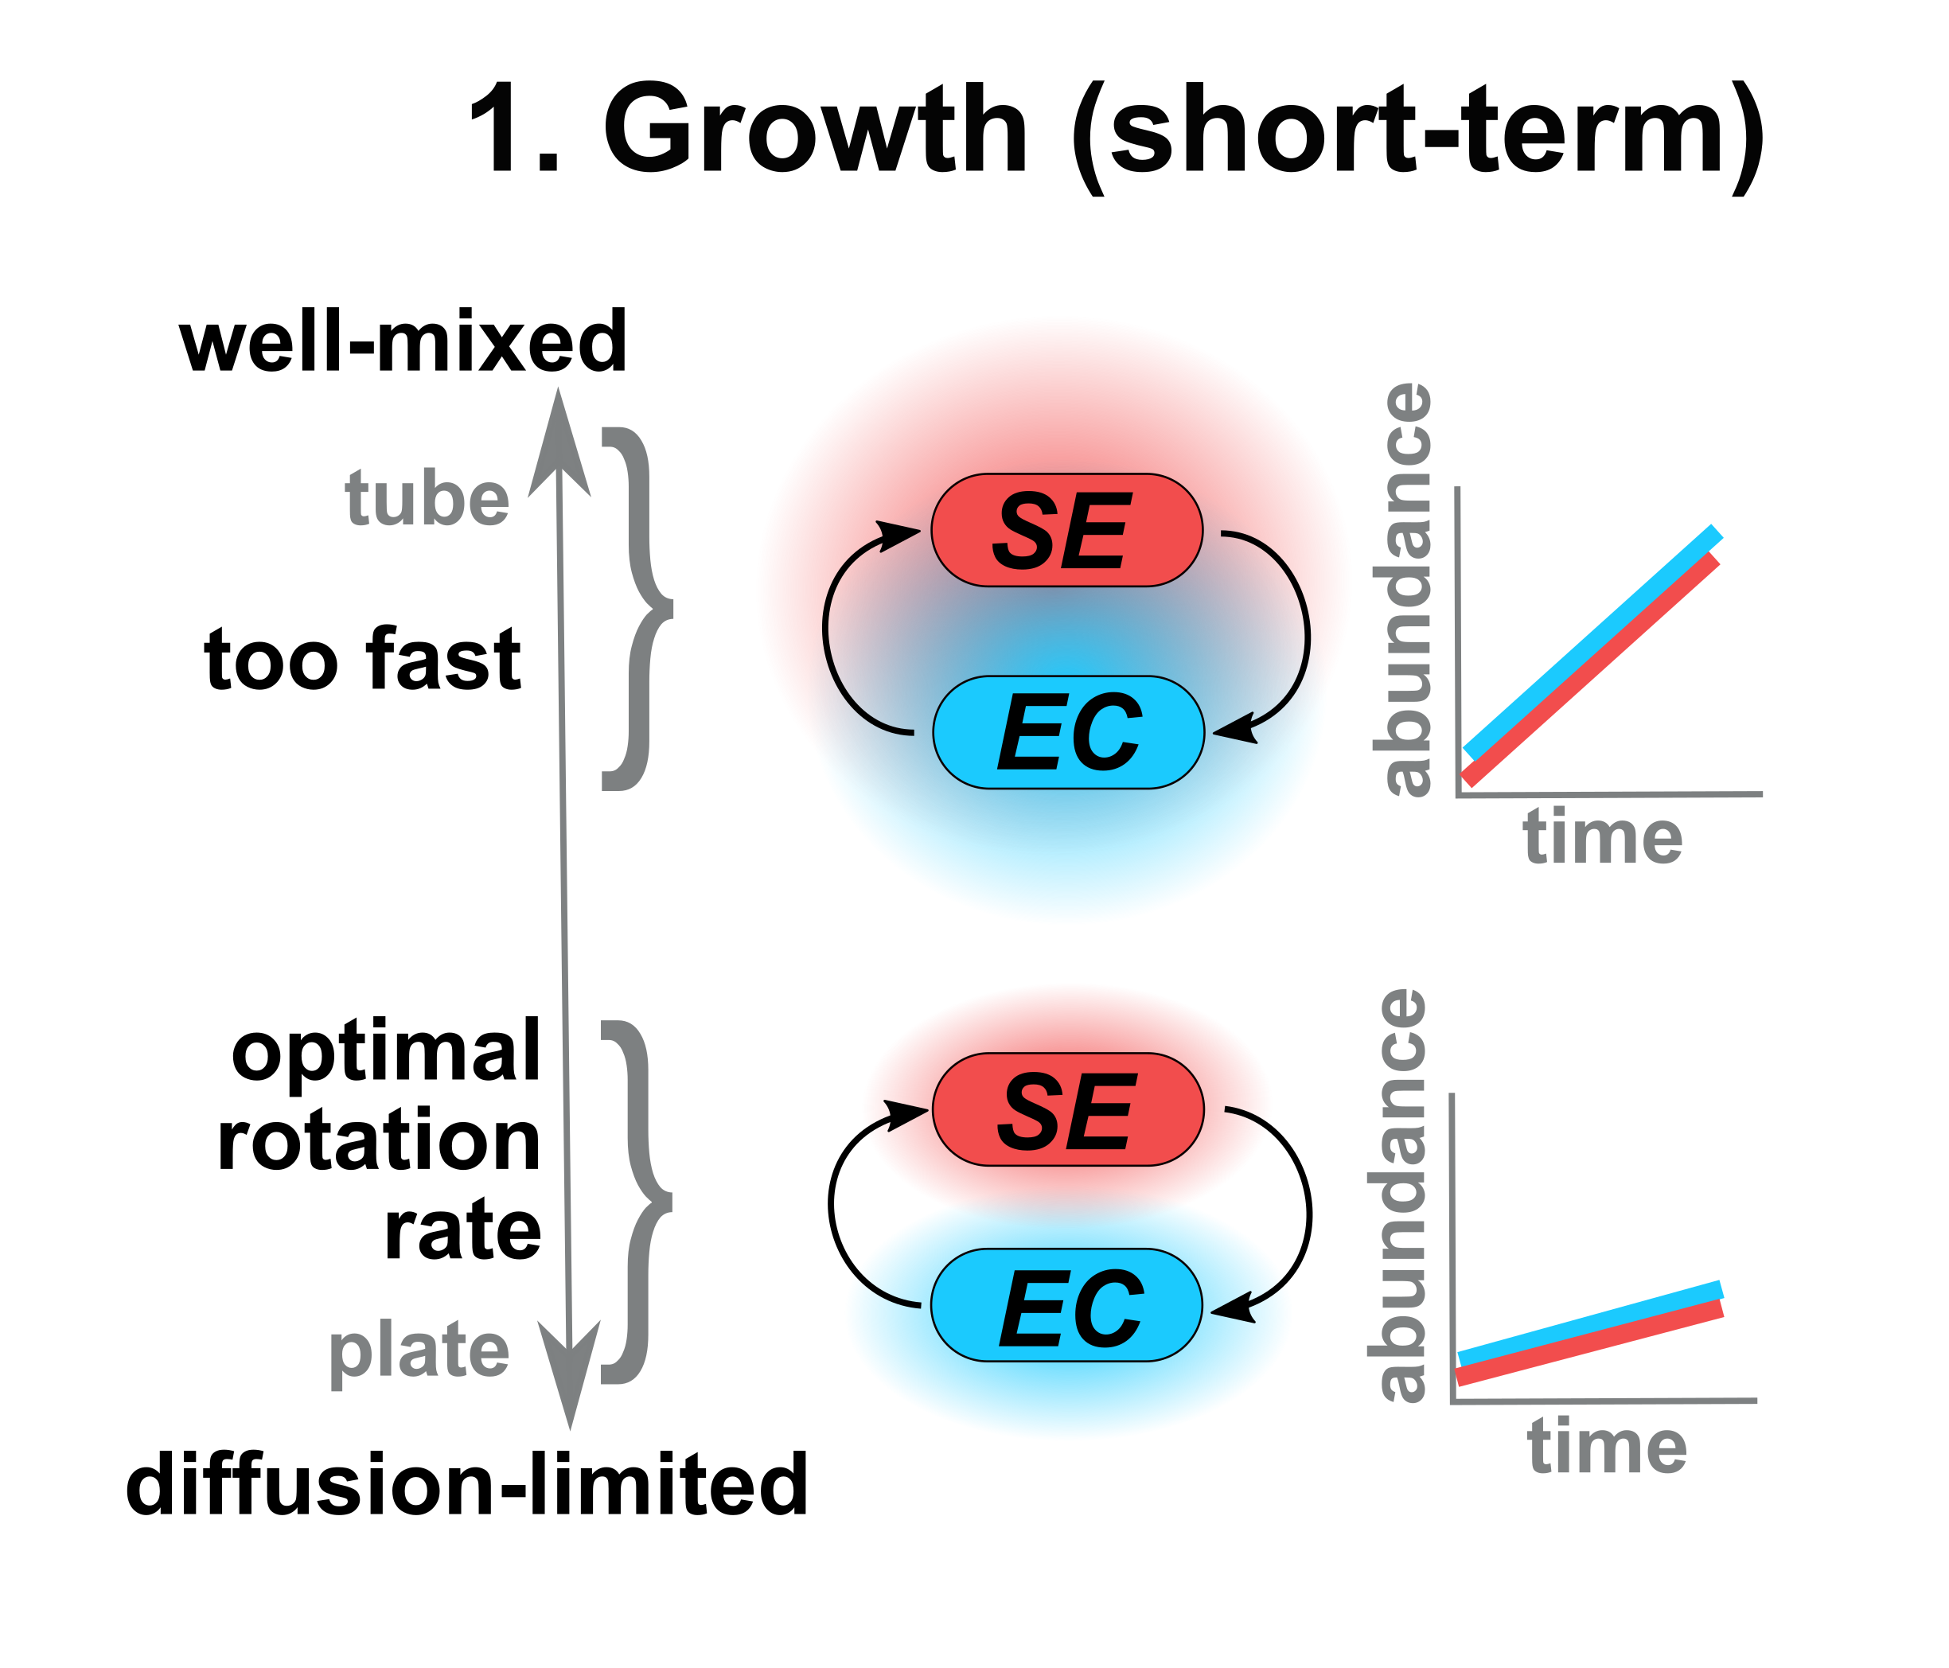
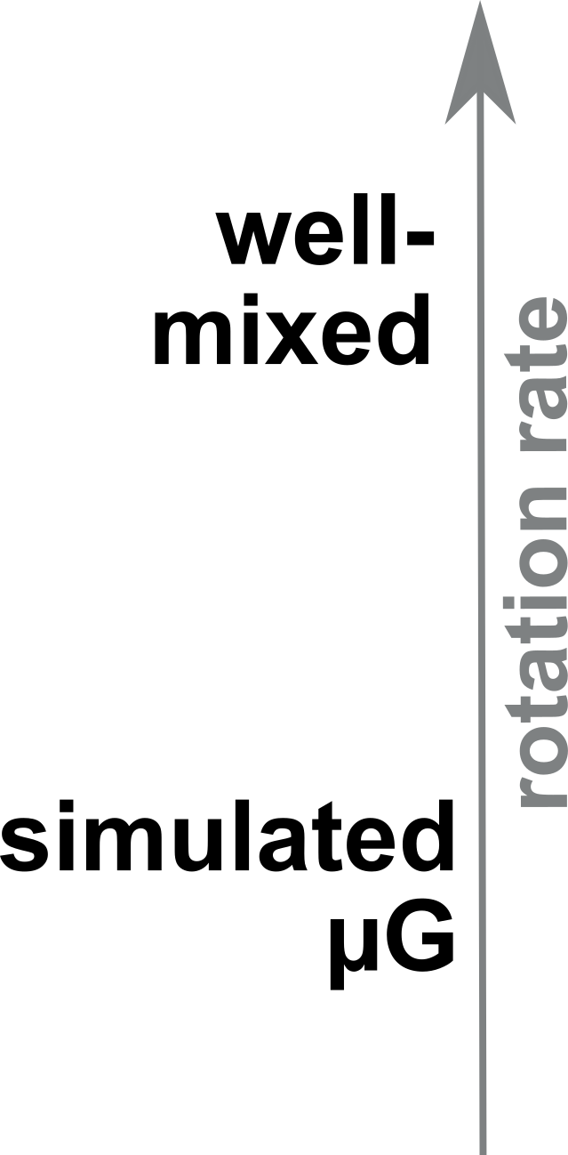
Microgravity should slow interspecies metabolite exchange
One hypothesis for the effects of spaceflight on microbial communities

Slide 21
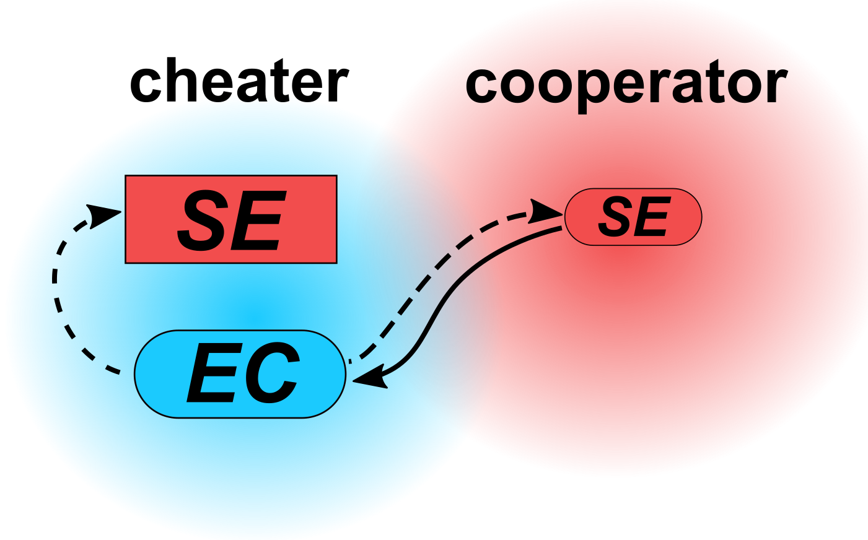
A cross-feeding bacterial community
with cheaters

Slide 22
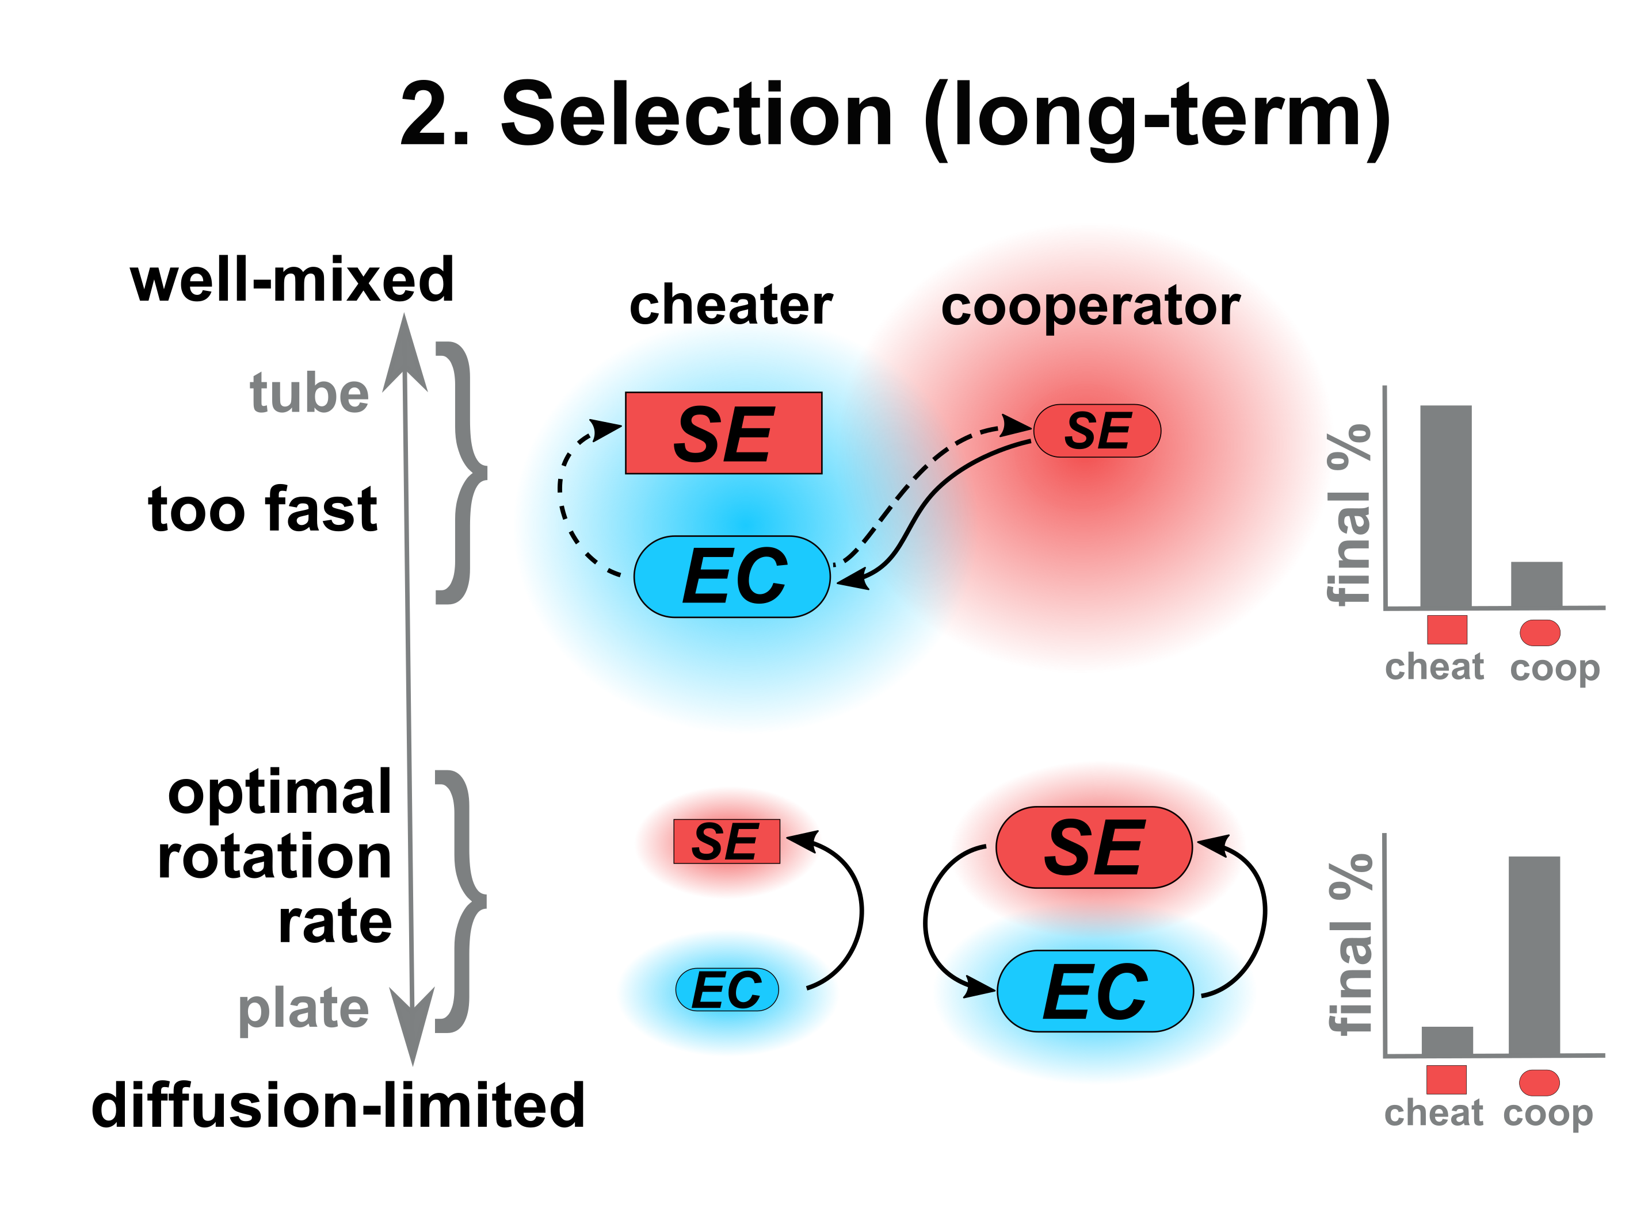
Microgravity should favor
cheaters over cooperators
Another hypothesis for the effects of spaceflight on microbial communities

Slide 23
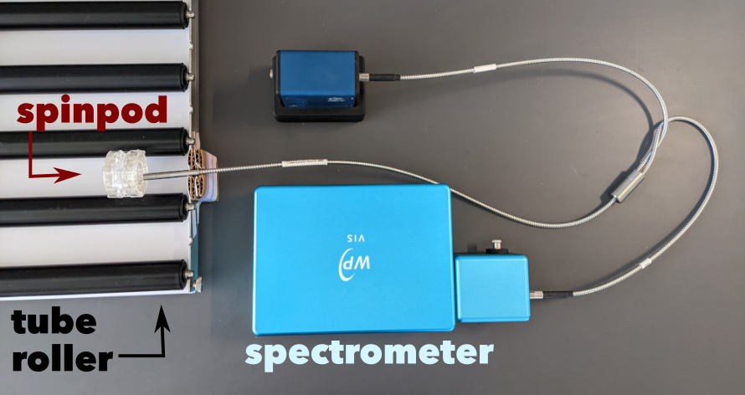
With fluorescence, we can measure growth and species ratios
while in simulated μG

Slide 24
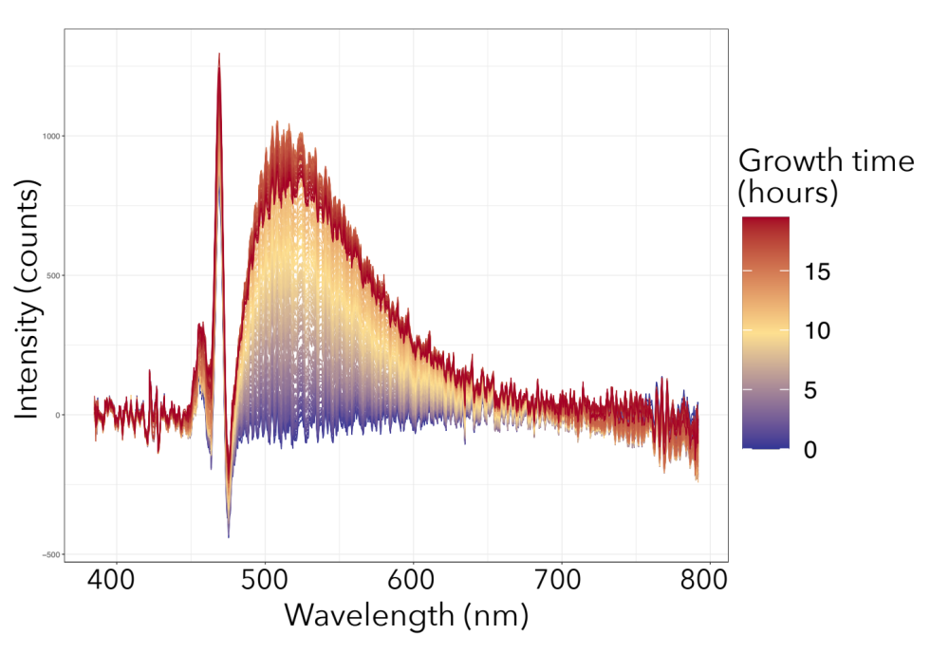
With fluorescence, we can measure growth while in simulated μG
The fluorescence peak from cells increases as biomass increases

Slide 25
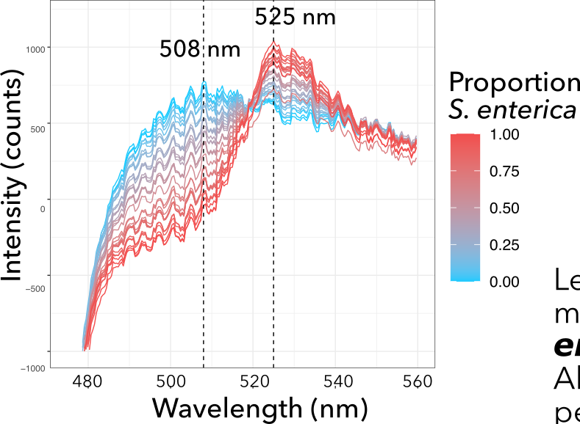
We can also measure species ratios
in situ
Ratio of peak heights at 508 nm and 525 nm is correlated to species ratio

Slide 26
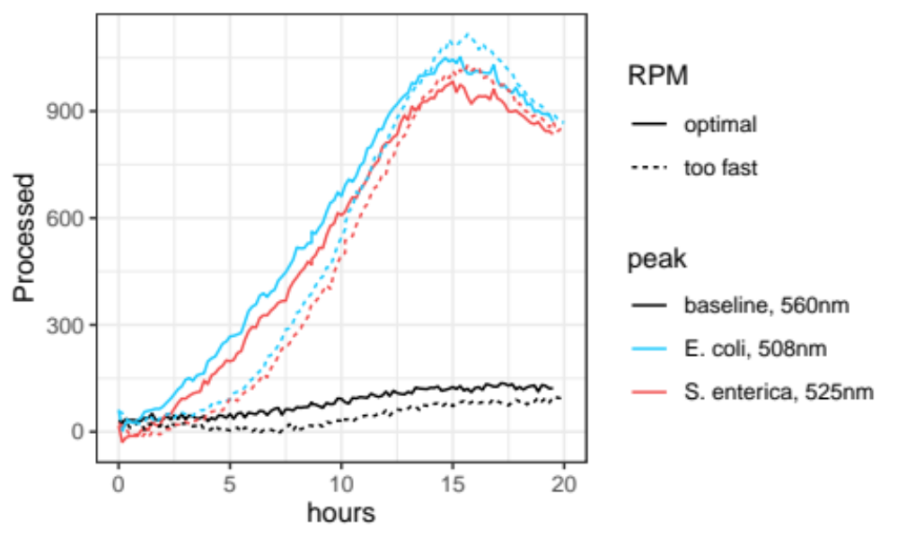
The community grows more slowly in simulated microgravity*
* Preliminary data! Pending more replicates and statistical analysis
simulated μG
well-mixed
Rotation rate affects growth rate. For E. coli (508 nm):
simulated μG: μ_{max}=6.07x10⁻³
well-mixed: μ_{max}=8.93x10⁻³
Notes:
See GrowthRateComparison230611.R

Slide 27
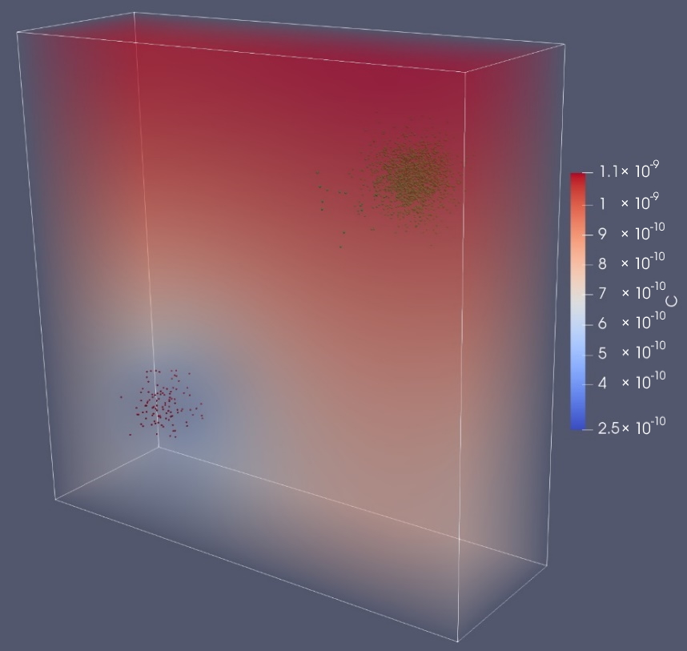
CAMDLES
CFD-DEM Artificial Microgravity Developments for Living Ecosystem Simulation:
a computational model of multispecies bacterial communities
in real and simulated microgravity
CAMDLES simulates:
fluid flows
bacterial growth and metabolism
chemical fluxes
gravity
Acetate
(cell equiv/
μm³)
Two single-species colonies in microgravity
An R, Lee JA. 2022. CAMDLES: CFD-DEM Simulation of Microbial Communities in Spaceflight and Artificial Microgravity. Life 12:660. doi:10.3390/life12050660

Slide 28
https://www.nasa.gov/hrp/5-hazards-of-human-spaceflight
Notes:
https://www.nasa.gov/hrp/5-hazards-of-human-spaceflight

Slide 29
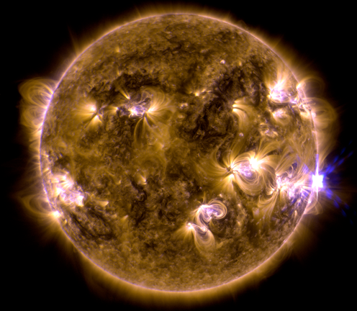
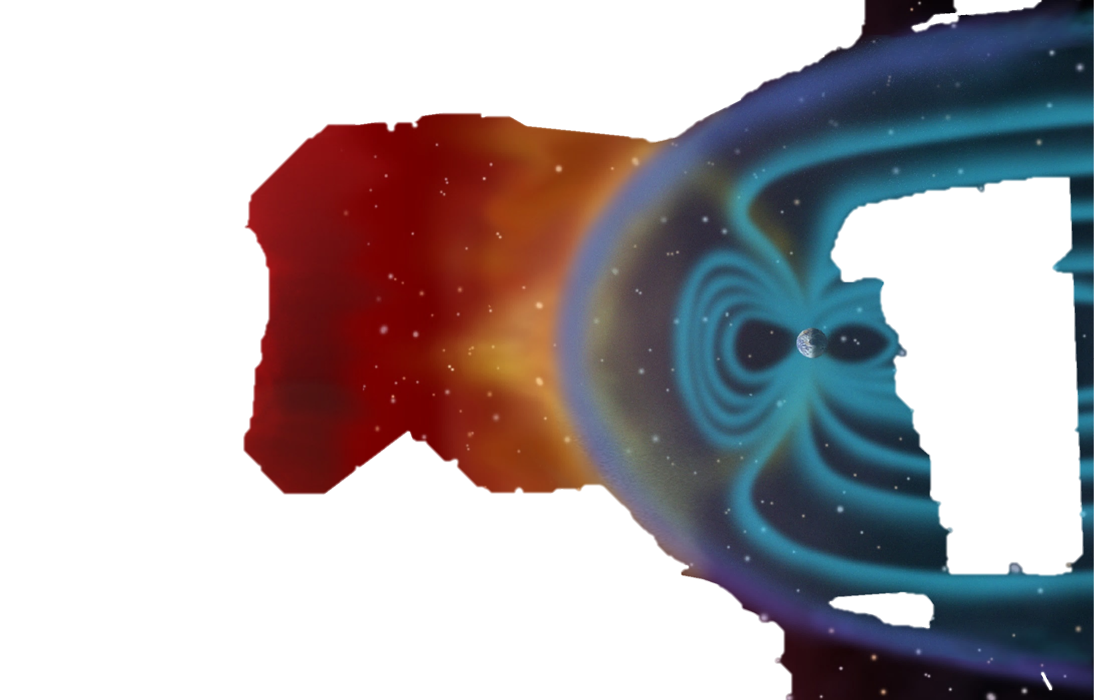
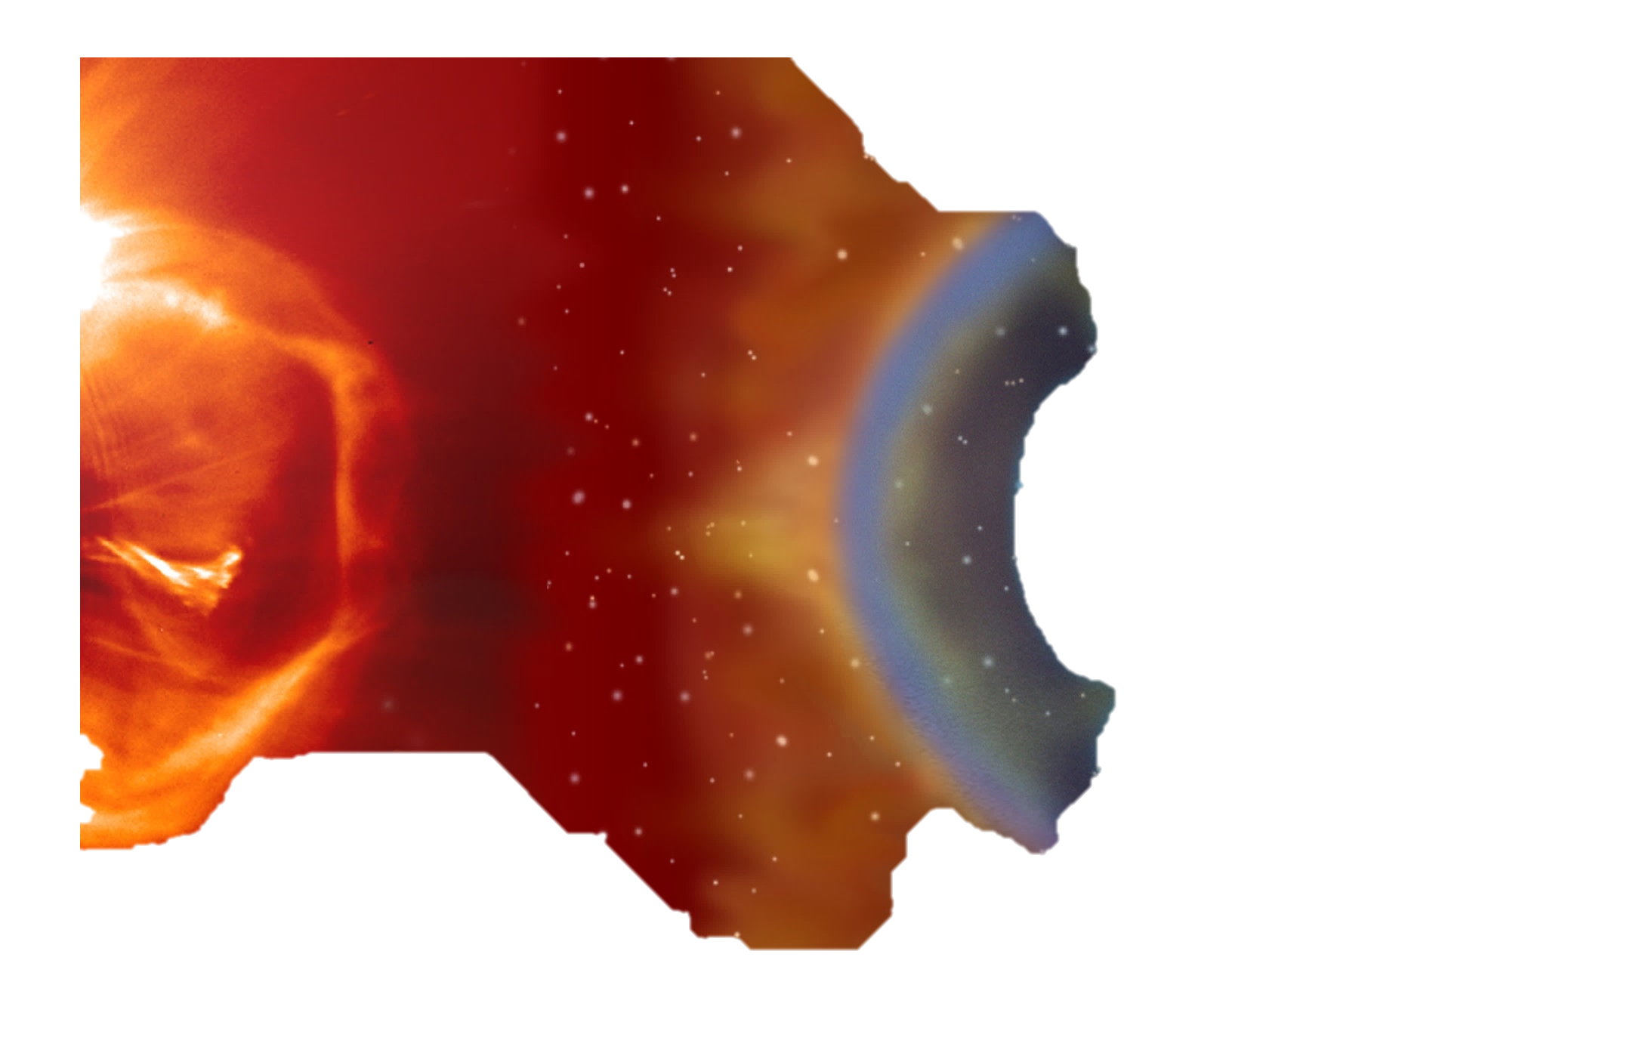
Deep space radiation: a hazard of a different flavor
Galactic Cosmic Rays (GCRs)
Solar Particle
Events (SPEs)
Trapped particles
SPEs: sporadic, transient (mins to days); high proton flux (low-medium energy)
GCRs: high-energy protons and highly charged, energetic heavy particles. Hard to shield.
Deep space radiation levels are modulated by the 11-year solar cycle
Image credit: NASA

Slide 30
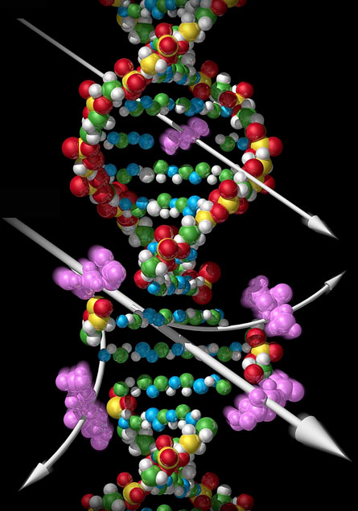
Radiation causes damage
in multiple ways
Direct DNA damage
(strand breaks, base damage)
Oxidative damage from Reactive Oxygen Species (ROS)
X-ray
Protein & Ion Leaks
Cell cycle arrest
Peroxidation of lipids
Heavy ion
Low ATP
DNA Damage
Repressed translation
image credit: M. Settles, NASA

Slide 31
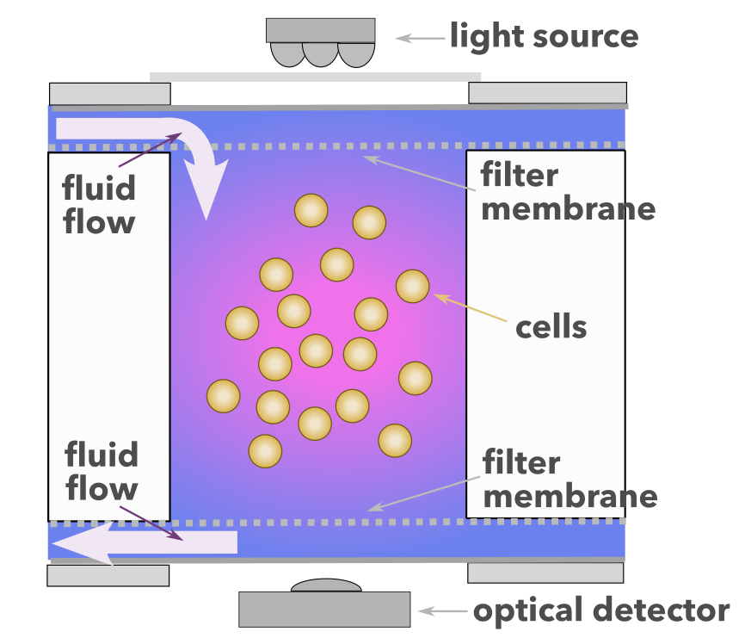
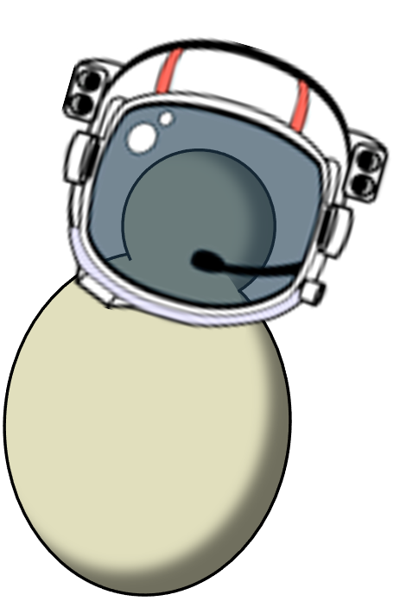
Yeast are a common model organism for deep-space radiobiology
Fluidic card well: cross-section
Fluidic card with yeast, BioSentinel mission
BioSentinel yeastronaut
Notes:
https://www.nasa.gov/feature/ames/nasa-s-biosentinel-team-prepares-cubesat-for-deep-space-flight

Slide 32
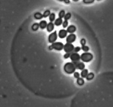
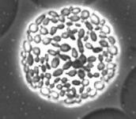
Single-cell yeast radiobiology
Lab study on the effects of spatially heterogeneous deep-space radiation
0 hrs 3 hrs 5 hrs 7 hrs 9 hrs
Individual cells are isolated in PicoShells.
Progeny stay together as a colony inside shell
PicoShells made of
Polyethylene glycol (PEG) contain cells but allow nutrient exchange
Collaboration with the Di Carlo lab, UCLA
Notes:
images from 10/24 timecourse
T0-4
T3-4
T7-4
T9-a7
see also T8-3 (not shown)

Slide 33
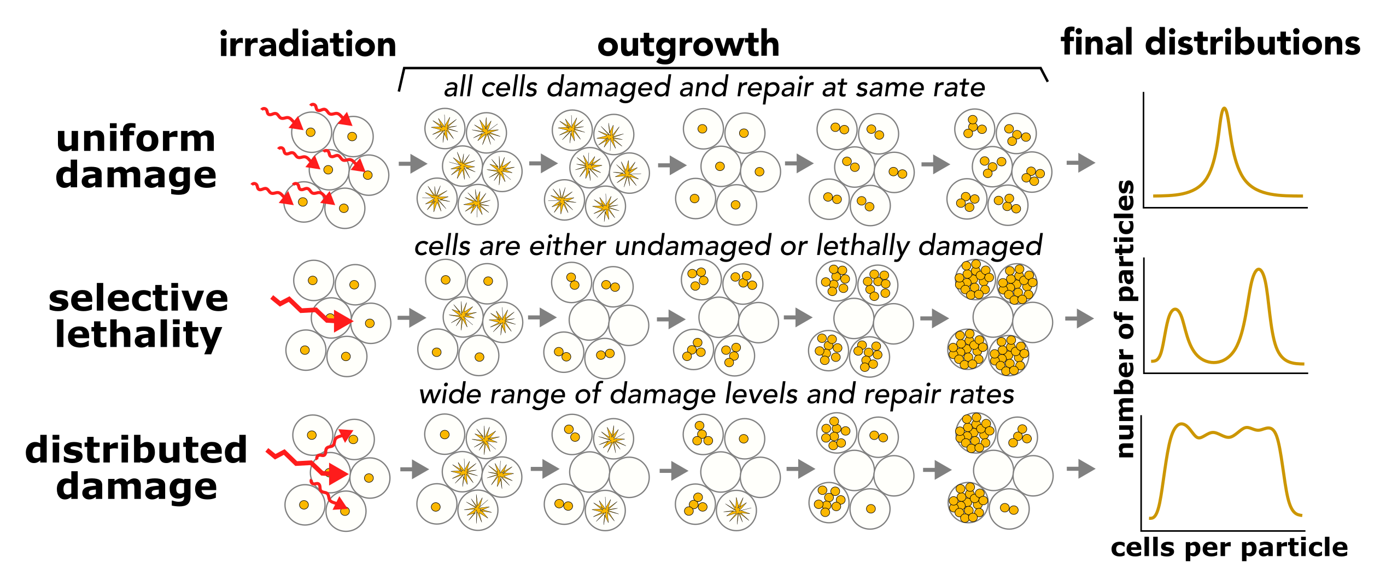
Encapsulation allows us to survey the distribution of single-cell responses
Hypotheses

Slide 34
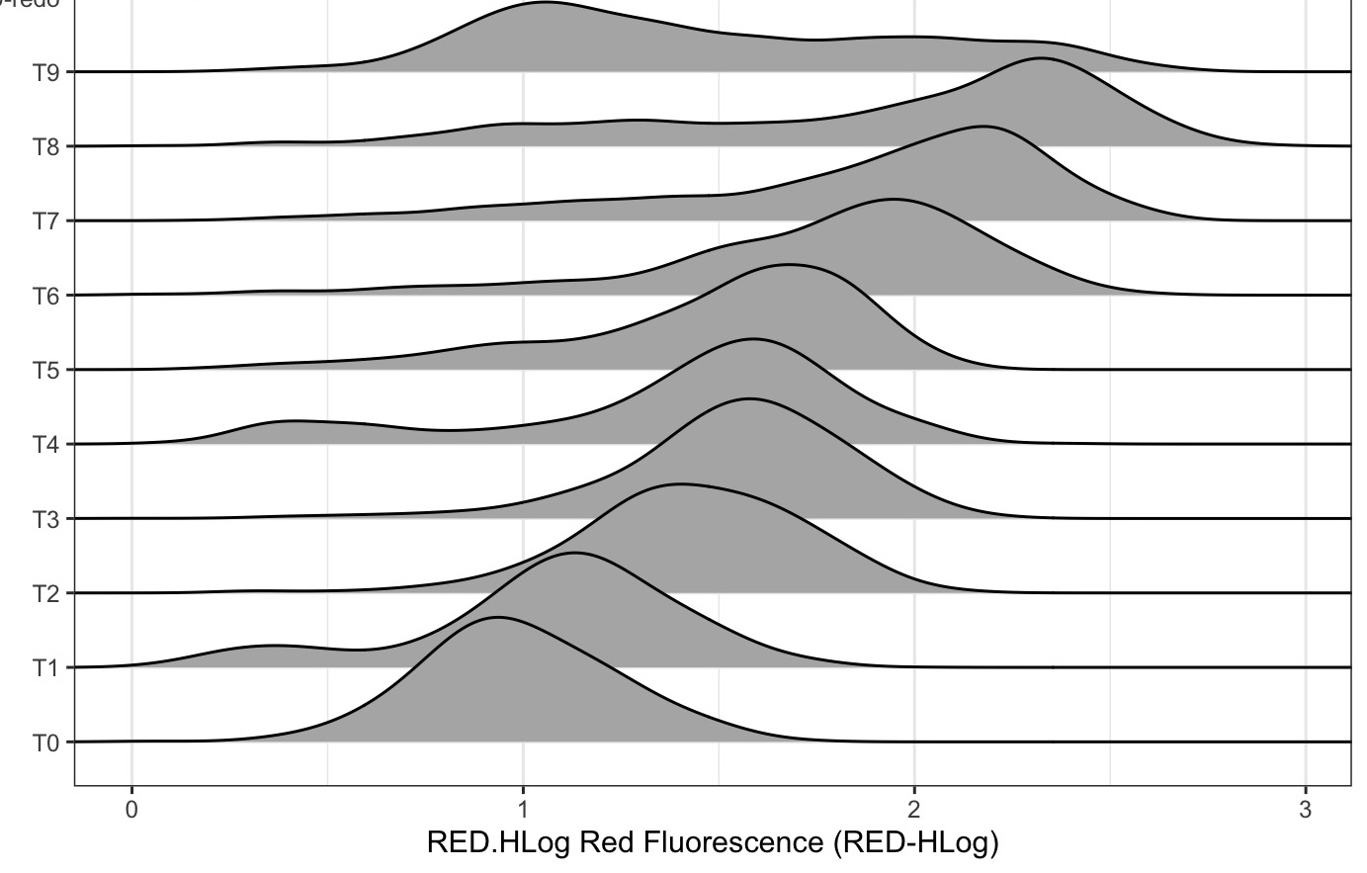
Flow cytometry enables tracking growth of clonal colonies over time
9
8
7
6
5
4
3
2
1
0
Growth time (hours)
number of events
Distribution of red fluorescence ~ cells per PicoShell (log scale)

Slide 35
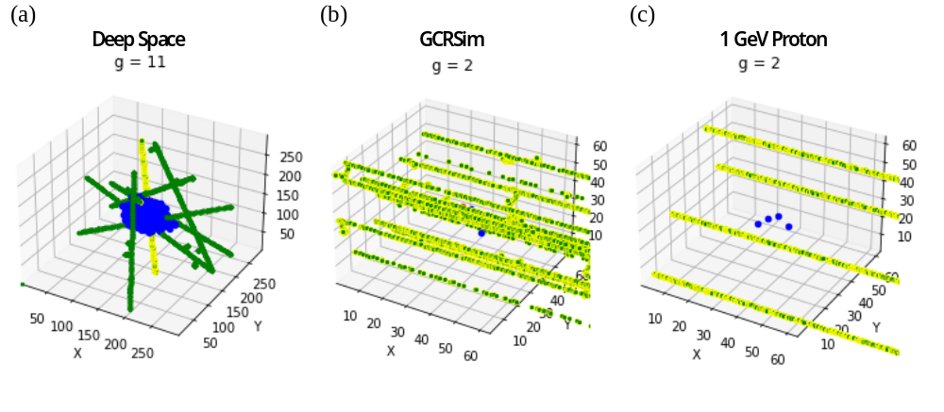
AMMPER
a computational model of yeast populations
exposed to Galactic Cosmic Ray (GCR) radiation
yeast population growth
radiation energy deposition (from RITRACKS)
ROS generation
cell damage and recovery
Accelerator
(simulated GCR)
Accelerator
(150 MeV protons)
Deep Space
yeast cells
image credits: Amrita Singh, NASA
radiation track
reactive oxygen species
Relativistic Ion Tracks: https://software.nasa.gov/software/MSC-25937-1

Slide 36
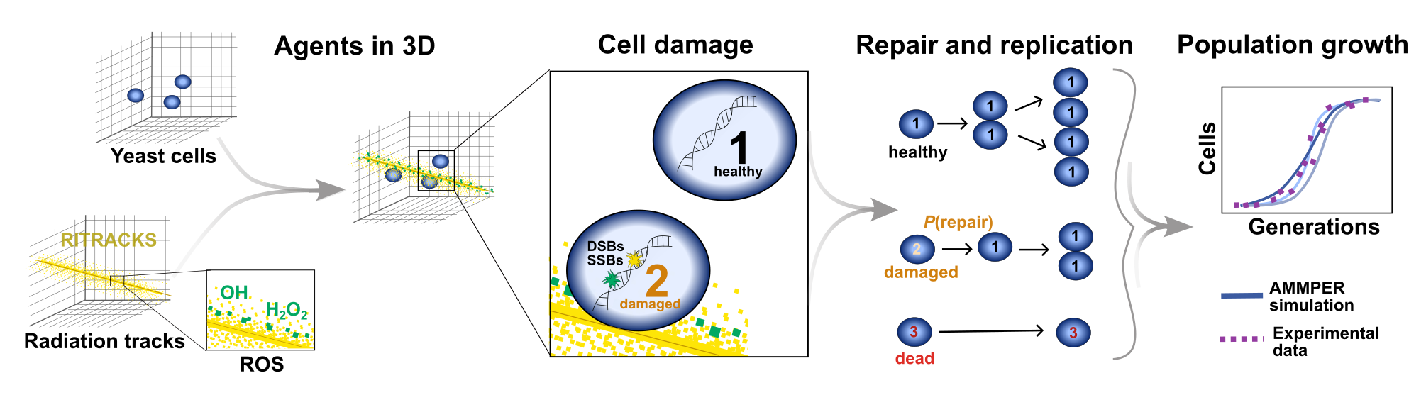
AMMPER
a computational model of yeast populations
exposed to Galactic Cosmic Ray (GCR) radiation
Preprint now on BioRxiv!
Singh et al. (2023) https://www.biorxiv.org/content/10.1101/2023.10.29.564630v1
Open-source software available at https://github.com/nasa/AMMPER

Slide 37
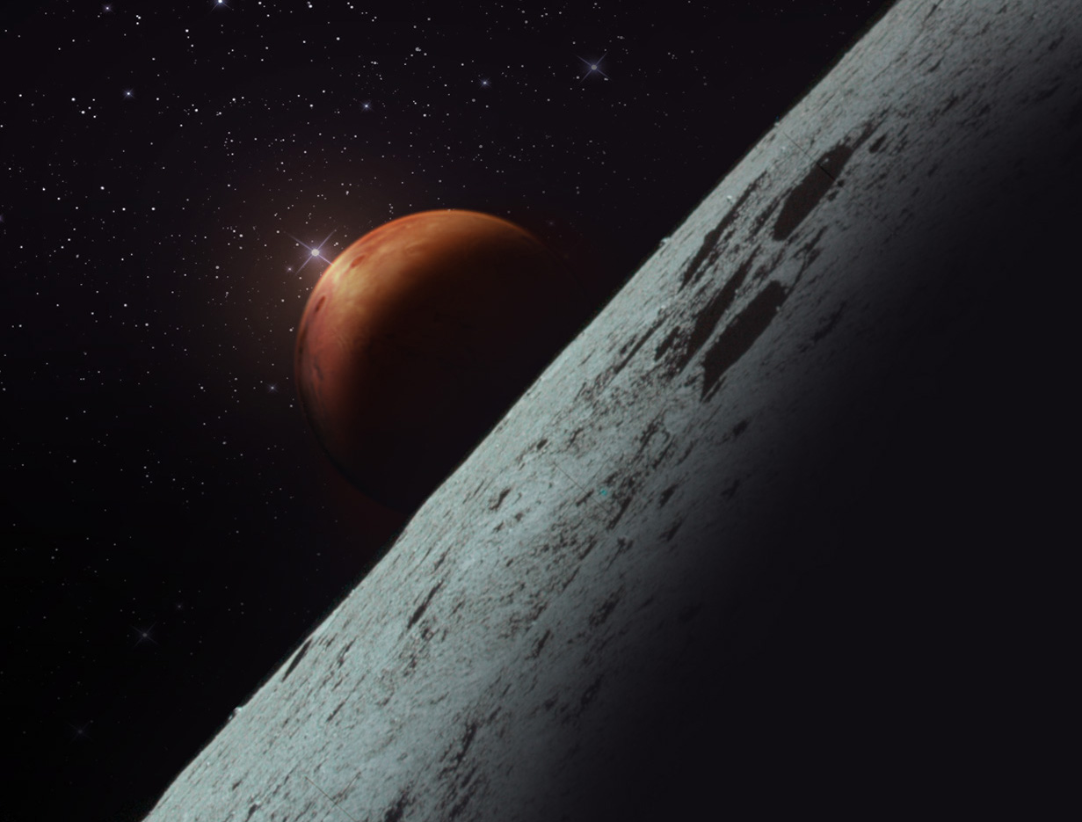
Conducting research in deep space
image credit: NASA

Slide 38
Conducting research in deep space
presents new challenges
Current platforms involve…
Longer payload integration / transit periods
→ longer stasis periods for organisms
Lower mass/volume/data limits
→ compact, efficient hardware
→ onboard data processing
Little / no crew time
→ autonomous / passive hardware
Little / no sample return
→ in situ measurement;
assays that return only data
image credit: NASA

Slide 39

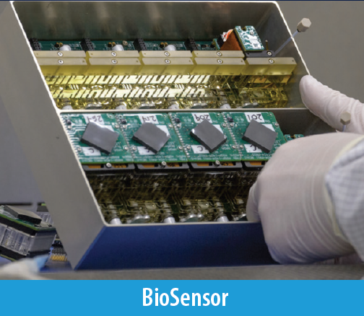
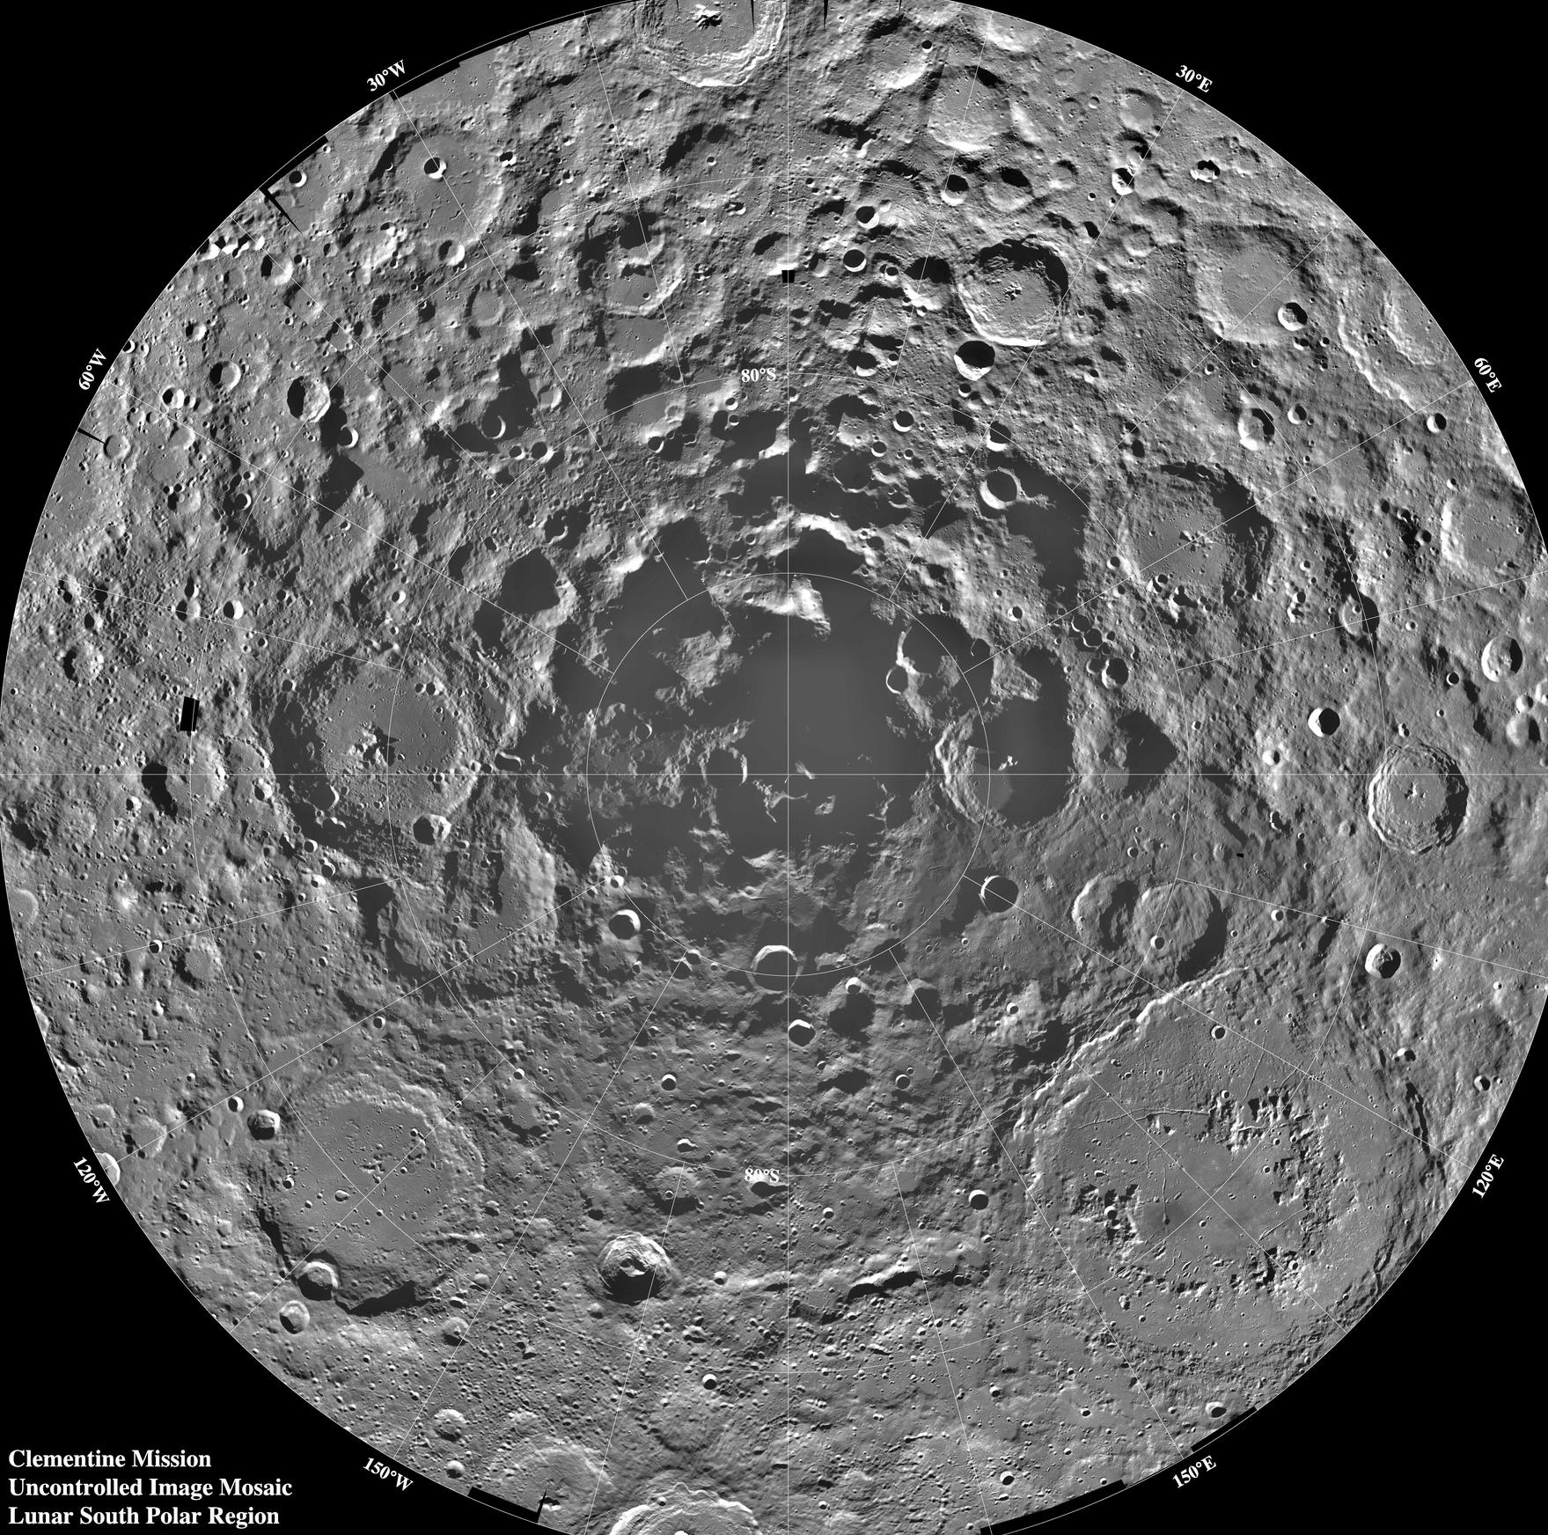


Lunar Explorer Instrument
for space biology Applications
a South Pole Lunar surface investigation
Motivation.
What are the radiation health risks for crewed exploration of the lunar surface?
Will proposed mitigations for crew health using in-space biomanufacturing be effective beyond low Earth orbit?
Approach.
Engineer yeast strains to test growth and metabolism for sensitivity to radiation.
Measure biologically relevant radiation in transit and on the lunar surface.
Expected Outcomes and Impact.
Determine cellular sensitivity to the lunar environment.
Evaluate feasibility of bioproduction on the Moon.
Test genetic strategies to enhance cellular tolerance to the lunar environment.
Determine ground truth radiation risks for crew.
Image credits: NASA
Team: Dr. A. Mark Settles (PI), Dr. Sergio Santa Maria (Deputy PI), Dr. Donald M. Hassler (Co-I, SwRI), David Pletcher (PM), Leandro James (SE)
For more information: https://www.nasa.gov/ames/leia

Slide 40


LEIA builds on generations of CubeSat biological missions
E. coli GeneSat-1 (2006 / 3U): gene expression
EcAMSat (2017 / 6U): antibiotic resistance
S. cerevisiae PharmaSat (2009 / 3U): drug dose response
BioSentinel (2022 / 6U): cell damage repair
B. subtilis O/OREOS* (2010 / 3U): survival, metabolism
*Organism/Organic Response to Orbital Stress
C. richardii SporeSat-1 (2014 / 3U): ion channel sensors, µ-centrifuges
Image credits: NASA

Slide 41

Lunar surface radiation:
yet another flavor of hazard
GCR
γ
Estimates of fast neutrons in lunar surface radiation
Mission | Project | Dose Type | % Fast Neutron
Lunar Prospector | LP | Effective | 16-18%
LRO | CRaTER | Absorbed | 0.7%
Chang’E 4 | LND | Absorbed | 23%
Lunar regolith absorbs galactic cosmic radiation (GCR) to produce secondary albedo neutrons
    High-energy, fast neutrons cause direct cellular damage
    Fast neutrons also produce ionizing radiation
    Estimates of surface neutron doses vary widely
Image credits: NASA

Slide 42

LEIA’s planned landing site:
Mons Mouton
Mons Mouton is a mesa-like lunar mountain near the Nobile Crater.
Visible from Earth, roughly the size of Delaware.
The VIPER mission will survey near the western rim of the crater.
LEIA will land in a more central region of the mountain.
Video Credit: Ernie Wright, NASA

Slide 43

Commercial Lunar Payload Services (CLPS)
CLPS relies on American companies to deliver NASA payloads from Earth to the surface of the Moon.
LEIA is a payload on CP-22 and scheduled to land in late 2026.
Peregrine-1: launched Jan 8, 2024. 1st NOVA-C (Odysseus): launched Feb 15, landed Feb 22, 2024
Image Credit: Jenny Mottar, NASA

Slide 44




LEIA Instrument suite
BioSensor
BioSensor is a microfluidic culturing system to measure yeast growth and metabolism.
ARES Timepix3 spectrometer measures charged particle radiation.
Mini-FND is a fast neutron detector.
ARES LET Spectrometer
Image credits: NASA

Slide 45



The BioSensor monitors cell growth
in microfluidic culture wells
Microfluidic card stack
Individual Cell Culture Well
~5 cm
BioSensor contains 16 microfluidic cards
Pumps and valves control medium addition through 2 separate manifolds
Each card has 16 culture wells (256 wells total)
Each well can record light absorbance data at 3 LED wavelengths
Image credits: BioSentinel project, NASA

Slide 46

alamarBlue dye helps us see
yeast metabolic activity
O⁻
N⁺
Resazurin
(Blue)
HO
O
O
Reduction of alamarBlue (aB)
changes dye color.
570 nm – measures pink aB
630 nm – measures blue aB
850 nm – measures cell growth
N
Resorufin
(Pink)
HO
O
O
H
N
Dihydroresorufin
(Colorless)
HO
O
OH
Credit: A.M. Settles and S.R. Santa Maria, NASA

Slide 47






Space Synthetic Biology: BioNutrients
Microbially fermented foods to produce essential nutrients
SB2022 (β-carotene)
23°C
25°C
S. cerevisiae var. boulardii producing β-carotene
Rationale: Engineer yeast and/or bacteria to produce essential nutrients when grown for a short period of time in edible media.
Rapid, on-demand production
Room temperature storage of organisms
Enriches pre-packaged foods with labile nutrients
Carotenoids selected as initial nutrient:
Light sensitive and degrades in packaged foods
Important to protect from macular degeneration
Antioxidant activity to protect against DNA damage
30°C
35°C
courtesy of Synthetic Biology Project/BioNutrients, F. Donovan, NASA

Slide 48
The BioSensor can monitor both metabolism and bioproduction
465 nm
570 nm
630 nm
Y55
Extract
aB
Relative Absorbance/Emission
350
400
450
500
550
600
650
700
Wavelength (nm)
Carotenoids absorb in blue wavelengths.
Replace 570 nm with a 465 nm LED.
Credit: A.M. Settles and S.R. Santa Maria, NASA

Slide 49

LEIA’s expected outcomes
Determine cellular sensitivity to the lunar environment.
Evaluate feasibility of bioproduction on the Moon.
Test genetic strategies to enhance cellular tolerance to the lunar environment.
Determine ground truth radiation risks for crew.
Image credit: NASA

Slide 50

Curiosity rover. image credit: NASA
Notes:
https://mars.nasa.gov/resources/3327/curiosity-at-center-of-attention-during-test/?site=msl

Slide 51


Planetary protection
Preventing forward contamination requires bioburden reduction (sterilization) of spacecraft components to:
inactivate viable microorganisms
eliminate cell debris and other potentially confounding biosignatures
Current methods (mostly Heat Microbial Reduction):
require removing hardware from the assembly room
are time-consuming and expensive
are incompatible with sensitive instruments
do not remove cell debris
Viking lander in preparation for HMR
Mars 2020 bit carousel assembly
Photo credits: NASA
Notes:
https://www.nasa.gov/press-release/nasa-s-planetary-protection-review-addresses-changing-reality-of-space-exploration
https://www.planetary.org/space-images/viking-in-the-oven

Slide 52

Femtosecond pulsed laser processing for sterilization
PI: Craig Zuhlke, University of Nebraska-Lincoln
High photon flux: 35 fs laser pulses (~1 x 10³¹ photons/(sec*cm²), ~0.1 J/cm²). Multi-photon, non-linear light-matter interactions.
High-speed surface scanning: ~2,500 cm² /sec - can be done in situ
Wavelength-tuned: Can enhance standard UV sterilization,
or take advantage of resonance absorption of water (2.7 µm)
Dual-pulse option: Two pulses spaced picoseconds apart.
Takes advantage of
time-dependent light-
matter interaction
processes.
Not previously used
for sterilization.
credit: Kaleb McQuillan, Craig Zuhlke
Sterilization research using high photon flux tuned wavelength femtosecond pulses is enabled by the Coherent Legend Elite Duo laser (see Figure 2) at UNL that was acquired with Defense University Research Instrumentation Program (DURIP 2016) funding ($488K). The laser is wavelength tunable from 800 nm to 15 microns. The wavelengths of 400 nm and 266 nm are also available using non-linear crystals available in the lab.
For this task only Bacillus subtilis will be used following the microbiology methods described in Section 2.4.1. Surfaces spiked with the spores will be illuminated with femtosecond pulses at various wavelengths below the damage threshold for the aluminum. Wavelengths of particular interest are resonance wavelengths for the water in the spores (e.g., 2.7 µm). As an alternative to using IR wavelengths, we will also investigate the use of UV wavelengths at frequency doubled (400 nm)
Figure 2. State-of-the-art femtosecond laser research facilities at UNL.

Slide 53


Slide 54


Femtosecond lasers may remove spore material
B. subtilis spores were deposited on mirror-polished aluminum
Processed at peak fluence = 0.04 J/cm² and a pulse count = 100,000
Pre-Processing
Post-Processing
credit: Kaleb McQuillan
Sterilization research using high photon flux tuned wavelength femtosecond pulses is enabled by the Coherent Legend Elite Duo laser (see Figure 2) at UNL that was acquired with Defense University Research Instrumentation Program (DURIP 2016) funding ($488K). The laser is wavelength tunable from 800 nm to 15 microns. The wavelengths of 400 nm and 266 nm are also available using non-linear crystals available in the lab.
For this task only Bacillus subtilis will be used following the microbiology methods described in Section 2.4.1. Surfaces spiked with the spores will be illuminated with femtosecond pulses at various wavelengths below the damage threshold for the aluminum. Wavelengths of particular interest are resonance wavelengths for the water in the spores (e.g., 2.7 µm). As an alternative to using IR wavelengths, we will also investigate the use of UV wavelengths at frequency doubled (400 nm)
Figure 2. State-of-the-art femtosecond laser research facilities at UNL.

Slide 55

Femtosecond lasers definitely
kill spores
B. subtilis spores were deposited on mirror-polished aluminum
Viability was assayed by removing spores from coupons with PVA peel,
then serial dilution and plating for colony-forming units.
5e+04
1e+05

Slide 56
Microbes are essential
to space exploration
BioSentinel
Model organisms to investigate space effects on biology
Ricco et al. 2020 doi: 10.1109/MAES.2019.2953760
Potential to keep astronauts healthy through regenerative life support and microbial biotech
credit: Miki Hyunh, NASA
They're coming with us anyway: microbiomes of astronauts and spacecraft
credit: NASA

Slide 57


Apply to become an Artemis generation astronaut before Tuesday, April 2!
https://www.nasa.gov/humans-in-space/astronauts/become-an-astronaut/

Slide 58



intern.nasa.gov

Slide 59


Thank you!
CAMDLES and
cross-feeding communities
Rocky An
Jess Gonzalez
Nathan Moreno
Juliana Gesztesi
Umme Nur Habiba
John Lawson
Tyler Quarton
Emmanouil Skountzos
Ashwin Ravichandran
Timothy Lannin (Northeastern)
Will Harcombe (U. Minnesota)
Jeremy Chacón (U. Minnesota)
AMMPER and
yeast radiobiology
Amrita Singh
Daniel Palacios
Madeline Marous
Pramesh Sharma
Diego Salgues
Sarah Pierce
Dino Di Carlo (UCLA)
Mark van Zee (UCLA)
Sergio Santa Maria
Diana Gentry
Lauren Liddell
Planetary Protection
Maha Ulhaq
Dylan Walsh
Trinity Smith
Ryan Ozatalar
Craig Zuhlke (U. Nebraska)
Graham Kaufman (U. Nebraska)
Kaleb McQuillan (U. Nebraska)
Support from: NASA Space Biology Program,
NASA Planetary Protection Research Program,
NASA Ames Space Life Sciences Training Program,
Space Grant, MUREP, ARIA, CIF

Slide 60

Project Team
A. Mark Settles (PI)
Sergio Santa Maria (Deputy PI)
Donald M. Hassler (Co-I, SwRI)
David Pletcher (PM)
Hami Ray (Deputy PM)
Science Team
Natalie Ball
Jared Broddrick
Jessica Chau
Katie FIsher
Diana Gentry
Chinmayee Govinda Raj
Aditya Hindupur
Jessica Lee (Project Scientist)
Lauren Liddell
Jack Miller (Radiation)
Kira Rienecker
Dunya Shuman
Sandra Vu
Engineering Team
Leandro James (Lead SE)
Earl Daley (Mechanical)
Matt McKay
Mike Padgen (Fluidics)
Victor Yeh
Brandon Schmitt (Software)
Bryan Kirsch
Mareyna Karlin
Nicholas Stoffle (ARES)
Brett Stroozas (OPs)
Steven Ormsby
Alex Szerszen (Thermal)
H. Kris Vogelsong (I&T)
Shang Wu (Electrical)
Nghia Mai
Neil Davies
Aidan Remy
Mini-FND (SwRI)
Michael Vincent (PM)
Yvette D. Tyler (SE)
Jianxin Chen
Bent Ehresmann
Bryan Pike
Travis Smith
Eddie Weigle
Cary Zeitlin (JSC)
Lu Zheng
SMA
Mariano Perez (CSO)
Ted Drude (SQA)
NASA Interns
Kylie Akiyama
Jennifer Gil Acevedo
Stephen Lantin
Dylan F. Walsh
Payne E. Turney
Funding
NASA Planetary Missions Program Office - PRISM
NASA Biological & Physical Sciences - Space Biology
Image credits: NASA

Slide 62


Slide 63

AMMPER v2.0 simulates
yeast growth and metabolism
alamarBlue color composition
Time (hours)
microbial metabolism catalyzes
alamarBlue reaction: blue → pink → colorless
Credit: Pramesh Sharma, NASA

Slide 64

Radiation might make communities
as weak as the weakest link
A third hypothesis for the effects of spaceflight on microbial communities

Slide 65



Radiation effects are not as strong as microgravity effects
Simulated uG
Well-mixed
Simulated uG
Well-mixed
OD₆₀₀
Viable cells (CFU/mL)
Linear models:
OD ~ hours + spin rate + radiation: r²_{adj} = 0.9519
CFU ~ hours + spin rate + radiation: r²_{adj}=0.8299
Both OD and CFU showed significant relationships to rotation rate (p<0.005) but not to radiation.
None
GCRSim

