Slide 1
Extraction and Analysis of 4 Decades of Radiation Events from GSFC’s SOARS database
Jesse Leitner
SMA Chief Engineer
NASA GSFC Code 300
Supported by Walt Thomas (Code 371 - reliability) and Rebekah Austin (Code 561 – radiation)

Slide 2
Outline
Background
Scope of presentation
Definitions
Early lessons
Data gathering and review from SOARS
On-orbit experiences of nonconventional space electronics
Mystery electronics failures
Conclusions

Slide 3
Definitions (as used in this document)
COTS parts: Parts for which the part manufacturer solely establishes and controls the specifications for performance, configuration and reliability, including design, materials, processes, and testing without additional requirements imposed by users and external organizations. The use of any particular MIL-PRF or MIL-STD test, or performance of any type of testing is at the manufacturer’s discretion, as would be the decision to issue a product change notice.
FMRR*: fully manufacturer radiation rated, to be used with rated levels for each radiation variant - includes manufacturer-rated radiation assurance for TID, SEE, and DDD
PMRR: partially manufacturer radiation rated – includes manufacturer-rated radiation assurance for one or two of TID, SEE, and DID
RHA: Radiation Hardness Assurance – the overall practice of assuring a mission’s performance in a radiation environment
Radiation-tolerance: ability to sustain performance and reliability under some level of radiation exposure
Radiation design margin (RDM): the multiple of the expected amount of time that a particular part, component, or system can survive in the given radiation environment. We recommend discontinuing the use of this term, not just due to ambiguity, but because RDM has never proven to be a valid predictor or limiter of time or exposure of a mission or its individual parts to radiation
Strategic testing: testing performed from a general, focused testing effort outside of a project or program, generally in contrast to lot-specific testing.
*often the RHA term is used accordingly, but we introduce these terms to avoid conflict with the general process of radiation hardness assurance and to allow for specification of the manufacturer rated values when pertinent, e.g. FMRR 100 krad (TID), 37 MeV cm^2/mg (SEE), 1e12 Neutrons/cm^2 (DDD)

Slide 4
Early Lessons from study
While some passive devices might experience radiation effects (part-level radiation testing has shown some examples), rarely is radiation hardness assurance performed on passives, no NASA missions require it, and there is no evidence discovered yet that passive part radiation susceptibility has contributed to any on-orbit events
  Circuit effects due to radiation are always possible and often do not rely on susceptibility of individual parts. These are often missed since there is rarely a test as you fly approach that involves radiation and the traditional space community has implemented RHA as a parts assurance function
  Radiation should not be a consideration for resistors or capacitors
  Actives generally represent < 10% of parts counts
Radiation is not in opposition to COTS (nor is there any relationship at all between radiation and COTS)
  Most MIL-SPEC parts do not have FMRR (or even PMRR)
    Ex: JANS2N2907AUB (numerous similar examples exist)
  Many COTS parts do have FMRR or PMRR
    Ex: IRHM57160 (numerous similar examples exist)
  Unfortunately, the term “COTS” is often selectively misused today to mean “non-FMRR” (among other things)
There are a wide range of successful approaches to address radiation
  Lot-specific radiation testing of all susceptible part types combined with circuit level analyses (this largely will not work with broad use of non-FMRR parts)
  Strategic testing of parts (not lot specific) with periodic retesting to check variability combined with radiation-tolerant design
  Use of familiar parts
  Strict radiation-tolerant design and rad-hard by design methods using FMRR parts as front-end defenders
Using non-FMRR parts demands a holistic approach at radiation, but most parts we use today are non-FMRR

Slide 5
Data gathering
GSFC effort has combed all the tens of thousands of Spacecraft On-orbit Anomaly Records (SOARs) since the late 1980’s to cull out radiation-related anomalies
  Initial broad search identified ~140
  Subsequent poring through data opened up over 850 more
  None with catastrophic mission results
  Currently correlating against pertinent hardware, events, and locations
  Many radiation effects have been experienced on FMRR parts and other parts deemed “space-grade*”
Collecting mission experiential data for missions broadly flying non-FMRR parts
  Substantial datasets from GSFC and some other organizations
Reviewed mission lifetime data compared to radiation-driven design lifetimes for GSFC-managed missions since 2000
  One conclusion: radiation-driven lifetime (RDM) has no connection to actual lifetime
Reviewed numerous parts lists from high-end missions, such as SDO and JWST
*space-grade is a highly-renowned marketing term that can best be defined as “designed and tested to endure the historical ground testing regimens employed to spacecraft and space instruments to provide confidence to survive a lengthy development time on the ground, the launch, and finally many years on-orbit”

Slide 6
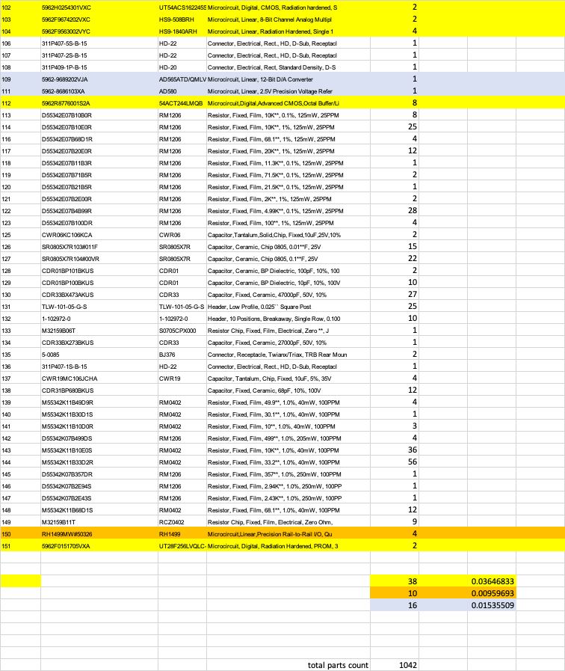
Typical BOM excerpt from high-end mission (Class B GEO)
Yellow highlight
MIL-SPEC FMRR
Orange highlight
COTS FMRR
Gray/purple highlight
Actives with no FMRR
Total parts count: 1042
Total MIL-SPEC FMRR: 3.6%
Total COTS FMRR: 10: 0.96%
Total non-FMRR and discrete semiconductors (requiring radiation testing or other forms of analysis: 16 (1.5%)

Slide 7
What do this BOM and other similar BOMs tell us?
Total active parts generally < 10% of part count (example has 6.1%)
FMRR parts are a mix of COTS and MIL-SPEC parts (example has 3.6% MIL/0.96% COTS)
Remaining active parts make up the rest, requiring radiation testing, ray-tracing, or other forms of analysis (example has 1.5% non-FMRR)
Non-FMRR parts were most likely not selected to save money (because cost for radiation testing was much higher than the savings, and thus cost was much higher)
If COTS were broadly permitted, then this would have no effect on the FMRR parts, but it would have simply opened more options for the non-FMRR parts, which all required radiation testing anyway (and which would require radiation testing whether COTS or MIL-SPEC)
Furthermore, the biggest drivers for the use of COTS are passives, e.g., needed to support modern FPGAs (extremely high capacitance with limited real estate).
Expanded use of COTS does not increase radiation risk for a project; however advanced technology missions enabled by high-performance COTS microcircuits will often demand new approaches to address radiation

Slide 8
Radiation and on-orbit non-RHA performance data sources
Test data:
  Traditional: radhome.gsfc.nasa.gov, transitioned to https://nepp.nasa.gov/pages/pubs.cfm
  New: esarad.esa.int
  New: pmpedia.space
On-orbit experiences (“fact of” - some info available)
  Spacecube data (LEO on-orbit – extensive non-FMRR and COTS – 10+ yr)
  Aerocube data (LEO on-orbit – 100% non-FMRR COTS – 10+ yr) (Aerospace Corporation)
  Swift data (585km x 604km, 20.6 deg - extensive COTS ~ 19 yrs)
  Ascent (GEO cubesat – launched 12/2021) (AFRL)
  Biosentinel (deep space cubesat – launched with Artemis)
  Newspace – extensive, limited data availability

Slide 9
GSFC On-orbit Radiation Effects: Current Results
Methods: Each anomaly record, including any attached data and information, was reviewed and scored according to the text descriptions for its "credibility" that the anomaly was, in fact, caused by space radiation (June - October 2023):
Anomaly record text describing a possible space radiation cause was coded PS.
Anomaly record text describing a likely, probable, or definite space radiation cause were coded PR, LK, and Y, respectively.
The rationale for using these three categorical codes was to capture as accurately as practical the text descriptions used in each record; LK and PR have approximately equal credence and Y is more definitive.
Overview facts:
852 Flight SOARS records indicated either possible (PS = 271) or combined likely, probable, or definite (LK, PR, Y = 581) radiation affected anomalies.
NOTE: Henceforth, LK, PR, and Y combined will be called PR, for brevity.
Records covered 73 spacecraft and 4 instruments, launched between 1983 and 2022. Thirty-seven (37) of those still are operating as of 31 December 2023.

Slide 10
GSFC On-orbit Radiation Effects: Overview Facts
56/77 missions (either spacecraft or instruments) were in either in LEO or geostationary orbits. The others included highly elliptic GEO, LaGrange point, heliocentric, and several other orbits. Three of the four instruments were hosted on ISS
56% of all radiation affected anomalies were recurring events; possible (PS) included 51% and probable (PR–combined, per above) included 59% of recurring events.
  - 10 spacecraft (FUSE, IBEX, LRO, POLAR, RXTE, SAMPEX, SWIFT, TERRA, THEMIS, and WIND) accounted for 83% of all recurring anomalies. All 10 had 20 or more radiation-induced anomalies. Excepting IBEX, they also were ones having the greatest numbers of SOARS Flight records – from over 125 to more than 1100 records for each.
  - These large numbers of radiation-affected and recurring events reflects non-uniform reporting into the SOARS database by operational missions. Some missions reported all anomalies, including all recurring events. Others reported only a portion of their flight anomalies or only an initial event that later recurred.
Spacecraft operating times range from 416 to 12,308 days (circa 31 December 2023); the longest operating "grandfather" spacecraft is the Hubble Space Telescope – at 33.7 years.

Slide 11
GSFC On-orbit Radiation Effects: Overview facts (cont’d)
Mission occurrence frequency data for radiation-induced events:
For each mission, occurrence frequencies were computed as the number of specified events divided by mission operating time, in days (to 31 December 2023, if the mission still is operational). This was performed for all (PS + PR), PR only, and PR discrete.
PR only removes the less credible possible events data; PR discrete data are the PR only data with associated recurring events discounted.
These extant frequency data are biased, when viewed from a mission risk perspective, because missions operating with no recorded radiation-affected events during its operating timeframe are not considered. (This is analogous to performing a Weibull analysis with only the failures and discounting the non-failed operating times.)
When viewed in the context of a technical mission risk, where the lower limit for a credible risk is a 0.1% likelihood (p_{occ} = 0.001):
35 missions (of 77) exceeded this threshold when All (PS + PR), including recurring events, were analyzed.
When PS and recurring events were excluded, this number decreased to 18 missions.
6 missions had credible likelihoods (p_{occ} > 0.001) simply because they had limited operating times, generally less than their design lifetimes (DLs).

Slide 12
GSFC On-orbit Radiation Effects: Overview facts (cont’d)
Only one mission mission recorded a radiation-induced anomaly mission impact as "Catastrophic." However, this event occurred several years after the mission's design life – at 2.9 times DL. Thus, from a mission success perspective, it had completed its mission requirements to its design life and the Catastrophic ranking likely overstated the mission impact.
803 of the 852 Flight radiation-induced anomalies had either "No effect" or "Minor" mission impacts (94%). This proportion is actually greater as several missions, particularly older ones, cited "- No data -" for mission impacts.
Several missions had listed mission impacts as "Significant," though a detailed reading of those anomaly records showed that the impacts were ranked incorrectly since most all had sustained only data or service losses that were restored after the causes were determined and corrected.

Slide 13
GSFC On-orbit Radiation Effects: Forward work
1. For occurrence frequency statistics, correct the computations to remove the bias.
  This will entail collecting appropriate SOARS Flight data on non-radiation-affected missions and integrating those data into the computations for each mission. Only non-affected missions operating at times of radiation-induced events for the radiation-affected missions would be applicable.
2. For the following analyses, we will use only the PR (combined) data subset.
Rationale: The above observed (to-date) frequency statistics indicate the PS data subset is substantially smaller (271 vs. 581 records) and those are "less credible" than the PR data subset.
The size of the PR data subset should provide adequate data for statistical comparisons and analyses.
3. Parse the data (PR combined) by orbit type to determine if there are significant differences between the orbit effects on mission radiation-induced anomalies.
4. Analyze the data to determine occurrence frequencies chronologically by launch dates.
Annual frequency data must be normalized via number of missions having radiation-induced anomalies to avoid biasing those data.
Consider analyzing data by launch decades or half decades to determine any significant findings.
5. Analyze chronological data to determine if on-orbit radiation-induced anomalies associate or correlate with the periodic solar cycle.

Slide 14
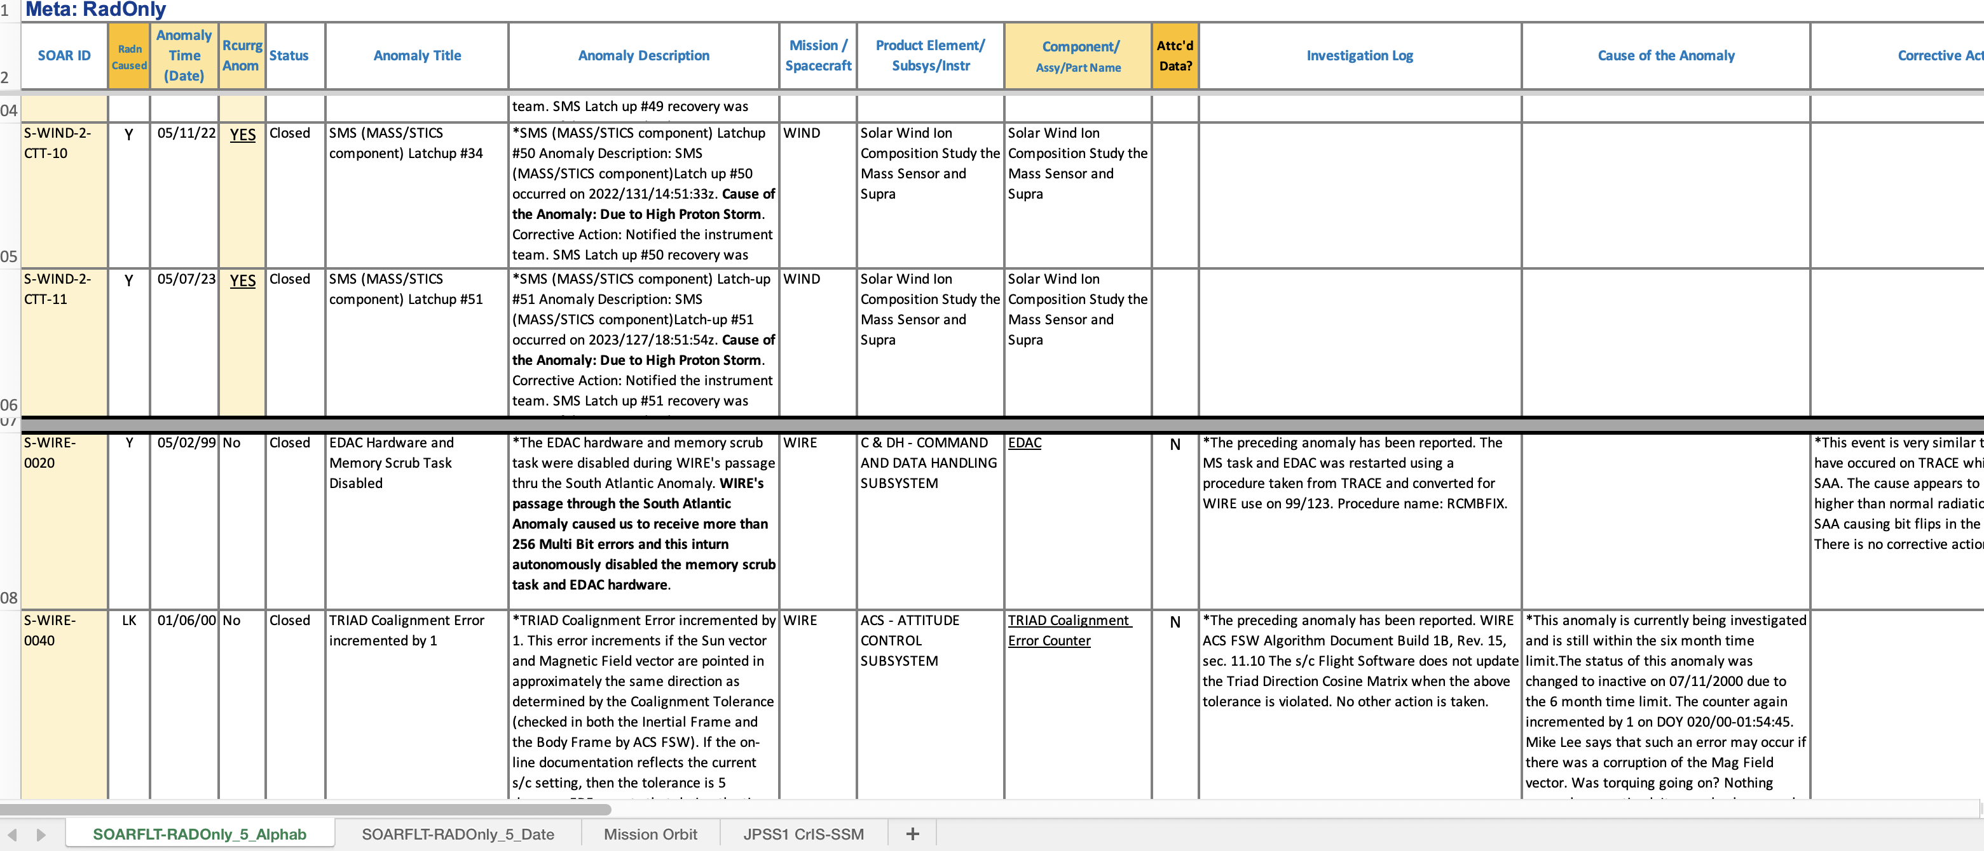
SOARS data review (1)

Slide 15
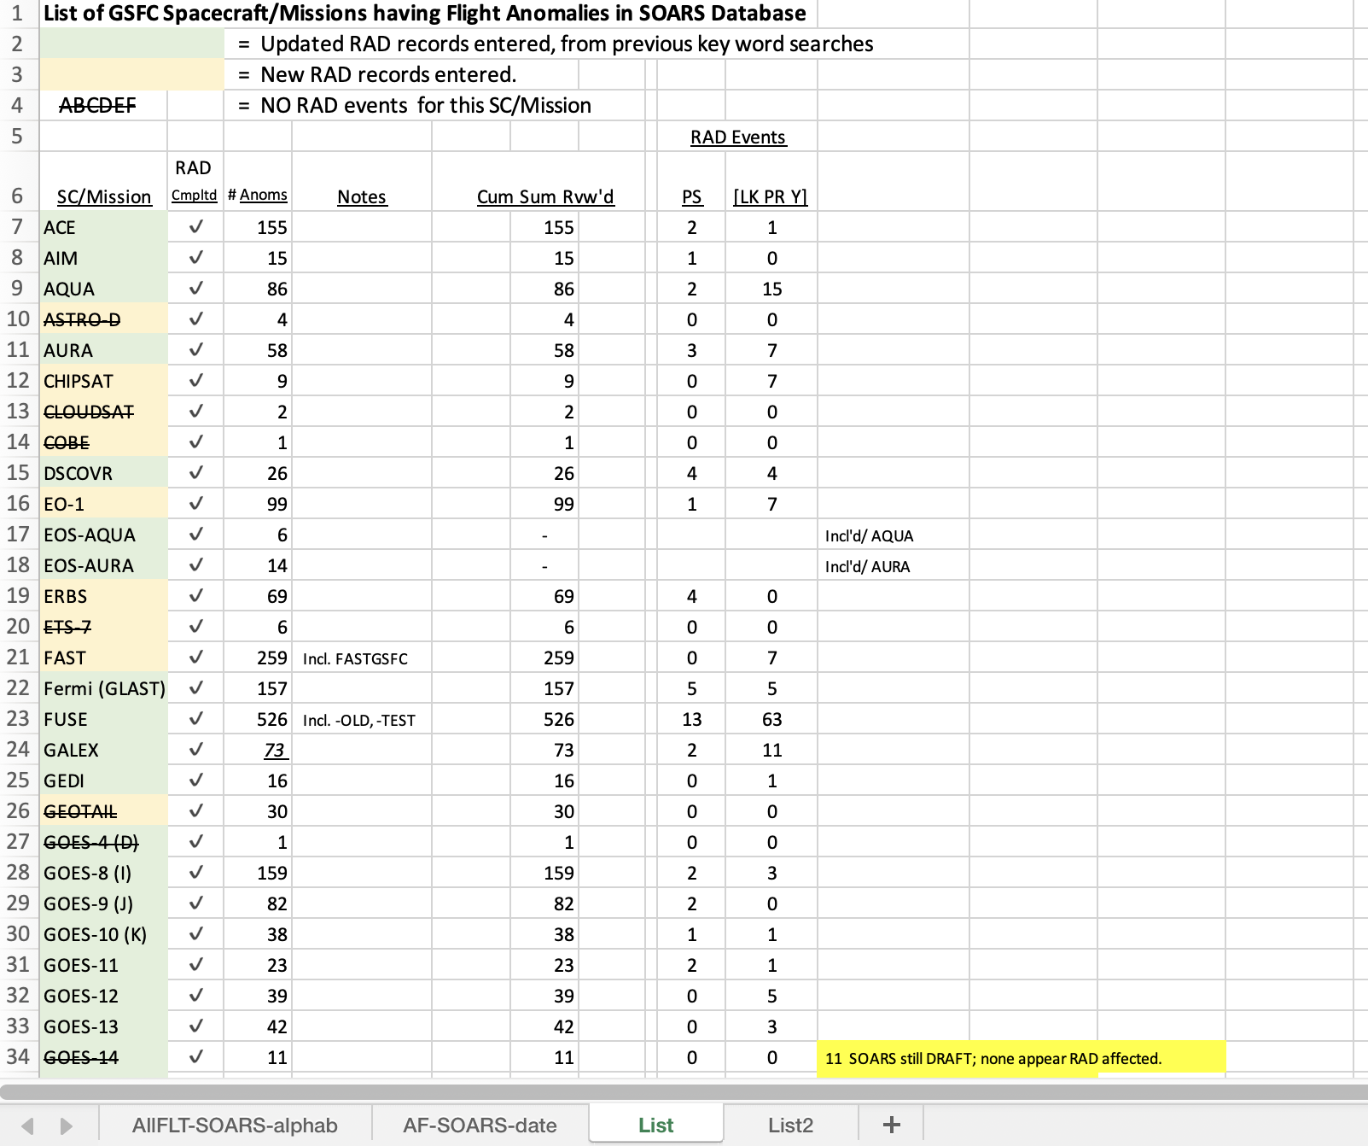
SOARS data review (2)

Slide 16
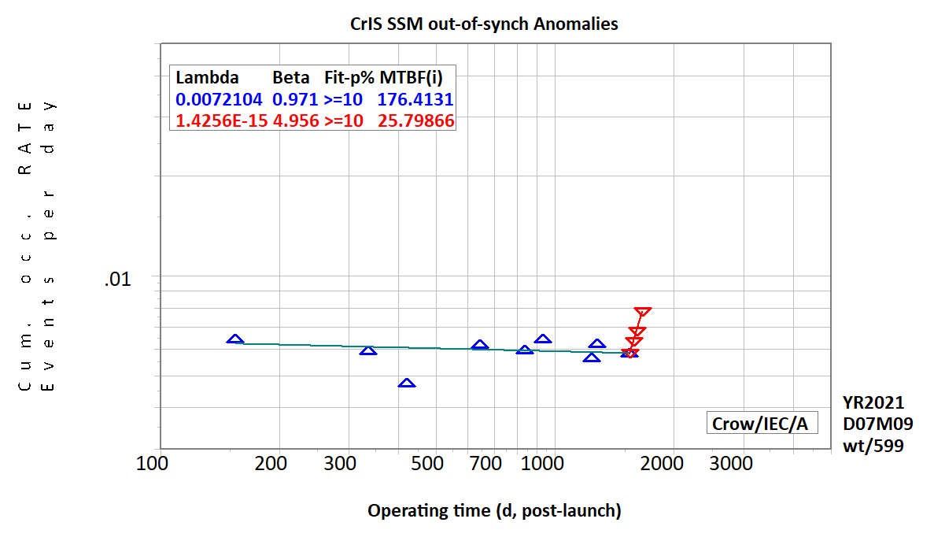
NPP CrIS Crow-AMSAA
CrIS out-of-synchronization (OOS) on-orbit anomalies.
For the first ~ 4.2 years, these anomalies were occurring randomly with time (β ~ 1). At day 1542 post-launch, anomalies began occurring at a significantly increasing rate. It appears that something changed in the system that induced OOS events to occur no longer randomly and at an increasing rate. The "system" includes the instrument itself, any possible spacecraft effects on the instrument, and any space environmental changes.
WT/599/2109007/Fn: CrIS-OOS-Anom's.pptx

Slide 17
On-orbit experiences outside of SOARS

Slide 18
SpaceCube Time-on-orbit
As of Oct 2021 (STP-H6 was turned off Dec 9, 2021 to make room for the next instrument)
Project | Version | Part Req | BOM Count | Operation Months | Xilinx Quantity | COTS % | COTS Months
RNS | v1.0 | 2+ | 3700 | 0.0833333 | 4 | 1% | 3.08333
MISSE-7 | v1.0 | N/A | 3100 | 90 | 4 | 2% | 5580
SMART | v1.5 | N/A | 1000 | 0.0333333 | 1 | 95% | 31.6667
STP-H4 CIB | v1.0 | N/A | 1500 | 30 | 2 | 1% | 450
STP-H4 ISE2.0 | v2.0-EM | N/A | 1250 | 30 | 3 | 98% | 36750
STP-H5 CIB | v1.0 | N/A | 1500 | 46.933333 | 2 | 1% | 704
STP-H5 ISEM | v2.0 Mini | N/A | 1000 | 46.933333 | 1 | 26% | 12202.7
STP-H5 Raven | v2.0-EM | N/A | 1500 | 46.933333 | 3 | 99% | 69696
RRM3 | v2.0 | N/A | 1429 | 36.666667 | 2 | 65% | 34057.8
STP-H6 CIB | v1.0 | N/A | 1500 | 31.833333 | 2 | 1% | 477.5
STP-H6 GPS | v2.0 | N/A | 1157 | 31.833333 | 2 | 65% | 23940.3
Restore-L Lidar | v2.0 | 3 | 2000 |  | 2 | 0% | N/A
STPSat6 | v2.0 Mini | N/A | 1500 |  | 1 | 98% | N/A
Totals | Units Flown | 11
 | Commercial FPGAs | 26
 | Commercial FPGA Device-Years | 83
 | Part Years | 57213
 | COTS Parts Years | 15324
Also to note: We flew many COTS components on some of these projects:
ISE2.0, SMART, and ISEM all flew COTS cameras that were ruggedized. SMART flew COTS SATA drives.
Raven flew a $5 USB interface card to an IR sensor
STP-H5 and -H6 have CHREC Space Processors (CSPs) that were 95% COTS components. See references for more info on CSP results (no failures to date)
RRM3 suffered a failure (outside of SpaceCube) that may have involved a specific COTS part, but the part was used in a stressing condition that any part would eventually fail.
NavCube Commercial vendor populated PWBs

Slide 19
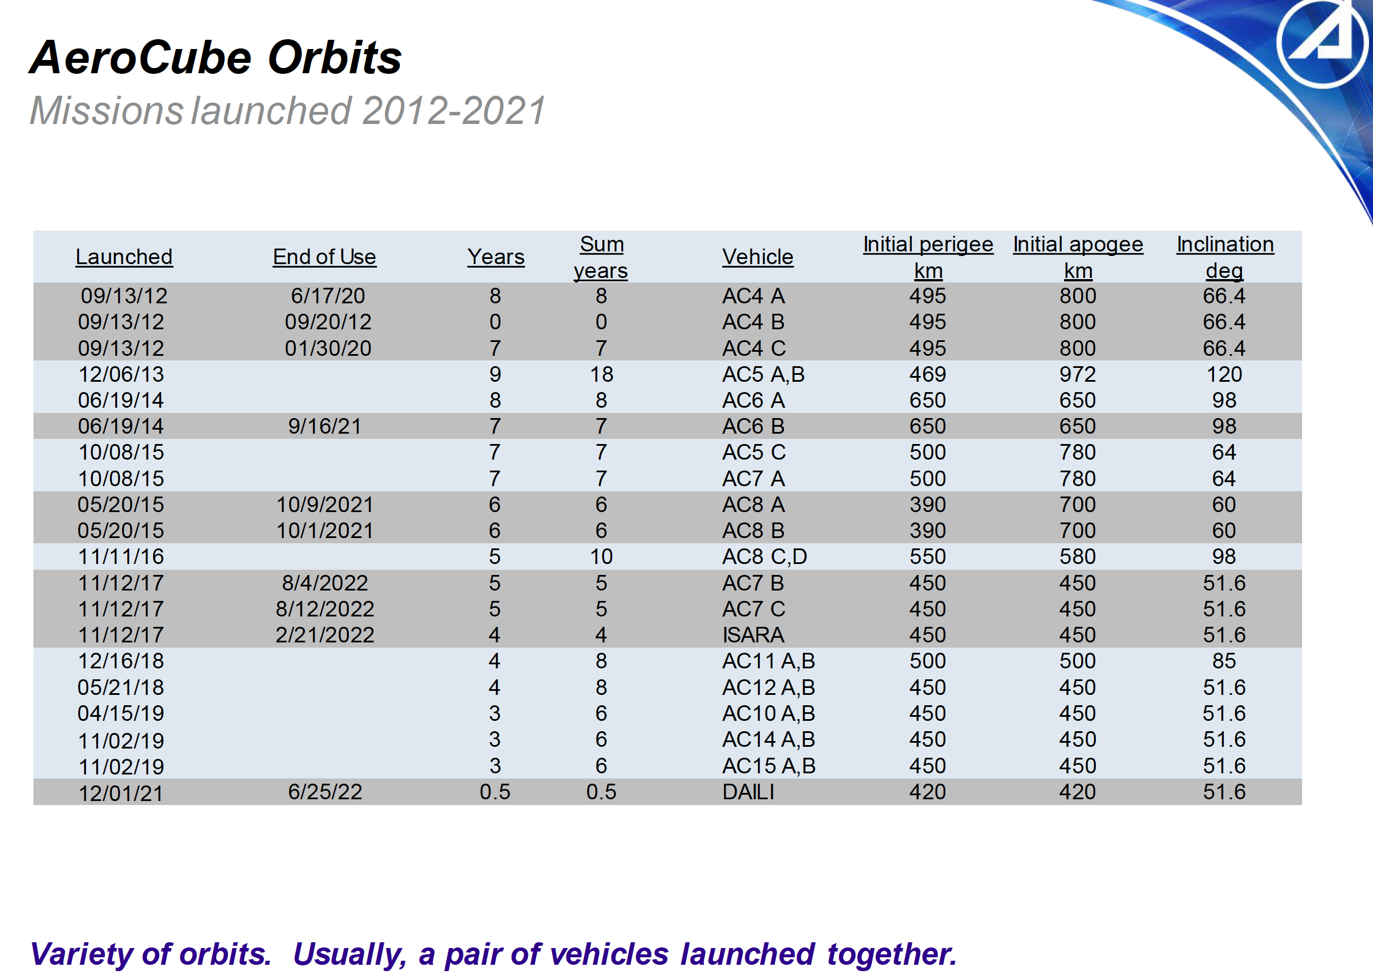
Aerocube orbits
No FMRR or PMRR parts used
Chart from: "Overview of the AeroCube Program and Experience with Alt-Grade Parts Usage”
Aerospace Corp, “MICROELECTRONICS RELIABILITY AND QUALIFICATION WORKSHOP”, Feb, 2023
Brian Hardy, The Aerospace Corporation

Slide 20
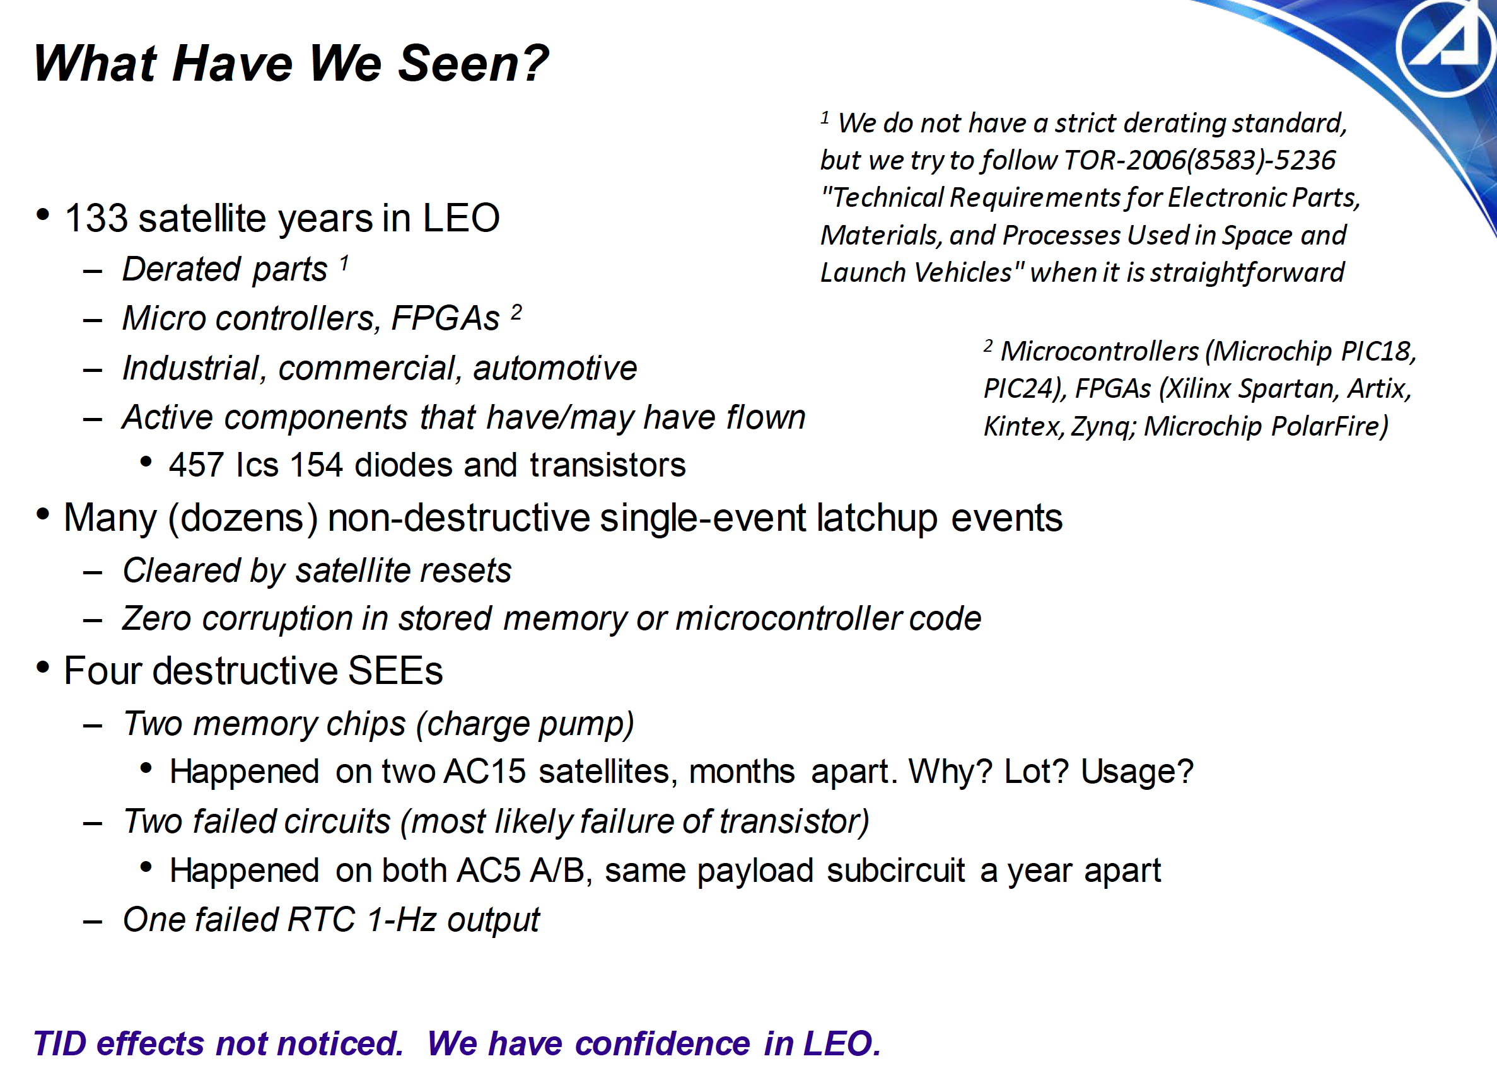
No FMRR or PMRR parts used
Chart from: "Overview of the AeroCube Program and Experience with Alt-Grade Parts Usage”
Aerospace Corp, “MICROELECTRONICS RELIABILITY AND QUALIFICATION WORKSHOP”, Feb, 2023
Brian Hardy, The Aerospace Corporation

Slide 21
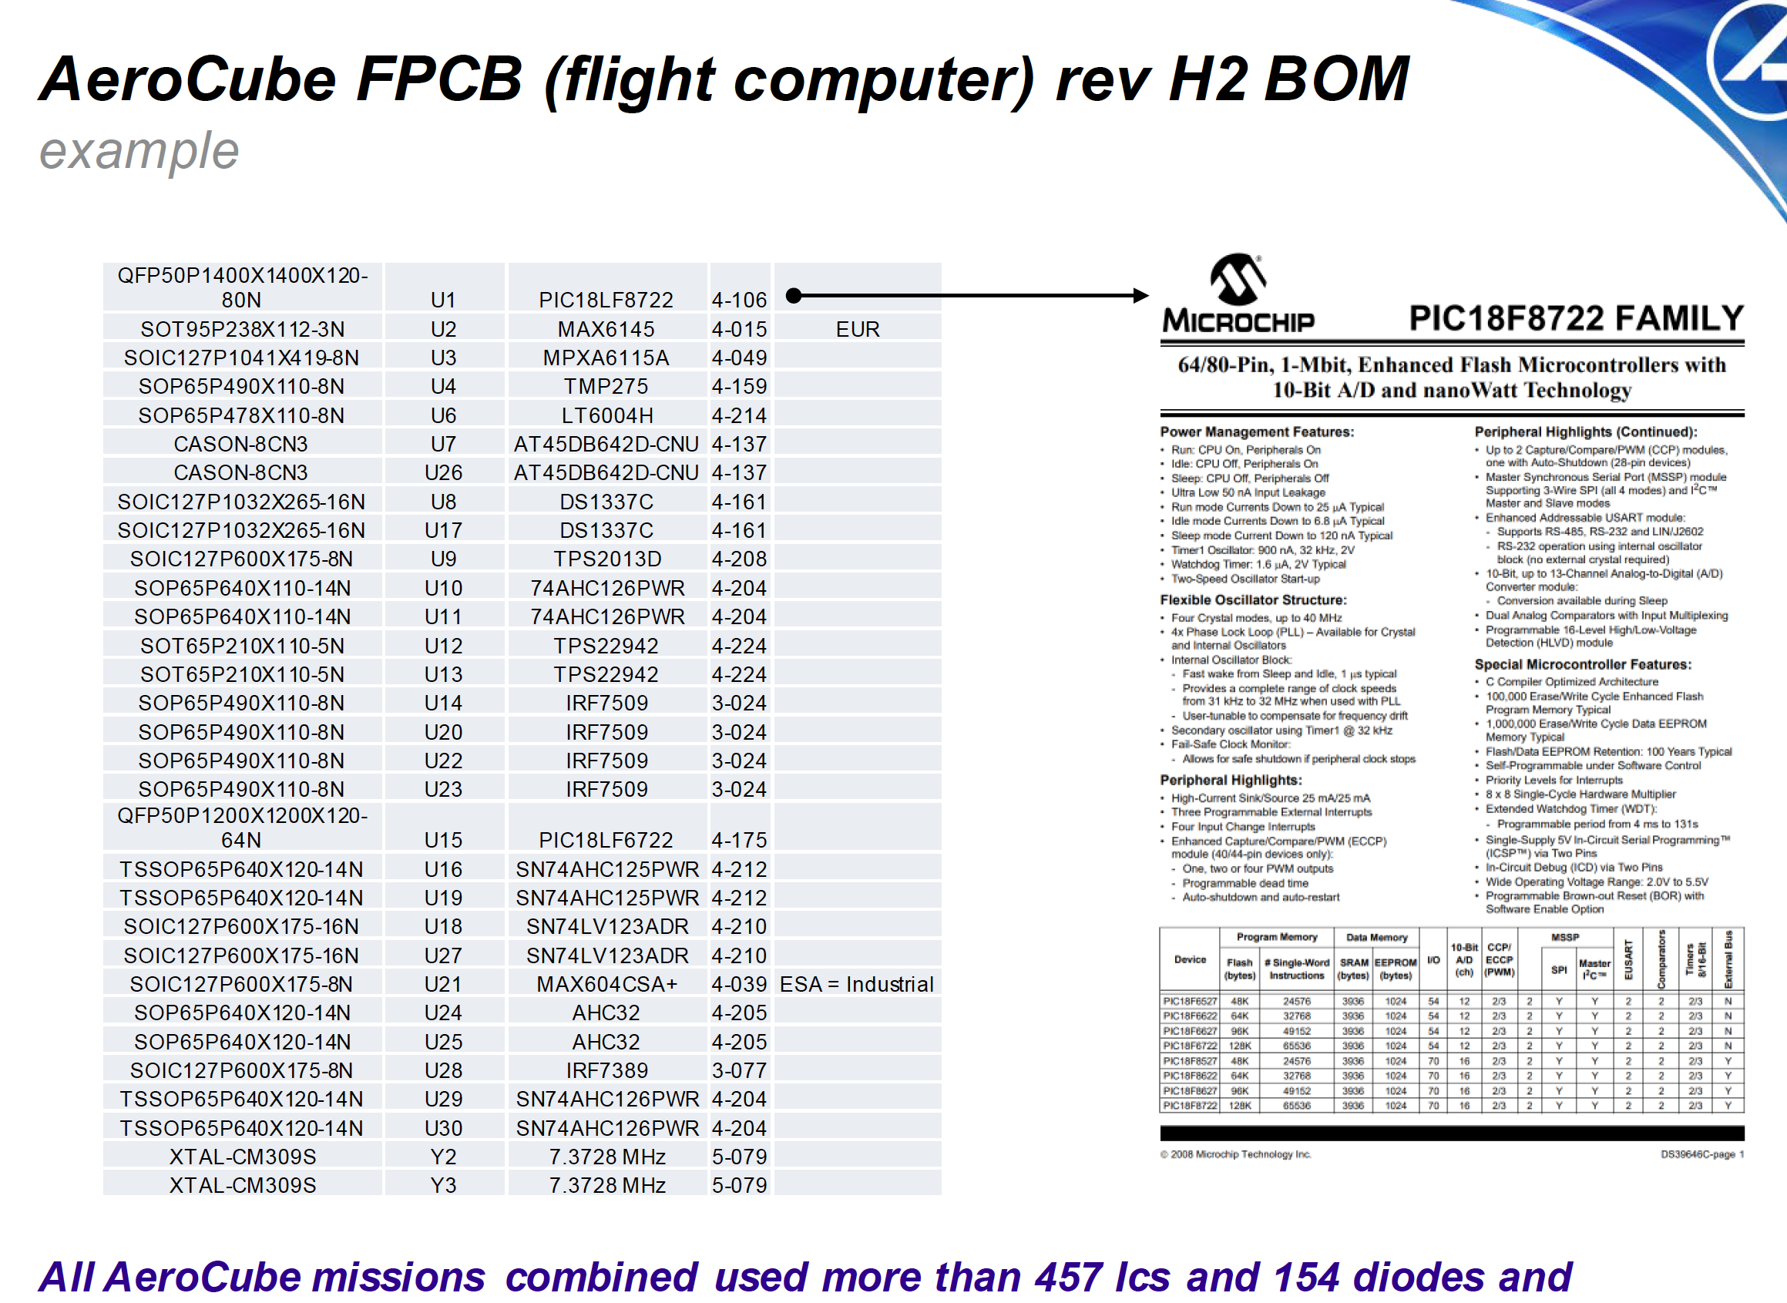
No FMRR or PMRR parts used
Chart from: "Overview of the AeroCube Program and Experience with Alt-Grade Parts Usage”
Aerospace Corp, “MICROELECTRONICS RELIABILITY AND QUALIFICATION WORKSHOP”, Feb, 2023
Brian Hardy, The Aerospace Corporation

Slide 22
Current on-orbit findings summary
Mission degradation or failure due to SEEs is most likely a circuit design problem (in good circuit designs, vulnerable parts largely threaten availability)
  HST optocoupler (should have included a filter)
  NASA ARC watchdog proximity failure (non realtime, > 2 sec, overcurrent protection)
  SMAP radar power supply (coupled voltage spikes with SETs)
  2 pair of Aerocube circuit failures (circuit not designed to mitigate radiation effects)
  Suspect: SNPP CrIS detector electronics failures (3)
Cumulative damage from SEEs is somewhat common but observed TID degradation is rare
  Going through verification process across all events
Nondestructive SEEs are continuous and ever-present, with no apparent bias towards parts with or without RHA (protected by circuit designs and ops rules)
Place a vulnerable part outside a spacecraft in a simple circuit and the result will be certain
  17 AD590s failed installed outside of AMPTE spacecraft (ELDRS)
System effects overcome component susceptibility (detectors on Chandra)
If you focus your radiation concerns at the part level, you will likely miss something

Slide 23
Mystery electronics failures
ICON: complete loss of power, mission ended after just over 3 years on Nov 25, 2022 (no event or location of incident identifiable).
CYGNSS: loss of command transmitter on one of 8 spacecraft after just over 6 years on Nov 26, 2022 (no event or location of incident identifiable). Remaining electronics remain functional as S/C is three-axis stable.
JPSS-2 Ka-band transmitter: failure after weeks on orbit just exiting the SAA. Redundant transmitter working.
Each incident has been thoroughly investigated with no cause determined. Radiation eliminated by review of parts. No thorough review of circuit radiation effects.

Slide 24
Conclusions
First-time broad review of about four decades of on-orbit anomaly data combined with about two decades of nonconventional electronics flight experiential data point to the need to re-evaluate our approaches at developing flight electronics
Across a wide spectrum of orbits (LEO, GEO, HEO, Lagrange point, heliocentric) single event effects have dominated our radiation experiences over the past 20 years with few noticeable effects of total ionizing dose
  Many cases perceived to be total ionizing apparently were cumulative damaging single event effects
Events and incidents have no apparent correlation with FMRR, PMRR, or parts with no manufacturer radiation rating
  Nonvolatile memory virtually always needs some form of protection
While many missions have had design lifetimes limited by radiation, radiation has not been life-limiting for any in the GSFC missions launched since 2000, even going well over 10x the original lifetime.

Slide 25
Backup

Slide 26
Source of Mission Risks
Primary elements of technical risk for space missions are the departures from
  The system being tested in its flight configuration
  The system being tested in a way that replicates its time on-orbit
  The system being tested in a way that replicates its on-orbit operation
Combined with the remnant problems that have been unresolved from that testing
Risk is minimized by using components that have been proven in the environment for the necessary lifetime, when possible, without interfering with their design or development
Not testing in flight configuration drives
  Technical risk
    That of not catching something important that threatens the system on-orbit
    That of limiting the performance or reliability through unnecessary or irrelevant restrictions
  Programmatic risk
    The use of time and money to address things that do not or are not likely to occur on-orbit
Review of on-orbit experiences is essential to validate items and approaches that cannot be tested in flight configuration

Slide 27
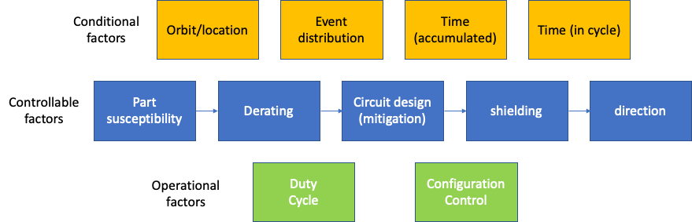
The multi-dimensional radiation problem

Slide 28
The charge
This effort must be driven by and informed from on-orbit experiences and data
On-orbit data show lack of correlation between piece-part radiation data and on-orbit experiences of spacecraft systems
  Hubble
  SMAP
  Chandra
  Swift
  Others
Benchmark problem
  Consider on-orbit experiences of non-RHA FPGA in a range of different regimes and lifetimes to estimate risk in new regime not enveloped by any of the other regimes

Slide 29
Status
First “skeleton draft” complete
  Includes the basic risk assessment principles
  Includes basic concepts relating radiation to risk
Effort on-going for several months
  Reliability expertise on board
  Radiation expertise on board
  Completed review of 30+ years of on-orbit anomaly data from GSFC missions (~9000 flight anomalies)
  Over 1000 hits associated with radiation-related search terms, pared down to ~140 that are due to radiation or possibly due to radiation.
    Subsequently, manual searches revealed that global searches were not sufficient, uncovering approximately 1000 more
  Hits are being correlated against regions, events, designs, components, and parts
Interacting with NOAA endorsed SBIR, which is developing a tool to broadly characterize and display space weather and radiation events
Presentation completed proving that expanded use of COTS parts does not increase radiation risk

Slide 30
White area: radiation susceptible (active) parts
Not radiation susceptible (green shaded)
COTS
custom
Note: this is not a Venn diagram, it is meant to give a rough sense of scale. The orange shaded area is not a subset of the green shaded area.
ESA/JAXA spec
RHA (orange shaded)
MIL-SPEC

Slide 31
Radiation risk and traceability
Traceability to wafer lot feeds radiation risk if you are using parts from multiple lot date codes and are not testing or demonstrating all lot date codes in space.
  Strategic testing can retire most of that risk
  The same points that are required about ILPMs, statistical process controls, and volume, all play into such risk in the same way
  If you purchase cheap consumer grade parts, then there may be uncertainty as to the origins of the parts or whether they really came from the same lot.
  Even ”hi-rel” parts might have multiple wafer lots in a single lot
  In general, the same features required to assure the selection and procurement of reliable COTS parts also address traceability concerns within a lot.
  Any part that is not process-controlled for radiation susceptibility can have variability throughout the lot, COTS or MIL-SPEC

Slide 32
Risk of failing radiation tests
This is not an artifact of using COTS; it’s an artifact of requiring a function that has no available solution that meets the radiation requirements, and the concern would apply to COTS and MIL-SPEC parts
Many developers use almost exclusively non-RHA parts very successfully, so this is not a significant concern
In some cases, the higher performance you are trying to achieve and the newer technology, the greater the challenge.
  In that case the choice is use what’s available or don’t execute the mission
Radiation-tolerant design and Rad-Hard By Design techniques will be needed to keep us moving forward

